Slide 1


How to Place Destiny barcodes on musical instruments
By joseph Yune

Slide 2
Table of contents
Destiny Barcode Information ------------------------------- Slide 3
General Rules for Placing Barcodes ----------------------- Slide 9
Individual Instrument Slides --------------------------------- Slide 11
Questions ---------------------------------------------------------- Slide 38

Slide 3
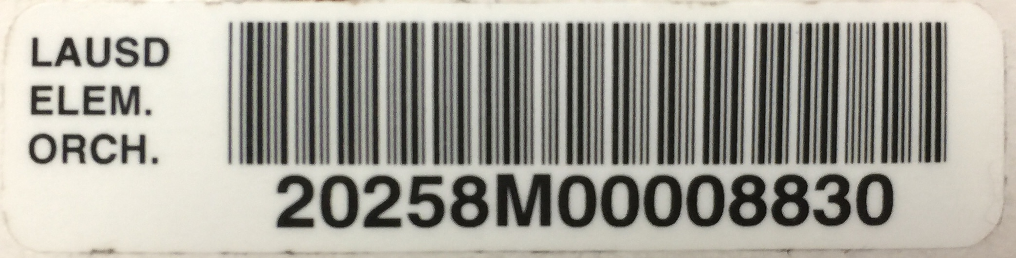
Destiny Barcode information P.1
1/2”
2”

Slide 4
Destiny Barcode information P.2
5 Digit School
Name Abbreviation

Slide 5
Destiny Barcode information p.3
“2” for Music
Instruments

Slide 6
Destiny Barcode information p.4
School
Location Code

Slide 7
Destiny Barcode information p.5
“M” stands for Music

Slide 8
Destiny Barcode information p.6
8 Digit
Serial Number

Slide 9
Destiny Barcode Additional Tape
1”
3”

Slide 10
General rules for placing destiny barcodes on instruments and cases
Place barcodes easily accessible, but away from frequent handling areas and line of sight (some students might take the barcodes off the instrument)
Do not place barcodes over any information on the instrument (e.g. serial numbers, brand names, school engravings, etc.)
Clean the surface thoroughly and wait for it to dry completely before placing the barcode sticker on the instrument (on a smooth surface)
Place the additional tape (prescription tape) over the Destiny barcode for added support (Additional tape dimension 1” x 3”)
Barcodes should not get in the way of the instrument functioning properly

Slide 11
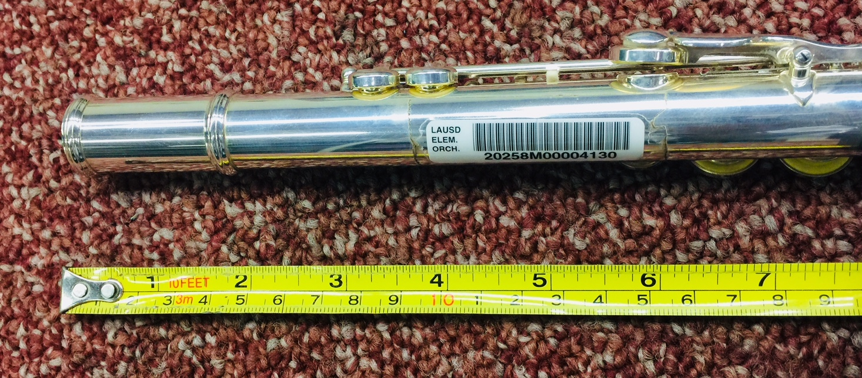
Flute
On the Body Joint as shown

Slide 12
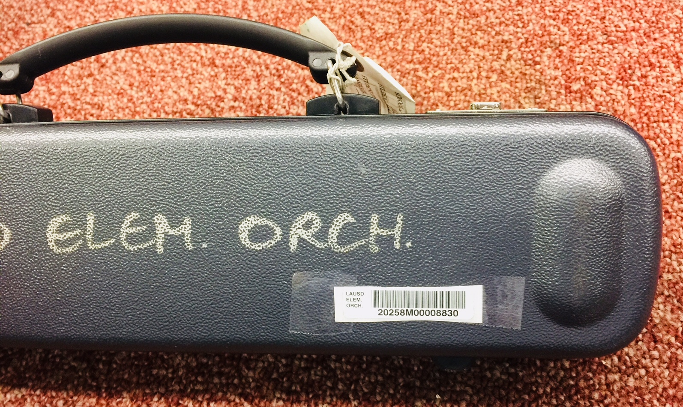
Flute Case
On the bottom right as shown

Slide 13
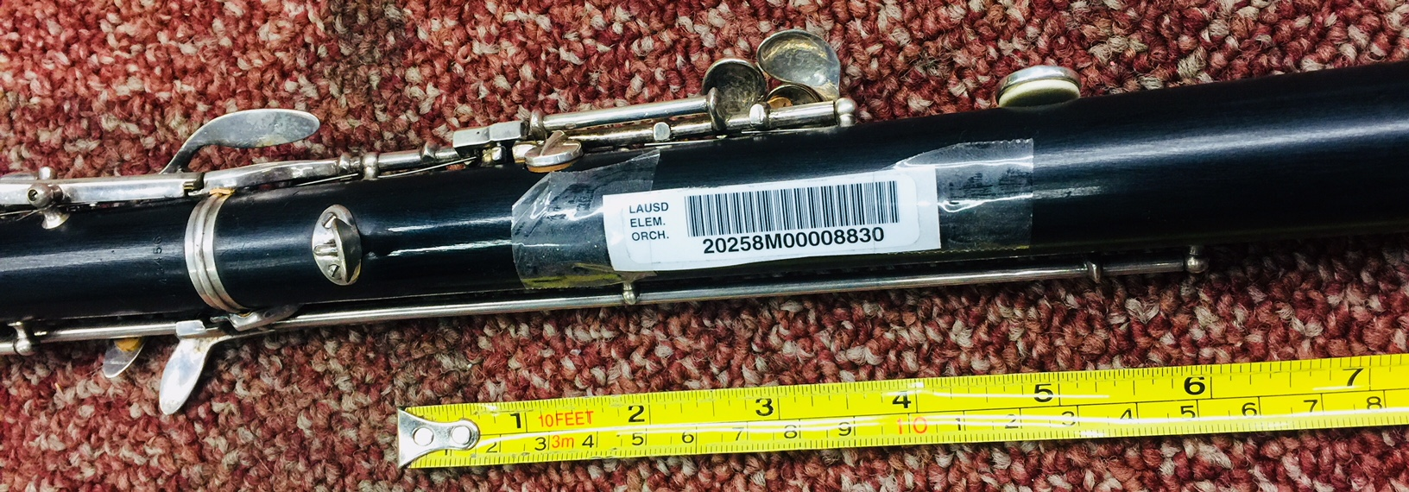
Oboe
Approximately 2 inches below the thumb rest as shown

Slide 14
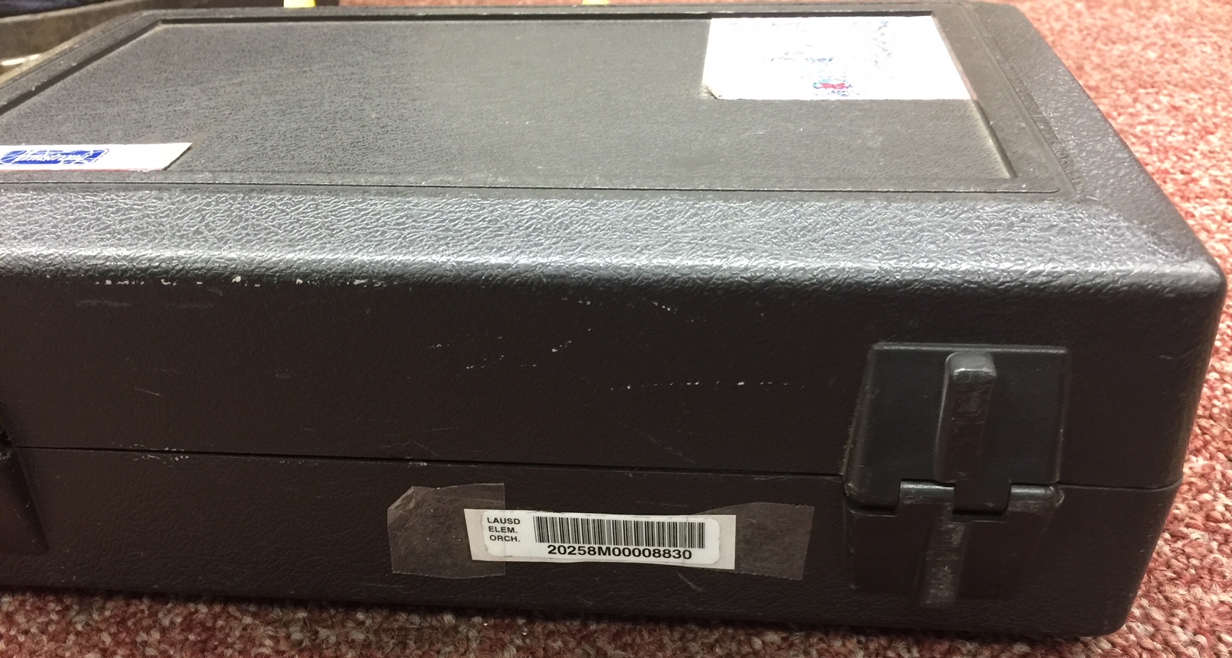
oboe Case
On the bottom right as shown

Slide 15
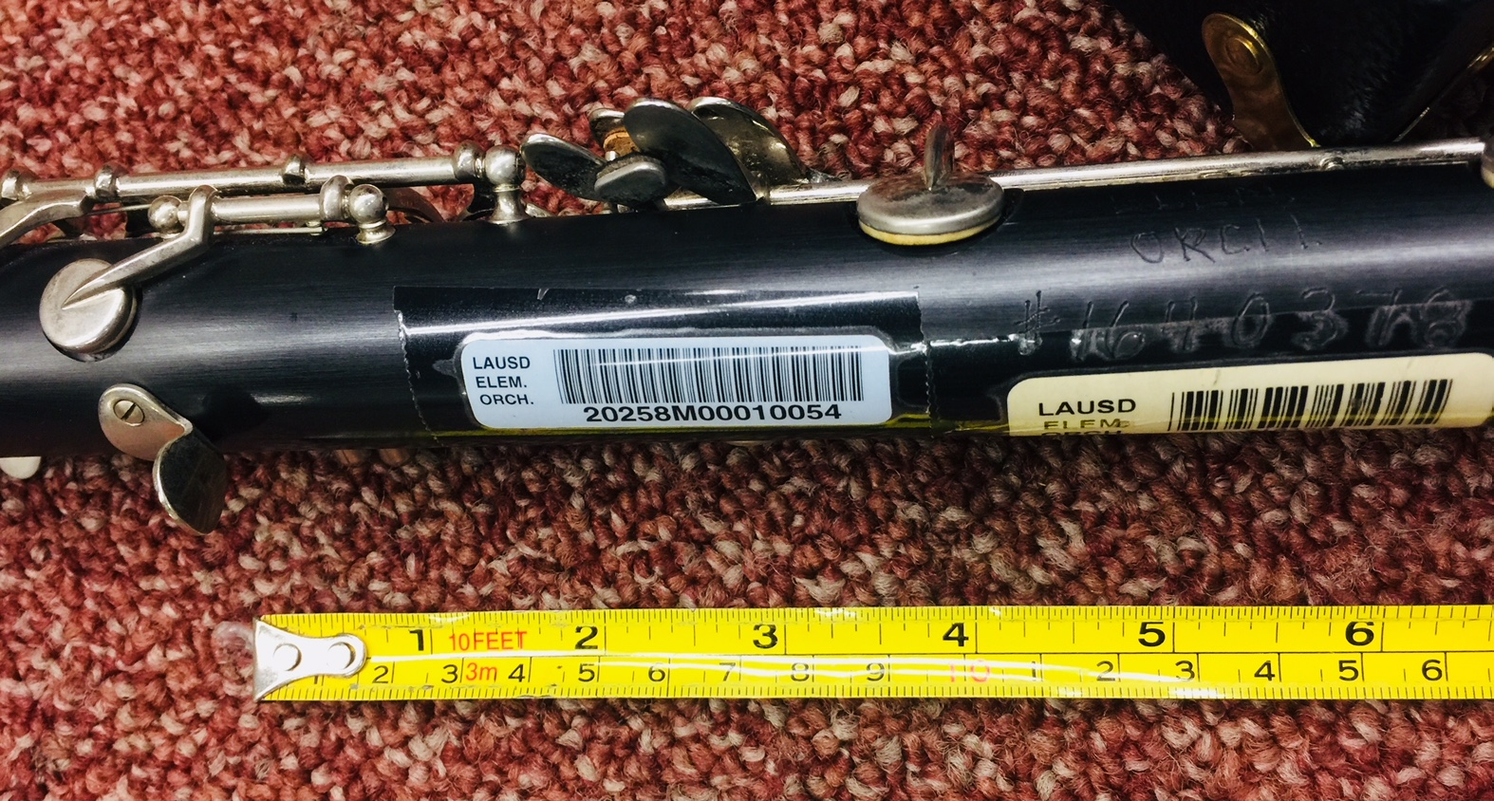
clarinet
Approximately 1-1/2 inches below the thumb rest as shown

Slide 16
Clarinet Case
On the bottom right as shown

Slide 17
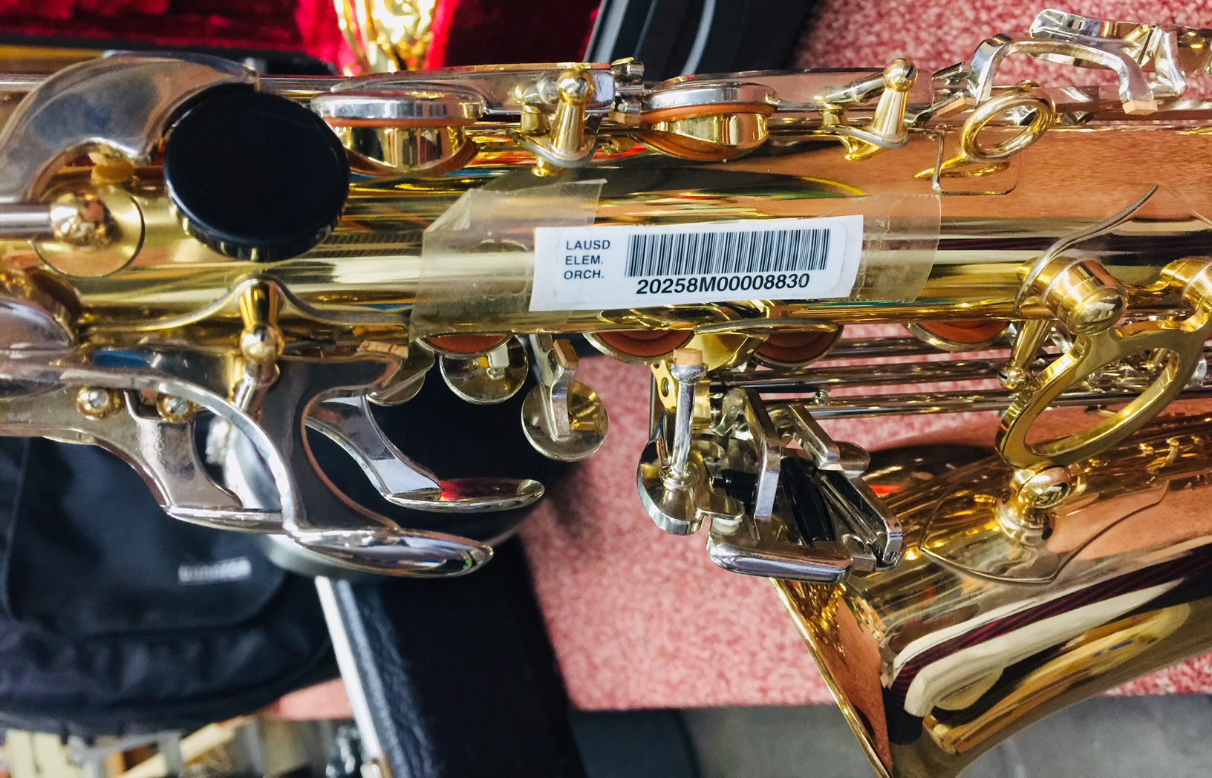
Saxophone
Approximately 1-1/2 inches below the left thumb rest between the keys as shown

Slide 18
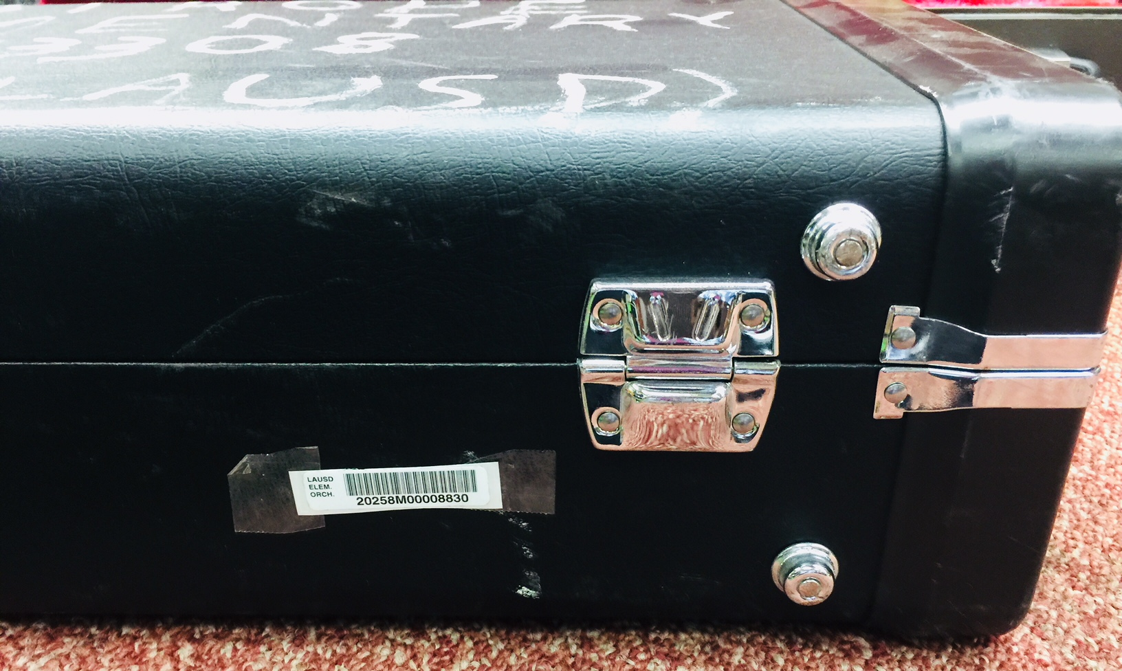
saxophone Case
On the bottom right as shown

Slide 19
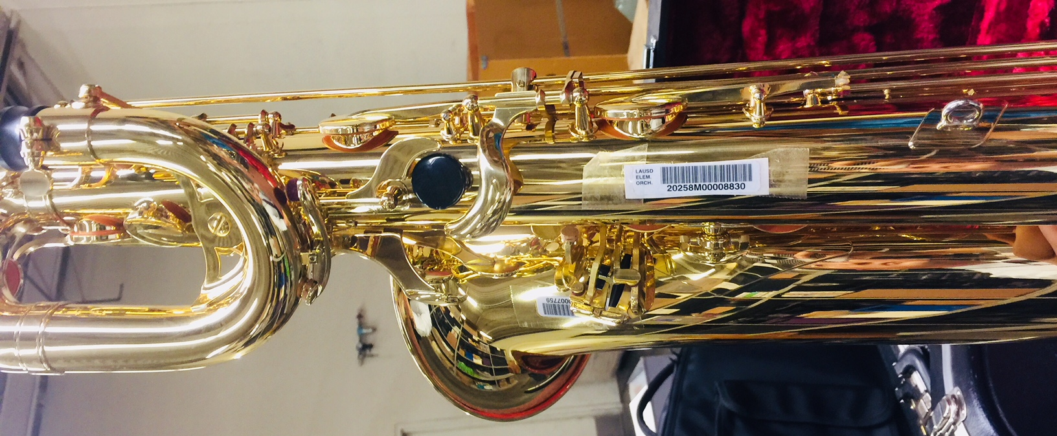
Baritone Saxophone
Approximately 2-1/2 inches below the left thumb rest between the keys as shown

Slide 20
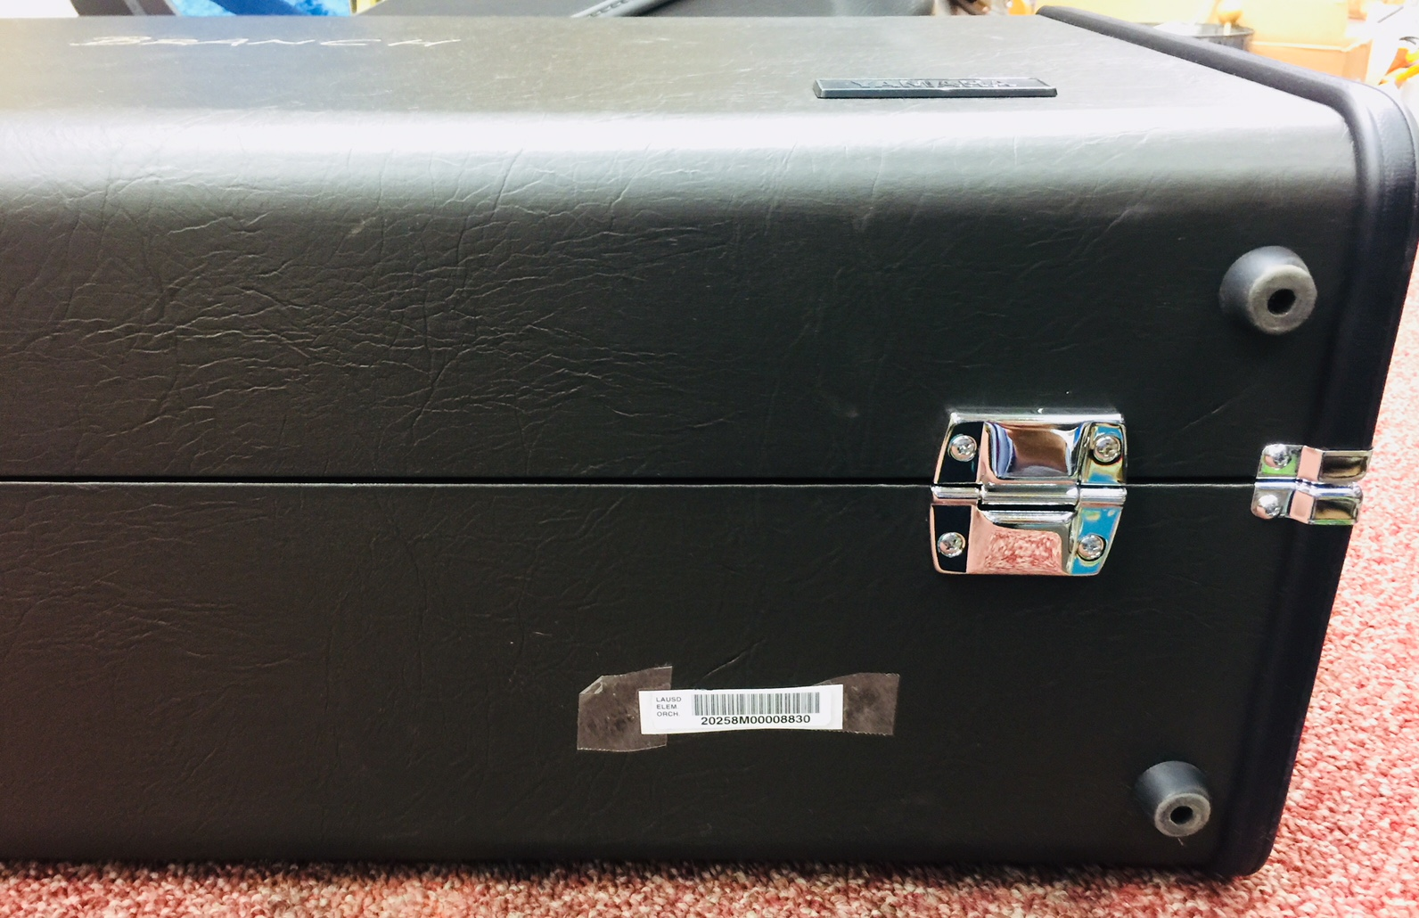
Baritone saxophone Case
On the bottom right as shown

Slide 21
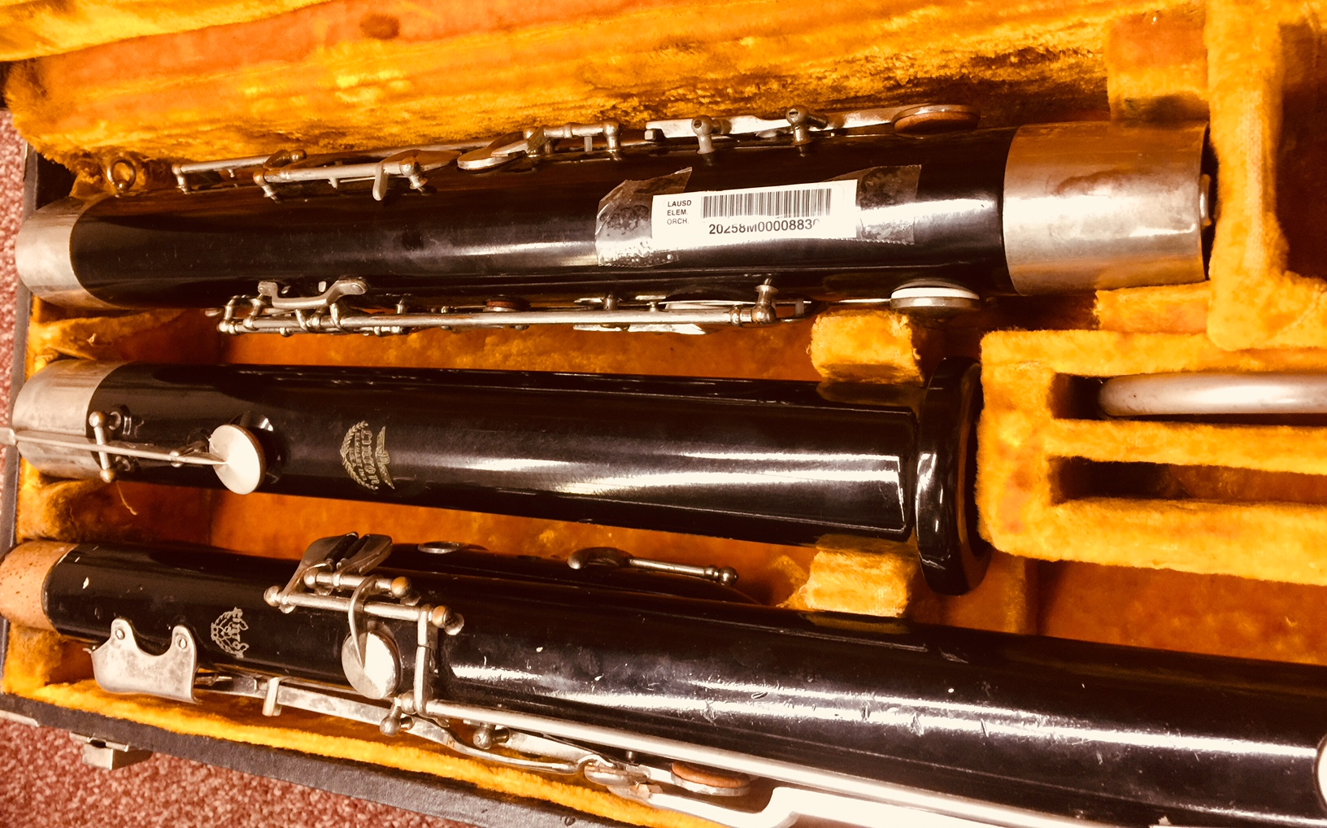
Bassoon
On the Boot Joint as shown

Slide 22
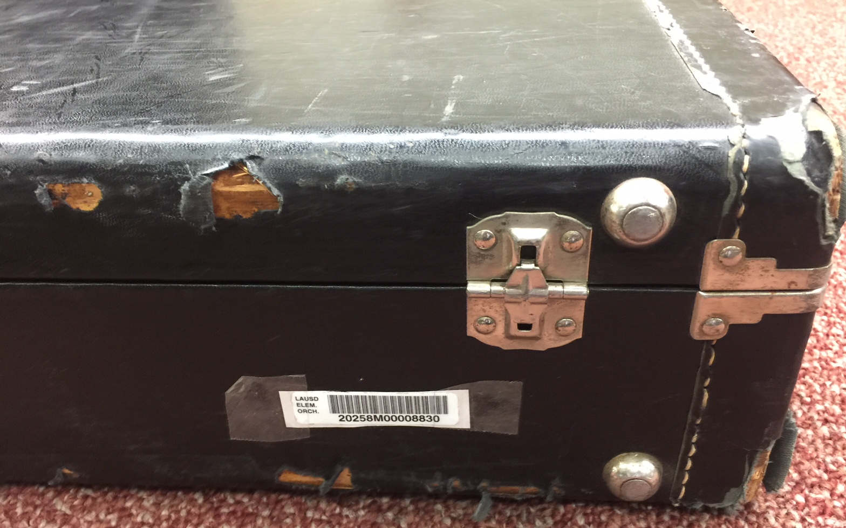
Bassoon Case
On the bottom right as shown

Slide 23
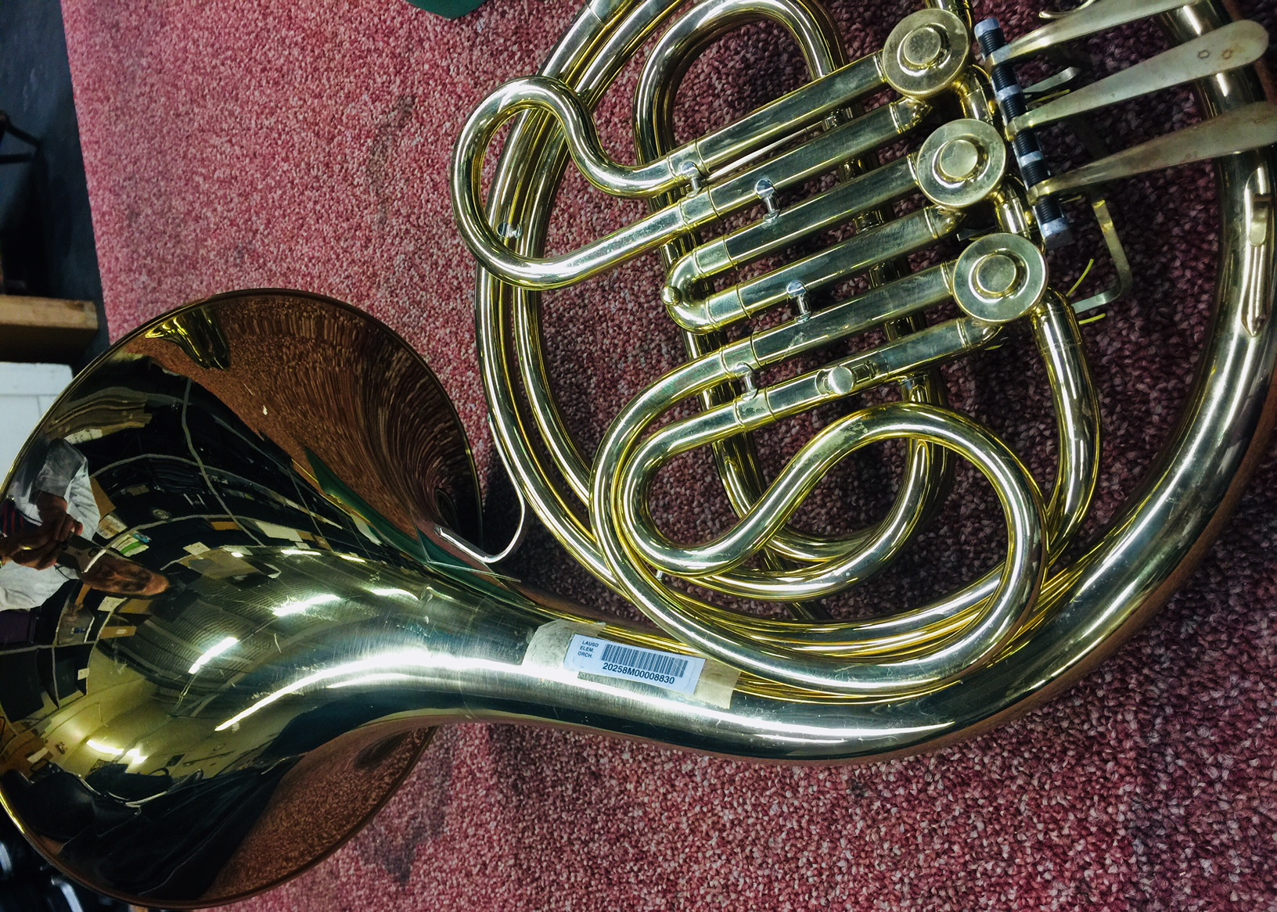
French horn
On the Bell as shown

Slide 24
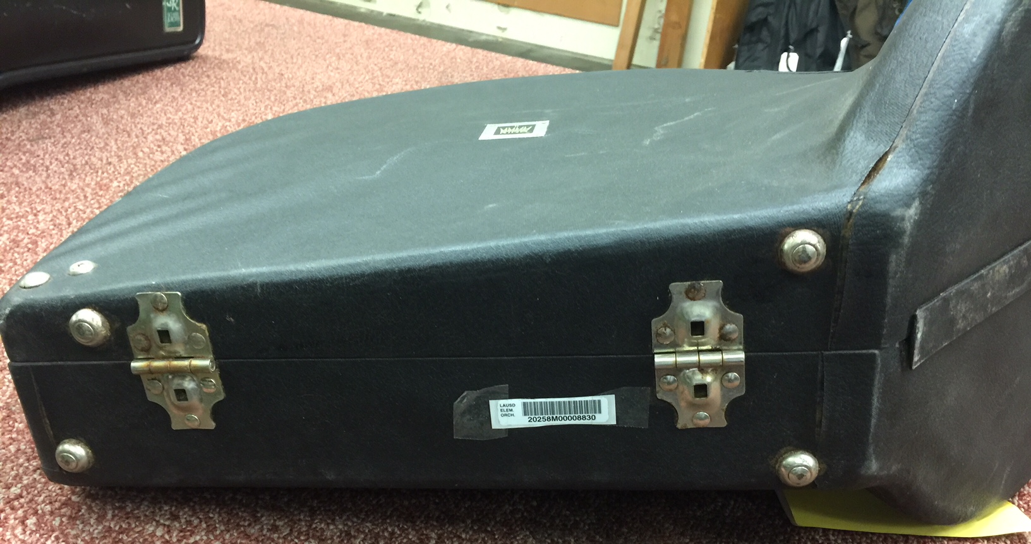
French horn Case
On the bottom right as shown

Slide 25
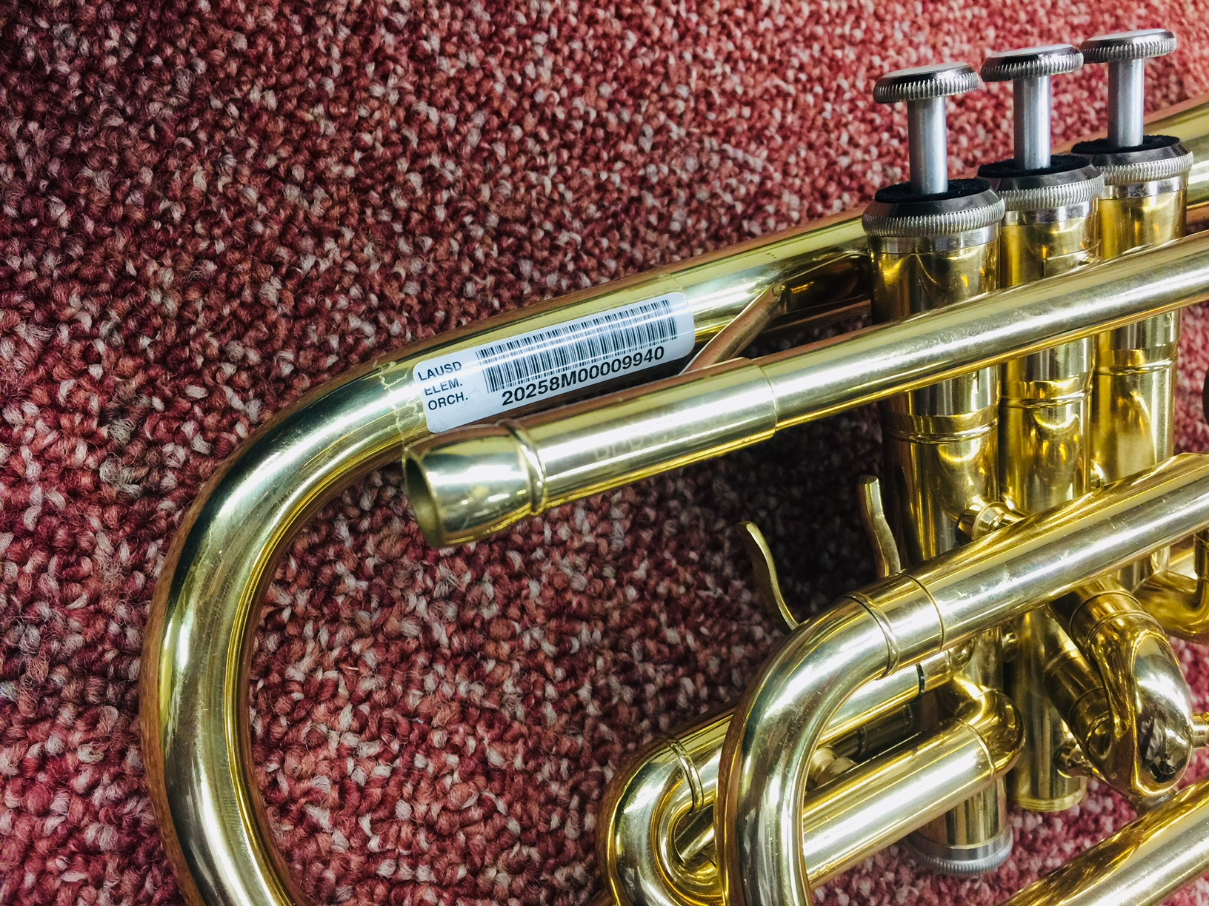
Cornet/trumpet
On the rear part of the Bell as shown

Slide 26
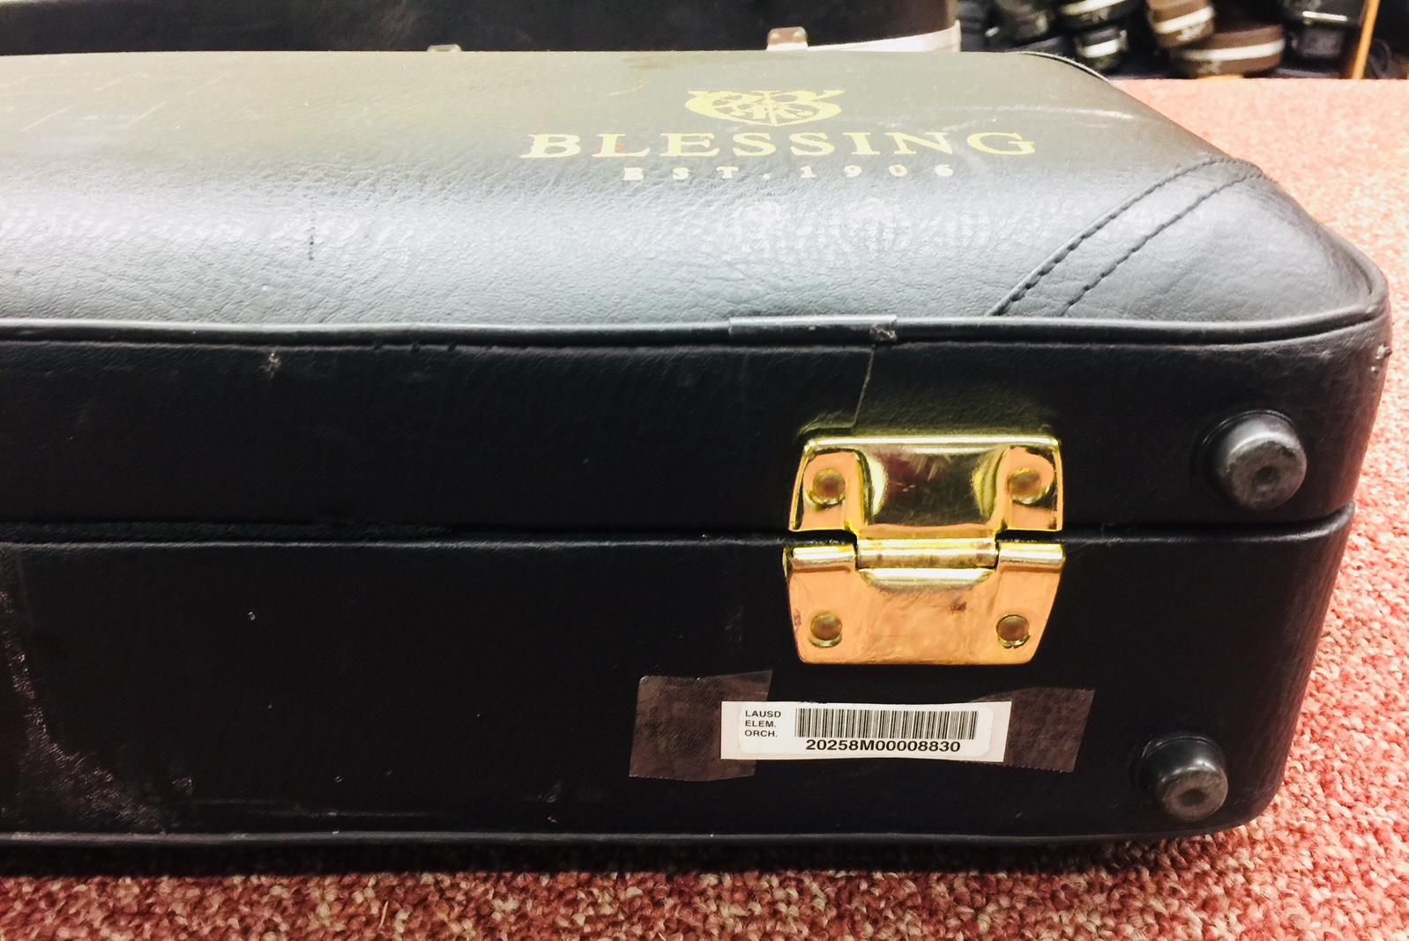
Cornet/trumpet Case
On the bottom right as shown

Slide 27
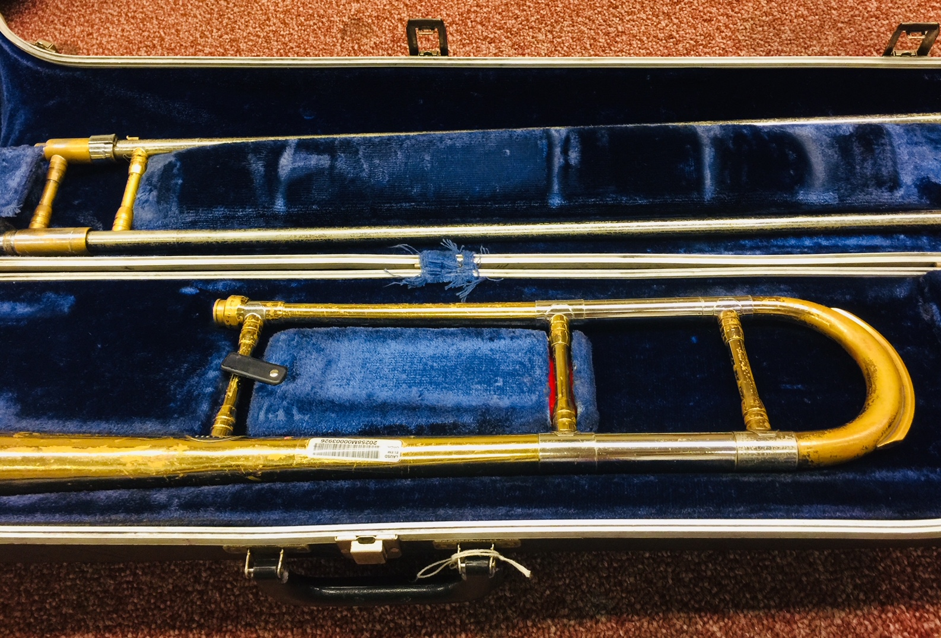
trombone
On the middle part of the Bell as shown

Slide 28
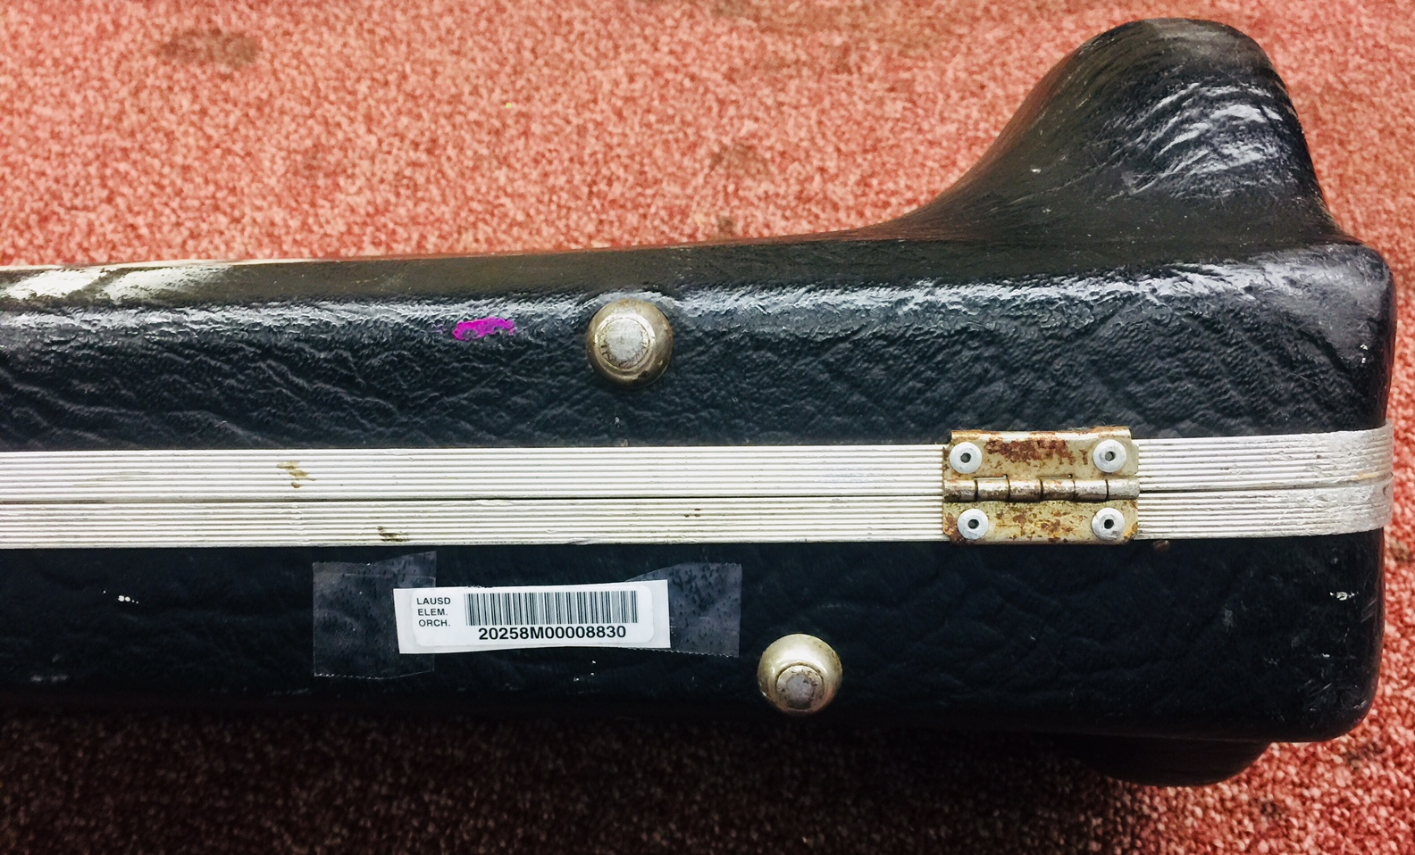
Trombone Case
On the bottom right as shown

Slide 29
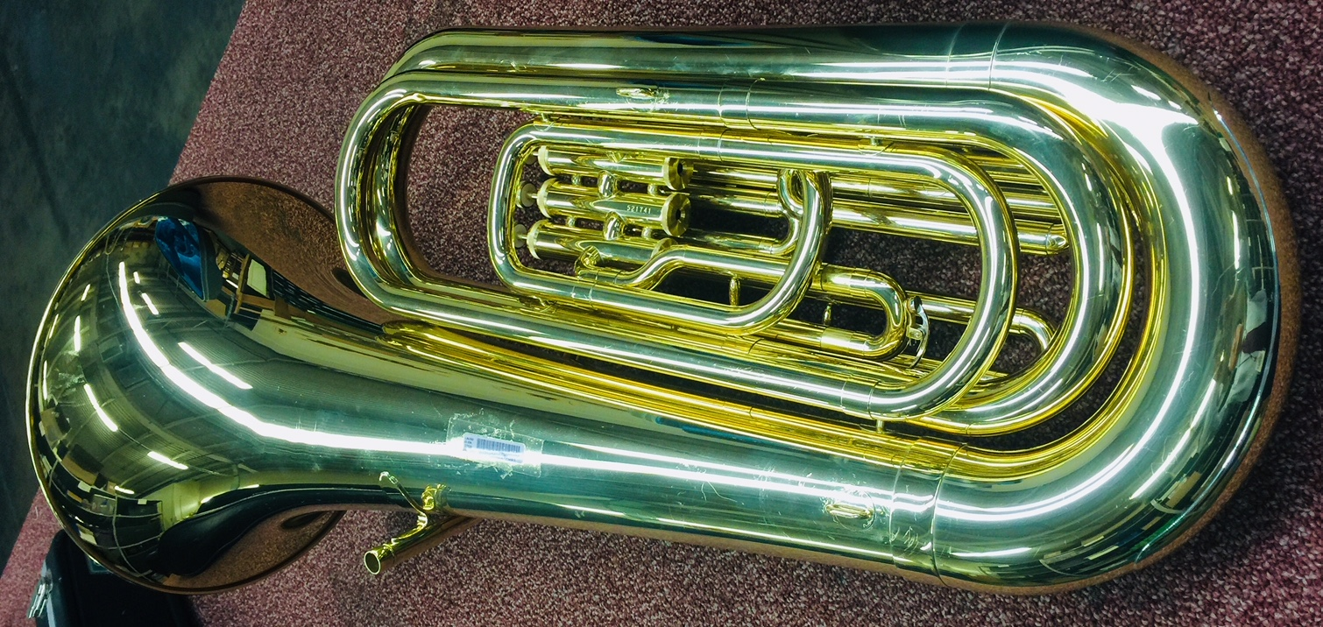
Euphonium/baritone/tuba
On the middle part of the Bell as shown

Slide 30
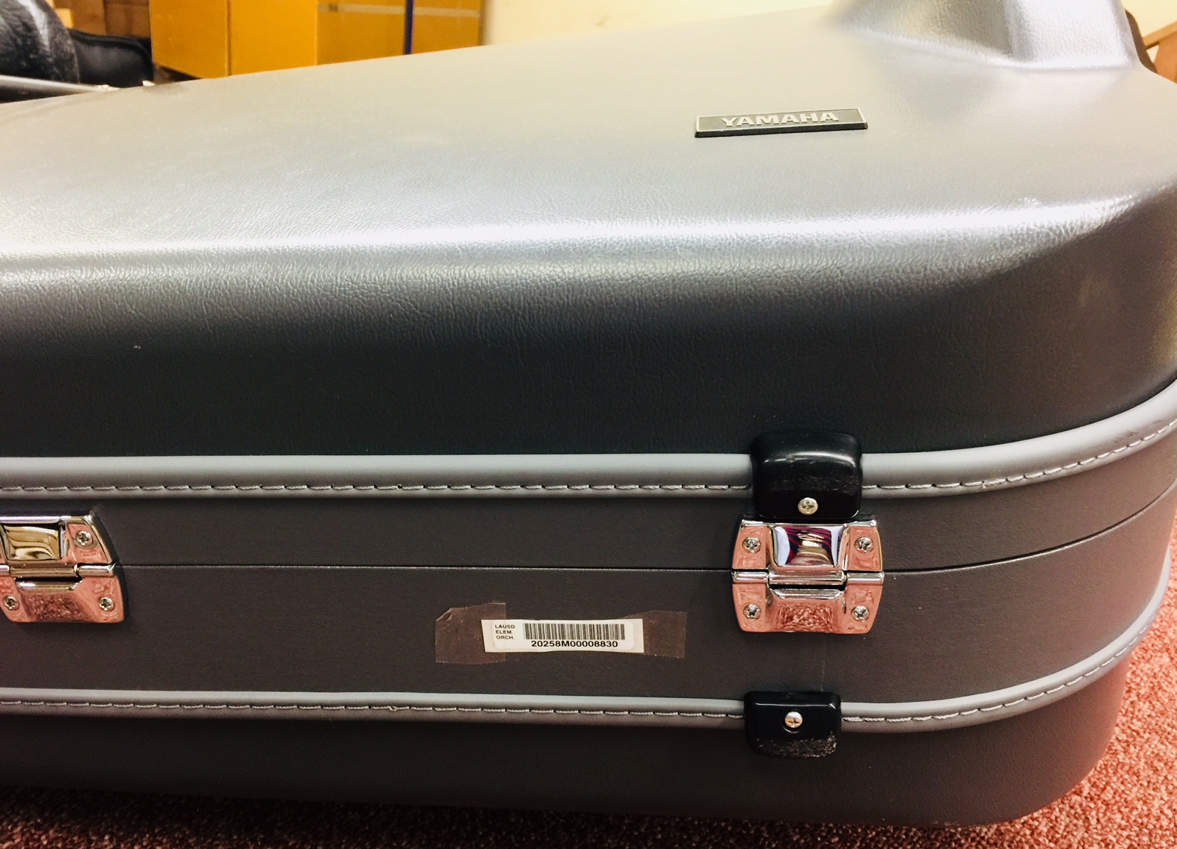
Euphonium/baritone/tuba Case
On the bottom right as shown

Slide 31
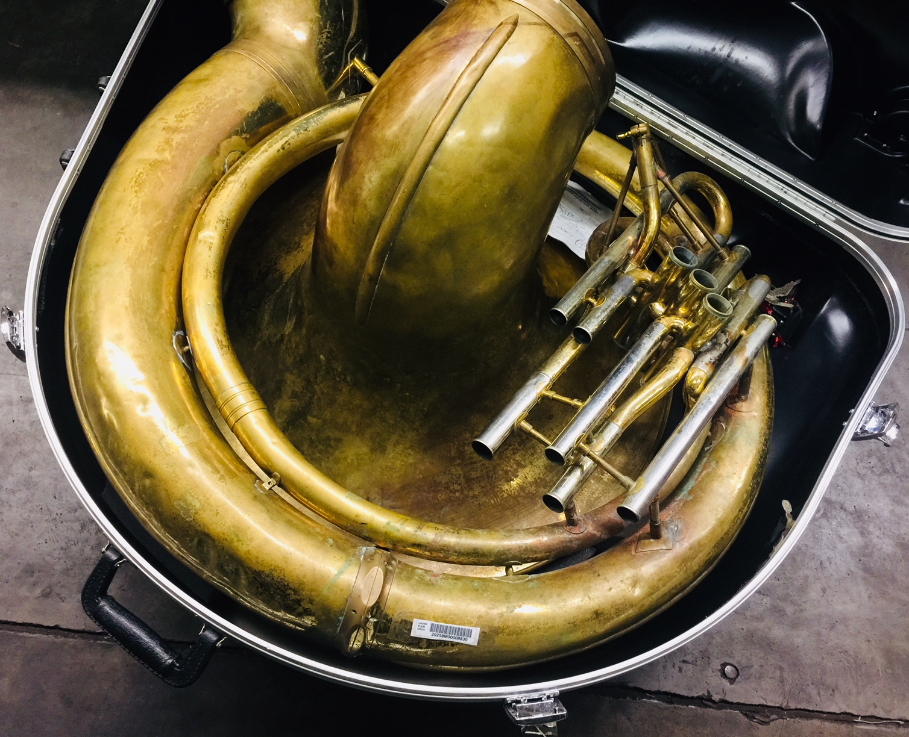
sousaphone
On the main body part of the instrument as shown

Slide 32
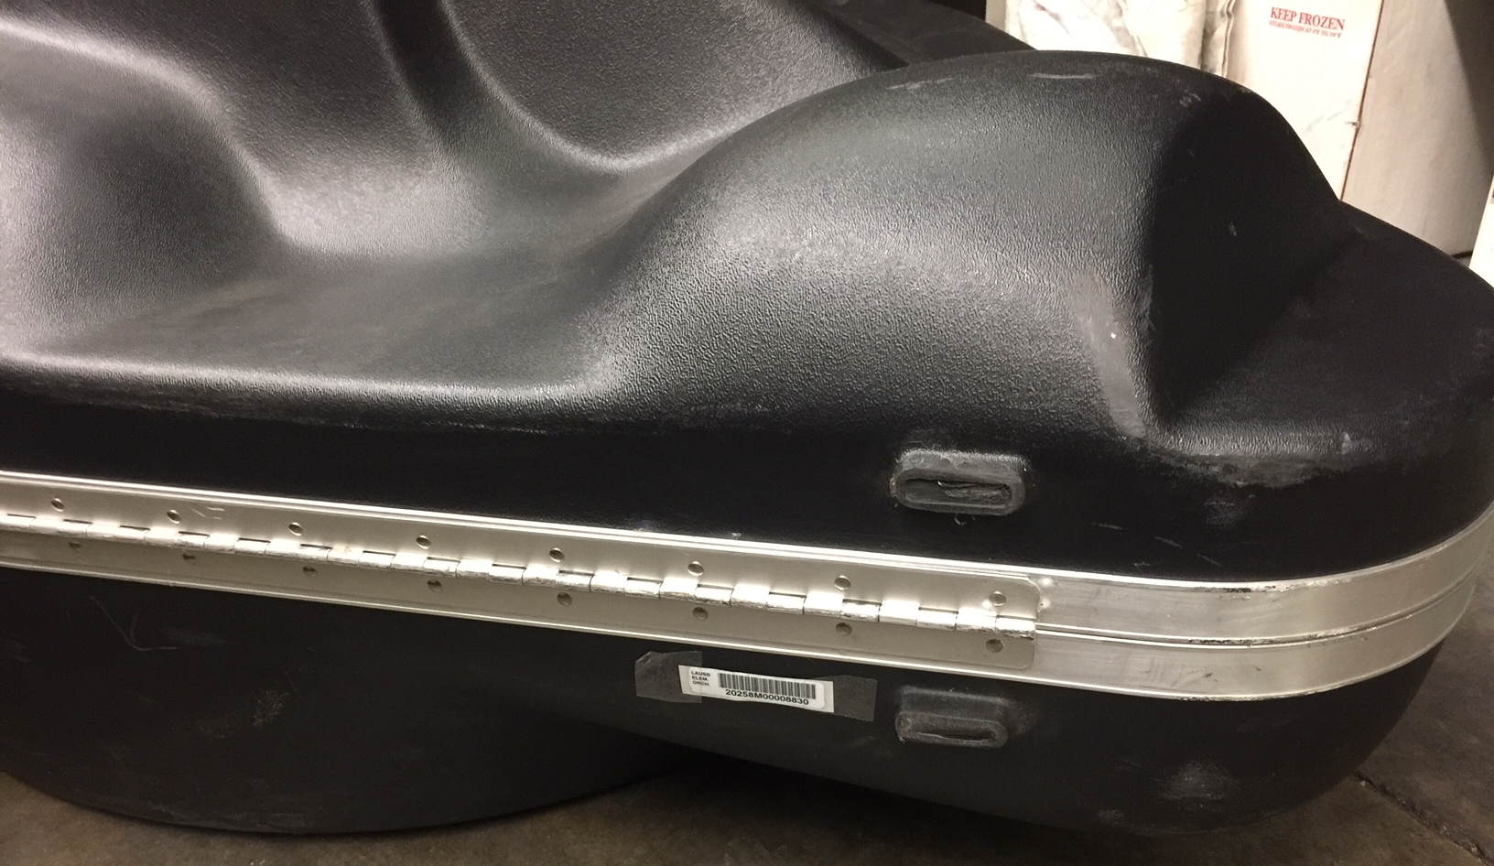
sousaphone Case
On the bottom right as shown

Slide 33
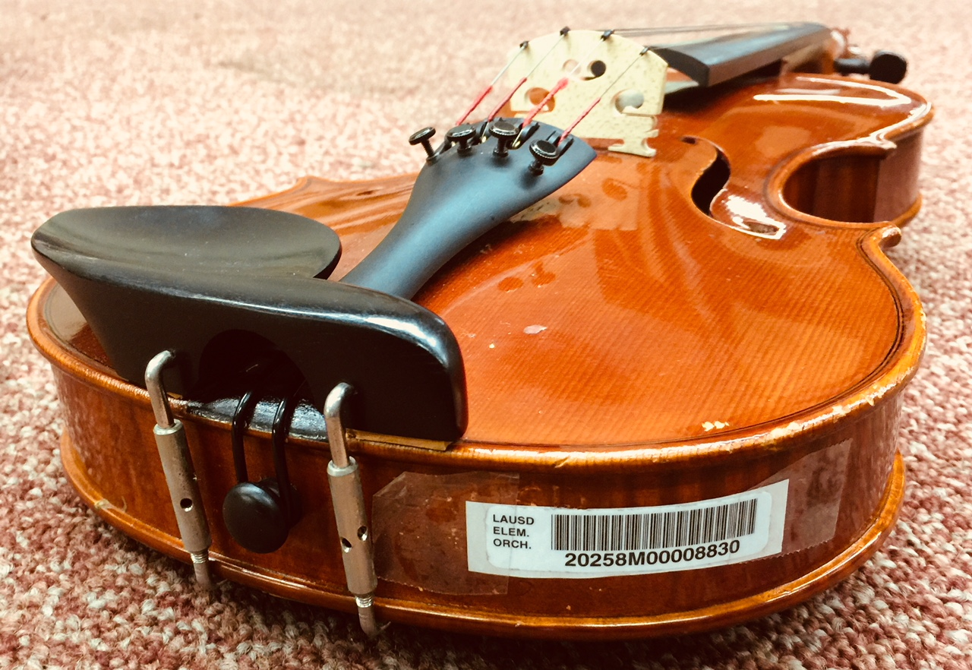
Violin/viola
On the bottom side, opposite of the chin rest as shown

Slide 34
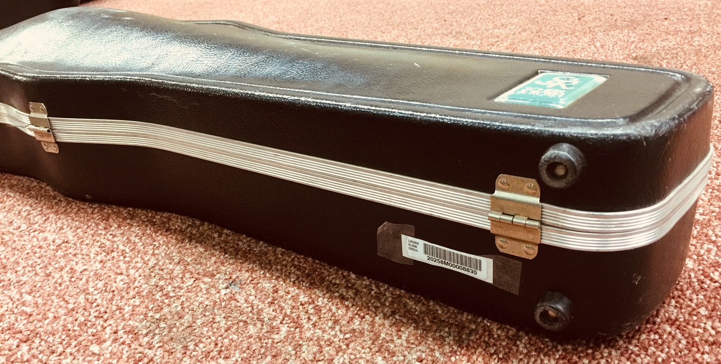
Violin/viola Case
On the bottom right, toward the front as shown

Slide 35
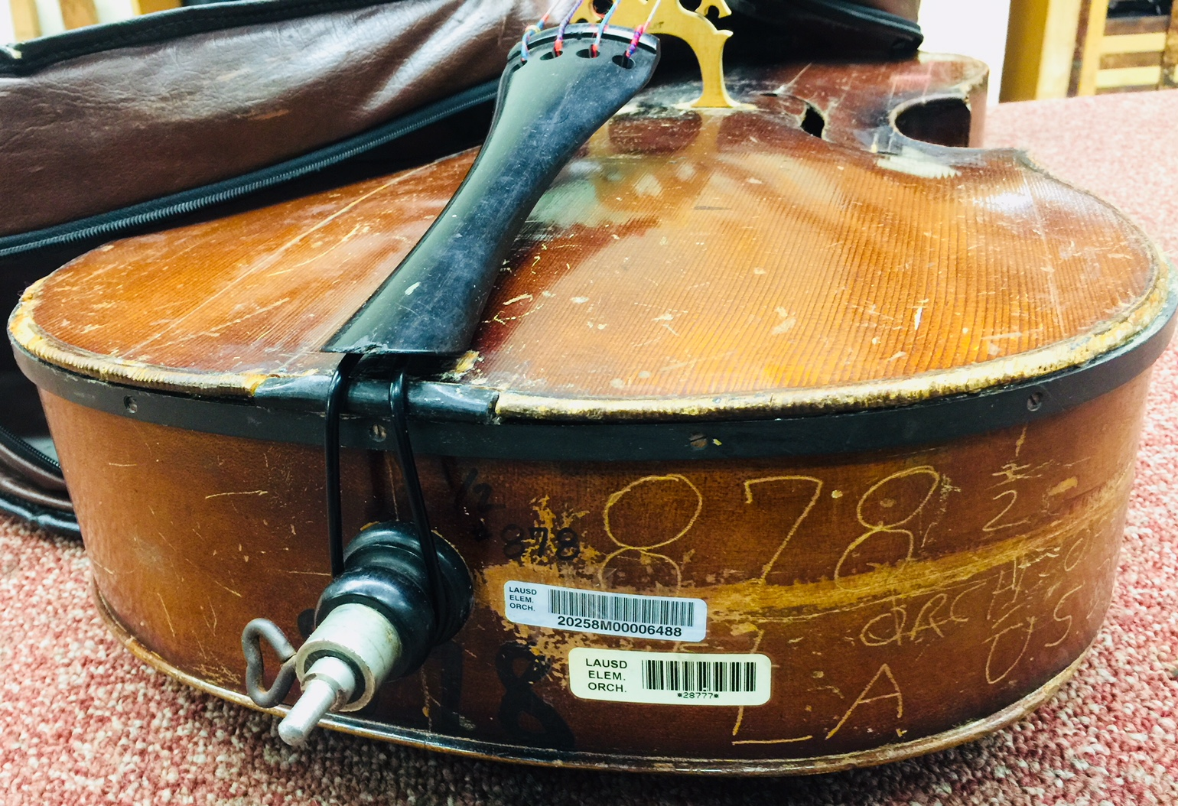
Cello/Double bass
On the bottom side, right of the endpin as shown

Slide 36
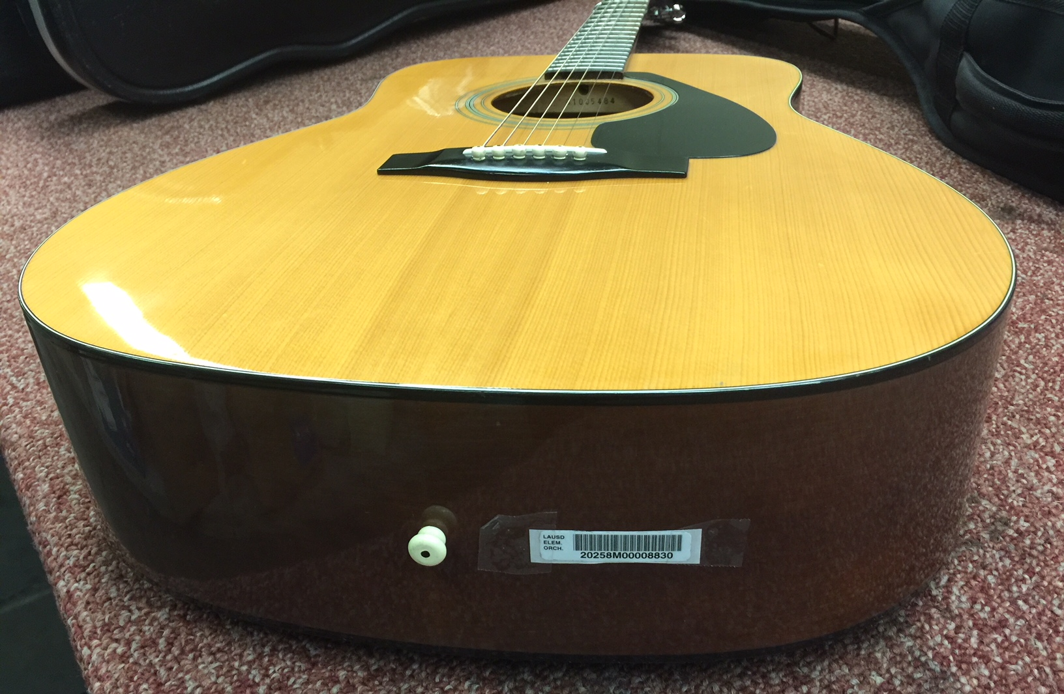
Guitar/ukulele
On the bottom side, right of the endpin as shown

Slide 37
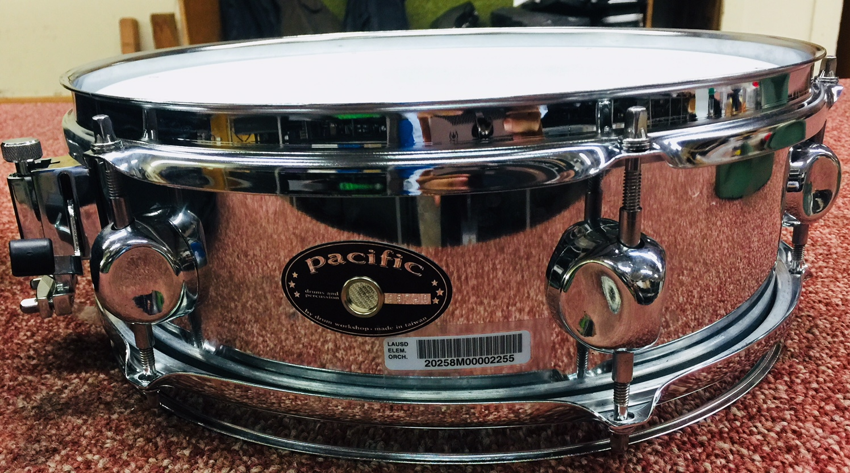
Drums/Keyboards/etc.
Close to the brand name without covering up information as shown

Slide 38
Questions?
Arts Education Branch:
Joseph Yune (jty9169@lausd.net) 213-241-3368
Christopher Rodriguez (chris.j.rodriguez@lausd.net) 213-241-5529

