Slide 1
Destiny reports
Viewing Destiny Reports from a Laptop or Desktop Computer
By Joseph Yune

Slide 2

Getting started
In order to view reports from the Destiny Website, you’ll need the following:
A Laptop or Desktop Computer (It will not work from a phone, iPad, etc. unless you run it through a browser)
LAUSD Single Sign-On Username and Password
Your Username must be in the Destiny system
We recommend Chrome browser for this purpose
It’s Your Destiny!
Image by Lyshashtra (used by permission)

Slide 3
Contents
Destiny Website ------------------------------------------- Slide 4
Finding the School (Method 1) ------------------------- Slide 5
Finding the School (Method 2) ------------------------- Slide 6
Logging In -------------------------------------------------- Slide 9
Circulation -------------------------------------------------- Slide 12
Running Reports ------------------------------------------- Slide 13
Running Reports by Saving it to Favorites ------------ Slide 15
Viewing Various Reports --------------------------------- Slide 22
Downloading Excel File of Report --------------------- Slide 27
Running Reports with Student Names ----------------- Slide 30

Slide 4
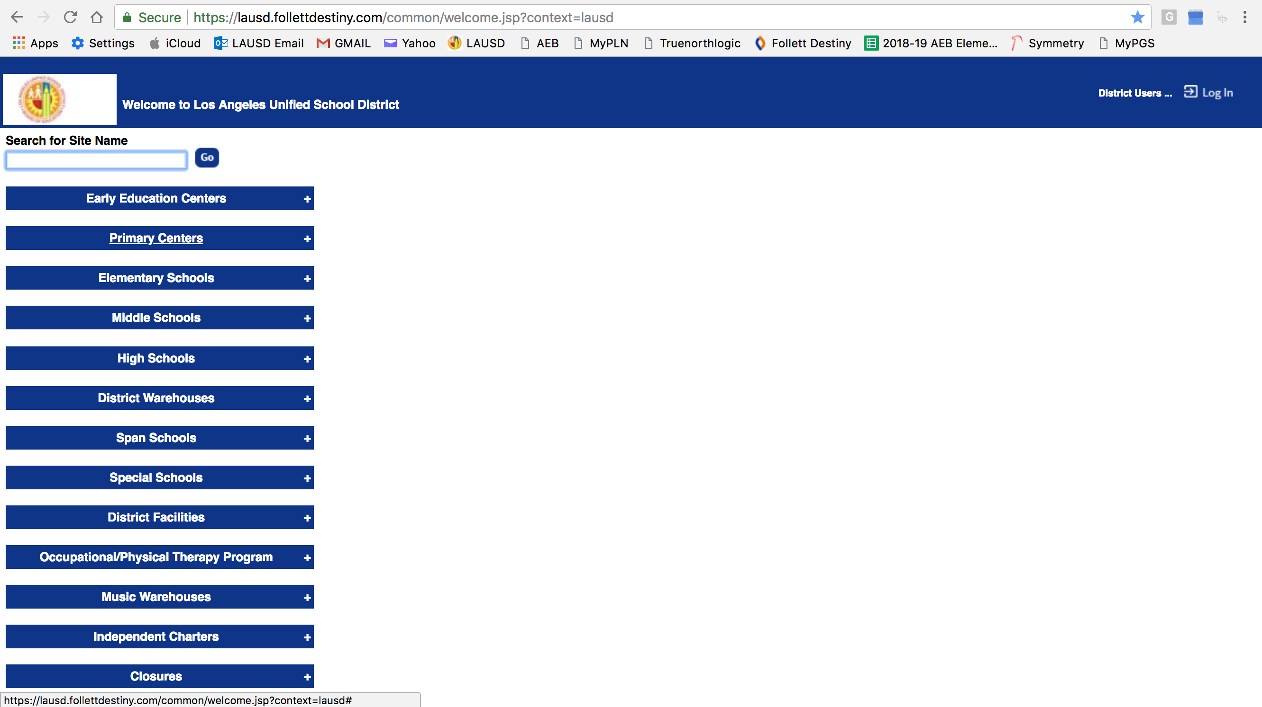
Destiny website
Destiny Website: https://lausd.follettdestiny.com (Type in the URL and press Enter)
Double check the spelling!

Slide 5
Finding the school (Method 1)
Type in the name of the school and press “Go” – then click on your school name

Slide 6
Finding the school (method 2)
Click “Elementary Schools” tab to search for Elementary Schools
Click “Middle Schools” tab to search for Middle Schools, etc.

Slide 7
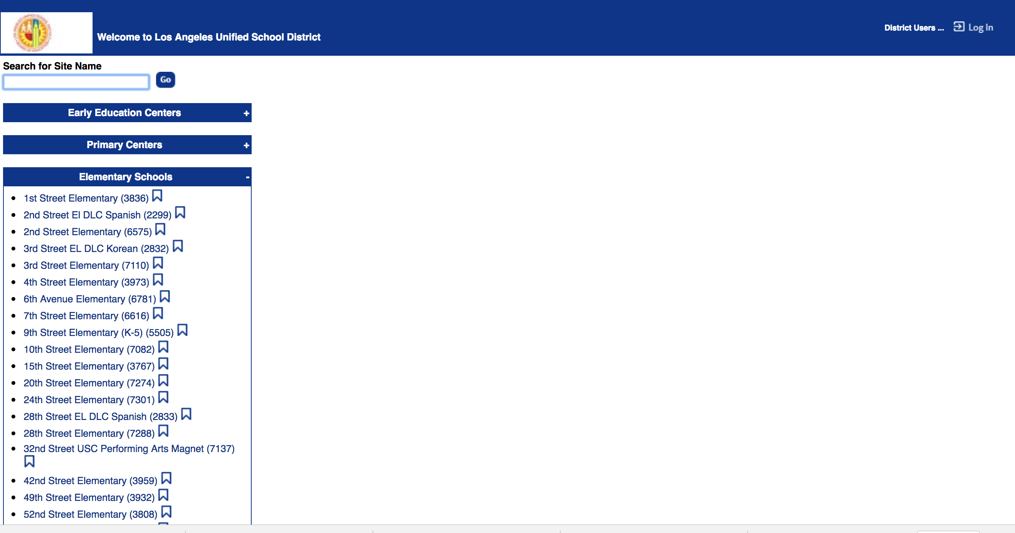
Search for your school
Scroll down to search for your school

Slide 8
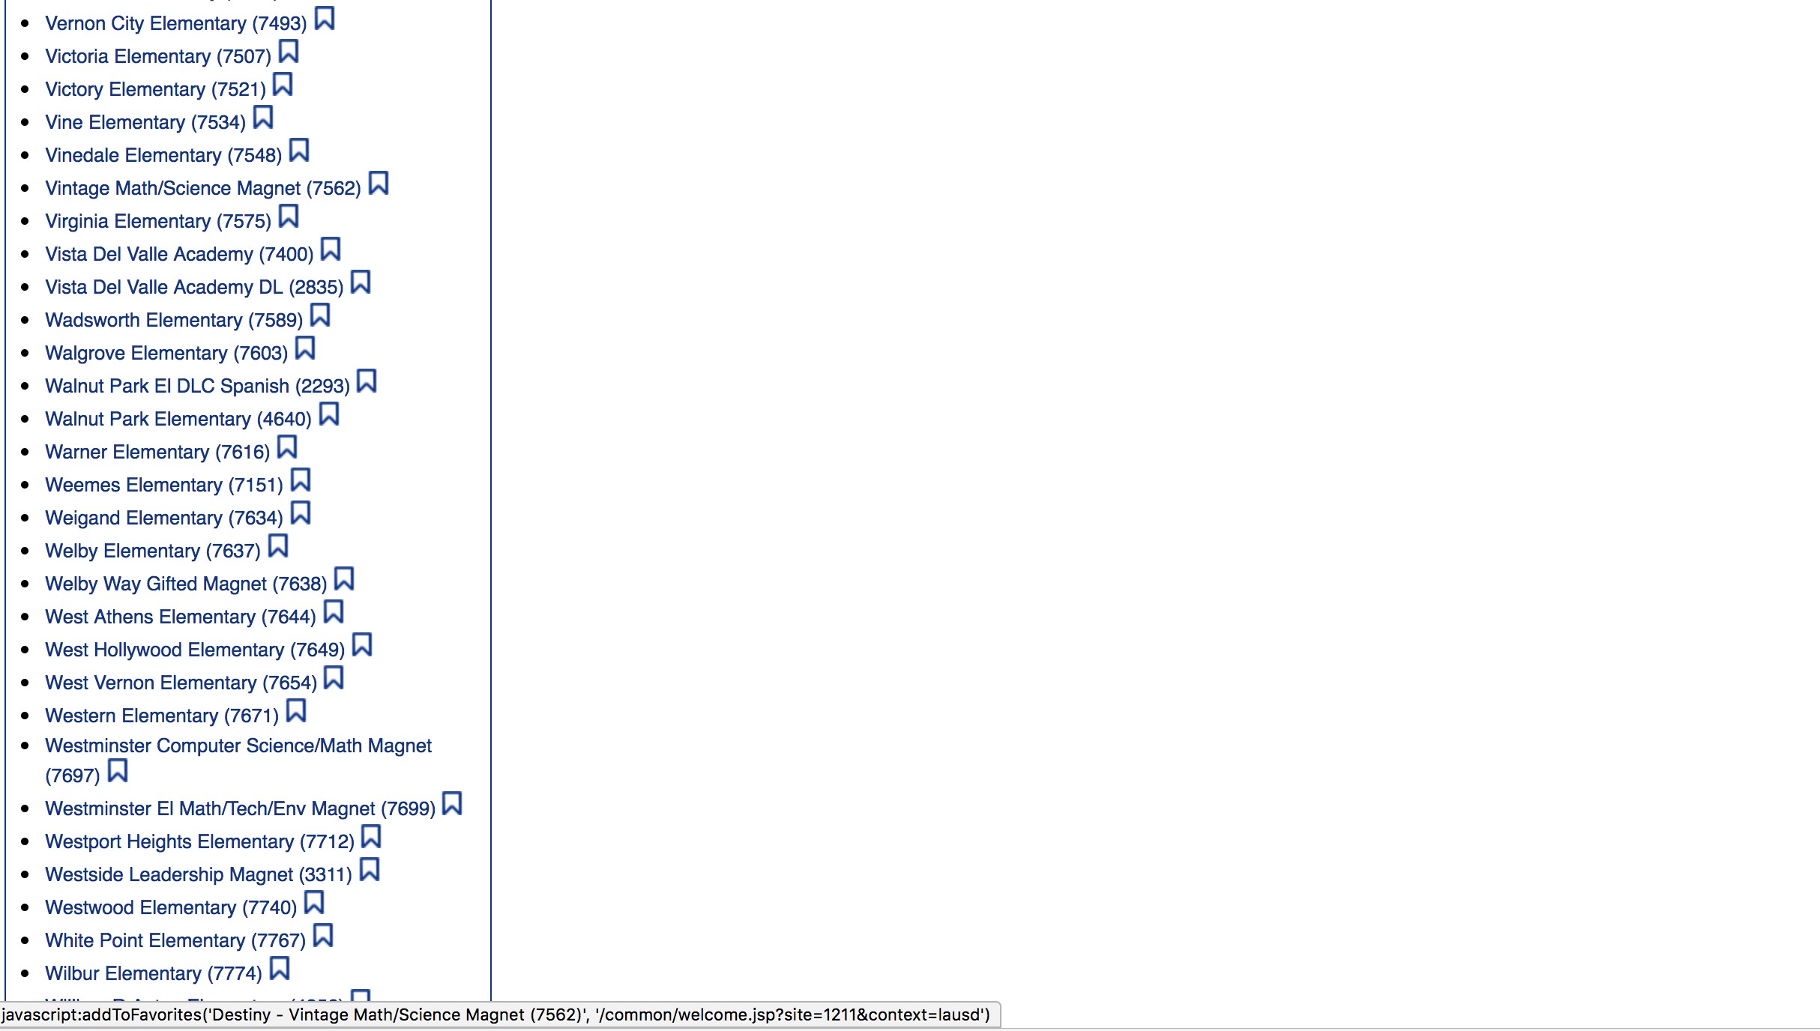
choose your school
Click on your school

Slide 9
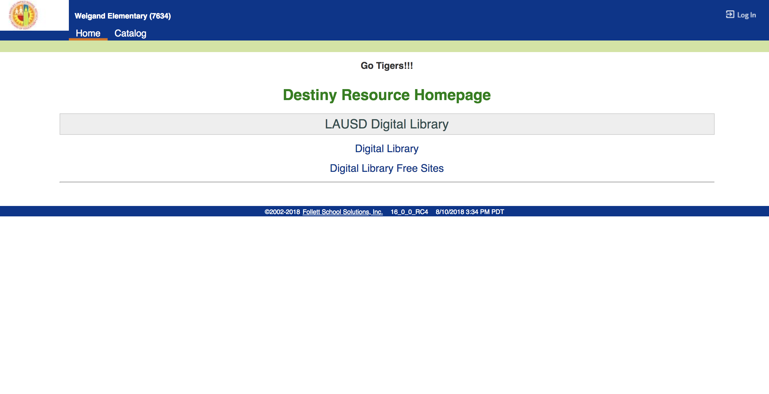
Logging in
On the top right corner, click on “Log In”

Slide 10
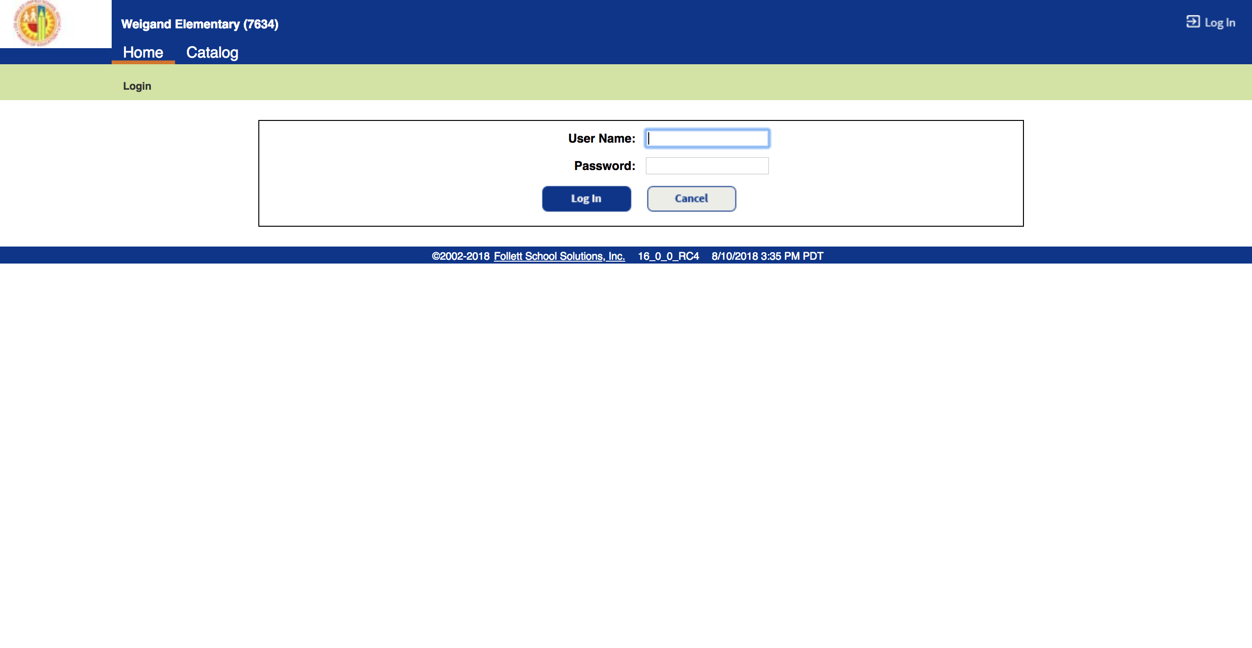
Logging in (continued)
Type in LAUSD Username (without @lausd.net) & Password, then click on “Log In”

Slide 11
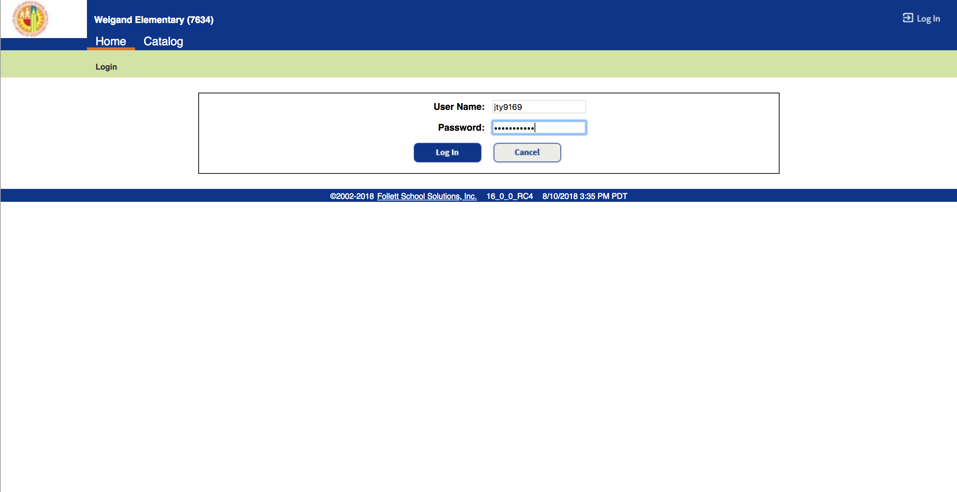
Logging in sample
Type in LAUSD Username (without @lausd.net) & Password, then click on “Log In”

Slide 12
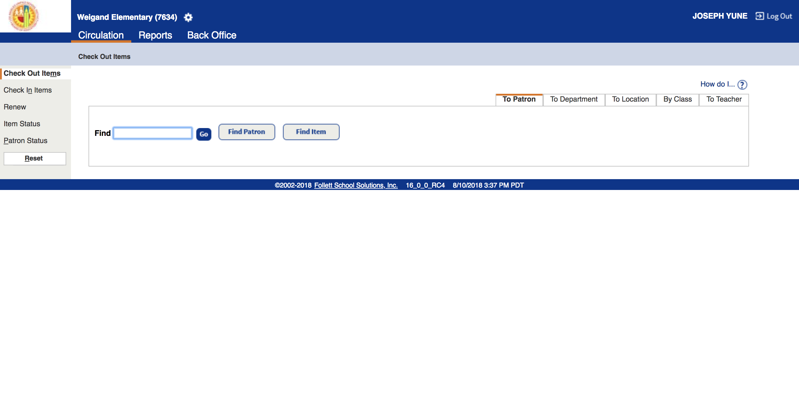
Circulation (FYI)
It begins with “Circulation” (in orange) to Check Out/Check In items
Click left side to change menu items on this page
*This presentation does not focus on “Circulation”
For circulation purposes, use Destiny Manual PowerPoint

Slide 13
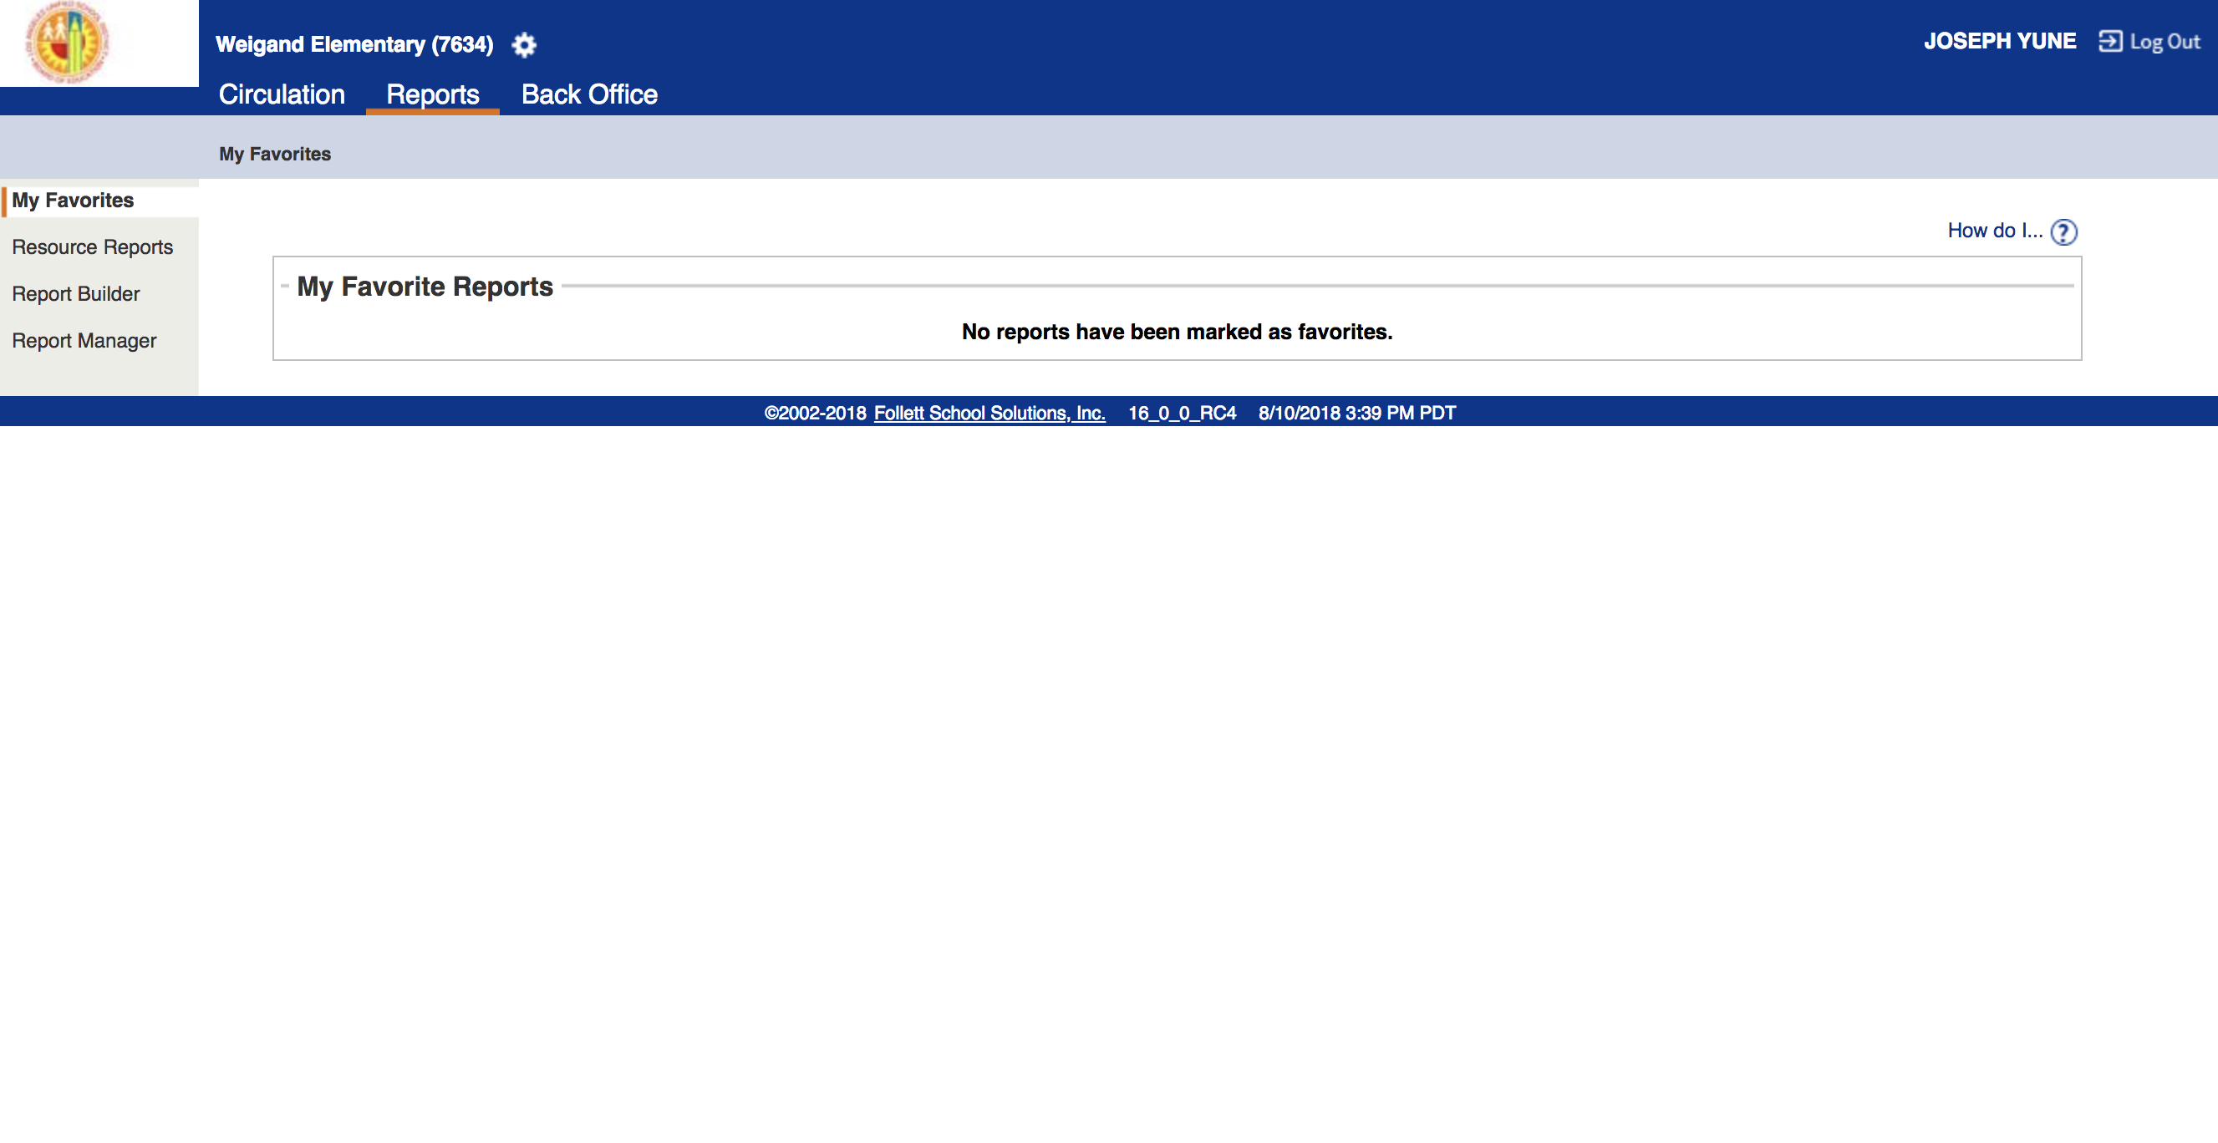
Running reports
To run reports, click on “Reports” (in orange)

Slide 14
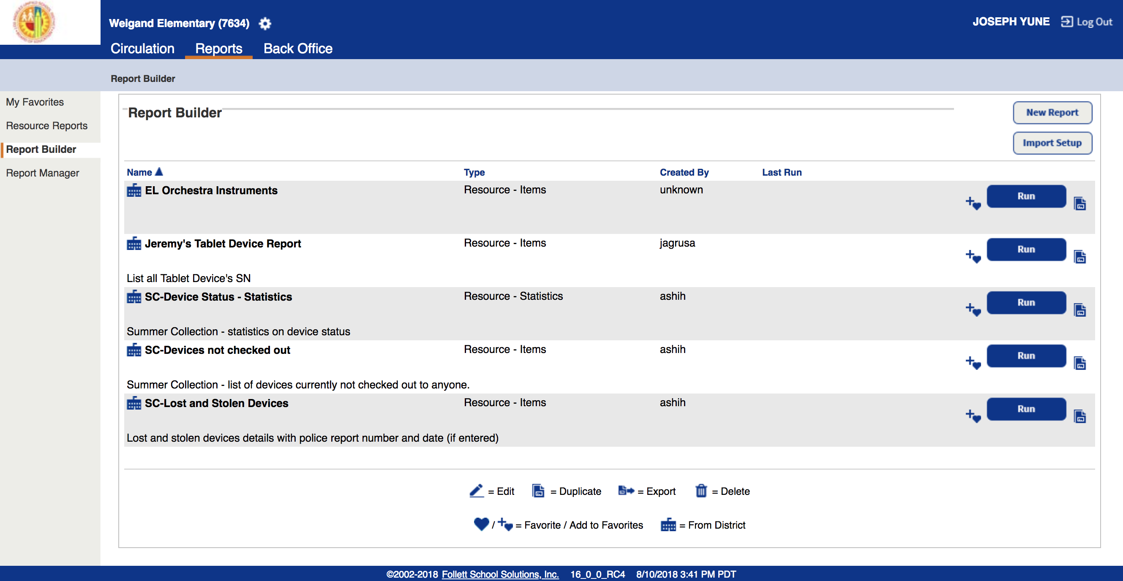
Running reports Continued p.2
Click on left side “Report Builder”
**You can skip the optional slides (Slides 14 to 16) and skip to Slide 17

Slide 15
Running reports Continued p.3 (OPtional)
(Optional) You may choose to place the instrument report in ”My Favorites” by clicking on the “+” – In “My Favorites” you’ll only see your choice of reports

Slide 16
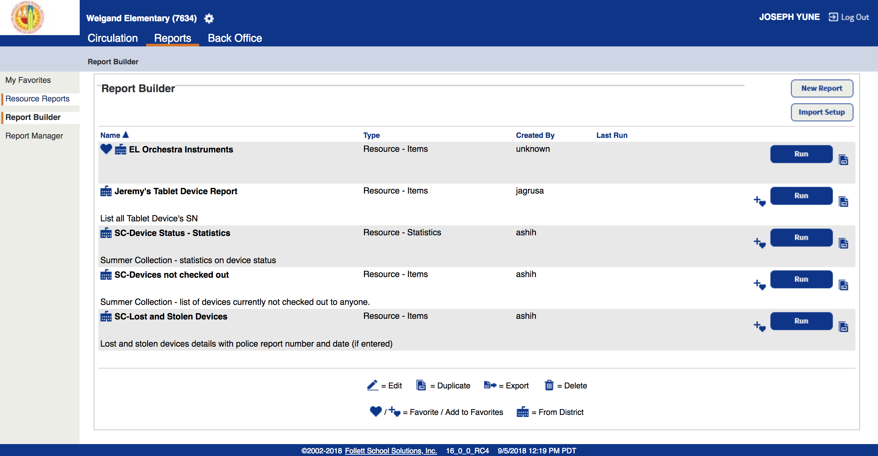
Running reports Continued p.4 (OPtional)
(Optional continued) Notice that “+” is gone here

Slide 17
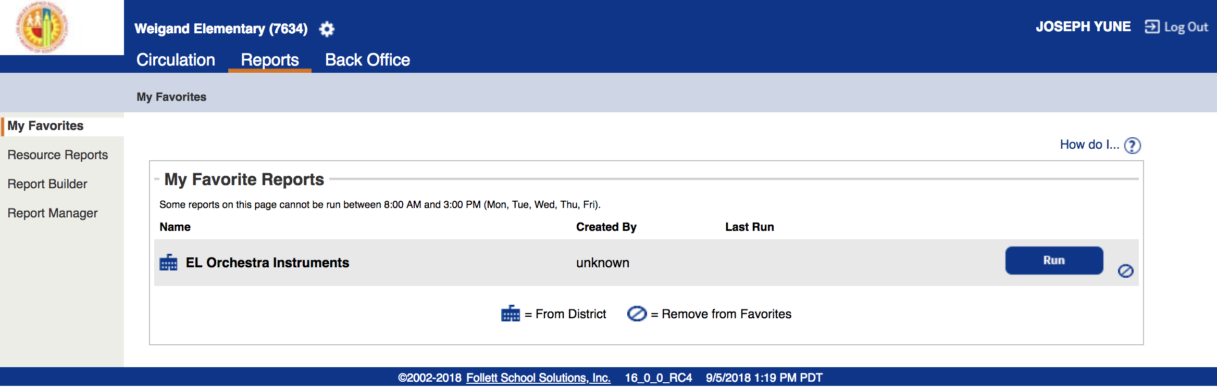
Running reports Continued p.5 (OPtional)
(Optional continued) If you click on ”My Favorites,” it only shows “EL Orchestra Instruments” – You can use this tab for future use and it will only show your favorite reports

Slide 18
Running reports Continued p.6
Search for “EL Orchestra Instruments” then click on “Run” tab

Slide 19
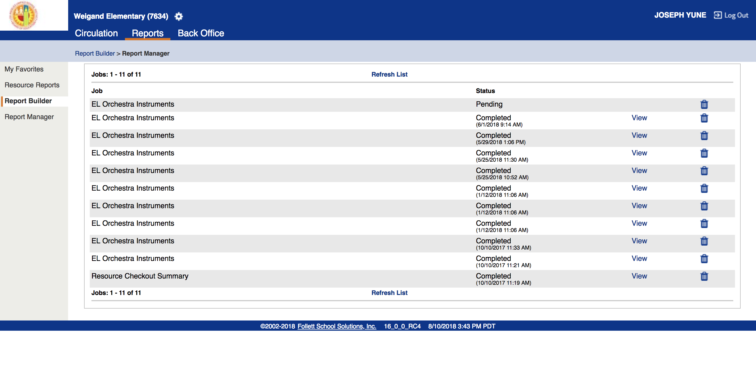
Running reports Continued p.7
“Pending” will appear

Slide 20
Running reports Continued p.8
Click on “Refresh List” until status shows “Completed” – You may need to click on it several times

Slide 21
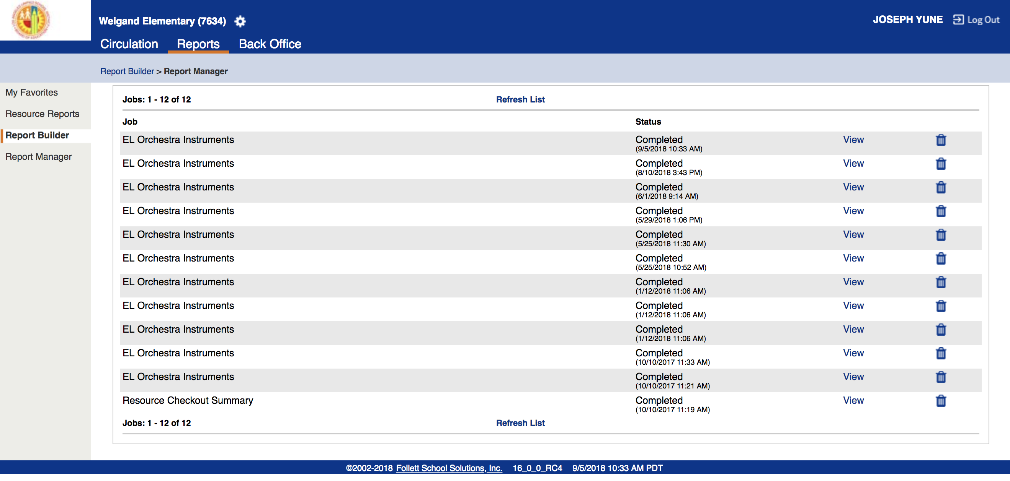
Running reports Continued p.9
When the Status shows “Completed,” then click on “View”

Slide 22
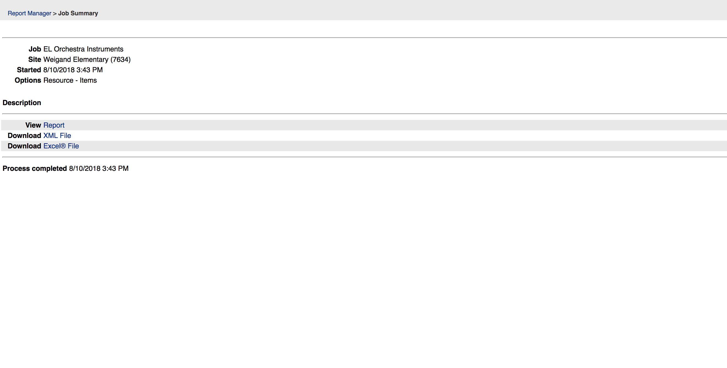
Viewing Various reports
Click on “Report” to view inventory status

Slide 23
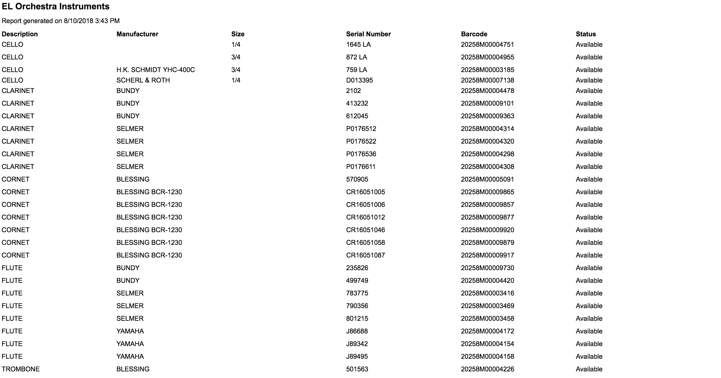
Viewing report
Sample “Report” page shows LAUSD instrument inventory at the school

Slide 24
printing report
You can choose to “Print” this report, or copy and paste to other programs such as “MS Word” to change format for preferred printing

Slide 25
downloading xml file
You can choose to Download “XML File”

Slide 26
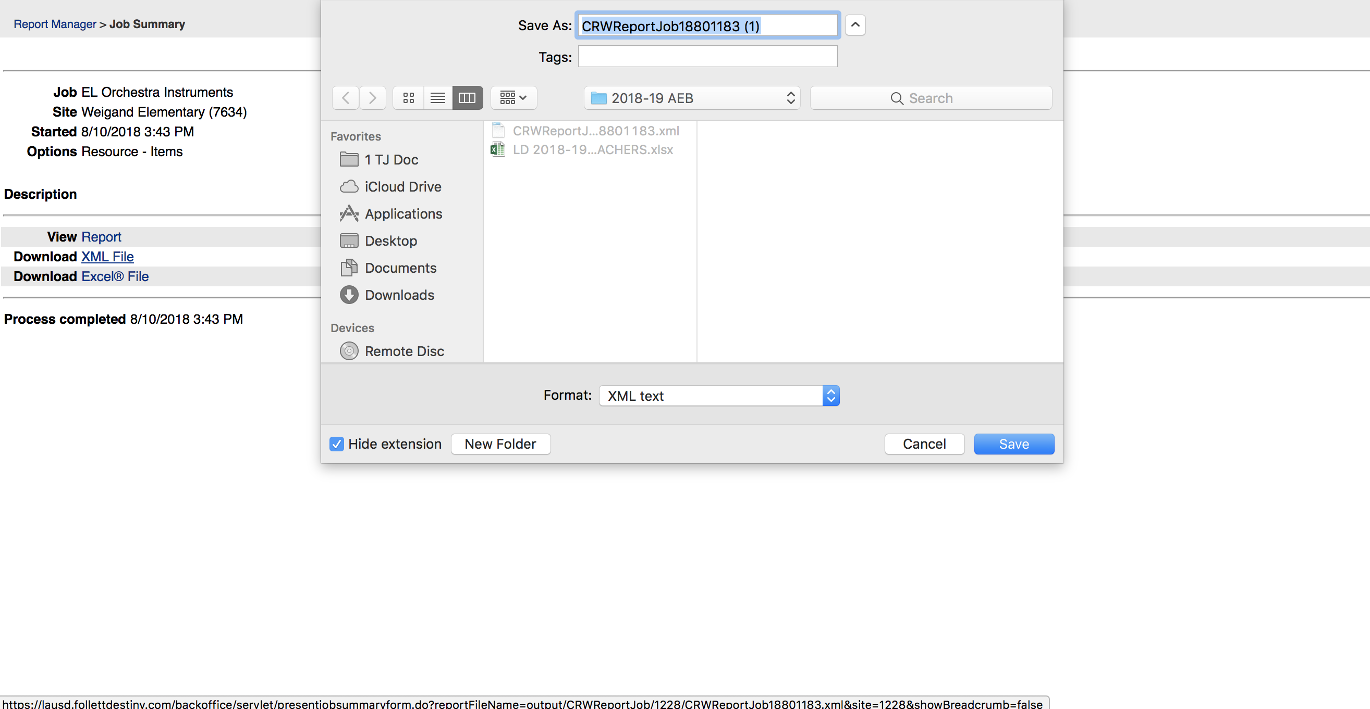
Downloading XML File continued
You can choose to “Download” XML File to your computer

Slide 27
downloading excel file
You can choose to Download “Excel File”

Slide 28
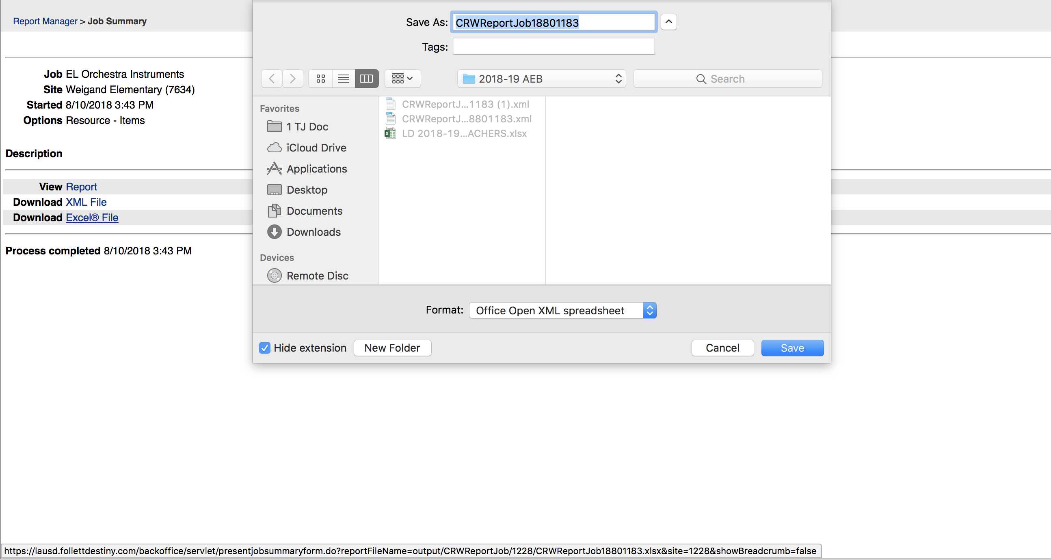
downloading excel file
You can choose to Download “Excel File”

Slide 29
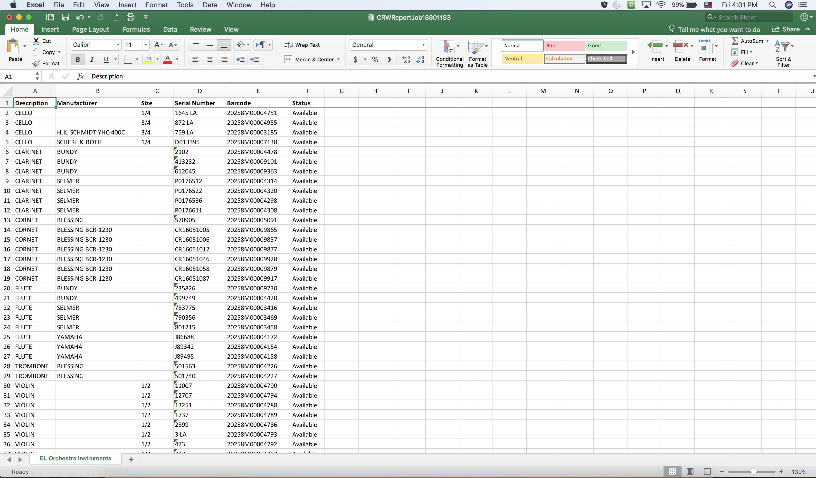
sample excel file
Sample “Excel File”

Slide 30
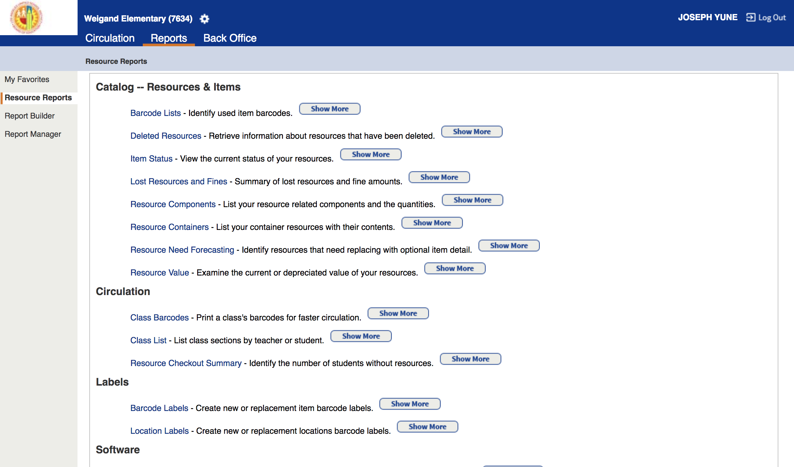
running reports with student names
Click on “Reports,” then click on “Resource Reports”

Slide 31
running reports with student names P.2
Under “Catalog - - Resources & Items,” click on “Item Status”

Slide 32
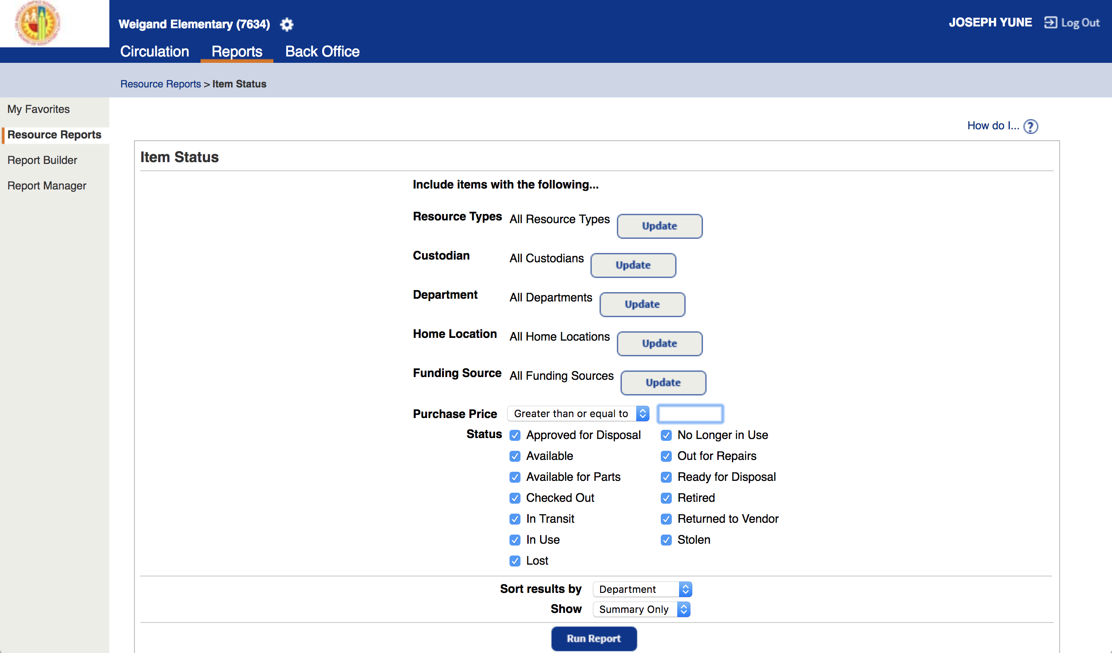
running reports with student names P.3
In “Resources Types,” click on “Update”

Slide 33
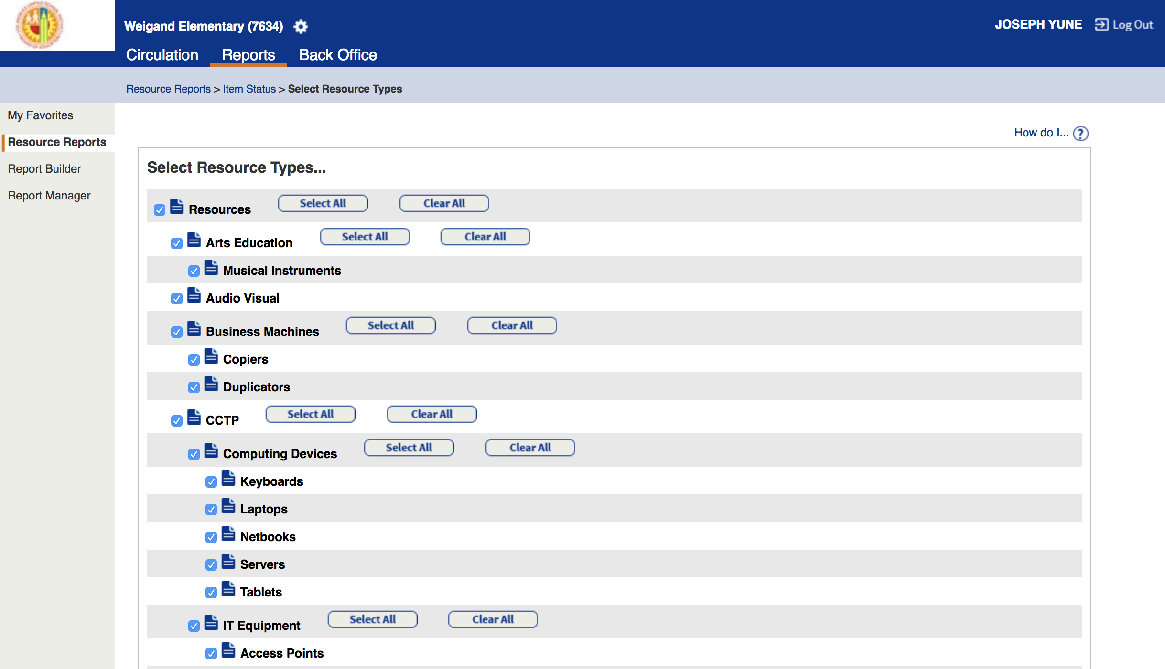
running reports with student names P.4
Under “Select Resource Types…,” click on “Clear All”

Slide 34
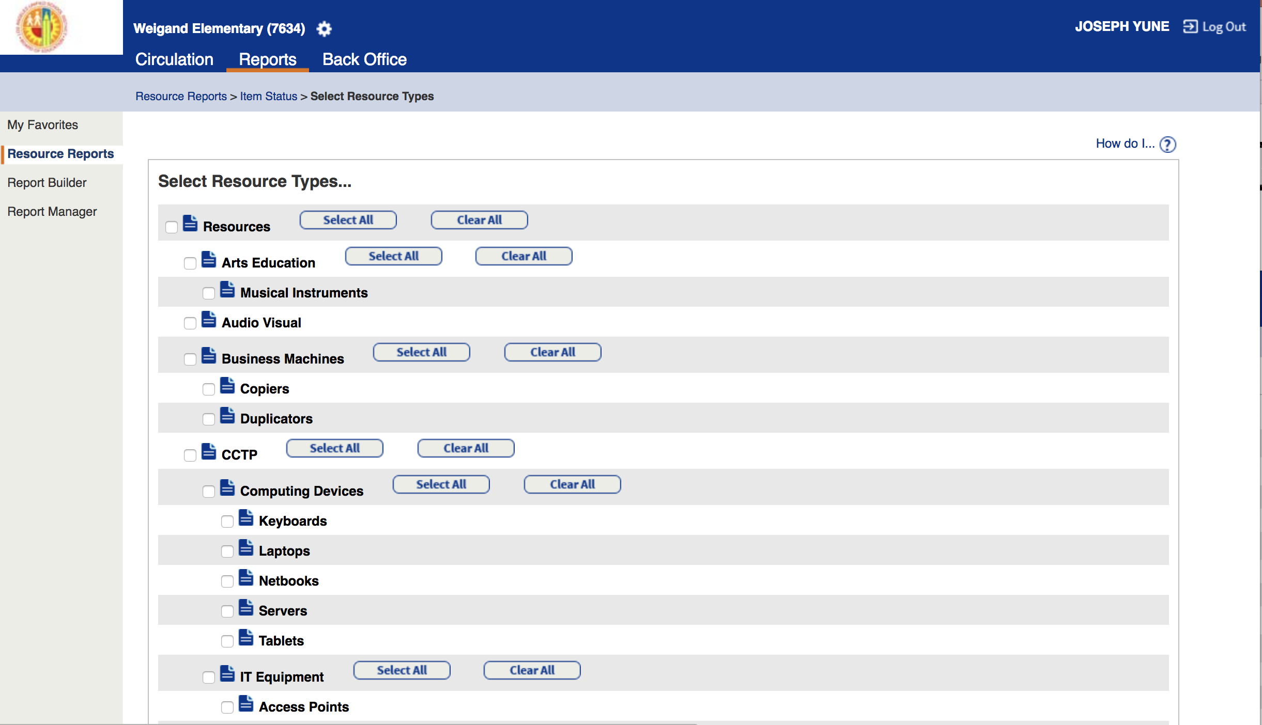
running reports with student names P.5
This is a sample of the screen – Notice all items were cleared

Slide 35
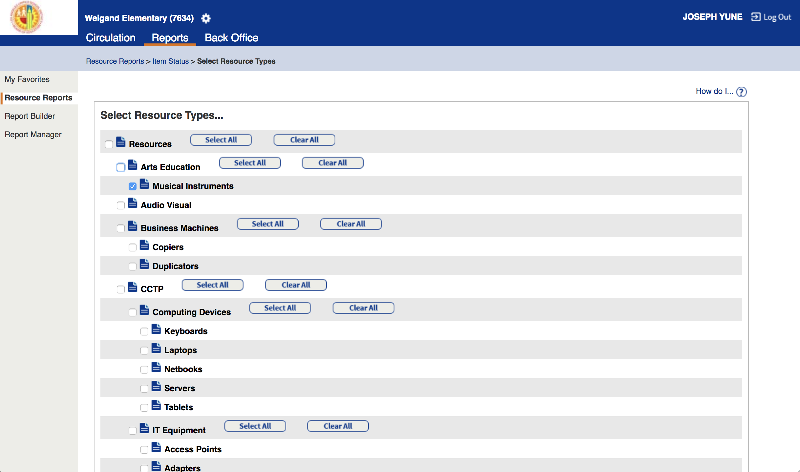
running reports with student names P.6
Click only on “Musical Instruments” and Scroll down

Slide 36
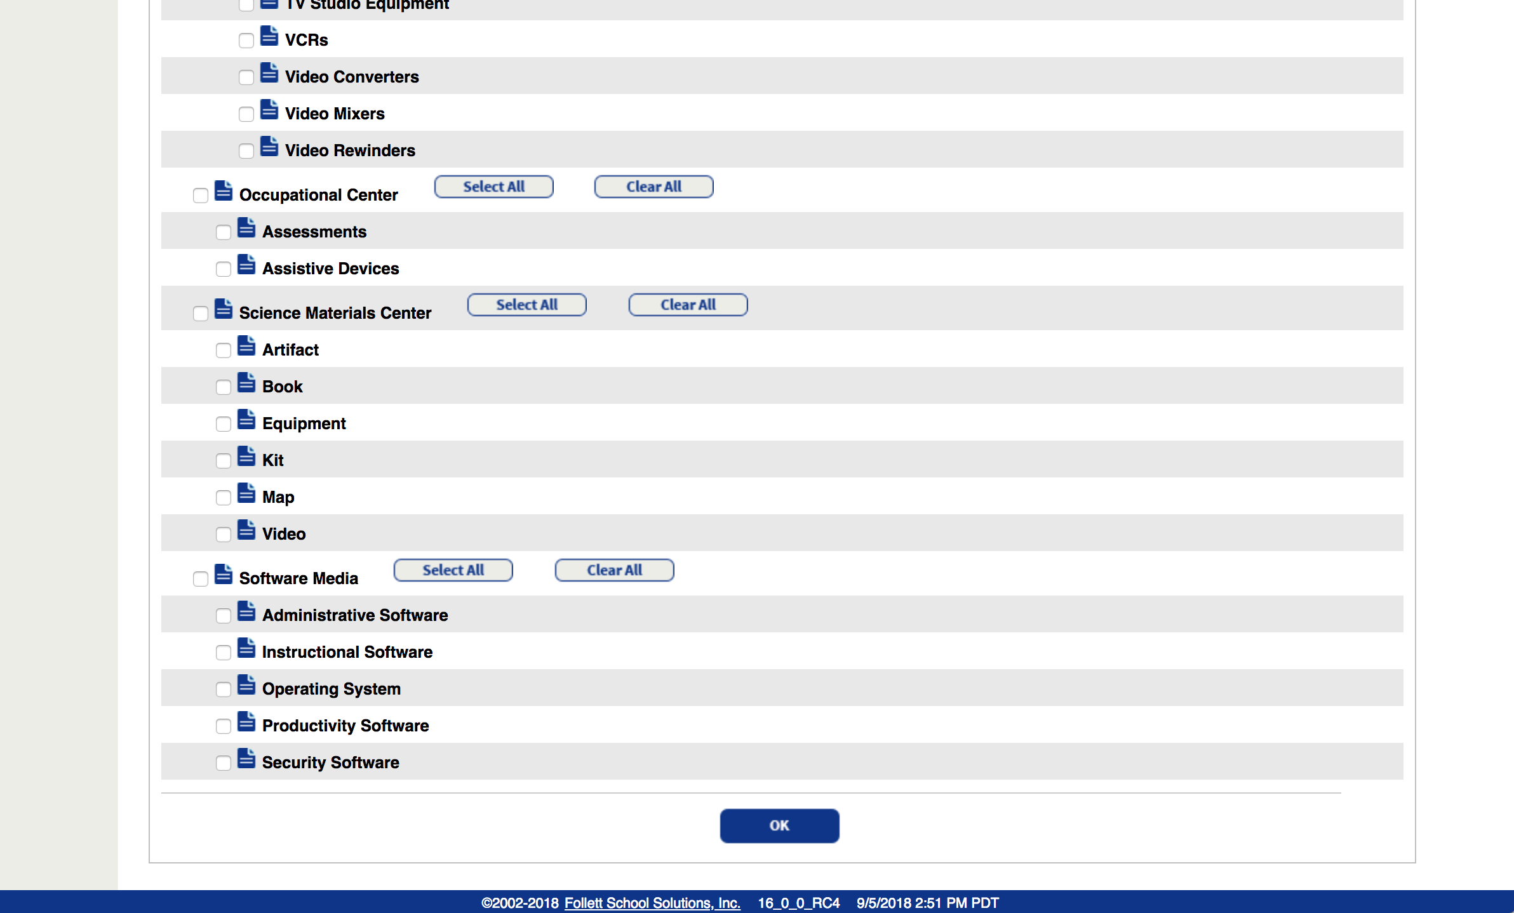
running reports with student names P.7
At the bottom, click on “OK”

Slide 37
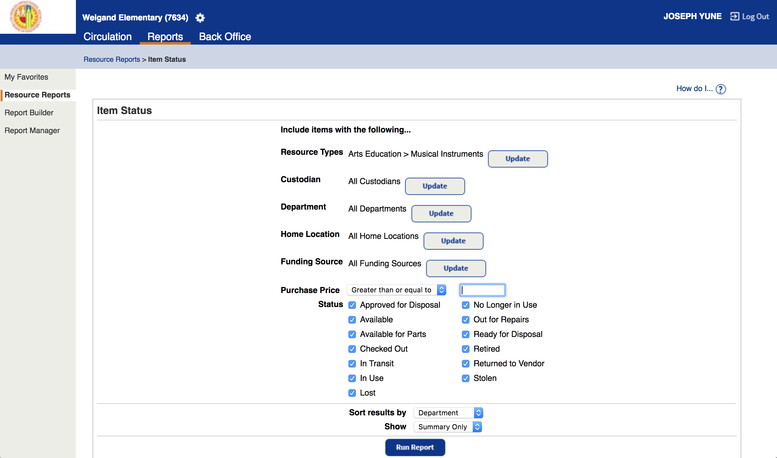
running reports with student names P.8
Under “Item Status,” look for “Status”

Slide 38
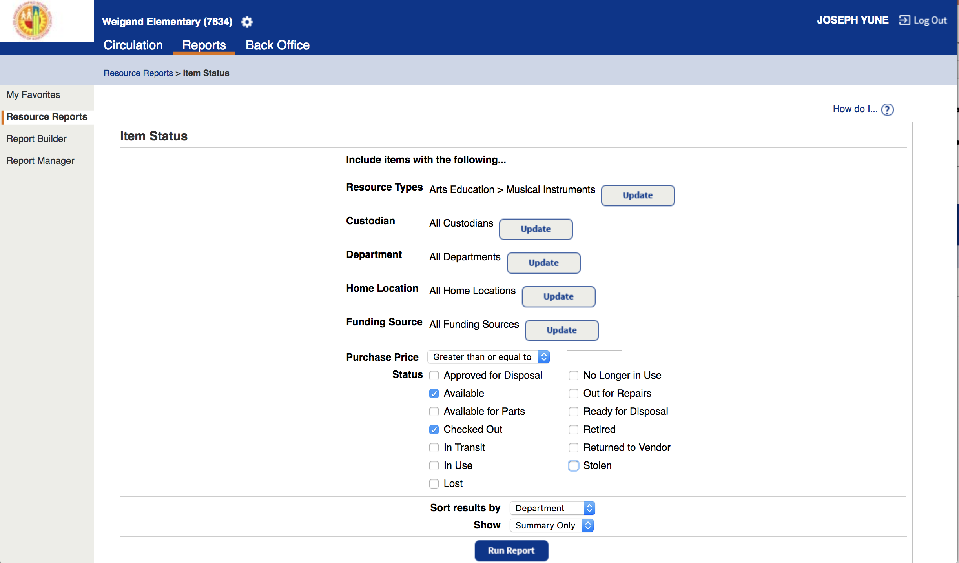
running reports with student names P.9
Un-click everything except for “Available” and “Checked Out”

Slide 39
running reports with student names P.10
Click on “Run Report”

Slide 40
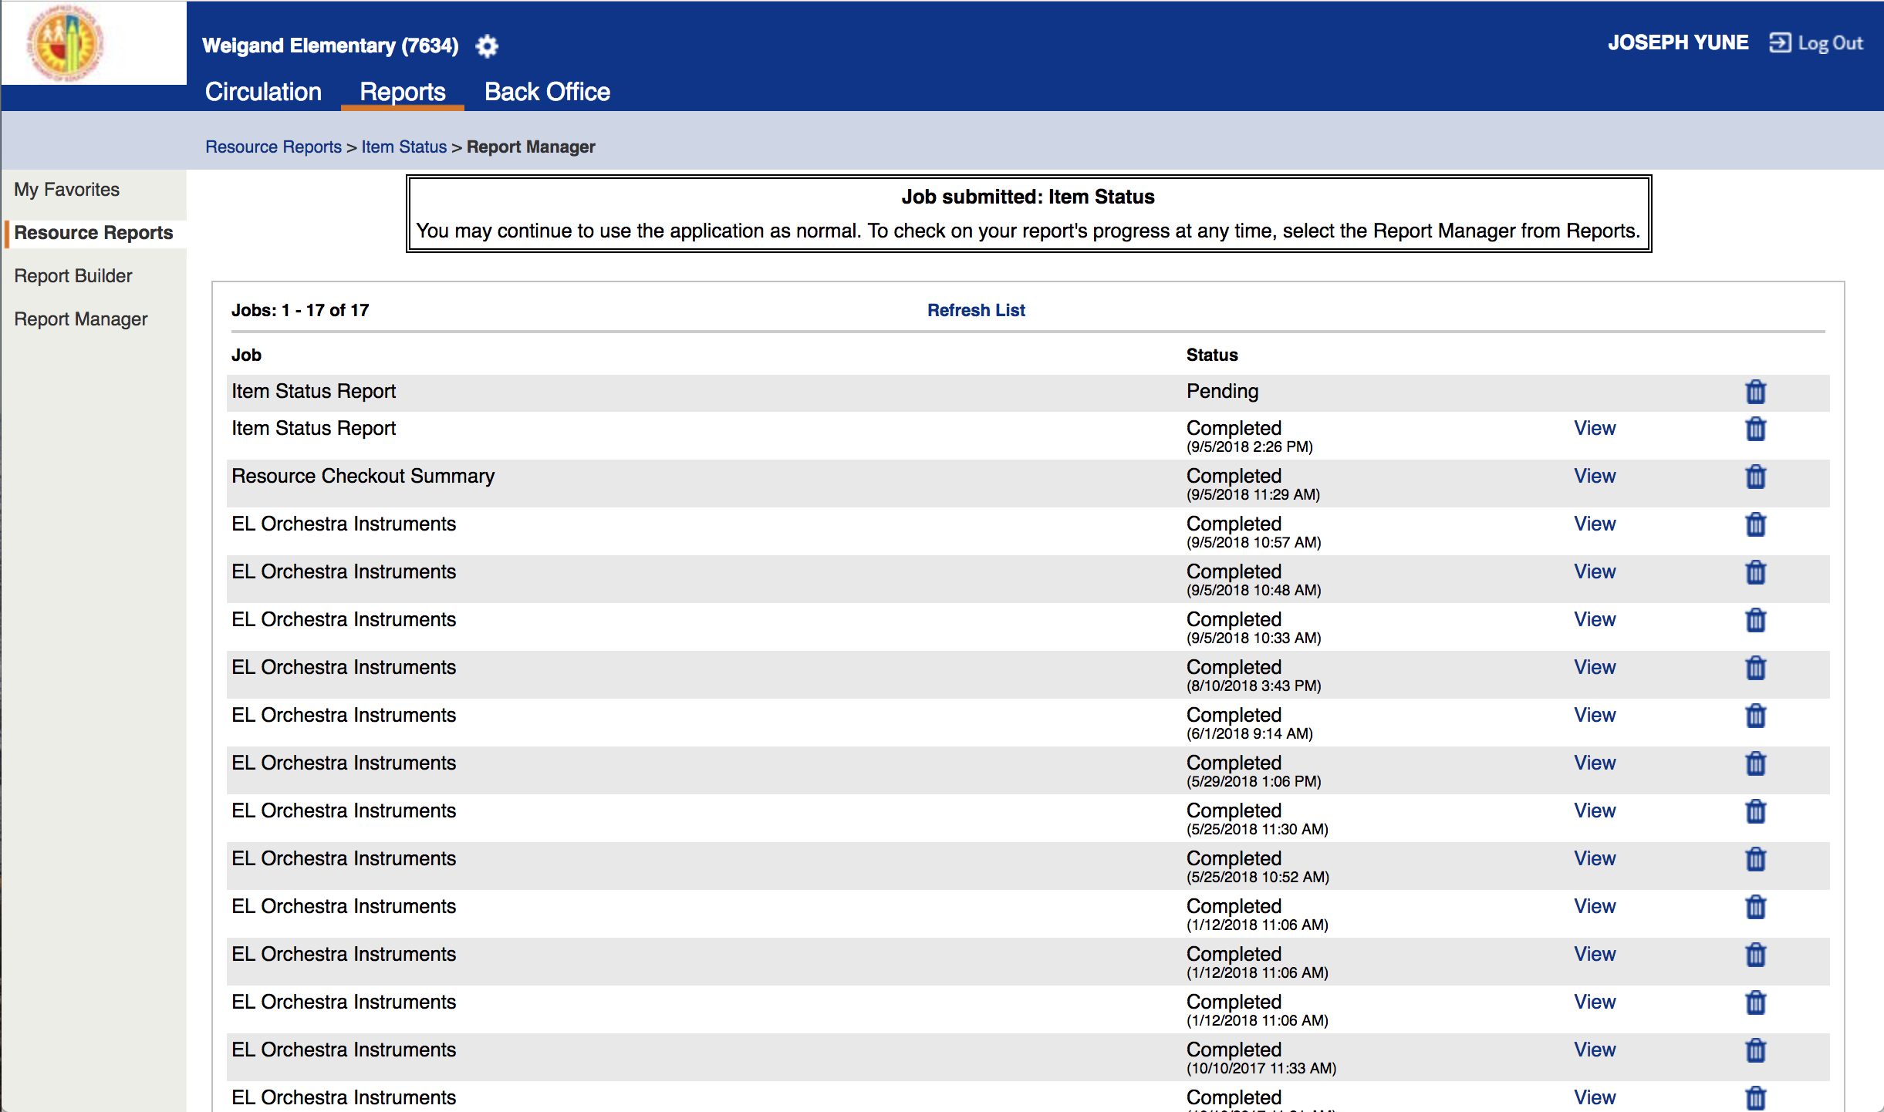
running reports with student names P.11
“Pending” will appear

Slide 41
To run reports with student names P.11
Click on “Refresh List” – You may have to click several times

Slide 42
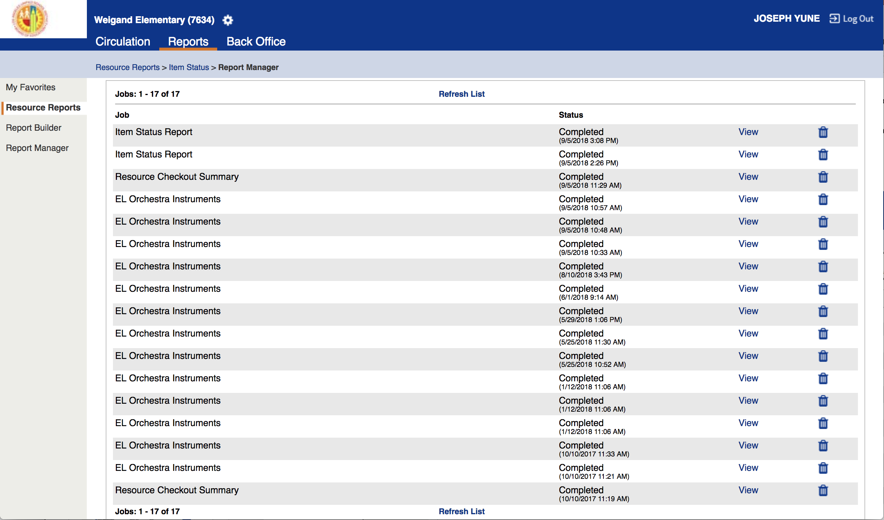
running reports with student names P.12
Click on “View”

Slide 43
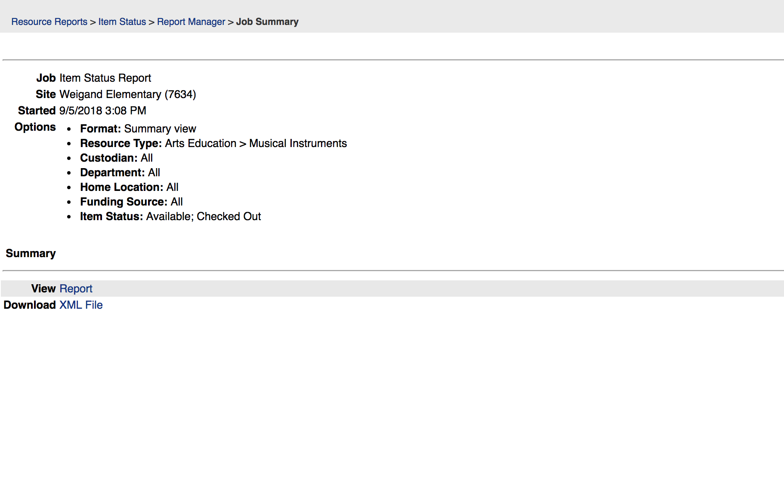
To run reports with student names P.13
Click on “Report” to view report

Slide 44
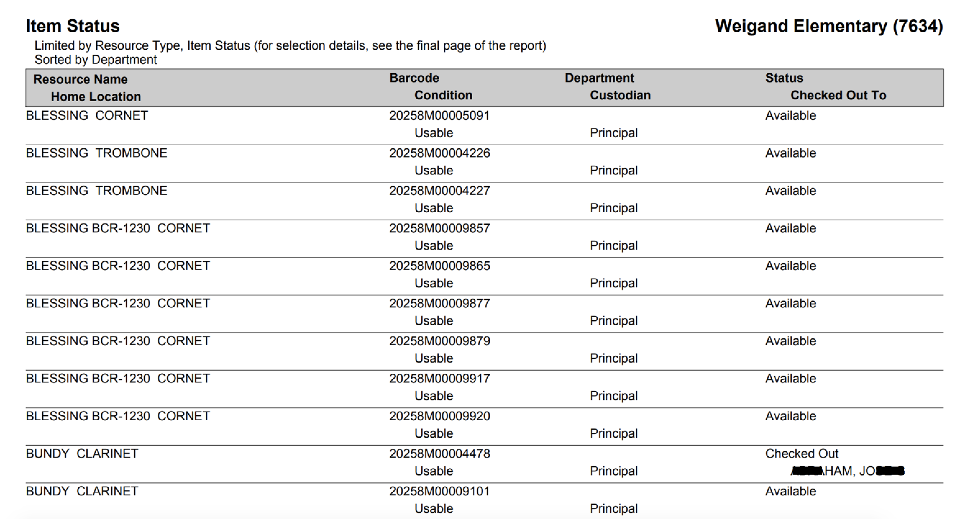
To run reports with student names P.14
Sample of the report page – Notice the student name appears with the item

Slide 45
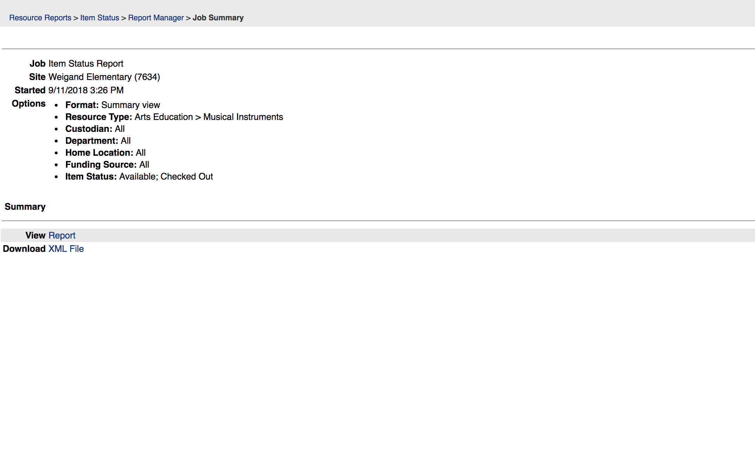
To run reports with student names P.15
You can choose to download the “XML File” – Click on “XML File”

Slide 46
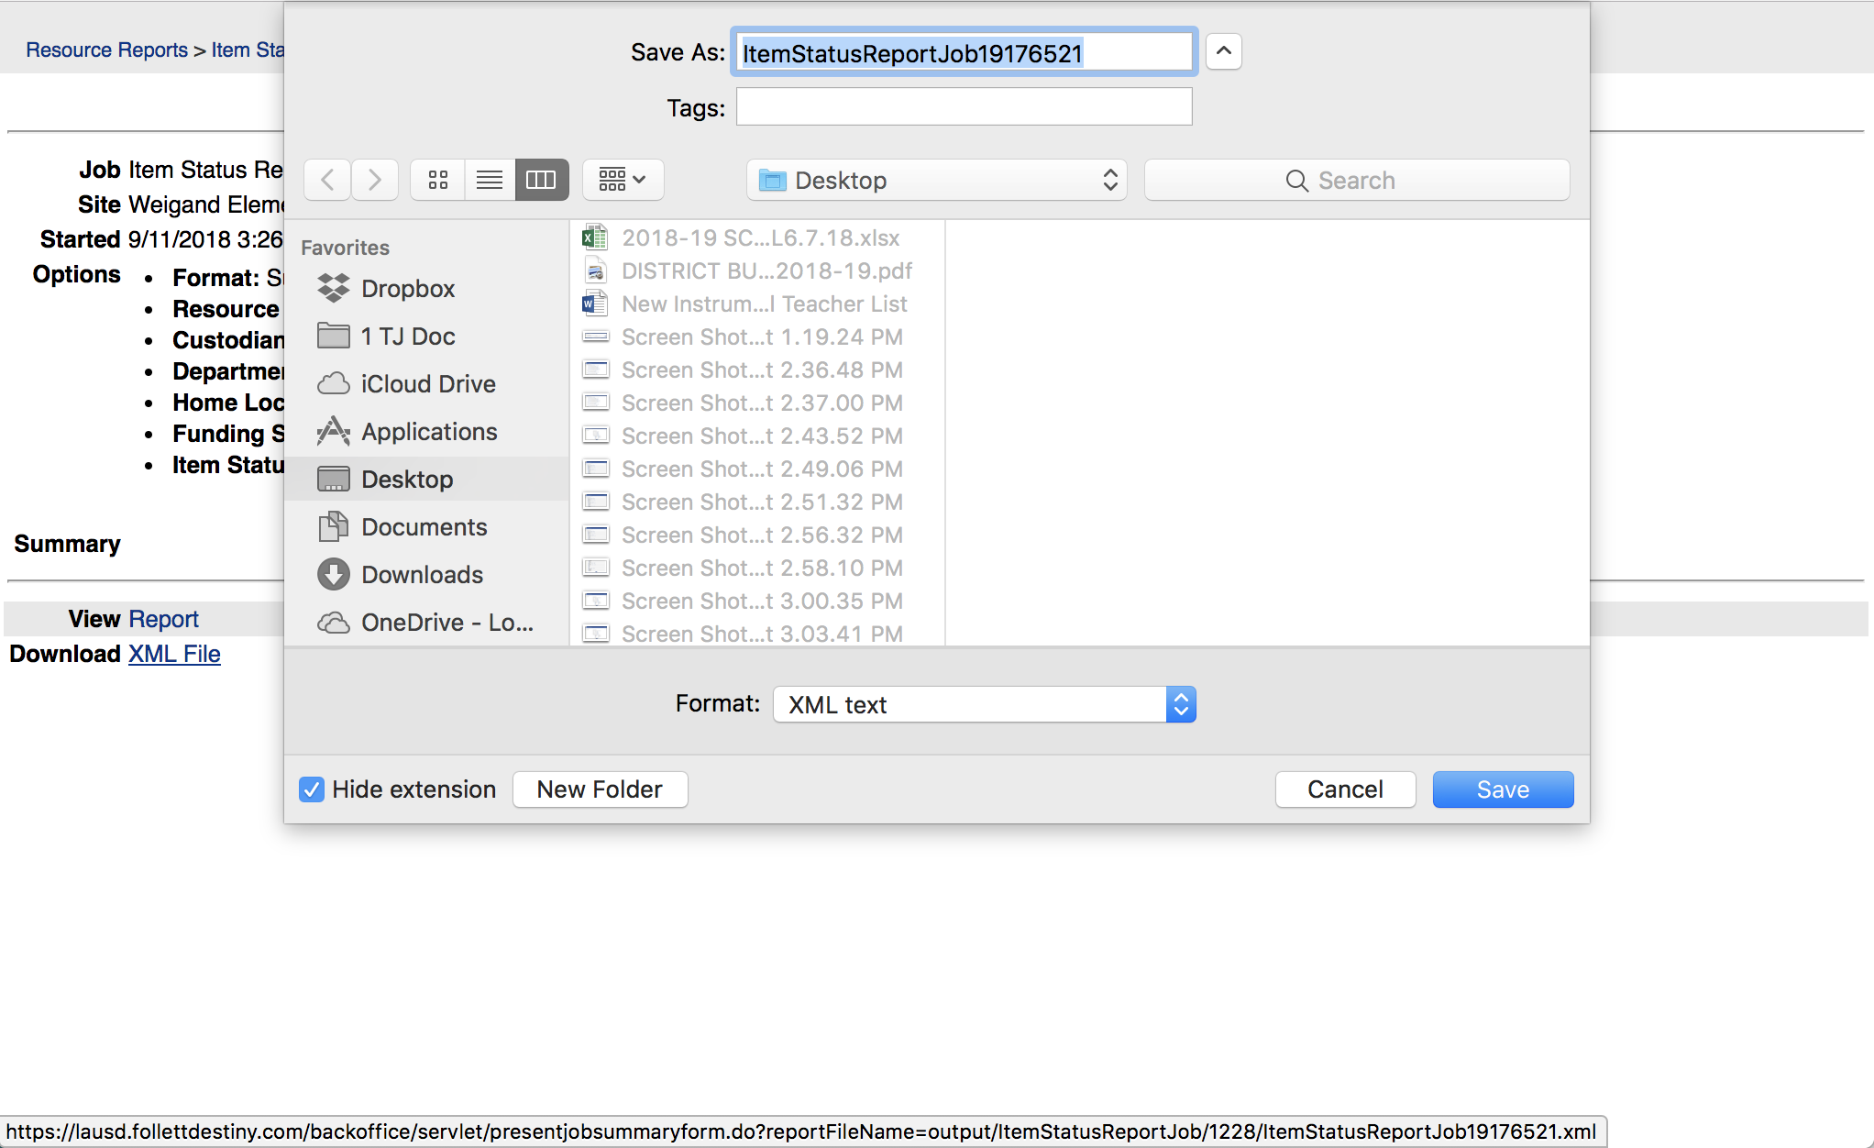
To run reports with student names P.16
You can choose to download the “XML File” – Click on “XML File”

Slide 47
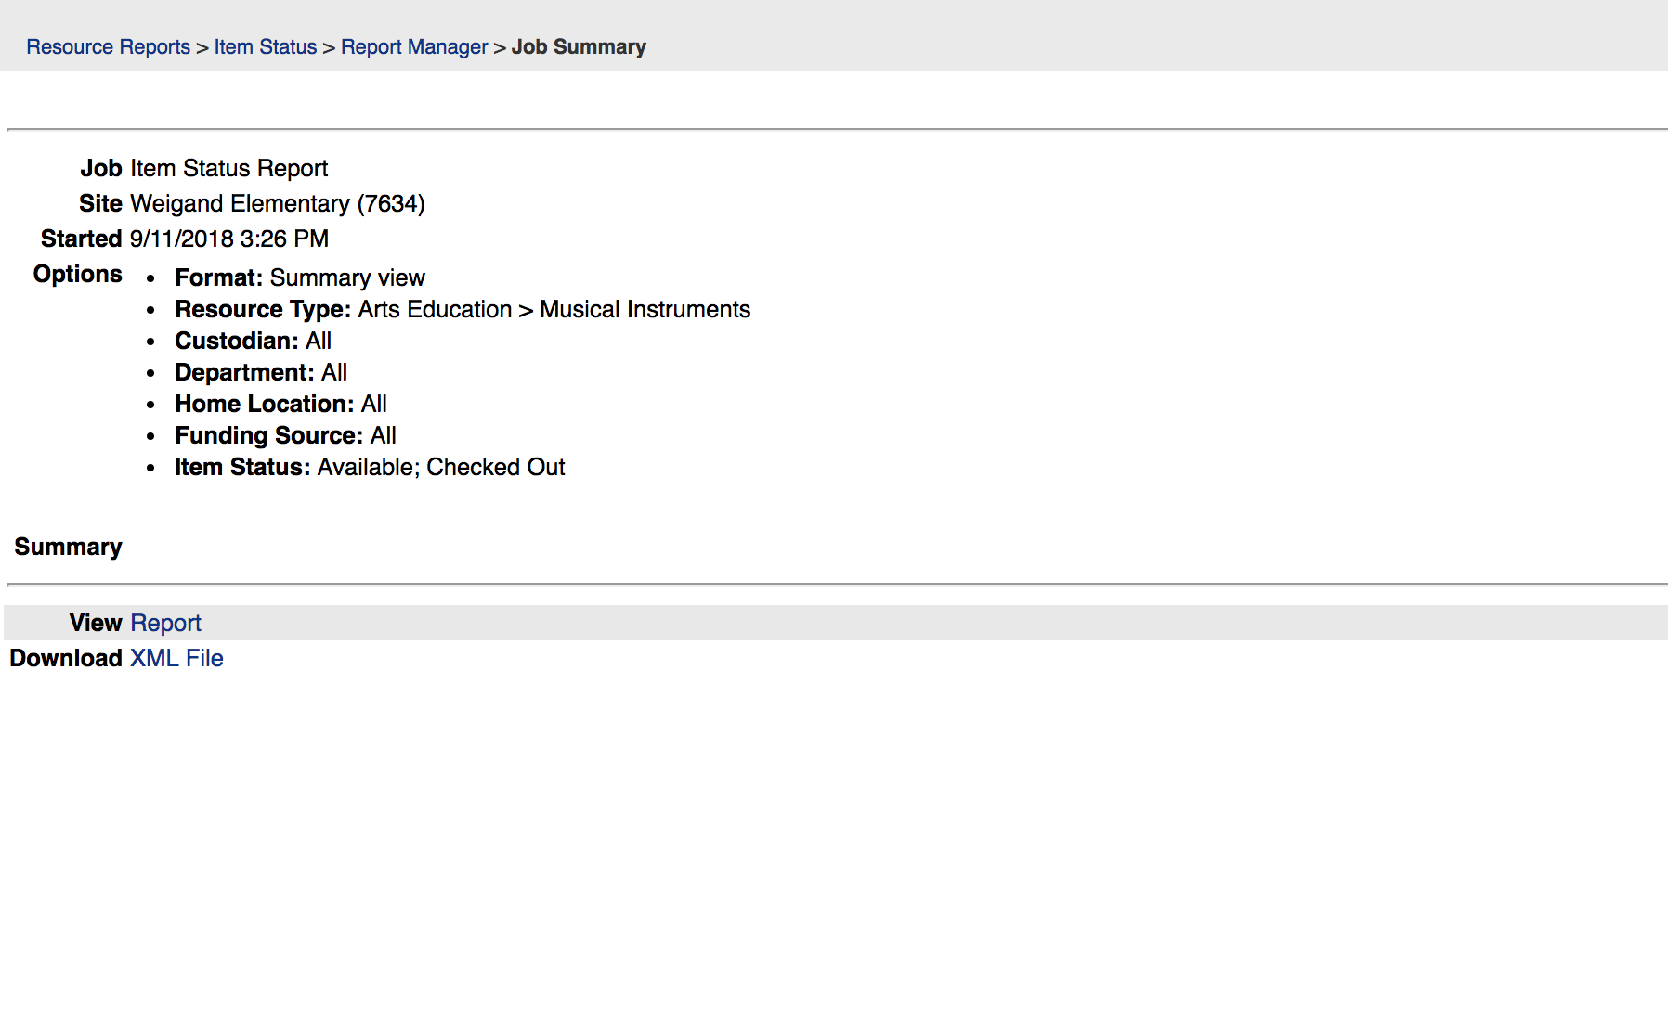
To log out
Click on the “Report Builder” to take you to the following screen (next slide)
Try NOT to click the top Left “Arrow” (back arrow) because sometimes it takes you out of the website

Slide 48
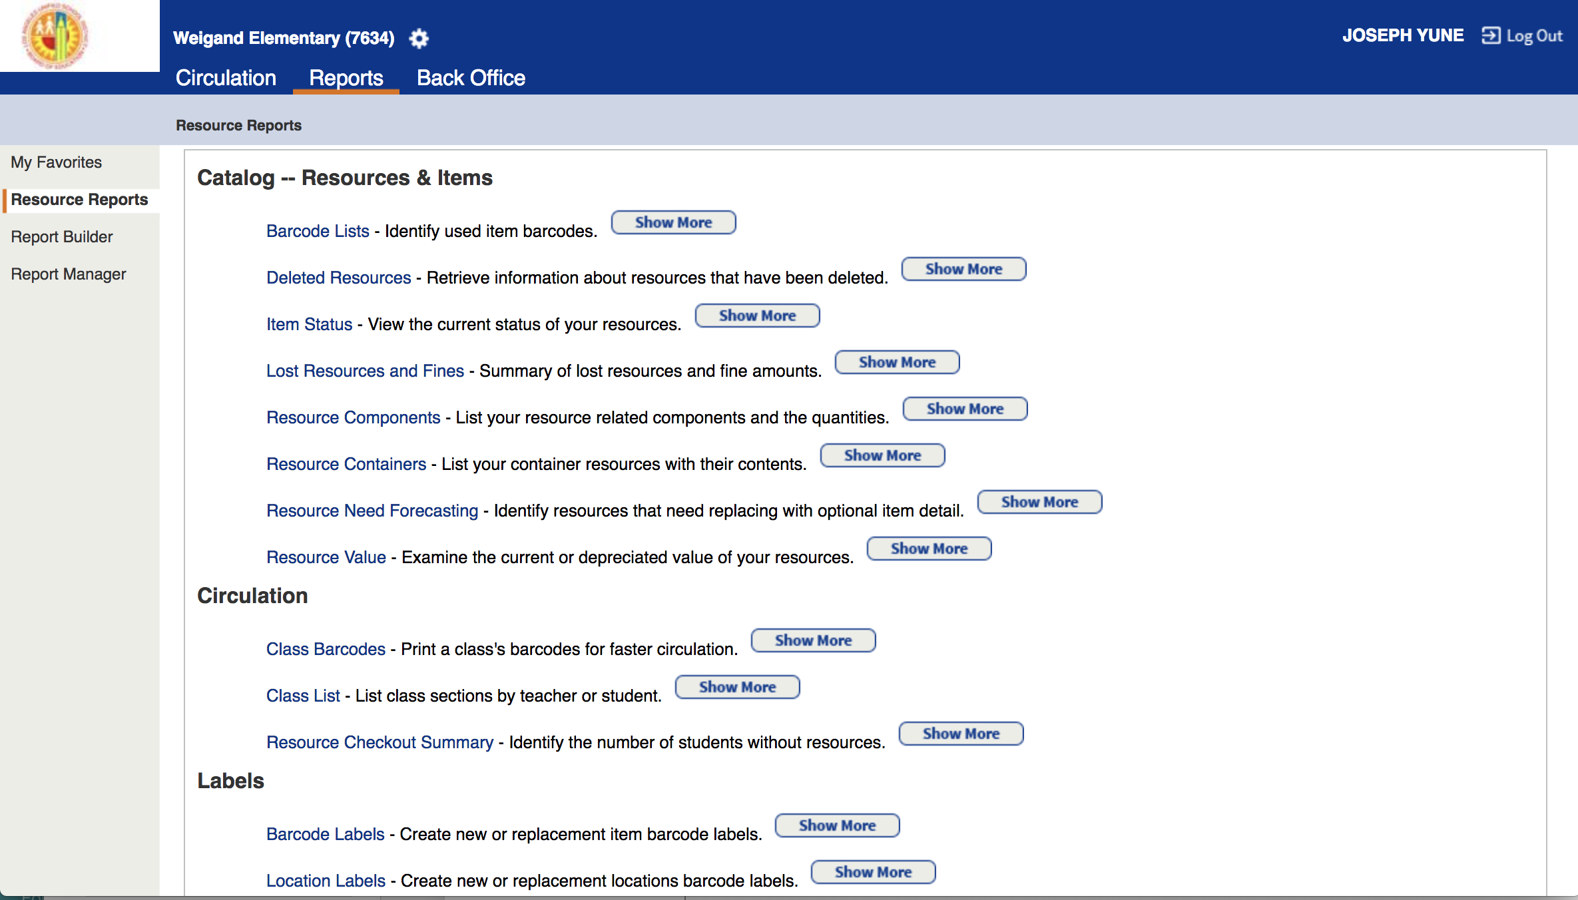
To log out
To Log Out from the Destiny page, click on “Log Out”

Slide 49
You did it!
Congratulations!
You just learned how to run reports on the Destiny website!
Questions:
Arts Education Branch: Joseph Yune (jty9169@lausd.net) 213-241-3368
ILTSS: Oscar Gonzalez (ogonza3@lausd.net) 213-241-0465

