Slide 1


How to Reprint Barcodes
By Joseph Yune

Slide 2
What you need:
Access to the internet via browser
We recommend Chrome browser for this purpose
LAUSD Single Sign-On Username and Password
Your Username must be in the Destiny system
*You need the barcode information your trying to reprint from your files

Slide 3
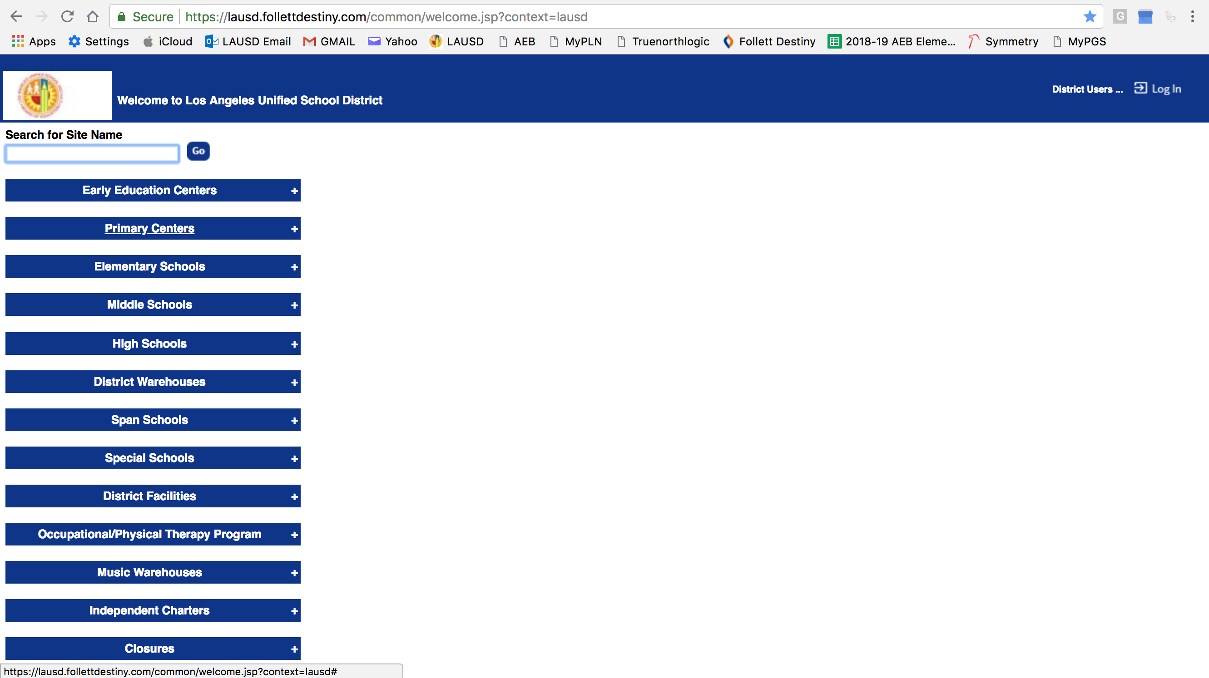
Destiny Website
Destiny Website: https://lausd.follettdestiny.com (Type in the URL and press Enter)
Double check the spelling!

Slide 4
Finding the School (Method 1)
Type in the name of the school and press “Go” – then click on your school name

Slide 5
Finding the School (Method 2)
Click “Elementary Schools” tab to search for Elementary Schools
Click “Middle Schools” tab to search for Middle Schools, etc.

Slide 6
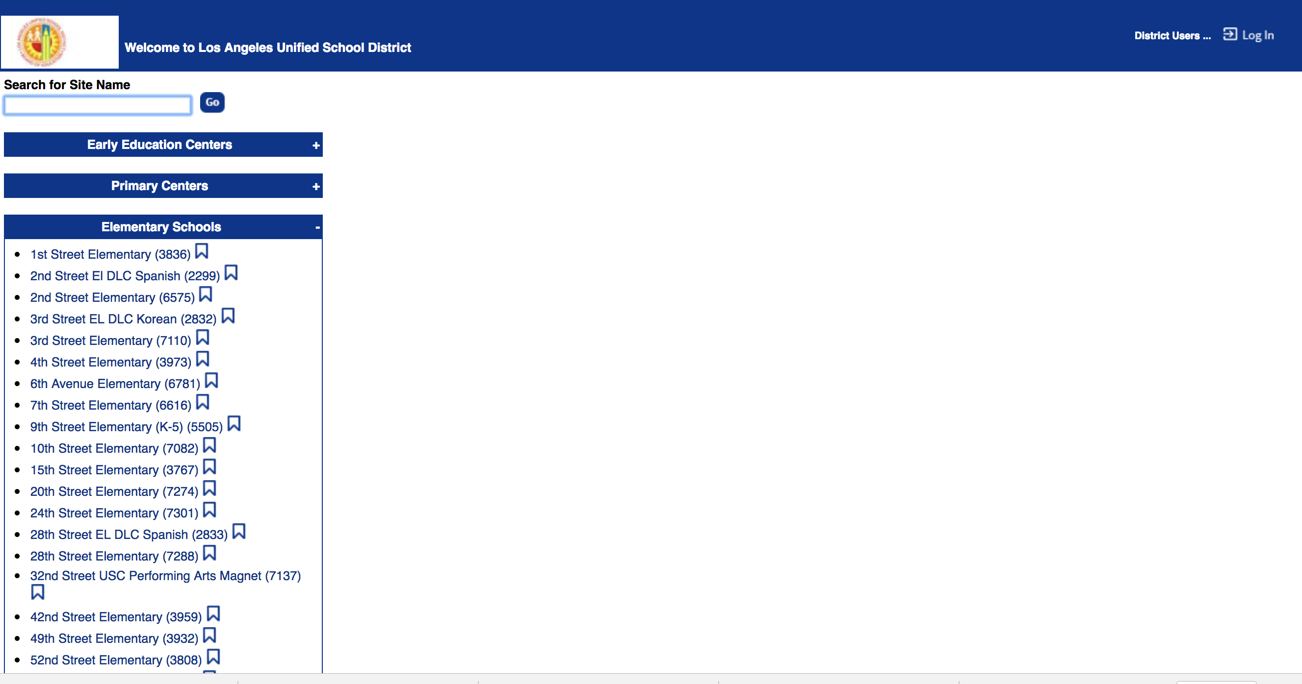
Search for Your School
Scroll down to search for your school

Slide 7
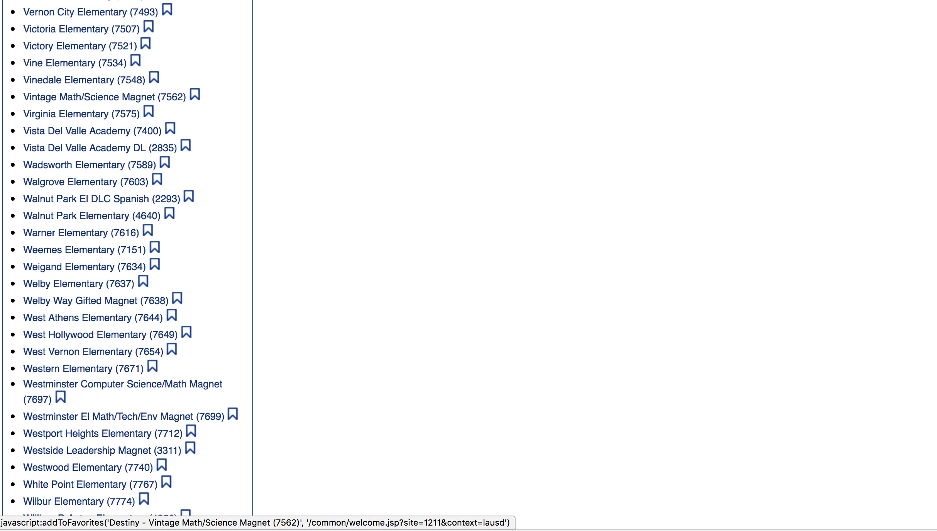
Choose Your School
Click on your school

Slide 8
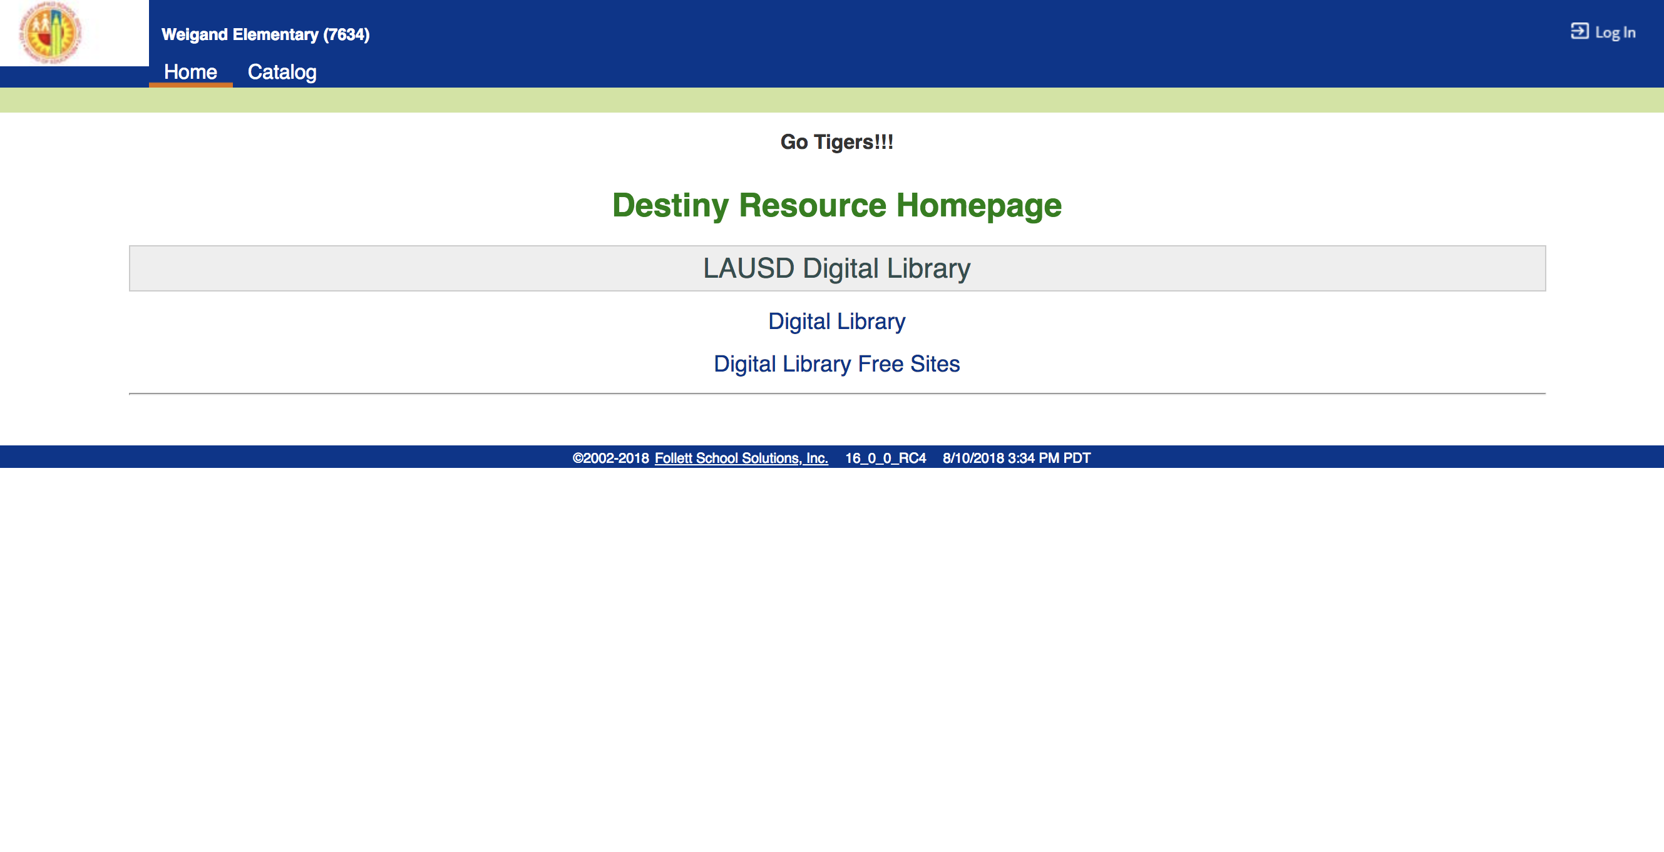
Logging In
On the top right corner, click on “Log In”

Slide 9
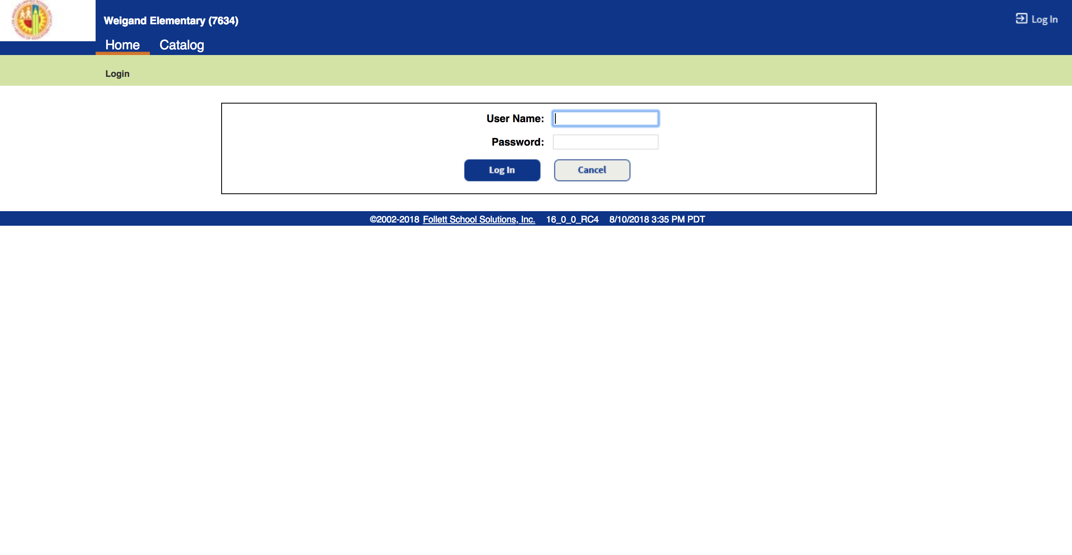
Logging In (Continued)
Type in LAUSD Username (Without @lausd.net) & Password, then click on “Log In”

Slide 10
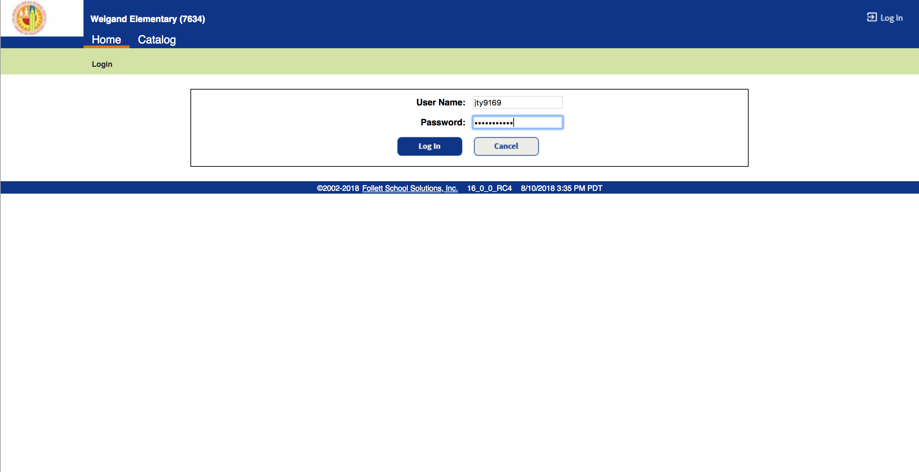
Logging In Sample
Type in LAUSD Username (Without @lausd.net) & Password, then click on “Log In”

Slide 11
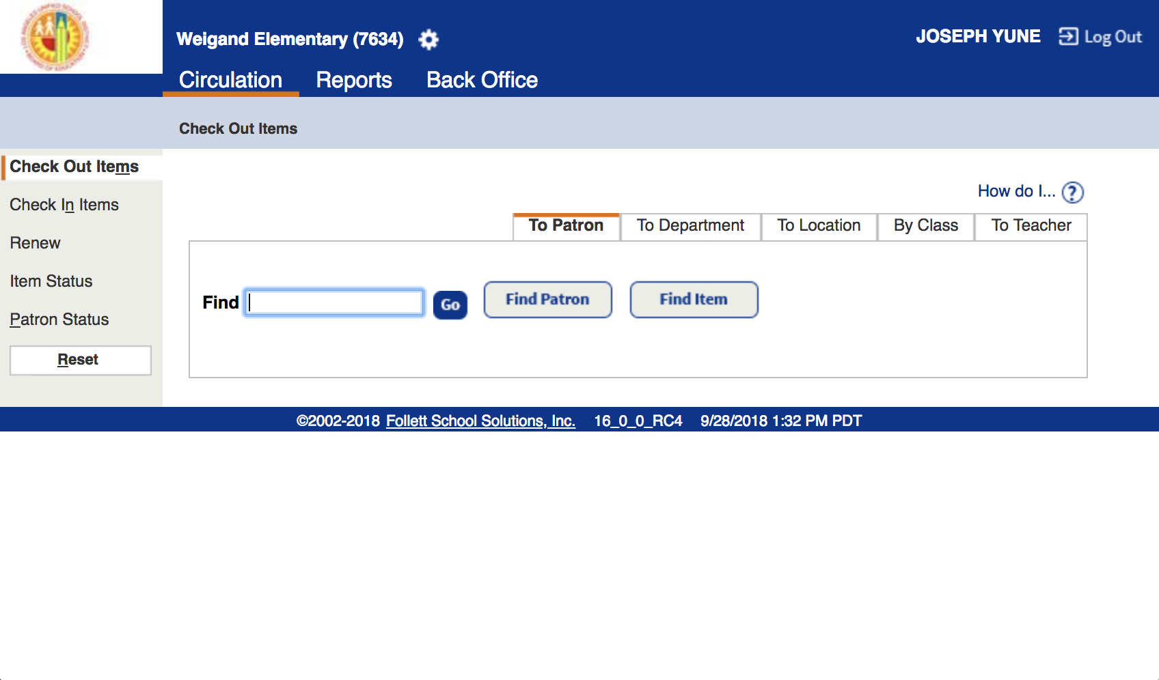
Reprinting Barcode P.1
This screen will appear by default with “Circulation” selected

Slide 12
Reprinting Barcode P.2
Click on “Item Status”

Slide 13
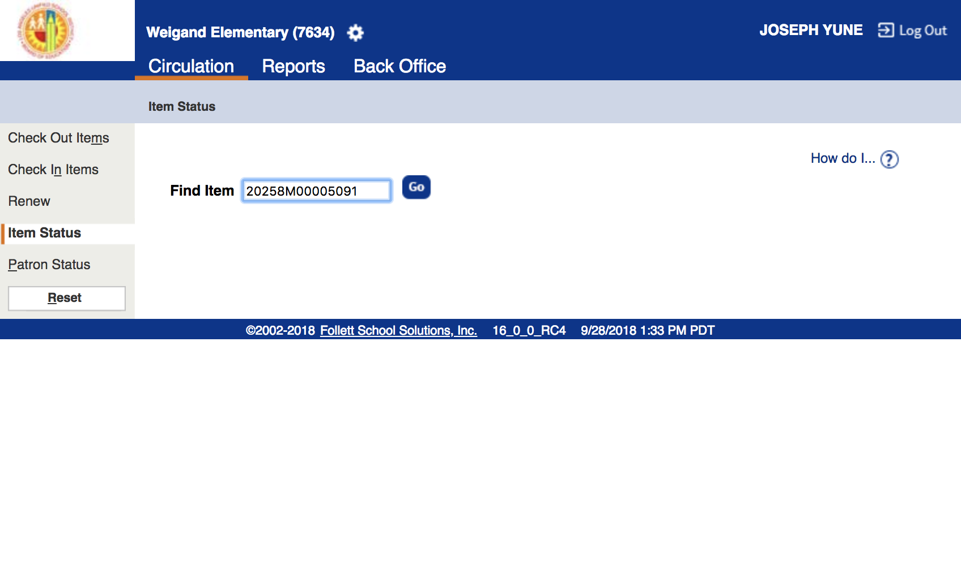
Reprinting Barcode P.3
Type in the barcode information and click on “Go”

Slide 14
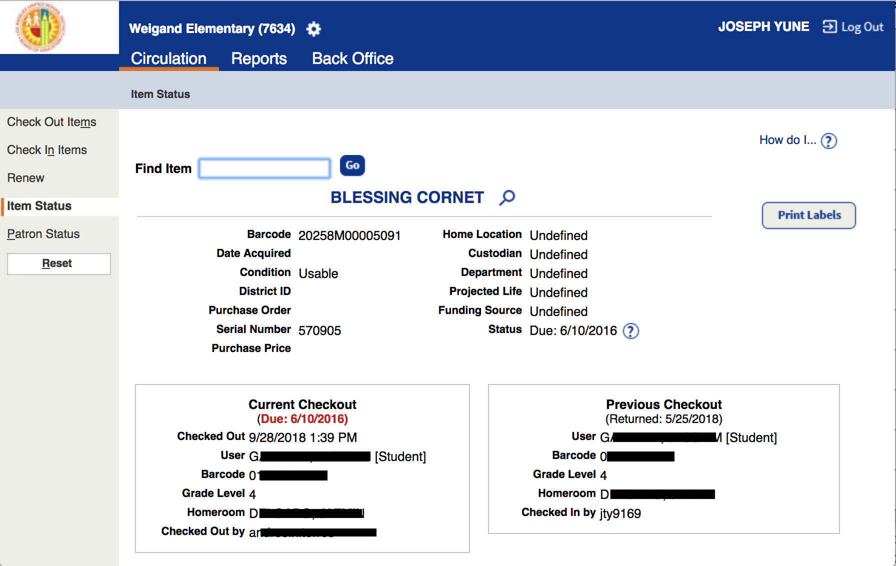
Reprinting Barcode P.4
Double check the information and click on “Print Labels”

Slide 15
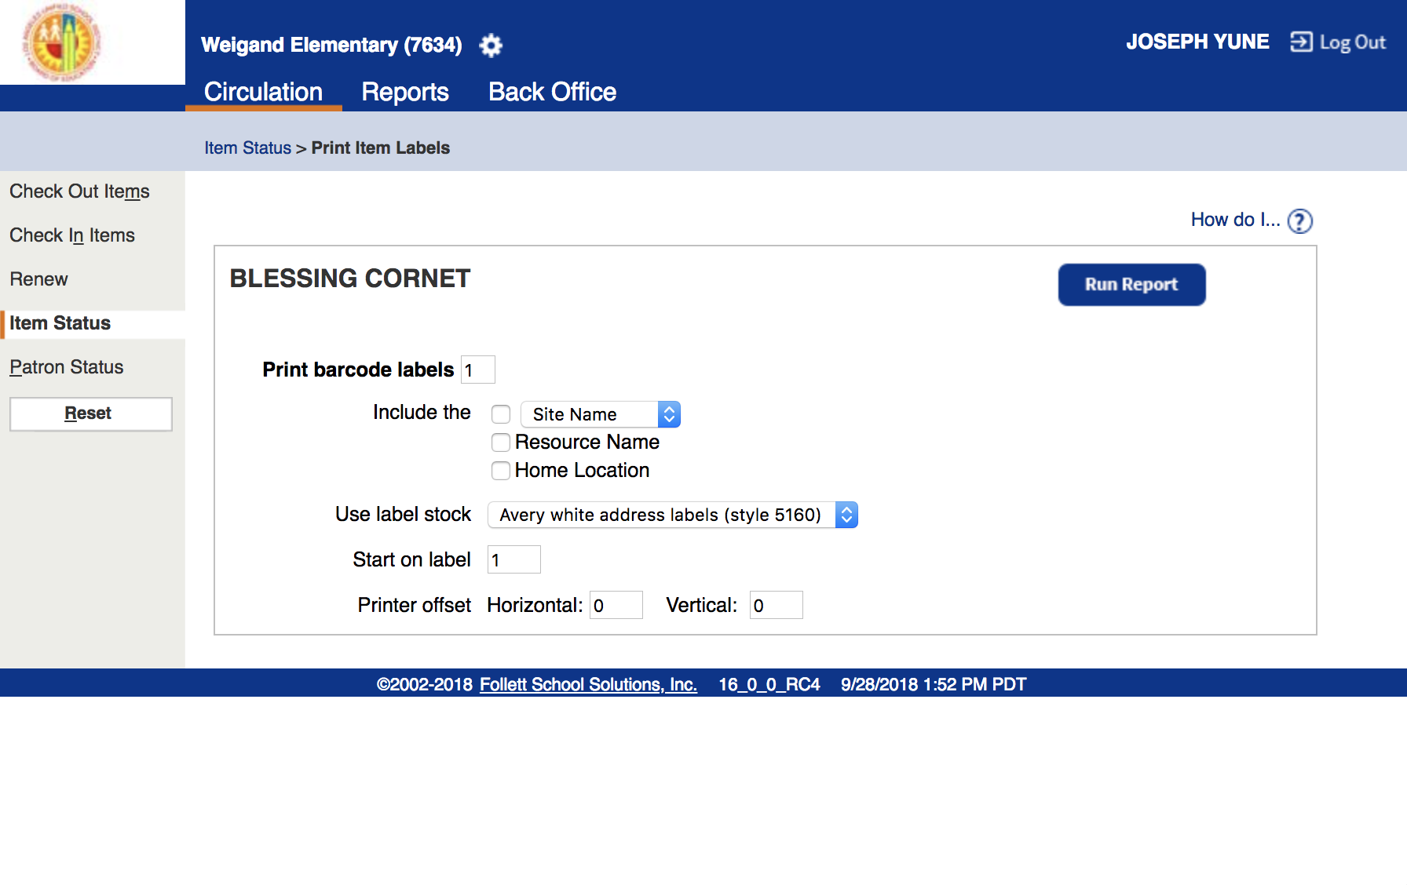
Reprinting Barcode P.5
Don’t change anything and click on “Run Report”

Slide 16
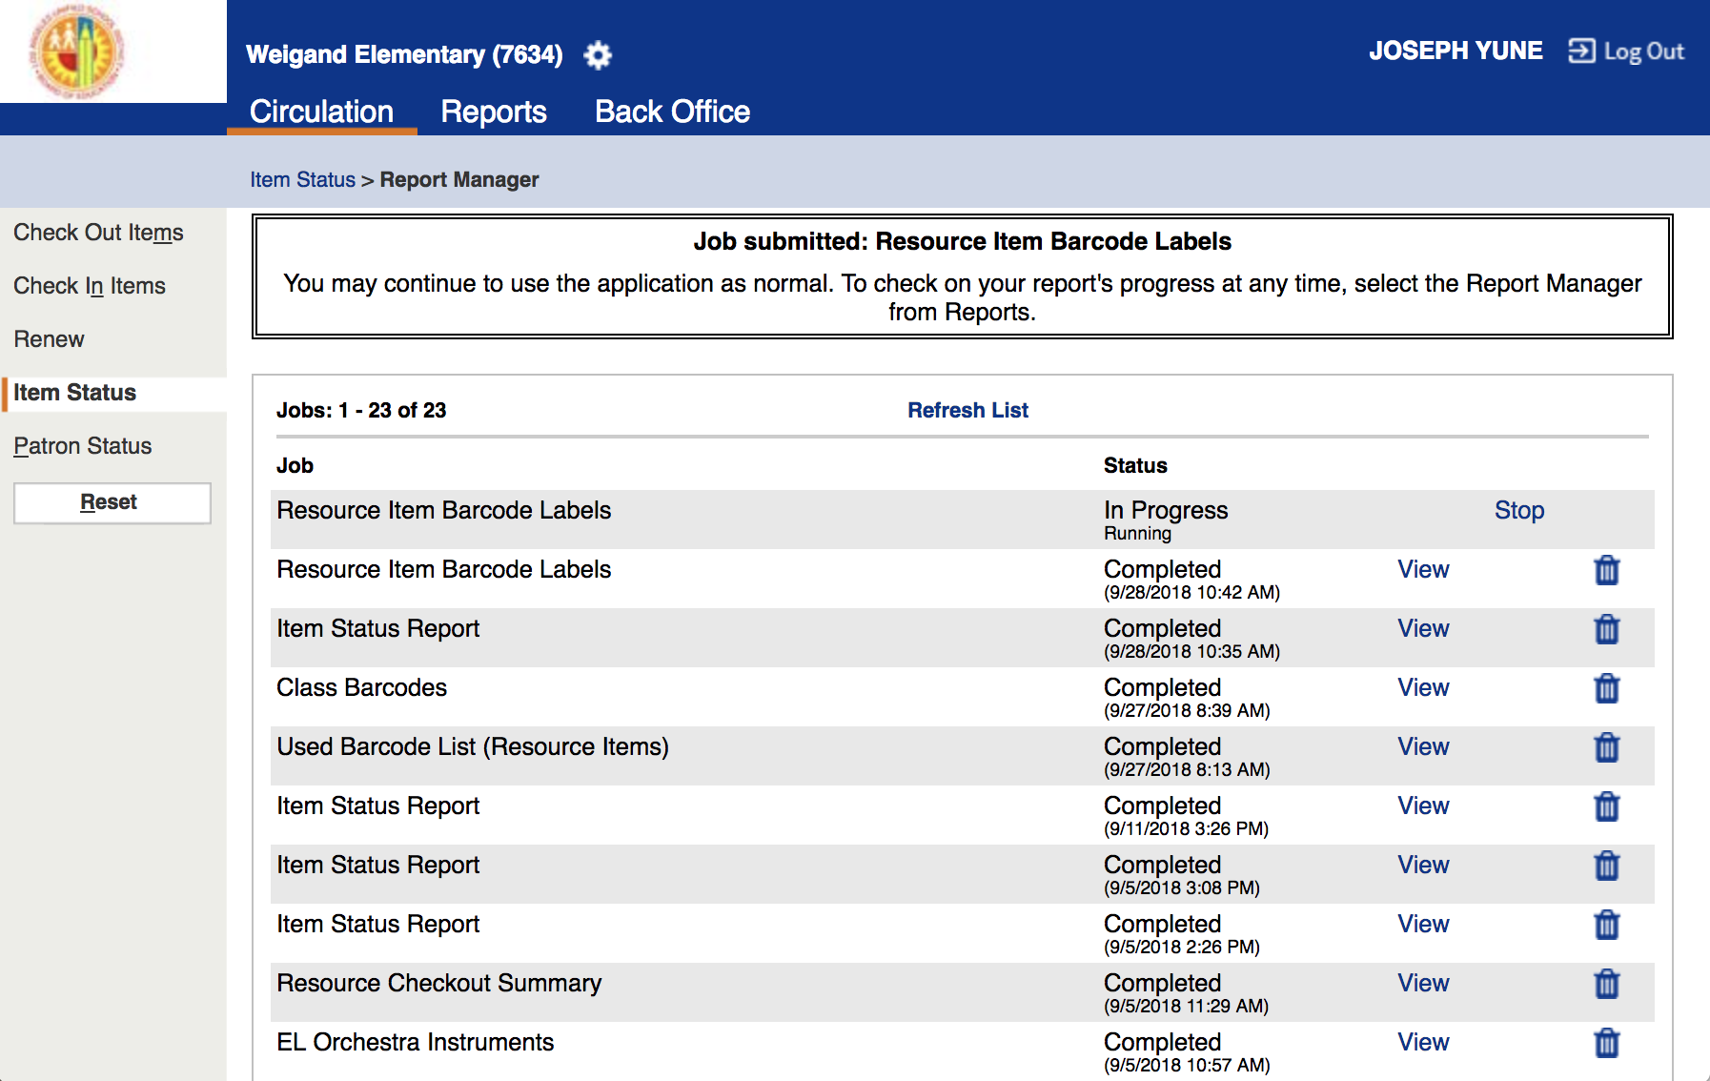
Reprinting Barcode P.6
Click on “Refresh List” until status shows “Completed” – You may need to click it several times

Slide 17
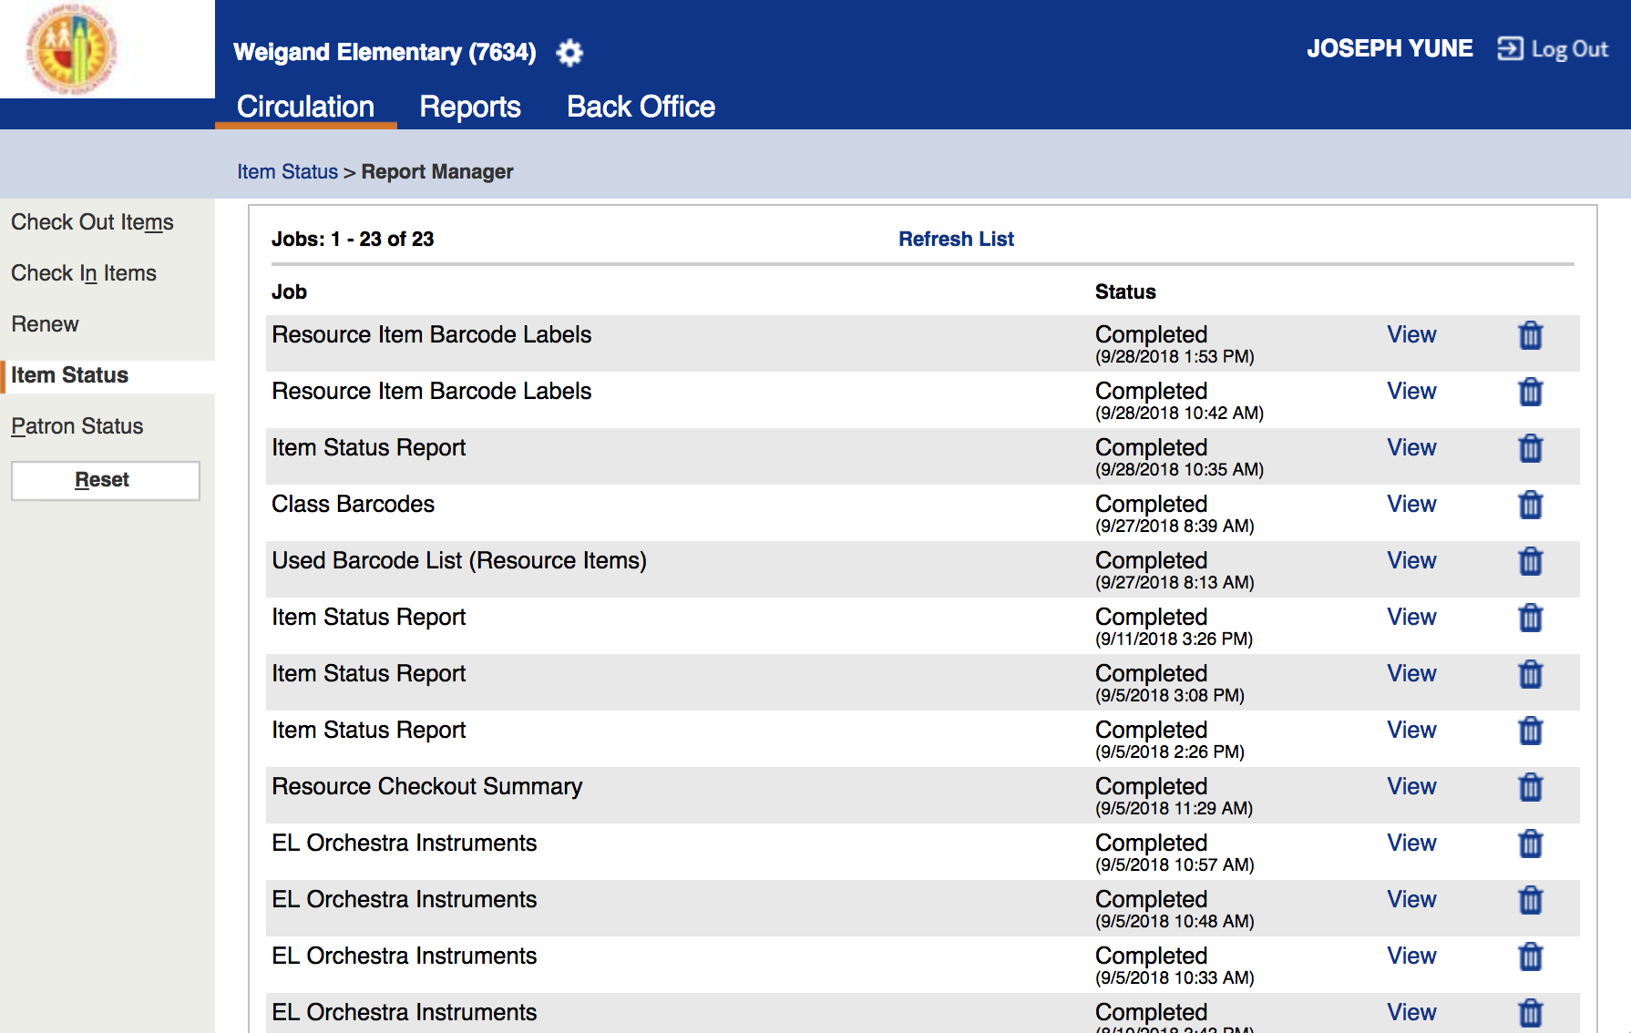
Reprinting Barcode P.7
Click on “View”

Slide 18
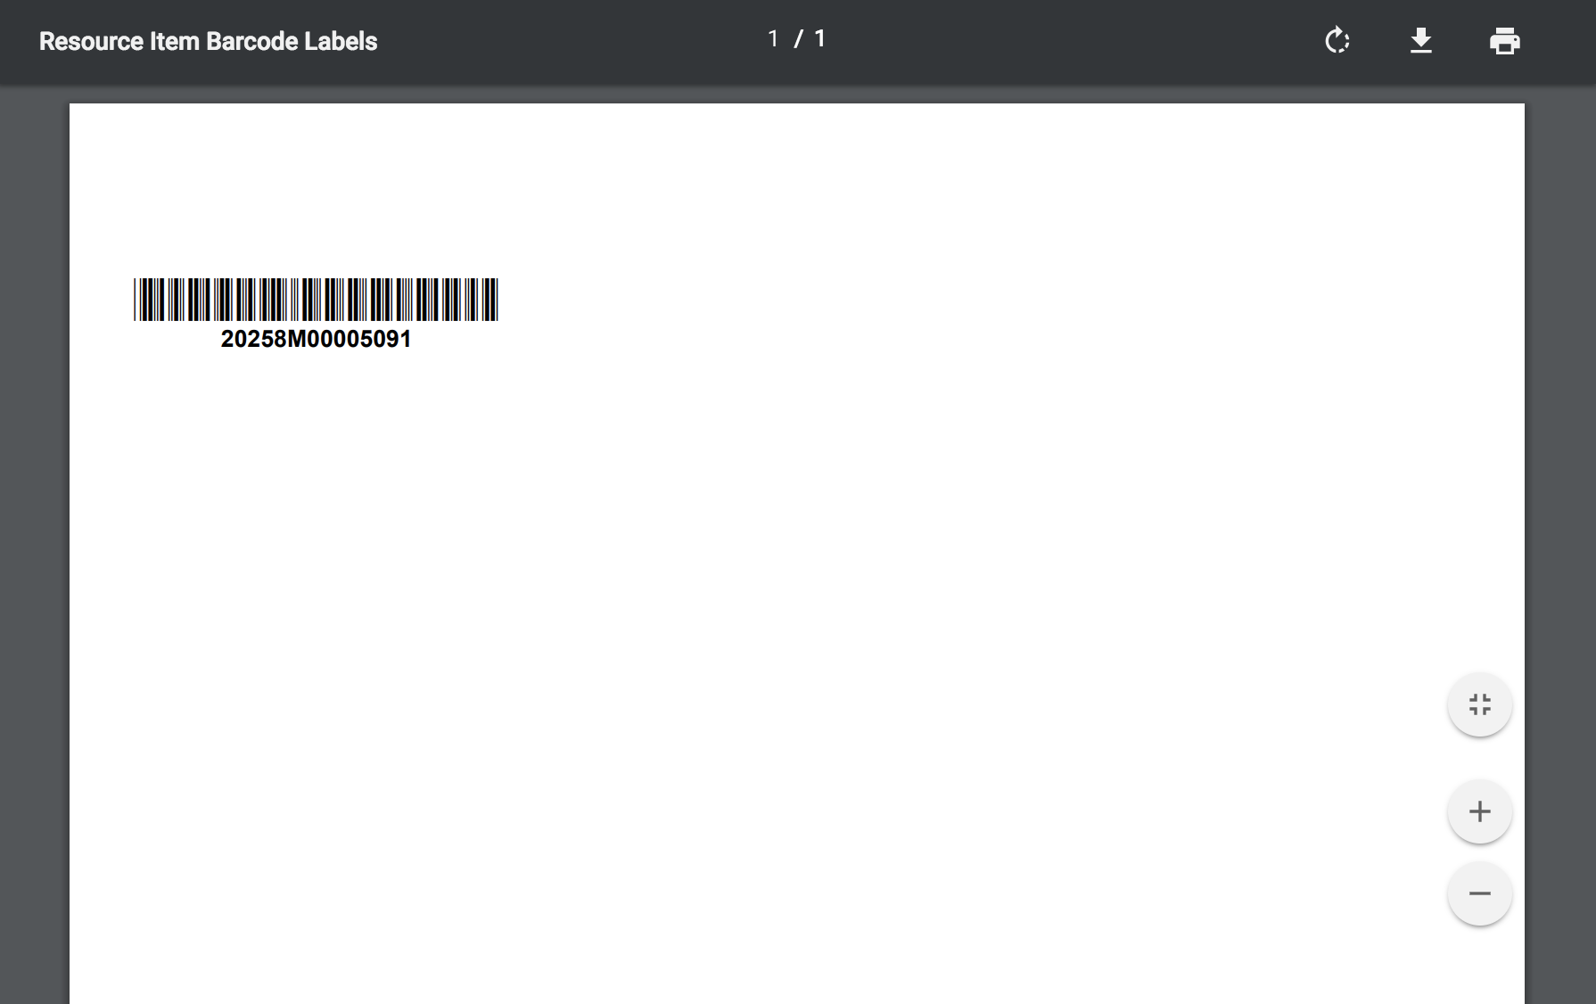
Reprinting Barcode P.8
You can choose to download (left) or print (right) the pages
*We recommend downloading, then printing (sometimes printing from the web browser does not work)

Slide 19
Reprinting Barcode P.9
You can cut out the barcode and tape it on the instrument

Slide 20
Logging Out
To Log Out from the Destiny page, click on “Log Out”

Slide 21
Questions?
Arts Education Branch:
Joseph Yune (jty9169@lausd.net) 213-241-3368
Christopher Rodriguez (chris.j.rodriguez@lausd.net) 213-241-5529

