Slide 1


Inputting Instrument Information into Destiny
By Joseph Yune

Slide 2
What you need:
Excel Spreadsheet Template
Barcoded Instruments
Instrument Information
School Information

Slide 3
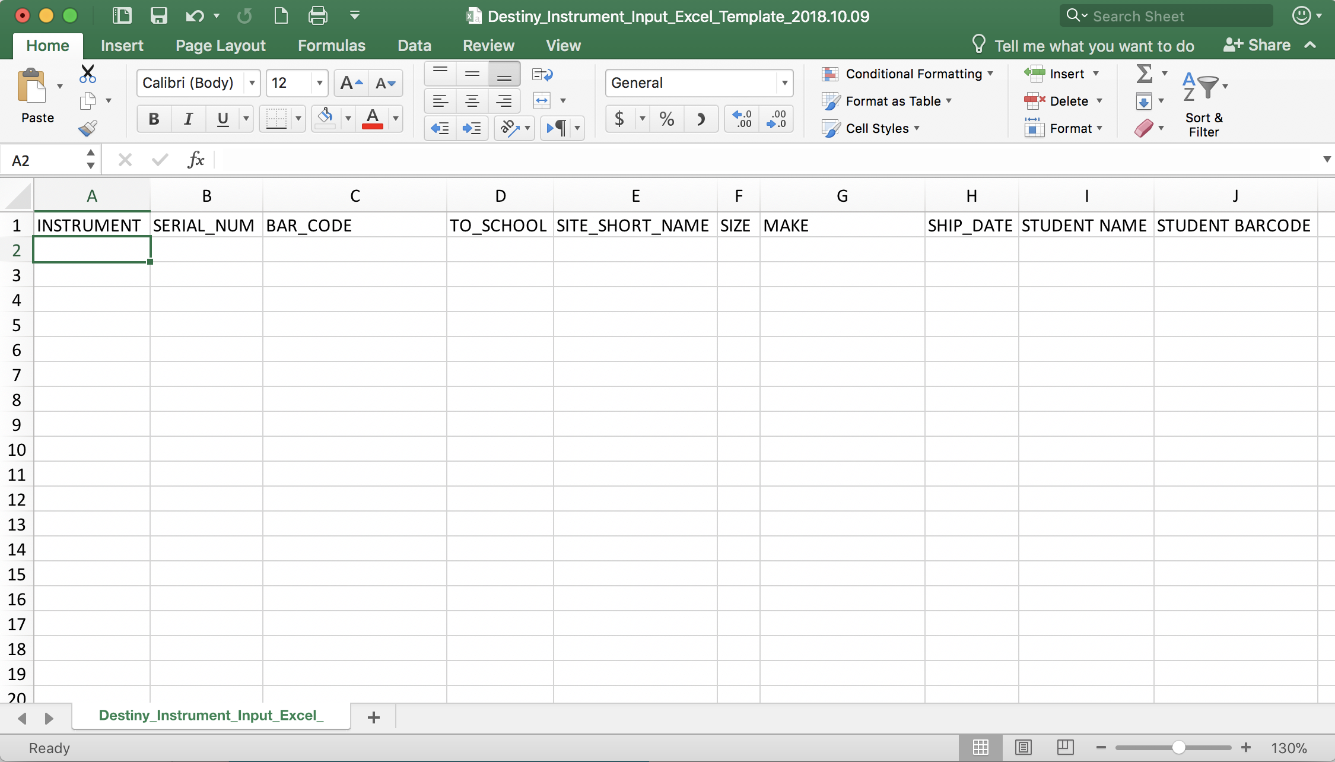
Step 1
Fill out the Excel template (See slide 12 for downloading template information)
Do not alter the template in any way (Any alteration will cause uploading problems)

Slide 4
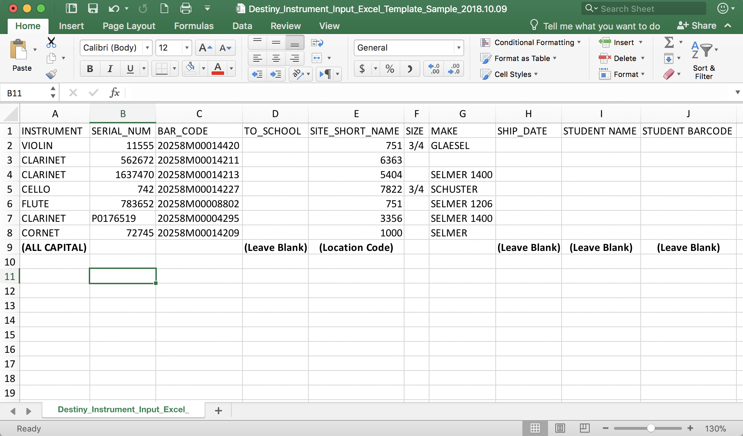
Step 1 (Sample)
Fill out the Excel template as shown

Slide 5
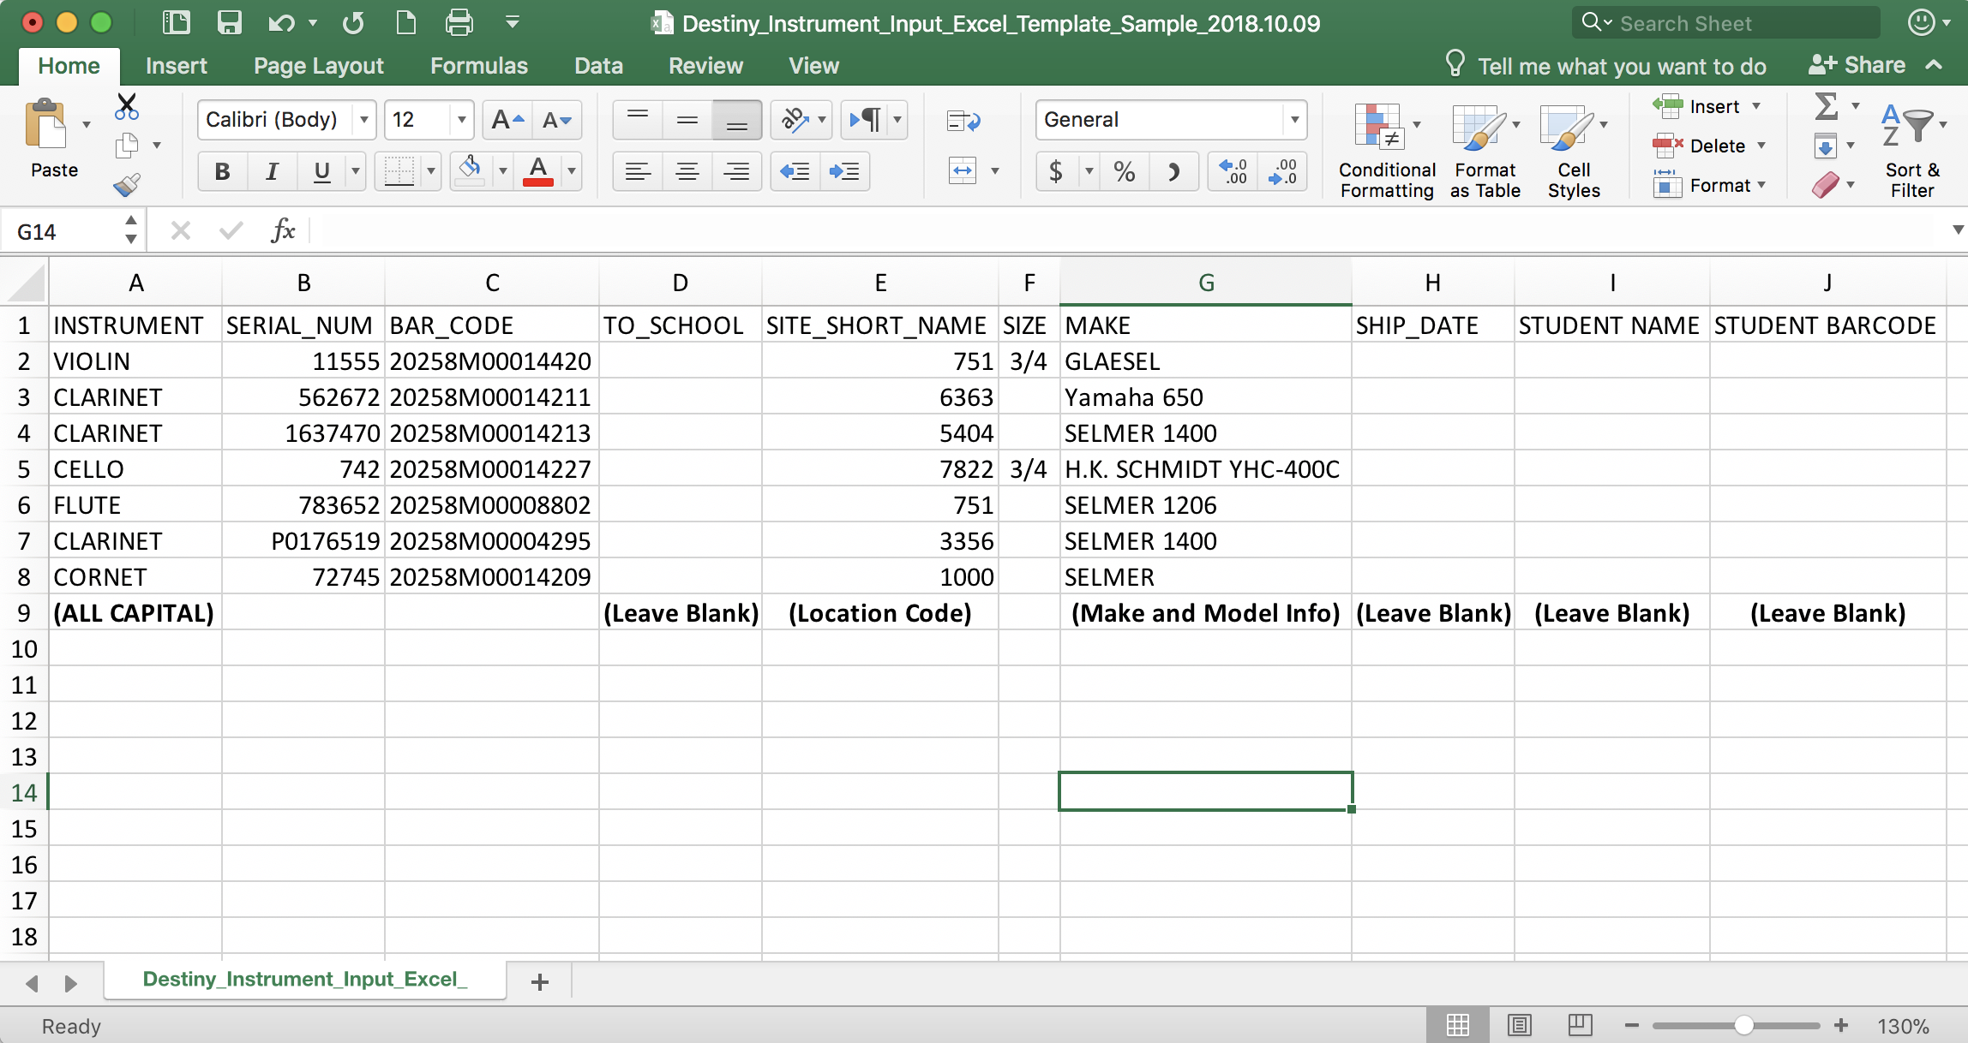
Step 1 (Sample 2)
Model numbers can be included in the “MAKE” box

Slide 6
Step 2
Save the spread sheet
Save As:
Destiny_Music_Info_SCHOOL NAME_Location Code_Date(YYYY.MM.DD)
The red is where you put your school name (In All CAPS), location code and the date the file is being sent in
Save it as “csv” file (this is by default)
Email attachment to:
Oscar Gonzalez (ogonza3@lausd.net) @ ILTSS

Slide 7
Standard Instrument Names for Destiny (Woodwind)
All Instrument information (Column A) MUST be inputted exactly as shown. It is case sensitive.
If the instrument your trying to input is not listed on these slides, contact Oscar Gonzalez (ogonza3@lausd.net).
Woodwinds: (USE ALL CAPITAL LETTERS)
PICCOLO
FLUTE
OBOE
ENGLISH HORN
CLARINET
BASS CLARINET
CONTRABASS CLARINET
SOPRANO SAXOPHONE
ALTO SAXOPHONE
TENOR SAXOPHONE
BARITONE SAXOPHONE
BASSOON
CONTRABASSOON

Slide 8
Standard Instrument Names for Destiny (Brass)
Brass: (USE ALL CAPITAL LETTERS)
PICCOLO TRUMPET
CORNET
TRUMPET
FLUGELHORN
MELLOPHONE
BASS TRUMPET
TENOR HORN
FRENCH HORN
TROMBONE
BASS TROMBONE
BARITONE
EUPHONIUM
TUBA
SOUSAPHONE

Slide 9
Standard Instrument Names for Destiny (Strings)
Strings: (USE ALL CAPITAL LETTERS)
VIOLIN
VIOLA
CELLO (Not Violoncello)
DOUBLE BASS (Not Contrabass, String Bass, Upright Bass or just Bass)
Other String Instruments:
CLASSICAL GUITAR
ACOUSTIC GUITAR
12 STRING GUITAR
ELECTRIC GUITAR
ELECTRIC BASS
UKULELE
GUITARRON, VIHUELA
BANJO
MANDOLIN, MANDOLA, MANDOCELLO
AUTOHARP
HARP

Slide 10
Standard Instrument Names for Destiny (Percussion)
Standard Percussion Instruments:
TIMPANI (by head size in inches, size info. in size cell)
MARIMBA
XYLOPHONE
GLOCKENSPIEL
CHIMES
WIND CHIME
SNARE DRUM
BASS DRUM
GONG
SUSPENDED CYMBAL
CRASH CYMBAL
HI-HAT (dash is needed)
RACK TOM, FLOOR TOM
BONGOS, CONGAS, CAJON…
Regarding Pianos* - Pianos will NOT be inventoried in Destiny

Slide 11
Standard Instrument Names for Destiny (Etc.)
PA Equipment:
MIXER
SOUND RACK
SPEAKER
AMPLIFIER
MICROPHONE
SPEAKER STAND
MICROPHONE STAND
Other:
HARPSICHORD
KEYBOARD (Electronic Keyboard)
HAND BELLS (Barcode on case)
TUNER
METRONOME
Cases: (In this order: CASE dash INSTRUMENT)
CASE-INSTRUMENT (e.g. CASE-DOUBLE BASS)

Slide 12
Questions?
Arts Education Branch:
Joseph Yune (jty9169@lausd.net) 213-241-3368
Christopher Rodriguez (chris.j.rodriguez@lausd.net) 213-241-5529
Arts Education Branch Website
https://achieve.lausd.net/arts
For Destiny: AEB website>Music>Music Resources>Destiny
ILTSS (For Destiny Issues):
Oscar Gonzalez (ogonza3@lausd.net) 213-241-0465

