Slide 1
Respect For All
School Year 2021-2022
Secondary Grades
Notes:
Note: Slides can be modified to address and respond to the needs and concerns of students by academic grade: sixth through twelfth Grades ( secondary grades).

Slide 2
Chancellor’s Regulation A-832
It is the policy of the New York City Department of Education (“DOE”) to maintain a safe and supportive learning and educational environment that is free from harassment, intimidation and/or bullying committed by students against other students and discrimination by students against other students on account of actual or perceived race, color, creed, ethnicity, national origin, citizenship/immigration status, religion, gender, gender identity, gender expression, sexual orientation, disability, or weight.
Notes:
It is a violation of this regulation for any student to harass, discriminate, intimidate or bully another student.
Such discrimination, harassment, intimidation and/or bullying is prohibited and will not be tolerated in school, during school hours, before or after school, while on school property, at school-sponsored events, while traveling in vehicles funded by the DOE or off school property when such behavior disrupts or would foreseeably disrupt the educational process or endangers or would foreseeably endanger the health, safety, morals, or welfare of the school community.
It is the policy of the DOE to prohibit retaliation against any student, parent, or DOE employee who in good faith reports or participates in an investigation of allegations of student-to-student discrimination, harassment, intimidation and/or bullying. Any adverse act against individuals due to their participation in such protected activity is considered retaliatory. Retaliation will be investigated and subject to appropriate disciplinary action if substantiated.

Slide 3
What is Bullying?
Bullying
Notes:
Activity: Record the question and the responses on poster-size paper and post them on the classroom wall or in the hallway. Make sure that each student is allowed the opportunity to respond.

Slide 4
Bullying is
Bullying is more than disagreements, differences of opinion, or conflicts that occur between friends and classmates.
Bullying definitions typically include:
The person is being hurt, harmed, or humiliated with words or behavior
The behavior may be a single incident or a series of repeated incidents or there is a concern that it will be repeated
The behavior is being done intentionally
The person being hurt has a hard time stopping or preventing the behavior
The hurtful behavior is carried out by those who have more power, such as being older, being physically bigger or stronger, having more social status, or when a group of students single out an individual

Slide 5
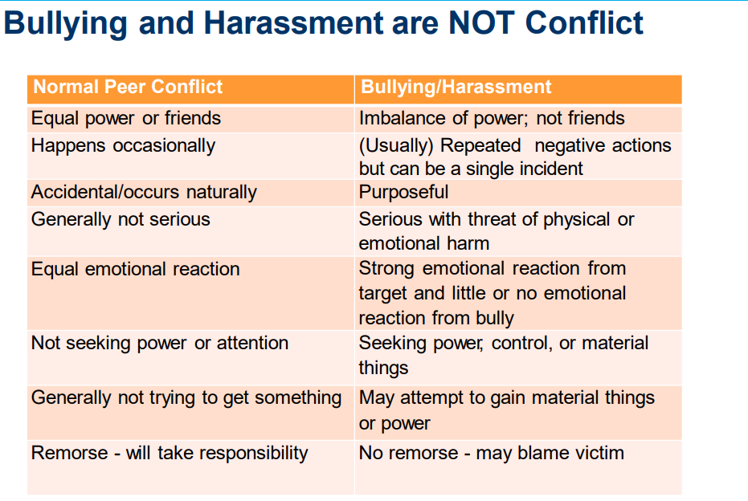
Bullying vs. Conflict
Notes:
Discuss with the students the differences between the two.
Conflict is a disagreement or argument in which both sides express their views.
Bullying is negative behavior directed by someone exerting power and control over another person

Slide 6
How Is Someone Bullied?
Bullying can take many forms:
face to face,
whispered comments,
making derogatory jokes, or slurs, including statements based on a student’s (actual or perceived) race, ethnicity, gender expression, sexual orientation, disability or weight
exclusion from peer groups designed to humiliate or isolate,
notes passed,
hurtful things written on bathroom walls,
humiliation in front of a group,
gossip and rumors,
telling stories about someone when they’re unable to defend themselves
gender stereotyping (e.g., “that’s so gay”, “you're so gay”)
deliberately using a name, mispronouncing a name or using a pronoun in a manner that discriminates, harasses, bullies, or intimidates based on a student’s actual or perceived race, color, creed, ethnicity, national origin, citizenship/immigration status, religion, gender, gender identity, gender expression, sexual orientation, disability or weight;
*All these instances of bullying can take place in the classroom or hallway, on the bus or in the locker room, online, while at lunch or playing at recess.
Notes:
Activity: Record the question and the responses on poster-size paper and post them on the classroom wall or in the hallway. Make sure that each student is allowed the opportunity to respond.
Additional examples
threats, taunts, teasing; • aggressive or menacing gestures; • using derogatory language; • making derogatory jokes, name calling, or slurs, including statements based on a student’s actual or perceived color, creed, national origin, citizenship/immigration status, religion, gender, gender identity; • written or graphic material, including graffiti, photographs, drawings, or videos, containing comments or stereotypes that are derogatory of others that are electronically circulated or are written or printed; • verbal or physical conduct that threatens another with harm; • hazing;

Slide 7
Cyberbullying
Bullying can also happen through social media, texts, and photos shared via phones, tablets, or computers.
When technology is used to bully someone, it’s called cyberbullying.
Specific instances of cyberbullying include sending mean text messages, making fun of someone’s post, sharing videos, stories, or photos that ridicule or humiliate someone, “trolling” someone to the point of harassment, posting personal information about someone else on the internet, and spreading rumors or gossip.
It may be a single incident or a series of related incidents
Notes:
If you see cyberbullying, you can: - Write something positive in response. - Contact the person being bullied and let them know you are there for them. - Report it to an adult at school or to the social media site.
Please visit our website for further resources, on Digital Citizenship and Social Media Guidelines, https://www.schools.nyc.gov/school-life/school-environment/digital-citizenship
Electronically transmitted communication via information technology including, but not limited to: Internet; cell phone; email; personal digital assistant; wireless handheld device; social media; blogs; chat rooms; and gaming systems.

Slide 8
What Are the Types of Bullying?
Physical
Verbal
Sexual
Emotional
Please share a few examples of each.
Notes:
Activity: Record the question and the responses on poster-size paper and post them on the classroom wall or in the hallway. Make sure that each student is allowed the opportunity to respond.

Slide 9
Physical Form of Bullying
Physical
This form of bullying is usually visible, and therefore easy to recognize. Think about the stereotypical movie scenes when someone knocks someone else’s books out of their hands or pushes them up against a locker.
Examples of physical bullying include pushing, shoving, hitting, kicking, biting, hair pulling, inappropriate touching, breaking objects, and taking or damaging another’s possessions.
Notes:
Schools will take action to support victims and to make sure bullying stops and that students will be subject to discipline where appropriate.

Slide 10
Verbal Forms of Bullying
Verbal
Using words, either out loud or in writing, is a common type of bullying because it’s quick, often done impulsively to elicit a response (and getting a response is typically the goal of bullying).
Verbal bullying is also easier to do without catching the attention of adults, making it harder to detect and more difficult to reprimand.
Examples include teasing, name calling, threats, intimidation, demeaning jokes, rumors, gossip, and slander—all of which can occur both in person or online.

Slide 11
Emotional Forms of Bullying
Emotional
Emotional bullying can be subtle and difficult to detect. It’s calculated and manipulative. It can be perpetuated by a single person but is more often executed by a group.
Emotional bullying can be extremely damaging and traumatic. It’s targeted at a person’s sense of self, causing them to question their self-worth and usually results in low or a complete lack of self-esteem.
Emotional bullying, whether it’s done in-person or online, could be excluding someone from a group or purposely leaving them out of activities, threatening to hurt or harm someone, telling lies in order to hurt another person’s reputation, or humiliating someone publicly.
What are some differences/similarities between Verbal and Emotional forms of bullying?

Slide 12
How Often?
Bullying happens more often than adults know:
Physical pain is often noticed, while emotional pain can be hidden
Happens outside the view of adults
Report bullying to your parents and school so you can get help for yourself and your friends
Notes:
Bullying most often occurs with whispered words, through gossip or rumors told from person to person. In addition to kids bullying outside the view of adults in the physical world, it’s especially true online. Kids hang out in places that adults don’t have access to, like group chats, gaming platforms, and social media sites designed for teens.
In addition to the fact that adults do not witness the bullying, the kids who experience it often do not tell their parents or their teachers. When a parent or teacher knows what’s going on, they are in a much better position to help change it for the better.

Slide 13
Who Is Involved?
There are three potential roles in a bullying situation:
Targets = The individual(s) to whom the behavior is directed
Those who bully ( aggressor) = The individual(s) who are directing the behavior
Bystanders/Witnesses = The individual(s) who see or know of the behavior

Slide 14
Who is targeted by bullying?
Research shows that students who are perceived to be different in some way—whether it’s height or weight or the clothes they wear; it might also be because of their disability, race, socioeconomic status, sexual orientation, religion, immigration status, or gender—are at an increased risk of being bullied.
Students who are bullied may also have lower self-esteem, less self-confidence, increased fear and anxiety, more depression, lower grades, and even suicidal thoughts.
Any student can be bullied and it is not dependent on things like age, race, religion gender, ethnicity, etc.
Notes:
Activity: Record the question and the responses on poster-size paper and post them on the classroom wall or in the hallway. Make sure that each student is allowed the opportunity to respond.

Slide 15
Who does the bullying?
While there are stereotypes about those that bully—scary tough guys with short tempers and intimidating qualities—it’s not appearance that defines who bullies; it’s behavior.
Bullying is an action, not a personality trait.
There is no one type of bully and it is not dependent on things like age, gender, religion, race, ethnicity, etc.
Notes:
Activity: Record the question and the responses on poster-size paper and post them on the classroom wall or in the hallway. Make sure that each student is allowed the opportunity to respond.

Slide 16
Who witnesses bullying?
Almost all students see bullying happen at some point.
They may not be getting bullied nor the ones doing the bullying, but bystanders/witnesses are important because their reactions can have a direct impact on the bullying situation.
When a group is watching a fight, there might be some who see what’s happening and then walk away; others who continue watching, but say nothing; and then there might be those who cheer on the violence.
Each response can affect the outcomes of a bullying situation.
*Those who witness bullying often express that they feel less safe at school. Their feelings about seeing the bullying range from anger to guilt to fear, and they often wish they could help but don’t know how.
Notes:
Activity: Record the question and the responses on poster-size paper and post them on the classroom wall or in the hallway. Make sure that each student is allowed the opportunity to respond.

Slide 17
Can someone play more than one role?
It’s more common that students play multiple roles throughout the day.
Someone who was bullied on the bus in the morning might be the one who makes fun of a younger kid that afternoon.
The kid who laughed while watching a fight yesterday might ask the new kid with no friends to sit with him at lunch today.
The individual who was the target of a vicious rumor on social media might spread gossip about a former friend during lunch the next day.
When thinking about who is involved in bullying, it’s important to not strictly label individuals. Calling someone a bully doesn’t factor everything that they may be experiencing.
Because bullying is about behavior, roles can be complex and complicated; there often aren’t clear-cut villains or heroes.
But that also means we’re all capable of altering that behavior and preventing bullying.
Notes:
Activity: Record the question and the responses on poster-size paper and post them on the classroom wall or in the hallway. Make sure that each student is allowed the opportunity to respond.

Slide 18
What If I’m Being Bullied?
No one ever deserves to be bullied
You have the right to learn in a safe school and therefore you should report bullying so you can get support from your school
Your opinion about what to do to is important
You don’t have to go through the bullying experience alone
Notes:
Activity: Record the question and the responses on poster-size paper and post them on the classroom wall or in the hallway. Make sure that each student is allowed the opportunity to respond.

Slide 19
What is self-advocacy?
Self-advocacy means communicating on your own behalf, letting others know what you need, and taking action in a direct and respectful manner:
Obtain what is helpful for you
Be involved in the decision-making process
Learn to say “no” and be OK with it
Respectfully express disagreement or differing opinion
Help express your ideas to prevent any bullying you’re experiencing
Tell someone, especially an adult
Develop your own action plan
Assert your rights
Notes:
Self-advocacy means communicating on your own behalf, letting others know what you need, and taking action in a direct and
respectful manner. Being your own advocate means that you ask for what you need while respecting the needs of others.
Bullying thrives on silence. Those who bully depend on their targets being silent, as it allows their behavior to continue without consequences. And yes, it can be really hard to talk about what’s happening. As difficult as it might be, it’s important to connect with someone and share what you are going through. Ideally, you’ll talk about it with a parent or an adult whom you trust. If you don’t feel able to tell an adult, confide in a friend
• Write down what is happening to you, when and where it takes place, and who is involved
• List your role in this action plan, who else should be involved, and what they could do
• Share this information with a parent and an adult you trust at school

Slide 20
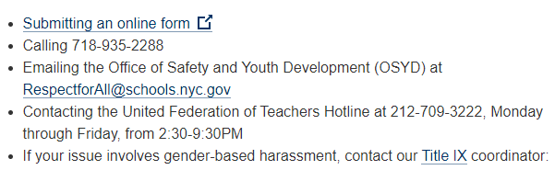
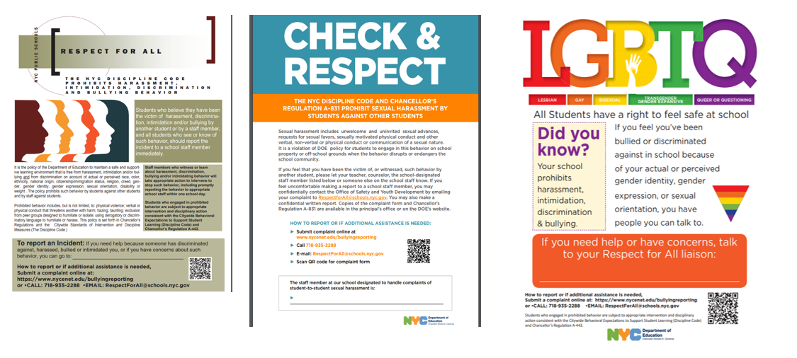
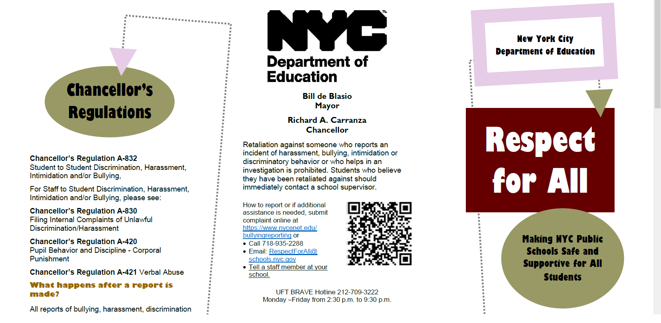
What should I do if my friend or I are being bullied?
If you are bullied at school, tell your teacher, school counselor, Respect for All Liaison or school principal. Telling is not snitching.
Report even if you do not know who harmed you
Notes:
If the alleged victim informs the principal/designee of safety concerns in regard to such notification, the principal/designee shall decide whether to inform the alleged victim’s parent(s) following consideration of privacy and safety concerns. The principal/designee may consult with their Senior Field Counsel in making this decision
Discuss with students:
Each school must conspicuously post “Respect for All” posters (available at https://www.schools.nyc.gov/school-life/policies-for-all/respect-for-all/respect-forall-handouts) in locations deemed highly visible to students, parents and staff. The posters must contain the name of the RFA liaison(s).
Students, parents, and individuals other than staff may report allegations of student-to-student discrimination, harassment, intimidation and/or bullying verbally or in writing, including by submitting the Complaint Reporting Forms (available at https://cdn-blob-prd.azureedge.net/prd-pws/docs/defaultsource/default-document-library/a-832-reporting-form.pdf?sfvrsn=43ca4491_6) to the principal/designee, RFA liaison, or any other school staff member, or via the online portal (available at https://www.nycenet.edu/bullyingreporting).
If a student or parent has concerns about making a report to the school, the student/parent may contact the Office of Safety and Youth Development (“OSYD”) by e-mailing the report to RespectforAll@schools.nyc.gov.

Slide 21
Your Rights
Every student has the right to feel safe at school.
If one adult isn’t able to help you, don’t give up! It is your right to talk with another adult, such as a parent.
When you do speak to a teacher, an administrator, or a person you trust at school:
Ask: “What can be done so I feel safe and other kids do, too?”
Share your action plan
Notes:
Discuss your school policy against bullying. Encourage all children to be students against bullying. Each school must annually distribute or make electronically available the written material prepared by OSYD highlighting the policies and procedures set forth in this regulation, including the procedures for how to make a report, (available at (https://www.schools.nyc.gov/school-life/policies-for-all/respect-for-all/respect-forall-handouts) to all school staff, parents and students.
Student Bill of Rights, https://www.schools.nyc.gov/get-involved/students/student-bill-of-rights

Slide 22
What If I Am Bullying?
Know that bullying is about behavior and that you can change your behavior.
Talk with an adult you trust - This can be someone at school, at home, or in your community. - Share what’s going on. - Ask for their advice and help.
Set a goal to change the negative behavior - It’s helpful to plan and strategize responses that are appropriate for situations. - Find a mentor and role model to guide you through challenging situations.
Be intentional with your actions - Think through how you want to respond to situations. - Frame your responses to be kinder, and more inclusive and accepting.
Notes:
Activity: Record the question and the responses on poster-size paper and post them on the classroom wall or in the hallway. Make sure that each student is allowed the opportunity to respond.

Slide 23
What If I Witness Bullying?
Think about what can happen to someone as a result of being bullied:
Feeling all alone,
Believing that no one cares,
Questioning whom you can trust, and
Wondering if anything will ever change.
That is a lonely place to be. Now imagine how that could be different. Think about how powerful it would be for someone who feels all alone to have another person reach out to them, especially someone their own age who understands what they might be feeling and shows that they care. That person can be YOU.
Notes:
Activity: Record the question and the responses on poster-size paper and post them on the classroom wall or in the hallway. Make sure that each student is allowed the opportunity to respond.

Slide 24
What If I Witness Bullying?, continued
Be available for conversation
Your goal doesn’t need to be fixing the problem; instead, focus on letting them express their story and their emotions. Here are some ways to connect:
Listen without judgment
Then, ask questions that allow them to talk through the story and their emotions:
Want to tell me what happened?
How are you doing? –
What would be helpful to you right now?
say “I’m here for you.”
Be a friend. Build them up.
The focus should be on supporting the person who is being bullied.
Talk with an adult
Notes:
Research shows that peers can be very effective at intervening in a bullying situation. A creative and sometimes challenging solution is to change the direction of the situation to a more positive course. It might take some preparation, practice, planning, and extra thought—it’s not easy to speak up against a wave of negativity—but research also shows that when one person speaks up, others will follow.
• Help them get away from a bullying situation by: - Asking them to walk with you. - Inviting another friend to join you—there’s safety and support in numbers!
• Change the subject when your peers start tearing someone down
• Find an adult who can come quickly and intervene. If you see cyberbullying, you can: - Write something positive in response. - Contact the person being bullied and let them know you are there for them. - Report it to an adult at school or to the social media site.

Slide 25
There is power in numbers
While it is absolutely important that each person does what they can, individual actions are magnified when we join forces.
When a group of individuals work together for a common cause, that is when real change happens.
Start a club or activity at your school that focuses on inclusion. For example, invite students with and without disabilities to work together on an art project each week.
Ask your teacher about researching other cultures for a presentation or project
Hold an open event where board games are played, resources are shared, anyone can participate, and everyone has someone to work with
Invite everyone to a game designed so that all levels of participants can actively participate
Create “safe spaces” on playgrounds/cafeteria that are monitored by peers and adults

Slide 26
Class Agreements
Bullying/harassment is never okay, cool, or acceptable.
No one EVER deserves to be bullied or harassed.
Our school is a safe and supportive environment for everyone.
Notes:
Discuss your school policy against bullying if you haven’t . Encourage all students to be against bullying/harassment.

Slide 27
What next?
Let’s discuss what can be done in our school to prevent bullying.
We will present them to your guidance counselor or principal.
Notes:
Additional activities:
Activity: Complete the Above the Line/Below the Line activity, https://www.pacer.org/bullying/classroom/elementary/activities/above-the-line.asp. Together, talk about what “above the line” behaviors and “below the line” behaviors are at school. Ask students to commit to promoting “above the line” behaviors within their classroom and school.
Activity: Create a classroom mural, with “I Care about Bullying Prevention Because … ” written in the center. Ask each student to add his or her reason.

Slide 28
Additional Activities: Video and Discussion
Watch “Bullies and Bystanders” Video. Visit PACERTeensAgainstBullying.org > AdvocacyForOthers (scroll to bottom of page):
Discussion questions:
What are some positive ways bystanders can help end bullying?
What are some negative ways bystanders can contribute to bullying?
What could you do as a bystander when you see physical bullying?
What could you do as a bystander when you see verbal bullying?
What could you do as a bystander when you see cyberbullying?
Notes:
Also watch Student Created Videos, at https://www.pacer.org/bullying/video/listing.asp?category=Student%20Created%20Video
Students need opportunities to practice their SEL skills by role-playing how to respond appropriately in bullying situations.
For example, when learning about empathy, students can discuss what it feels like to be bullied and to watch an incident of bullying.
They can practice effective responses to bullying situations and help-seeking behaviors for both victims and bystanders.
Teachers can brainstorm with students how bystanders should behave, and then practice these actions in role-play situations. Teachers should then encourage students to apply what they are learning outside the classroom.

Slide 29
Class Resources
NYCDOE Respect For All: Listing of guides for reporting bullying and/or harassment complaints, bullying definition; citywide announcements; key materials, resources at a glance, additional ant-bias resources; and curriculum resources.
NYCDOE Social Emotional Learning: Teaching social-emotional skills is as important as teaching academic skills. Providing students with instruction in social-emotional skills serves as both an overarching prevention strategy and as a primary intervention strategy, especially for children who will benefit significantly from an expanded “toolkit” of responses that includes appropriate, pro-social strategies for effectively interacting with others.
WeTeachNYC: Contains a set of resources designed and curated to support teachers in engaging in culturally responsive and sustaining ways. Schools should utilize these resources in ways that best serve the school community.
Eyes on Bullying Toolkit: What can you do?: A downloadable toolkit designed to help children and adults examine their beliefs about bullying, learn how to recognize and effectively respond to bullying both at the time of the incident and after it has ended, and take strategic steps to help prevent bullying from occurring.
MindOH: This website offers numerous resources on bullying, including Bullying Tips and Tools for teachers and parents, several “Thinking It Through” classroom lessons for students on bullying topics (e.g., teasing, bystander roles), tips for preventing cyberbullying, an entire lesson plan series, and parent-child activities on bullying.

Slide 30
Questions or comments
Please email Respectforall@schools.nyc.gov

