Slide 1
New Elementary CA Content
Standards Progress Report Card
Module 3: Technology and MiSiS job aids
Field-test version
Los Angeles Unified School District

Slide 2
Series of PD Modules
Module 1: August-September
History and Purpose
Module 2: September-October
Standards-based grading and programs
Module 3: October
Technology and MiSiS job aids

Slide 3
Reporting Period | MiSiS Grade Entry Window
 | Start Date | End Date | Parent Conference Dates
First | 8/15/2017 | 11/3/2017 | November 6-9, 2017
MiSiS Grade Entry: 10/19/17—11/9/17
Second | 11/6/2017 | 2/23/2018 | February 26- March 2, 2018
MiSiS Grade Entry: 2/9/18—3/2/18
Third | 2/26/2018 | 6/7/2018 | June 4-8, 2018 (optional)
MiSiS Grade Entry: 5/18/18—6/8/18
Notes:
The test will begin during the first official MiSiS grade entry window*. 1st Reporting Period
Teachers will complete the current report card for their students as the official progress report.
Concurrently, teachers will test the prototype in MiSiS during the grade entry window.
Testing will continue during all subsequent grade entry windows.
There will be compensation provided for participating teachers and administrators. Ten regular hours of X-rate

Slide 4
Objective
To learn how to complete the progress report in MiSiS using the job aids.
Notes:
SCOPE OF THE PROJECT
Our objectives for today are:
We need your assistance to test the new progress report card.
To provide the schools participating in the field test the scope and expectations for the progress report pilot
To collect relevant information from teachers to shape the preparations for the district-wide transition to the K/5 Elementary CA Content Standards Progress Report

Slide 5
What might you be wondering at this time?
Parking Lot
Notes:
NEW SLIDE
Facilitator chart the questions/concerns=participant feedback

Slide 6
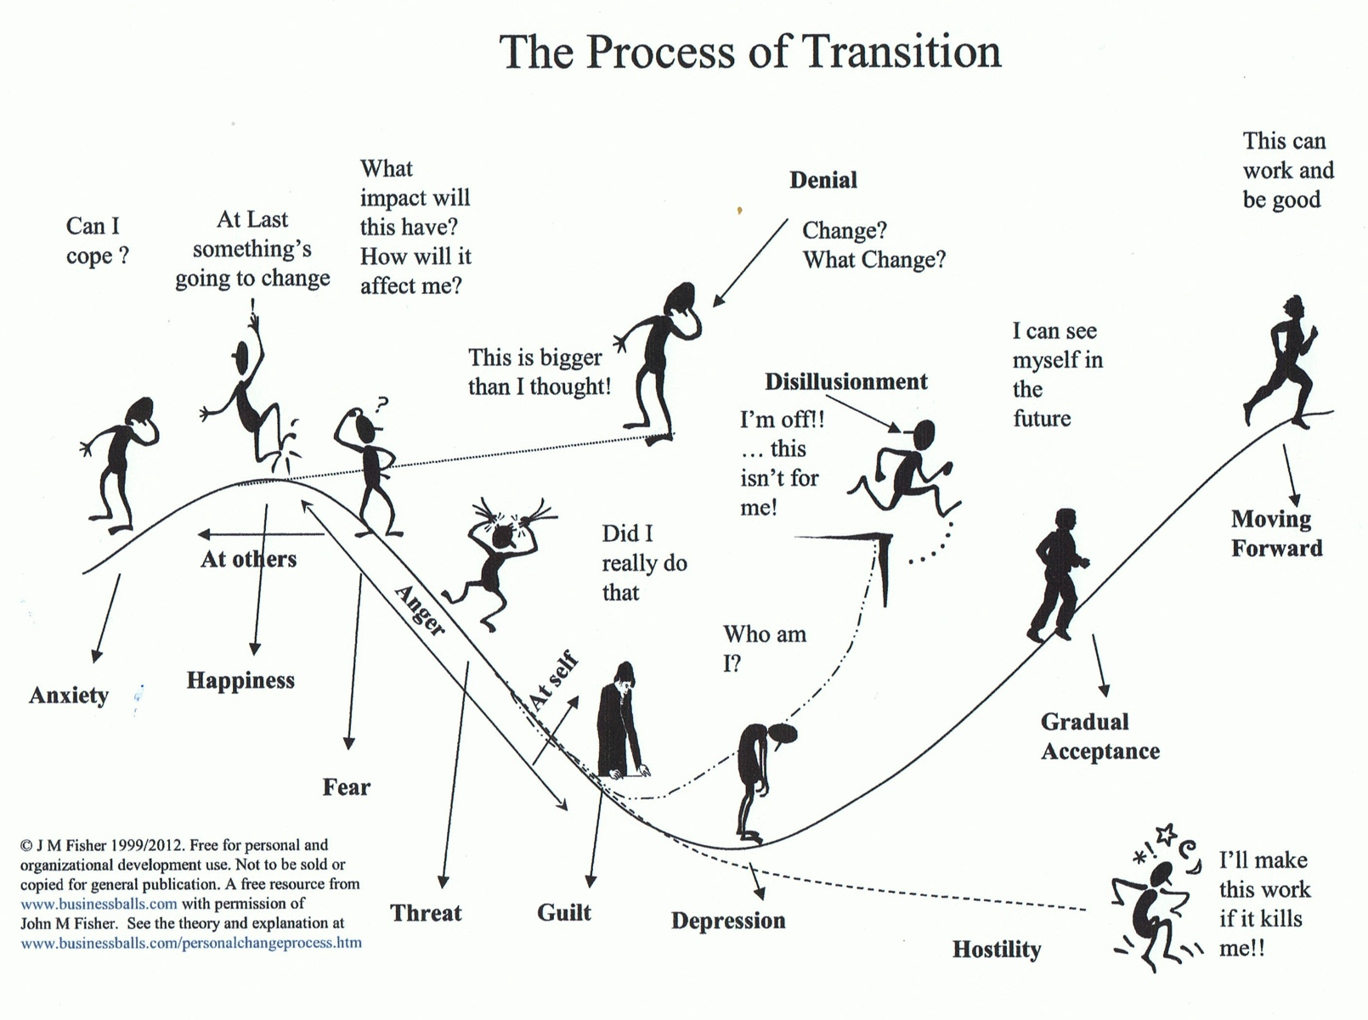

Slide 7
Additional Resources
Teacher Progress Report Checklist Test MiSiS
New Progress Report Parent Conference Script

Slide 8

Module 3 Main Topic
Section I
The MiSiS Screens

Slide 9
Section I
The MiSiS Screens

Slide 10
Content
1
Grades by Class
Current Grade Recording Process & Proposed Grade Recording Process
Grades by Student
  Current Grade Recording Process & Proposed Grade Recording Process
Elementary Report Card
  Current Report Card & Proposed Report Card
Teacher Verification Report
  Current TVR & Proposed TVR
Database Design & Glossary
  Proposed Database Design and Key Terms
2
3
4
5

Slide 11


Grades by Class
WHAT
The grades by class screen allows a user to enter grades and comments for students assigned to the same class (course-section) on one single screen.
WHY
This is especially helpful for teachers taking these classes where they are able to award marks for the class in one go instead of awarding marks for different students individually.
1

Slide 12
Grades by Class
CURRENT GRADE RECORDING PROCESS

Slide 13

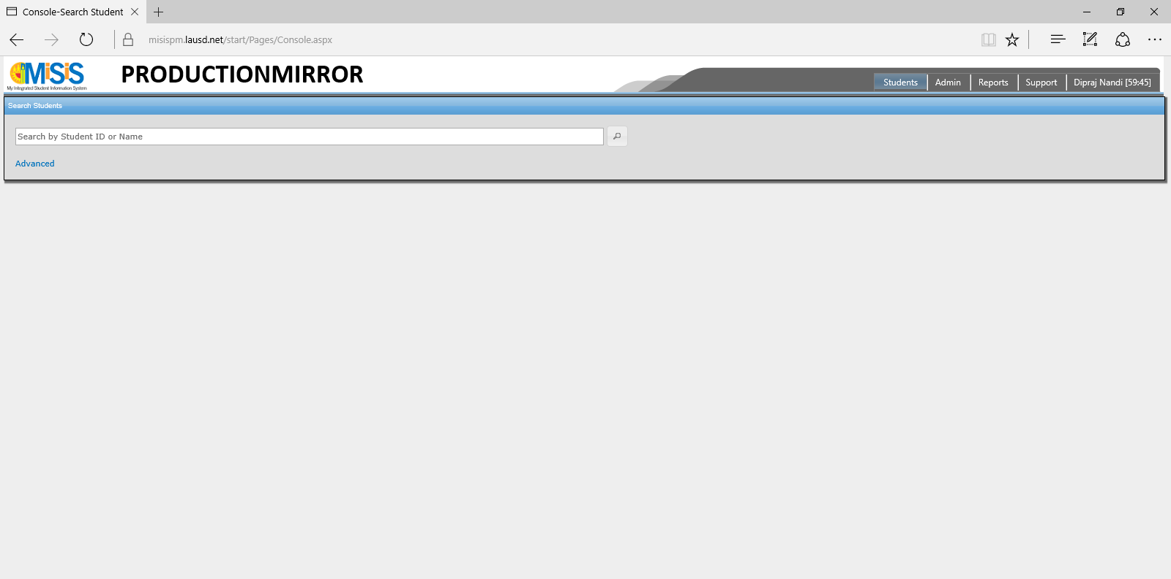

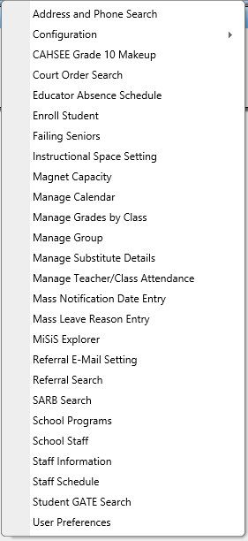


Current Grade Recording Process
1
GRADES BY CLASS
Navigate to
Manage Grades by Class
under
Admin on the menu

Slide 14
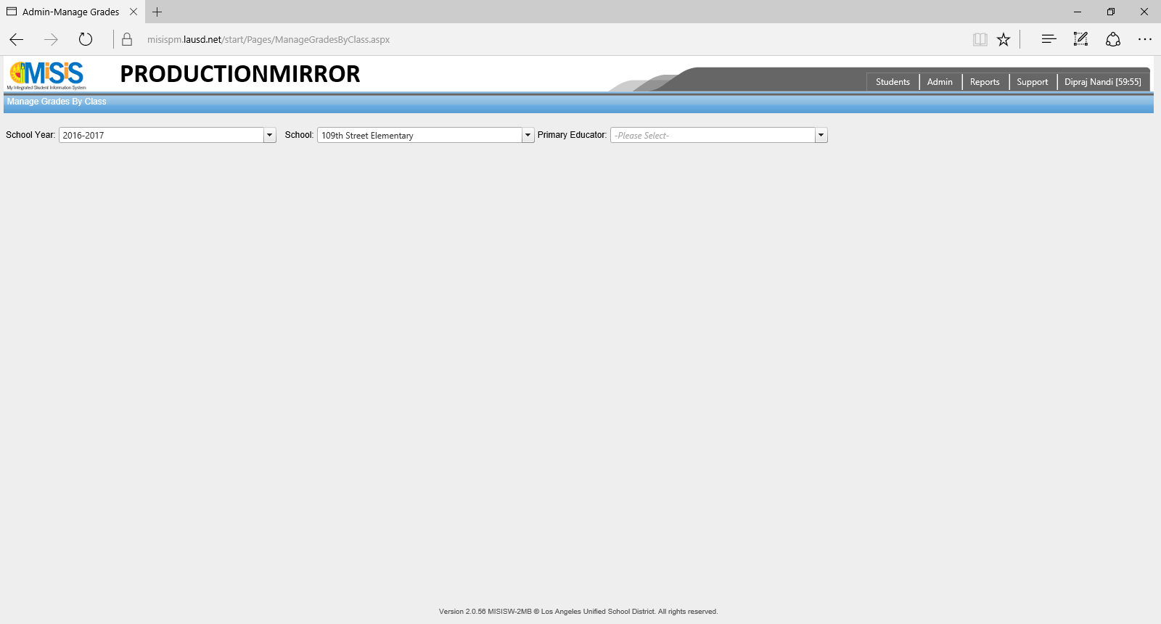
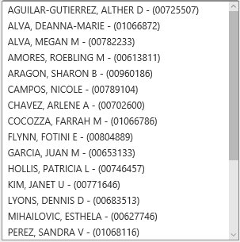
Current Grade Recording Process
2
GRADES BY CLASS
Select
School Year,
School
and Primary Educator
on the presented screen
(Manage Grades by Class)

Slide 15
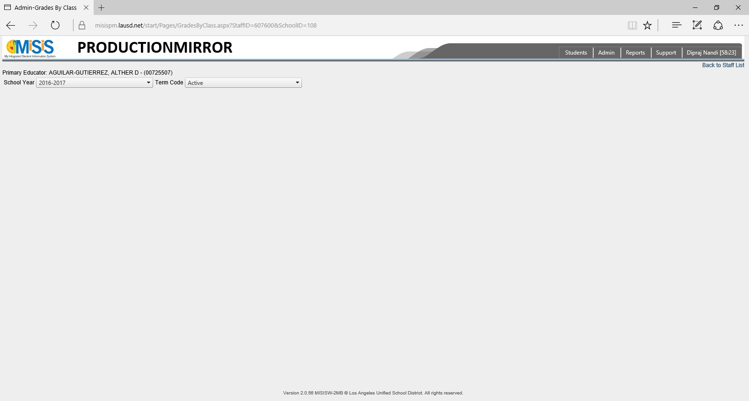


Current Grade Recording Process
3
GRADES BY CLASS
Select
School Year
and Term Code
on the presented screen
(Grades by Class)

Slide 16
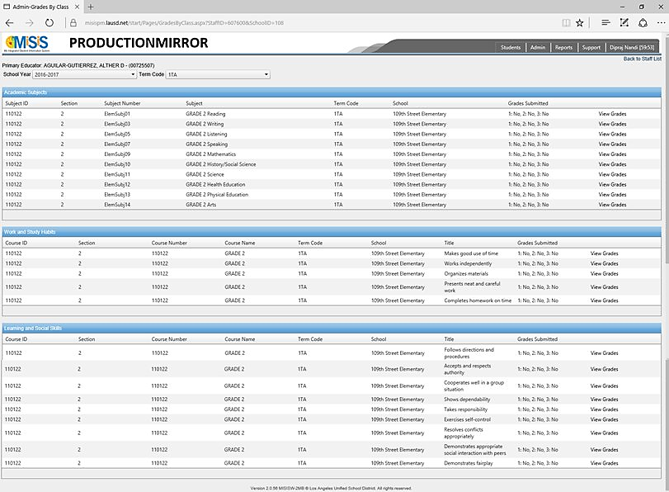

Current Grade Recording Process
4
GRADES BY CLASS
Select
View Grades
against the row that you intend to view or edit on the presented screen
(Grades by Class)

Slide 17
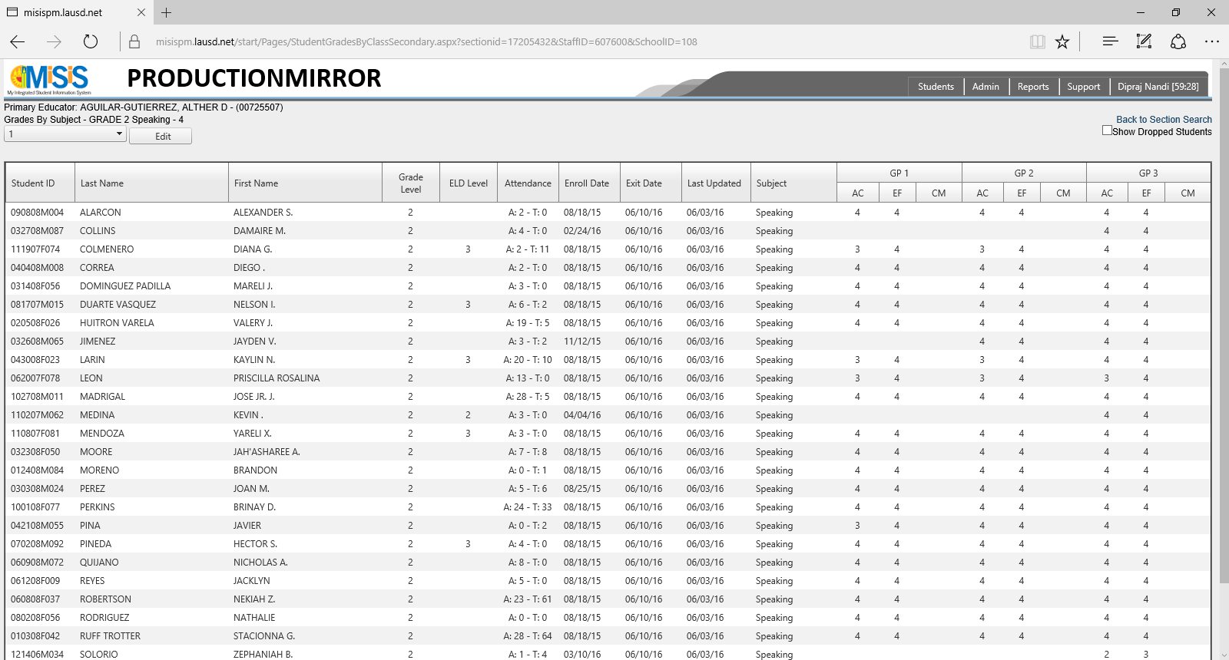


Current Grade Recording Process
5
GRADES BY CLASS
Select
Grading Period
that you intend to edit grades for and click on Edit on the presented screen
(Student Grades by Class)

Slide 18
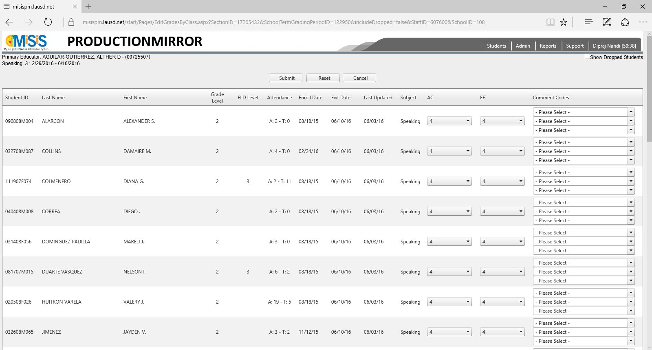
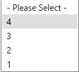
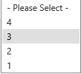
Current Grade Recording Process
6
GRADES BY CLASS
Change the
grade(s)/ comment(s)
against the row(s) that you intend to edit on the presented screen and click Submit
(Edit Grades by Class)

Slide 19
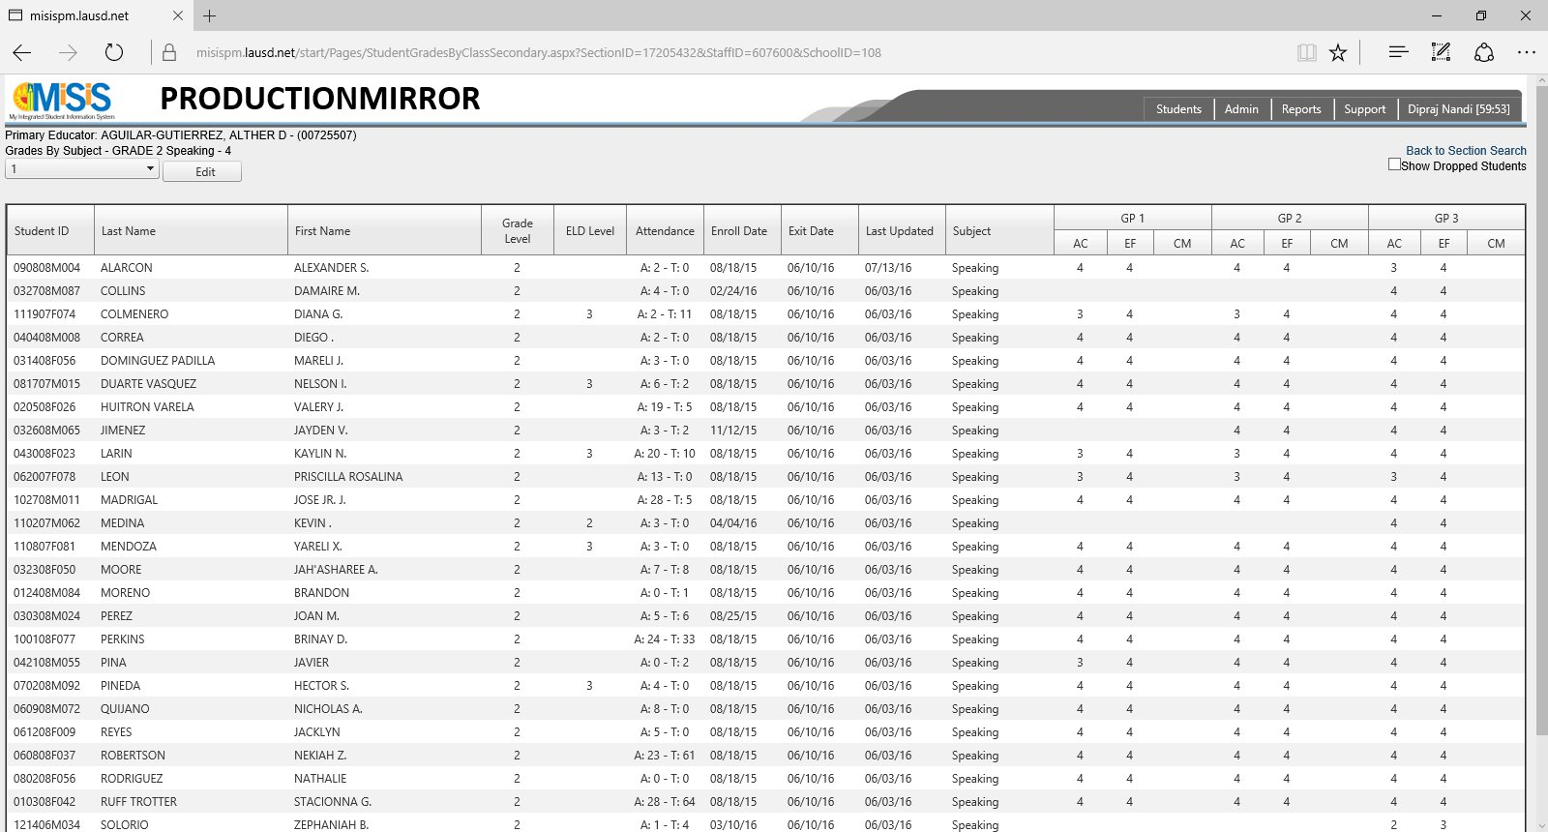
Current Grade Recording Process
7
GRADES BY CLASS
You can now verify the
grade(s)/ comment(s)
that were edited have been updated correctly on the presented screen
(Student Grades by Class)

Slide 20
Grades by Class
PROPOSED GRADE RECORDING PROCESS

Slide 21
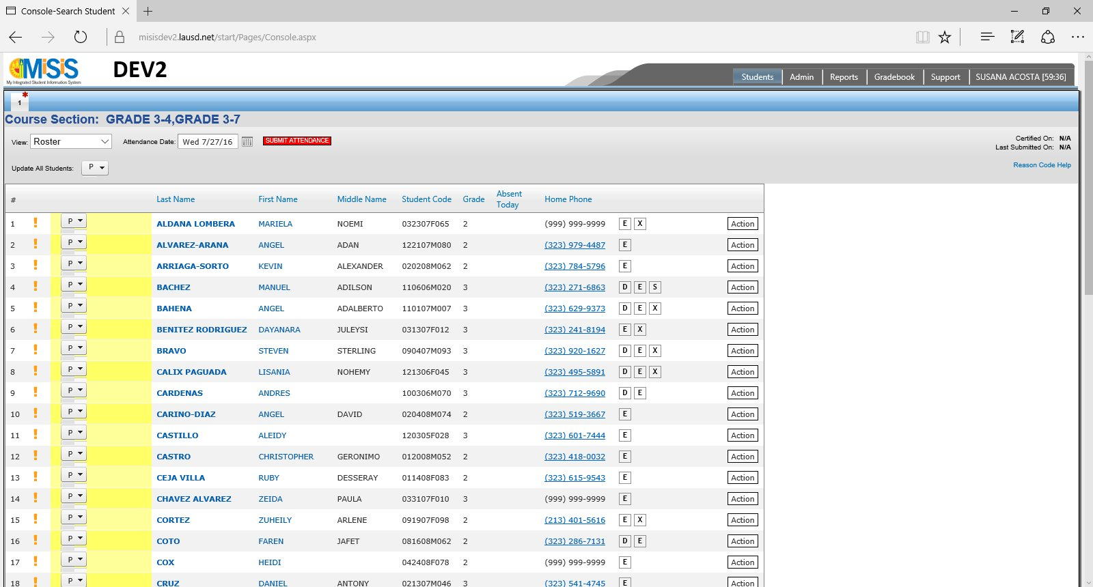
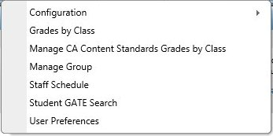
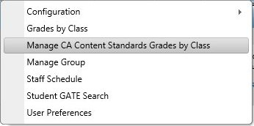
Proposed Grade Recording Process
1
GRADES BY CLASS
Navigate to
Manage CA Content Standards Grades by Class
under
Admin on the menu

Slide 22
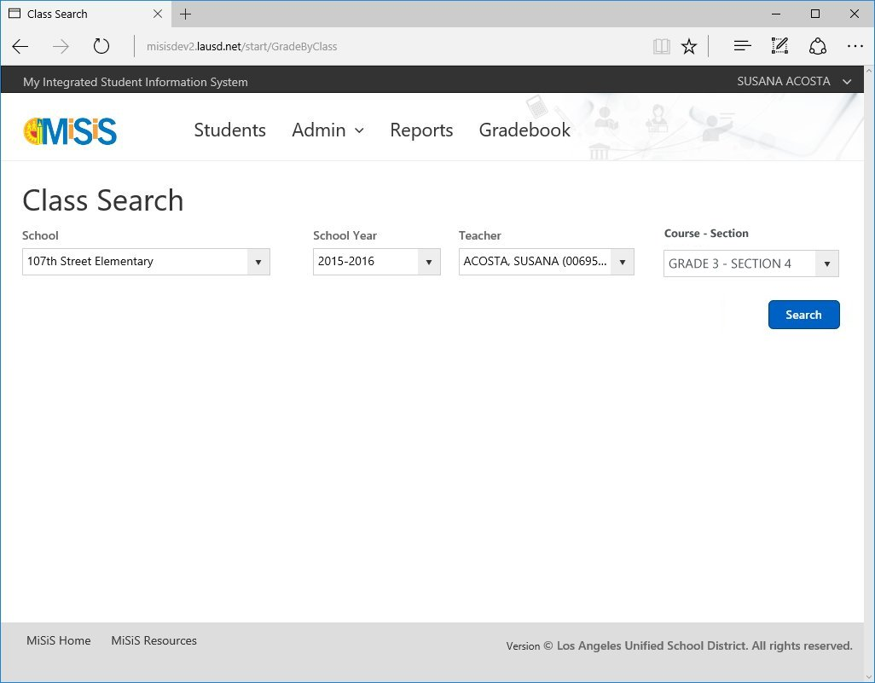
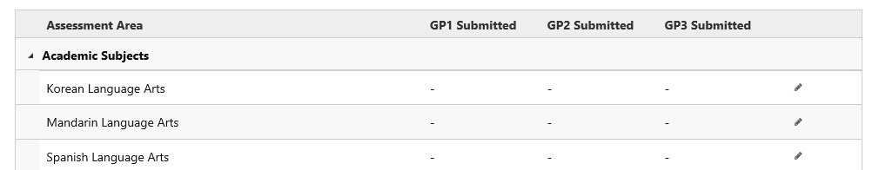
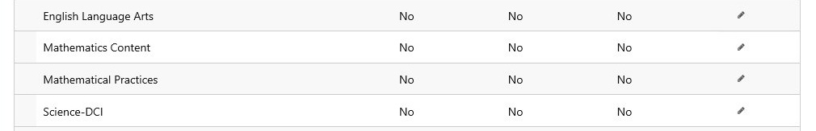
Proposed Grade Recording Process
2
GRADES BY CLASS
Select (where applicable) the parameters (school, school year, teacher, grade level) to indicate search criteria for class search and hit Search.
From the search results, click on the pencil icon alongside the class to be viewed/edited.

Slide 23
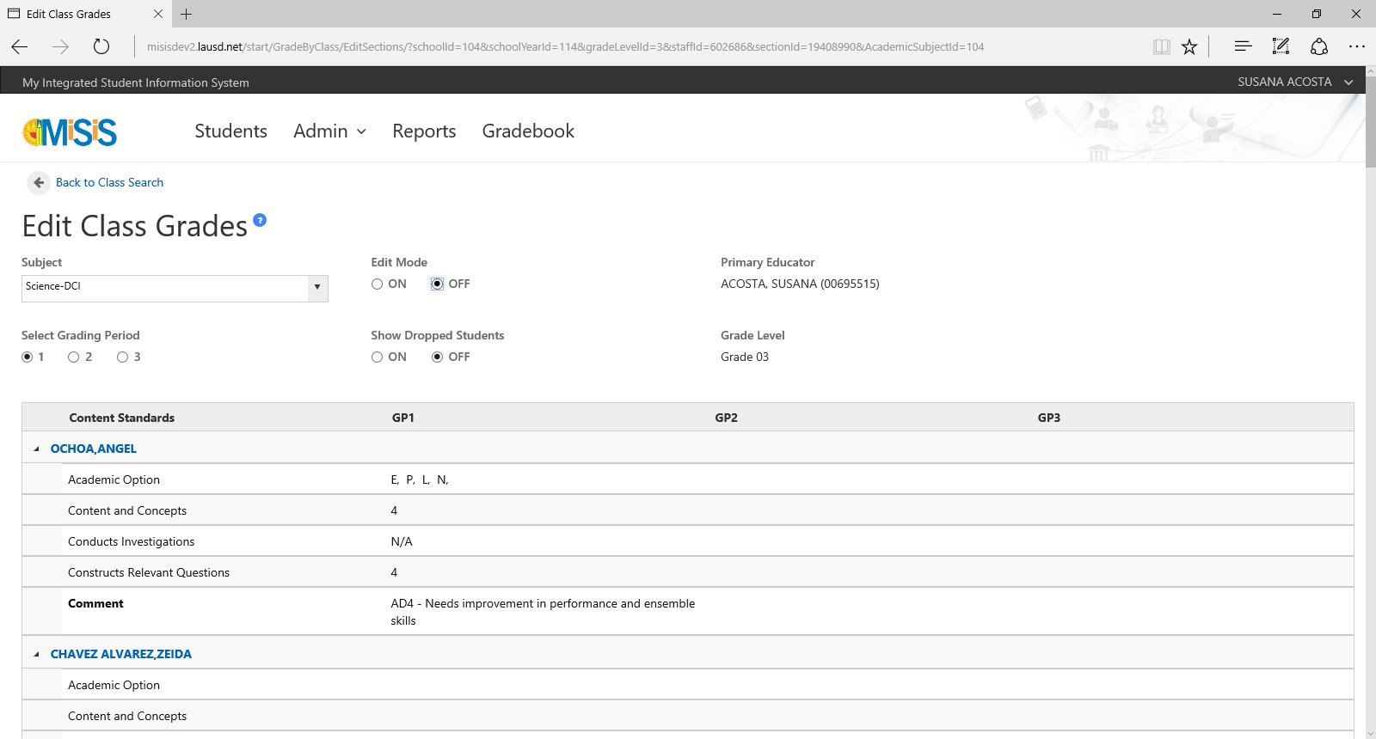
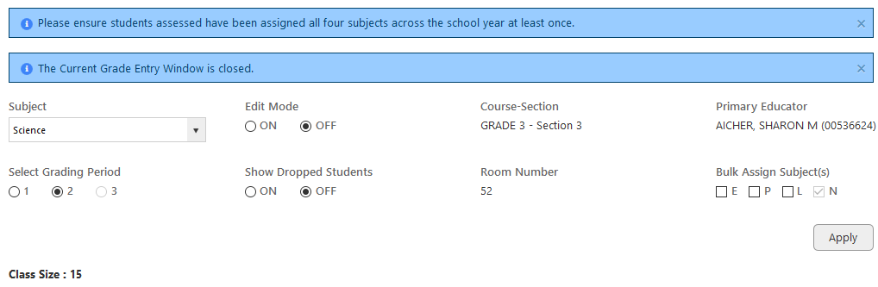
Proposed Grade Recording Process
3
GRADES BY CLASS
Grades, comments and academic options can be viewed on this screen for the chosen class.
To make changes, the edit mode should be set to on.

Slide 24
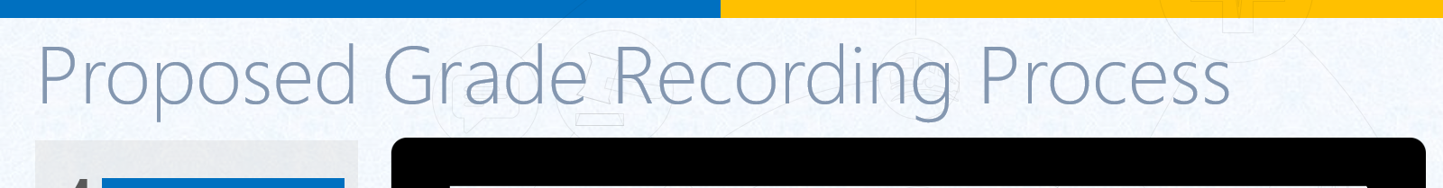
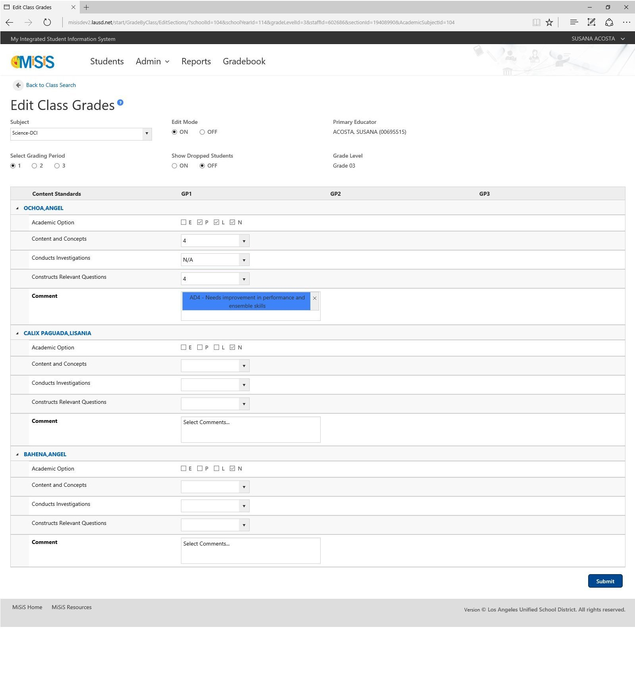
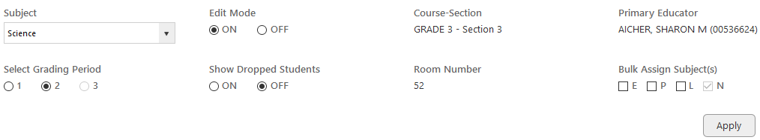

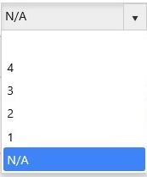
Proposed Grade Recording Process
4
GRADES BY CLASS
Changes can now be made to academic options, grades and comments for the selected grading period.
Changes are recorded when the submit button is clicked at the bottom of the screen.

Slide 25
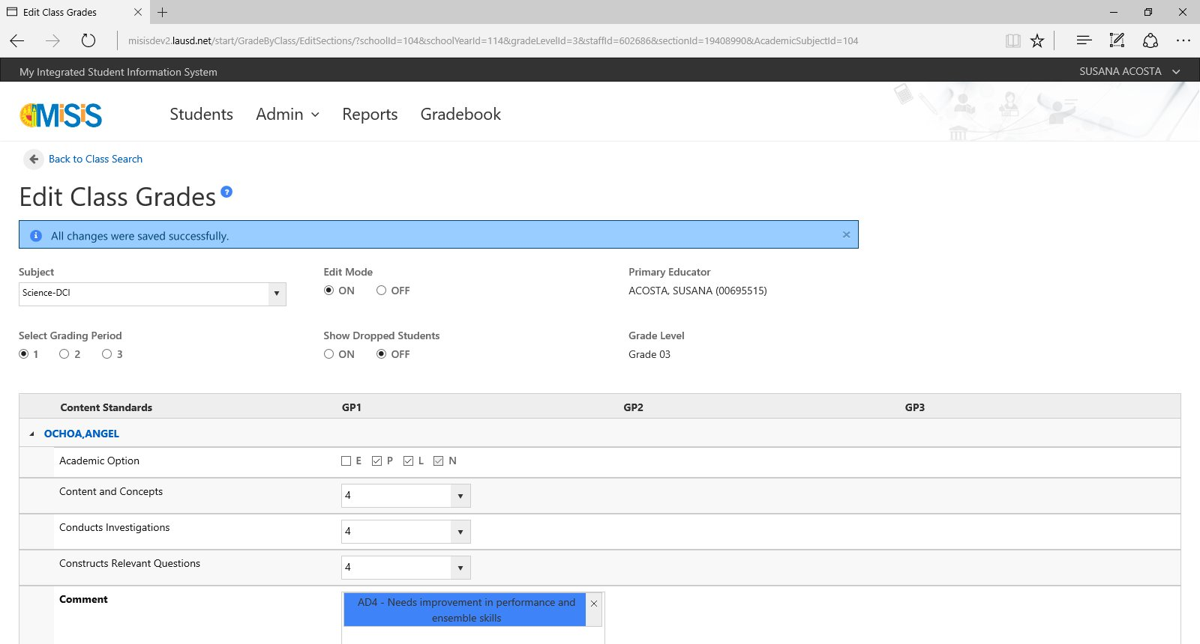
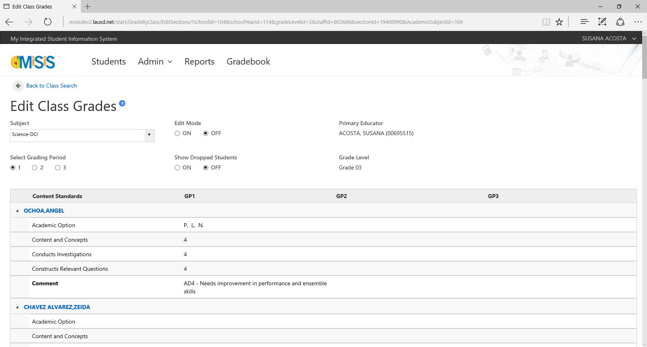
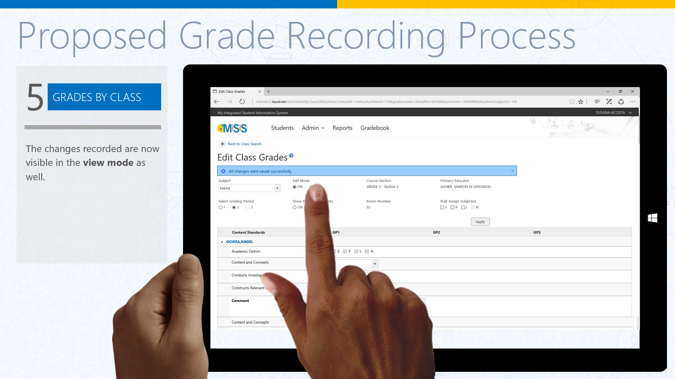
Proposed Grade Recording Process
5
GRADES BY CLASS
The changes recorded are now visible in the view mode as well.

Slide 26
Grades by Student
WHAT
The grades by student screen allows a user to enter grades and comments for a particular student for all subjects (or, content standards) assigned to the student via the student profile.
WHY
This is especially helpful for office managers or teachers who need to edit grades or comments for a particular student regardless of the class they’re assigned to.
2

Slide 27
Grades by Student
CURRENT GRADE RECORDING PROCESS

Slide 28
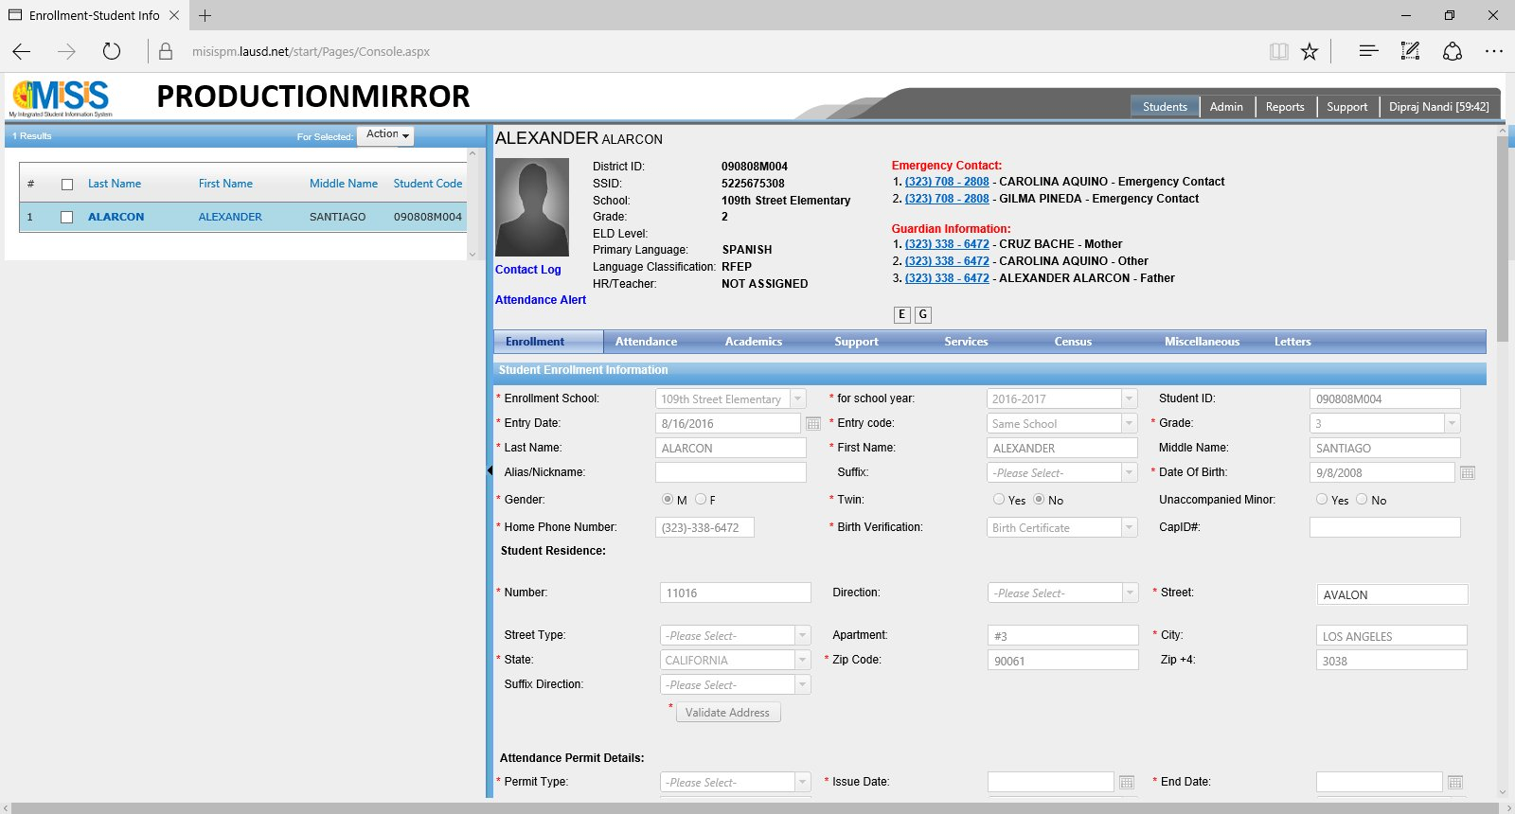
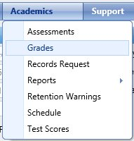
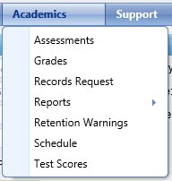
Current Grade Recording Process
1
GRADES BY STUDENT
Navigate to Grades
under Academics on the
student profile navigation menu

Slide 29
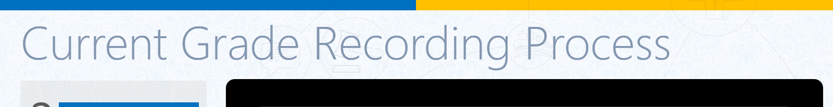
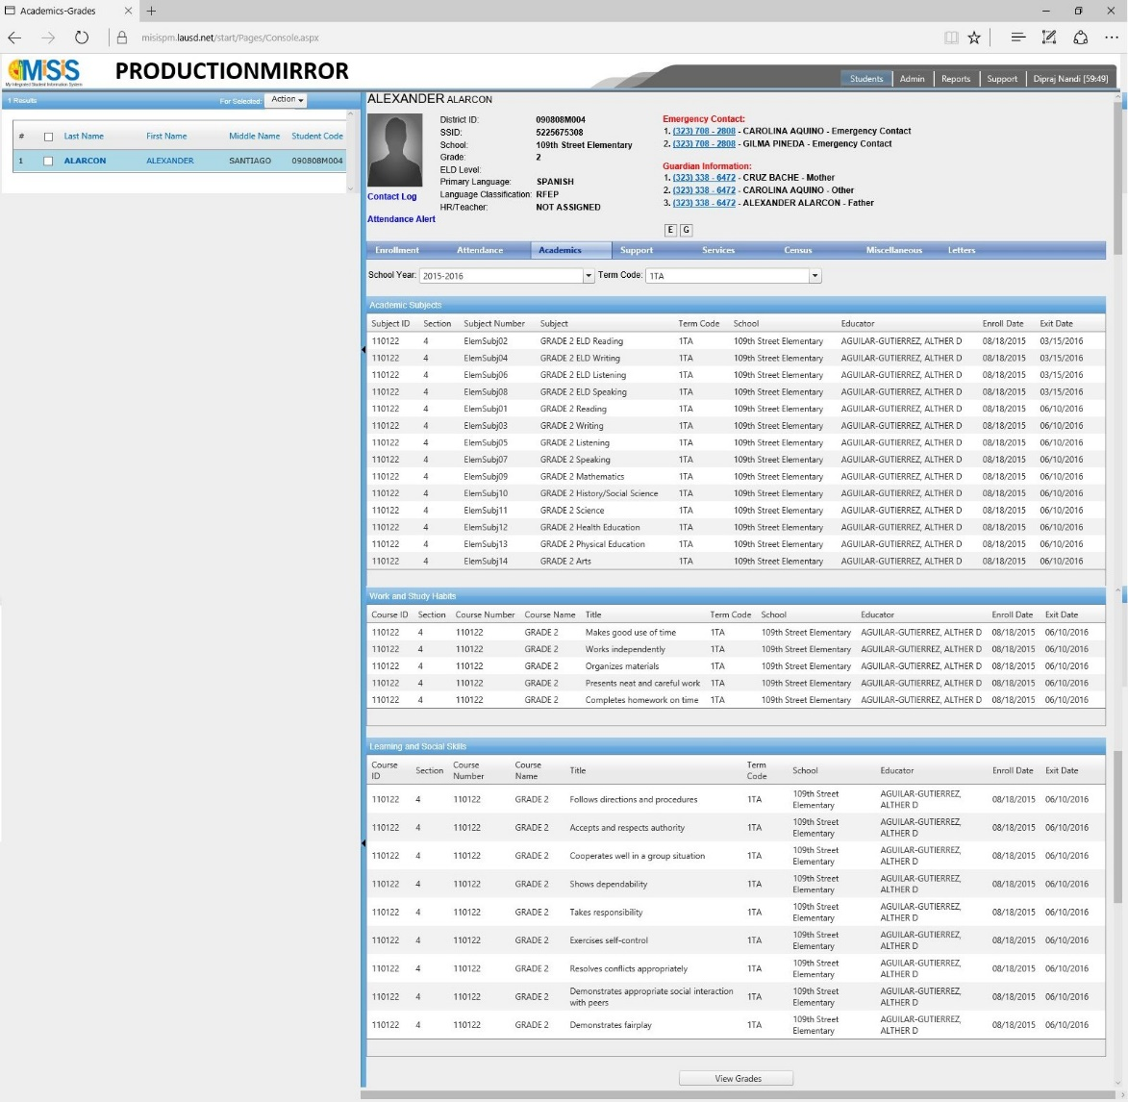
Current Grade Recording Process
2
GRADES BY STUDENT
Scroll down and click on
View Grades
at the bottom of the presented screen

Slide 30
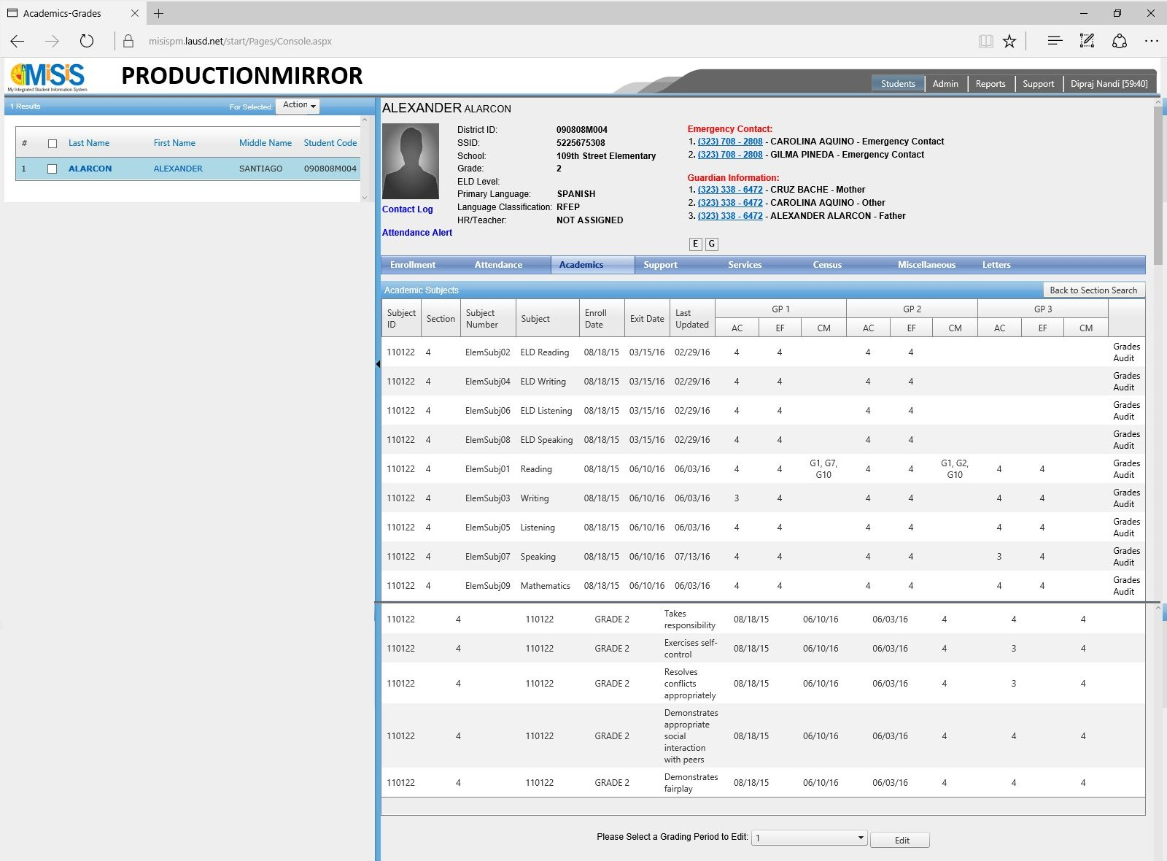


Current Grade Recording Process
3
GRADES BY STUDENT
Scroll down and select
Grading Period to be edited at the bottom of the screen and click on Edit

Slide 31

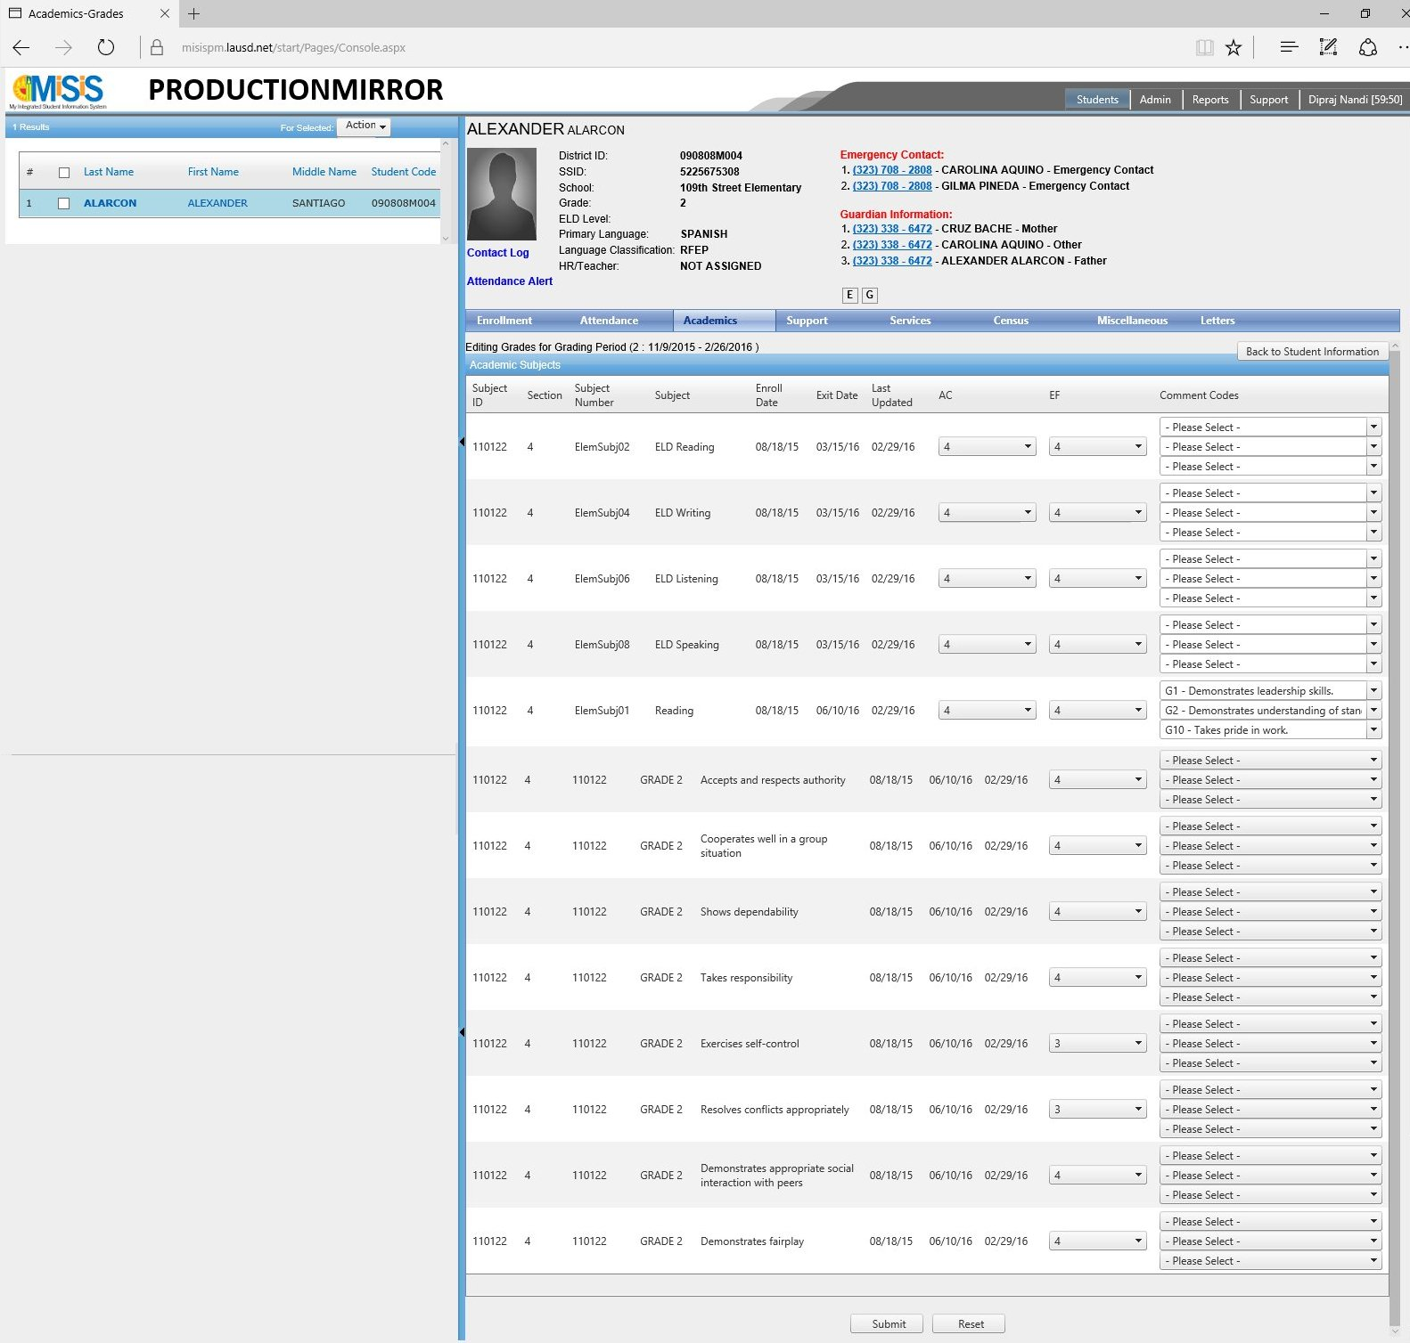
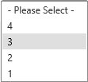
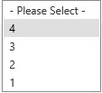
Current Grade Recording Process
4
GRADES BY STUDENT
Select new grade/comment
to be awarded and scroll down to hit the submit button

Slide 32
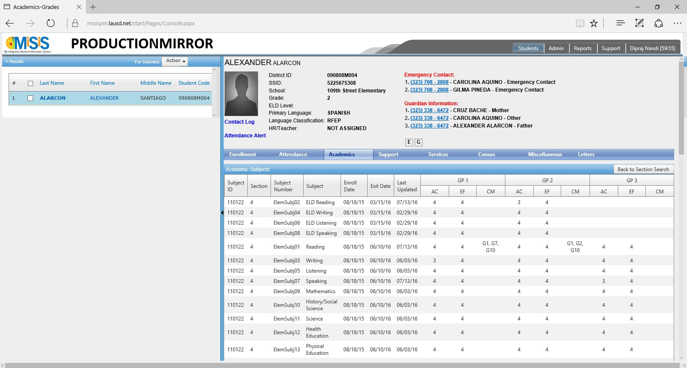
Current Grade Recording Process
5
GRADES BY STUDENT
You can now verify the
grade(s)/ comment(s)
that were edited have been updated correctly on the presented screen

Slide 33
Grades by Student
PROPOSED GRADE RECORDING PROCESS

Slide 34
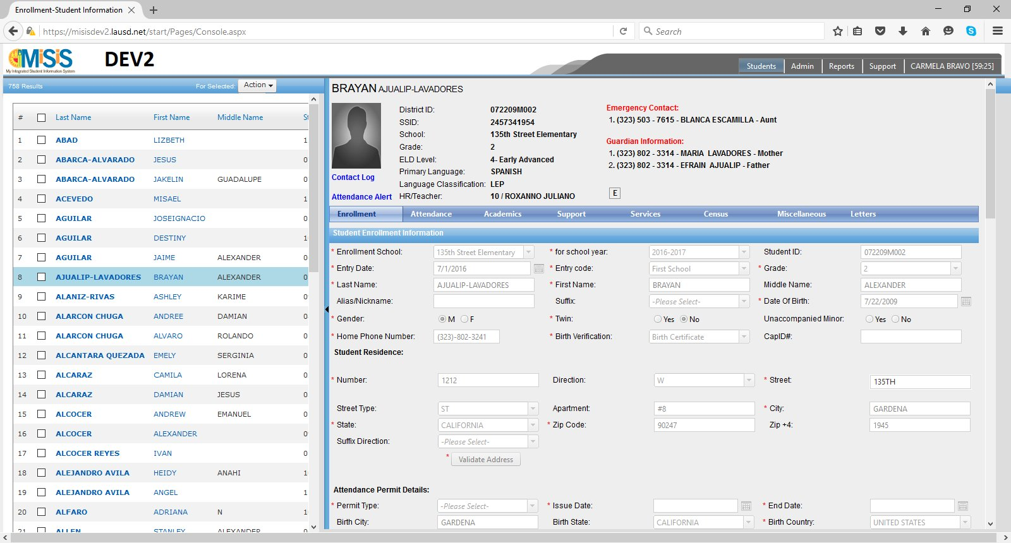
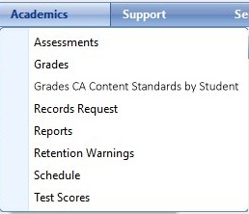
Proposed Grade Recording Process
1
GRADES BY STUDENT
Navigate to Grades CA Content Standards by Student
under Academics on the
student profile navigation menu

Slide 35
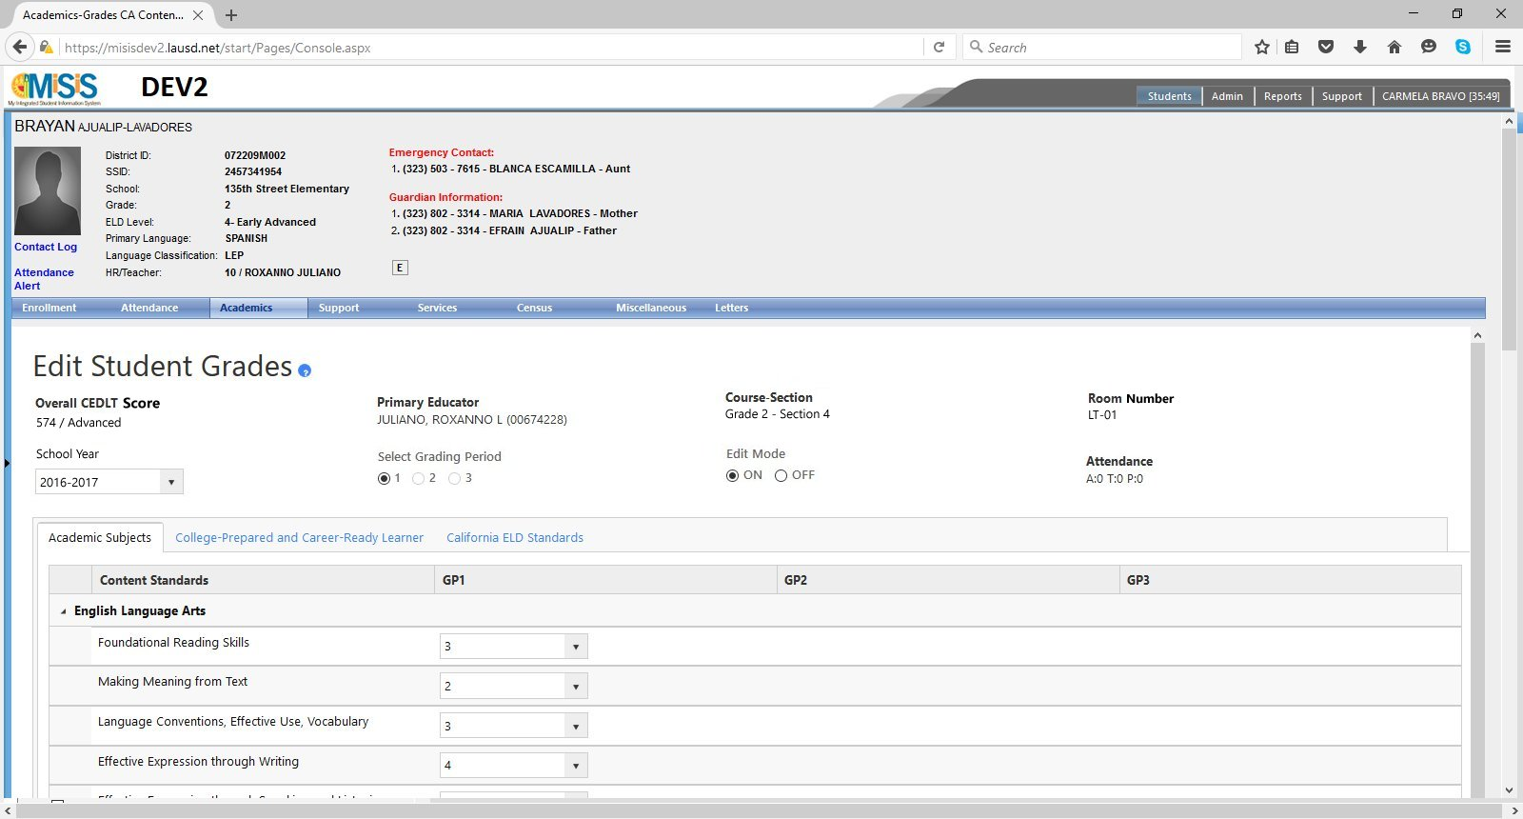
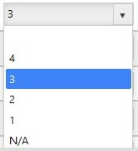

Proposed Grade Recording Process
2
GRADES BY STUDENT
Set the Edit Mode to ON, select the school year and grading period and proceed to editing the grade(s)/ comment(s) that need to be updated.

Slide 36
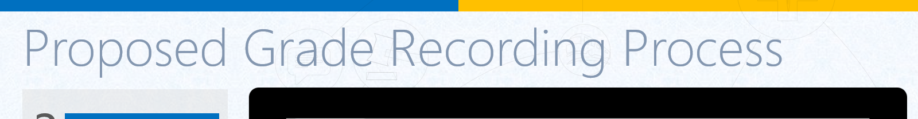
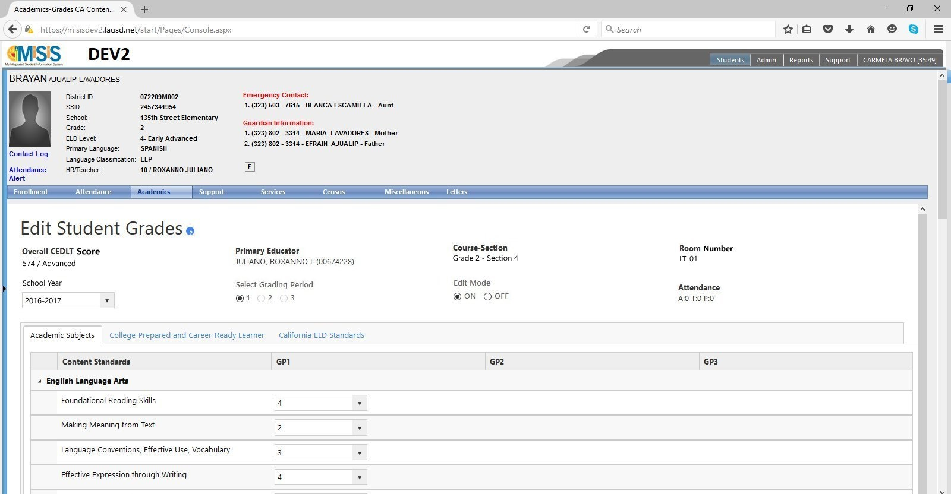
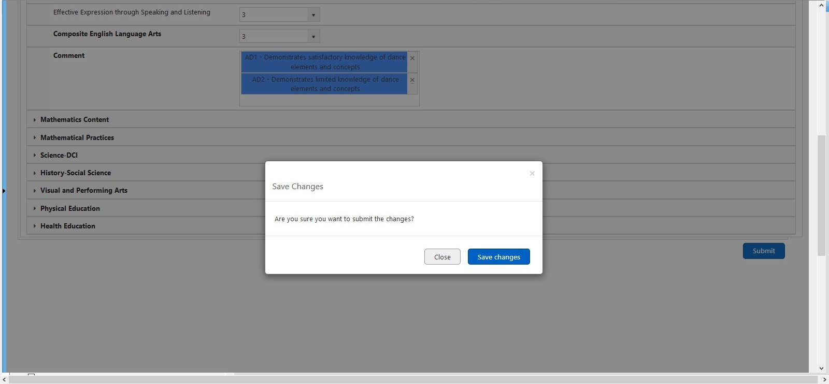
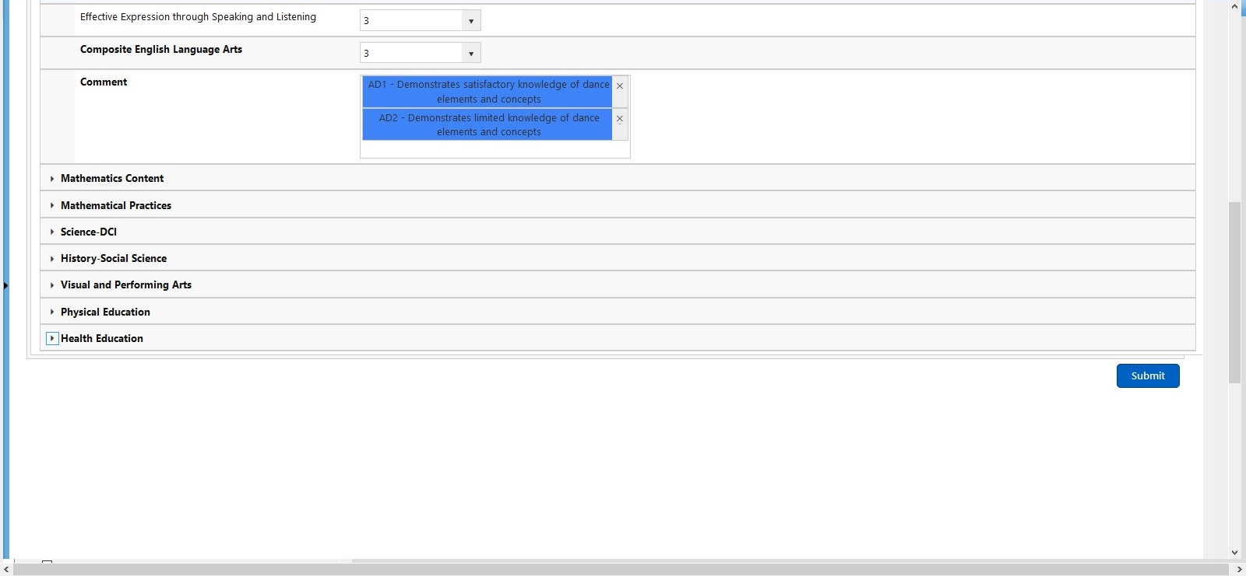
Proposed Grade Recording Process
3
GRADES BY STUDENT
Submit changes by clicking on the button at the bottom of the screen and confirming the subsequently presented alert.
All changes were saved successfully.

Slide 37
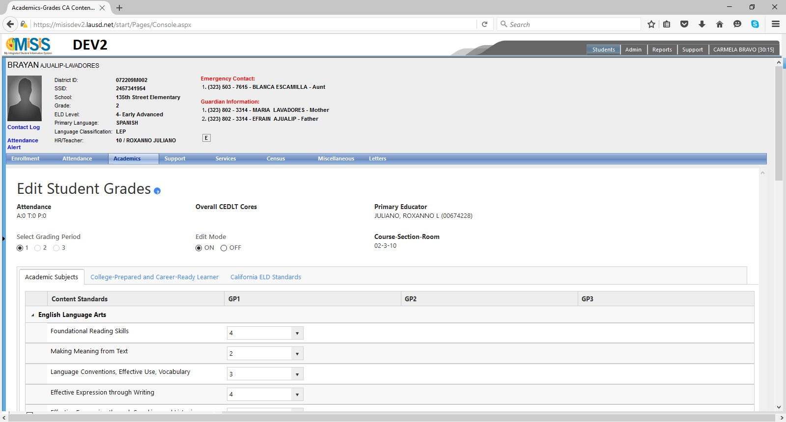
Proposed Grade Recording Process
4
GRADES BY STUDENT
You can now verify the
grade(s)/ comment(s)
that were edited have been updated correctly on the presented screen

Slide 38
Elementary Report Card
WHAT
This report helps generate the Elementary Report Card for students enrolled in elementary grade levels. For the scope of pilot-1 for CA Elementary Content Standards, the grade levels are K, 1, 2, 3, 4, 5 (and 6 in schools which consider it elementary).
WHY
In order to print and present report cards to students (and their parent(s)/guardian(s)), this is an essential report that allows generation of report cards on-demand by staff.
3

Slide 39
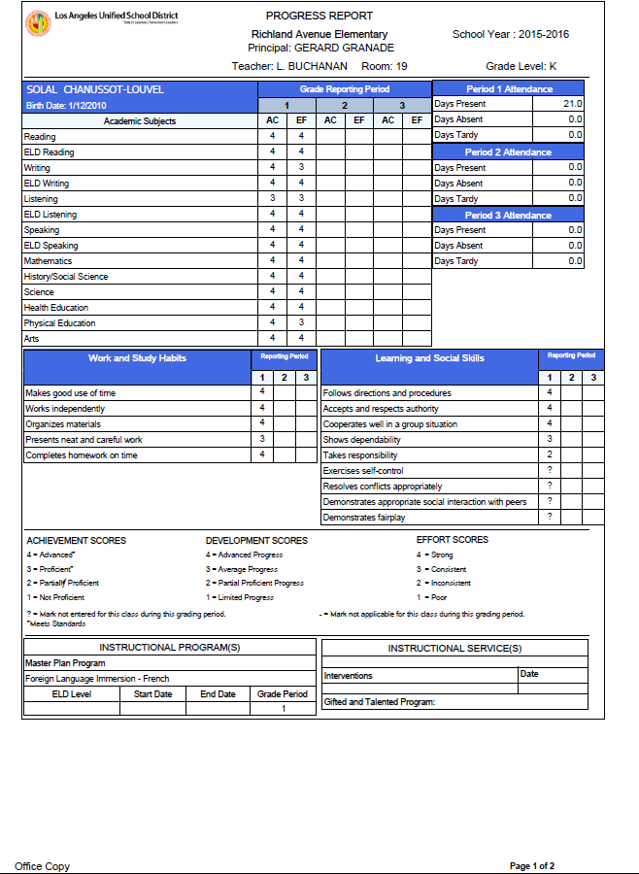
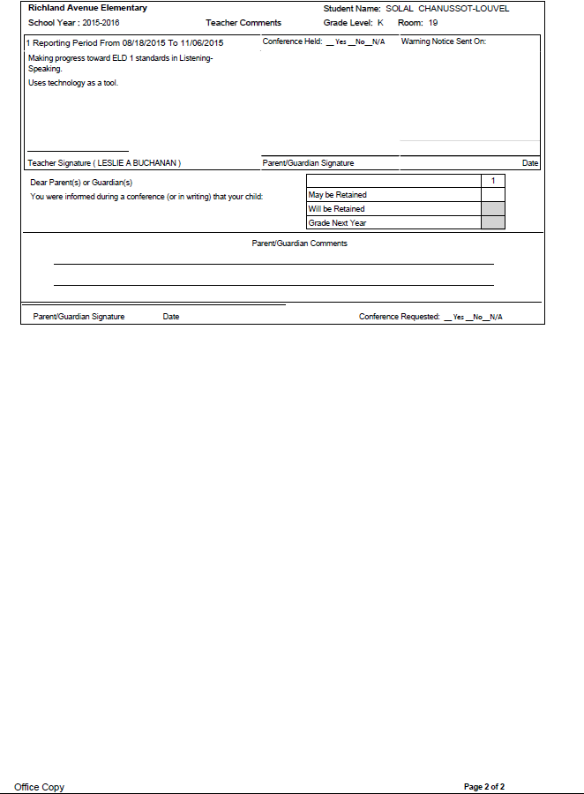
Elementary Report Card
1
EXISTING LAYOUT
FIRST PAGE
SECOND PAGE
The layout shared alongside represents the current elementary report card.

Slide 40
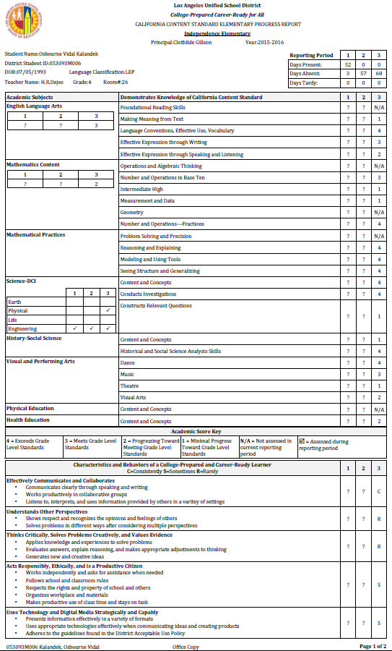
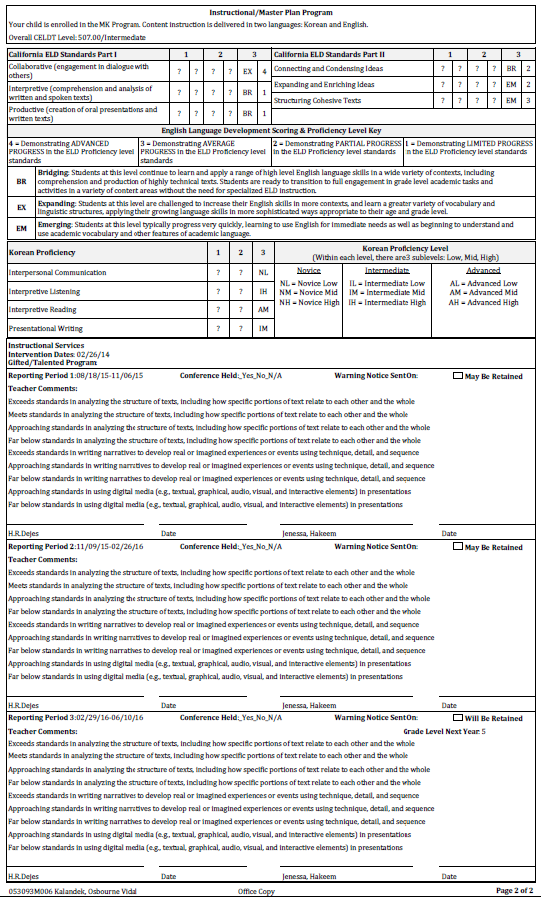
Elementary Report Card
2
PROPOSED LAYOUT
FIRST PAGE
SECOND PAGE
The layout shared alongside represents the proposed elementary report card supporting Elementary CA Content Standards.

Slide 41
Teacher Verification Report
WHAT
This report helps generate the Teacher Verification Report for students enrolled in elementary grade levels. For the scope of pilot-1 for CA Elementary Content Standards, the grade levels are K, 1, 2, 3, 4, 5 (and 6 in schools which consider it elementary).
WHY
In order to determine that grades and comments have been correctly awarded by a teacher, this is an essential report that helps generate a verification report to help the teacher/staff assess the same.
4

Slide 42

Teacher Verification Report
1
EXISTING LAYOUT
The layout shared alongside represents the current elementary teacher verification report for Academic Subjects. The same layout is used for generating reports on Learning & Social Skills and Work & Study Habits.

Slide 43

Teacher Verification Report
2
PROPOSED LAYOUT
NAMES OF STUDENTS
ACADEMIC SUBJECTS
The layout shared alongside represents the proposed elementary teacher verification report supporting Elementary CA Content Standards. As noticeable, a single report is used for all assessment areas – unlike the current layout.
COLLEGE PREPARED & CAREER READY LEARNER
<TARGET> LANGUAGE PROFICIENCY
ENGLISH LANGUAGE DEVELOPMENT
COMMENTS & ATTENDANCE

Slide 44
Glossary
Content Standard: Specific content areas that students should learn at each grade level . The content standards that a student is assigned are determined based on the student’s grade level, language classification, master plan program and instruction model.
Grading Period (GP): A grading period is a date range during which students are evaluated and grades are awarded for their assigned content standards. There are three such periods for Elementary Schools during one school year (GP1, GP2, GP3).
Assessment Area: Broadly, assessment areas are a logical grouping of content standards that serve as categories for aggregating related content standards. These groupings are Academic Subjects, Characteristics and Behaviors of a College Prepared and Career Ready Learner, Master Plan Program and Instructional Program.
Subject: Under each assessment area, there would be one or more subjects which have content standards against them. The applicability of these subjects (like content standards) for a student is determined based on the student’s grade level, language classification, master plan program and instruction model (school-specific).
Composite Grade: For certain subjects, in addition to the content standards, grades are also required to be awarded at the subject level – this is termed a composite grade.
Academic Option: For certain subjects (such as Science-DCI), there are sub-courses (namely Earth (E), Life (L), Engineering (N) and Physical (P)) which are taught to the students during one or more grading periods and the grades awarded for content standards during these grading periods are attributed to these academic options.
Attendance: The days present, absent and tardy displayed for a student includes attendance from all section enrollments of the student at the most recent school during the given school year – therefore, this count may include attendance from previous teacher(s).

Slide 45
Series of PD Modules
Module 1: August-September
History and Purpose
Module 2: September-October
Standards-based grading and programs
Module 3: October
Technology and MiSiS job aids

Slide 46
Thank you!
For additional questions: (213) 241-5333
Division of Instruction

