Slide 1
Edgecombe County
Board of Education
Redistricting: All Draft Plan Options
Submitted May 8, 2025
Deborah Stagner, Tharrington Smith
Blake Esselstyn, Mapfigure Consulting

Slide 2
Descriptive Summary
Plan Name | Primary Consideration(s)
Option A | Preserving the cores of districts adopted in 2021 to the extent possible
Option B-2* | Creating districts with compact, regular shapes
Option C | Intactness and groupings of identified communities of interest
Option D | Replication of County Commission districts to the extent possible without pairing incumbent Board members*
Option D-2 | Revision of Option D to reduce divisions of communities of interest in Rocky Mount and retain more constituents for District 5
* All plan options listed here prevent pairing of incumbents in a district. Option B was initially drawn without consideration of incumbency, but upon discovery that with only very minor modifications it could be made to avoid incumbent pairing, it was supplanted by the revised version, called Option B-2.

Slide 3
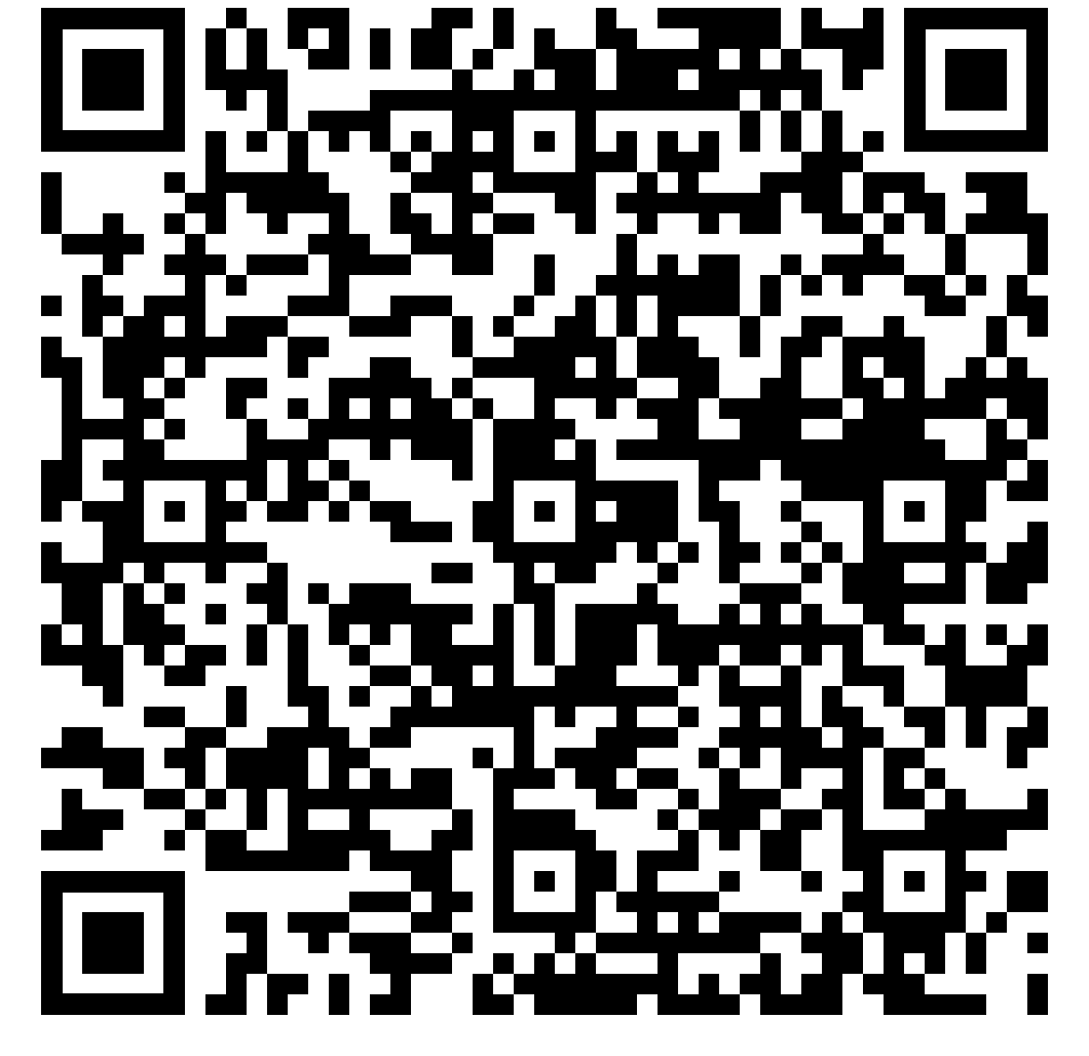
All plan options can be viewed in the interactive map
Available at geofigure.com
Or via the QR code →
Allows zooming in and out
With computer or tablet, allows searching for addresses, streets, or landmarks
Includes other layers

Slide 4
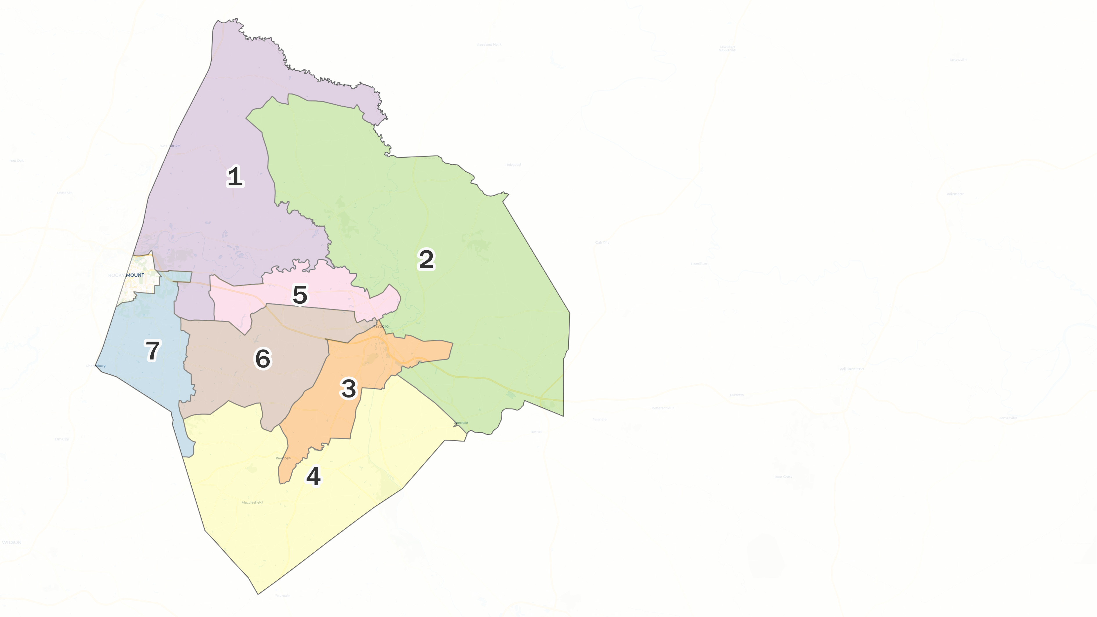
Existing Districts
Prepared March 2025 by Blake Esselstyn of Mapfigure Consulting.
Statistics generated from 2020 decennial census data.
Minority race classifications include individuals who identify as that race alone or in combination.

Slide 5
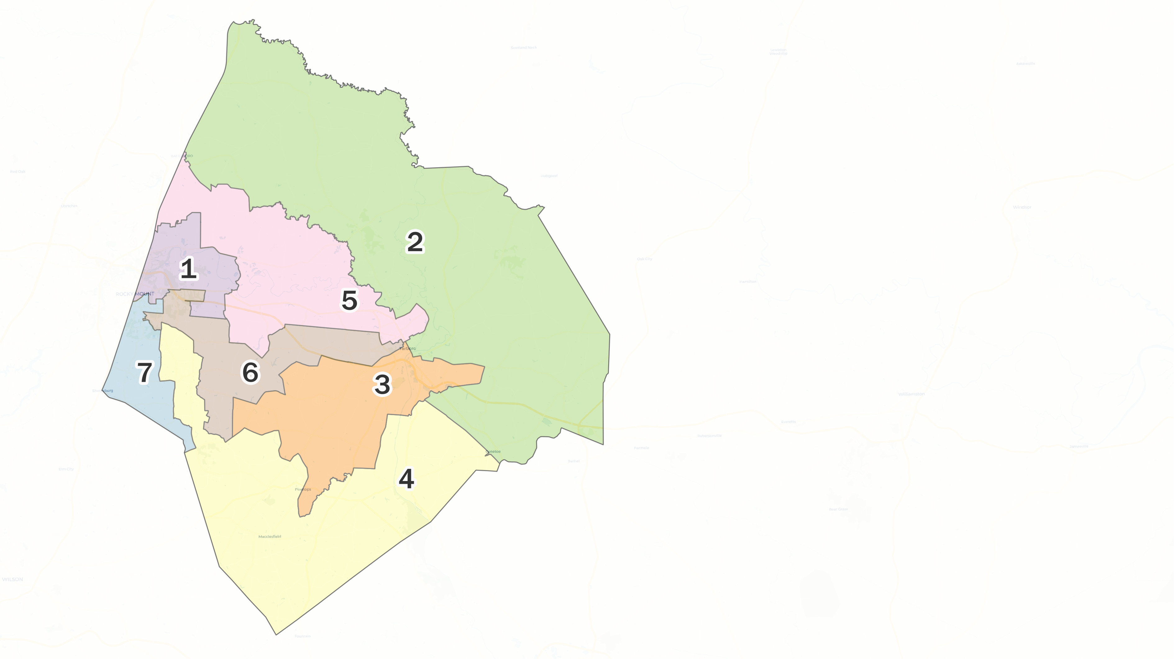
Draft Option A
Prepared March 2025 by Blake Esselstyn of Mapfigure Consulting.
Statistics generated from 2020 decennial census data.
Minority race classifications include individuals who identify as that race alone or in combination.

Slide 6
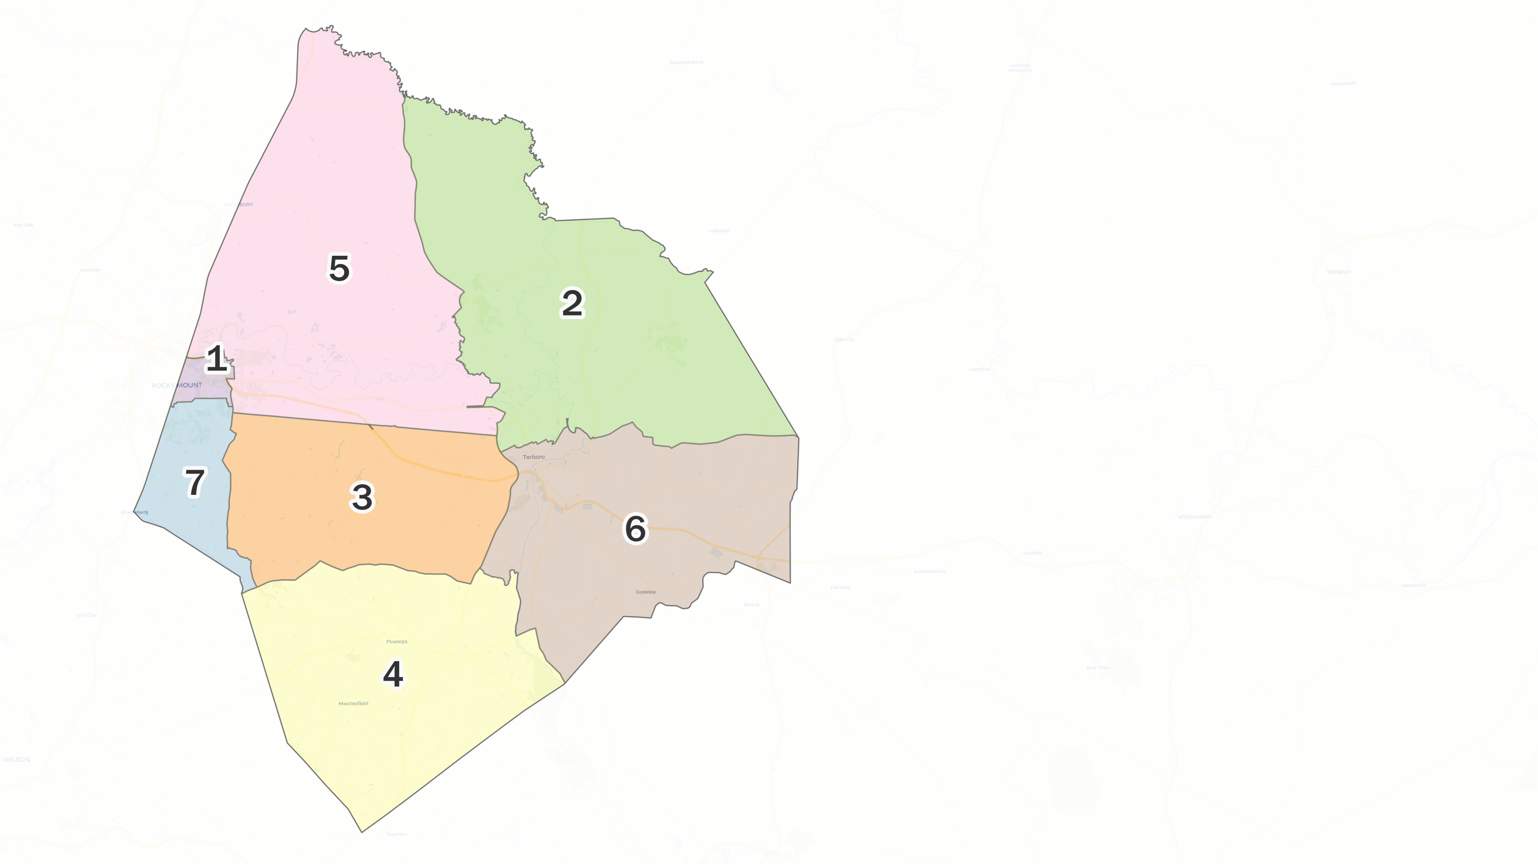
Draft Option B-2
Prepared March 2025 by Blake Esselstyn of Mapfigure Consulting.
Statistics generated from 2020 decennial census data.
Minority race classifications include individuals who identify as that race alone or in combination.

Slide 7
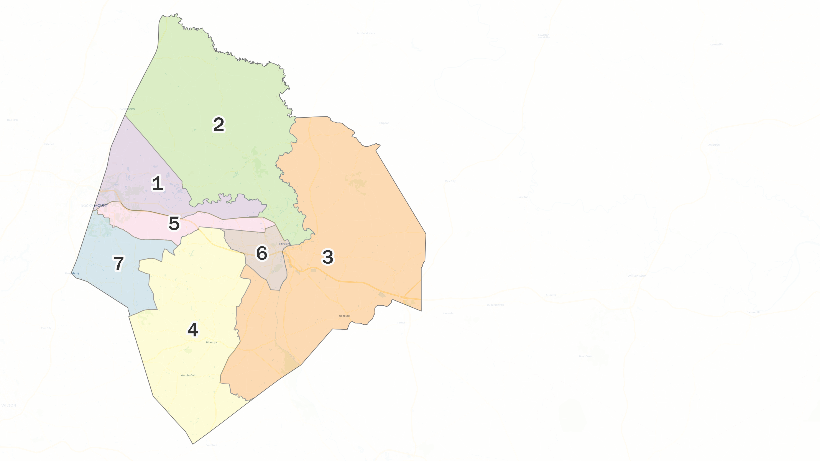
Draft Option C
Prepared March 2025 by Blake Esselstyn of Mapfigure Consulting.
Statistics generated from 2020 decennial census data.
Minority race classifications include individuals who identify as that race alone or in combination.

Slide 8
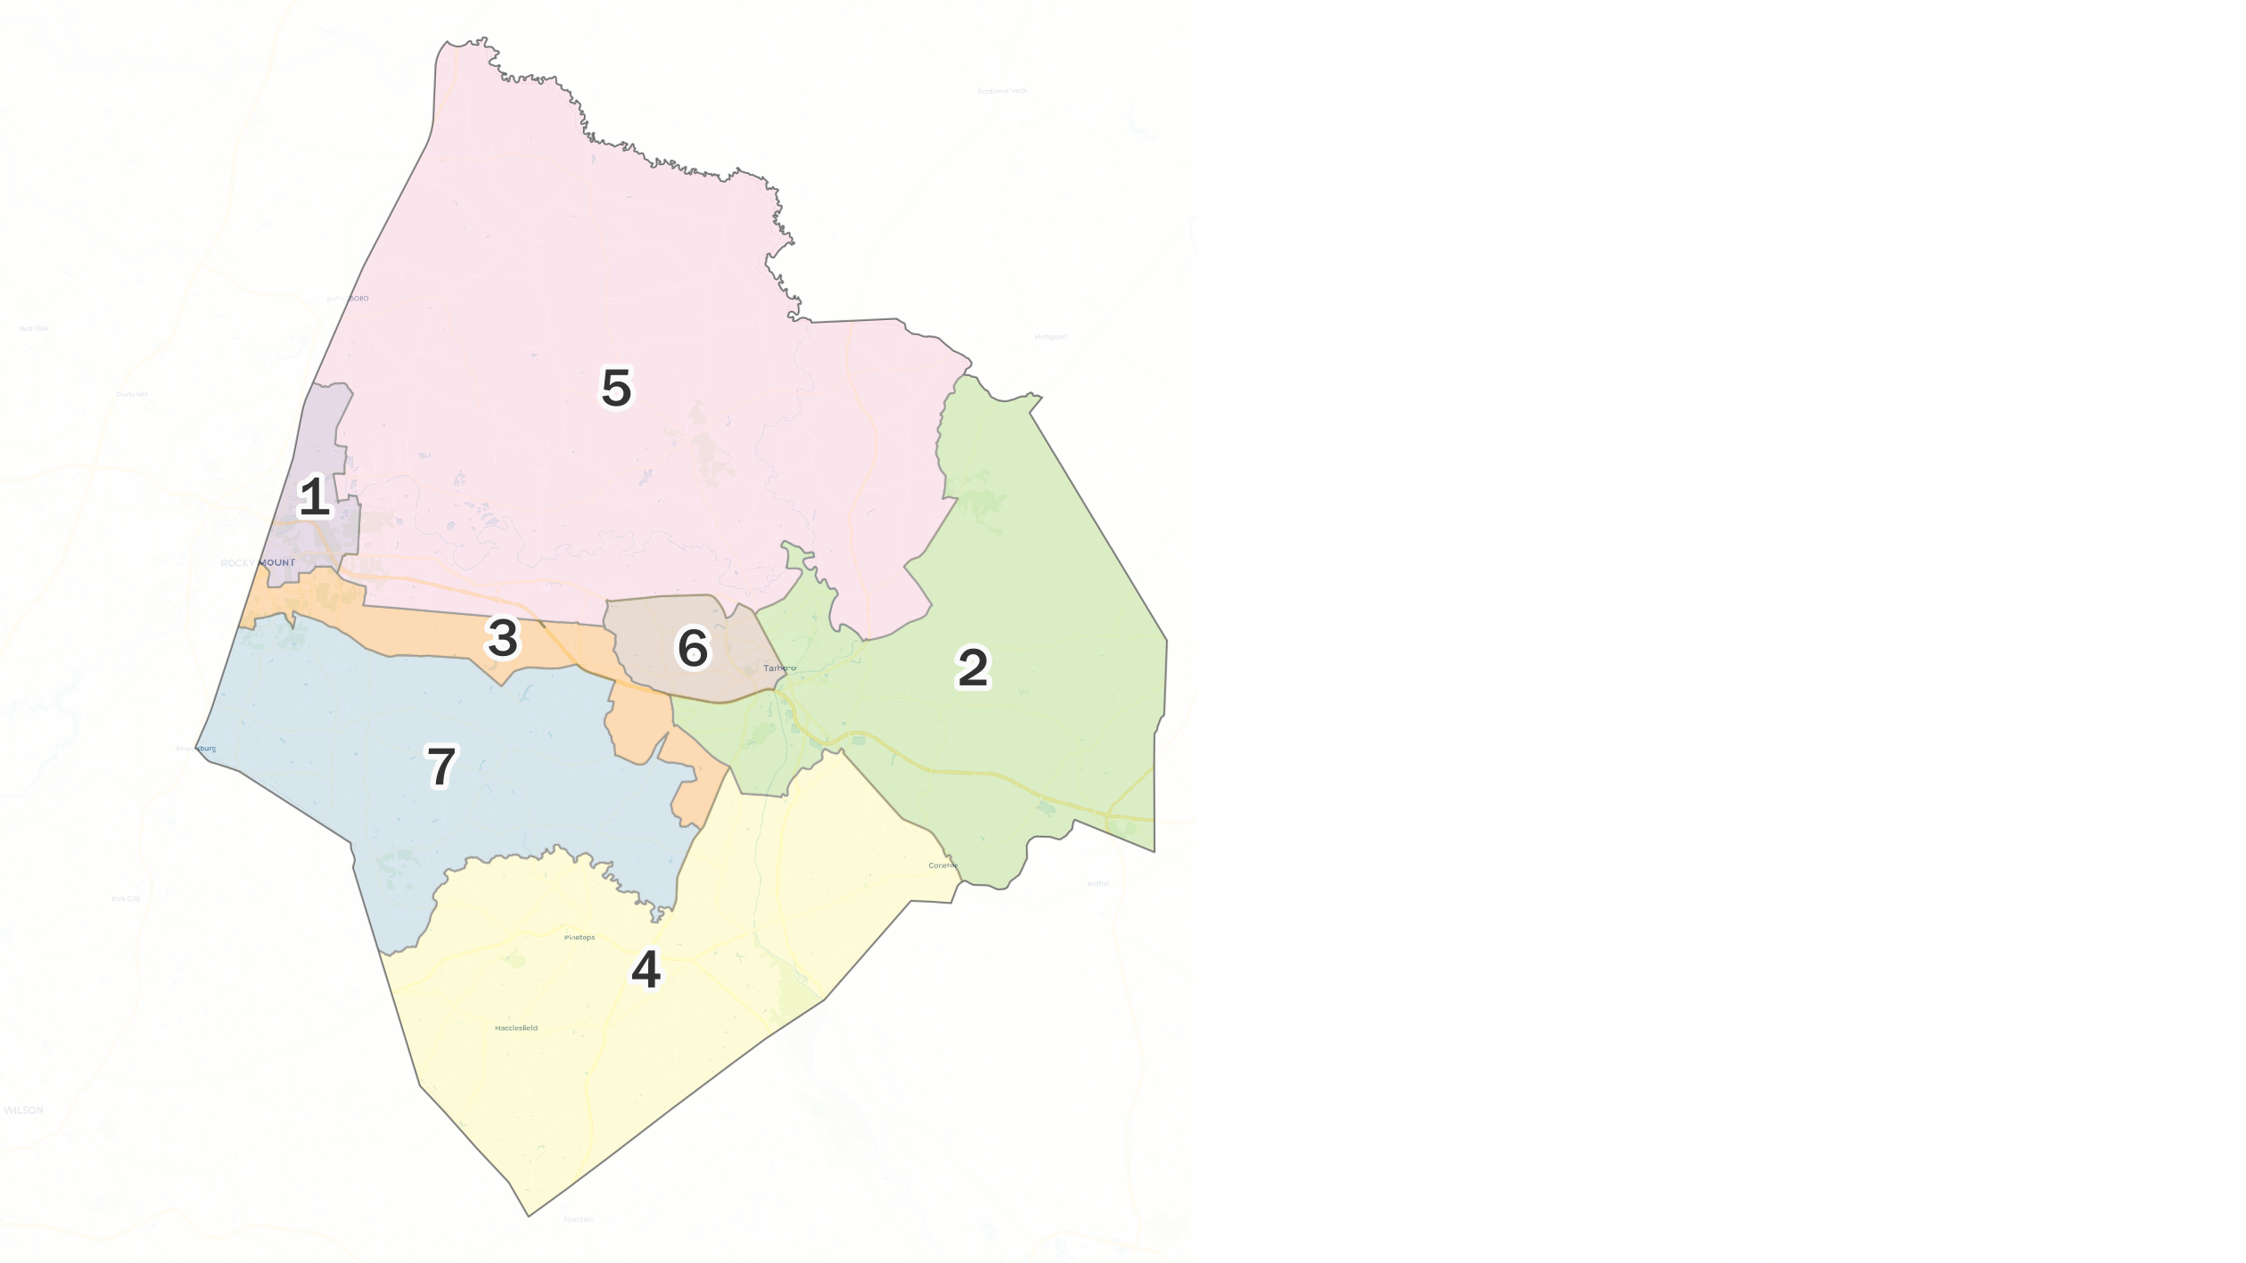
Draft Option D
Prepared April 2025 by Blake Esselstyn of Mapfigure Consulting.
Statistics generated from 2020 decennial census data.
Minority race classifications include individuals who identify as that race alone or in combination.

Slide 9
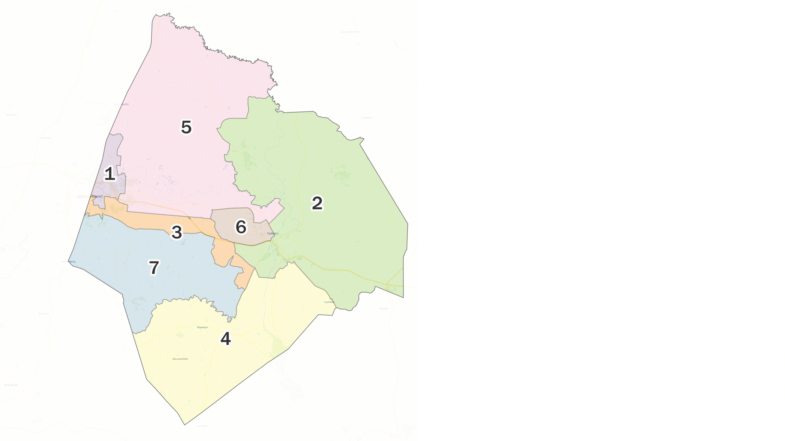
Draft Option D-2
Prepared April 2025 by Blake Esselstyn of Mapfigure Consulting.
Statistics generated from 2020 decennial census data.
Minority race classifications include individuals who identify as that race alone or in combination.

