Slide 1
Los Angeles Unified School District
Administrator Certification
Fall 2018
Annual District Policy/Procedure Training Presented by the
Information Technology Human Resources Unit
Lionel Barreda, Sr. Human Resources Rep
Carly Ntoya, Division HR Administrator
ITD HR Web Site: achieve.lausd.net/ithr

Slide 2
AGENDA
Automated External Defibrillator Certification (AEDs)
Bullying and Hazing Policy
  Student to Student and Student to Adult
Child Abuse and Neglect Reporting Requirements
  Child Abuse and Neglect Reporting Requirements
  Code of Conduct With Students
Employee Attendance
  Board of Education Report 393-0304
  ITD Attendance Policy
  New Certification of Absences Form
  Sign-in/Sign-Out Policy (Payroll Concepts Manual)

Slide 3


AGENDA
Ethics Policies
  Employee Code of Ethics
Family Medical Leave and Reasonable Accommodations
  (federal) Family and Medical Leave Act (FMLA)
  California Family Rights Act (CFRA)
Bulletin - Mandatory Posting of Regulatory Notices Relating to Federal and State Employment Laws
Reasonable Accommodations for Individuals with Disabilities
Injury & Illness Prevention Program
  BUL-3772.3-Injury & Illness Prevention Program Requirements

Slide 4


AGENDA
INTERNET SAFETY
  Cyber Awareness
  Policy Regarding Internet Safety for Students
  Social Media Policy District Computer and Network Systems
  Bul-999.12 Responsible Use Policy (RUP) For District

Slide 5
AGENDA
NON DISCRIMINATION,
SEXUAL HARASSMENT & OSHA 300
NONDISCRIMINATION INFORMATION AND SEXUAL HARASSMENT POLICY
  Sec 504 of the Rehabilitation Act 1973
  Non-Discrimination and Anti-Harassment (Including Sexual Harassment) Policy and Complaint Procedure
  Sexual Harassment Policy(Student to Student) (Adult to Student) (Student to Adult)
  Title IX Policy / Complaint Process
OSHA FORM 300: SUMMARY OF WORK RELATED INJURIES
  Cal/OSHA Annual Summary of Injuries and Illnesses

Slide 6
AGENDA
STUDENT AND EMPLOYEE SECURITY
  Incident System Tracking Accountability Report (ISTAR)Bul-5269.2
Suicide Prevention; Threat; and Crisis Intervention
  Organizing for Crisis Intervention
  Suicide Prevention, Intervention and Postvention (Students)
  Threat Assessment and Management (Student-to-Student, Student-to-Adult)
UNIFORM COMPLAINT PROCEDURES (UCP)
    Uniform Complaint Procedures
WILLIAMS COMPLAINTS
  Williams Complaint Procedures

Slide 7
AGENDA TOPICS
Other important District and Division..
Special Classification Requirements
Modified Tuition Reimbursement for ITD Employees
Bul-6488.1 Drug Alcohol & Tobacco-Free Workplace
Bul-5798.0 Workplace Violence, Bullying and Threats (Adults to Adults)
Overtime Policy
Bul-6401.1 District Owned Vehicles, Policies, Procedures, and Responsibilities
Information Protection Policy
Security of Personnel Information
Security of Personal Items / Board Rule 1266
Asset Management – Inventory Control Form

Slide 8
The Directors of Student Medical and Employee Health Services manage the Automated External Defibrillators (AEDs) Program of Los Angeles Unified School District (LAUSD). AED’s are located on multiple floors in the Beaudry building.
The policies and protocols provide uniformity and guidance in the administration and maintenance of the AED Program. Trained personnel will use an AED on persons who are unconscious, not breathing, or gasping, and not exhibiting signs of circulation. AEDs will be maintained on the premises of selected schools, and other locations in the Los Angeles Unified School District.
Automated External Defibrillator Certification (AEDs) Bul. -4480.1 - Policy and Procedure for the Acquisition and Use of Automated External Defibrillators (AEDs)

Slide 9
Bullying & Hazing Policy (BUL - 5212.2)
Bullying and Hazing Policy (Student-to-Student, Adult-to-Student and Student-to-Adult)
This bulletin also reaffirms the policy against bullying in all areas of the District’s jurisdiction, updates the definition and types of bullying and provides recommendations on the investigations, monitoring, documentation and communication regarding incidents of bullying and hazing.
Some acts of bullying or hazing may constitute other categories of misconduct, such as assault, battery, child abuse, hate-motivated incident, criminal activity, or sexual harassment and, as such, violate other District policies.
Notes:
This bulletin also reaffirms the policy against bullying in all areas of the District’s jurisdiction, updates the definition and types of bullying and provides recommendations on the investigations, monitoring, documentations and communications regarding incidents of bullying and hazing.

Slide 10
All incidents must meet the impact criteria of bullying to be considered as such:
A. Cyberbullying is committed by means of any electronic communication device, such as a cellular phone, computer, or tablet and may include messages, texts, sounds, images, posts on social network, Internet websites, and the creation of false profiles or credible impersonations of another actual person without their consent (CA Ed. Code § 32261 (a-g), CA Penal Code §§ 528.5 – 529).
B. Physical bullying includes the intentional, unwelcome acts of beating, biting, fighting, hitting, kicking, poking, punching, pushing, shoving, spitting and tripping.
C. Social or relational bullying include: spreading rumors, manipulating relationships, exclusion, blackmailing, isolating, rejecting, using peer pressure and ranking personal characteristics.

Slide 11
Bullying & Hazing Policy (BUL - 5212.2)
D. Verbal and non-verbal bullying include: gossiping, making rude noises, name-calling, spreading rumors, hurtful teasing and threatening gestures.
E. Playful teasing is good-natured joking and name-calling among friends with the intention of building closeness. By contrast, bullying is malicious teasing among individuals who are not friends with the intention of invoking harm, fear or humiliation. Teasing may have the unintended outcome of invoking embarrassment, whereas in bullying, invoking embarrassment is the intended goal.
Teasing and bullying may appear similar, but the differentiating variables are the relationship between the parties and the intention of the perpetrators.

Slide 12
STAFF RESPONSIBILITIES
Model and enforce appropriate behavior by creating an environment where mutual respect, tolerance, civility, and acceptance among students and staff are promoted, and students understand that bullying and hazing are inappropriate, harmful, and taken seriously
Be familiar with the indicators of and appropriate responses to bullying and hazing.
Communicate and reinforce positive behavior expectations and norms
Intervene immediately and safely with any act of discrimination, harassment, intimidation, hazing or bullying

Slide 13
Bullying & Hazing Policy (BUL - 5212.2)
EMPLOYEE RESPONSABILITIES
Intervene immediately and safely with any act of discrimination, harassment, intimidation, hazing or bullying.
Report any complaints or incidents of bullying or hazing involving a District employee to the site administrator immediately.
Document incidents of bullying and hazing in iSTAR and/or MiSiS.

Slide 14
Child Abuse Awareness Training (BUL-6338.4)
Child Abuse Awareness Training (CAAT) is aimed to assist employees to better identify and report suspected child abuse
These trainings are part of the District-wide initiative to ensure that all District employees clearly understand their duty to protect our students, their individual responsibility as mandated reporters of suspected child abuse and serve to certify that employees understand their responsibilities in reporting suspected child abuse

Slide 15
Child Abuse Reporting BUL-1347.4
All District employees are mandated reporters of suspected child abuse or neglect.
Major Changes: Effective July 01, 2018 the online CAAT training has been transitioned to the My Professional Learning Network (MyPLN)
When two or more mandated reporters have reasonable suspicion of child abuse and when there is an agreement among them, one report may be made by a single party selected by mutual agreement. However, any party who has knowledge that the designated member failed to file the suspected child abuse report (SCAR) shall thereafter file the SCAR.

Slide 16
Child Abuse Reporting BUL - 1347.4
Mandated reporters with reasonable suspicion of child abuse or neglect must: 1) call an appropriate local law enforcement agency or Department of Children Family Services (DCFS) immediately or as soon as practically possible (site administrator should provide class coverage if needed); and 2) submit the written report to the agency called within 36 hours of receiving the information.
Failure to comply with this policy may subject an employee to discipline, including dismissal, and possible suspension or revocation of credentials. Failure to comply may subject an employee to personal civil and/or criminal liability, which can result in the cost of defense and subsequent related damages.

Slide 17
Child Abuse Reporting BUL - 1347.4 - Continued
Individual Employee Responsibilities
All District employees must sign Attachment D,
Employee Acknowledgement of Suspected Child Abuse Reporting District Policy and Legal Requirements,” at the time of initial employment and again annually at each site to which the employee is assigned.
Please review bulletin 1347.3

Slide 18
Child Abuse Awareness Training (6338.4)
    FALL
    Bul-6338.3 Mandatory CAAT & Resources
All employees are auto-enrolled and are required to complete the Fall CAAT and assessment annually between July 1 and no later than September 30.
New employees hired after September 30 are required to complete the Fall CAAT within 30 days of initial employment and annually thereafter.
FALL ASSESSMENT:
After reviewing the Fall CAAT video, all employees must pass the assessment with a 100% completion percentage to demonstrate their knowledge and comprehension.
Employees who fail to complete this mandatory training may be subject to disciplinary action.
Major Changes: Effective July 01, 2018 the online CAAT training has been transitioned to the My Professional Learning Network (MyPLN)
Notes:
Note: New contractors hired after July 1, 2016, are automatically enrolled in the Learning Zone class. All other contractors can self-enroll in the class and take the assessment by following the instructions on the Learning Zone home page. A valid single sign on account is required to self-enroll

Slide 19
Child Abuse Reporting (Continued)
ABOLITION OF CORPORAL PUNISHMENT- BUL -5747.2
The purpose of this Bulletin is to restate and reaffirm the importance of the District’s policy against the use of corporal punishment. By action taken on October 15, 1984, the Board of Education determined that the use of corporal punishment as a disciplinary option at any grade level and with any student was abolished. Corporal discipline, in any form, is not to be used within this District.

Slide 20
Child Abuse Reporting (Continued)
ABOLITION OF CORPORAL PUNISHMENT BUL - 5747.2
Under the law, “corporal punishment” is defined as willful infliction of, or willfully causing the infliction of, physical pain on a pupil.
Corporal punishment refers to the intentional application of physical pain as a method of changing behavior. District employees are directed to not engage in the use of corporal punishment, which includes but is not limited to engaging in a mutual physical altercation, food deprivation, hitting, painful body postures, pinching, pushing, shaking, slapping, tripping, use of excessive exercise drills, or prevention of use of restrooms.

Slide 21
BUL - 5167.0 Code Of Conduct With Students
The purpose of this policy is to delineate those situations and advise employees/individuals that, when allegations of inappropriate conduct or behavior are made, the District is obligated to investigate the allegations and, if warranted, take appropriate administrative and/or disciplinary action.
This policy is also a notification to administrators/ principals/supervisors/unit heads of their responsibilities to provide notice and give clear guidance to employees and all individuals who work with or have contact with students regarding the District document, “Code of Conduct with Students.”
The Online training Module is available via the MyPLN Network for use at staff meeting, during employee work hours, or at a time approved by the site administrator during an employees’ assigned working hours.

Slide 22
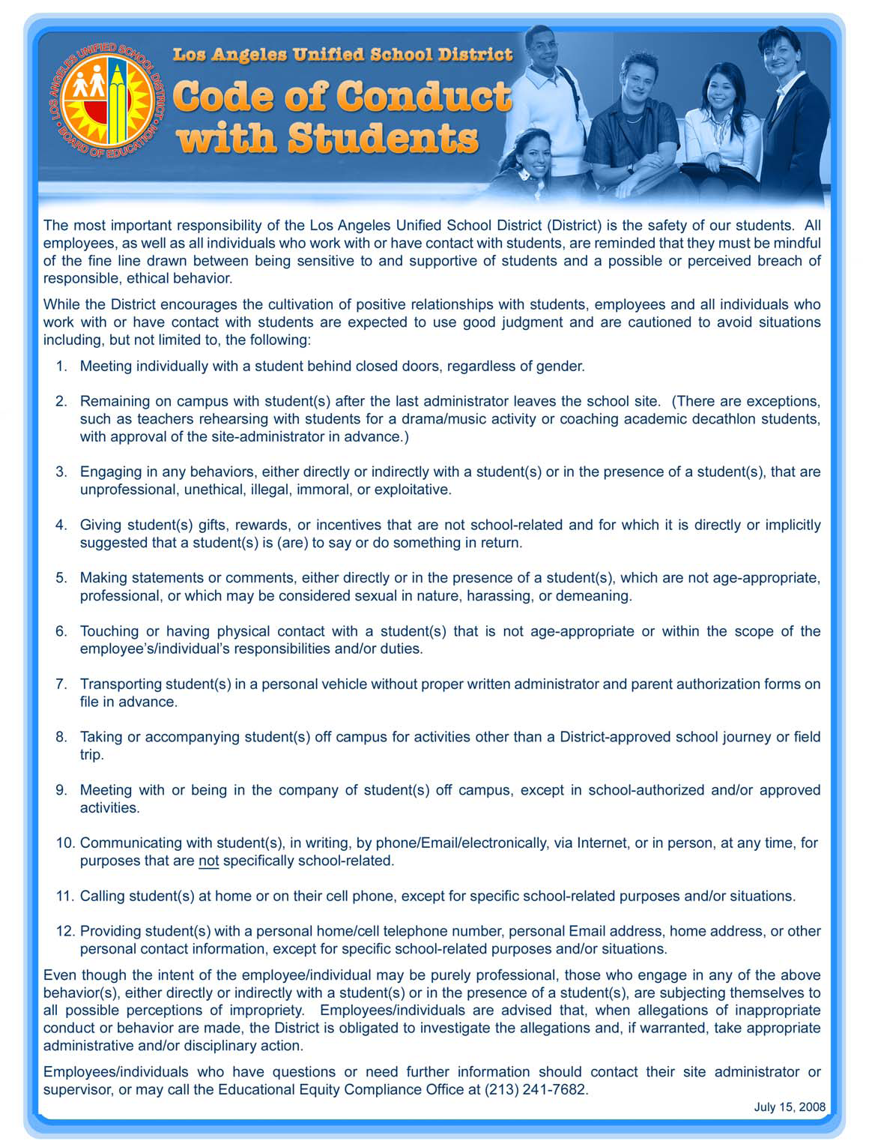

Slide 23
Attendance Review

Slide 24
Absence Management Report
The Attendance Program was established in 2004 in order to support the Superintendent’s staff attendance goal.
LAUSD’s Attendance Goal is for all District employees to be at work 96% of their assigned basis.
The data is retrieved from the SAP Attendance Report

Slide 25
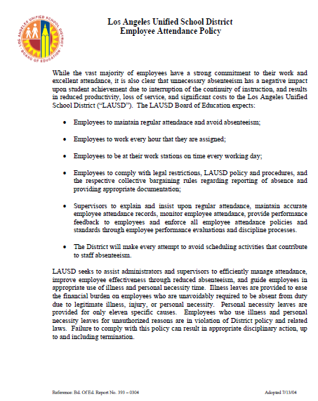
BOE report 393-0304
LAUSD Employee Attendance Policy

Slide 26
Attendance Policy, updates, Guidelines
Paid illness days are not an entitlement to be used in addition to, or in place of, vacation days.
This policy is not designed to deny leave to those who need it rather to encourage prudent use of benefitted time and discourage unnecessary illness absences.

Slide 27
LAUSD Employee Attendance Policy
The LAUSD Board of Education expects employees to:
  Maintain regular attendance and avoid absenteeism;
  Work every hour that they are assigned;
  Be at their work stations on time every working day;
  Comply with legal restrictions, LAUSD policy and procedures, and the respective collective bargaining rules regarding reporting of absence and providing appropriate documentation
The LAUSD Board of Education expects supervisors to:
  Explain and insist upon regular attendance, maintain accurate employee attendance records, monitor employee attendance, provide performance feedback to employees and enforce employee attendance policies and standards through employee performance evaluations and the discipline process.

Slide 28
ITD Employee Attendance Policy cont’d
The following are guidelines for the ITD Attendance Policy for which an employee may receive either a verbal or written counseling.
Further incidents may result in progressive discipline
# of Separate Incidents | # of Days | Potential Action
5 | 10 | Verbal Conference
7 | 13 | Written Conference

Slide 29
What is a 96% Attendance Rate?
Basis | Assigned Days | Assigned Hours | Maximum No. of unprotected absences to achieve 96%
A | 261 | 2088 | 10
E | 234 | 1872 | 9
B | 221 | 1768 | 8
C | 193 | 1544 | 7

Slide 30
Protected / Unprotected Hours
Protected hours are not considered when calculating an employees attendance rate.
Protected Hours | Unprotected Hours
CFRA – California Family Rights Act | Half-Pay Illness
FMLA – Family Medical Leave Act | Illness
Jury Duty | Personal Necessity
Kin Care (Labor Code 233) | Unpaid Time
PDL – Pregnancy Disability Leave | Workers’ Compensation*

Slide 31
Staff Attendance Overview
ITD will:
MONITOR
Review Attendance Monthly Check for increase in unprotected absences
OUTREACH
Offer FMLA Counsel and Guidance
RECOGNIZE
Certificates Bulletin Boards Meetings
ENGAGE
Training Posters

Slide 32
Certification of Absence Forms
BUL-6307.5
The updated forms Certification/Request of Absence for Illness, Family Illness, New Child (Form No. 60.ILL; rev. 04/02/18) and Certification/Request of Absence for Non-Illness (Form No. 60.NON-ILL; rev. 04/02/18)
Revisions include options for Court Appearance, School Activity, and 1994 Vacation Bank Hours
Please do not use any old benefit forms to report absences after occurring on or after 04/02/18.

Slide 33
Attendance Policy, updates, Guidelines
CHANGES EFFECTIVE July 1, 2017:
Protected Personal Necessity
Personal Necessity will include protected absences that are protected by State and Federal regulations. Employees may now use Personal Necessity for the following Protected Absences:
Religious Holiday of the Employee’s Faith
Appearance in Court as a Litigant or Witness Under Subpoena

Slide 34
Attendance Policy, updates, Guidelines
Protected Personal Necessity (continued)
SCHOOL ACTIVITES, RELIGIOUS HOLIDAYS…
  (ARE EXAMPLES OF PN REQUIRING ADVANCED NOTICE)
  Note: Advance notice and supporting documentation is required for pre-approval by the employees’ Supervisor and/or Administrator. For additional information, refer to the appropriate Collective Bargaining Unit Agreement.

Slide 35
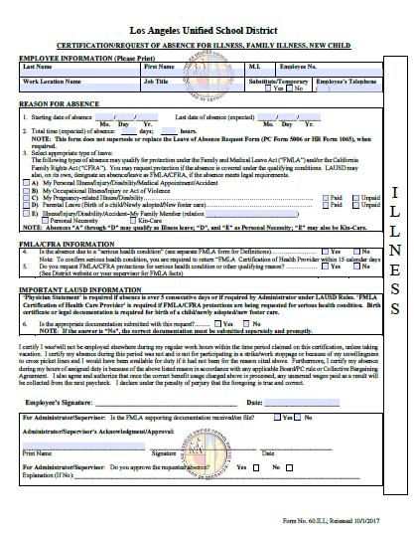
Illness
Notes:
Note:
Absence selections must be made according to the applicable Board Rules, Personnel Commission Rules, Collective Bargaining Agreements and District Policies governing the employee.

Slide 36
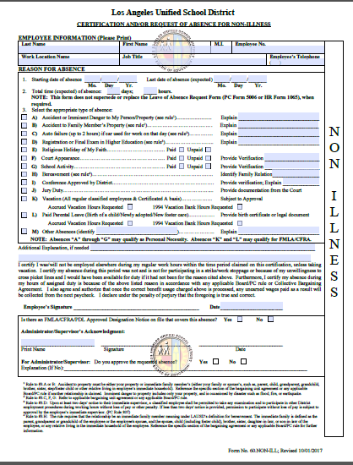
Non-Illness
Religious activity
School Activity
You may elect to request use of 1994 banked hours

Slide 37
ATTENDANCE POLICY BUL 6307.5
REQUIRED RECORD KEEPING…
A time card is the District’s official document of an employee’s attendance/absence for time reporting purposes. The use of the time card is mandated in the Board Rules and is subject to the District designated auditors.
Completed and approved absence certification forms are required PRIOR to the reporting of absence time.
Records substantiating the time reported to the Payroll Administration for salary payment must be kept on file and retained at the location for a period of five years in accordance with the Board of Education report.

Slide 38
Sign-In/Sign-Out Policy (March )
All certificated employees shall, upon each arrival to and departure from their assigned work location, enter their initials on a form provided by the District.
All classified employees, except those identified in Personnel Commission Rule 596 (over-time exempt), sign in by recording the actual time of arrival but not earlier than the assigned start time and sign out by recording the actual time of departure but not later than the scheduled stop time from their assigned work location(s).
Payroll Concepts Manual (February 2017)

Slide 39
BUL-3772.3
Injury & Illness Prevention Program
The bulletin has been issued by the Office of Environmental Health & Safety (OEHS) and aligned with the California OSHA requirements.
California Code of Regulations mandate the District maintain a safe & healthy workplace for employees. Corporate Criminal Liability Act holds managers & corporations liable for concealing knowledge of serious dangers to employees. The IIPP has specific responsibilities and procedures assigned and implemented to prevent employee injuries and illnesses. IIPP must be available for review by an Occupational Safety & Health Administration Officer (OSHA) during an inspection or accident investigation.
To view the Annual Mandatory OEHS Injury Illness Prevention Power Point Training Presentation, Please go to: - Click on https://lausd.wistia.com/medias/cppwg1625z (Ctrl + Left Click)

Slide 40

Injury, Illness & Prevention

Slide 41
Ethics Policy (BUL - 4748.0)
Policy
The LAUSD is committed to cultivating ethical conduct to build trust and to improve organizational performance.
It is the responsibility of all certificated and classified staff (including substitutes and part-timers) to be knowledgeable about LAUSD’s ethics policies and to take an active role in promoting an organizational culture that encourages ethical conduct.
This bulletin provides additional information on the resources available to help district staff address ethics concerns in a proactive and transparent manner.

Slide 42
Synopsis of Existing Ethics Policies
LAUSD has four Board-approved ethics policies which staff should be familiar with. A brief high-level synopsis of each policy is as follows:
1. Employee Code of Ethics – addresses use of position, use of resources, gifts, etc.
2. Conflict of Interest Code – addresses conflicts, recusals, and mandated disclosure
3. Contractor Code of Conduct – addresses limits on working with and for vendors
4. Lobbying Disclosure Code – addresses limits on marketing and influence efforts
To access the above Codes, please go to the Ethics Office website at:
http://achieve.lausd.net/Page/3048 or http://ethics.lausd.net/

Slide 43
Employee Code Of Ethics Overview
Core Principles:
To help us achieve our mission, we are committed to three core ethical principles:
Commitment to Excellence
District and Personal Integrity
Responsibility
Our Code of Ethics helps develop trust by describing what the public can expect from us, and what we can expect from each other and our District. It plays a central role in our District’s commitment to help District personnel achieve the highest ethical standards in their professional activities and relationships.
Our goal is to create a culture that fosters trust, commitment to excellence and responsibility, personal and institutional integrity, and avoids conflicts of interest and appearances of impropriety.

Slide 44
Employee Code of Conduct continued…
Each District employee has the responsibility:
To set a good example of ethical conduct in his or her LAUSD work.
To be familiar with LAUSD’s ethics policies and to participate in annual training activities such as the “ethics booster.”
To contribute to proactive and transparent management of potential ethics concerns by raising matters in a respectful and constructive manner.
To seek guidance from a supervisor or other trustworthy source, if you are unsure of the most ethical and responsible course of action.
To know that you are not just a role model to your peers, but equally important to the students of the LAUSD.

Slide 45
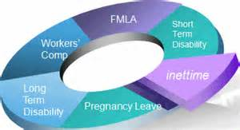
BUL-1205.3
Family and Medical Leave Act &
California Family Rights Act Policy
PURPOSE:
The purpose of this bulletin is to outline administrative procedures for responding to employee requests for FMLA/CFRA leave and to inform employees of their rights and responsibilities for taking FMLA/CFRA leave.
Notes:
The District is committed to continued compliance with the federal Family and Medical Leave Act (FMLA) and the California Family Rights Act (CFRA). FMLA and CFRA require that employers provide to an eligible employee a maximum of twelve (12) work weeks of protected leave per FMLA year for the employee’s own serious health condition; the serious health condition of a covered family member; to bond with the employee’s child after the child’s birth; placement with the employee of a child through adoption or foster care; or military exigency leave for a covered service member.
An eligible employee is entitled to take up to 26 work weeks of protected leave per FMLA year to care for a covered military service member with a serious illness or injury sustained while on active military duty.
Where there is a conflict between the provisions of FMLA and CFRA, the provision which provides the greater family or medical leave rights to the employee will prevail.

Slide 46
SECTION II
BUL-1205.3
Family and Medical Leave Act &
California Family Rights Act Policy
POLICY:
The District is committed to continued compliance with the federal Family and Medical Leave Act (FMLA) and the California Family Rights Act (CFRA). FMLA and CFRA require that employers provide to an eligible employee a maximum of twelve (12) work weeks of protected leave per FMLA year for the employee’s own serious health condition; the serious health condition of a covered family member; to bond with the employee’s child after the child’s birth; placement with the employee of a child through adoption or foster care; or military exigency leave for a covered service member.
An eligible employee is entitled to take up to 26 work weeks of protected leave per FMLA year to care for a covered military service member with a serious illness or injury sustained while on active military duty.
Notes:
Reasons for Leave
Eligible employees can receive FMLA/CFRA leave for any of the following reasons:
A. Birth of an employee’s child (“bonding”). Leave must be completed prior to the child’s 1st birthday.
B. Placement of a child with the employee for adoption or foster care, including time to prepare for the placement as well as bonding time after the placement of the child. Leave must be completed within one year of the child being placed with the employee.
C. To care for the employee’s own Serious Health Condition.
D. To care for the Serious Health Condition of a Family Member. (See Definitions.)
Any qualifying exigency arising out of the employee’s Family Member’s active duty in the United States Armed Forces (or if such eligible family member has been notified of an impending call or order to active duty) in support of a contingency operation (FMLA only).
F. To care for the employee’s Family Member or next of kin who is undergoing medical treatment, recuperation, or therapy, or is otherwise on the temporary disability retired list for a serious injury or illness sustained while on active military duty in the Armed Forces (FMLA only for next of kin).
Under FMLA, an employee’s pregnancy related conditions fall under a Serious Health Condition entitling the employee to FMLA leave. FMLA leave will run concurrently with leave under California’s Pregnancy Disability Leave Act (PDL). Pregnancy related leaves, however, do not exhaust CFRA leave entitlement because an employee is entitled to up to four months of protected time for pregnancy related conditions under PDL. Under California law, an employee eligible under CFRA and PDL may be provided leave up to 12 weeks plus 4 month.
Mention time off for domestic violence, sexual assault and stalking.

Slide 47
SECTION II BUL-4569.1(Rev. June 9, 2014)
Reasonable Accommodation for Individuals with Disabilities
The reasonable accommodation process requires the cooperation of all involved to ensure that individuals with a disability are provided the accommodation necessary to perform the essential functions of their job and receive the benefits and privileges of employment.
Federal and state statutes mandate that the employer engage the employee/applicant in an interactive process to determine effective “reasonable accommodation” any time the employee/applicant requests a reasonable accommodation, or if the disability is known and the employer becomes aware of a potential need for accommodation.

Slide 48
SECTION II - BUL—4991.9
Mandatory Posting of Regulatory Notices
Relating to Federal and State Employment Laws
The purpose of this Bulletin is to set forth the policy and procedures for posting required state and federal notices regarding employee rights.
What you should know:
All notices must be posted in an area frequented by employees, where they are highly visible, and may be easily read during the workday.

Slide 49

CYBER Security Awareness

Slide 50

IT SECURITY_SOCIAL ENGINEERING AND PHISHING

Slide 51

IT SECURITY PHYSICAL SECURITY

Slide 52
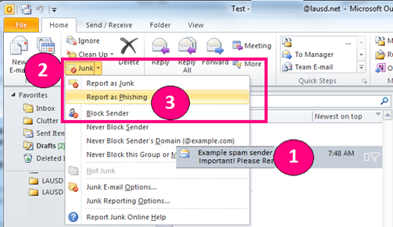

Reporting Phishing Email Attacks
Microsoft Outlook installed on computer
Microsoft Outlook using internet browser
1. Select the suspected E-mail
2. Select the button “Junk”
3. Select the “Report as Junk” or “Report as Phishing”

Slide 53
INTERNET SAFETY
BUL-5688.2 - Social Media Policy for Employees and Associated Persons (Rev. 1/2015)
The District encourages positive relationships between students, employees and associated persons. There is, however, a distinction between being supportive of students and the real or perceived breach of confidentiality or misconduct.
Major Changes – Updated guidelines and definitions for District users while engaging in Social media
Employees and all associated persons who work with or have contact with students are expected to follow all District policies, including BUL – 999.11, Responsible Use Policy (RUP) For District Computer Systems, and BUL - 5167.0, Code of Conduct with Students –

Slide 54
Internet Safety - Continued
Social Media Policy for Employees and Associated Persons - Continued
Posting inappropriate threatening, harassing, racist, biased, derogatory, disparaging or bullying comments toward or about any student, employee, or associated person on any website is prohibited and may be subject to discipline.
Threats are taken seriously and are subject to law enforcement intervention, including but not limited to formal threat assessments. [Refer to BUL - 5798.0, Workplace Violence, Bullying and Threats (Adult-to-Adult)]
Use of District logos or images on one’s personal social networking sites is prohibited. If you wish to promote a specific LAUSD activity or event, you may do so in accordance with the Office of Communications and Media Services guidelines.
Misrepresenting oneself by using someone else’s identity may be identity theft. It is advisable to periodically check that one’s identity has not been compromised.

Slide 55
Internet Safety - Continued
Social Media Policy for Employees and Associated Persons (continued)
Any employee or associated person engaging in inappropriate conduct including the inappropriate use of social media sites during or after school hours may be subject to discipline.
Never share confidential or privileged information about students or personnel (e.g., grades, attendance records, or other pupil/personnel record information).
Users should have no expectation of privacy regarding their use of District property, network and/or Internet access to files, including email. The District reserves the right to monitor users’ online activities and to access, review, copy, and store or delete any electronic communication or files and/or disclose them to others as it deems necessary. [Refer to BUL – 999.11, Responsible Use Policy (RUP) For District Computer Systems]

Slide 56
Internet Safety
Responsible Use Policy
  BUL – 999.12 Responsible Use Policy (8/18/15)
    The District’s Responsible Use Policy (“RUP”) is to prevent unauthorized access and other unlawful activities by users online, prevent unauthorized disclosure of or access to sensitive information, and to comply with the Children’s Internet Protection Act (“CIPA”).
    As used in this policy, “user” includes anyone using the computers, Internet, email, chat rooms and other forms of direct electronic communications or equipment provided by the District (the “network.”). Only current students or employees are authorized to use the network.
    Changes include: clarifying the use of District email for transmission of student records, authorized software, hardware use and Virtual Private Network (VPN) access. The revision adds an additional state compliance requirement set forth by the California Electronics Communications Privacy Act (CalECPA) . The revision also includes a clear desk and clear screen requirement.
    Please take time and read the bulletin in its entirety

Slide 57
NON DISCRIMINATION
BUL-4692.6 SEC 504 OF THE REHAB. ACT OF 1973
The District affirms that no qualified student with a disability shall, on the basis of disability, be excluded from participation in, be denied the benefits of, or otherwise be subjected to discrimination, harassment, intimidation and bullying under any District program or activity.
The denial of equal access to District education programs and/or activities and/or the denial of a “free appropriate public education” (FAPE) on the basis of a student’s disability(ies) is considered disability-based discrimination under federal and state law.
Similarly, the District must make reasonable accommodations to its policies, practices and procedures when necessary to ensure other individuals with disabilities, such as parents and the general public, are not discriminated against on the basis of disability.
Notes:
READ SLIDE

Slide 58
NON DISCRIMINATION
BUL-2521.2 TITLE IX COMPLAINT PROCESS
District prohibits discrimination & harassment based on sex including, orientation, gender identity, pregnancy, childbirth or related med condition, ethnicity (color race, origin, ancestry), religion, disability (mental or physical), or reasonable accommodation, age, marital status
Harassment based on any above is unlawful discrimination & will not be tolerated.
District prohibit retaliation against anyone who files a complaint or participates in an investigation.
Employee to employee discrimination harassment contact: Equal Employment Opportunity Section (213.241.7685) Beaudry 20th Fl
website: http://achieve.lausd.net/Page/3494
Notes:
READ SLIDE

Slide 59
  Bul-6612.0 Non-Discrimination and Anti-Harassment (Including Sexual Harassment) Policy and Complaint Procedure
This Policy prohibits discrimination and harassment or differential treatment on the basis of race, gender/sex (including gender identity, gender expression, pregnancy, childbirth, breastfeeding, and pregnancy related medical conditions), sexual orientation, religion, color, national origin, ancestry, physical or mental disability, medical condition (cancer-related and genetic characteristics), military and veteran status, marital status, registered domestic partner status, age (40 and above), genetic information, political belief or affiliation (not union related), or any other basis protected by federal, state or local law, ordinance, or regulation.
Notes:
All such discrimination and harassment is unlawful, including such harassment against applicants, employees, and persons who provide services pursuant to a contract.
Such individuals are protected from discrimination or harassment based on the above-listed protected categories, whether they actually have or are perceived to have these characteristics.

Slide 60
Sexual Harassment
Sexual Harassment Student-to-Adult (BUL-3349.1)
Definitions: California Education Code and California Code of Regulations define sexual harassment as “unwelcome sexual advances, requests for sexual favors, or other verbal, visual, or physical conduct of a sexual nature made by someone from or in the work or educational setting, whether it occurs between individuals of the same sex or individuals of opposite sexes under conditions specified in California Code of Regulations.”
LAUSD is committed to maintaining a working and learning environment that is free from sexual harassment. Sexual harassment of or by employees, students, or persons doing business for the District, is a form of sex discrimination in that it constitutes differential treatment on the basis of sex, or actual or perceived sexual orientation or gender. As such, it is a violation of state and federal laws and a violation of this policy.
Notes:
Read Slide

Slide 61
  Discrimination and Sexual Harassment Consequences
The District considers discrimination and harassment (including sexual) of any kind to be a major offense, which can result in disciplinary action to the offending employee up to and including termination.
Any District employee who believes that she or he has been a victim of discrimination or harassment by another employee or nonemployee shall bring the problem to the attention of the site administrator, so that appropriate action may be taken to resolve the problem.
Complaints will be promptly investigated in a way that respects the privacy of the parties concerned.
The District prohibits retaliatory behavior against anyone who files a complaint of discrimination or harassment or any participant in the investigation of such a complaint.
Notes:
This bulletin replaces Bulletin No. S-27, Employment Discrimination Complaint Procedure, issued by Human Resources, dated December 3, 2001, and Bulletin No. 1893.1, “Sexual Harassment Policy (Employee-To-Employee,” issued by the Office of General Counsel, dated August 1, 2005. This revision combines the two former Bulletins into a single Bulletin and contains updated information regarding the related resources listed. This revision also reflects current state and federal requirements and provides guidance and procedures for investigating complaints of discrimination and harassment.

Slide 62
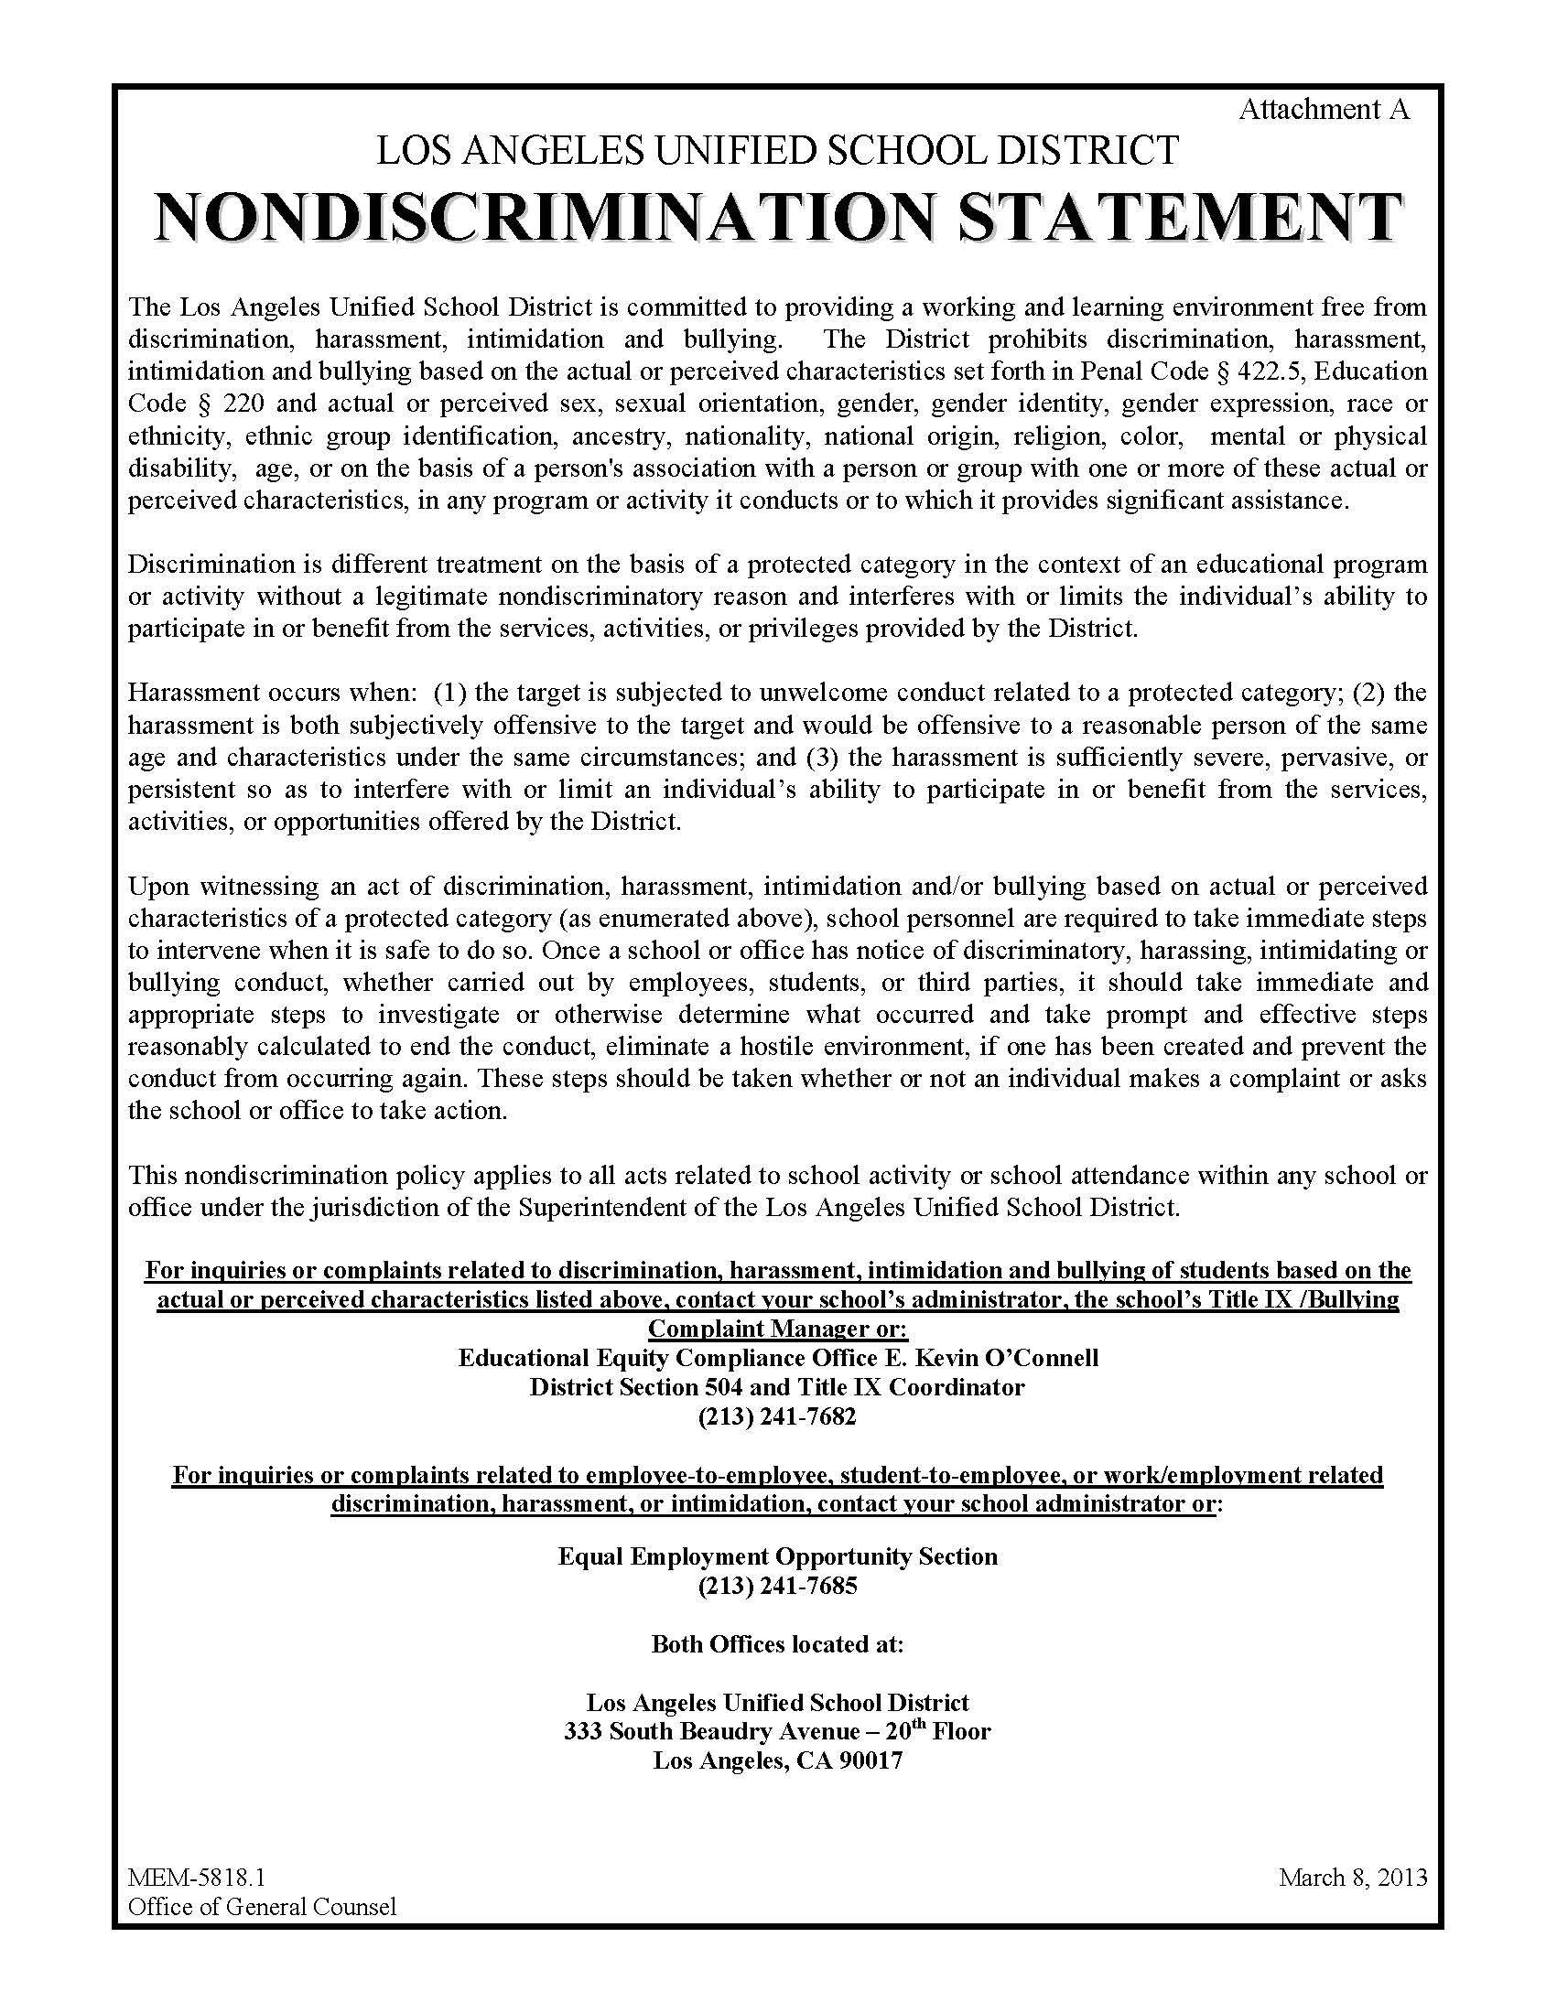
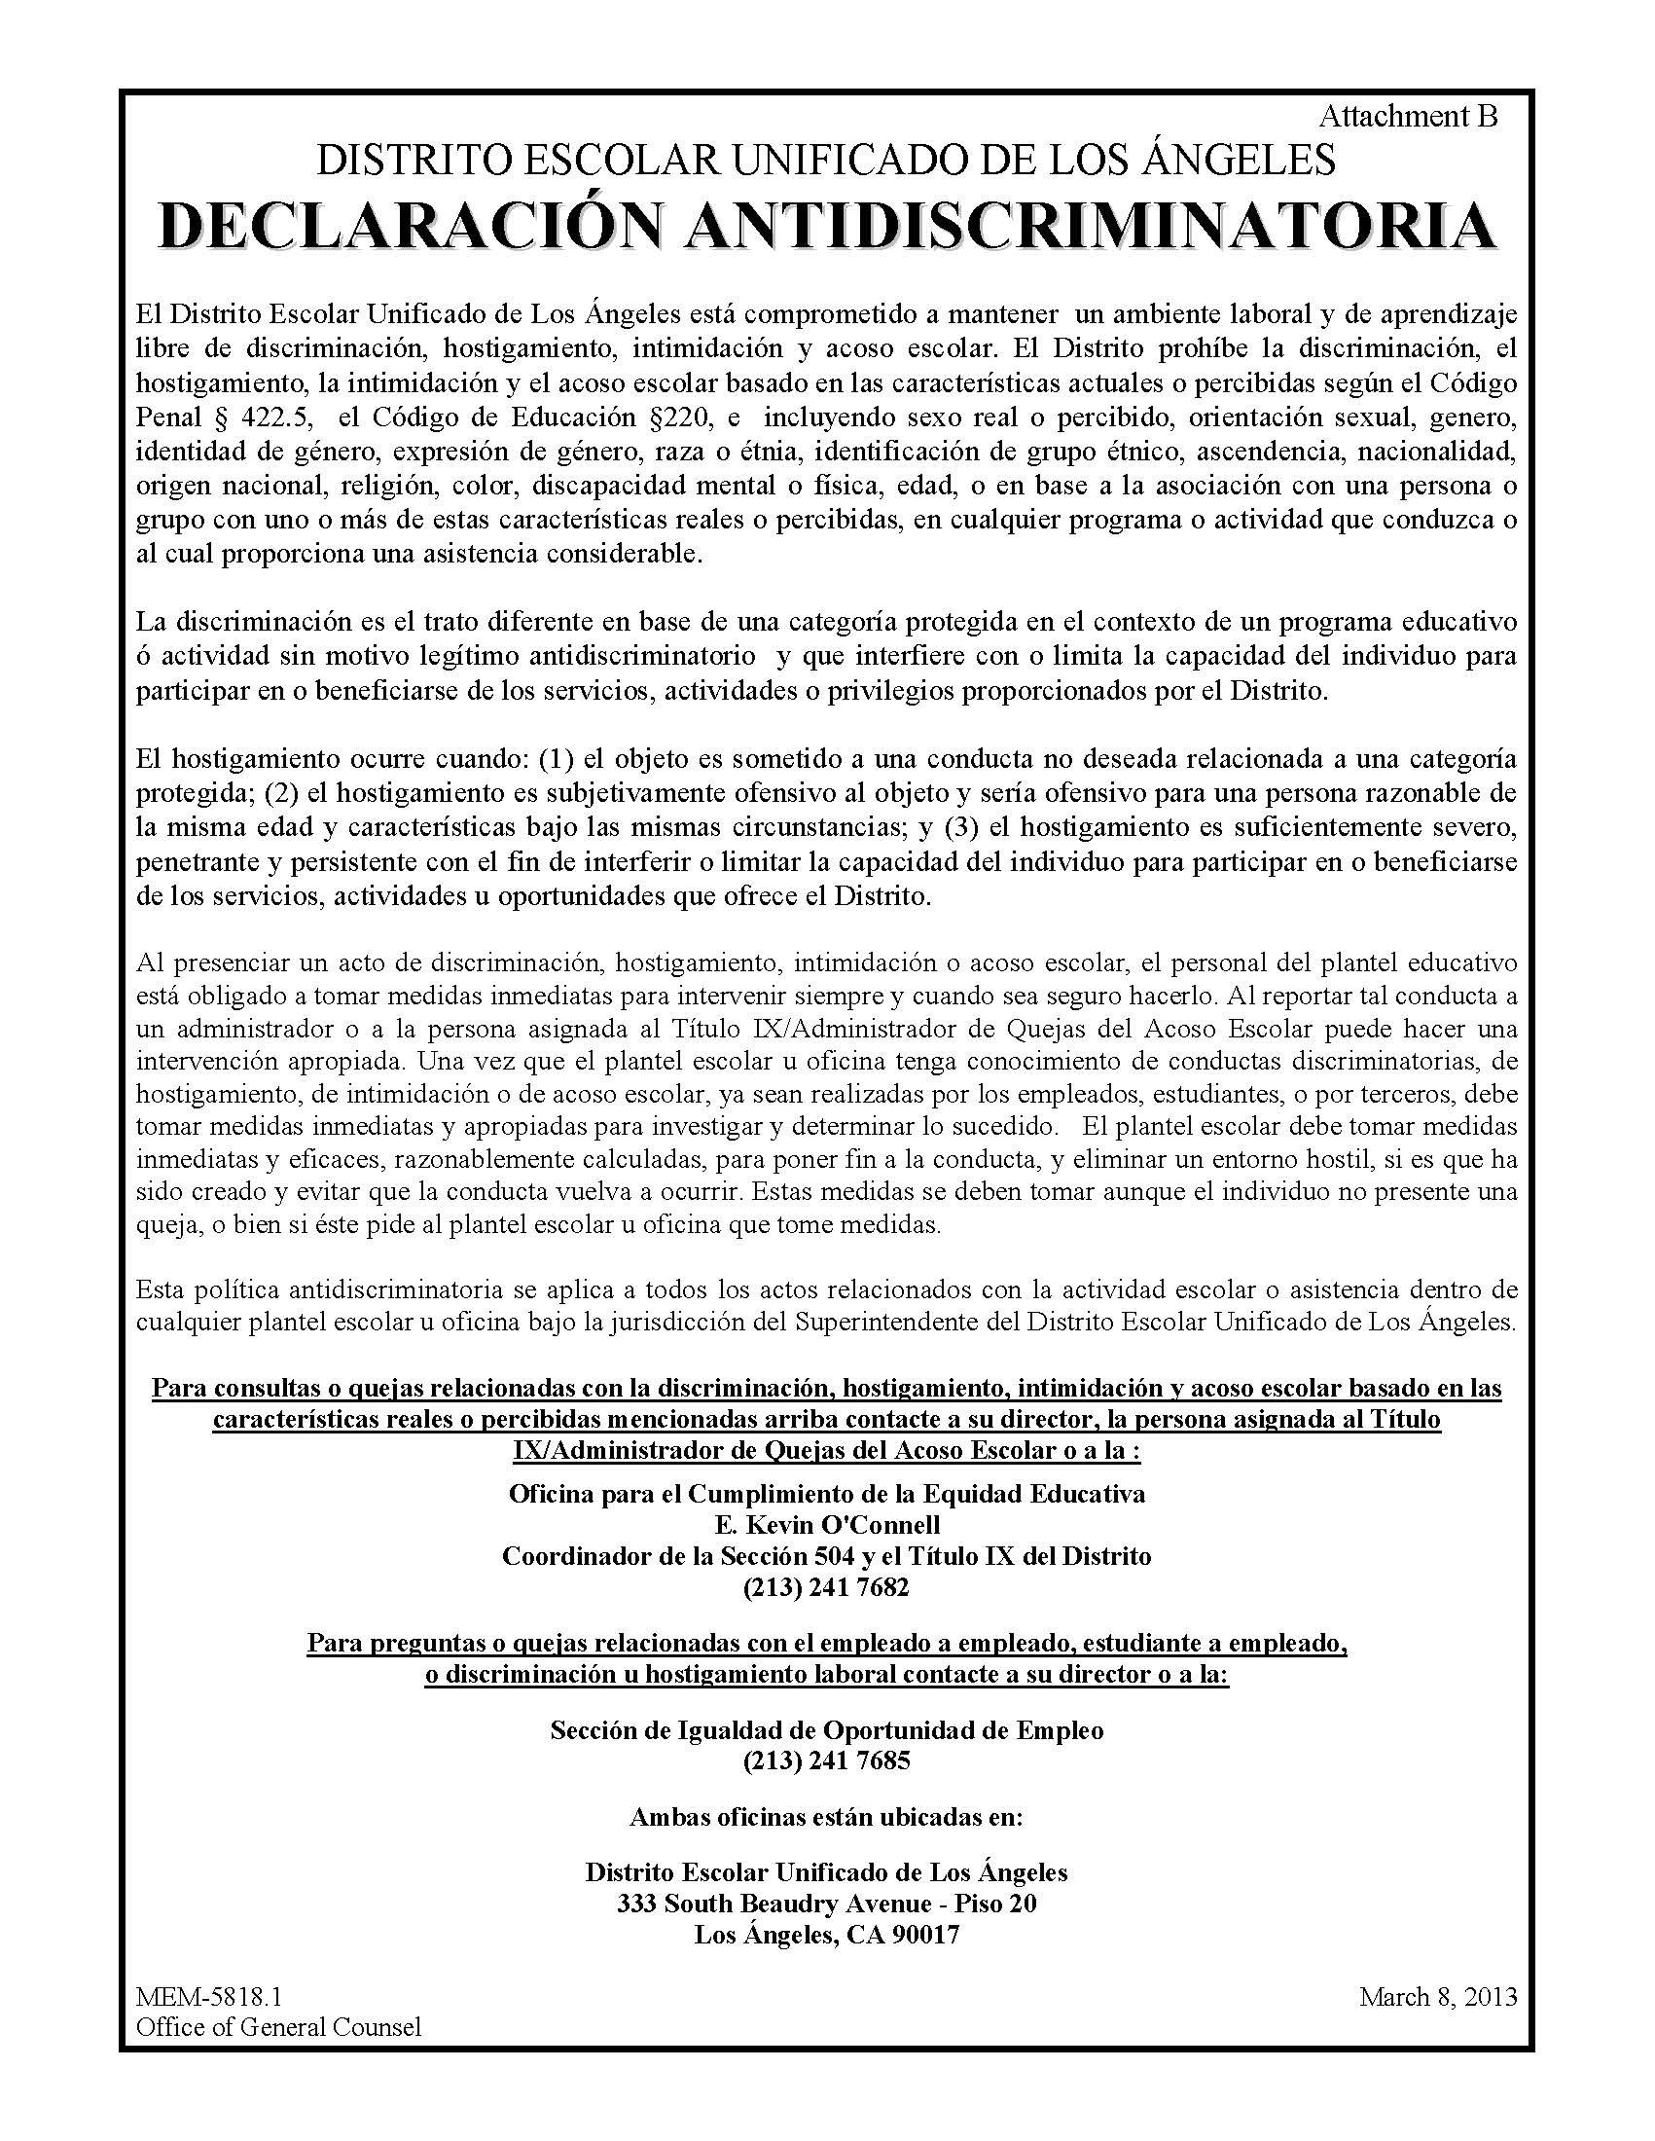
Nondiscrimination Information & Sexual Harassment Policy
Mandatory Postings/required notices
Required Notices:
Notes:
This is an example of the NONDISCRIMINATION STATEMENT. IT IS POSTED IN BOTH ENGLISH AND SPANISH.

Slide 63
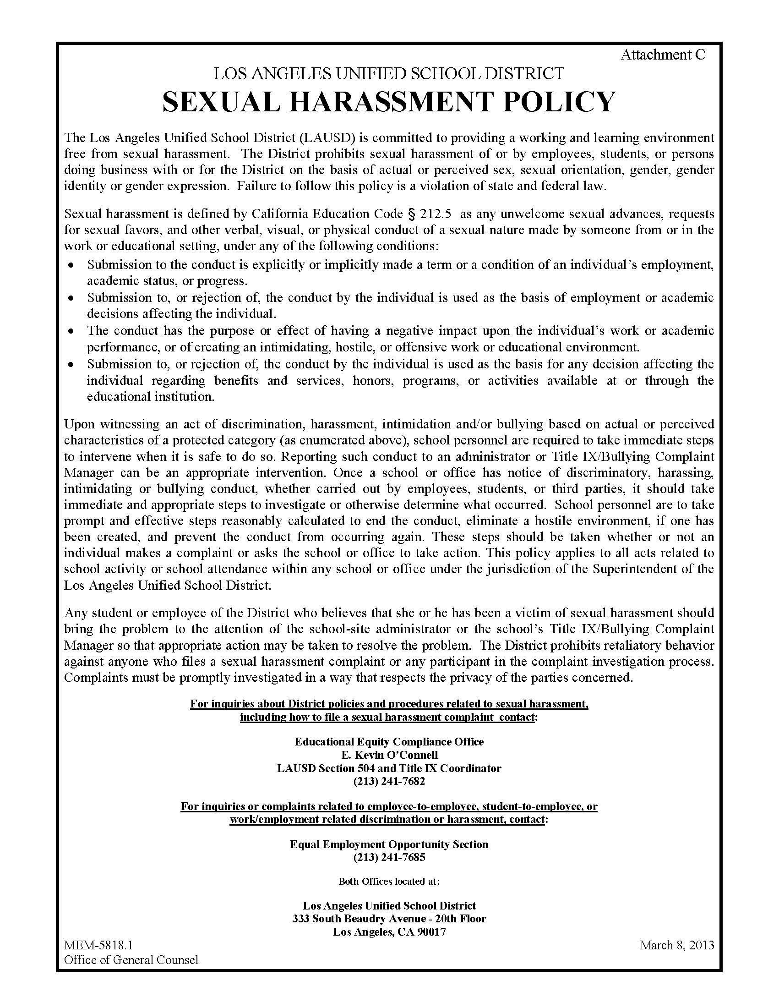
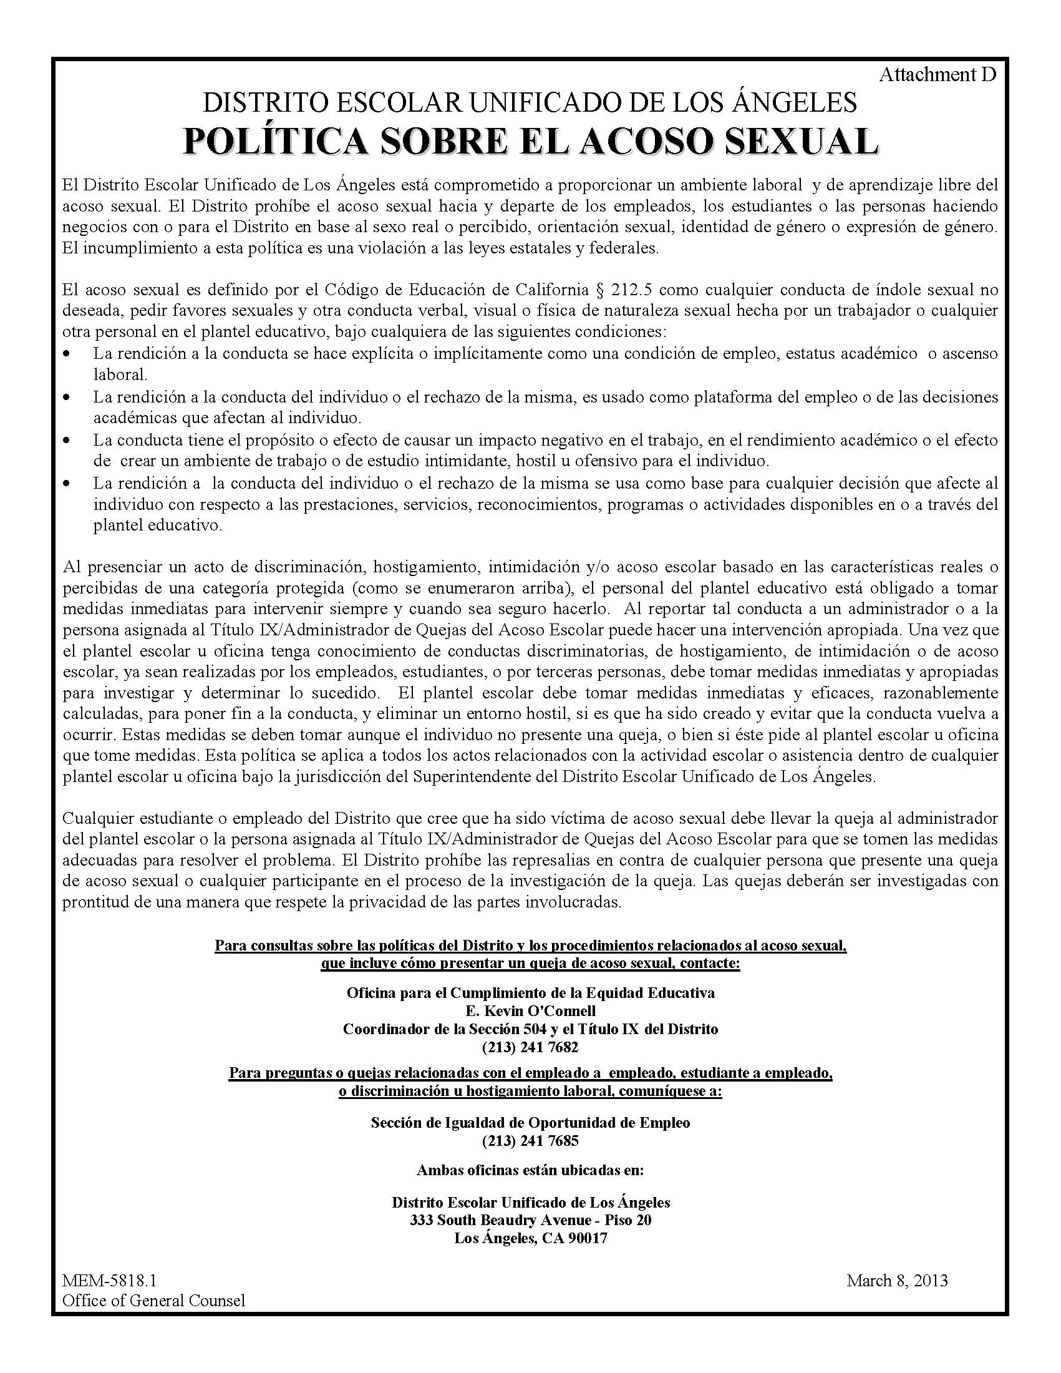
Nondiscrimination Information & Sexual Harassment Policy
Mandatory Postings/required notices
Required Notices:
Notes:
This is an example of the SEXUAL HARASSMENT POLICY. IT IS POSTED IN BOTH ENGLISH AND SPANISH.

Slide 64
Cal/OSHA Log of Injuries and Illnesses
(REF-5693.2)
California State law requires every employer to maintain a log of work-related injuries and illnesses and to display the Annual Summary of Work-Related Injuries and Illnesses (California Occupational Safety and Health Administration (Cal/OSHA) Form 300A).
This form must be posted in a conspicuous place where notices to employees are customarily posted from February 1 until April 30th each year at each site.

Slide 65
Student and employee security
Incident System Tracking Accountability Report (ISTAR)Bul-5269.2
The District’s Incident System Tracking Accountability Report (ISTAR) is the District-wide electronic tool to report and document incidents involving students, employees, or the school community which occur on or near District schools and sites.
Accurate reporting enables the Educational Service Center (ESC), Central Office and other responders to mobilize efficiently and effectively and allocate appropriate resources to address incidents and provide support to schools, offices, and those affected.
The system is also intended to reduce potential miscommunication. ISTAR will capture more specific incident information and produce more accurate and meaningful data to find similarities in incidents so that divisions can develop solutions and strategies to address these incidents and improve the response process(es).

Slide 66
Suicide PREVENTION, THREAT, AND CRISIS INTERVENTION
BUL - 2637.3
This bulletin replaces BUL-2637.1 Suicide Prevention, Intervention and Postvention, on the same subject issued by School Operations and Student Health and Human Services, dated July 16, 2012. The following are major changes included in this bulletin:
Clarification of guidelines and practices regarding when certificated staff accompany a student to the hospital (Page 7)
Guidance for providing pertinent student information, including a summary of the incident and any related documents, when a student is transported for a psychiatric evaluation (Page 7)
The level of risk, No Known Current Risk, has been added as an option to use when determining level of risk. Please note that assessing at this level still recommends action steps, including contacting the parent and documenting on iSTAR (see Attachment C).
All attachments were revised and updated. For additional handouts and information in additional languages* please visit https://suicideprevention.lausd.net.

Slide 67
Crisis Preparedness, Response and Recovery
  This Bulletin replaces BUL-962.1 Organizing for Crisis Intervention, on the same subject issued by the Office of the Chief Operating Officer, dated December 7, 2005
The purpose of this Bulletin is to outline administrative guidelines and procedures for responding to crises that may impact the school community.
  Crisis preparedness, response and recovery efforts in the educational setting are crucial in restoring a safe and healthy learning environment. These efforts promote resiliency and a sense of self-efficacy for students, staff and school community stakeholders.
  Providing effective crisis management and interventions can mitigate negative social-emotional consequences, reduce the period of school disruption as well as restore safety and security to the school community to promote attendance, academic achievement, and wellness.

Slide 68
Suicide PREVENTION, THREAT,
AND CRISIS INTERVENTION
BUL - 2637.3 Suicide Prevention, Intervention
and Postvention (Students)
The purpose of this bulletin is to outline administrative procedures for intervening with suicidal and self-injurious students and offer guidelines to school site crisis teams in the aftermath of a student death by suicide.
All District employees are expected to:
Inform the school site administrator/designee immediately or as soon as possible of any concerns, reports or behaviors relating to student suicide or self-injury.
Adhere to the Suicide Prevention, Intervention and Postvention (SPIP) policy and act in accordance with the policy.

Slide 69
Threat Assessment and Management
(Student-to-Student, Student-to-Adult)Bul-5799.0
POLICY: The Los Angeles Unified School District is committed to providing a safe, civil and secure school environment. In order to fulfill the District's mission, it is essential that all LAUSD students are able to learn in an environment that is safe and free from acts of intimidation, threats of violence or actual violence. No individual shall be subjected to retaliation, reprisal, or disciplinary action for reporting acts pursuant to this policy.
Any student who commits acts of violence or threatening behavior at school or any school related activity may be subject to removal from the premises, subject to disciplinary action and/or subject to criminal penalties. This action may be taken when there is reasonable cause to believe that such person has willfully disrupted the orderly operation of such campus or facility, as defined in Education Code §32210.
This policy encompasses behaviors or actions by students. The policy is applicable to all schools, District and school-related activities and in all areas within the District’s jurisdiction.

Slide 70
MEM 5159.8 Uniform Complaint Procedures (UCP)
LAUSD has the primary responsibility to ensure compliance with applicable state and federal laws and regulations, and shall investigate complaints alleging failure to comply with applicable state and federal laws and regulations and/or alleging discrimination.
Complainants are encouraged, where possible, to try to resolve their complaints directly at the school or work site or with their local district office.
Uniform complaints may be used to file noncompliance or unlawful discrimination complaints and/or to appeal District decisions regarding such complaints. Uniform complaint form is located at end of memorandum 5159.7

Slide 71
WILLIAMS COMPLAINT PROCEDURES – BUL 4759.4
(Excerpt of Main Legislation Requirements)
A. There should be sufficient textbooks and instructional materials. That means each pupil, including English learners, must have textbooks or instructional materials, or both, to use in class and to take home or use after class.
B. School facilities must be clean, safe, and maintained in good repair in addition to the following: 1. A school restroom should be maintained or cleaned regularly, fully operational, stocked with consumable supplies and/or a hand dryer. 2. A school must keep all restrooms open during school hours when pupils are in class, and/or a sufficient number of restrooms open during school hours when pupils are in class.
C. There should be no teacher vacancies.
D. There should be no teacher misassignments
Note: Additional requirements may be found in Bul-4759.3

Slide 72


  Other District and Division Policies…

Slide 73
Special classification requirements
All licenses or certifications requirements that are not specified as preferred under “special” in the class description are required and must be kept valid by the incumbent for the duration of the time they are in the classification.
Failure to maintain the required certification for your classification may subject you to immediate removal from your position and possible disciplinary action.
It is each employee’s responsibility to provide ITD administration with copies of licenses or certificates as they are attained and renewed.

Slide 74
DRUG ALCOHOL AND TOBACCO-FREE WORKPLACE (BUL-6488.1)
The policy of the District is to maintain a drug-and alcohol-free workplace and prohibit the manufacture, sale, distribution, dispensing, possession, or use of illicit drugs and alcohol by employees in all workplaces.
It is also the policy of the District to prohibit smoking and the use of all tobacco products such as e-cigarettes and peripherals, at all times, on all District property, District-owned or leased buildings, and in District vehicles, by all persons, including employees, students and visitors at any school or District site or any school-sponsored event.
Notes:
Talk about impact of reporting for duty under the influence of drugs or alcohol.

Slide 75
Drug Alcohol And Tobacco-Free Workplace - Continued
Federal regulations require employees to abide by this policy as a condition of employment and further require that newly hired employees will receive a written notice of the District’s commitment to a drug-and alcohol-free workplace.
This policy in no way precludes administrative or disciplinary action by the District for drug-related and alcohol-related violations occurring outside the workplace.
Criminal drug or alcohol statute convictions for a violation occurring in the workplace must be reported no later than five (5) days after a conviction. Such reports shall be made to the Employee Relations/Services Section, Human Resources Division, at 213-241-6591.
PLEASE NOTE: Employees are required to immediately report any arrest or conviction(s) to the Division HR Administrator or designee within 24 hours or as soon as practicable.

Slide 76
Workplace Violence, Bullying and Threats - Adults to Adults
(BUL–5798.0)
The LAUSD is and civil working environment that committed to providing a safe is safe and free from acts of intimidation, threats of violence or actual violence.
No employee shall be subjected to retaliation, reprisal, or disciplinary action for reporting acts pursuant to this policy.
Any individual who commits acts of violence or threatening or disruptive behavior in the workplace may be subject to removal from the premises, disciplinary action and/or criminal penalties.
This policy encompasses behaviors or actions by District employees and associated adults (e.g., parents, campus volunteers, and vendors). The policy is applicable in schools, at District and school related activities and events and at all areas within the District’s jurisdiction.

Slide 77
Workplace Violence, Bullying and Threats (Adults to Adults ) Continued
Board Resolution - Respectful Treatment Of All Persons (Attachment G)
Resolved, That the Los Angeles Unified School District reaffirm its policy that students and adults in both schools and offices should treat all persons equally and respectfully and refrain from the willful or negligent use of slurs against any person on the basis or race, language spoken, color, sex, religion, handicap, national origin, immigration status, age, sexual orientation, or political belief; and be it further
Resolved, That the District further ask that a school-wide code of discipline regarding name-calling be developed at each school, and enforced by teachers, administrators, and other staff members; and be it further
Resolved, That District administrators bring this policy to the attention of all employees and students, and to constructively administer its enforcement.

Slide 78
BUL-5996.1 Overtime Policy
The policy of the District, in accordance with the federal Fair Labor Standards Act and California law, is to provide overtime pay to eligible employees at time and one half for all work in excess of eight hours a day or forty hours a week for employees on a standard workweek (5 days, 8 hours per day). Variation from this policy is described under Section II and III of this bulletin.
Regular and probationary classified employees are eligible for overtime pay. Classified administrative and executive employees (as described in Personnel Commission Rule 596) are not eligible for overtime pay. Certificated employees are not eligible for overtime pay.
Overtime must be approved in advance except in the case of extreme circumstances.
Employees should not be assigned to work more than 44 hours of overtime per month or more than 528 hours of overtime per fiscal year.

Slide 79
Use of Privately Owned Vehicles
(BUL - 5310.0)
This policy applies to the use of private vehicles by
  LAUSD employees during the course and scope of the employees’ approved employment duties and activities.
  Employees, parents and other volunteers on district approved field trips.
Employees that use their personal vehicle for District Business are required to submit a copy of their valid California Driver’s License and proof of Liability Insurance at least annually to the Division HR Administrator and the site Administrator.
If a license is a requirement of your classification, you must notify the Division’s Human Resources Unit within 24 hours or the first business day of your license is suspended or revoked.

Slide 80
District Owned Vehicles, Policies, Procedures, and Responsibilities (BUL-6401.1)
Employee may use District-owned vehicles only for official business and work-related activities. Cars and vans used to transport employees on District business may not be taken home.
Every driver shall be familiar with and observe all State of California Vehicle Codes, and local traffic rules and ordinances, including traffic control signs, posted speed limits, parking restrictions, and other applicable rules and regulations governing vehicle operations.
It is the responsibility of the employee to visually inspect the vehicle prior to its use to ensure that the vehicle is in a safe and clean operating condition (e.g., material or equipment that obstructs the driver’s vision and/or may cause injury in the event of an accident.

Slide 81
District Owned Vehicles, Policies, Procedures, and Responsibilities Continued
Misuse of a District-owned vehicle that may lead to the removal of the vehicle include:
Suspend/revoke vehicle privileges, disciplinary action, and/or may be liable to the District for costs resulting from any misuse of a District-owned vehicle.
Failure to report an accident or wrongfully leaving the scene of an accident.
Incur Multiple preventable accidents causing financial loss to the District.

Slide 82
BUL-1077.2 Information Protection Policy
It is the policy of the LAUSD to protect sensitive information. As a public institution, much of the information possessed by the District is a matter of public record.
Every employee of the school district must ensure the proper protection of information, whether in paper or electronic form.
Violations of this policy may result in discipline, up to and including dismissal of personnel violating the policy.
Example of the type of information requiring extreme care and sensitivity in handling:
  student or health care records. There are severe penalties when these records are mishandled and/or transferred to the wrong party and without consent.

Slide 83
Security of Personnel Information
The sensitive and private nature of the information to which employees of the Information Technology Division have access necessitates that they thoroughly understand their responsibility with respect to these materials.
Any willful action that compromises the integrity of a personnel transaction is cause for dismissal.

Slide 84
Security for Personal Items
Personal Belongings, Valuables and District Property
LAUSD Administrative Headquarters is occupied
day and night by employees, contractors and visitors.
Please take precautions for your own safety and
the security of your personal belongings and District property, especially during holiday seasons.

Slide 85
USE OF DISTRICT PROPERTY AND EQUIPMENT BY EMPLOYEES
BOARD RULE 1266
  Employees of the LAUSD are generally not permitted to use District time, mailboxes, equipment of any kind or supplies thereof (collectively, “District equipment”) for personal use.
  Personal use” - use for noncommercial purposes other than performance of the employee’s assigned duties. District equipment should be used for and dedicated to official business and personal use of such equipment should be kept to a minimum.
  No employee or other person is permitted to remove any property owned or controlled by the District from premises owned or occupied by the District for personal use.
  Any violation of any provisions of this Rule shall be grounds for discipline up to and including termination.

Slide 86
Board Rule 1266 - Continued
  Personal telephone calls, e-mail messages, and internet communications or use should be brief, kept to a minimum, limited to calls within the local calling area and should be placed, received, or reviewed only during an employee’s lunch hour, break time or before or after work hours.
  The District requests cooperation from its employees in keeping all such personal telephone calls to a minimum by asking others to call employees at work only on urgent matters.
  All other District equipment is, except in emergencies or other exigent circumstances, available exclusively for official District business. Employees of the District (as well as other users of the District’s computer or communications systems) have no reasonable expectation of privacy relative to the use of the District’s equipment or communication systems.

Slide 87
Questions?
ITD Human Resources Staff Contact Numbers
Carly Ntoya, Division Human Resources Administrator:
213-241-0310
Lionel Barreda, Senior Human Resources Representative:
213-241-3985
Maggie Mohler, Secretary: 213-241-2687
Confidential Fax: 213-241-4137
Please download and read the all of the Administrative Certification Policies at the ITD HR Website:
http://achieve.lausd.net/ithr
Click on the download link on the home page.

