Slide 1
MyData Tips and Tricks
A Must-Read for
MyData Users
April 2016

Slide 2
Congratulations! You just got a MyData account. Now what?
If this is the first time you are navigating within MyData, please make sure you go through the rest of these slides. These will tell you what hardware and software requirements and settings you will need to ensure a successful and smooth MyData experience.
Happy trails to you!
Click to continue

Slide 3
Table of Contents
Click on a topic to get to that slide:
Minimum System Requirements
Browser Compatibility
Reviewing LAUSD’s Information Protection Policy
Downloading Adobe Acrobat (for Detail Reports)
Disabling Pop-up Blockers
Blue vs Black Numbers
Clear My Filters
Using the Masking Feature
Printing Reports
Downloading Reports to MS-Excel
MyData Assistance

Slide 4
Minimum System Requirements to Run MyData Reports
Before using MyData, please make sure that your computer meets the following minimum system requirements:
PC users:
MS Windows Win7 or higher
Mozilla Firefox v40 or higher
Adobe Acrobat Reader v.7 or higher
Mac users:
OS v10.10.x
Mozilla Firefox v40 or higher
Adobe Acrobat Reader v7 or higher
Back to Table of Contents

Slide 5
Browser Compatibility
Before using MyData, please make sure that you are using a browser that is compatible with MyData:
Microsoft Windows 7 or Higher:
Firefox
Apple Mac OS 10.10.x
Firefox
Back to Table of Contents

Slide 6
Reviewing the Information Protection Policy
MyData reports contain sensitive student and employee information. Before accessing these reports, it is highly recommended that you read LAUSD’s Information Protection Policy to understand the importance of the policies around this sensitive information.
Back to Table of Contents

Slide 7
Downloading Adobe Acrobat
To print reports, you will need Adobe Acrobat Reader software installed on your machine. You will also need Adobe Acrobat Reader to open some of the detail reports.
To download Adobe Acrobat, go to https://adobe.com/
Back to Table of Contents

Slide 8
Disabling Pop-Up Blockers
MyData detail reports open in a new window. If you have pop-up blockers enabled, you will need to disable them to view the detail reports.
To disable pop-up blocker in Firefox:
On the menu bar select Tools > Options.
Select Content.
Uncheck the box for Block pop-up windows.
Back to Table of Contents

Slide 9
Blue vs Black Numbers
When you access most of the aggregate reports, you will see blue numbers as well as black numbers in the cells. What is the significance of these colors?
The blue numbers are hyperlinks that can be drilled to obtain a detail report such as list of individual students. To drill, simply click on the blue number with your left mouse. A detail report will open in a new window, giving you names of individual students.
Detail reports also show student ID’s as blue links, which means that you can click on the link to drill to individual student information.
Back to Table of Contents

Slide 10
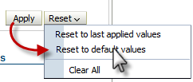
Clear My Filters
After customizing a report and making changes to the filters, how do I undo the filters so I can get back to the default report?
To set all filters back to the default, click on Reset, and select the Reset to default values. This will reset the filters back to the default values for that report.
Back to Table of Contents

Slide 11
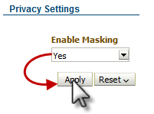
Using the Masking Feature
When doing PD for my staff, is there a way to prevent the student names and ID’s from being displayed on the screen?
Yes, you can do this by using the masking feature. When applied, the student names and ID’s are displayed as “xxxxx.”
To turn on this feature, scroll down to the Privacy Settings filter. In the Enable Masking filter, change the setting to Yes, then click Apply. The student names will now be displayed as “xxxxx.”
Note: The masking feature is currently available only on the Classroom dashboard reports.
Back to Table of Contents

Slide 12
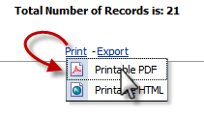
Printing Reports
I printed a report, but the filters on the left side are taking too much space and I cannot see the entire report on one page. How can I get a clean, formatted copy of the report?
To print a report, click the Print link located under the report and select Printable PDF. This will give you a formatted copy of the report.
Do not use the print function of the browser, as this will give you a screen-shot version of the report, not a formatted version that is ready for printing.
Back to Table of Contents

Slide 13
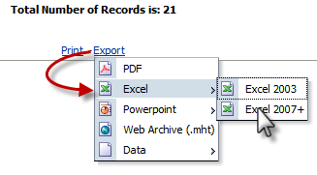
Downloading Reports to MS-Excel
Can I download a report to Excel ?
Yes, most of the reports in MyData are capable of being downloaded to Excel. The only reports that cannot be downloaded are the Student Comprehensive Reports.
To download to Excel, click on the Export link under the report and select Excel > Excel 2007+.
Back to Table of Contents

Slide 14
MyData Assistance
For MyData assistance, the following options are available to you:
ITD Helpdesk (213) 241-5200
MyData Phone (213) 241-3014 or (213) 241-0503
MyData Fax (213) 241-8420
MyData Trainers mydata@lausd.net
Back to Table of Contents

