Slide 1

Smarter Balanced Assessment
Professional Development Resources
Elementary Assistant Principals’ Organization
Division of Instruction and Student Testing Branch
September 10, 2015
Katie McGrath, Director, Elementary Instruction
Edwin Guerra, Coordinator, Student Testing Branch

Slide 2
Overarching Goal
Establish a common understanding and use of the Smarter Balanced Assessment System as a tool to help focus district and school improvement.
We are sharing…
Talking points
Resources and PD

Slide 3
Self-Rate Your Knowledge
1
  I know that SBAC summative assessments in ELA and Math were given last spring in grades 3-8 and 11 only.
2
  I know that the SBAC system contains more than just summative assessments.
3
  I could explain to you the two main components of SBAC beyond the summative assessment.
4
  I am very familiar with the three main SBAC components and could explain to you their individual, varied, and related uses.
5
  I know all the components of SBAC inside and out; I am prepared to train others.

Slide 4
The “Balanced” in Smarter Balanced refers both to our model of an interconnected system of summative, interim, and formative components, as well as a balance between technologically advanced computer adaptive testing (CAT) and extended, thematically related performance tasks.

Slide 5
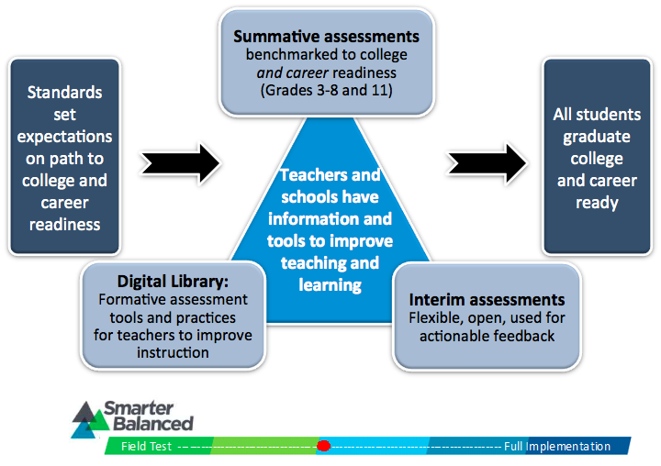
Smarter Balanced as a System

Slide 6
Data Examination
Process – Integrating assessment into the instructional cycle
Instruction
Assessment
Curriculum
Notes:
The BEAL training fits with both slide 6 as part of the Data Examination Process as well as in slides 18 and 19 and/or as part of the content in slide 28 Smarter Balanced PD Resources. I really think that the BEAL training is a valuable and commendable endeavor that we are providing our schools. Just some considerations…

Slide 7
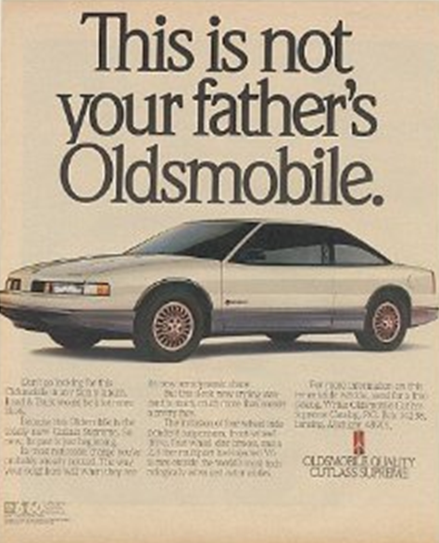
Notes:
California
State Superintendent of Public Instruction: Tom Torlakson
K-12 State Lead: Deb Sigman, Deputy Superintendent of the District, School & Innovation Branch
Higher Education Leads:
Monica Lin, Associate Director of Undergraduate Admissions, University of California
Linda Michalowski, Vice Chancellor, Student Services and Special Programs Division, California Community Colleges
Beverly Young, Assistant Vice Chancellor, Academic Affairs, California State University

Slide 8


Assessments

Slide 9
Shared Files and Resources
wested.box.com/LAUSD
tinyurl.com/SBACLAUSDPD
http://tinyurl.com/CDEtools

Slide 10
Summative Test Reporting
Preliminary Results available electronically from the Online Reporting System (ORS) include:
  Student results
  Aggregate results
  Comparisons of school, district, state results
Student Score Report results
(paper reports)
Electronic Data File
(as in the past)
Notes:
Talk about the different types of results that are coming to LEAs with the summative assessment scores

Slide 11
Summative Assessment Scores
Overall Scale Score
Achievement Level
  Level 1. Standard not met
  Level 2. Standard nearly met
  Level 3. Standard met
  Level 4. Standard exceeded
Claims
  Below Standard
  At or Near Standard
  Above Standard

Slide 12
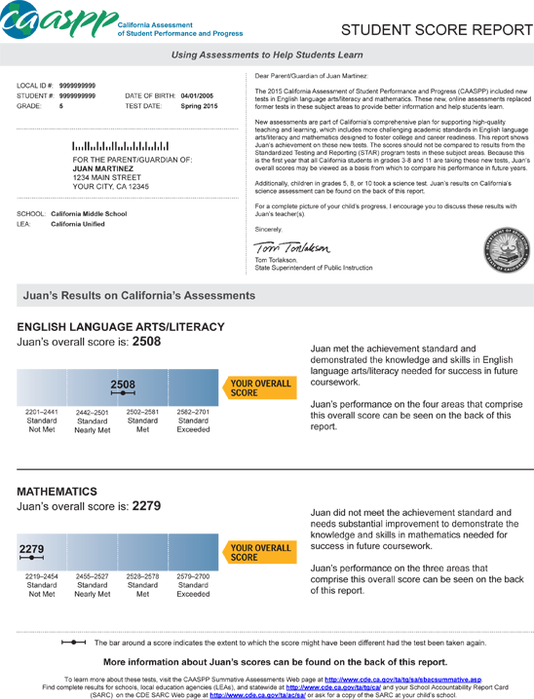
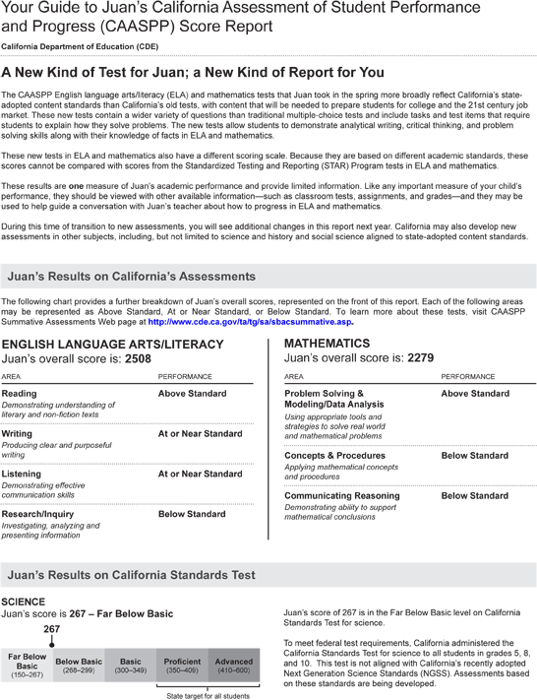
Individual Student Report (ISR)
Notes:
Electronic Handout
Two pages; need to be sent to parent per Ed code 60640.
If arrive after last day of school; need to send out within first 20 days of the next school year.

Slide 13
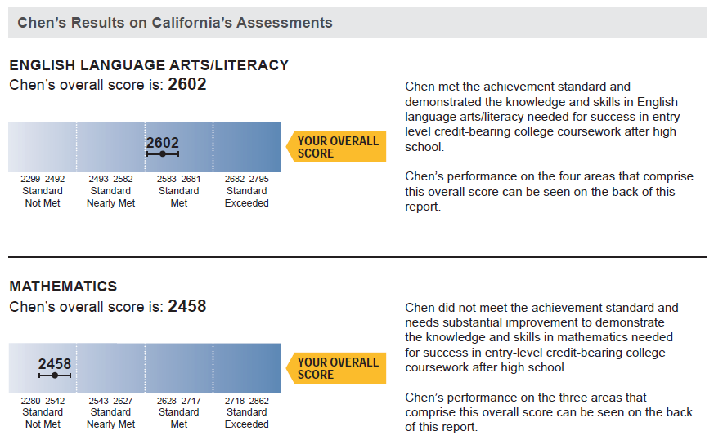
Scale Score and Achievement Level
Notes:
Bottom of page one

Slide 14
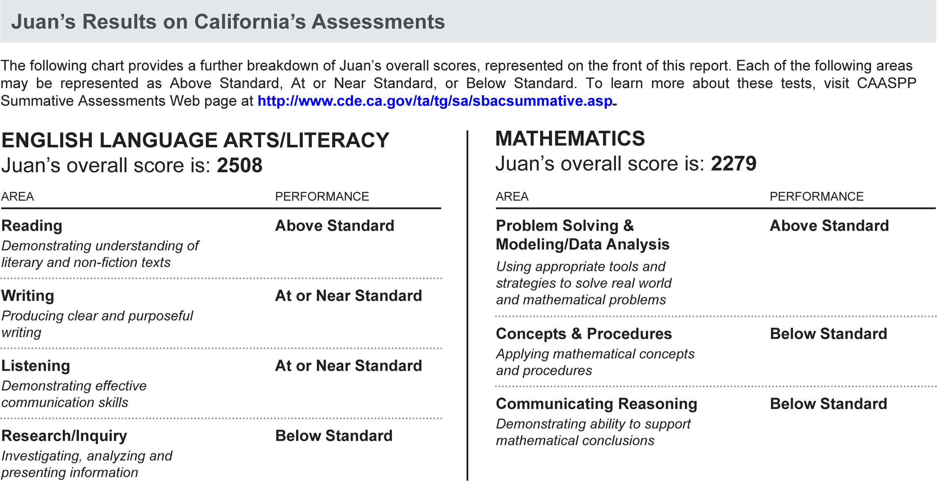
Breakdown of Overall Score (Claims)
Notes:
Mary
Bottom of page two

Slide 15
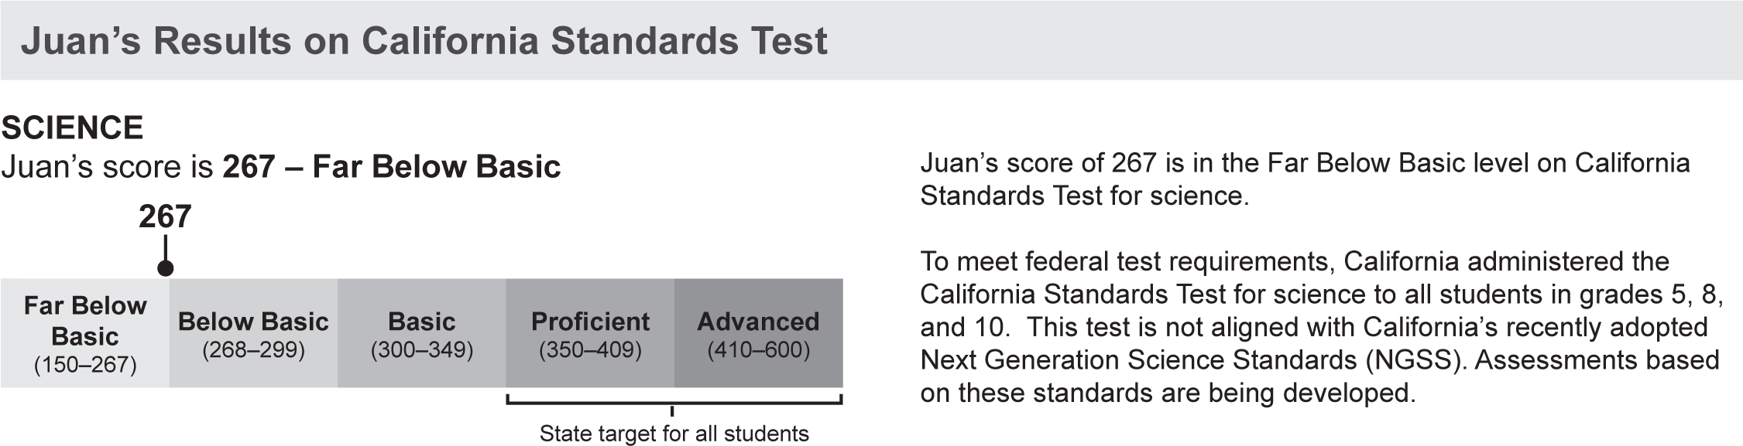
Science CST, CMA, CAPA
Notes:
Mary
Page two, as appropriate for student

Slide 16
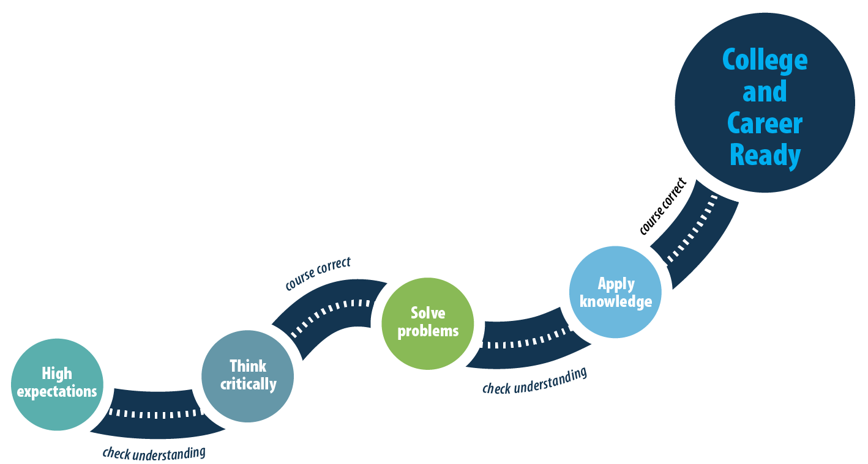
Summative Assessment Communication Resources
New Resources
  New Future, New Test
  with Talking Points (PPT)
  Communication Tips (PPT)
  Role Play Cards with
  Instructions (DOC)
  http://www.cde.ca.gov/ta/tg/ca/sprintcomtools.asp
Notes:
Useful tools

Slide 17

Summative Assessments
What sits square with you?
What’s rolling around in your head?
What are three things you want to remember?
Notes:
Chart and post-its

Slide 18
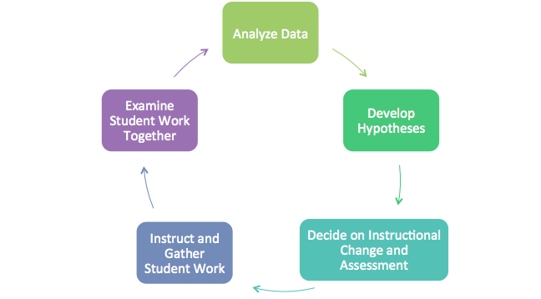
Cycle of Collaborative Inquiry

Slide 19
Data Examination
Process – Use the Tools Available
Overall Scores
English language arts/ Literacy
Claim Scores
Examination of Claims/Targets
Claims
Targets
Standards
Use of Guiding Questions
Use guiding questions as you consider the implications to teaching and learning
Listening
Reading
Research
Writing
Data Template
Draft a data template that would be helpful to site leaders as they review their own data
Mathematics
Concepts and Procedures
Problem Solving
Communicating Reasoning
Modeling and Data Analysis
Notes:
Review the blueprints and the achievement levels
Learn how the claims connect to the targets and standards
Focus on understanding the claims and the Threshold Achievement Level Descriptors (ALDs)
ALDs are rubrics that provide student performance expectations!

Slide 20
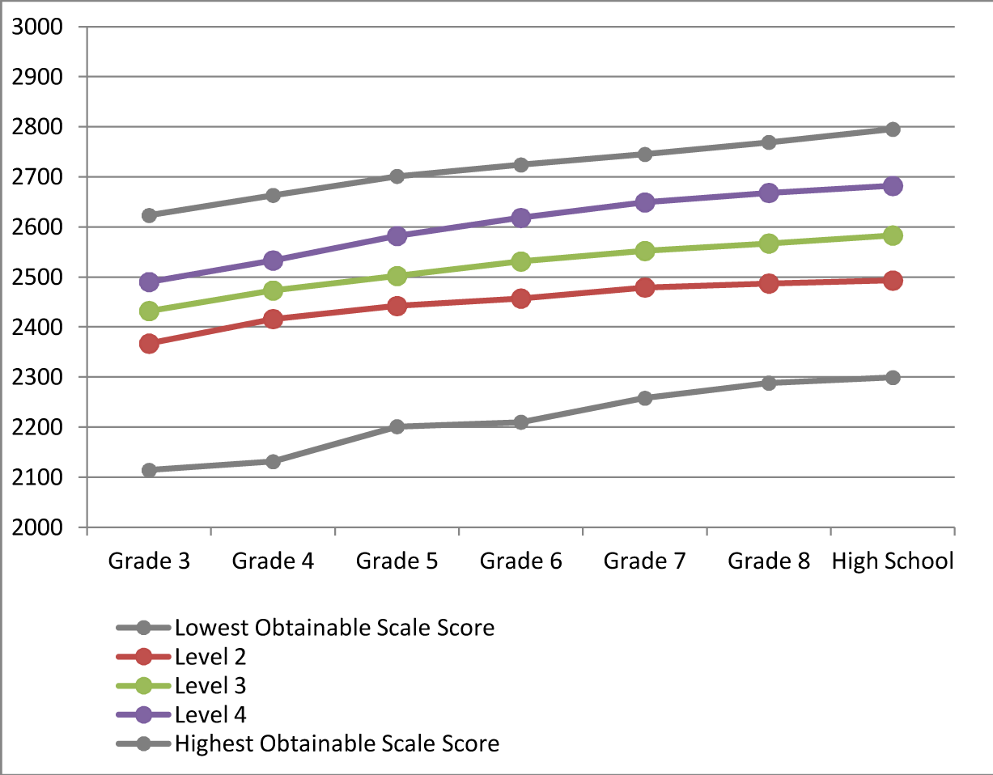
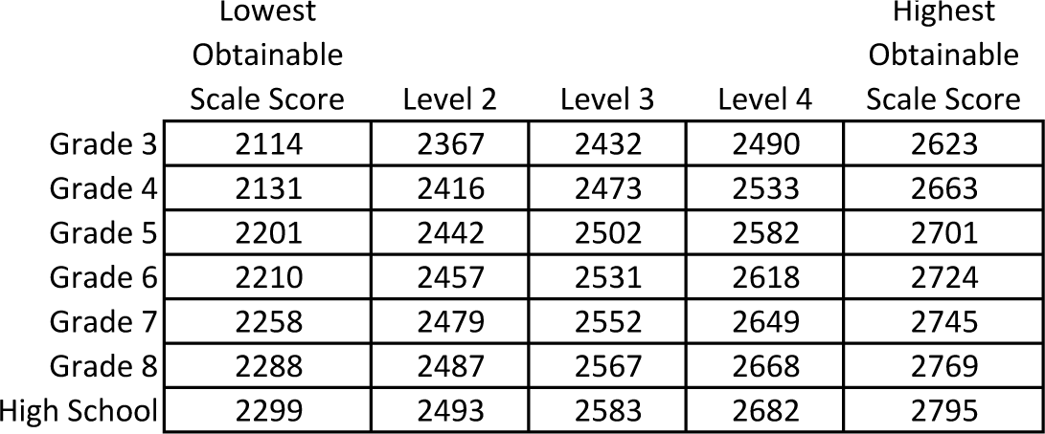
ELA Threshold Scale Scores
Notes:
Activity:
What do you see here?
What are some questions that you think teachers and site administrators are likely to ask?
Refer to handout

Slide 21
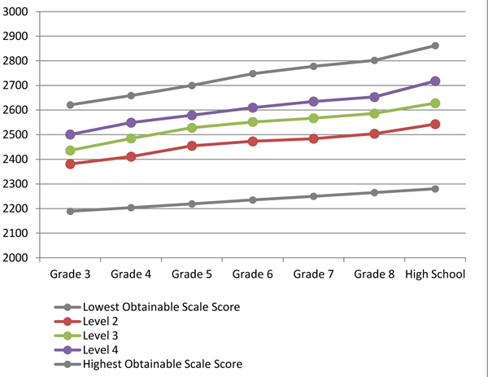
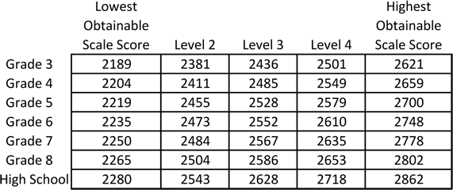
Mathematics Threshold Scale Scores
Notes:
Point here is to help them remember to get teachers excited about being able to see growth over time.
Refer to handout…

Slide 22
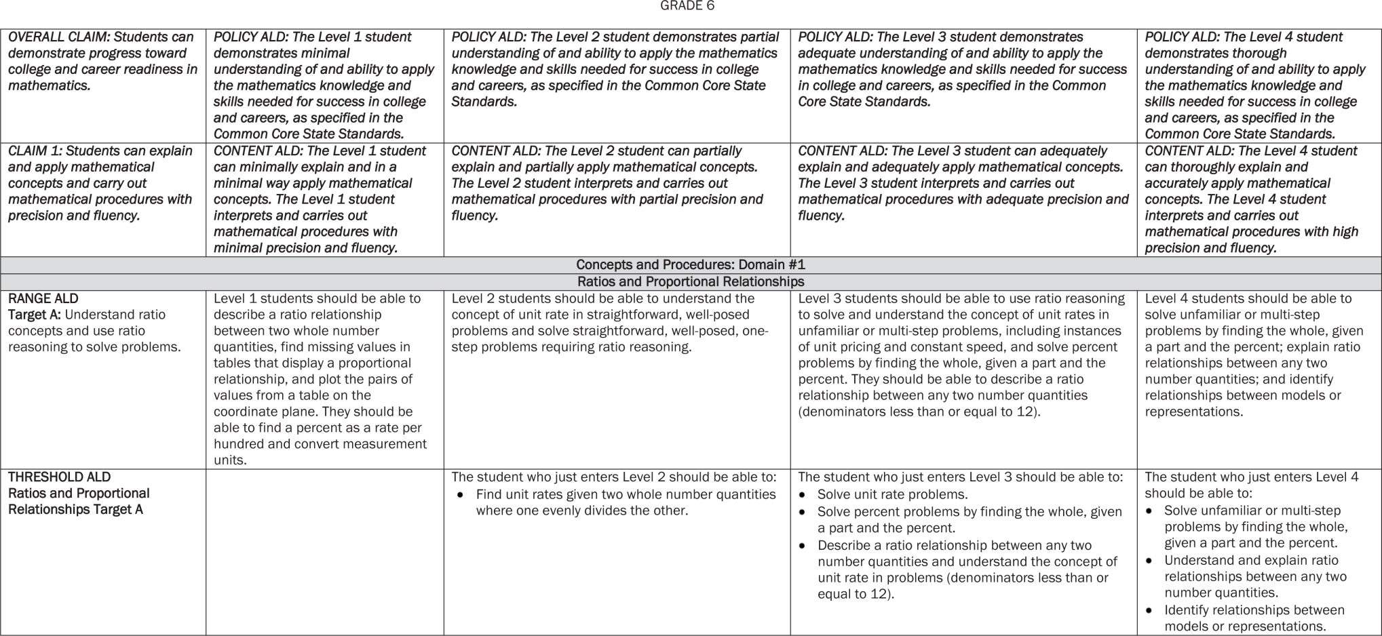
Achievement Level Descriptors
Notes:
Refer to Handout (hard copy for 6th grade) (and in Box for all grades)
Give participants ten minutes to review and digest the TALDs.
Most Important Point:
Ask participants to write down (Bob is using Box) a key point or significant idea they’ve derived from readying the document.
Then have group members share their M.I.P with a partner or with their table group.

Slide 23
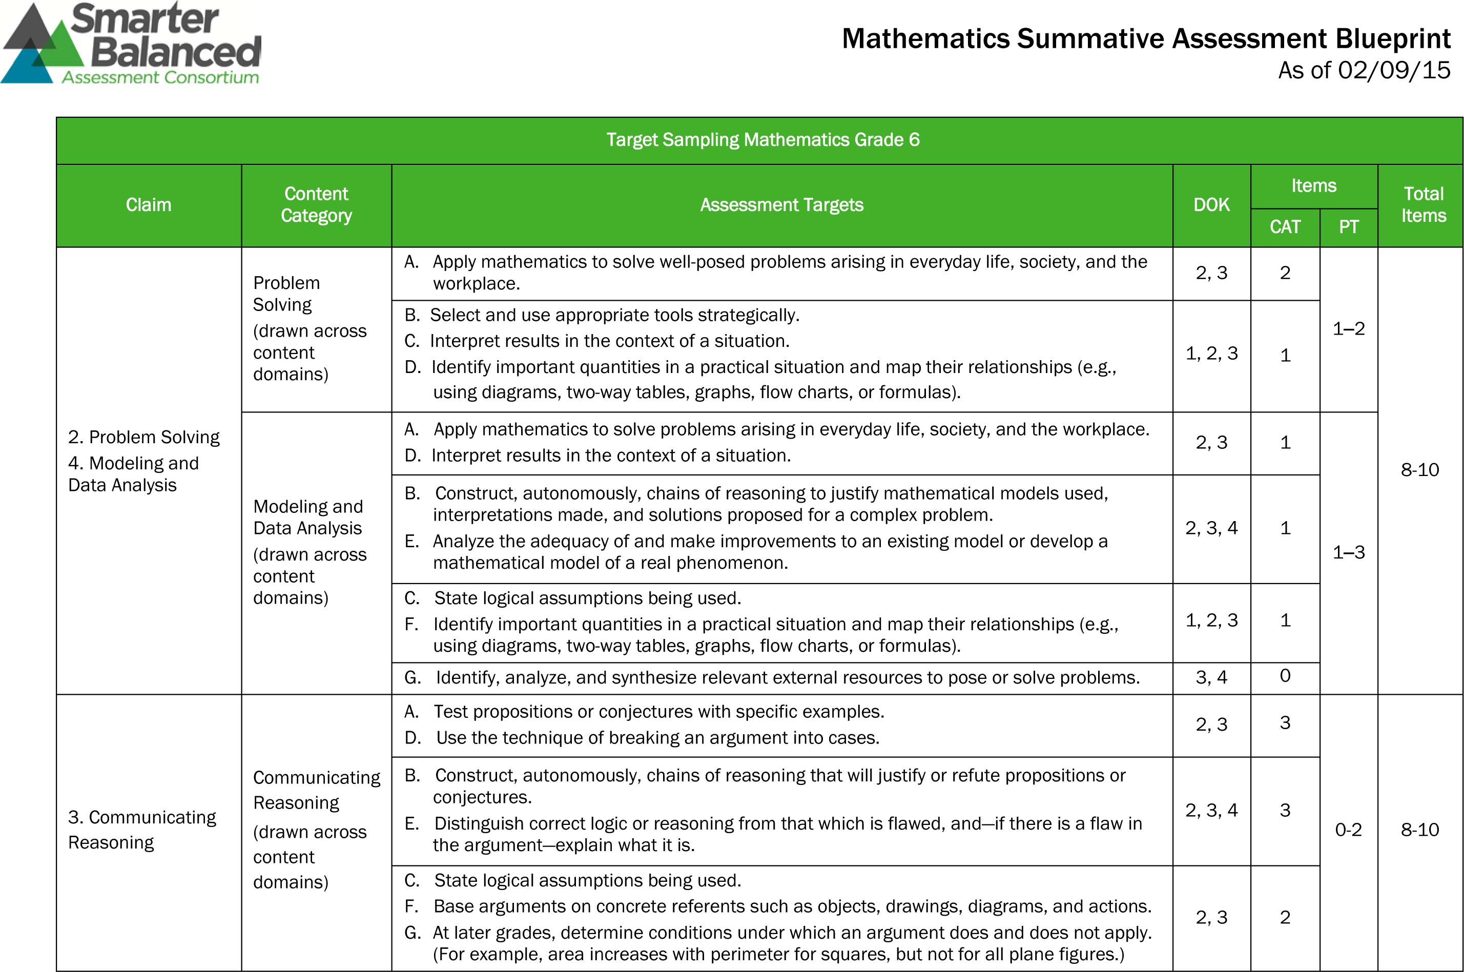
Summative Assessment Blueprints
Notes:
Give participants time to find these in Box and take a look at them.

Slide 24
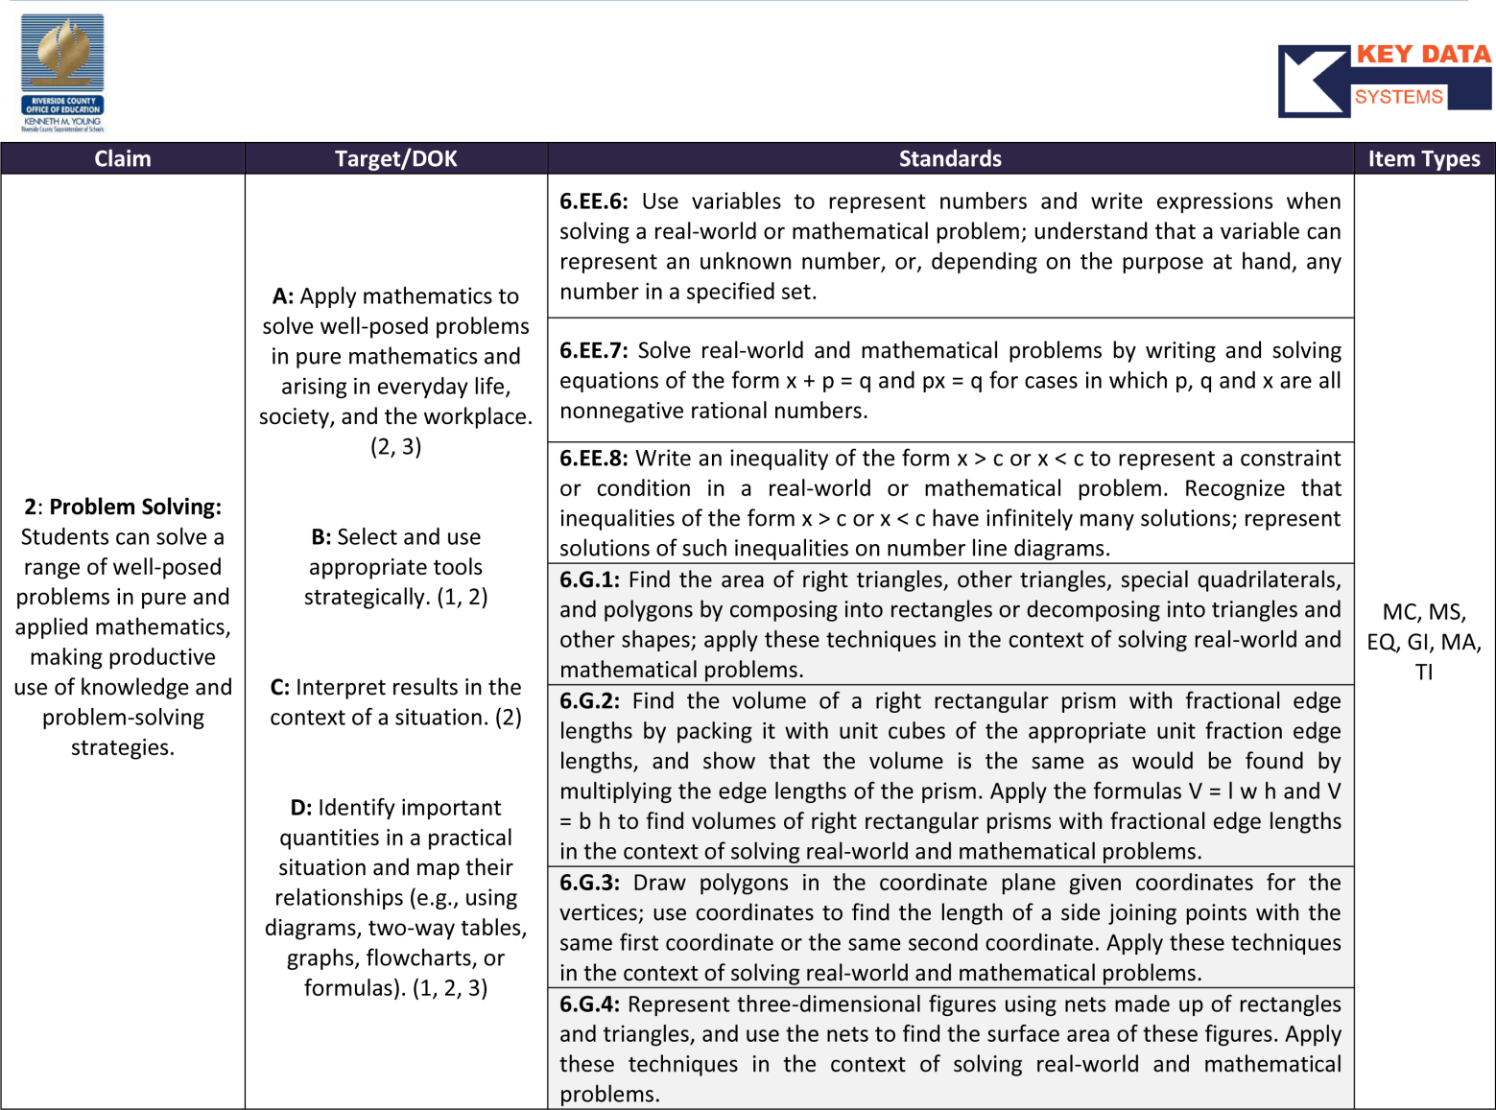
Understanding the Claims
Notes:
Handout (6th grade) and in box
Activity:
Give participants time to review the Riverside COE documents.
Most Important Point:
Ask participants to write down (Bob is using Box) a key point or significant idea they’ve derived from reading the document.
Then have group members share their M.I.P with a partner or with their table group.

Slide 25
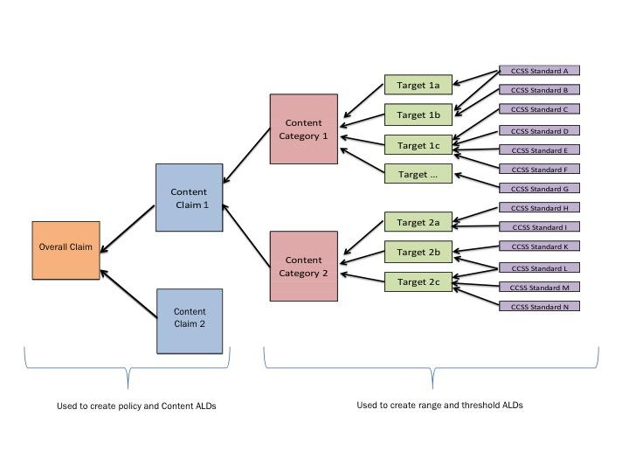
Claims, Targets and Standards

Slide 26
Student Reports
District will mail one copy to parents within 20 days of receipt
One set will be shipped to schools
Additional copies of student reports available through Online Reporting System (ORS)
Summary reports no longer provided by CDE

Slide 27
District Resources
Student level data will be downloaded into MiSIS
Student level and aggregate data will be loaded into MyData
Policy document will include sample student reports and the CAASPP Student Score Report Guide
Talking Points, infograph (old vs. new test), and sample parent letter posted on Student Testing Branch website

Slide 28
Smarter Balanced PD Resources
Examine the Smarter Balanced summative assessment results
Support cycles of collaborative inquiry
Align assessments to Threshold Achievement Level Descriptors (ALDs)
Notes:
The BEAL training fits with both slide 6 as part of the Data Examination Process as well as in slides 18 and 19 and/or as part of the content in slide 28 Smarter Balanced PD Resources. I really think that the BEAL training is a valuable and commendable endeavor that we are providing our schools. Just some considerations…

Slide 29
Shared Files and Website
wested.box.com/LAUSD
tinyurl.com/SBACLAUSDPD
http://tinyurl.com/CDEtools

Slide 30
Thank you!
Division of Instruction and Student Testing Branch
Katie McGrath, Director, Elementary Instruction
katie.mcgrath@lausd.net
Moses Jorge, Coordinator, Student Testing Branch
mxj8467@lausd.net

