Slide 1

Smarter Balanced Assessment
Professional Development Resources
Derrick Chau, Ph.D. - Director of Secondary Instruction
Oscar Lafarga - Student Testing Branch

Slide 2
Objectives
Review Smarter Balanced system and reporting
Share district talking points and resources
Share Division of Instruction professional development resources

Slide 3
Assessing Your Understanding
About the SBAC Summative Assessment...
How is the SBAC Summative Assessment different than the CSTs? | What Do You Want to Know?

Slide 4
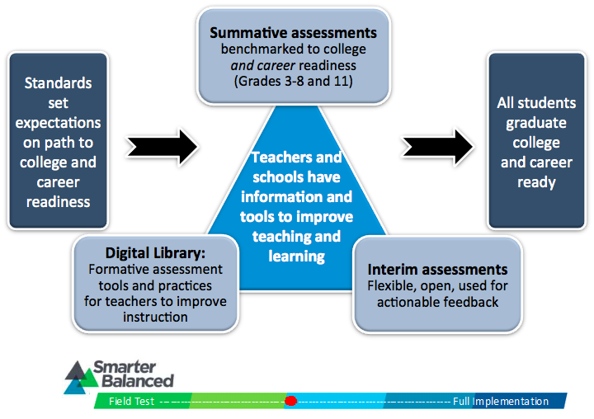
Smarter Balanced as a System

Slide 5
Smarter Balanced Summative Results
Overall Scale Score (2000-3000)
Achievement Levels (for ELA/Literacy and Mathematics
Claims
Standard Not Met | Standard Nearly Met | Standard Met (EAP - College Conditional Ready) | Standard Exceeded (EAP - College Ready)
Below Standard | At or Near Standard | Above Standard

Slide 6
Claims and Levels
English Language Arts/Literacy
Reading
Writing
Listening
Research/Inquiry
Mathematics
Problem Solving & Modeling/Data Analysis
Concepts & Procedures
Communicating Reasoning
Below Standard | At or Near Standard | Above Standard

Slide 7
Student Reports
District will mail one copy to parents within 20 days of receipt
One set will be shipped to schools
Additional copies of student reports available through Online Reporting System (ORS)
Summary reports no longer provided by CDE

Slide 8
District Resources
Student level data will be downloaded into MiSIS
Student level and aggregate data will be loaded into MyData
Policy document will include sample student reports and the CAASPP Student Score Report Guide
Talking Points, infograph (old vs. new test), and sample parent letter posted on Student Testing Branch website

Slide 9
Division of Instruction Resources
Smarter Balanced Assessment Professional Development Resources are located at:
tinyurl.com/SBACLAUSDPD

Slide 10
Overall SBAC PD Guidance
Focus on Smarter Balanced as an assessment system
Don’t approach analyzing Smarter Balanced summative assessment results like CSTs
Concentrate on developing collaborative teams to engage in cycles of inquiry to improve instruction

Slide 11
General Smarter Balanced PD Resources (for whole staff PD)
Review the blueprints and the achievement levels
Learn how the claims connect to the targets and standards
Focus on understanding the claims and the Threshold Achievement Level Descriptors (ALDs)
    ALDs are rubrics that provide student performance expectations!

Slide 12
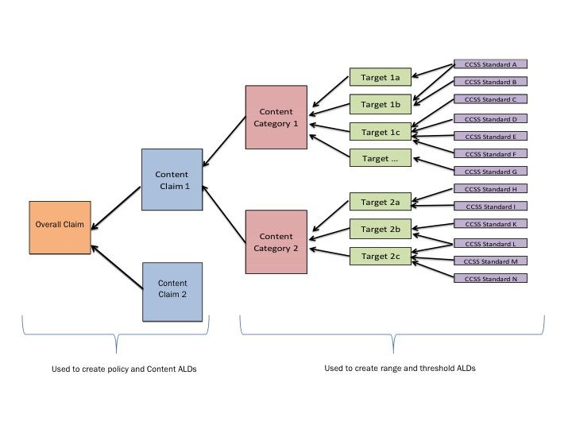
Relationship between Claims, Targets and Standards

Slide 13
Content-Area Smarter Balanced PD Resources (for department PD)
Ensure all content areas are examining the Smarter Balanced summative assessment results
Support cycles of collaborative inquiry within department teams
Align assessments to ALDs (Smarter Balanced rubrics)

Slide 14
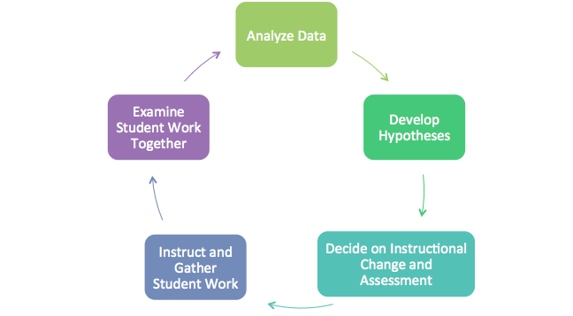
Cycle of Collaborative Inquiry

Slide 15
Takeaways for SBAC PD
Schools with the most collaborative teacher teams focused on improving instruction will improve the most
All teachers need to focus on developing student academic language skills
Speaking and listening skills are connected to reading and writing development
tinyurl.com/SBACLAUSDPD

