Slide 1
Student Support and Progress Team
The SSPT process emphasizes that early intervention for struggling students is a function of the general education program and not of special education.
The purpose of the SSPT is to function as a school-based problem-solving team composed primarily of general educators who provide support to teachers to improve the quality of the general education program and reduce the underachievement of students.

Slide 2
Student Support and Progress Team
Determines areas of need to accelerate learning for all students
Identifies achievement disparities (focus grades and focus areas)
Recommends differentiated and systematic supports needed to close achievement gaps to promote success for all students
Emphasizes that early intervention for struggling students is a function of the general education program and not of special education.
SST
COST
LAT
Student Support and Progress Team

Slide 3

Multi-Tiered System of Support and the Student Support and Progress Team
School-wide Monitoring
Conduct On-going Progress Monitoring
Follow-up Meeting; Data-Based Decision Making
Conduct the SSPT Meeting
Implement the Interventions
SSPT Referral Process
School-wide Monitoring
Notes:
This is an OVERVIEW of the process and it begins with school-wide monitoring at least 8 times per year. This helps to identify where we are as a school, in our Tier I instructional practices. In other words, what percentage of our students are benefiting from Tier I core instruciton? If less than 80% of our students are successfully benefiting, then we need to go back and plan around stronger Tier I systems, before we should look at whether individual students are having difficulty.
Once we have strong Tier I foundational systems in place, then we should support underachieving and/or struggling students through the SSPT.
3

Slide 4
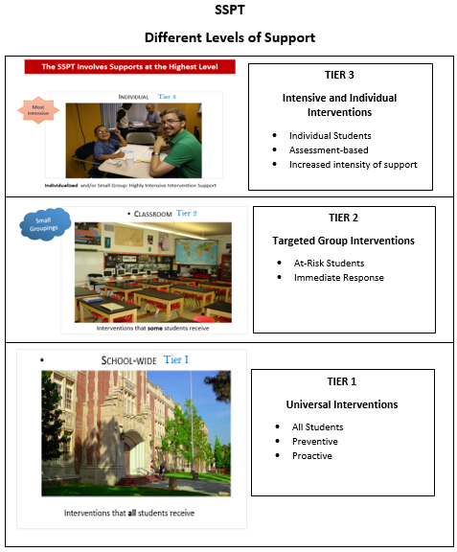
The SSPT Involves Different Levels of Support
Notes:
Students who receive school-wide interventions are generally progressing well, but may require slight support to continue their successful path. They are a part of the majority of students experiencing success and generally will not require an SSPT meeting. School-wide supports will be offered within the school and/or within the classroom.

Slide 5
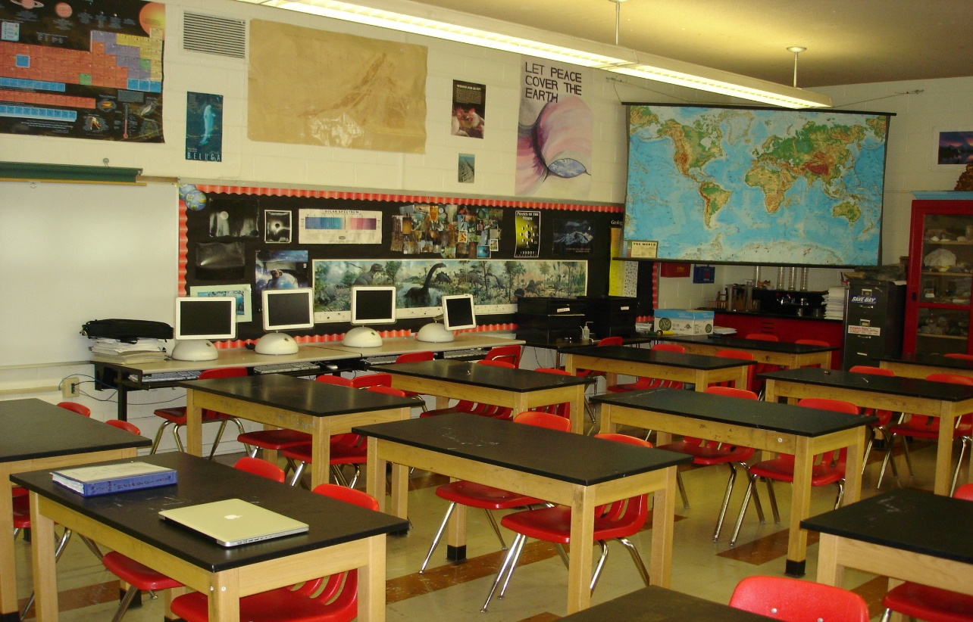
The SSPT Involves Increasing the Level of Support
Classroom
Small Groupings
Tier 2
Interventions that some students receive
Notes:
Some students will require small group instruction. The small groups are tailored to the individual students’ needs and instruction is delivered using a variety of strategies, approaches and techniques that are targeted to the students needs. Students who receive this level of support may require an SSPT meeting.

Slide 6
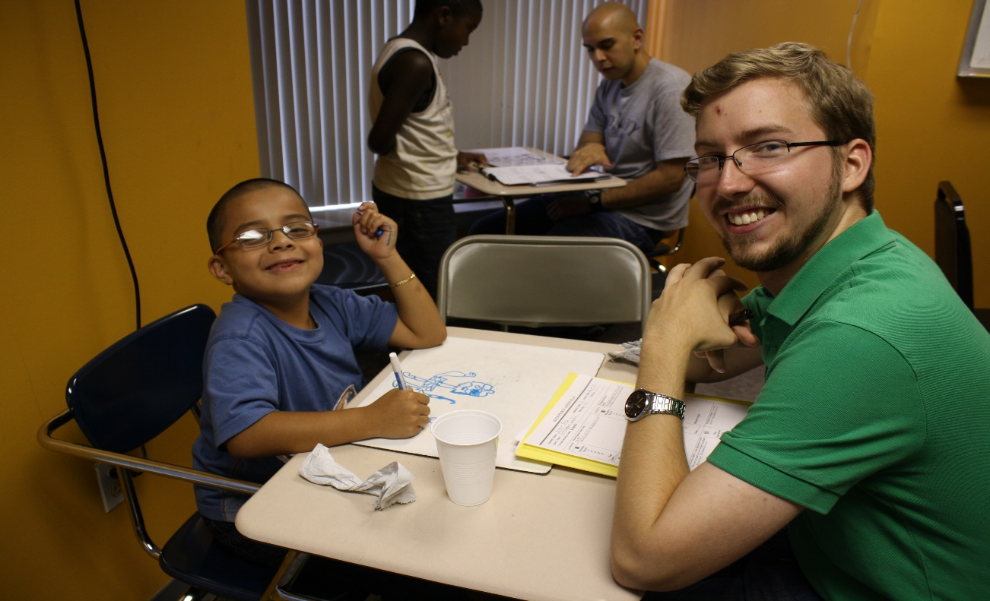
The SSPT Involves Supports at the Highest Level
Tier 3
Individual
Most Intensive
Individualized and/or Small Group: Highly Intensive Intervention Support
Notes:
Some students at the Tier III level of support may require daily intervention. This type of intervention is temporary in nature, with the purpose to provide highly targeted and intensive instruction to accelerate student learning and transition the student back into small flexible groupings.

Slide 7
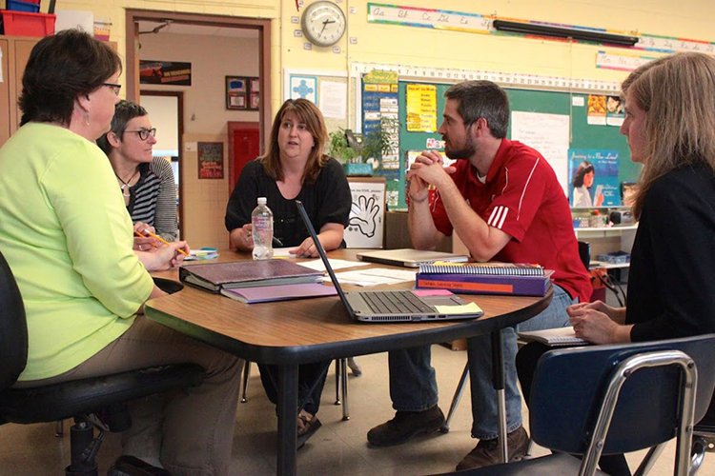
School-wide Monitoring:
Teachers will meet and review the performance of all the students at the school.
They will make recommendations regarding any students that need an SSPT meeting.
Teachers will also make recommendations regarding targeted supports (i.e., school-wide, classroom, and individual interventions).

Slide 8

Who Can Make A Referral to the SSPT?
A parent/caregiver can make a referral to the SSPT.
The parent fills out an SSPT Request Form* and gives it to the
SSPT Designee.
The SSPT Designee will schedule a meeting with the parent to
review the parent’s concerns and complete the referral information.
The SSPT Designee will also gather
helpful information from the child’s
teacher(s)
Notes:
8

Slide 9


How can I actively participate in My Child’s SSPT Meeting?
Be informed ahead of time regarding what to expect. The SSPT strives to create a culture of collaboration.
Know how to prepare for it (e.g., what is the process, who are the members and what is their role, what are some of the reasons why a parent may participate).
To ensure a successful meeting, become knowledgeable about the process. Knowledge is key to helping you fully prepare for a successful meeting.
Notes:
9

Slide 10
How can I actively participate in My Child’s SSPT Meeting?
Be informed ahead of time regarding what to expect. The SSPT strives to create a culture of collaboration.
Know how to prepare for it (e.g., what is the process, who are the members and what is their role, what are some of the reasons why a parent may participate).
To ensure a successful meeting, become knowledgeable about the process. Knowledge is key to helping you fully prepare for a successful meeting.
Notes:
10

Slide 11


Possible SSPT Members
SSPT Members
Administrator or Designee
General Education Teacher
Parent
Instructional Specialists
Health and Human Services Personnel
EL/Master Plan Expert (Designee)
Student (when appropriate)
Related Services Personnel
Notes:
Depending on the staffing of the school, the members in red are recommended to participate as they bring expertise in different areas. The student participates, if it is age appropriate, as well as the parent and any related service providers (as needed).
Consideration for student participation should include the age/developmental level of the student, as well as the reason for referral. The team cultivates a collaborative culture and deepens learning by utilizing what everyone brings to the table.
11

Slide 12
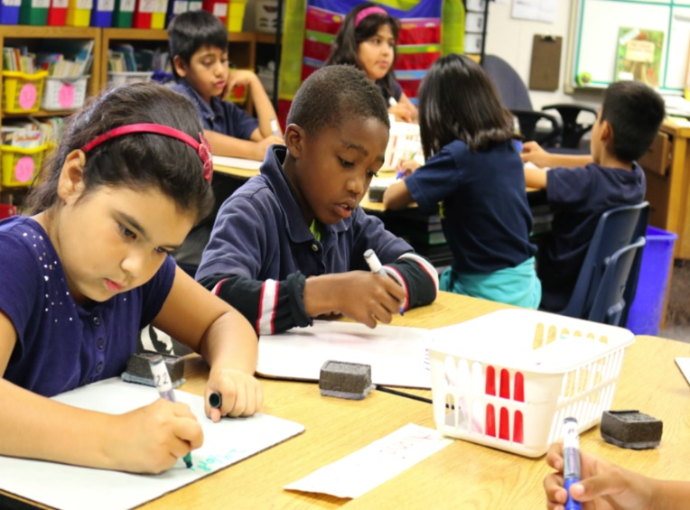
What to expect in preparation for an SSPT Meeting?
The SSPT Designee will schedule the meeting and notify the parent using the Parent Invitation Letter*.
The team will review the child’s educational performance.
Notes:
If you have any additional information that you feel is important to your child’s education, please share it with the team and if possible provide it to the Designee in advance of the meeting.
12

Slide 13

Active Parent Participation at an SSPT Meeting
If you have received a Parent Invitation Letter, plan to attend your child’s SSPT Meeting.
Participate in the discussion regarding your child’s performance
Participate in the development of goals. The goals will be reviewed within the next 6-8 weeks.
Ask questions regarding how you might help your child at home, to achieve his/her SSPT goals at school.
Encourage your child to participate in all aspects of the intervention.

Slide 14


What should I expect at the SSPT Meeting?
The team members will introduce themselves
The SSPT Designee will review the student information that was provided in advance and gather any new information.
As a group, the SSPT develops goals that are individualized to the student’s needs and completes the Student Intervention Plan.
The team will brainstorm intervention supports and provide a description of the
supports, such as what it is, when it will be provided, by whom and how often.
Notes:
14

Slide 15


Scheduling a Follow-up Meeting
  The teacher will provide the intervention supports.
  The teacher will monitor the student’s progress to see how well the child is learning new information.
  A follow-up meeting is scheduled within 6-8 weeks to determine how well the student is responding to the supports and review the student’s progress.

Slide 16

At the Follow-Up Meeting
The team will review the student’s progress at the follow-up meeting and determine the most appropriate next steps:
Modify the intervention (i.e., instructional strategy, intervention program, goals, grouping, duration and frequency)
Continue the intervention
Adjust the level of tiered support, based on student outcome data
Review and consider a Section 504 Plan
Recommend Reclassification of English Learners
Exit the Student Support and Progress Team process and make decisions regarding educational needs and next steps

