Slide 1


Pathway to Biliteracy Awards,
Honoring and Celebrating Language & Culture
Family Informational Sessions
October 6th-28th, 2025
TK-1st Grade Informational Sessions
October 6th and 7th, 2025
Notes:
Time: 1 minute
Welcome! Please take a moment to sign in: https://forms.gle/QbCHWJDS4xNL3mHP6
Play Music as we wait to start: https://www.yout-ube.com/watch?v=_UucPr2M-qU&t=390s

Slide 2
Notes:
Aram
Time: 1 minute
Resources on Land Acknowledgements
https://www.csusm.edu/cicsc/land.pdf
http://landacknowledgements.org/wp-content/uploads/2018/10/Acknowledgement-Guide-finalfinal.pdf

Slide 3
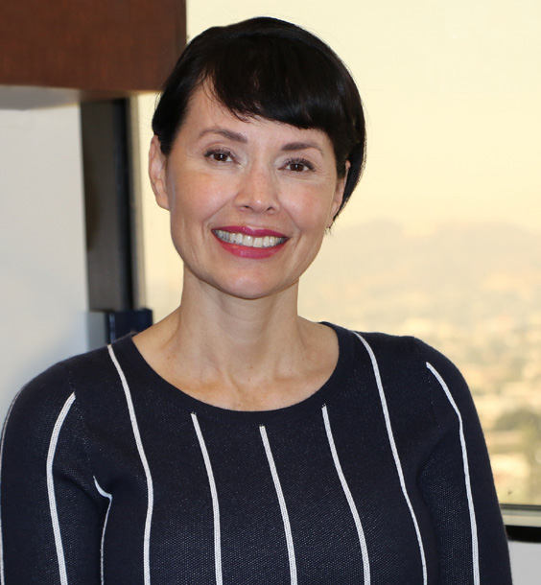
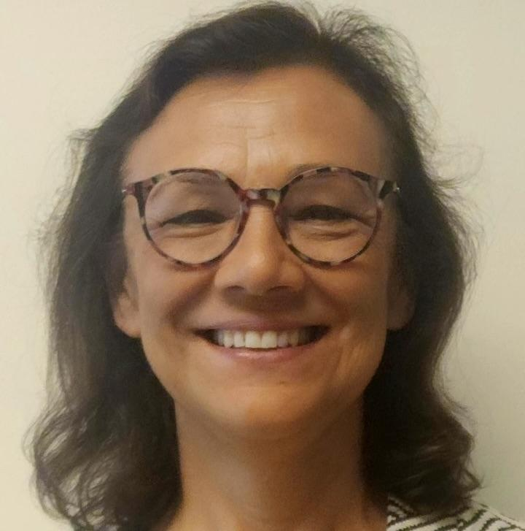
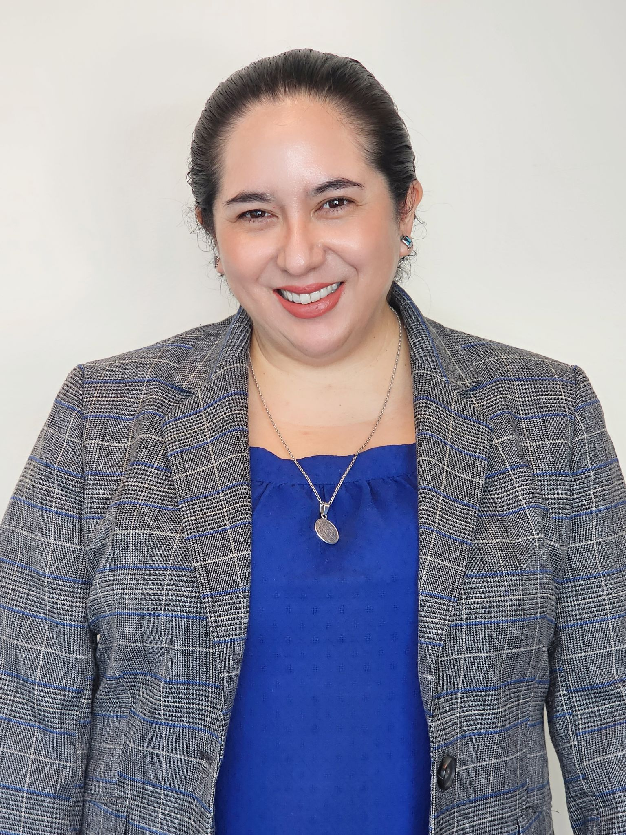
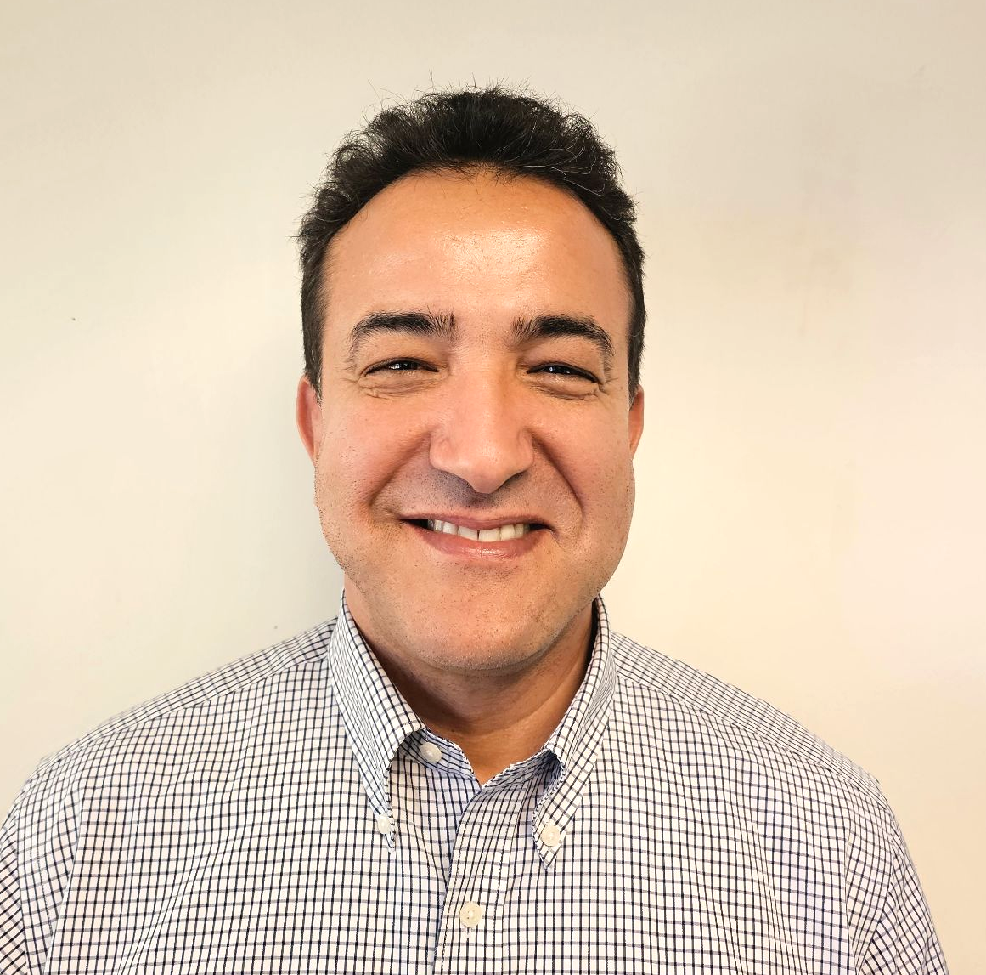
Meet our MMED Leadership
Lydia Acosta Stephens
Ana Guzman
Roxanna Sosa
Youssef Mossadaq
Executive Director
Parent of they/them kiddo
Administrator
Dual Language Education
World Languages and Cultures
Coordinator
World Languages & Cultures
Administrative Coordinator
Dual Language Education
Notes:
Aram
Time: 30 seconds
Here are our mighty leaders…

Slide 4
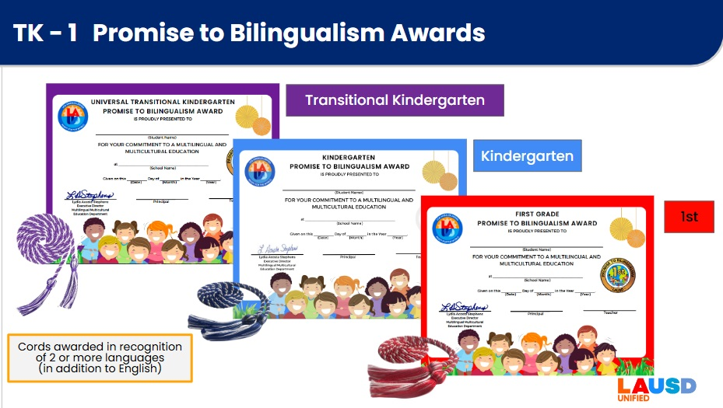




A Friendly Reminder
Today’s Virtual Informational Session is intended for family members of students in grades:
TK
Kindergarten
1st Grade
Notes:
Aram
Time: 1 minute
Say: While we are all happy to see you in attendance today, do remember that this presentation is intended for family members of students in grades UTK, K, and 1st. You are free to attend this session if your child is not in any of those grades, of course, but do know that the criteria covered in the presentation will reflect those three grades.

Slide 5
Today’s Session
What are the Promise to Bilingualism Awards in TK-1st?
What does my child need to do to earn the award(s)?
How can I support my child at home?
Notes:
Aram
Time: 30 sec

Slide 6
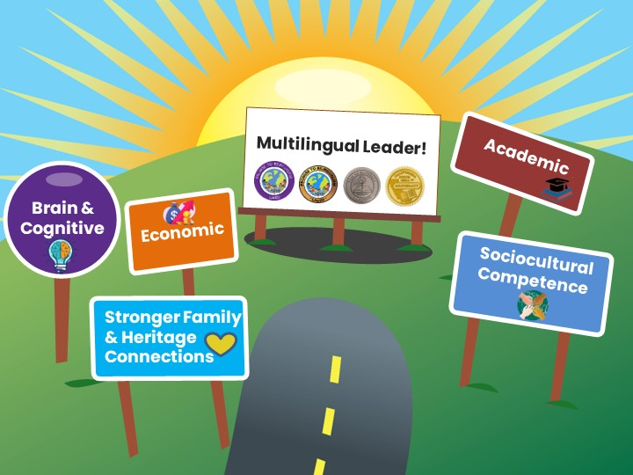



Benefits of Bilingualism and Biliteracy
Which one
resonates with
you & why?
Share in the chat!
Share in the chat!
Lifelong Advantages
Notes:
Aram
Time: 2 minutes
Say: The experience of mastering two or more languages has enormous benefits for students. People who are able to speak, read, and write in two or more languages are able to participate in several different cultural and language worlds. Multilingual proficiency actually strengthens how the brain functions. Let’s look at some of the benefits of be bilingual and biliterate:
DLE benefits ALL our students:
Brain & Cognitive Function:
Cognitive flexibility
Improves decision-making skills
Better problem-solving abilities
Have a stronger sense of self
Academic:
Increased academic performance
Advanced language courses
Biliteracy awards and District and State Seals of Biliteracy
Economic:
Competitive in the global economy
Have expanded job opportunities with higher pay
Sociocultural Competence
Awareness and understanding of other cultures
Can be “citizens of the world” with a more comprehensive and tolerant perspective
Stronger Family & Heritage Connections
Bridge builders for their families
Access to the wisdom of their heritage cultures
Ask: In the chat, go ahead and share your response to the following question: Which one of these benefits of bilingualism and biliteracy resonates with you?
Mastering two or more languages has enormous benefits for students. People who are able to speak, read and write in two or more languages are able to participate in several different cultural and language worlds.
Bilingualism is associated with more cognitive flexibility and better problem solving abilities.
Children who are bilingual tend to perform better on achievement tests.
Job opportunities become available throughout the globe for those who are bilingual, and there are often financial benefits associated with bilingual skills in the labor market.
The study of another language expands one’s worldview and builds cross-cultural understanding.
More than one-third of California school children speak a language other than English at home. The development of strong bilingual skills that include home language and English provide them the capacity to participate actively in both of their language worlds, and to be bridge builders and translators for their families.

Slide 7
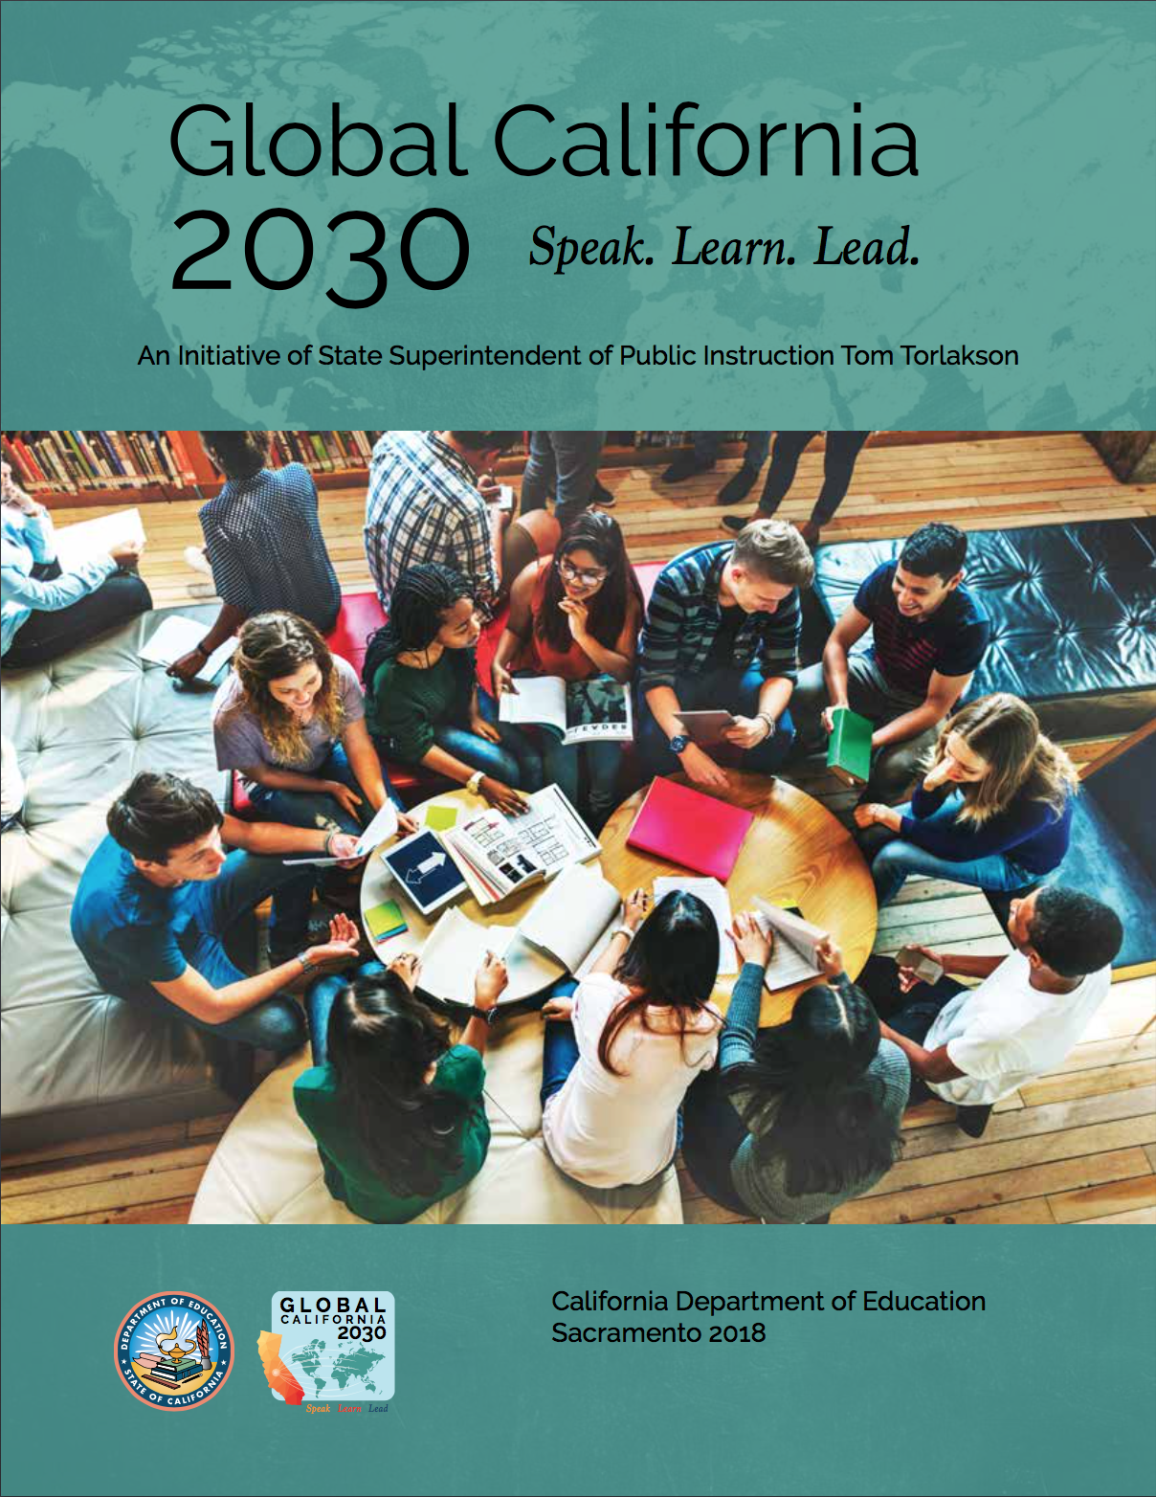
Global California 2030
A Call to Action!
“By 2030, we want half of all K–12 students to participate in programs leading to proficiency in two or more languages, either through a class, a program, or an experience. By 2040, we want three out of four students to be proficient in two or more languages, earning them a State Seal of Biliteracy.”
-Tom Torlakson, former State Superintendent
Notes:
Aram
Time: 30 sec
Here is a little background on what drives our work here in LAUSD. This initiative is a call to action, urging parents, educators, and legislators to support a multilingual California where students are provided the opportunity to become bilingual and biliterate.
By 2030, this initiative envisions that half of California’s K–12 students will be enrolled in programs that develop proficiency in two or more languages.
By 2040, three out of four California students will be proficient in two or more languages and earn the State Seal of Biliteracy.
Link: https://drive.google.com/file/d/1wZzqgKNbygjRUKS6hW176TAT1i51UGnx/view?usp=sharing

Slide 8

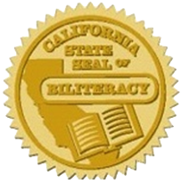
Strategic Plan 2022-2026
“Provide students with expanded opportunities to become multilingual through dual and world language programs, including American Sign Language.” pg. 26
“By 2026, ensure at least 50% of our graduating seniors receive the California Seal of Biliteracy.”
-Alberto Carvalho, Superintendent
Notes:
Aram
Say: It’s important to note that our 2022-2026 strategic plan is supported by our Pathway to Biliteracy Awards, as it is our goal by 2026 to ensure that at least 50% of our graduating seniors receive the CSSB.
Time: 30 sec

Slide 9



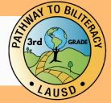

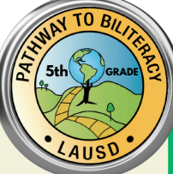
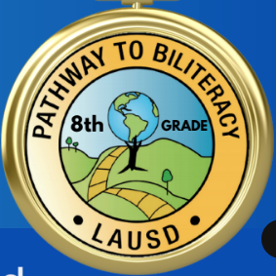
The Multilingual Journey
California Department of Education &
L.A. Unified
Seals of Biliteracy
Promise to Bilingualism Awards
Pathway to Biliteracy
Awards
Transitional
Kindergarten
5th Grade
8th Grade
12th Grade
Kindergarten
1st Grade
3rd Grade
TK
Notes:
Aram
Time: 1 min
Here is the Pathway to bilingualism and Biliteracy that all students can follow in L.A. Unified, to become biliterate and eventually receive the honor of Seals of Biliteracy on their high school diplomas. You as family members can help your children embark on this journey, as UTK, K, and 1st Grade Promise to Bilingualism awards lay the foundation of multilingualism for our little ones.
We are excited to announce all seven awards where we honor our learners, with UTK followed by the Kinder and 1st Grade awards, and then moving onto 3rd and 5th grade at the elementary level, and later moving onto middle school and high school with 8th and 12th grade. As you can see, earning an award at each of these key points in your child’s educational career for demonstrates a certain level of proficiency in speaking one or more languages in addition to English.
In 2023, 6,600 CDE seals of biliteracy or 24% were earned by the 2023 senior class.
REF-062900.4 Pathway Awards Policy: https://drive.google.com/file/d/1cyrkbgzAC7nyYJyy3J38oNrP7wcixIdj/view?usp=share_link

Slide 10
What are the
Promise to Bilingualism Awards
in TK-1st?
TK

Slide 11
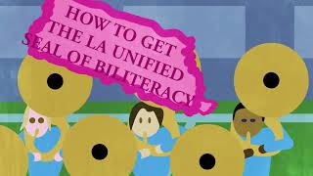
Video-Pathway to Biliteracy Awards
Notes:
Aram
Time: 6 minutes
Say: Now, let’s take a look at our Pathway to Biliteracy Awards video that highlights what the award(s) is/are, the benefits of being multilingual, how students can obtain the award, and the processes that this entails. Note that UTK students, in addition to Kindergarten and 1st grade are now honor with a Promise to Bilingualism award as well.
Time: Video: 5.04 min. (5 minutes)
Video link: https://www.youtube.com/watch?v=J_tnbmdH8hI (English)
Video link en Espanol:

Slide 12

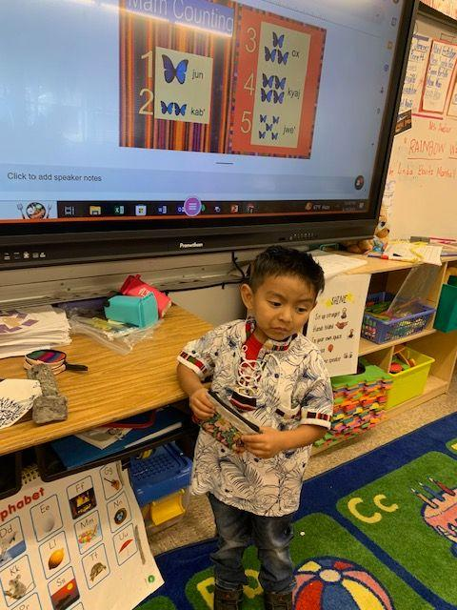
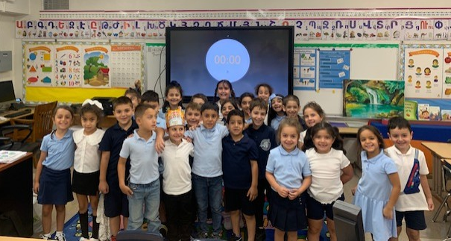
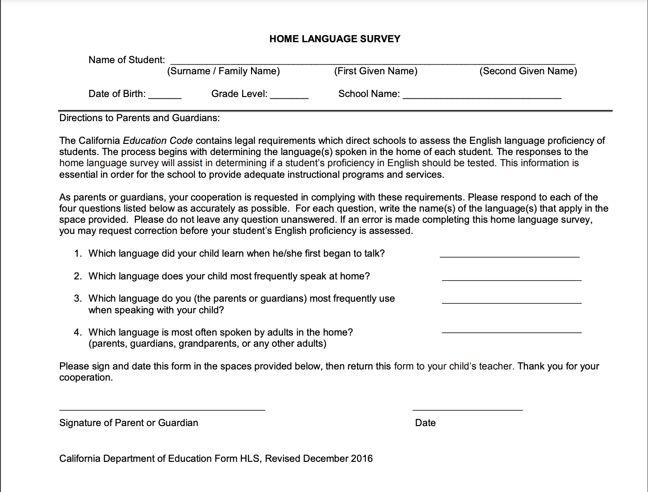
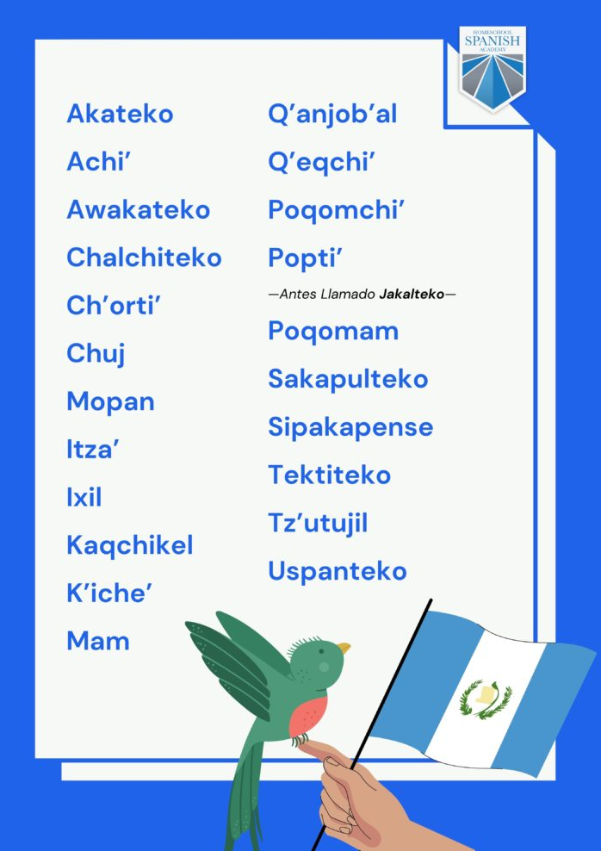
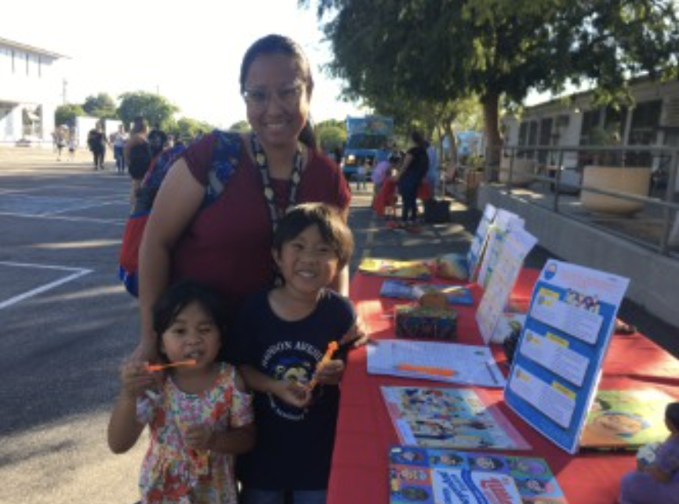
First Step! The Home Language Survey helps recognize
the gifts of multilingualism and honor cultural identities
Home Language Survey
You are your child’s biggest advocate!
Notes:
Aram
Time: 2 minutes
Say: The moment your child steps foot into a LAUSD school, their journey to multilingualism begins. As your child’s biggest advocate, The Home Language Survey helps you voice your child’s linguistic gifts.
Now we might be wondering, how might my child’s teacher/school be able to identify who might be eligible for an award? There are multiple ways:
The student’s home language survey :
2) Communicate with your child’s teacher what languages are spoken at home (Native language, heritage language, language of inter-ethnic communication, etc.). There may not just be the home language, but other languages being spoken as well.
Link to CA Home Language Survey: https://www.cde.ca.gov/ta/cr/documents/hls2020.pdf
The moment you steps foot into a LAUSD school, their journey to multilingualism begins. The Home Language Survey has helped us identify the many different languages that are spoken by our students across the school district.

Slide 13
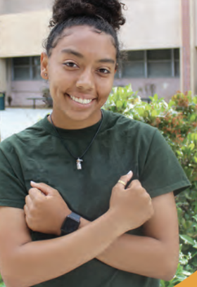
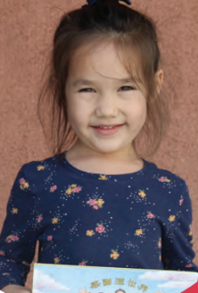
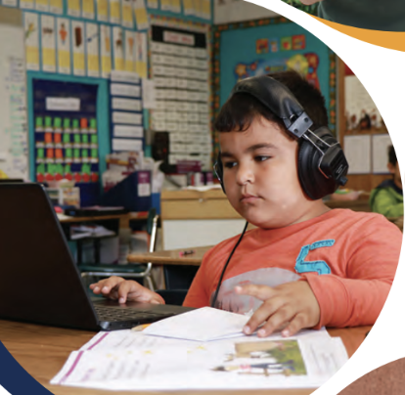
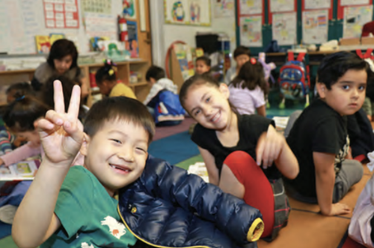
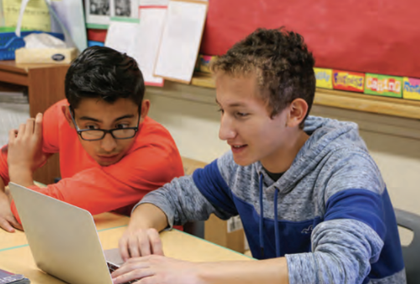
LA Unified’s Diverse Students
154 different languages are spoken in LAUSD schools:
The primary Language other than English (LOTE) is Spanish (88%)
Other languages include: Armenian (2%), Russian (2%), Korean (1%), Filipino (1%), Farsi (1%), Arabic, Vietnamese, K’iche’, Bengali, Cantonese to name a few.
Notes:
Aram
‘
Time: 30 seconds
From the Home Language Surveys, we have identified that 154 different languages are spoken in LAUSD schools:
The primary LOTE language is Spanish (88%)
Other languages include: Armenian, Russian, Korean, Arabic, Farsi, Vietnamese, K’iche’ (a Mayan language of Guatemala), Bengali, Cantonese to name a few

Slide 14
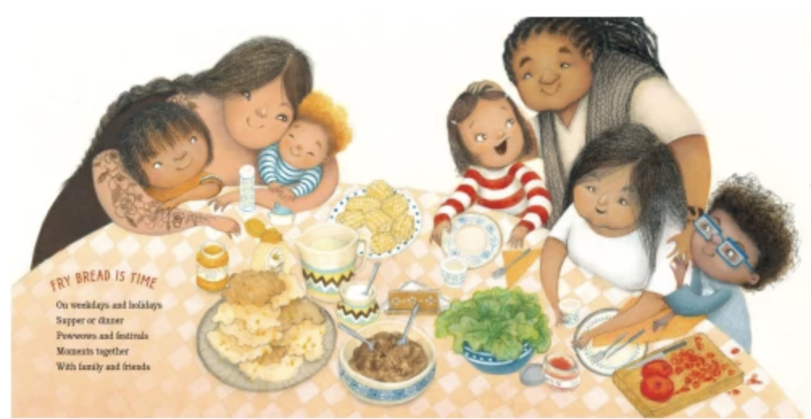
What language(s) do you speak
at home?
Share in the chat!
Notes:
Aram
Time: 1 minute
Say: As we’ve now gone over the different ways your child’s culture and identity can be honored through the languages spoken at home, we want to know from you! What language(s) do you and your children speak at home?
Go ahead and type the language(s) in the chat.

Slide 15
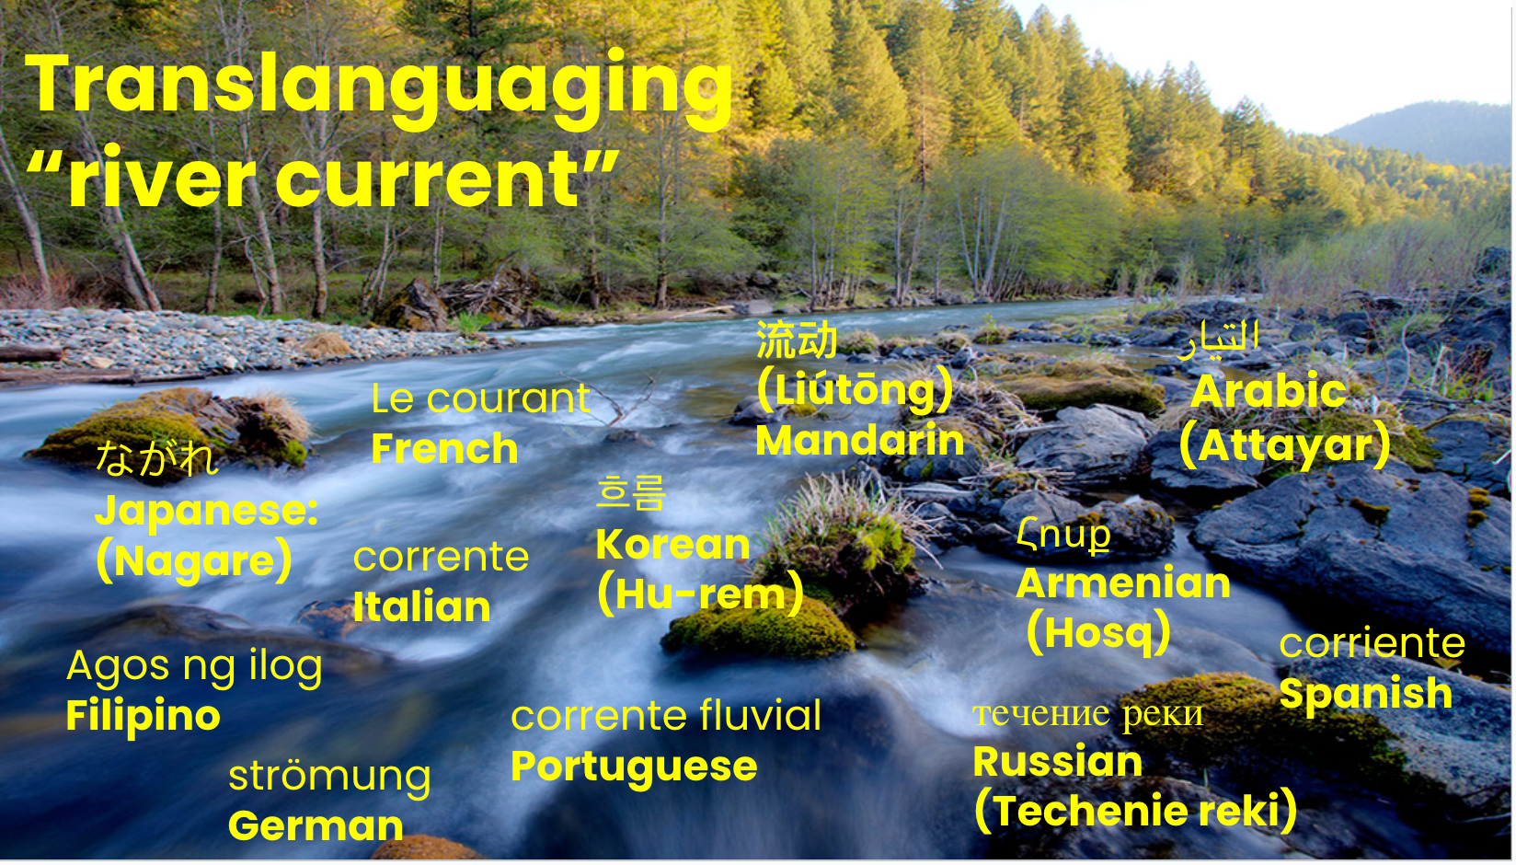
Sources: All Students Must Thrive & The Translanguaging Classroom: Leveraging Student Bilingualism for Learning
Notes:
This slide: 1.5 minutes
SAY:
In relation to all of the languages we might speak and the Promise to Bilingualism Awards, let’s take a look at this image here. Here we see a river, more precisely, a river current. This image is representative of the shift in mindset from a separation of languages, or monolingualism, to holistic multilingualism. Moreover, this image is representative of a pedagogy and a stance known as Translanguaging. Translanguaging, simply put, is the natural and flexible way that multilingual individuals draw on their entire linguistic repertoire—all the words, grammar, and ways of speaking they know—to communicate and make sense of the world, rather than separating their languages into distinct categories.

Slide 16

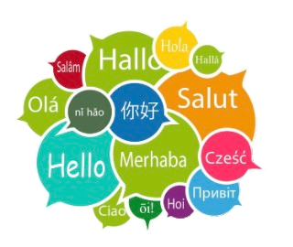
Languages Recognized
100+
 | LANGUAGES
1 | SPANISH
2 | MANDARIN
3 | ARMENIAN
4 | KOREAN
5 | FRENCH
6 | RUSSIAN
7 | JAPANESE
8 | FARSI
9 | HEBREW
10 | ARABIC
11 | FILIPINO
12 | AMERICAN SIGN LANGUAGE(ASL)
13 | HINDI
14 | PORTUGUESE
15 | TAMIL
16 | VIETNAMESE
17 | BENGALI
18 | GERMAN
19 | OTHER
20 | UKRAINIAN
 | LANGUAGES
21 | SIGN LANGUAGE
22 | THAI
23 | INDONESIAN
24 | POLISH
25 | PUNJABI
26 | TURKISH
27 | URDU
28 | AMHARIC
29 | GUJARATI
30 | PASHTO
31 | ROMANIAN
32 | TELUGU
33 | GREEK
34 | ITALIAN
35 | SWAHILI
36 | SWEDISH
37 | UZBEK
38 | ALBANIAN
39 | CAMBODIAN
40 | CANTONESE
41 | DUTCH
 | LANGUAGES
42 | HUNGARIAN
44 | KANNADA
45 | MARATHI
46 | NAVAJO
47 | JAVANESE
48 | AFGHAN
49 | AFRIKAANS
50 | ASSYRIAN
51 | BULGARIAN
52 | BURMESE
53 | CROATIAN
54 | CZECH
55 | FINNISH
56 | MONGOLIAN
57 | NEPALI
58 | SERBIAN
59 | SLOVAK
60 | SOMALI
61 | TIGRINYA
62 | YORUBA
63 | ZAPOTECO
Data from MiSiS 6/14/23
Notes:
Aram
Time: 30 sec
Through our Pathway to Biliteracy Awards, we have recognized over 63 languages!!! Here is the list of ALL languages awarded for our UTK-8th grade Pathway Awards this past school year.
Now some of you may have input more than one language in the chat! Guess what?! Those students who are proficient in multiple languages are also awarded cords.

Slide 17



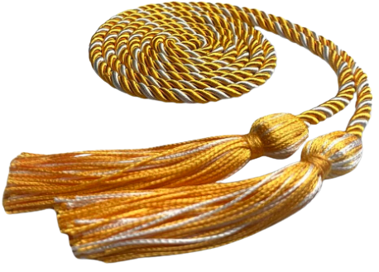

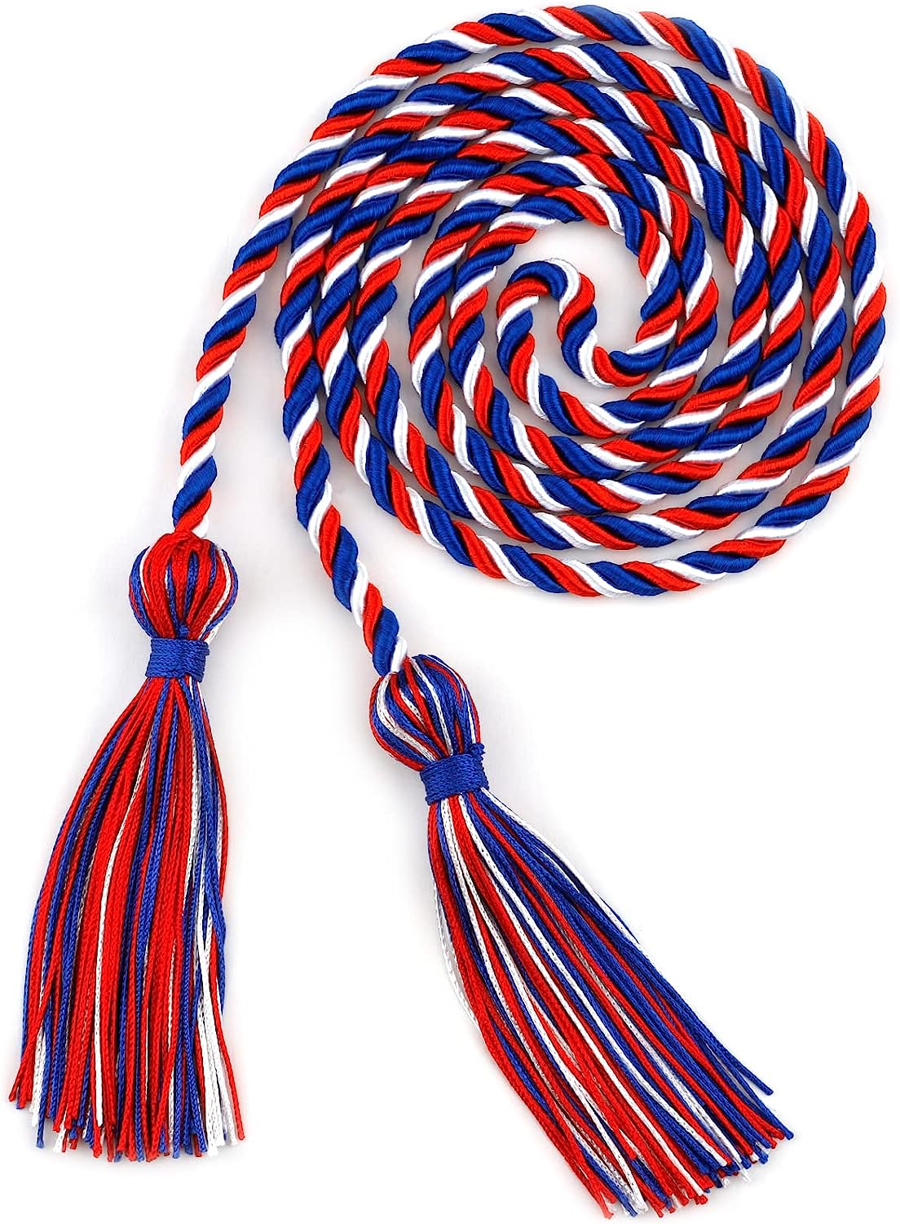
Awards Earned in Multiple Languages
 | LANGUAGES
1 | MANDARIN,SPANISH
2 | ARMENIAN,RUSSIAN
3 | KOREAN,SPANISH
4 | FRENCH,SPANISH
5 | SPANISH,VIETNAMESE
6 | ARMENIAN,SPANISH
7 | JAPANESE,SPANISH
8 | MANDARIN,RUSSIAN
9 | RUSSIAN,UKRAINIAN
10 | ARABIC,SPANISH
11 | FRENCH,PORTUGUESE
12 | GERMAN,SPANISH
13 | RUSSIAN,SPANISH
14 | AFRIKAANS,SPANISH
15 | ALBANIAN,SPANISH
16 | AMERICAN SIGN LANGUAGE(ASL),SPANISH
17 | ARABIC,URDU
18 | CAMBODIAN,SPANISH
19 | FARSI,FRENCH
20 | FILIPINO,SWEDISH
 | LANGUAGES
21 | FRENCH,GREEK
22 | FRENCH,HEBREW
23 | FRENCH,KOREAN
24 | FRENCH,POLISH
25 | FRENCH,SIGN LANGUAGE,SPANISH
26 | FRENCH,TURKISH
27 | GERMAN,SWEDISH
28 | HEBREW,SPANISH
29 | HINDI,SPANISH
30 | JAPANESE,KOREAN
31 | JAPANESE,MANDARIN
32 | KOREAN,MANDARIN
33 | POLISH,SPANISH
34 | PUNJABI,SPANISH
35 | SIGN LANGUAGE,SPANISH
36 | SLOVAK,SPANISH
37 | SPANISH,SWAHILI
38 | SPANISH,TAMIL
39 | SPANISH,ZAPOTECO
40 | FRENCH,GREEK
Cords awarded in recognition of 2 or more languages
(in addition to English)
TK
Kindergarten
1st grade
3rd grade
5th grade
8th grade
Data from MiSiS 6/14/23
Notes:
Aram
Time: 1 min.
Along with the certificate, students who earn the award in multiple languages also earn a chord of recognition for being multilingual in 2 or more languages in addition to English .

Slide 18
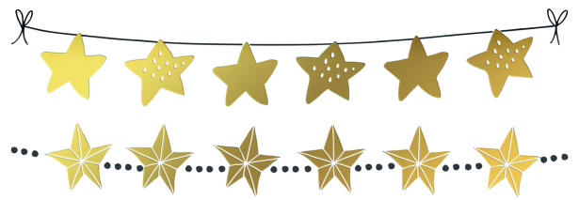
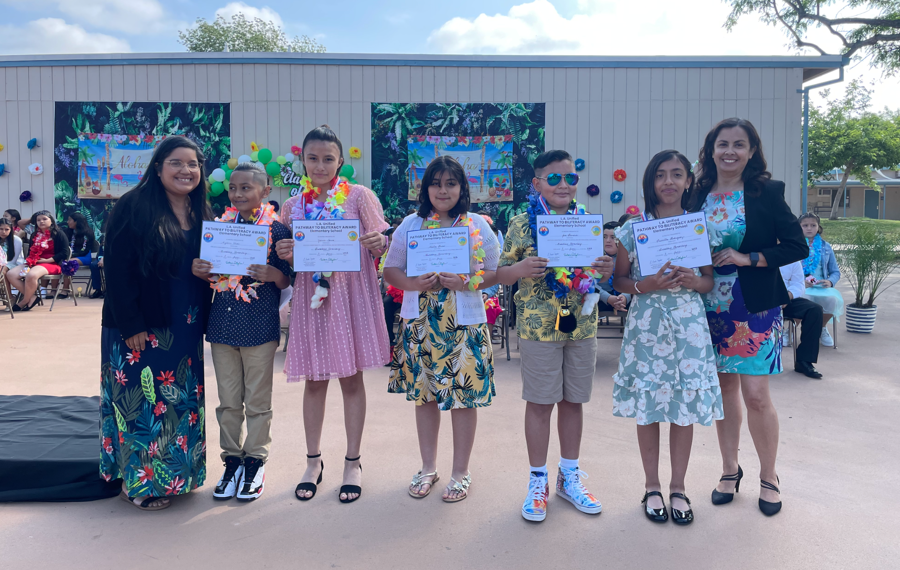
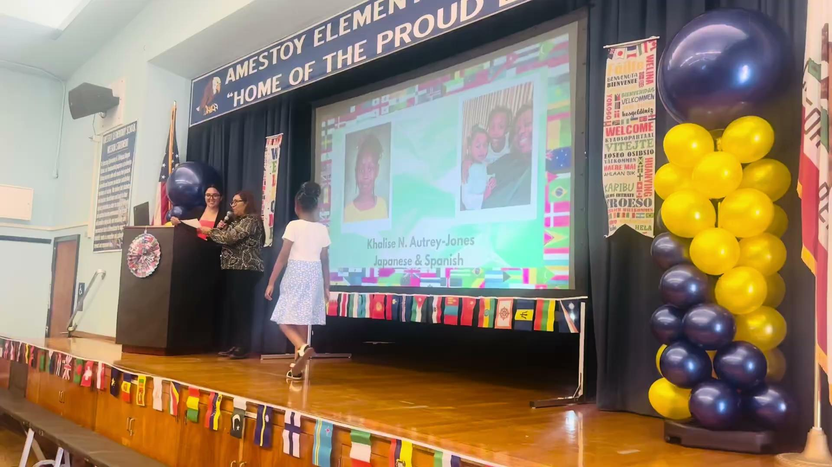
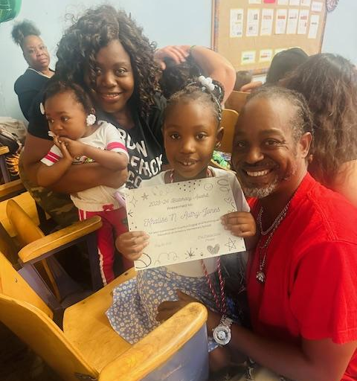
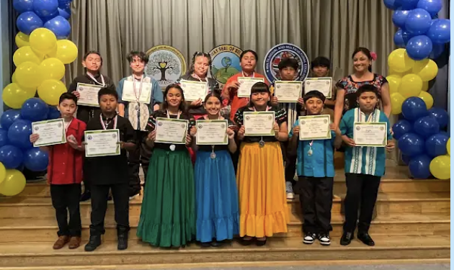
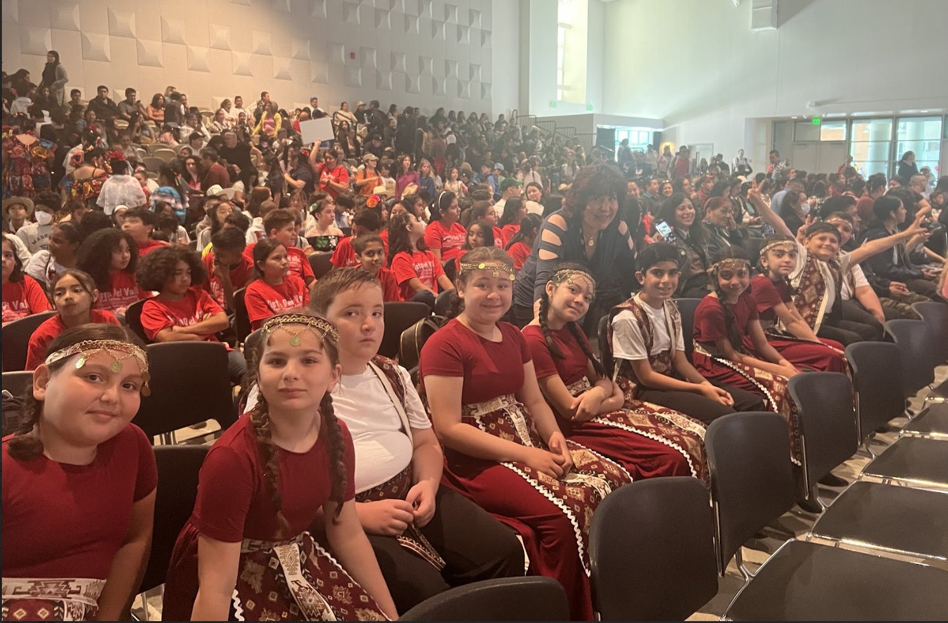
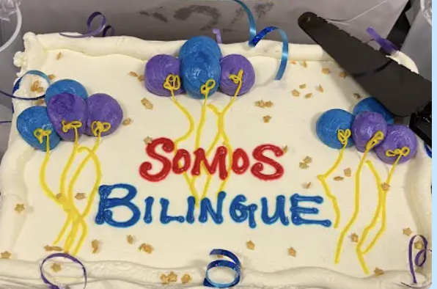
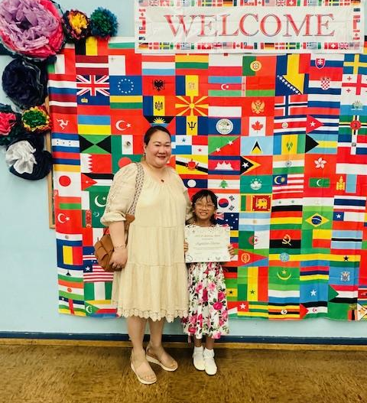

Celebrating the Pathway to Multiliteracy
Мы многоязычны
Մենք բազմալեզու խոսնակներ ենք
Bilingual Tayo
우리는 이중 언어를 구사합니다
Honoring culture, celebrating linguistic gifts, preserving culture,
valuing students’ multilingual assets
Notes:
Aram
Time: 2 minutes
Tech: show video: 0.41 min.
Say: We are so excited to showcase and celebrate a few of our multilingual students who have been recognized at our schools. As you can see from colorful display of celebrations in this slide, it is a celebration of their multilingual journey. We will watch a short video of a 1st grade student from Amestoy ES who is being recognized for their multilingual proficiency in multiple languages, Japanese and Spanish.
We invite you to be part of this call to advocacy and celebration of recognition! Thank you for being part of this movement.
We will now show you the elementary Flow of Advocacy Tasks at the school site level.

Slide 19
The Multilingual Journey
California Department of Education &
L.A. Unified
Seals of Biliteracy
Promise to Bilingualism Awards
Pathway to Biliteracy
Awards
Transitional
Kindergarten
5th Grade
8th Grade
12th Grade
Kindergarten
1st Grade
3rd Grade
TK
19
Notes:
Aram
Time: 1 min
Here is the Pathway to bilingualism and Biliteracy that all students can follow in L.A. Unified, to become biliterate and eventually receive the honor of Seals of Biliteracy on their high school diplomas. You as family members can help your children embark on this journey, as UTK, K, and 1st Grade Promise to Bilingualism awards lay the foundation of multilingualism for our little ones.
We are excited to announce all seven awards where we honor our learners, with UTK followed by the Kinder and 1st Grade awards, and then moving onto 3rd and 5th grade at the elementary level, and later moving onto middle school and high school with 8th and 12th grade. As you can see, earning an award at each of these key points in your child’s educational career for demonstrates a certain level of proficiency in speaking one or more languages in addition to English.
In 2023, 6,600 CDE seals of biliteracy or 24% were earned by the 2023 senior class.
Thanks for being your child’s first advocate!

Slide 20
How does your child earn the
TK - 1st Grade
Promise to Bilingualism Awards?
Notes:
Aram
Time: 1 minute
Say: Now let’s take a look at how your child can obtain a Promise to Bilingualism award at the UTK, K, and 1st Grade levels. The criteria, while similar at each of those grade levels, has some important differences as well.
Aram: UTK-1st Grade

Slide 21
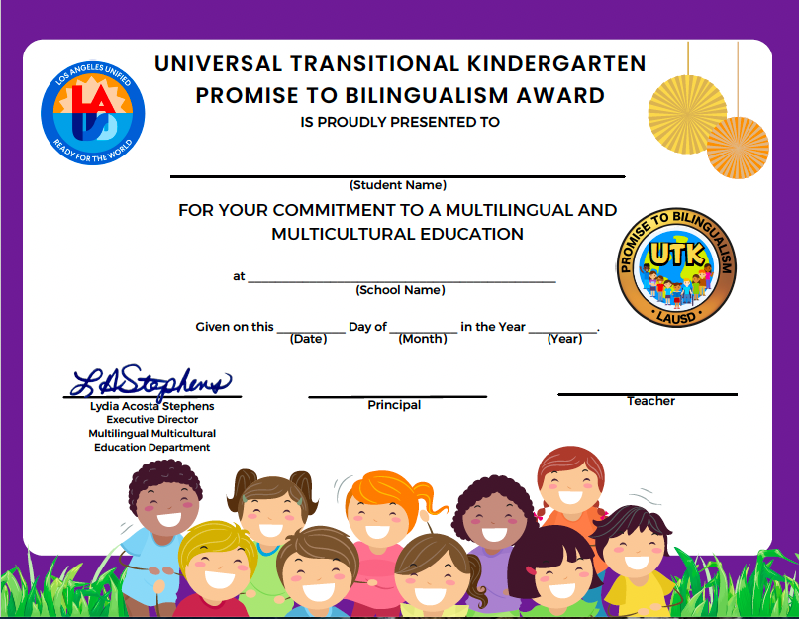
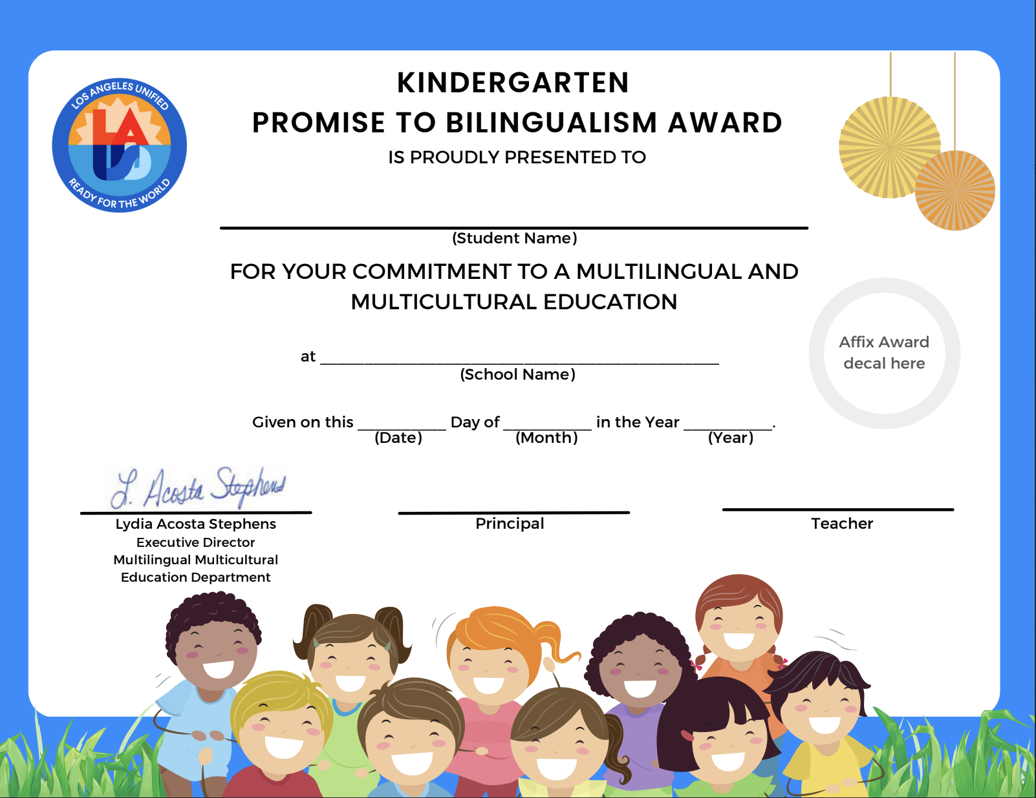
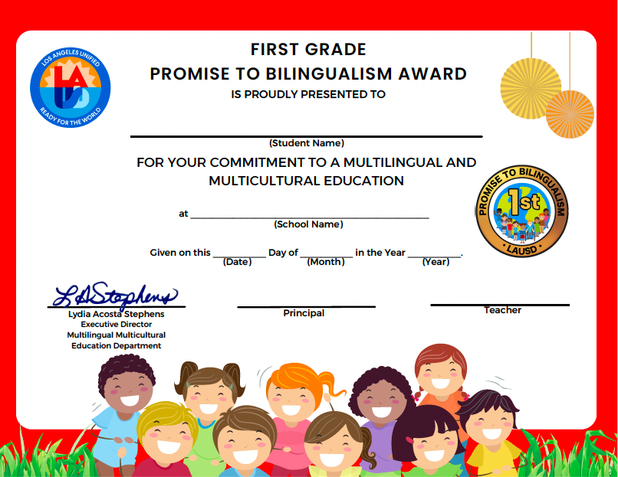


TK - 1 Promise to Bilingualism Awards
Transitional Kindergarten
TRANSITIONAL KINDERGARTEN AWARD
Kindergarten
1st
Cords awarded in recognition of 2 or more languages
(in addition to English)
Notes:
Aram
Time: 2 minutes
Say: The goal is to build pathways towards biliteracy and to encourage the love of learning multiple languages. Along the pathway to attainment of high-level biliterate competency, there are developmental stages. We offer three Promise to Bilingualism Awards in the first three years of their educational careers to recognize this developmental stage that can set a powerful foundation for biliteracy skills.
Additionally, note that those students who are able to complete the award criteria in two or more languages (Students can meet the criteria in as many languages as they possibly can) will also be awarded cords, in addition to their award certificate.

Slide 22
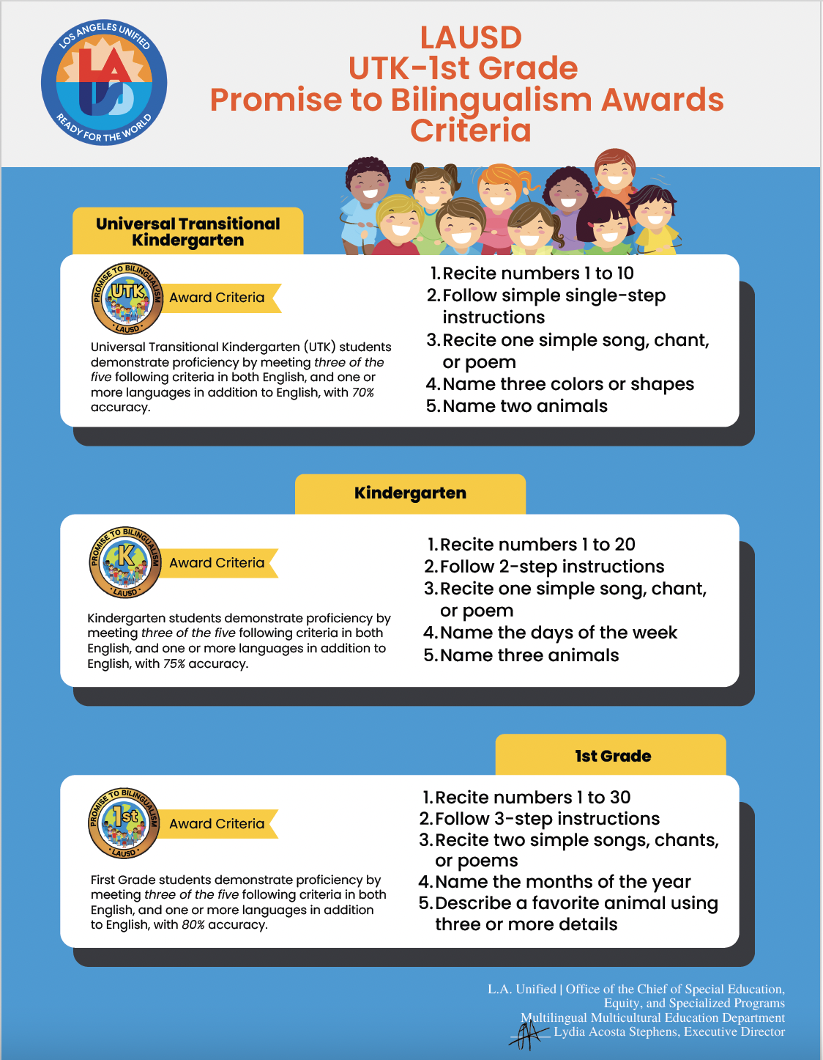
TK-1st Grade Promise to Bilingualism Criteria
Transitional Kindergarten
Notes:
Aram
Time: 2 minutes to go through infographic
Say: One might be asking, what are the criteria for earning a “Promise to Bilingualism” award? You can find the criteria for each grade level using this infographic. Notice that the general criteria remains the same for all grade levels. Merely the accuracy percentages for student responses increase grade-by-grade. In a few minutes, we’ll be going over with you how this criteria infographic will be connected with the rest of the advocacy tasks that will need to be completed.
Share the following links:
TK-1 Criteria Infographic: https://drive.google.com/file/d/16dRblVDyc5ZSGAntLBUkt4f7AXwwk0OY/view?usp=sharing
TK-1 Criteria Infographic in DLE Languages:https://drive.google.com/file/d/1wERpG8AtHBzOlNt03gOiscoqbJUMv_iW/view?usp=sharing
Read Slide Criteria.
Para TK (Preescolar) - los alumnos demuestran competencia lingüística al cumplir con tres de los cinco criterios siguientes en inglés y uno o más idiomas, con un 70% de precisión en los objetivos propuestos.
Recitar los números del 1 al 10
Seguir una instrucción sencilla de un solo paso
Contar una cancion, canto o poema sencillo
Nombrar tres colores o figuras
Nombrar dos animales
Para Kinder (Jardin de infancia) - igual cumplir con tres de los cinco criterios siguientes en inglés y uno o más idiomas, con un 75% de precisión en los objetivos propuestos.
Recitar los números del 1 al 20
Seguir instrucciones de dos pasos
Contar una cancion, canto o poema sencillo
Nombrar los días de la semana
Nombrar tres animales
Para Primer grado - igual cumplir con tres de los cinco criterios siguientes en inglés y uno o más idiomas, ahora con un 80% de precisión en los objetivos propuestos.
Recitar los números del 1 al 30
Seguir instrucciones de tres pasos
Contar dos canciones, cantos o poemas sencillos
Nombrar los meses del año
Describir un animal favorito usando tres o más adjetivos

Slide 23
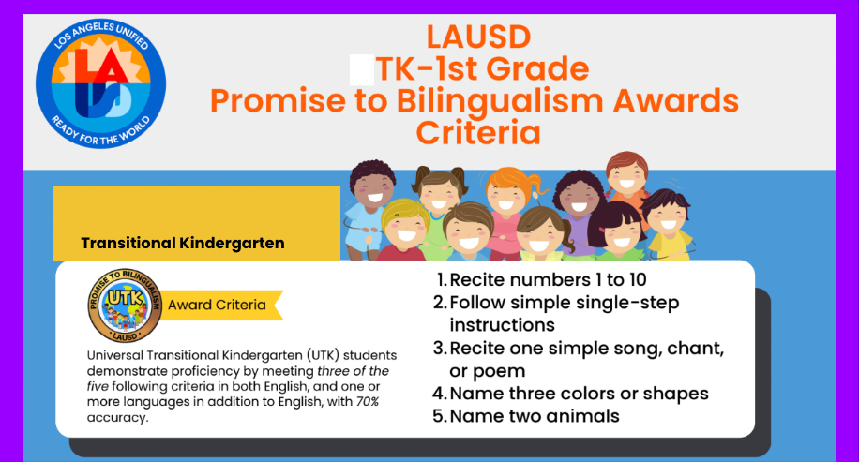
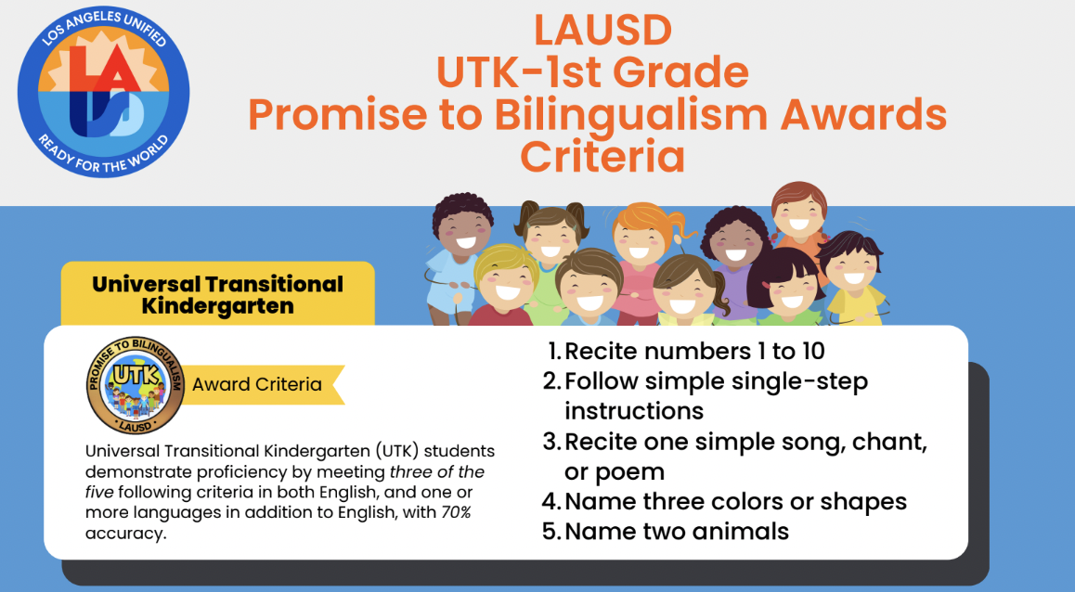

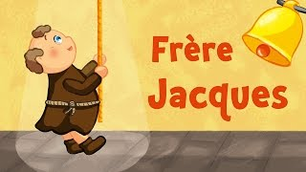

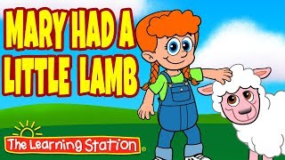
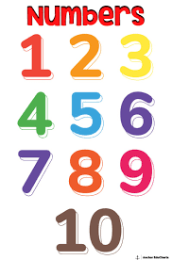
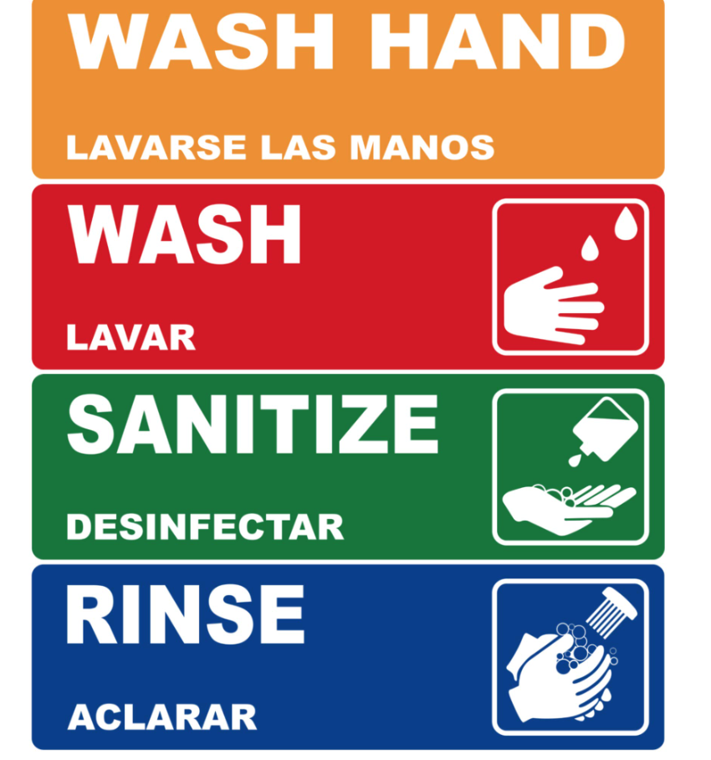
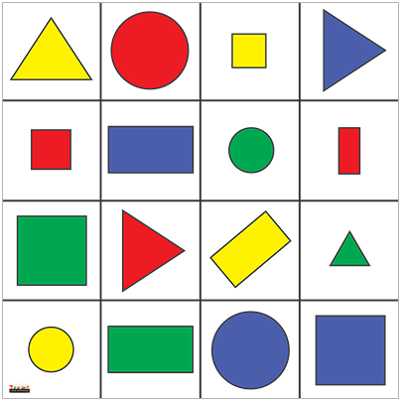
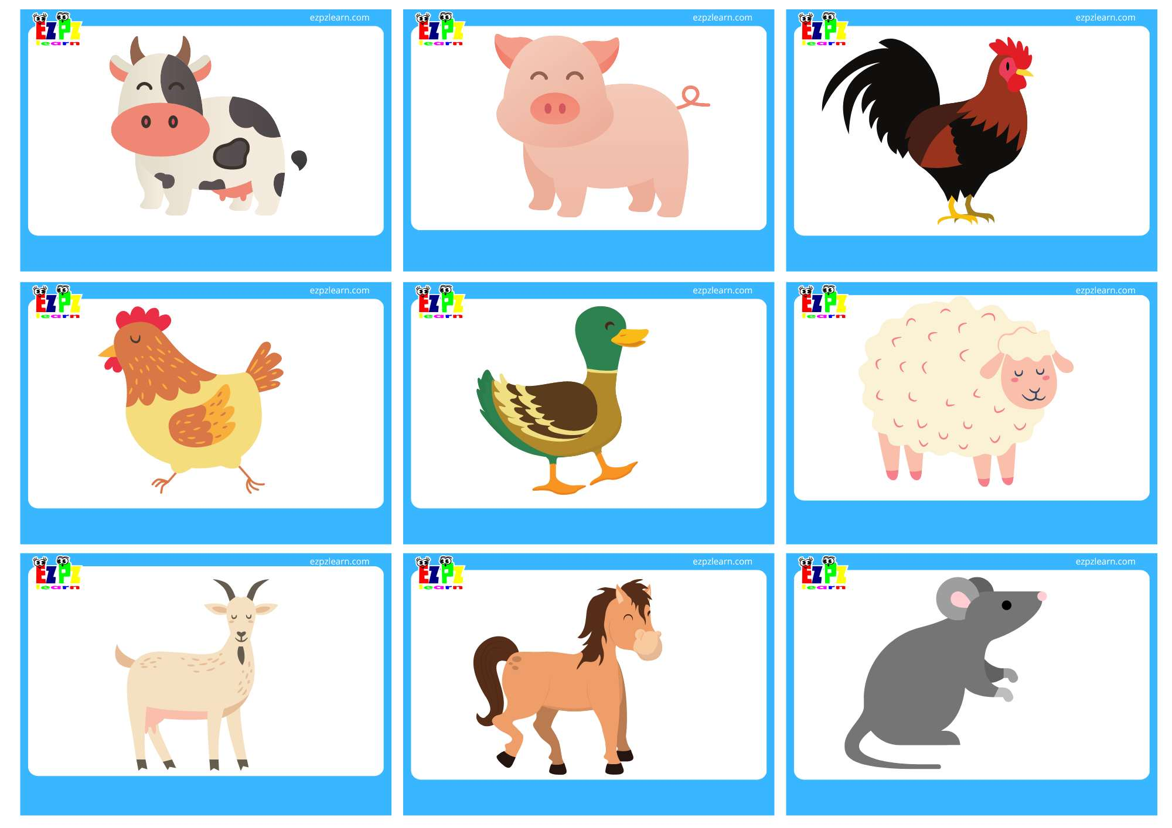
TK - Transitional Kindergarten Criteria
Students demonstrate proficiency by meeting 3 of the 5 following criteria in both English, and one or more languages.
Transitional Kindergarten
UTK
TK
ENJUAGAR
Notes:
Aram
Time: 1 min
Link: https://www.youtube.com/watch?v=mPU_I3L-9R8
Say: Let’s take a look at these checklists one-by-one. What must students at the UTK level be able to do to demonstrate their biliteracy?
Universal Transitional Kindergarten:
Students demonstrate proficiency by meeting three of the five following criteria in both English, and one or more languages, with 70% accuracy on the checklist (Attachment B):
a. Recite numbers 1 to 10
b. Follow a simple single-step instruction
c. Sing one simple song, chant, or poem (Play video)
d. Name three colors or shapes
e. Name two animals
Knowing that these are the different prompts that your child may have to answer, consider in what ways you could support them at home in having them meet the criteria. A little bit later on in this presentation, we will also go over some suggestions and supports that have proven to be beneficial.

Slide 24
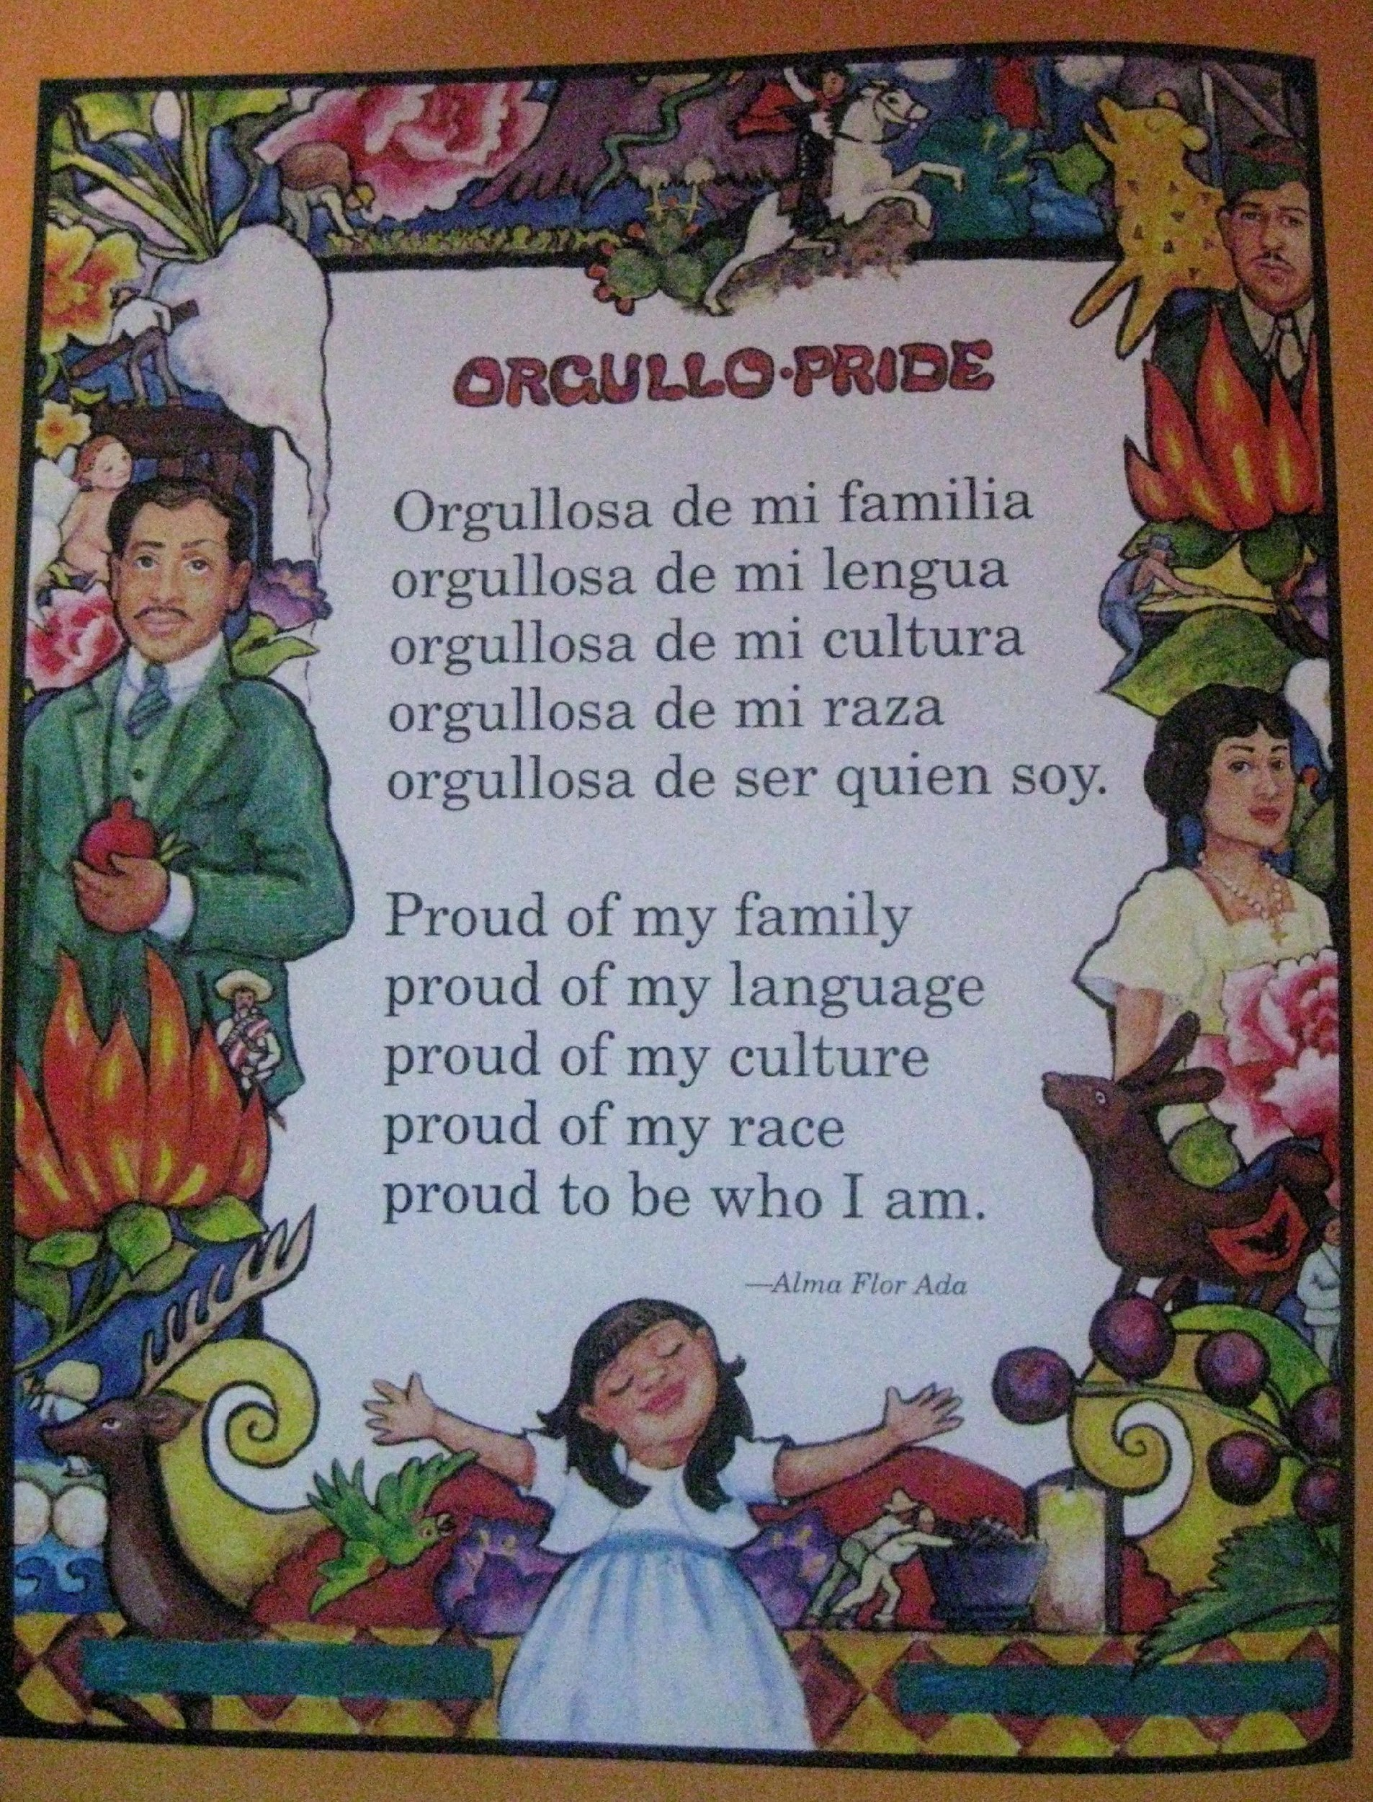
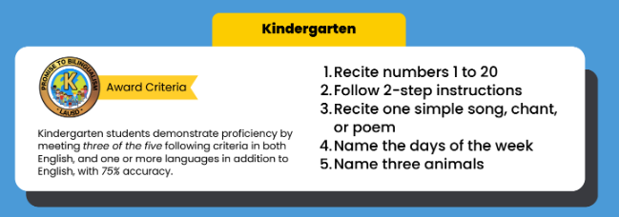
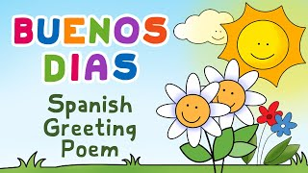



Kindergarten Criteria
Students demonstrate proficiency by meeting 3 of the 5 following criteria in both English, and one or more languages.
Notes:
Aram
Time: 1 min
Link:
Say: Let’s take a look at these checklists one-by-one. What must students at the UTK level be able to do to demonstrate their biliteracy?
Universal Transitional Kindergarten:
Students demonstrate proficiency by meeting three of the five following criteria in both English, and one or more languages, with 70% accuracy on the checklist (Attachment B):
a. Recite numbers 1 to 20
b. Follow two-step instructions
c. Recite one simple song, chant, or poem
d. Name three colors or shapes
e. Name two animals

Slide 25





1st Grade Criteria
Students demonstrate proficiency by meeting 3 of the 5 following criteria in both English, and one or more languages.
Notes:
Aram
Time: 1 min
Link:
Say: Let’s take a look at these checklists one-by-one. What must students at the UTK level be able to do to demonstrate their biliteracy?
Transitional Kindergarten:
Students demonstrate proficiency by meeting three of the five following criteria in both English, and one or more languages, with 70% accuracy on the checklist (Attachment B):
a. Recite numbers 1 to 10
b. Follow a simple single-step instruction
c. Sing one simple song, chant, or poem
d. Name three colors or shapes
e. Name two animals

Slide 26




Promise to Bilingualism Award Recipients
K
Cord earned: Romanian & French
Notes:
Aram
Time: 2 minutes
Let me introduce you to a couple of our Promise to Bilingualism recipients. On your left, we have Janell, proudly showing their award earned in TK for their bilingualism in Spanish and English. On the right, we have a special student I had the pleasure of meeting last year. This is Matei, a kindergartner from one of our LAUSD schools. Matei earned the award and the chord because he showed proficiency for Romanian, French and English. He was invited to one of our school board meetings where he recited a moving poem in Romanian to our Board Members. Here he is with his proud parents.

Slide 27
Q & A
Notes:
Aram

Slide 28

Literacy Family Resources
A Multilingual Journey to Pathway Awards
Home and Community
Support Resources
Notes:
Link to Family Resources: https://drive.google.com/drive/folders/1nTnD_jH4lHXstwAeVN_BMt_-a4xB2d_T?dmr=1&ec=wgc-drive-hero-goto

Slide 29
Your Community and Home as a Resource!
Call out the names of objects in more than 1 language!
At the grocery store, restaurant, laundromat, bakeries, Target…
Write recipes, thank you letters, announcements and party invitations in multiple languages
Watch a kid-friendly show in another language
Share stories
Sing songs

Slide 30


Supporting Your Child’s Bilingualism
Notes:
Aram
Say: Here are some ways you can support your child’s journey to multilingualism back at home.
PDF

Slide 31



Multilingual Literacy Home Support
Shared moments at home that can strengthen multilingual superpowers!
Please click on images and titles of websites to reveal link to websites and additional external resources!
Notes:
11:15 - 11:15 am
Thank you for being here families on behalf of your children. We wanted to share with you various home experiences and supports that you can begin to do with your kids to prepare for this multilingual world that is here! Any little step you might take to bring multilingualism into your home is a testament to the love and pride you have for your kids, and in the beliefs that they are limitless and have boundless potential! Let’s explore some ways to support multilingualism at home! We will begin by thinking about experiences that will not require a lot of technology or any at all, and also to emphasize that learning another language is more than just vocabulary and learning phrases here and there. “Language is not just words”. Next slide.

Slide 32









Spanish Resources
Epic
Read children’s stories and lessons in Spanish at The Spanish Experiment.
Storybooks Canada
Access SORA by using parent’s or students’ Schoology credentials.
Access the Epic digital library and follow progress with reading activities!
Notes:
Aram
Time: 30 seconds
Say: Here are our Spanish resources

Slide 33




Armenian Resources
Dino Lingo Armenian Books for Kids | Access Armenian literature through SORA by using parent’s or students’ Schoology credentials.
Pokrik Armenian Children's Literature | Erexa.am Children’s Literature
Notes:
Aram
Time: 30 seconds
Say: Here are our Armenian resources
https://poqrik.am/category/%D5%B4%D5%A1%D5%B6%D5%AF%D5%A1%D5%AF%D5%A1%D5%B6-%D5%A3%D6%80%D5%A1%D5%A4%D5%A1%D6%80%D5%A1%D5%B6/

Slide 34




Korean Resources
Access SORA by using parent’s or students’ Schoology credentials.
https://storybookscanada.ca/stories/ko/
https://m.sc.or.kr/happy2/bookDown.do
https://ridibooks.com/category/free-books/1320
Notes:
Aram
Time: 30 seconds
Say: Here are our Korean resources

Slide 35




Mandarin Resources

Slide 36




Filipino Resources

Slide 37


French Resources
Free Kids Books - French | Storybooks Canada
French stories and Literature
Storybooks Canada is a free open educational resource that promotes literacy and language learning in homes, schools, and communities. Select from a large selection of languages.

Slide 38



Various Languages Resources
 | Farsi Children’s Literature Access SORA by using parent’s or students’ Schoology credentials.
German & French Literature
Access the Epic digital library and follow progress with reading activities!

Slide 39







Supports from the LA Public Library
Free!
Physical and Electronic Cards are both available!
Notes:
Time: 1 minute
Link to LA Public Library: https://www.lapl.org/
Link to LA Public Library Card Application: https://www.lapl.org/sites/default/files/media/pdf/about/Library_Card_App.pdf
Download the library card application, fill it out, and then take it into any LA Public Library location
E-card Registration: https://www.lapl.org/about-lapl/contact-us/e-card/e-card-registration
E-Card Registration en Español: https://www.lapl.org/about-lapl/contact-us/e-card/solicitud-tarjeta-electronica

Slide 40
















Learning Library on Sora
The LAUSD Learning Library on Sora is the quickest and easiest way to read digital books. LAUSD students and staff can log in using their SSO and instantly access hundreds of ebooks and audiobooks on virtually any device, for FREE. We have ebooks and audiobooks in Korean, Mandarin, Russian, Spanish, Arabic, and French. For more information, click HERE.
Thousands of great reads are waiting for you in the LAUSD Learning Library on Sora. Open all day, everyday.
Notes:
Aram/Blanca
Time: 2 minutes
Say: The LAUSD Learning library is the quickest and easiest way to read digital books. LAUSD students, family members and staff can use their single sign on to instantly access hundreds of ebooks and audiobooks.

Slide 41


Celebrating the Promise to Biliteracy
All LAUSD Schools, Dual Language Education (DLE) Programs
and World Languages and Cultures (WLC) Secondary Courses
Region North
38 DLE programs
(Spanish, Armenian & Korean)
Region East
84 DLE programs
(Spanish, Mandarin & Arabic)
Region West
60 DLE programs
(Spanish, Korean, Mandarin, French, Armenian & Japanese)
Region South
50 DLE programs
(Spanish, Korean,
Mandarin & Japanese)
A total of 378 secondary schools offer LOTE WLC courses.
Notes:
Aram
Time: 1 min.
Say:
We are proud to share all the DLE and target languages offered by Regions and we are excited to announce that will will soon offer a DLE program in Russian in SY 25-26.
We are addressing the call to a bilingual and multilingual California, in accordance with the CA Global 2030 initiative.
We will now take a look at the history and advocacy behind DLE that has inspired us to offer and strengthen DLE programs.

Slide 42

MMED Dual Language & World Languages Team Contact Information
TK-1st Promise to Bilingualism | Aram Davtyan, DLE Specialist | aram.davtyan@lausd.net | (213) 241-2042
3rd Grade Pathway to Biliteracy | Blanca Valle-Alvarado, DLE Specialist | bvalle@lausd.net | (213) 241-4172
5th Grade Pathway to Biliteracy | Blanca Valle-Alvarado, DLE Specialist | bvalle@lausd.net | (213) 241-4172
8th Grade Pathway to Biliteracy | Elise Kim, DLE Specialist | elise.kim@lausd.net | (213) 241-5582
12th Grade SEALS of Biliteracy | Youssef Mossadaq, WLC Coordinator | yxm9573@lausd.net | (213) 241-4517
Notes:
Aram/Blanca
Time: 1 min
Read Slide

Slide 43
Next Steps
How are you going to help your child earn the Promise to Bilingualism award and stay on the Pathway to Biliteracy to strengthen their multilingual super powers?
Notes:
As a parent interested in your child earning the award:
Let your child’s teacher know that your child speaks more than one language, if you’re not in a Dual Language program.
Ask if your child’s school already has a Pathway to Biliteracy Committee and remember: parents may volunteer to be a part of it to support.
Continue to support your child with language at home.

Slide 44


Don’t Forget to…
Inform your child’s teacher that they have multilingual superpowers! | Engage your child with fun multilingual activities: Go on a word hunt around your community Write family recipes, letters, thank you cards | Ask your school leadership about Pathway Awards process?
Notes:
Reading in your home and in your neighborhood: go on a word hunt, flip through magazines, flyers, billboards, buses, menus, street signs, read the diverse city we line in!
Write down family recipes, diary entries, poems, rhymes, memories, interactive journals, draw a map of your neighborhood with labels, directions, experiment with words here and there in another language
Plan a party and create multilingual invitations
Create multilingual grocery lists
Write a letter to a friend or family member, add a phrase in a different language
Send a thank you note to someone special, add a phrase in a different language

Slide 46


Thank YOU!
Notes:
Thank you for joining us today and please be sure to reach out to us if you have any questions.

