Slide 1


Pathway to Biliteracy Awards, Honoring and Celebrating Language & Culture
Family Informational Sessions for
Grades 3 and 5/6
October, 2025
El camino hacia los premios de la biliteracidad, honrando y celebrando el lenguaje y la cultura
Sesiones Informativas
de grados 3er y 5/6º
para familias
octubre del 2025
Notes:
Time: 1 minute
Play Music as we wait to start: https://www.yout-ube.com/watch?v=_UucPr2M-qU&t=390s
Welcome to 2025-2026 Multilingualism Awards (TK-8th Pathway to Biliteracy and 12th Grade State Seal of Biliteracy, Honoring and Celebrating Languages & Cultures Family Informational Session. Please take a moment to sign in: https://forms.gle/p4gs5Gm2zmsKRnNq6

Slide 2
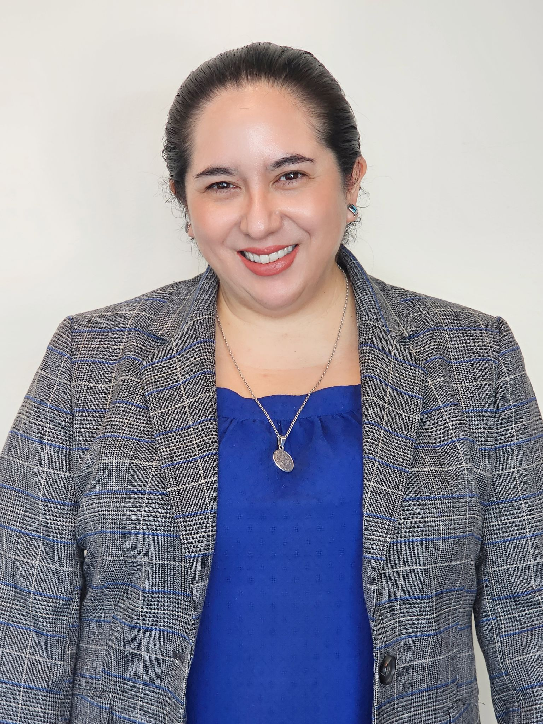
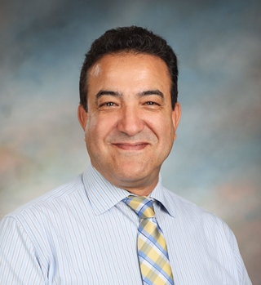
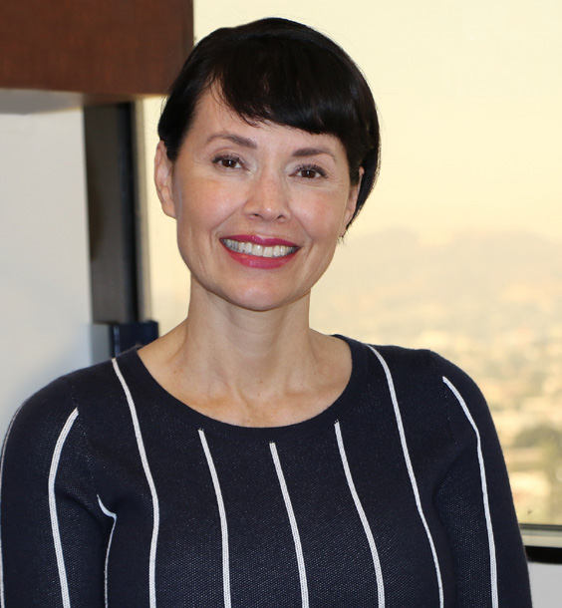
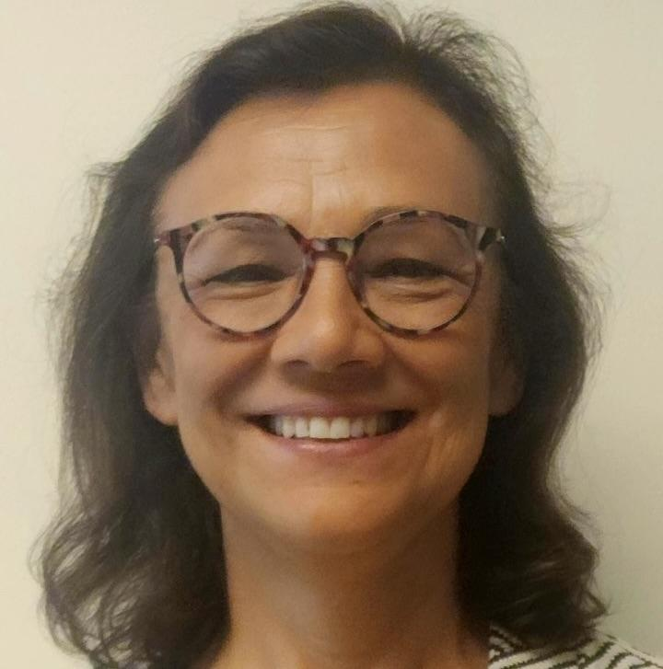
Meet our MMED Leadership
Nuestros líderes
Lydia Acosta Stephens
Ana M. Guzman
Roxanna Sosa
Youssef Mossadaq
Executive Director
Directora ejecutiva
Parent of they/them kiddo
Administrator
Dual Language Education
World Languages and Cultures
Administradora
Educación de lenguaje dual
Idiomas y culturas mundiales
Coordinator
World Languages & Cultures
Coordinador
Idiomas y culturas mundiales
Administrative Coordinator
Dual Language Education
Coordinadora administrativa
Educación de lenguaje dual
Notes:
Blanca
Time: 30 seconds
Here are our mighty leaders…

Slide 4
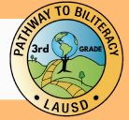

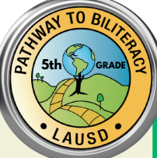
Recordatorio amable
La sesión informativa virtual de hoy está dirigida a familias de estudiantes en los grados:
3er grado
5º/6º grado
Friendly Reminder
Today’s Virtual Informational Session is intended for family members of students in grades:
3rd Grade
5th/6th Grade
Notes:
Blanca
Time: 1 minute
Say: While we are all happy to see you in attendance today, do remember that this presentation is intended for family members of students in grades 3, 5/6. You are free to attend this session if your child is not in any of those grades, of course, but do know that the criteria covered in the presentation will reflect those three grades.

Slide 5
Today’s Session
La sesión de hoy
Questions to Answer Today: Preguntas a contestar hoy:
What are the Path to Bilingualism Awards in 3rd and 5th/6th Grades?
What does my child need to do to earn the award(s)?
How can I support my child at home?
¿Qué son los Premios Camino a la Biliteracidad en 3er-5º/6º grado?
¿Qué necesita hacer mi estudiante para recibir el premio?
¿Cómo puedo apoyar a mi estudiante en casa?
Notes:
Blanca
Time: 1 minute
Say: Today’s session will be focusing on addressing the following questions:
What are the Promise to Bilingualism Awards in Grades 3rd and 5th/6th Grades?
What does my child need to do to earn the award(s)
How can I support my child at home?
Before we answer those questions for you, let’s first take a look at some of the benefits of being bilingual.

Slide 6
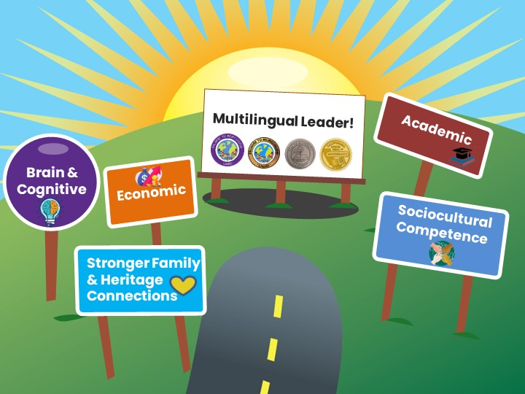



Benefits of Bilingualism and Biliteracy
Beneficios del bilingüismo y la biliteracidad
Which one
resonates with
you & why?
¿Cuál ventaja le llama la atención y por qué?
Lifelong Advantages
Ventajas para toda la vida
Líder multilingüe
Cerebral y cognitivo
Económico
Académico
Competencia sociocultural
Conexiones Familiares
Share in the chat!
¡Comparta en el chat!
Notes:
Blanca
Time: 2 minutes
Say: The experience of mastering two or more languages has enormous benefits for students. People who are able to speak, read, and write in two or more languages are able to participate in several different cultural and language worlds. Multilingual proficiency actually strengthens how the brain functions. Let’s look at some of the benefits of be bilingual and biliterate:
DLE benefits ALL our students:
Brain & Cognitive Function:
Cognitive flexibility
Improves decision-making skills
Better problem-solving abilities
Have a stronger sense of self
Academic:
Increased academic performance
Advanced language courses
Biliteracy awards and District and State Seals of Biliteracy
Economic:
Competitive in the global economy
Have expanded job opportunities with higher pay
Sociocultural Competence
Awareness and understanding of other cultures
Can be “citizens of the world” with a more comprehensive and tolerant perspective
Stronger Family & Heritage Connections
Bridge builders for their families
Access to the wisdom of their heritage cultures
Ask: In the chat, go ahead and share your response to the following question: Which on of these benefits of bilingualism and biliteracy resonates with you?
Mastering two or more languages has enormous benefits for students. People who are able to speak, read and write in two or more languages are able to participate in several different cultural and language worlds.
Bilingualism is associated with more cognitive flexibility and better problem solving abilities.
Children who are bilingual tend to perform better on achievement tests.
Job opportunities become available throughout the globe for those who are bilingual, and there are often financial benefits associated with bilingual skills in the labor market.
The study of another language expands one’s worldview and builds cross-cultural understanding.
More than one-third of California school children speak a language other than English at home. The development of strong bilingual skills that include home language and English provide them the capacity to participate actively in both of their language worlds, and to be bridge builders and translators for their families.

Slide 7

Global California 2030 A Call to Action!
“By 2030, we want half of all K–12 students to participate in programs leading to proficiency in two or more languages, either through a class, a program, or an experience. By 2040, we want three out of four students to be proficient in two or more languages, earning them a State Seal of Biliteracy.”
-Tom Torlakson, former State Superintendent
California global 2030
¡Un llamado a la acción!
“Para 2030, queremos que la mitad de todos los estudiantes K-12 participen en programas que les permitan dominar dos o más idiomas, ya sea a través de una clase, un programa o una experiencia. Para 2040, queremos que tres de cada cuatro estudiantes dominen dos o más idiomas, lo que les permitirá obtener un Sello Estatal de Alfabetización Bilingüe”.
-Tom Torlakson, ex superintendente estatal
Notes:
Blanca
Time: 30 sec
Here is a short background on what drives our work here in LAUSD. This initiative is a call to action, urging parents, educators, and legislators to support a multilingual California where students are provided the opportunity to become bilingual and biliterate.
By 2030, this initiative envisions that half of California’s K–12 students will be enrolled in programs that develop proficiency in two or more languages.
By 2040, three out of four California students will be proficient in two or more languages and earn the State Seal of Biliteracy.
Link: https://drive.google.com/file/d/1wZzqgKNbygjRUKS6hW176TAT1i51UGnx/view?usp=sharing

Slide 8

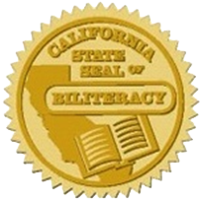
Strategic Plan 2022-2026
Plan Estratégico 2022-2026
"Proporcionar a los estudiantes mayores oportunidades para volverse multilingües a través de programas duales y de idiomas mundiales, incluido el lenguaje de señas americano". pág. 26
“Provide students with expanded opportunities to become multilingual through dual and world language programs, including American Sign Language.” pg. 26
“By 2026, ensure at least 50% of our graduating seniors receive the California Seal of Biliteracy.”
-Alberto Carvalho, Superintendent
“Para 2026, asegurar que al menos el 50% de nuestros estudiantes que se gradúan reciban el Sello de Alfabetización Bilingüe de California”.
-Alberto Carvalho, Superintendent
Notes:
Blanca
Say: It’s important to note that our 2022-2026 strategic plan is supported by our Pathway to Biliteracy Awards, as it is our goal by 2026 to ensure that at least 50% of our graduating seniors receive the CSSB.
Ask: Do you have children who are in high school? Do they know they can obtain a SSB? Encourage them to ask their school teachers and counselors!
Time: 30 sec

Slide 9

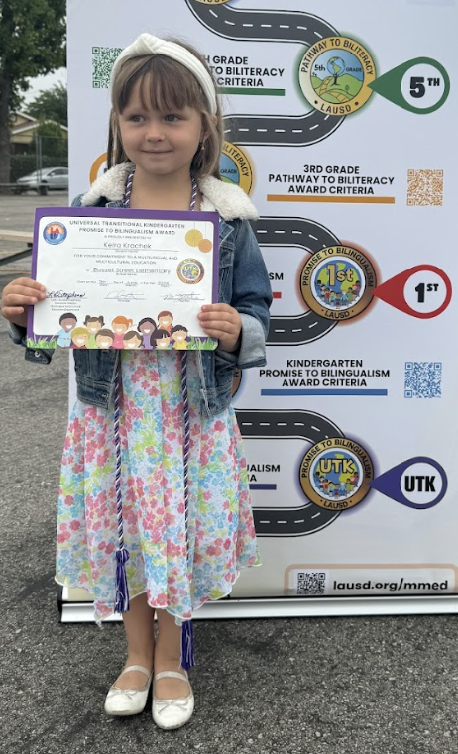





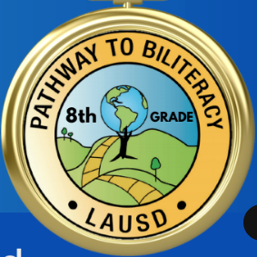
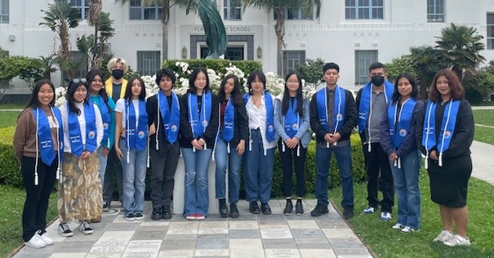
The Multilingual Journey/El camino multilingüe
California Department of Education & L.A. Unified Seals
of Biliteracy
Departamento de Educación de California y
Distrito Unificado de Los Ángeles
Sellos de la biliteracidad
Promise to Bilingualism Awards
Premios Promesa al Bilingüismo
Pathway to Biliteracy Awards
Premios Camino a la Biliteracidad
5/6th Grade
8th Grade
12th Grade
Transitional
Kindergarten
Kindergarten
1st Grade
3rd Grade
TK
9
Notes:
Blanca
Time: 1 min
Here is the Pathway to bilingualism and Biliteracy that all students can follow in L.A. Unified, to become biliterate and eventually receive the honor of Seals of Biliteracy on their high school diplomas. You as family members can help your children embark on this journey, as UTK, K, and 1st Grade Promise to Bilingualism awards lay the foundation of multilingualism for our little ones.
We are excited to announce all seven awards where we honor our learners, with UTK followed by the Kinder and 1st Grade awards, and then moving onto 3rd and 5th grade at the elementary level, and later moving onto middle school and high school with 8th and 12th grade. As you can see, earning an award at each of these key points in your child’s educational career for demonstrates a certain level of proficiency in speaking one or more languages in addition to English.
In 2023, 6,600 CDE seals of biliteracy or 24% were earned by the 2023 senior class.
REF-062900.4 Pathway Awards Policy: https://drive.google.com/file/d/1cyrkbgzAC7nyYJyy3J38oNrP7wcixIdj/view?usp=share_link

Slide 10
What are the
Pathway to Biliteracy Awards
in 3rd and 5th/6th Grade?
¿Cuáles son los
premios Camino al Biliteracidad
en 3er - 5º/6º grado?

Slide 11

Video-Pathway to Biliteracy Awards
Premios caminos hacia la biliteracidad
Link to video in Spanish available. Enlace disponible para el video en español.
Notes:
Aram
Time: 6 minutes
Say: Now, let’s take a look at our Pathway to Biliteracy Awards video that highlights what the award(s) is/are, the benefits of being multilingual, how students can obtain the award, and the processes that this entails. Note that UTK students, in addition to Kindergarten and 1st grade, and now 3rd grade honor with a Promise to Bilingualism award as well.
Time: Video: 5.04 min. (5 minutes)
Video link: https://www.youtube.com/watch?v=J_tnbmdH8hI (English)
Video link en Espanol: https://lausd.wistia.com/medias/uqlignw0os

Slide 12

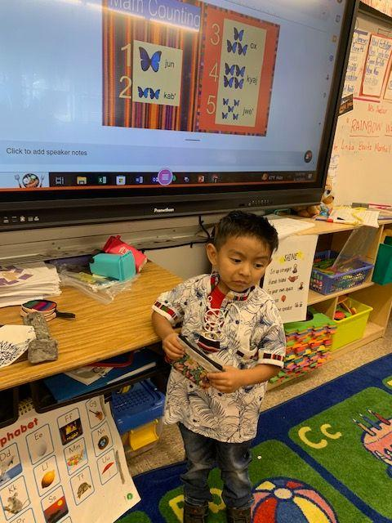
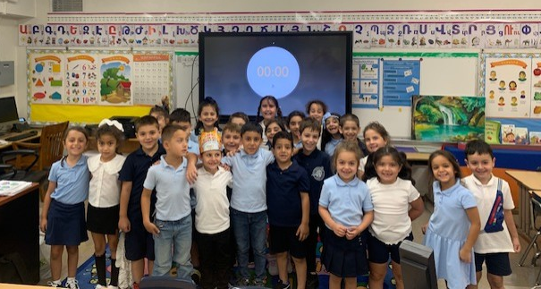
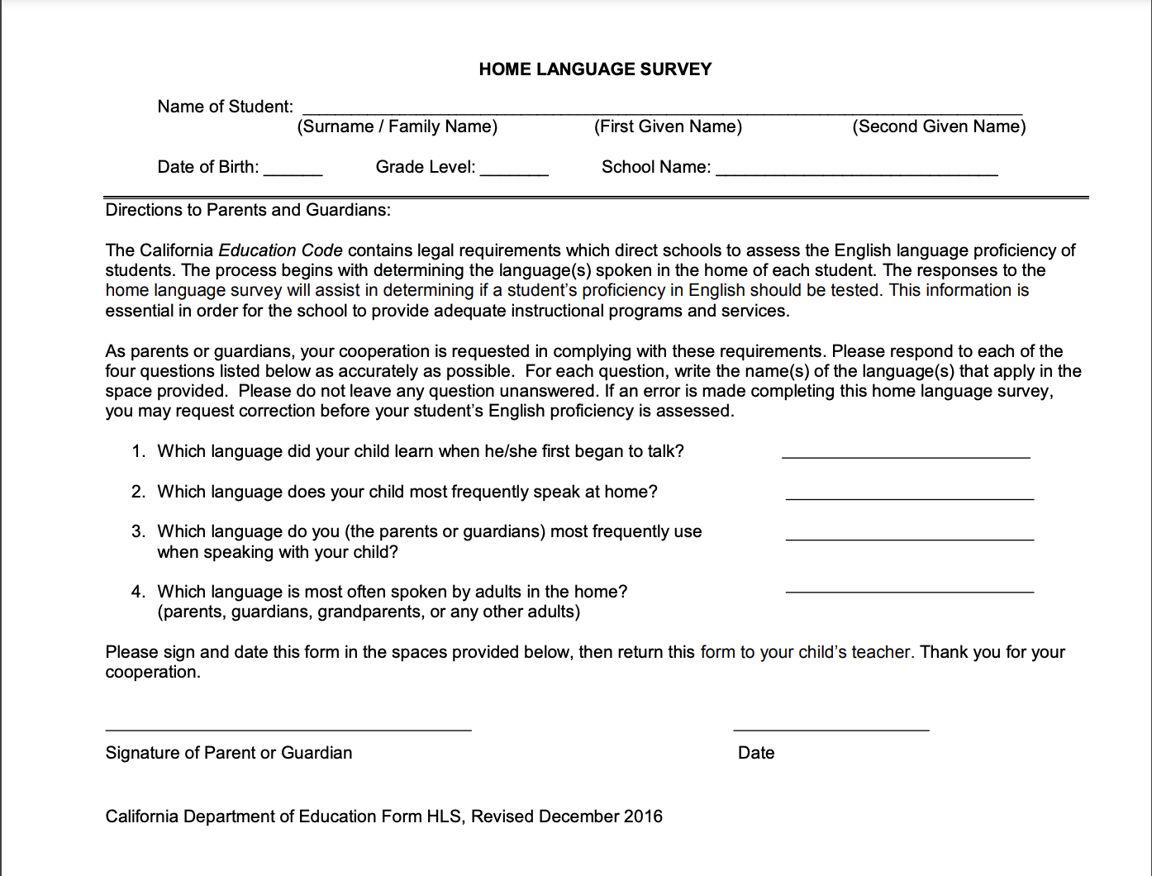
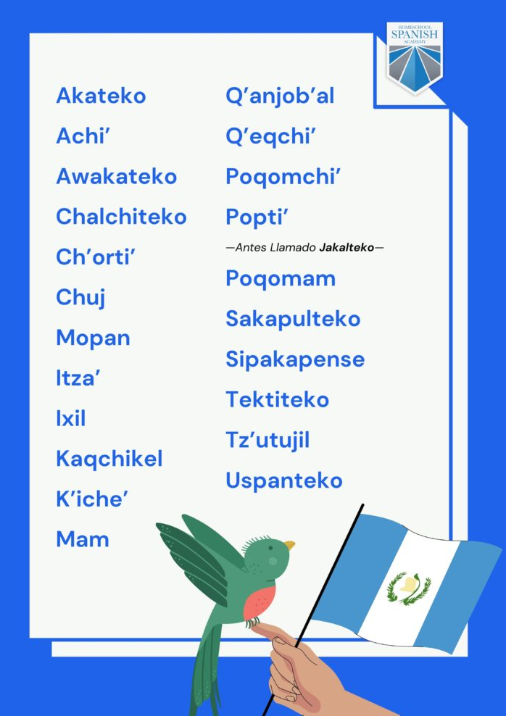
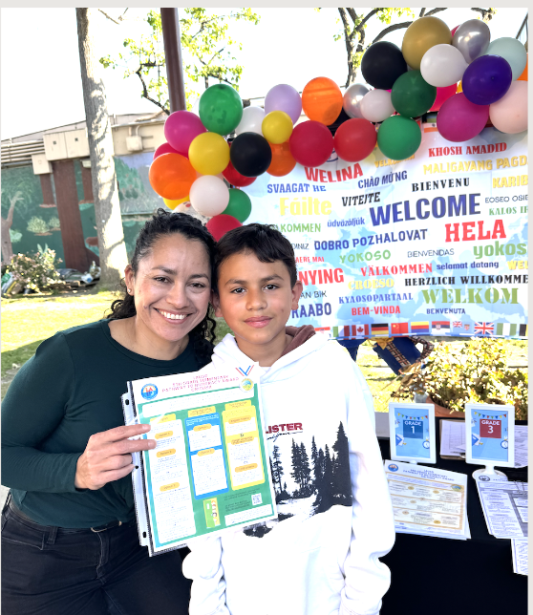
First Step! ¡Primeros pasos!
Recognize the gifts of multilingualism and honor cultural identities
Reconoce las riquezas multilingües y honra las identidades culturales
Home Language Survey
Encuesta del idioma en el hogar
You are your child’s biggest advocate!
¡Su lucha y apoyo es lo más importante para su hija/o!
Notes:
Time: 2 minutes
Say: The moment your child steps foot into a LAUSD school, their journey to multilingualism begins. As your child’s biggest advocate, The Home Language Survey helps you voice your child’s linguistic gifts.
Now we might be wondering, how might my child’s teacher/school be able to identify who might be eligible for an award? There are multiple ways:
The student’s home language survey :
2) Communicate with your child’s teacher what languages are spoken at home (Native language, heritage language, language of inter-ethnic communication, etc.). There may not just be the home language, but other languages being spoken as well.
Link to Home Language Survey:
The moment you steps foot into a LAUSD school, their journey to multilingualism begins. The Home Language Survey has helped us identify the many different languages that are spoken by our students across the school district.

Slide 13
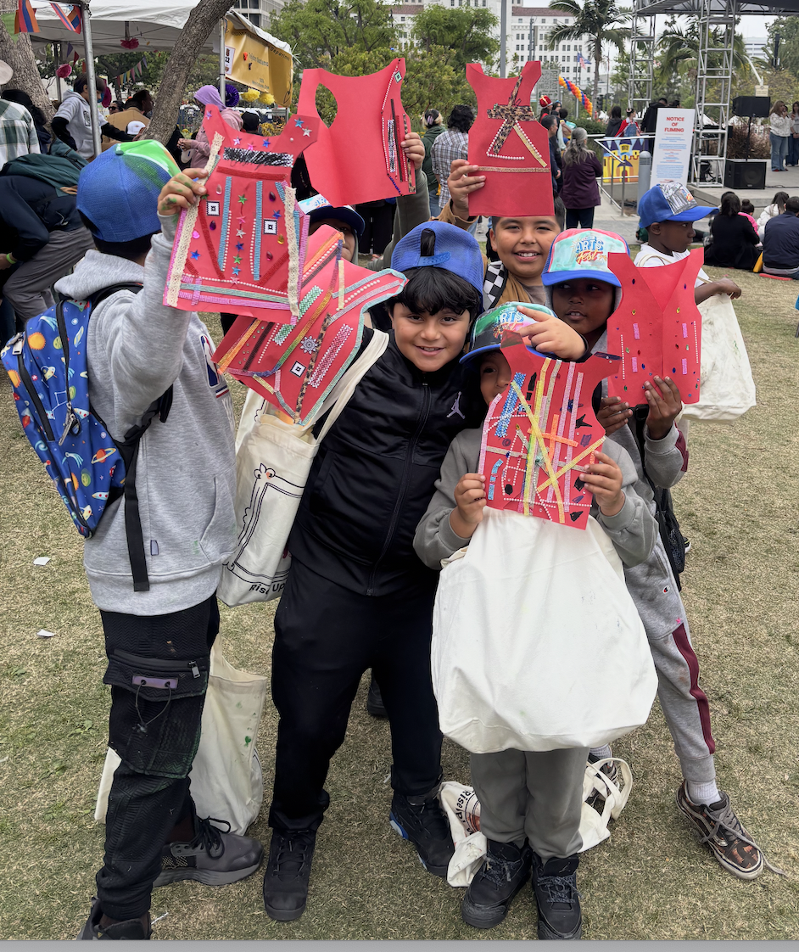

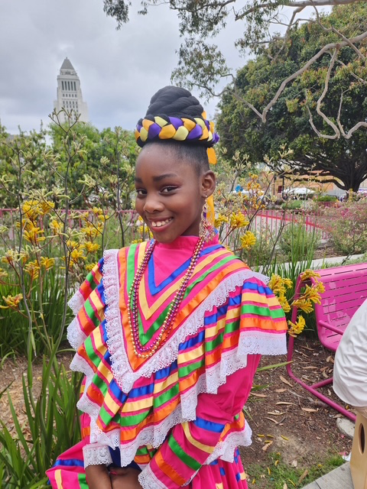
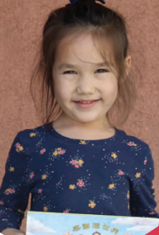
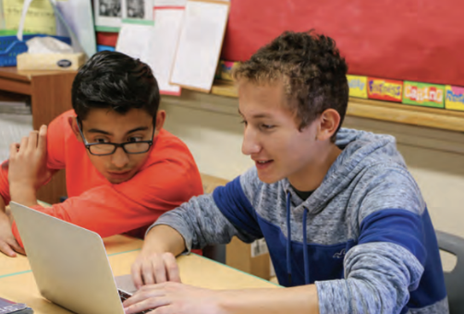
LA Unified’s Diverse Students
Los diversos estudiantes del LAUSD
En las escuelas del LAUSD se hablan 154 idiomas diferentes:
El idioma principal además del inglés (LOTE) es el español (88%)
Otros idiomas incluyen:
armenio (2%), ruso (2%), coreano (1%), filipino (1%), farsi (1%), árabe, vietnamita, k'iche', bengalí, cantonés, por nombrar algunos.
154 different languages are spoken in LAUSD schools:
The primary Language other than English (LOTE) is Spanish (88%)
Other languages include: Armenian (2%), Russian (2%), Korean (1%), Filipino (1%), Farsi (1%), Arabic, Vietnamese, K’iche’, Bengali, Cantonese to name a few.
Notes:
Blanca
‘
Time: 30 seconds
From the Home Language Surveys, we have identified that 154 different languages are spoken in LAUSD schools:
The primary LOTE language is Spanish (88%)
Other languages include: Armenian, Russian, Korean, Arabic, Farsi, Vietnamese, K’iche’ (a Mayan language of Guatemala), Bengali, Cantonese to name a few

Slide 14
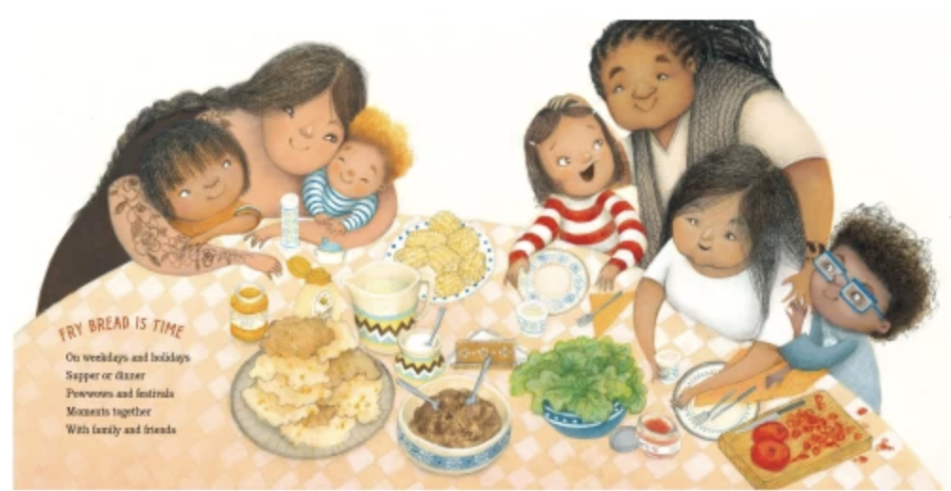
What language(s) do you speak
at home?
¿Qué idioma(s) hablas en casa?
Share in the chat!
¡Comparta en el chat!
Share in the chat!
Notes:
Aram
Time: 1 minute
Say: As we’ve now gone over the different ways your child’s culture and identity can be honored through the languages spoken at home, we want to know from you! What language(s) do you and your children speak at home?
Go ahead and type the language(s) in the chat.

Slide 15
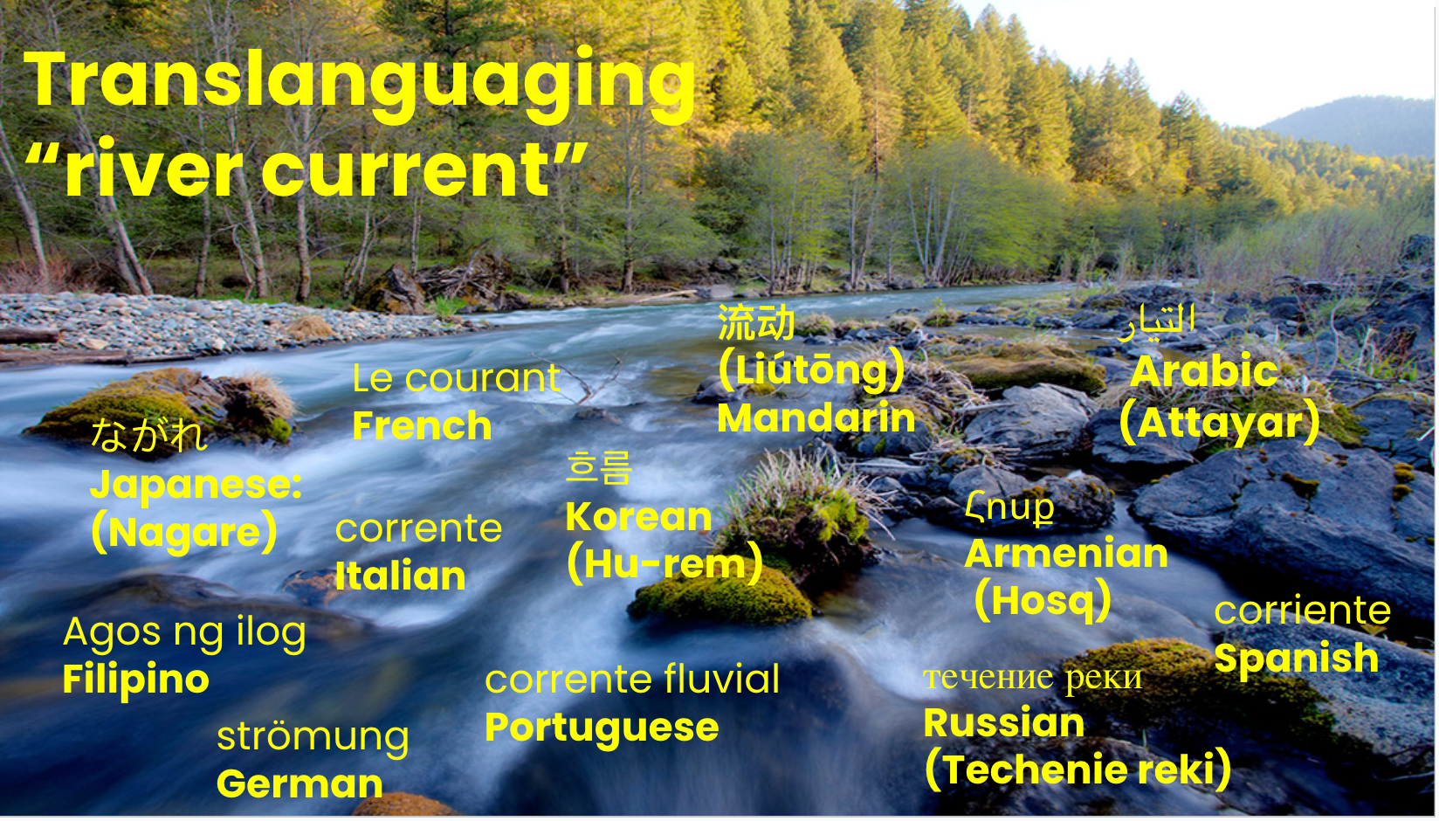
Sources: All Students Must Thrive & The Translanguaging Classroom: Leveraging Student Bilingualism for Learning
Notes:
This slide: 1.5 minutes
SAY:
And it is with all the the languages that we speak so fluidly at home, like a river current, we also wanted to highlight that as being multilingual, our dynamic multilingualism runs through all aspects of the classroom, school,s playgrounds, homes, and communities. The use of language is an integrated whole, like a thriving river ecology, just as you see on your screen. That is, the languages that we, our children, our students speak don’t live separately, but rather, are interconnected.
Another critical building block of translanguaging as authored by Dr. Ofelia Garcia and friends, is the translanguaging rover current.
The authors use the metaphor of the translanguaging current to refer to the current or flow of students’ dynamic bilingualism that runs through all aspects of the classroom, schools, playgrounds, homes and communities. The current perceives use of language as an integrated whole, like a thriving multilingual river ecology, where students connect and bridge social and home spaces with linguistic practices that are usually considered separate.
The translanguaging current is the “unvoiced dialogues”, intrapersonal thinking, and the natural flow of students’ multilingualism and language practices in the classroom.
In letting the translanguaging current flow in a classroom, you can enact a translanguaging stance
Extra information for facilitators:
We suggest that the translanguaging corriente, produced and driven by the positive energy of students bilingualism, flows throughout all classrooms. Metaphorically, we think about the translanguaging corriente as a river current that you can’t always see or feel, but that is always present, always moving, and responsible for changes in the (classroom) landscape. Sometimes the translanguaging corriente flows gently under the surface, for example, in classrooms where teachers do not generally tap into students’ home language practices for learning. At other times the translanguaging corriente is much stronger, for example, in bilingual classrooms or English-medium classrooms that do draw on students’ home language practices.
“unvoiced dialogues”, the natural flow of students’ multilingualism in the classroom, always present, always moving, ever-changing
p.10 Thrive
“To tap into racial realities, teachers must recognize the importance of race, understand its impact on learning, and listen to the stories, experiences, concerns, and fears that students of color may share about their experiences as racialized beings.”
We suggest that the translanguaging corriente, produced and driven by the positive energy of students bilingualism, flows throughout all classrooms. Metaphorically, we think about the translanguaging corriente as a river current that you can’t always see or feel, but that is always present, always moving, and responsible for changes in the (classroom) landscape. Sometimes the translanguaging corriente flows gently under the surface, for example, in classrooms where teachers do not generally tap into students’ home language practices for learning. At other times the translanguaging corriente is much stronger, for example, in bilingual classrooms or English-medium classrooms that do draw on students’ home language practices.

Slide 16






Awards Earned in Multiple Languages/
Premios obtenidos en varios idiomas
 | LANGUAGES
1 | MANDARIN,SPANISH
2 | ARMENIAN,RUSSIAN
3 | KOREAN,SPANISH
4 | FRENCH,SPANISH
5 | SPANISH,VIETNAMESE
6 | ARMENIAN,SPANISH
7 | JAPANESE,SPANISH
8 | MANDARIN,RUSSIAN
9 | RUSSIAN,UKRAINIAN
10 | ARABIC,SPANISH
11 | FRENCH,PORTUGUESE
12 | GERMAN,SPANISH
13 | RUSSIAN,SPANISH
14 | AFRIKAANS,SPANISH
15 | ALBANIAN,SPANISH
16 | AMERICAN SIGN LANGUAGE(ASL),SPANISH
17 | ARABIC,URDU
18 | CAMBODIAN,SPANISH
19 | FARSI,FRENCH
20 | FILIPINO,SWEDISH
 | LANGUAGES
21 | FRENCH,GREEK
22 | FRENCH,HEBREW
23 | FRENCH,KOREAN
24 | FRENCH,POLISH
25 | FRENCH,SIGN LANGUAGE,SPANISH
26 | FRENCH,TURKISH
27 | GERMAN,SWEDISH
28 | HEBREW,SPANISH
29 | HINDI,SPANISH
30 | JAPANESE,KOREAN
31 | JAPANESE,MANDARIN
32 | KOREAN,MANDARIN
33 | POLISH,SPANISH
34 | PUNJABI,SPANISH
35 | SIGN LANGUAGE,SPANISH
36 | SLOVAK,SPANISH
37 | SPANISH,SWAHILI
38 | SPANISH,TAMIL
39 | SPANISH,ZAPOTECO
40 | FRENCH,GREEK
Cords awarded in recognition of 2 or more languages
(in addition to English)
Cordones otorgados en reconocimiento
a 2 o más idiomas. (además del inglés)
TK
Kindergarten
1st grade
3rd grade
5th/6th grade
Data from MiSiS 6/14/23
8th grade
Notes:
Blanca
Time: 1 min.
Along with the certificate, students who earn the award in multiple languages also earn a chord of recognition for being multilingual in 2 or more languages in addition to English .

Slide 17

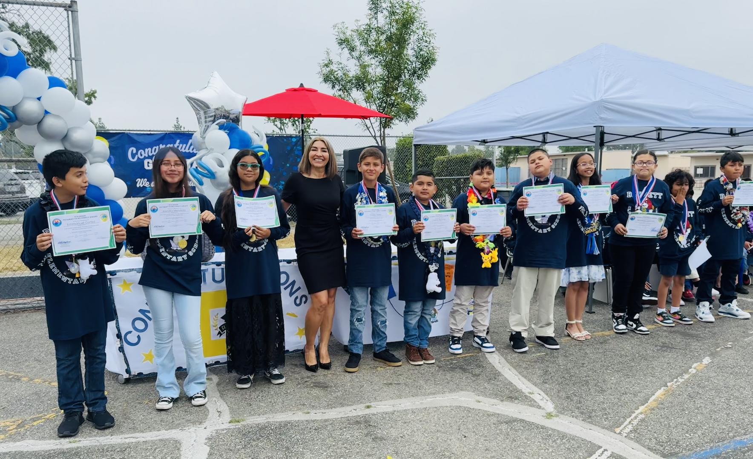
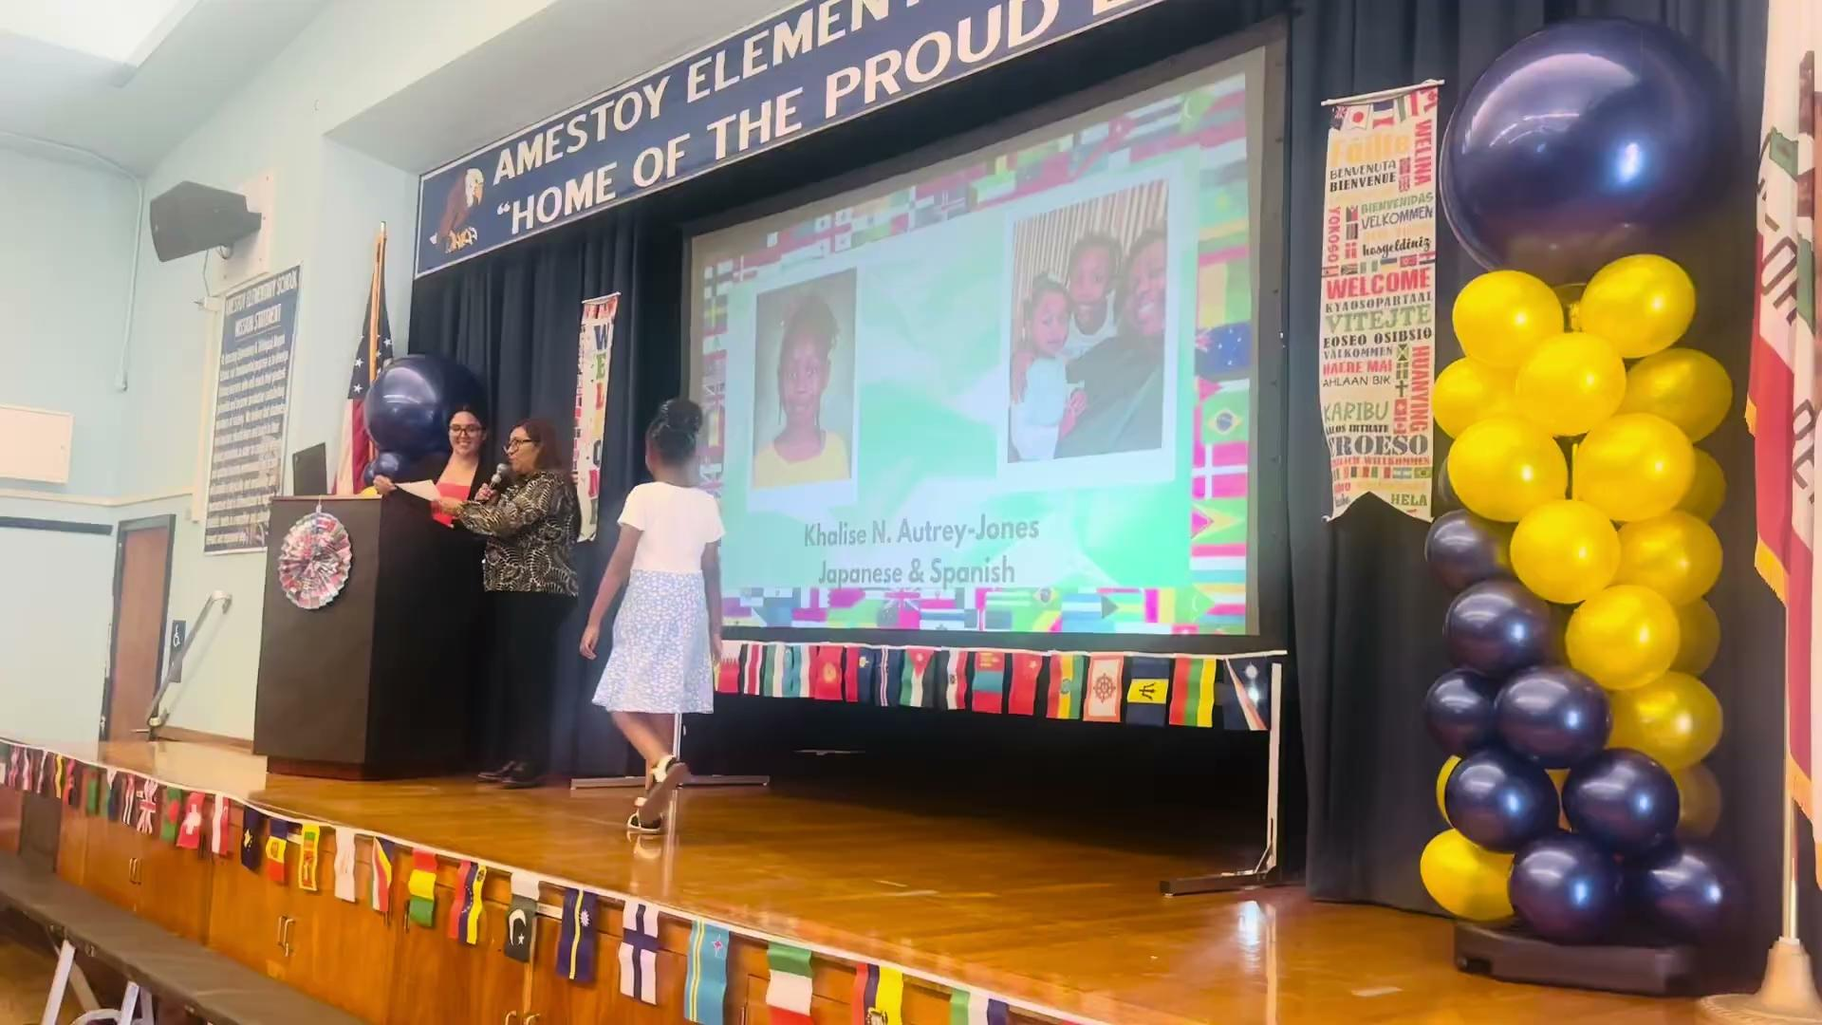
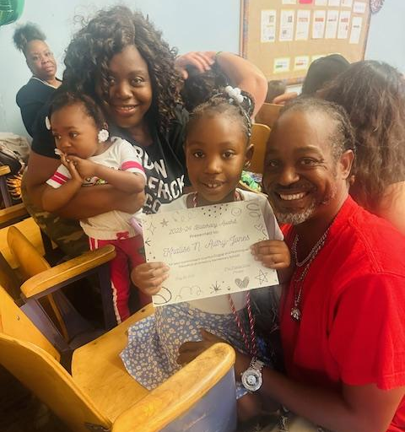
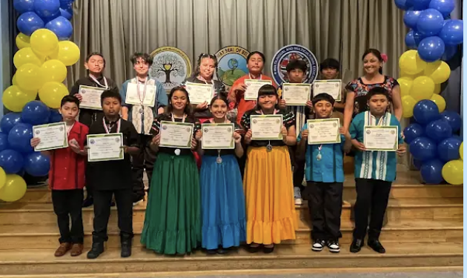
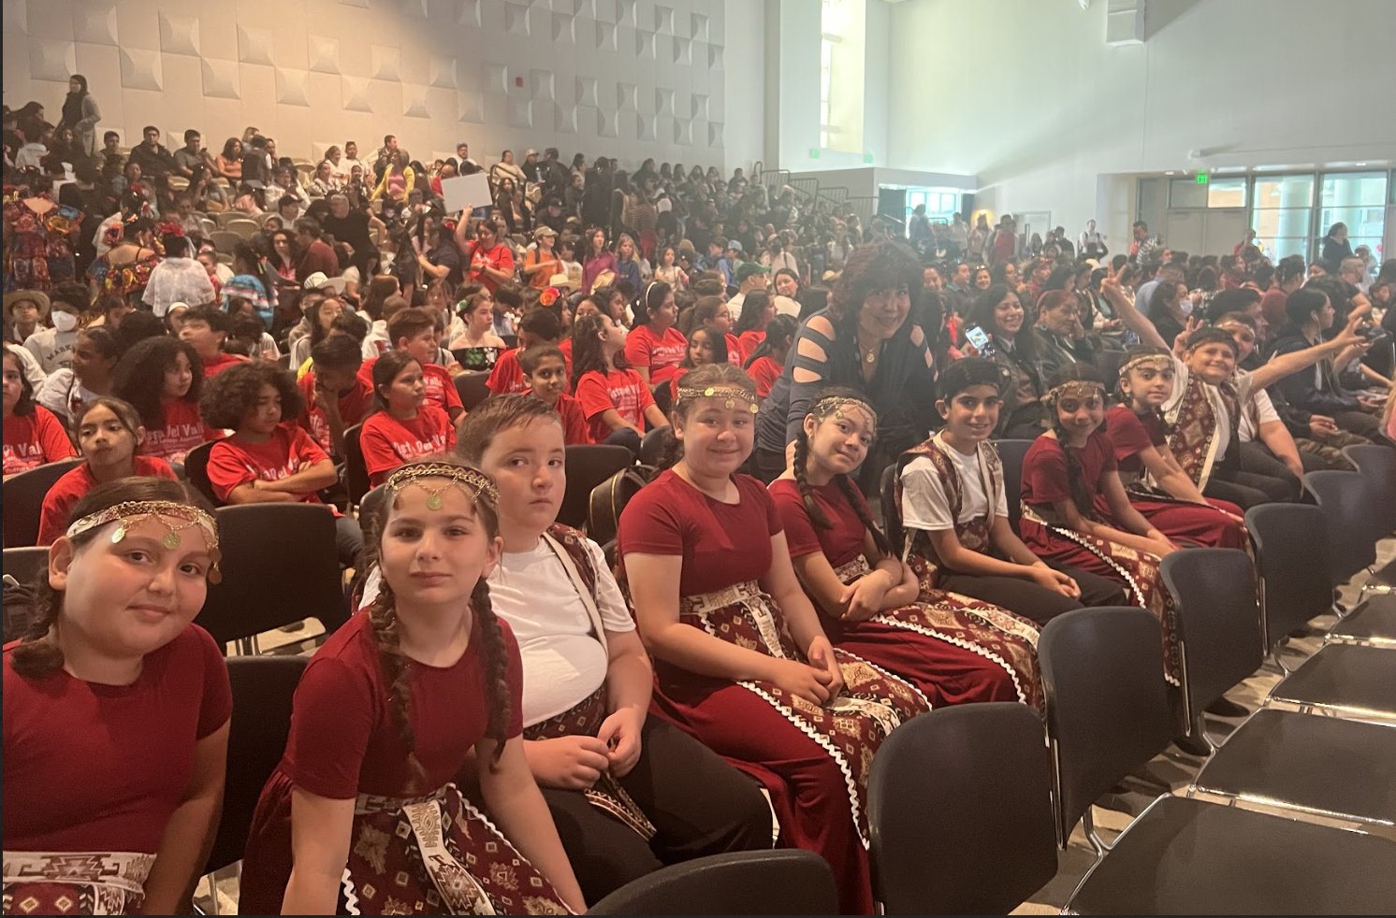
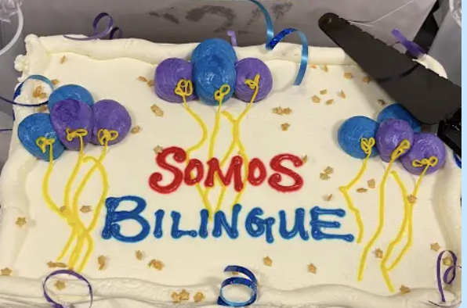
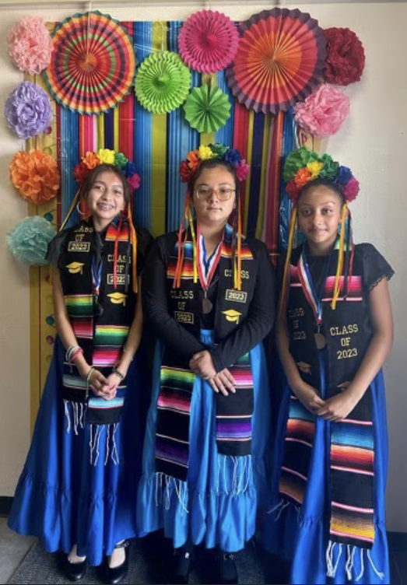

Celebrating the Pathway to Multiliteracy
Celebrando el camino hacia la multiliteracidad
Мы многоязычны
Մենք բազմալեզու խոսնակներ ենք
Bilingual Tayo
우리는 이중 언어를 구사합니다
Honoring culture, celebrating linguistic gifts, preserving culture,
valuing students’ multilingual assets
Honrar la cultura, celebrar las riqueza lingüísticas, preservar la cultura,
valorar los fondos multilingües de los estudiantes.
Notes:
Blanca
Time: 2 minutes
Tech: show video: 0.41 min.
Say: We are so excited to showcase and celebrate a few of our multilingual students who have been recognized at our schools. As you can see from colorful display of celebrations in this slide, it is a celebration of their multilingual journey. We will watch a short video of a 1st grade student from Amestoy ES who is being recognized for their multilingual proficiency in multiple languages, Japanese and Spanish.
We invite you to be part of this call to advocacy and celebration of recognition! Thank you for being part of this movement.

Slide 18
How does your child earn the
3rd, 5th/6th Grade
Pathway to Biliteracy Awards?
¿Cómo recibe
su hijo/a en
3er o 5/6º grado, los premios Camino a la biliteracidad?
Notes:
Aram
Time: 1 minute
Say: Now let’s take a look at how your child can obtain a Promise to Bilingualism award at the UTK, K, and 1st Grade levels. The criteria, while similar at each of those grade levels, has some important differences as well.
Aram: UTK-1st Grade

Slide 19
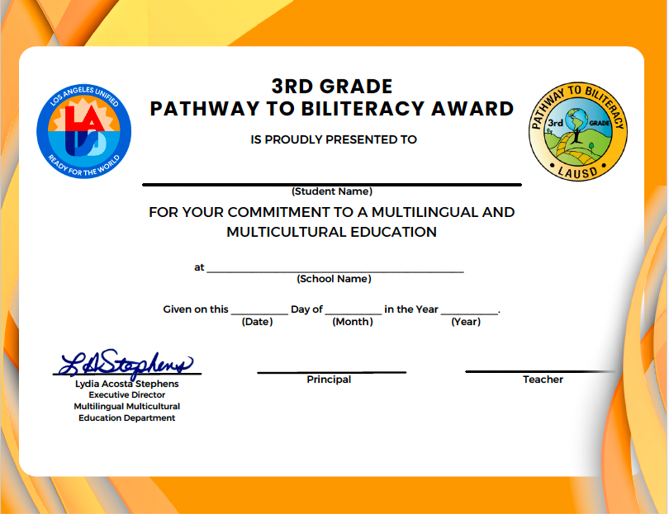
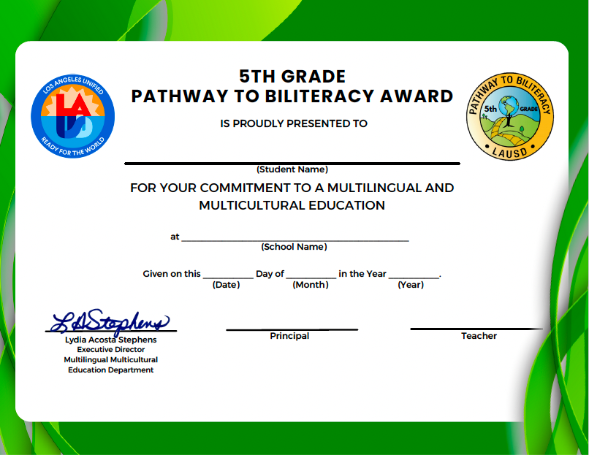

3rd & 5/6th Grade Pathway to Biliteracy Awards
5/6th only: certificate
& medal
5/6º solamente
certificado & medalla
Cords awarded to demonstrating 2 or more languages (in addition to English)
Cordones otorgados en reconocimiento
a 2 o más idiomas (además del inglés)
Notes:
Blanca
Time: 1 minute
Say: The goal is to build pathways towards biliteracy and to encourage the love of learning multiple languages. Along the pathway to attainment of high-level biliterate competency, there are developmental stages. We offer three Promise to Bilingualism Awards in the first three years of their educational careers to recognize this developmental stage that can set a powerful foundation for biliteracy skills.
Additionally, note that those students who are able to complete the award criteria in two or more languages (Students can meet the criteria in as many languages as they possibly can) will also be awarded cords, in addition to their award certificate.
Tech support: click2: For those students who earn the award in more than two languages, they get a gold/white chord.

Slide 20
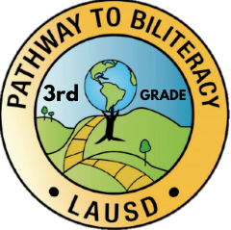
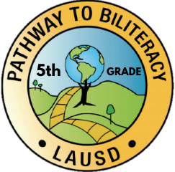
3rd & 5/6th Grade
Pathway to Biliteracy Award
Notes:
Blanca

Slide 21
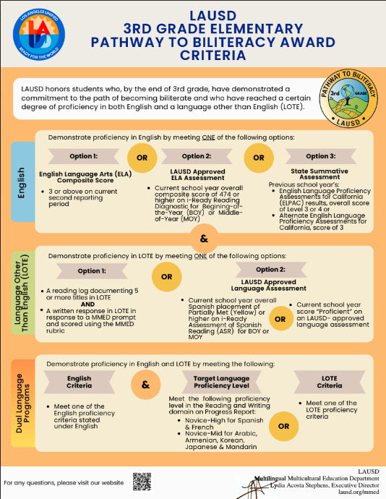


3rd Grade
Pathway to Biliteracy Award Criteria
Criterios del camino
a la biliteracidad de 3er grado
Notes:
Blanca
Time: 2 minutes to go through infographic
Say: One might be asking, what are the criteria for earning a 3rd Gr ” Pathway to Biliteracy” award? You can find the criteria for each grade level using this infographic. Notice that the general criteria remains the same for all grade levels. Merely the accuracy percentages for student responses increase grade-by-grade. In a few minutes, we’ll be going over with you how this criteria infographic will be connected with the rest of the advocacy tasks that will need to be completed.
Share the following links:
3rd Grade Criteria Infographic:
Nos da un placer anunciar el nuevo Premio Camino a la Alfabetización Bilingüe de Primaria: LAUSD ahora honra a los estudiantes que, al final del tercer grado, han demostrado un compromiso con el camino de la alfabetización bilingüe y que han alcanzado un cierto grado de dominio tanto del inglés como de un idioma distinto del inglés (LOTE).
En inglés: el estudiante puede demostrar competencia a través de su calificación/puntuación compuesta en Artes del lenguaje inglés (ELA) de 3 o mejor.
O a través de una evaluación del distrito: La evaluación de lectura i-Ready se puede utilizar para cumplir con los requisitos de los criterios para el inglés.
O estatal, con la Evaluación del Dominio del Idioma Inglés (ELPAC) requerido para aprendices de inglés.

Slide 22
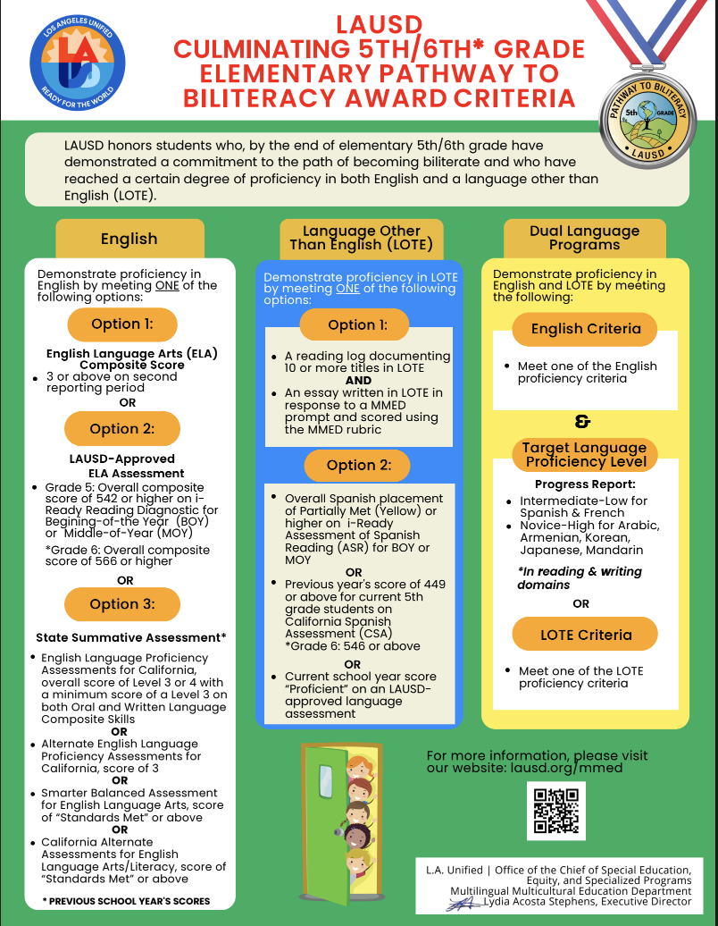
5th/6th Grade Pathway to Biliteracy Award Criteria
Criterios del camino
a la biliteracidad de
5º/6º grado
Notes:
Blanca
Time: 5+ minutes
5th Grade Criteria Infographic:

Slide 23
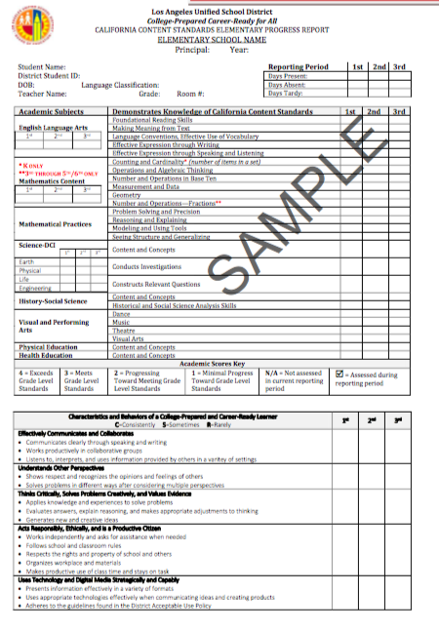
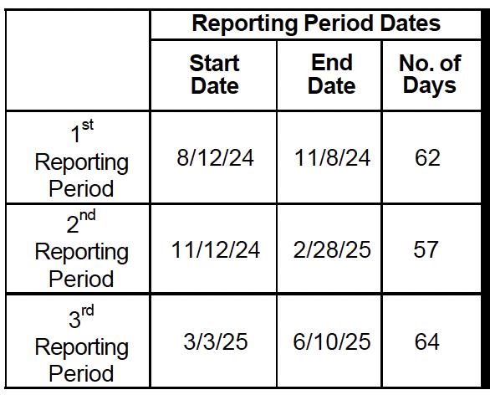

Option 1 to Meet English Requirement
Opción 1 de requisitos para Inglés
Verification of English Criteria
English Language Arts composite score of 3 or above on the current year second reporting period
Informe de progreso academico
11/10/25
3/6/26
62
Academic Achievement
Multilingual students achieve high levels of content knowledge in two languages.
Notes:
Blanca
Multilingual students achieve high levels of content knowledge in two languages. So, to demonstrate proficiency in English, they have several options.
Option #1:
Verification of English Proficiency Criteria – English language proficiency can be demonstrated by meeting one of the following:
Option 1. ELA composite score of 3 or above on the current year second reporting period
Dates for 2nd Reporting Period: 11/12/24-2/28/25

Slide 24
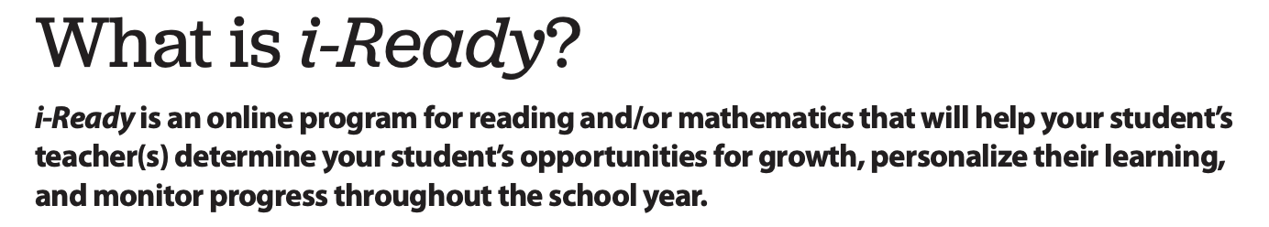

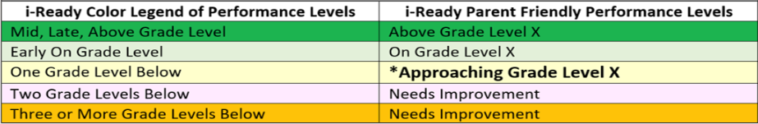

Option 2 to Meet English Requirement
2^{nda} opción de requisitos para inglés
Verification of English Criteria
Achievement of Approaching or meeting grade level on i-Ready Reading Diagnostic for Beginning-of-the-Year or Middle-of-Year:
Grade 3: Overall Scale Score of 474 or higher
Grade 5: Overall Scale Score of 542 or higher
Grade 6: Overall Scale Score of 566 or higher
Notes:
Multilingual students achieve high levels of content knowledge in two languages. So, to demonstrate proficiency in English, they have several options.
Option #2:
Verification of English Criteria
Achievement of Approaching or meeting grade level expectations on i-Ready English Reading Diagnostic for Beginning-of-the-Year or Middle-of-Year
Grade 3: Overall Composite score of 474 or higher
Grade 5: Overall Composite score of 542 or higher
Grade 6: Overall Scale Score of 566 or higher
What is iReady? Read slide

Slide 25




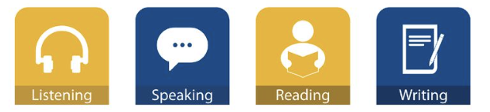
Option 3 to Meet English Requirement
Tercera opción de requisitos para Inglés
Verification of English Criteria
Overall score of 3 or above on the previous school year’s English Language Proficiency Assessments for California (ELPAC) or Alternate English Language Proficiency Assessments for California (AELPAC)
en ingles: Escuchar Hablar Leer Escribir
Notes:
Blanca
Multilingual students achieve high levels of content knowledge in two languages. So, to demonstrate proficiency in English, they have several options.
Option #3:
Verification of English Criteria
Overall score of 3 or above on the previous school year’s English Language Proficiency Assessments for California (ELPAC) or Alternate English Language Proficiency Assessments for California (AELPAC)
What is ELPAC? A test used to measure how well students in K-12 understand English when English is not their primary language
It includes assessment of the four domains: listening, speaking, reading and writing
Parents receive ELPAC/AELPAC student reports at the end of school year or before. Please see your child’s teacher to know your son/daughter’s score.

Slide 26
Requirements for
Language(s) Other Than English
Requisitos para otros idiomas
en adición al inglés

Slide 27

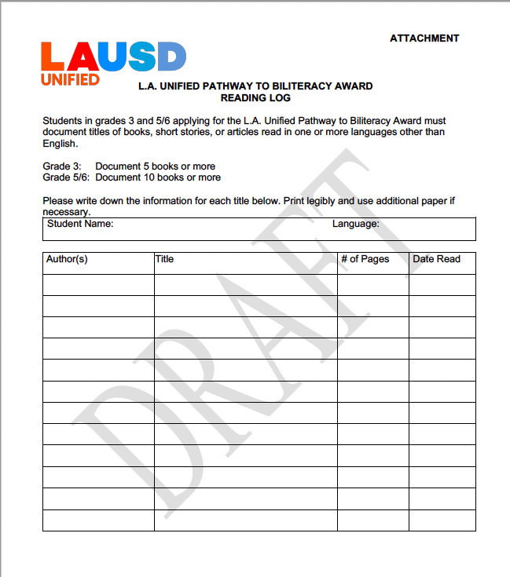



Option 1 to Meet Language Other Than English Requirements
1^{era} Opción de requisitos para idiomas aparte de Inglés
Show proficiency in a Language Other than English:
Complete a reading log and respond to a written response in another language other than English
Grade 3: document 5 or more titles in LOTE AND written response
Grade 5/6: document 10 or more titles in LOTE AND written essay
SAMPLE WRITING TASKS
Write out a plan of what you want to do with family friends visiting from Guatemala. (Think about your community or city and where you would take them).
Write an email to a friend in Korea about simple everyday problems that you have at school and at home. Find out if they have the same problems where they are. (School)
Create an advertisement for your favorite invention–real or imagined. What does it do? What do you like about it? (Subjects)
Reading log for 3rd/5th/6th Graders
&
Notes:
To demonstrate proficiency in LOTE, they have several options as well:
Verification of LOTE Criteria – LOTE proficiency can be demonstrated by meeting one of the following:
Grade 3: Reading Log documenting 5 or more titles of books, short stories, or articles on Attachment H, L.A. Unified Pathway to Biliteracy Reading Log Template and written response in a second language in response to the MMED prompt and scored using the MMED rubric
Grade 5: Reading Log documenting 10 or more titles of books, short stories, or articles on Attachment H, L.A. Unified Pathway to Biliteracy Reading Log , and an essay written in a second language in response to the MMED prompt and scored using the MMED rubric
See Avant Writing Samples (Proficiency Levels): https://www.avantassessment.com/writing-examples/spanish

Slide 28
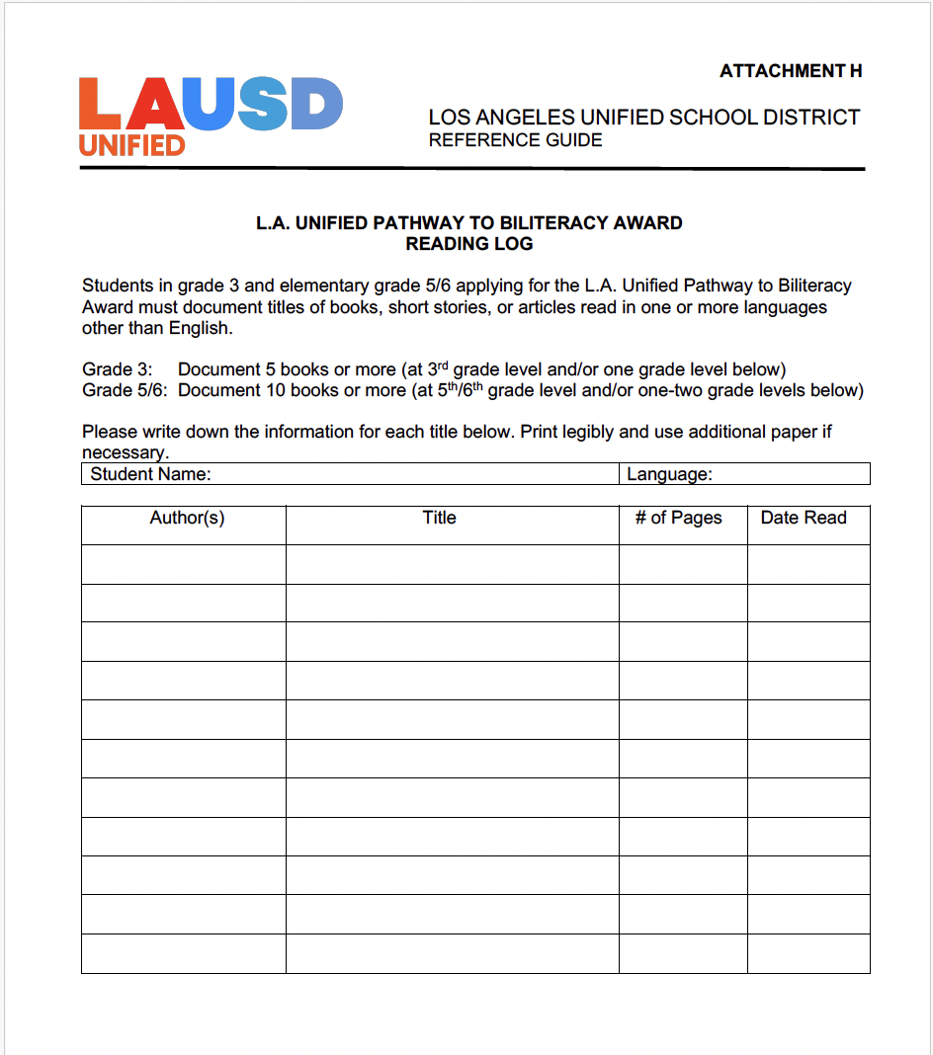
Option 1 to Meet Language Other Than English Requirements
1^{era} Opción de requisitos para idiomas aparte de Inglés
Show proficiency in a Language Other than English:
Complete a reading log and respond to a written response in another language other than English
Grade 3: document 5 or more titles in LOTE AND written response
Grade 5/6: document 10 or more titles in LOTE AND written essay
Demostrar competencia en un idioma distinto del inglés:
Completar un registro de lectura y responder a una respuesta escrita en otro idioma distinto del inglés
Grado 3: documentar 5 o más títulos en LOTE Y una respuesta escrita
Grado 5/6: documentar 10 o más títulos en LOTE Y un ensayo escrito
Registro de lectura para 3^{er/}5º/6º grado
EJEMPLOS DE TAREAS DE ESCRITURA
Escribe un plan de lo que quieres hacer con tus familiares que vienen de visita desde Guatemala. (Piensa en tu comunidad o ciudad y adónde los llevarías).
Escribe un correo electrónico a un amigo en Corea sobre problemas cotidianos sencillos que tienes en la escuela y en casa. Averigua si tienen los mismos problemas en el lugar donde ellos viven. (Escuela)
Crea un anuncio para tu invento favorito, real o imaginario. ¿Qué hace? ¿Qué te gusta de él? (Temas)
&
Notes:
To demonstrate proficiency in LOTE, they have several options as well:
Verification of LOTE Criteria – LOTE proficiency can be demonstrated by meeting one of the following:
Grade 3: Reading Log documenting 5 or more titles of books, short stories, or articles on Attachment H, L.A. Unified Pathway to Biliteracy Reading Log Template and written response in a second language in response to the MMED prompt and scored using the MMED rubric
Grade 5: Reading Log documenting 10 or more titles of books, short stories, or articles on Attachment H, L.A. Unified Pathway to Biliteracy Reading Log , and an essay written in a second language in response to the MMED prompt and scored using the MMED rubric
Link to Reading Log: https://drive.google.com/file/d/1ULKK-RSwLXnEo5GvuBKSEYbFqVMnNkY_/view?usp=sharing
CLICK FOR SPANISH SLIDE

Slide 29


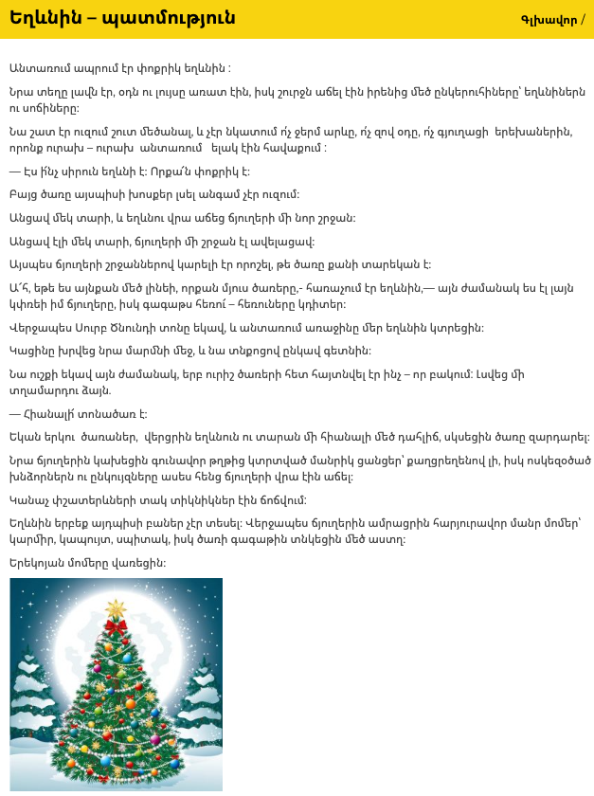
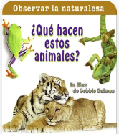
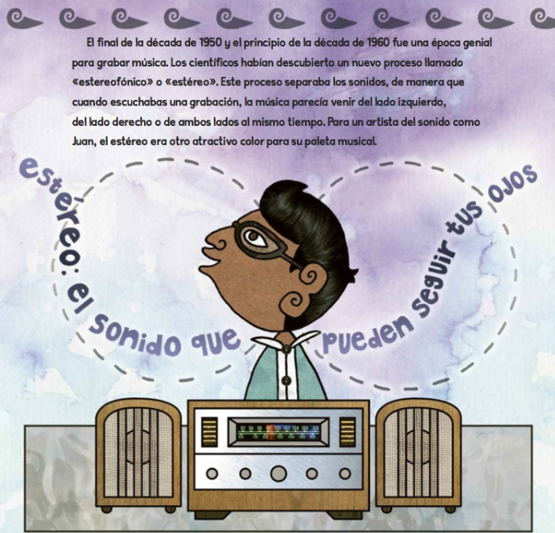
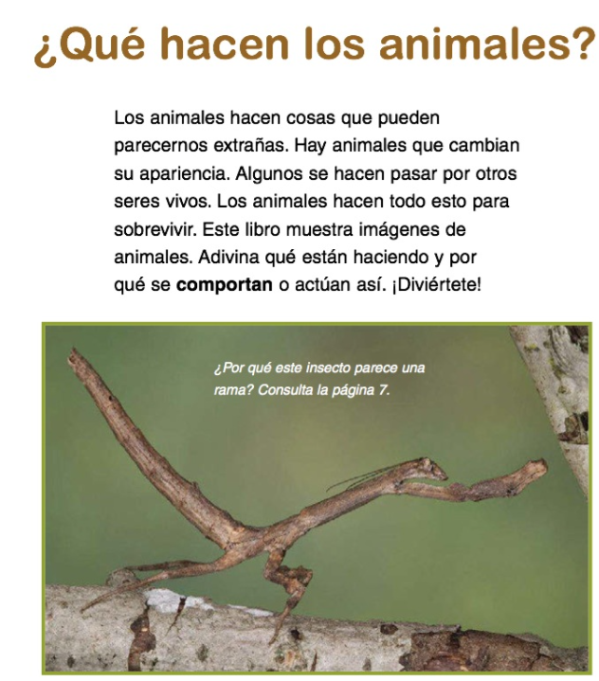

Sample Texts for Reading Logs
Ejemplos de texto para leer
Sample Texts for Grade 3/3er grado
Sample Texts for Grade 5/5º grado

Slide 30
3rd Grade Student Writing Self-Assessment
Autoevaluación de escritura para estudiantes de tercer grado
5 | 4 | 3 | 2 | 1
Intermediate High | Intermediate Mid | Intermediate Low | Novice-High | Novice-Mid
I can write information on familiar and everyday topics using more than one paragraphs(3-5 sentences). | I can write information on familiar and everyday topics using sentences and paragraphs(3-5 sentences). | I can write information on familiar and everyday topics using simple sentences most of the time. | I can write information on familiar and everyday topics using phrases and some simple sentences. | I can write information on familiar and everyday topics using a variety of practiced or memorized words or phrases.
Passing for Category I: 2+ Dutch, French, Italian, Norwegian, Portuguese, Romanian, Swedish, and Spanish. Passing for Category II- IV Languages: 1+ All Other Languages Rubric adapted from: ACTFL Can-Do Statements
Notes:
In red are additions
Category 1: Languages closely related to English (i.e., Spanish, French, Italian)
Category 2: Languages with linguistic/cultural differences from English (Bulgarian, Korean, Japanese, Mandarin)

Slide 31
5th Grade Student Writing Self-Assessment
Autoevaluación de escritura para estudiantes de 5º grado
5 | 4 | 3 | 2 | 1
Intermediate High | Intermediate Mid | Intermediate Low | Novice-High | Novice-Mid
I can write information on familiar and everyday topics using more than one paragraphs(3-5 sentences). | I can write information on familiar and everyday topics using sentences and paragraphs(3-5 sentences). | I can write information on familiar and everyday topics using simple sentences most of the time. | I can write information on familiar and everyday topics using phrases and some simple sentences. | I can write information on familiar and everyday topics using a variety of practiced or memorized words or phrases.
Passing for Category I: 3+ Dutch, French, Italian, Norwegian, Portuguese, Romanian, Swedish, and Spanish. Passing for Category II- IV Languages: 2+ All Other Languages Rubric adapted from: ACTFL Can-Do Statements
Notes:
In red are additions

Slide 32
Option 2 to Meet Language Other Than English (Spanish)
2^{nda} opción de requisitos para idiomas aparte de Inglés (español)
Verification for Spanish Criteria Criterio para verificar dominio en español
i-Ready Evaluación Diagnóstica de lectura en español for Beginning-of-the-Year or Middle-of-Year
Grade 3: Overall Scale Score of 356 or higher
Grade 5: Overall Scale Score of 404 or higher
Grade 6: Overall Scale Score of 427 or higher
La Evaluación Diagnóstica de lectura en español es una evaluación creada originalmente en español, para ayudarle a saber si el rendimiento de sus estudiantes corresponde al nivel de grado de lectura en español.
Niveles de expectativa
Excede expectativas del nivel de grado
Expectativas a nivel de grado
Aproximandose a nivel de grado
Notes:
Blanca
Assessment for Spanish Reading: Evaluación de lectura en español:
¿Qué es la Evaluación i-Ready de lectura en español?
La Evaluación de lectura en español es una evaluación digital con texto y audio en español auténtico. El propósito de la evaluación es medir si su estudiante se está desempeñando al nivel del grado en lectura en español, no darle una puntuación o calificación.
Meet Grade-Level Expectations: On grade level or above grade level: Students at this level have demonstrated facility with reading on grade level in Spanish. These students may benefit from continued on-grade level instruction or later, more challenging instruction.
Partially Met Grade-Level Expectations:approaching grade level: Students at this level have demonstrated facility with some grade-level Spanish Reading skills. These students may benefit from continued practice in on-grade level instruction with more targeted instruction in some areas
Link to Family Guide Spanish: https://i-readycentral.com/download/?res=480&view_pdf=1

Slide 33

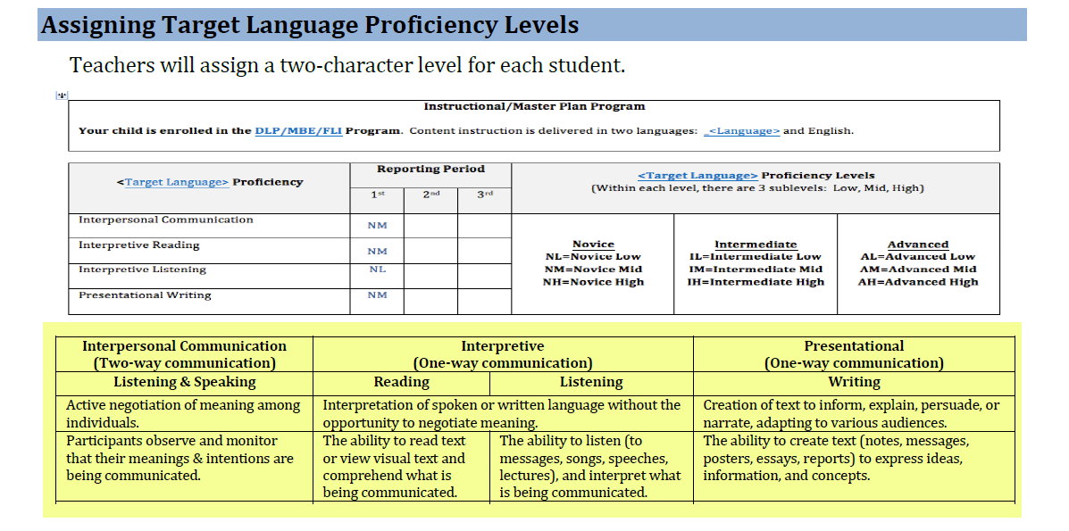

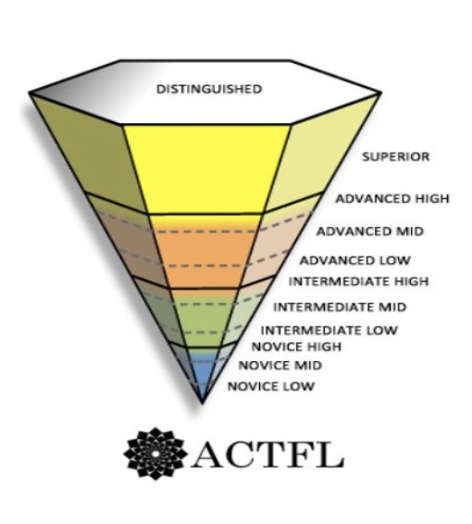
Dual Language Criteria
Requisitos para el estudiantes del programa lenguaje Dual
Show Proficiency in the Target Language in the Progress Report Card:
Grade 3: Novice High or above (Spanish, French) or Novice Mid or above (Arabic, Armenian, Korean, Japanese, Mandarin) in reading and writing
Grades 5/6: Intermediate Low or above (Spanish, French) or Novice High or above (Arabic, Armenian, Korean, Japanese, Mandarin) in reading and writing
NL
NH
NH
IH
NH
NM
IH
Notes:
Blanca
3rd: In Target Language, a minimum score of “Novice-High" for languages closely related to English (Spanish, French) or a minimum score of “Novice-Mid" for languages with significant linguistic or cultural differences from English (Arabic, Armenian, Korean, Japanese, Mandarin), in the Reading and Writing domains on a Progress Report
5th: In Target Language, a minimum score of “Intermediate-Low” for languages closely related to English (Spanish, French) or a minimum score of “Novice-High" for languages with significant linguistic differences from English (Arabic, Armenian, Korean, Japanese, Mandarin), in the Reading and Writing domains on a Progress Report
Only if more information requested by parents:
Armenian, Arabic, Korean, Mandarin Proficiency Target: https://drive.google.com/file/d/18_I77NjKxgoVciAAEYzUwetFs4w7AmbE/view?usp=sharing
Spanish and French Proficiency Target: https://drive.google.com/file/d/1fM6qgAl1b44_yhQHL0o0oz3fEMhFxBEH/view?usp=sharing

Slide 34
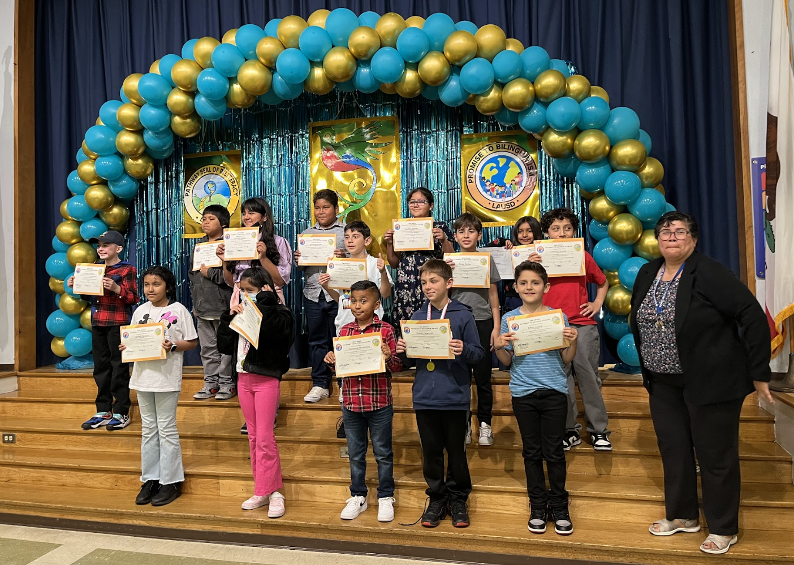
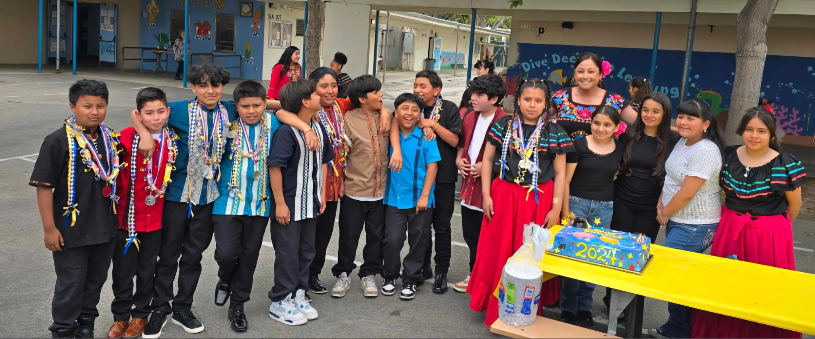



Pathway to Biliteracy Award Recipients/
Los ganadores del Premio Camino al Biliteracidad
Notes:
Blanca
Time: 2 minutes
Let me introduce you to a couple of our Pathway to Bilingualism recipients from: Ford ES, Stoner ES and Richland ES

Slide 35

Questions about 3rd, 5th/6th Grade Requirements?
¿Preguntas sobre los requisitos
de 3er, 5º/6º?
Notes:
Blanca

Slide 36

Literacy Family Resources
A Multilingual Journey to Pathway Awards
Home and Community
Support Resources
Recursos de lectoescritura para familias
Un camino al multilingüismo hacia los premios
Hogar y comunidad
Recursos de apoyo
Notes:
Blanca
Welcome School Leaders. Today we will discuss the importance of strategic instructional planning using the Adjusted Blueprints and Priority Standards. By closely examining the Adjusted Blueprints, we gain a detailed roadmap of the key concepts and skills assessed in the Smarter Balanced Assessment (SBA). This insight allows us to prioritize and focus on the critical Priority Standards that align with our educational goals. Through strategic planning, we can ensure that our teachers are dedicating time and resources to the most essential content areas, maximizing the impact of our instructional efforts. This approach not only aligns with assessment requirements but also provides a targeted focus on student mastery of priority skills, setting the stage for academic success.
Link to Family Resources: https://drive.google.com/drive/folders/1nTnD_jH4lHXstwAeVN_BMt_-a4xB2d_T?dmr=1&ec=wgc-drive-hero-goto
Recursos para la familias: https://drive.google.com/drive/folders/1nTnD_jH4lHXstwAeVN_BMt_-a4xB2d_T?dmr=1&ec=wgc-drive-hero-goto

Slide 37

Your Community and Home as a Resource!
¡Su comunidad y su hogar como recurso!
Describe objects in more than 1 language at the grocery store, restaurant, laundromat, bakeries, Target…
Write recipes, thank you letters, announcements and party invitations in multiple languages
Watch a kid-friendly show in another language
Share stories
Sing songs
¡Describa los objetos en más de 1 idioma en el supermercado, restaurante, lavandería, panaderías, Target…
Escriba recetas, cartas de agradecimiento, anuncios e invitaciones a fiestas en varios idiomas.
Mire un programa para niños en otros idiomas
Compartir historias
Cantar canciones
Notes:
Blanca

Slide 38


Supporting Your Child’s Bilingualism
Apoyando el bilingüismo de su hijo
Notes:
Blanca
Say: Here are some ways you can support your child’s journey to multilingualism back at home.
PDF English 9 Ways to Child’s Bilingualism: https://drive.google.com/file/d/1CFtcHU124RqAngfHkZNISNn_o-wJwmhb/view?usp=sharing
PDF Spaniish 9 Formas de apoyar el bilingüismo de su hijo/a: https://drive.google.com/file/d/1X4A500RcG-BApaHq2exNqVWF6dg8c7Mn/view?usp=sharing

Slide 39


Multilingual Literacy Home Support
Shared moments at home that can strengthen multilingual superpowers!
Please click on images and titles of websites to reveal link to websites and additional external resources!
Apoyo de lectoescritura multilingüe
¡Momentos compartidos en casa que pueden fortalecer los superpoderes multilingües!
Haga clic en las imágenes y los títulos de los sitios web para revelar enlaces a sitios web y recursos externos adicionales.
Notes:
Blanca
Link to Literacy Family Supports Deck 2025-2026: https://docs.google.com/presentation/d/1bAbmVOraCXxJwbE1LlT-YFWl6I419kp-/edit?usp=sharing&ouid=114560927774420752133&rtpof=true&sd=true
Thank you for being here families on behalf of your children. We wanted to share with you various home experiences and supports that you can begin to do with your kids to prepare for this multilingual world that is here! Any little step you might take to bring multilingualism into your home is a testament to the love and pride you have for your kids, and in the beliefs that they are limitless and have boundless potential! Let’s explore some ways to support multilingualism at home! We will begin by thinking about experiences that will not require a lot of technology or any at all, and also to emphasize that learning another language is more than just vocabulary and learning phrases here and there. “Language is not just words”. Next slide.

Slide 40







Spanish Resources/Recursos en español
Epic
Lea cuentos y lecciones en español.
Read children’s stories and lessons in Spanish at The Spanish Experiment.
Storybooks Canada
Access SORA by using parent’s or students’ Schoology credentials.
Utilice SORA a través de Schoology con la contraseña de estudiante o padre.
Access the Epic digital library and follow progress with reading activities!
Utilice EPIC, una biblioteca digital.
Notes:
Blanca
Time: 30 seconds
Say: Here are our Spanish resources

Slide 41




Armenian Resources/Recursos armenios
Dino Lingo Armenian Books for Kids | Access Armenian literature through SORA by using parent’s or students’ Schoology credentials.
Pokrik Armenian Children's Literature | Erexa.am Children’s Literature
Notes:
Blanca
Time: 30 seconds
Say: Here are our Armenian resources
Link to Sora: https://company.overdrive.com/lausd-for-students/

Slide 42




Korean Resources/Recursos coreanos
Access SORA by using parent’s or students’ Schoology credentials.
https://storybookscanada.ca/stories/ko/
https://m.sc.or.kr/happy2/bookDown.do
https://ridibooks.com/category/free-books/1320
Notes:
Blanca
Time: 30 seconds
Say: Here are our Korean resources

Slide 43






Mandarin Resources/Recursos mandarín
Storybooks for Learning Chinese
Quick Chinese Lessons
Dudu, Leveled Story Books
Notes:
Blanca

Slide 44




Filipino Resources/Recursos filipinos
Notes:
Blanca

Slide 45


French Resources/Recursos franceses
Free Kids Books - French | Storybooks Canada
French stories and Literature
Storybooks Canada is a free open educational resource that promotes literacy and language learning in homes, schools, and communities. Select from a large selection of languages.
Storybooks Canada es un recurso educativo abierto y gratuito que promueve la alfabetización y el aprendizaje de idiomas en hogares, escuelas y comunidades. Seleccione entre una gran selección de idiomas.
Notes:
Blanca

Slide 46



Various Languages Resources/Recursos en varios idiomas
 | Farsi Children’s Literature Access SORA by using parent’s or students’ Schoology credentials. Utilizar SORA utilizando las credenciales de Schoology de padres o estudiantes.
German & French Literature
Access the Epic digital library and follow progress with reading activities!
¡Utilizar a la biblioteca digital de Epic y siga el progreso con las actividades de lectura!
Notes:
Blanca

Slide 47
K’iche’ Resources/Recursos en K’iche’
20 animals in K’iche’ Language Course: A Beginner to Advanced Level K'iche' Online Course Audio Dictionary: K’iche’ – Spanish (Swarthmore Univ) Illustrated Bilingual Dictionary: SPN - K’ICHE’ Counting 1-10 in K’iche’ Numbers 0 -20 in K’iche’ Maya K’iche’ phrase book Living Maya Time Loteria
For your information-K’iche’ is primary an oral language.
Notes:
Blanca
K’iche’ is primary an oral language.
Zapotec

Slide 48







Supports from the LA Public Library/
Apoyos de la Biblioteca Pública de Los Ángeles
Free!
Physical and Electronic Cards are both available!
Notes:
Blanca
Time: 1 minute
Link to LA Public Library: https://www.lapl.org/
Link to LA Public Library Card Application: https://www.lapl.org/sites/default/files/media/pdf/about/Library_Card_App.pdf
Download the library card application, fill it out, and then take it into any LA Public Library location
E-card Registration: https://www.lapl.org/about-lapl/contact-us/e-card/e-card-registration
E-Card Registration en Español: https://www.lapl.org/about-lapl/contact-us/e-card/solicitud-tarjeta-electronica

Slide 49















Learning Library on Sora/
Biblioteca de aprendizaje en Sora
The LAUSD Learning Library on Sora is the quickest and easiest way to read digital books. LAUSD students and staff can log in using their SSO and instantly access hundreds of ebooks and audiobooks on virtually any device, for FREE. We have ebooks and audiobooks in Korean, Mandarin, Russian, Spanish, Arabic, and French. For more information, click HERE.
Thousands of great reads are waiting for you in the LAUSD Learning Library on Sora. Open all day, everyday.
Notes:
Blanca
Time: 2 minutes
Say: The LAUSD Learning library is the quickest and easiest way to read digital books. LAUSD students, family members and staff can use their single sign on to instantly access hundreds of ebooks and audiobooks.

Slide 50


Celebrating the Promise to Biliteracy
All LAUSD Schools, Dual Language Education (DLE) Programs and
World Languages and Cultures (WLC) Secondary Courses
Celebrando la promesa a la biliteracidad
Todas las escuelas del LAUSD, los programas de educación en dos idiomas (DLE) y
Cursos secundarios de lenguas y culturas del mundo (WLC)
Region North
38 DLE programs
(Spanish, Armenian & Korean)
Region East
84 DLE programs
(Spanish, Mandarin & Arabic)
Region West
60 DLE programs
(Spanish, Korean, Mandarin, French, Armenian & Japanese)
Region South
50 DLE programs
(Spanish, Korean,
Mandarin & Japanese)
A total of 384 secondary schools offer LOTE WLC courses.
378 escuelas secundarias ofrecen cursos de idiomas mundiales.
Notes:
Blanca
Time: 1 min.
Say:
We are proud to share all the DLE and target languages offered by Regions and we are excited to announce that will will soon offer a DLE program in Russian in SY 25-26.
We are addressing the call to a bilingual and multilingual California, in accordance with the CA Global 2030 initiative.
We will now take a look at the history and advocacy behind DLE that has inspired us to offer and strengthen DLE programs.

Slide 51

MMED Dual Language & World Languages Team Contact Information
Información de contacto: Equipo MMED,
Educación de lenguaje dual e Idiomas mundiales
UTK-1st Promise to Bilingualism Promesa al bilingüismo | Aram Davtyan, DLE Specialist | aram.davtyan@lausd.net | (213) 241-2042
3rd Grade Pathway to Biliteracy, Camino a la biliteracidad | Blanca Valle-Alvarado, DLE Specialist | bvalle@lausd.net | (213) 241-4172
5/6th Grade Pathway to Biliteracy, Camino a la biliteracidad | Blanca Valle-Alvarado, DLE Specialist | bvalle@lausd.net | (213) 241-4172
8th Grade Pathway to Biliteracy, Camino a la biliteracidad | Elise Kim, DLE Specialist | elise.kim@lausd.net | (213) 241-5582
12th Grade SEALS of Biliteracy, Sellos de la biliteracidad | Youssef Mossadaq, WLC Coordinator | yxm9573@lausd.net | (213) 241-4517
Notes:
Aram/Blanca
Time: 1 min
Read Slide

Slide 52
Next Steps
How are you going to help your child earn the award and stay on the Pathway to Biliteracy to strengthen their multilingual super powers?
Próximos pasos
¿Cómo va a ayudar a su hijo/a a obtener el premio y permanecer en el camino hacia la biliteracidad para fortalecer sus superpoderes multilingües?
Notes:
Blanca
a parent interested in your child earning the award:
Let your child’s teacher know that your child speaks more than one language, if you’re not in a Dual Language program.
Ask if your child’s school already has a Pathway to Biliteracy Committee and remember: parents may volunteer to be a part of it to support.
Continue to support your child with language at home.

Slide 53



Don’t Forget to…No olvides…
Inform your child’s teacher that they have multilingual superpowers! ¡Informe al maestro de su hijo/a que tiene superpoderes multilingües! | Engage your child with fun multilingual activities: Go on a word hunt around your community Write family recipes, letters, thank you cards Involucra a tu hijo/a con divertidas actividades multilingües: Realice una búsqueda de palabras en su comunidad Escribe recetas familiares, cartas, tarjetas de agradecimiento. | Ask your school leadership about Pathway Awards process? Pregunte a los líderes de su escuela sobre el proceso de recibir los premios en 3er, 5º/6º
Notes:
Blanca
Reading in your home and in your neighborhood: go on a word hunt, flip through magazines, flyers, billboards, buses, menus, street signs, read the diverse city we line in!
Write down family recipes, diary entries, poems, rhymes, memories, interactive journals, draw a map of your neighborhood with labels, directions, experiment with words here and there in another language
Plan a party and create multilingual invitations
Create multilingual grocery lists
Write a letter to a friend or family member, add a phrase in a different language
Send a thank you note to someone special, add a phrase in a different language

Slide 54


Slide 55






DRAFT 2025-2026 Criteria Checklists Are Now Available!
TK
Grade 3
Reading Log
Grades 3, 5/6
Kinder
1st
Gr 5/6
Notes:
Aram
Time: 2 minutes
Say: We’ve now seen the infographic that states the criteria to check students’ biliteracy for grades UTK-1st. Here we make the connection between the criteria on the infographic to the checklists that will be needed to check for each student’s biliteracy, at each grade level, by their respective teachers.
It is these checklists that assist us in verifying the criteria for English and languages other than English that we indicated on our “Team Advocacy” slide. Once verification is complete, these checklists will be given to the certificated staff member who has been deemed the designee at your school site.
Link to DRAFT of Verification Criteria UTK-5/6:

