Slide 1


CA ELD Standards and Grading Guidance
Elementary
Notes:
This presentation will serve as a tool to assist elementary teachers of English Leaners in communicating student progress using the new progress report with the 2012 CA ELD Standards.

Slide 2

Grounding
What are some systems you have used for EL grading?
What were some learnings from the systems you used?
How did these systems help you to understand a student’s progress?

Slide 3
LEARNING OUTCOMES
Gain understanding of the suggested guidelines available to support the completion of the new Progress Report for ELD.
Learn of the resources available that support a cohesive standards-based grading system.

Slide 4
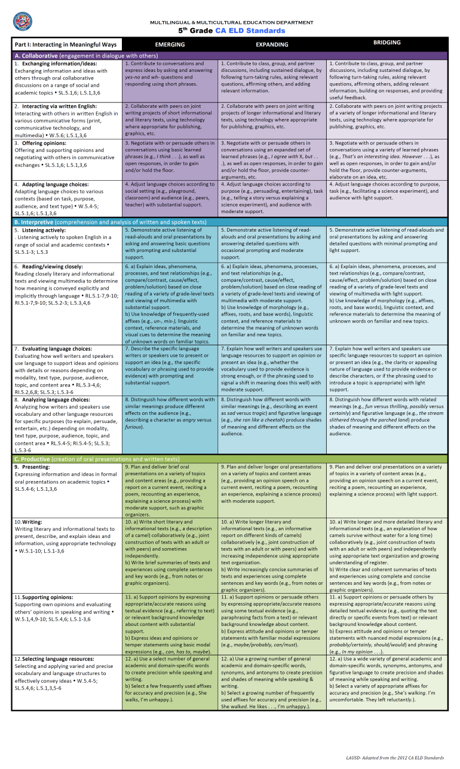
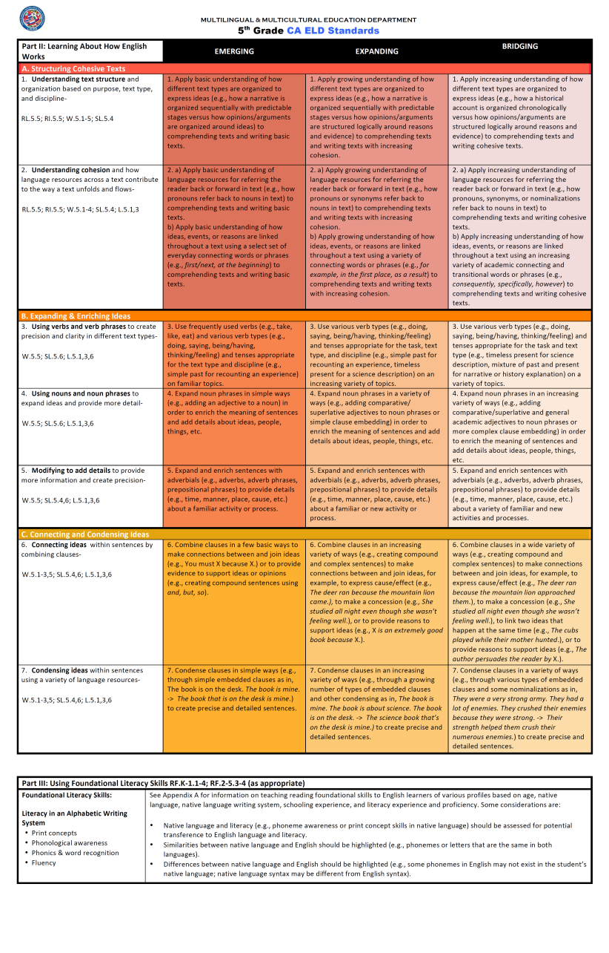
CA ELD Standards
Notes:
2 min.
(Handout)
Here are the Standards at a Glance Cards – these are grade level specific.
The first side (purple, blue, green) is the Part I: Interacting in Meaningful Ways.
Notice the three modes:
Collaborative
Interpretive
Productive
On the back (shades of orange) is the Part II: Learning About How English Works.
Notice the three language processes:
Structuring Cohesive Text
Expanding & Enriching Ideas
Connecting and Condensing Ideas
At the bottom is Part III: Using Foundational Literacy Skills

Slide 5

Part I: Interacting in Meaningful Ways
3 Modes
Collaborative
Interpretive
Productive
Strands
CCSS
i.e. SL.K.1
Proficiency levels
Language of the Standards
Part I: Interacting in Meaningful Ways
Notes:
2 min.
Here are the Standards at a Glance Cards – these are grade level specific.
The first side (purple, blue, green) is the Part I: Interacting in Meaningful Ways.
Notice the three modes:
Collaborative
Interpretive
Productive

Slide 6
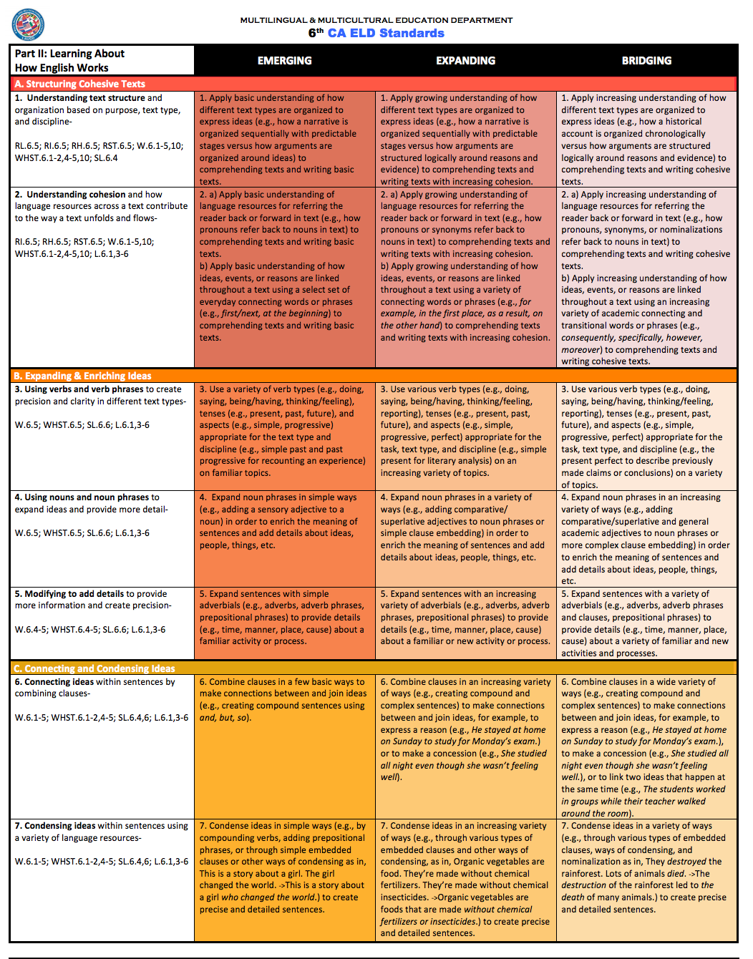
Part II: Learning About How English Works
3 Processes
Structuring Cohesive Texts
Expanding and Enriching Ideas
Connecting and Condensing Ideas
Strands
CCSS
i.e. SL.2.1
Proficiency levels
Language of the Standards
Part II: Learning About How English Works
Notes:
2 min.
Here are the Standards at a Glance Cards – these are grade level specific.
On the back (shades of orange) is the Part II: Learning About How English Works.
Notice the three language processes:
Structuring Cohesive Text
Expanding & Enriching Ideas
Connecting and Condensing Ideas
At the bottom is Part III: Using Foundational Literacy Skills

Slide 7
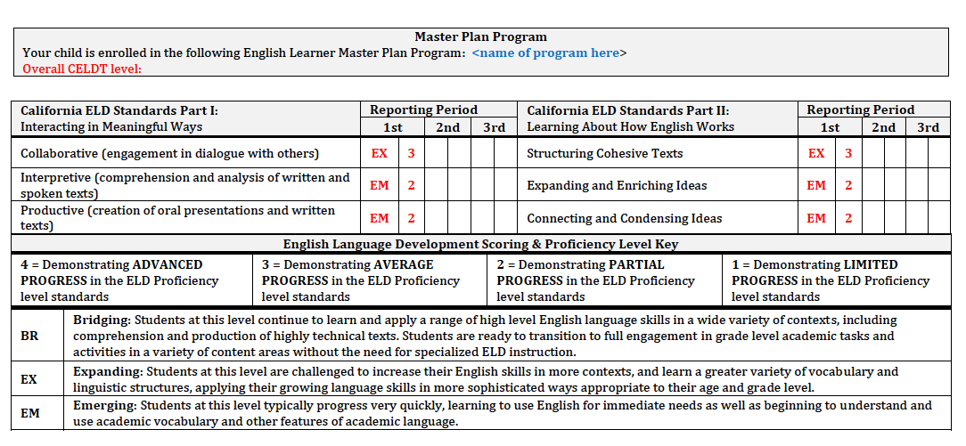
ELD Progress Report
Identification of Master Plan Instructional Program
3
3
Overall mark of progress (advanced, average, partial or limited) in ELD considering the student’s proficiency level and his/her progress based on the instruction provided for Part I and II Standards
for the reporting period (numeric)
Identification of student ELD proficiency level score (BR, EX, or EM) within each mode and process
Notes:
New Report Card populates in the system in the student’s current Language Classification
PLEASE NOTE: The ELD CELDT LEVEL (at the very top left) adheres to the 1999 CA ELD Standards. Teachers should not focus on this to determine score.

Slide 8
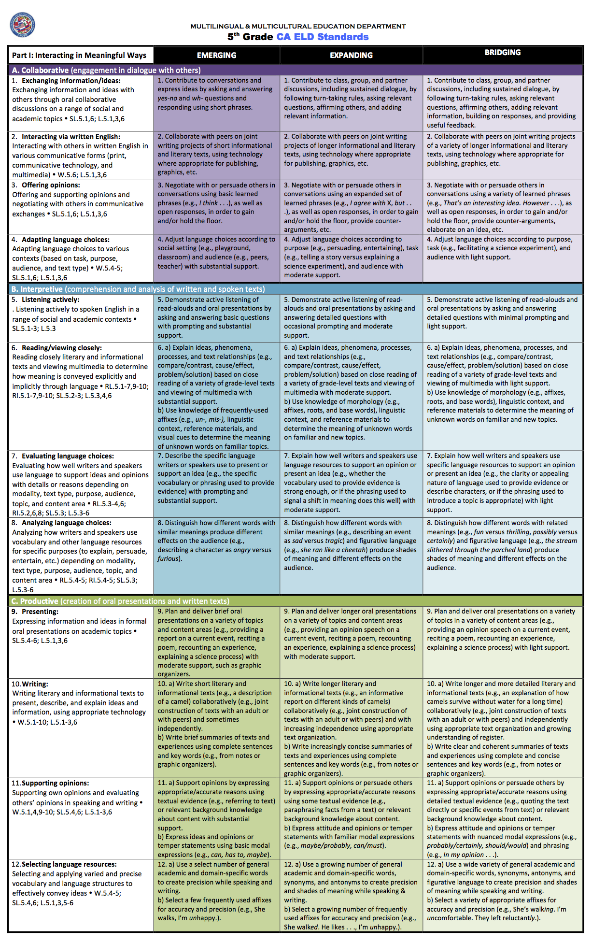
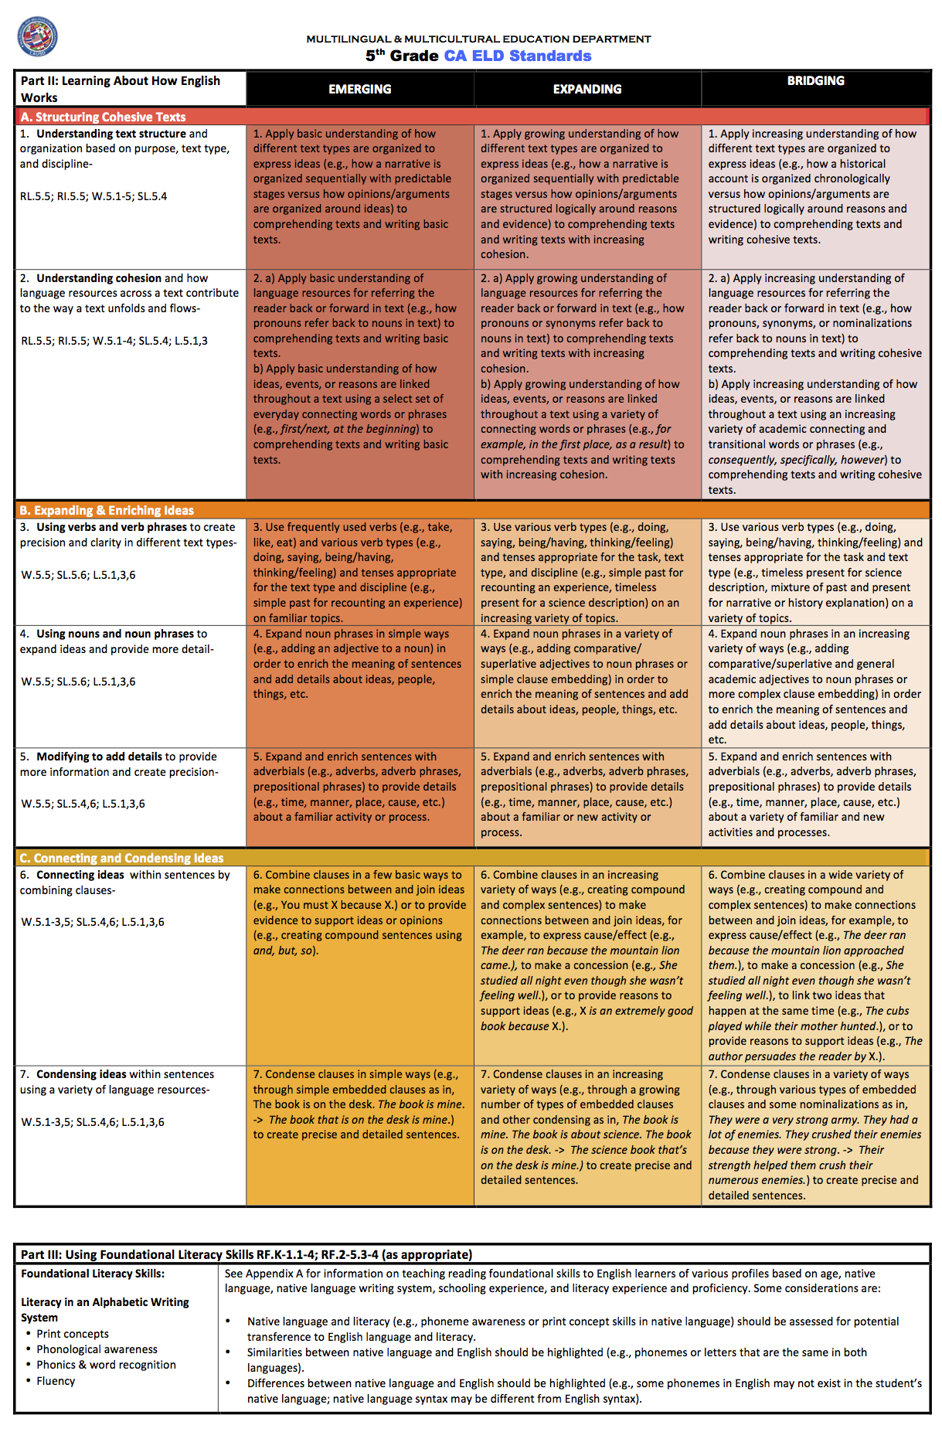
ELD Progress Report Features
PART I OF ELD STANDARDS:
3 MODES of Communication
PART II OF ELD STANDARDS :
3 Language PROCESSES
3
3
Notes:
Browse the EL Progress Report SAMPLE
EL Students will be scored based on their Progress TOWARDS proficiency

Slide 9
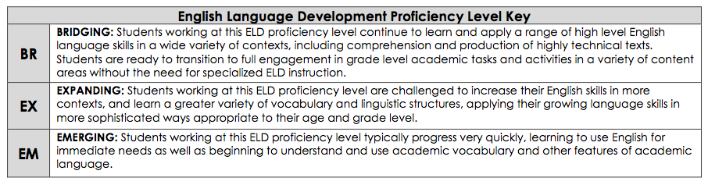
ELD Progress Report Features
Notes:
BROWSE THE Key that describes the characteristics of the 3 proficiency levels—Emerging, Expanding, and Bridging
Highlight key words/phrases that define the level of proficiency. Discuss…
The EL Report includes a Key that describes the characteristics of the 3 proficiency levels—Emerging, Expanding, and Bridging

Slide 10

What is one new learning with the New ELD Progress Report?

Slide 11

WHAT TO CONSIDER WHEN GRADING ENGLISH LEARNERS ON THEIR PROGRESS

Slide 12
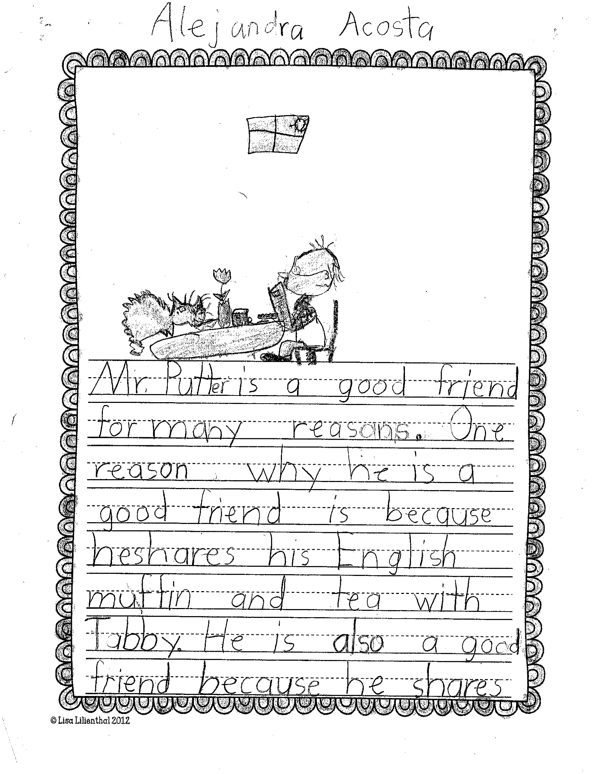
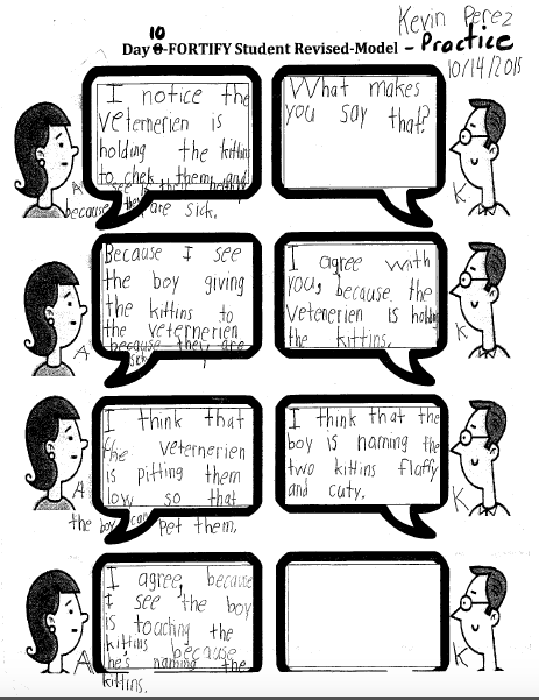

CONSIDER THE FOLLOWING WHEN GRADING ELs:
Grading Guidance
Identify student work and teacher observations (e.g. SPF, Content Area work, formal and informal assessments) –Designated & Integrated ELD.
Select student work and use teacher observations:
Content Area Work-ELA
Student Progress Form
Informal & Formal Observations
Designated & Integrated ELD
Notes:
As with any content area, in order to assess student progress we start with collecting a variety of student work samples—which should include Student Progress Forms or SPFs, Content Area Work, as well as formal and Informal assessments collected during Designated and Integrated ELD.
Please note that student work should not be limited to the Designated ELD Start Smart Unit.

Slide 13
CONSIDER THE FOLLOWING WHEN GRADING ELs:
2. Identify the ELD Standards addressed using the ELD Standards at a Glance and indicate the current level of performance for each ELD Standard addressed
PI.3.1.EX
PI.3.4.EX
PII.3.3.EM
PROFICIENCY LEVEL
EM = Emerging
EX = Expanding
BR = Bridging
Notes:
Explain that Part 1 & Part 2 of the ELD Standards have 3 modes & 3 Processes. The students will receive a grade and will be placed in their proficiency level in each mode based on the language of the standards.
Analyze the level of proficiency in the Modes and Processes
In the Emerging level the students are provided with a lot of support, a lot of scaffolds, and they respond with one or two word answers, minimal output.
In the Expanding level the students are provided with less support, less scaffolds, and they respond with phrases, with more independent output.
In the Bridging level the students are provided with minimal supports and scaffolds, they respond with complete sentences, and meaningful output.
(color coded to show the decrease of support)

Slide 14
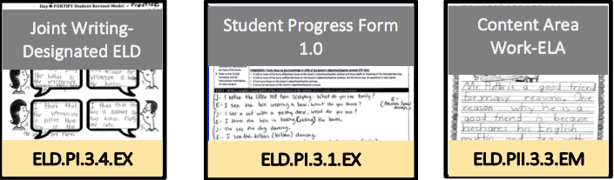
CONSIDER THE FOLLOWING WHEN GRADING ELs:
3. Label work with the CA ELD Standards and Proficiency Level
PLEASE NOTE: STUDENT WORK CAN PROVIDE EVIDENCE OF PROGRESS ON MORE THAN ONE STANDARD
Notes:
A work sample most definitely can identify with more than one ELD standard addressed.

Slide 15
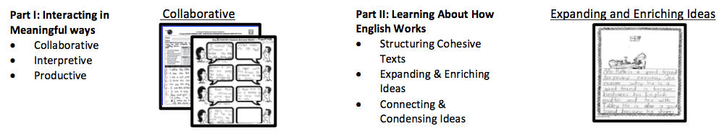
CONSIDER THE FOLLOWING WHEN GRADING ELs:
4. Sort representative work into modes and/or processes
Collaborative
PLEASE NOTE: STUDENT WORK CAN PROVIDE EVIDENCE OF PROGRESS ON MORE THAN ONE MODE AND/OR PROCESSES
Notes:
A work sample most definitely can identify with both a ELD Mode and/or a process.

Slide 16
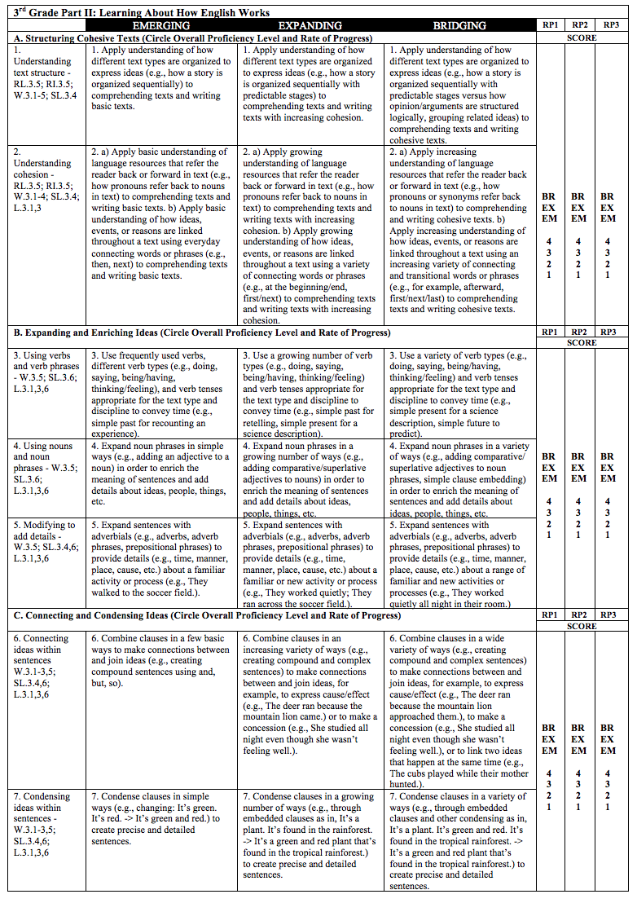
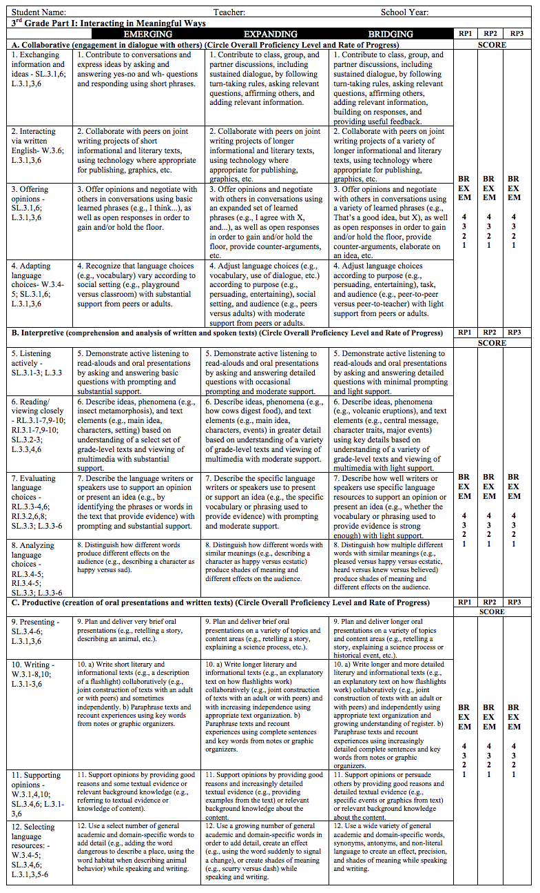
CONSIDER THE FOLLOWING WHEN GRADING ELs:
5. Circle the current Proficiency Level for each ELD standard addressed during the current reporting period
Teachers may use the newly available resource, grade level specific “Progress Report Card Scoring Protocol”, on the MMED website
Notes:
The students will be placed in their proficiency level in each mode & process addressed, based on the language of the standards.
Students may demonstrate various proficiency levels with each standard addressed.
In the Emerging level the students are provided with a lot of support, a lot of scaffolds, and they respond with one or two word answers, minimal output.
In the Expanding level the students are provided with less support, less scaffolds, and they respond with phrases, with more independent output.
In the Bridging level the students are provided with minimal supports and scaffolds, they respond with complete sentences, and meaningful output.
(color coded to show the decrease of support)

Slide 17
CONSIDER THE FOLLOWING WHEN GRADING ELs:
6. Use the CA ELD Standards to determine Overall Level of Proficiency score for each Mode or Process (Provide sufficient student work samples and teacher anecdotal records as rationale for score).
Notes:
Teachers must determine an OVERALL Proficiency Level for each Mode & Process.

Slide 18
CONSIDER THE FOLLOWING WHEN GRADING ELs:
7. Use the English Language Development Scoring and Proficiency Level Key to determine rate of progress within each reporting period for each Mode or Process
Notes:
Students may demonstrate various proficiency levels with each standard addressed. Teachers must determine an score based on the students GROWTH TOWARDS PROGRESS for each Mode & Process.

Slide 19
What Does This Mean?
3
3
This means that this student is working at an Overall Proficiency level score of Expanding in the Collaborative mode and is demonstrating average progress in the ELD Proficiency level standards.

Slide 20

A/B Partner Share
3
3
This means that this student is working at an Overall Proficiency level score of ________________ in the _________ mode/process and is demonstrating _________in the ELD Proficiency level standards.
Partner A
Notes:
This means that this student is working an Overall Proficiency Level score of Emerging in the Interpretive mode and is demonstrating partial progress in the ELD Proficiency level standards.

Slide 21
A/B Partner Share
3
3
This means that this student is working at an Overall Proficiency level score of ________________ in the _________ mode/process and is demonstrating _________in the ELD Proficiency level standards.
Partner B
Notes:
This means that this student is working an Overall Proficiency Level score of Emerging in the expanding and enriching ideas process and is demonstrating average progress in the ELD Proficiency level standards.

Slide 22



REFLECTION
What might be one current practice that “bridges” to the implementation of the New ELD Progress Report?
What might be one “roadblock” in completing the report?

Slide 23

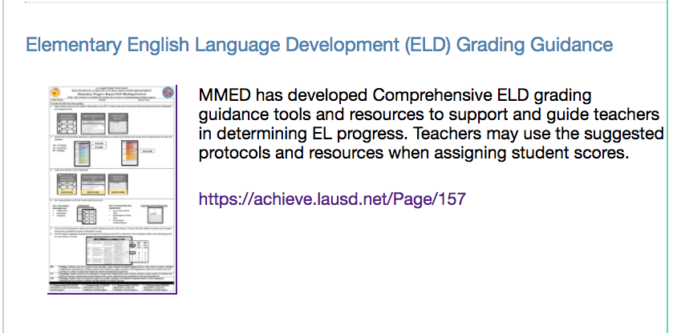
Notes:
MMED has provided a Grading Guidance Page. Please visit the MMED website to browse the resources that offer support.

Slide 24
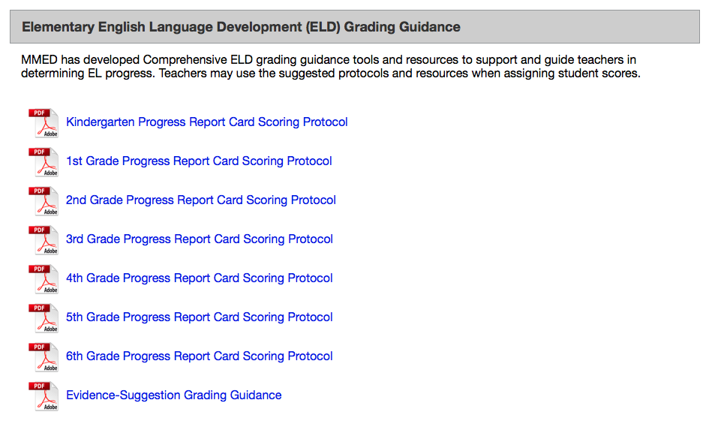
Notes:
Grade—Level Specific protocols are available for K-5 teachers. 6th Grade can use the 5th Grade Protocol.

Slide 25
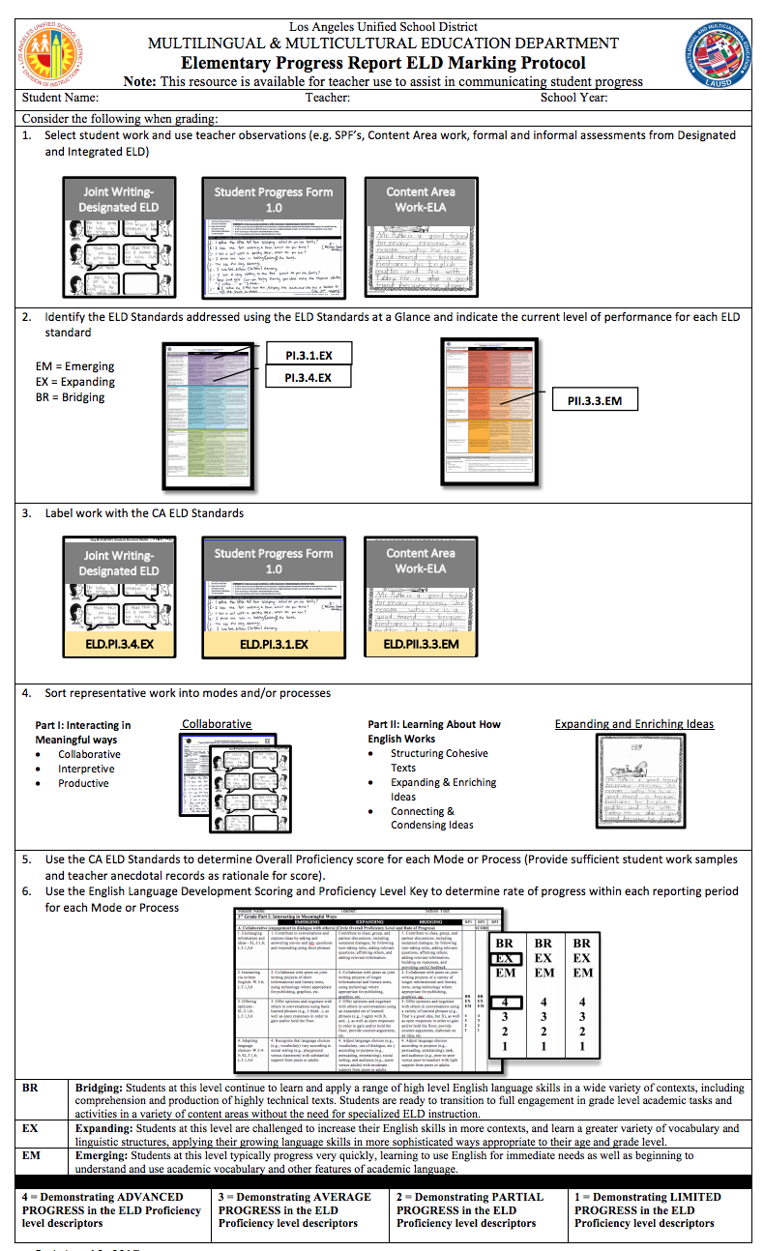
PROGRESS REPORT SCORING PROTOCOL K-6
Elementary Progress Report ELD Marking Protocol
English Language Development Scoring and Proficiency Level Key
PART I PART II
Notes:
3-Page Protocol includes:
Elementary Progress Report ELD Marking Protocol
English Language Development Scoring and Proficiency Level Key (Part I & Part II of ELD Standards)

Slide 26
Notes:
Another resource is the Evidence-Suggested Grading Guidance

Slide 27
Evidence-Suggested Grading Guidance
Notes:
Evidence-Suggested Grading Guidance offers ideas as to what type of student work might be collected and graded with the current curricular resources

Slide 28

Calibration is Key!
Notes:
Determining student grades are best done in a small group setting. When teachers dialogue and calibrate on how to score a student work sample, the standards & rubrics/criteria are clearer and the results become more consistent throughout the grade level.

