Slide 1
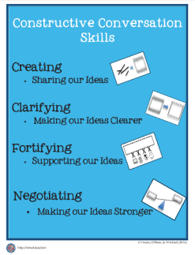
Integrated eld/math
Multilingual and Multicultural Education Department
Constructive Conversation Skills
and Mathematical Discourse
Notes:
This presentation is designed for 1.5 hours

Slide 2
AGENDA
WELCOME & GROUNDING
EL DATA
INTEGRATED ELD
INTEGRATED ELD/MATH
LESSON COMPONENTS
CONSTRUCTIVE CONVERSATION SKILLS
MATHEMATICAL DISCOURSE
CONSTRUCTIVE CONVERSATION SKILLS & MATH DISCOURSE
WRAP UP / REFLECT

Slide 3

GROUNDING VIDEO
Notes:
Play 3 minute video

Slide 4

GUIDING QUESTION – TURN & TALK
How do we diminish barriers and provide access to English Learners during math instruction?

Slide 5

LEARNING OUTCOMES
Review EL data and understand the instructional implications
Understand the essential components of Integrated ELD/Math instruction
Experience and learn about protocols that support ELs during Integrated ELD/Math instruction within the context of a Three Phase math lesson
Understand instructional practices and available resources for Integrated ELD/Math
Notes:
These learning outcomes address the entire set of PD’s on Integrated ELD Math. We may not accomplish all of them today.

Slide 6
AGENDA
WELCOME & GROUNDING
EL DATA
INTEGRATED ELD
INTEGRATED ELD/MATH
LESSON COMPONENTS
CONSTRUCTIVE CONVERSATION SKILLS
MATHEMATICAL DISCOURSE
CONSTRUCTIVE CONVERSATION SKILLS & MATH DISCOURSE
WRAP UP / REFLECT

Slide 7
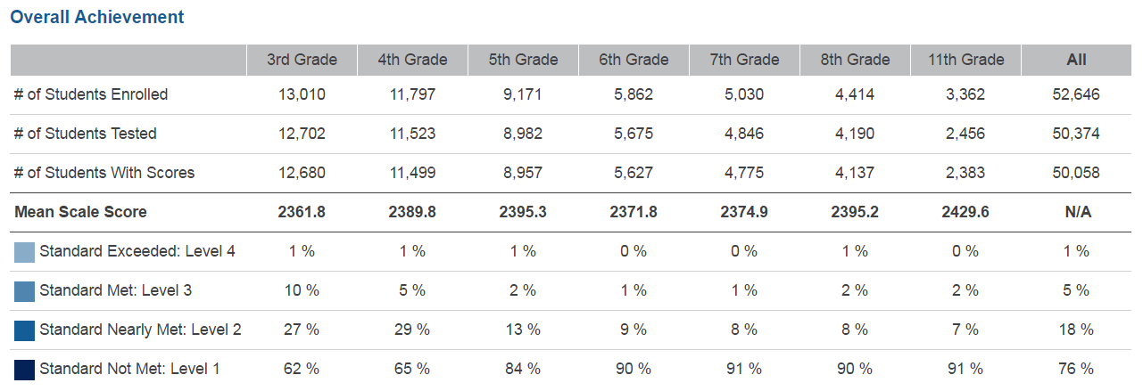
SBAC – 2016 MATHEMATICS – LAUSD – ELs
Notes:
Take a look at this data from the CDE website for English Learners in Math for LAUSD.
What do you notice?
You will see that in all grades 3-8 and 11th, LAUSD had a total of:
6% of our ELs who scored Standard Exceeded and Standard Met (combined)
94% of our ELs who scored Standard Nearly Met and Standard Not Met (combined)
76% of our ELs who scored Standard Not Met
Our English Learners need our support in Math.
At the very least, there should be more students scoring at LEVEL 2 (nearly met) and less students scoring at LEVEL 1 (not met).
Today we will be looking at the type of support we can provide to make sure we don’t have as many ELs in the LEVEL 1 group.

Slide 8


CA MATH FRAMEWORK
The role of English language proficiency must be a consideration for English learners who experience difficulties in learning mathematics... It is not possible to separate the content of mathematics from the language in which it is discussed
and taught.
-- Universal Access Chapter, p. 684-685
Notes:
Our CA Math Framework on the CDE website states the following:
READ QUOTE
It says that when teaching Math we DO need to consider our ELs because we cannot separate the content of mathematics from language
The language needs of our ELs need to be supported during Math instruction.

Slide 9
TEACHING AND LEARNING FRAMEWORK
1b1. Awareness of Students' Skills, Knowledge, and Language Proficiency
Uses information about students’ academic strengths and needs in planning.
Notes:
When we do this, we are developing in the following element of our Teaching and Leaning Framework.

Slide 10
AGENDA
WELCOME & GROUNDING
EL DATA
INTEGRATED ELD
INTEGRATED ELD/MATH
LESSON COMPONENTS
CONSTRUCTIVE CONVERSATION SKILLS
MATHEMATICAL DISCOURSE
CONSTRUCTIVE CONVERSATION SKILLS & MATH DISCOURSE
WRAP UP / REFLECT

Slide 11
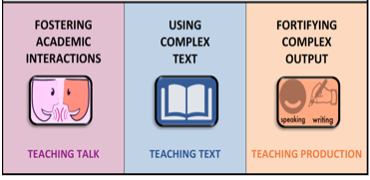

A Comprehensive ELD program consists of…
Designated ELD
Integrated ELD
Notes:
A Comprehensive ELD program includes both Designated and Integrated ELD.
Click animation (Designated ELD):
Designated ELD is the specific time of the day in which students are learning English.
Click animation (Integrated ELD):
Integrated ELD is throughout the day as ELs are learning content and English at the same time.

Slide 12

ELA/ELD FRAMEWORK
This framework uses the term integrated ELD to refer to ELD taught throughout the day and across the disciplines. All teachers with ELs in their classrooms should use the CA ELD Standards in addition to their focal CA CCSS for ELA/Literacy and other content standards to support their ELs’ linguistic
and academic progress.
-- Chapter 2, p. 108
Notes:
Our CA ELD FRAMEWORK says
READ QUOTE
This means Integrated ELD should be happening for our ELs during ELA, Math, Science, Social Studies, etc…

Slide 13
Integrated ELD
PURPOSE
Throughout the day and across the disciplines, ELs learn to use English as they simultaneously develop academic English and academic content. Ch. 2 pg. 107
All teachers with ELs in their classroom use CA ELD Standards in tandem with the CA CCSS for ELA/ Literacy and other content standards Ch. 2 pg. 106
Values and build on primary language and culture and other forms of prior knowledge Ch. 2 pg. 114
Instruction that includes an abundance of collaborative discussions about content, meaningful interaction with complex texts, and engaging and intellectually rich tasks. Ch. 2 pg. 108
Builds both content knowledge and academic English Ch. 2 pg. 114
OUTCOME
EL students learn and apply content knowledge, the purposes for using language and how English works. Ch. 2 pg. 109
Notes:
To understanding INTEGRATED ELD better, let’s read some key points about the purpose of INTEGRATED ELD.
Click to show each bullet. Ask participants to read each one out loud.
Ask: Which of these do you think are happening now in your Math classroom? Share your ideas with a partner.

Slide 14
AGENDA
WELCOME & GROUNDING
EL DATA
INTEGRATED ELD
INTEGRATED ELD/MATH
LESSON COMPONENTS
CONSTRUCTIVE CONVERSATION SKILLS
MATHEMATICAL DISCOURSE
CONSTRUCTIVE CONVERSATION SKILLS & MATH DISCOURSE
WRAP UP / REFLECT

Slide 15


INTEGRATED ELD LESSON COMPONENTS
CA ELD Standards in Tandem with Content Standards
Content and Language Objective
Scaffolds
Strategic Grouping
Formative Assessment
High Impact Essential Practices
Notes:
The essential elements of a comprehensive ELD program have the following:
CA ELD Standards working in tandem with CONTENT STANDARDS
Content and language objective ( this is for integrated ELD)
Scaffolds
Strategic group to offer instructional support that meet students’ specific needs
Formative assessment (SPF)
And for our district we have the HIGH IMPACT ESSENTIAL PRACTICES. These practices come from the book called Common Core in Diverse Classrooms by Jeff Zweirs. Our Constructive Conversation Skills support our ELs in participating in these High Impact Essential practices.

Slide 16
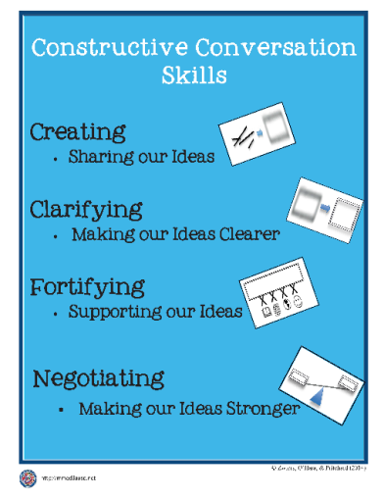



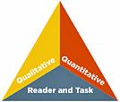

HIGH IMPACT ESSENTIAL PRACTICES
ELA/ELD Framework Integrated ELD
High-Impact
Essential Practices
Promoting Collaborative
Discussions About Content
(A Focus on Language Development & Content)
Ch. 2, p. 110
Fostering
Academic Interactions
Supporting Comprehension & Interpretation of Complex Text
(A Focus on Meaning Making and Content)
Ch. 2, p. 111
Using
Complex Text
Supporting Academic
Writing & Speaking
(A Focus on Effective Expression & Content)
Ch. 2, p. 113
Fortifying
Complex Output
Notes:
Constructive Conversation Skills support the High Impact Essential Practices.
The High Impact Practices are:
FOSTERING ACADEMIC INTERACTIONS, USING COMPLEX TEXT, AND FORTIFYING COMPLEX OUTPUT
Both come from the work of Jeff Zwiers out of Stanford University. In his work Jeff Zwiers talks about how important the High Impact Practices are during INTEGRATED ELD.
The Constructive Conversation Skills are a part of our Designated ELD Instruction and should also be used to support our English Learners during Integrated ELD Instruction.
Having our students become proficient in these skills helps our English Learners engage in the High Impact Practices.

Slide 17
AGENDA
WELCOME & GROUNDING
EL DATA
INTEGRATED ELD
INTEGRATED ELD/MATH
LESSON COMPONENTS
CONSTRUCTIVE CONVERSATION SKILLS
MATHEMATICAL DISCOURSE
CONSTRUCTIVE CONVERSATION SKILLS & MATH DISCOURSE
WRAP UP / REFLECT

Slide 18



How are you utilizing Constructive Conversation Skills in your classroom?
What are CC Skills?
O.K. Yeah. Sure.
GREAT!
Notes:
How are CONSTRUCTIVE CONVERSATION SKILLS going in your classroom?
RHETORICAL QUESTION: What minion do you feel like?
CONSTRUCTIVE CONVERASTION SKILLS will have an important role to play in INTEGRATED ELD/MATH.

Slide 19
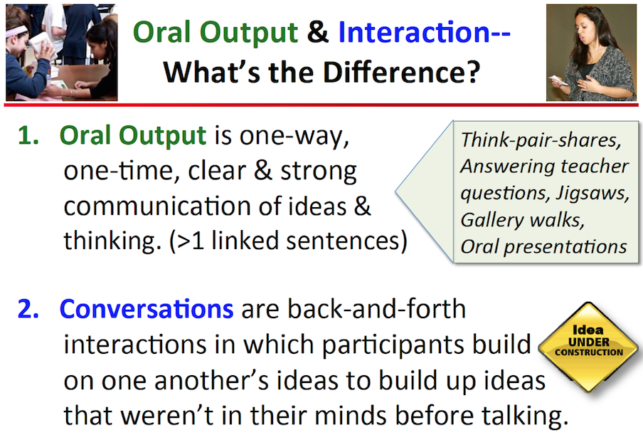
Notes:
Let’s review Constructive Conversation Skills. Oral Output is different from a Conversation.
ORAL OUTPUT is (READ DEFINITION ON SLIDE)
CONVERSATIONS are (READ DEFINITION ON SLIDE)
CONSTRUCTIVE CONVERSATIONS are ideas under construction where the conversation takes shape as it is happening based on what is being said in the moment. The goal of teaching our ELs these skills is that they begin to take ownership of them and use them independently in an academic conversation with others.

Slide 20


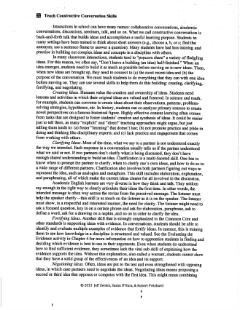

What are the defining characteristics of each skill?
Notes:
The use of the skills - create, clarify, fortify, and negotiate in a conversation - will support students to have deeper understanding of the content.
Review hand gestures for each skill.
Students will be explicitly taught these skills in DESIGNATED ELD. They will be an essential part of INTEGRATED ELD as well.
You will READ the page describing the CONSTRUCTIVE CONVERSATION SKILLS and as you read be thinking about this guiding question at the top of the slide:
WHAT ARE THE DEFINING CHARACTERISTICS OF EACH SKILL?

Slide 21

LINES OF COMMUNICATION
Form two lines (Line A / Line B), each person should be facing another person in the line (everyone should have a partner)
At the signal, partners will have 1 minute to discuss the guiding question for the first CONSTRUCTIVE CONVERSATION SKILL.
After a minute is over Line A will move one position to the left. The partner at the end of Line A will move down the center aisle to find a new partner.
Discussion will continue with the next CONSTRUCTIVE CONVERSATION SKILL.
Notes:
Use this slide to help set up the LINES OF COMMUNICATION
Use the next slide to help participants keep track of which SKILL they are supposed to discuss

Slide 22





CONSTRUCTIVE CONVERSATION SKILLS
What are the defining characteristics of each skill?
CREATE
CLARIFY
FORTIFY
NEGOTIATE
Notes:
Click to show each Constructive Conversation Skill when the LINES OF COMMUNICATION are ready to discuss.
Allow time for quick whole group share out for each skill after the LINES OF COMMUNICATION are over.

Slide 23
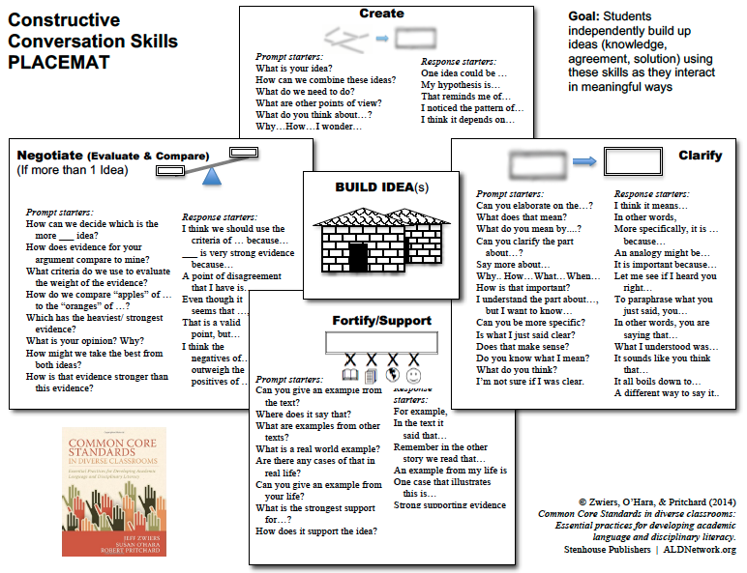
Prompt & Response Starters
Notes:
The Prompt and Response Starters are Scaffolds for students to support them in beginning to have conversations where they are CREATING, CLARIFYING, FORTIFYING, AND NEGOTIATING on their own.
This placemat is a teacher tool. Teachers would select the prompt and response starters students might need to use depending on student need, lesson objectives, and the task at hand.

Slide 24
AGENDA
WELCOME & GROUNDING
EL DATA
INTEGRATED ELD
INTEGRATED ELD/MATH
LESSON COMPONENTS
CONSTRUCTIVE CONVERSATION SKILLS
MATHEMATICAL DISCOURSE
CONSTRUCTIVE CONVERSATION SKILLS & MATH DISCOURSE
WRAP UP / REFLECT

Slide 25

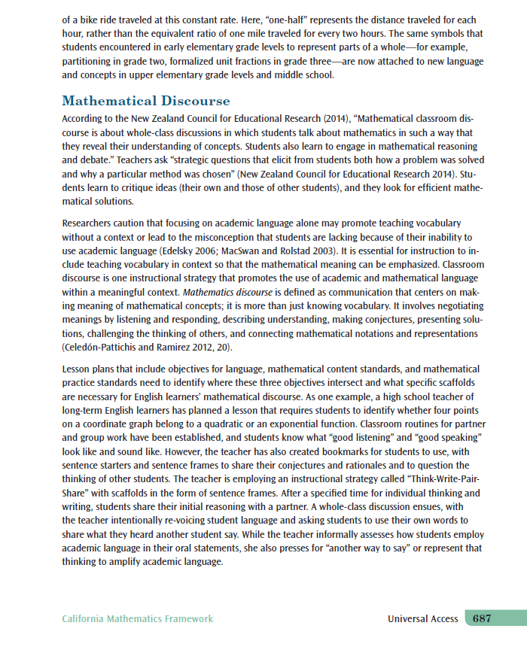
CA MATH FRAMEWORK
Mathematical Discourse p. 687
Text Rendering
Purpose: To collaboratively construct meaning, clarify, and expand our thinking about a text or document.
Steps:
1. Select a sentence that you think/feel is significant.
2. Select a phrase that you think/feel is significant.
3. Select a word that you think/feel is significant.
4. Prepare to share.
Notes:
Now that we have read about Constructive Conversation Skills, we need to see how these skills support MATHEMATICAL DISCOURSE.
To do that, we will be reading a page about MATHEMATICAL DISCOURSE from our CA Math Framework.
To process this reading together we will be using a TEXT RENDERING PROTOCOL.
READ DIRECTIONS FROM THE SLIDE to explain the protcol.

Slide 26




DISCUSSING THE CA MATH FRAMEWORK
Meet Your Sole Mates
Find 1 or 2 others wearing similar shoes
Discuss the following:
  Share your sentence, phrase, and word and why you felt it was significant.

Slide 27
AGENDA
WELCOME & GROUNDING
EL DATA
INTEGRATED ELD
INTEGRATED ELD/MATH
LESSON COMPONENTS
CONSTRUCTIVE CONVERSATION SKILLS
MATHEMATICAL DISCOURSE
CONSTRUCTIVE CONVERSATION SKILLS & MATH DISCOURSE
WRAP UP / REFLECT

Slide 28
CA MATH FRAMEWORK
Mathematics discourse is defined as communication that centers on making meaning of mathematical concepts. It involves negotiating meanings by listening and responding, describing understanding, making conjectures, presenting solutions, challenging the thinking of others,
and connecting mathematical notations
and representations.
-- Universal Access Chapter, p. 687
Notes:
Our CA Math Framework says that
READ QUOTE
Ask: What comes to mind when you read this quote?

Slide 29


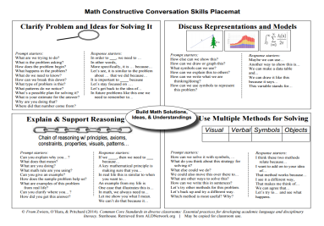
CONSTRUCTIVE CONVERSATION SKILLS
Promoting Collaborative
Discussions About Content
(A Focus on Language Development & Content)
Ch. 2, p. 110
Supporting Comprehension & Interpretation of Complex Text
(A Focus on Meaning Making and Content)
Ch. 2, p. 111
Notes:
When you read this, you can’t help but think about the Constructive Conversation Skills. Students must be able to CREATE, CLARIFY, FORTIFY, and NEGOTIATE in order to participate in Mathematical Discourse.
The prompt and response starters are scaffolds for students to begin using the language of the skill.
There are also some Prompt and Response Starters for Math which you may find helpful.

Slide 30
AGENDA
WELCOME & GROUNDING
EL DATA
INTEGRATED ELD
INTEGRATED ELD/MATH
LESSON COMPONENTS
CONSTRUCTIVE CONVERSATION SKILLS
MATHEMATICAL DISCOURSE
CONSTRUCTIVE CONVERSATION SKILLS & MATH DISCOURSE
WRAP UP / REFLECT

Slide 31
GUIDING QUESTION – TURN AND TALK
How can our English Learners use Constructive Conversation Skills to engage in Mathematical Discourse?
What can we do to support them?
Create
Clarify
Fortify
Negotiate
Notes:
Let’s take some time to share our ideas about how we can use CONSTRUCTIVE CONVERSATION SKILL in Math.
READ QUESTION ON SLIDE and allow time for discussion.

Slide 32
INTEGRATED ELD LESSON COMPONENTS
CA ELD Standards in Tandem with Content Standards
Content and Language Objective
Scaffolds
Strategic Grouping
Formative Assessment
High Impact Essential Practices (Jeff Zwiers)
Notes:
What elements of an Integrated ELD Lesson are you already doing/using in your classroom?
What might be new for you or your grade level?
What might be our next steps to try?

Slide 33
LEARNING OUTCOMES
Review EL data and understand the instructional implications
Understand the essential components of Integrated ELD/Math instruction
Experience and learn about protocols that support ELs during Integrated ELD/Math instruction within the context of a Three Phase math lesson
Understand instructional practices and available resources for Integrated ELD/Math
Notes:
Remember, these learning outcomes address the entire set of PD’s on Integrated ELD Math. We may not have accomplished all of them today.
What Learning Outcomes did we reach today?

Slide 34
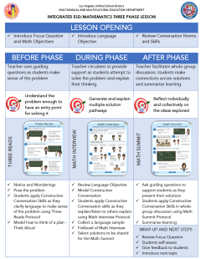
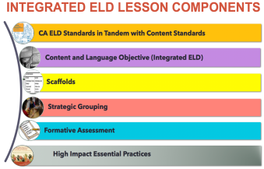
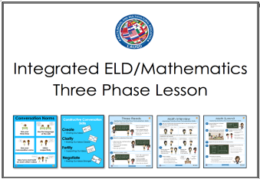
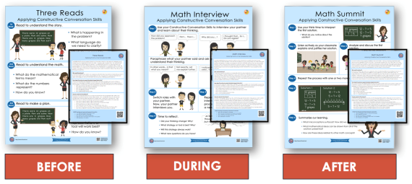

Integrated ELD/Math Resources to Support ELs with Problem Solving and Math Discourse
1. What are the expectations for Integrated ELD?
2. Model Lesson
At-A-Glance
3. Model Lessons Gr. K-6
One Per Grade Level
4. Posters
&
Companion Cards For Protocols
5. Video of Gr. K Lesson
Gr. 3 & Gr. 4 Coming Soon
MMED
Notes:
There are a number of INTEGRATED ELD RESOURCES our MMED (Multilingual Multicultural Education Department) office in LAUSD has created.
They include the Integrated ELD Lesson Component List
Model Lesson At a Glance Handout
Integrated ELD Model Lessons
Posters and Companion Cards for Protocols to support ELs
Videos

Slide 35
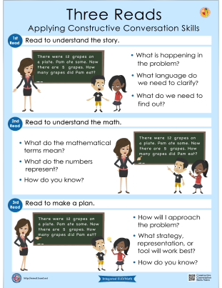
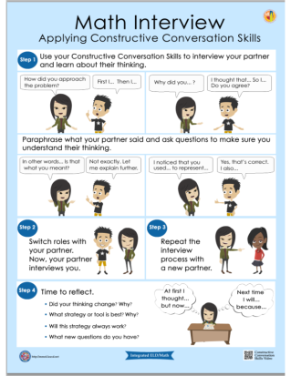
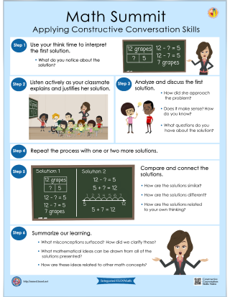
Posters & Companion Cards
BEFORE
DURING
AFTER
Notes:
The protocols developed by MMED to support English Learners during the Three Phase Lesson (BEFORE, DURING, AFTER) are:
Three Reads Protocol, Math Interview, and Math Summit. These protocols do not have to be used within a THREE PHASE LESSON. They can also stand alone during a Math Lesson.

Slide 36
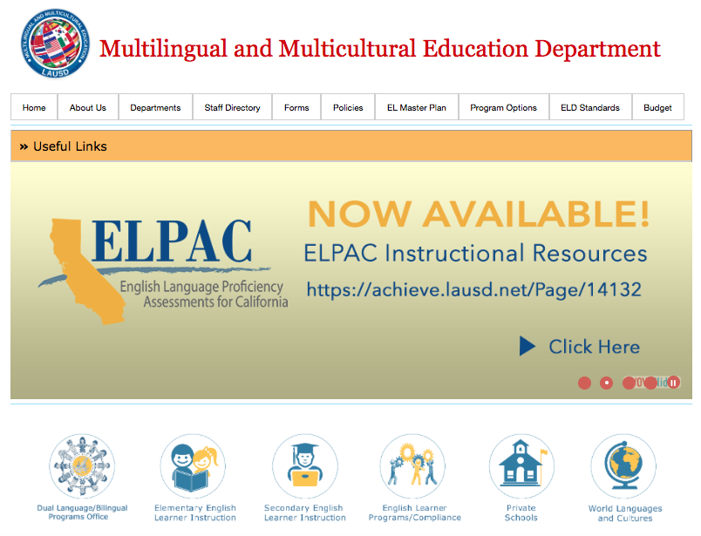


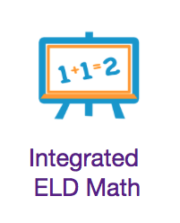
mmed.lausd.net
Notes:
To learn more about these resources you can go to the MMED website.

Slide 37
Integrated eld/math
Multilingual and Multicultural Education Department
Constructive Conversation Skills
and Mathematical Discourse
Notes:
Thank You!

