Slide 1
Integrated eld/math
Multilingual and Multicultural Education Department
Purpose
and Lesson Components
Notes:
This presentation is designed for 1.5 hours

Slide 2
AGENDA
WELCOME & GROUNDING
EL DATA
INTEGRATED ELD
INTEGRATED ELD AND MATH
INTEGRATED ELD/MATH
LESSON COMPONENTS
INTEGRATED ELD/MATH
RESOURCES
LESSON OBJECTIVES
WRAP UP / REFLECT

Slide 3

GROUNDING VIDEO
https://lausd.wistia.com/medias/eq2vgohjfd
Notes:
Play 3 minute video

Slide 4

GUIDING QUESTION – TURN & TALK
How do we diminish barriers and provide access to English Learners during math instruction?

Slide 5

LEARNING OUTCOMES
Review EL data and understand the instructional implications
Understand the essential components of Integrated ELD/Math instruction
Experience and learn about protocols that support ELs during Integrated ELD/Math instruction within the context of a Three Phase math lesson
Understand instructional practices and available resources for Integrated ELD/Math
Notes:
These learning outcomes address the entire set of PD’s on Integrated ELD Math. We may not accomplish all of them today.

Slide 6
AGENDA
WELCOME & GROUNDING
EL DATA
INTEGRATED ELD
INTEGRATED ELD AND MATH
INTEGRATED ELD/MATH
LESSON COMPONENTS
INTEGRATED ELD/MATH
RESOURCES
LESSON OBJECTIVES
WRAP UP / REFLECT

Slide 7
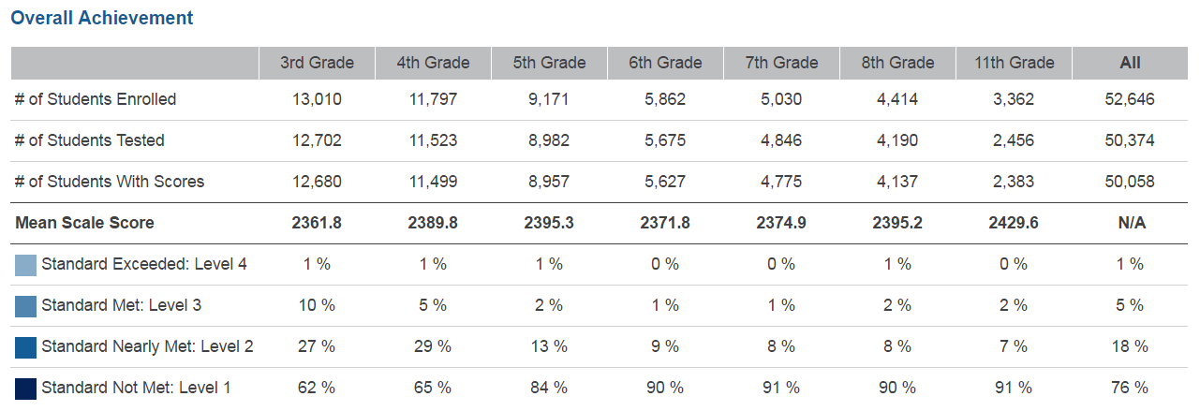
SBAC – 2016 MATHEMATICS – LAUSD – ELs
Notes:
Take a look at this data from the CDE website for English Learners in Math for LAUSD.
What do you notice?
You will see that in all grades 3-8 and 11th, LAUSD had a total of:
6% of our ELs who scored Standard Exceeded and Standard Met (combined)
94% of our ELs who scored Standard Nearly Met and Standard Not Met (combined)
76% of our ELs who scored Standard Not Met
Our English Learners need our support in Math.
At the very least, there should be more students scoring at LEVEL 2 (nearly met) and less students scoring at LEVEL 1 (not met).
Today we will be looking at the type of support we can provide to make sure we don’t have as many ELs in the LEVEL 1 group.

Slide 8


CA MATH FRAMEWORK
The role of English language proficiency must be a consideration for English learners who experience difficulties in learning mathematics... It is not possible to separate the content of mathematics from the language in which it is discussed
and taught.
-- Universal Access Chapter, p. 684-685
Notes:
Our CA Math Framework on the CDE website states the following:
READ QUOTE
It says that when teaching Math we DO need to consider our ELs because we cannot separate the content of mathematics from language
The language needs of our ELs need to be supported during Math instruction.

Slide 9
TEACHING AND LEARNING FRAMEWORK
1b1. Awareness of Students' Skills, Knowledge, and Language Proficiency
Uses information about students’ academic strengths and needs in planning.
Notes:
When we do this, we are developing in the following element of our Teaching and Leaning Framework.

Slide 10
AGENDA
WELCOME & GROUNDING
EL DATA
INTEGRATED ELD
INTEGRATED ELD AND MATH
INTEGRATED ELD/MATH
LESSON COMPONENTS
INTEGRATED ELD/MATH
RESOURCES
LESSON OBJECTIVES
WRAP UP / REFLECT

Slide 11
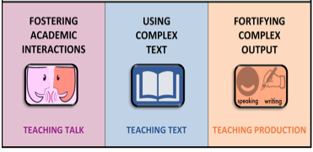

A Comprehensive ELD program consists of…
Designated ELD
Integrated ELD
Notes:
A Comprehensive ELD program includes both Designated and Integrated ELD.
Click animation (Designated ELD):
Designated ELD is the specific time of the day in which students are learning English.
Click animation (Integrated ELD):
Integrated ELD is throughout the day as ELs are learning content and English at the same time.

Slide 12

ELA/ELD FRAMEWORK
This framework uses the term integrated ELD to refer to ELD taught throughout the day and across the disciplines. All teachers with ELs in their classrooms should use the CA ELD Standards in addition to their focal CA CCSS for ELA/Literacy and other content standards to support their ELs’ linguistic
and academic progress.
-- Chapter 2, p. 108
Notes:
Our CA ELD FRAMEWORK says
READ QUOTE
This means Integrated ELD should be happening for our ELs during ELA, Math, Science, Social Studies, etc…

Slide 13
Integrated ELD
PURPOSE
Throughout the day and across the disciplines, ELs learn to use English as they simultaneously develop academic English and academic content. Ch. 2 pg. 107
All teachers with ELs in their classroom use CA ELD Standards in tandem with the CA CCSS for ELA/ Literacy and other content standards Ch. 2 pg. 106
Values and build on primary language and culture and other forms of prior knowledge Ch. 2 pg. 114
Instruction that includes an abundance of collaborative discussions about content, meaningful interaction with complex texts, and engaging and intellectually rich tasks. Ch. 2 pg. 108
Builds both content knowledge and academic English Ch. 2 pg. 114
OUTCOME
EL students learn and apply content knowledge, the purposes for using language and how English works. Ch. 2 pg. 109
Notes:
To understanding INTEGRATED ELD better, let’s read some key points about the purpose of INTEGRATED ELD.
Click to show each bullet. Ask participants to read each one out loud.
Ask: Which of these do you think are happening now in your Math classroom? Share your ideas with a partner.

Slide 14
AGENDA
WELCOME & GROUNDING
EL DATA
INTEGRATED ELD
INTEGRATED ELD AND MATH
INTEGRATED ELD/MATH
LESSON COMPONENTS
INTEGRATED ELD/MATH
RESOURCES
LESSON OBJECTIVES
WRAP UP / REFLECT

Slide 15

READING THE ELA/ELD FRAMEWORK
How do these ideas connect to
Math instruction for ELs?
p.108 Integrated ELD: READ P1
p.110 Promoting Collaborative Discussions About Content: READ P2
p.111 Supporting Comprehension and Interpretation of Complex Texts: READ P1
p.113 Supporting Academic Writing and Speaking: READ P1
p.114 Implications for Integrated ELD: READ ALL
Notes:
This reading comes from Chapter 2 of the ELD/ELA Framework.
Please look for the BOLDED SECTION HEADINGS on each of the pages listed.
Read the paragraphs UNDERNEATH the bolded headings.
For example, on p. 111 – look for the heading titled “SUPPORTING COMPREHENSION AND INTERPRETATION OF COMPLEX TEXTS”
and read the 1st Paragraph underneath that heading. Do not read the 1st paragraph on the page.
As you read be thinking about the question at the top of the slide
“HOW DO THESE IDEAS CONNECT TO MATH INSTRUTION FOR ELs?”

Slide 16




DISCUSSING THE ELA/ELD FRAMEWORK
Meet Your Sole Mate
Find 1 or 2 others wearing similar shoes
Discuss the following:
How do these ideas connect to Math Instruction for English Learners?
Notes:
Now that you have read in the ELD Framework, find your SOLE MATE partner and share your ideas about the guiding question:
HOW DO THESE IDEAS CONNECT TO MATH INSTRUCTION FOR ENGLISH LEARNERS

Slide 17



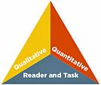

Comprehensive ELD: LAUSD Alignment
ELA/ELD Framework Integrated ELD
High-Impact
Essential Practices
Promoting Collaborative
Discussions About Content
(A Focus on Language Development & Content)
Ch. 2, p. 110
Fostering
Academic Interactions
Supporting Comprehension & Interpretation of Complex Text
(A Focus on Meaning Making and Content)
Ch. 2, p. 111
Using
Complex Text
Supporting Academic
Writing & Speaking
(A Focus on Effective Expression & Content)
Ch. 2, p. 113
Fortifying
Complex Output
Notes:
CLICK
We have read in the ELA/ELD Framework about Integrated ELD
CLICK
Jeff Zwiers work is based off of the ELD Framework. LAUSD is using his work to inform the development of designated and integrated ELD resources WHICH include his High Impact Practices.
CLICK
We read a paragraph in the section of the ELD framework called PROMOTING COLLABORATIVE DISCUSSION ABOUT CONTENT
CLICK
Jeff Zwiers refers to that as FOSTERING ACADEMIC INTERACTIONS in his work. This term is also part of our LAUSD Frame of Practice. FOSTERING ACADEMIC INTERACTIONS is also known as TALK TIME during designated ELD.
CLICK
We read a paragraph in the section of the ELD framework called SUPPORTING COMPREHENSION AND INTERPRETATION OF COMPLEX TEXT
CLICK
Jeff Zwiers refers to that as USING COMPLEX TEXT in his work. This term is also part of our LAUSD Frame of Practice. USING COMPLEX TEXT is also known as TEXT TIME during designated ELD.
CLICK
We read a paragraph in the section of the ELD framework called SUPPORTING ACADEMIC WRITINNG AND SPEAKING
CLICK
Jeff Zwiers refers to that as FORTIFYING COMPLEX OUTPUT in his work. This term is also part of our LAUSD Frame of Practice. FORTIFYING COMPLEX OUTPUT is also known as TABLE TIME during designated ELD.
WE WILL BE REFERRING TO THESE HIGH IMPACT PRACTICES AGAIN DURING THIS PD AND THE OTHER INTEGRATED ELD/MATH PDs AS WELL.

Slide 18
AGENDA
WELCOME & GROUNDING
EL DATA
INTEGRATED ELD
INTEGRATED ELD AND MATH
INTEGRATED ELD/MATH
LESSON COMPONENTS
INTEGRATED ELD/MATH
RESOURCES
LESSON OBJECTIVES
WRAP UP / REFLECT

Slide 19


INTEGRATED ELD LESSON COMPONENTS
CA ELD Standards in Tandem with Content Standards
Content and Language Objective (Integrated ELD)
Scaffolds
Strategic Grouping
Formative Assessment
High Impact Essential Practices (Jeff Zwiers)
Notes:
The essential elements of a comprehensive ELD program have the following:
CA ELD Standards working in tandem with CONTENT STANDARDS
Content and language objective ( this is for integrated ELD)
Scaffolds
Strategic group to offer instructional support that meet students’ specific needs
Formative assessment (SPF)
And for our district we have the HIGH IMPACT ESSENTIAL PRACTICES. These practices come from the book called Common Core in Diverse Classrooms by Jeff Zweirs. Our Constructive Conversation Skills support our ELs in participating in these High Impact Essential practices.

Slide 20
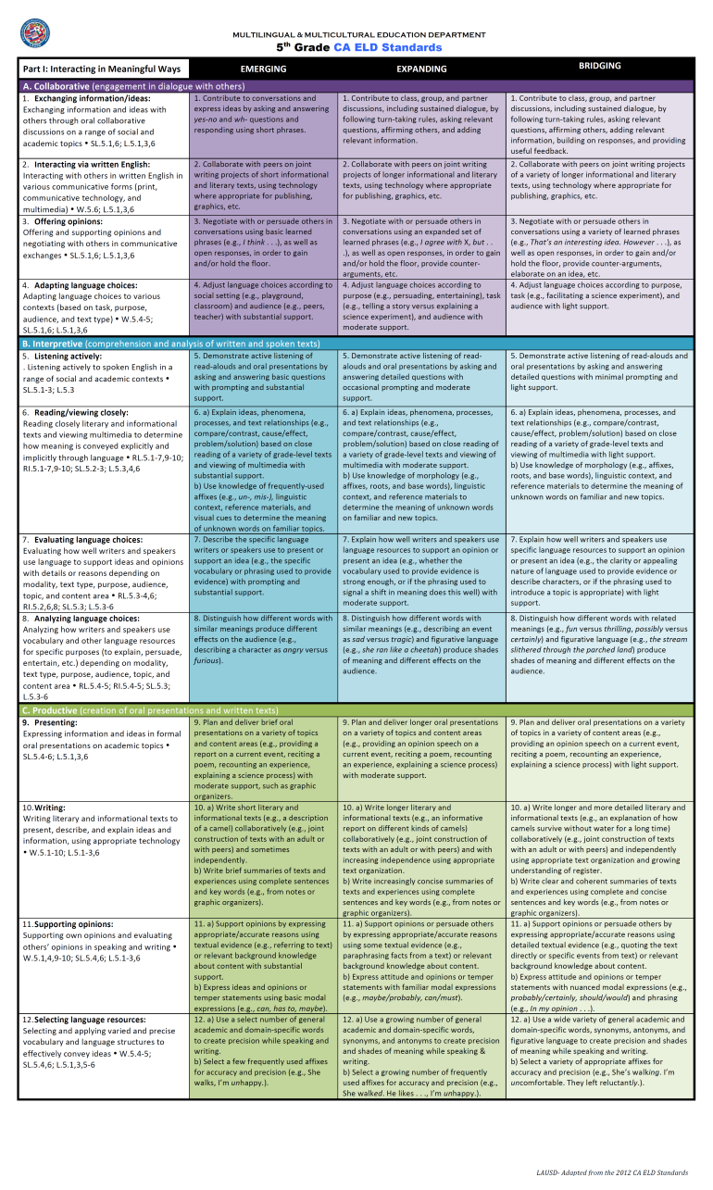
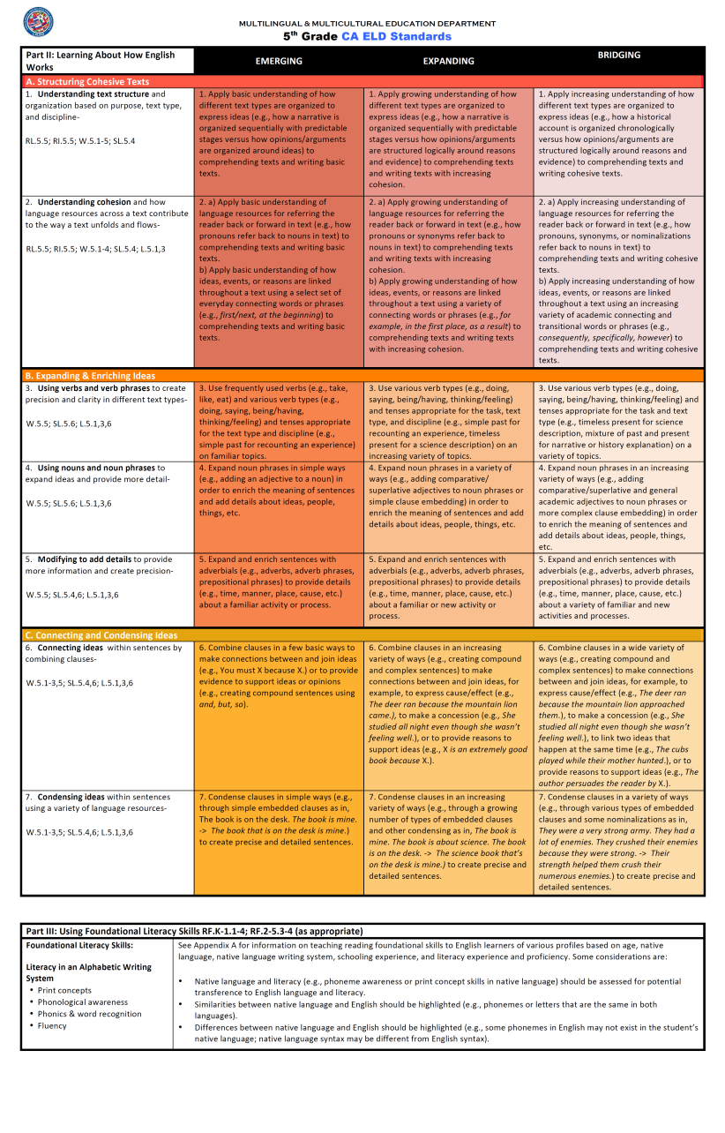
2012 CA ELD Standards
Notes:
Let’s do a quick review of our ELD Standards. You will see these being used in the Integrated ELD/Math lesson we will be looking at.

Slide 21

Part I: Interacting in Meaningful Ways
3 Modes
  Collaborative
  Interpretive
  Productive
Strands
CCSS
i.e. SL.K.1
Proficiency levels
Language of the Standards
Part I: Interacting in Meaningful Ways is about understanding how we use language to communicate and interact in meaningful ways in various contexts and disciplines
Part I: Interacting in Meaningful Ways
Part I: Interacting in Meaningful Ways
Notes:
This section highlights: Part 1 of the CA ELD Standards Interacting in Meaningful Ways.
Part I: Interacting in Meaningful Ways is about understanding how we use language to communicate and interact in meaningful ways in various contexts and disciplines.
There are three modes of Interacting in Meaningful Ways here: Collaborative, Interpretive, and Productive.
ONE OF THESE STANDARDS COULD BE INCLUDED IN AN INTEGRATED ELD/MATH LESSON.

Slide 22
Part II: Learning About How English Works
3 Processes
  Structuring Cohesive Texts
  Expanding and Enriching Ideas
  Connecting and Condensing Ideas
Strands
CCSS
i.e. SL.2.1
Proficiency levels
Language of the Standards
Part II: Learning About How English Works is about understanding the language resources and processes we use to articulate our thinking, both orally and in writing
Part II: Learning About How English Works
Part II: Learning About How English Works
Notes:
This section highlights: Part II of the CA ELD Standards: Learning About How English Works
Part II is about understanding the language resources and processes we use to articulate our thinking, both orally and in writing.

Slide 23
Part III: Using Foundational Literacy Skills
Literacy in an Alphabetic Writing System
Print Concepts
Phonological Awareness
Phonics & word recognition
Fluency
Chapter 6 (previously Appendix A)
Differences between native language and English – contrastive analysis
Part III: Using Foundational Literacy Skills is about instructional considerations based on knowledge of the literacy and language of English Learners that should be applied when teaching Reading Foundational Skills
Notes:
The next part is:
Part III: Using Foundational Literacy Skills: The foundational literacy skills will be addressed through the English Language Arts time (covered in Appendix A)
Part III shares the instructional considerations based on knowledge of the literacy and language of English Learners that should be applied when teaching Reading Foundational Skills.
ONE OF THESE STANDARDS COULD BE INCLUDED IN AN INTEGRATED ELD/MATH LESSON.

Slide 24
CA MATH FRAMEWORK
The CA ELD standards are designed and intended to be used in tandem with the CA CCSSM to support ELs in mainstream academic content classrooms... Neither the CA CCSSM nor the CA ELD standards should be treated as checklists. Instead, the CA ELD standards should be utilized
as a tool to equip ELs to better understand mathematics concepts and solve problems.
-- Universal Access Chapter, p. 690
Notes:
Our CA Math Framework’s Universal Access Chapter says
READ QUOTE
This means an INTEGRATED ELD/Math Lesson will incorporate the use of ELD STANDARDS along with the Math Standards

Slide 25
INTEGRATED ELD LESSON COMPONENTS
CA ELD Standards in Tandem with Content Standards
Content and Language Objective
Scaffolds
Strategic Grouping
Formative Assessment
High Impact Essential Practices
Notes:
Let’s take a look at what is meant by Content and Language Objectives

Slide 26
CA MATH FRAMEWORK
Language objectives articulate for learners the academic language functions and skills that they need to master to fully participate in the lesson and meet the grade-level content standards... learners construct new understandings and knowledge through language, whether unpacking new
learning for themselves or justifying their
reasoning to a peer.
-- Universal Access Chapter, p. 686
Notes:
Our CA Math Framework’s Universal Access Chapter says
READ QUOTE
Our Math Framework is saying that Language Objectives are important to ensure English Learners can fully participate in the lesson.

Slide 27
AGENDA
WELCOME & GROUNDING
EL DATA
INTEGRATED ELD
INTEGRATED ELD AND MATH
INTEGRATED ELD/MATH
LESSON COMPONENTS
INTEGRATED ELD/MATH
RESOURCES
LESSON OBJECTIVES
WRAP UP / REFLECT

Slide 28
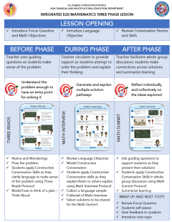
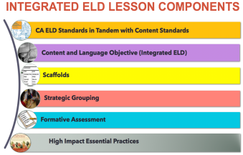
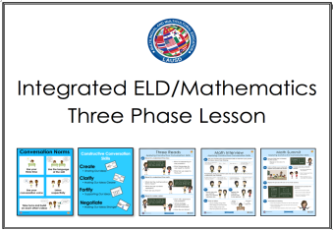
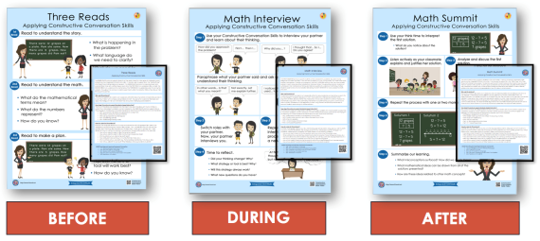

Integrated ELD/Math Resources to Support ELs with Problem Solving and Math Discourse
1. What are the expectations for Integrated ELD?
2. Model Lesson
At-A-Glance
3. Model Lessons Gr. K-6
One Per Grade Level
4. Posters
&
Companion Cards For Protocols
5. Video of Gr. K Lesson
Gr. 3 & Gr. 4 Coming Soon
MMED
Notes:
There are a number of INTEGRATED ELD RESOURCES our MMED (Multilingual Multicultural Education Department) office in LAUSD has created.
They include the Integrated ELD Lesson Component List
Model Lesson At a Glance Handout
Integrated ELD Model Lessons
Posters and Companion Cards for Protocols to support ELs
Videos

Slide 29
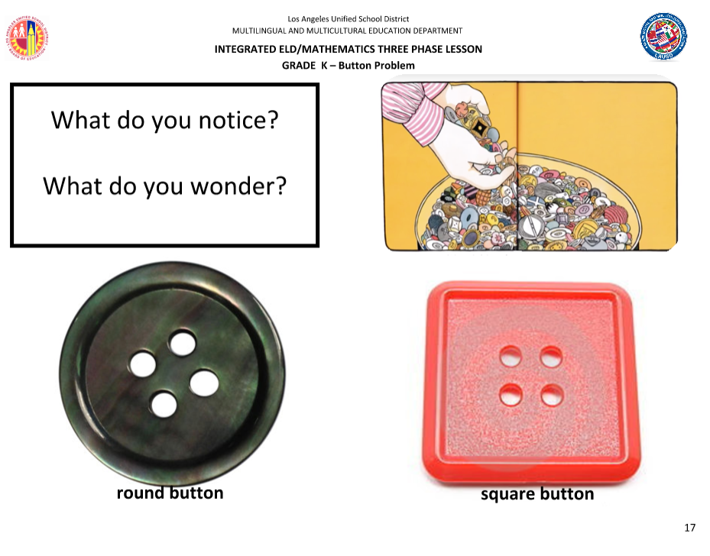

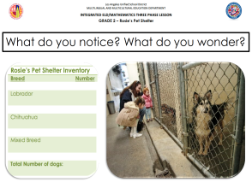

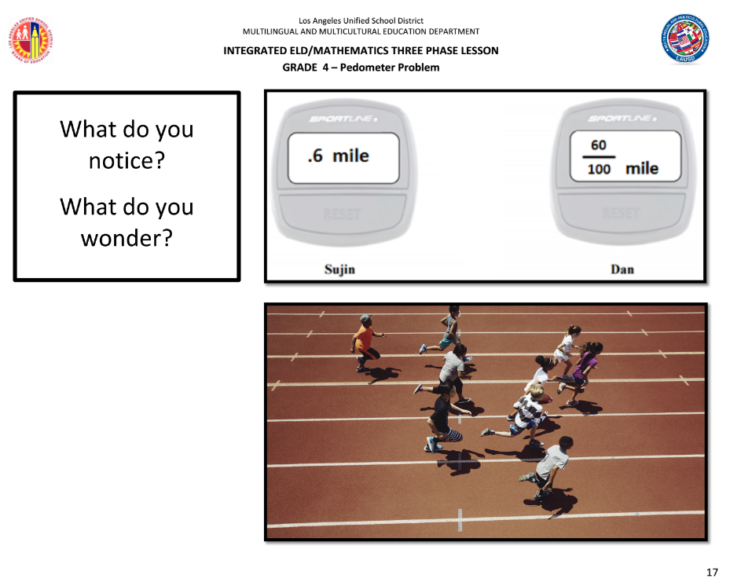
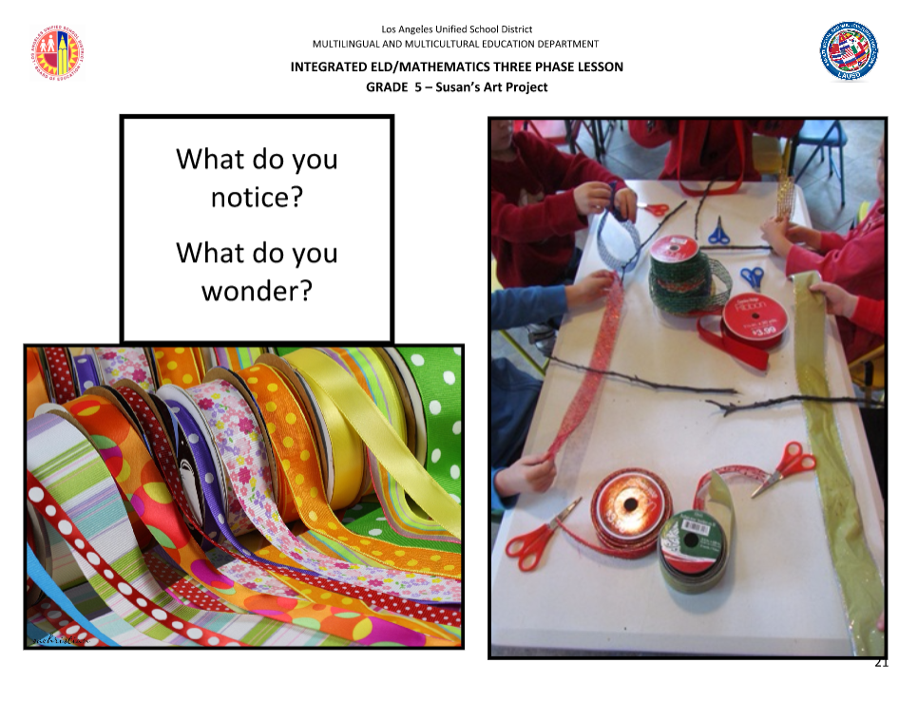
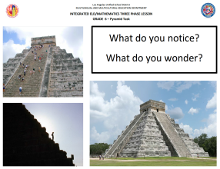
INTEGRATED ELD/MATH THREE PHASE MODEL LESSONS
KINDERGARTEN
1ST GRADE
2
2ND GRADE
3RD GRADE
4TH GRADE
2
5TH GRADE
2
6TH GRADE
Notes:
Today we will be using one of these MODEL INTEGRATED ELD LESSONS. There is 1 MODEL lesson that has been created for each grade K-6.
We will be studying the Kinder Lesson together. Each lesson has the same structure and format.

Slide 30
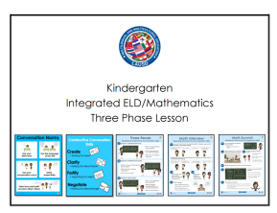
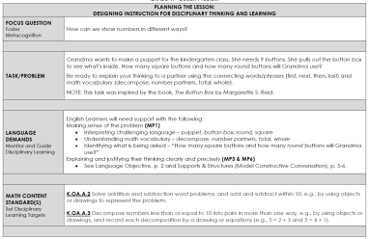
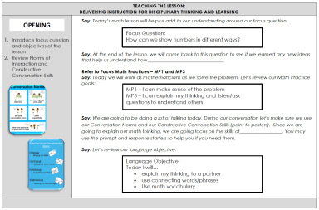
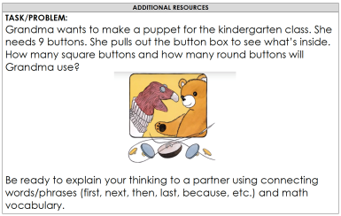
INTEGRATED ELD/MATH MODEL LESSON, GR.K
PLANNING THE LESSON, p. 1 – 6
TEACHING THE LESSON, p. 7 – 14
ADDITIONAL RESOURCES, p. 15– 19
Notes:
Each Lesson is divided into 3 sections.
PLANNING THE LESSON
TEACHING THE LESSON
ADDITIONAL RESOURCES

Slide 31
AGENDA
WELCOME & GROUNDING
EL DATA
INTEGRATED ELD
INTEGRATED ELD AND MATH
INTEGRATED ELD/MATH
LESSON COMPONENTS
INTEGRATED ELD/MATH
RESOURCES
LESSON OBJECTIVES
WRAP UP / REFLECT

Slide 32

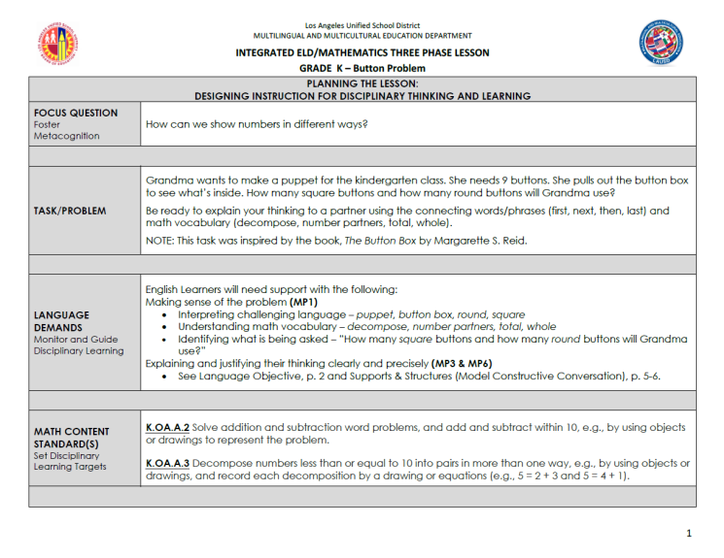
INTEGRATED ELD/MATH MODEL LESSON, GR.K
Scan p. 1
What do you notice?
FOCUS QUESTION
TASK

Slide 33
INTEGRATED ELD/MATH MODEL LESSON, GR.K
Scan p. 1
What do you notice?
LANGUAGE DEMANDS

Slide 34
LANGUAGE DEMANDS
Teachers routinely examine the texts and tasks used for instruction to identify language that may be challenging for ELs.
--ELA/ELD Framework, Chapter 2, p. 114
Notes:
REFLECTING ON THE LANGUAGE DEMANDS AS A TEACHER IS IMPORTANT.
Our CA ELD Framework says”
READ QUOTE
Reflecting on the language demands of the task will help us in determining what type of support our ELs might need.

Slide 35
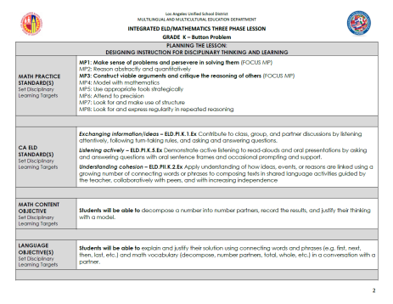
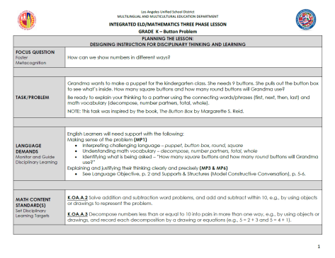
INTEGRATED ELD/MATH MODEL LESSON, GR.K
Scan p. 1-2
What do you notice?
MATH CONTENT
MATH PRACTICE
ELD STANDARDS

Slide 36
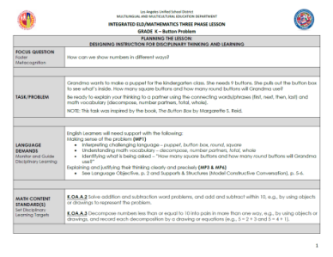
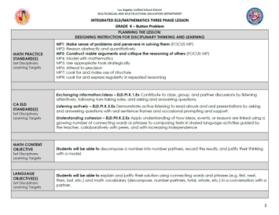
INTEGRATED ELD/MATH MODEL LESSON, GR.K
Language Demand:
Explaining and justifying their thinking clearly and precisely.
ELD Standards:
ELD P1.K.1 Exchanging Information/ Ideas
ELD P1.K.5 Listening Actively
ELD PII.K.2 Understanding Cohesion
Language Objective:
SWBAT explain and justify their solution using connecting words and phrases and math vocabulary in a conversation with a partner.
Notes:
Each Model lesson details:
The potential language demands for the lesson/task
The ELD Standards that are being used in tandem with the Math Standards
A Language Objective for the lesson the teacher is using to guide planning, formative assessment, and decision making during the lesson

Slide 37
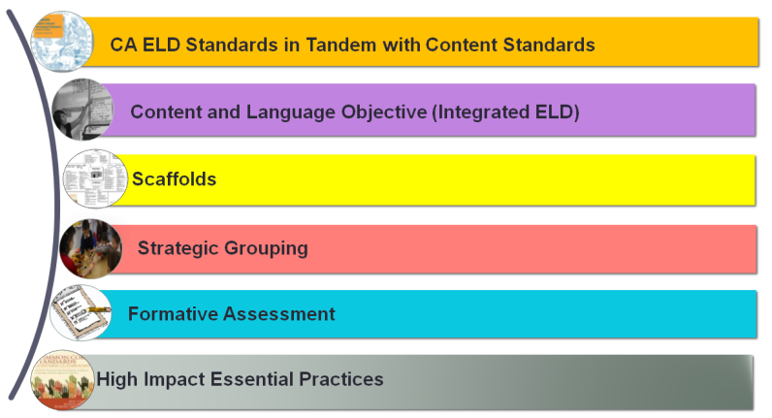
INTEGRATED ELD/MATH MODEL LESSON, GR.K
  What Integrated ELD lesson components have we seen in the sample lesson so far?
Notes:
So far we have seen the orange and purple COMPONENTS in the Model Kinder Lesson.
Let’s see what a Kindergarten teacher, Maggie Saldivar at Ranchito Ave Elementary does to plan for her lesson.

Slide 38
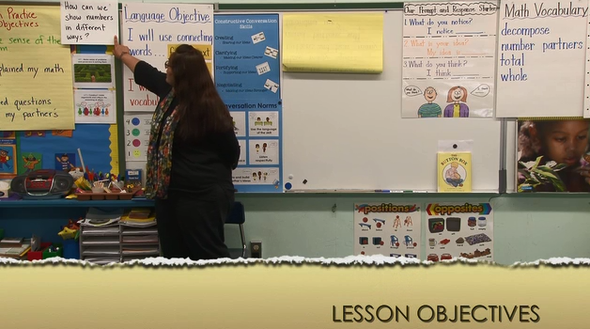
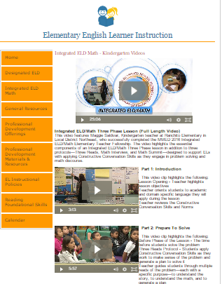
INTEGRATED ELD/MATH K VIDEO
LESSON OBJECTIVES
Click here to find the Kindergarten Integrated ELD/Math video
_
Notes:
As we watch this portion of the video, think about the following:
READ FROM THE SLIDE
Allow time for participants to watch the video and discuss.
You can find the video at:
http://achieve.lausd.net/Page/11671#spn-content

Slide 39
INTEGRATED ELD/MATH K VIDEO
LESSON OBJECTIVES
How were standards used in planning the lesson?
  Math Content Standards
  Math Practice Standards
  ELD Standards
How were lesson objectives posed to the students?
_
Notes:
As we watch this portion of the video, think about the following:
READ FROM THE SLIDE
Allow time for participants to watch the video and discuss.
You can find the video at:
http://achieve.lausd.net/Page/11671#spn-content

Slide 40
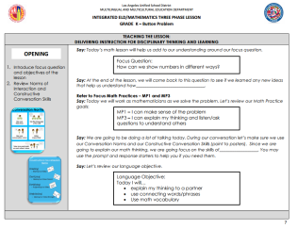
INTEGRATED ELD/MATH MODEL LESSON, GR.K
Scan p. 7 of the lesson
Discuss the following with a partner:
  What do you notice?
  What do you wonder?

Slide 41
TEACHING AND LEARNING FRAMEWORK
1d1. Standards-Based Learning Activities:
Activities are designed to engage students in cognitively challenging work that is aligned to the standards.
Notes:
When we do this, we are developing in the following element of our Teaching and Leaning Framework.

Slide 42
AGENDA
WELCOME & GROUNDING
EL DATA
INTEGRATED ELD
INTEGRATED ELD AND MATH
INTEGRATED ELD/MATH
LESSON COMPONENTS
INTEGRATED ELD/MATH
RESOURCES
LESSON OBJECTIVES
WRAP UP / REFLECT

Slide 43
INTEGRATED ELD LESSON COMPONENTS
CA ELD Standards in Tandem with Content Standards
Content and Language Objective
Scaffolds
Strategic Grouping
Formative Assessment
High Impact Essential Practices
Notes:
Today, we have been introduced to the INTEGRATED ELD LESSON COMPONENTS and seen the first two in a Kindergarten lesson.

Slide 44

GUIDING QUESTION TURN AND TALK
How do the Integrated ELD Lesson Components act together to support English Learners?

Slide 45
LEARNING OUTCOMES
Review EL data and understand the instructional implications
Identify the essential components of Integrated ELD/Math instruction
Experience and learn about protocols that support ELs during Integrated ELD/Math instruction within the context of a Three Phase math lesson
Understand instructional practices and available resources for Integrated ELD/Math
Notes:
Remember, these learning outcomes address the entire set of PD’s on Integrated ELD Math. We may not have accomplished all of them today.
What Learning Outcomes did we reach today?

Slide 46
Integrated ELD/Math Resources to Support ELs with Problem Solving and Math Discourse
1. What are the expectations for Integrated ELD?
2. Model Lesson
At-A-Glance
3. Model Lessons Gr. K-6
One Per Grade Level
4. Posters
&
Companion Cards For Protocols
5. Video of Gr. K Lesson
Gr. 3 & Gr. 4 Coming Soon
MMED
Notes:
There are a number of INTEGRATED ELD RESOURCES our MMED (Multilingual Multicultural Education Department) office in LAUSD has created.
They include the Integrated ELD Lesson Component List
Model Lesson At a Glance Handout
Integrated ELD Model Lessons
Posters and Companion Cards for Protocols to support ELs
Videos

Slide 47
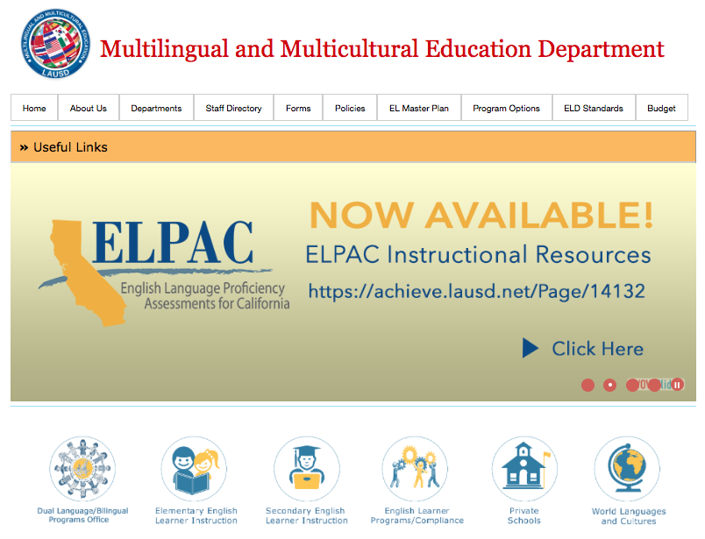


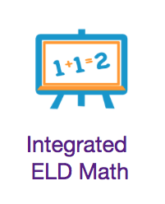
mmed.lausd.net
Notes:
To learn more about these resources you can go to the MMED website.

Slide 48
Integrated eld/math
Multilingual and Multicultural Education Department
Purpose
and Lesson Components
Notes:
Thank You!

