Slide 1
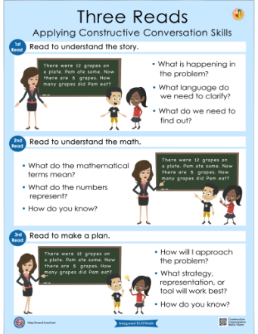
Integrated eld/math
Multilingual and Multicultural Education Department
Three Reads Protocol
Notes:
This presentation is designed for 1.5 hours

Slide 2
AGENDA
GROUNDING AND EL DATA
INTEGRATED ELD/MATH
THREE PHASE LESSON STRUCTURE
INTEGRATED ELD/MATH RESOURCES
LESSON OBJECTIVES
BEFORE PHASE
THREE READS PROTOCOL
WRAP UP/ REFLECT

Slide 3

GROUNDING VIDEO
Notes:
Play 3 minute video

Slide 4

GUIDING QUESTION – TURN & TALK
How do we diminish barriers and provide access to English Learners during math instruction?

Slide 5

LEARNING OUTCOMES
Review EL data and understand the instructional implications
Understand the essential components of Integrated ELD/Math instruction
Experience and learn about protocols that support ELs during Integrated ELD/Math instruction within the context of a Three Phase math lesson
Understand instructional practices and available resources for Integrated ELD/Math
Notes:
These learning outcomes address the entire set of PD’s on Integrated ELD Math. We may not accomplish all of them today.

Slide 6
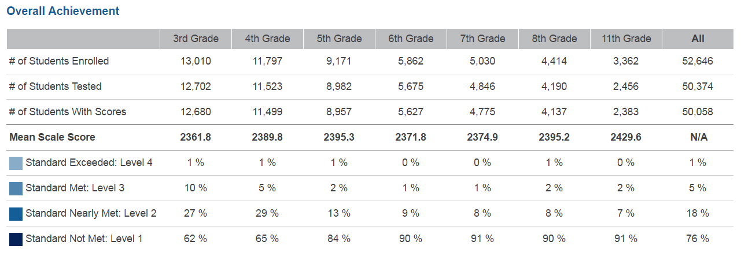
SBAC – 2016 MATHEMATICS – LAUSD – ELs
Notes:
Take a look at this data from the CDE website for English Learners in Math for LAUSD.
What do you notice?
You will see that in all grades 3-8 and 11th, LAUSD had a total of:
6% of our ELs who scored Standard Exceeded and Standard Met (combined)
94% of our ELs who scored Standard Nearly Met and Standard Not Met (combined)
76% of our ELs who scored Standard Not Met
Our English Learners need our support in Math.
At the very least, there should be more students scoring at LEVEL 2 (nearly met) and less students scoring at LEVEL 1 (not met).
Today we will be looking at the type of support we can provide to make sure we don’t have as many ELs in the LEVEL 1 group.

Slide 7


CA MATH FRAMEWORK
The role of English language proficiency must be a consideration for English learners who experience difficulties in learning mathematics... It is not possible to separate the content of mathematics from the language in which it is discussed
and taught.
-- Universal Access Chapter, p. 684-685
Notes:
Our CA Math Framework on the CDE website states the following:
READ QUOTE
It says that when teaching Math we DO need to consider our ELs because we cannot separate the content of mathematics from language
The language needs of our ELs need to be supported during Math instruction.

Slide 8
TEACHING AND LEARNING FRAMEWORK
1b1. Awareness of Students' Skills, Knowledge, and Language Proficiency
Uses information about students’ academic strengths and needs in planning.
Notes:
When we do this, we are developing in the following element of our Teaching and Leaning Framework.

Slide 9
AGENDA
GROUNDING AND EL DATA
INTEGRATED ELD/MATH
THREE PHASE LESSON STRUCTURE
INTEGRATED ELD/MATH RESOURCES
LESSON OBJECTIVES
BEFORE PHASE
THREE READS PROTOCOL
WRAP UP/ REFLECT

Slide 10
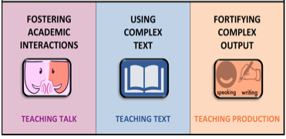

A Comprehensive ELD program consists of…
Designated ELD
Integrated ELD
Notes:
A Comprehensive ELD program includes both Designated and Integrated ELD.
Click animation (Designated ELD):
Designated ELD is the specific time of the day in which students are learning English.
Click animation (Integrated ELD):
Integrated ELD is throughout the day as ELs are learning content and English at the same time.

Slide 11

ELA/ELD FRAMEWORK
This framework uses the term integrated ELD to refer to ELD taught throughout the day and across the disciplines. All teachers with ELs in their classrooms should use the CA ELD Standards in addition to their focal CA CCSS for ELA/Literacy and other content standards to support their ELs’ linguistic
and academic progress.
-- Chapter 2, p. 108
Notes:
Our CA ELD FRAMEWORK says
READ QUOTE
This means Integrated ELD should be happening for our ELs during ELA, Math, Science, Social Studies, etc…

Slide 12
Integrated ELD
PURPOSE
Throughout the day and across the disciplines, ELs learn to use English as they simultaneously develop academic English and academic content. Ch. 2 pg. 107
All teachers with ELs in their classroom use CA ELD Standards in tandem with the CA CCSS for ELA/ Literacy and other content standards Ch. 2 pg. 106
Values and build on primary language and culture and other forms of prior knowledge Ch. 2 pg. 114
Instruction that includes an abundance of collaborative discussions about content, meaningful interaction with complex texts, and engaging and intellectually rich tasks. Ch. 2 pg. 108
Builds both content knowledge and academic English Ch. 2 pg. 114
OUTCOME
EL students learn and apply content knowledge, the purposes for using language and how English works. Ch. 2 pg. 109
Notes:
To understanding INTEGRATED ELD better, let’s read some key points about the purpose of INTEGRATED ELD.
Click to show each bullet. Ask participants to read each one out loud.
Ask: Which of these do you think are happening now in your Math classroom? Share your ideas with a partner.

Slide 13


INTEGRATED ELD LESSON COMPONENTS
CA ELD Standards in Tandem with Content Standards
Content and Language Objective
Scaffolds
Strategic Grouping
Formative Assessment
High Impact Essential Practices
Notes:
The essential elements of a comprehensive ELD program have the following:
CA ELD Standards working in tandem with CONTENT STANDARDS
Content and language objective ( this is for integrated ELD)
Scaffolds
Strategic group to offer instructional support that meet students’ specific needs
Formative assessment (SPF)
And for our district we have the HIGH IMPACT ESSENTIAL PRACTICES. These practices come from the book called Common Core in Diverse Classrooms by Jeff Zweirs. Our Constructive Conversation Skills support our ELs in participating in these High Impact Essential practices.

Slide 14
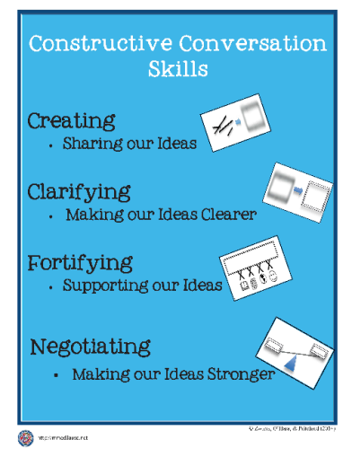



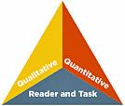

HIGH IMPACT ESSENTIAL PRACTICES
ELA/ELD Framework Integrated ELD
High-Impact
Essential Practices
Promoting Collaborative
Discussions About Content
(A Focus on Language Development & Content)
Ch. 2, p. 110
Fostering
Academic Interactions
Supporting Comprehension & Interpretation of Complex Text
(A Focus on Meaning Making and Content)
Ch. 2, p. 111
Using
Complex Text
Supporting Academic
Writing & Speaking
(A Focus on Effective Expression & Content)
Ch. 2, p. 113
Fortifying
Complex Output
Notes:
Constructive Conversation Skills support the High Impact Essential Practices.
The High Impact Practices are:
FOSTERING ACADEMIC INTERACTIONS, USING COMPLEX TEXT, AND FORTIFYING COMPLEX OUTPUT
Both come from the work of Jeff Zwiers out of Stanford University. In his work Jeff Zwiers talks about how important the High Impact Practices are during INTEGRATED ELD.
The Constructive Conversation Skills are a part of our Designated ELD Instruction and should also be used to support our English Learners during Integrated ELD Instruction.
Having our students become proficient in these skills helps our English Learners engage in the High Impact Practices.

Slide 15
AGENDA
GROUNDING AND EL DATA
INTEGRATED ELD/MATH
THREE PHASE LESSON STRUCTURE
INTEGRATED ELD/MATH RESOURCES
LESSON OBJECTIVES
BEFORE PHASE
THREE READS PROTOCOL
WRAP UP/ REFLECT

Slide 16
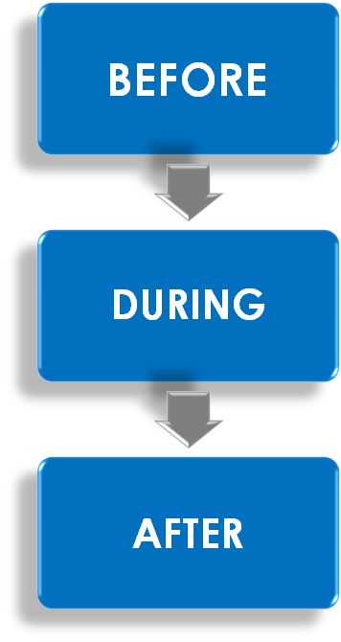
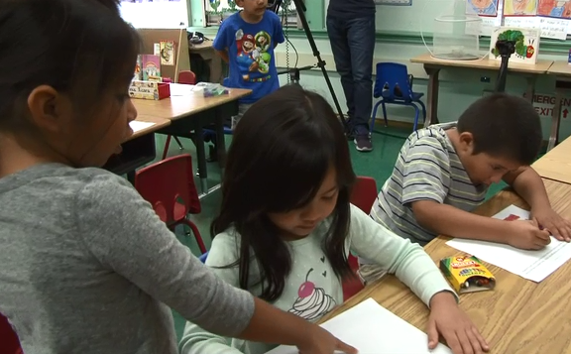
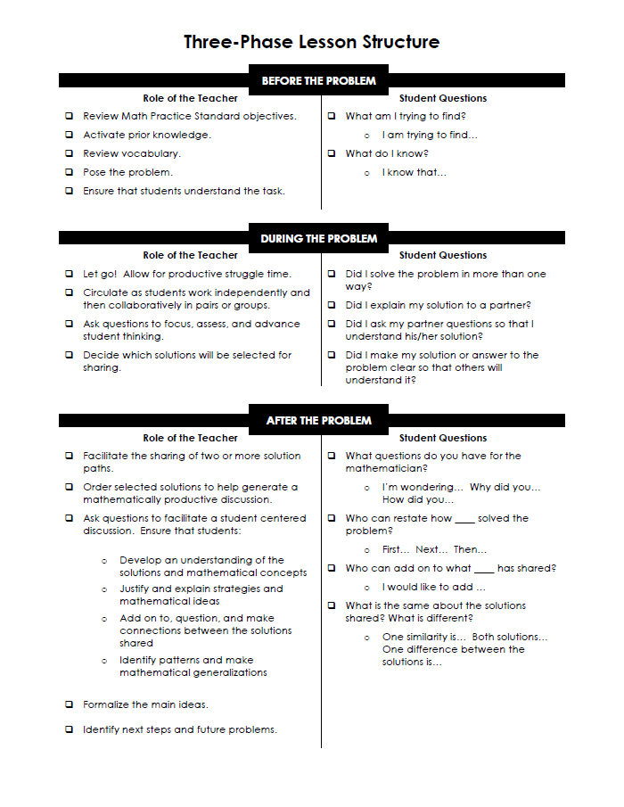
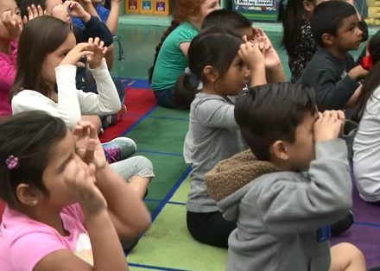
THREE PHASE LESSON STRUCTURE
Notes:
The INTEGRATED ELD/MATH LESSON RESOURCES created by LAUSD were developed with the intent of supporting the Three Phase Lesson in Math. The Three Phase Lesson is a problem solving lesson, NOT a DIRECT INSTRUCTION lesson.
The INTEGRATED ELD/MATH LESSON PROTOCOLS, like the THREE READS, MATH INTERVIEW, AND MATH SUMMIT, can also be used independently during a regular Math Lesson.
Let’s take a look at the structure of a THREE PHASE LESSON.

Slide 17
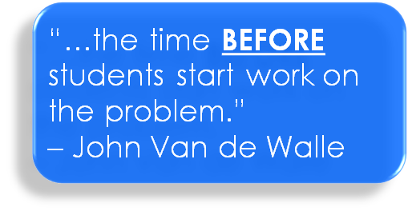
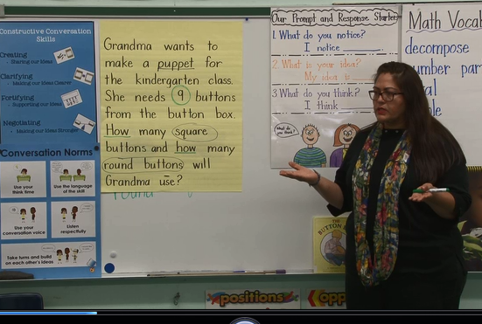
THREE PHASE LESSON STRUCTURE
Notes:
Take a moment to read about this phase on your handout.

Slide 18
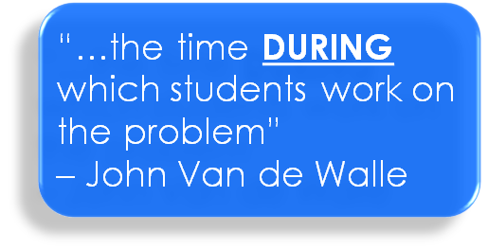
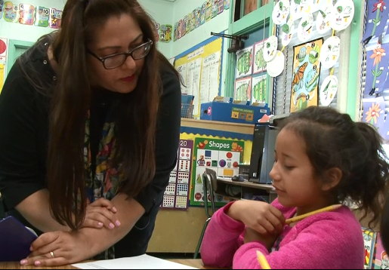
THREE PHASE LESSON STRUCTURE
HANDOUT
Notes:
Take a moment to read about this phase on your handout.

Slide 19
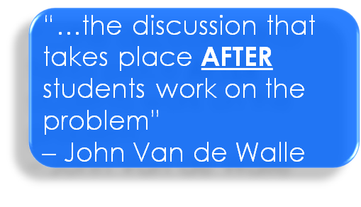
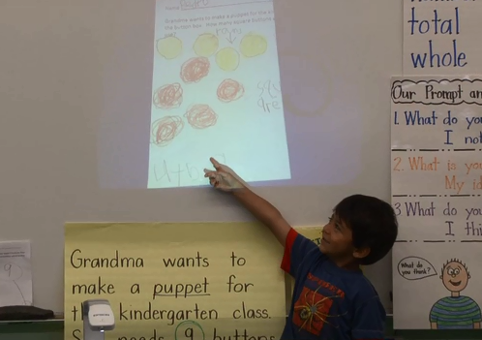
THREE PHASE LESSON STRUCTURE
HANDOUT
Notes:
Take a moment to read about this phase on your handout.

Slide 20
AGENDA
GROUNDING AND EL DATA
INTEGRATED ELD/MATH
THREE PHASE LESSON STRUCTURE
INTEGRATED ELD/MATH RESOURCES
LESSON OBJECTIVES
BEFORE PHASE
THREE READS PROTOCOL
WRAP UP/ REFLECT

Slide 21
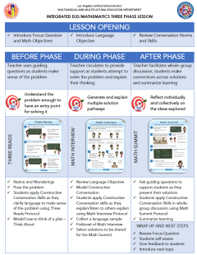
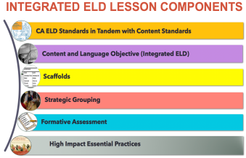
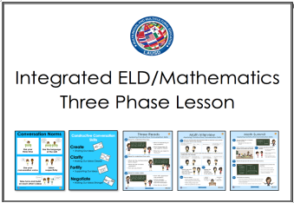
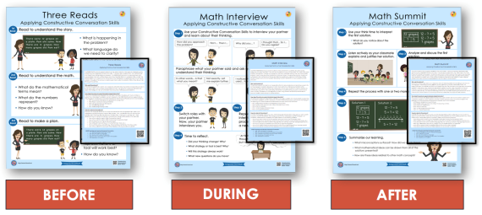

Integrated ELD/Math Resources to Support ELs with Problem Solving and Math Discourse
1. What are the expectations for Integrated ELD?
2. Model Lesson
At-A-Glance
3. Model Lessons Gr. K-6
One Per Grade Level
4. Posters
&
Companion Cards For Protocols
5. Video of Gr. K Lesson
Gr. 3 & Gr. 4 Coming Soon
MMED
Notes:
There are a number of INTEGRATED ELD RESOURCES our MMED (Multilingual Multicultural Education Department) office in LAUSD has created.
They include the Integrated ELD Lesson Component List
Model Lesson At a Glance Handout
Integrated ELD Model Lessons
Posters and Companion Cards for Protocols to support ELs
Videos

Slide 22
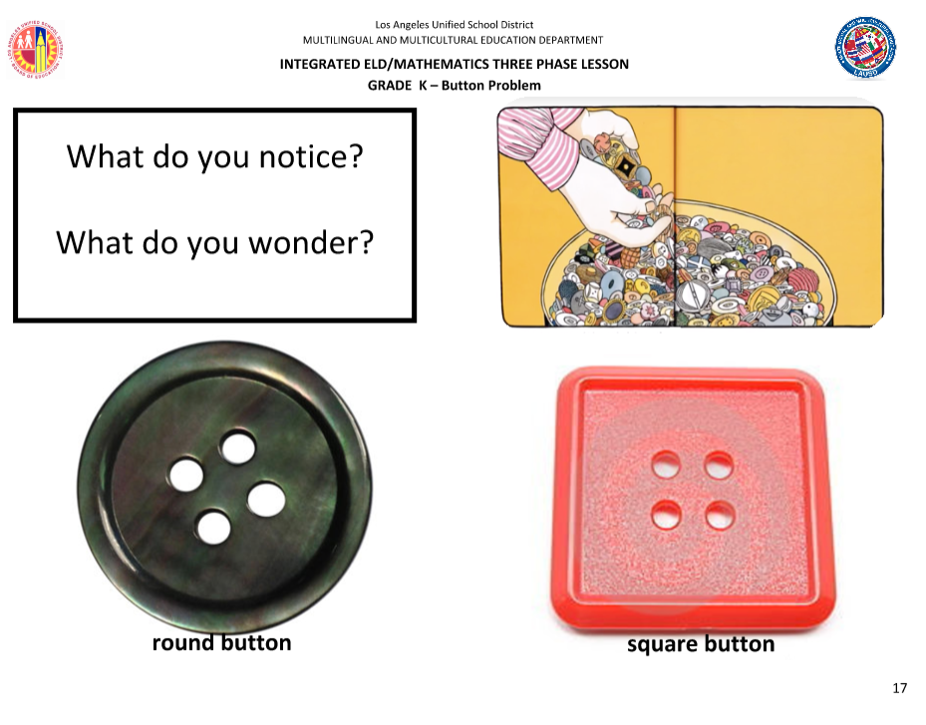
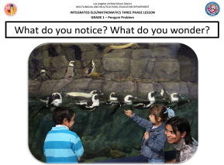
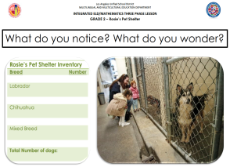

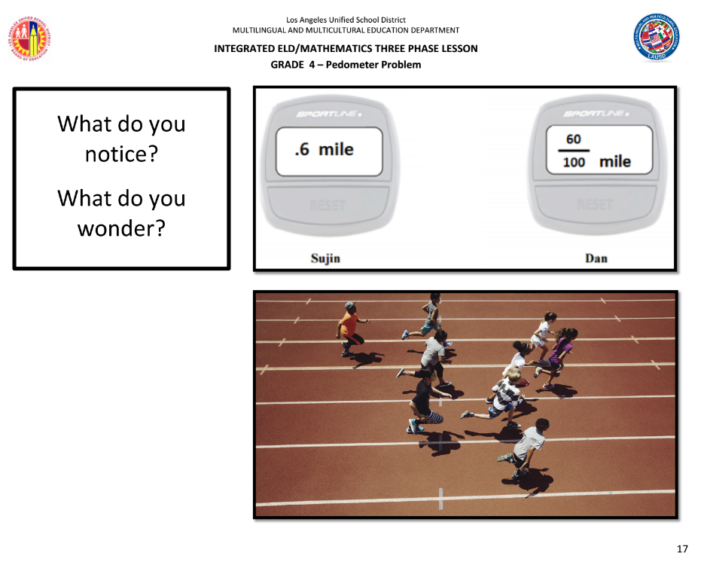
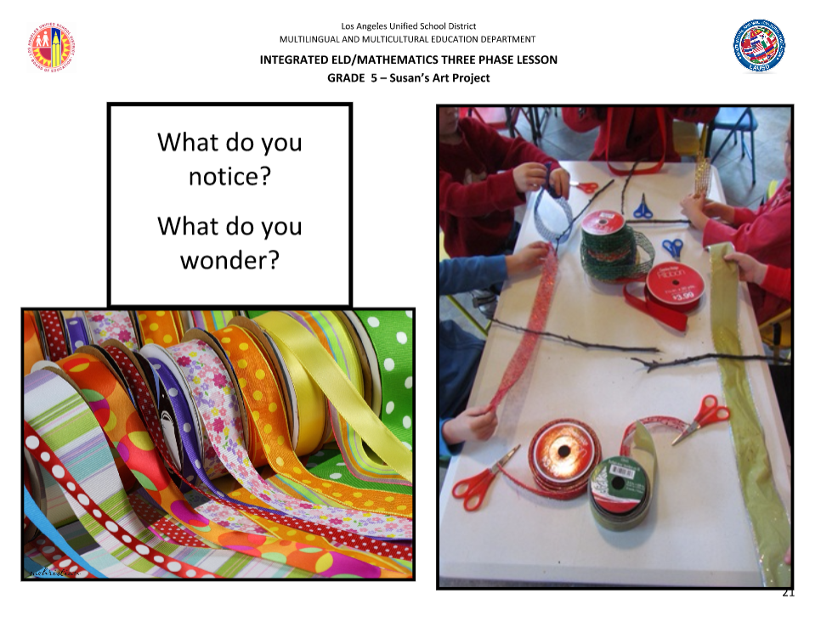
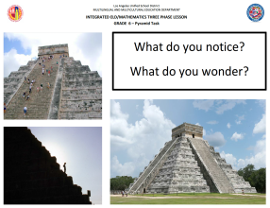
INTEGRATED ELD/MATH THREE PHASE MODEL LESSONS
KINDERGARTEN
1ST GRADE
2
2ND GRADE
3RD GRADE
4TH GRADE
2
5TH GRADE
2
6TH GRADE
Notes:
Today we will be using one of these MODEL INTEGRATED ELD LESSONS. There is 1 MODEL lesson that has been created for each grade K-6.
We will be studying the Kinder Lesson together. Each lesson has the same structure and format.

Slide 23
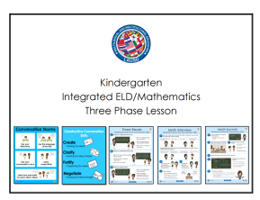
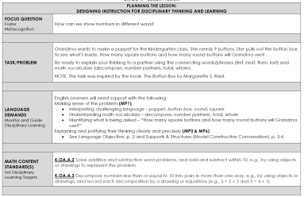
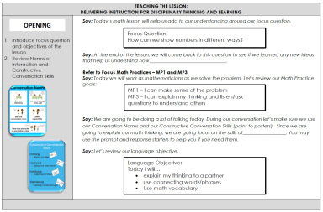
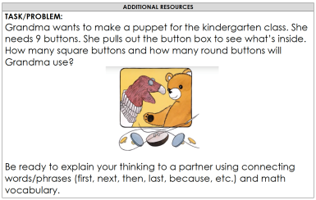
INTEGRATED ELD/MATH MODEL LESSON, GR.K
PLANNING THE LESSON, p. 1 – 6
TEACHING THE LESSON, p. 7 – 14
ADDITIONAL RESOURCES, p. 15– 19
Notes:
Each Lesson is divided into 3 sections.
PLANNING THE LESSON
TEACHING THE LESSON
ADDITIONAL RESOURCES

Slide 24
AGENDA
GROUNDING AND EL DATA
INTEGRATED ELD/MATH
THREE PHASE LESSON STRUCTURE
INTEGRATED ELD/MATH RESOURCES
LESSON OBJECTIVES
BEFORE PHASE
THREE READS PROTOCOL
WRAP UP/ REFLECT

Slide 25
INTEGRATED ELD LESSON COMPONENTS
CA ELD Standards in Tandem with Content Standards
Content and Language Objective
Scaffolds
Strategic Grouping
Formative Assessment
High Impact Essential Practices
Notes:
Let’s take a look at what the first two elements (orange and purple) look like in an INTEGRATED ELD/MATH LESSON.

Slide 26
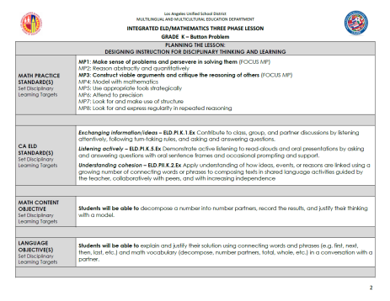
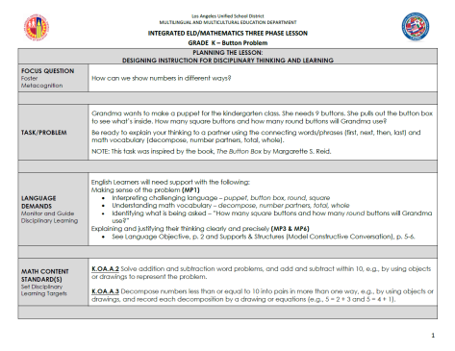
INTEGRATED ELD/MATH MODEL LESSON, GR.K
Scan p. 1-2
What do you notice?
MATH CONTENT
MATH PRACTICE
ELD STANDARDS

Slide 27
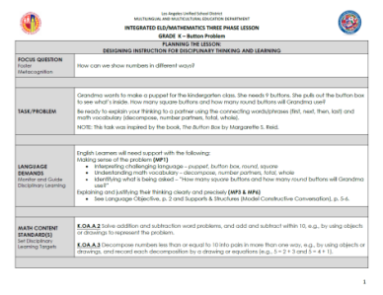
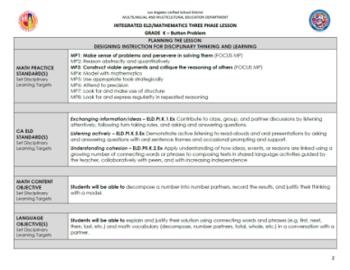
INTEGRATED ELD/MATH MODEL LESSON, GR.K
Language Demand:
Explaining and justifying their thinking clearly and precisely.
ELD Standards:
ELD P1.K.1 Exchanging Information/ Ideas
ELD P1.K.5 Listening Actively
ELD PII.K.2 Understanding Cohesion
Language Objective:
SWBAT explain and justify their solution using connecting words and phrases and math vocabulary in a conversation with a partner.
Notes:
Each Model lesson details:
The potential language demands for the lesson/task
The ELD Standards that are being used in tandem with the Math Standards
A Language Objective for the lesson the teacher is using to guide planning, formative assessment, and decision making during the lesson

Slide 28
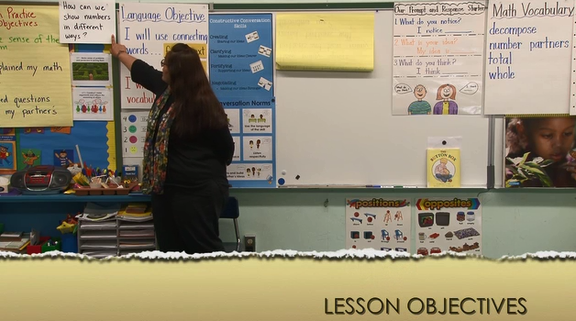
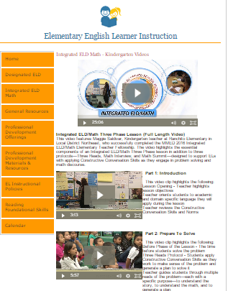
INTEGRATED ELD/MATH K VIDEO
LESSON OBJECTIVES
Click here to find the Kindergarten Integrated ELD/Math video
_
Notes:
As we watch this portion of the video, think about the following:
READ FROM THE SLIDE
Allow time for participants to watch the video and discuss.
You can find the video at:
http://achieve.lausd.net/Page/11671#spn-content

Slide 29
INTEGRATED ELD/MATH K VIDEO
LESSON OBJECTIVES
How were standards used in planning the lesson?
Math Content Standards
Math Practice Standards
ELD Standards
How were lesson objectives posed to the students?
_
Notes:
As we watch this portion of the video, think about the following:
READ FROM THE SLIDE
Allow time for participants to watch the video and discuss.
You can find the video at:
http://achieve.lausd.net/Page/11671#spn-content

Slide 30
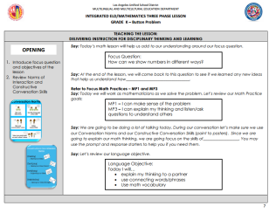
INTEGRATED ELD/MATH MODEL LESSON, GR.K
Scan p. 7 of the lesson
Discuss the following with a partner:
What do you notice?
What do you wonder?

Slide 31
TEACHING AND LEARNING FRAMEWORK
1d1. Standards-Based Learning Activities:
Activities are designed to engage students in cognitively challenging work that is aligned to the standards.
Notes:
When we do this, we are developing in the following element of our Teaching and Leaning Framework.

Slide 32
AGENDA
GROUNDING AND EL DATA
INTEGRATED ELD/MATH
THREE PHASE LESSON STRUCTURE
INTEGRATED ELD/MATH RESOURCES
LESSON OBJECTIVES
BEFORE PHASE
THREE READS PROTOCOL
WRAP UP/ REFLECT

Slide 33
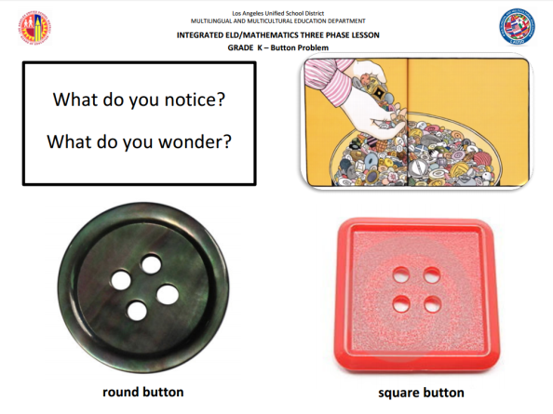
PLANNING FOR THE BEFORE PHASE
Activate prior knowledge
Review vocabulary
Pose the problem
Ensure that students understand the task
Notes:
First, let’s learn a little bit about the BEFORE PHASE.
In the BEFORE PHASE of a THREE PHASE LESSON you want to
READ BULLET POINTS FROM THE SLIDE
In the Kinder MODEL LESSON we are looking at today, the teacher could activate prior knowledge and review vocabulary in the task by showing students some pictures that go with the problem and asking them, WHAT DO YOU NOTICE AND WHAT DO YOU WONDER?

Slide 34
AGENDA
GROUNDING AND EL DATA
INTEGRATED ELD/MATH
THREE PHASE LESSON STRUCTURE
INTEGRATED ELD/MATH RESOURCES
LESSON OBJECTIVES
BEFORE PHASE
THREE READS PROTOCOL
WRAP UP/ REFLECT

Slide 35

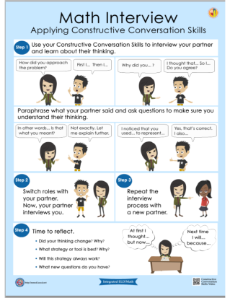
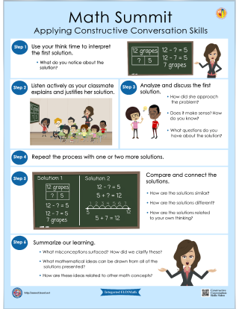
Posters & Companion Cards
BEFORE
DURING
AFTER
Notes:
The protocols developed by MMED to support English Learners during the Three Phase Lesson (BEFORE, DURING, AFTER) are:
Three Reads Protocol, Math Interview, and Math Summit.
These protocols do not have to be used within a THREE PHASE LESSON. They can also stand alone during a Math Lesson.
Each protocol comes with a poster for classroom use and a companion card for the teacher.

Slide 36

THREE READS PROTOCOL
Before students begin a problem
Prepares students to make sense of the problem and persevere to solve (MP1)
Prepares students to demonstrate actively listening to read alouds
(CA ELD PI B5) or close reading
(CA ELD P1 B6)
Provides an entry point for students into the problem to begin thinking about the math

Slide 37
THREE READS PROTOCOL
Read the Three Reads poster
Discuss the following with a partner:
What do you notice?
What do you wonder?

Slide 38
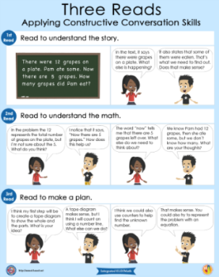
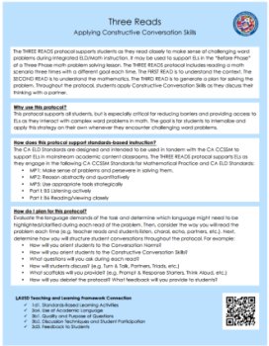
THREE READS PROTOCOL – TURN & TALK
Read both sides of the companion card
Discuss the following with a partner:
How are students applying Constructive Conversation skills?

Slide 39
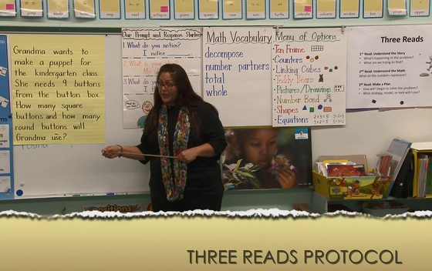
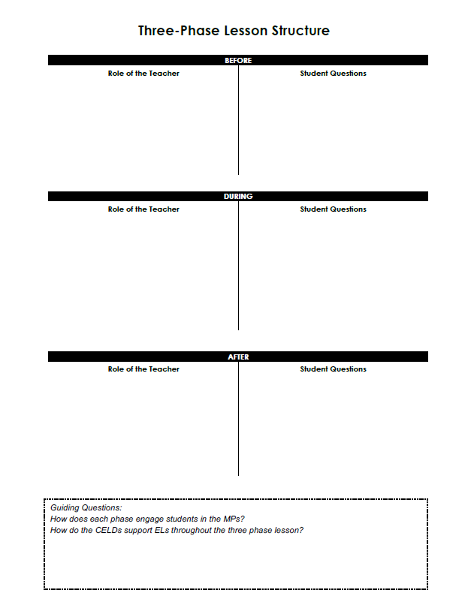
INTEGRATED ELD/MATH K VIDEO
THREE READS
_
Notes:
As you watch the video, feel free to take notes.
You can find the video at:
http://achieve.lausd.net/Page/11671#spn-content
Have participants share what they noticed and wonder about the video

Slide 40

INTEGRATED ELD/MATH MODEL LESSON, GR.K
Scan p. 8 – 9 of the lesson
Discuss the following with a partner:
What do you notice?
What do you wonder?
How might you use this protocol in your classroom?
Notes:
Let’s take a look at these page of our sample lesson plan. Read the vignette that shows how the teacher sets up the Three Read with students.
READ DIRECTIONS FROM SLIDE

Slide 41

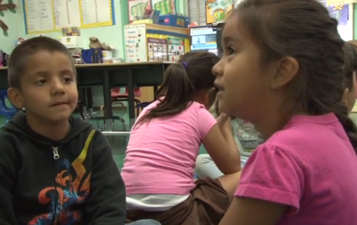



CONSTRUCTIVE CONVERSATION SKILLS
How were the Constructive Conversation Skills used during the Three Reads Protocol?
CREATE
CLARIFY
FORTIFY
NEGOTIATE

Slide 42
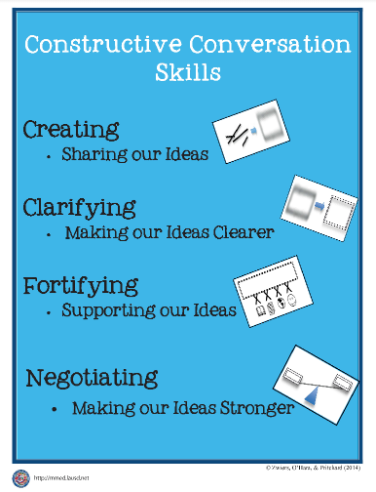
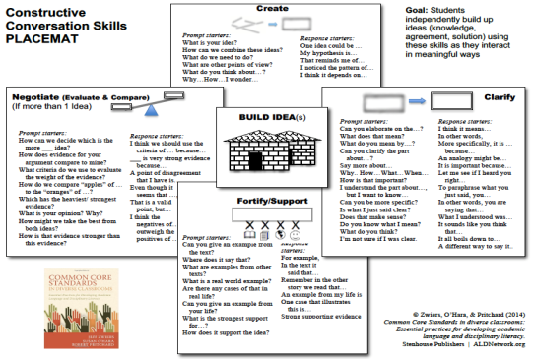
CA MATH FRAMEWORK
CONSTRUCTIVE CONVERSATION SKILLS
Mathematics discourse is defined as communication that centers on making meaning of mathematical concepts. It involves negotiating meanings by listening and responding, describing understanding, making conjectures, presenting solutions, challenging the thinking of others,
and connecting mathematical notations
and representations.
-- Universal Access Chapter, p. 687
Notes:
Our CA Math Framework says that
READ QUOTE
Ask: What comes to mind when you read this quote?
CLICK
The Constructive Conversation Skills!
Using them during the Three Reads is a critical part of Developing Mathematical Discourse

Slide 43
THREE READS PROTOCOL
Which of the High-Impact Practices are we addressing with the Three Reads Protocol?
ELA/ELD Framework Integrated ELD
High-Impact
Essential Practices
Promoting Collaborative
Discussions About Content
(A Focus on Language Development & Content)
Ch. 2, p. 110
Fostering
Academic Interactions
Supporting Comprehension & Interpretation of Complex Text
(A Focus on Meaning Making and Content)
Ch. 2, p. 111
Using
Complex Text
Supporting Academic
Writing & Speaking
(A Focus on Effective Expression & Content)
Ch. 2, p. 113
Fortifying
Complex Output

Slide 44
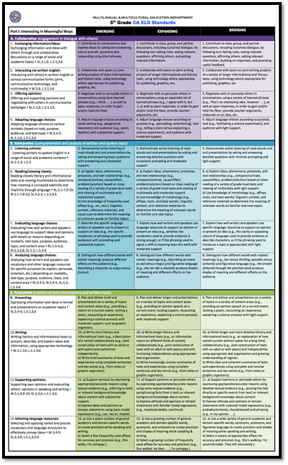
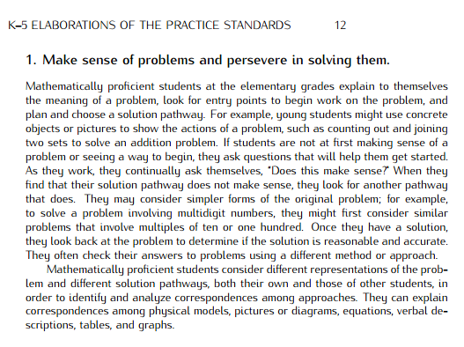
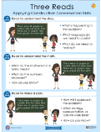
CA ELD and MATH PRACTICE STANDARDS
PI B6- Reading/Viewing Closely
Reading closely literary and informational texts and viewing multimedia to determine how meaning is conveyed explicitly and implicitly through language.
How does the Three Reads Protocol support the CA ELD and Math Practice Standards?
Notes:
With this protocol, the teacher was focusing on one ELD standard in particular.
CLICK.
But the teacher is also focusing on Math Standards. In this case a Math Practice was also a focus.
Take a few minutes to read about this Math Practice.
CLICK
Now, think about how the ELD standard, the Math Practice, and the protocol are connected.
Take a couple minutes to answer this guiding question with a partner.

Slide 45
AGENDA
GROUNDING AND EL DATA
INTEGRATED ELD/MATH
THREE PHASE LESSON STRUCTURE
INTEGRATED ELD/MATH RESOURCES
LESSON OBJECTIVES
BEFORE PHASE
THREE READS PROTOCOL
WRAP UP/ REFLECT

Slide 46
TURN & TALK
GUIDING QUESTION
How does the Three Reads Protocol diminish barriers and provide access to English Learners during math instruction?

Slide 47
INTEGRATED ELD LESSON COMPONENTS
CA ELD Standards in Tandem with Content Standards
Content and Language Objective
Scaffolds
Strategic Grouping
Formative Assessment
High Impact Essential Practices (Jeff Zwiers)
Notes:
Today, we have seen what the INTEGRATED ELD LESSON COMPONENTS look like in a Kindergarten lesson.
What elements of an Integrated ELD Lesson are you already doing/using in your classroom?
What might be new for you or your grade level?
What might be our next steps?

Slide 48
LEARNING OUTCOMES
Review EL data and understand the instructional implications
Understand the essential components of Integrated ELD/Math instruction
Experience and learn about protocols that support ELs during Integrated ELD/Math instruction within the context of a Three Phase math lesson
Understand instructional practices and available resources for Integrated ELD/Math
Notes:
Remember, these learning outcomes address the entire set of PD’s on Integrated ELD Math. We may not have accomplished all of them today.
What Learning Outcomes did we reach today?

Slide 49
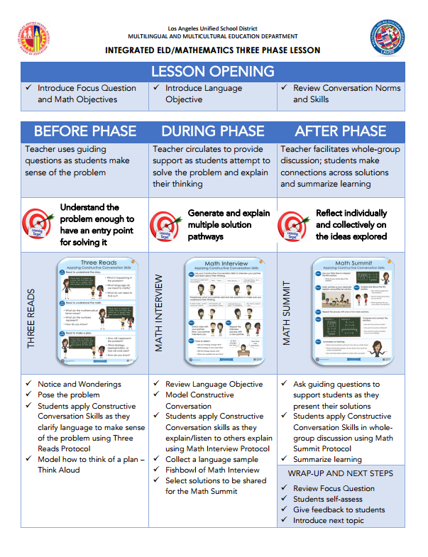
INTEGRATED ELD MATH THREE PHASE LESSON HANDOUT
Notes:
If you are already implementing the THREE PHASE LESSON AT YOUR SCHOOL, this handout can help us to remember what each phase for the THREE PHASE LESSON IS ABOUT and how the PROTOCOLS support the THREE PHASE LESSON.

Slide 50
Integrated ELD/Math Resources to Support ELs with Problem Solving and Math Discourse
1. What are the expectations for Integrated ELD?
2. Model Lesson
At-A-Glance
3. Model Lessons Gr. K-6
One Per Grade Level
4. Posters
&
Companion Cards For Protocols
5. Video of Gr. K Lesson
Gr. 3 & Gr. 4 Coming Soon
MMED
Notes:
There are a number of INTEGRATED ELD RESOURCES our MMED (Multilingual Multicultural Education Department) office in LAUSD has created.
They include the Integrated ELD Lesson Component List
Model Lesson At a Glance Handout
Integrated ELD Model Lessons
Posters and Companion Cards for Protocols to support ELs
Videos

Slide 51




mmed.lausd.net
Notes:
To learn more about these resources you can go to the MMED website.

Slide 52
Integrated eld/math
Multilingual and Multicultural Education Department
Three Reads Protocol
Notes:
Thank you!

