Slide 1
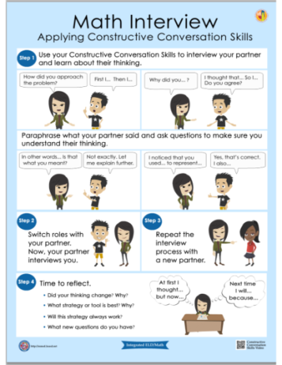
Integrated eld/math
Multilingual and Multicultural Education Department
Math Interview Protocol
Notes:
This presentation is designed for 1.5 hours

Slide 2
AGENDA
GROUNDING AND EL DATA
INTEGRATED ELD/MATH
THREE PHASE LESSON STRUCTURE
INTEGRATED ELD/MATH RESOURCES
LESSON OBJECTIVES
DURING
PHASE
MATH INTERVIEW PROTOCOL
WRAP UP/ REFLECT

Slide 3

GROUNDING VIDEO
Notes:
Play 3 minute video

Slide 4

GUIDING QUESTION – TURN & TALK
How do we diminish barriers and provide access to English Learners during math instruction?

Slide 5

LEARNING OUTCOMES
Review EL data and understand the instructional implications
Understand the essential components of Integrated ELD/Math instruction
Experience and learn about protocols that support ELs during Integrated ELD/Math instruction within the context of a Three Phase math lesson
Understand instructional practices and available resources for Integrated ELD/Math
Notes:
These learning outcomes address the entire set of PD’s on Integrated ELD Math. We may not accomplish all of them today.

Slide 6
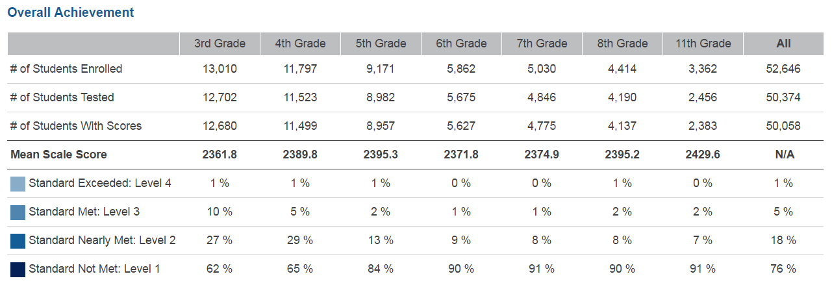
SBAC – 2016 MATHEMATICS – LAUSD – ELs
Notes:
Take a look at this data from the CDE website for English Learners in Math for LAUSD.
What do you notice?
You will see that in all grades 3-8 and 11th, LAUSD had a total of:
6% of our ELs who scored Standard Exceeded and Standard Met (combined)
94% of our ELs who scored Standard Nearly Met and Standard Not Met (combined)
76% of our ELs who scored Standard Not Met
Our English Learners need our support in Math.
At the very least, there should be more students scoring at LEVEL 2 (nearly met) and less students scoring at LEVEL 1 (not met).
Today we will be looking at the type of support we can provide to make sure we don’t have as many ELs in the LEVEL 1 group.

Slide 7


CA MATH FRAMEWORK
The role of English language proficiency must be a consideration for English learners who experience difficulties in learning mathematics... It is not possible to separate the content of mathematics from the language in which it is discussed
and taught.
-- Universal Access Chapter, p. 684-685
Notes:
Our CA Math Framework on the CDE website states the following:
READ QUOTE
It says that when teaching Math we DO need to consider our ELs because we cannot separate the content of mathematics from language
The language needs of our ELs need to be supported during Math instruction.

Slide 8
TEACHING AND LEARNING FRAMEWORK
1b1. Awareness of Students' Skills, Knowledge, and Language Proficiency
Uses information about students’ academic strengths and needs in planning.
Notes:
When we do this, we are developing in the following element of our Teaching and Leaning Framework.

Slide 9
AGENDA
GROUNDING AND EL DATA
INTEGRATED ELD/MATH
THREE PHASE LESSON STRUCTURE
INTEGRATED ELD/MATH RESOURCES
LESSON OBJECTIVES
DURING
PHASE
MATH INTERVIEW PROTOCOL
WRAP UP/ REFLECT

Slide 10
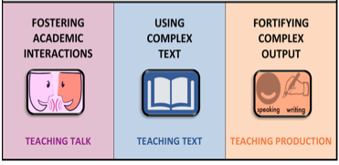

A Comprehensive ELD program consists of…
Designated ELD
Integrated ELD
Notes:
A Comprehensive ELD program includes both Designated and Integrated ELD.
Click animation (Designated ELD):
Designated ELD is the specific time of the day in which students are learning English.
Click animation (Integrated ELD):
Integrated ELD is throughout the day as ELs are learning content and English at the same time.

Slide 11

ELA/ELD FRAMEWORK
This framework uses the term integrated ELD to refer to ELD taught throughout the day and across the disciplines. All teachers with ELs in their classrooms should use the CA ELD Standards in addition to their focal CA CCSS for ELA/Literacy and other content standards to support their ELs’ linguistic
and academic progress.
-- Chapter 2, p. 108
Notes:
Our CA ELD FRAMEWORK says
READ QUOTE
This means Integrated ELD should be happening for our ELs during ELA, Math, Science, Social Studies, etc…

Slide 12
Integrated ELD
PURPOSE
Throughout the day and across the disciplines, ELs learn to use English as they simultaneously develop academic English and academic content. Ch. 2 pg. 107
All teachers with ELs in their classroom use CA ELD Standards in tandem with the CA CCSS for ELA/ Literacy and other content standards Ch. 2 pg. 106
Values and build on primary language and culture and other forms of prior knowledge Ch. 2 pg. 114
Instruction that includes an abundance of collaborative discussions about content, meaningful interaction with complex texts, and engaging and intellectually rich tasks. Ch. 2 pg. 108
Builds both content knowledge and academic English Ch. 2 pg. 114
OUTCOME
EL students learn and apply content knowledge, the purposes for using language and how English works. Ch. 2 pg. 109
Notes:
To understanding INTEGRATED ELD better, let’s read some key points about the purpose of INTEGRATED ELD.
Click to show each bullet. Ask participants to read each one out loud.
Ask: Which of these do you think are happening now in your Math classroom? Share your ideas with a partner.

Slide 13


INTEGRATED ELD LESSON COMPONENTS
CA ELD Standards in Tandem with Content Standards
Content and Language Objective
Scaffolds
Strategic Grouping
Formative Assessment
High Impact Essential Practices
Notes:
The essential elements of a comprehensive ELD program have the following:
CA ELD Standards working in tandem with CONTENT STANDARDS
Content and language objective ( this is for integrated ELD)
Scaffolds
Strategic group to offer instructional support that meet students’ specific needs
Formative assessment (SPF)
And for our district we have the HIGH IMPACT ESSENTIAL PRACTICES. These practices come from the book called Common Core in Diverse Classrooms by Jeff Zweirs. Our Constructive Conversation Skills support our ELs in participating in these High Impact Essential practices.

Slide 14
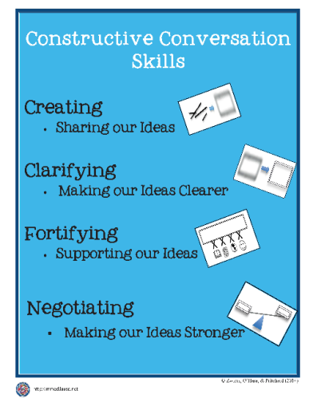



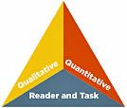

HIGH IMPACT ESSENTIAL PRACTICES
ELA/ELD Framework Integrated ELD
High-Impact
Essential Practices
Promoting Collaborative
Discussions About Content
(A Focus on Language Development & Content)
Ch. 2, p. 110
Fostering
Academic Interactions
Supporting Comprehension & Interpretation of Complex Text
(A Focus on Meaning Making and Content)
Ch. 2, p. 111
Using
Complex Text
Supporting Academic
Writing & Speaking
(A Focus on Effective Expression & Content)
Ch. 2, p. 113
Fortifying
Complex Output
Notes:
Constructive Conversation Skills support the High Impact Essential Practices.
The High Impact Practices are:
FOSTERING ACADEMIC INTERACTIONS, USING COMPLEX TEXT, AND FORTIFYING COMPLEX OUTPUT
Both come from the work of Jeff Zwiers out of Stanford University. In his work Jeff Zwiers talks about how important the High Impact Practices are during INTEGRATED ELD.
The Constructive Conversation Skills are a part of our Designated ELD Instruction and should also be used to support our English Learners during Integrated ELD Instruction.
Having our students become proficient in these skills helps our English Learners engage in the High Impact Practices.

Slide 15
AGENDA
GROUNDING AND EL DATA
INTEGRATED ELD/MATH
THREE PHASE LESSON STRUCTURE
INTEGRATED ELD/MATH RESOURCES
LESSON OBJECTIVES
DURING
PHASE
MATH INTERVIEW PROTOCOL
WRAP UP/ REFLECT

Slide 16
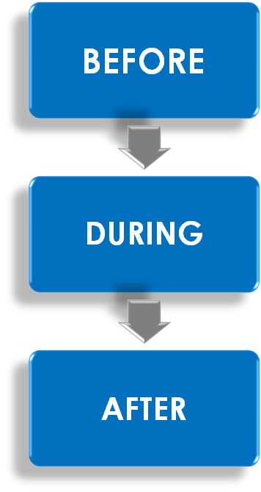

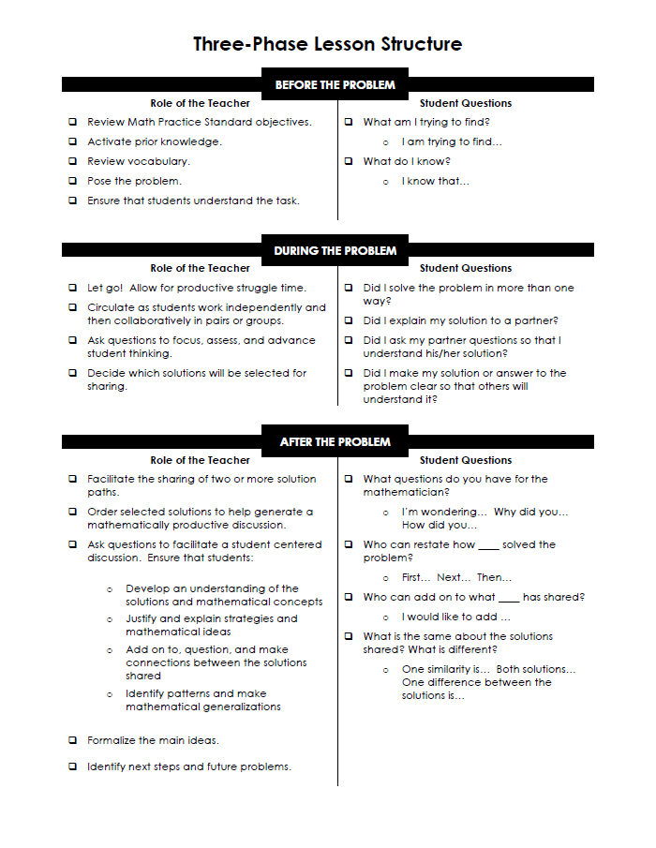
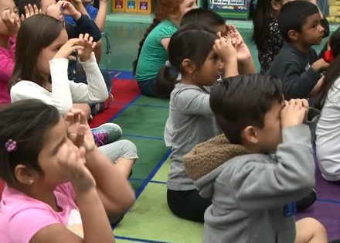
THREE PHASE LESSON STRUCTURE
Notes:
The INTEGRATED ELD/MATH LESSON RESOURCES created by LAUSD were developed with the intent of supporting the Three Phase Lesson in Math. The Three Phase Lesson is a problem solving lesson, NOT a DIRECT INSTRUCTION lesson.
The INTEGRATED ELD/MATH LESSON PROTOCOLS, like the THREE READS, MATH INTERVIEW, AND MATH SUMMIT, can also be used independently during a regular Math Lesson.
Let’s take a look at the structure of a THREE PHASE LESSON.

Slide 17
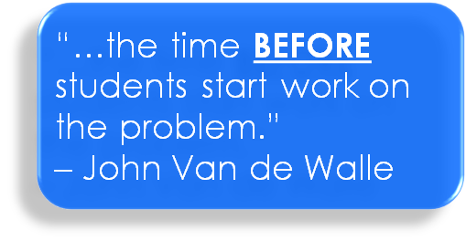
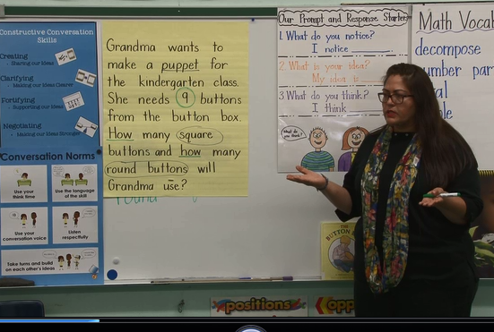
THREE PHASE LESSON STRUCTURE
Notes:
Take a moment to read about this phase on your handout.

Slide 18
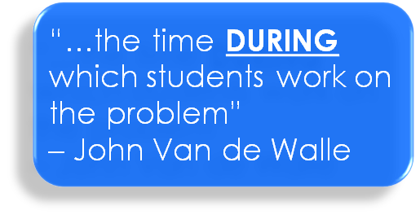
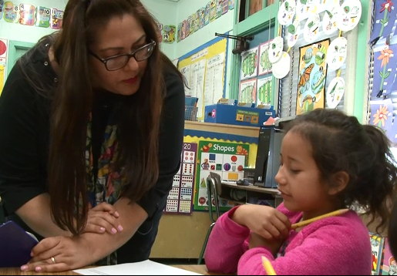
THREE PHASE LESSON STRUCTURE
HANDOUT
Notes:
Take a moment to read about this phase on your handout.

Slide 19

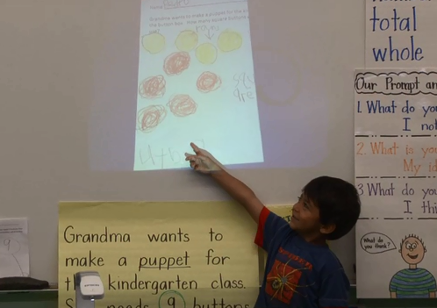
THREE PHASE LESSON STRUCTURE
HANDOUT
Notes:
Take a moment to read about this phase on your handout.

Slide 20
AGENDA
GROUNDING AND EL DATA
INTEGRATED ELD/MATH
THREE PHASE LESSON STRUCTURE
INTEGRATED ELD/MATH RESOURCES
LESSON OBJECTIVES
DURING
PHASE
MATH INTERVIEW PROTOCOL
WRAP UP/ REFLECT

Slide 21
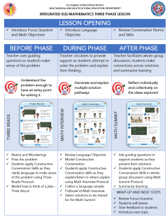
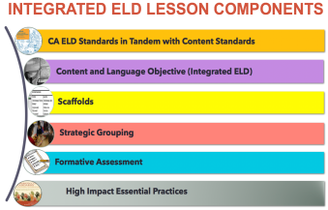
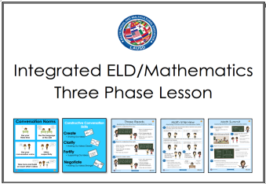


Integrated ELD/Math Resources to Support ELs with Problem Solving and Math Discourse
1. What are the expectations for Integrated ELD?
2. Model Lesson
At-A-Glance
3. Model Lessons Gr. K-6
One Per Grade Level
4. Posters
&
Companion Cards For Protocols
5. Video of Gr. K Lesson
Gr. 3 & Gr. 4 Coming Soon
MMED
Notes:
There are a number of INTEGRATED ELD RESOURCES our MMED (Multilingual Multicultural Education Department) office in LAUSD has created.
They include the Integrated ELD Lesson Component List
Model Lesson At a Glance Handout
Integrated ELD Model Lessons
Posters and Companion Cards for Protocols to support ELs
Videos

Slide 22
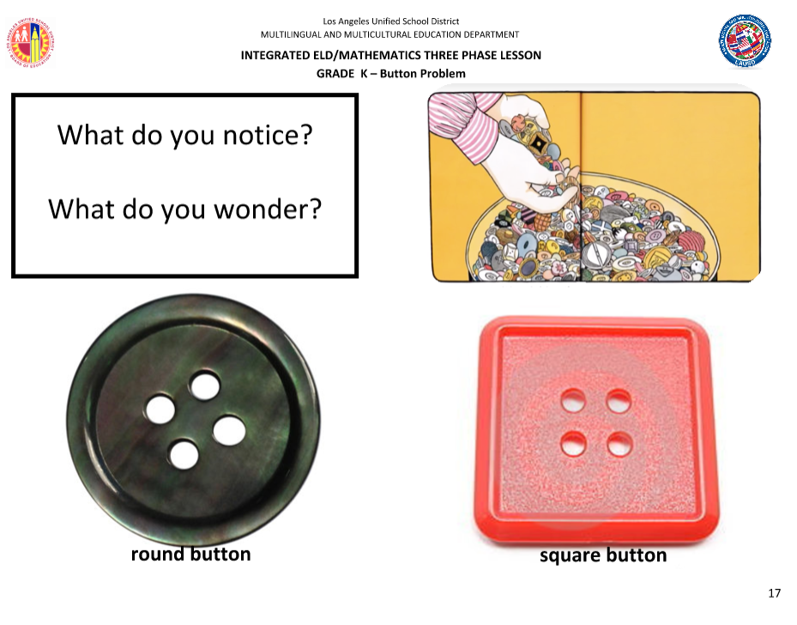



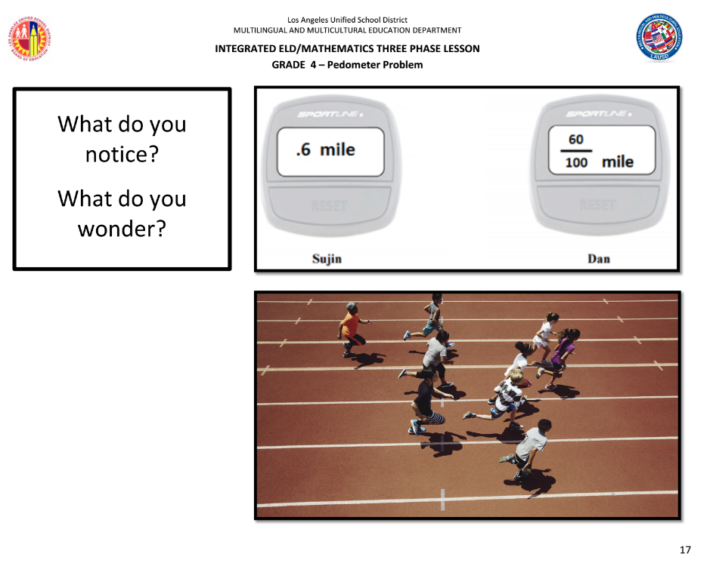
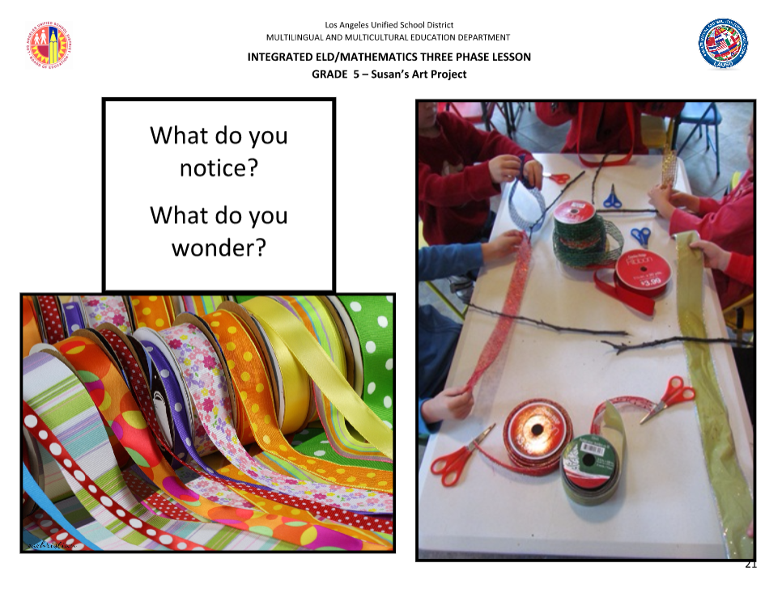
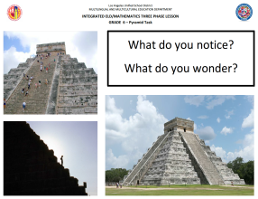
INTEGRATED ELD/MATH THREE PHASE MODEL LESSONS
KINDERGARTEN
1ST GRADE
2
2ND GRADE
3RD GRADE
4TH GRADE
2
5TH GRADE
2
6TH GRADE
Notes:
Today we will be using one of these MODEL INTEGRATED ELD LESSONS. There is 1 MODEL lesson that has been created for each grade K-6.
We will be studying the Kinder Lesson together. Each lesson has the same structure and format.

Slide 23
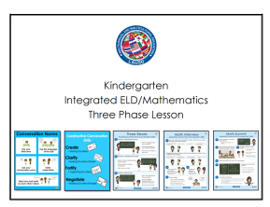
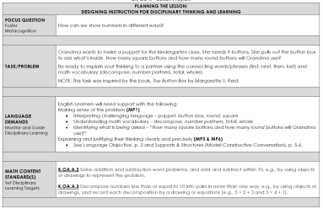
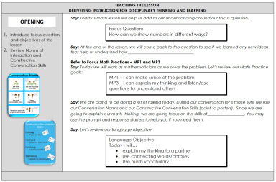
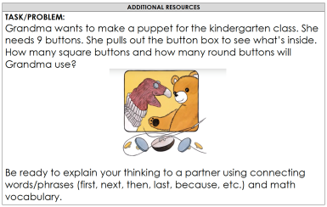
INTEGRATED ELD/MATH MODEL LESSON, GR.K
PLANNING THE LESSON, p. 1 – 6
TEACHING THE LESSON, p. 7 – 14
ADDITIONAL RESOURCES, p. 15– 19
Notes:
Each Lesson is divided into 3 sections.
PLANNING THE LESSON
TEACHING THE LESSON
ADDITIONAL RESOURCES

Slide 24
AGENDA
GROUNDING AND EL DATA
INTEGRATED ELD/MATH
THREE PHASE LESSON STRUCTURE
INTEGRATED ELD/MATH RESOURCES
LESSON OBJECTIVES
DURING
PHASE
MATH INTERVIEW PROTOCOL
WRAP UP/ REFLECT

Slide 25
INTEGRATED ELD LESSON COMPONENTS
CA ELD Standards in Tandem with Content Standards
Content and Language Objective
Scaffolds
Strategic Grouping
Formative Assessment
High Impact Essential Practices
Notes:
Let’s take a look at what the first two elements (orange and purple) look like in an INTEGRATED ELD/MATH LESSON.

Slide 26
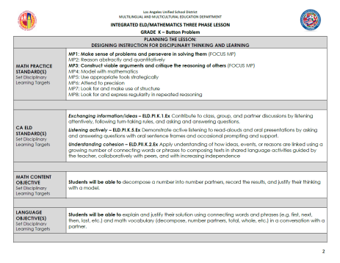
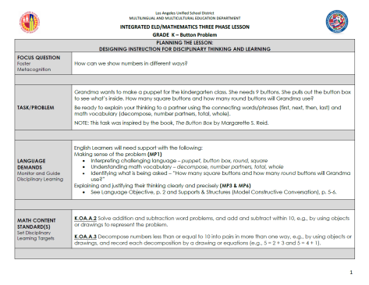
INTEGRATED ELD/MATH MODEL LESSON, GR.K
Scan p. 1-2
What do you notice?
MATH CONTENT
MATH PRACTICE
ELD STANDARDS

Slide 27
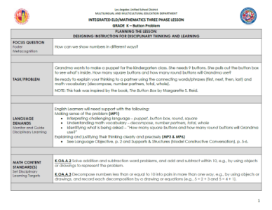
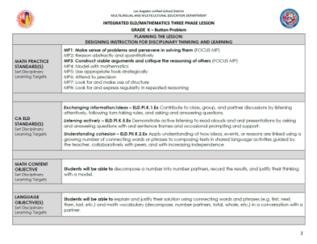
INTEGRATED ELD/MATH MODEL LESSON, GR.K
Language Demand:
Explaining and justifying their thinking clearly and precisely.
ELD Standards:
ELD P1.K.1 Exchanging Information/ Ideas
ELD P1.K.5 Listening Actively
ELD PII.K.2 Understanding Cohesion
Language Objective:
SWBAT explain and justify their solution using connecting words and phrases and math vocabulary in a conversation with a partner.
Notes:
Each Model lesson details:
The potential language demands for the lesson/task
The ELD Standards that are being used in tandem with the Math Standards
A Language Objective for the lesson the teacher is using to guide planning, formative assessment, and decision making during the lesson

Slide 28
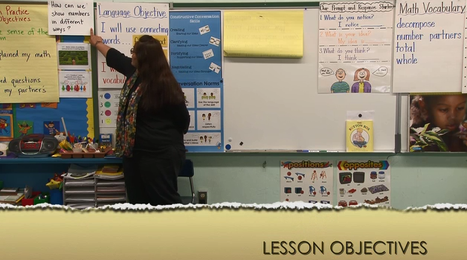
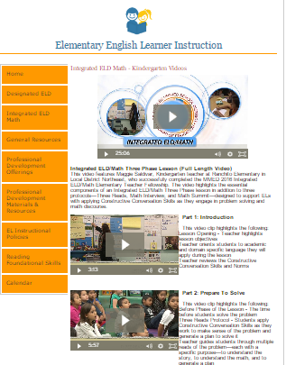
INTEGRATED ELD/MATH K VIDEO
LESSON OBJECTIVES
Click here to find the Kindergarten Integrated ELD/Math video
_
Notes:
As we watch this portion of the video, think about the following:
READ FROM THE SLIDE
Allow time for participants to watch the video and discuss.
You can find the video at:
http://achieve.lausd.net/Page/11671#spn-content

Slide 29
INTEGRATED ELD/MATH K VIDEO
LESSON OBJECTIVES
How were standards used in planning the lesson?
  Math Content Standards
  Math Practice Standards
  ELD Standards
How were lesson objectives posed to the students?
_
Notes:
As we watch this portion of the video, think about the following:
READ FROM THE SLIDE
Allow time for participants to watch the video and discuss.
You can find the video at:
http://achieve.lausd.net/Page/11671#spn-content

Slide 30
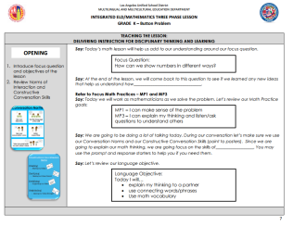
INTEGRATED ELD/MATH MODEL LESSON, GR.K
Scan p. 7 of the lesson
Discuss the following with a partner:
  What do you notice?
  What do you wonder?

Slide 31
TEACHING AND LEARNING FRAMEWORK
1d1. Standards-Based Learning Activities:
Activities are designed to engage students in cognitively challenging work that is aligned to the standards.
Notes:
When we do this, we are developing in the following element of our Teaching and Leaning Framework.

Slide 32
AGENDA
GROUNDING AND EL DATA
INTEGRATED ELD/MATH
THREE PHASE LESSON STRUCTURE
INTEGRATED ELD/MATH RESOURCES
LESSON OBJECTIVES
DURING
PHASE
MATH INTERVIEW PROTOCOL
WRAP UP/ REFLECT

Slide 33
PLANNING FOR THE DURING PHASE
Let go! Allow for productive struggle time.
Circulate as students work independently and then collaboratively in pairs or groups.
Ask questions to FOCUS, ASSESS, AND ADVANCE student thinking.
Decide which solutions will be selected for sharing.
Notes:
First, let’s learn a little bit about the DURING PHASE.
In the DURING PHASE of a THREE PHASE LESSON you want to
READ BULLET POINTS FROM THE SLIDE

Slide 34
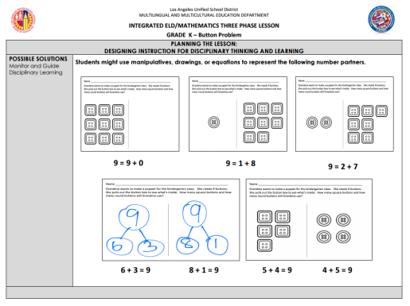
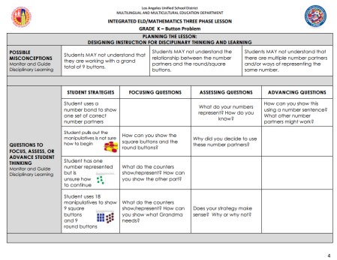
PLANNING FOR THE DURING PHASE
Scan p. 3-4
Possible Solutions
Possible Misconceptions
Questions to FOCUS, ASSESS, AND ADVANCE student thinking
Notes:
WHEN PLANNING FOR THE MATH INTERVIEW OR THE DURING PHASE OF THE LESSON IT IS IMPORTANT THAT WE SOLVE THE PROBLEM/TASK OURSELVES AS MANY WAYS AS POSSIBLE AND CONSIDER MISCONCEPTIONS STUDENTS MIGHT HAVE.
We should also consider what possible questions we may want to ask students as they work on the problem.

Slide 35
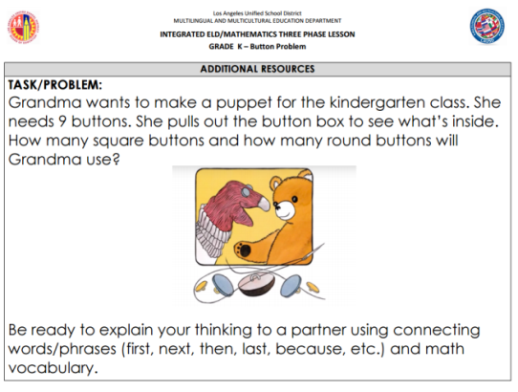
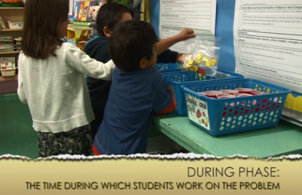
STUDENTS SOLVE THE PROBLEM
Notes:
Students solve the problem in the during phase. Let’s watch a video clip of what Maggie Saldivar (Ranchito Ave. Elementary) does in the DURING PHASE of her lesson.

Slide 36
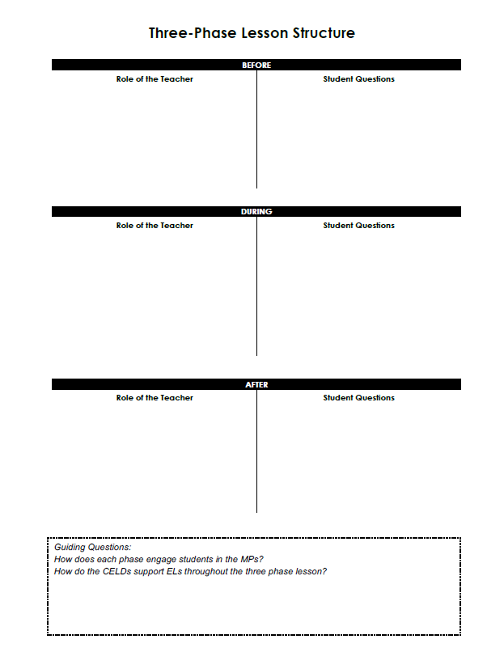
INTEGRATED ELD/MATH K VIDEO
DURING PHASE
Notes:
As you watch the video, feel free to take notes.
You can find the video at:
http://achieve.lausd.net/Page/11671#spn-content
Have participants share what they noticed and wonder about the video

Slide 37
TEACHING AND LEARNING FRAMEWORK
3b1. Quality and Purpose of Questions:
Questions are designed to challenge students and elicit high-level thinking.
Notes:
When we do this, we are developing in the following element of our Teaching and Leaning Framework.

Slide 38
AGENDA
GROUNDING AND EL DATA
INTEGRATED ELD/MATH
THREE PHASE LESSON STRUCTURE
INTEGRATED ELD/MATH RESOURCES
LESSON OBJECTIVES
DURING
PHASE
MATH INTERVIEW PROTOCOL
WRAP UP/ REFLECT

Slide 39
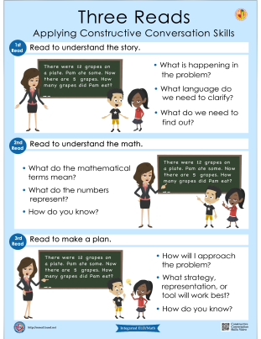
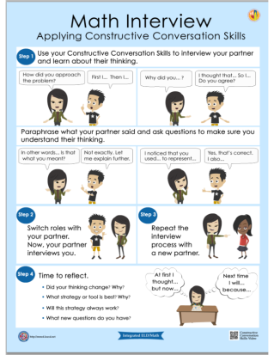
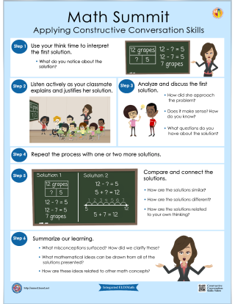
Posters & Companion Cards
BEFORE
DURING
AFTER
Notes:
The protocols developed by MMED to support English Learners during the Three Phase Lesson (BEFORE, DURING, AFTER) are:
Three Reads Protocol, Math Interview, and Math Summit.
These protocols do not have to be used within a THREE PHASE LESSON. They can also stand alone during a Math Lesson.
Each protocol comes with a poster for classroom use and a companion card for the teacher.

Slide 40

MATH INTERVIEW SCAFFOLDS
Teachers determine opportunities to highlight and discuss language resources
e.g., powerful or precise vocabulary,
different ways of combining ideas in sentences…
--ELA/ELD Framework, Chapter 2, p. 114
Model Constructive Conversations
Prompt & Response Starters
Fishbowl
Notes:
Our ELD framework says:
READ QUOTE
In this video clip you will see Maggie use various scaffolds to support her students during the Math Interview. You may want to try one of these in your classroom to support your students during the Math Interview.
Maggie uses a Model Constructive Conversation
Prompt and Response Starters and
Fishbowl

Slide 41

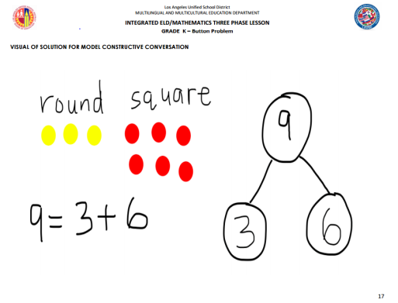
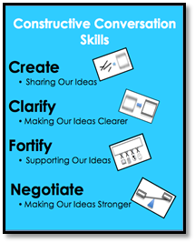
MATH INTERVIEW SCAFFOLDS
PROVIDE A MODEL CONSTRUCTIVE CONVERSATION
STUDENTS LISTEN FOR THE LANGUAGE OF THE SKILL
Notes:
The Model Constructive Conversation is a part of Designated ELD.
Here Maggie is having students listen to a model constructive conversation so they can hear what a good conversation sounds like focusing on the language of the skill that Maggie wants her students to use and also incorporating the language objective.
Maggie decides to record the model constructive conversation on her phone and have her students listen to it three times.

Slide 42

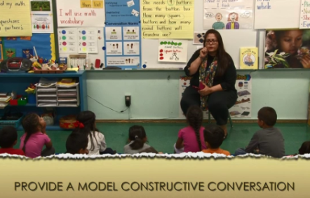
INTEGRATED ELD/MATH K VIDEO
MODEL CONSTRUCTIVE CONVERSATION
_
Notes:
As you watch the video, feel free to take notes.
You can find the video at:
http://achieve.lausd.net/Page/11671#spn-content
Have participants share what they noticed and wonder about the video

Slide 43

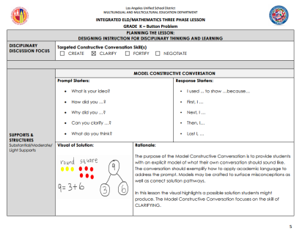
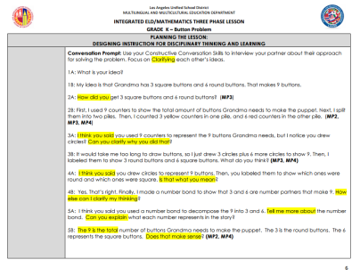
INTEGRATED ELD/MATH MODEL LESSON, GR.K
Scan p. 5 – 6 for the Model CC
Discuss the following with a partner:
  What do you notice?
  What do you wonder?
  How might you use this scaffold in your classroom?

Slide 44
MATH INTERVIEW PROTOCOL
Which of the
High-Impact Practices are we supporting with the Model Constructive Conversation?
High-Impact
Essential Practices
Fostering
Academic Interactions
Using
Complex Text
Fortifying
Complex Output

Slide 45

MATH INTERVIEW PROTOCOL
During academic discussions with peers
Engages students in creating viable arguments and critiquing the reasoning of others (MP3)
Engages students in Exchanging
Ideas (CA ELD PI A1)
Provides an opportunity for ELs to use mathematical discourse in partner and group discussions with support.

Slide 46
MATH INTERVIEW PROTOCOL
Read the Math Interview poster
Discuss the following with a partner:
  What do you notice?
  What do you wonder?

Slide 47
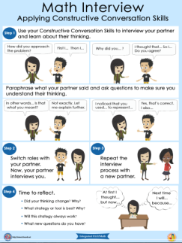
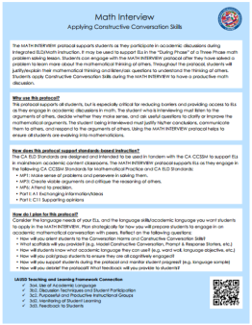
MATH INTERVIEW PROTOCOL – TURN & TALK
Read both sides of the companion card
Discuss the following with a partner:
  How are students applying Constructive Conversation skills?

Slide 48
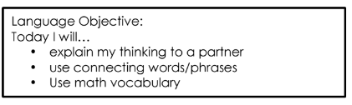

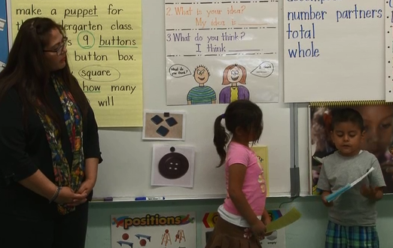
MATH INTERVIEW SCAFFOLDS
FISHBOWL
Notes:
When we watch the clip of the Math Interview, we will see Maggie use a fishbowl strategy to help support her ELs in the type of language they are using.

Slide 49

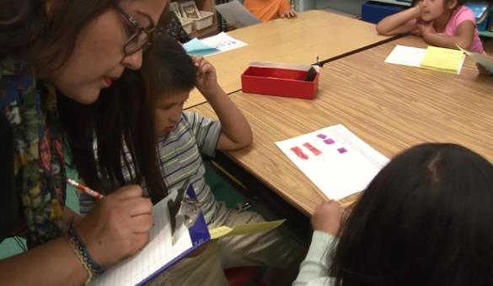
MATH INTERVIEW PROTOCOL
COLLECTING LANGUAGE SAMPLES
_
Notes:
We will also see Maggie practice formative assessment by collecting language samples of what her students are saying.

Slide 50

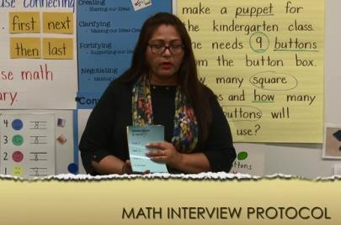
INTEGRATED ELD/MATH K VIDEO
MATH INTERVIEW
_
Notes:
As you watch the video, feel free to take notes.
You can find the video at:
http://achieve.lausd.net/Page/11671#spn-content
Have participants share what they noticed and wonder about the video

Slide 51



INTEGRATED ELD/MATH MODEL LESSON, GR.K
Scan p.10-12 for the Math Interview
Discuss the following with a partner:
  What do you notice?
  What do you wonder?
  How might you use this protocol in your classroom?
Notes:
Let’s take a look at these page of our sample lesson plan. Read the vignette that shows how the teacher sets up the MATH INTERVIEW with students.
READ DIRECTIONS FROM SLIDE

Slide 52





CONSTRUCTIVE CONVERSATION SKILLS
How were the Constructive Conversation Skills used during the Math Interview Protocol?
CREATE
CLARIFY
FORTIFY
NEGOTIATE

Slide 53


CA MATH FRAMEWORK
CONSTRUCTIVE CONVERSATION SKILLS
Mathematics discourse is defined as communication that centers on making meaning of mathematical concepts. It involves negotiating meanings by listening and responding, describing understanding, making conjectures, presenting solutions, challenging the thinking of others,
and connecting mathematical notations
and representations.
-- Universal Access Chapter, p. 687
Notes:
Our CA Math Framework says that
READ QUOTE
Ask: What comes to mind when you read this quote?
CLICK
The Constructive Conversation Skills!
Using them during the Three Reads is a critical part of Developing Mathematical Discourse

Slide 54
MATH INTERVIEW PROTOCOL
Which of the High-Impact Practices are we addressing with the Math Interview Protocol?
ELA/ELD Framework Integrated ELD
High-Impact
Essential Practices
Promoting Collaborative
Discussions About Content
(A Focus on Language Development & Content)
Ch. 2, p. 110
Fostering
Academic Interactions
Supporting Comprehension & Interpretation of Complex Text
(A Focus on Meaning Making and Content)
Ch. 2, p. 111
Using
Complex Text
Supporting Academic
Writing & Speaking
(A Focus on Effective Expression & Content)
Ch. 2, p. 113
Fortifying
Complex Output

Slide 55



CA ELD and MATH PRACTICE STANDARDS
PI A1- Exchanging Information and Ideas
Exchanging information and ideas with others through oral collaborative conversations on a range of social and academic topics.
How does the Math Interview Protocol support the CA ELD and Math Practice Standards?
Notes:
With this protocol, the teacher was focusing on one ELD standard in particular.
CLICK.
But the teacher is also focusing on Math Standards. In this case a Math Practice was also a focus.
Take a few minutes to read about this Math Practice.
CLICK
Now, think about how the ELD standard, the Math Practice, and the protocol are connected.
Take a couple minutes to answer this guiding question with a partner.

Slide 56
AGENDA
GROUNDING AND EL DATA
INTEGRATED ELD/MATH
THREE PHASE LESSON STRUCTURE
INTEGRATED ELD/MATH RESOURCES
LESSON OBJECTIVES
DURING
PHASE
MATH INTERVIEW PROTOCOL
WRAP UP/ REFLECT

Slide 57
TURN & TALK
GUIDING QUESTION
How does the Math Interview Protocol diminish barriers and provide access to English Learners during math instruction?

Slide 58
INTEGRATED ELD LESSON COMPONENTS
CA ELD Standards in Tandem with Content Standards
Content and Language Objective
Scaffolds
Strategic Grouping
Formative Assessment
High Impact Essential Practices
Notes:
Today, we have seen what the INTEGRATED ELD LESSON COMPONENTS look like in a Kindergarten lesson.
What elements of an Integrated ELD Lesson are you already doing/using in your classroom?
What might be new for you or your grade level?
What might be our next steps?

Slide 59
LEARNING OUTCOMES
Review EL data and understand the instructional implications
Identify the essential components of Integrated ELD/Math instruction
Experience and learn about protocols that support ELs during Integrated ELD/Math instruction within the context of a Three Phase math lesson
Understand instructional practices and available resources for Integrated ELD/Math
Notes:
Remember, these learning outcomes address the entire set of PD’s on Integrated ELD Math. We may not have accomplished all of them today.
What Learning Outcomes did we reach today?

Slide 60

INTEGRATED ELD MATH
THREE PHASE LESSON HANDOUT
Notes:
If you are already implementing the THREE PHASE LESSON AT YOUR SCHOOL, this handout can help us to remember what each phase for the THREE PHASE LESSON IS ABOUT and how the PROTOCOLS support the THREE PHASE LESSON.

Slide 61
Integrated ELD/Math Resources to Support ELs with Problem Solving and Math Discourse
1. What are the expectations for Integrated ELD?
2. Model Lesson
At-A-Glance
3. Model Lessons Gr. K-6
One Per Grade Level
4. Posters
&
Companion Cards For Protocols
5. Video of Gr. K Lesson
Gr. 3 & Gr. 4 Coming Soon
MMED
Notes:
There are a number of INTEGRATED ELD RESOURCES our MMED (Multilingual Multicultural Education Department) office in LAUSD has created.
They include the Integrated ELD Lesson Component List
Model Lesson At a Glance Handout
Integrated ELD Model Lessons
Posters and Companion Cards for Protocols to support ELs
Videos

Slide 62




mmed.lausd.net
Notes:
To learn more about these resources you can go to the MMED website.

Slide 63
Integrated eld/math
Multilingual and Multicultural Education Department
Math Interview Protocol
Notes:
Thank you!

