Slide 1

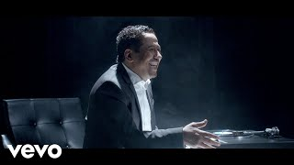
12th Grade Seal of Biliteracy Award Family Informational Meeting
Información - Sello de Alfabetización Bilingüe del 12avo Grado
Informational Sessions
October 27 and 28, 2025
11:15 AM - 12:15 PM
or
5:00 PM - 6:00 PM
Sesiones Informativas
27 y 28 de octubre de 2025
11:15 a. m. a 12:15 p. m.
o
5:00 p. m. a 6:00 p. m.
Notes:
Play Music as we wait to start: https://www.yout-ube.com/watch?v=_UucPr2M-qU&t=390s
Link to sign-in: https://forms.gle/eFBvhfk7bVz2bjdn9
Welcome! We’re glad you’re here for the 12th Grade Multilingual Awards Information Session. Please take a moment to sign in: : https://forms.gle/eFBvhfk7bVz2bjdn9

Slide 3
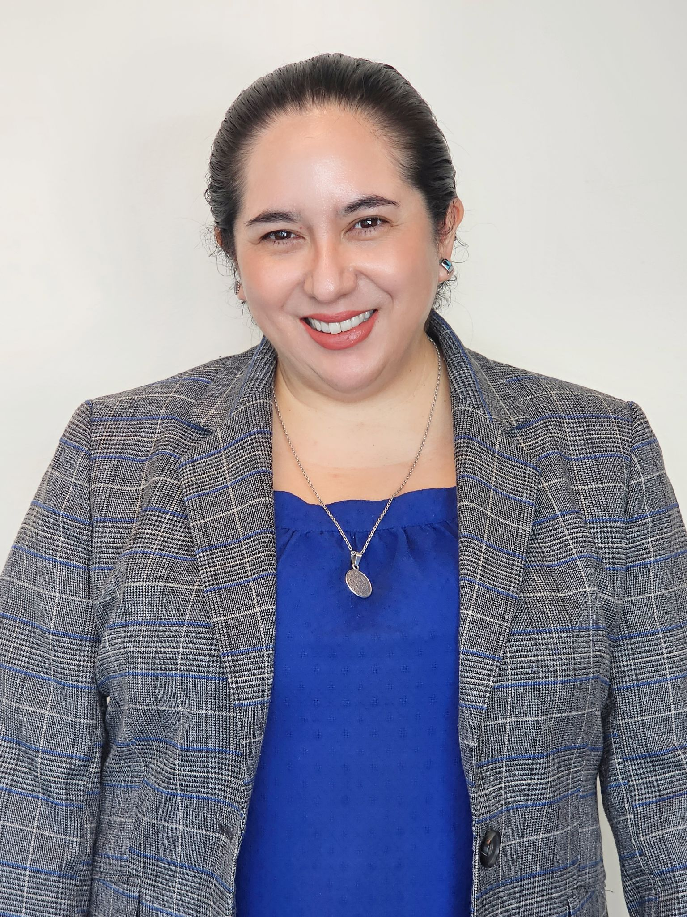
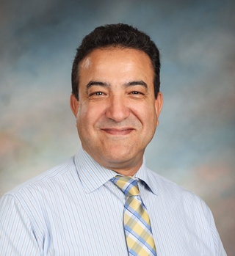
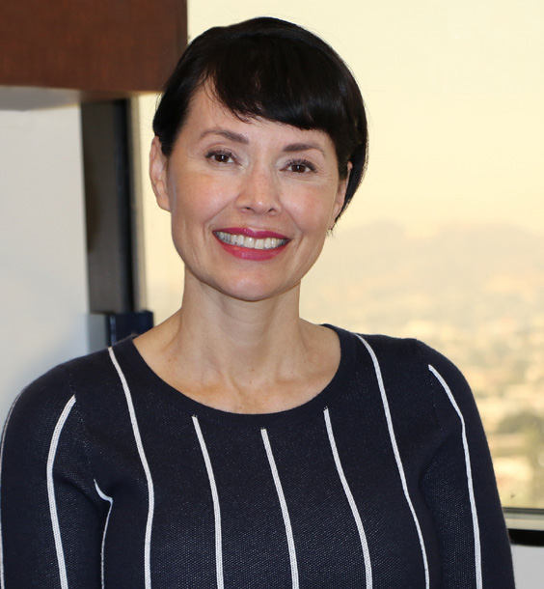
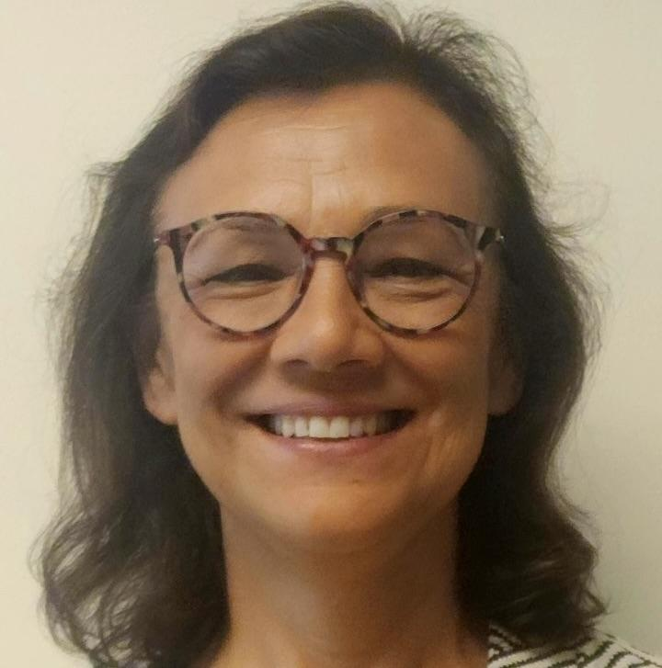
Meet our MMED Leadership
Nuestros líderes
Lydia Acosta Stephens
Ana M. Guzman
Roxanna Sosa
Youssef Mossadaq
Executive Director
Directora ejecutiva
Parent of they/them kiddo
Administrator
Dual Language Education
World Languages and Cultures
Administradora
Educación de lenguaje dual
Idiomas y culturas mundiales
Coordinator
World Languages & Cultures
Coordinador
Idiomas y culturas mundiales
Administrative Coordinator
Dual Language Education
Coordinadora administrativa
Educación de lenguaje dual

Slide 4
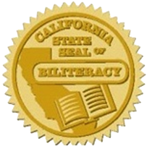

Recordatorio
La sesión informativa virtual de hoy está dirigida a familias de estudiantes en el grado:
12º grado
Friendly Reminder
Today’s Virtual Informational Session is intended for family members of students in:
12th Grade
Notes:
Time: 1 minute
Say: Friendly reminder, that this virtual informational session is for family members of students in grade 8 in middle school.
While we are all happy to see you in attendance today, do remember that this presentation is intended for family members of students in grade 8. You are free to attend this session if your child is not in any of those grades, of course, but do know that the criteria covered in the presentation will reflect those three grades.

Slide 5
Today’s Session
La sesión de hoy
What is the Seal of to Biliteracy Award in 12th Grade?
What does my child need to do to earn the award?
How can I support my child at home?
¿Qué es el Sello del Premio de Alfabetización Bilingüe de 12.º grado?
¿Qué necesita hacer mi estudiante para recibir el premio?
¿Cómo puedo apoyar a mi estudiante en casa?
Notes:
Time: 1 minute
Say: what are we focusing on today? We will be focusing on addressing the following questions:
What are the Pathway to Biliteracy Award in Grade 8?
What does my child need to do to earn the award
How can I support my child at home?

Slide 6
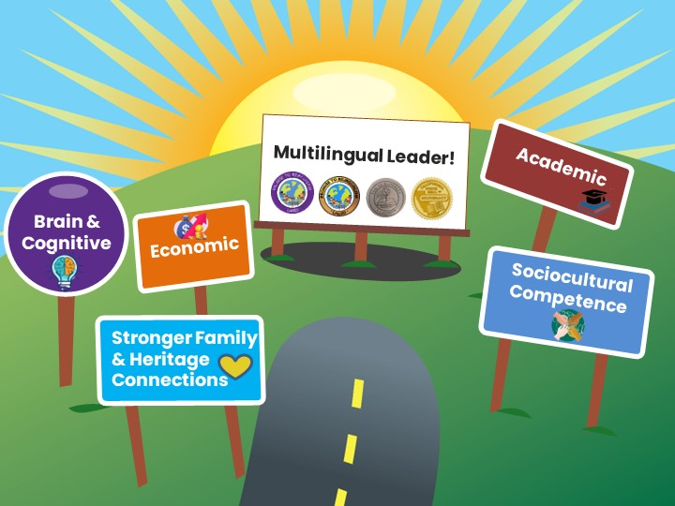



Benefits of Bilingualism and Biliteracy
Beneficios del bilingüismo y la biliteracidad
Which one
resonates with
you & why?
¿Cuál ventaja le llama la atención y por qué?
Lifelong Advantages
Ventajas para toda la vida
Líder multilingüe
Cerebral y cognitivo
Económico
Académico
Competencia sociocultural
Conexiones Familiares
Share in the chat!
¡Comparta en el chat!
Notes:
Time: 2 minutes
Say: Say: The experience of mastering two or more languages has enormous benefits for students. People who are able to speak, read, and write in two or more languages are able to participate in several different cultural and language worlds. Multilingual proficiency actually strengthens how the brain functions. Let’s look at some of the benefits of be bilingual and biliterate:
DLE benefits ALL our students:
Brain & Cognitive Function:
Cognitive flexibility
Improves decision-making skills
Better problem-solving abilities
Have a stronger sense of self
Academic:
Increased academic performance
Advanced language courses
Biliteracy awards and District and State Seals of Biliteracy
Economic:
Competitive in the global economy
Have expanded job opportunities with higher pay
Sociocultural Competence
Awareness and understanding of other cultures
Can be “citizens of the world” with a more comprehensive and tolerant perspective
Stronger Family & Heritage Connections
Bridge builders for their families
Access to the wisdom of their heritage cultures
Ask: Now In the chat, go ahead and share your response to the following question: Which one of these benefits of bilingualism and biliteracy resonates with you?
________
Mastering two or more languages has enormous benefits for students. People who are able to speak, read and write in two or more languages are able to participate in several different cultural and language worlds.
Bilingualism is associated with more cognitive flexibility and better problem solving abilities.
Children who are bilingual tend to perform better on achievement tests.
Job opportunities become available throughout the globe for those who are bilingual, and there are often financial benefits associated with bilingual skills in the labor market.
The study of another language expands one’s worldview and builds cross-cultural understanding.
More than one-third of California school children speak a language other than English at home. The development of strong bilingual skills that include home language and English provide them the capacity to participate actively in both of their language worlds, and to be bridge builders and translators for their families.

Slide 7

Global California 2030 A Call to Action!
“By 2030, we want half of all K–12 students to participate in programs leading to proficiency in two or more languages, either through a class, a program, or an experience. By 2040, we want three out of four students to be proficient in two or more languages, earning them a State Seal of Biliteracy.”
-Tom Torlakson, former State Superintendent
California global 2030
¡Un llamado a la acción!
“Para 2030, queremos que la mitad de todos los estudiantes K-12 participen en programas que les permitan dominar dos o más idiomas, ya sea a través de una clase, un programa o una experiencia. Para 2040, queremos que tres de cada cuatro estudiantes dominen dos o más idiomas, lo que les permitirá obtener un Sello Estatal de Alfabetización Bilingüe”.
-Tom Torlakson, ex superintendente estatal
Notes:
Time: 30 sec
By 2030, this initiative envisions that half of California’s K–12 students will be enrolled in programs that develop proficiency in two or more languages.
By 2040, three out of four California students will be proficient in two or more languages and earn the State Seal of Biliteracy.
Link: https://drive.google.com/file/d/1wZzqgKNbygjRUKS6hW176TAT1i51UGnx/view?usp=sharing

Slide 8

Strategic Plan 2022-2026
Plan Estratégico 2022-2026
“Provide students with expanded opportunities to become multilingual through dual and world language programs, including American Sign Language.” pg. 26
"Proporcionar a los estudiantes mayores oportunidades para volverse multilingües a través de programas duales y de idiomas mundiales, incluido el lenguaje de señas americano." página. 26
“By 2026, ensure at least 50% of our graduating seniors receive the California Seal of Biliteracy.”
“Para 2026, asegurar que al menos el 50% de nuestros estudiantes que se gradúan reciban el Sello de Alfabetización Bilingüe de California”.
-Alberto Carvalho, Superintendent
-Alberto Carvalho, Superintendent
Notes:
Time: 30 sec
It’s important to note that our 2022-2026 strategic plan is supported by our Pathway to Biliteracy Awards, as it is our goal by 2026 to ensure that at least 50% of our graduating seniors receive the CSSB.
Read the slide

Slide 9
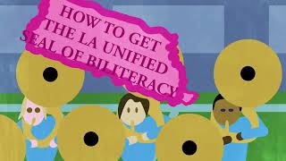
Video-Pathway to Biliteracy Awards
Premios caminos hacia la biliteracidad
Link to video in Spanish available. Enlace disponible para el video en español.
Notes:
Time: 6 minutes
Say: Now, let’s take a look at our Pathway to Biliteracy Awards video that highlights what the award(s) is/are, the benefits of being multilingual, how students can obtain the award, and the processes that this entails. Note that UTK students, in addition to Kindergarten and 1st grade are now honor with a Promise to Bilingualism award as well.
Time: Video: 5.04 min. (5 minutes)
Video link: https://www.youtube.com/watch?v=J_tnbmdH8hI (English)
Video link en Espaol: https://lausd.wistia.com/medias/uqlignw0os

Slide 10

Why The Multilingualism?
¿Por qué el Multilingüismo?
The Bilingual/Multilingual Mind:
Is more flexible
Can multitask more effectively
Is able to concentrate on important tasks and block out distractions
Has improved capacity to resolve problems and overcome obstacles
Has stronger interpersonal and self-regulation skills
La Mente Bilingüe/Multilingüe:
Es más flexible
Puede realizar múltiples tareas de manera más efectivamente
Es capaz de concentrarse en tareas importantes y bloquear distracciones
Tiene mejor capacidad para resolver problemas y superar obstáculos.
Tiene habilidades interpersonales y de autorregulación más fuertes
Notes:
1 min
Read slide
LOTE Assessment Request Form: https://forms.gle/m9jkassVi6uEkGm6A

Slide 11

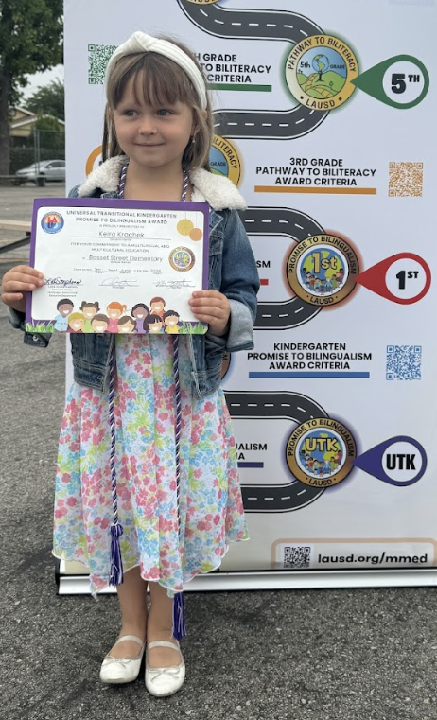





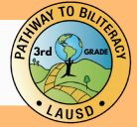
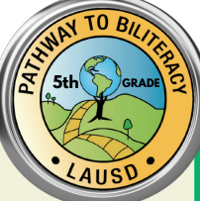
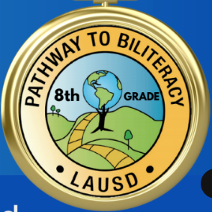
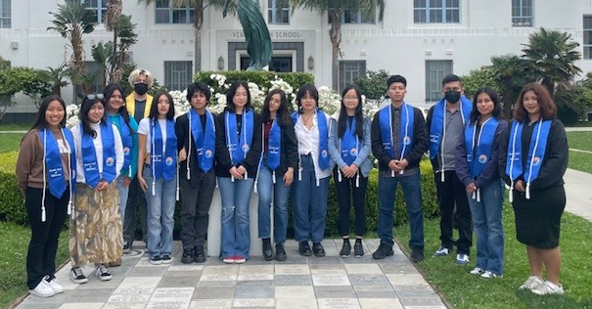
The Multilingual Journey/El camino multilingüe
California Department of Education & L.A. Unified Seals
of Biliteracy
Departamento de Educación de California y
Distrito Unificado de Los Ángeles
Sellos de la biliteracidad
Promise to Bilingualism Awards
Premios Promesa al Bilingüismo
Pathway to Biliteracy Awards
Premios Camino a la Biliteracidad
5/6th Grade
8th Grade
12th Grade
Transitional
Kindergarten
Kindergarten
1st Grade
3rd Grade
TK
11
Notes:
Time: 1 min
Here is the Pathway to bilingualism and Biliteracy that all students can follow in L.A. Unified, to become biliterate and eventually receive the honor of Seals of Biliteracy on their high school diplomas. You as family members can help your children embark on this journey, as UTK, K, and 1st Grade Promise to Bilingualism awards lay the foundation of multilingualism for our little ones.
We are excited to announce all seven awards where we honor our learners, with UTK followed by the Kinder and 1st Grade awards, and then moving onto 3rd and 5th grade at the elementary level, and later moving onto middle school and high school with 8th and 12th grade. As you can see, earning an award at each of these key points in your child’s educational career for demonstrates a certain level of proficiency in speaking one or more languages in addition to English.
In 2023, 6,600 CDE seals of biliteracy or 24% were earned by the 2023 senior class.
REF-062900.4 Pathway Awards Policy: https://drive.google.com/file/d/1cyrkbgzAC7nyYJyy3J38oNrP7wcixIdj/view?usp=share_link

Slide 12
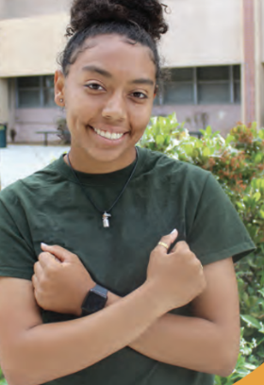
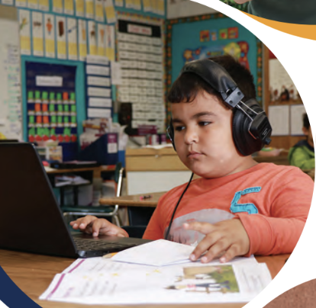
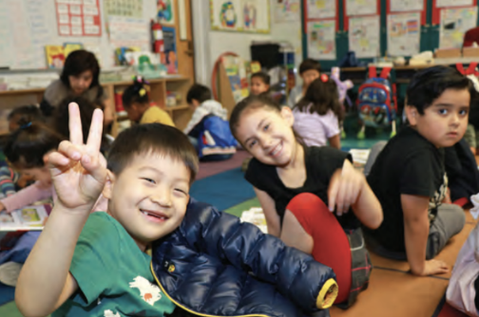
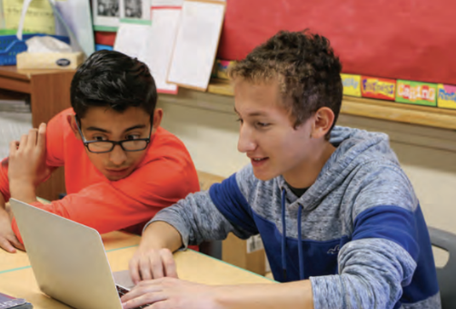
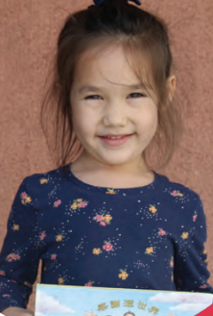
LA Unified’s Diverse Students
Los diversos estudiantes del LAUSD
En las escuelas del LAUSD se hablan 154 idiomas diferentes:
El idioma principal además del inglés (LOTE) es el español (88%)
Otros idiomas incluyen:
armenio (2%), ruso (2%), coreano (1%), filipino (1%), farsi (1%), árabe, vietnamita, k'iche', bengalí, cantonés, por nombrar algunos.
154 different languages are spoken in LAUSD schools:
The primary Language other than English (LOTE) is Spanish (88%)
Other languages include: Armenian (2%), Russian (2%), Korean (1%), Filipino (1%), Farsi (1%), Arabic, Vietnamese, K’iche’, Bengali, Cantonese to name a few.
Notes:
Time: 30 seconds
From the Home Language Surveys, we have identified that 154 different languages are spoken in LAUSD schools:
The primary LOTE language is Spanish (88%)
Other languages include: Armenian, Russian, Korean, Arabic, Farsi, Vietnamese, K’iche’ (a Mayan language of Guatemala), Bengali, Cantonese to name a few

Slide 13
Essential Understandings:
Multilingual Journey Awards & SSB
Comprensiones esenciales:
Premios Camino Multilingüe y SSB
Proficiency in any Indigenous, Community and Global Language(s) and English
  Assets-based & vision-based to affirm students’ languages and cultures
All students can be honored and recognized
Celebrating Biliteracy
Dominio de cualquier idioma indígena, comunitario y global e inglés.
  Basado en activos y basado en visión para afirmar los idiomas y las culturas de los estudiantes
Todos los estudiantes pueden ser honrados y reconocidos.
Celebrando la alfabetización bilingüe

Slide 14
What is the 12th
Grade Seal of
Biliteracy ?
¿Qué es el Sello de Alfabetización Bilingüe del Grado 12?

Slide 15
L.A. Unified Seal of Biliteracy Criteria
Criterios para el Sello de Biliteracidad del Distrito Escolar Unificado de L.A.
Recognition by the Los Angeles Unified School District for graduating high school students who have attained a high level of proficiency in speaking, reading, and writing in one or more languages in addition to English, who may be English Learners.
Reconocimiento por parte del Distrito Escolar Unificado de Los Ángeles para los estudiantes del grado doce que han alcanzado un alto nivel de competencia en hablar, leer y escribir en uno o más idiomas además del inglés, que pueden ser estudiantes de aprendices de inglés.
Notes:
Read slide-
Recognition by the Los Angeles Unified School District for graduating high school students who have attained a high level of proficiency in speaking, reading, and writing in one or more languages in addition to English, who may be English Learners.
El orador dice:
Reconocimiento por parte del Distrito Escolar Unificado de Los Ángeles para los estudiantes del grado doce que han alcanzado un alto nivel de competencia en hablar, leer y escribir en uno o más idiomas además del inglés, que pueden ser estudiantes de aprendices de inglés.

Slide 16
State Seal of Biliteracy
Sello de Alfabetización Bilingüe
The Seal of Biliteracy is awarded by the state in recognition of students who have studied and attained proficiency in two or more languages by 12th grade high school graduation.
El Sello de Alfabetización Bilingüe es un premio otorgado por el estado en reconocimiento a los estudiantes que han estudiado y alcanzado el dominio de dos o más idiomas al graduarse del 12avo grado.
Notes:
Read Slide-
The Seal of Biliteracy is awarded by a school, district, or a state in recognition of students who have studied and attained proficiency in two or more languages by 12th grade high school graduation.
El orador dice:
El Sello de Alfabetización Bilingüe es un premio otorgado por el estado en reconocimiento a los estudiantes que han estudiado y alcanzado el dominio de dos o más idiomas al graduarse del 12avo grado.

Slide 17

L.A. Unified Pathway and Seal of Biliteracy Video
Distrito Unificado de L.A. Camino y Sello de Biliteracidad Video
Notes:
Say: please enjoy this informational video that outlines the different awards L.A. Unified School District has established to encourage students to develop their skills in one or more languages in addition to English. The Spanish version is available on the MMED website.
Spanish Video Link: https://lausd.wistia.com/medias/uqlignw0os
Este video habla de todos los reconocimientos que el Distrito Unificado de Los Ángeles ofrece a los estudiantes en su trayectoria académica desde Kinder hasta el 12avo (doceavo) grado.

Slide 18
All 12th Graders Welcome!
¡Bienvenidos a Todos los Estudiantes del 12avo Grado!
All students in 12th grade regardless of language classification or program participation:
Mainstream English
English Learner
Neurodiverse Learner
Are eligible to apply for the L.A. Unified and State Seal of Biliteracy Award.
Todos los estudiantes del grado doce independientemente de la clasificación del idioma o la participación en el programa:
Inglés convencional
Aprendices de inglés
Aprendices neurodiversos
Son elegibles para solicitar el Sello de Alfabetización Bilingüe del Distrito Escolar de Los Ángeles y del Estado.
Notes:
Read slide-
All students in 12th grade regardless of language classification or program participation:
Mainstream English
English Learner
Neurodiverse Learners
Are eligible to apply for the L.A. Unified and State Seal of Biliteracy Award.
Premio del Sello de Alfabetización Bilingüe disponible para estudiantes del 12avo (doceavo) grado independiente del program en el qué están inscritos en el distrito
Inglés convencional
Aprendices de inglés
Aprendices Neurodiversos

Slide 19
Awards Criteria
Criterios para los Premios
Notes:
Please sign-in https://forms.gle/iwM6jUPtSK5816xX8

Slide 20
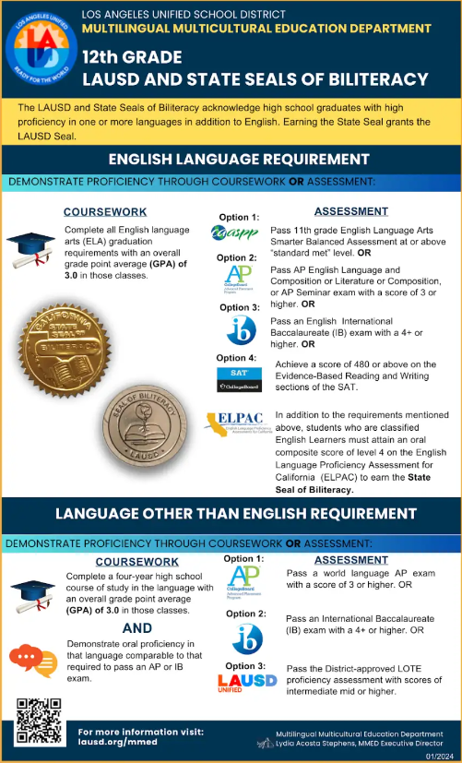
12th Grade Seal of Bilitearcy Infographic
The infographic explains what requirements the 12th Grade student must fulfill to qualify for the Seal of Biliteracy. Both English and Language Other Than English are required.
La infografía explica qué requisitos debe cumplir el estudiante de 12º grado para calificar para el Sello de Alfabetización Bilingüe. Se requiere inglés y dominio de otro idioma.
Notes:
https://drive.google.com/file/d/1sF0M_4pLbXRWvZSgqr9T0SZl9_YxtJkF/view?usp=sharing

Slide 21


ELA & LOTE Both Required
AND
ELA
LOTE
Notes:
Time: 1 minute
Say: Please note that both ELA and Lote are required to fulfill the requirements for the Seal of Biliteracy.
There are 2 Requirement that must be fulfilled in order to qualify for the Seal of Biliteracy awards: 1) Demonstrate Proficiency in English and 2) Demonstrate Language Mastery in language in addition to English.
Here is the flyer in the chat:
https://drive.google.com/file/d/1sF0M_4pLbXRWvZSgqr9T0SZl9_YxtJkF/view?usp=sharing

Slide 22

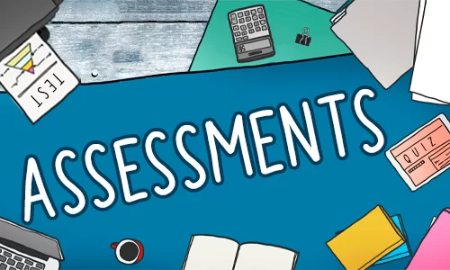
English Criteria
ELA
ELA
OR
Notes:
Time: 30 seconds
Say: Now we will explore the ELA requirements needed to meet the eligibility for the Seal of Biliteracy.

Slide 23
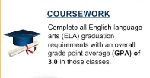
ELA Coursework
Complete all ELA graduation requirements with GPA of 3.0 or above.
Completar todos los requisitos de graduación de ELA con un GPA de 3.0 o superior.

Slide 24
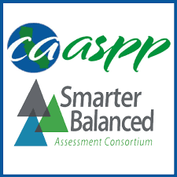


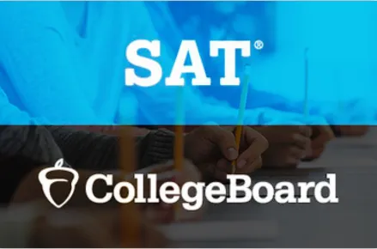
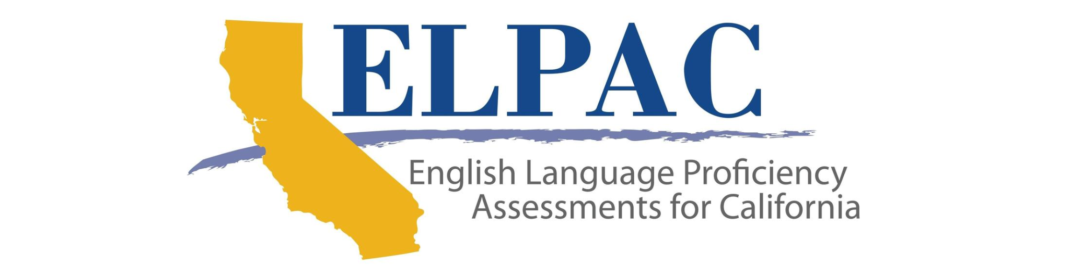
ELA Assessment
“Standards Met” or above on 11th grade SBA exam, OR
Pass AP English Language and Composition or Literature or Composition, or AP Seminar exam with a score of 3 or higher OR
Pass an English International Baccalaureate with a 4 or higher OR
Score of 480 or above in Evidence-Based Reading and Writing on the the SAT
Proficiency on most recent Summative ELPAC with an overall performance level 4. (for ELs only)

Slide 25
English Criteria
Coursework | OR | Assessment
Complete all ELA graduation requirements with GPA of 3.0 or above. |  | “Standards Met” or above on 11th grade SBA exam, OR
 |  | Pass AP English Language and Composition or Literature or Composition, or AP Seminar exam with a score of 3 or higher OR
 |  | Pass an English International Baccalaureate with a 4 or higher OR
 |  | Score of 480 or above in Evidence-Based Reading and Writing on the the SAT
 |  | Proficiency on most recent Summative ELPAC with an overall Oral Composite performance level 4. (for ELs only)
Notes:
Time: 2 minutes
Say: Students need to fulfill the following in order to meet the English Language Requirement for the Seal of Biliteracy.
Completion of all ELA graduation requirements with an overall coursework GPA of 3.0 or above and
“Standards Met” or above on student’s 11th grade SBA exam, or
demonstrate proficiency on the LAUSD Reading Assessment with a score of “Benchmark” or above (for students who did not take the SBA or did not meet the standard) or
Pass AP English Language and Composition or Literature or Composition, or AP Seminar exam with a score of 3 or higher
Student currently designated as an English Learner, must demonstrate proficiency on the English Language Proficiency Assessment for California (ELPAC) with an overall performance level 4 on the most recent Summative ELPAC.

Slide 26

Language Other Than English
(LOTE) Criteria
OR
Notes:
Time: 30 seconds
Say: Now we will explore the LOTE requirements needed to meet the eligibility for the Seal of Biliteracy.
12th grade Seal of Biliteracy Infographic: https://drive.google.com/file/d/1sF0M_4pLbXRWvZSgqr9T0SZl9_YxtJkF/view?usp=sharing

Slide 27
LOTE Coursework
4 years of high school World Language course
AND
Demonstrate proficiency in that language similar to that needed to pass AP or IB exam

Slide 28
LOTE Assessment
Pass an AP world Language exam with a score of 3 or higher OR
Pass an International Baccalaureate exam with a score of 4 or higher OR
Pass a district approved LOTE assessment with a score of Intermediate-mid or higher

Slide 29
Language Other Than English
(LOTE) Criteria
Coursework | OR | Assessment
4 years of high school World Language course AND Demonstrate proficiency in that language similar to that needed to pass AP or IB exam |  | Pass a world Language exam with a score of 3 or higher OR
 |  | Pass an International Baccalaureate exam with a score of 4 or higher OR
 |  | Pass a district approved LOTE assessment with a score of Intermediate-mid or higher
Notes:
Time: 2 minutes
Say: To meet the LOTE requirement, students need to demonstrate through coursework or assessment.
For the coursework option, students need to complete a four-year high school course of study in the language with an overall grade point average (GPA) of 3.0 in those classes and demonstrate oral proficiency in that language comparable to that required to pass an AP or IB exam.
For the assessment option, students are required to pass a world language AP exam with a score of 3 or higher, or pass an International Baccalaureate (IB) exam with a 4+ or higher, or Pass the District-approved LOTE proficiency assessment with scores of intermediate mid or higher
Note that students who have taken the SAT II Subject Test or Essay prior to discontinuation by College Board, may still qualify for the Seal of Biliteracy with a score of 600+ or

Slide 30
LAUSD Unified and State Seal of Biliteracy
Students who earn the CDE Seal of Biliteracy will automatically earn the LAUSD Seal
Notes:
Name
Time: 30 seconds
Say: Please note that students who have met the requirements for the State Seal of Biliteracy also qualify for the LAUSD Seal of Biliteracy.

Slide 31


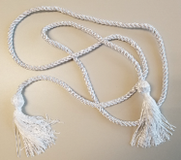
End-of-Year Ceremony
Ceremonia de Fin de Año
Students wear white Cords at Graduation Ceremony
Seals Affixed on Diploma
Blue Stole for Double Seals
Transcript Notation
Los estudiantes usan cordones blancos en la ceremonia de graduación.
Sellos están colocados en el diploma.
La estola azul es para sellos dobles.
La transcripción recibe la notación.
Notes:
Time 1 minute
Say:
In High School, students in 12th grade receive a gold seal for the State award, a silver seal for the L.A. Unified award, and a white cord to wear at graduation.
Students who earn the Seal of Biliteracy for multiple languages also receive a stole to wear over their cap and gown at graduation.
Last years here in L.A. Unified, we have tested 42 different Languages including indigenous and ASL
Orador dice:
En la preparatoria estudiantes del 12avo (doceavo) grado reciben sellos en su diplomas: el Sello Dorado para representar el Premio del Estado, El Sello Plateado para representar el Premio del Distrito Unificado de Los Ángeles. También reciben un cordón blanco para la graduación y para multiple sellos una estola azul.
El año pasado el Distrito Escolar de Los Angeles evaluó estudiantes que hablan 42 (cuarenta y dos) idiomas, incluyendo lenguajes de sordo mudo ASL y lenguajes indígenas.

Slide 32

Questions about 12th Grade Requirements?
¿Preguntas sobre los requisitos de 12º?

Slide 33

Literacy Family Resources
A Multilingual Journey to Pathway Awards
Home and Community
Support Resources
Recursos de lectoescritura para familias
Un camino al multilingüismo hacia los premios
Hogar y comunidad
Recursos de apoyo
Notes:
Welcome School Leaders. Today we will discuss the importance of strategic instructional planning using the Adjusted Blueprints and Priority Standards. By closely examining the Adjusted Blueprints, we gain a detailed roadmap of the key concepts and skills assessed in the Smarter Balanced Assessment (SBA). This insight allows us to prioritize and focus on the critical Priority Standards that align with our educational goals. Through strategic planning, we can ensure that our teachers are dedicating time and resources to the most essential content areas, maximizing the impact of our instructional efforts. This approach not only aligns with assessment requirements but also provides a targeted focus on student mastery of priority skills, setting the stage for academic success.

Slide 34
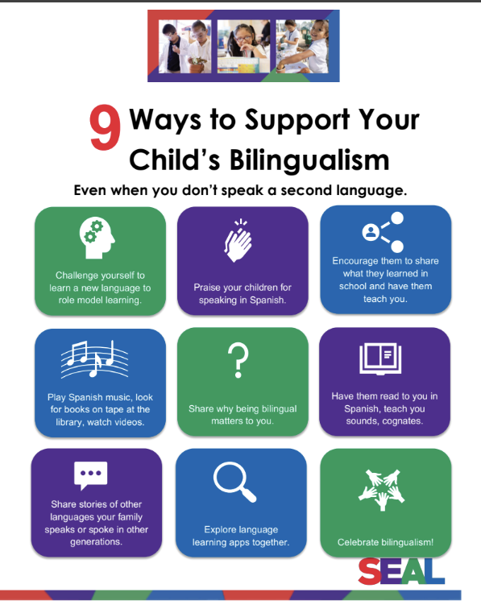
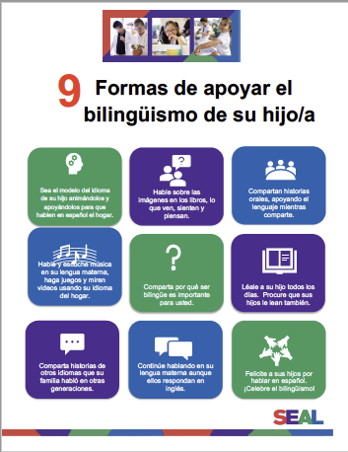
Supporting Your Child’s Bilingualism
Apoyando el bilingüismo de su hijo
Notes:
Say: Here are some ways you can support your child’s journey to multilingualism back at home.
Challenge yourself to learn a new language to role model learning.
Praise your children for speaking in Spanish.
Encourage them to share what they learned in school and have them teach you.
Play Spanish music, look for books on tape at the library, watch videos.
Share why being bilingual matters to you.
Have them read to you in Spanish, teach you sounds, cognates.
Share stories of other languages your family speaks or spoke in other generations.
Explore language learning apps together.
Celebrate bilingualism!

Slide 35


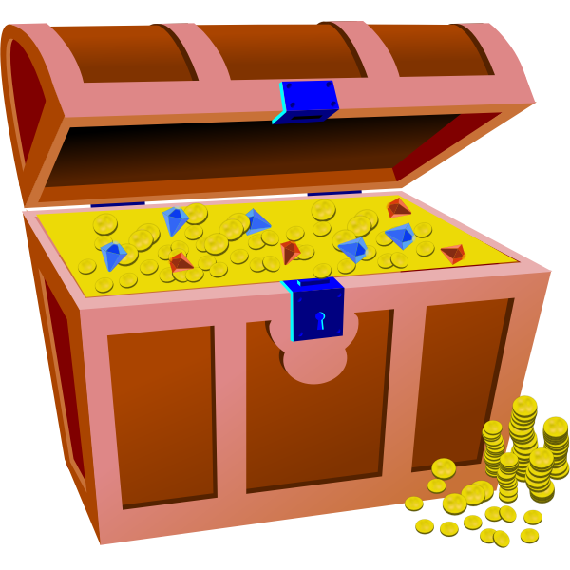
Multilingual Literacy Home Support
Shared moments at home that can strengthen multilingual superpowers!
Please click on images and titles of websites to reveal link to websites and additional external resources!
Apoyo de lectoescritura multilingüe
¡Momentos compartidos en casa que pueden fortalecer los superpoderes multilingües!
Haga clic en las imágenes y los títulos de los sitios web para revelar enlaces a sitios web y recursos externos adicionales.
Notes:
Link to Literacy Family Supports 2024-2025: https://docs.google.com/presentation/d/18LIR9c0zGwk-dFVRKRgabbF4_cj07vOh/edit?usp=sharing&ouid=111643500403429059579&rtpof=true&sd=true
We wanted to share with you various home experiences and supports that you can begin to do with your kids to prepare for this multilingual world that is here! Any little step you might take to bring multilingualism into your home is a testament to the love and pride you have for your kids, and in the beliefs that they are limitless and have boundless potential! Let’s explore some ways to support multilingualism at home! We will begin by thinking about experiences that will not require a lot of technology or any at all, and also to emphasize that learning another language is more than just vocabulary and learning phrases here and there. “Language is not just words”. Next slide.

Slide 36
















Learning Library on Sora/
Biblioteca de aprendizaje en Sora
The LAUSD Learning Library on Sora is the quickest and easiest way to read digital books. LAUSD students and staff can log in using their SSO and instantly access hundreds of ebooks and audiobooks on virtually any device, for FREE. We have ebooks and audiobooks in Korean, Mandarin, Russian, Spanish, Arabic, and French. For more information, click HERE.
Thousands of great reads are waiting for you in the LAUSD Learning Library on Sora. Open all day, everyday.
Notes:
Time: 2 minutes
Say: The LAUSD Learning library is the quickest and easiest way to read digital books. LAUSD students, family members and staff can use their single sign on to instantly access hundreds of ebooks and audiobooks.

Slide 37
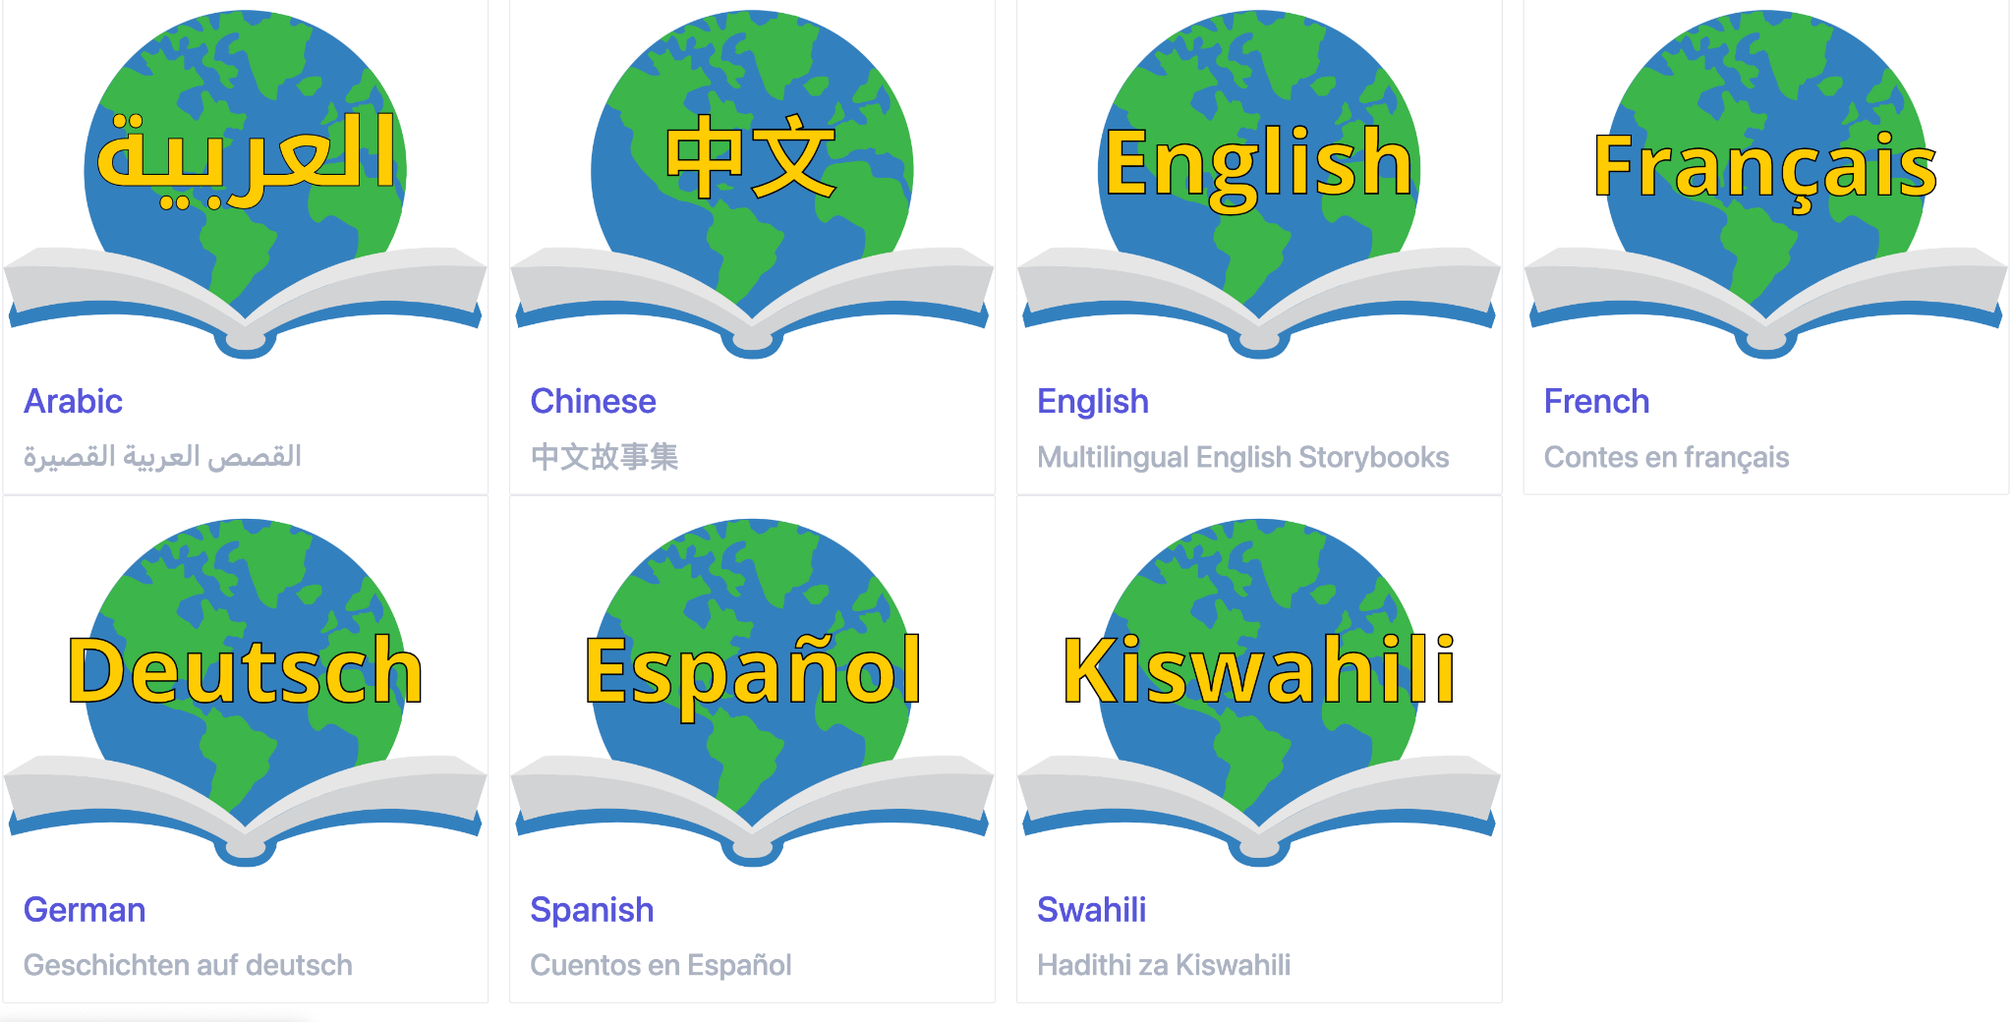
Global Storybooks is a free multilingual literacy resource for language teachers and learners of all ages. Read, teach, download, and listen to illustrated stories in many languages. Check out our featured sites, language teaching resources, and community projects. To learn more, see our FAQ and video.
Global Storybooks Portal
Notes:
Link to Global Storybooks Portal: https://globalstorybooks.net/

Slide 38
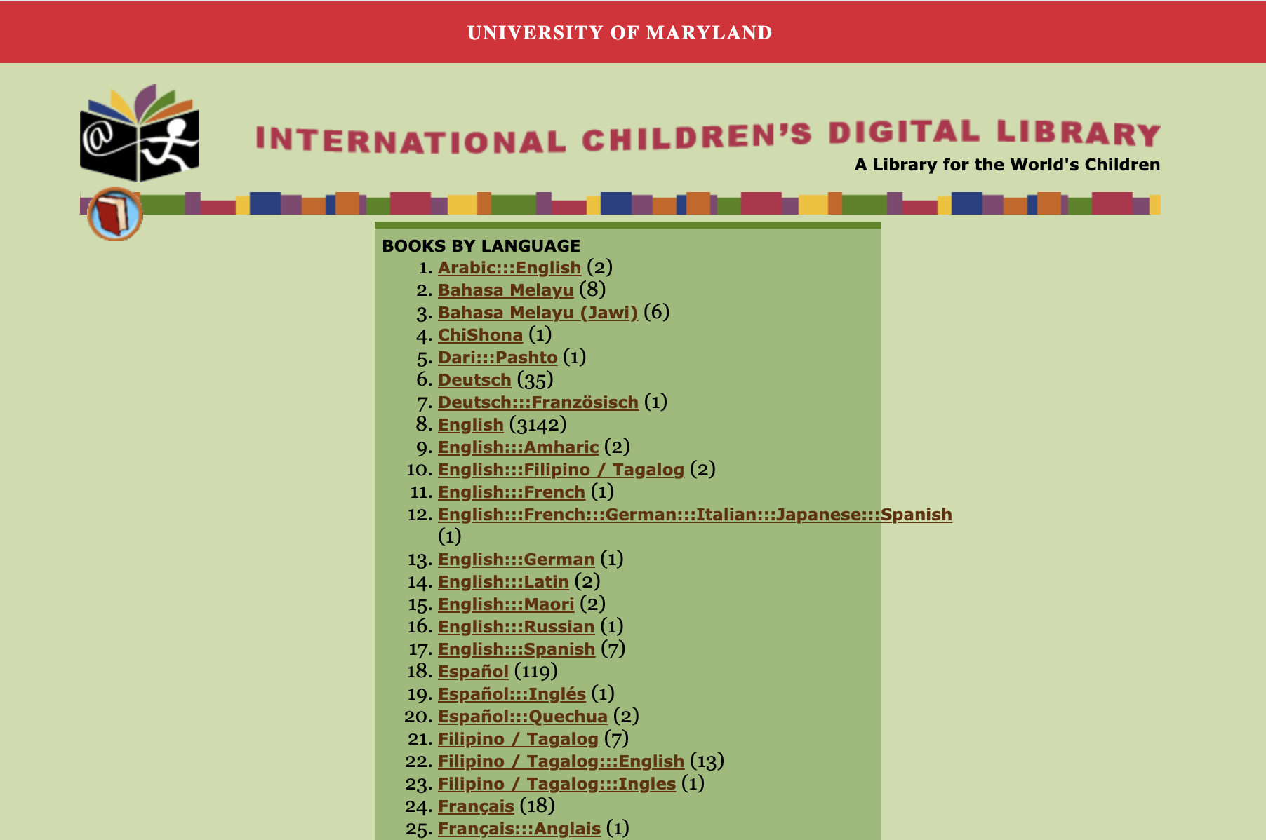
International Children’s Digital Library
Notes:
Drop in Chat: International Children’s Digital Library http://www.childrenslibrary.org/library/books_by_language.html

Slide 39






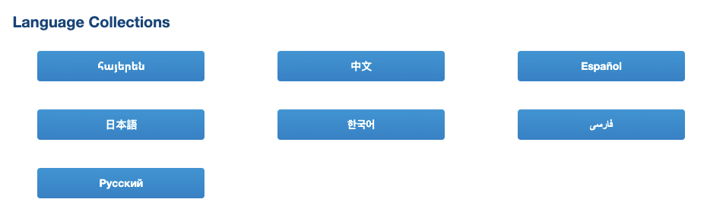
Supports from the LA Public Library/
Apoyos de la Biblioteca Pública de Los Ángeles
Free!
Physical and Electronic Cards are both available!
Notes:
Time: 1 minute
Link to LA Public Library: https://www.lapl.org/
Link to LA Public Library Card Application: https://www.lapl.org/sites/default/files/media/pdf/about/Library_Card_App.pdf
Download the library card application, fill it out, and then take it into any LA Public Library location
E-card Registration: https://www.lapl.org/about-lapl/contact-us/e-card/e-card-registration
E-Card Registration en Español: https://www.lapl.org/about-lapl/contact-us/e-card/solicitud-tarjeta-electronica

Slide 40
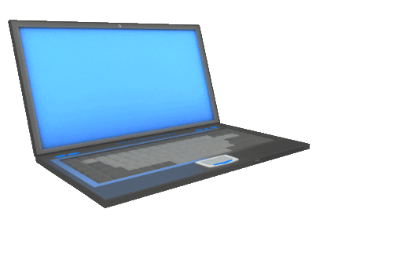
MMED Dual Language & World Languages Team Contact Information
UTK-1st Promise to Bilingualism Promesa al bilingüismo | Aram Davtyan, DLE Specialist | aram.davtyan@lausd.net | (213) 241-2042
3rd Grade Pathway to Biliteracy, Camino a la biliteracidad | Blanca Valle-Alvarado, DLE Specialist | bvalle@lausd.net | (213) 241-4172
5/6th Grade Pathway to Biliteracy, Camino a la biliteracidad | Blanca Valle-Alvarado, DLE Specialist | bvalle@lausd.net | (213) 241-4172
8th Grade Pathway to Biliteracy, Camino a la biliteracidad | Elise Kim, DLE Specialist | elise.kim@lausd.net | (213) 241-5582
12th Grade SEALS of Biliteracy, Sellos de la biliteracidad | Youssef Mossadaq, WLC Coordinator | yxm9573@lausd.net | (213) 241-4517
Notes:
Name
Time: 1 minute
Read Slide
UTK-1st Promise to Bilingualism Promesa al bilingüismo - Aram Davtyan, DLE Specialist - aram.davtyan@lausd.net (213) 241-2042
3rd Grade Pathway to Biliteracy, Camino a la biliteracidad & 5/6th Grade Pathway to Biliteracy, Camino a la biliteracidad, Blanca Valle-Alvarado, DLE Specialist - bvalle@lausd.net (213) 241-4172
8th Grade Pathway to Biliteracy, Camino a la biliteracidad Elise Kim, DLE Specialist, elise.kim@lausd.net (213) 241-5582
12th Grade SEALS of Biliteracy, Sellos de la biliteracidad - Youssef Mossadaq, WLC Coordinator - yxm9573@lausd.net (213) 241-4517

Slide 41
Questions about 12th Grade Requirements?
¿Preguntas sobre los requisitos de 12º?

Slide 42


