Slide 1


Pathway to Biliteracy Awards, Honoring and Celebrating Language & Culture
Family Informational Sessions for
Grade 8
October 2025
El camino hacia los premios de la biliteracidad, honrando y celebrando el lenguaje y la cultura
Sesiones Informativas
de grado 8º
para familias
octubre del 2025
Notes:
Time: 1 minute
Play Music as we wait to start: https://www.yout-ube.com/watch?v=_UucPr2M-qU&t=390s
Welcome families.
This is the Pathway to Biliteracy Awards, Honoring and Celebrating Language & Culture
Family Informational Sessions for
Grades 8

Slide 2
Notes:
Time: 1 minute
We begin with recognizing our native community - read the slide
Resources on Land Acknowledgements
https://www.csusm.edu/cicsc/land.pdf
http://landacknowledgements.org/wp-content/uploads/2018/10/Acknowledgement-Guide-finalfinal.pdf
호늑베탐, 아히히롬, 이요힌컴

Slide 3
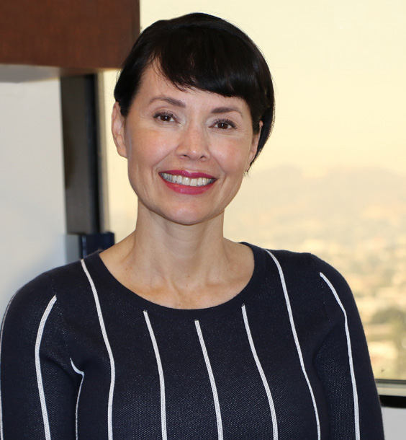
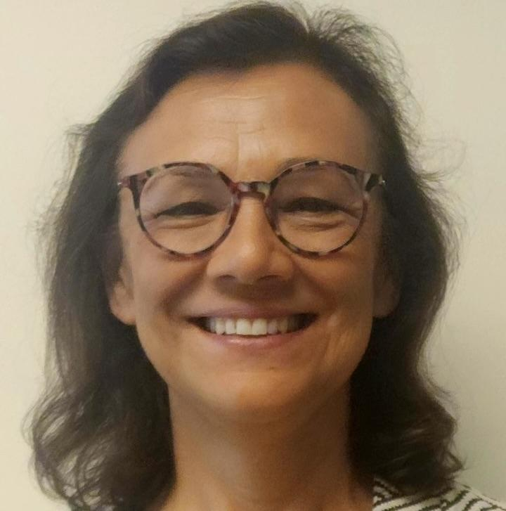
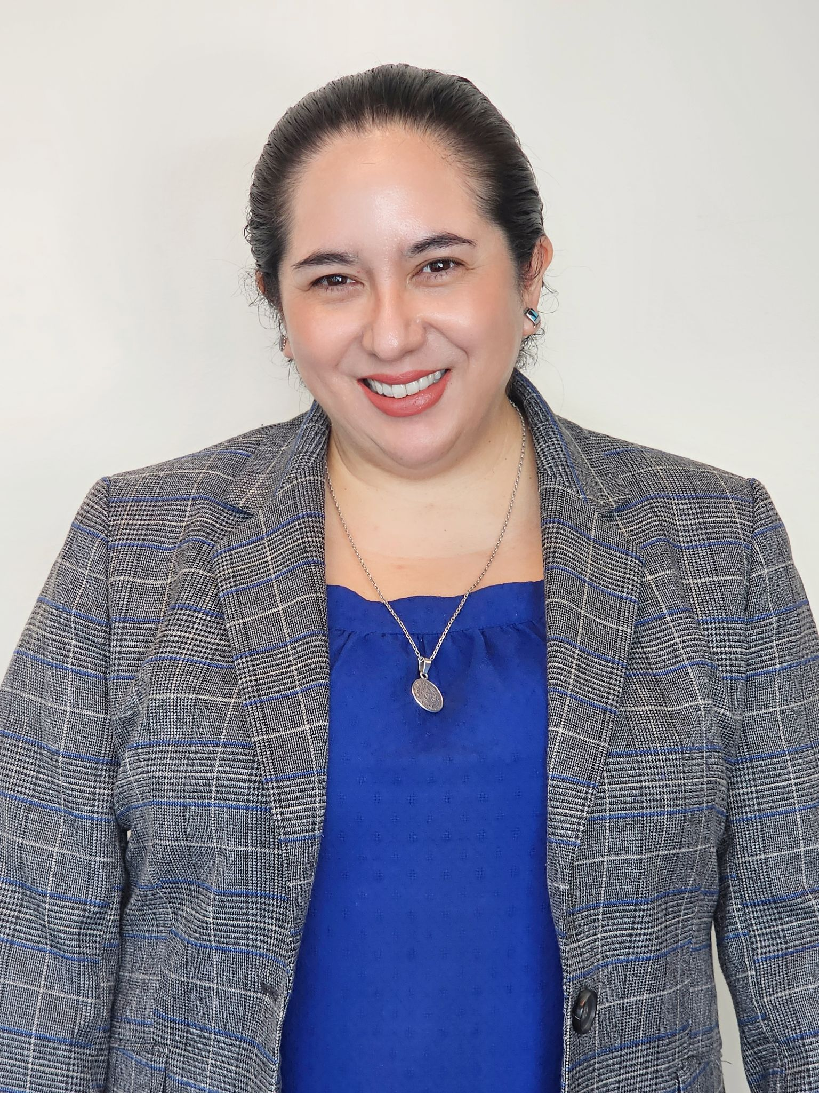
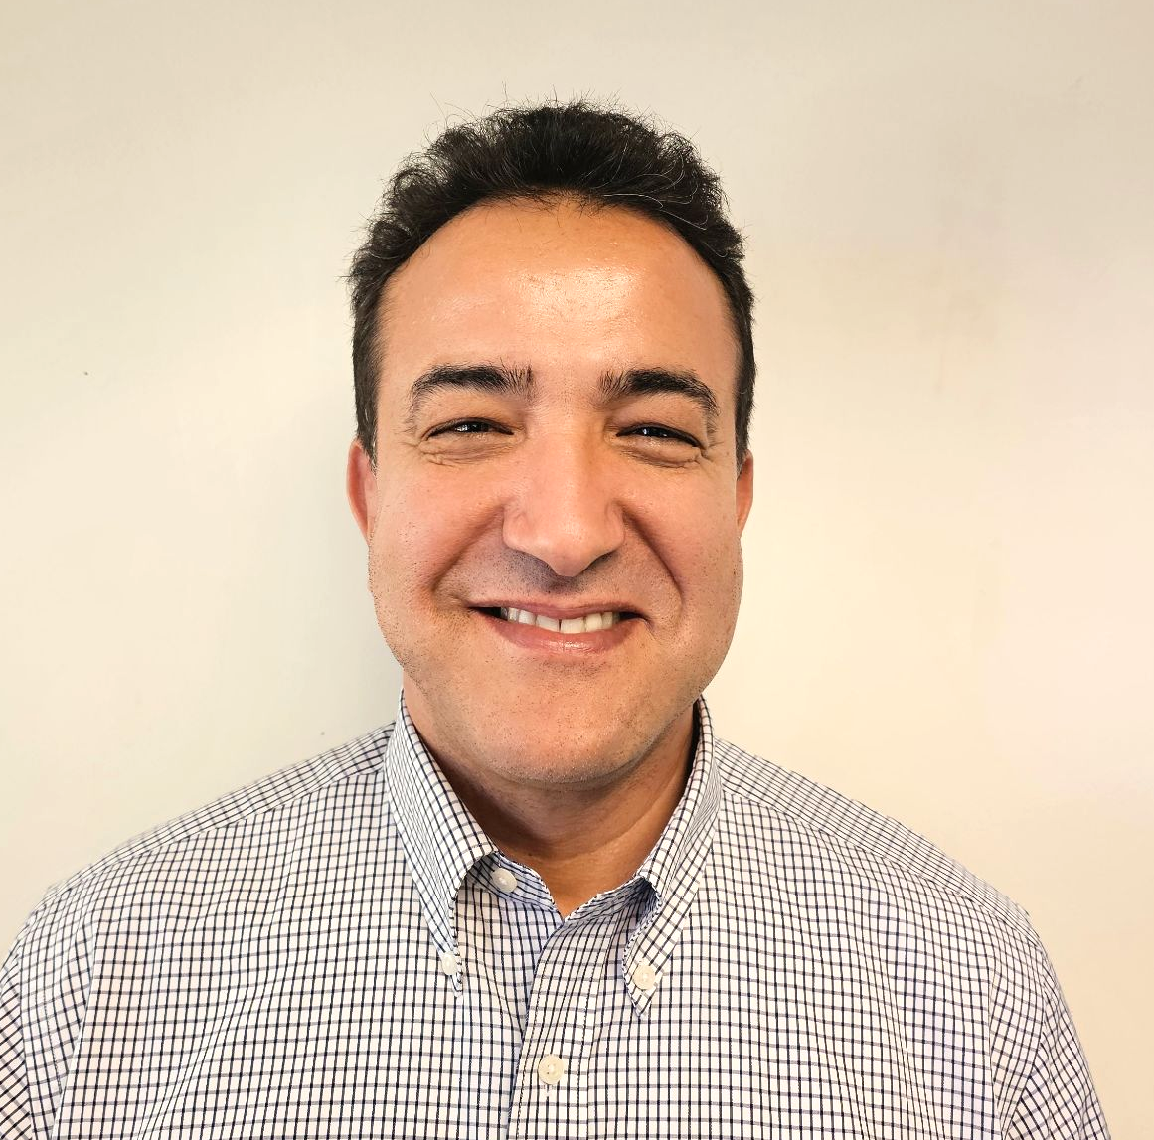
Meet our MMED Leadership
Nuestros líderes
Lydia Acosta Stephens
Ana M. Guzman
Roxanna Sosa
Youssef Mossadaq
Executive Director
Directora ejecutiva
Parent of they/them kiddo
Administrator
Dual Language Education
World Languages and Cultures
Administradora
Educación de lenguaje dual
Idiomas y culturas mundiales
Coordinator
World Languages & Cultures
Coordinador
Idiomas y culturas mundiales
Administrative Coordinator
Dual Language Education
Coordinadora administrativa
Educación de lenguaje dual
Notes:
Time: 30 seconds
Here are our mighty leaders…

Slide 4

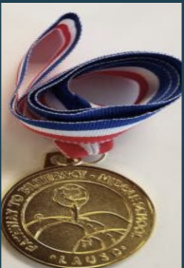
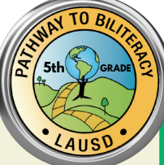
Recordatorio
La sesión informativa virtual de hoy está dirigida a familias de estudiantes en el grado:
8º grado
Friendly Reminder
Today’s Virtual Informational Session is intended for family members of students in grade:
8th Grade
Notes:
Time: 1 minute
Say: Friendly reminder, that this virtual informational session is for family members of students in grade 8 in middle school.
While we are all happy to see you in attendance today, do remember that this presentation is intended for family members of students in grade 8. You are free to attend this session if your child is not in any of those grades, of course, but do know that the criteria covered in the presentation will reflect those three grades.

Slide 5
Today’s Session
La sesión de hoy
What is the Pathway to Biliteracy Award in 8th Grade?
What does my child need to do to earn the award?
How can I support my child at home?
¿Qué son los Premios Camino al Biliteracidad en
8º grado?
¿Qué necesita hacer mi estudiante para recibir el premio?
¿Cómo puedo apoyar a mi estudiante en casa?
Notes:
Time: 1 minute
Say: what are we focusing on today? We will be focusing on addressing the following questions:
What is the Pathway to Biliteracy Award in Grade 8?
What does my child need to do to earn the award
How can I support my child at home?

Slide 6
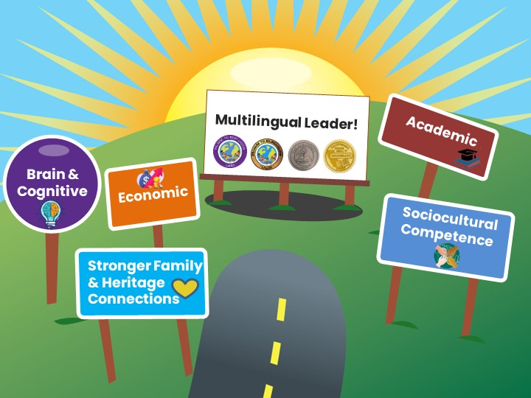



Benefits of Bilingualism and Biliteracy
Beneficios del bilingüismo y la biliteracidad
Which one
resonates with
you & why?
¿Cuál ventaja le llama la atención y por qué?
Lifelong Advantages
Ventajas para toda la vida
Líder multilingüe
Cerebral y cognitivo
Económico
Académico
Competencia sociocultural
Conexiones Familiares
Share in the chat!
¡Comparta en el chat!
Notes:
Time: 2 minutes
Say: Say: The experience of mastering two or more languages has enormous benefits for students. People who are able to speak, read, and write in two or more languages are able to participate in several different cultural and language worlds. Multilingual proficiency actually strengthens how the brain functions. Let’s look at some of the benefits of be bilingual and biliterate:
Here are some benefits of bilingualism and biliteracy
Brain & Cognitive Function:
Cognitive flexibility
Improves decision-making skills
Better problem-solving abilities
Have a stronger sense of self
Academic:
Increased academic performance
Advanced language courses
Biliteracy awards and District and State Seals of Biliteracy
Economic:
Competitive in the global economy
Have expanded job opportunities with higher pay
Sociocultural Competence
Awareness and understanding of other cultures
Can be “citizens of the world” with a more comprehensive and tolerant perspective
Stronger Family & Heritage Connections
Bridge builders for their families
Access to the wisdom of their heritage cultures
Ask: Now In the chat, go ahead and share your response to the following question: Which one of these benefits of bilingualism and biliteracy resonates with you?
________
Mastering two or more languages has enormous benefits for students. People who are able to speak, read and write in two or more languages are able to participate in several different cultural and language worlds.
Bilingualism is associated with more cognitive flexibility and better problem solving abilities.
Children who are bilingual tend to perform better on achievement tests.
Job opportunities become available throughout the globe for those who are bilingual, and there are often financial benefits associated with bilingual skills in the labor market.
The study of another language expands one’s worldview and builds cross-cultural understanding.
More than one-third of California school children speak a language other than English at home. The development of strong bilingual skills that include home language and English provide them the capacity to participate actively in both of their language worlds, and to be bridge builders and translators for their families.

Slide 7
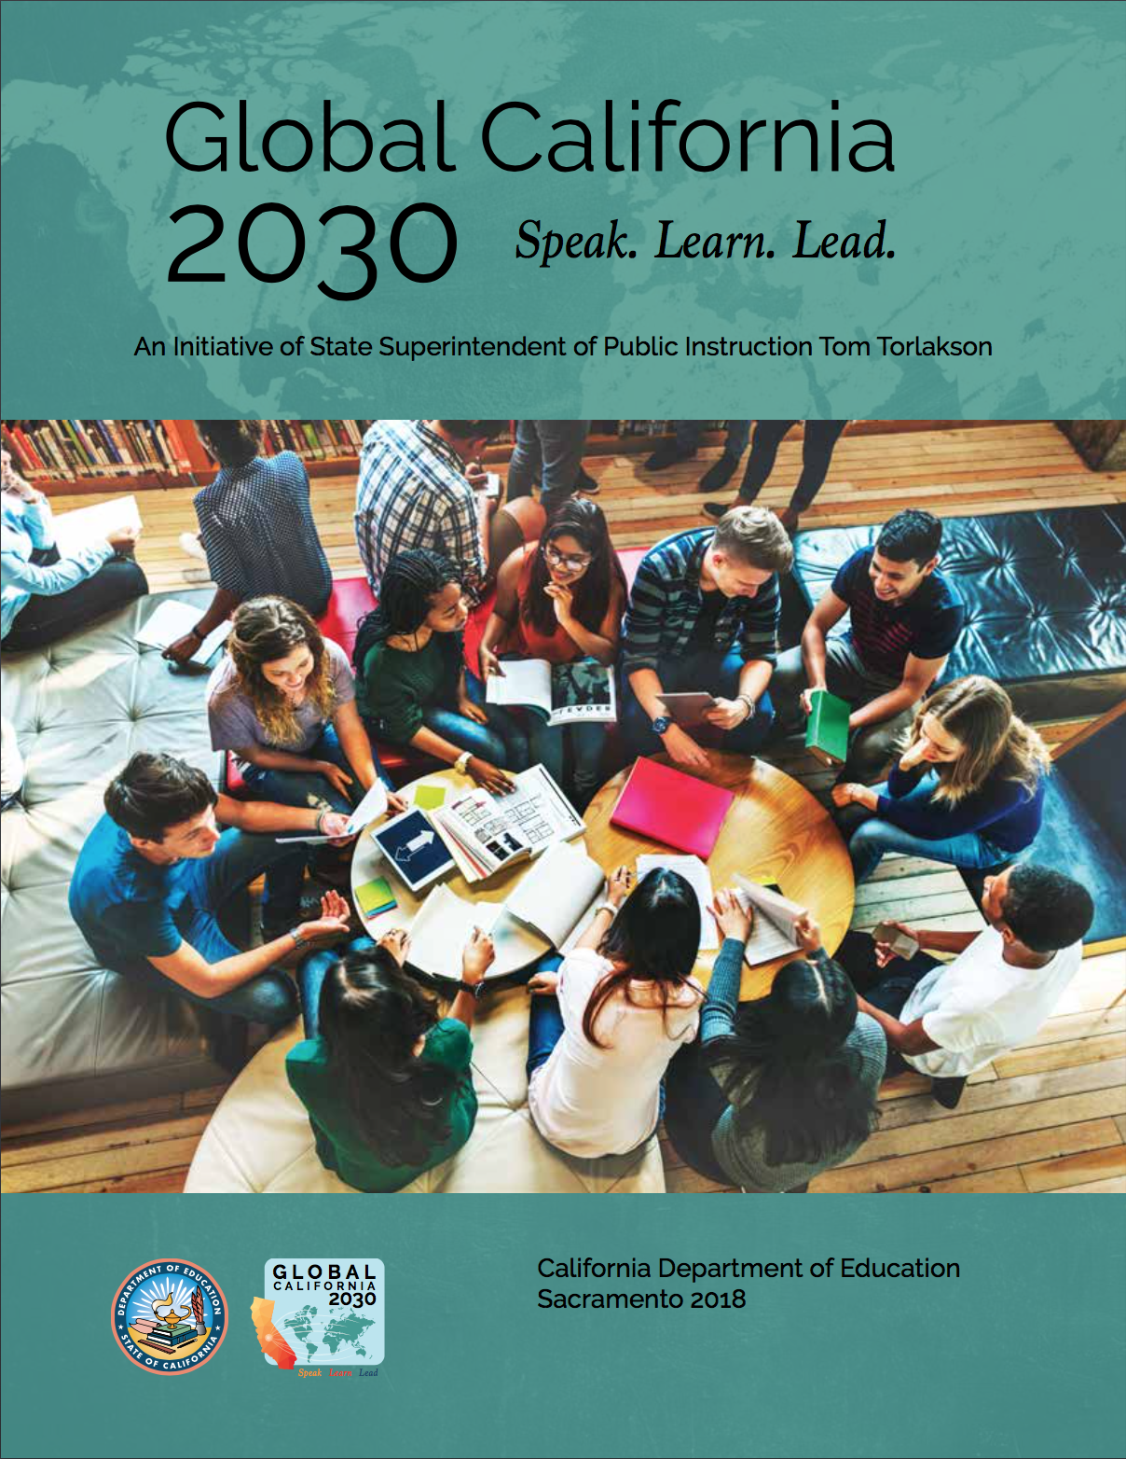
Global California 2030 A Call to Action!
“By 2030, we want half of all K–12 students to participate in programs leading to proficiency in two or more languages, either through a class, a program, or an experience. By 2040, we want three out of four students to be proficient in two or more languages, earning them a State Seal of Biliteracy.”
-Tom Torlakson, former State Superintendent
California global 2030
¡Un llamado a la acción!
“Para 2030, queremos que la mitad de todos los estudiantes K-12 participen en programas que les permitan dominar dos o más idiomas, ya sea a través de una clase, un programa o una experiencia. Para 2040, queremos que tres de cada cuatro estudiantes dominen dos o más idiomas, lo que les permitirá obtener un Sello Estatal de Alfabetización Bilingüe”.
-Tom Torlakson, ex superintendente estatal
Notes:
Time: 30 sec
By 2030, this initiative envisions that half of California’s K–12 students will be enrolled in programs that develop proficiency in two or more languages.
By 2040, three out of four California students will be proficient in two or more languages and earn the State Seal of Biliteracy.
Link: https://drive.google.com/file/d/1wZzqgKNbygjRUKS6hW176TAT1i51UGnx/view?usp=sharing

Slide 8

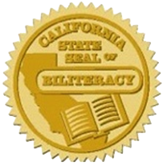
Strategic Plan 2022-2026
Plan Estratégico 2022-2026
“Provide students with expanded opportunities to become multilingual through dual and world language programs, including American Sign Language.” pg. 26
"Proporcionar a los estudiantes mayores oportunidades para volverse multilingües a través de programas duales y de idiomas mundiales, incluido el lenguaje de señas americano." página. 26
“By 2026, ensure at least 50% of our graduating seniors receive the California Seal of Biliteracy.”
“Para 2026, asegurar que al menos el 50% de nuestros estudiantes que se gradúan reciban el Sello de Alfabetización Bilingüe de California”.
-Alberto Carvalho, Superintendent
-Alberto Carvalho, Superintendent
Notes:
Time: 30 sec
It’s important to note that our 2022-2026 strategic plan is supported by our Pathway to Biliteracy Awards, as it is our goal by 2026 to ensure that at least 50% of our graduating seniors receive the CSSB.
Read the slide

Slide 9
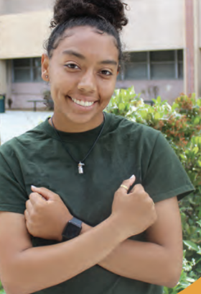
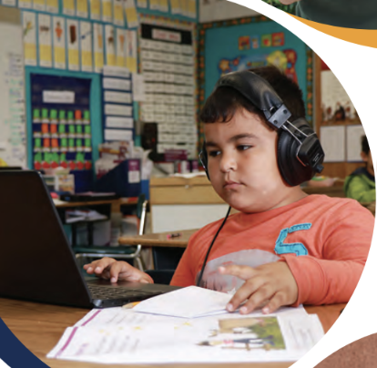

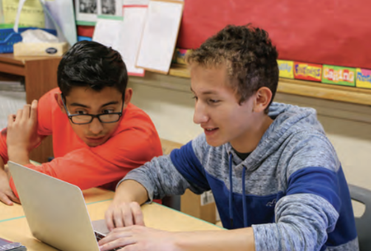
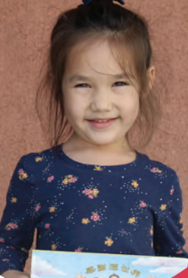
LA Unified’s Diverse Students
Los diversos estudiantes del LAUSD
En las escuelas del LAUSD se hablan 160 idiomas diferentes:
El idioma principal además del inglés (LOTE) es el español (88%)
Otros idiomas incluyen:
armenio (2%), ruso (2%), coreano (1%), filipino (1%), farsi (1%), árabe, vietnamita, k'iche', bengalí, cantonés, por nombrar algunos.
160 different languages are spoken in LAUSD schools:
The primary Language other than English (LOTE) is Spanish (88%)
Other languages include: Armenian (2%), Russian (2%), Korean (1%), Filipino (1%), Farsi (1%), Arabic, Vietnamese, K’iche’, Bengali, Cantonese to name a few.
Notes:
‘
Time: 30 seconds
From the Home Language Surveys, we have identified that 160 different languages are spoken in LAUSD schools:
The primary LOTE language is Spanish (88%)
Other languages include: Armenian, Russian, Korean, Arabic, Farsi, Vietnamese, K’iche’ (a Mayan language of Guatemala), Bengali, Cantonese to name a few

Slide 10
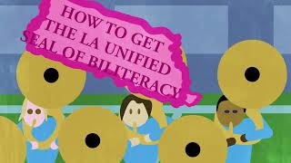
Video-Pathway to Biliteracy Awards
Premios caminos hacia la biliteracidad
Link to video in Spanish available. Enlace disponible para el video en español.
Notes:
Time: 6 minutes
Say: Now, let’s take a look at our Pathway to Biliteracy Awards video that highlights what the award(s) is/are, the benefits of being multilingual, how students can obtain the award, and the processes that this entails. Note that UTK students, in addition to Kindergarten and 1st grade are now honor with a Promise to Bilingualism award as well.
Time: Video: 5.04 min. (5 minutes)
Video link: https://www.youtube.com/watch?v=J_tnbmdH8hI (English)
Video link en español: https://lausd.wistia.com/medias/uqlignw0os

Slide 11

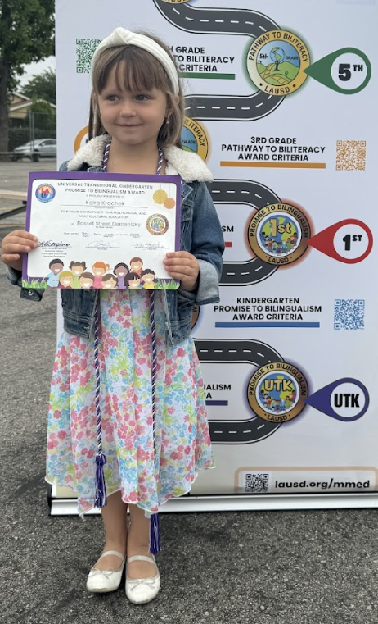




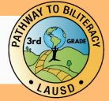

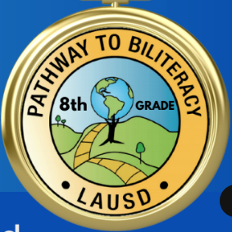
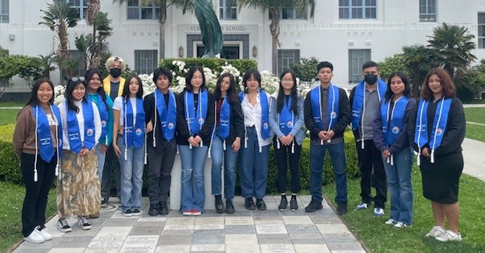
The Multilingual Journey/El camino multilingüe
California Department of Education & L.A. Unified Seals
of Biliteracy
Departamento de Educación de California y
Distrito Unificado de Los Ángeles
Sellos de la biliteracidad
Promise to Bilingualism Awards
Premios Promesa al Bilingüismo
Pathway to Biliteracy Awards
Premios Camino a la Biliteracidad
5/6th Grade
8th Grade
12th Grade
Transitional
Kindergarten
Kindergarten
1st Grade
3rd Grade
TK
11
Notes:
Blanca
Time: 1 min
Here is the Pathway to bilingualism and Biliteracy that all students can follow in L.A. Unified, to become biliterate and eventually receive the honor of Seals of Biliteracy on their high school diplomas. You as family members can help your children embark on this journey, as UTK, K, and 1st Grade Promise to Bilingualism awards lay the foundation of multilingualism for our little ones.
We are excited to announce all seven awards where we honor our learners, with UTK followed by the Kinder and 1st Grade awards, and then moving onto 3rd and 5th grade at the elementary level, and later moving onto middle school and high school with 8th and 12th grade. As you can see, earning an award at each of these key points in your child’s educational career for demonstrates a certain level of proficiency in speaking one or more languages in addition to English.
In 2023, 6,600 CDE seals of biliteracy or 24% were earned by the 2023 senior class.
REF-062900.4 Pathway Awards Policy: https://drive.google.com/file/d/1cyrkbgzAC7nyYJyy3J38oNrP7wcixIdj/view?usp=share_link

Slide 12



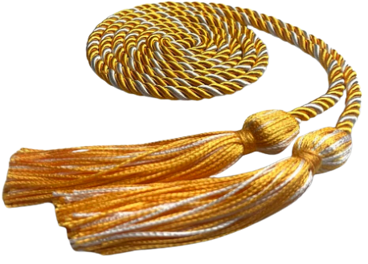


Awards Earned in Multiple Languages/Premios obtenidos en varios idiomas
 | LANGUAGES
1 | MANDARIN,SPANISH
2 | ARMENIAN,RUSSIAN
3 | KOREAN,SPANISH
4 | FRENCH,SPANISH
5 | SPANISH,VIETNAMESE
6 | ARMENIAN,SPANISH
7 | JAPANESE,SPANISH
8 | MANDARIN,RUSSIAN
9 | RUSSIAN,UKRAINIAN
10 | ARABIC,SPANISH
11 | FRENCH,PORTUGUESE
12 | GERMAN,SPANISH
13 | RUSSIAN,SPANISH
14 | AFRIKAANS,SPANISH
15 | ALBANIAN,SPANISH
16 | AMERICAN SIGN LANGUAGE(ASL),SPANISH
17 | ARABIC,URDU
18 | CAMBODIAN,SPANISH
19 | FARSI,FRENCH
20 | FILIPINO,SWEDISH
 | LANGUAGES
21 | FRENCH,GREEK
22 | FRENCH,HEBREW
23 | FRENCH,KOREAN
24 | FRENCH,POLISH
25 | FRENCH,SIGN LANGUAGE,SPANISH
26 | FRENCH,TURKISH
27 | GERMAN,SWEDISH
28 | HEBREW,SPANISH
29 | HINDI,SPANISH
30 | JAPANESE,KOREAN
31 | JAPANESE,MANDARIN
32 | KOREAN,MANDARIN
33 | POLISH,SPANISH
34 | PUNJABI,SPANISH
35 | SIGN LANGUAGE,SPANISH
36 | SLOVAK,SPANISH
37 | SPANISH,SWAHILI
38 | SPANISH,TAMIL
39 | SPANISH,ZAPOTECO
40 | FRENCH,GREEK
Cords awarded in recognition of 2 or more languages
(in addition to English)
Cordones otorgados en reconocimiento a 2 o más idiomas. (además del inglés)
UTK
Kindergarten
1st grade
3rd grade
5th grade
8th grade
Data from MiSiS 6/14/23
Notes:
Time: 1 min.
Along with the certificate, students who earn the award in multiple languages also earn a chord of recognition for being multilingual in 2 or more languages in addition to English .

Slide 13
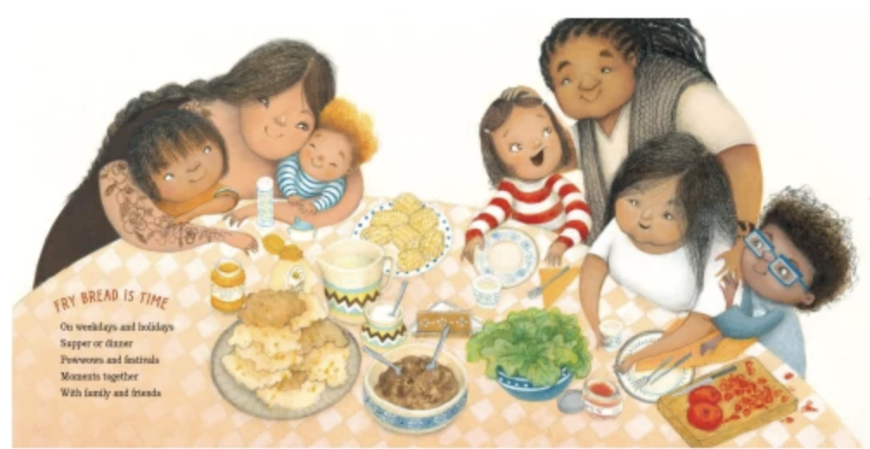
What language(s) do you speak
at home?
¿Qué idioma(s) hablas en casa?
Share in the chat!
¡Comparta en el chat!
Share in the chat!
Notes:
Time: 1 minute
Say: As we’ve now gone over the different ways honor your child’s culture and identity through the languages spoken at home, we want to know from you! What language(s) do you and your children speak at home?
Go ahead and type the language(s) in the chat.

Slide 14
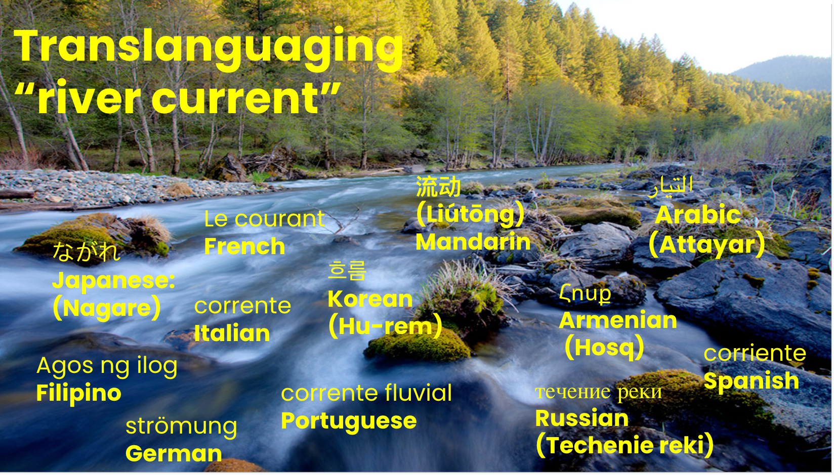
Sources: All Students Must Thrive & The Translanguaging Classroom: Leveraging Student Bilingualism for Learning
Notes:
This slide: 1.5 minutes
SAY:
And it is with all the the languages that we speak so fluidly at home, like a river current, we also wanted to highlight that as being multilingual, our dynamic multilingualism runs through all aspects of the classroom, school,s playgrounds, homes, and communities. The use of language is an integrated whole, like a thriving river ecology, just as you see on your screen. That is, the languages that we, our children, our students speak don’t live separately, but rather, are interconnected.
Another critical building block of translanguaging as authored by Dr. Ofelia Garcia and friends, is the translanguaging rover current.
The authors use the metaphor of the translanguaging current to refer to the current or flow of students’ dynamic bilingualism that runs through all aspects of the classroom, schools, playgrounds, homes and communities. The current perceives use of language as an integrated whole, like a thriving multilingual river ecology, where students connect and bridge social and home spaces with linguistic practices that are usually considered separate.
The translanguaging current is the “unvoiced dialogues”, intrapersonal thinking, and the natural flow of students’ multilingualism and language practices in the classroom.
In letting the translanguaging current flow in a classroom, you can enact a translanguaging stance
Extra information for facilitators:
We suggest that the translanguaging corriente, produced and driven by the positive energy of students bilingualism, flows throughout all classrooms. Metaphorically, we think about the translanguaging corriente as a river current that you can’t always see or feel, but that is always present, always moving, and responsible for changes in the (classroom) landscape. Sometimes the translanguaging corriente flows gently under the surface, for example, in classrooms where teachers do not generally tap into students’ home language practices for learning. At other times the translanguaging corriente is much stronger, for example, in bilingual classrooms or English-medium classrooms that do draw on students’ home language practices.
“unvoiced dialogues”, the natural flow of students’ multilingualism in the classroom, always present, always moving, ever-changing
p.10 Thrive
“To tap into racial realities, teachers must recognize the importance of race, understand its impact on learning, and listen to the stories, experiences, concerns, and fears that students of color may share about their experiences as racialized beings.”
We suggest that the translanguaging corriente, produced and driven by the positive energy of students bilingualism, flows throughout all classrooms. Metaphorically, we think about the translanguaging corriente as a river current that you can’t always see or feel, but that is always present, always moving, and responsible for changes in the (classroom) landscape. Sometimes the translanguaging corriente flows gently under the surface, for example, in classrooms where teachers do not generally tap into students’ home language practices for learning. At other times the translanguaging corriente is much stronger, for example, in bilingual classrooms or English-medium classrooms that do draw on students’ home language practices.

Slide 15
What is the
Pathway to Biliteracy Award
in 8th Grade?
¿Cuáles son los
premios Camino al Biliteracidad
en 8º grado?

Slide 16
How does your child earn the
8th Grade
Pathway to Biliteracy Award?
¿Cómo recibe su hijo/a en
8º grado, los premios Camino a la biliteracidad?

Slide 17
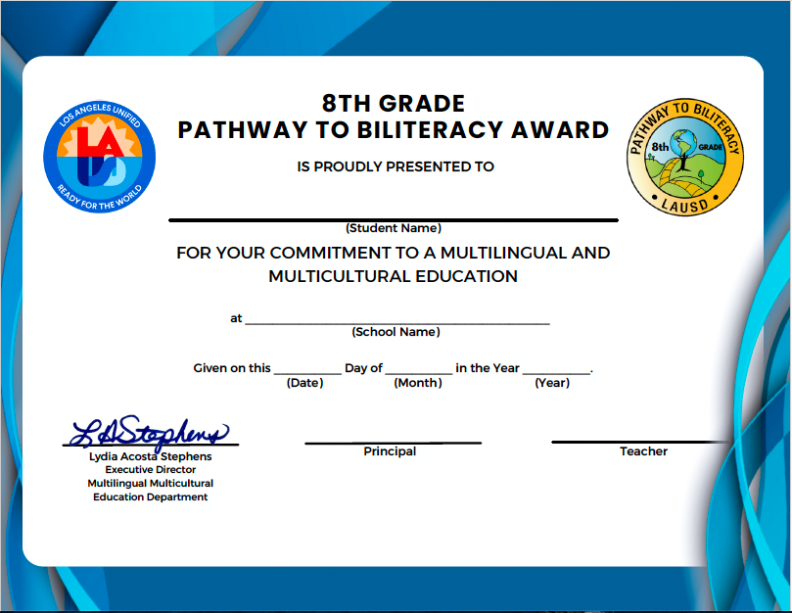
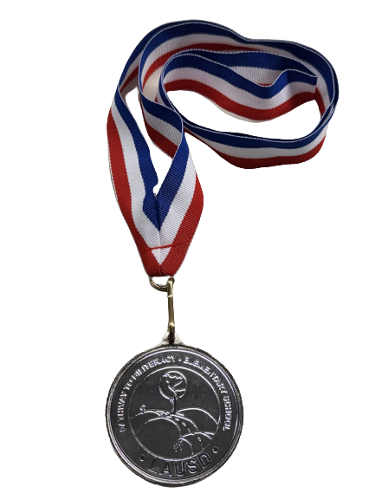

8th Grade Middle School
Pathway to Biliteracy Award
2 or more languages (in addition to English)
Notes:
30 sec
So you are looking at the middle school 8th grade Pathway to Biliteracy Award certificate and the GOLD medal the students might be receiving. For those students who can speaking more than two languages other than english you will be honored with a tri-color chord.
We will review how students can receive this award.

Slide 18
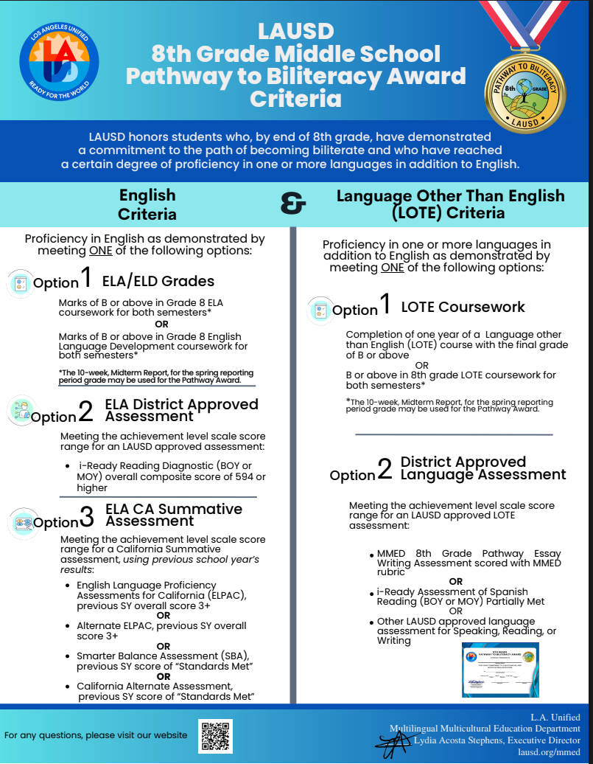


8th Grade Criteria or Requirements
Notes:
30 sec.
The 8th Grade Middle School Pathway to Biliteracy Awards Criteria Infographic is an easy to read document that outlines the options available to meet the criteria in both English and a Language Other Than English (LOTE) in one page.
Link to 8th grade Pathway Award Criteria: https://drive.google.com/file/d/1LaPJ_xJCZ_RSMQuVmFa4mawDqYiawNar/view?usp=sharing

Slide 19
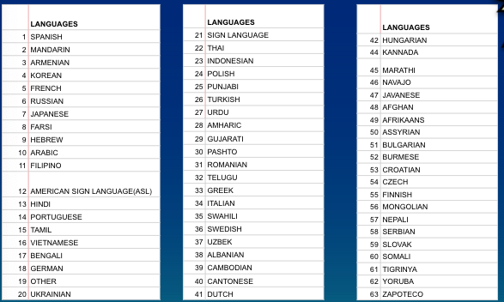
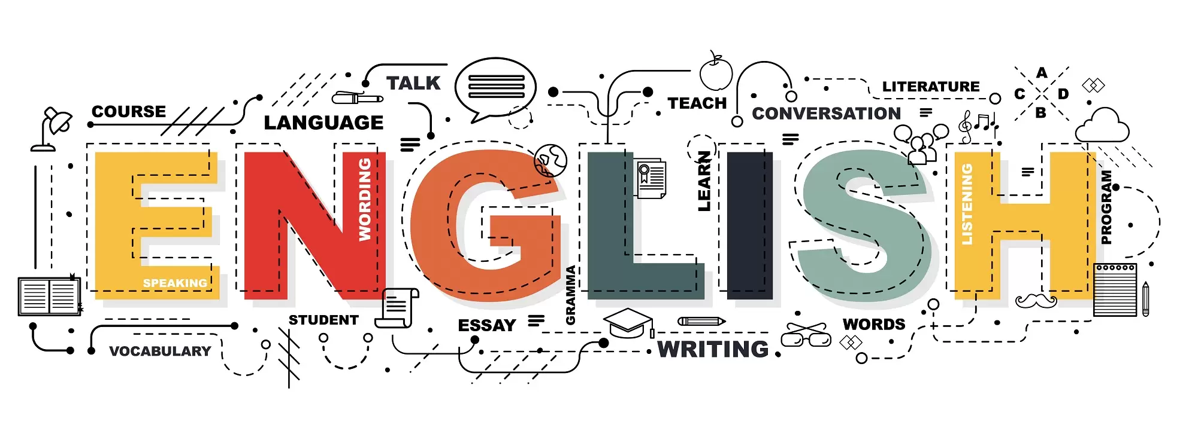

Criteria/Criterios
English/ inglés
Language Other than English (LOTE)
Requisitos para otros idiomas
en adición al inglés
Notes:
30 sec
To earn the 8th grade Pathway Award, students must fulfill both the English and LOTE requirements.

Slide 20


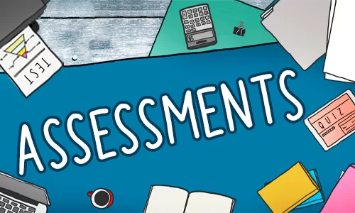
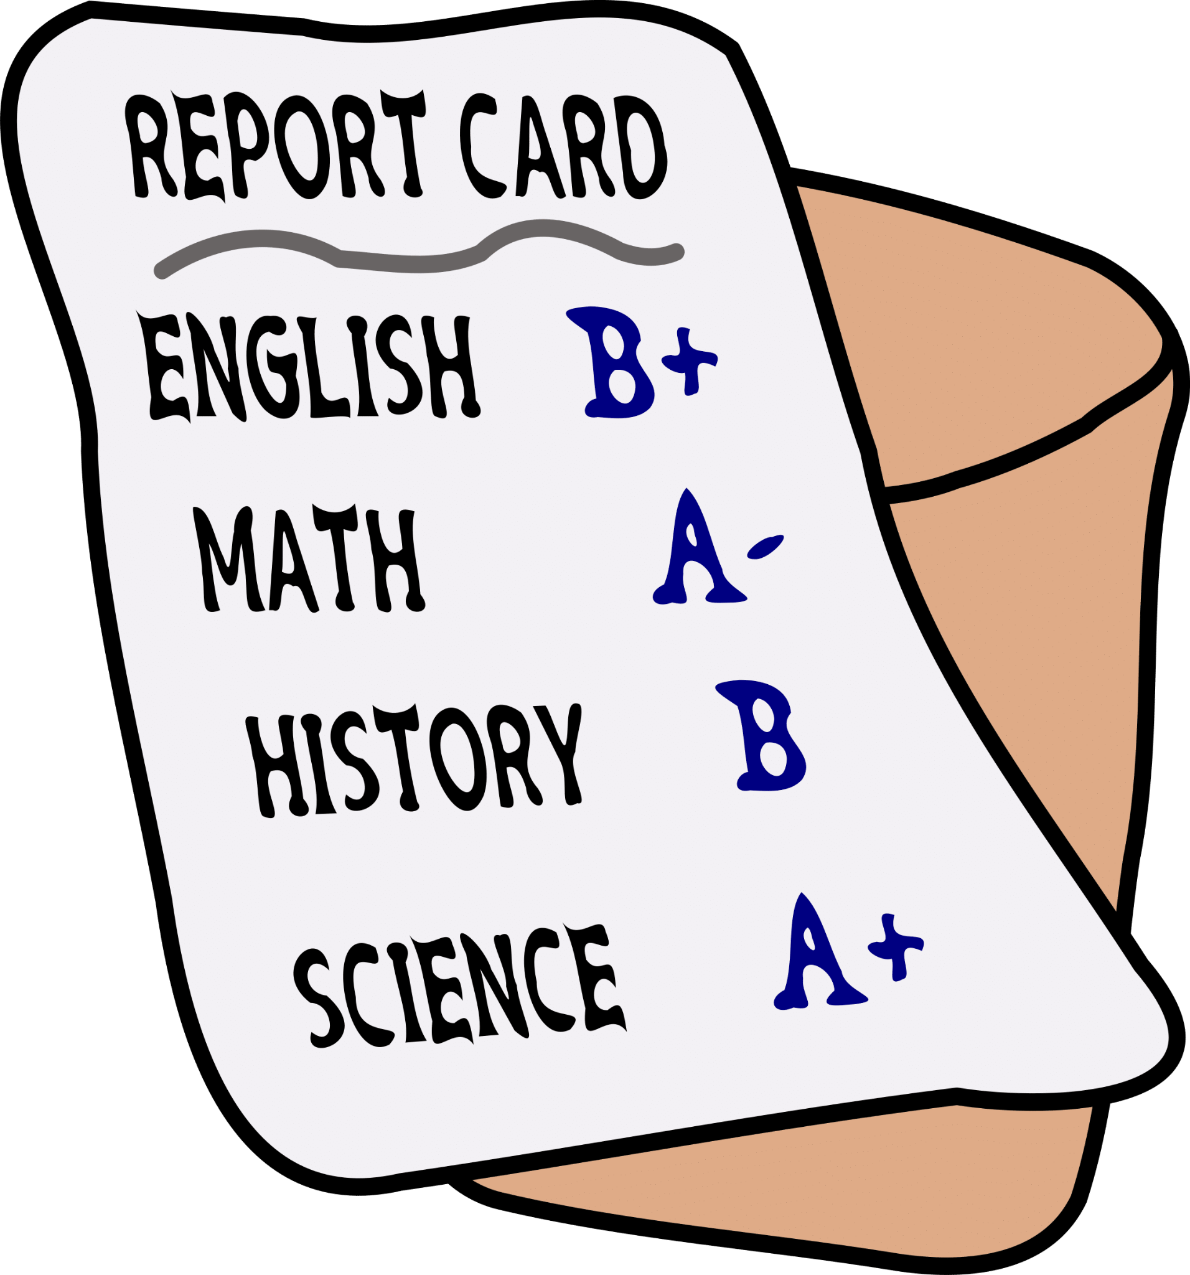
For Both English & LOTE
Notes:
30 sec
For both English and LOTE requirements. These requirements can be met either by completing the necessary coursework or by passing the appropriate assessments.

Slide 21



English Criteria - Coursework
Grade B or above in 8th grade ELA or ELD course
for both semesters
Notes:
1 min
To meet the English criteria through coursework, students must receive a grade of B or above in English language arts for both semesters. Students who are learning English at this time and taking an English development class, they can qualify if they earn a B in your English development class. The key word here is the Grade B or above in both semesters.

Slide 22
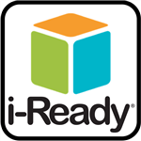




English Criteria - Assessments
Criterios- Evaluaciones
SBA or CA Alternate Assessment (last year’s scores) - Standards Met
BOY or MOY score of 583 or higher
ELPAC or
Alternate ELPAC (last year’s scores)
Score 3 or higher
Notes:
1 min
If a student doesn’t receive a grade B or above in your 8th grade English or ELD class, he/she can still meet the requirements by passing one of the assessment options
If a student Scores 594 or higher on the Beginning-of-the-Year (BOY) or Middle-of-the-Year (MOY) i-Ready Reading Diagnostic ELA assessment.
Also if a student received Standards Met on the last year’s SBA (Smart Balanced Assessment)/CA Alternate Assessments
For english learning student - if he/she took ELPAC last year and scored 3 or above in the last year’s ELPAC/Alternate ELPAC, the student met English requirement.
So if the students have met one of the options that i spoke about, the students are one step closer to earning the Pathway Award in the 8th grade.
Link to 8th grade Pathway Award Criteria: https://drive.google.com/file/d/1LaPJ_xJCZ_RSMQuVmFa4mawDqYiawNar/view?usp=sharing

Slide 23
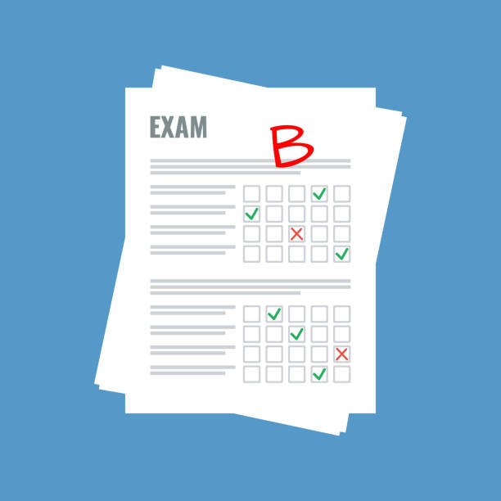
LOTE Criteria - Coursework
Requisitos para otros idiomas en adición al inglés
1 year of LOTE course (Gr. 6th or 7th)
Grade B or above in the final semester
8th grade LOTE course
Grade B or above for both semesters
Notes:
1 min
In previous slides, we went over the English requirements for the Pathway Award. Now, let’s talk about the LOTE, or Language Other Than English, requirements.
There are a few ways students can meet this requirement. One option is to complete a full year of a LOTE course with a final grade of ‘B’ or better.
If you’re taking a LOTE course for the first time this year in 8th grade, you’ll need to keep a ‘B’ or higher in both semesters. If a student is currently taking a LOTE course, focus on getting a ‘B’ or better this semester, and next semester.
In the spring, your child’s counselors will check his/her progress with the 10-week Midterm Report for the second semester.

Slide 24



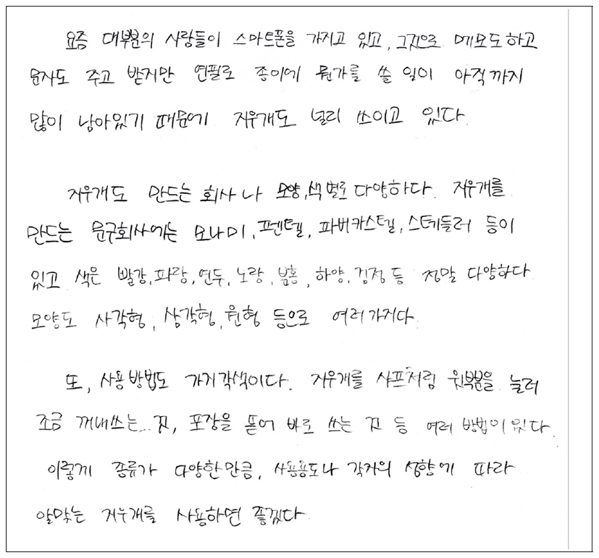
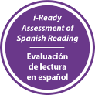
LOTE Criteria - Assessments
Pass Speaking OR Reading OR Writing
Pass MMED 8th Grade Essay Writing
LAUSD approved assessment
Assessment of Spanish Reading (ASR)- Partially Met (BOY or MOY)
Notes:
1 min
Another option to fulfill the LOTE requirement is by meeting one of the following criteria:
You can pass a district-approved assessment, such as an essay writing assessment, which will be scored using the MMED rubric. OR
you can pass one of the three domains—speaking, reading, or writing—on the AVANT assessment, which is also district-approved.
If you are a Spanish speaker,
Achieve a "Partially Met" score on the i-Ready Spanish Reading Assessment.

Slide 25

LOTE Criteria - Writing Assessments
Requisitos para otros idiomas en adición al inglés
Ejemplos de evaluaciones de escritura
SAMPLE WRITING TASKS
Write out a plan of what you want to do with family friends visiting from Guatemala. (Think about your community or city and where you would take them).
Write an email to a friend in Korea about simple everyday problems that you have at school and at home. Find out if they have the same problems where they are. (School)
Create an advertisement for your favorite invention–real or imagined. What does it do? What do you like about it? (Subjects)
Pass MMED 8th Grade Essay Writing
Notes:
1 min
If the student decides to take a MMED essay writing in LOTE, here are some sample writing tasks.
Write out a plan of what you want to do with family friends visiting from Guatemala. (Think about your community or city and where you would take them).
Write an email to a friend in Korea about simple everyday problems that you have at school and at home. Find out if they have the same problems where they are. (School)
Create an advertisement for your favorite invention–real or imagined. What does it do? What do you like about it? (Subjects)

Slide 26
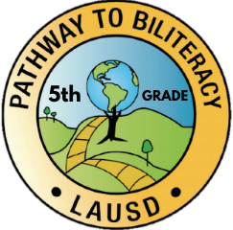
8th Grade Student Writing Self-Assessment
Rúbrica de escritura para 8º grado
5 | 4 | 3 | 2 | 1
Intermediate High | Intermediate Mid | Intermediate Low | Novice-High | Novice-Mid
I can write information on familiar and everyday topics using more than one paragraphs(min of 5 sentences). | I can write information on familiar and everyday topics using sentences and paragraphs(min of 5 sentences). | I can write information on familiar and everyday topics using simple sentences . (5 sentences). | I can write information on familiar and everyday topics using phrases and some simple sentences. | I can write information on familiar and everyday topics using a variety of practiced or memorized words or phrases.
Passing for Category I: 4+ Dutch, French, Italian, Norwegian, Portuguese, Romanian, Swedish, and Spanish. Passing for Category II- IV Languages: 3+ All Other Languages Rubric adapted from: ACTFL Can-Do Statements
Notes:
1 min
If you choose the MMED essay writing option, you’ll be asked to write an essay in response to a specific prompt in the target language. The passing score varies by language category.
A passing score for Category I languages would be 4 or higher. And Category I languages are Dutch, French, Italian, Norwegian, Portuguese, Romanian, Swedish, and Spanish.
All other languages fall under the other categories and would pass with a 3 or higher on the rubric.

Slide 27

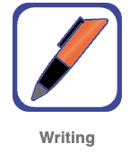
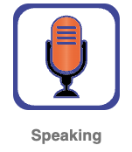
LOTE Criteria - Avant Assessments
LOTE Criteria - Assessments
LAUSD approved assessment
TEXT/ FUNCTIONS/COMPLEXITY
STAMP Level 4 - Strings of sentences with some added detail. Enhanced by the use of prepositional phrases, adverbs, etc.
STAMP Level 3 - Simple sentences. Simple structures and functions of the language.
Passing for Category I: 4+ Dutch, French, Italian, Norwegian, Portuguese, Romanian, Swedish, and Spanish.
Passing for Category II- IV Languages: 3+ All Other Languages
Notes:
1 min
Another option to fulfill LOTE criteria is taking LAUSD approved assessment called AVANT.
The student can chose to take one of the following domains - speaking or reading or writing. These are the number levels assigned by AVANT, which relate to the ACTFL scale. For the purposes of this award, students who assess in Category I languages must meet a STAMP Level 4 or above to meet the criteria and all other languages a STAMP Level 3 or above.

Slide 28

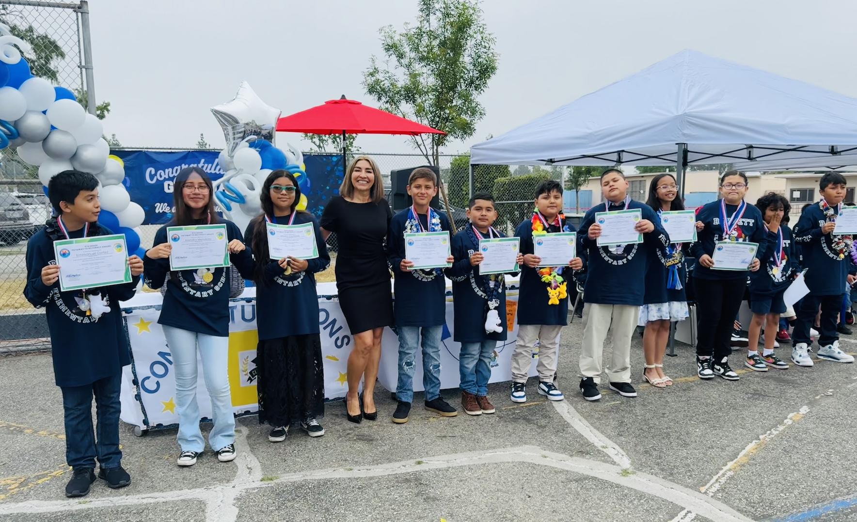
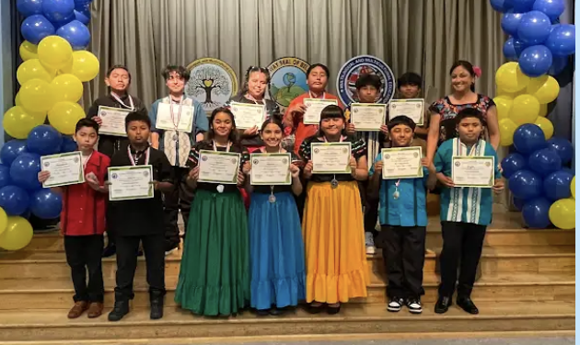
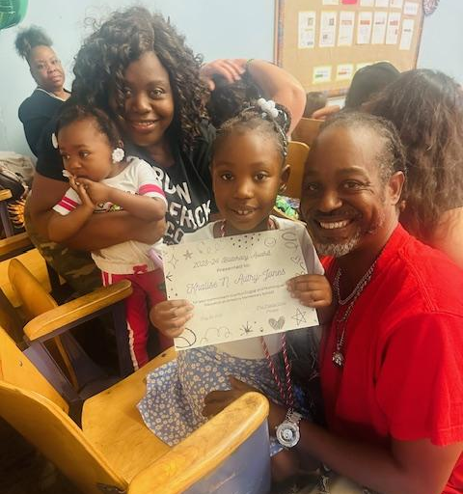
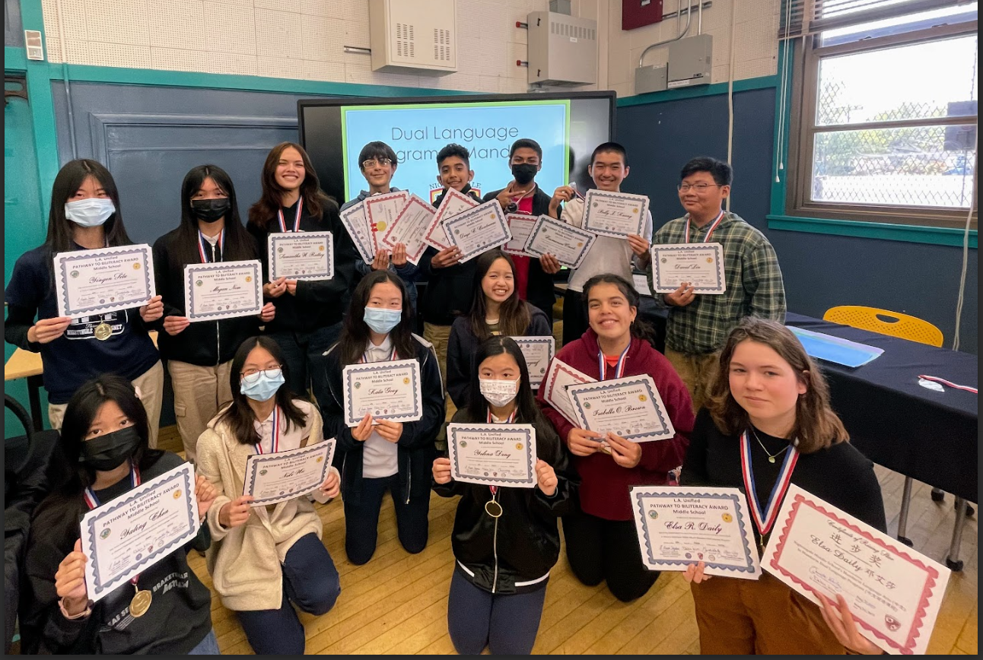
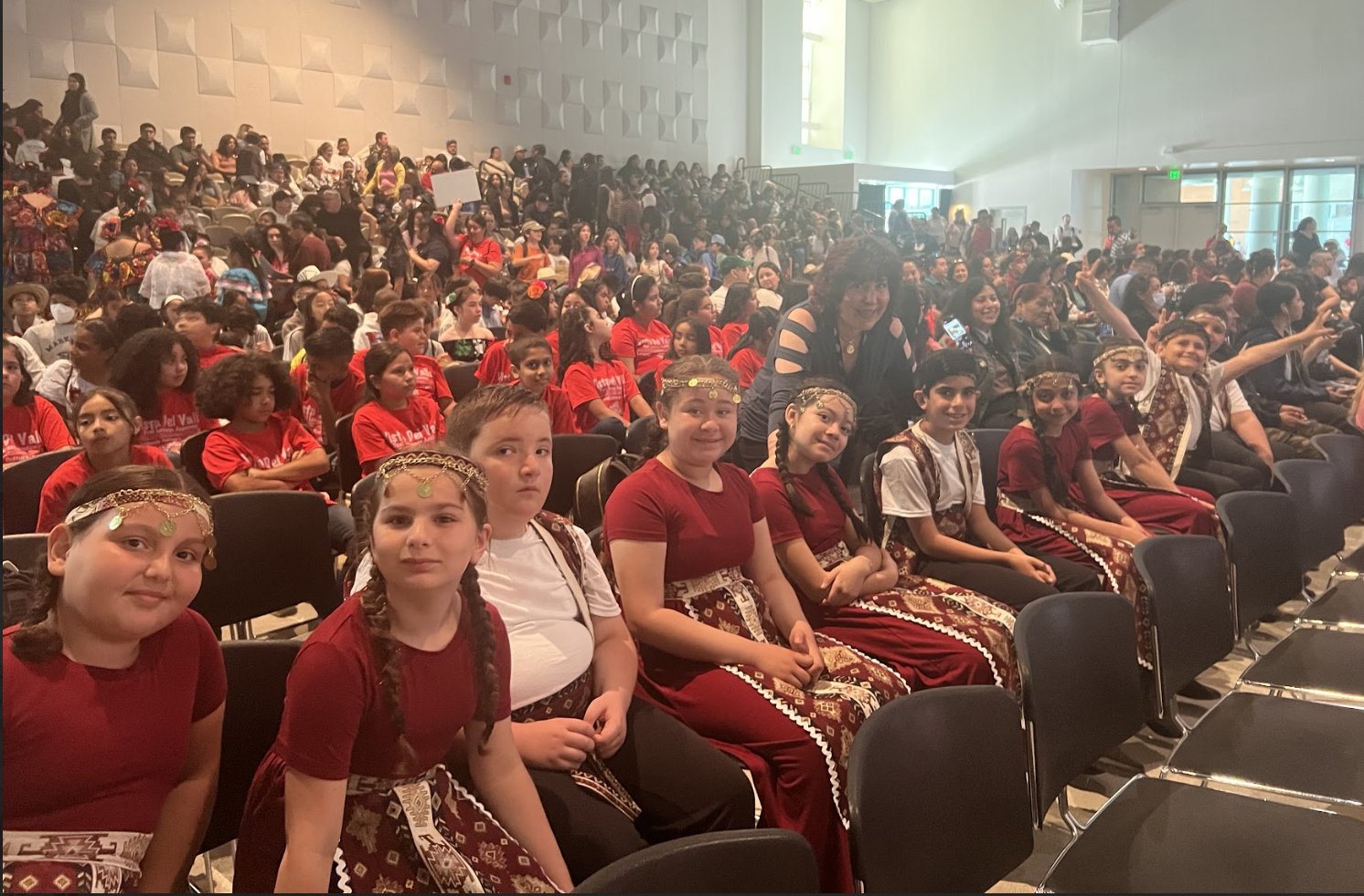
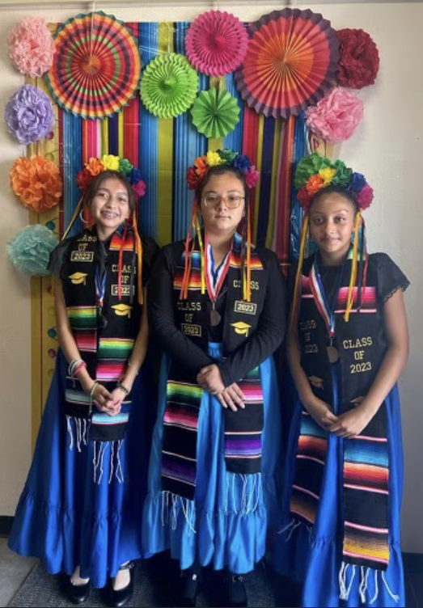
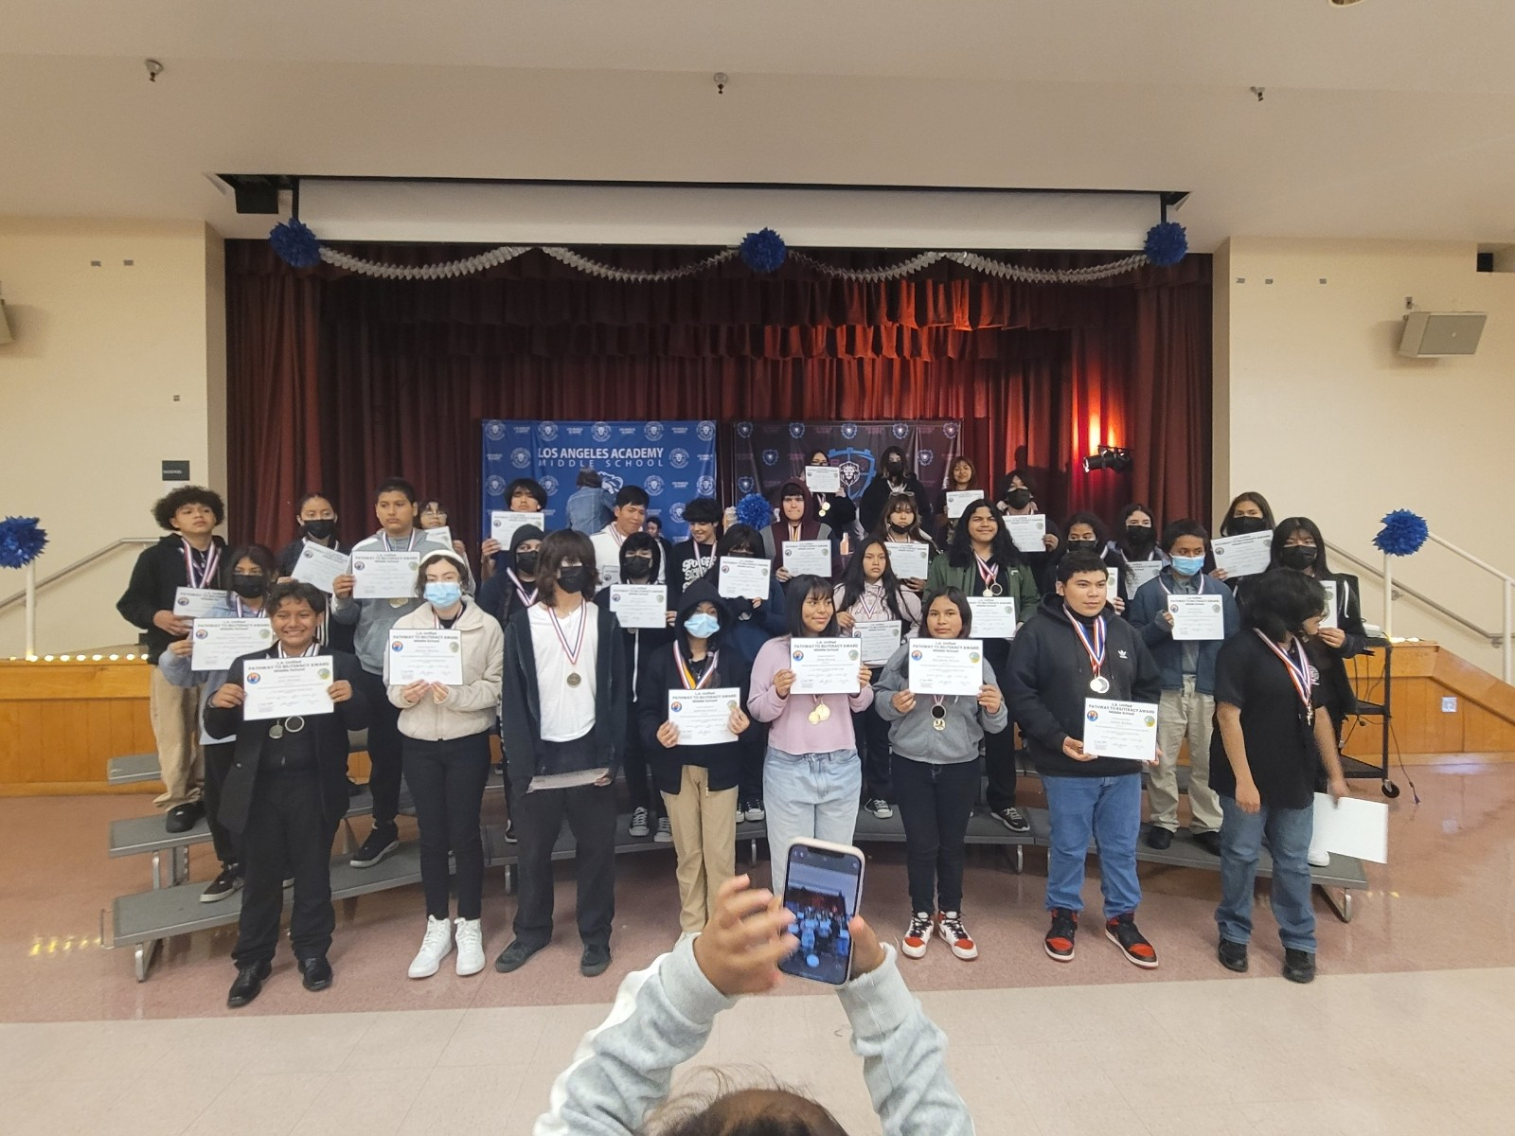

Celebrating the Pathway to Multiliteracy
Celebrando el camino hacia la multiliteracidad
Мы многоязычны
Մենք բազմալեզու խոսնակներ ենք
Bilingual Tayo
우리는 이중 언어를 구사합니다
Honoring culture, celebrating linguistic gifts, preserving culture,
valuing students’ multilingual assets
Honrar la cultura, celebrar las riqueza lingüísticas, preservar la cultura,
valorar los fondos multilingües de los estudiantes.
Notes:
Time: 2 minutes
Say: We are so excited to showcase and celebrate a few of our multilingual students who have been recognized at our schools. As you can see from colorful display of celebrations in this slide, it is a celebration of their multilingual journey. We will watch a short video of a 1st grade student from Amestoy ES who is being recognized for their multilingual proficiency in multiple languages, Japanese and Spanish.
We invite you to be part of this call to advocacy and celebration of recognition! Thank you for being part of this movement.

Slide 29

Questions about 8th Grade Requirements?
¿Preguntas sobre los requisitos de 8º?

Slide 30
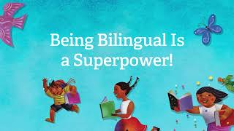

Slide 31

Family Supports
Ideas for at-home support:
Read Books Together
Leverage Family Members to Practice Language
Create a Safe Space...It Doesn’t Have to Be Perfect
Listen to Bilingual Books on Youtube
Use Rosetta Stone or other online programs/apps
Listen to Music in other languages
Watch Videos in other languages
Notes:
Here are various ways that families can support with language development for one or more languages in addition to English.
READ SLIDE…
Share childhood memories; actively listen to multilingual songs, kid friendly
jokes, riddles, tongue-twisters, news, cartoons, stories, radio, take a virtual
tour, and engage in conversations about their connections to other
languages and cultures.
Have a conversation about… and how might this be stated in another
language?
○ Some details you remember
○ The main idea of the story
○ Something new you learned
○ How this connects to who you are
○ How the topics connect to other languages
and cultures
If you don’t have a DL courses at your school, work with your school community for future program implementation.
Aquí hay varias formas en que las familias pueden apoyar el desarrollo del lenguaje para uno o más idiomas además del inglés en casa.
Si no tiene Programa de Lenguaje Dual en su escuela, trabaje con su comunidad escolar para implementar el programa en el futuro.

Slide 32

Literacy Family Resources
A Multilingual Journey to Pathway Awards
Home and Community
Support Resources
Recursos de lectoescritura para familias
Un camino al multilingüismo hacia los premios
Hogar y comunidad
Recursos de apoyo
Notes:
Welcome School Leaders. Today we will discuss the importance of strategic instructional planning using the Adjusted Blueprints and Priority Standards. By closely examining the Adjusted Blueprints, we gain a detailed roadmap of the key concepts and skills assessed in the Smarter Balanced Assessment (SBA). This insight allows us to prioritize and focus on the critical Priority Standards that align with our educational goals. Through strategic planning, we can ensure that our teachers are dedicating time and resources to the most essential content areas, maximizing the impact of our instructional efforts. This approach not only aligns with assessment requirements but also provides a targeted focus on student mastery of priority skills, setting the stage for academic success.

Slide 33

Your Community and Home as a Resource!
¡Su comunidad y su hogar como recurso!
Describe objects in more than 1 language at the grocery store, restaurant, laundromat, bakeries, Target…
Write recipes, thank you letters, announcements and party invitations in multiple languages
Watch a kid-friendly show in another language
Share stories
Sing songs
¡Describa los objetos en más de 1 idioma en el supermercado, restaurante, lavandería, panaderías, Target…
Escriba recetas, cartas de agradecimiento, anuncios e invitaciones a fiestas en varios idiomas.
Mire un programa para niños en otros idiomas
Compartir historias
Cantar canciones

Slide 34
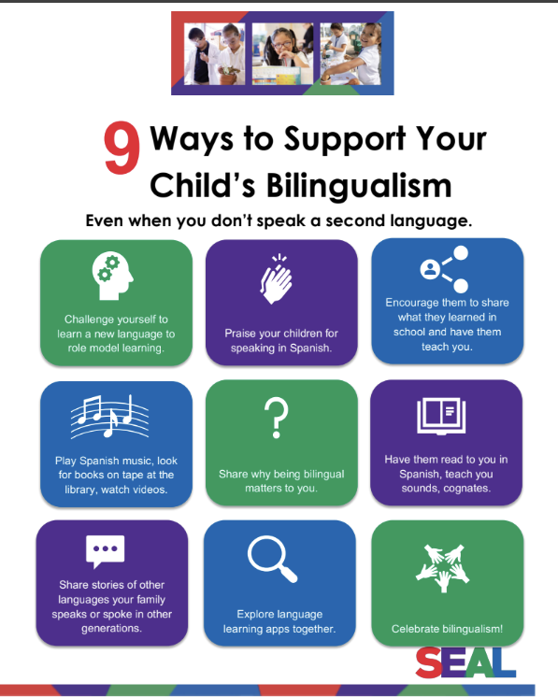
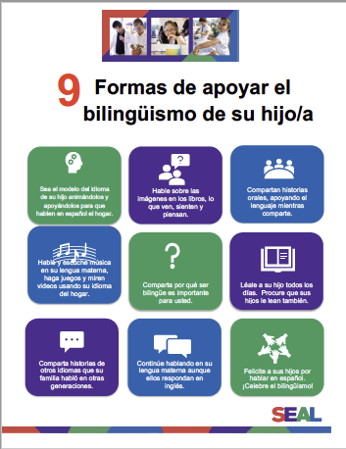
Supporting Your Child’s Bilingualism
Apoyando el bilingüismo de su hijo
Notes:
Say: Here are some ways you can support your child’s journey to multilingualism back at home.
Challenge yourself to learn a new language to role model learning.
Praise your children for speaking in Spanish.
Encourage them to share what they learned in school and have them teach you.
Play Spanish music, look for books on tape at the library, watch videos.
Share why being bilingual matters to you.
Have them read to you in Spanish, teach you sounds, cognates.
Share stories of other languages your family speaks or spoke in other generations.
Explore language learning apps together.
Celebrate bilingualism!

Slide 35
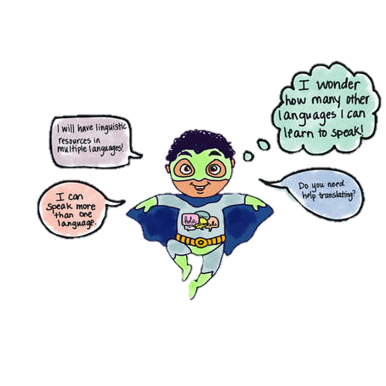

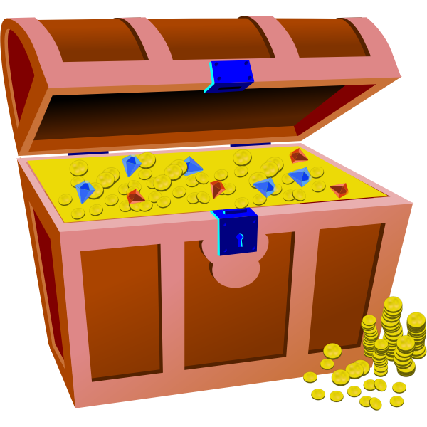
Multilingual Literacy Home Support
Shared moments at home that can strengthen multilingual superpowers!
Please click on images and titles of websites to reveal link to websites and additional external resources!
Apoyo de lectoescritura multilingüe
¡Momentos compartidos en casa que pueden fortalecer los superpoderes multilingües!
Haga clic en las imágenes y los títulos de los sitios web para revelar enlaces a sitios web y recursos externos adicionales.
Notes:
Link to Literacy Family Supports 2024-2025: https://docs.google.com/presentation/d/18LIR9c0zGwk-dFVRKRgabbF4_cj07vOh/edit?usp=sharing&ouid=111643500403429059579&rtpof=true&sd=true
We wanted to share with you various home experiences and supports that you can begin to do with your kids to prepare for this multilingual world that is here! Any little step you might take to bring multilingualism into your home is a testament to the love and pride you have for your kids, and in the beliefs that they are limitless and have boundless potential! Let’s explore some ways to support multilingualism at home! We will begin by thinking about experiences that will not require a lot of technology or any at all, and also to emphasize that learning another language is more than just vocabulary and learning phrases here and there. “Language is not just words”. Next slide.

Slide 36

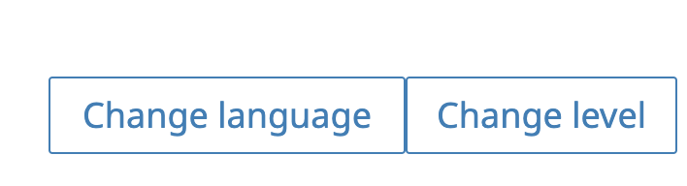
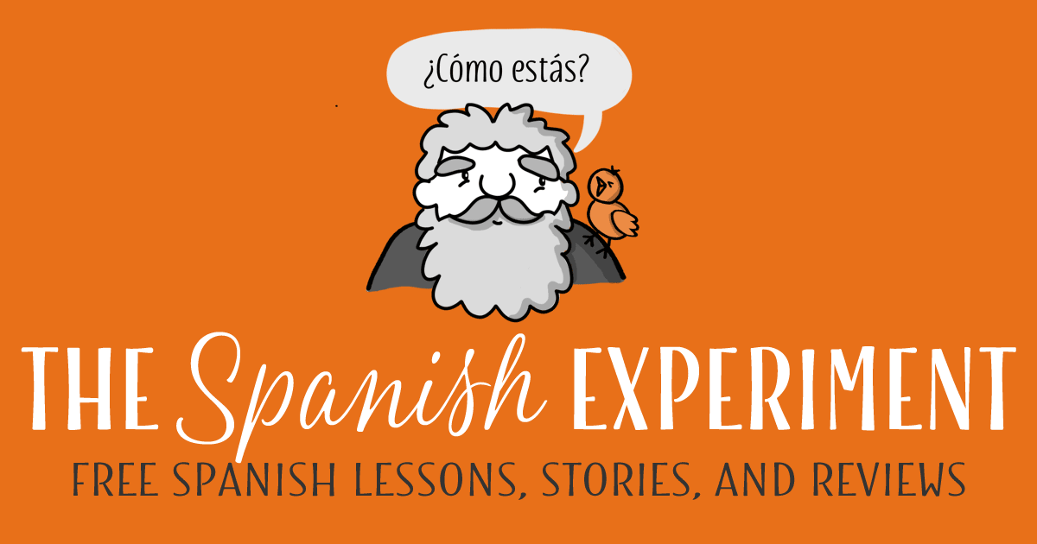
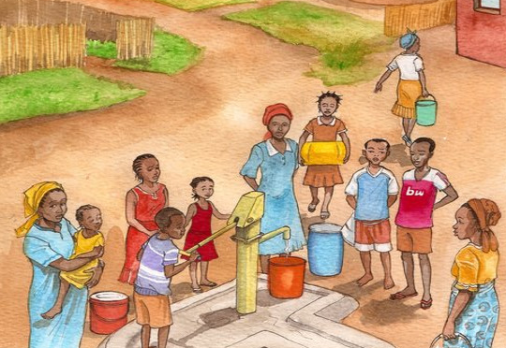



Spanish Resources/Recursos en español
Epic
Lea cuentos y lecciones en español.
Read children’s stories and lessons in Spanish at The Spanish Experiment.
Storybooks Canada
Access SORA by using parent’s or students’ Schoology credentials.
Utilice SORA a través de Schoology con la contraseña de estudiante o padre.
Access the Epic digital library and follow progress with reading activities!
Utilice EPIC, una biblioteca digital.
Notes:
Time: 30 seconds
Say: Here are our Spanish resources

Slide 37




Armenian Resources/Recursos armenios
Dino Lingo Armenian Books for Kids | Access Armenian literature through SORA by using parent’s or students’ Schoology credentials.
Pokrik Armenian Children's Literature | Erexa.am Children’s Literature
Notes:
Time: 30 seconds
Say: Here are our Armenian resources
Link to Sora: https://company.overdrive.com/lausd-for-students/

Slide 38




Korean Resources/Recursos coreanos
Access SORA by using parent’s or students’ Schoology credentials.
https://storybookscanada.ca/stories/ko/
https://m.sc.or.kr/happy2/bookDown.do
https://ridibooks.com/category/free-books/1320
Notes:
Time: 30 seconds
Say: Here are our Korean resources

Slide 39






Mandarin Resources/Recursos mandarín
Storybooks for Learning Chinese
Quick Chinese Lessons
Dudu, Leveled Story Books

Slide 40




Filipino Resources/Recursos filipinos

Slide 41


French Resources/Recursos franceses
Free Kids Books - French | Storybooks Canada
French stories and Literature
Storybooks Canada is a free open educational resource that promotes literacy and language learning in homes, schools, and communities. Select from a large selection of languages.
Storybooks Canada es un recurso educativo abierto y gratuito que promueve la alfabetización y el aprendizaje de idiomas en hogares, escuelas y comunidades. Seleccione entre una gran selección de idiomas.

Slide 42



Various Languages Resources/Recursos en varios idiomas
 | Farsi Children’s Literature Access SORA by using parent’s or students’ Schoology credentials. Utilizar SORA utilizando las credenciales de Schoology de padres o estudiantes.
German & French Literature
Access the Epic digital library and follow progress with reading activities!
¡Utilizar a la biblioteca digital de Epic y siga el progreso con las actividades de lectura!

Slide 43
K’iche’ Resources/Recursos en K’iche’
20 animals in K’iche’ Language Course: A Beginner to Advanced Level K'iche' Online Course Audio Dictionary: K’iche’ – Spanish (Swarthmore Univ) Illustrated Bilingual Dictionary: SPN - K’ICHE’ Counting 1-10 in K’iche’ Numbers 0 -20 in K’iche’ Maya K’iche’ phrase book Living Maya Time Loteria
For your information-K’iche’ is primary an oral language.
Notes:
K’iche’ is primary an oral language.
Zapotec

Slide 44

Global Storybooks is a free multilingual literacy resource for language teachers and learners of all ages. Read, teach, download, and listen to illustrated stories in many languages. Check out our featured sites, language teaching resources, and community projects. To learn more, see our FAQ and video.
Global Storybooks Portal
Notes:
Link to Global Storybooks Portal: https://globalstorybooks.net/

Slide 45

International Children’s Digital Library
Notes:
Drop in Chat: http://www.childrenslibrary.org/library/books_by_language.html

Slide 46







Supports from the LA Public Library/
Apoyos de la Biblioteca Pública de Los Ángeles
Free!
Physical and Electronic Cards are both available!
Notes:
Time: 1 minute
Link to LA Public Library: https://www.lapl.org/
Link to LA Public Library Card Application: https://www.lapl.org/sites/default/files/media/pdf/about/Library_Card_App.pdf
Download the library card application, fill it out, and then take it into any LA Public Library location
E-card Registration: https://www.lapl.org/about-lapl/contact-us/e-card/e-card-registration
E-Card Registration en Español: https://www.lapl.org/about-lapl/contact-us/e-card/solicitud-tarjeta-electronica

Slide 47
















Learning Library on Sora/
Biblioteca de aprendizaje en Sora
The LAUSD Learning Library on Sora is the quickest and easiest way to read digital books. LAUSD students and staff can log in using their SSO and instantly access hundreds of ebooks and audiobooks on virtually any device, for FREE. We have ebooks and audiobooks in Korean, Mandarin, Russian, Spanish, Arabic, and French. For more information, click HERE.
Thousands of great reads are waiting for you in the LAUSD Learning Library on Sora. Open all day, everyday.
Notes:
Time: 2 minutes
Say: The LAUSD Learning library is the quickest and easiest way to read digital books. LAUSD students, family members and staff can use their single sign on to instantly access hundreds of ebooks and audiobooks.

Slide 48










Notes:
2 minutes
Say: What are some ways to support your child to keep up and maintain their target language?
Reading an age-appropriate book (fiction or nonfiction), story, comic, recipe, magazine, or other text in the target language, including reading to a younger child in the home language,
Writing a story, poem, or letter in the target language, keeping a journal in the home language, write to another family member in the target language or create a comic for a younger sibling
Teaching a sibling a game in the home language, telling a story in the target language, explaining what they learned in school that day in the target language, talking on the phone with a relative in the home language, interviewing an older relative in the target language
listening to a story in the home language; interviewing an older relative in the home language; listening to the radio, songs, a movie, or television program in the home language and discussing it afterwards; listening to a speech or sermon in the home language
These are ALL different ways that you can engage your linguistic superpowers.

Slide 49
Next Steps
How are you going to help your child earn the award and stay on the Pathway to Biliteracy to strengthen their multilingual super powers?
Próximos pasos
¿Cómo va a ayudar a su hijo/a a obtener el premio y permanecer en el camino hacia la biliteracidad para fortalecer sus superpoderes multilingües?
Notes:
a parent interested in your child earning the award:
Let your child’s teacher know that your child speaks more than one language, if you’re not in a Dual Language program.
Ask if your child’s school already has a Pathway to Biliteracy Committee and remember: parents may volunteer to be a part of it to support.
Continue to support your child with language at home.

Slide 50



Don’t Forget to…
No olvides…
Inform your child’s counselor that they have multilingual superpowers! ¡Informe al maestro de su hijo/a que tiene superpoderes multilingües! | Engage your child with fun multilingual activities: Go on a word hunt around your community Write family recipes, letters, thank you cards Involucra a tu hijo/a con divertidas actividades multilingües: Realice una búsqueda de palabras en su comunidad Escribe recetas familiares, cartas, tarjetas de agradecimiento. | Ask your school leadership about Pathway Awards process? Pregunte a los líderes de su escuela sobre el proceso de recibir los Premios en 3º

Slide 51
Questions about 8th Grade Requirements?
¿Preguntas sobre los requisitos
de 8º?

Slide 52

MMED Dual Language & World Languages Team Contact Information
Información de contacto: Equipo MMED,
Educación de lenguaje dual e Idiomas mundiales
UTK-1st Promise to Bilingualism Promesa al bilingüismo | Aram Davtyan, DLE Specialist | aram.davtyan@lausd.net | (213) 241-2042
3rd Grade Pathway to Biliteracy, Camino a la biliteracidad | Blanca Valle-Alvarado, DLE Specialist | bvalle@lausd.net | (213) 241-4172
5/6th Grade Pathway to Biliteracy, Camino a la biliteracidad | Blanca Valle-Alvarado, DLE Specialist | bvalle@lausd.net | (213) 241-4172
8th Grade Pathway to Biliteracy, Camino a la biliteracidad | Elise Kim, DLE Specialist | elise.kim@lausd.net | (213) 241-5582
12th Grade SEALS of Biliteracy, Sellos de la biliteracidad | Youssef Mossadaq, WLC Coordinator | yxm9573@lausd.net | (213) 241-4517
Notes:
Time: 1 min
Read Slide

Slide 53



