Slide 1



Literacy Family Resources
A Multilingual Journey to Pathway Awards
Home Support Resources
Recursos de lectoescritura para familias
Un camino al multilingüismo hacia los premios
Recursos de apoyo para el hogar y comunidad
Notes:
Welcome School Leaders. Today we will discuss the importance of strategic instructional planning using the Adjusted Blueprints and Priority Standards. By closely examining the Adjusted Blueprints, we gain a detailed roadmap of the key concepts and skills assessed in the Smarter Balanced Assessment (SBA). This insight allows us to prioritize and focus on the critical Priority Standards that align with our educational goals. Through strategic planning, we can ensure that our teachers are dedicating time and resources to the most essential content areas, maximizing the impact of our instructional efforts. This approach not only aligns with assessment requirements but also provides a targeted focus on student mastery of priority skills, setting the stage for academic success.

Slide 2
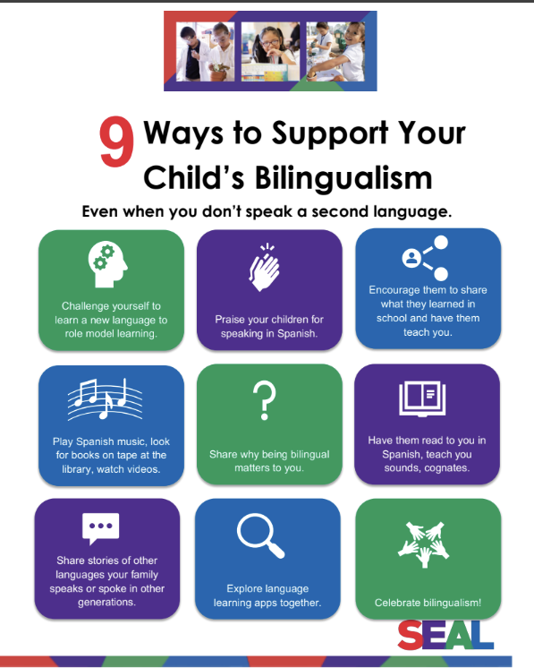
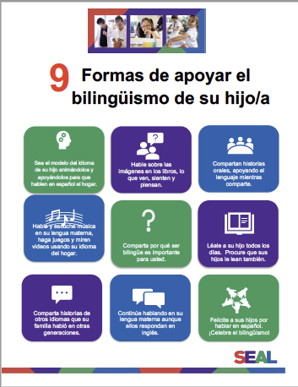

Supporting Your Child’s Bilingualism
Apoyando el bilingüismo de su hijo
Notes:
Say: Here are some ways you can support your child’s journey to multilingualism back at home.
PDF English 9 Ways to Child’s Bilingualism: https://drive.google.com/file/d/1CFtcHU124RqAngfHkZNISNn_o-wJwmhb/view?usp=sharing
PDF Spaniish 9 Formas de apoyar el bilingüismo de su hijo/a: https://drive.google.com/file/d/1X4A500RcG-BApaHq2exNqVWF6dg8c7Mn/view?usp=sharing

Slide 3
Table of Contents
Armenian Resources | Slide #5
Filipino Resources | Slide #6
French Resources | Slide #7
K’itche’ | Slide #8
Korean Resources | Slide #9
Mandarin Resources | Slide #10
Spanish Resources | Slide #11
Various Other Languages | Slide #12-13
Learning Library Resource-SORA | Slide #14
Los Angeles Public Library Resource | Slide #15
UTK-1st Grade Tips for Success | Slide #16-17
Grades 3, 5/ Tips for Success | Slide #18-21
Grades 8, 12 Tips for Success | Slide #22-24

Slide 4
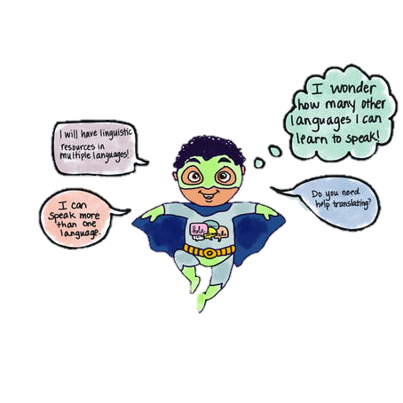
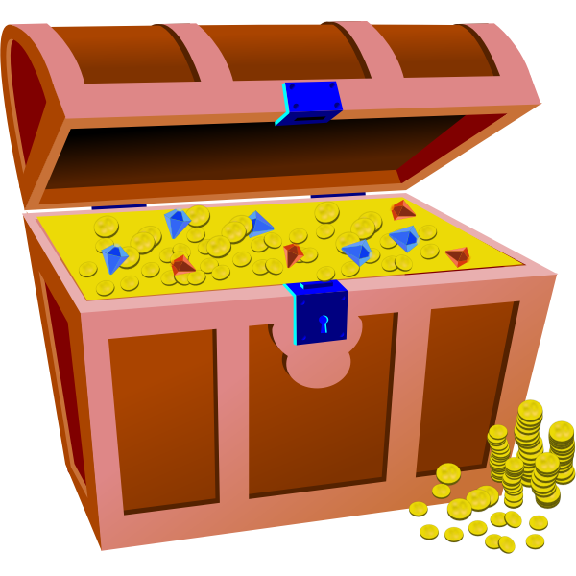
Multilingual Literacy Home Support
Shared moments at home that can strengthen multilingual superpowers!
Please click on images and titles of websites to reveal link to websites and additional external resources!
Apoyo de lectoescritura multilingüe
¡Momentos compartidos en casa que pueden fortalecer los superpoderes multilingües!
Haga clic en las imágenes y los títulos de los sitios web para revelar enlaces a sitios web y recursos externos adicionales.
Notes:
11:15 - 11:15 am
Thank you for being here families on behalf of your children. We wanted to share with you various home experiences and supports that you can begin to do with your kids to prepare for this multilingual world that is here! Any little step you might take to bring multilingualism into your home is a testament to the love and pride you have for your kids, and in the beliefs that they are limitless and have boundless potential! Let’s explore some ways to support multilingualism at home! We will begin by thinking about experiences that will not require a lot of technology or any at all, and also to emphasize that learning another language is more than just vocabulary and learning phrases here and there. “Language is not just words”. Next slide.
Link to Literacy Family Supports 2024-2025: https://docs.google.com/presentation/d/1bAbmVOraCXxJwbE1LlT-YFWl6I419kp-/edit?usp=sharing&ouid=114560927774420752133&rtpof=true&sd=true

Slide 5

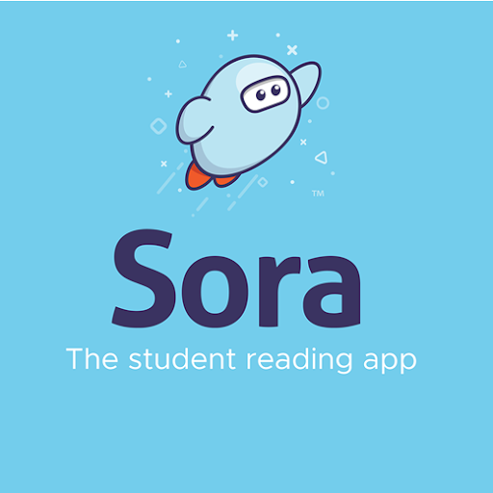

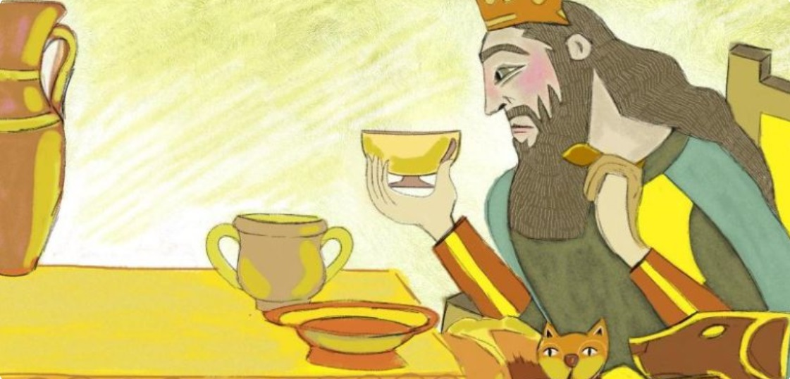
Armenian Resources
Dino Lingo Armenian Books for Kids | Access Armenian literature through SORA by using parent’s or students’ Schoology credentials.
Pokrik Armenian Children's Literature | Erexa.am Children’s Literature

Slide 6



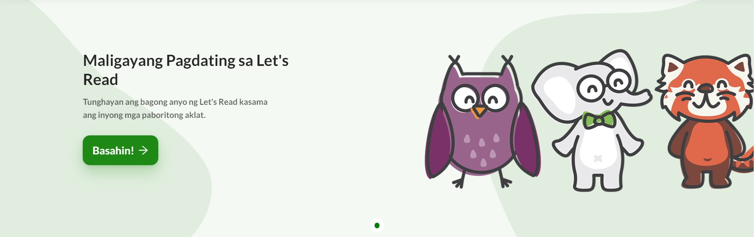
Filipino Resources/Recursos filipinos

Slide 7


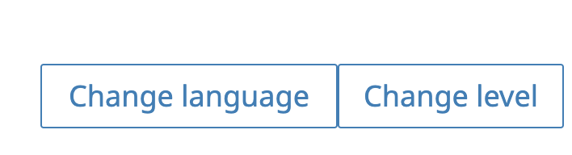

French Resources/Recursos franceses
Free Kids Books - French | Storybooks Canada
French stories and Literature
Storybooks Canada is a free open educational resource that promotes literacy and language learning in homes, schools, and communities. Select from a large selection of languages.
Storybooks Canada es un recurso educativo abierto y gratuito que promueve la alfabetización y el aprendizaje de idiomas en hogares, escuelas y comunidades. Seleccione entre una gran selección de idiomas.

Slide 8
K’iche’ Resources
Home-based learning infographics for parents in K’iche’ | English | Spanish The K'iche’ Alphabet 20 animals in K’iche’ Language Course: A Beginner to Advanced Level K'iche' Online Course Audio Dictionary: K’iche’ – Spanish (Swarthmore Univ) Illustrated Bilingual Dictionary: SPN - K’ICHE’ Counting 1-10 in K’iche’ Numbers 0 -20 in K’iche’ Maya K’iche’ phrase book Living Maya Time Loteria Normative Grammar of the K'iche' Language/Gramática Normativa del Idioma K´iche´/KEMTAQANIK K´ICHE´TZIJ
For your information-K’iche’ is primary an oral language.
Notes:
K’iche’ is primary an oral language.
Zapotec

Slide 9



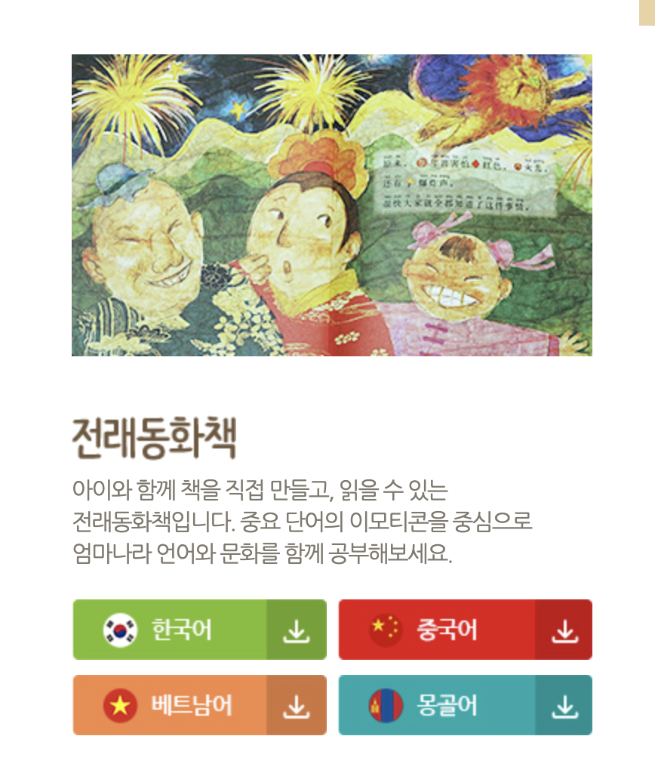

Korean Resources
Access SORA by using parent’s or students’ Schoology credentials.
https://storybookscanada.ca/stories/ko/
https://m.sc.or.kr/happy2/bookDown.do
https://ridibooks.com/category/free-books/1320

Slide 10

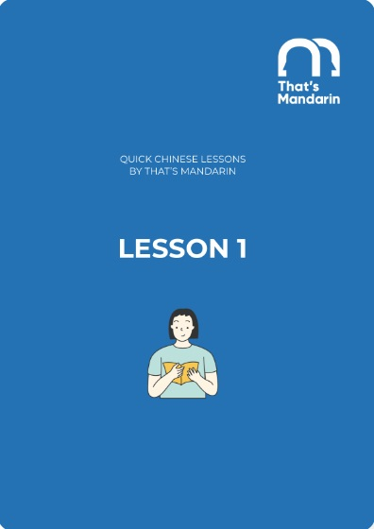




Mandarin Resources/Recursos mandarín
Storybooks for Learning Chinese
Quick Chinese Lessons
Dudu, Leveled Story Books
Notes:
Blanca

Slide 11

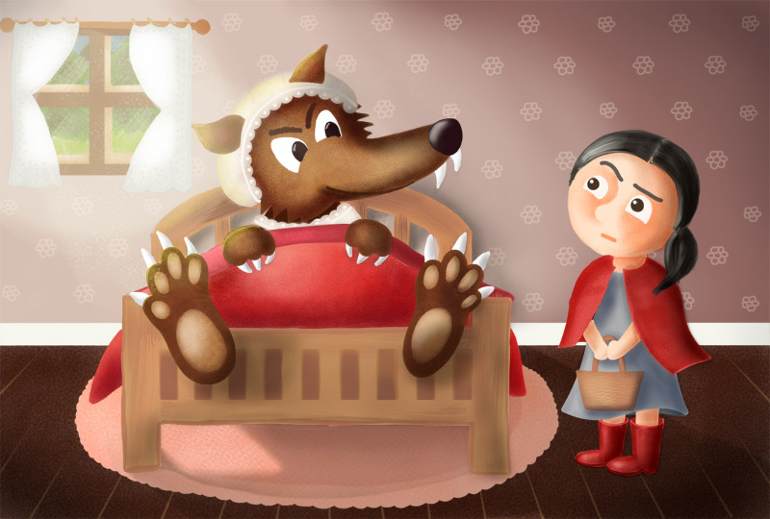
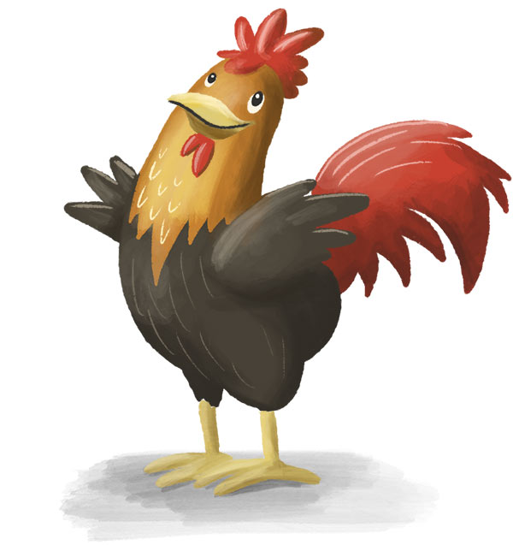
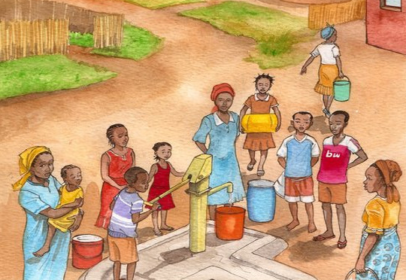

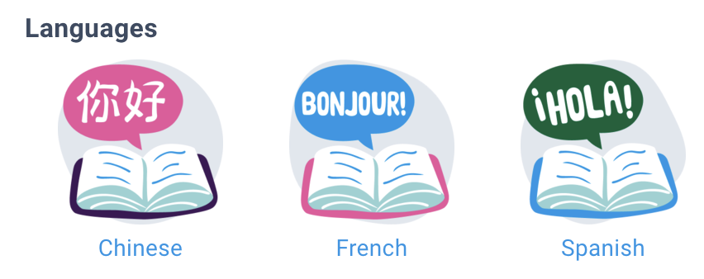
Spanish Resources
Epic
Read children’s stories and lessons in Spanish at The Spanish Experiment.
Storybooks Canada
Access SORA by using parent’s or students’ Schoology credentials.
Access the Epic digital library and follow progress with reading activities!

Slide 12

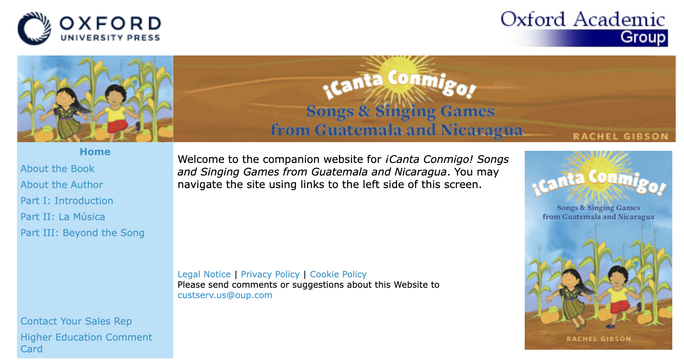



Spanish Resources
Sing with me! Songs and Games
from Guatemala & Nicaragua
Spanish Rhymes

Slide 13
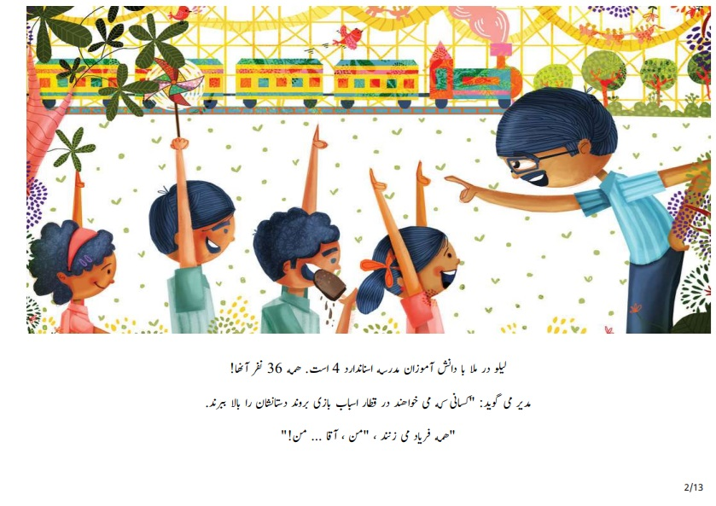

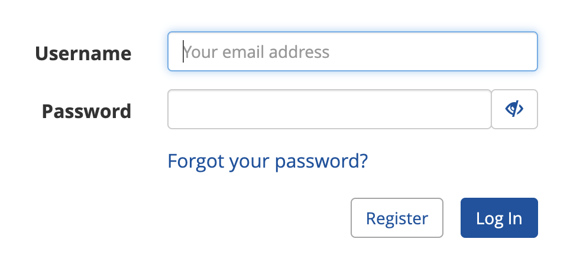
Various Languages Resources
 | Farsi Children’s Literature Access SORA by using parent’s or students’ Schoology credentials.
German & French Literature
Access the Epic digital library and follow progress with reading activities!

Slide 14
Various Languages Resources
Free Kids Books - French | Storybooks Canada
French stories and Literature
Storybooks Canada is a free open educational resource that promotes literacy and language learning in homes, schools, and communities. Select from a large selection of languages.

Slide 15
















Learning Library on Sora/
Biblioteca de aprendizaje en Sora
The LAUSD Learning Library on Sora is the quickest and easiest way to read digital books. LAUSD students and staff can log in using their SSO and instantly access hundreds of ebooks and audiobooks on virtually any device, for FREE. We have ebooks and audiobooks in Korean, Mandarin, Russian, Spanish, Arabic, and French. For more information, click HERE.
Thousands of great reads are waiting for you in the LAUSD Learning Library on Sora. Open all day, everyday.
Notes:
Aram/Blanca
Time: 2 minutes
Say: The LAUSD Learning library is the quickest and easiest way to read digital books. LAUSD students, family members and staff can use their single sign on to instantly access hundreds of ebooks and audiobooks.

Slide 16






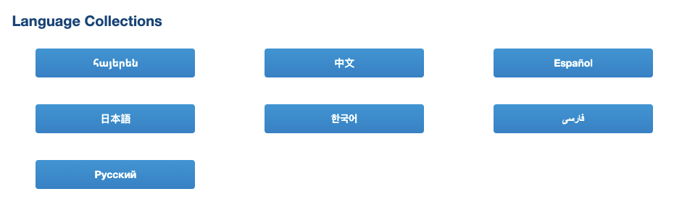
Supports from the LA Public Library
Free!
Physical and Electronic Cards are both available!
Notes:
Time: 1 minute
Link to LA Public Library: https://www.lapl.org/
Link to LA Public Library Card Application: https://www.lapl.org/sites/default/files/media/pdf/about/Library_Card_App.pdf
Download the library card application, fill it out, and then take it into any LA Public Library location
E-card Registration: https://www.lapl.org/about-lapl/contact-us/e-card/e-card-registration
E-Card Registration en Español: https://www.lapl.org/about-lapl/contact-us/e-card/solicitud-tarjeta-electronica

Slide 17
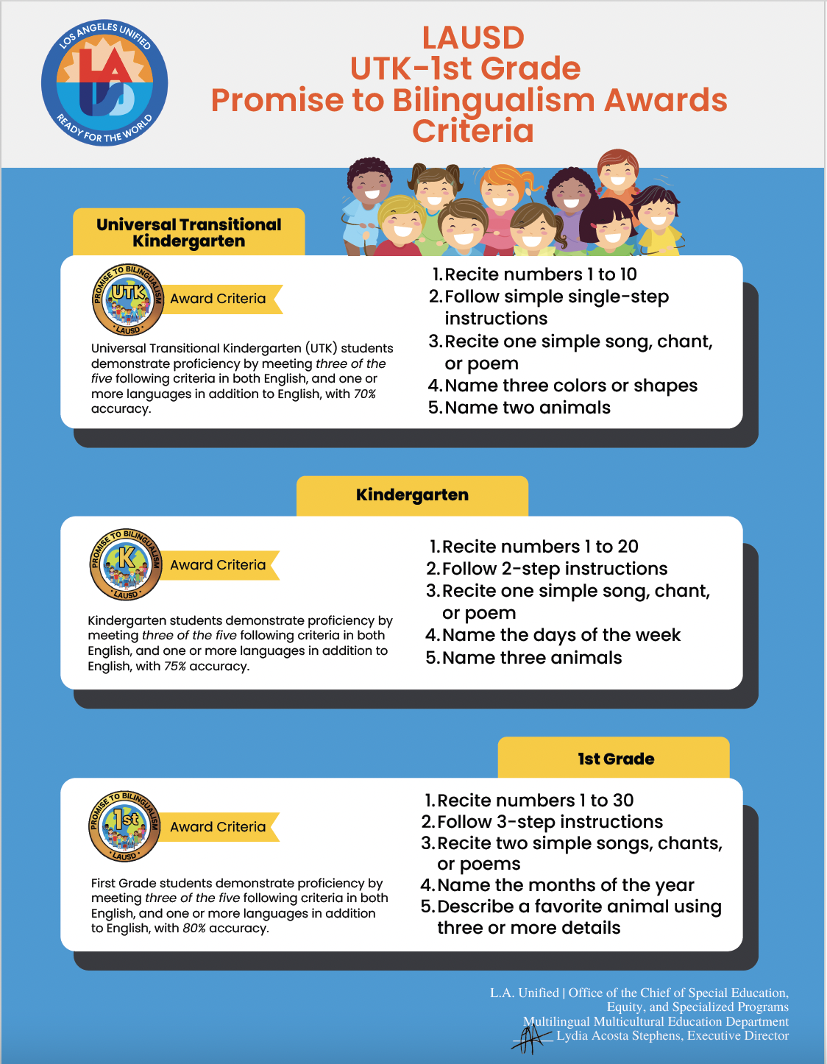
UTK, Kinder, 1st Grade
Criteria Supports

Slide 18


Your Community and Home as a Resource!
¡Su comunidad y su hogar como recurso!
Call out the names of objects in more than 1 language!
At the grocery store, restaurant, laundromat, bakeries, Target…
Count the objects around you! Count the toys, kitchen utensils, tiles in your home, trees on your street, flowers in the garden…
Share family stories
Sing songs
Describe your favorite plush animals or toys using details
¡Di los nombres de objetos en más de 1 idioma!
En el supermercado, restaurante, lavandería, panaderías, Target…
¡Cuenta los objetos a tu alrededor! Cuenten los juguetes, utensilios de la cocina, azulejos de tu casa, árboles en tu calle, flores del jardín…
Compartir historias de familia
Cantar canciones
Describe tus peluches o juguetes favoritos usando detalles

Slide 19
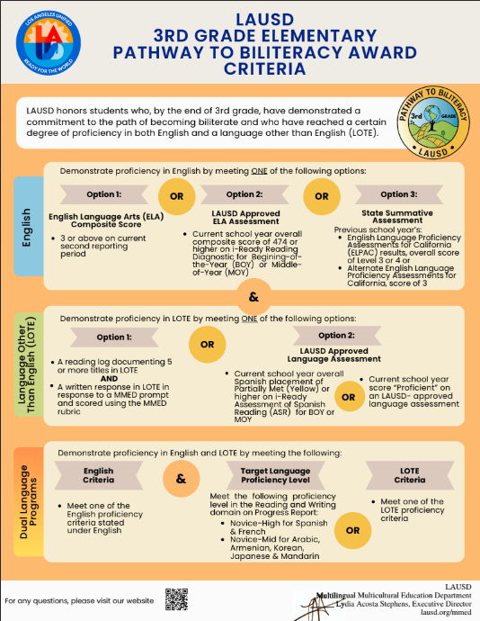
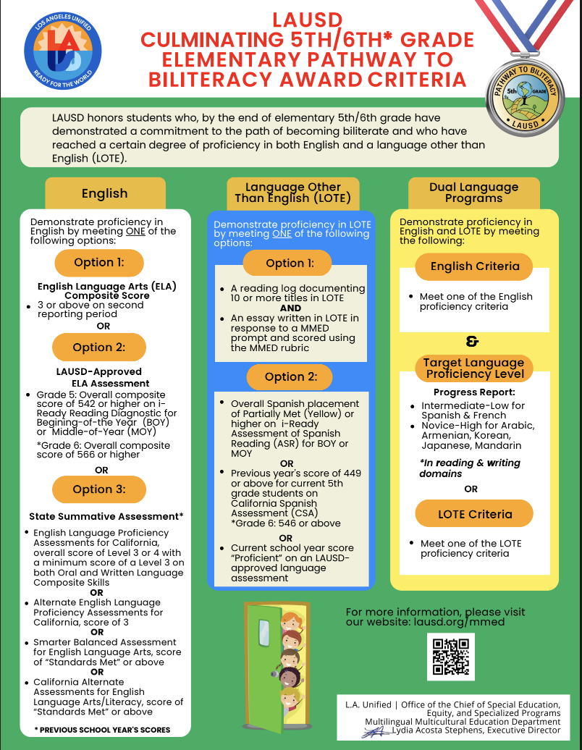
3rd, 5th/6th Grades
Criteria Supports

Slide 20
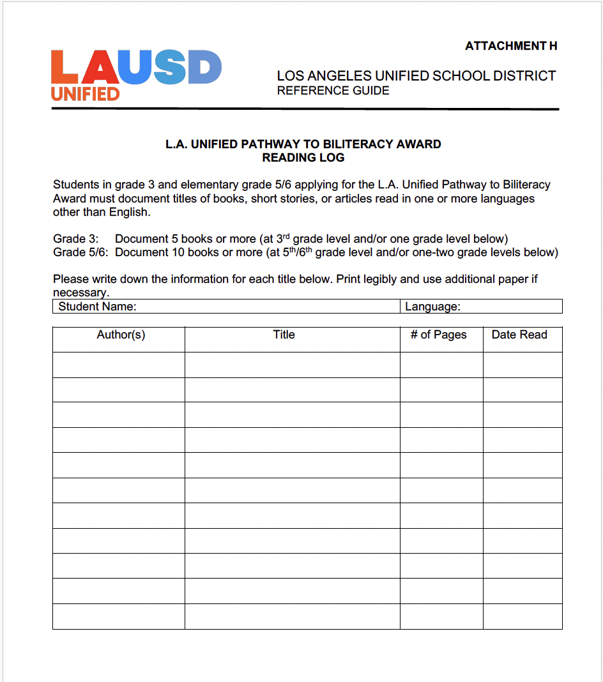
Reading Log
Grades 3, 5/6
Explore the various literacy websites, enjoy the book, and keep track
of your reading!
Notes:
Link to Reading Log:

Slide 21





Option 1 to Meet Language Other Than English Requirements
1^{era} Opción de requisitos para idiomas aparte de Inglés
Show proficiency in a Language Other than English:
Complete a reading log and respond to a written response in another language other than English
Grade 3: document 5 or more titles in LOTE AND written response
Grade 5/6: document 10 or more titles in LOTE AND written essay
SAMPLE WRITING TASKS for 3rd, 5th/6th
Write out a plan of what you want to do with family friends visiting from Guatemala. (Think about your community or city and where you would take them).
Write an email to a friend in Korea about simple everyday problems that you have at school and at home. Find out if they have the same problems where they are. (School)
Create an advertisement for your favorite invention–real or imagined. What does it do? What do you like about it? (Subjects)
Reading log for 3rd Graders
&
Notes:
To demonstrate proficiency in LOTE, they have several options as well:
Verification of LOTE Criteria – LOTE proficiency can be demonstrated by meeting one of the following:
Grade 3: Reading Log documenting 5 or more titles of books, short stories, or articles on Attachment H, L.A. Unified Pathway to Biliteracy Reading Log Template and written response in a second language in response to the MMED prompt and scored using the MMED rubric
Grade 5: Reading Log documenting 10 or more titles of books, short stories, or articles on Attachment H, L.A. Unified Pathway to Biliteracy Reading Log , and an essay written in a second language in response to the MMED prompt and scored using the MMED rubric

Slide 22
Your Community and Home as a Resource!
¡Su comunidad y su hogar como recurso!
Share family stories and retell them to other family members and/or friends
Visit your local library, bookstores, or literacy websites
Practice your reading and language skills in learning apps, like iChinese, Boost lectura, i-Ready, etc.
Write emails, thank you cards and/or recipes to your family members or friends in a language other than English
Comparte historias de familia y recuentalas con tus familiares y/o amigos
Visita a tu biblioteca local, librerias en tu comunidad, o sitios web literarios
Practica tus destrezas de lectura y lenguaje en aplicaciones como iChinese, Boost Lectura, i-Ready etc.
Escribe correos electrónicos, tarjetas de agradecimiento, y/o recetas con tus familiares o amigos en otro idioma aparte de inglés

Slide 23
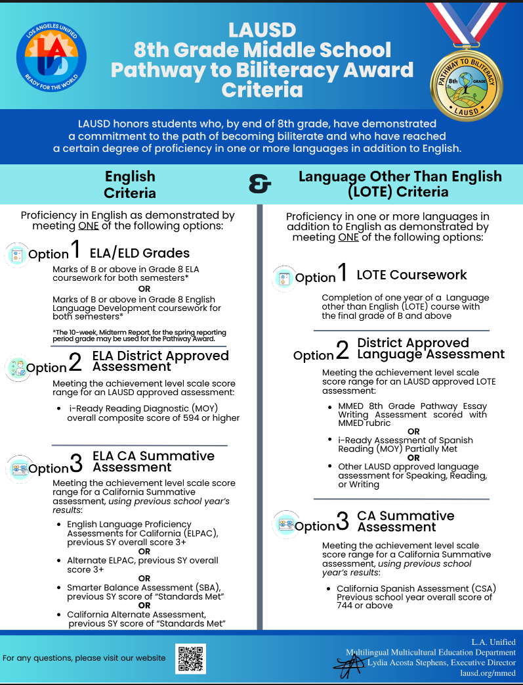
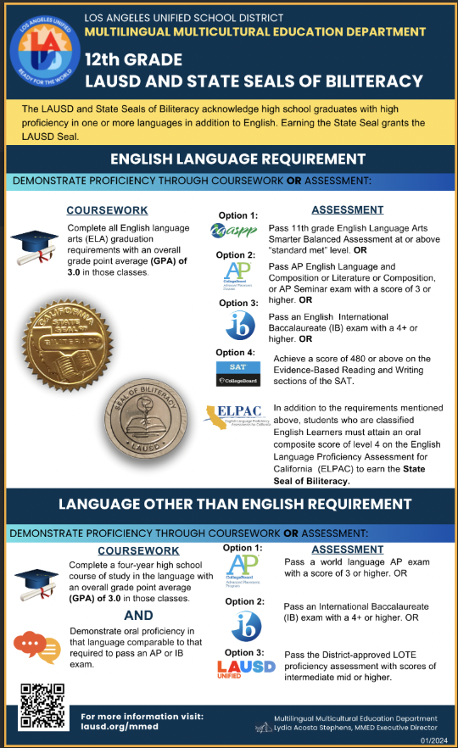
8th & 12th Grade
Criteria Supports

Slide 24
Option 2 to Meet Language Other Than English Requirements
2^{nda} Opción de requisitos para idiomas aparte de Inglés
Show proficiency in a Language Other than English:
Respond to a written response in another language other than English
Grade 8: Write an essay response using complete sentences in a paragraph form
SAMPLE WRITING TASKS (to be completed in another language other than English)
Write out a plan of what you want to do with family friends visiting from Guatemala. (Think about your community or city and where you would take them).
Write an email to a friend in Korea about simple everyday problems that you have at school and at home. Find out if they have the same problems where they are. (School)
Create an advertisement for your favorite invention–real or imagined. What does it do? What do you like about it? (Subjects)
Write a friendly letter to your friend who has moved to a different state. Tell them why you miss them. (Familiar topic)
Write a college application essay about the extracurricular activities you are involved with. Describe the activities and why they are important to your community or the world.
Notes:
To demonstrate proficiency in LOTE, they have several options as well:
Verification of LOTE Criteria – LOTE proficiency can be demonstrated by meeting one of the following:
Grade 3: Reading Log documenting 5 or more titles of books, short stories, or articles on Attachment H, L.A. Unified Pathway to Biliteracy Reading Log Template and written response in a second language in response to the MMED prompt and scored using the MMED rubric
Grade 5: Reading Log documenting 10 or more titles of books, short stories, or articles on Attachment H, L.A. Unified Pathway to Biliteracy Reading Log , and an essay written in a second language in response to the MMED prompt and scored using the MMED rubric

Slide 25
Your Community and Home as a Resource!
¡Su comunidad y su hogar como recurso!
Share family stories and write them in detail to other family members and/or friends
Visit your local library, bookstores, or literacy websites
Practice your reading and language skills in learning apps, like iChinese, i-Ready
Write emails, recipes, and/or informative letters to your family members or friends in a language other than English
Comparte historias de familia y recuentalas con tus familiares y/o amigos
Visita a tu biblioteca local, librerias en tu comunidad, o sitios web literarios
Practica tus destrezas de lectura y lenguaje en aplicaciones como iChinese, Boost Lectura, i-Ready etc.
Escribe correos electrónicos, recetas, y/o cartas informativas a tus familiares o amigos en otro idioma aparte de inglés

