Slide 1



ELPAC AWARENESS
MODULE
English Language Proficiency Assessments
for CA
Banked Time
Professional Development
Notes:
1 minute
Welcome participants.
Read title. Today we will learn about the ELPAC, which will replace the annual CELDT this year.
First, we will learn about the contents of the ELPAC and discuss the instructional implications of this new assessment.
We will learn more about the timeline for this assessment and other general information at the end of the module.

Slide 2

Norms
Presume positive intentions
Place inquiry at the center to allow for processing, probing, and think time
Be prompt
Build a network through respect and support
Notes:
1 minute.
Have participants read.

Slide 3


Our Students
Change the trajectory of students’ future through quality instruction
    Equity and access:
    Moving beyond basic understanding
    AP courses
    Honors classes
Notes:
1 minute
English learners face a dual load. They must access academic content in a second language at the same time that they are learning that second language. We must ensure that our students are on a pathway to equity by moving them beyond basic understanding to becoming college and career ready. Progress with the ELD standards, as measured by the ELPAC and reclassification is just the beginning on their upward path.

Slide 4
ELPAC Awareness Objectives
Participate in a sample performance task
Understand the background of the ELPAC
Unpack an ELPAC task
  Understand the test items for a grade-span
  Understand the instructional implications of a specific task
Notes:
1 minute
Have participants read.

Slide 5


ELPAC is replacing the CELDT
Notes:
30 seconds
Read to participants

Slide 6
What is the ELPAC?
The ELPAC is:
The new assessment to assess students’ English language proficiency and determine their level of proficiency in English
Aligned with the 2012 English Language Development (ELD) Standards
Notes:
1 minute
Have participants read.

Slide 7
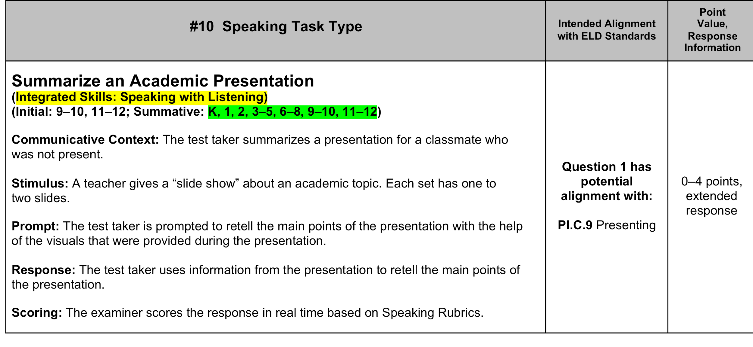
ELPAC Task Sample
Notes:
2 minutes
This is an example of one of the ELPAC task types.
Take 30 seconds to read it.
What do you notice? What do students need to be able to do?
Possible answers: Students must listen actively, There are integrated skills: Listening and Speaking. The item is for K-12, it is Included in Initial and Summative (annual) assessment. Students must summarize, tell main idea and details. Scoring will be on a 1-4 rubric
Adapted from CABE provided materials

Slide 8

Task: Summarize an Academic Presentation
Integrated Skills: Speaking with Listening
Grades: K-12
Teacher needs to… | Student needs to…
Present a “slide show” about an academic topic | Listen Actively Summarize the main points of the presentation using the visuals provided
What should you hear in a student response?
Notes:
1 minute
Summary of Task.
Read to participants. Have them share what they should hear to an elbow partner.

Slide 9

ELPAC Task Sample: Social Studies
PROMPT: Summarize the presentation by stating the main points and supporting details with the help of the visuals.
Slide 1
Slide 2
Notes:
1 minute
We are going to show you what this task type might possibly look like in the ELPAC. For ELPAC at the 3rd-12th spans, the teacher voice will be recorded to ensure consistency, as with SBAC TOMS
Presentation can only be read ONCE.

Slide 10

ELPAC Task Sample: Social Studies
PROMPT: Summarize the presentation by stating the main points and supporting details with the help of the visuals.
Slide 1
Slide 2
Notes:
2 minutes
Teacher Role – Read prompt and PLAY THE RECORDING by clicking on speaker icon, then triangle to play teacher audio.
Student takes notes
Oral prompt (teacher presentation) can only be read ONCE.
SPEAKERS REQUIRED

Slide 11

ELPAC Task Sample: Social Studies
PROMPT: Summarize the presentation by stating the main points and supporting details with the help of the visuals.
Slide 1
Slide 2
Notes:
1 minute
This response is from a student who had no prior instruction in this topic.
PLAY THE RECORDING by pressing on black bar icon between the infographic and the visual text, then the triangle to play the student response.
SPEAKERS REQUIRED

Slide 12
What Did You Notice About the Task?
Two integrated skills: listening and speaking
Student needs to listen actively to a teacher presentation
Student can take notes and use the notes in his/her presentation
Student needs to summarize, identify the main idea, and details
Academic topic is based on Social Studies
Notes:
2 minutes
Participants share out some of their findings. Take 1-2 comments. If necessary, guide participants to focus on what was in the task, rather than going to instructional implications. We will explore instructional implications later.
Then click for animation and read each bullet.

Slide 13
What did you notice about the Academic Language?
Teacher Model
Student Response
An important idea in both texts is that people struggled for the basics like food and housing. One example in the infographic is that nearly 25% percent of Americans were in poverty.
Many had to wait in “bread lines” just to have enough to eat.
Another example is the picture of the woman and two children who live in the shantytown.
Additionally, they are barefoot and their clothes are dirty and tattered.
In conclusion, both texts show how people were affected by the Great Depression.
I think you said that people lost their jobs, like they’re struggling to get like money to live in like clear houses like we do and the…
I think they get their foods like from people who want to help them they are serving them like they’re giving them charity or something
and um they live in torn down houses
and like this one, her family is not, is like, they’re not healthy, they don’t look healthy and I think their mother lost her job. She lost like her job.
So…
Notes:
3 minutes
Let’s look at the student response to understand what a sample task might look like. Note that student got the main idea and key concepts—the gist of the presentation. Student began with the main idea related to the teacher model, but did not identify it as the main idea. Student is beginning to use precise academic language—“don’t look healthy” as opposed to “barefoot with dirty and tattered clothes”. Additionally, student understood the concept of a shantytown. The student used the text as resource to equate breadlines with the concept of charity. Teacher provides conclusion and student did not.

Slide 14
Task
Content
Academic Language
Present Information
Social Studies
Structure
Vocabulary
Summarize
Notes:
1 minute
As we go through this PD, we will keep coming back to this graphic that shows how ELPAC reflects what actually happens in a classroom. Teachers present students with a task—in our example, it was summarize and present. The stimulus for the task was Social Studies. Teacher and students use academic language as the currency to articulate and complete the task—in our example, it was structure and vocabulary.
The student obtained information through listening and the visual text, had to evaluate it to decide what to summarize and what was the main idea and supporting details and then communicate that information through an oral presentation.

Slide 15
The information presented in this
ELPAC Awareness
has been gathered from the publicly released documents from the California Department of Education (CDE) and Educational Testing Services (ETS), many of which are drafts which may be revised prior to the full implementation of the ELPAC.
Notes:
1 minute
Since the ELPAC will begin next year, we will be sharing all the public information that is available at the present time.
There are no sample questions, nor rubrics yet as we had with the CELDT. More information will become available as we get closer to the testing window beginning February 1.
Adapted from CABE provided materials

Slide 16
SBAC Claims for ELA | ELPAC High-Level Claims
Claim #3—Speaking and Listening “Students can employ effective speaking and listening skills for a range of purposes and audiences.” | Listening: An EL can comprehend spoken English (conversations, discussions, and oral presentations) in a range of social and academic contexts. Speaking: An EL can express information, ideas, and participate in grade-level conversations and group and class discussions.
.
Handout #2
Notes:
1 minute
Have participants take out Handout #2. This handout shows the SBAC Claims for Speaking and Listening and the ELPAC (High-level) claims side by side for Speaking and Listening.
Have participants examine their handout.
SBAC Claims are for ELA, Social Studies, Science and Technical Subjects
Ask: How does the ELPAC claims relate to SBAC claims? Participants should note that they are very similar.
Say: Quality Tier 1, standard based, instruction in Integrated and Designated ELD will support our ELs success in SBAC and ELPAC. It’s the whole. The INTO and FROM. This is important because ELs carry two backpacks. One is for language and the other is for content in their second language.

Slide 17
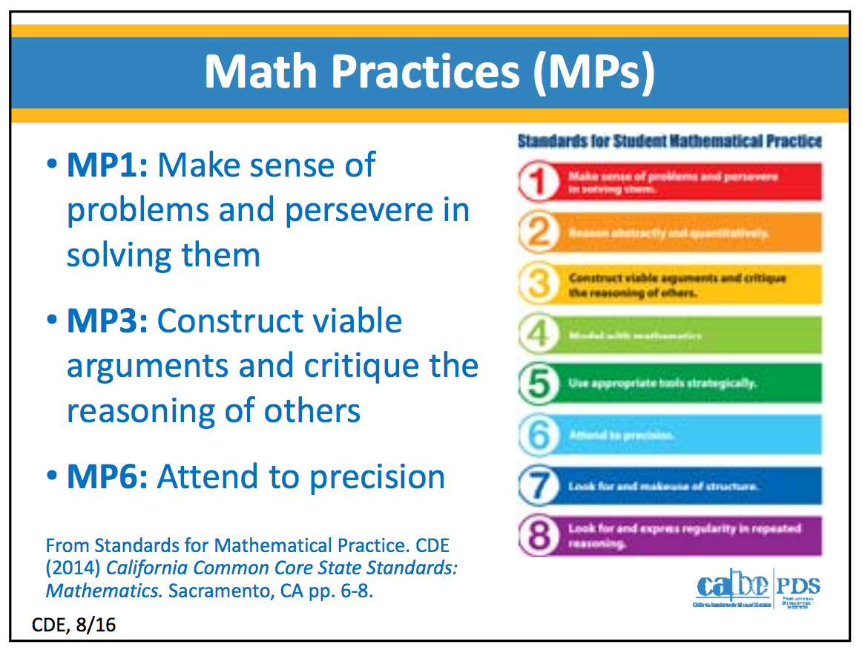
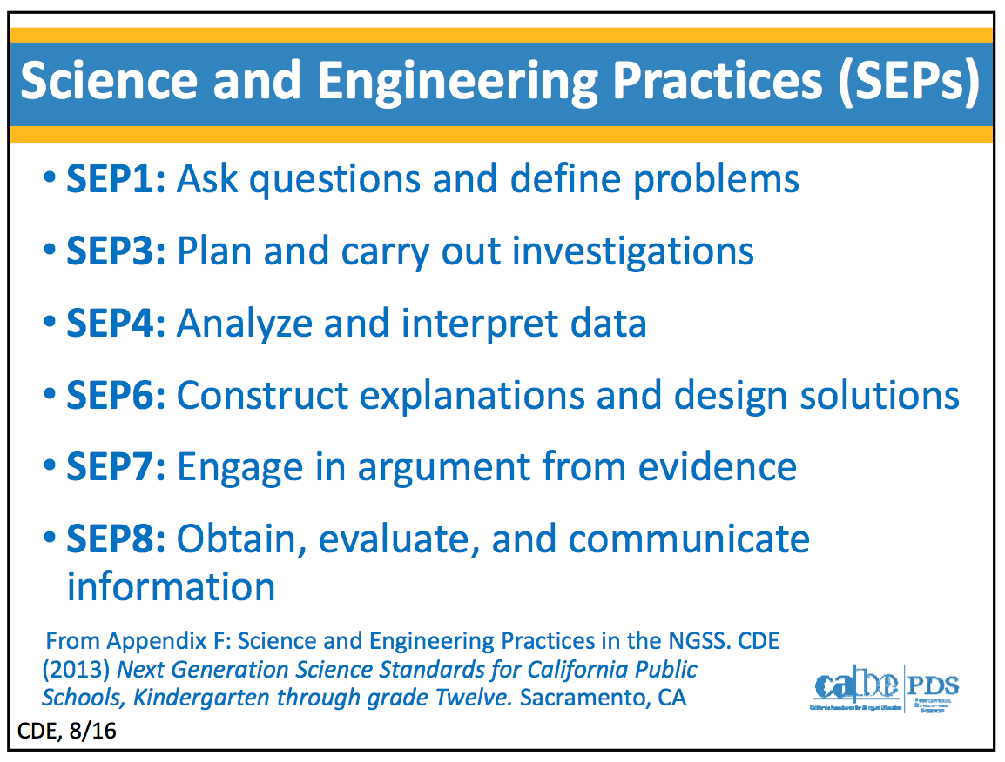
Handout #2
Notes:
2 minutes
Refer to Handout #2. The ELPAC does NOT test content knowledge, however:
ELPAC emphasizes the academic language related to these 3 Math and 6 Science and Engineering practices listed here. Math and Science teachers need to provide opportunities for students to use language to explore these practices.
Even though we used Social Studies content as an example in the task, the ELPAC skills tested can be used with a Science or Math example. Content teachers will play a vital role in supporting ELPAC success.
Adapted from CABE provided materials

Slide 18
ELPAC
Task Types & Blueprint Composite Introduction
By Grade Span
ELPAC Grade/Grade Spans:
K, 1, 2, 3-5, 6-8, 9-10, and 11-12
Notes:
30 seconds
Now, we will investigate the ELPAC contents for your grade-span to understand its instructional implications.

Slide 19
Task
Content
Academic Language
Present Information
Social Studies
Structure
Vocabulary
Summarize
Notes:
1 minute
We began this session by experiencing an ELPAC task. There are 32 ELPAC tasks, 25 of which are new items and 7 from the CELDT found to be aligned to the new standards. At an individual grade-span, there are 17 to 19 task items.

Slide 20

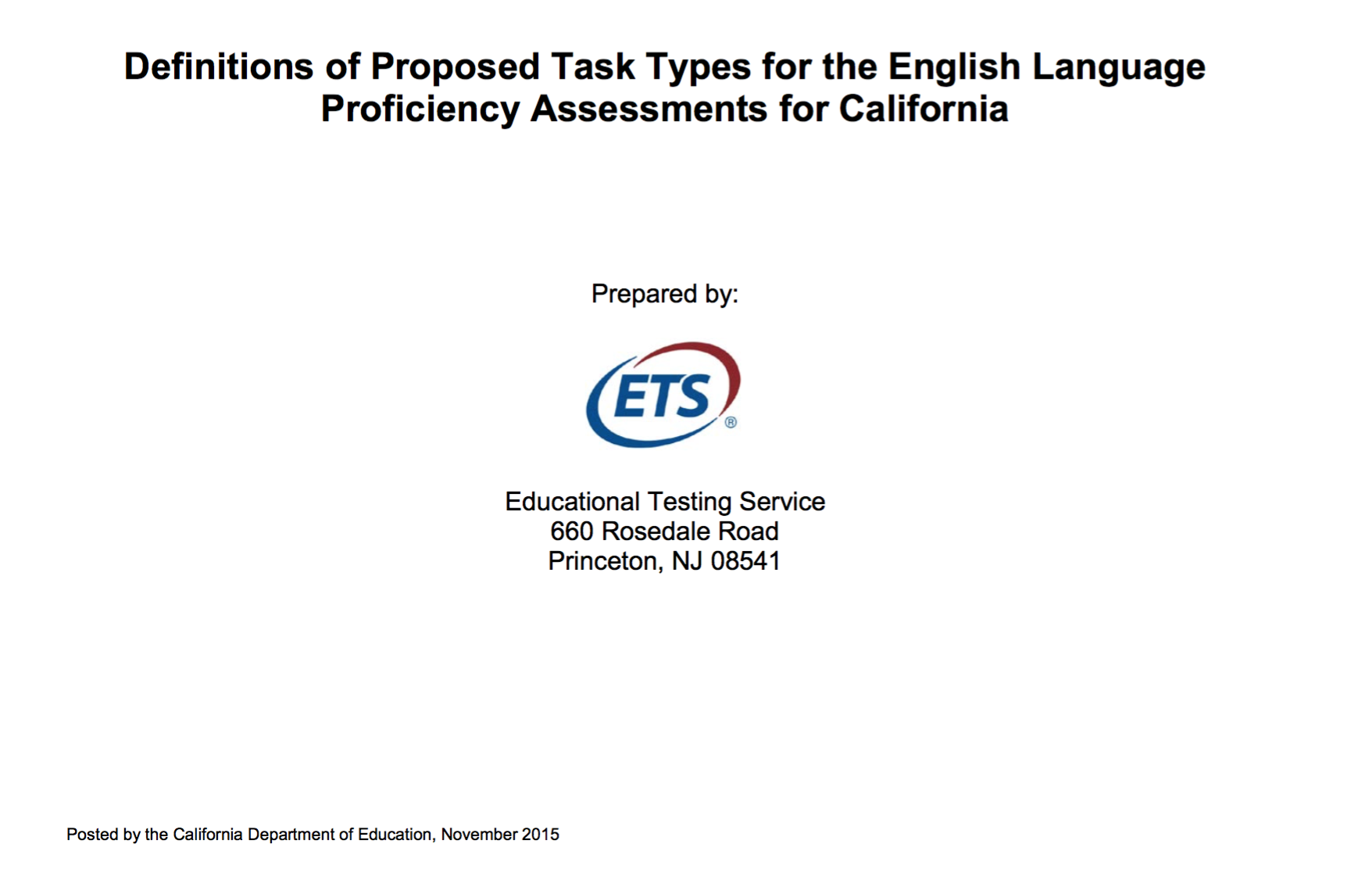
CA State ELPAC Resources
Notes:
1 minute
These are the public resources from the state that explain the ELPAC.
The Proposed Test Blueprints provides information on which task types are in the initial and summative tests and their point value for each grade/grade span: K, 1, 2, 3-5, 6-8, 9-10, and 11-12. The Definitions of Proposed Task Types provides a more in-depth description of each task and its standards alignment for both initial and summative assessments for all grades.
This is the extent of information here are no release questions nor rubrics for the tasks at this time.
For our instructional purposes, we might want to focus on the summative assessment. It might be more useful for instruction to have the information arranged by grade-span. The following document was designed to meet these needs.

Slide 21
Handout #3
Notes:
30 seconds
Have participants take out Handout #3 for their grade level/span.
The Proposed Task Types & Blueprint Composite was designed by LAUSD to support teachers and staff in understanding the content of the Summative ELPAC to begin to consider instructional implications.

Slide 22
Domain
Task Type
Description
ELD
Standard(s) Alignment
Item
Point Value
Total
Point Value
Totals for Domain
Notes:
2 mins.
Click on animation to show callouts and elaborate.
Although the ELD Standards integrate domains, for example, collaborating to write, Federal guidelines require that students are assessed in the 4 domains and in comprehension (listening and reading). Therefore, the ELPAC is still divided into domains.

Slide 23
Task Types & Blueprint
Form a group of four by grade span:
K, 1, 2, 3-5,6-8, 9-10, 11-12
Number off:
Page 1 Expert--Listening
Page 2 Expert--Speaking
Page 3 Expert--Reading
Page 4 Expert--Writing
Notes:
2 minutes
Have participants form groups of four by grade level, grade span or content areas (secondary). Give time to move into groups. Have groups number off and verify by saying each number while they raise their hands. If necessary, there can be two members with the same number, but no group smaller than four or larger than 5.
Note: If there are few participants, K and TK may form a group. First and 2nd can team, as their summative assessments are similar. Third through 5th have the same assessment, so they may collaborate.
Note: If the module is divided into half-hour segments, have a recorder for each grade write down the assignments of each expert for next time. They will share their findings then. Collect materials and save for Part II.

Slide 24
ELPAC
Task Types & Blueprint Composite Dig-in
By Grade Span
ELPAC Grade/Grade Spans:
K, 1, 2, 3-5, 6-8, 9-10, and 11-12
Notes:
Note if this the first activity for the next half hour, have grade level recorders remind group members what numbers they were assigned.
Distribute Task Types and Blueprint Composite from Part I

Slide 25
Explore the Task Types & Blueprint Composite
Individually, skim your Composite page to prepare to share out with your grade level:
What do you notice about your task types?
Annotate and take notes in
your note section to prepare
to share with your group
Handout #3
Notes:
2.5 minutes total
30 seconds--Read slide.
2 minutes—Experts read and annotate.

Slide 26
Small Group
Discussion
Assign a timekeeper
  Each expert will have two (2) minutes to share out
Report to your group:
What do you notice about the tasks in your assigned page?
Listening Expert (#1) starts
Each expert shares in order while others take notes
Notes:
9 minutes total
1 minute—read slide and clarify. Have timekeepers share with group what time it will be in 8 minutes.
8 minutes—Experts share with their groups. Remind experts to stick to what they see in the text while sharing. Monitor to ensure that each expert is taking no more than their allotted time and that others have opportunities to take notes.
Have 1-2 participants share their overall noticings with the whole group.

Slide 27
ELPAC
Unpack a Task Type
By Grade Span
ELPAC Grade/Grade Spans:
K, 1, 2, 3-5, 6-8, 9-10, and 11-12
Notes:
30 seconds
Now that we understand what tasks are in a test for your grade span, you will work together with your group to go deeper into the instructional implications for the task from the beginning of the module.

Slide 28
ELPAC General Overview
K and grade 1 students are administered the test one‐on‐one
Group administration is provided for Listening, Reading and Writing at grades two through twelve (2–12)
Speaking items are administered to all students one‐on‐one and scored by a trained test examiner “in real time.”
The Listening domain at grades K–2 will be read aloud to students by a test examiner
At grades 3–12, recorded audio on TOMS will be used to deliver Listening items
The Writing domain will be entirely constructed‐response items
The Writing domain will not contain any multiple‐choice items
Notes:
1 minute
Here is more information about the structure of the ELPAC.
Read emphasizing highlighted words
Adapted from CABE provided materials

Slide 29
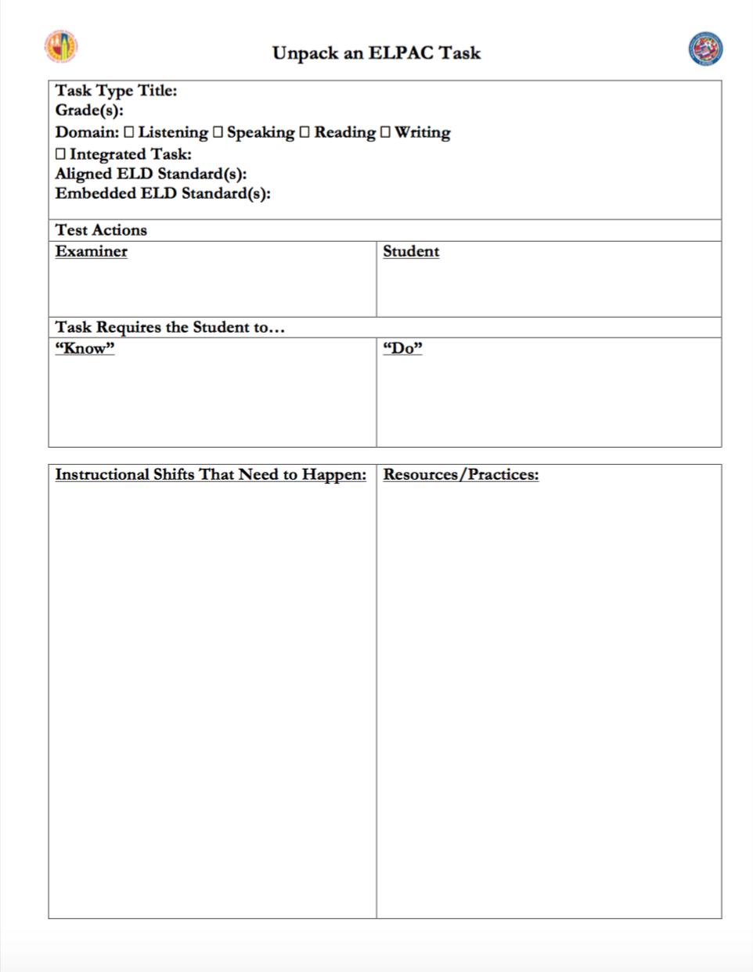
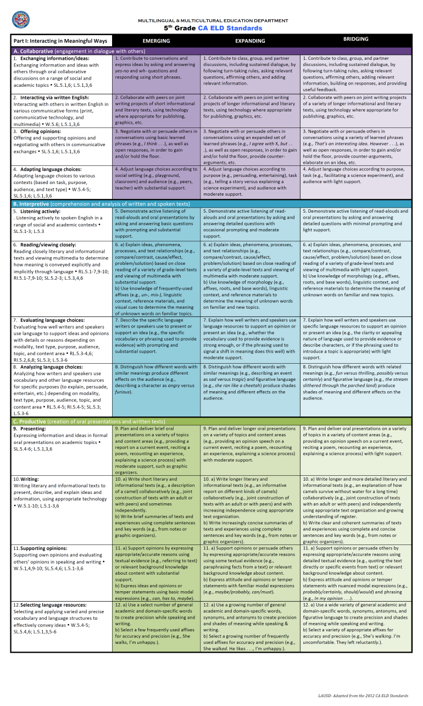
Collaborating to Unpack the ELPAC
With your grade level/content group, consider the instructional implications of Summarize an Academic Presentation
Refer to your:
“ELPAC Task Planner” instructions and template
ELD Standards at a Glance—What standards are aligned and embedded in the task?
Handouts #4 & #5
Notes:
3 minutes
Participants will continue in their grade level/content group.
Display documents as you read the slide. Give participants time to skim the documents. Have participants consider the aligned and embedded standards to think about the instructional implications
Note: if another hour is available, groups of 2-4 can explore other tasks to deepen their understanding of the ELPAC. See Unpack the ELPAC Tasks!
Adapted from CABE provided materials

Slide 30
Sample
In a second language
Unpacking an
ELPAC
Task
Handout #5
Notes:
4 minutes total
1 minute--Take participants through the completed template by clicking animations and explaining.
3 minutes--Have participants plan at their table before charting. One member can write group ideas on template to prepare.

Slide 31
Unpack the ELPAC Task Poster
Collaboratively record your ELPAC Task analysis on chart paper for Summarize an Academic Presentation Integrated Skills: Speaking with Listening and include:
  Grade level/content area
  Instructional Shifts
  Instructional resources and practices
Be prepared to share your findings with everyone!
Notes:
7 minutes
Notify timekeepers to set their devices. Ask them what time it will be in seven minutes.
Remind participants that their chart will be a large t-chart with instructional shifts and instructional resources and practices.
Participants create their posters.
If time to share out: At end of time, have group stand in front of their poster, do fickle finger of fate to select spokesperson (everyone puts their finger in the air. At the count of 3, they point to who they want to present for their group, the person with the most people pointing at them shares).
Adapted from CABE provided materials

Slide 32
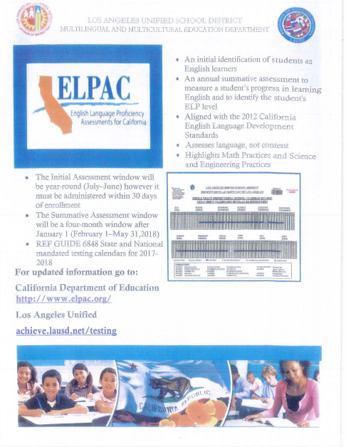
Additional ELPAC Information
Handouts #6-#7
Notes:
30 seconds
In your packet, you will find a flyer with additional information about the ELPAC including logistics.

Slide 33
ELPAC Timeline
2017-18 | 2018-19
ELPAC Initial Field Test
CELDT (Initial Only) ELPAC Summative (February 1-May 31 2018) | ELPAC Initial ELPAC Summative
Notes:
30 seconds
Here is the timeline for the ELPAC. The summative will be administered this spring. California Department of Education has set the window from February 1--May 31, 2018.
46 LAUSD schools who participated last year in the Summative Assessment field test will participate in the ELPAC Initial Assessment field test in August and September 2017. ELPAC will be used for both initial and summative tests in 2018-19.
Adapted from CABE provided materials

Slide 34
Reflecting and Connecting
Now that you have a greater understanding of the ELPAC Tasks, what are your
next steps?
Notes:
1 minute
Read slide.
Give participants think time, then have them share with an elbow partner.

