Slide 1
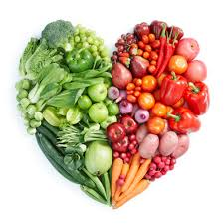
I Love
Healthy Food
Add a catchy title that represents your central theme
You Should, Too!
Don’t forget to add your names and date
Presented by: _____________________
Notes:
Hi I’m ________ and I am here to tell you about why healthy food is beneficial.
Read title: I Love Healthy Food.
Click 1: You Should, Too!

Slide 2


Claim: Healthy food is beneficial!
This is your overview slide. Include 2 reasons you will discuss in your presentation.
Reason 1: Eating healthy food leads to a happier life.
Reason 2: Eating healthy food helps you think and learn better.
Images add detail to your slides, include one or more.
Notes:
Did you know that eating healthy food such as fruits and vegetables is good for you?
Click 1: Well, one benefit of eating healthy food is that it leads to a happier life. When you are healthy you are happier.
Click 2:Another benefit of eating healthy food is that it helps you think and learn better.

Slide 3
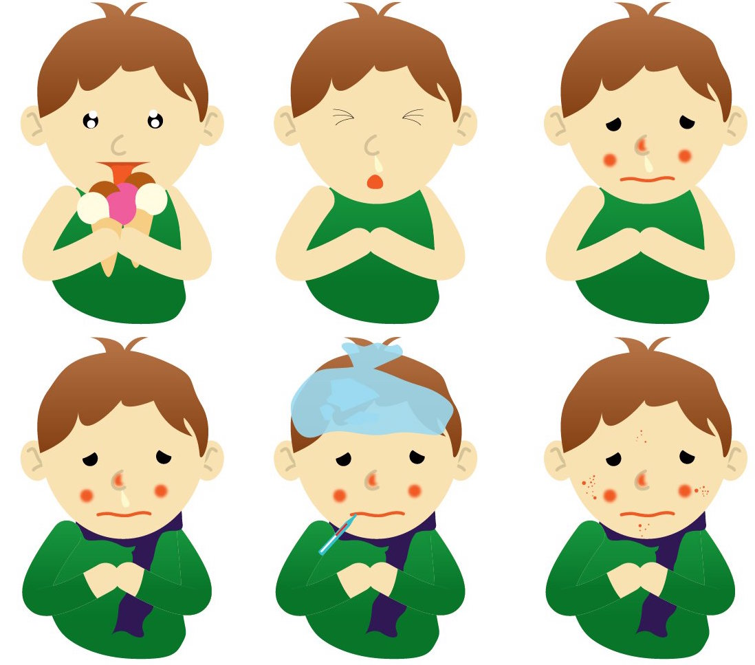
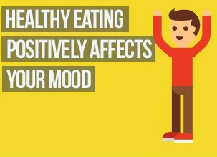
Reason 1: Eating healthy food helps you to be happy.
This slide present the first reason of your presentation. Make sure you include the reason as well as supporting evidence.
When your body is not healthy you get sick a lot, which is not fun.
When your body is healthy you don’t get sick and you have more time to have fun.
These images represent the supporting evidence for this slide.
Notes:
Like I said, one reason to eat healthy food is that it leads to a happier life.
Click 1: For example, when you eat junk food, it makes your body unhealthy. When your body is not healthy, you get sick a lot, which is not fun.
Click 2: Additionally, when your body is healthy you don’t get sick and you have more energy and time to have fun.

Slide 4

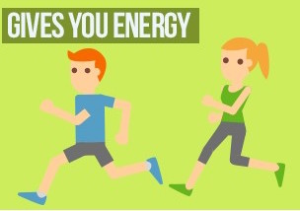
Reason 2: Eating healthy food helps you think and learn better.
This slide explains the second reason supporting the claim. Add bullet points as well as images.
Healthy foods have more vitamins and nutrition for your body.
The nutrients from healthy food give you energy to think and be active.
Notes:
Another reason to eat healthy food is that it helps you think and learn better at school.
Click 1: For example, healthy foods such as fruits and vegetables provide more vitamins and nutrition for your body.
Click 2: Furthermore, the nutrients from healthy food give you energy to think, learn, and be active. Healthy food is good fuel for your body.

Slide 5

Informational Video About Healthy Food
Add multimedia (videos/audio/link) to your presentation for supporting evidence and to make it entertaining for your audience.
Make sure the video supports at least one of the reasons.
https://www.youtube.com/watch?v=u1sh_XGKJ-Q
Notes:
This is an informational video that provides additional information about the benefits of eating healthy foods.

Slide 6
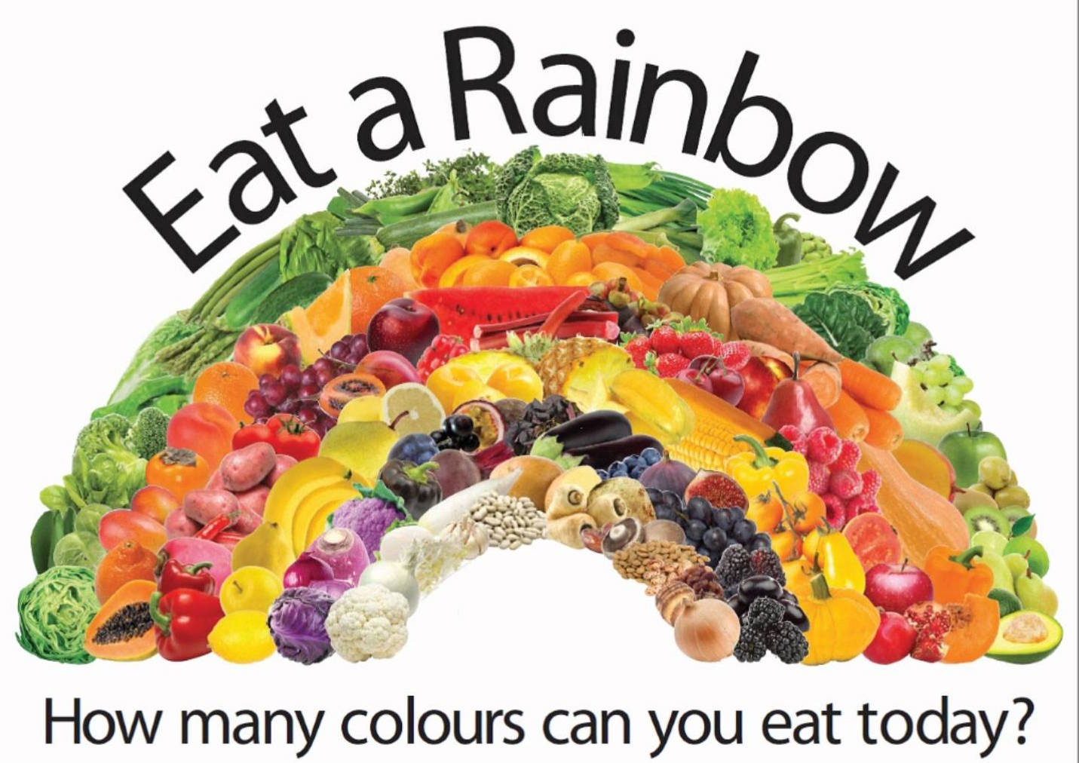
Conclusion
Healthy foods such as fruits and vegetables are beneficial because they help keep you happy, healthy, and strong. Start now! Eat a rainbow everyday!
Invite your audience to participate by including an action they can take to get involved!

Slide 7
Questions?
Invite your audience to participate by including an action they can take to get involved!

