Slide 1


Unpack the ELPAC Tasks!
ELPAC Awareness Module
Follow-up
Notes:
Optional ELPAC Awareness Module Follow-up
30 seconds
Welcome Participants.
In the banked time module, we looked in depth at one task type-Summarize an Academic Presentation. Today, you and your group will unpack a task for your grade span/content area and share your learnings with other groups to further understand the instructional implications of ELPAC.
*Slide information adapted from CABE provided materials

Slide 2
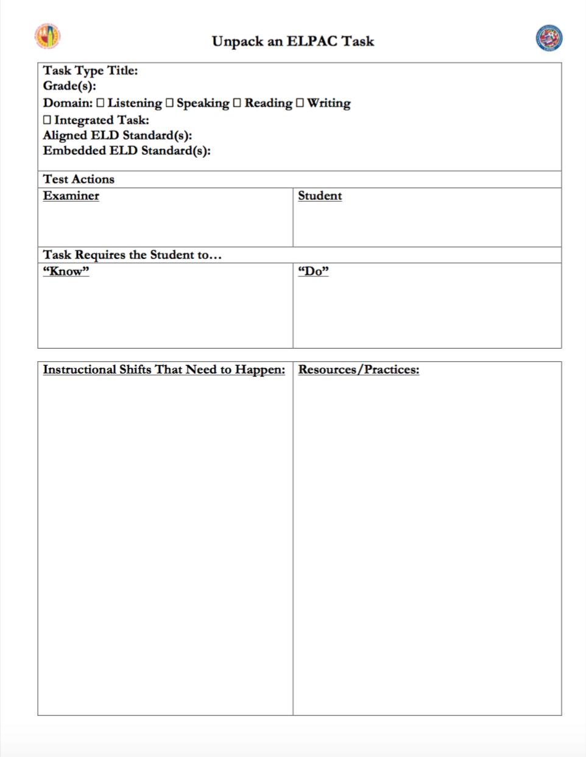
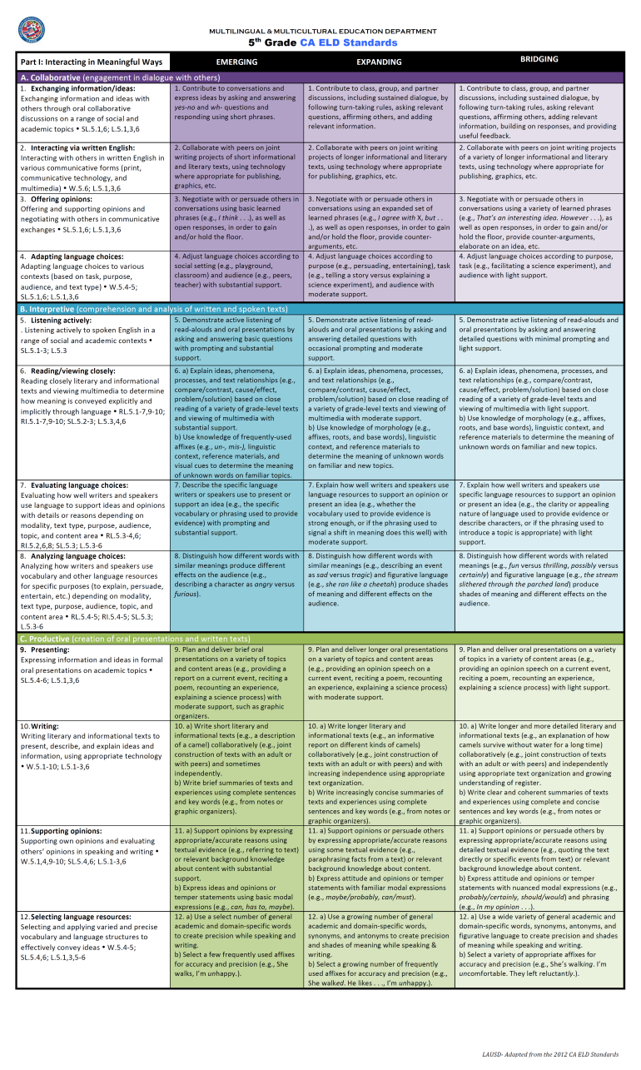
Collaborating to Unpack the ELPAC
With your group of four, choose an ELPAC Task
Refer to your:
“ELPAC Task Planner” instructions and template
ELD Standards at a Glance
Handouts #8-#9
Notes:
2 minutes
Participants will get in a group of three to four by grade spans (K,1, 2-5, 6-12) or content area.
Distribute handouts 8 and 9.
Display documents as you read the slide. Give participants time to skim the documents.
Adapted from CABE provided materials

Slide 3
In a second language
Sample
Unpacking an
ELPAC
Task
Handout #10
Notes:
7 minutes total
2 minutes--Take participants through the completed template by clicking animation and reading each section.
5 minutes--Distribute large tasks. Have participants plan.
Note: Embedded standards are ELD standard(s) needed to perform task which have not been called out in a task type. For example, Summarize an Academic Task requires a student to listen actively (Part I B 5), although only Part I C 9-Presenting is referred to. An ELPAC task may or may not have embedded standards.
*Slide information adapted from CABE provided materials

Slide 4

Unpack the ELPAC Task Poster
Collaboratively record your ELPAC Task analysis on chart paper and include:
Task type Title:
Grade:
Domain:
Integrated Task:
Aligned ELD Standard(s):
Embedded ELD Standard(s):
Be prepared to share your findings with everyone!
Test Actions
Examiner Student
Task Requires the Student to…
“Know” ”Do”
Instructional Shifts That Need to Happen:
Resources/Practices
Notes:
30 minutes
Remind participants that their chart will just look like a large template. This is everything in the template, just called out.
Participants create their posters. Check in with group and timekeepers at 15 and 5 minute mark.
Adapted from CABE provided materials

Slide 5
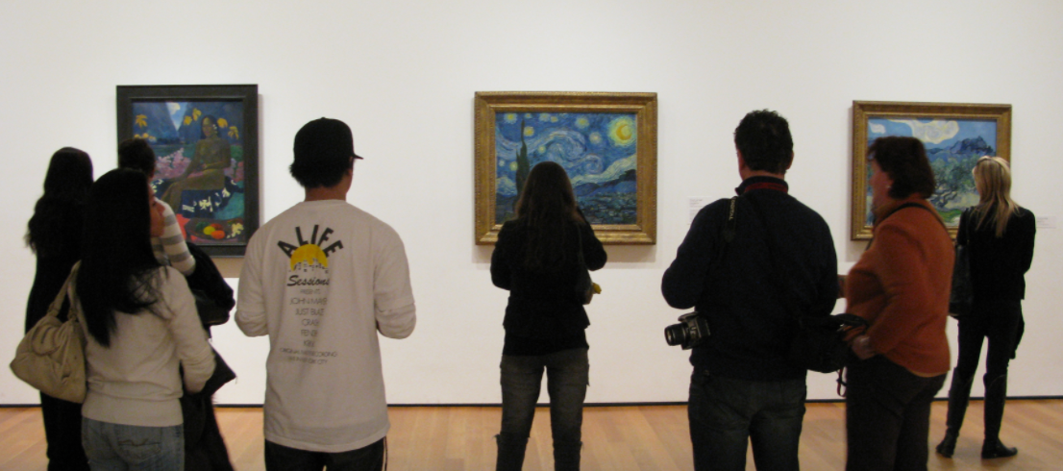
Gallery Walk
As you walk, use your Task Type and Blueprint Composite Notes section to
collect ideas
Notes:
15 minutes
Gallery walk option A: At end of time creating poster, have group stand in front of their poster, do fickle finger of fate to select spokesperson (everyone puts their finger in the air, at the count of 3, point to who you want to present for your group, the person with the most people pointing at them shares, or chooses someone else to share). and have groups assign timekeeper, move clockwise each minute or so. Check in with groups for first few rotations to ensure that time is monitored.
Option B (little time for gallery walk): Groups stand in front of their poster to begin a self-guided tour moving clockwise. They may return to their seats when done.

Slide 6
Reflecting and Connecting
Now that you have a greater understanding of the ELPAC Tasks, what are your
next steps?
On the reverse side of your ELPAC Task Planner, list your next steps
Notes:
4 minutes
Read slide. Give participants time to write. Ask 1-2 participants to share their next steps. Consider participants’ feedback in implementing follow-up professional development.

