Slide 1



School Experience Survey
How Survey Results are Used
Office of Data and Accountability
Data Privacy, Analysis, & Reporting Branch
Dr. Kevon Tucker-Seeley – Director

Slide 2


Slide 3

School Experience Survey Purpose
The School Experience Survey is designed to gather feedback from students, parents, teachers, and staff so that schools can learn what they are doing well and what they need to work on.

Slide 4
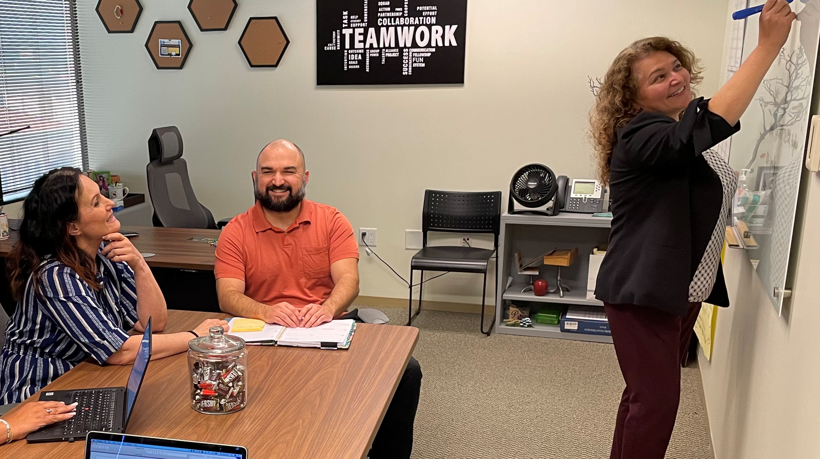



How Different Groups Use School Experience Survey Results
4

Slide 5
How Different Groups Use Survey Data
Principals use survey results for:
  Budgeting purposes
  Completing their School Plan for Student Achievement (SPSA)
  Reporting requirements for the Accrediting Commission for Schools, Western Association of Schools and Colleges (ACS WASC)
  Setting annual goals
  Evaluating and responding to stakeholder concerns
Parents use survey results for:
  Comparing school results to District, LD, CoS, and other schools’ results.
  Establishing School Site Council priorities to discuss with principals
CoSAs use survey results for:
  Tracking schools’ performance on key indicators
  Establishing goals and priorities to effect change in their schools

Slide 6

School Experience Survey
Why are Results Important?
6

Slide 7
Importance of Survey Results
Results from the School Experience Survey (SES) are important for a number of reasons:
1. For accountability purposes, the District is required by the State to administer a “Local Climate Survey” annually and to report results. LAUSD reports progress toward:
  Schools seeking input from parents/guardians in decision making
  Schools promoting parental participation in programs
  Students reporting being happy at school and feeling like they are a part of their school
  Students feeling safe at school
  Students being treated with respect by adults at their school

Slide 8

Importance of Survey Results
In addition, SES results are used for:
2. Reporting progress towards LCAP goals:
  Percentage of students who feel a part of their school
  Percentage of parents participating in the SES
  Percentage of parents who agree with the statement, “My school provides resources to help me support my child’s education.”
  Percentage of students who feel safe at school
3. Providing feedback to schools to make necessary changes and improvements
4. Reporting progress towards LAUSD Strategic Plan Priorities and District Goals

Slide 9

2022-2026 Strategic Plan
9

Slide 10
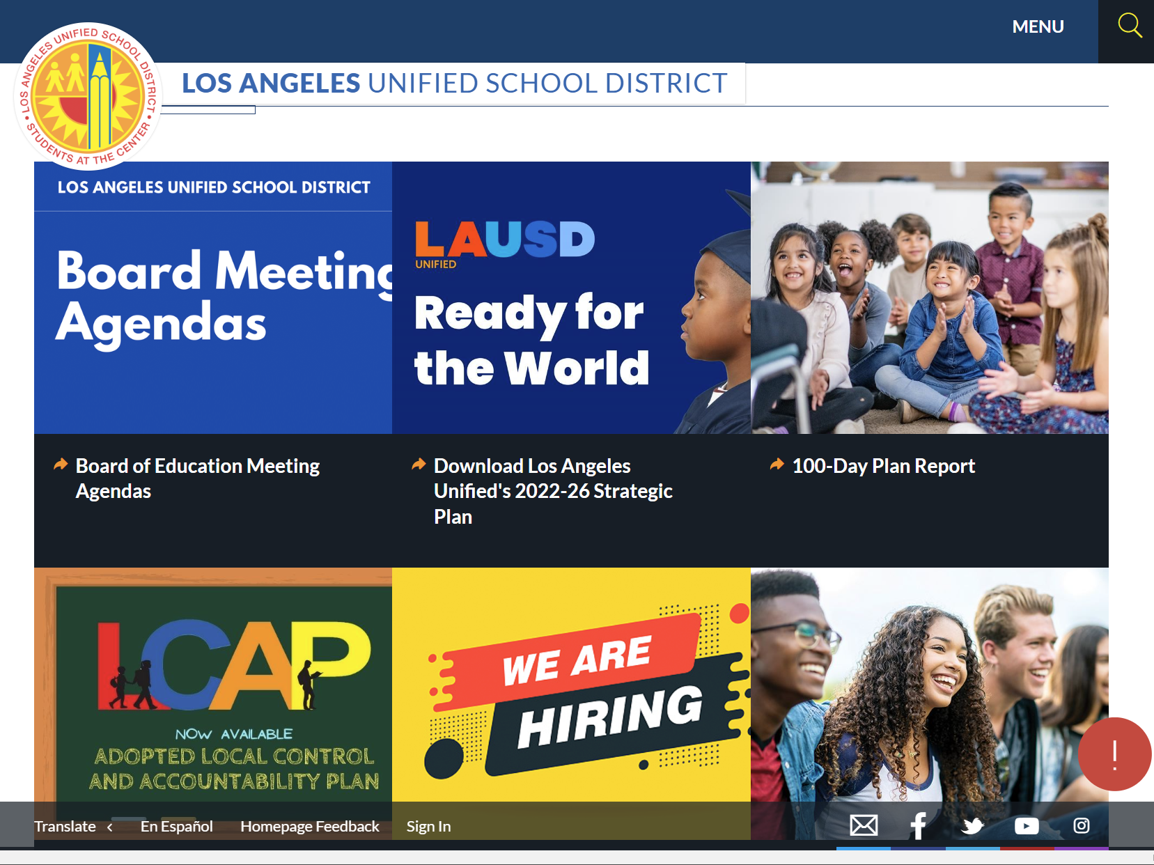
Accessing the Strategic Plan
Go To: https://achieve.lausd.net/Page/1
10

Slide 11
School Experience Survey Additional Resources
For more detailed information about how School Experience Survey data is used to support the Strategic Plan, please review the following presentation:
School Experience Survey Connections to the Strategic Plan [Available Now Online]
For more detailed information about how to access School Experience Survey results, please review the following presentation:
School Experience Survey: Accessing Results Using the SES Dashboard [Available Now Online]

Slide 12

School Experience Survey:
For more information…

Slide 13
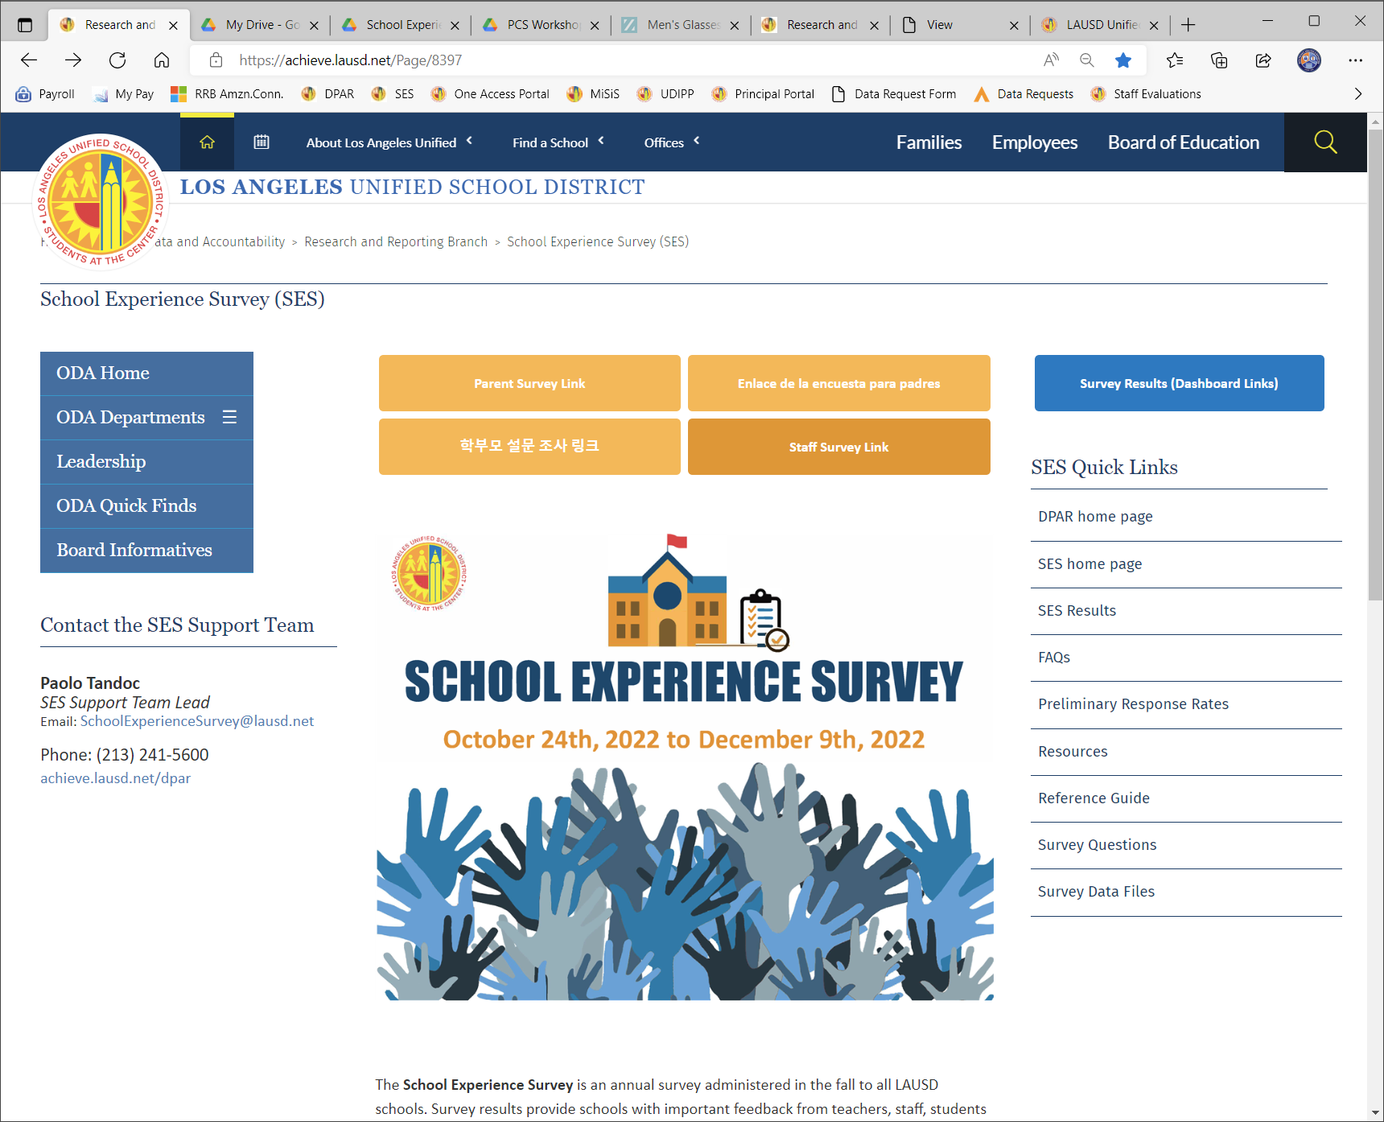
School Experience Survey Resources
School Experience Survey Website: https://achieve.lausd.net/Page/8397
On this page you will find the link to the 2021-22 Survey Results dashboard as well as useful information like Resources and Survey Questions

Slide 14
SES Support Team Contact Information
If you have any questions about the Survey, please send an email to the
School Experience Survey Support Team.
Email Address: SchoolExperienceSurvey@lausd.net

