Slide 1


School Experience Survey:
How to Access School Results

Slide 2

Where Do I Go for My School’s SES Results?
1. Go to this site: https://achieve.lausd.net/SchoolExperienceSurvey
2. Click here to access the Survey Results Dashboard with each school’s results
FYI: You can also click on “Survey Results SES Dashboard” to go to the page with all available survey results dashboards.

Slide 3
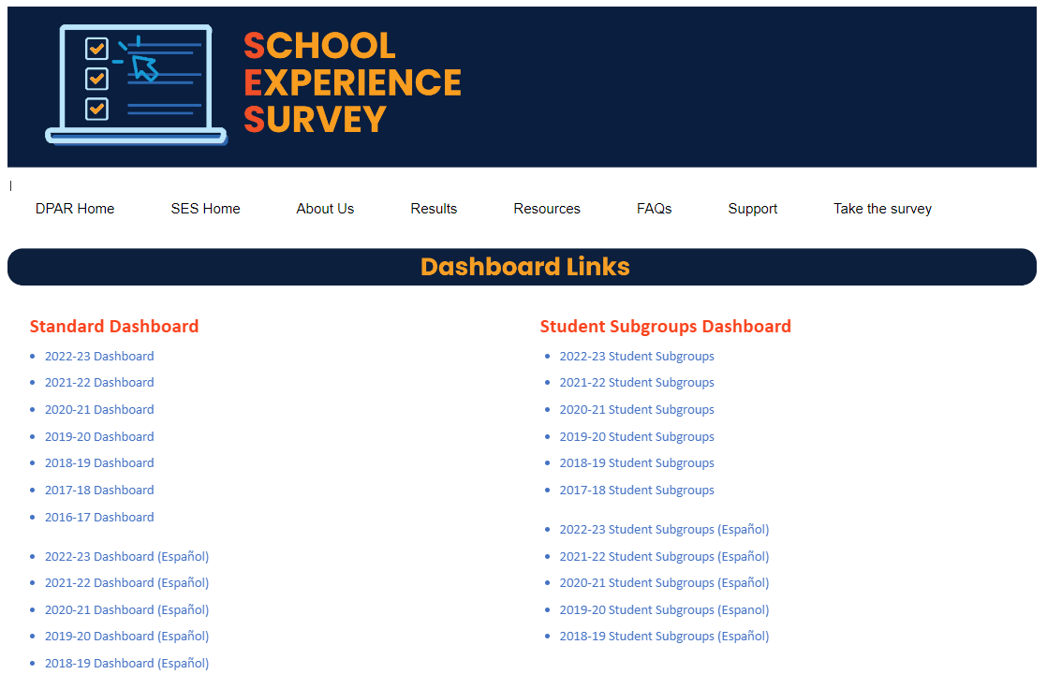
Links to ALL SES Results Dashboards
SES Results Dashboard Links: https://achieve.lausd.net/Page/19462
On this page you will find the link to the 2022-23 Survey Results Dashboard as well as the Student Subgroups Results Dashboard

Slide 4
Organization of the School Experience Survey Results Dashboard
The School Experience Survey (SES) is administered each fall to 4 “Groups” of people. Survey items are organized into 3 “Categories,” with several “Content Areas” each to further organize the survey items.
SES Groups | SES Categories
 | Academics | School Climate | Social-Emotional Learning
 | Content Areas: | Content Areas: | Content Areas:
Students: | Academic Focus | Bullying | Growth Mindset
 | Cognitive Engagement | Connectedness | Self-efficacy
 | Future Orientation | Expectations for Behavior | Self-management
 | Technology | Opp. for Part. & Leadership | Student Social Awareness
 |  | Safety | Self-Awareness
 |  |  | Responsible Decision-Making
All Staff: | Academic Focus | Resource Availability | n/a
 |  | Safety | n/a
 |  | School Climate Staff | n/a
 |  | School Climate Students | n/a
 |  | School Discipline | n/a
 |  | Student Behavior | n/a
Teachers: | Educator Development | Teaching Satisfaction | n/a
 | Focus on English Learners |  | n/a
 | Instructional Improvement |  | n/a
 | Integrated Technology |  | n/a
Parents: | Future Orientation | Customer Service | n/a
 | High Quality Schooling | Parent Engagement | n/a
 |  | Parent Involvement | n/a
 |  | Resource Availability | n/a
 |  | Safety | n/a

Slide 5
SES Results Dashboard Main Page: Key Areas and Things to Note
Survey results are available in the SES Dashboard: https://achieve.lausd.net/Page/19462
Key areas to look for on main page of SES Dashboard:
School / District / COS / BD
Group
Category
Content Areas
Participation Rates for each group (students, parents, staff, teachers)
Color-coded scale (“Strongly Disagree” to “Strongly Agree”)
Things to Note:
Number of responses to each item (if <11, results are suppressed)
Side-by-side comparison of school and LAUSD results

Slide 6
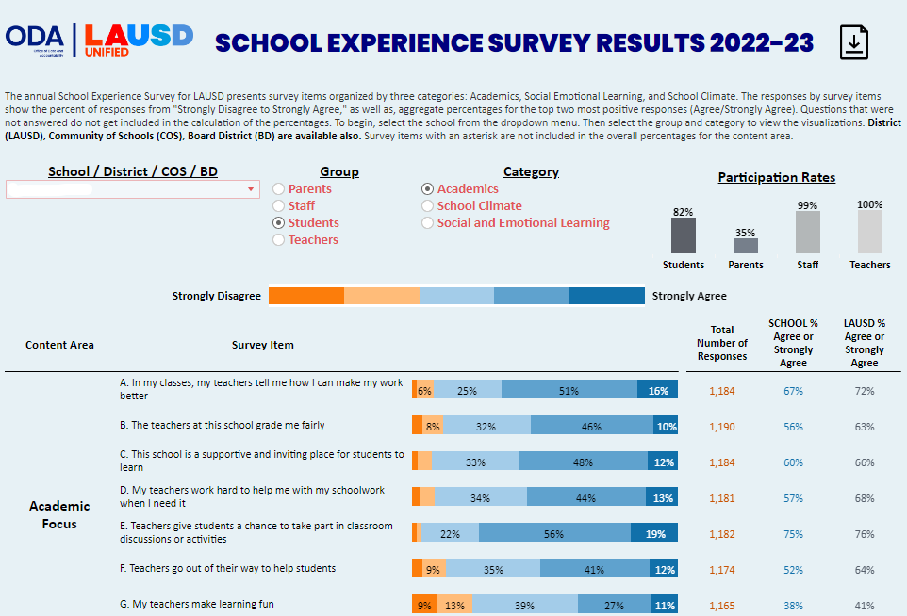
SES Results Dashboard: Main Page Key Areas
Participation rates for each group
Color-coded scale:
Orange = Strongly Disagree
Dark Blue = Strongly Agree
SCHOOL vs. LAUSD comparisons and “Number of Responses”

Slide 7
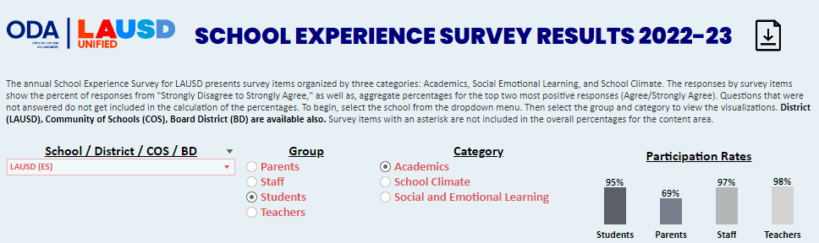
SES Dashboard: Selecting School
Click here to create PDF
Step 1. Use pull-down menu to choose School Name

Slide 8
SES Dashboard: Selecting Group and Category
Step 2. Select Group
(e.g. Students)
Step 3. Select Category
(e.g. Social-Emotional Learning)

Slide 9
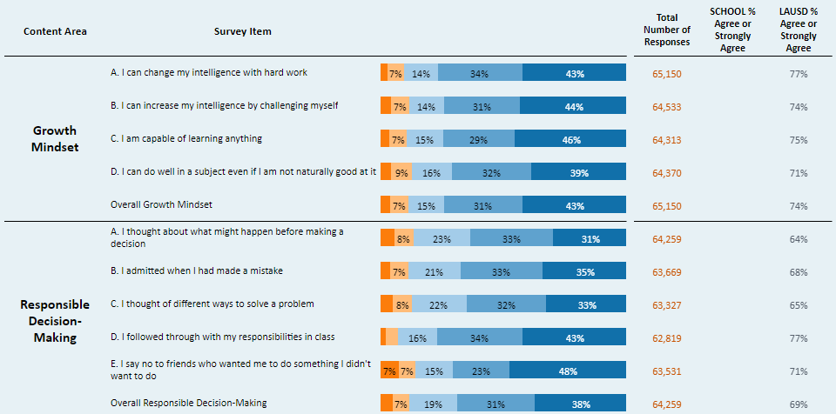
SES Dashboard: Content Areas and Survey Items
“Social-Emotional Learning”
Content
Areas
(2 of 6)
Note “Overall” results for Content Areas

Slide 10
School Experience Survey:
Student Subgroup Results Dashboard
Notes:
NOTE: AL PLACEHOLDER GRAPHICS. IF WE USE THESE SLIDES I WILL USE CURRENT GRAPHICS

Slide 11
Where Do I Go for My School’s SES Student Subgroup Results?
1. Go to this site: https://achieve.lausd.net/SchoolExperienceSurvey
2. Click here to access the Survey Results Dashboard for each school’s results
FYI: You can also click on “Survey Results SES Dashboard” to go to the page with all available survey results dashboards.

Slide 12
Links to ALL SES Results Dashboards
SES Results Dashboard Links: https://achieve.lausd.net/Page/19462
On this page you will find the link to the 2022-23 Survey Results Dashboard as well as the Student Subgroups Results Dashboard

Slide 13
Student Subgroup SES Results Dashboard
Survey results for each school are available in the SES Student Subgroup Dashboard: https://achieve.lausd.net/Page/19462
Key areas to look for on main page of dashboard:
School Name
Category & Content Area
“All” students + Grade Levels + 10 student subgroups (gender, race/ethnicity, programs) results for each item.
Things to Note:
Number of responses to each item (if <11, results are suppressed)
Overlay comparison of school and LAUSD results. District results are gray bars behind various-colored bars indicating school results.

Slide 14
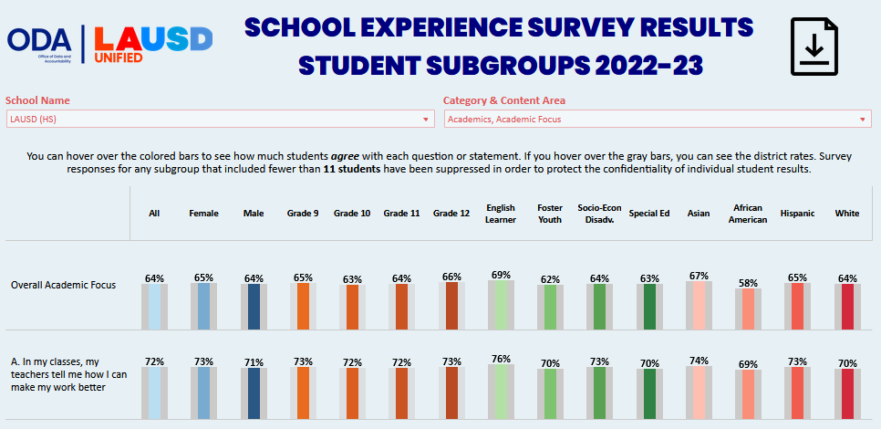
Student Subgroup SES Results Dashboard: Main Page
10 Subgroups
All students

Slide 15
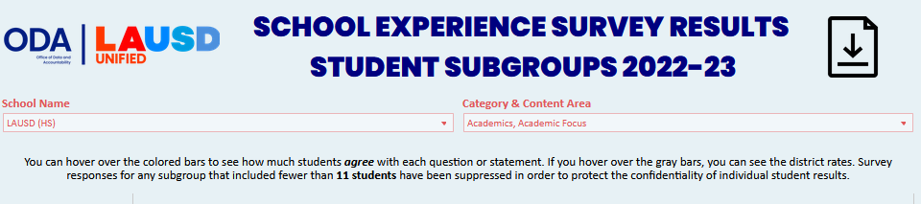
Student Subgroup SES Results Dashboard: Selecting School and Category
Click here to create PDF
Step 1. Use pull-down menu to choose School Name
Step 2. Select Category
(e.g. Academics, Academic Focus)

Slide 16
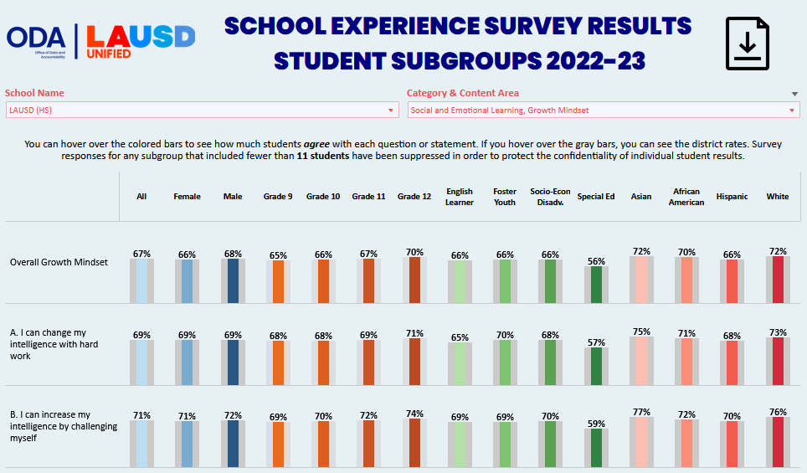
SES Dashboard: Social-Emotional Learning (SEL) Items
“Social-Emotional Learning” Content
Area (1 of 6)
Note “Overall” results for each Content Area

Slide 17
School Experience Survey: Support

Slide 18
School Experience Survey Resources
School Experience Survey Website: https://achieve.lausd.net/Page/8397
On this page you will find the link to the 2022-23 Survey Results dashboard
You will also find documents with survey information and questions in Resources

Slide 19

SES Support Team Contact Information
If you have any questions about the Survey, please send an email to the
School Experience Survey Support Team
Email Address: SchoolExperienceSurvey@lausd.net

