Slide 1


English Language Development (ELD) and the California ELD Standards
Parent and Community Services

Slide 2
Objectives
Understanding English Language Development (ELD) and the California ELD Standards (CA ELD Standards)
Supporting children’s language development in the home language and in English

Slide 3
1. Understanding English Language Development (ELD) and the California ELD Standards (CA ELD Standards)

Slide 4

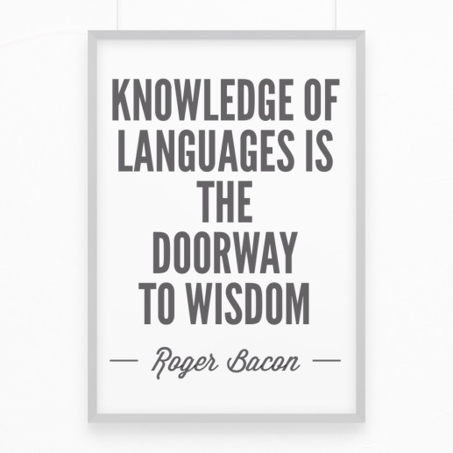


Grounding Activity

Slide 5



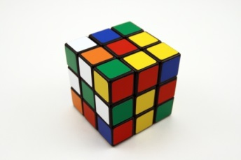

Why is language important?
essential for communication
convey inner thoughts and emotions
allows us to reveal higher intellectual processes
to make sense of complex and abstract thought
maintain culture

Slide 6

Why is it important to maintain the home language?
Group Activity
Personal: critical to identity
Social: links to family and community members
Educational: high academic achievement
Intellectual: develop and express complex thinking
Economic: increased employment opportunities
[©2000, IDRA. This article originally appeared in the IDRA Newsletter by the Intercultural Development Research Association. - See more at: http://www.idra.org/IDRA_Newsletter/January_2000_Bilingual_Education/Why_is_it_Important_to_Maintain_the_Native_Language?/#sthash.bSE3h2fm.dpuf

Slide 7
What does research say?
Literacy skills and knowledge transfer across languages.
Teaching students to read in their first language promotes higher levels of reading achievement.
The bilingual experience improves the brain’s executive function (planning and problem solving).

Slide 8




What must students be able to do with language?
Comprehend and evaluate ideas and complex text
Construct explanations
Justify answers
Convey ideas and information to others using academic language
Science
English Language Arts (ELA)
Math

Slide 9
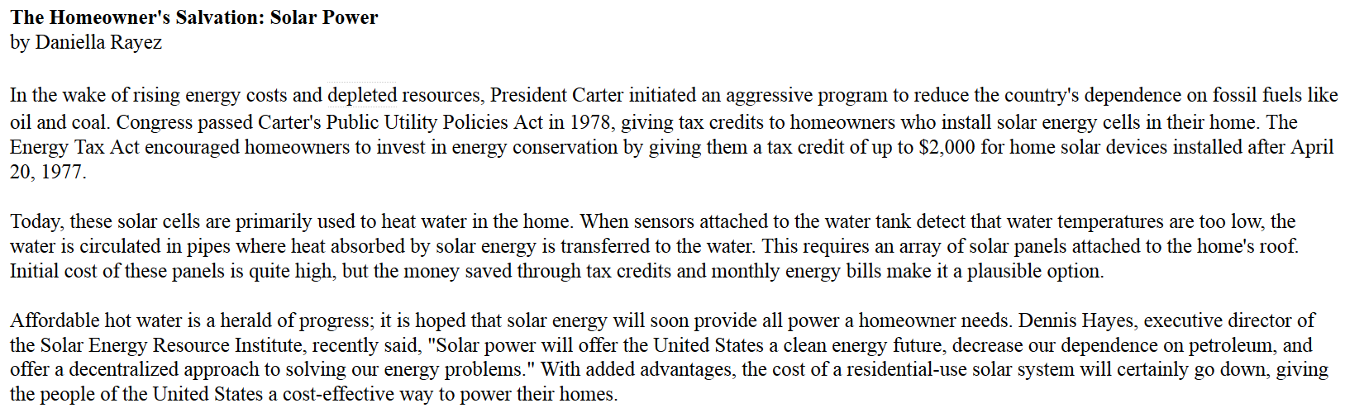
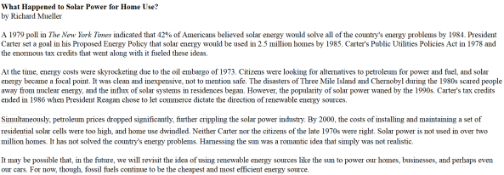
What must students be able to do in English language arts?
9th Grade
Smarter Balanced Assessment English Language Arts (ELA) Training Test Question
Read the sentences from “What Happened to Solar Power for Home Use”?
Simultaneously, petroleum prices dropped significantly, further crippling the solar power industry. By 2000, the cost of installing and maintaining a set of residential solar-cells were too high and home use dwindled
Based on the sentences, what can a reader conclude about the author’s predictions in “The Homeowner’s Salvation: Solar Energy”? Support your answer with evidence from the text.

Slide 10
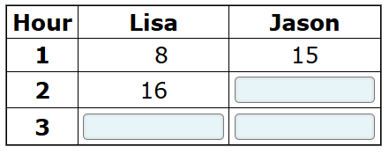
What must students be able to do in math?
9th Grade
Smarter Balanced Assessment Math Training Test Question
Lisa and Jason both deliver newspapers. In the first hour Jason delivered 15 newspapers. Lisa and Jason continue to deliver newspapers at the same rate for the next 2 hours.
Complete the table to show how many newspapers each delivers during the second and third hours.

Slide 11

What is English Language Development (ELD)?
What? Daily English instruction provided to all English
learners
Why? To help ELs learn English as quickly as possible
and understand and use academic
English
How? Comprehensive ELD
Goal: English learners are college and career ready

Slide 12
What is Comprehensive ELD?
Designated ELD
A specific time in the day during which ELs learn about how English works for successful participation in academic tasks.
Integrated ELD
Throughout the day and across subjects, ELs learn to use English as they develop academic English and academic content.
Source: CA ELA/ELD Framework

Slide 13
What are the CA ELD Standards?
What? Skills English learners need to master in English to
meet grade level expectations
Why? To help ELs perform at or above grade
level academic work in all content areas
Goal: English learners are college and career ready
Source: 2012 CA ELD Standards
Notes:
*

Slide 14


New California ELD Standards
OLD 1997 CA ELD Standards
NEW 2012 CA ELD Standards
Aligned to the CA ELA Content State Standards

Slide 15
Major Changes in ELD Standards
Handout 1
OLD 1997
NEW 2012
ELD proficiency levels:
Emerging
Expanding
Bridging
ELD proficiency Levels:
1 Beginning
2 Early Intermediate
3 Intermediate
4 Early Advanced
5 Advanced
ELD Standards by:
Part I - Interacting in Meaningful Ways
Part II -Learning About How English Works
Part III -Using Foundational Skills
ELD Standards by domains:
Reading
Writing
Listening
Speaking
Standards organized by grade spans:
(K-2, 3-5, 6-8, 9-12)
Standards organized by
grade level:
(K, 1, 2, 3, 4, 5, 6, 7, 8, 9-10, 11-12)

Slide 16
Major Changes in ELD Standards Cont.
OLD 1997
NEW 2012
ELD Standards addressed
during:
ELD – separate block of time
Throughout the day – with use of specialized strategies
ELD Standards addressed
during:
Designated ELD
Protected block of time
ELD standards are the focus
Integrated ELD
Throughout the day across the content areas
ELs learn to use English as they learn content knowledge

Slide 17
ELD Proficiency Levels
Emerging
Expanding
Bridging

Slide 18
Proficiency Level Descriptors
Emerging
Expanding
Bridging
Learning to use English for immediate needs as well as beginning to understand and use academic vocabulary
Applying their growing language skills in more sophisticated ways appropriate to their age and grade level
Applying high-level language skills in a variety of contexts. Transition to full engagement in grade-level academic tasks

Slide 19
3rd Grade Examples
Standard: Offering Opinions
Emerging
Expanding
Bridging
I think that oranges are good.
I agree with Mary and Tom that eating oranges is good.
That’s a good idea, but eating other fruits too is better.
Standard: Connecting Ideas
The deer and the lion came.
The deer ran because the mountain lion came.
The deer ran because the mountain lion approached them.

Slide 20
9th-10th Grade Examples
Standard: Supporting opinions and persuading others
Emerging
Expanding
Bridging
Would you say that again?
I see your point but I disagree with you.
I heard you say X, and I haven’t thought about that before. However…
Standard: Connecting Ideas
I want to read this book because it describes the solar system
He stayed at home on Sunday in order to study for Monday’s exam.
Women’s lives were changed forever after World War II as a result of joining the work force.

Slide 21


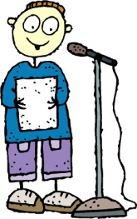

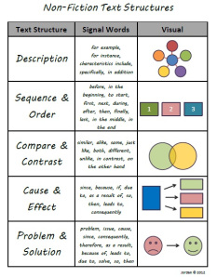
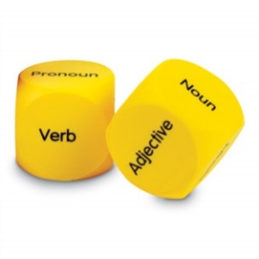

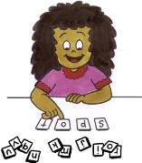

How are standards organized?
Handout 2
Part I: Interacting in Meaningful Ways
Part II: Learning About How English Works
Part III: Foundational Skills
Critical literacy skills needed in English language arts

Slide 22
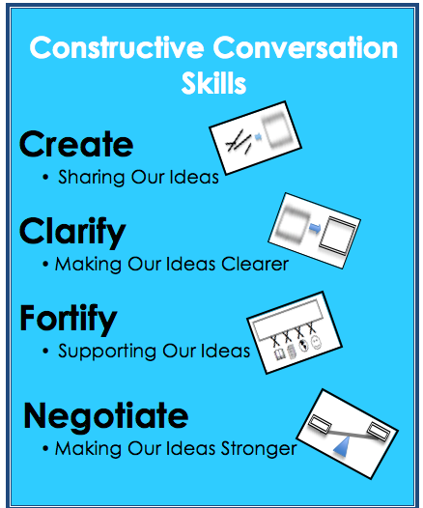
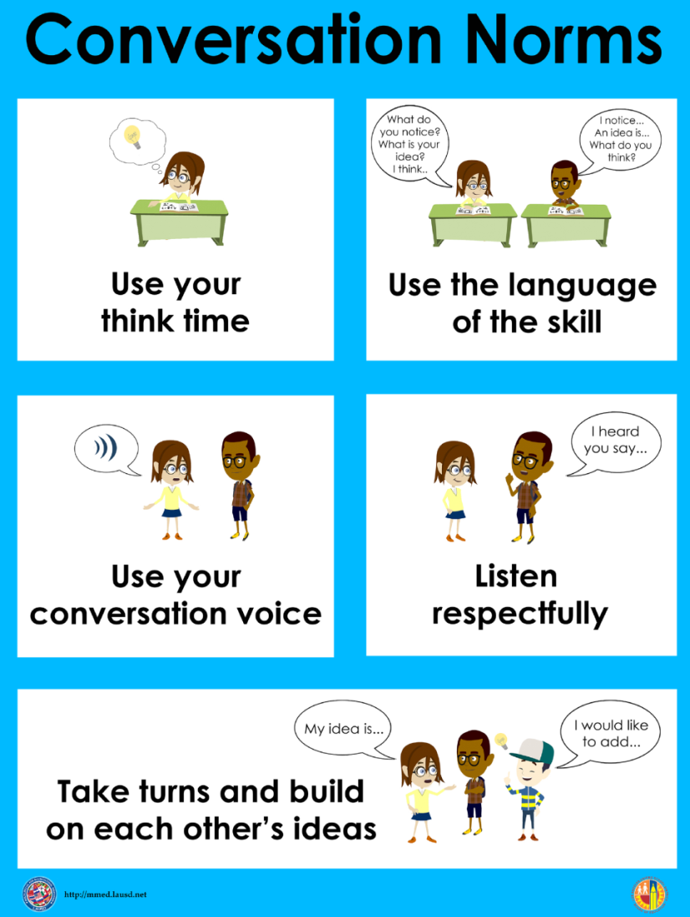
Posters Used in Classrooms

Slide 23
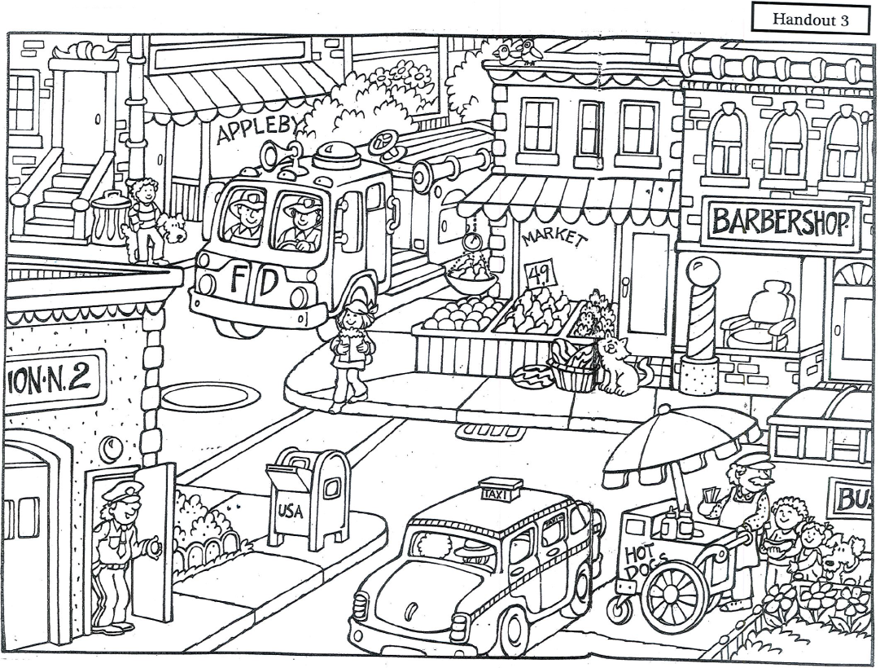
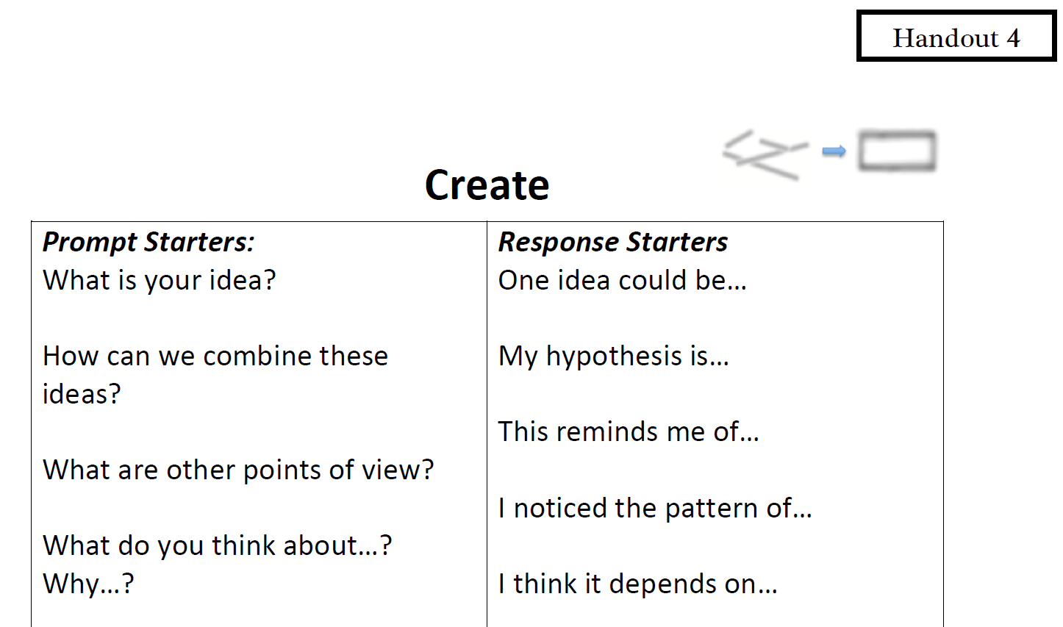
Constructive Conversation Skill Game
Handout 3 & 4

Slide 24

Constructive Conversation Skill Game
Use your think time to study the visual text.
Use the visual text and prompts to build your Constructive Conversation.
Take turns in a round robin fashion and use the language of the skill (Create) to build your Constructive Conversation.

Slide 25
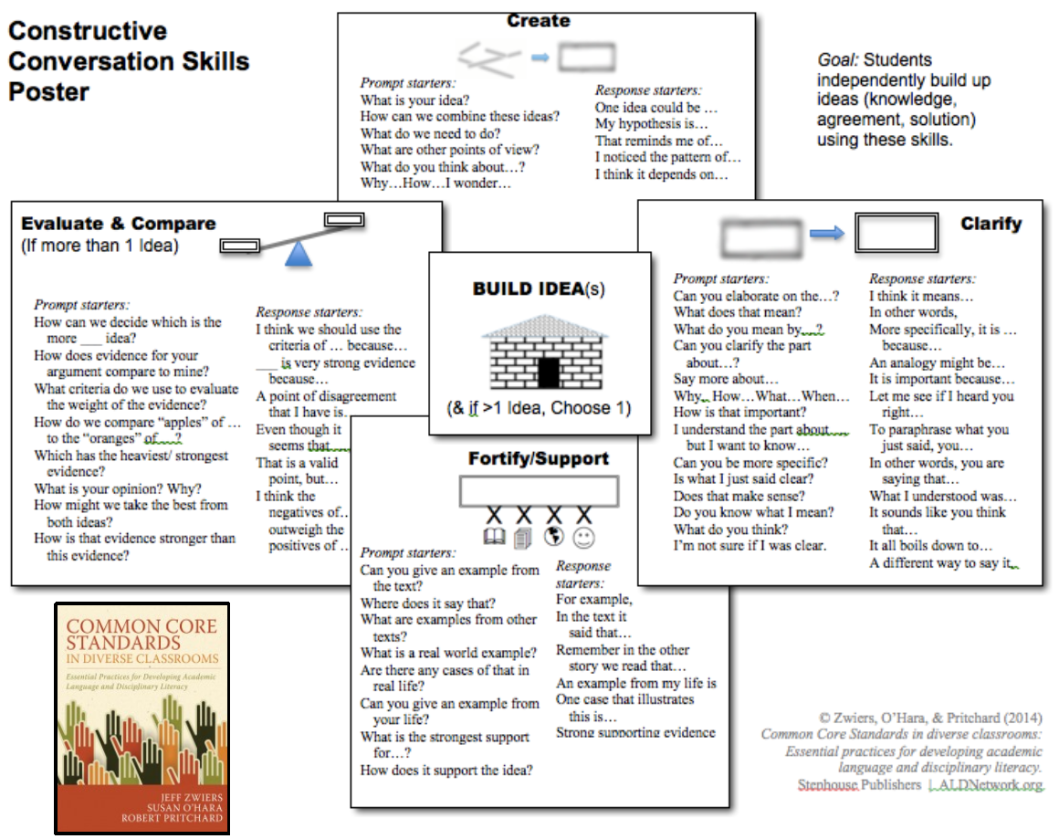
Classroom Poster
Handout 5

Slide 26
2. Supporting children’s language development in the home language and in English

Slide 27
Strategies for Language Development to Use at Home
Handout 6
Encourage children to use the home language. This will not interfere with learning English.
As you read to children or talk with them, pause to let them ask questions, make comments, and complete ideas. Seek out your child’s opinion. For example, ask, “What do you think we need to do?”
Talk daily about everyday events and activities.

Slide 28
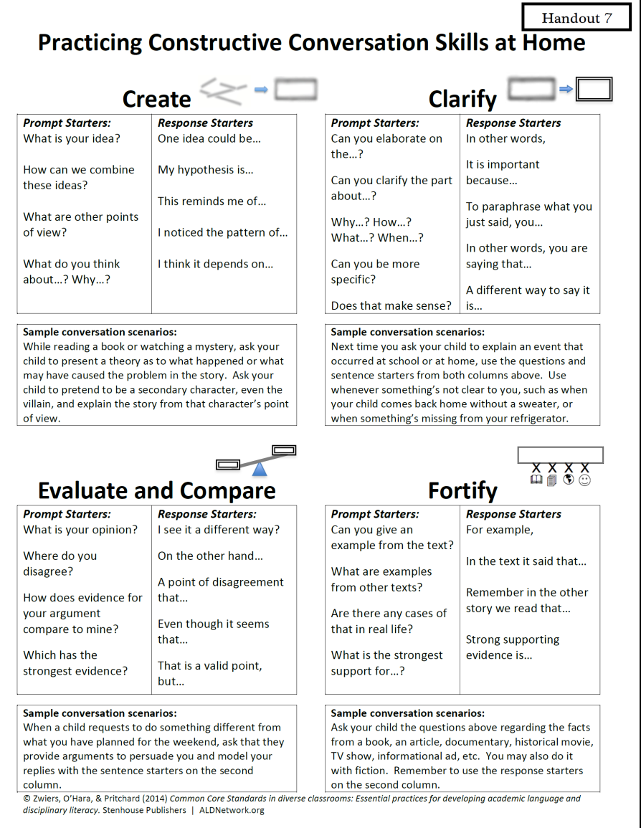
Practicing Constructive Conversation Skills at Home
Handout 7

Slide 29
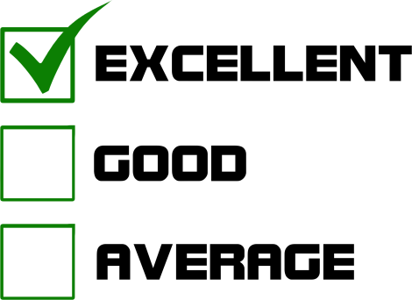
How do you know if your child is making good progress?
Handout 8
Communicate with teachers.
Ask for additional meetings with teachers if you have concerns.
Talk to the EL Designee and/or counselors.
Use the Taking Action form.

Slide 30

Reflection
“…it is up to you to create a warm and comfortable environment in which your child can grow to learn the complexities of language. The communication skills that your child learns early in life will be the foundation for his or her communication abilities for the future. Strong language skills are an asset that will promote a lifetime of effective communication.”
By Leonardo De Valoes, Adjunct Faculty 2014

Slide 31

For all you do,
We Appreciate you!
Thank you for your participation.

