Slide 1

School Site Council (SSC) Parent
Election
Date:_____
Bulletin 6475.6 Guidelines for Required School Site Council and English Learner Advisory Committee
Elección de Padres del Consejo del Plantel Escolar (SSC)
Fecha: ____________
Boletin 6475.6 Normas para el requerido Consejo del Plantel Escolar y el Comité Asesor para Aprendices de Inglés
Notes:
Click

Slide 2


Welcome Bienvenidos
Principal
Director(a)
Student Body President
Presidente Estudiantil
Community Representative
Representante de Comunidad
School Title I Designee
Designada(o) del Programa Título I
English Learner Program Designee
Designada(o) del Programa de Aprendices de Inglés
name
name
name
name
name
School Leadership Team /Equipo de Liderazgo Escolar
Notes:
To do: Complete slide. Please ensure that each school leadership member offers a warm greeting.
Click

Slide 3

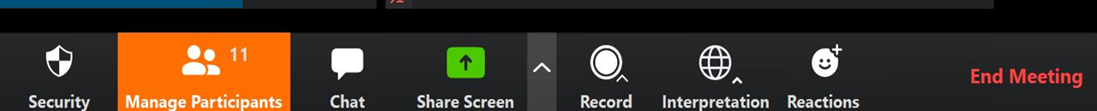
Interpretation Services: Laptop or Computer
Servicios de interpretación: computadora portátil o de escritorio
Click on the globe icon at the bottom of the screen.
Select the language of preference for you.
You will engage and listen to the presentation in the language you select.
Haga clic en el símbolo del mundo en la parte de abajo de su pantalla.
Seleccione el idioma que le gustaría escuchar.
Participará y escuchará la presentación en el idioma que seleccione.
Notes:
Say: We have interpretation services if you are joining us on a computer.
I am sorry Chromebooks don’t offer the translation feature. If you are on a Chromebook, please stay on your computer for so you can see us on the screen and use the chat feature. For audio join us via phone.
I will provide more guidance shortly.
For those that are on the computer ,please click on the globe icon at the bottom of the screen.
Select the language of preference for you.
You will engage and listen to the presentation in the language you select.
Click

Slide 4


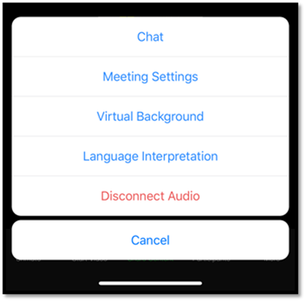
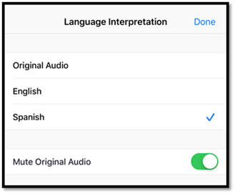
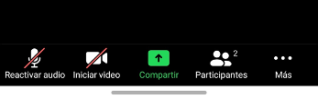
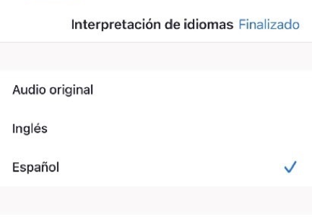
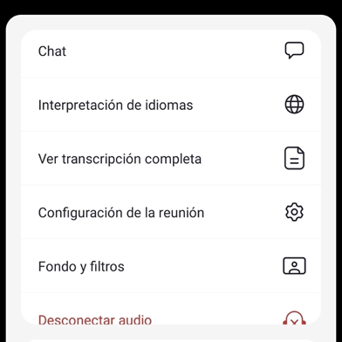
Interpretation Services: Mobile Device
Servicios de interpretación: dispositivo móvil
Notes:
Say: For those who are joining us via phone, please click on the three dots.
Select Language Interpretation.
Select language of preference.
Click on Done.
Click

Slide 5
Steps to Rename Yourself on Zoom
Cómo cambiar el nombre en su pantalla
Step 1: Hover over your picture located by the picture gallery with your cursor and search for the three dots found on the top right-hand corner of your picture.
Step 2: Click the three-dotted icon found over your picture.
Step 3: Click More.
Step 4: Choose Rename
Step 5: Enter the full name used when you enrolled your students at the school site, then click Save to finish the change.
Paso 1: Ponga su cursor en su foto ubicada en la galería de fotos y busque los tres puntitos en la esquina de la parte derecha de su rectángulo con su foto.
Paso 2: Haga clic en los tres puntitos que están en su foto.
Paso 3: Haga clic en Más.
Paso 4: Escoja Re nombrar
Paso 5: Ingrese su nombre completo de la manera que lo escribió al matricular a sus estudiantes en el plantel escolar, después haga clic en Guardar para aceptar el cambio.
Notes:
Say: In order to know who is in the room, please follow the following 5 steps:
Step 1: Hover over your picture located by the picture gallery with your cursor and search for the three dots found on the top right-hand corner of your picture.
Step 2: Click the three-dotted icon found over your picture.
Step 3: Click More.
Step 4: Choose Rename to change your screen name displayed to other participants.
Step 5: Enter the full name used when you enrolled your students at the school site, then click Save to finish the change.
Click

Slide 6

Engaging on Zoom
Participación por medio de Zoom
If you need assistance accessing Zoom for this meeting, send an email to ___________ and a team member will assist you.
Zoom includes a “Chat” tab where you can type your questions for the presenters.
Si necesita ayuda con acceder a Zoom para esta reunion, envie un coreo a _______________ y un miembro de nuestro equipo le ayudara.
Zoom tiene una pistaña de Chat en donde usted puede hacer preguntas a los presentadores.
Notes:
To do: Add contact e-mail.
Say: If you need assistance accessing Zoom for this meeting, send an email to ___________ and a team member will assist you. Zoom includes a “Chat” tab where you can type your questions for the presenters.
Click

Slide 7

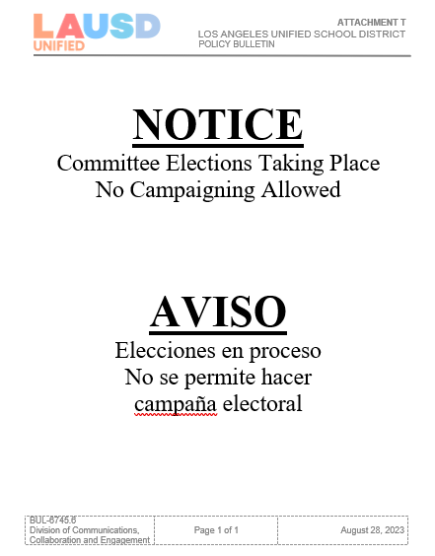
Sign In
Attendance:
Welcome! Please sign in on the Chat.
Please enter your first and last name and indicate if you are a parent/legal guardian of a student at the school site, community member, staff or visitor.
Parents/legal guardians, please type your child’s first and last name.
Lista de Asistencia
Asistencia:
¡Bienvenidos! Por favor, registrarse en el “Chat”.
Favor de escriba su nombre y apellido e indique si usted es un padre o madre/tutor legal, miembro de la comunidad, o visitante.
Padre o madre/tutor legal, por favor también escriban el nombre y apellido de su estudiante.
Notes:
Say: Please note that this meeting is being recorded.
In order to know who is in the room, please use the Chat as the sign-in to this meeting.
Please enter your first and last name and indicate if you are a parent/legal guardian of a student at the school site, community member, or visitor.
Parents/legal guardians, please type your child’s first and last name.
Click

Slide 8

Greetings!
Notes:
Say: Welcome and thank you for being part of the SSC for this school year.
Click

Slide 9
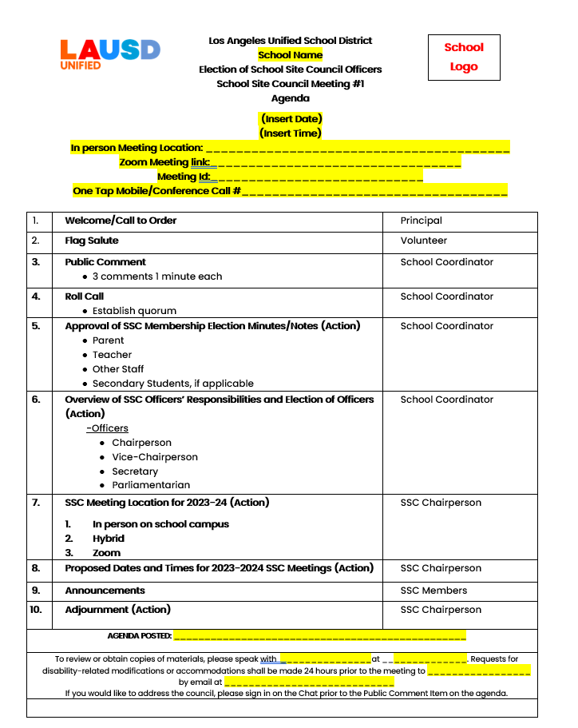
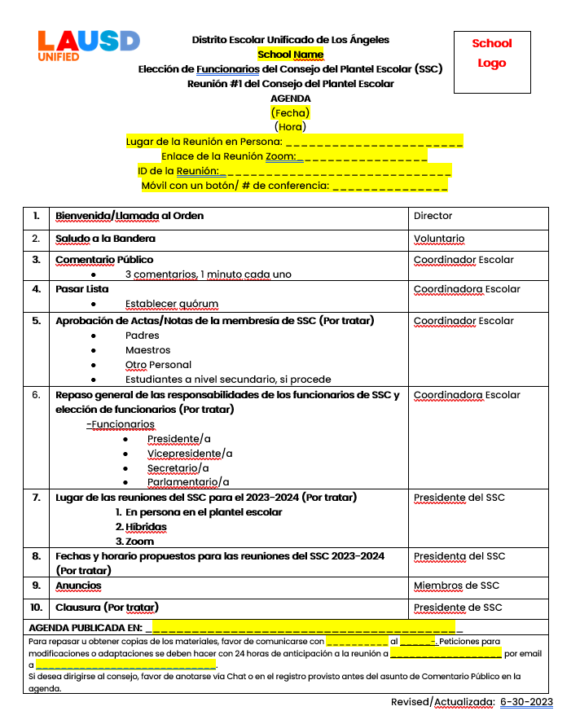
Agenda
Agenda
Please insert your agenda on this slide.
Notes:
Say: this is today’s agenda
Click

Slide 10

Pledge of Allegiance
Juramento a la Bandera
I pledge allegiance to the flag of the United States of America and to the Republic for which it stands, one nation under God, indivisible, with liberty and justice for all.
Prometo lealtad a la bandera de los estados Unidos de América y a la Republica que representa, una Nación ante Dios, indivisible con Libertad y justicia para todos.
Notes:
Say: Might I have a volunteer lead us in the Pledge of Allegiance?
Click

Slide 11
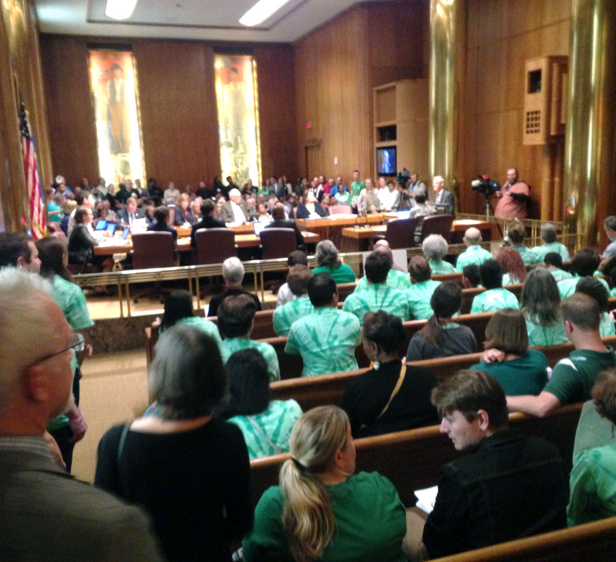
Public Comment
Comentario Publico

Slide 12
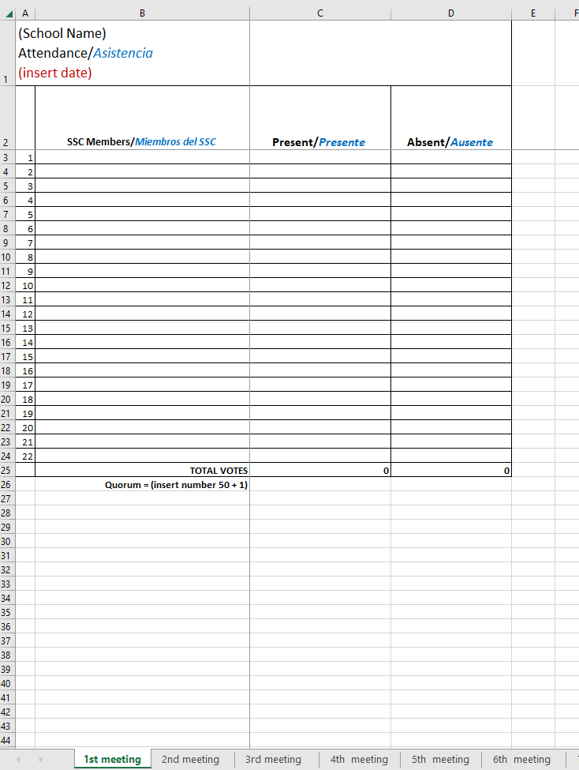
Roll Call Establishment of Quorum
Pasar Lista
Establecimiento de quorum
Notes:
To do: Use the attendace excel sheet in tools for school on at each meeting.
Say: Thank you let’s see who is with us today.
Read each name on the list and mark them absent or presented.
Say: We have ___ members present.
Quorum has been established with ____ present.
Or
We don’t have quorum, because we need ____ present
Click

Slide 13

Formation Waiver Request
Petición de una extensión de formación

Slide 14

Approval of SSC Membership Election Minutes/Notes
Aprobación de Actas/Notas de la membresía de SSC
Actas de la Elección de Padres
Notas de la Elección Maestros
Notas de la Elección Otro Personal
Notas Estudiantes a nivel secundario
Parent Election Minutes
Teacher Election Minutes
Other Staff Election Minutes
Student (Secondary Schools) Election Minutes
Notes:
Say: Might I have a volunteer lead us in the Pledge of Allegiance?
Click

Slide 15
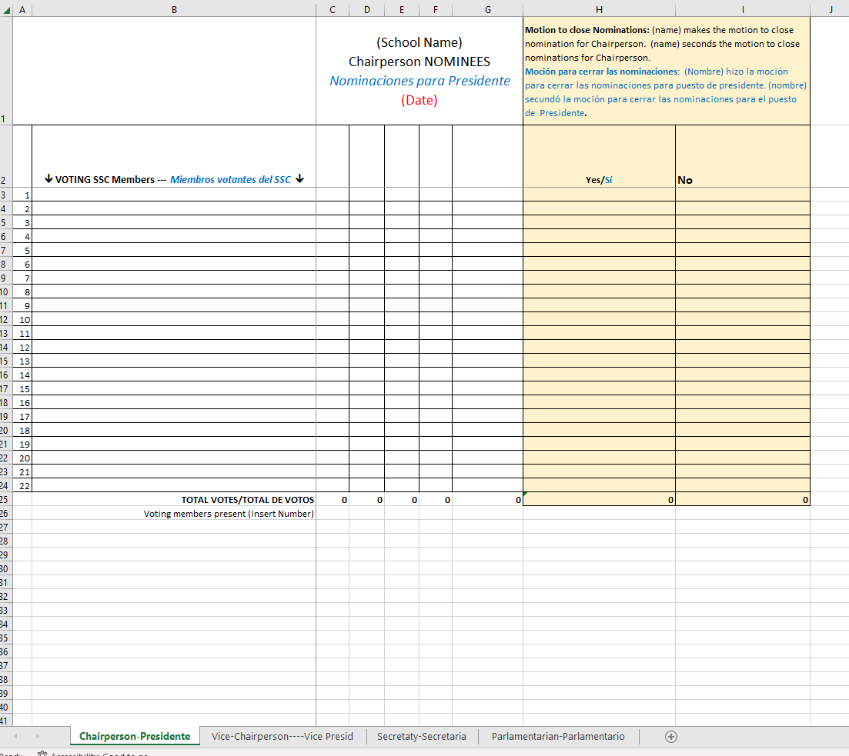
Motion regarding Approval of SSC membership Election Minutes/Notes
Moción acerca de Aprobación de Actas/Notas de la membresía de SSC
Notes:
To do:
Make sure that on the names of all parents/legal guardians that are present are on the second column, starting on the third row.
Once all names are displayed, state how many seats are available.
Open the floor for nominations.
Type the names of the community members who accept their nominations or self-nominate.
Ask the question three times, “Is anyone else interested?”
If none are interested, ask for a motion from the parents to close nominations.
Add the name of the person making the motion.
Add the name of the person who seconded the motion.
Repeat the motion audibly and take a roll call vote.
Once you have finished taking the roll call vote, continue by saying the following:
Please state your name and who you are voting for.
Once everyone has voted, please announce the results.
Display the Excel sheet.
Click

Slide 16
SSC Officer Election
Elección de Miembros de Oficiales del SSC

Slide 17

SSC Officers
Oficiales de SSC
CHAIRPERSON
• Preside at all meetings of the SSC, ensuring all rules and bylaws are followed.
• Sign all letters, reports, and other communications of the SSC.
• Perform all duties relevant to the office of the Chairperson.
• Participate in the planning of meeting agendas.
• Have other such duties as prescribed by the SSC.
PRESIDENTE/A
• Encabezar todas las reuniones del SSC, asegurándose que se cumple con todas la reglas y estatutos.
• Firmar todas las cartas, informes y cualquier otro tipo de comunicación del SSC
• Desempeñar otros deberes apropiados para el cargo de Presidente.
• Participar en la planificación de las agendas para la reunión.
• Desempeñar otros deberes asignados por SSC.
Notes:
Say: SSC has four officers. I will share a little about each of their responsibilities, which we will review again when we have officer elections.
The first one is Chairperson. (Read descriptions below)
CHAIRPERSON
Preside at all meetings.
Sign all letters, reports and other communications of the council.
Perform all duties relevant to the office of the Chairperson.
Participate in the planning of the meeting agendas.
Have other such duties as are prescribed by the council.
Click VICE-CHAIRPERSON
Represent the Chairperson in assigned duties.
Substitute for the Chairperson in his or her absence.
Participate in the planning of the agenda.
Click SECRETARY
Conduct roll call to establish quorum.
Keep minutes of all regular and additional meetings of the council.
Provide the signed and dated original meeting minutes to the principal or designee.
Assist in keeping the records of the council.
Maintain a current roster of the council members.
Perform other such duties as are assigned by the Chairperson.
Participate in the planning of the agenda
Click PARLIAMENTARIAN
Assist the Chairperson in ensuring all rules and bylaws are followed.
Be knowledgeable about the California Open Meeting Law (Greene Act), District policies, bylaws of the council, and selected parliamentary procedures.
Participate in the planning of the agenda.

Slide 18
Motion regarding Chairperson position
Moción acerca de la posición de Presidente
Notes:
To do:
Make sure that on the names of all parents/legal guardians that are present are on the second column, starting on the third row.
Once all names are displayed, state how many seats are available.
Open the floor for nominations.
Type the names of the community members who accept their nominations or self-nominate.
Ask the question three times, “Is anyone else interested?”
If none are interested, ask for a motion from the parents to close nominations.
Add the name of the person making the motion.
Add the name of the person who seconded the motion.
Repeat the motion audibly and take a roll call vote.
Once you have finished taking the roll call vote, continue by saying the following:
Please state your name and who you are voting for.
Once everyone has voted, please announce the results.
Display the Excel sheet.
Click

Slide 19
SSC Officers
Oficiales de SSC
VICE-CHAIRPERSON
Represent the Chairperson in assigned duties.
Serve as the Chairperson in his or her absences from a meeting.
Participate in the planning of meeting agendas
VICE-PRESIDENTE
Representar al Presidente en sus deberes asignados
Fungir como el Presidente en su ausencia en las reuniones.
Participar en la planificación de las agendas para la reunión.
Notes:
Say: SSC has four officers. I will share a little about each of their responsibilities, which we will review again when we have officer elections.
The first one is Chairperson. (Read descriptions below)
CHAIRPERSON
Preside at all meetings.
Sign all letters, reports and other communications of the council.
Perform all duties relevant to the office of the Chairperson.
Participate in the planning of the meeting agendas.
Have other such duties as are prescribed by the council.
Click VICE-CHAIRPERSON
Represent the Chairperson in assigned duties.
Substitute for the Chairperson in his or her absence.
Participate in the planning of the agenda.
Click SECRETARY
Conduct roll call to establish quorum.
Keep minutes of all regular and additional meetings of the council.
Provide the signed and dated original meeting minutes to the principal or designee.
Assist in keeping the records of the council.
Maintain a current roster of the council members.
Perform other such duties as are assigned by the Chairperson.
Participate in the planning of the agenda
Click PARLIAMENTARIAN
Assist the Chairperson in ensuring all rules and bylaws are followed.
Be knowledgeable about the California Open Meeting Law (Greene Act), District policies, bylaws of the council, and selected parliamentary procedures.
Participate in the planning of the agenda.

Slide 20
Motion regarding Vice-Chairperson position
Moción acerca de la posición de Vicepresidente
Notes:
To do:
Make sure that on the names of all parents/legal guardians that are present are on the second column, starting on the third row.
Once all names are displayed, state how many seats are available.
Open the floor for nominations.
Type the names of the community members who accept their nominations or self-nominate.
Ask the question three times, “Is anyone else interested?”
If none are interested, ask for a motion from the parents to close nominations.
Add the name of the person making the motion.
Add the name of the person who seconded the motion.
Repeat the motion audibly and take a roll call vote.
Once you have finished taking the roll call vote, continue by saying the following:
Please state your name and who you are voting for.
Once everyone has voted, please announce the results.
Display the Excel sheet.
Click

Slide 21
SSC Officers
Oficiales de SSC
SECRETARIO/A
Registrar actas para todas las reuniones de SSC.
Proporcionar copias exactas de las actas de dichas reuniones a los miembros de SSC y a la persona designada en la escuela de Título I.
Ayudar con mantener los registros del SSC.
Mantener una lista actualizada de los miembros del SSC.
Desempeñar otros deberes asignados por el Presidente del SSC.
Participar en la planificación de la agenda
SECRETARY
Keep minutes of all meetings of the SSC.
Transmit true and correct copies of the minutes of such meetings to members of the SSC and school Title I designee.
Assist in keeping the records of the SSC.
Maintain a current roster of SSC members.
Perform other such duties as are assigned by the Chairperson of the SSC.
Participate in the planning of the agenda.
Notes:
Say: SSC has four officers. I will share a little about each of their responsibilities, which we will review again when we have officer elections.
The first one is Chairperson. (Read descriptions below)
CHAIRPERSON
Preside at all meetings.
Sign all letters, reports and other communications of the council.
Perform all duties relevant to the office of the Chairperson.
Participate in the planning of the meeting agendas.
Have other such duties as are prescribed by the council.
Click VICE-CHAIRPERSON
Represent the Chairperson in assigned duties.
Substitute for the Chairperson in his or her absence.
Participate in the planning of the agenda.
Click SECRETARY
Conduct roll call to establish quorum.
Keep minutes of all regular and additional meetings of the council.
Provide the signed and dated original meeting minutes to the principal or designee.
Assist in keeping the records of the council.
Maintain a current roster of the council members.
Perform other such duties as are assigned by the Chairperson.
Participate in the planning of the agenda
Click PARLIAMENTARIAN
Assist the Chairperson in ensuring all rules and bylaws are followed.
Be knowledgeable about the California Open Meeting Law (Greene Act), District policies, bylaws of the council, and selected parliamentary procedures.
Participate in the planning of the agenda.

Slide 22
Motion regarding Secretary position
Moción acerca de la posición de Secretaria
Notes:
To do:
Make sure that on the names of all parents/legal guardians that are present are on the second column, starting on the third row.
Once all names are displayed, state how many seats are available.
Open the floor for nominations.
Type the names of the community members who accept their nominations or self-nominate.
Ask the question three times, “Is anyone else interested?”
If none are interested, ask for a motion from the parents to close nominations.
Add the name of the person making the motion.
Add the name of the person who seconded the motion.
Repeat the motion audibly and take a roll call vote.
Once you have finished taking the roll call vote, continue by saying the following:
Please state your name and who you are voting for.
Once everyone has voted, please announce the results.
Display the Excel sheet.
Click

Slide 23
SSC Officers
Oficiales de SSC
PARLIAMENTARIAN
Assist the Chairperson in ensuring all rules and bylaws are followed.
Vote on any matter submitted for a vote.
Be knowledgeable about the bylaws of the Council, the parliamentary procedure prescribed by Robert’s Rules of Order, and the California Open Meeting Law (Greene Act).
Participate in the planning of the agenda.
PARLAMENTARIO
Ayudar a Presidente para garantizar que todos los reglamentos estatus se cumplan.
Participar en la votación de cualquier asunto que se someta a voto.
Estar informado sobre los estatutos del consejo, los procedimientos parlamentarios, la selección del Reglamento del Orden Parlamentario de Roberto y la Ley de Reuniones Públicas de California (Decreto Greene).
Participar en la planificación de la agenda
Notes:
Say: SSC has four officers. I will share a little about each of their responsibilities, which we will review again when we have officer elections.
The first one is Chairperson. (Read descriptions below)
CHAIRPERSON
Preside at all meetings.
Sign all letters, reports and other communications of the council.
Perform all duties relevant to the office of the Chairperson.
Participate in the planning of the meeting agendas.
Have other such duties as are prescribed by the council.
Click VICE-CHAIRPERSON
Represent the Chairperson in assigned duties.
Substitute for the Chairperson in his or her absence.
Participate in the planning of the agenda.
Click SECRETARY
Conduct roll call to establish quorum.
Keep minutes of all regular and additional meetings of the council.
Provide the signed and dated original meeting minutes to the principal or designee.
Assist in keeping the records of the council.
Maintain a current roster of the council members.
Perform other such duties as are assigned by the Chairperson.
Participate in the planning of the agenda
Click PARLIAMENTARIAN
Assist the Chairperson in ensuring all rules and bylaws are followed.
Be knowledgeable about the California Open Meeting Law (Greene Act), District policies, bylaws of the council, and selected parliamentary procedures.
Participate in the planning of the agenda.

Slide 24
Motion regarding Parliamentarian position
Moción acerca de la posición de Parlamentario
Notes:
To do:
Make sure that on the names of all parents/legal guardians that are present are on the second column, starting on the third row.
Once all names are displayed, state how many seats are available.
Open the floor for nominations.
Type the names of the community members who accept their nominations or self-nominate.
Ask the question three times, “Is anyone else interested?”
If none are interested, ask for a motion from the parents to close nominations.
Add the name of the person making the motion.
Add the name of the person who seconded the motion.
Repeat the motion audibly and take a roll call vote.
Once you have finished taking the roll call vote, continue by saying the following:
Please state your name and who you are voting for.
Once everyone has voted, please announce the results.
Display the Excel sheet.
Click

Slide 25
New SSC Officers/Nuevos Oficiales de SSC
CHAIRPERSON/PRESIDENTE/A _____________
VICE-CHAIRPERSON/VICE-PRESIDENTE _____________
SECRETARY/SECRETARIO/A ___________
PARLIAMENTARIAN/PARLAMENTARIO ____________
Notes:
Introduce your newly elected SSC officers.

Slide 26
Vote Votación
SSC Meeting Location for 2023-24 (Action)
In person on school campus​
Hybrid
Zoom
Lugar de las reuniones del SSC para el 2023-2024 (Por tratar)
En persona en el plantel escolar
Híbridas
Zoom
Notes:
Introduce your newly elected SSC officers.

Slide 27
Motion regarding Location and time of SSC meetings
Moción acerca del horario y locación de la reunión
Notes:
To do:
Make sure that on the names of all parents/legal guardians that are present are on the second column, starting on the third row.
Once all names are displayed, state how many seats are available.
Open the floor for nominations.
Type the names of the community members who accept their nominations or self-nominate.
Ask the question three times, “Is anyone else interested?”
If none are interested, ask for a motion from the parents to close nominations.
Add the name of the person making the motion.
Add the name of the person who seconded the motion.
Repeat the motion audibly and take a roll call vote.
Once you have finished taking the roll call vote, continue by saying the following:
Please state your name and who you are voting for.
Once everyone has voted, please announce the results.
Display the Excel sheet.
Click

Slide 28
Announcements Anuncios
Notes:
Say: Thank you we have these recourse for you to support your work.
Click

Slide 29

Resources Recursos
Notes:
Say: Thank you we have these recourse for you to support your work.
Click

Slide 30

Resources Recursos
This Photo by Unknown Author is licensed under CC BY-SA
Notes:
Say: Thank you we have these recourse for you to support your work.
Click

Slide 31

Bulletin 6745.6 Guidelines for the Required
School Site Council and English Learner Advisory Committee
Boletín 6745.6 Normas para el Requerido Consejo del Plantel
Escolar y el Comité Asesor para Aprendices de Ingles
Bulletin 6745.6 is available in English and Spanish: El Boletín 6745.6 esta disponible en Ingles y Español:
https://lausd.org/SFACE
Notes:
Say: One of the structures that grew out of the Civil Rights Movement in our work with Title I is the School Site Council. It is meant to be a group with diverse stakeholders coming together to share their voices on how to help our highest need students and families receive the support needed to increase their academic achievement and wellness. Our District provides guidance on the School Site Council in Bulletin 6745.5.
Bulletin 6745.5 that contains the guidelines for SSC and the English Learner Advisory Committee, as well as a variety of templates to support the work of SSC members and officers.
You can download a copy of the Bulletin by going to https://achieve.lausd.net/pcss
Note: The Word version of all templates is available on this website under the Tools for Schools tab under the SSC heading: https://achieve.lausd.net/Page/11304
Click

Slide 32


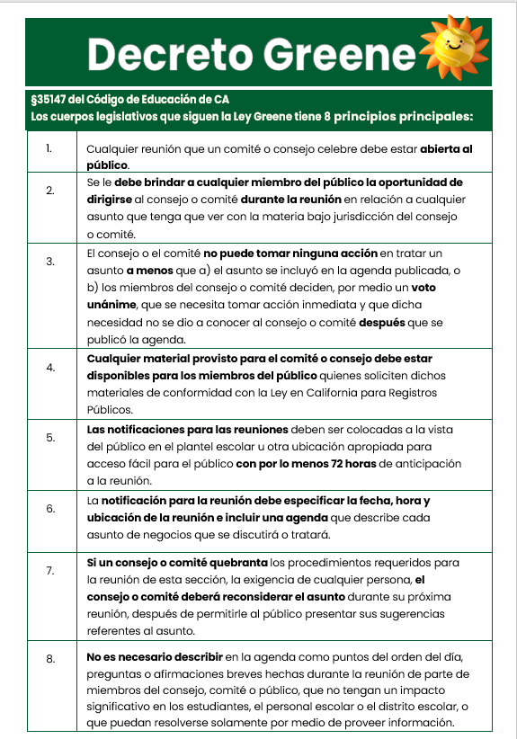
Handouts
Hojas Informativas
LAUSD Operating Norms And Code Of Conduct For The SSC And The ELAC
Normas de Funcionamiento de LAUSD Para El SSC y ELAC
Greene Act
Decreto Greene
Notes:
Say: If you become a member, these are some key items you need to be know.
Note: The Operating Norms can be found in the Bulletin. The Greene Act is referred to in the Bulletin and its summary can be found in CA Education Code, Section 35147.
Say: As members you will be asked to sign the LAUSD Operating Norms and the Code of Conduct for ELAC and SSC. These norms and requirements serve as agreements members make to communicate and engage using democratic principles. Here are a few of the items listed therein:
It asks that we keep students as a priority in making decisions.
Listen attentively, speak respectfully and not interrupt while another is speaking.
Believe we can agree to disagree and that there is more than one solution to a problem.
The Greene Act is what guides the operation of our ELAC and SSC meetings.
Some of the key requirements are:
Any member of the public shall be able to address the committee or council during the meeting on any item within the subject matter jurisdiction of the council or committee.
Notice of the meeting shall be posted at the school site or other appropriate place accessible to the public at least 72 hours prior to the meeting.
The meeting notice shall specify the date, time, and location and contain an agenda describing each item of business to be discussed or acted upon.
As you notice, these documents are about keeping order and offering respect to all.
Click

Slide 33

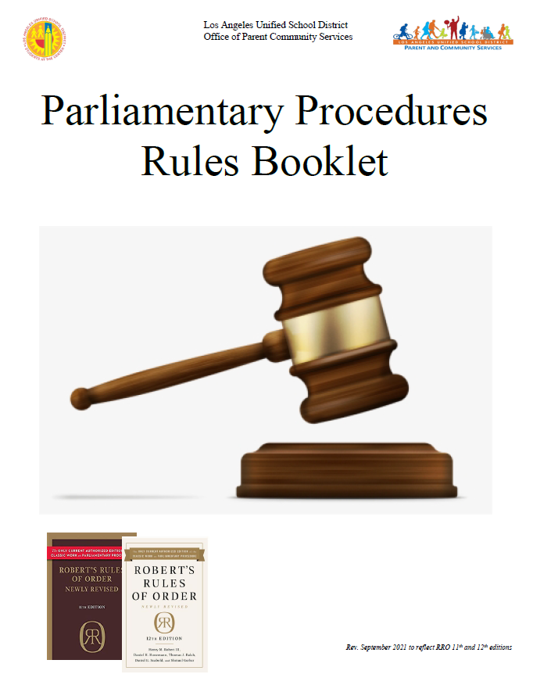
Handouts
Hojas Informativas
Roberts Rules of Order
Reglas de Roberto
Attachment Q
Parliamentary Procedures
Folleto Reglas Parlamentarias
Notes:
Say: If you become a member, these are some key items you need to be know.
These are tools that will help support our officers as they lead the work in partnership with us.
Attachment Q is the Selected Robert's Rules of Order, which is a type of parliamentary procedure.
Parliamentary Procedures Rules Booklet provides additional guidance and definitions, and it can be found on this link on the slide: https://achieve.lausd.net/cms/lib/CA01000043/Centricity/Domain/577/CAC/Spanish%20Booklet%20Brief%20Parliamentary%20Procedures%20Guide_%20rev%20%2010%201%20%2021%20Spanish_.pdf
Click

Slide 34


Handouts
Hojas Informativas
School Site Council (SSC): Purpose, Composition and Responsibilities
Consejo Del Plantel Escolar (SSC): Propósito, Composición, y Responsabilidades
School Site Council (SSC)
Officer Responsibilities
Consejo del Plantel Escolar (SSC)
Responsabilidades de los Oficiales
Notes:
Say: Today we will cover the purpose, composition and responsibilities of the School Site Council (SSC). We will provide more information on the specific responsibilities of officers at a later date, and we wanted you to know that there are officers for this council who lead the orderly operation of this group.
Click

Slide 35
Contact Information
Información de Contacto
(Name), Title
E-mail/Correo Electrónico
Phone Number/Numero de Teléfono
School Logo
(Name), Title
E-mail/Correo Electrónico
Phone Number/Numero de Teléfono
(Name), Title
E-mail/Correo Electrónico
Phone Number/Numero de Teléfono
Notes:
Say: I look forward to working with you. This is our contact information.
If you have any questions, please reach out to us.
Click

Slide 36
Thank you!!!
¡¡¡Gracias!!!
Contact your Local District Parent and Community Engagement Administrator for support.
Comuníquese con su Administrador del Distrito Local de Padres y
Involucración de Comunidad por apoyo.
Region/Región | PACE Administrative Coordinator | Email
East/Este | Megan Guerrero Amaris Medina | mguerr3@lausd.net amaris.medina@lausd.net
West/Oeste
North/Norte | Laura Fuentes & Jeremiah Gonzalez | Lxf1109@lausd.net Jjg2443@lausd.net
South/Sur | Leticia Estrada de Carreon | ldecarre@lausd.net
Virtual Academy and Continuation Schools/Academia Virtual y Escalas de Continuación | Laura Bañuelos | lxb0446@lausd.net
Notes:
Say: Thank you for joining us. If you have additional questions regarding School Site Councils and how they operate in our District, or if you need additional support, you can always contact the Local District Parent and Community Engagement team as well. The name of the administrators for these teams are listed here.
I look forward to partnering with you this year.

