Slide 1

KNOWLEDGE IS POWER! ¡SABER ES PODER!
Presented by: Federal and State Education Programs Branch (FSEP)
Presentado por: Oficina de Programas Educativos Federales y Estatales (FSEP, por sus siglas en inglés)
Notes:
This presentation is titled Knowledge is Power because as an SSC member the more you know about the Title I Program, the better equipped you will be to support your school. For today’s presentation, you will learn about your responsibility as the SSC to oversee the Title I program.
Our goal for today is to take you through all the slides today but know that if we don’t the final slides are resources to help you access your school’s budgets.

Slide 2

Objective
Provide a better understanding of school finance and its relationship to School Site Councils particularly as it relates to Title I.
Objetivo
Proveer un mejor entendimiento de las finanzas escolares y su relación con los Consejos Escolares, particularmente en lo relacionado con Título I.
Notes:
READ SLIDE

Slide 3



What is Title I?
¿Que es Título I?
The purpose of this program is to provide all children significant opportunity to receive a fair, equitable, and high-quality education and to close educational achievement gaps.
El propósito de este programa es proporcionar a todos los niños una oportunidad significativa para recibir una educación justa, equitativa y de alta calidad y cerrar las brechas de rendimiento educativo.
Notes:
READ SLIDE
Say,” Funds are used to support effective, evidence-based educational strategies that close the achievement gap and enable the students to meet the state's challenging academic standards.
There is a myth that Title I resources are only for students from low-income homes, this is not true. Title I resources are primarily to support students at-risk of not meeting academic standards.”

Slide 4
Clasificación dentro del Programa de Título I Año Escolar 2025-2026
2025-2026 School Year (SY) Title I Ranking
Students meeting all three criteria below were included in the counts for 2025-2026 Title I ranking.
Student must be enrolled at the school by the 2024 - 2025 Fall Census Day (i.e., CBEDS Day) which was October 2, 2024; and
Student must be 5 – 17 years old on October 2, 2024; and
Student must have submitted a complete Household Income Form by the October deadline and was determined to be eligible for free/reduced-price meals.
Los estudiantes que cumplen con los tres abajo, se incluyeron en el conteo para la clasificación dentro de Título I para el 2025-2026.
El estudiante debe estar inscrito en la escuela antes Día del Censo en otoño 2022 – 2023 (el día CBEDS) que fue el 2 de octubre de 2024; y
El estudiante debe tener entre 5 y 17 años de edad para el 2 de octubre de 2024; y
El estudiante debe de haber entregado un formulario completo de ingresos del hogar antes de la fecha limite de octubre y haber sido determinado como elegible para las comidas gratuitas o a precio reducido.
Notes:
READ SLIDE
Say, “In school year 2023-2024, Household income forms were required for all students enrolled on Census Day. 2023-2024 was a baseline year to collect data. In school year 2027-2028, schools will request that parents complete these Household Income Forms again. In between that time, only students that are new to the District will complete the HIF.
Eligibility for the free/reduced price meal program is reported to the state via the California Longitudinal Pupil Achievement System (CALPADS) and is then used as part of the calculation in determining a school’s Title I ranking.

Slide 5
Per Pupil Rate 2025-2026
Cantidad por estudiante
2025-2026
Title l / Título I 7S046, 70S46
Parent Involvement / Participación de los padres 7E046
Title I Tier Nivel de Título I | Poverty Percentage Porcentaje de pobreza | Per Pupil Rate Cantidad por estudiante
1 | 100% - 65% | $965
2 | 64.99% - 50% | $730
3 | 49.99% - 45% | $552
Hold Harmless/Mantener sin consecuencia | First year out of Title I/Primer año fuera de título I | $383
Title I Tier Nivel de Título I | Poverty Percentage Porcentaje de pobreza | Per Pupil Rate Cantidad por estudiante
1 | 100% - 65% | $12
2 | 64.99% - 50% | $10
3 | 49.99% - 45% | $8
Hold Harmless/Mantener sin consecuencia | First year out of Title I/Primer año fuera de título I | $6
Notes:
READ SLIDE
Say, “There are 4 tiers as you can see here. In LAUSD, when a Title I school drops below 45% for the first time, the District still provides some Title I support in hopes that the following year, their percentage will increase.”

Slide 6
Recursos de Financiación Escolar
School Funding Resources
Restricted
Restringidos
Specially-Funded Programs:
Federal Programs (Title I and Title III)
Grants (CTE, Perkins)
Special Education
Cafeteria
Programas de Subvención Específica:
Programas federales (Título I y Título III)
Subvenciones (CTE, Perkins)
Educación especial
Cafetería
Unrestricted
Sin restricciones
Local Control Funding Formula (LCFF)
General Fund School Program
Supplemental & Concentration Grants*
*Earmarked for Targeted Student Population (TSP) funds
Donations
Fórmula de Financiación de Control Local (LCFF)
Programa Escolar de Fondos Generales
Subvención Suplementaria y de Concentración*
*Fondos reservados para las "Poblaciones estudiantiles específicas (Conocido en inglés como TSP)
Donaciones
Notes:
READ SLIDE
Say, “For the purpose of today’s training, we will only focus on the restricted funds, primarily Title I funds.”

Slide 7
Federal Budgets
in the SPSA
Presupuestos federales en el SPSA
Your school may not have all the programs listed below.
Title I (7S046) for School Wide Program (SWP) or Title I (70S46) for Targeted Assistance School (TAS)
Title I Parent Engagement (7E046)
Comprehensive Support and Improvement (CSI) for state identified schools (7T691) or for schools that exited CSI, Title I (7T505)
English Learner Program Support, Title III (7T197) and Title I (7727T)
Centrally funded Interventionists, Title I (7501T) or (7726T)
Es posible que su escuela no tenga todos los programas que se enumeran a continuación.
Título I (7S046) para Programa aplicable a toda la escuela (SWP) o Título I (70S46) para escuelas de programa de ayuda específica (TAS)
Participación de los Padres de Título I (7E046)
Apoyo e intervención intensivos (CSI) solamente para escuelas identificadas por el estado (7T691) o escuelas que salieron de CSI, Titulo I (7T505)
Apoyo para el programa de Aprendices de Inglés Titulo III (7T197) y Titulo I (7727T)
Intervencionista financiado centralmente (7501T) o (7726T)
Notes:
Review the different programs and the funding associated with them. Inform schools that T3 funding provides a Multilingual Multicultural Academic Language Coach, formally known as a Title III Coach.
This is not an exhaustive list.

Slide 8
School Plan for Student Achievement (SPSA)
Plan Escolar para el Rendimiento Estudiantil
Notes:
If there is time go through the slides to show the information they contain.

Slide 9
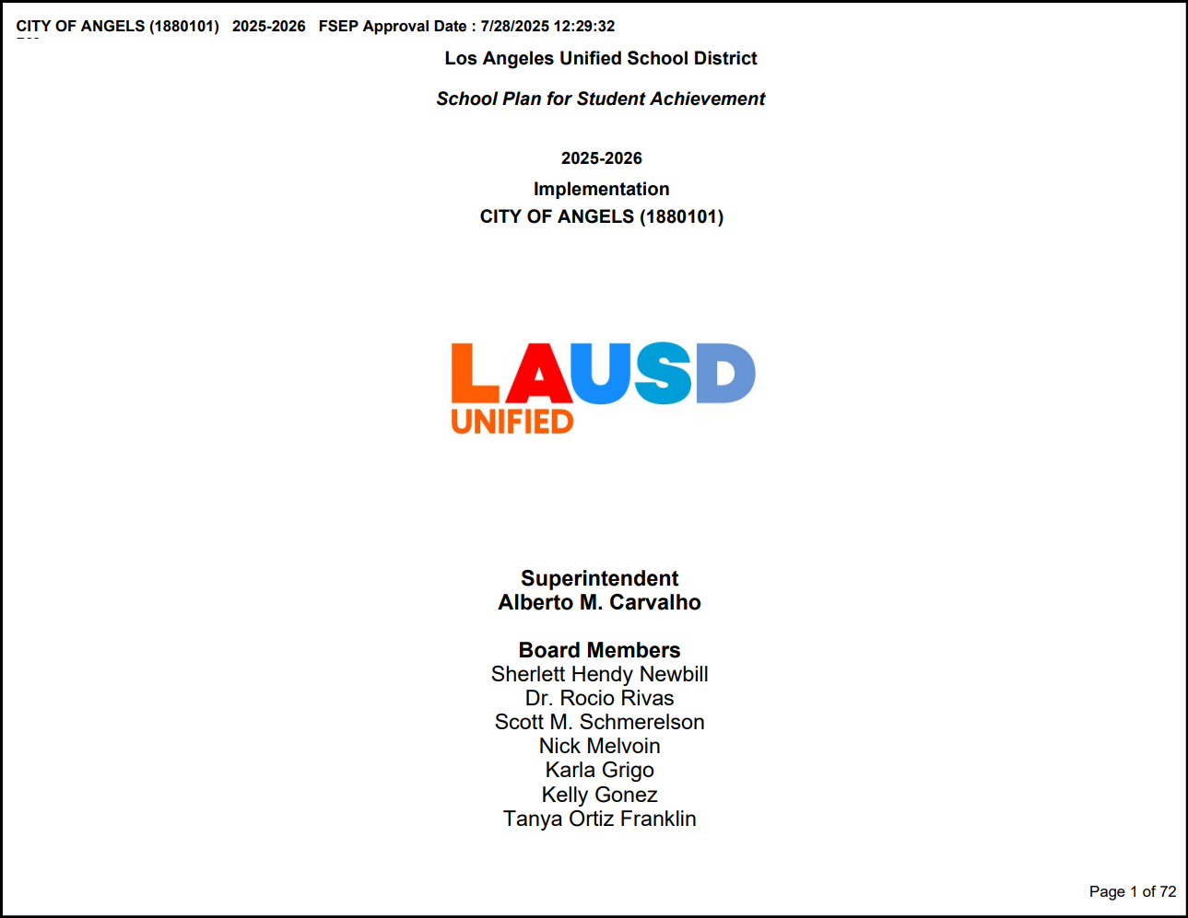
Cover Page of the SPSA Página Titular del SPSA
NOTE: Your school’s 2025-2026 SPSA can be downloaded/saved or
printed as a PDF file.
NOTA: Se puede bajar/guardar o imprimir en formato PDF el SPSA
2025-2026 de su escuela.
Notes:
Say, “ This is the cover page of a fully approved SPSA. The upper left-hand corner shows the day and time FSEP approved the plan on behalf of the District. California Education Code 64001 requires that all schools participating in programs funded through the Consolidated Application (Con App) develop a SPSA. The goal of the SPSA is to ensure that schools have one comprehensive plan to meet all the categorical program needs.”

Slide 10
School Plans
Planes Escolares
A comprehensive needs assessment/ Una evaluación integral de las necesidades
A comprehensive plan based on data/ Un plan integral basado en los datos
An evaluation to determine whether the plan has worked and what improvements may be needed/ Una evaluación para determinar si el plan funcionó o no y qué mejoras podría necesitar
Notes:
READ SLIDE
Say “Title I is a program and not a funding source. For a school’s Title I program to be successful, the plan must meet all three criteria.”
A comprehensive needs assessment
A comprehensive plan based on data
An evaluation to determine whether the plan has worked and what improvements may be needed.

Slide 11
SPSA: Continuous Improvement Cycle
SPSA: Ciclo de mejora continua constante
Conduct comprehensive needs assessment, including data analysis/SPSA Evaluation
Develop measurable objectives and identify evidence-based strategies in the SPSA Pillar pages
Develop budget based upon prioritized expenditures that support and align to the evidence-based strategies described in the SPSA Pillar pages
Monitor the implementation of the SPSA and adjust as necessary
Realizar la evaluación integral de las necesidades incluyendo un análisis de datos y evaluación del SPSA
Desarrollar objetivos medibles e identificar las estrategias basadas en evidencia en las páginas del SPSA
Desarrollar un presupuesto basado en los gastos clasificados por prioridad que apoyen y estén alineados con las estrategias basadas en evidencia en las páginas pilares del SPSA
Monitorear la implementación del SPSA y modificar cuando sea necesario
SPSA: Continuous Improvement Cycle
SPSA: Ciclo de mejora continua constante
Notes:
READ SLIDE
Say, “ The SPSA is a living document that follows the continuous improvement cycle”
READ THROUGH EACH STEP IN THE CYCLE.

Slide 12
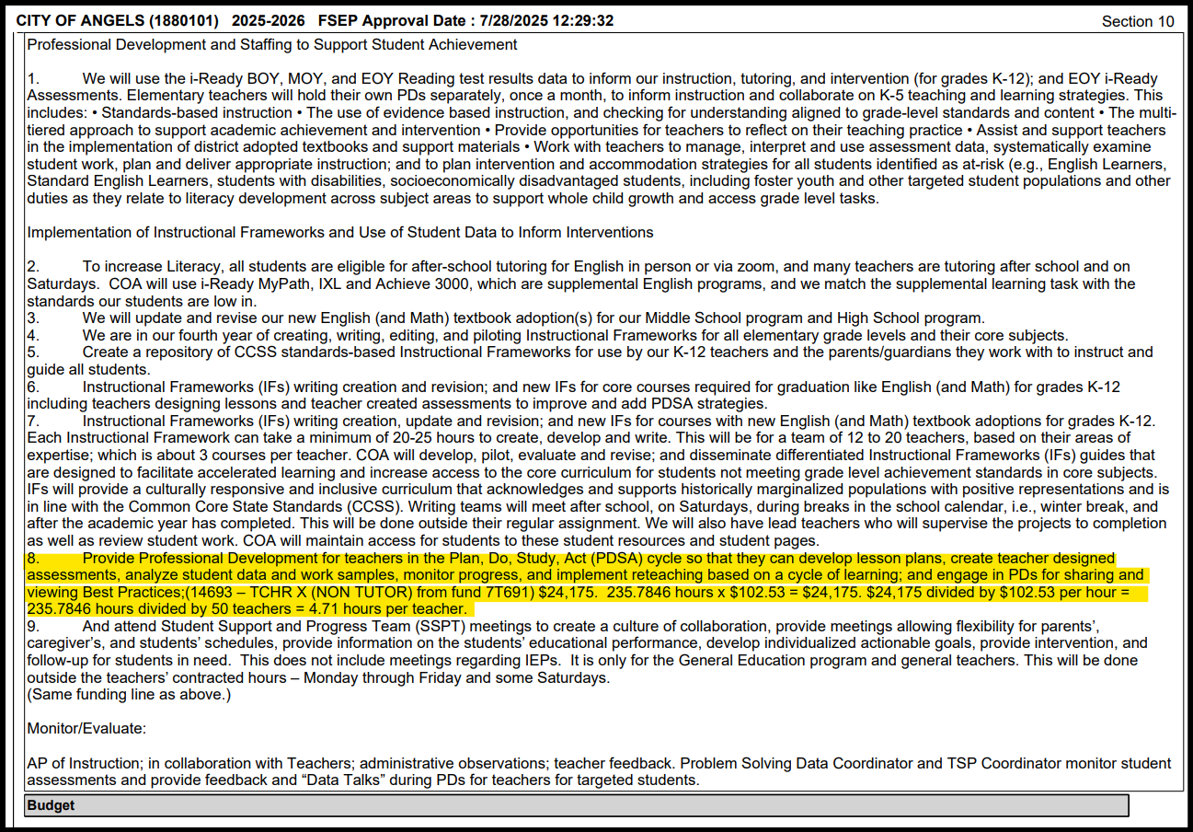
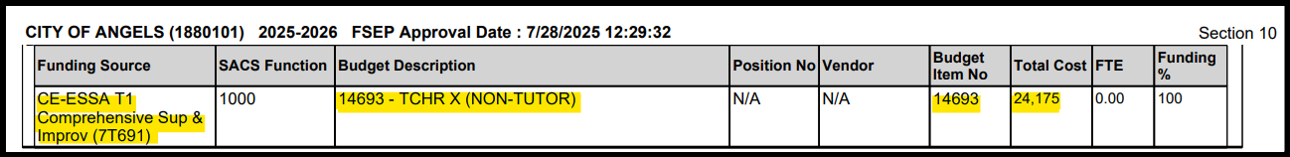
Sample of a Completed and Approved SPSA Page
Muestra de la página del SPSA Completada y Aprobada
Notes:
THIS SLIDE HAS FLY-IN SCREENSHOTS, THE FOCUS IS ON X-TIME, DISCUSS HOW ALL ASPECTS, DESCRIPTION, MONITORING AND FUNDING ARE ALIGNED.

Slide 13
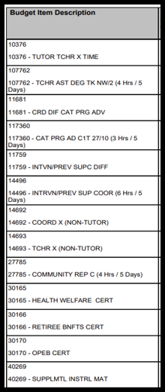
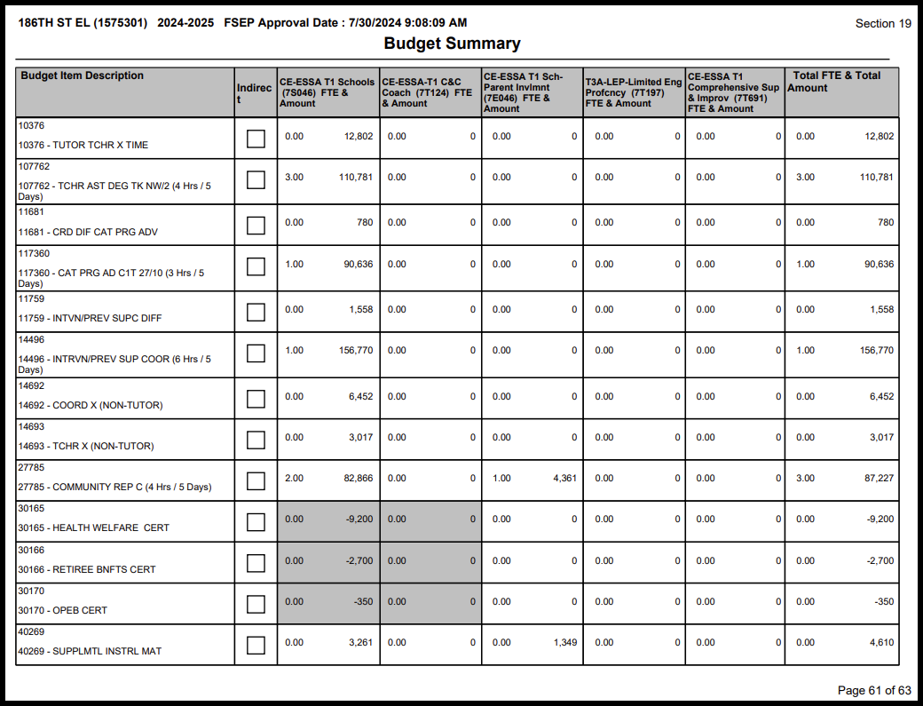
Sample of Approved SPSA Budget Summary
Muestra de resumen del presupuesto del SPSA aprobado
Notes:
Discuss how the budget summary is located at the end of the approved SPSA. When flyouts appear, discuss that these are the budgets that would have been discussed with the SSC. Mention that not all schools will have all the programs listed.
On the second flyout, discuss some of the different expenditures and how they would be used to support the school site.

Slide 14
SPSA Modification Page
Página de modificaciones al SPSA
Purpose: As schools monitor their SPSA and determine that adjustments need to be made based on data analysis, the SPSA Modification Pages must be used to describe what will be adjusted to meet the needs of the instructional program.
Changes in strategies and actions including expenditures, will need to be reviewed and approved by the SSC.
Propósito: A medida que las escuelas monitorean su SPSA y determinan que es necesario hacer ajustes basados en el análisis de datos, las Páginas de Modificación de SPSA deben usarse para describir lo que se ajustará para satisfacer las necesidades del programa de instrucción.
Los cambios en las estrategias y acciones, incluidos los gastos, deberán ser revisados y aprobados por el SSC.
Notes:
READ SLIDE
“As mentioned earlier, the SPSA is a living document and when the needs of the school change, those changes need to be documented.”

Slide 15
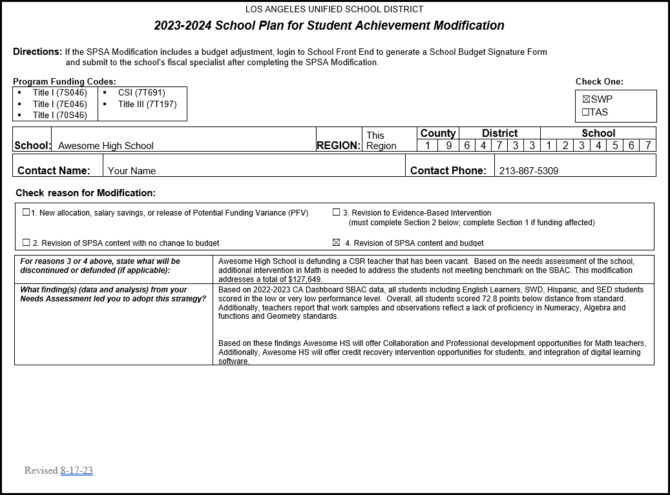
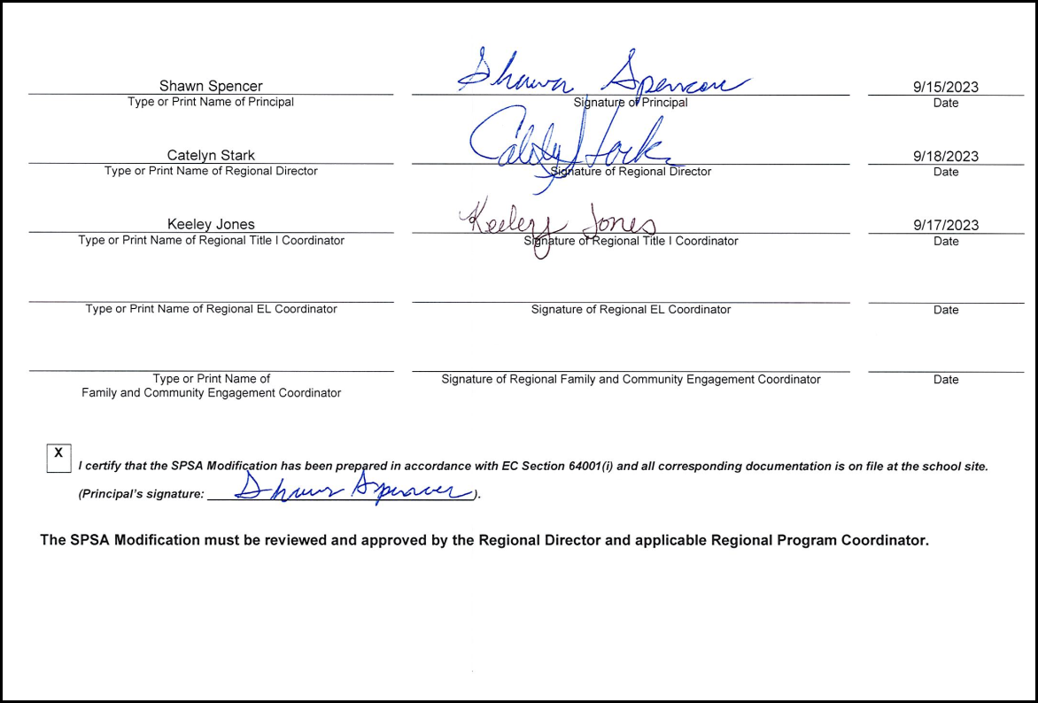
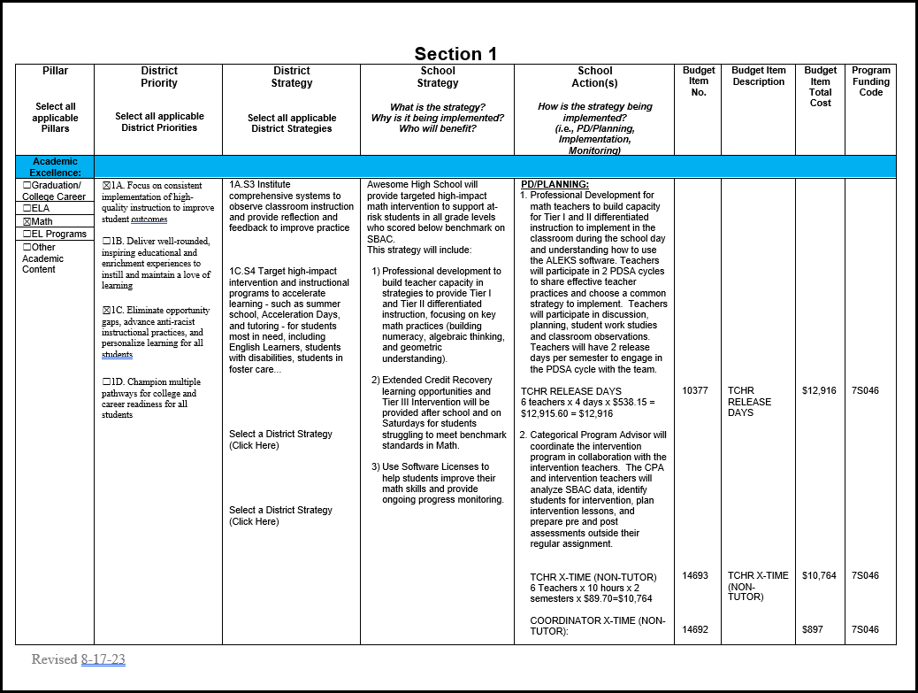
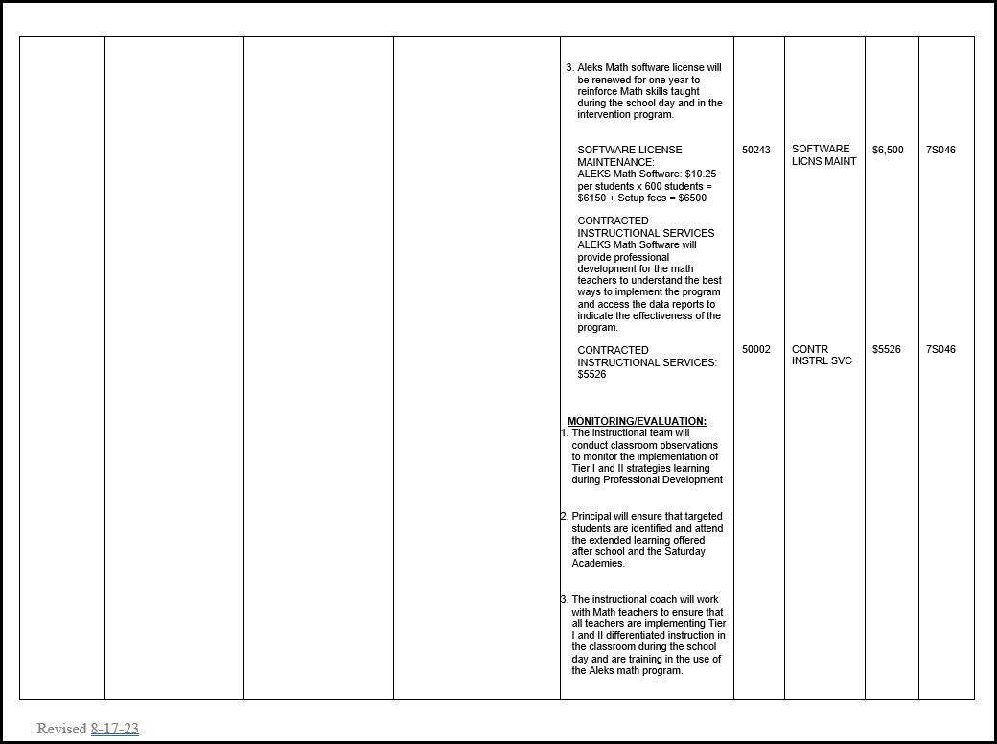
Sample of a SPSA Modification Page
Muestra de la página de modificación al SPSA
Notes:
BRIEFLY DISCUSS THE MODIFICATION, THE DIFFERENT PARTS TO THE MOD, AND THE IMPORTANCE OF SIGNATURES.

Slide 16
Turn and Talk
Comenta con tu compañero/a
Look at page XX in your School Plan for Student Achievement handout. How much Tutor Teacher X-time is invested in this budget?
Veamos la página XX del material impreso del Plan Escolar para el Rendimiento del Estudiante. ¿Cuánto hay disponible para gastar en Tiempo X para Maestros Tutores?

Slide 17

Check point 1
Punto de verificación 1

Slide 18
True or False Verdadero o falso
Title I funds are only to be used to support students from low-income families.
Los fondos del Título I solo se utilizarán para apoyar a los estudiantes de familias de bajos ingresos.
False/Falso
Notes:
READ SLIDE THEN CLICK FOR ANSWER, DISCUSS IF NECESSARY

Slide 19
True or False Verdadero o falso
The SPSA is based on the following three requirements: 1) A comprehensive needs assessment, 2) A comprehensive plan based on data, and 3) An evaluation to determine whether the plan has worked and what improvements may be needed.
Los planes SPSA deben basarse en tres requerimientos:1) Una evaluación de las necesidades, 2) Un plan integral basado en los datos, y 3) Una evaluación para determinar si el plan funcionó o no y qué mejoras podría necesitar.
True/Verdadero
Notes:
READ SLIDE THEN CLICK FOR ANSWER, DISCUSS IF NECESSARY

Slide 20
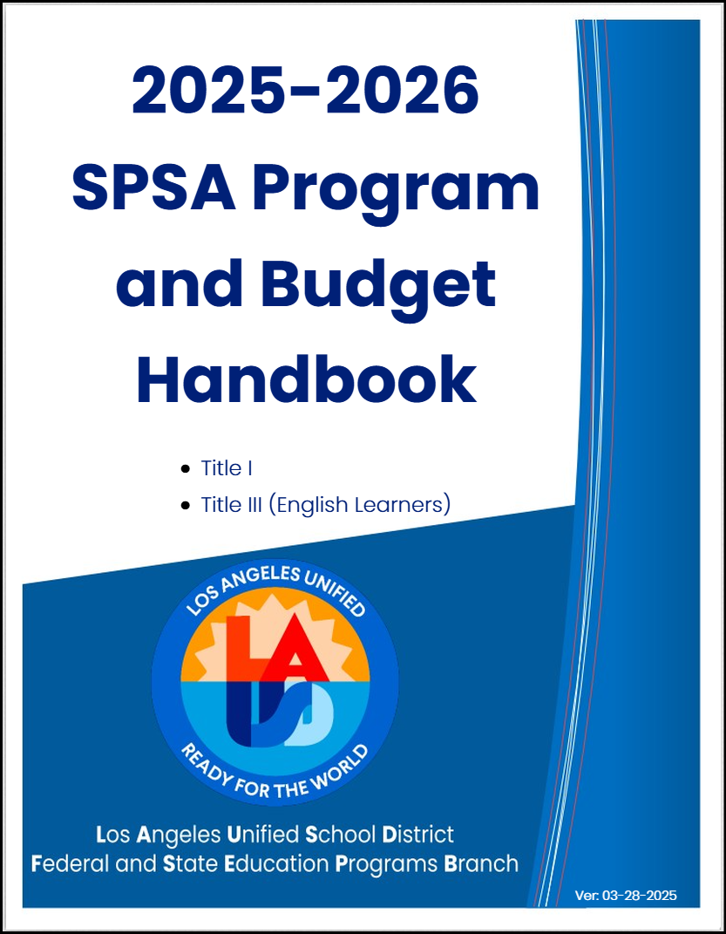
2025-2026 Program and Budget Handbook Manual de Programas y Presupuesto para el 2025-2026
The program and budget handbook provides guidelines to help schools make the compliant budgetary decisions to support the implementation of the SPSA.
El Manual de Presupuesto por Programas proporciona directrices para ayudar a las escuelas a tomar las decisiones presupuestarias conformes para apoyar la implementación de la SPSA.
Notes:
READ SLIDE

Slide 21
Developing a School Budget (Program and Budget Handbook)
Desarrollo de un Presupuesto Escolar (Manual de Programas y Presupuesto)
Must be based on the assessed needs of participating students as determined by conducting a comprehensive needs assessment as described in the SPSA.
Must demonstrate a clear relationship between the plan and expenditures.
Must support improved academic achievement and/or the restructuring of budget expenditures if necessary.
Debe basarse en las necesidades evaluadas de los estudiantes participantes, las cuales se establecen a través de llevar a cabo una evaluación integral de las necesidades, según se describe en el SPSA.
Debe demostrar una relación clara entre el plan y los gastos planificados.
Debe apoyar la mejoría del rendimiento académico y/o reestructurar los gastos de presupuestarios, si así se requiere.
Notes:
READ SLIDE

Slide 22
Supplement not Supplant
Suplementar y no Suplantar
Title I program funds must supplement all available general funds and must not supplant these state and local funds.
Los fondos del programa Título I deben complementar todos los fondos generales disponibles y no deben suplantar dichos fondos locales y estatales
Notes:
READ SLIDE
Say, “ This is the general rule with Title I funds, especially at the District level. At the school level, there is a rule used.”

Slide 23
Necessary/Necesario
Reasonable/Razonable
Allocable/ Permisible
Allowability
Permisible
Notes:
Say “Each proposed expenditure of Title I funds must be “allowable” as defined by law and District policy. It therefore must meet the following criteria:
Necessary - The proposed expenditure appropriately addresses one or more program needs identified and targeted in the school’s SPSA.
Reasonable - The purchase price does not exceed that which would be incurred by a prudent person under the circumstances at the time.
Allocable - Consistent with applicable rules, limits, and other requirements of Title I funding.
NOTE: The expenditure must be specifically described and budgeted in the School Plan for Student Achievement (SPSA).”

Slide 24

School Site Council Purview
Ámbito del Consejo Escolar
Notes:
If there is time go through the slides to show the information they contain.

Slide 25
School-Site Council Approval
Aprobación del Consejo Escolar
The SPSA and accompanying budgets need to be developed with recommendations from appropriate committees; and the written recommendations must be brought to the School-Site Council (SSC) for review and approval.
The school’s English Learner Advisory Committee (ELAC) is one of those that must have the opportunity to provide recommendations.
El SPSA y los presupuestos adyacentes deben desarrollarse con las recomendaciones de los comités apropiados y las recomendaciones escritas deben presentarse ante el Consejo Escolar (SSC) para su revisión y aprobación.
El Comité Asesor de Estudiantes de Inglés (ELAC) de la escuela es uno de los que debe tener la oportunidad de proporcionar recomendaciones.
Notes:
READ SLIDE

Slide 26
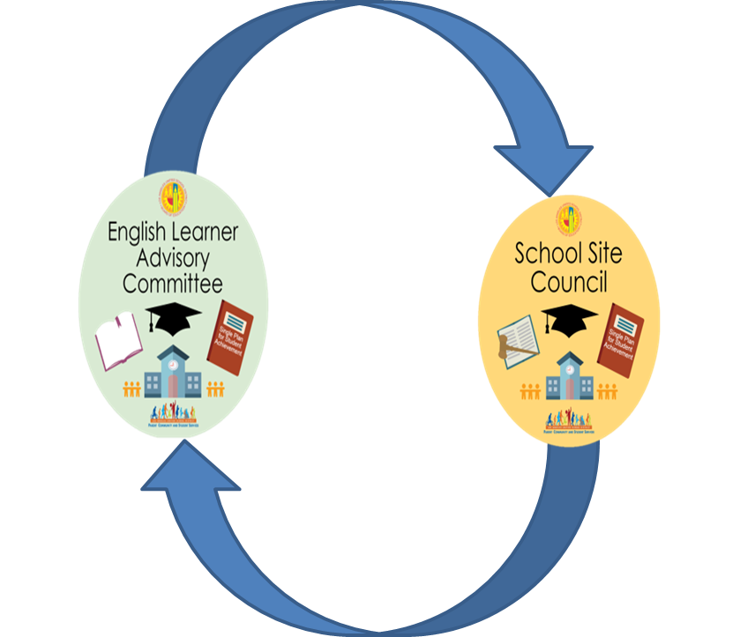
Connection Between ELAC and SSC
Conexión entre
ELAC y SSC
School Site Council is responsible for developing the SPSA with advisement from the ELAC on an annual basis.
El Consejo del Sitio Escolar es responsable de desarrollar la SPSA con el asesoramiento anual de la ELAC.
Notes:
READ SLIDE

Slide 27
Advisement and Approval Between ELAC and SSC
Consideración y Aprobación entre
ELAC y SSC
ELAC Advisement
Step 1: Membership reviews and discusses EL data and programs.
Step 2: Membership will take a vote.
Step 3: After the meeting, ELAC provides the written advice to the SSC.
Consideración de ELAC
Paso 1: La membresía revisa y discute los datos y programas de EL.
Paso 2: La membresía tomará una votación.
Paso 3: Después de la reunión, ELAC proporciona el asesoramiento por escrito al SSC.
Notes:
READ SLIDE

Slide 28
Advisement and Approval Between ELAC and SSC
Consideración y Aprobación entre
ELAC y SSC
SSC Approval
Step 1: SSC reviews and discusses advisement from ELAC.
Step 2: Membership will take a vote to consider and accept advisement from ELAC.
Step 3 : After the meeting, SSC provides a written response to the ELAC.
Aprobación de SSC
Paso 1: SSC revisa y discute el asesoramiento de ELAC.
Paso 2: La membresía tomará una votación para considerar y aceptar el asesoramiento de ELAC.
Paso 3: Después de la reunión, el SSC proporciona una respuesta por escrito al ELAC.
Notes:
READ SLIDE

Slide 29
SSC Response
Respuesta de SSC
SSC must respond​ to ELAC's written advice within 30 days, or at the next official ​SSC meeting.​ ELAC Advisement must be an Action Item on the SSC agenda.
SSC debe responder al consejo escrito de ELAC dentro de los 30 días, o en la próxima reunión oficial de SSC. El asesoramiento de ELAC debe ser un punto de acción en la agenda de SSC.
Notes:
READ SLIDE
It is important to stress that...

Slide 30

Turn and Talk
Comenta con tu compañero/a
How does your SSC work with your school’s English Learner Advisory Committee?
¿Cómo trabaja su SCC con su Comité Consejero de Aprendices de Ingles?
Notes:
READ SLIDE
Say,” There is a myth that Title I resources are only for students from low-income homes, this is not true. Title I resources are primarily to support students at-risk of not meeting academic standards.

Slide 31






Monitoring
Supervisión
Regional Director site visits
SSC periodic review of implementation of programs
Leadership team ongoing review of data and performance dialogues
Administrative Team classroom walkthroughs and feedback
Observations and post-observation conferences
Calibration of student work after performance task and/or assessment
Visitas del Director de la región al plantel escolar
Revisión periódica por el SSC de la implementación de los programas
Revisión continua de los datos y diálogos de desempeño de parte del equipo de liderazgo
Recorridos a los salones de parte del Equipo Administrativo, con los comentarios y las sugerencias pertinentes
Observaciones y conferencias posteriores a la observación
Evaluación de los trabajos estudiantiles después de realizar las tareas y/o exámenes
Notes:
This slide lists some of the different ways that the strategies and actions in school’s SPSA is monitored. The results of this monitoring would then be shared with the SSC to help determine what steps, if any are needed, to revise the SPSA.
READ SLIDE

Slide 32
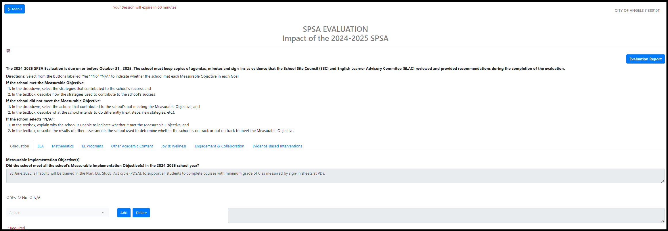
SPSA Evaluation
Evaluación del SPSA
Per Education Code 64001(g), the School Site Council (SSC) must evaluate, at least annually, the effectiveness of planned activities.
Results will inform and guide subsequent plan revisions.
De conformidad con el Código de Educación 64001 (g), el Consejo Escolar (SSC) debe evaluar, por lo menos una vez al año, la eficacia de las actividades planificadas.
Los resultados informarán y guiarán las modificaciones subsecuentes del plan.
Notes:
READ SLIDE
The SSC is responsible for reviewing the results and voting to approve the final version of the evaluation. Discuss the turn in deadline for the 24-25 SPSA Evaluation, Oct 31.

Slide 33
Comentar con tu compañero/a
Turn and Talk
Look at page XX in your School Plan for Student Achievement handout. What do you notice about the SPSA Evaluation page?
Veamos la página XX del Plan Escolar para el Rendimiento del Estudiante. ¿Qué notas acerca de la página de evaluación del SPSA?
Notes:
READ SLIDE
Say,” There is a myth that Title I resources are only for students from low-income homes, this is not true. Title I resources are primarily to support students at-risk of not meeting academic standards.

Slide 34
Check point 2
Punto de verificación 2

Slide 35
True or False Verdadero o falso
A Title I school can use its funds to purchase anything the school wants.
Una escuela participando en el programa de Titulo I puede usar sus fondos para comprar lo que quieran.
False/Falso
Notes:
READ SLIDE THEN CLICK FOR ANSWER, DISCUSS IF NECESSARY

Slide 36
True or False Verdadero o falso
The SPSA can be modified as the needs of the school’s instructional program change, based on the analysis of data.
El SPSA se puede modificar a medida que cambian las necesidades del programa de instrucción de la escuela, según el análisis de los datos.
True/Verdadero
Notes:
READ SLIDE THEN CLICK FOR ANSWER, DISCUSS IF NECESSARY

Slide 37
Resources Recursos
Notes:
If there is time, go through the slides to show the information they contain.

Slide 38
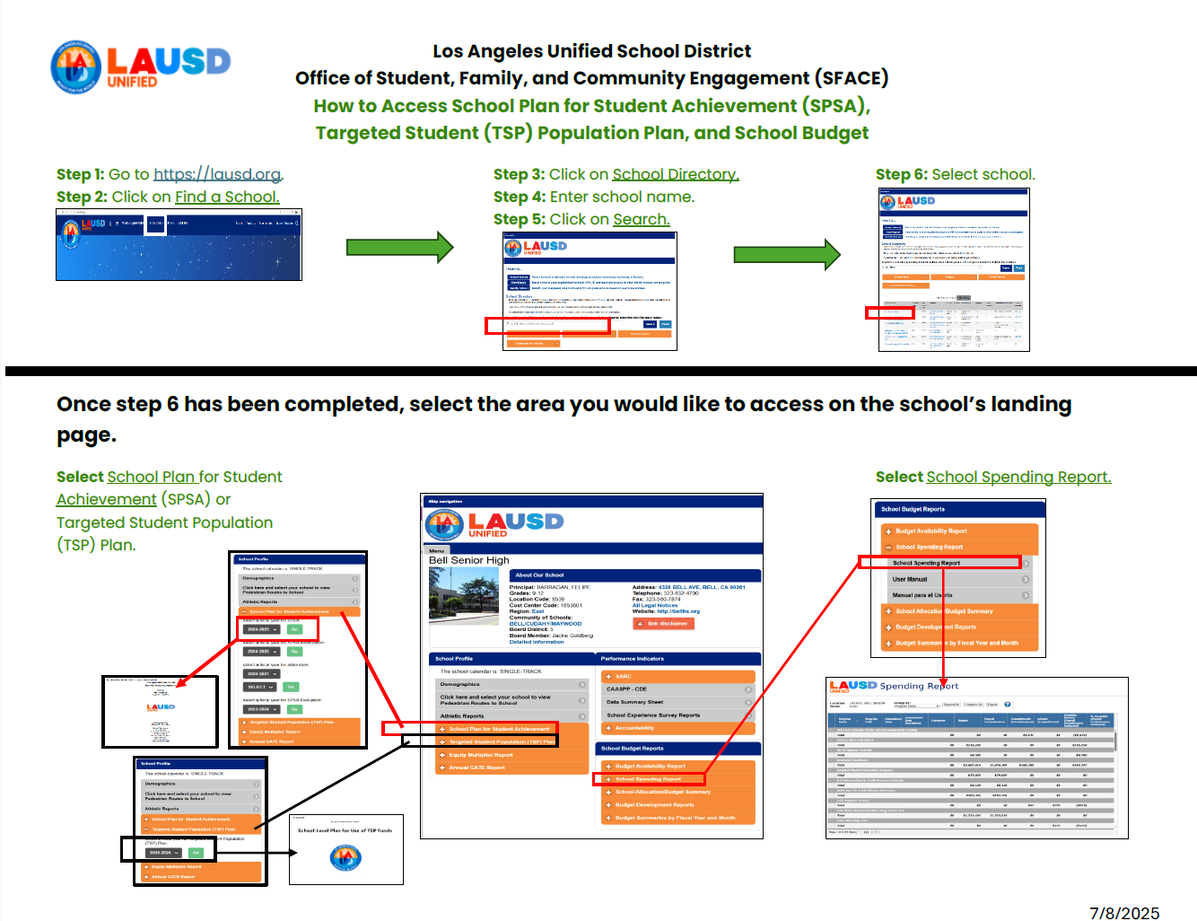
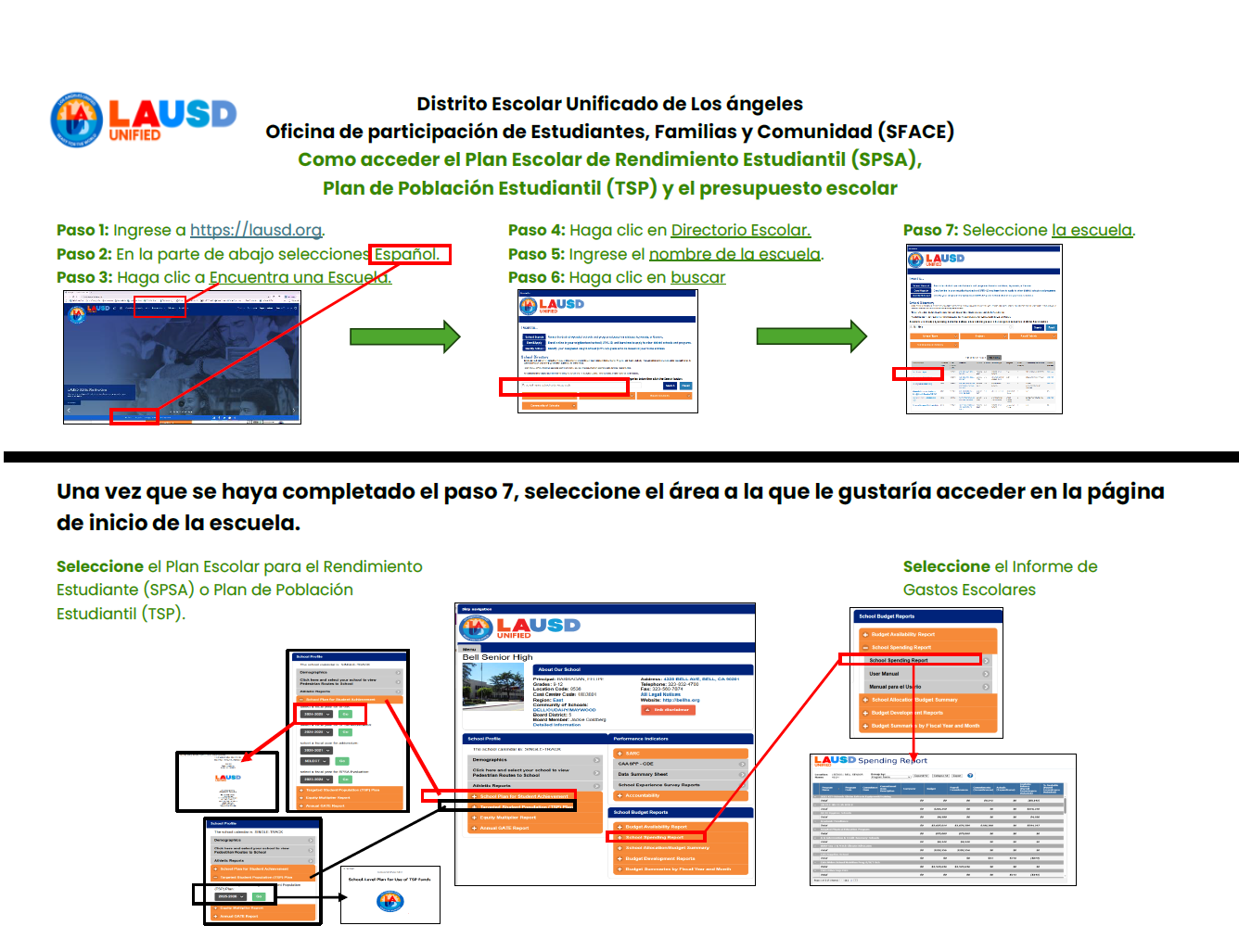
Accessing the Budget Acceso al presupuesto

Slide 39
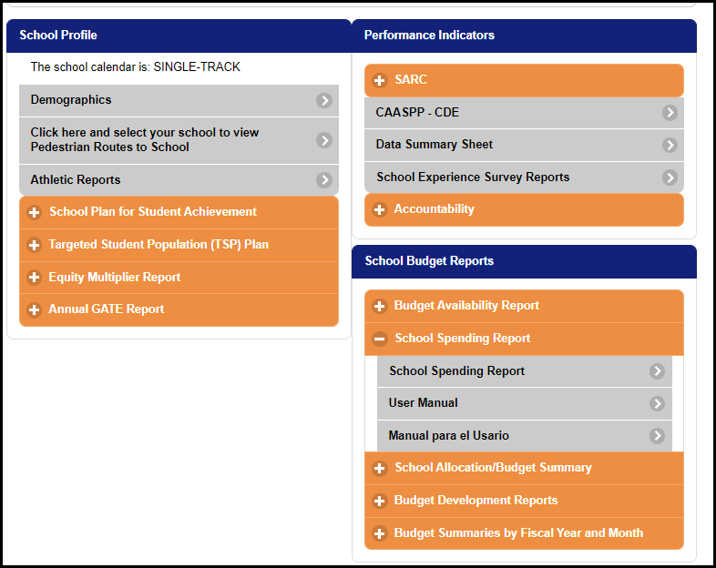
Accessing the Budget Acceso al presupuesto

Slide 40
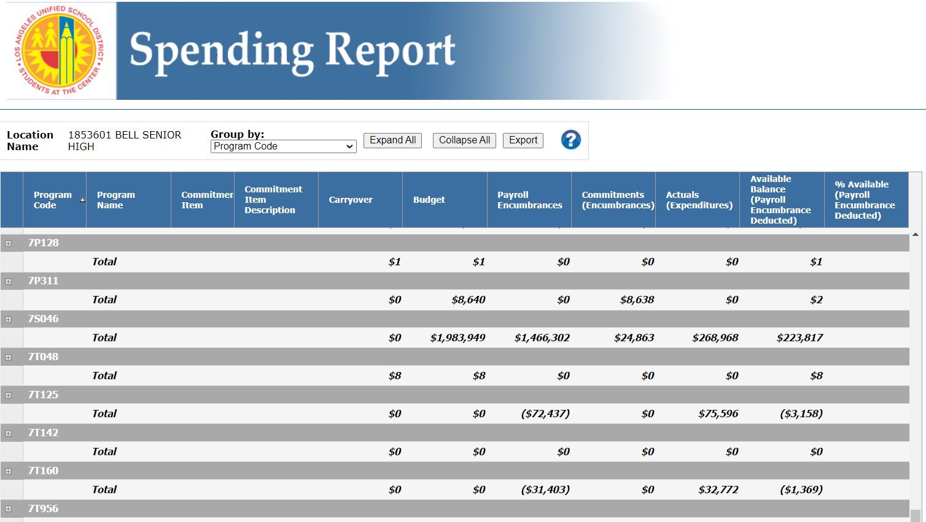
Spending Report Summary
Resumen del Informe de Gastos

Slide 41
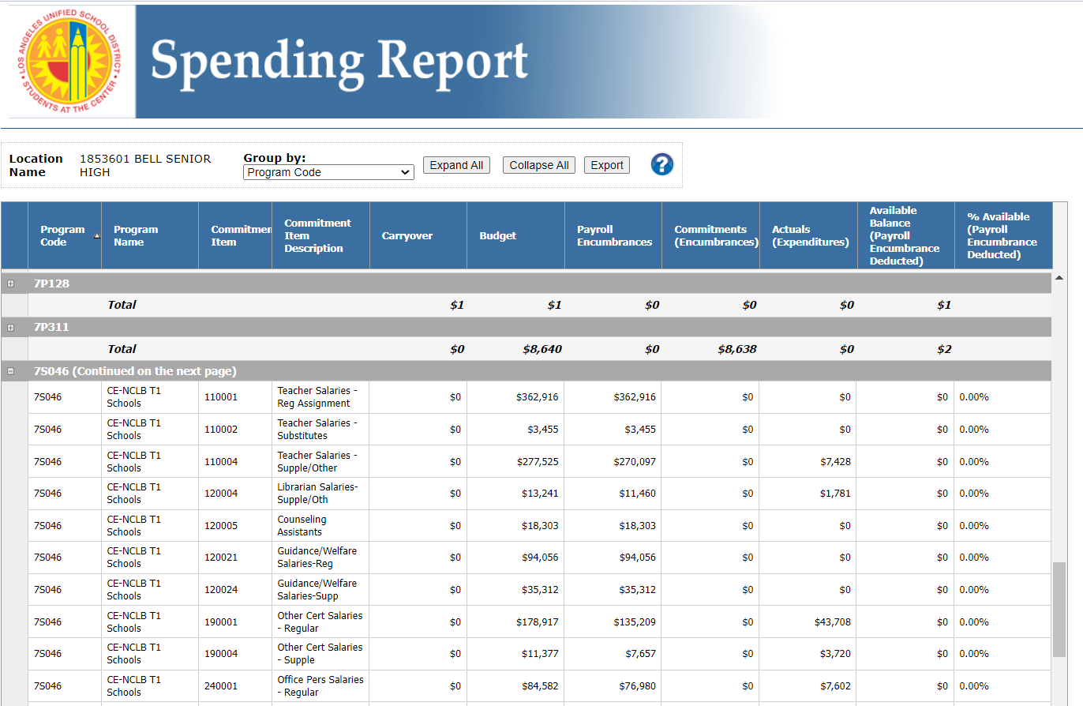
Title I Budget
Presupuesto de Título I

Slide 42
Accessing the Budget Acceso al presupuesto

Slide 43
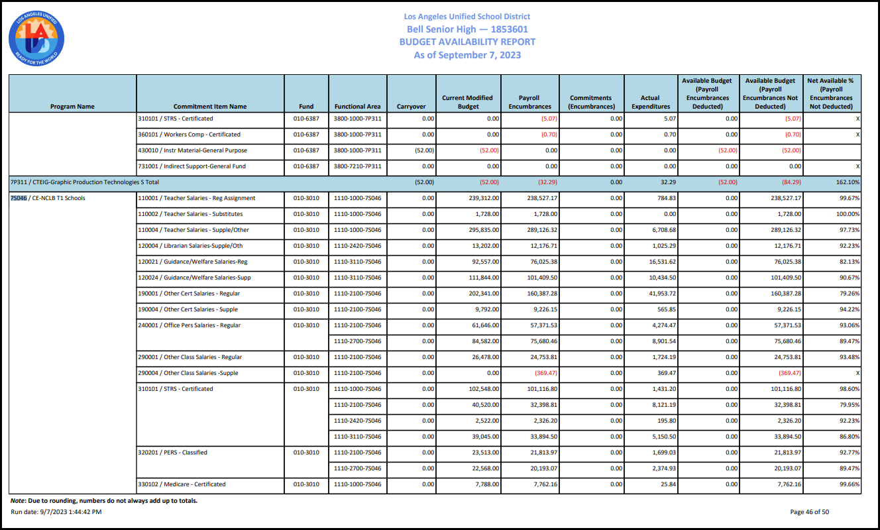
Budget Availability Report
Informe de disponibilidad presupuestaria

Slide 44
How to Find Your School’s SPSA Online Cómo encontrar el SPSA de su escuela en línea
Go to the LAUSD Home Page
Click on “Find-a-School”
Click “School Directory”(new LAUSD Homepage only)
Type School Name
Click “Search”
Click School Name that Appears
Click “Budget Availability Report” or “School Spending Report”
In the drop down menu, click the report type once more
The budget reports that appear are updated every 24 hours
Visitar la (nueva) página principal de LAUSD
Hacer clic en "Find a School"
Haga clic en "School Directory" (Directorio de escuelas)(solo en la nueva página de inicio de LAUSD)
Ingresar el nombre de la escuela
Hacer clic en “Search”
Hacer clic en el nombre de la escuela una vez aparezca
Hacer clic en “Budget Availability Report” o en “School Spending Report
En el menú desplegable, haga clic en el tipo de informe una vez más
Los informes de presupuesto que aparecen se actualizan cada 24 horas
Notes:
If there is time go through the slides to show the information they contain.

Slide 45
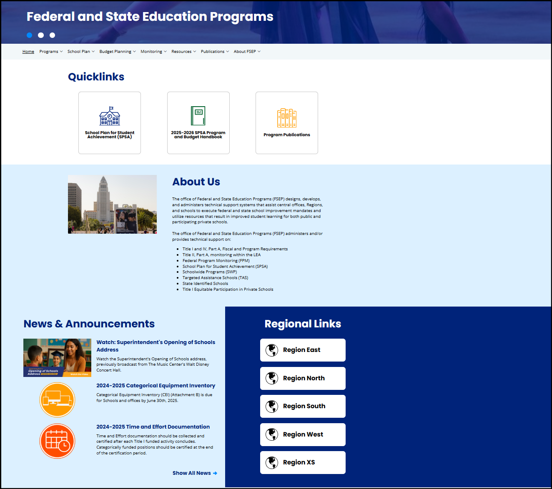
Staying in the know fsep.lausd.org
Mantenerse al tanto fsep.lausd.org
Notes:
Federal and State Education Programs website will have a plethora of information.

Slide 46
Regional Title I Coordinators
Coordinadores Regionales del Título I
Region Región | Title I Coordinators Coordinador de título I | Email Correo electrónico
East | Reyna Corral Ileana Albert Diana Sanchez | reyna.corral@lausd.net ina3368@lausd.net dab9296@lausd.net
North | Kristi Schlachet Daniella Simon Cecilia Riquelme | kms4424@lausd.net dxs3318@lausd.net criquelm@lausd.net
South | Deborah Davidock Dr. María Morales Thomas Oscar Salas | dad7293@lausd.net m.moralesthomas@lausd.net osalas@lausd.net
West | Celina Reynoso Susan Jamerson | celina.reynoso@lausd.net susan.jamerson@lausd.net
Virtual Academies & Option Schools | Supported by FSEP Central Office

Slide 47
Regional FACE Administrators Administradores Regionales de FACE
Region Región | FACE Administrative Coordinators Coordinador Administrativo/a de FACE | Email Correo Electronico
East | Megan Guerrero Amaris Medina | mguerr3@lausd.net amaris.medina@lausd.net
North | Laura Fuentes Dr. Jeremiah Gonzalez | lxf1109@lausd.net jjg2443@lausd.net
South | Ursula Martin | umartin@lausd.net
West | Crystal Dukes | crystal.dukes@lausd.net
Virtual Academies/ Option Schools | Connie Brandstetter | clb0104@lausd.net

Slide 48
Knowledge Check Verificacion de conocimiento
Title I funds are only for students of low-income families.
Fondos de Título I son solo para estudiantes de bajo ingreso.
True A. Verdad
B. False B. Falso
B
Notes:
READ SLIDE THEN CLICK FOR ANSWER, DISCUSS IF NECESSARY

Slide 49
Knowledge Check Verificacion de conocimiento
What 3 requirements does the SPSA need?
Qué 3 requisitos necesita el SPSA.
Expenditures, plan, list from teachers.
Evaluation, input, student vote.
Needs Assessment, plan, evaluation.
C
Gastos, plan, lista de profesores.
Evaluación, aporte, voto de estudiantes.
Evaluación, plan, evaluación de necesidades.
Notes:
READ SLIDE THEN CLICK FOR ANSWER, DISCUSS IF NECESSARY

Slide 50
Knowledge Check Verificacion de conocimiento
Schools can use Title I to purchase whatever they want.
Escuelas pueden usar Título I para comprar lo que quieran.
B
True A. Verdad
B. False B. Falso
Notes:
READ SLIDE THEN CLICK FOR ANSWER, DISCUSS IF NECESSARY

Slide 51
Knowledge Check Verificacion de conocimiento
How many tiers of Title I funding are there? Cuántos niveles de financiación del Título I hay?
D
1
2
3
4
1
2
3
4
Notes:
READ SLIDE THEN CLICK FOR ANSWER, DISCUSS IF NECESSARY

Slide 52
Knowledge Check Verificacion de conocimiento
The SPSA can be modified as needed.
El SPSA se puede modificar según sea necesario.
A
True A. Verdad
B. False B. Falso
Notes:
READ SLIDE THEN CLICK FOR ANSWER, DISCUSS IF NECESSARY

Slide 53
Knowledge Check Verificacion de conocimiento
Title I funds are under the purview of which group below.
Los fondos del Título I están bajo el ámbito de que grupo.
Local School Leadership Council.
School Site Council.
English Learner Advisory Committee.
Consejo de liderazgo escolar local
Consejo Escolar
Comité Asesor de Estudiantes de Inglés
B
Notes:
READ SLIDE THEN CLICK FOR ANSWER, DISCUSS IF NECESSARY

Slide 54
Knowledge Check Verificacion de conocimiento
The SSC has purview over TSP Funds.
El SSC tiene competencia sobre los fondos del TSP.
B
True A. Verdad
B. False B. Falso
Notes:
READ SLIDE THEN CLICK FOR ANSWER, DISCUSS IF NECESSARY

Slide 55
Knowledge Check Verificacion de conocimiento
ELAC is required to make recommendations to SSC.
Se requiere que ELAC haga recomendaciones al SSC.
A
True A. Verdad
B. False B. Falso
Notes:
READ SLIDE THEN CLICK FOR ANSWER, DISCUSS IF NECESSARY

Slide 56
Knowledge Check Verificacion de conocimiento
You have an important role as an SSC member. Usted juega un papel importante como miembro del SSC.
A
True A. Verdad
B. False B. Falso
Notes:
READ SLIDE THEN CLICK FOR ANSWER, DISCUSS IF NECESSARY

