Slide 1

Building Partnership with Families through Staff Professional Learning
[DATE]

Slide 2
Agenda
Agenda Item | Format
Inclusion Activity | Paired Conversation
The Why of Family Engagement | Whole Group
Partnering with Families Activity | Individual and Small Groups
Resource Sharing | Whole Group

Slide 3



Inclusion
PD Line UP
Line up according to your comfort level with partnering with your students’ families.
Share with a lineup neighbor: Why is partnering with families so important? What conditions would help you create family partnership?

Slide 4
1. The WHY of Family Engagement

Slide 5
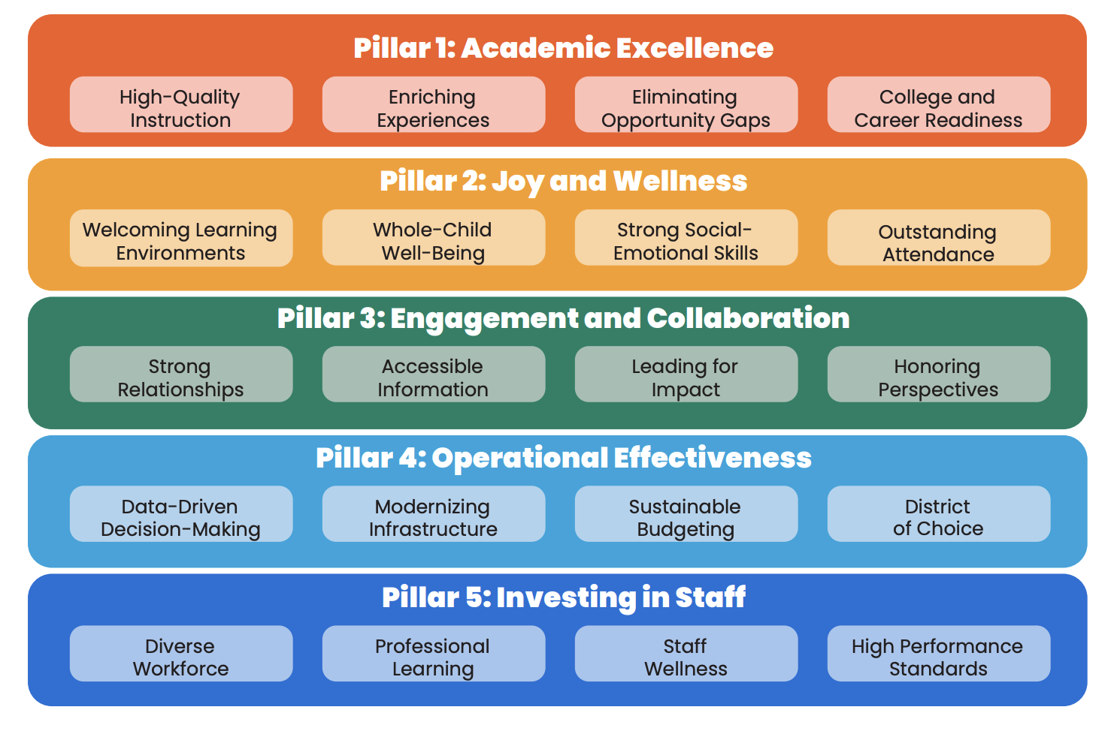


Strategic Plan and Framework Alignment

Slide 6


Family Engagement: Goal vs Strategy Mindset
Family Engagement as a Goal:
Traditional Mindset
Parents coming to school + volunteering = parent involvement
Family Engagement as a Strategy: Progressive Mindset
Quality instruction + family engagement = increased student learning

Slide 7
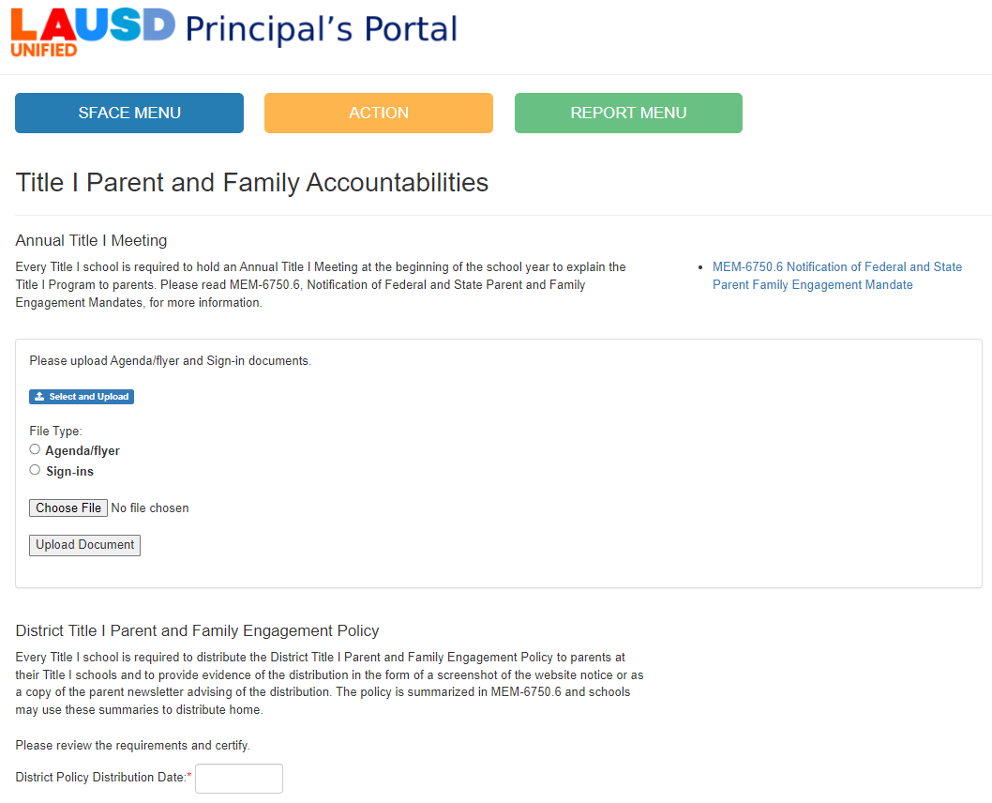
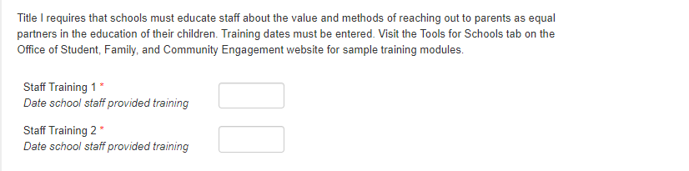
Principal Portal -Title I Family Engagement Professional Development

Slide 8



Involve-Engage-Empower: Alignment and Integration in School Plans
Involve
One-way, informational and staff lead
Engage
Two-way dialog, co-development
Empower/Activate
Families take ownership of learning, co-lead
Targeted Student Population (TSP) Plan and School Plan for Student Achievement (SPSA)

Slide 9
Turn and Talk - Core Beliefs/Mindset
Which of these Core Beliefs resonates with you?
Core Belief #1: All families have dreams for their children and want the best for them.
Core Belief #2: All families have the capacity to support their children’s learning.
Core Belief 3: Families and school staff are equal partners.
Core Belief #4: The responsibility for cultivating and sustaining partnerships among school, home, and community rests primarily with school staff, especially school leaders.
Source: https://ascd.org/el/articles/unlocking-families-potential-a-conversation-with-karen-l.-mapp

Slide 10
2. Partnering with Families

Slide 11
[Hidden slide – view notes or Facilitator Guide for additional guidance on Section 2 of this presentation]

Slide 12
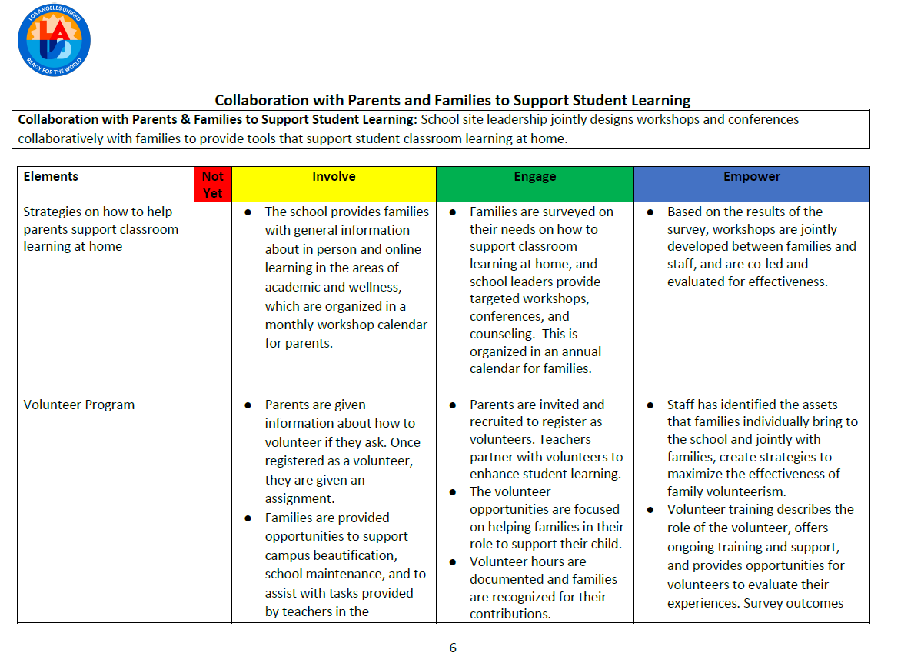



Explore the LA Unified’s Family Empowerment Rubric
Part 1: Read Page 1 of the Rubric.
Part 2: Number off to form 6 expert groups based on the Rubric Categories.
Part 3: Choose a spokesperson and share the gist of your rubric category, elements and levels of empowerment.
Notes:
https://www.lausd.org/cms/lib/CA01000043/Centricity//Domain/577/LAUSD%20Empowerment%20Rubric.pdf

Slide 13




Read and Reflect - Six Shifts to Better Family Engagement
Shift 1: Engage Across Transitions and Settings
Shift 2: Tap Families’ Strengths and Resilience
Shift 3: Deepen Relationships with Families
Shift 4: Nurture Relationships with Families
Shift 5: Cultivate Relationships Among Families
Shift 6: Empower Families as Leaders
Part 1 – Read blog article on website.
Part 2 – Generate implementation ideas based on the Six Shifts.
Part 3 – Vote up the best ideas.
Notes:
https://blog.searchinstitute.org/six-shifts-better-family-engagement

Slide 14

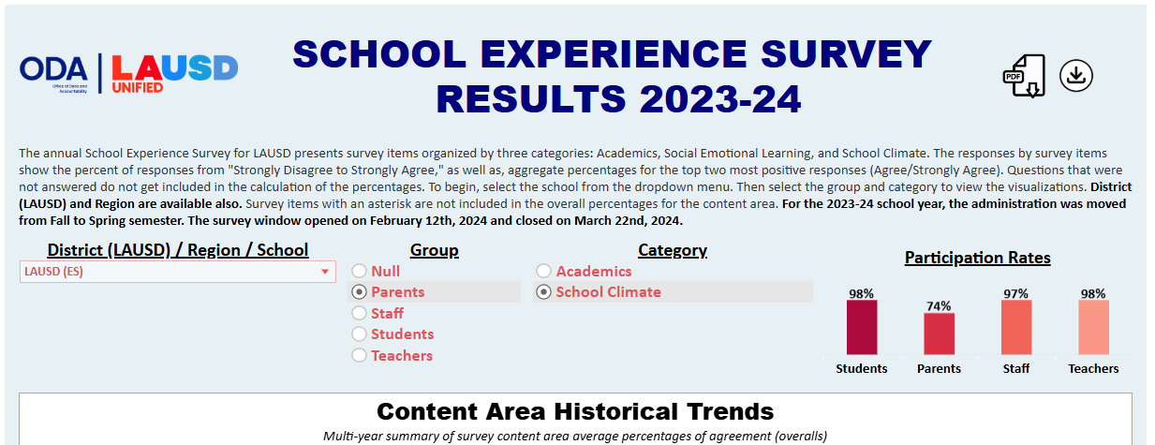
School Experience Survey – Parent/Family Perceptions Using the What?, So What? Now What? Protocol
Part 1
In small groups, explore the School Experience Survey (SES) Dashboard: https://www.lausd.org/Page/19462
Select the latest year’s results.
Explore both the “Academics” and “School Climate” results.
In the Dashboard, use the dropdown to select your school.
Select “Parent” Group.
Notes:
https://www.lausd.org/Page/19462

Slide 15
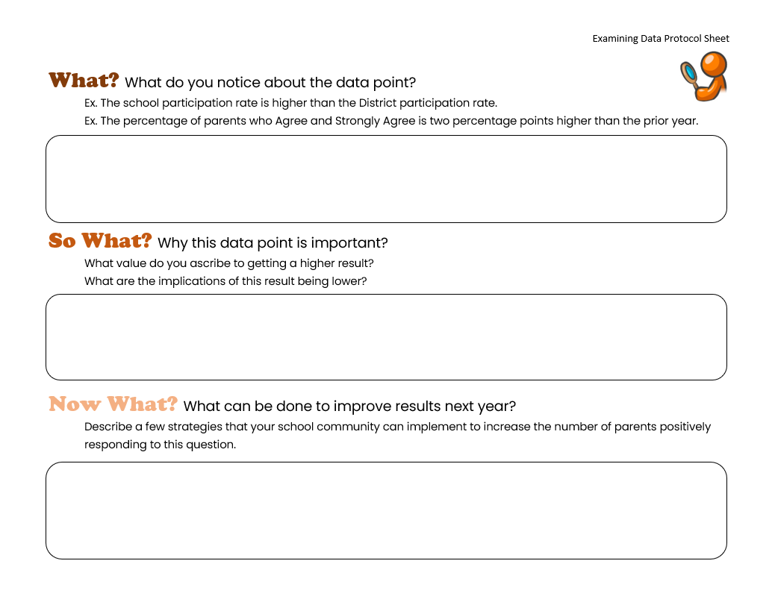
School Experience Survey (SES) – Parent/Family Perceptions Using the What?, So What? Now What? Protocol
Part 2
In your small group, choose one SES parent/caregiver question and response to focus on.
Use the What?, So What?, Now What? Protocol to develop some action steps to increase positive responses on the SES.
Choose a question where there is room for improvement.
Notes:
https://docs.google.com/document/d/1MfFFDByls4wqefrX-InkjljUF-A8qfda/edit?usp=sharing&ouid=107149143496428911533&rtpof=true&sd=true

Slide 16
Title I Parent and Family Engagement Policy and Compact Review
[Picture/Screenshot of Title I Parent and Family Engagement Policy]
[Picture/Screenshot of Title I School-Parent Compact]
How are these documents developed?
What role do parents play in the development and review of these documents?
How do these documents connect to learning at the classroom-level?

Slide 17


Book Study: Texts on Family Engagement
Powerful Partnerships
Everyone Wins!

Slide 18
3. Additional Family Engagement Resources

Slide 19
[Insert school name] Website resources for Families
[insert screenshot of parent and family resources found on your school’s webpage]

Slide 20
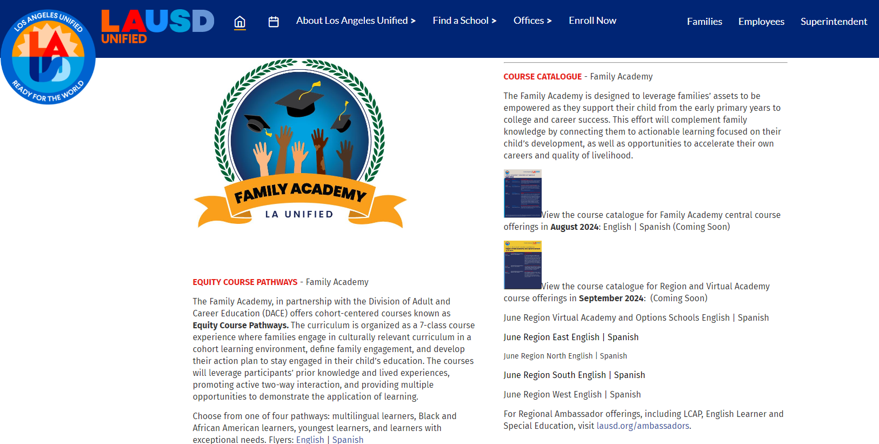
Family Academy
District and Region family engagement opportunities for families
www.lausd.org/familyacademy
Notes:
www.lausd.org/familyacademy

Slide 21
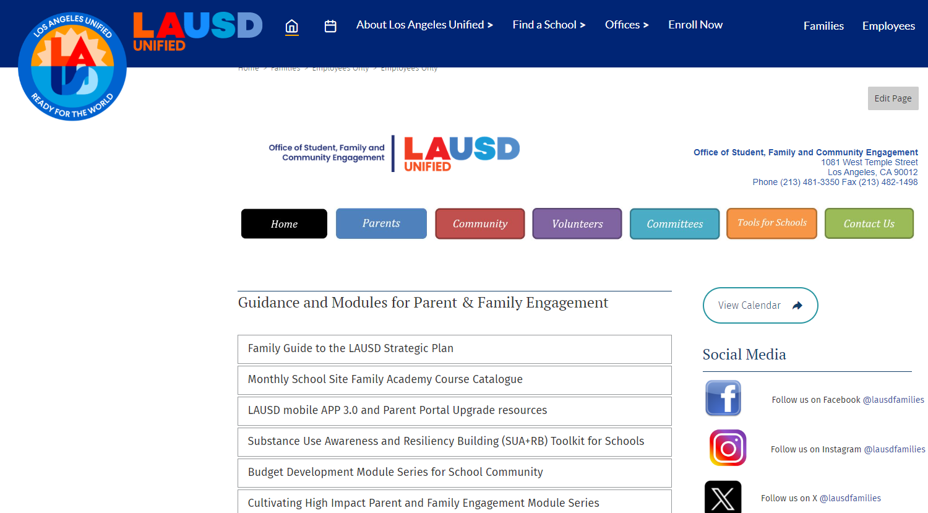
Student, Family and Community Engagement Website + Tools for Schools
Modules and resources for school-based family engagement
www.lausd.org/sface
www.lausd.org/toolsforschools
Notes:
www.lausd.org/sface
www.lausd.org/toolsforschools

Slide 22






Family Engagement Micro-Credential
Learn how to build a strong foundation for family engagement that honors parent/family perspectives and supports student wellness and achievement.
First micro-credential of its kind
Utilizing the latest national research on family engagement
Team-based approach - Principal, Teacher/Coordinator, and Community Representative
Are you ready to take family engagement to the next level?
Cohort applications open in the Spring for Fall enrollment.
Notes:
lausd.org/microcred

Slide 23
Family engagement is a strategy for increased student achievement.
Thank you!

