Slide 1



School Site Council (SSC)
School Name
Date:_____
SSC / SPSA
Slide Deck Template
Consejo del Plantel Escolar(SSC)
Nombre de la Escuela
Fecha: ____________
Notes:
Click

Slide 2


Welcome
Bienvenidos
Principal
Director(a)
Student Body President
Presidente Estudiantil
Community Representative
Representante de Comunidad
School Title I Designee
Designada(o) del Programa Título I
English Learner Program Designee
Designada(o) del Programa de Aprendices de Inglés
name
name
name
name
name
School Leadership Team /Equipo de Liderazgo Escolar
Notes:
To do: Complete slide. Please ensure that each school leadership member offers a warm greeting.
Click

Slide 3

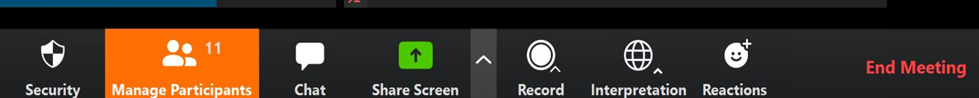
Interpretation Services: Laptop or Computer
Servicios de interpretación: computadora portátil o de escritorio
Click on the globe icon at the bottom of the screen.
Select the language of preference for you.
You will engage and listen to the presentation in the language you select.
Haga clic en el símbolo del mundo en la parte de abajo de su pantalla.
Seleccione el idioma que le gustaría escuchar.
Participará y escuchará la presentación en el idioma que seleccione.
Use if this is a hybrid meeting!
Notes:
Say: We have interpretation services if you are joining us on a computer.
I am sorry Chromebooks don’t offer the translation feature. If you are on a Chromebook, please stay on your computer for so you can see us on the screen and use the chat feature. For audio join us via phone.
I will provide more guidance shortly.
For those that are on the computer ,please click on the globe icon at the bottom of the screen.
Select the language of preference for you.
You will engage and listen to the presentation in the language you select.
Click

Slide 4


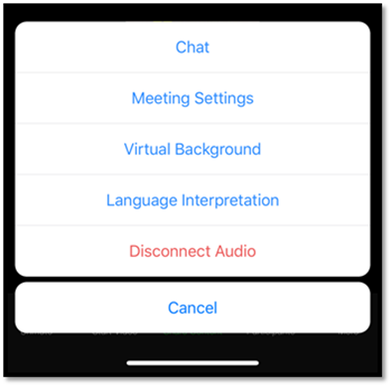
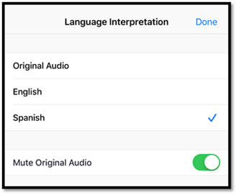
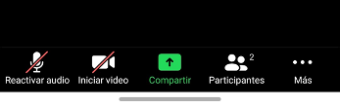
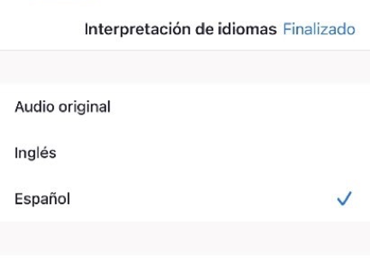
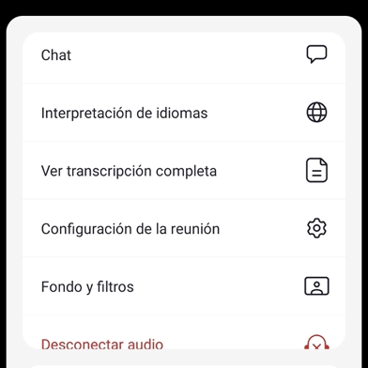
Interpretation Services: Mobile Device
Servicios de interpretación: dispositivo móvil
Use if this is a hybrid meeting!
Notes:
Say: For those who are joining us via phone, please click on the three dots.
Select Language Interpretation.
Select language of preference.
Click on Done.
Click

Slide 5
Steps to Rename Yourself on Zoom
Cómo cambiar el nombre en su pantalla
Step 1: Hover over your picture located by the picture gallery with your cursor and search for the three dots found on the top right-hand corner of your picture.
Step 2: Click the three-dotted icon found over your picture.
Step 3: Click More.
Step 4: Choose Rename
Step 5: Enter the full name used when you enrolled your students at the school site, then click Save to finish the change.
Paso 1: Ponga su cursor en su foto ubicada en la galería de fotos y busque los tres puntitos en la esquina de la parte derecha de su rectángulo con su foto.
Paso 2: Haga clic en los tres puntitos que están en su foto.
Paso 3: Haga clic en Más.
Paso 4: Escoja Re nombrar
Paso 5: Ingrese su nombre completo de la manera que lo escribió al matricular a sus estudiantes en el plantel escolar, después haga clic en Guardar para aceptar el cambio.
Use if this is a hybrid meeting!
Notes:
Say: In order to know who is in the room, please follow the following 5 steps:
Step 1: Hover over your picture located by the picture gallery with your cursor and search for the three dots found on the top right-hand corner of your picture.
Step 2: Click the three-dotted icon found over your picture.
Step 3: Click More.
Step 4: Choose Rename to change your screen name displayed to other participants.
Step 5: Enter the full name used when you enrolled your students at the school site, then click Save to finish the change.
Click

Slide 6

Engaging on Zoom
Participación por medio de Zoom
If you need assistance accessing Zoom for this meeting, send an email to ___________ and a team member will assist you.
Zoom includes a “Chat” tab where you can type your questions for the presenters.
Use if this is a hybrid meeting!
Si necesita ayuda con acceder a Zoom para esta reunion, envie un coreo a _______________ y un miembro de nuestro equipo le ayudara.
Zoom tiene una pistaña de Chat en donde usted puede hacer preguntas a los presentadores.
Notes:
To do: Add contact e-mail.
Say: If you need assistance accessing Zoom for this meeting, send an email to ___________ and a team member will assist you. Zoom includes a “Chat” tab where you can type your questions for the presenters.
Click

Slide 7
Sign In
Attendance:
Welcome! Please sign in on the Chat.
Please enter your first and last name and indicate if you are a parent/legal guardian of a student at the school site, community member, staff or visitor.
Parents/legal guardians, please type your child’s first and last name.
Use if this is a hybrid meeting!
Lista de Asistencia
Asistencia:
¡Bienvenidos! Por favor, registrarse en el “Chat”.
Favor de escriba su nombre y apellido e indique si usted es un padre o madre/tutor legal, miembro de la comunidad, o visitante.
Padre o madre/tutor legal, por favor también escriban el nombre y apellido de su estudiante.
Notes:
Say: Please note that this meeting is being recorded.
In order to know who is in the room, please use the Chat as the sign-in to this meeting.
Please enter your first and last name and indicate if you are a parent/legal guardian of a student at the school site, community member, or visitor.
Parents/legal guardians, please type your child’s first and last name.
Click

Slide 8
Greetings!/Saludos!
Welcome/Roll Call
Bienvenidos/Llamada al Orden
Notes:
Say: Welcome and thank you for being part of the SSC for this school year.
Click

Slide 9
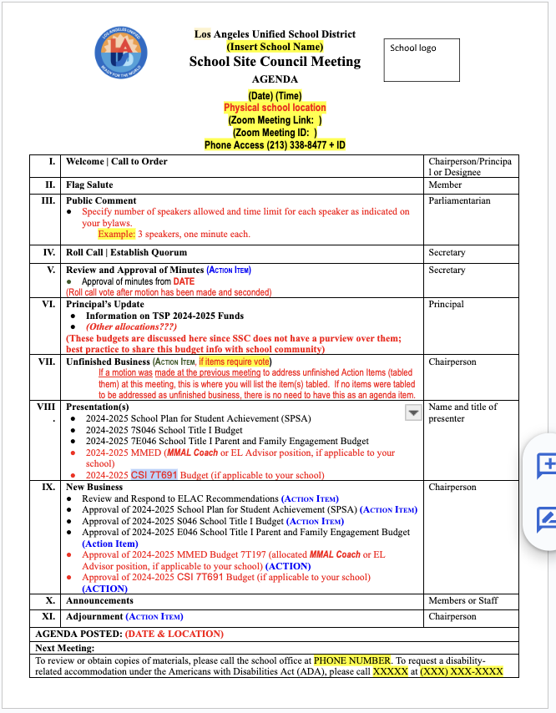
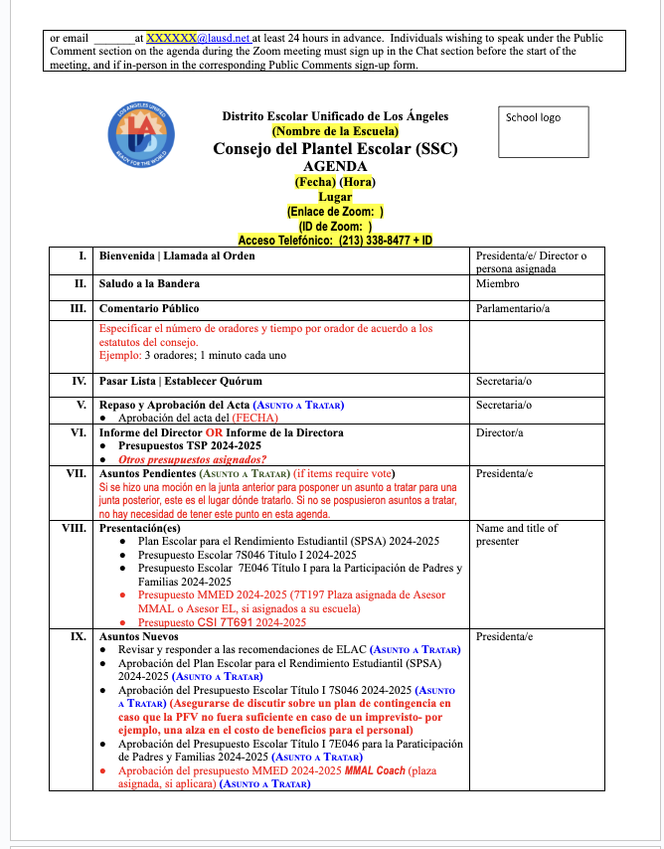
Agenda
Agenda
These documents are hyperlinked. Make them yours by going to FILE-MAKE A COPY.
Please insert your agenda on this slide.
Notes:
Say: this is today’s agenda
Click

Slide 10
**This slide is only for the designee in preparation for the SSC meeting.
Agenda
Agenda
SSC agendas must include:
A review of the School Plan for Student Achievement with relevant data at each meeting
Items related to program and/or budget changes
Annual review/evaluation of School Plan for Student Achievement advice from ELAC (should be submitted in writing and read to members)
Respond to ELAC advice at the next SSC meeting within 30 days
Las agendas del SSC deben incluir:
Una revisión del Plan Escolar para el Aprovechamiento Estudiantil con datos relevantes en cada reunión
Los asuntos relacionados a los programas y/o cambios en el presupuesto
Revisión/evaluación anual del Plan Escolar para el Aprovechamiento Estudiantil Sugerencias del ELAC para el Aprovechamiento (deben presentarse por escrito y leerse para los miembros)
Respuesta a las sugerencias del ELAC en la próxima reunión de SSC dentro de un plazo de 30 días.
Notes:
Say: this is today’s agenda
Click

Slide 11
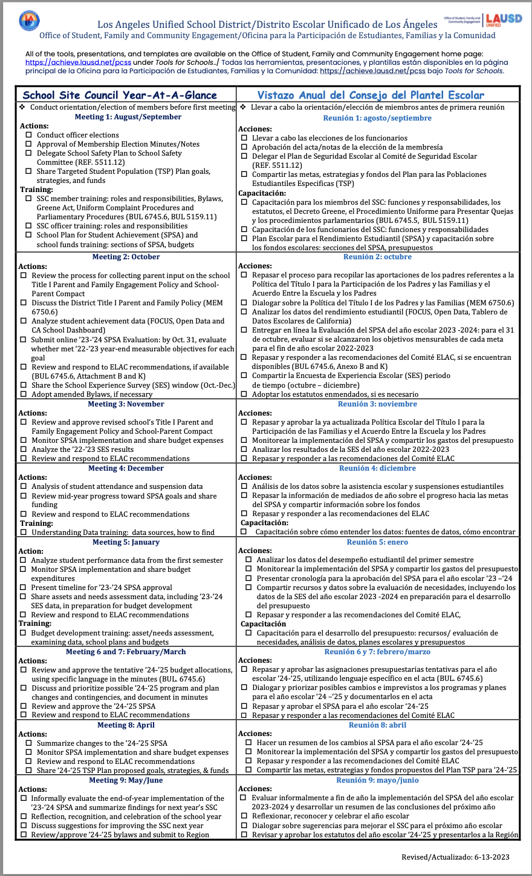
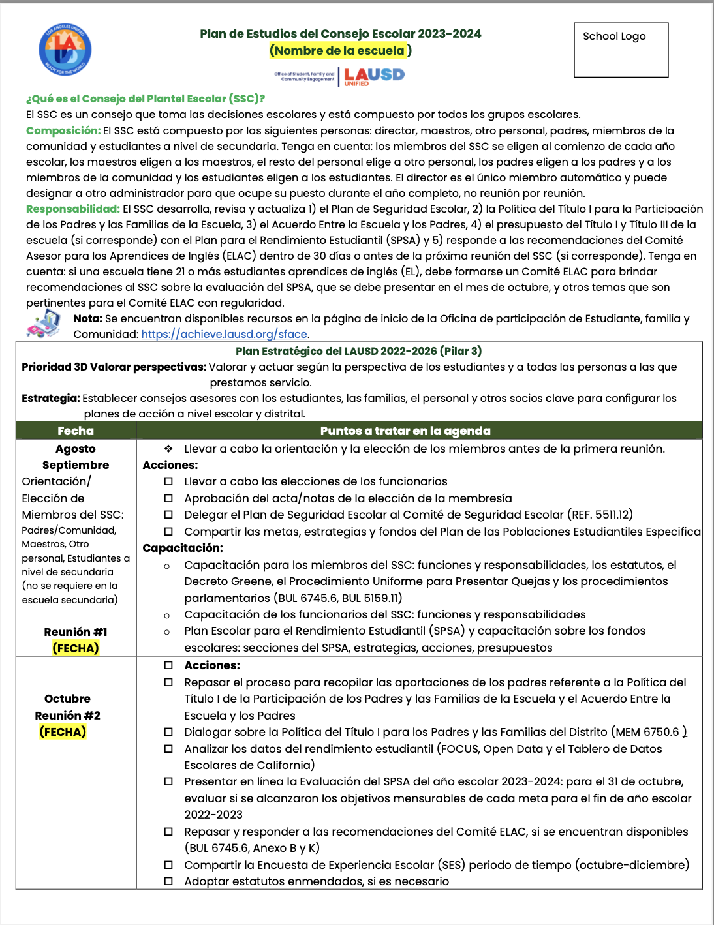
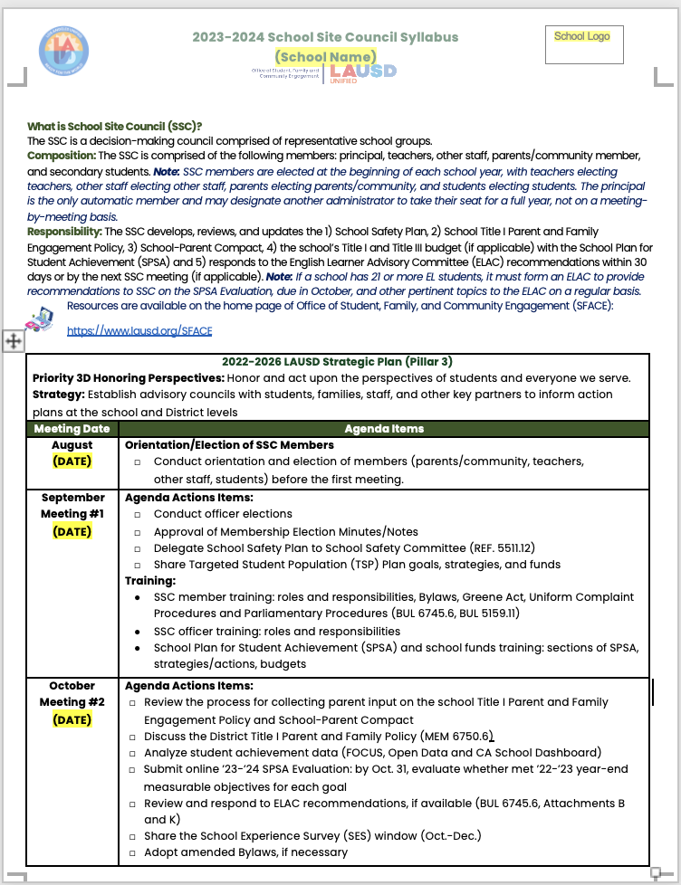
*This slide is only for the designee in preparation for the SSC meeting.
**Use the SSC Year at a Glance and School Site Council Syllabus drive your agenda and meetings.
These documents are hyperlinked. Make them yours by going to FILE-MAKE A COPY.
Notes:
Say: this is today’s agenda
Click

Slide 12

Pledge of Allegiance
Juramento a la Bandera
I pledge allegiance to the flag of the United States of America and to the Republic for which it stands, one nation under God, indivisible, with liberty and justice for all.
Prometo lealtad a la bandera de los estados Unidos de América y a la Republica que representa, una Nación ante Dios, indivisible con Libertad y justicia para todos.
Notes:
Say: Might I have a volunteer lead us in the Pledge of Allegiance?
Click

Slide 13
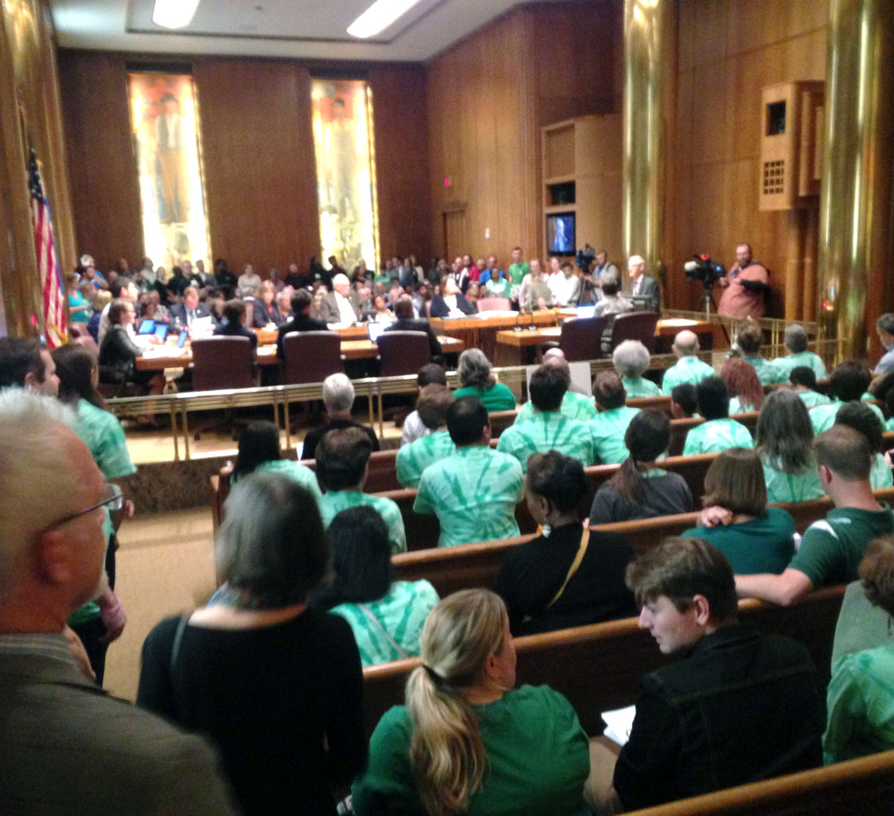
Comentario Publico
Public Comment

Slide 14
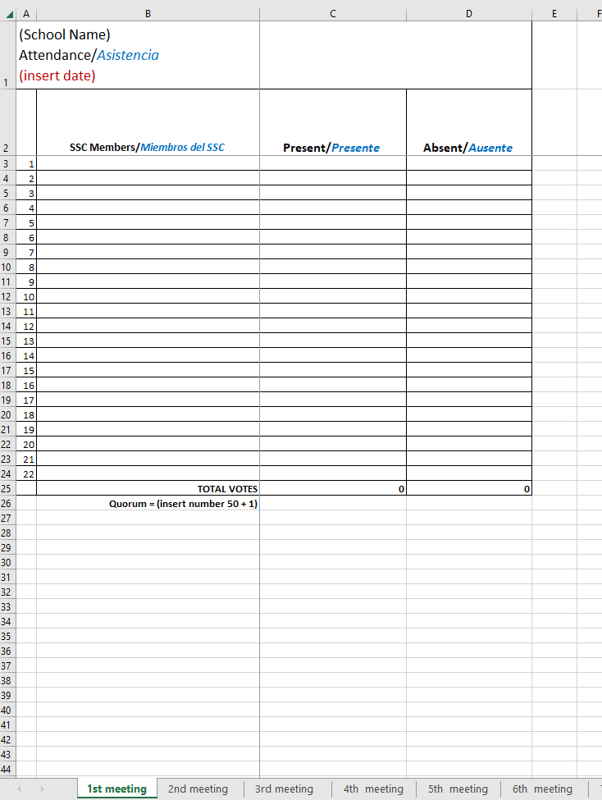
Roll Call
Establishment of Quorum
These documents are hyperlinked. Make them yours by going to FILE-MAKE A COPY.
Pasar Lista
Establecimiento de quorum
Notes:
To do: Use the attendace excel sheet in tools for school on at each meeting.
Say: Thank you let’s see who is with us today.
Read each name on the list and mark them absent or presented.
Say: We have ___ members present.
Quorum has been established with ____ present.
Or
We don’t have quorum, because we need ____ present
Click

Slide 15

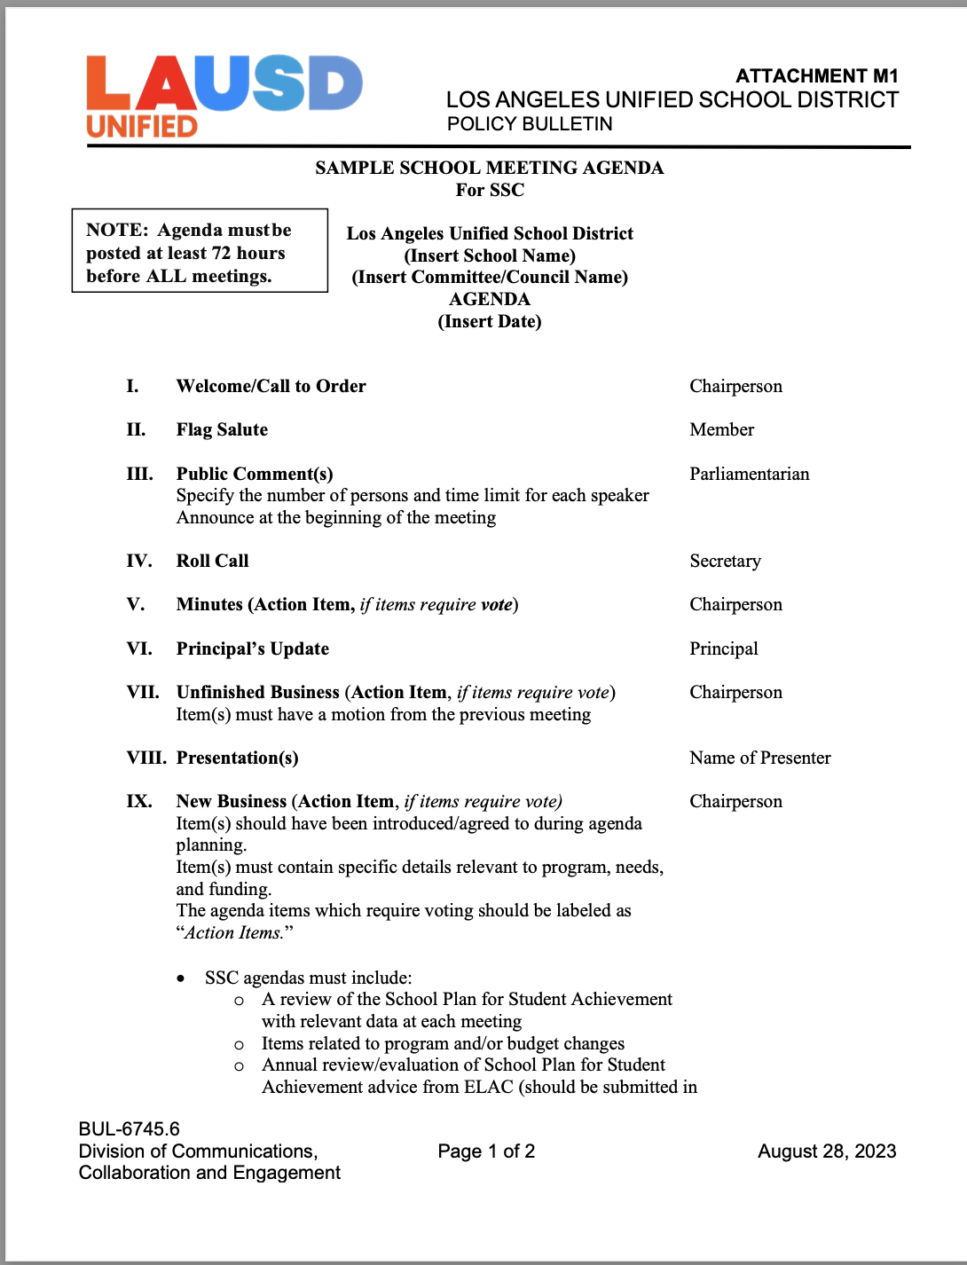
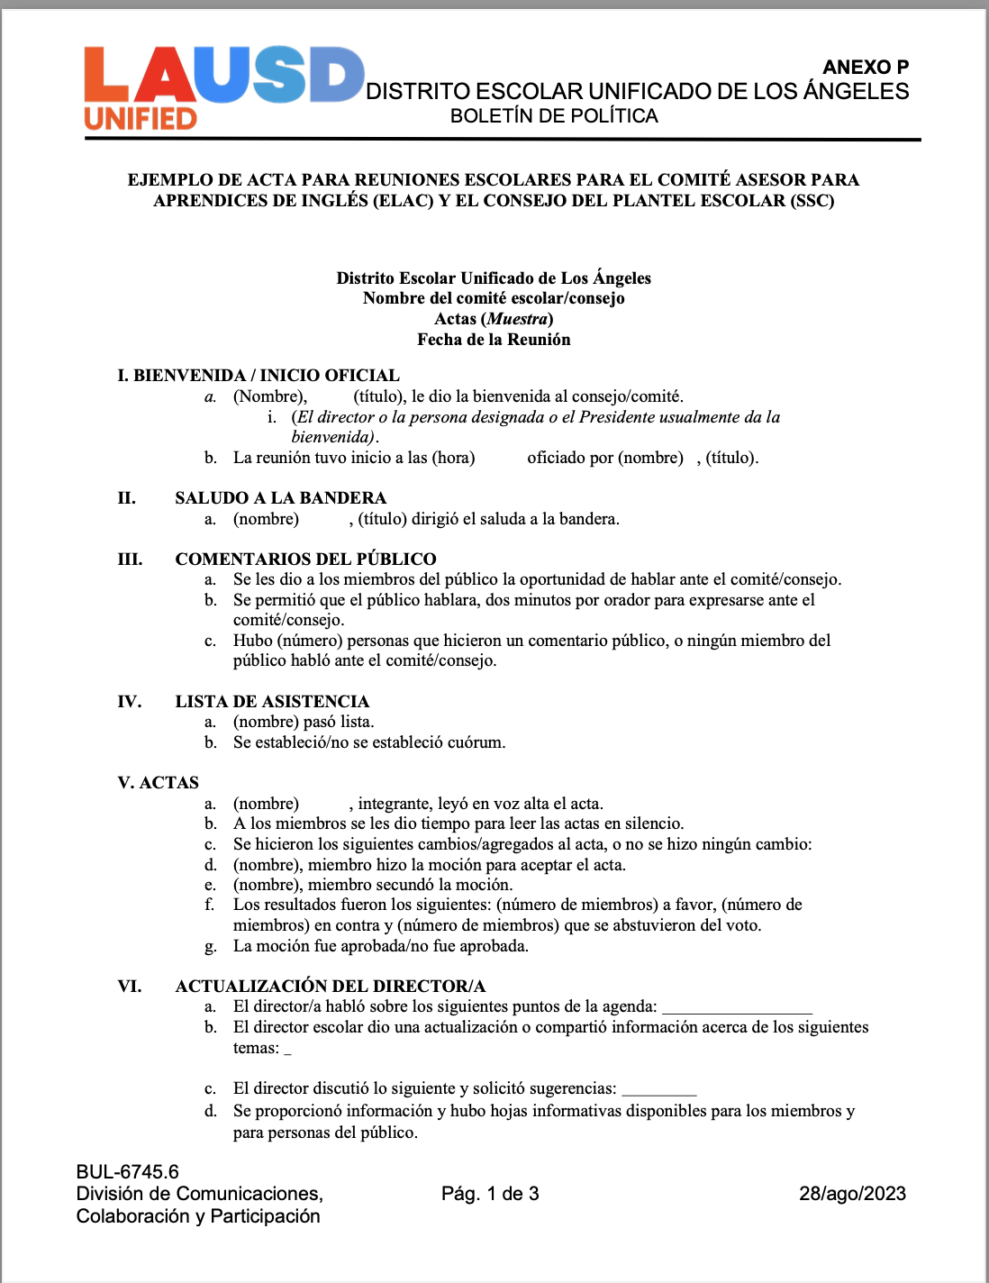
Approval of SSC Minutes/Notes
Aprobación de Actas/Notas
These documents are hyperlinked. Make them yours by going to FILE-MAKE A COPY.
Notes:
Say: Might I have a volunteer lead us in the Pledge of Allegiance?
Click

Slide 16
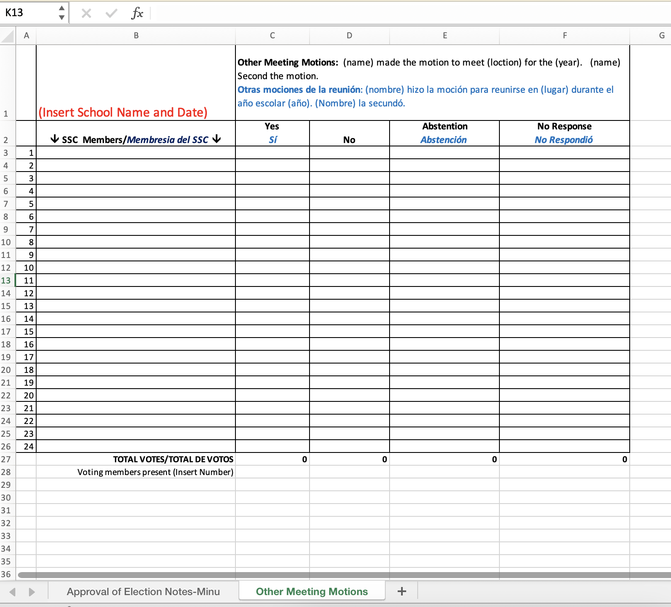
Motion regarding Approval of SSC Minutes/Notes & Other Motions
These documents are hyperlinked. Make them yours by going to FILE-MAKE A COPY.
Moción acerca de Aprobación de Actas/Notas de SSC y otras mociones
Notes:
To do:
Make sure that on the names of all parents/legal guardians that are present are on the second column, starting on the third row.
Once all names are displayed, state how many seats are available.
Open the floor for nominations.
Type the names of the community members who accept their nominations or self-nominate.
Ask the question three times, “Is anyone else interested?”
If none are interested, ask for a motion from the parents to close nominations.
Add the name of the person making the motion.
Add the name of the person who seconded the motion.
Repeat the motion audibly and take a roll call vote.
Once you have finished taking the roll call vote, continue by saying the following:
Please state your name and who you are voting for.
Once everyone has voted, please announce the results.
Display the Excel sheet.
Click

Slide 17
Principal’s Update
1.
2.
3.
Actualización del Director
1.
2.
3
**Add additional slides as needed.
Notes:
Say: Thank you we have these recourse for you to support your work.
Click

Slide 18
Unfinished Business (Action Item, if items require vote)
1.
2.
3.
Asuntos pendientes (Asunto de acción, si el asunto requiere votación)
1.
2.
3.
**Add additional slides as needed.
Notes:
Say: Thank you we have these recourse for you to support your work.
Click

Slide 19
Presentation(s)
2024-2025 School Plan for Student Achievement (SPSA)
2024-2025 7S046 School Title I Budget
2024-2025 7E046 School Title I Parent and Family Engagement Budget
2024-2025 MMED 7T197 MMAL Coach or EL Advisor position (if applicable)
2024-2025 CSI 7T691 Budget (if applicable)
2024-2025 Coll & Career Coach 7T124 Budget (if applicable)
2024-2025 Contingency Plan for the Council’s consideration (optional, BUT highly recommended)
Presentación(es)
Plan Escolar para el Rendimiento Estudiantil (SPSA) 2024-2025
Presupuesto Escolar 7S046 Título I 2024-2025
Presupuesto Escolar 7E046 Título I para la Participación de Padres y Familias 2024-2025
Presupuesto MMED 2024-2025 7T197 Plaza asignada de Asesor MMAL o Asesor EL (si corresponde)
Presupuesto CSI 7T691 2024-2025 (si corresponde)
Presupuesto Coll & Career Coach 7T124 2024-2025 (si corresponde)
Plan de Contingencia 2024-2025 (opcional, PERO muy recomendado)
**Add additional slides as needed. Feel free to add an individual slide for each of the numbered items above.
Notes:
Say: Thank you we have these recourse for you to support your work.
Click

Slide 20
New Business
Review and Respond to ELAC Recommendations (Action Item)
Approval of 2024-2025 School Plan for Student Achievement (SPSA) (Action Item)
Approval of 2024-2025 S046 School Title I Budget (Action Item)(Be sure to discuss a contingency plan in case the PFV is not sufficient in the event of an unforeseen event - for example, an increase in the cost of benefits for staff)
Approval of 2024-2025 E046 School Title I Parent and Family Engagement Budget (Action Item)
Approval of 2024-2025 MMED Budget 7T197 allocated MMAL Coach or EL Advisor position (if applicable) (ACTION)
Approval of 2024-2025 CSI 7T691 Budget allocated CSI 7T691 Budget (if applicable) (ACTION)
Approval of the 2024-2025 Coll & Career Coach 7T124 Budget (if applicable) (ACTION)
Approval of a 2024-2025 Contingency Plan (optional, BUT highly recommended you do both the *shortage and **overage) (ACTION)
Asuntos Nuevos
Revisar y responder a las recomendaciones de ELAC (Asunto a Tratar)
Aprobación del Plan Escolar para el Rendimiento Estudiantil (SPSA) 2024-2024 (Asunto a Tratar)
Aprobación del Presupuesto Escolar Título I 7S046 2024-2025 (Asunto a Tratar) (Asegurarse de discutir sobre un plan de contingencia en caso que la PFV no fuera suficiente en caso de un imprevisto- por ejemplo, una alza en el costo de beneficios para el personal)
Aprobación del Presupuesto Escolar Título I 7E046 para la Paraticipación de Padres y Familias 2024-2025 (Asunto a Tratar)
Aprobación del presupuesto MMED 7T197 2023-2024 MMAL Coach (si aplicara) (Asunto a Tratar)
Aprobación del presupuesto CSI 7T691 2024-2025 plaza CSI 7T691 (si aplicara) (Asunto a Tratar)
Aprobación del presupuesto Coll & Career Coach 7T124 2024-2025 (si corresponde) (Asunto a Tratar)
Aprobación de un Plan de Contingencia 2024-2025 (opcional, PERO muy recomendado hagan tanto la *escasez como el **exceso)(Asunto a Tratar)
**Add additional slides as needed. Feel free to add an individual slide for each of the numbered items above.
Notes:
Say: Thank you we have these recourse for you to support your work.
Click

Slide 21
Agenda Recommendations/Next Meeting (Action Item)
1.
2.
3.
Recomendaciones para la Agenda/Sigiuente Reunion (Asuntos de acción)
1.
2.
3.
Notes:
Say: Thank you we have these recourse for you to support your work.
Click

Slide 22
Resources
Handouts
Web Links
Other
Recursos
1. Folletos
2. Enlaces web
3. Otro
**Add additional slides as needed.
Notes:
Say: Thank you we have these recourse for you to support your work.
Click

Slide 23
Announcements
1.
2.
3.
Anuncios
1.
2.
3
**Add additional slides as needed.
Notes:
Say: Thank you we have these recourse for you to support your work.
Click

Slide 24
Adjournment
Clausura
Notes:
Say: Thank you we have these recourse for you to support your work.
Click

Slide 25
Contact Information
Información de Contacto
School Logo
(Name), Title
E-mail/Correo Electrónico
Phone Number/Numero de Teléfono
(Name), Title
E-mail/Correo Electrónico
Phone Number/Numero de Teléfono
(Name), Title
E-mail/Correo Electrónico
Phone Number/Numero de Teléfono
Notes:
Say: I look forward to working with you. This is our contact information.
If you have any questions, please reach out to us.
Click

Slide 26
Thank You
Gracias
Si tiene preguntas favor de llamar a (Coordinator's name) al (school phone number) o por correo electronico al (e-mail).
If you have any questions, please call (coordinator name) at (school phone number) or e-mail at (insert e-mail).
Notes:
Say: Thank you we have these recourse for you to support your work.
Click

