Slide 1
CAC Group Activity
September 20, 2017

Slide 2

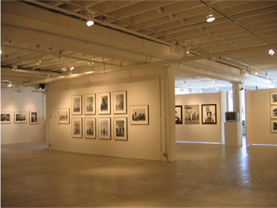
CAC Member
Gallery walk
Please walk around the room and review the names on the charts.
If you have your name on more than one chart, please pick an area you would like to focus on.
Please go to the table that has the area identified.
On the table is a list with the names of the participants, please initial your name.

Slide 3
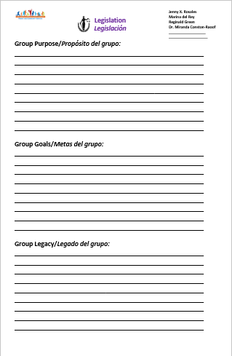

CAC Member
Group work
With an elbow partner take a minute to share what you believe the Group Purpose should be. (5 minutes)
At the table, please identify a person who will chart your discussion.
AT each group going counter clockwise share what you heard. Please, allow time for the person charting to write it down.
Please repeat the process with Group Goals, and Group Legacy.

Slide 4


Group Share
Each group will identify a person who will share with the rest of the CAC Members. (5 minutes each group)
The rest of the groups will listen attentively and take notes.
After the process has been completed, CAC members may write additional comments on a post-it and add it to the corresponding group work.
CAC Member

Slide 5
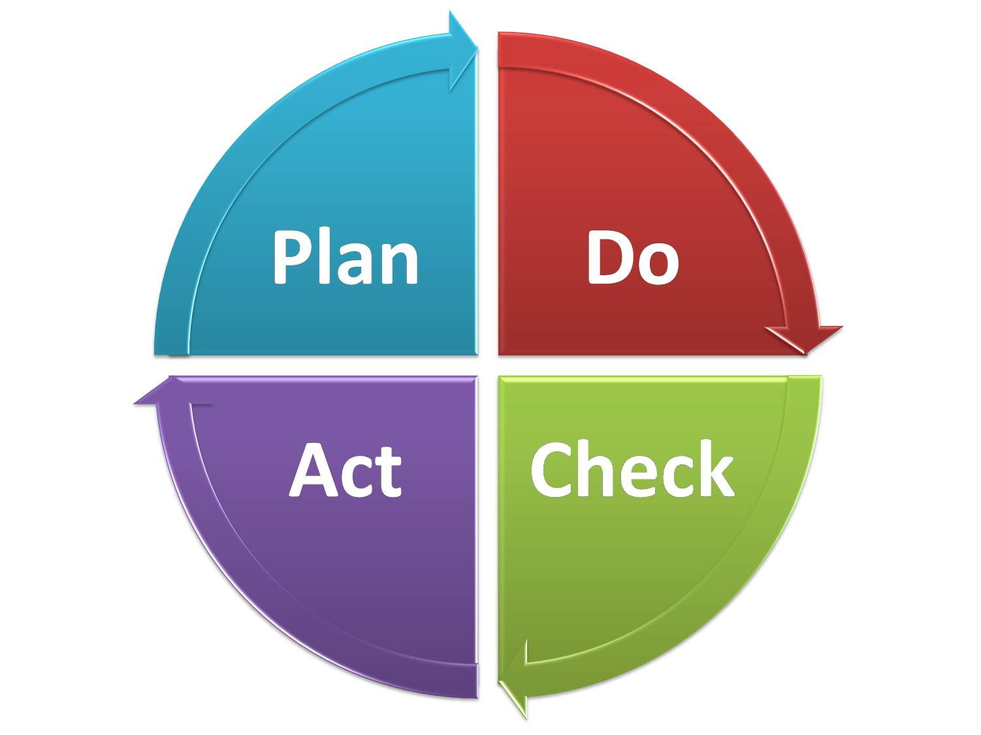
CAC Member
Next step
Each group will outline their next steps and their timeline.

