Slide 1


LCAP- Program & Goal Update
Los Angeles Unified School District
Division of District Operations
POSITIVE AND SAFE SCHOOL ENVIRONMENTS
Presented by: Dr. Earl R. Perkins, Associate Superintendent
Deborah Brandy, Director
Office of the Superintendent – Division of District Operations
Parent Advisory Committee (PAC) Meeting – February 16, 2017

Slide 2

Discipline Foundation Policy-Restorative Justice
Background and Efforts
2
  The District adopted the Discipline Foundation Policy in March 2007. The policy provided an overarching umbrella for student discipline.
2007 - 2014
In the Fall of 2011, the District entered into an Agreement to Resolve with the Office of Civil Rights (OCR) to address concerns regarding disproportionate suspension rates.
Ongoing data monitoring and analysis
On May 14, 2013, the LAUSD Board of Education adopted by majority vote the Board Resolution 2013 School Discipline Policy and School Climate Bill of Rights
Office of School Operations, in collaboration with various divisions, focused on major projects to fulfill the Board Resolution requirements.
Ongoing data monitoring and analysis
Rubric of Implementation
Performance Dialogue with Local District Administrator of Operations
Ongoing data monitoring
Revision and publication of policy Bulletin
5 Restorative Justice Advisers and 45 Restorative Justice Teacher Advisers were hired
Provided online Student Discipline data reports published monthly on the District website and data monitoring
Restorative Justice Tier I Trainings for COHORT 1 (149 schools)
Limited data access due to MiSiS rollout
2014 -2016
20 additional Restorative Justice Teacher Advisers were hired
Complete Restorative Justice Tier II/III trainings for COHORT 2 schools
Started Restorative Justice Tier II/III trainings for COHORT 3 schools
Ongoing data monitoring and analysis commencing second semester
Continue to work with SWPBIS Task Force, Charter Schools, community, business and philanthropic partners
2016 -2017
Continue to monitor implementation of SWPBIS and Restorative Justice.
Continue to work with community, business and philanthropic partners for schools to have access to be a full- service community school.
Ongoing data monitoring and analysis.
Thru 2020
1

Slide 3
LAUSD Investment to Support Targeted Youth
3
2

Slide 4
LCFF Investment
4
LCFF Investments
2014-2015
$4.2M
Positions
Training
Misc.
25 RJ Teacher Advisers
RJ Trainer Expert
Independent Auditor Contract
5 ESC RJ Advisers
Professional Development Training
1 RJ Coordinator
Training Materials
1 Adm. Staff Aide
LCFF Investments
2015-2016
$7.2M
Positions
Training
Misc.
45 RJ Teacher Advisers
RJ Trainer Expert
Independent Auditor Contract
6 LD RJ Advisers
Professional Development Training
1 RJ Specialist
1 Adm. Staff Aide
Training Materials
LCFF Investments
2016-2016
$9.2M
Positions
Training
Misc.
65 RJ Teacher Advisers
RJ Trainer Expert
Independent Auditor Contract
6 LD RJ Advisers
Professional Development Training
2 RJ Specialists
Training Materials
1 Adm. Staff Aide
3

Slide 5






Funding for Training (TOTAL OVER THREE YEARS)
The Program Description
5
As part of the Local Control Funding Formula (LCFF), LAUSD The Division of District Operations has received investment funds since 2014-2015 SY to ensure effective and fair handling of student behavior. This process has taken place primarily through the promotion of positive solutions and the reform of student discipline policies and practices. Specific goals and targets of school safety and climate are addressed.
For the last four years, the Division of District Operations in collaboration with various offices, schools and stakeholder groups, has made remarkable progress in implementing Restorative Justice practices. Significant progress has been made in the 25 demonstrations schools and the identified schools which have shown a reduction of the instructional days lost each year as a result of suspension.
Through the LCFF funds, Restorative Justice trainings have also been provided to various District offices and several parent/community groups.
Completed RJ Trainings COHORTS 1, 2, 3, 4 & 5 798 schools | COHORT 5 142 schools Training in RJ Tier II/Tier III 65 RJ Teacher Advisers – Identified schools Proposed 20 Additional RJ Teacher Adviser supports selected schools 57 schools supported by LD RJ Adviser
Districtwide Full
Implementation
by 2020
2019-2020
Completed RJ Trainings COHORTS 1, 2, 3 & 4 656 schools | COHORT 5 142 schools Training in RJ Tier I 20 RJ Teacher Advisers – Identified schools Proposed 20 Additional RJ Teacher Adviser supports selected schools 102 schools supported by LD RJ Adviser | COHORT 4 162schools Training in RJ Tier II/Tier III 45 RJ Teacher Advisers – Identified schools Proposed 20 Additional RJ Teacher Adviser supports Demonstration schools 97 schools supported by LD RJ Adviser
2018-2019
2017-2018
Completed RJ Trainings COHORTS 1, 2 & 3 494 schools | COHORT 4 162 schools Training in RJ Tier I 45 RJ Teacher Advisers – Identified schools Proposed 20 Additional RJ Teacher Adviser supports selected schools 97 schools supported by LD RJ Adviser | COHORT 3 199schools Training in RJ Tier II/Tier III Proposed 20 Additional RJ Teacher Adviser supports Demonstration schools 126 schools supported by LD RJ Adviser
2016-2017
Completed RJ Trainings COHORTS 1 & 2 295 schools | COHORT 3 199 schools Training in RJ Tier I Proposed 20 Additional RJ Teacher Advisers – Identified schools 126 schools supported by LD RJ Adviser | COHORT 2 146schools Training in RJ Tier II/Tier III 20 RJ Teacher Adviser – Demonstration schools 126 schools supported by LD RJ Adviser
2015- 2016
Completed RJ Trainings COHORT 1 149 schools | COHORT 2 146 schools Training in RJ Tier I 20 RJ Teacher Adviser supports selected schools 126 schools supported by LD RJ Adviser | COHORT 1 149 schools Training in RJ Tier II/Tier III 25 RJ Teacher Adviser supports Demonstration schools 124 schools supported by ESC RJ Adviser
2014-2015
 | COHORT 1 149 schools Training in RJ Tier I 25 RJ Teacher Adviser 124 schools supported by ESC RJ Adviser
2013
On May 14, 2013, the Board adopted by majority vote the Board Resolution 2013 School Discipline Policy and School Discipline Bill of Rights.
4

Slide 6
Research Evidence
Rationale for the Program
6
The District is committed to providing safe and healthy school environments that support all students in every aspect of their well-being. LAUSD students, staff and parents/guardians value fair and consistent guidelines for implementing and developing a culture of discipline based on positive behavior interventions and away from punitive approaches that infringe on instructional time.
Restorative Justice practices have become part of the culture and climate of the Los Angeles Unified School District. These practices are promoted by the state of California and U.S. Federal Government. The Federal Government has issued guidelines that explicitly recommend Restorative practices as an alternative to harmful, racially-bi­ased zero-tolerance policies.
The WestEd Research and Evaluation (WestEd.org) team interviewed a focus group of 15 experts and 38 practitioners of RJ at school sites. The results of the interviews indicated that school communities must understand the school climate and the source of issues that a school has to contend with before implementing RJ. Effective implementation requires that all school community members should undergo an initial RJ introduction and have an opportunity to familiarize themselves through practice. It t is important that schools receive training, have a common training curriculum, tools to measure the outcomes and impact, and strong leadership endorsing and advocating for change in a school’s approach to discipline.
5

Slide 7
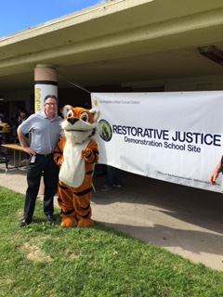
Research Evidence
Rationale for the Program
The experts interviewed by WestEd also stated that successful implementation requires a school principal who is committed to RJ and also to creating a restorative environment.
Currently John Hopkins University, Diplomas Now, the RAND Corporation, and the U.S. Department of Justice are conducting research projects to measure the level of RJ implementation in schools and the impact on the school climates.
As an essential part of our commitment, the District continues to invest in providing training and resources to schools. The Discipline Foundation Policy is the foundation of the District’s approach and provides a framework to support positive student behavior in schools.
6

Slide 8
Rationale for the Program
8
In response the Office for Civil Rights Agreement to Resolve and in alignment with AB 1729 and LAUSD Board Resolution - 2013 School Discipline Policy and School Climate Bill of Rights, the Division of District Operations continues to focus on:
Other means of correction and alternatives to suspension strategies to eliminate the disproportionality in discipline imposed on African American students.
Cultivating an environment of positive behavior intervention and supports
DISCIPLINE FOUNDATION POLICY
Restorative Justice
In order to support student’s positive behavior, all schools are responsible for adopting, implementing, and maintaining Tier I supports aligned with the District’s Discipline Foundation Policy: School-Wide Positive Behavior Intervention Support and the School Climate Bill of Rights. School-Wide Positive Behavior Intervention and Support (SWPBIS) is a research-based, highly-effective approach to creating, teaching, and reinforcing students’ social, emotional, and academic learning skills that improve and sustain academic achievement as well as the mental and emotional well-being of all students.
Restorative Justice is a philosophy and an approach to discipline that moves away from traditional discipline toward restoring a sense of harmony and wellbeing for all those affected by a hurtful act.
  Tier I focuses on relationships through the practice of community building circles, facilitated by trained staff members.
  Tier II focuses on repairing harm, accountability, and making things as right as possible, through the implementation of harm circles facilitated by the Restorative Justice Teacher Adviser and trained support staff members.
  Tier III focuses on re-integrating students to the school setting after suspensions or other absences, facilitated by the Restorative Justice Teacher Adviser and trained support staff members.
7

Slide 9
Related Goals and Metrics
9
8

Slide 10
Identified Early Trends
10
Instructional Days Lost to Suspension – All Students
Instructional days lost to suspension is the total number of school days students are absent due to suspension. In school year 2007-08, the District lost 74,765 instructional days to suspension. In school year 2015-16, the District lost 6,574 instructional days to suspension.
Suspension Rate – All Students
The suspension rate is calculated by dividing out-of-school suspensions by student enrollment. In school year 2007-08, the District’s suspension rate was 8.1%. In school year 2015-16, the District’s suspension rate was 0.59%, a 93% decrease over eight years.
9

Slide 11
Intended Outcomes
11
10

Slide 12
Types of Intervention
MyData Discipline Referrals
dated 7/1/2016 – 11/28/2016
1,187 of the discipline referrals submitted had Restorative Justice as an intervention.
Restorative Justice is one of the top 10 interventions used out of 34 different types of intervention for the submitted discipline referrals from July 1 thru November 28, 2016.
INTERVENTIONS USED Total
1 Conference with Student 8,635
2 Parent Contact 5,884
3 Conference with Parent 4,564
4 Detention 2,755
5 Counseling by Support Staff 1,562
6 Law Enforcement Notification 1,493
7 Conflict Resolution 1,423
8 Other 1,328
9 Restorative Justice Program 1,187
10 Counseling Individual 1,170
11

Slide 13
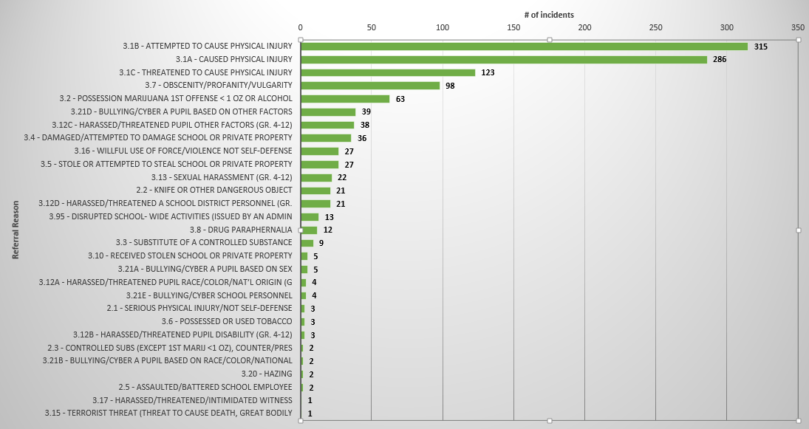
Restorative Justice Intervention
By Infraction Type
MyData Discipline Referrals
7/1/2016 – 11/28/2016
Restorative Justice was used as intervention for
31 different types of infractions.
Restorative Justice was used as an intervention for 29 different types of infractions submitted from July 1 thru November 28, 2016.
The top 3 types of infractions that used Restorative Justice as an intervention are related to physical injury.
1 Attempted to cause physical injury 315
2 Caused physical injury 286
3 Threatened to cause physical injury 123
The top 3 types of infraction that are related to physical injury used Restorative Justice as intervention.
1 |  | Attempted to cause physical injury | 358
2 |  | Caused physical injury | 289
3 |  | Threatened to cause physical injury | 162
Note: Only the most severe referral
reason in the discipline referral is listed
12

Slide 14
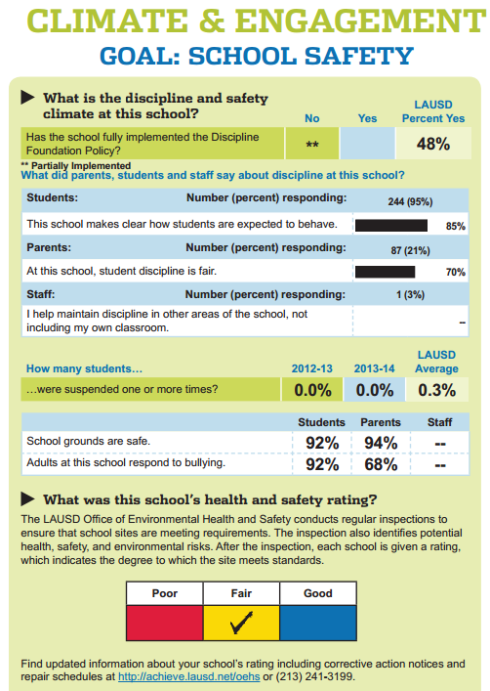

Intended Outcomes
14
13

Slide 15
Considerations
15
14

Slide 16
Next Steps and Anticipated Changes
16
RESOURCES TRAINING AND SUPPORT | SYSTEM TOOLS EVALUATION TOOLS
Discipline Foundation Policy Training Restorative Justice Training Training by Creative Educational Consultants, INC. Division of District Operations Local District Restorative Justice Advisers Restorative Justice Teacher Advisers Student Discipline Expulsion and Support Unit - Policy Bulletin - Guidance and Support Division of Special Education - Behavior Support Unit Suspension Analysis - Student with Disabilities with 5 or more days of Suspension Action Steps Independent Auditor, Educational Resources Consultants (ERC) School Report Card-Culture and Climate Survey Questions | MyData Discipline Report Review - MiSiS Error Report - Discipline Referral Report Review - Suspension Report Review Risk Report Local Control Accountability Plan (LCAP) - Metrics and Targets Division of District Operations Key Performance Indicator Restorative Justice Implementation Assessment Learning Zone Restorative Justice Training Report Discipline Foundation Policy System - Rubric of Implementation (ROI) - Complaint System Independent Auditor, Educational Resources Consultants (ERC) School Report Card-Culture and Climate Survey Questions
15

Slide 17
Questions?
17

