Slide 1

FOSTER YOUTH Achievement PROGRAM LCAP- Program & Goal Update
PAC Meeting – February 16, 2017

Slide 2
Focus Areas
Data & Accountability
Caregiver & Community Engagement
Professional Development
Youth Engagement
Notes:
13.6 million dollars

Slide 3
Community Partners
The Foster Youth Achievement Program will continue to collaborate with the
following community partners throughout the development of the program:
City Partnership (YouthSource, FamilySource, WorkSource Centers)
Los Angeles County, Department of Children and Family Services (DCFS)
Los Angeles County, Department of Probation
Los Angels County, Office of Education (LACOE)
National Center for Youth LAW-FosterEd
LA Trust for Children’s Health
Public Counsel
Children’s Law Center
Alliance for Children’s Rights
Advancement Project
New Ways to Work
Notes:
13.6 million dollars

Slide 4
LAUSD and DCFS Data Match
LAUSD receives DCFS client information once a week (Saturdays)
LAUSD matches the DCFS client data base to the LAUSD student data base.
As a result of this Data Match:
DCFS receives student records (i.e., grades and attendance)
LAUSD is able to identify foster youth within the District
Notes:
13.6 million dollars

Slide 5
Foster Youth Definition
Definition of Foster Youth per Local Control Funding Formula (LCFF)
A child/youth who has been declared a dependent of the court due to the presence or risk of abuse or neglect.
A child/youth subject to a petition filed under WIC Sec. 602, meaning a court has taken jurisdiction and declared the child to be a dependent of the court due to the child’s violation of certain criminal laws AND is ordered to be removed from the home.
Youth between the ages of 18-21 who is enrolled in high school college or vocational school, is a non-minor dependent under the placement responsibility of child welfare, probation, or tribal organization participating in a transitional living case plan.
Youth living outside of the home (as defined by EC Sec. 42238.01b) may include but not limited to; A county shelter, court specified home, foster family agency certified home, foster family home, group home, guardian with dependency, medical facility, non-foster care home, relative home, small family home, supervised independent living placement, Tribal Specified Home, or temporarily living in Juvenile Hall.
Notes:
13.6 million dollars

Slide 6
Foster Care Placement Types
Foster Youth may reside with/in
Foster Parents
(unrelated)
Biological Parents or Relative Caregivers
Families who plan to adopt
Juvenile Hall
Group Homes
Notes:
13.6 million dollars

Slide 7
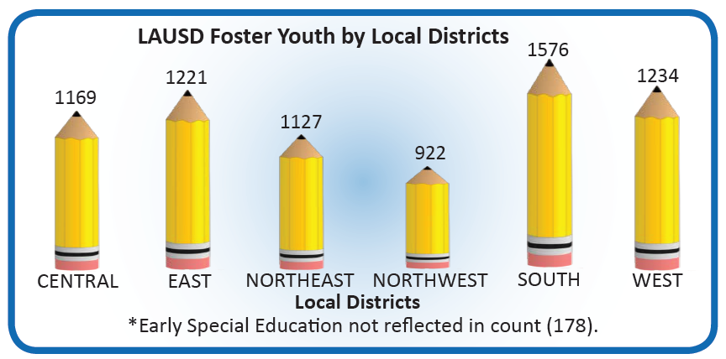
Foster Youth by Local District
Notes:
13.6 million dollars

Slide 8
Program Description
District Investment: $13 million dollars
LAUSD has worked closely with community stakeholders on program development, formulating program goals and expected outcomes.
The goals of the Foster Youth Achievement Program are to:
Provide support services to all foster youth attending LAUSD schools
Conduct comprehensive academic assessments
Promote school stability
Facilitate timely enrollment
Improve caregiver participation in the academic process
Provide continuous training and education on legislation and policy related to foster youth
Notes:
13 million dollars
82 School Based Foster Youth Counselors are assigned to every school to:
Conduct comprehensive academic assessments
Provide on-going intensive case management services
Individual and group counseling
Collaborate with school site personnel by participating in multi-disciplinary case conferences (i.e. IEP, SST)
Promote school stability
Advocate for the educational rights of foster youth
Monitor and increase the attendance and graduation rates of foster youth
Provide dropout prevention and recovery services
Provide transition counseling by encouraging foster youth to participate in the Pathways to College Program
Collaborate with District and community partners to coordinate services for foster youth

Slide 9
Research Evidence – Rationale for Program
9

Slide 10
Intended Outcomes
It is expected that the comprehensive academic assessments conducted and
interventions implemented by counselors within the Foster Youth Achievement
Program will serve to:
Attendance Rates
Performance on State Tests
Graduation Rates
Chronic Absenteeism
Number of Suspensions
Drop Out Rates
Notes:
What is the intended outcome for the year?
Set benchmark? Will target most likely be reached?

Slide 11
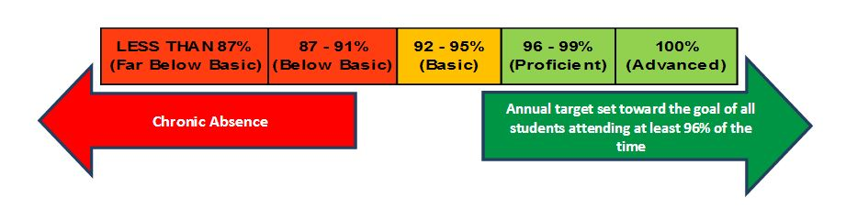
Foster Youth Attendance Rates
2014 - 2016
Notes:
What is the intended outcome for the year?
Set benchmark? Will target most likely be reached?

Slide 12
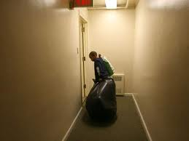
Considerations
12
Some identified barriers to school success are:
Being removed from their homes and communities
Separation from siblings
Unpredictable, frequent changes in homes and schools
Having the Department of Children and Family Services (DCFS) and the court system involved in all aspects of their lives

Slide 13
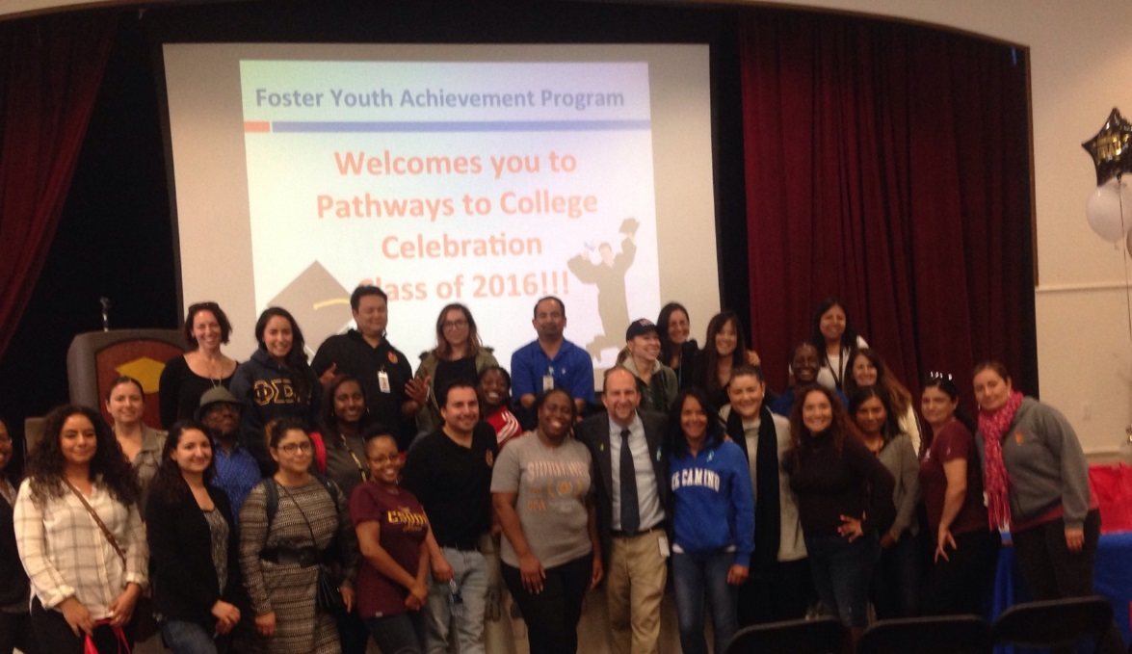

Program Highlights
13
FOSTER YOUTH LEADERSHIP COUNCIL (FYLC)
FOSTER YOUTH CAMP (SUMMER, WINTER, AND SPRING)
PATHWAYS TO COLLEGE CELEBRATION
FOSTER YOUTH SHADOW DAY

Slide 14
Next Steps
14
Promote School Stability in School of Origin
Every Student Succeeds Act (ESSA)

Slide 15
Questions?
15

