Slide 1
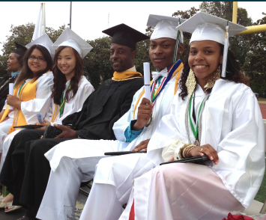

Graduation Progress and A-G Diploma Program
DELAC LCAP SESSION – DAY 1
April 20, 2017
Notes:
Presenting the our progress towards 100% graduation.
First looking at our preliminary achievements for the Class of 2016.
The indicators and progress of the current Class of 2017 and a new graduation dashboard tool that will support our monitoring and support of all high school students towards graduation and college eligibility.

Slide 2
Purpose
LAUSD Graduation Requirements
Credit Recovery Pathways
Students On-track for A-G Requirements
Class of 2017 Progress towards graduation
A-G Diploma Program: Mid-Year Report

Slide 3

Pathways for Student
Graduate College Prepared and Career Ready
Senior High School
Middle School
Elementary
Pre K - 12

Slide 4
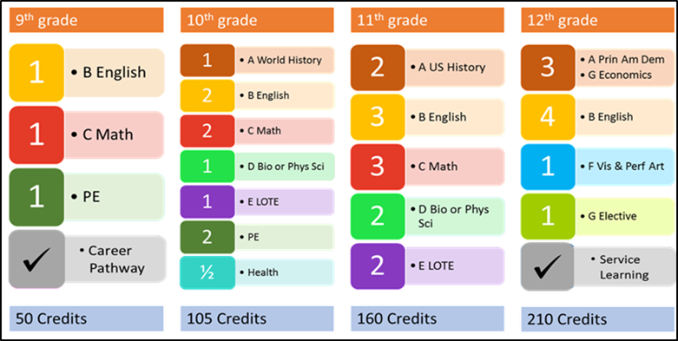
Graduation Requirements

Slide 5


C
REDIT RECOVERY
Program Opportunities
for
High School Students

Slide 6
Traditional means of credit recovery…
      Auxiliaries
        Opportunities during the school day for students to retake a failed course
        Approximately 138 auxiliary courses are currently being offered across the district for credit recovery
Independent Study
  Provides flexibility for students to recover missing credits
  Each student enters into a personalized agreement at his or her school with the subject teacher, stipulating the assignments and assessments required, expectations, and time frame for completion of the course

Slide 7
Digital learning opportunities based on mastery learning…
  Students proceed through each online course at their own pace as they demonstrate mastery of materials, and focus on concepts needing further instruction. The recommended duration of these courses is 12 weeks.
Blended Learning Model
  Schools provide a subject area credentialed teacher to support students through the curriculum
  A site coordinator/counselor is responsible for supporting students and monitoring program implementation at the school
  Virtual Learning Model
    An online platform teacher is provided
    School site provides a mentor for each student to monitor progress acting as a liaison between the school and program

Slide 8
New Credit Recovery Pilot Programs
They grew out of the performance dialogues of 2015 that involved all local districts
Each was designed within LAUSD as a new way of thinking around how best to support our students in need of credit recovery
The programs utilize current district resources including personnel, curriculum materials and technology

Slide 9
PASS
(Performance Assessment Student Support)
A modular program that meets the needs of students who have failed Algebra 1, Algebra 2, Geometry, 9th grade English Language Arts, and/or 10th grade English Language Arts courses
There is no time-in-seat requirement
Students proceed through each module at their own pace as they demonstrate mastery, and are provided differentiated instruction including technology components, on concepts needing further instruction
Once students demonstrate proficiency in each of the modules, they earn a passing grade and recover missing credits

Slide 10
RIG
(Recovery + Intervention = Graduation)
A system whereby students can recover credit for failed classes by taking up to two pass-thru classes at the options school site during the school day, while remaining enrolled at the comprehensive high school
RIG classes are also being offered after school and in the evening, providing maximum flexibility for student participation to complete A-G course credits
Partnerships have been created between 20 comprehensive high schools and the co-located continuation school to offer these credit recovery opportunities.

Slide 11
STAR 17
(Students Taking Action for Readiness)
A program that provides extended time at the end of each semester for students to demonstrate proficiency on the concepts and skills needing further instruction
Students are provide the opportunity to raise existing grades by participating in additional hours
The students enter a contract with the teacher of record, their parent and school counselor that specifies the requirements

Slide 12
Adult Education
Provides opportunities for students to take courses after school at 38 high school campuses across the district
Community College
Students have opportunities to take community college courses during or after the school day

Slide 13
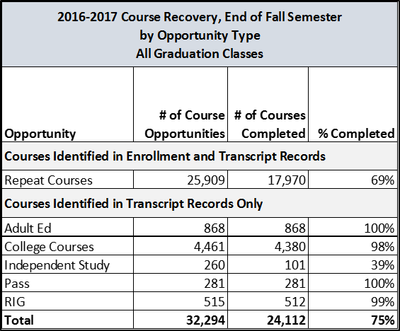
Fall 2016-17 Credit Recovery Summary
All Graduation Classes

Slide 14
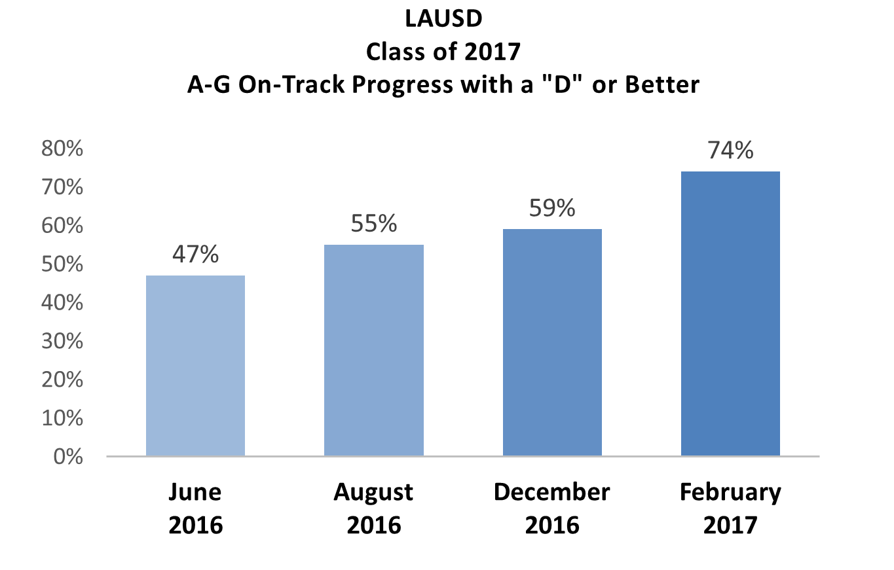
Based on current spring course enrollment with successful completion of a D or above
Data Source: MyData and Feb. Grad Dashboard
Notes:
Cynthia: Percent Graduating with a “C or above”
We continue to increase the number of 9th through 12th grade students that complete all of their A-G requirements with a “C or better” and are eligible for 4 year universities.

Slide 15
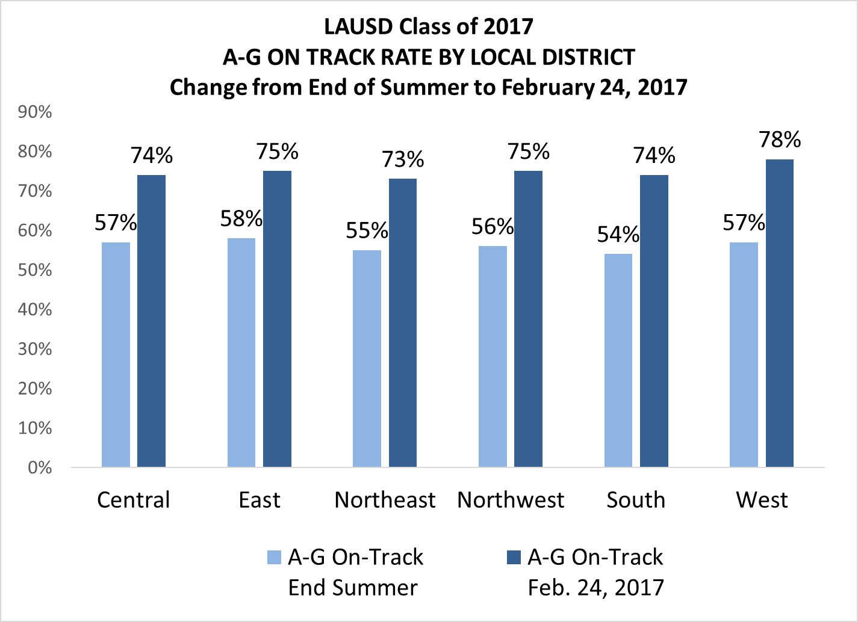
Based on current spring course enrollment with successful completion of a D or above
Data Source: MyData (End of Summer) Grad Dashboard (2017)

Slide 16
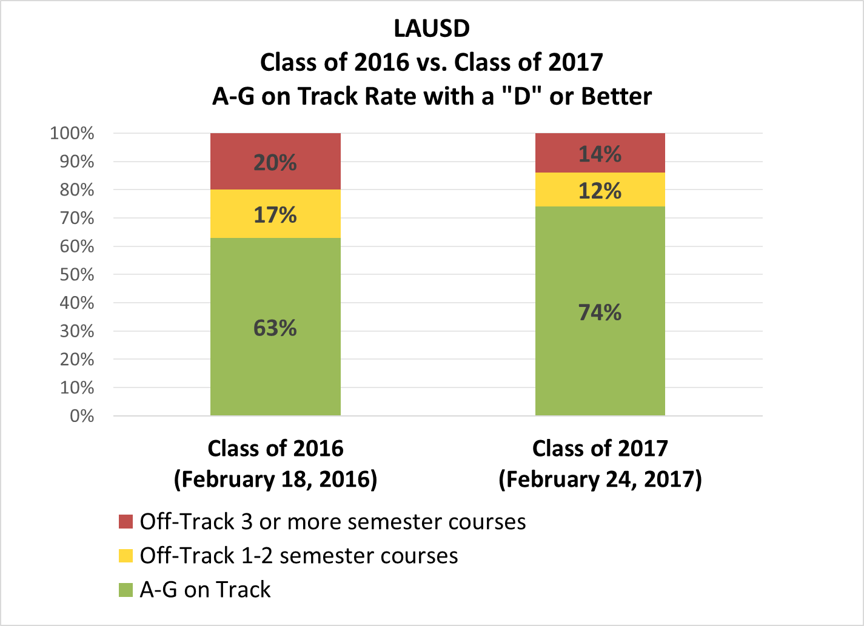
Based on current spring course enrollment with successful completion of a D or above
Data Source: MyData (2016) Grad Dashboard (2017)
Notes:
Carol Slide : LAUSD CLASS ON-TRACK PROGRESS
We are currently 5 percent higher compared to where we were at the end of the fall semester with the Class of 2016. Of the 41% off track, 19% are off track by 1-2 courses.

Slide 17
Based on current spring course enrollment with successful completion of a D or above
Data Source: Grad Dashboard (2-24-17)
Notes:
Carol Slide : LAUSD CLASS ON-TRACK PROGRESS
We are currently 5 percent higher compared to where we were at the end of the fall semester with the Class of 2016. Of the 41% off track, 19% are off track by 1-2 courses.

Slide 18
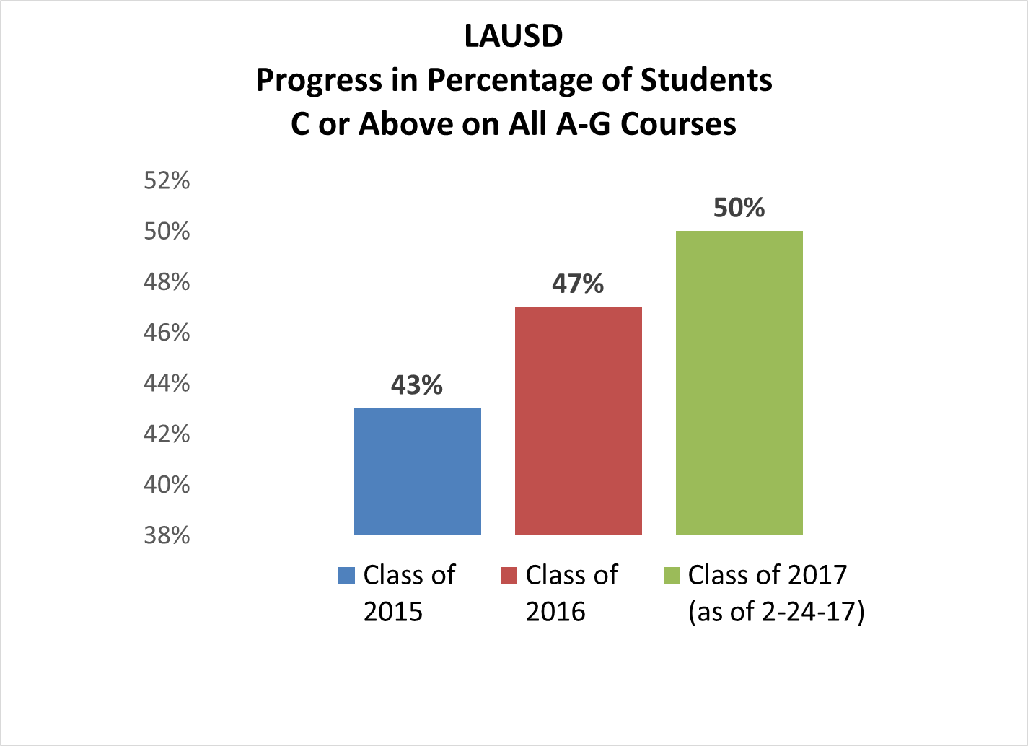
Notes:
Cynthia: Percent Graduating with a “C or above”
When just looking at the graduating class, we increased the number of students that complete all of their A-G requirements with a “C or better” from 43% to 47%.

Slide 19
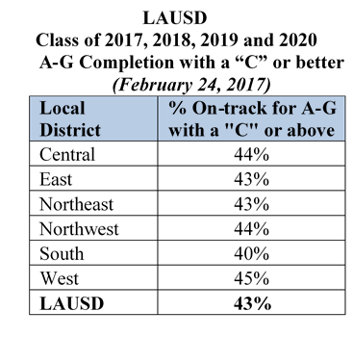
Notes:
Cynthia: Percent Graduating with a “C or above”
When just looking at the graduating class, we increased the number of students that complete all of their A-G requirements with a “C or better” from 43% to 47%.

Slide 20
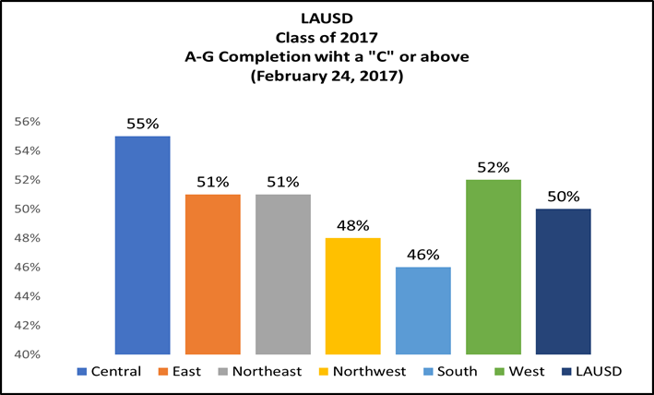
Class of 2017
Current A-G Completion with a “C” or above

Slide 21
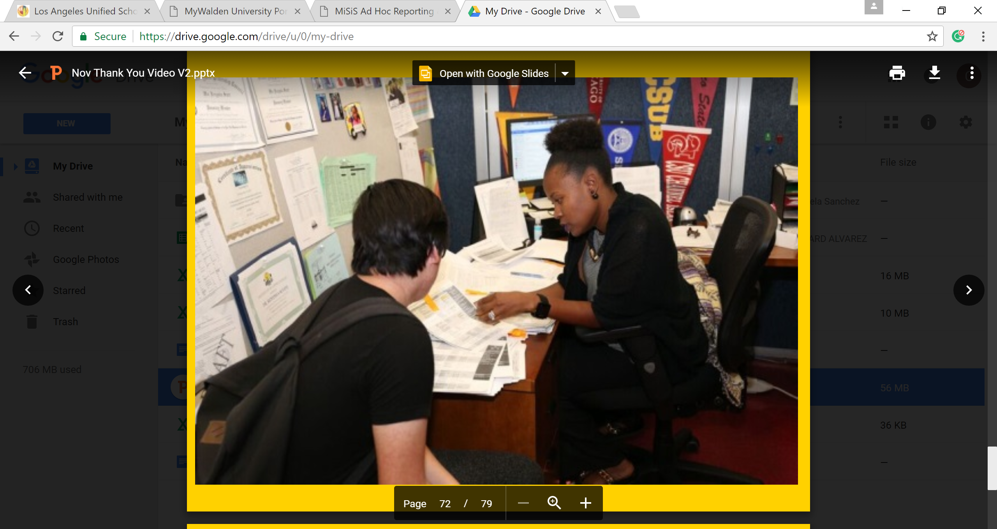
Individual Graduation Plans
IGP Completion Rate – Feb. 21, 2017
 | Number Completed | Percentage Completed
LD Central | 40807 | 97%
LD East | 44429 | 98%
LD Northeast | 39393 | 98%
LD Northwest | 39484 | 97%
LD South | 36014 | 98%
LD West | 31982 | 93%
All Local Districts | 233686 | 97%
Data Source: MiSiS (February, 21, 2017)
Notes:
Jesus Slide : INDIVIDUAL GRADUATION PLANS
Annual planning occurs when counselors meet with their students to discuss their Individual Graduation Plans.
Current number of completed IGP meetings ___
If students are not on track to graduate, counselors meet with them twice a year to monitor and discuss intervention and credit recovery options.

Slide 22
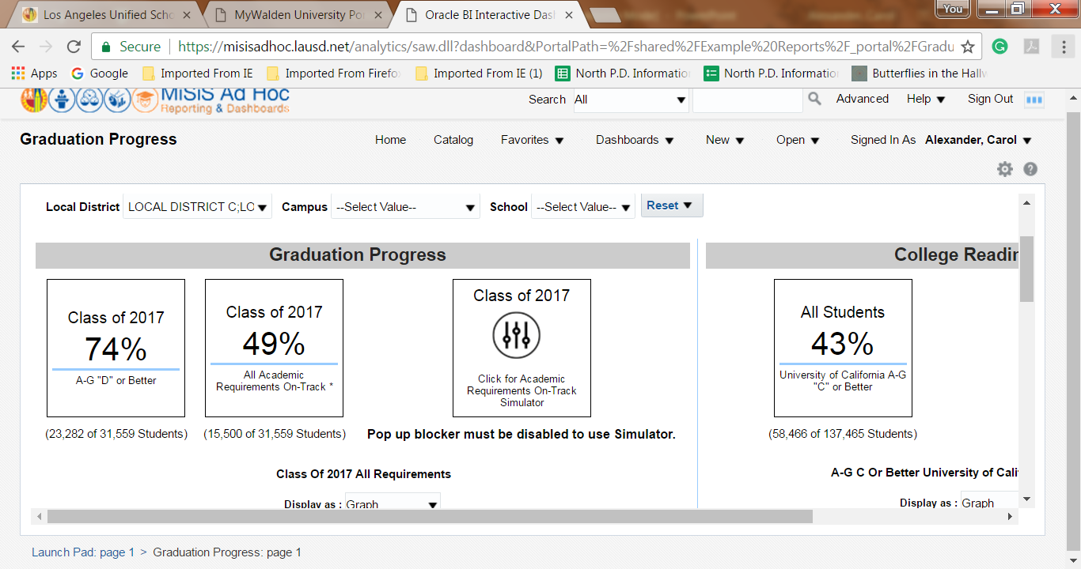
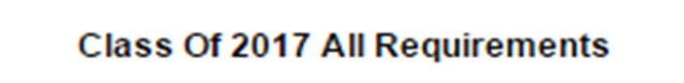
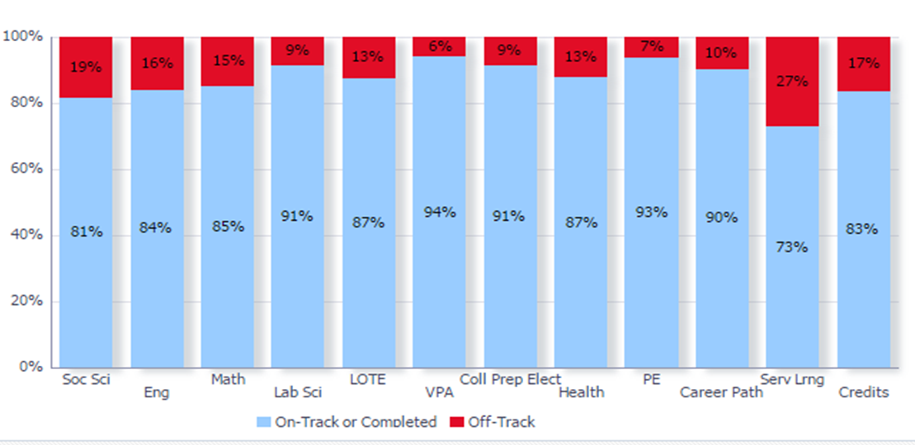
Graduation Progress Dashboard
Class of 2017 All Graduation Requirements
Data may be filtered by LD or school site
On-Track for A-G with a D or Better
On-Track for ALL Graduation Requirements
Break down of On-Track Rates by each Graduation Requirement
Data Pulled 2-24-17
Notes:
Derrick: Dashboard Slide #1
In order to assist schools in making informed decisions about how to support students, the Information Technology Division and Office of Data and Accountability, in collaboration with the Division of Instruction, have developed an online data tracking and analysis tool. This sample screen shot of the Graduation Progress Dashboard shows data including on-track progress and a breakdown of progress on each graduation requirement.

Slide 23
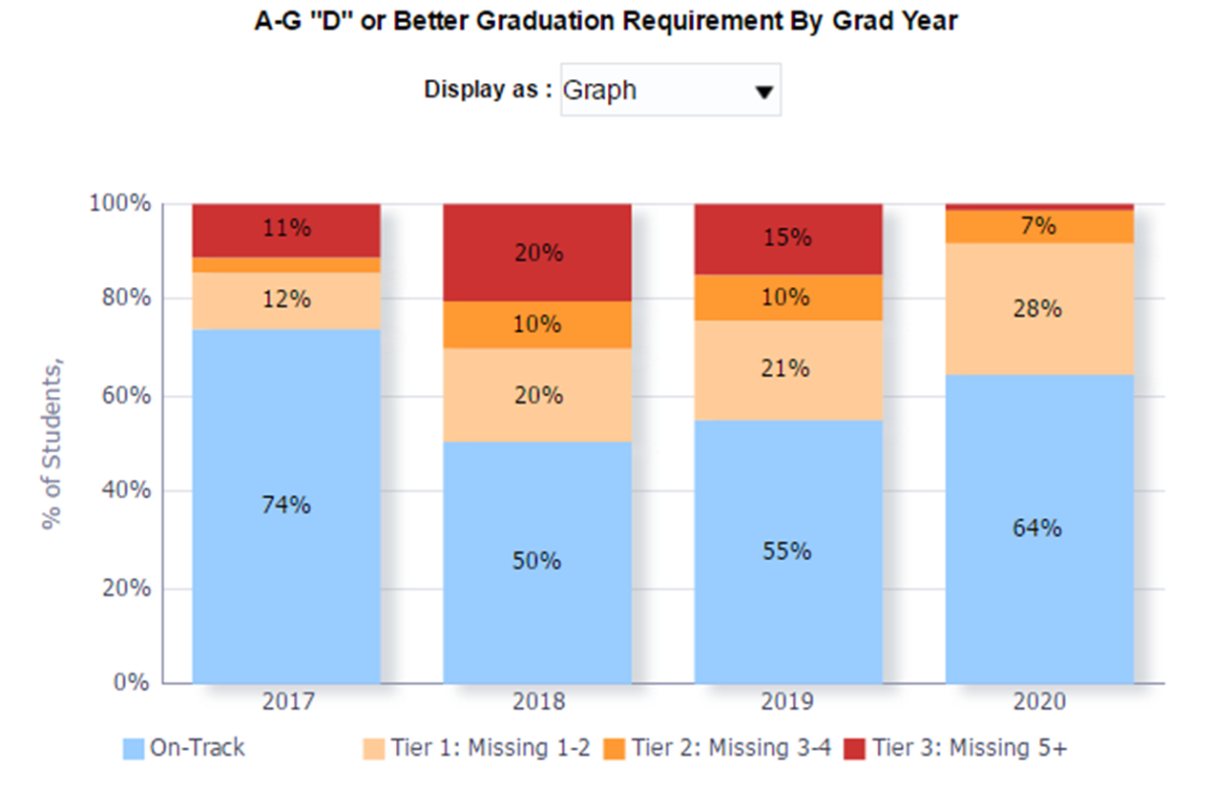
Graduation Progress Dashboard
A-G “D” or Better Graduation Requirement by Grad Year
On-Track for A-G with a “D” or Better by Grad Year
Colored Tier Breakdown
Data Pulled 2-24-17
Notes:
Dashboard Slide #2
The Graduation Progress Dashboard allows school site personnel to track graduation progress of students in each grade level and to target supports and resources to support students. The colored tiers indicate how many courses the students are missing to be on track.

Slide 24
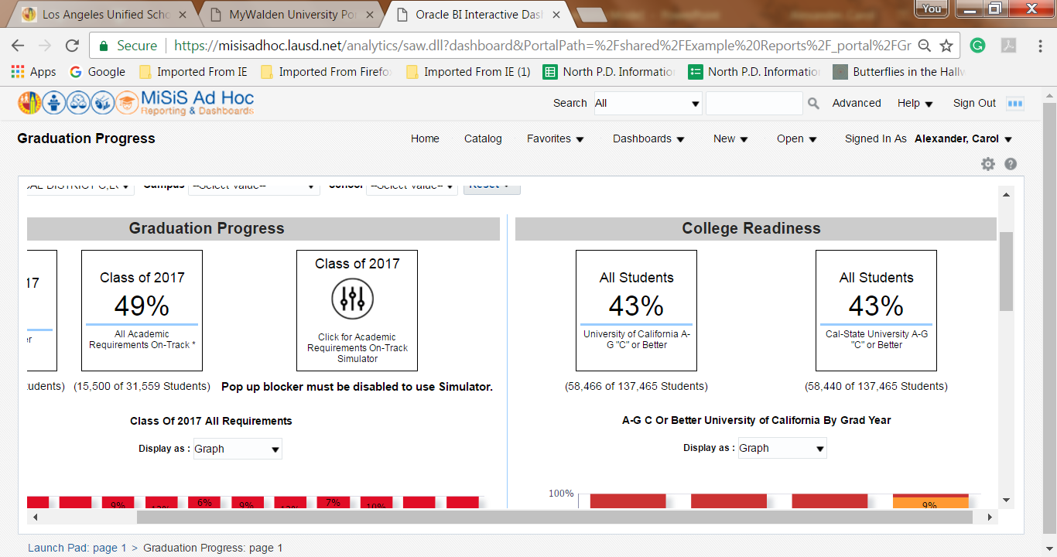
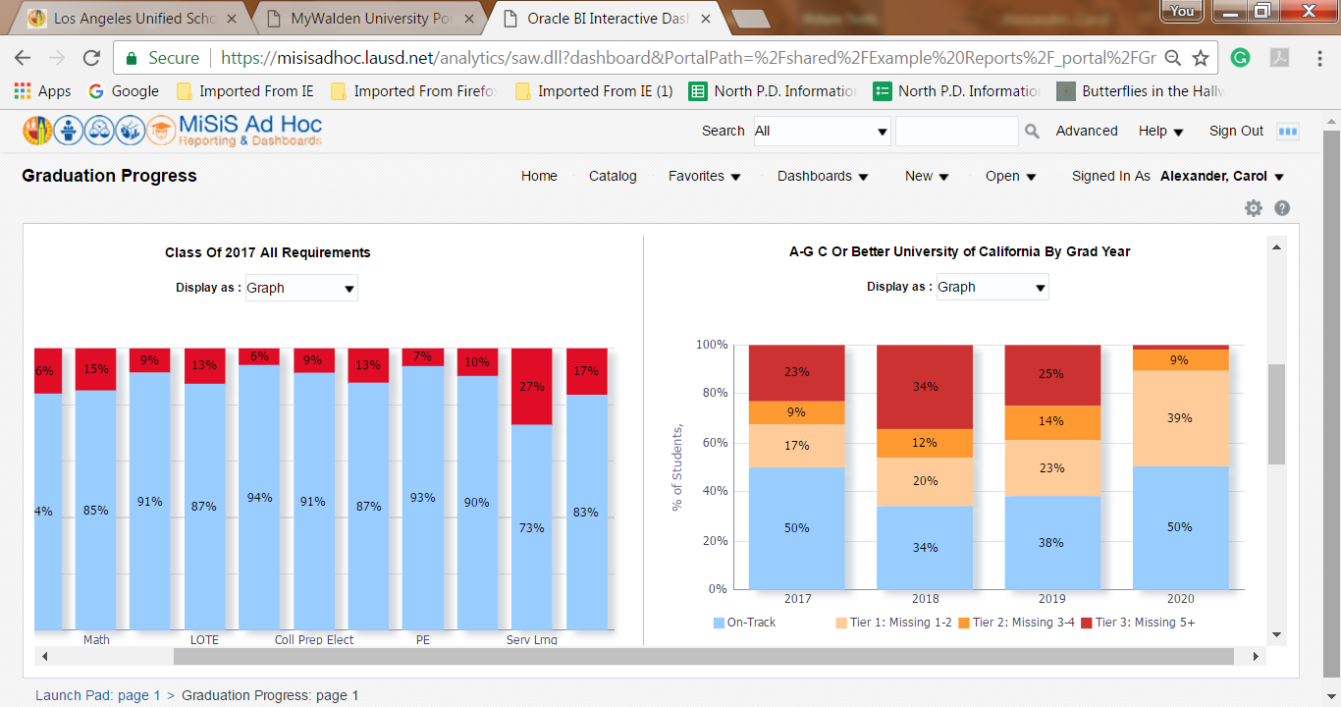
Graduation Progress Dashboard
  A-G “C” or Better, University of California by Grad Year
On-Track for University of CA A-G with a
“C” or Better
On-Track for
Cal-State University
A-G with a
“C” or Better
Breakdown of
On-Track with a “C” or Better for University of CA by Grad Year
Data Pulled 2-24-17
Notes:
Derrick: Dashboard Slide #3
We know that most students aspire to attend college, and the Graduation Progress Dashboard also provides tracking for student progress on meeting college readiness requirements for the University of California requirements. In order to meet state university requirements students must have a “C” or better in all A-G courses. This sample screen shot shows how students are progressing toward meeting the UC requirements and also shows how students are progressing in each grade level.

Slide 25
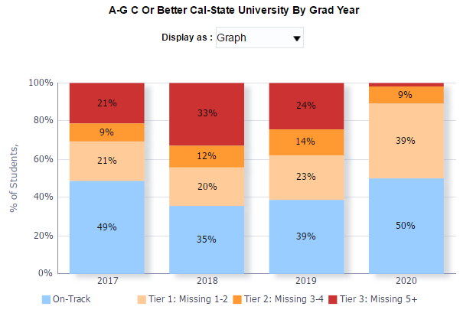
Graduation Progress Dashboard
  A-G “C” or Better, California State University by Grad Year
Breakdown of
On-Track with a
“C” or Better for
Cal-State University
by Grad Year
Data Pulled 2-24-17
Notes:
Derrick: Dashboard Slide #4
This sample screen shot shows how students are progressing toward the CSU requirements and also shows how students are progressing in each grade level.

Slide 26




A-G Diploma Program
Mid-Year Report

Slide 27
Background
Historic investment in child welfare and attendance and dropout prevention and intervention services in the LAUSD
Alignment with the District’s Strategic Plan goal of 100% graduation and Zero Dropouts Resolution
Three-tiered dropout prevention and intervention framework aimed at increasing course passage and A-G on-track rates
Administered by Pupil Services, Division of Student Health and Human Services

Slide 28
A-G Diploma Program Goals
Goal 1- Analyze/plan, track and share data
Goal 2- Teach College and Career Readiness
Goal 3- Implement Absence and Dropout Prevention and Intervention Strategies
Notes:
Goal 1
Share school site data monthly with administrative staff and academic counselors to guide the intervention plan and strategies implemented at each individual school site.
Extract progress reports every 5 weeks to review data with students, parents and school site staff and increase awareness of academic progress by all stakeholders.
Extract attendance data daily to assess student attendance patterns and trends. Identify if there are classes students are not attending regularly in order guide attendance intervention plan.
Goal 2
Collaborate with college and career counselor on activities to promote college and career awareness
Coordinate college and career fairs
Disseminate information to students, parents and staff about scholarships, off campus college fairs and Cash for college events
Goal 3
Provide individual counseling to each student in their cohort (Tier 2 or Tier 3) to monitor progress in completing individual graduation plan (IGP) and address barriers to academic achievement.
Consult and collaborate with the academic counselor to review transcripts, IGP and graduation exemptions of all students in tiers 2 and 3.
Provide informational presentations on attendance goals and laws to students, parents and staff.
Provide informational presentations on A-G requirements and credit accrual process to students, parents and staff.
Provide informational meetings on credit recovery options available on campus and in the community to students, parents and staff.
Serve as a member of the Student Success & Progress Team (SSPT) to coordinate services for students including referral to LAUSD alternative educational sites.

Slide 29
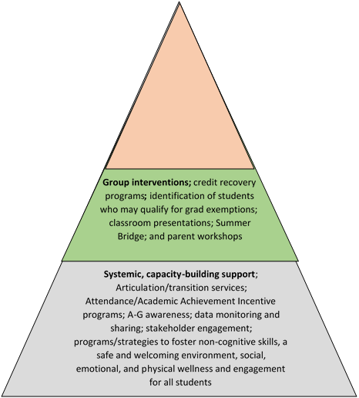
Program Framework
Focus on 26,613* students identified as Tier 2 and Tier 3 at the end of the Spring 2016 semester (Program Cohort)
A-G PSA Counselor in every Title 1 High School
Targeted case management; Personalized, direct student & family support; progress monitoring
Notes:
Much of this presentation will focus on the progress of the 26,613 students who received targeted case management in the fall of 2016-17; these students were identified based on being 3 or more classes (Tier 2) or 5 or more classes (Tier 3) off-track from meeting A-G graduation requirements
*NOTE adjustment/correction to the original cohort number
students enrolled in continuation schools (about 3,000) within the zones of support had been inadvertently included in the original targeted case management cohort
about 1,500 magnet students inadvertently excluded (due to having a different location code) from the data pull, but included for services in the data file provided to counselors

Slide 30
Summary of Services
August 2016-December 2016
2,312 School-wide Assessment/Planning activities
2,432 Student group sessions
2,498 A-G informational meetings with 29,064 participants
2,509 Collaborative Consultations regarding targeted students with 16,955 participants
40,577 Student contacts
1,596 Presentations at SSPT, SART or SARB
8,499 Parent contacts
1,472 Home visits
3,877 Alternative education referrals for credit recovery
Presentations to all six local district leadership teams regarding A-G Diploma Program, PSA Counselor roles, responsibilities and opportunities for collaboration
Ongoing collaboration with K-12 Counseling Director and Coordinators in each Local District

Slide 31
What do we know about the Cohort?

Slide 32
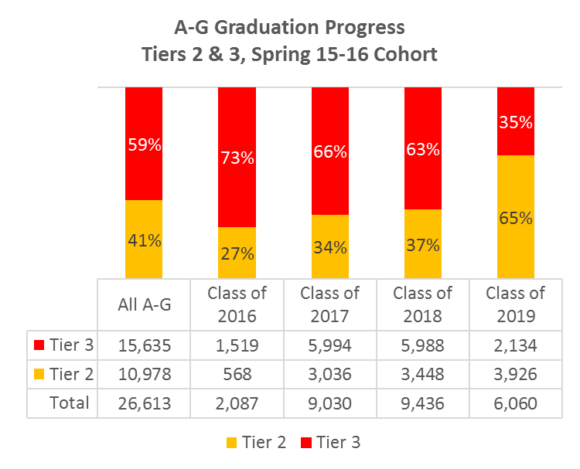
Cohort by Graduating Class
26,613 students identified in Tier 2 and Tier 3 in Spring 2016
Classes of 2016-2019
Notes:
Updated numbers
n = 26,613
No continuations (removed about 3,000 students;
Added magnets (added about 1,500 students)
MINIMAL CHANGES TO OUTCOMES
Spring 15-16
Tier 3 shrank slightly
Tier 2 grew slightly

Slide 33
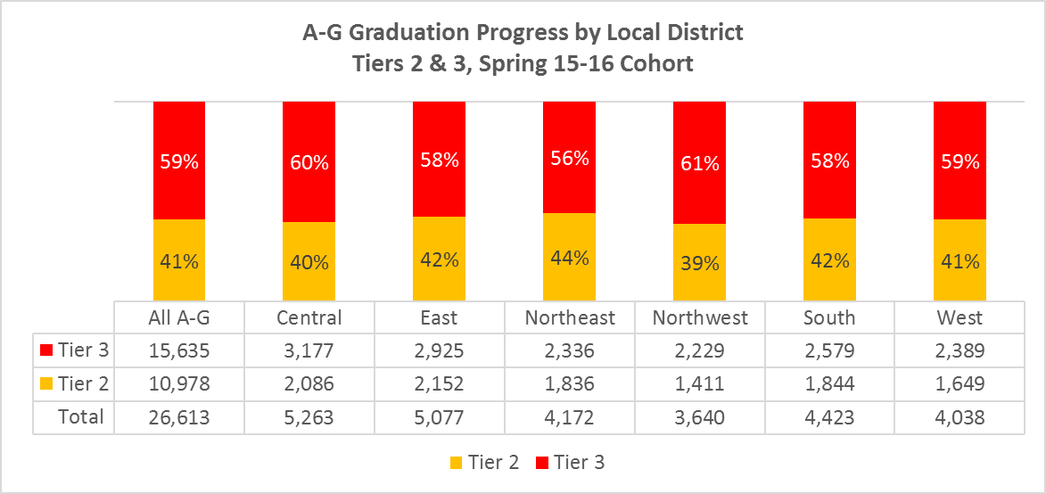
Cohort by Local District

Slide 34
Cohort Progress
After Fall 2016 Semester
Notes:
Using a cohort model allowed us to look at data differently. Often reports only provide overall progress of those students that are still enrolled. Comparing different points in time often does represent the same students.
Comparing the progress of the same students allowed us to not only see how many are progressing. But it also allows us to see who is leaving, giving us an opportunity to take action and make systemic change to improve outcomes for all students.

Slide 35
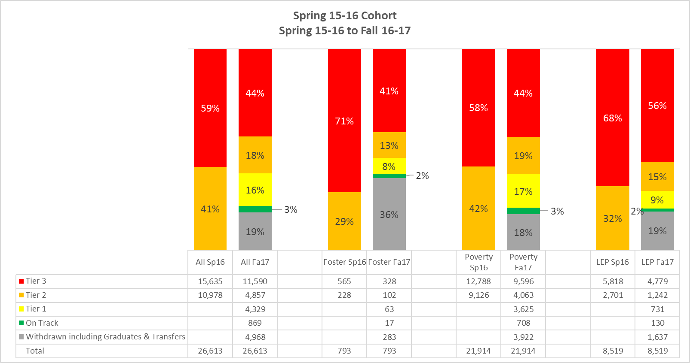
Cohort A-G Graduation Progress
Classes of 2016-2019
Notes:
COHORT UPDATE n= 26,613
Fall 16-17
Slightly smaller differences in reduction of Tiers 2/3
On track – no change
Withdrawn students almost no change in %
After one semester we can see that students that were moving from Tier 2 (orange) and Tier 3 into Tier 1 (yellow) and On track status (green)
15% decrease in Tier 3
23% decrease in Tier 2
16% increase in Tier 1 -4,329 students
3% increase in on track-869 students
We also identified 4,968 students that were no longer enrolled in the K-12 LAUSD system,
These students may have:
-Transferred to another California school
-Graduated
-Enrolled in the Adult Ed system
-Moved out of state or out of the country
-Or Disconnected from the educational system.
Chart also provides progress on Targeted Student Populations within the cohort
We still find disparities among Foster Youth and English learners.
In particular this data also highlights the transiency of Foster Youth as 36% of those students were no longer enrolled in LAUSD after one semester.

Slide 36
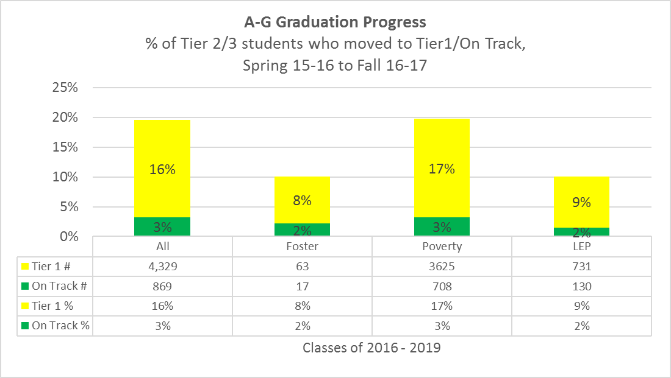
Notes:
Significant progress being made: Almost 20% of Tier 2/3 students (A-G cohort) are moving up to Tier 1 and On Track
Some gains, but more progress still needed for subgroups: Foster and LEP are not making same gains as everyone else

Slide 37
Notes:
Tier movement slide highlighting the movement of the cohort (Tiers 2/3) from Spring 15-16 to Fall 16-17
In Tier 2, 3,844 students moved up to Tier1/On Track (about 1/3 of students)
About a 1/3 of Tier 2 students showed improvement
About 25% fell to Tier 3
In Tier 3, 3,197 students moved up to Tiers 2/1/On Track (about 1/5 of students)
More than half of Tier 3 students did not change
Students who are farther behind are less likely to return to school the next year (withdrawn)

Slide 38
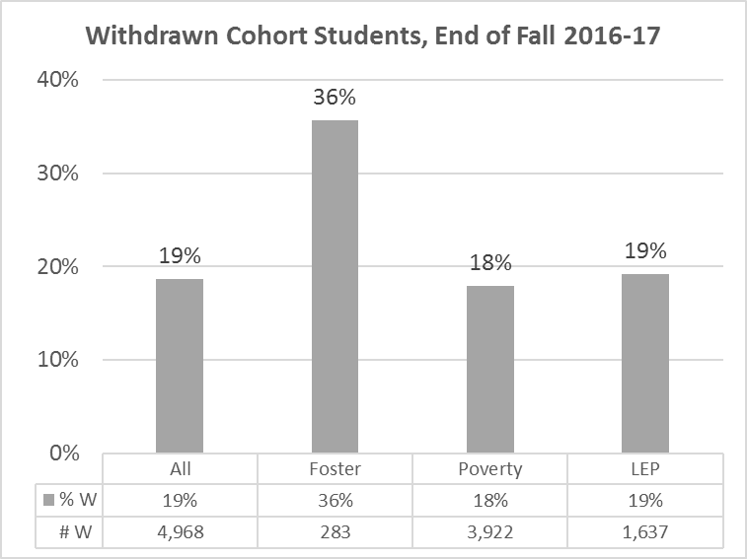
Notes:
% of cohort that left school before the end of the following semester (Fall 16-17)
4,968 students total
High % of foster youth withdrawn

Slide 39
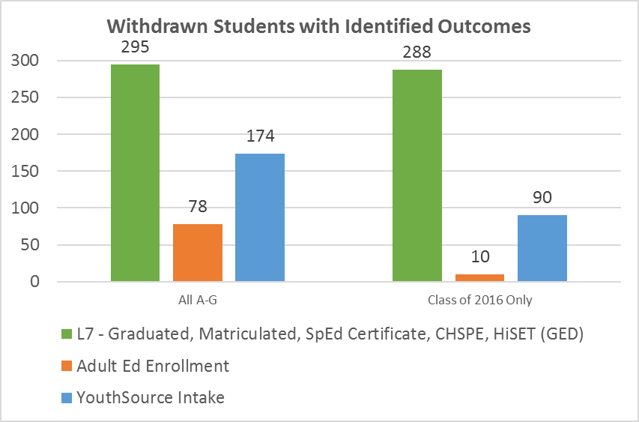
Notes:
547 students total (out of 4,968) have either graduated, enrolled in adult school, or been referred and seen by a YouthSource PSA
Almost all the L7s were from the Class of 2016 as well as half the YouthSource referrals

Slide 40
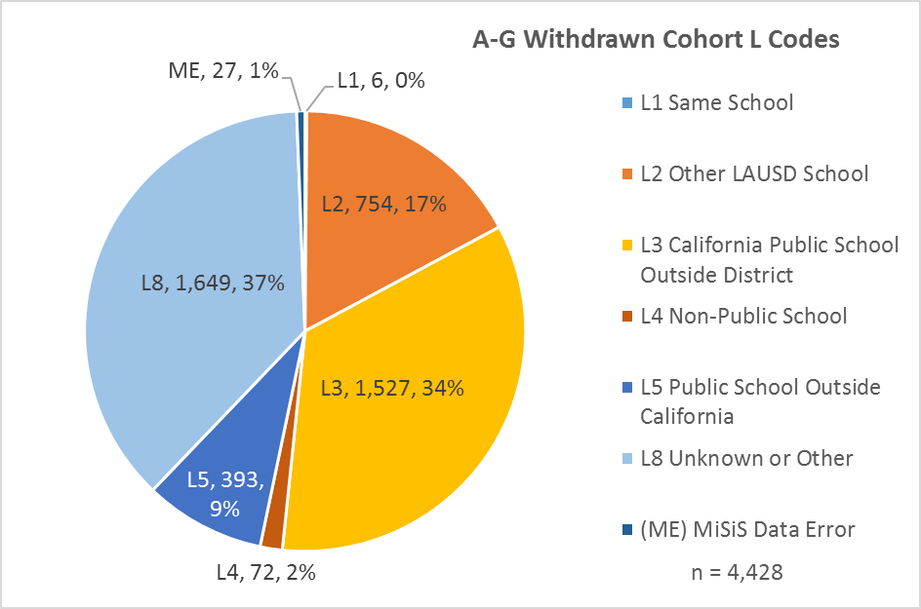
Notes:
Summary of L codes of 4,428 students not accounted for by L7s, adult Ed enrollment and YouthSource
L8 is largest category, followed by L3

Slide 41
A-G Diploma Program
Withdrawal/Leaver Protocol (all “Leavers”)
Convene school-site Dropout Prevention Team to review and manage processes for student withdrawal/leavers; if available, collaborate with the school-based PSA Counselor
Weekly to Monthly-Run the MiSiS Enrollment & Withdrawal (E & W) Report for the current month to verify the enrollment status and enrollment location of all withdrawn students
Verify that MiSiS Withdrawal Records are supported by the required documentation (transcripts, court orders, records requests, enrollment paperwork, etc.)
Account for all pending and verified students in the SOS Log (Total/Pending/Verified section)
Notes:
Counselors run school-wide leaver lists at least monthly and work to verify successful transfer and re-enrollment for all withdrawn students

Slide 42
Total Withdrawals Verified by
A-G Diploma Program PSA Counselors
September 2016 through January 2017
Local District | Central | East | West | South | Northeast | Northwest | CHS/Tri-City | Totals
Total Withdrawals | 2,054 | 1,884 | 1,889 | 1,783 | 1,833 | 1,463 | 151 | 11,057
Total Verified | 1,123 | 1,158 | 1,057 | 1,461 | 1,124 | 672 | 16 | 6,611
% Verified | 55% | 61% | 56% | 82% | 61% | 46% | 11% | 60%
Notes:
To date,

Slide 43
Student Stories

Slide 44
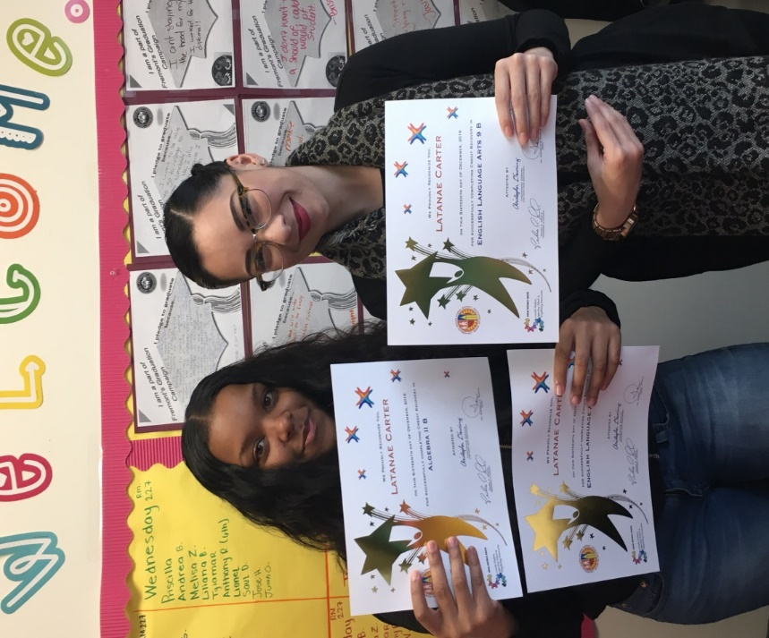

Latanae Carter
Fremont High school
Class of 2017
Tier 3 at end of Spring 2016
Accepted to California State University
Dominguez Hills
Wants to become a Social Worker
Notes:
A-G Counselor Diana Delgado began working with Latanae Carter in September 2016 after she re-enrolled back to John C. Fremont High School after attending Sierra Vista High School in Nevada for a year.
When Latanae re-enrolled at Fremont she was classified as class of 2017, she was a tier 3 caseload and was identified as missing 7 A-G classes.
Latanae and Ms. Delgado continued to work closely for the rest of the semester. During her first semester back, Latanae demonstrated tremendous passion and dedication to reach graduation. Upon their first meeting, she pledged to be part of Fremont's graduation campaign ran by the A-G Diploma Program Counselors by sharing, "I want a high school diploma and a college degree. I want to be successful, I want to be a social worker".
On her journey to success, Latanae was enrolled in our Edgenuity and Saturday School credit recovery programs. Latanae would also participate in our after-school credit recovery program implemented by ARC and our A-G Diploma Program Counselors 3 X's a week. With such opportunities, Latanae was able to recover 15 credits through Edgenuity and is currently recovering an additional 5 credits. She was also able to successfully recover 5 credits by attending Saturday school adding up to a total of 20 credits recovered in just one semester!
Latanae was recognized in December 2016 during our A-G Diploma Program Lunch Recognition Ceremony along with 10 other students for successfully moving down tiers. She began on tier 3 in September of 2016 and now as of February 2017, she is "on-track".
Latanae is expected to walk the stage and graduate this June as long as she passes all her A-G classes this semester.
Not only has Latanae been able to get on-track towards graduation, she has also been successfully admitted to California State University, Dominguez Hills.
Finally, Latanae was also recently nominated by the administrator of the School of Environmental and Social Justice (SLC) as one of three students eligible for a COPA scholarship. She successfully submitted her application Friday, January27, 2017 and is awaiting a response.

Slide 45
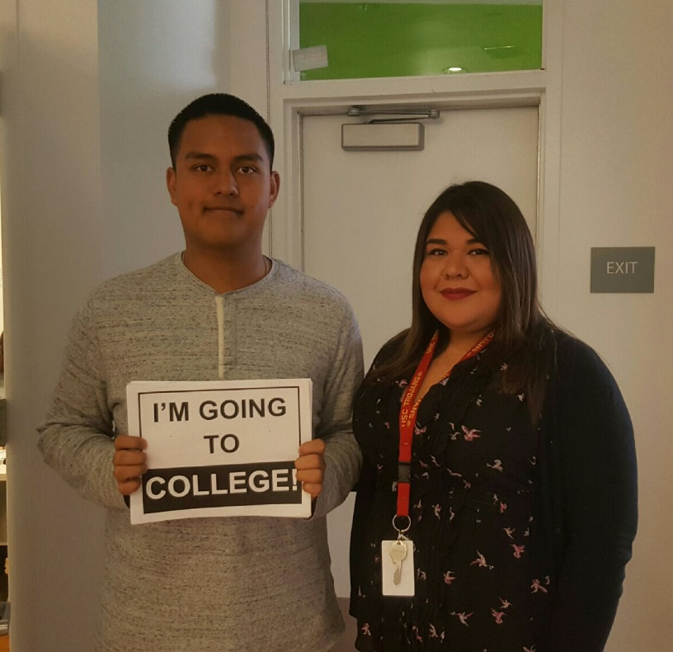
Erick Flores
Garfield High School
Class of 2017
Tier 3 at the end of Spring 2016
Applied to CSUN and CSULA
Wants to become an Engineer for the Department of Justice
Notes:
A-G counselor Oralia Bahena Catalan met Erick Flores during the first week at Garfield High School. He was a senior who had been identified as Tier 3, was missing several courses and had yet to begin work on credit recovery.
From their initial meeting we discussed what he wanted to do after high school and how a diploma would benefit him.
Oralia informed Erick about the A-G program and our goals. In addition, she notified him that she would be following up on his progress, would check in on him, and was determined to see him graduate.
He told Oralia he would be just as committed to graduating and was willing to do whatever it took to get there.
Together with his academic counselor they were able to enroll Erick in APEX courses and winter session credit recovery.
Erick was able to recover his credits and is now on track to graduate. Erick was successful in his credit recovery and became eligible to apply to four year universities.
Erick plans to one day have a career with the Department of Justice.
Erick credits his success to being identified early in the year, being offered credit recovery options, and knowing that someone is holding him accountable to his goals.
Additionally, when asked what helped him turn his life around, Erick responded by simply saying “You told me I had potential”.
Erick is currently labeled as a homeless student as well

Slide 46
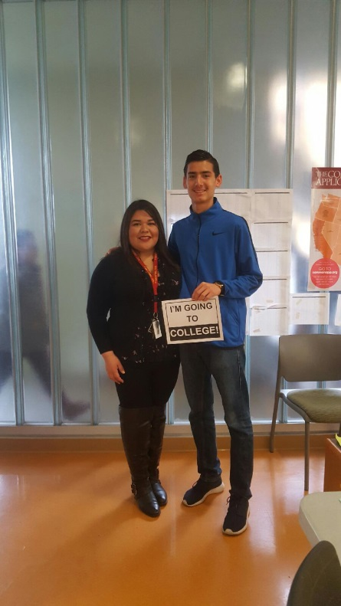
Omar Castrejon
Garfield High School
Class of 2017
Tier 3 at the end of Spring 2016
Will be attending California State University, Los Angeles
Notes:
Omar Castrejon was born in the US but due to family circumstances he and his parents moved out of the country. Erick currently lives with his Aunt while his parents reside in Mexico
At 16 years old Omar decided that he wanted to go to college. He enrolled at Garfield High School and began informing himself about graduation requirements.
In the fall, Omar was identified as a tier 3 student. The A-g Counselor Oralia Behena Catalan conducted an overview of his transcript and informed him that he needed to begin the credit recovery process by enrolling in APEX, Adult School, and Saturday School.
Omar was determined and enrolled in all three.
In October, Oralia along with the College Counselor, Ms. Lopez, informed Omar that due to his hard work and dedication, he would be eligible to apply to a four year university.
Omar registered for the SAT, applied to college, and recently has been accepted to CSULA.
Omar will be the first in his family to pursue a post-secondary education.

Slide 47
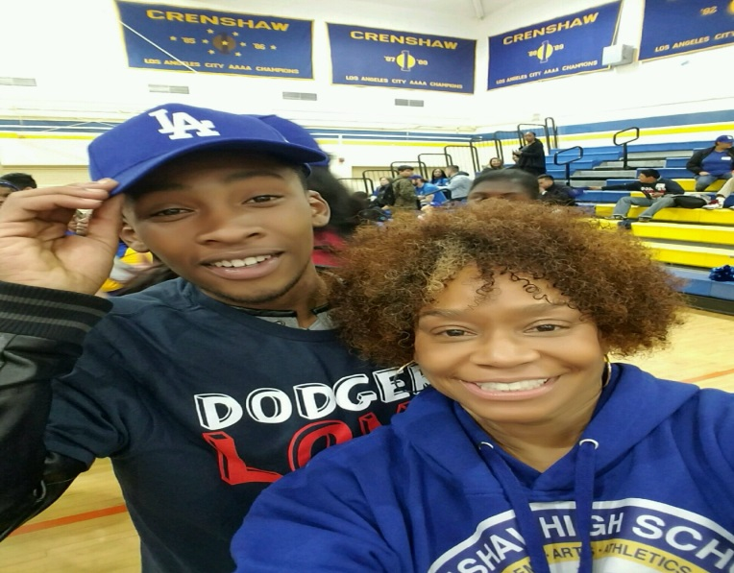
Shawan Duggans
Crenshaw High School
Class of 2017
Tier 3 at the of Spring 2016
Applied to Langston University
Wants to join the Navy
.
Notes:
As I reflect on all my years at Crenshaw High School I wouldn’t change a thing. I learned so much about myself that I didn’t know. I am a talented ambitious, strong will, well mannered, and humble young man. Some describe me as outgoing, the life of the party just a fun guy to be around. The world needs an individual like me around to improve on people’s well-being. I value friendship, companionship, and being a Good Samaritan when someone needs a hand. I come from an economically disadvantaged household. I have three sisters, four brothers, and my mom, I have additional siblings but only so many people can sleep in one household. We had to work extra hard for our clothes and even harder if we wanted to look good. The neighborhood around us wasn’t safe but I grew accustomed to the kids on my street and the chaos around me. Growing up in the neighborhood I grew up in, I tended to get myself in a lot of trouble. I got in several fights, hung out with the wrong crowds and was incarcerated. I had every obstacle that could slow me down or hold me back. Based on my life style no one ever thought I would be successful. I am currently on track to graduate. After graduation I plan to enlist in the Navy or attend Langston University in Langston, Oklahoma. Looking back my scholarly pursuits and the challenges I went through in life they shaped me into the man I am today. I WILL make a positive impact on my family, my community and most of all on myself

Slide 48
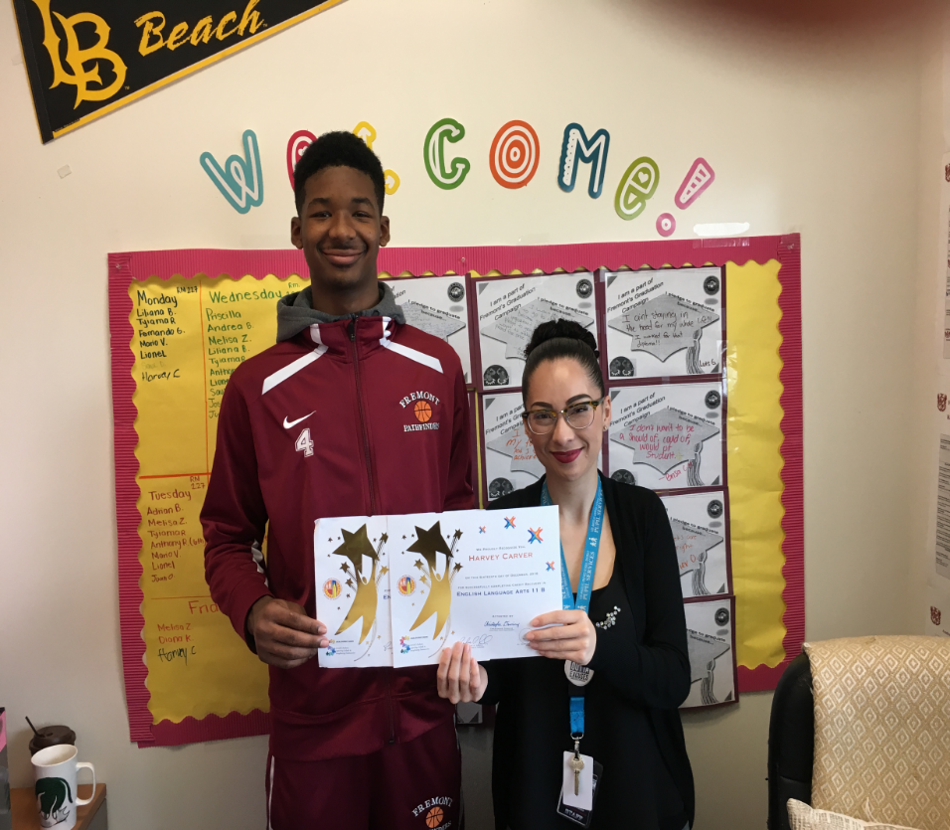
Harvey Carver
Fremont High School
Class of 2017
Tier 3 at the of Spring 2016
Will be attending College of the Canyons
Wants to be a College Basketball Coach
Notes:
A-G Counselor Diana Delgado started working with Harvey Carver last semester after he was identified as a class of 2017 - tier 3 student.
Harvey was identified as missing 5 A-G classes and was therefor placed in Diana’s AP(Action Plan) 25 caseload.
Harvey and Diana continued to work closely for the remainder of the semester by offering services such as intensive case management, A-G education, and credit recovery opportunities.
In efforts to recover credits Harvey was enrolled into our Edgenuity and Saturday School credit recovery programs. Enrolled in such programs he was able to recover 10 credits through Edgenuity and 5 credits through Saturday.
Harvey has been able to successfully drop from a Tier 3 students behind on 5 or more A-G Classes to a Tier 2 student who is only behind 3 A-G classes. Today, Harvey continues to be enrolled in Edgenuity and Saturday school in efforts to recover 10 more A-G credits. Although Harvey has had behavioral difficulties in the past, he has demonstrated tremendous effort this school year.
Last semester he was recognized during our A-G Diploma Program lunch recognition ceremony for successfully dropping tiers.
This semester he is an active member of the varsity basketball team and challenges himself everyday to remain eligible to play with the team by maintaining good grades.
Harvey is expected to graduate this upcoming June as long as he passes his remaining A-G classes.
He plans on attending College of the Canyons in Santa Clarita where he hopes to continue his basketball career."

Slide 49
Next Steps
Examine practices at school sites that support non-grads (e.g. Class of 2016)
Continue deeper dive into students withdrawn student data
    Where are they?
    Continue to coordinate re-engagement efforts with YouthSource System, Options Schools and Adult Ed
    Maintain ongoing tracking and re-engagement of leavers
  SHHS Professional Development for Options School Staff to build capacity on addressing social emotional needs of students
  Educational Pathways Collaborative meeting with Adult Education and Pupil Services in March 2017
    Increase collaboration and coordination
    Increase knowledge of programs and services

Slide 50
Next Steps
Celebrate successes of students that transition to Tier 1 or On Track and those going to college
Implement strategies that provide graduating students with engagement in college and career pathways (e.g. Summer Youth Employment, Adult Ed vocational programs, L.A. College Promise)
End of the Year Report
  Update on graduation progress for cohort students (graduating class, Local District)
  Continue follow up on all withdrawn students
  Credit accrual
  Attendance
  Student Stories
  School Successes
  Schools that demonstrate little or no improvement
Notes:
Credit accrual-Students may have made progress by accruing credits but that is not reflected in them moving out of Tier 3 because it is 5 classes to infinity.

Slide 51
Thank you!

