Slide 1
Equitable Funding
Financimiento Equitativo
April 27, 2017
PAC

Slide 2

Our Mission / Nuestra misión
TO TRANSFORM SCHOOLS AND REVOLUTIONIZE SCHOOL SYSTEMS TO EMPOWER ALL STUDENTS WITH A HIGH-QUALITY EDUCATION
TRANSFORMAR LAS ESCUELAS Y REVOLUCIONAR LOS SISTEMAS ESCOLARES PARA EMPODERAR A TODOS LOS ESTUDIANTES UNA EDUCACIÓN DE ALTA CALIDAD

Slide 3
Systems Change / Cambio de sistemas
Partnership 2020 Systems Change Goal: Champion more equitable district policies and practices that cut the achievement gap for the highest-need schools in LA Unified.
Meta de 2020 del Partnership para el cambio en sistemas: Promover políticas y prácticas de distrito más equitativas que reduzcan la brecha de rendimiento para las escuelas de mayor necesidad en LA Unified.

Slide 4
Objectives / Objetivos
Be inspired to influence equitable funding.
Inspírese para influir en el financiamiento equitativo.

Slide 5
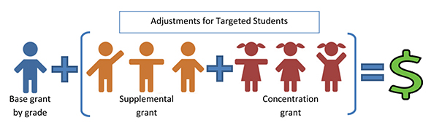
LCFF/LCAP 101
Adjustments for Targeted Student Populations /
Cambios para Estudiantes Dirigidos (TSP)
Notes:
In this conversation today, we’re focusing on just the TSP funding as an opportunity to influence the larger budget. (TSP is the start)
To get a big picture sense of how LCFF impacts the LAUSD budget: TSP students generate about $1B in additional funds (on top of base funding) out of the total $8.4 billion operating budget

Slide 6
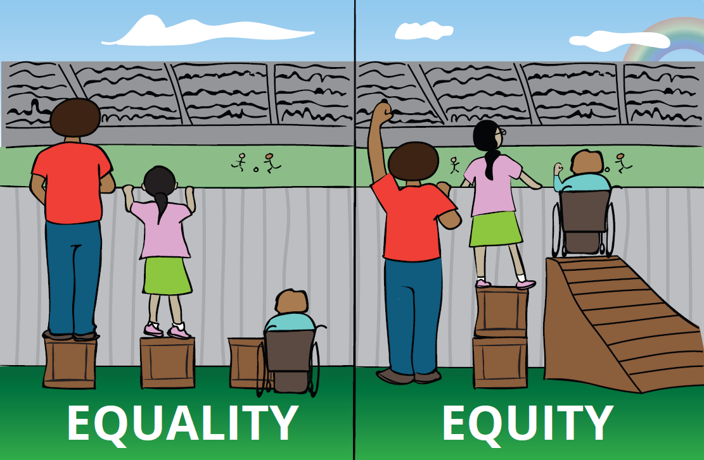
How should we make decisions? ¿Cómo debemos tomar decisiones?
IGUALDAD EQUIDAD
Notes:
Should we make decisions based on everyone gets the same or everyone gets what they need to access their education?

Slide 7

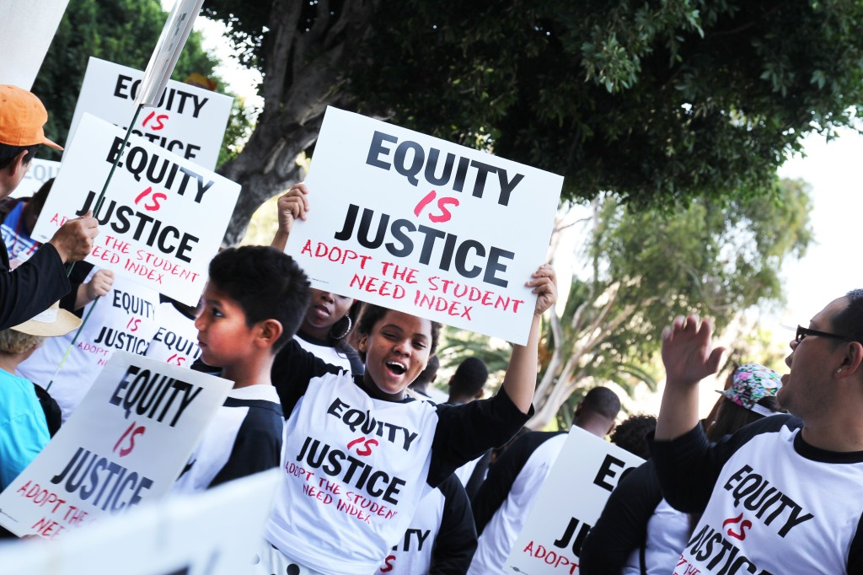
Equity is Justice / Equidad es Justicia
2014 Resolution / Resolución
Notes:
Community partners and LAUSD agree that we should make decisions based on equity.

Slide 8
Funding Indices / Índices de financiamiento
Indicators / Indicadores | Indice de LAUSD considera: | Indice de ICS/AP/CoCo considera:
Targeted Students (Foster Youth, Low-Income, English learners) / Estudiantes dirigidos (Jóvenes adoptivos, de bajos ingresos, estudiantes de inglés) | X | X
Homeless Students / Estudiantes sin hogar | X | X
Student achievement / Logro de estudiante |  | X
School Climate (suspensions, expulsions, dropout rates) / Clima escolar |  | X
Neighborhood conditions (health outcomes, exposure to violence, access to resources such as youth programming and early care/education) / Las condiciones de la comunidad (resultados en salud, exposición a la violencia, acceso a recursos como la programación para jóvenes y la atención / educación temprana) |  | X
Notes:
The Equity is Justice resolution asked us to construct and adopt an index, similar to one created by the Advancement Project, Community Coalition and InnerCity Struggle to rank and distribute dollars to our schools. Both indices include the TSP students as indicators.

Slide 9
Funding Indices / Índices de financiamiento
Indicators / Indicadores | Indice de LAUSD considera: | Indice de ICS/AP/CoCo considera:
Targeted Students (Foster Youth, Low-Income, English learners) / Estudiantes dirigidos (Jóvenes adoptivos, de bajos ingresos, estudiantes de inglés) | X | X
Homeless Students / Estudiantes sin hogar | X | X
Student achievement / Logro de estudiante |  | X
School Climate (suspensions, expulsions, dropout rates) / Clima escolar |  | X
Neighborhood conditions (health outcomes, exposure to violence, access to resources such as youth programming and early care/education) / Las condiciones de la comunidad (resultados en salud, exposición a la violencia, acceso a recursos como la programación para jóvenes y la atención / educación temprana) |  | X
Notes:
The index referenced in the resolution – the one created by ICS/CoCo and AP - also looked at factors like academic outcomes, school climate, and community factors, like gun violence. These factors are not in the current LAUSD index.

Slide 10
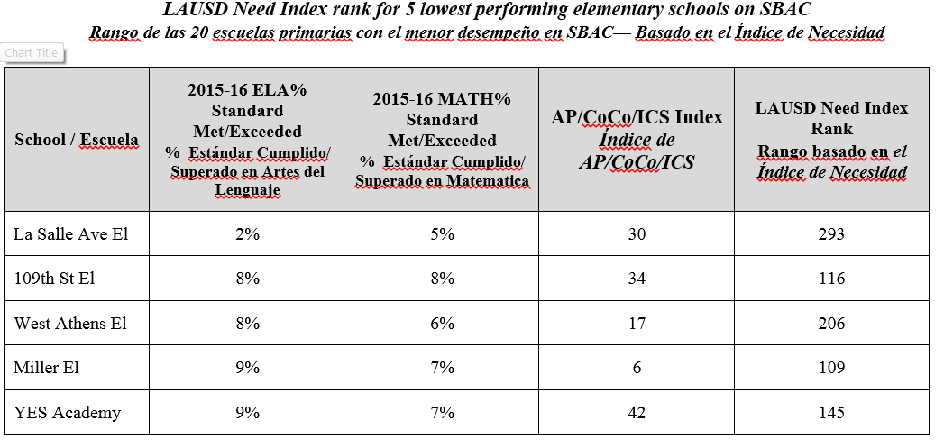
The Differences / Las Diferencias
Focusing on Academics: What do you notice?
Enfocarse en los Académicos: ¿Qué nota?
Notes:
When we include additional indicators like this one showing academic indicators, the schools’ ranking change. This chart shows the schools that scored the lowest on SBAC last year and their respective rankings on the LAUSD and AP/CoCo/ICS index.
We can imagine how the index might change if we did include academic indicators or others like school climate and neighborhood conditions.

Slide 11
Examples from The Partnership Ejemplos del Partnership
Joyner Elementary School and Jordan High School are Partnership schools in the Watts community, ranked high on the index prepared by AP/ICS/CoCo, but lower on the LAUSD Need Index. Many other schools have similar differences.
La Escuela Primaria Joyner y la Escuela Preparatoria Jordan son escuelas con el Partnership en la comunidad de Watts, clasificadas altas en el índice preparado por AP / ICS / CoCo, pero mas bajo en el Índice de Necesidades del LAUSD. Muchas otras escuelas tienen diferencias similares.
School | AP/ICS/CoCo Ranking | LAUSD Ranking
Joyner Elementary | #1 | #102 (out of 492)
Jordan High School | #2 | #30 (out of 103)
Notes:
We’re going to share two examples where we have collaborated with the district on additional supports for schools with high needs. These schools are located in Watts, near the Jordan Downs housing developments, one of the poorest communities in LA.
Despite the differences in the rankings, both LAUSD and the Partnership have recognized the need at these schools and made special investments to meet these needs.
.

Slide 12
Collaborative Commitment to Equity Compromiso de colaboración con la equidad
LAUSD & Partnership recognize great need and have collaboratively provided more support:
LAUSD & Partnership reconocen una gran necesidad y han dado más apoyo en forma colaborativa:
School | LAUSD Additional Support | Partnership Additional Support
Joyner Elementary School | Staffing Flexibility ½ Assistant Principal Full Time PSA | 3 days of PSW PD & Coaching Software Licenses
Jordan High School | Staffing Flexibility Attendance Incentive Counselor (9th grade) PSA support | Assistant Principal Technology PD & Coaching (especially RJ)
Notes:
Despite the differences in the rankings, both LAUSD and the Partnership have recognized the need at these schools and made special investments to meet these needs.
However, improving the index would ensure that all similar schools get these supports automatically across the entire district, without requiring special intervention. This is our opportunity to Fix It.
Joyner
retained 5 teachers that otherwise would have been displaced or laid off
Partnership, through a foundation, supported 3 days of a psychiatric social worker
Jordan
- Allowed to hire CSUDH teaching fellow for Social Studies – ethnic studies
- 2013-14 AP funded by Partnership (which Reed funding now covers)

Slide 13
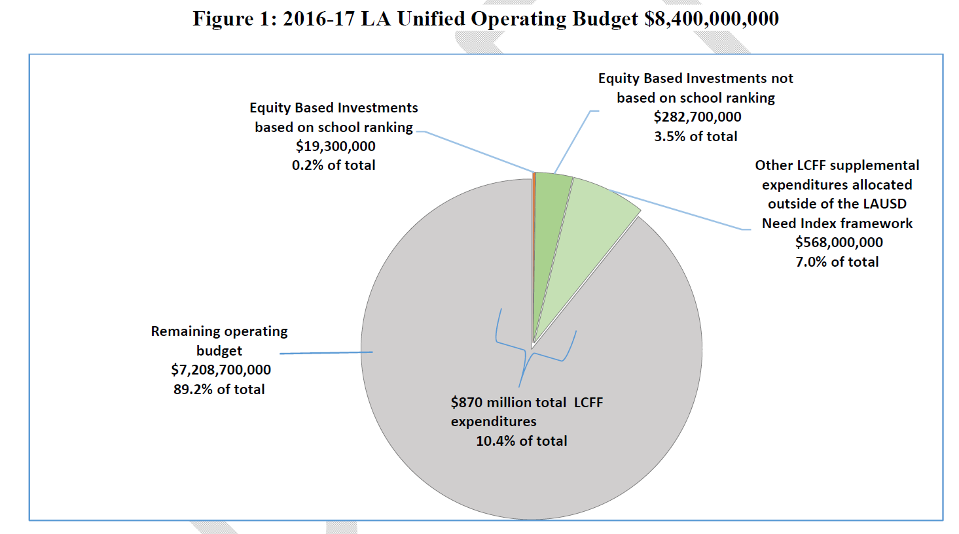
The LAUSD Index: Applied
El índice LAUSD: Aplicado
Notes:
Currently 2% (19 million)of the TSP dollars are allocated based on a school’s ranking on the need index. The rest of $850 million is spent centrally or allocated to schools based on other criteria, such as the size of a school, the arts index, etc.
We can imagine (and would like to see) it applied to all $870 million.
This is our opportunity to Use it.

Slide 14
Our Goal / Nuestra Meta
1
High need → More funding
Equity-Based Investments
0 500 1000
200
Low need → Less funding
0 100 200
School Ranking on LAUSD Index
Notes:
When we use a revised index, the schools ranked highest on the index will receive the most amount of funding (first red dot). The schools ranked lower will receive some, but less funding.

Slide 15
What can we do? ¿Qué podemos hacer?
Fix It: Inclusively define “need” (using indicators that are collectively determined) for our student need index. Update the index and use the index to rank or tier schools.
Use It: Distribute TSP dollars (and potentially more LCFF dollars) based on the index.
Arreglarlo: Inclusive definimos la "necesidad" (usando indicadores que se determinan colectivamente) para nuestro índice de necesidades de los estudiantes. Actualizar el índice y usar el índice para clasificar o clasificar las escuelas.
Usarlo: Distribuir los dólares de TSP (y potencialmente más dólares de LCFF) basados en el índice.
Notes:
Locally, we can continue to evolve it together and use it.

Slide 16
What can we do? ¿Qué podemos hacer?
We can…
Advocate together at the state and/or federal level for more funding and more equitable funding for our highest need schools
Invite partners and funders to support our highest need schools
Podemos…
Abogar juntos a nivel estatal y / o federal para obtener más fondos y financiamiento más equitativo para nuestras escuelas de mayor necesidad
Invite a socios y donantes a apoyar a nuestras escuelas de mayor necesidad
Notes:
We can also advocate together to bring in more funding overall – from the state, the federal government, partners and funders.

