Slide 1

LCAP Update
2016 - 2017
A District on the Move
April 2017
1

Slide 2
Welcome

Slide 3
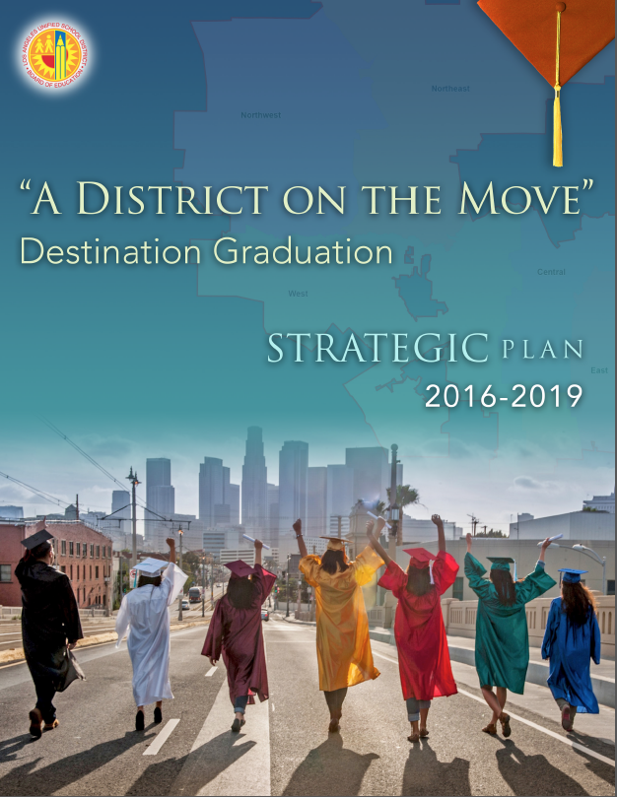


Slide 4
Summary of Engagement
Fall 2016
22 meetings Held Across the District
Over 1,400 Total Attendees
31 Partner Organizations & Offices
18,713 Individual Responses
In-Person & Online Survey
Qualitative & Quantitative Questions
Group Discussion Notes
4

Slide 5
What are some areas where your school
has shown improvement over the last year?
14%
Parent Engagement
11%
Academic Counseling
Support for struggling students
10%

Slide 6
What are some areas your school needs to improve?
Desktop Application
16%
Support for struggling students
13%
Parent Engagement
Academic Proficiency
10%

Slide 7
I feel like my school should provide (more) support for:
Desktop Application
23%
English Learners
23%
Teachers
Youth in Special Education
15%

Slide 8
Themes from Small Group Discussions
“Not waiting till senior year – start in middle school. Middle school is very important – don’t lose them. Ensure they graduate.”
“Visualize college within school complex.”
Engage Parents
Offer Extracurriculars, Electives, & Enrichment
We heard…
Ensure students receive Academic Counselling
Reduce Class Size
Provide Intervention & Tutoring
Support Teachers with Training & TA’s
“Invest in educational programs such as Project Steps, Gear Up, Student Ambassadors as well as hire more counselors to teach students about their graduation requirements.”

Slide 9
Update on the District’s Budget

Slide 10



LCFF Implementation and the GAP Funding
Full LCFF Implementation
LCFF
Funding
Year 1
Portion of Gap $ Filled
Total Funding Gap
LCFF
Funding
Full LCFF Implementation
Year 2
More Gap $
Total Funding Gap
LCFF
Funding
Full LCFF Implementation
Year 3
More Gap $
Total Funding Gap

Slide 11
Review of Ending Balances
(Dollars in Millions) | 2016-17 | 2017-18 | 2018-19
Estimated Ending Balance September (Year-End) | $164.1 | ($551.9) | ($1,379.1)
Estimated Ending Balance December ( 1st Interim), Prior to Realignment Exercise | $267.1 | ($441.2) | ($1,458.1)
Change Due to Realignment Exercise | $262.7 | $458.4 | $484.9
Estimated, Ending Balance December(1st Interim), After Realignment Exercise | $529.9 | $280.0 | ($252.0)
Change Due to Fiscal Plan | $29.2 | $111.6 | $111.6
Estimated, Ending Balance December (1st Interim), After Realignment and Fiscal Stabilization Plan | $559.1 | $420.8 | $0.3
Changes After December (1st Interim) | ($22.8) | ($129.3) | ($77.9)
Revised Ending Balance (as of January 2017) | $536.2 | $268.7 | ($229.6)

Slide 12
Budget in Balance
(As of December 2016)
Revenues
Beginning Balances
LCFF
Expenditures
Existing Expenditure
Other Revenues
Pension Cost
Health & Welfare Cost
Special Education
Central Office
Reductions
Notes:
Declining Enrollment
FY 13-14 556,115
FY 14-15 542,433
FY 15-16 528,065
FY 16-17 513,875
1% change in Enrollment is approximately is 39M
1% change in ADA is approximately is $41M
1% change in unduplicated count is $4.5M
Structural Deficit

Slide 13
Budget is Out of Balance
(As of January 2017)
Revenues
Beginning Balances
LCFF
Expenditures
Existing Expenditure
Additional Requirement
Other Revenues
Additional Pension Cost
CalPers
Rubbish
Utilities
Pension Cost
Health & Welfare Cost
Federal Revenues
Special Education
ACLU/PA
Central Office
Reductions
Unduplicated Count
CALSTRS
Blue Ribbon Recommendation
Attendance
Notes:
1P estimates did not include Prop 55 revenues
The proposed Governor’s Budget already includes Prop 55

Slide 14
Personal Budget Example
Revenue
Expenditures
One-time yard sale/
Lotto Ticket win!
College
(Savings Account Now)
Other Income
Entertainment and Travel
Salary/Wages
Food/Utilities
When Income doesn’t cover home costs, that is a Deficit
Mortgage/Rent

Slide 15



Reimagining Programs
With limited new resources in mind, the District embarked on an effort this year to redefine how existing programs could be transformed to better serve our Targeted Student Populations.
General Program
(i.e. Nurses)
Target Nurses to high need schools and students

Slide 16
Reframing how LAUSD’s Budget Speaks to Student Needs
Proposal to make adjustment to the LCAP will include the following as realigned programs intended to better serve our targeted student populations.
General Preschool Program
Recognize contribution to preschool program for Low-income students
Nursing Services
Reallocate Nursing staff to high needs schools with high medical incidences
Technology Support Services
Reallocate IT staff to high needs schools
Salary Increase for Teachers
Improved teaching climate and retention of teachers

Slide 17
LAUSD: Equity as a driver for Programs
Equity-Based Programs underway at LAUSD.
- Targeted Student Populations (Low-Income, English Learners, Foster Youth)
- Indicators that assess student need and program impact
Nursing Services
Reallocate Nursing staff to high needs schools with high medical incidences
Arts Program
Reallocate arts programs to high needs schools with limited access to the Arts
A-G Equity
Focus on TSP students that are not on-track to complete A-G.

Slide 18
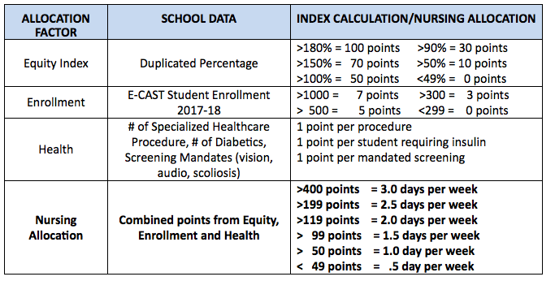
LAUSD: Equity as a driver for Programs
Equity-Based Programs underway at LAUSD.
- Targeted Student Populations (Low-Income, English Learners, Foster Youth)
- Indicators that assess student need and program impact
Nursing Services

Slide 19
LAUSD: Equity as a driver for Programs
Equity-Based Programs underway at LAUSD.
- Targeted Student Populations (Low-Income, English Learners, Foster Youth)
- Indicators that assess student need and program impact
Arts Equity
The Arts Equity Index (AEI) categorizes all LAUSD schools (K-12) based on the scope of their provided arts instruction, arts resources, arts professional development, Title 1 Status, and Student Equity Index (Poverty, Foster Students, English Language Learners). How does the AEI provide equity to the schools?
Based on their category (1 - grossly underserved, 2 – underserved, 3 – developing, 4 – strong), assessments are taken to provide more equity of arts resources, and to ensure that all students have appropriate arts access and instruction. Expansion of LAUSD Arts through the AEI (2015-2016):
45 new arts teachers have been placed in the most underserved schools in the district
$2 million in arts allocations have been provided to all schools based upon their AEI category
27 Community Arts Partners are now serving high-need schools with in-school and after school programs
Re-alignment of existing arts personnel to provide more equitable arts instruction

Slide 20

Student Needs Index: TSP Resources
Targeted student populations are central to identifying our schools with the highest need and the intended use of the Local Control Funding Formula
Duplicate %
-Low-income-
-English Learners-
-Foster Youth-
$
Central Budget and Resources

Slide 21
Revisiting our LCAP Commitments
A – G interventions
Arts Programs for Neediest Schools
Elective Courses
English Learner Coaches
Counseling and Human Services
Various School Personnel
Early Education
Increased Support of Foster Youth
Increased Restorative Justice programs
Technology Support
School Funds to support Targeted Youth (TSP funds)

Slide 22
Next Steps
Initial Community Feedback Report released
Local District Budget Update Meetings
Superintendent provides formal responses to PAC & DELAC
Jan
Feb/ Mar
May
Feb
Apr
June
All schools complete School Report Card Workshops
Parent Advisory Committee & DELAC submit formal LCAP comments to Superintendent
Formal Public Hearings. LCAP is approved by the Board of Education.
June 13th & 20th
22

Slide 23
Thank you! For more information, visit lcff.lausd.net
23

