Slide 1

Early literacy
Proficiency for all: percentage of 2nd grade Students meeting early literacy benchmarks derrick chau, sr. executive director
DIVISION OF INSTRUCTION
PAC LCAP SESSION – April 2017

Slide 2

Early Language and Literacy Plan
Notes:
Primary Goals
Improve student achievement
Use data to drive the instruction
Implement multi-tiered systems of support
265 schools participating; Cite ELLP Report
Critical learning instructional path: literacy
Big picture of becoming literate, the continuum
Key stages mapped: 1) Early, basic literacy, foundational skills, language levels and needs; intermediate, advanced
Specific objectives, precise indicators, skills and teaching required

Slide 3
All students read, write, speak, and listen with accuracy and comprehension by the end of 2nd grade.
Notes:
On time on the path to becoming broadly literate. Research says….
Several research studies have demonstrated that early cognitive and linguistic development predict later achievement—even much later. Various measures administered at the preschool and kindergarten levels reveal that patterns of preschool learning are closely linked with reading achievement in the primary grades (Scarborough, 1998). Young children who demonstrate oral language proficiency and early abilities in processing print do better in learning to read in first, second, and third grades (Scarborough, 2001). This means that learning achieved during these early years is likely to be sustained throughout the primary-school years and is an important basis for successful early performance in school.
Success in literacy learning during the primary grades is even more indicative of later literacy achievement. Seventy-four percent of children who perform poorly in reading in third grade continue to do so into high school, further underlining the importance of preparing children to enter school ready to learn (Fletcher & Lyon, 1998). *
*National Institute for Literacy, Developing Early Literacy Report of the National Early Literacy Panel, 2008, page xiv

Slide 4
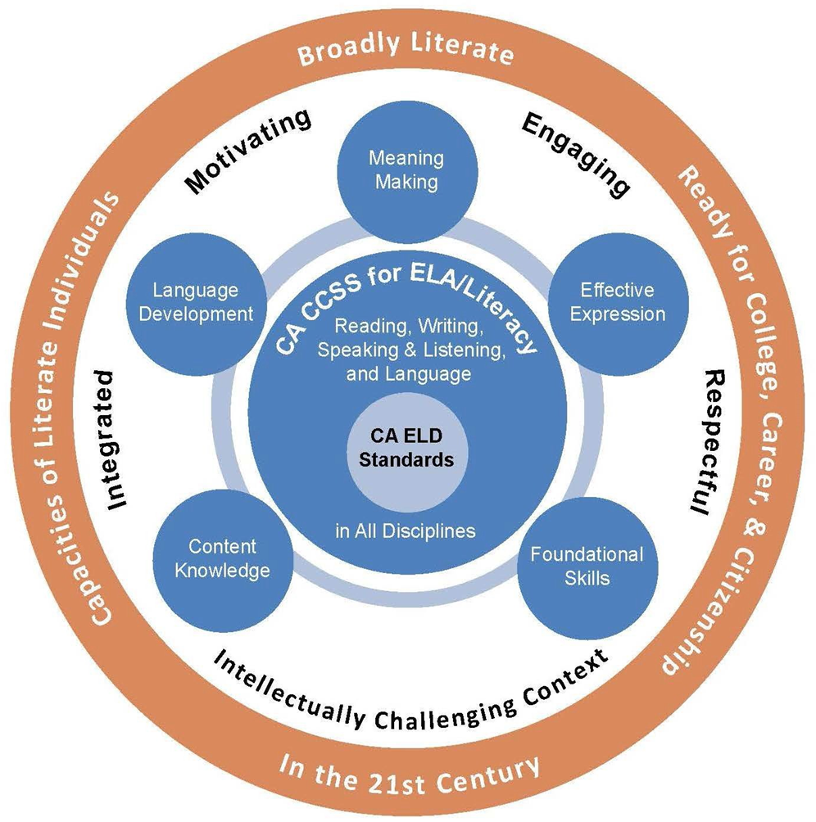
ELA/ELD Framework
Notes:
A BRIEF NOTE ON EACH OF THE THEMES
HANDOUT EXE

Slide 5




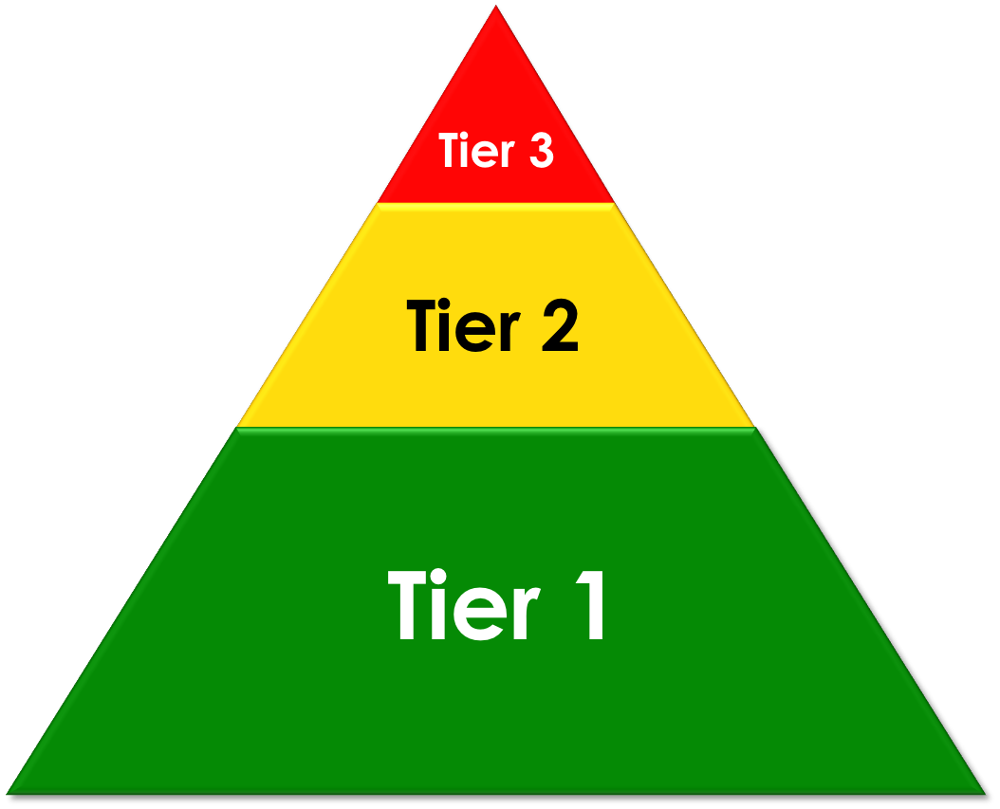


Multi-tiered System of Supports
Notes:
Is a review from last time
MTSS builds a system of prevention, early intervention, and support to ensure that all students are learning from the instruction. It establishes a system that
intentionally focuses on leadership, professional development, and an empowering culture.
Kansas MTSS incorporates a continuum of assessment, curriculum, and instruction. This systemic approach supports both struggling and advanced learners through the selection and implementation of increasingly intense evidence-based interventions in response to both academic and behavioral needs.
MTSS is the bigger picture (Organizational framework for alignment of initiatives and RTI is intervention)
MTSS looking at the entire organization
MTSS preventative Context, quality first instruction, Circle is the preventive
PDSA is the implementation science
Today we will spend most of our time in the professional development arc in an effort to support the learning cycle at the schools sites.

Slide 6
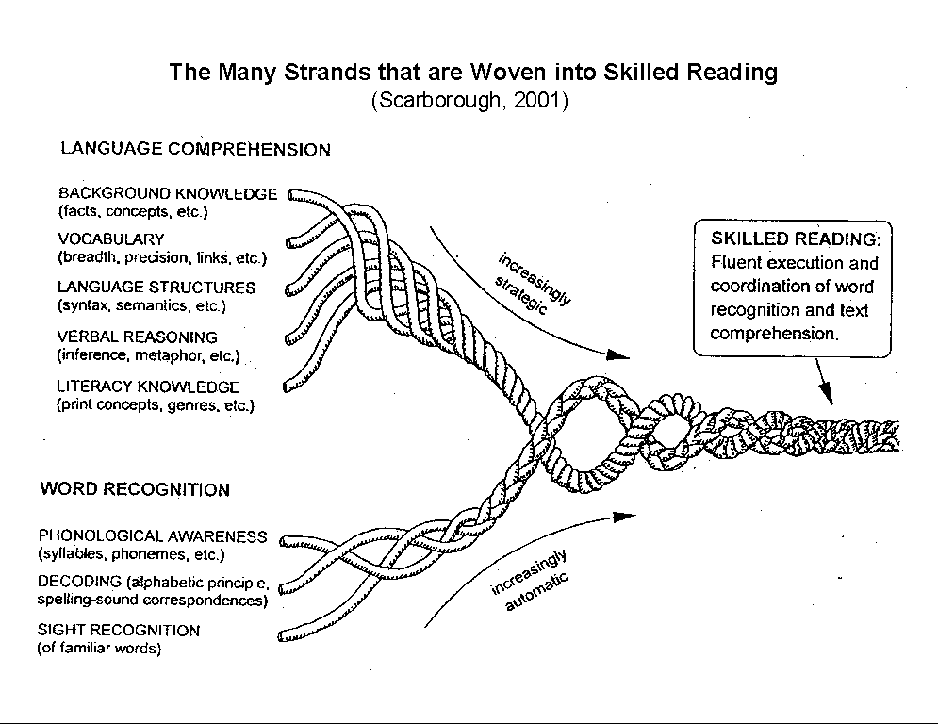
The Many Strands that are Woven into Skilled Reading
(Scarborough, 2001)
COMPREHENSION
Skilled Reading- fluent with comprehension
BACKGROUND KNOWLEDGE
VOCABULARY KNOWLEDGE
LANGUAGE STRUCTURES
VERBAL REASONING
LITERACY KNOWLEDGE
increasingly
strategic
WORD RECOGNITION
PHONEMIC AWARENESS
DECODING (and SPELLING)
SIGHT RECOGNITION
increasingly
automatic
Notes:
Pedagogy
Reading is a multifaceted skill, gradually acquired over years of instruction and practice.
Scarborough 2001 (Hollis)
WORD RECOGNITION: When we say a student can “read” we need to be aware of all of the components that make up being a good reader.
LANGUAGE COMPREHENSION: these strands are the Golden Arches of reading:
Background Knowledge
Vocabulary Knowledge
Language Structures – includes knowledge of grammar and syntax needed for comprehending complex sentence structure
Verbal reasoning – higher order thinking skills
Literacy knowledge – text structure, reading different types of text for different purposes
LOTS OF ROOM FOR THINGS TO GO WRONG

Slide 7


Slide 8
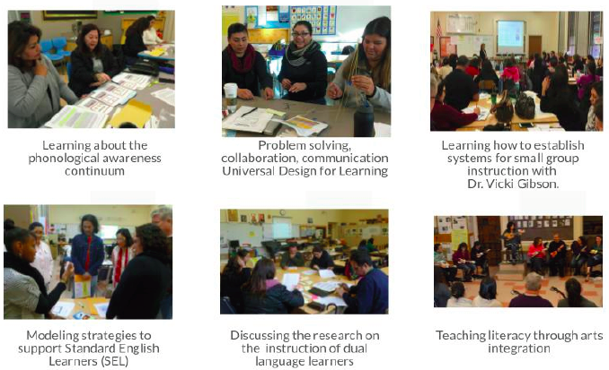
Learning to Teach Reading

Slide 9
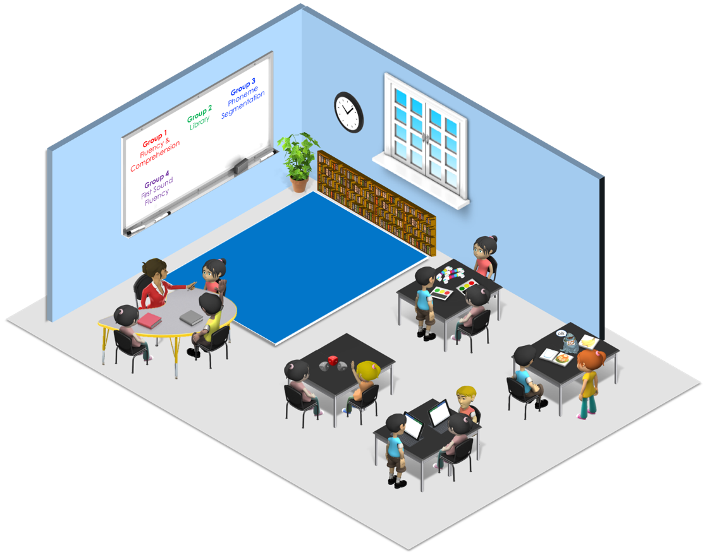


Phoneme Isolation
Onset Rime
Segmentation
Phoneme Blending
Syllable Segmentation
Phoneme Blending
Notes:
One class with students grouped by need. SO what does this look like?
Targeted small group instruction, students working in small groups, and teachers providing instruction specific to the need of each individual child.
Focus on foundational skills, language, and literacy
Goal of 45-60 minutes of academy time daily
Data-driven instructional approach

Slide 10
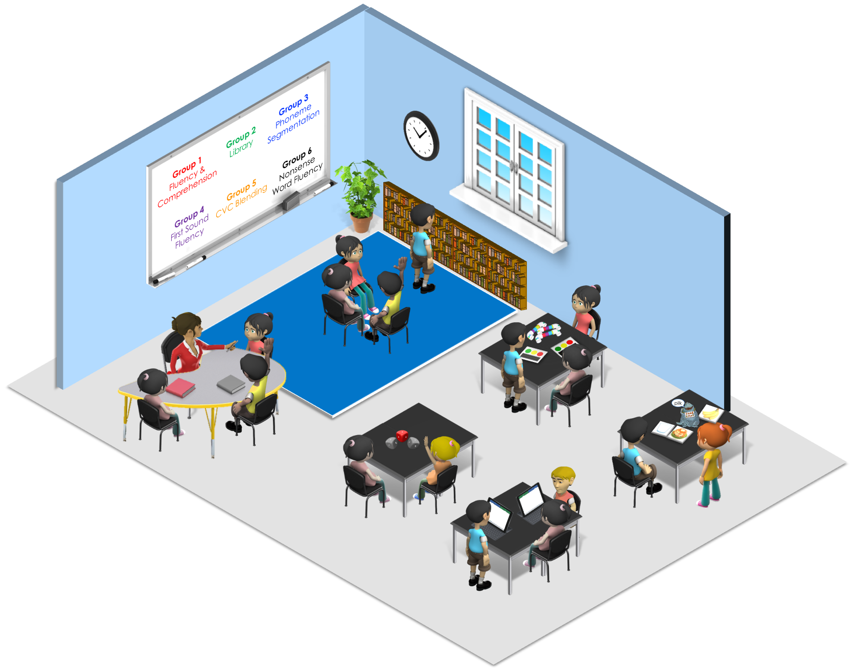
Comprehension
Fluency
CVC Blending
Phonological
Awareness
Notes:
Multiple classrooms working together. Plan and share planning with teacher-partners.
Be clear that the skills match the data
By sharing the responsibility, teachers are able to reach eight distinct needs of their students at the same time.
So in this model, let’s zoom in on how that collaboration might look like. The teacher with the group of 27 may be working on different comprehension strategies. Her small group and the students’ learning station will all reflect that whereas the students down here in the red are in the classrooms focusing on phonological awareness are smaller in number of pupils and again, all the learning stations will mirror that

Slide 11
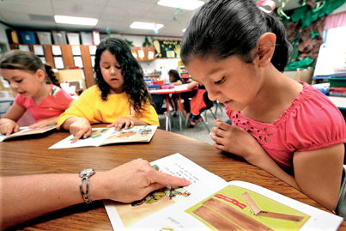
Guided Reading
A teaching approach that helps readers access increasingly challenging texts over time.
Notes:
Comprehension is the active process of drawing or extracting meaning from print material. It is NOT memorization or regurgitation.
Responding to questions and retelling stories provides students with comprehension practice; in addition to these activities, comprehension must be explicitly taught.
Students need direct and explicit small group instruction in comprehension. This includes providing multiple models, guided practice, and independent practice of skills.
Constructive Conversations!
In the early stages of learning to read, comprehension instruction should focus on general language skills, literal comprehension, and basic story grammar through three components:
Explicit and systematic teaching of foundational language skills.
Teaching comprehension related to stories the teacher reads orally to provide practice with listening comprehension skills and facilitate vocabulary development.
Teaching comprehension related to text that students read. Texts used will be less complex than those that can be used for oral comprehension instruction.
Comprehension instruction then shifts to inferential comprehension, summarization, comprehension monitoring, determination of main ideas, and use of multiple strategies (Carnine, Silbert, Kame- enui, & Tarver, 2010).
Consider whether foundational literacy skills are impacting comprehension and address through instruction.
Adjust instruction based on student literacy level by being more explicit and allowing more practice time.
Practice comprehension strategies in a student’s native language as a scaffold to comprehension of English text.

Slide 12
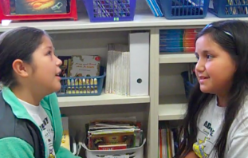
Students respond to meaningful prompts in meaningful ways, using academic language, reasoning using evidence, talking through ideas, and become empowered through productive struggle.
CONSTRUCTIVE CONVERSATIONS
Notes:
In authentic interaction work, students use knowledge and language (grammar, vocabulary, and organized ideas to clarify, fortify, and negotiate complex thoughts. Our current and future students can benefit from this major shift in pedagogy, which is a shift from training them to choose answers to training them to pose questions, explore different points of view, and build meanings with others.

Slide 13
CYCLE OF TARGETED INSTRUCTION
Collect Data/Universal Screening
Monitor Instructional Progress
Collect Diagnostic Evidence/
Probe DIBELS
Teach
Interpret Evidence
Purposeful Grouping
Make Instructional Decisions
Notes:
(minutes and notes included on previous slide)
CALL THIS OUT TO REFER TO HANDOUTS ADD PRESENTER KEY NOTES
We are going to revisit the white paper and the ELD chapter 6 after break, so you might want to review them.

Slide 14
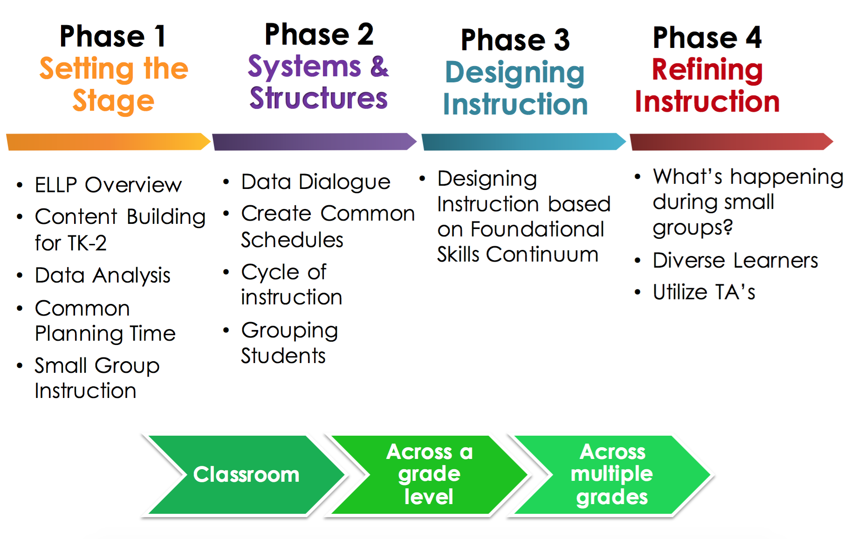
IMPLEMENTATION SUPPORT
Cohort 1 (85) Cohort 2 (180) Cohort 3 TBD

Slide 15
BookRoom Collections
Notes:
Guided reading offers small-group support and explicit teaching to help students take on more challenging texts.
The Continuum of Literacy Learning, Introduction, p.5 Fountas and Pinnell
Training Introduction/Objectives: Benchmark Education Company Introduction
If participants are not familiar with Benchmark Education Company, use this opportunity to provide a brief overview:
Benchmark Education Company’s mission is to provide classroom-tested solutions that help differentiate instruction and enable EVERY student to achieve success and to develop exceptional teacher tools proven to accelerate student achievement.
Benchmark Education BookRoom Collection supports English Language Arts/English Language Development. Our BookRoom is designed to address the goals, context, and themes of ELA/Literacy and ELD instruction embodied in the English Language Arts/English Language Development Framework, and to integrate seamlessly the California Common Core State Standards for ELA/Literacy and the California English Language Development Standards.

Slide 16
GRADUAL RELEASE
Apply
Independent Reading
Apply and Extend
S
Teacher
Guided Reading
Guide
Practice and Apply
Ts
tS
Share
Shared Reading
Observe and Practice
T
Model
Read Aloud
Observe and Absorb
Student
Notes:
State that the purpose for understanding this is to really gain insight to where GR sits on the continuum of the Gradual Release of Responsibility and how the power switches from teacher carrying the load to student.
Benchmark Literacy Overview: Gradual Release of Responsibility
We know that students learn more effectively when instruction is based on the Gradual Release of Responsibility.
(click) First the teacher models the skill or behavior he/she is teaching. The teacher assumes the entire role of responsibility. They observe and absorb.
(click) Next the teacher begins to share the responsibility by asking for student input of ideas and thoughts. They absorb and practice.
(click) Then the teacher assumes the role of the guide—giving students the majority of the responsibility for the learning. They practice and apply.
(click) Finally the student assumes all of the responsibility for the learning by applying the new skill to independent practice. They apply and practice.
Trainer Note:
Asset based model trusting students have the capability…setting them up to be able to work independently. If you have been incorporating Constructive Conversation skills, EL students, and all will have the tools so that they will be successful with gradual release and be prepared for making meaning with their peers and independently.
In the event teachers are not familiar with the Gradual Release of Responsibility instructional model, you can share this background information.
Gallagher and Pearson, 1983: “If teachers focused their attention on a strategy, beginning with a great deal of modeling and gradually releasing responsibility to the children to practice it independently, …students could actually be taught to think differently as they read. They would comprehend more deeply, critically, and analytically.” The instructional path includes: teacher modeling, shared and interactive practice, guided practice, and independent practice. The goal is to move students successfully from the introduction of a skill to independent application. Please refer them to the handout giving more details.

Slide 17
EMPHASIS ON ELD
…for ELs at all levels of English language proficiency, meaningful interaction with others and with complex texts is essential for learning language and learning content.
Through collaborative conversations about rich texts and concepts and through deep interactions with complex informational and literacy texts, ELs extend both their language and knowledge of the world.
ELA/ELD Framework for California Public Schools
Notes:
19 -All teachers with English Learners in their classroom use CA ELD Standards in tandem with the CA CS for ELA/ Literacy and other content

Slide 18

MONITORING DEVELOPMENT
Vocabulary & Language Skills
Basic Early Literacy Skills
Reading Comprehension
Phonemic Awareness
Phonics
Accurate & Connected Reading of Text
Alphabetic Principle
Advanced Phonics & Word Attack Skills
Oral Language Screener
First Sound Fluency
Phoneme Segmentation Fluency
Nonsense Word Fluency
DIBELS Oral Reading Fluency
DAZE
DIBELS Oral Reading Fluency
DIBELS Oral Reading Fluency
Indicators
Notes:
ANIMATED INDICATORS
22-The ultimate goal of all reading instruction is Reading Comprehension:
We each Basic Early Literacy skills or Foundational Skills so because we want students to be able to read independently and make sense of their reading.
The first skill listed is Vocabulary and Language.
As you notice the box goes all the way out to prior to any formal instruction.
Language is the foundation to all literacy skills.
We need to speak before we can read, and these skills begin in the home, at birth, and are furthered in pre-school.
We always teach language, especially with our EL and SEL Students.
Phonemic awareness: It assesses student learning in foundational reading skills…how children learn to decode printed text so that they can access text on their own
Phonics:
Alphabetic Principle:
Advanced Phonics and Word Attack Skills
Accurate and Connected Reading of Text
DIBELS
Oral Language Screener
First Sound Fluency
Phoneme Segmentation Fluency
Nonsense Word Fluency
DIBELS Oral Reading Fluency
DAZE
_____________________
We have always know that vocabulary and language skills are essential as necessary learning from the beginning of instruction in TK and K.
The goal of reading instruction is comprehension. We have always known that we can wait to until students can decode to teach comprehension.
Therefore, although our focus and measure/assessment has been on foundational skills, we have always taught oral language skills, vocabulary (2-3 min Total 3 hour 28 min)
TW: Here are a couple of instructional resources to help you identify the target skill as you review the data
Have teachers pull out the Handouts and explain that we will be using these as we work through our model of this section of the process
Core Sourcebook continuum
HO of next slide
EL PSF Draft
SEL Transfer chart
Remind teachers that although we don’t have it here…knowledge of their students in the process is essential and they should be including their own data, CELDT, etc as they move through this process
Now we are wrapping up. Our goal of Reading Instruction is Reading comprehension.
We know that this slide show has been a lot of information
Now we would like to come back to earlier learning to demonstrate how intimately connected reading foundational skills are to reading comprehension still a really important…
This slide refers to the DIBELS assessments that we have giving over the past few years. As a district, we have used DIBELS Dynamic Indicators of Early Literacy Skills to assess student learning. It is here because it also explains how student learn to read

Slide 19


TEXTBOOK SELECTION
CA State Board of Education approved Standards-aligned ELA/ELD instructional programs
In an adoption and selection year…
LAUSD Textbook Selection Committees formed to conduct an evidence based evaluation and review
LAUSD Textbook Selection Committee met to deliberate, build consensus, and rank the programs
Notes:
We want you to to know the LAUSD textbook selection process for two reasons
Transparency, people often wonder how programs get selected
So that you have the necessary background knowledge as you share information with teachers at your school site.
There are lots of wonderings out there about how does the district decide. We had a clear, rigorous process
The State of California adopts new textbook programs for each content area in a 7 year cycle.
In November 2015 State of California adopted the ELA /ELD Literacy Textbook programs that were common core aligned
As part of the State process, adopted programs were reviewed and verified that they:
Included common core standards
Designed for common core implementation
There were 4 on the list for program 2, which is the ELA/ELD with Designated ELD
LAUSD Process
ELA/ELD Textbook programs have been approved by the State of California, therefore, are already adopted
LAUSD conducts a textbook selection process to choose which state adopted program best meets the needs of LAUSD students
Textbook Pre-Selection committee
Representatives from: MMED Multilingual Multicultural Education Department, SPED- Division of Special Education, ELA Elementary Literacy, Dual Language
Reviewed programs through district lens and evaluation rubric
Committee reviewed 4 programs, and 3 went forward to the Teacher Textbook Selection Committee
Textbook Selection Committee was formed for the purpose of reviewing programs and making recommendations for which program best meets the needs of LAUSD students
18 members
Representatives recommended by MMED, DL,SPED, UTLA, AALA,
classroom teachers from each local district
Dedicated, thoughtful group
As part of the review process Textbook Selection Committee
Full day of training for all Textbook Selection Committee
CCSS and ELD Standards
Integrated and Designated ELD
District Lens
Rubric
Approximately a month to review materials at their home or school
Attended Publisher presentations
Used evaluation rubric to collect evidence on programs
Deliberations over a day and half
Result was the ranking of programs
Benchmark Advance #1
Mc Graw Hill Wonders #2
Parents and Students were included:
With the assistance of Parent Community and Student Services materials were shared with parents and students to get feedback
Feedback was shared with the committee

Slide 20
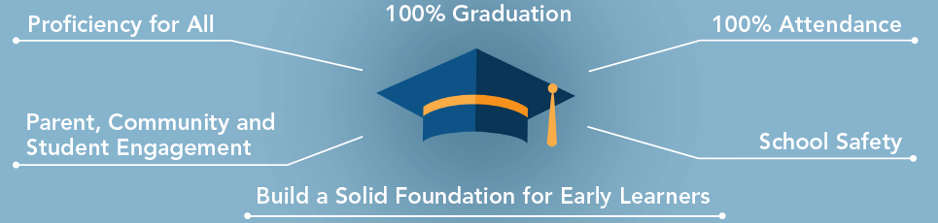
GOALS

Slide 21
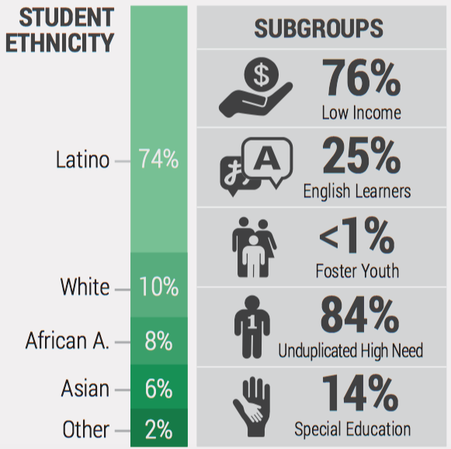
OUR STUDENTS BY ETHNICITY
Notes:
115,000 English Learners
82,867 Students with Disabilities
10,000 in Dual Language/Bilingual program education
25,000 probable Standard English Learners
62,000 students are identified as Gifted and Talented (GATE)
migrant, homeless, foster youth, low income, or living in a variety of alternative situations

Slide 22
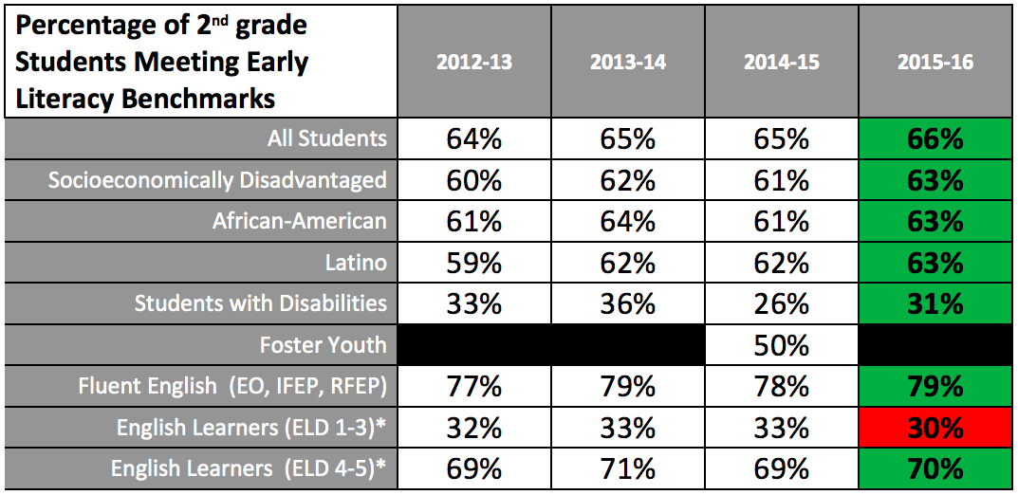
THE WORK. THE OPPORTUNITY.
Notes:
This table breaks down the percentage of 2nd grade students meeting early literacy benchmarks in greater detail.
It demonstrates that this percentage had remained constant at recent years at about 65 percent.
Last year, we were able to move the needle up in nearly all subgroups—see all green.
Additionally, the data for the 85 schools participating in the ELLP is even more promising.
Therefore, while there is work to do, there is reason to be optimistic that we are moving in the right direction.
It is also noteworthy that students who speak fluent English, including those who have reclassified, perform significantly better on the DIBELS, even better than the District average.
This reinforces the importance of reclassifying English Learners as soon as possible.

Slide 23
RECLASSIFICATION RATES
Notes:
This slide shows the reclassification rates by elementary, middle, and high schools.
While there has been fluctuation, middle schools have at times achieved reclassification rates above 20 percent in recent years.
We should continue to work together to share best practices and help English Learners reclassify as early as possible so that they proceed throughout their education with the benefit of speaking two languages.

Slide 24
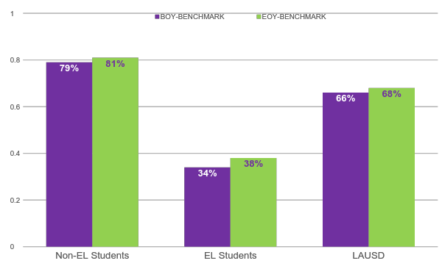
Early Literacy Skills, Gr. 2, 2015-2016
25,800
11,161
36,961
Notes:
2015-2016 Beginning of the Year to End of the Year cohorts of students: non-EL, EL, All

Slide 25
So What Does The Composite Score Tell Us?
Likelihood of success on future benchmark
10%-20% 40%-60% 80%- 90%
Type of support needed for student
Intensive Intervention
Strategic Intervention
Core Support
Which students should likely receive progress monitoring.
The frequency of progress monitoring.
Notes:
Before we take a look at the data, let’s review what the composite score tells us:
First, the composite score tells us the likelihood of success on the next benchmark.
Then it helps us know what type of support a student needs.
This leads to helping us know which students receive progress monitoring.
And finally, this gives us guidance on how often we should be checking in on a student’s progress.

Slide 26
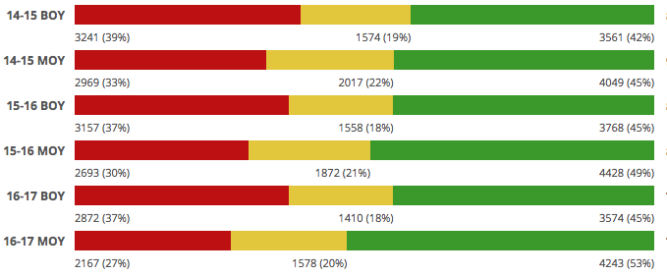
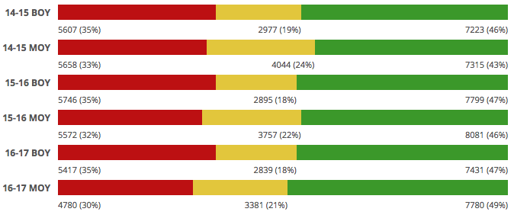
ELLP Performance Over Time
Kindergarten
Cohort 1
-6
+3
-7
+4
-10
+8
Cohort 2
-2
-3
-3
-1
-5
+2

Slide 27
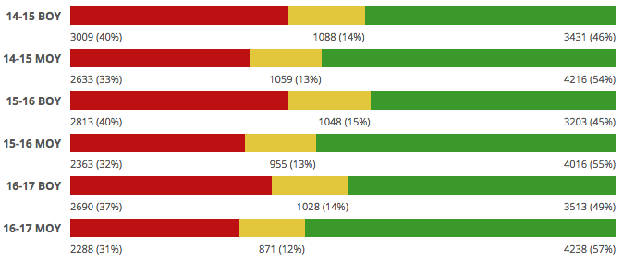
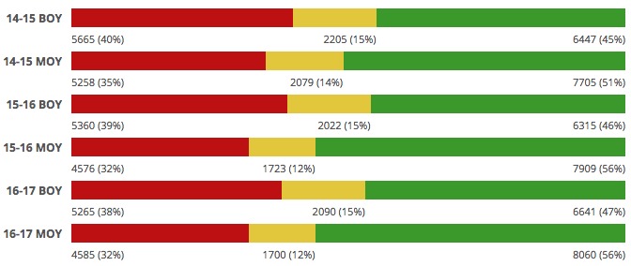
ELLP Performance Over Time - 1st Grade
Cohort 1
-7
+ 9
-8
+10
-6
+ 8
Cohort 2
-5
+ 6
-7
+10
-6
+ 9

Slide 28
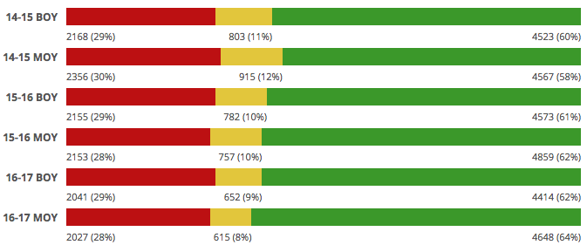
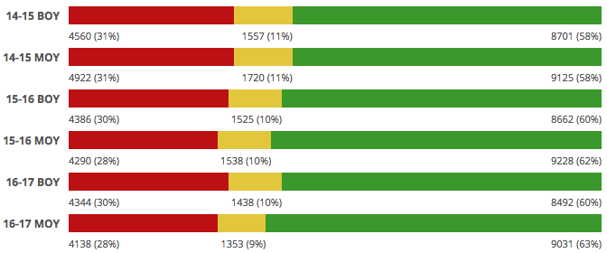
ELLP Performance Over Time - 2nd grade
Cohort 1
+1
-2
-1
+1
-1
+2
Cohort 2
0
0
-2
+2
-2
+3

Slide 29
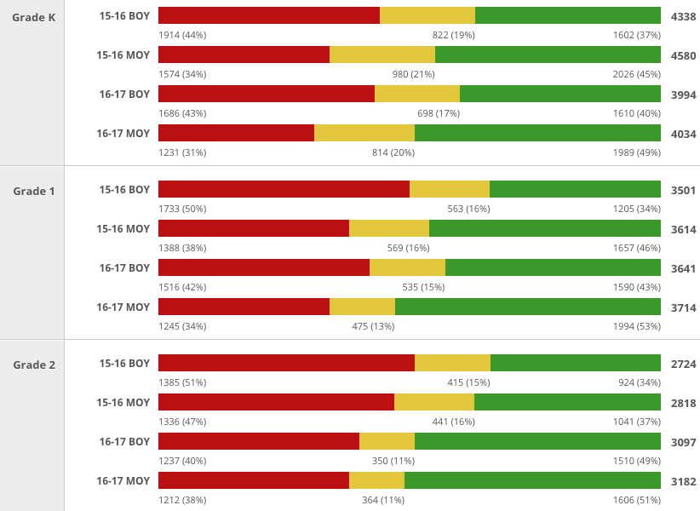
ELLP Cohort 1 Performance Over Time
EL Students
-10
+8
-12
+9
-12
+12
-8
+10
-4
+3
-2
+3

Slide 30
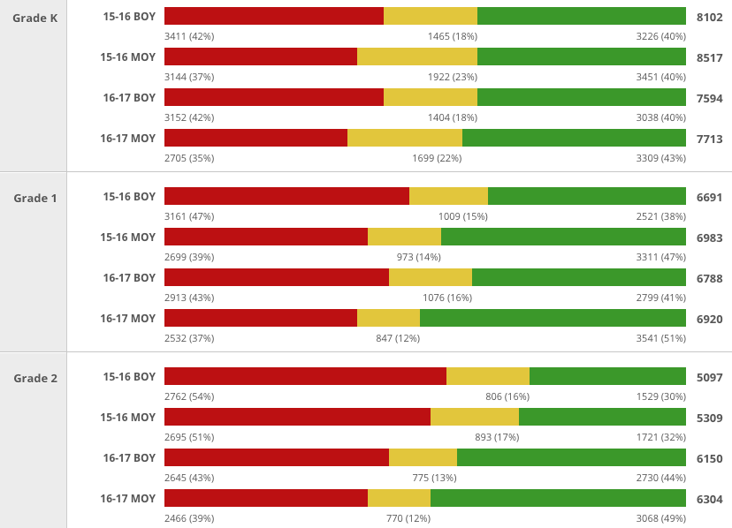
ELLP Cohort 2 Performance Over Time
EL Students
-5
0
-7
+3
-8
+9
-6
+10
-3
+2
-4
+5

Slide 31
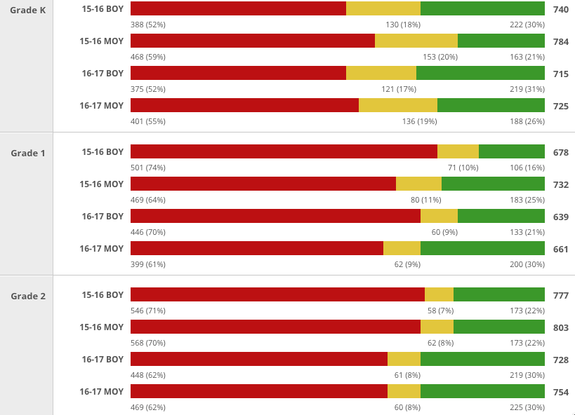
ELLP Cohort 1 Performance Over Time
Special Education Students
+7
-9
+3
-5
-10
+9
-9
+9
-1
0
0
0

Slide 32
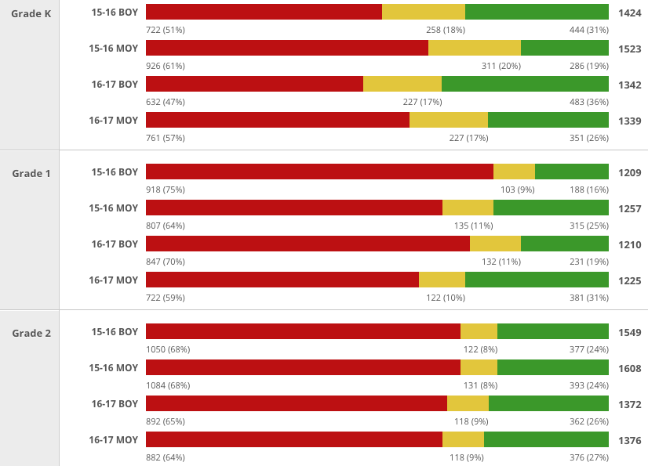
ELLP Cohort 2 Performance Over Time
Special Education Students
+10
-12
+10
-10
-11
+9
-11
+12
0
0
-1
+1

Slide 33
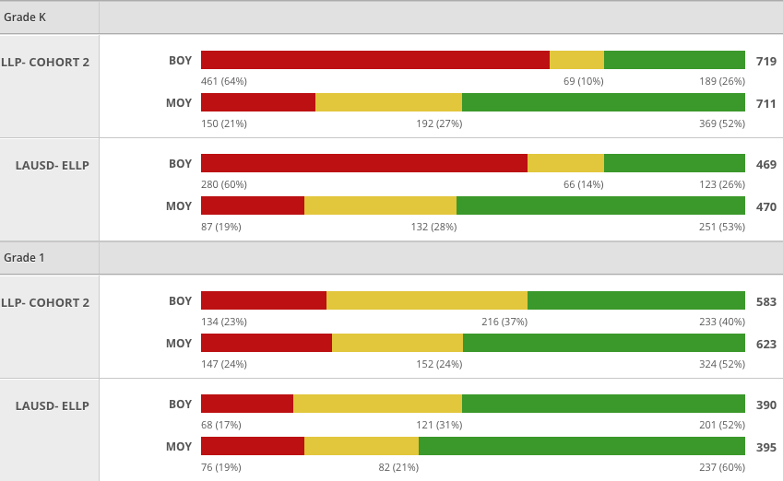
ELLP IDEL Performance, Grades K and 1
Chohort 2
-43
+26
Chohort 1
-41
+27
Chohort 2
+1
+12
Chohort 1
+2
+8

Slide 34
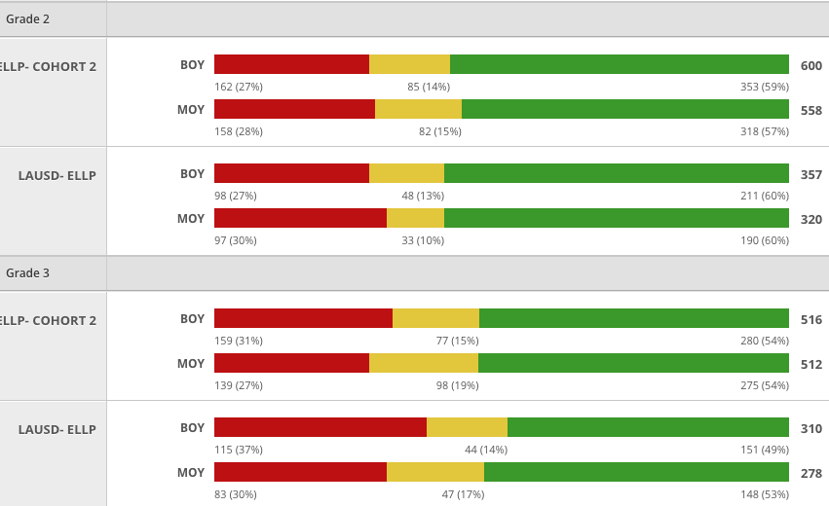
ELLP IDEL Performance, Grades 2 and 3
Chohort 2
+1
-2
Chohort 1
+3
0
Chohort 2
-4
0
Chohort 1
-7
+4

Slide 35

CONSIDERATIONS
35

Slide 36

265 PARTICIPATING SCHOOLS
IN EARLY LANGUAGE AND LITERACY PLAN (ELLP)
UP FROM 85 IN 2015-16
Notes:
In 2016-2017, there will be 265 schools participating in the Early Language and Literacy Plan (ELLP).
This represents an impressive increase of 180 schools from the 2015-2016 school year.

Slide 37
Questions?
37

