Slide 1


Slide 2

Pupil Services Mission Statement
“To ensure that all LAUSD students are enrolled, attending, engaged and on-track to graduate”

Slide 3
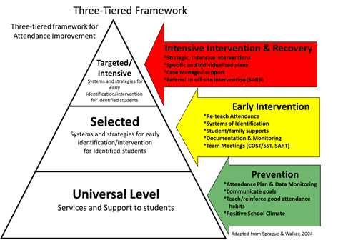
Pupil Services and Attendance Counselors
    Master’s Degree and/or a Doctoral degree
    Pupil Personnel Services and Child Welfare and Attendance credential
    Child welfare and attendance advocates
    Utilize a three-tiered model
        Prevention
        Early intervention
        Intensive intervention
    Improve individual and system-wide student attendance, engagement, achievement and graduation
    Work directly with students who experience difficulties in achieving their academic potential due to social/emotional, home and community barriers
    Specialized units provide additional support services that are needed by the specific populations they serve.

Slide 4
Student attendance:
is a strong predictor of academic performance from K-12;
is strongly correlated with on-time graduation;
is often an indicator of individual student’s physical and/or mental health;
is often an indicator of school culture, expectations, parent engagement, and a safe and welcoming environment;
greatly impacts school and district budgets, with losses in Average Daily Attendance (ADA) revenue resulting in fewer dollars for all schools (as well as lost instructional time, often for the students who need it most).

Slide 5

Chronic Absence
Chronic absence is particularly detrimental to our youngest students and those growing up in poverty:
Early Literacy skills
Disrupts instruction for all students
Lower ELA & Math test scores in later grades
Higher risk for dropping out
Chronic absence reduction has been identified as a key area for focus in California’s new Local Control and Accountability Plan (LCAP) and by the Campaign for Grade Level Reading.
Notes:
Students who miss 18 days or more in Kindergarten:
Are more likely to perform poorly in first grade (Reading)
Demonstrate lower academic achievement in fifth grade
By sixth grade, a pattern of absence is a predictor of high school dropout
A Serious National Problem
Particularly detrimental to our youngest students and those living in poverty
Disrupts development of early literacy skills
Disrupts instruction for all students
Results in lower ELA and Math scores in later grades
Increases the risk that a student will dropout
Has been recognized through the LCAP and Campaign for Grade Level Reading as a key area for improvement to improve student outcomes and address the achievement gap

Slide 6
“What Matters for Staying On Track and Graduating in Chicago Public Schools” (July 2007)

Slide 7
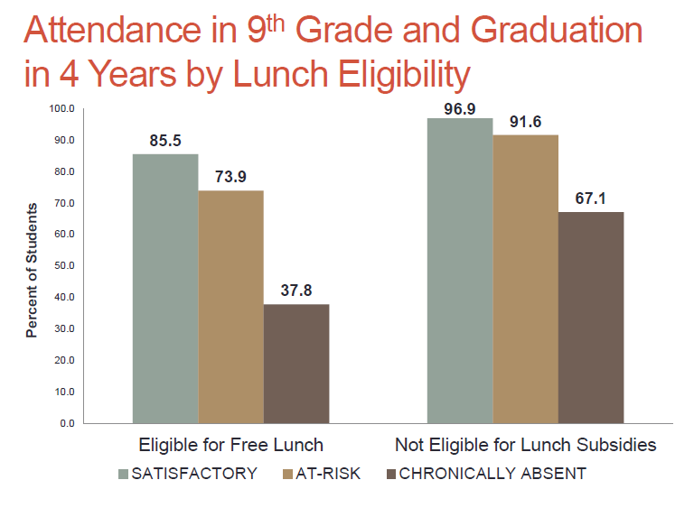
Poor Attendance Is A Problem Across Income; But Even More Important For Students In Poverty
Presentation to: The Interagency Council for Ending the Achievement Gap
November 7, 2013 CT State Dept of Education
attendanceworks.org

Slide 8
LAUSD Attendance Data

Slide 9

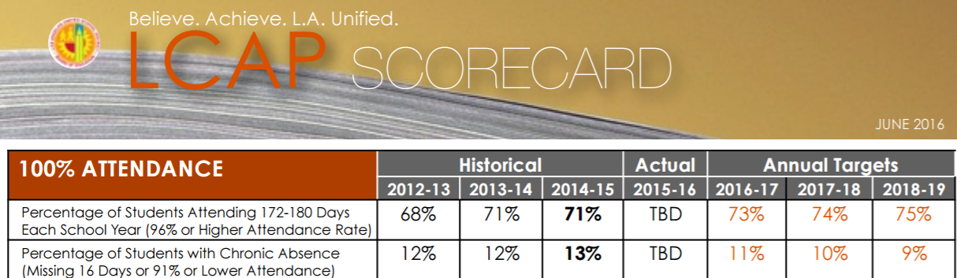
LCAP Attendance Goals 2016-17
The 2016-17 District attendance goal is for:
73% or more of students to maintain an attendance rate of 96% or higher throughout the school year
11% or less of students to be chronically absent (Chronic Absence is defined as missing 9% or more of the school year)

Slide 10
Tracking Attendance Data
LCAP Target:
2016-17: 73% of students attending here
LCAP Target: 11% or fewer students
Chronic Absence
Notes:
In LAUSD, we have recognized the critical need to identify and track student attendance trends.
We have aligned student attendance with academic language.
Notice the RED area – these students are considered CHRONICALLY ABSENT from school, being absent about 10% (or more) of their enrolled time.
We must have strategies are in place to maintain students in the green area and move students 95% or below up. Proficient attendance means better academic outcomes for our students.

Slide 11
Attendance Bands at the end of the school year
Instructional Days = 180
Advanced
0 ABSENCES
Proficient
1-7 ABSENCES
Basic
8-14 ABSENCES
Below Basic
15-23 ABSENCES
Far Below Basic
MORE THAN 23 ABSENCES

Slide 12
LCAP target= 73%
Notes:
On the other end of the attendance bands, we track the rates of students attending at/above 96% attendance;
While we have seen increases in the % of students attending at our 96% goal, rates are still unacceptably low among many grade levels, particularly our youngest students, high school students, and students receiving special education services.

Slide 13
1 in 5
1 in 6
LCAP target = 11% or lower
Notes:
Here is LAUSD’s chronic absence data for each of the last four school years by grade level;
Data consistently demonstrates higher levels of chronic absence among our youngest students, Grade 9 students, and students receiving special education services; Overall, we have seen a reduction in the % of students who were chronically absent in each of the last four school years, but still, about 13 out of every 100 LAUSD students missed three or more weeks of school last year. This equates to about 80,000 students.
We have also found a pattern of disproportionality (higher absenteeism) among our African American students, who have been significantly over-represented among students who were chronically absent.

Slide 14
Understanding the LCAP Attendance Goal
To maintain Proficient/Advanced Attendance, students may miss no more than 1 day for every 25 days enrolled.
*Please note that these breakdowns apply to students who have been enrolled continuously since the first day of school. Students who enroll late will have fewer days of instruction, and must therefore miss fewer days of school to maintain a 96% attendance rate.
How many days can a student have missed at the end of March and still have 96% attendance?
Notes:
To maintain Prof/Adv attendance, a student should not be absent more than 1 day for every 25 days. This is a “pacing” method for our students and families and a way for us to gauge how students are progressing with attendance. This chart gives an easy way of understand this pacing for each month.
How many days can a student miss to still be considered as having Prof/Adv. Attendance by the end of November? Answer: No more than 2 absences.
Reference tool that gives the calendar of instructional days and the number of absences by band.

Slide 15
District-wide Attendance Bands by Grade Level Cumulative YTD (2016-17)
Chronic Absence Goal: 11% or lower
Prof/Adv Goal:
73% or higher
Source: MyData
Cumulative Data YTD 2016-17 Thru March 31, 2017

Slide 16
District-wide Attendance Bands Comparison by Foster Youth Population YTD (2016-17)
Chronic Absence Goal: 11% or lower
Prof/Adv Goal:
73% or higher
Source: MyData (LAUSD count includes Foster youth)
Cumulative Data YTD 2016-17 Thru March 31, 2017

Slide 17
District-wide Attendance Bands by Language Classification Cumulative YTD (2016-17)
Chronic Absence Goal: 11% or lower
Prof/Adv Goal:
73% or higher
Source: MyData
Cumulative Data YTD 2016-17 Thru March 31, 2017

Slide 18
District-wide Attendance Bands Comparison by Poverty Indicator YTD (2016-17)
Chronic Absence Goal: 11% or lower
Prof/Adv Goal:
73% or higher
Source: MyData
Cumulative Data YTD 2016-17 Thru March 31, 2017

Slide 19
What we are doing to support students and families

Slide 20
Absence Prevention and Intervention

Slide 21
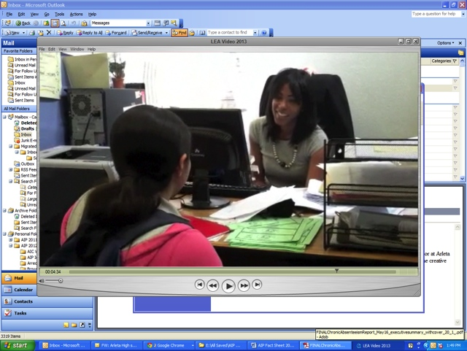
Pupil Services and Attendance Counselors
Early Outreach and Targeted Support
Implement Absence Prevention and Intervention Programs
Analyze and address barriers to attendance
  Academic issues, family dynamics, bullying, drugs and alcohol, gangs, mental health issues, community factors of violence, etc.
  Link students and families to community resources
Attendance Improvement Program
Pupil Services and Attendance

Slide 22
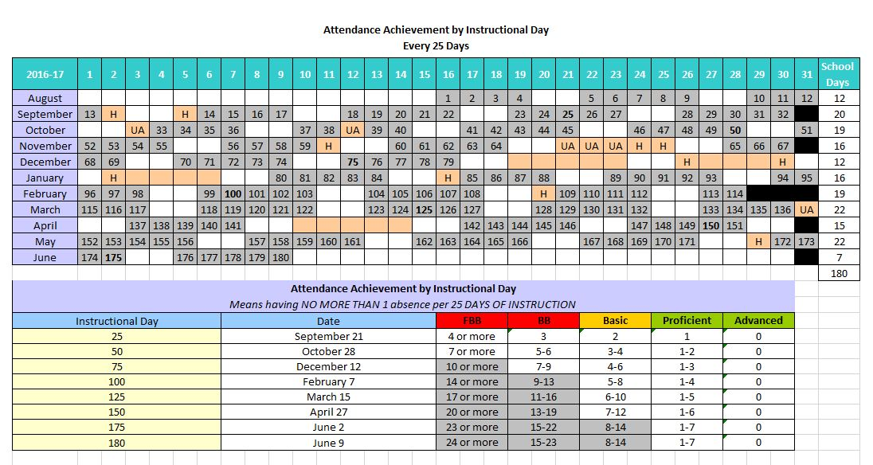

Slide 23
Attendance Improvement (AI)
Supports selected, high-need LAUSD schools to increase the percentage of students attending school at a rate of 96% or higher in Transitional Kindergarten, Kindergarten and Grade 9
Committed to engaging parents, students, school staff, and community members in a common vision of graduation for all students
AIP Schools have consistently demonstrated significant gains in Proficient/Advanced attendance rates and declines in chronic absence rates outpacing district-wide improvements in both Kinder and Grade 9

Slide 24
Attendance Improvement Program
District focus on increasing student attendance
  Launched in September 2011
  Focused child welfare and attendance support for TK/Kinder/Ninth Grade
Strategically improve Performance Meter rates of student attendance in lowest grade levels
Prevent and address Chronic Absence
Currently, Attendance Improvement Counselors (AICs) serve over 6,700 TK, Kindergarten, and Ninth Grade students
  32 Elementary Schools and 10 high schools throughout the District
Attendance Improvement Program
Pupil Services and Attendance
Notes:
Reference the mission statement/schools selected handout
In response to the critical need for attendance improvement in Kindergarten and Grade 9, the LAUSD launched the Attendance Improvement Program (AIP) in September of 2011. The AIP serves schools with the lowest rates of Proficient/Advanced (96% or higher) attendance in Kindergarten or Grade 9.

Slide 25

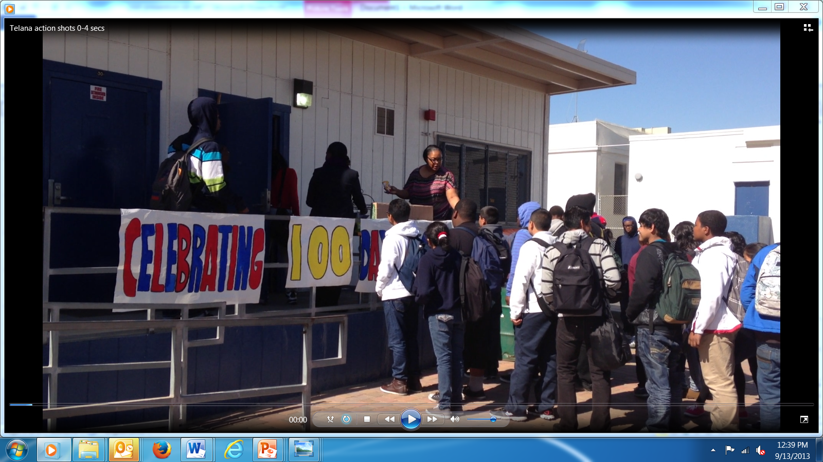
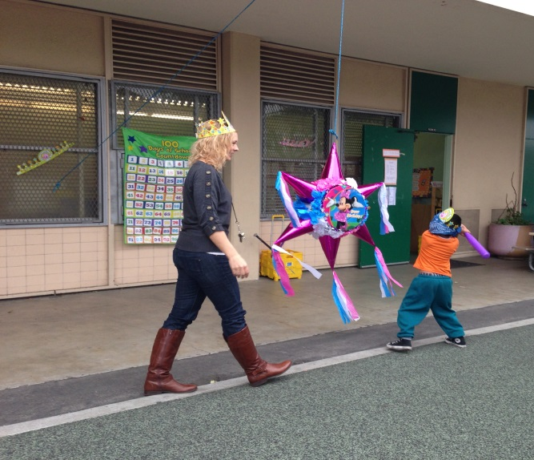


Attendance Improvement Counselors
Implement Prevention and Intervention Programs
  Create incentive programs using universal and tiered strategies (attendance incentives, events, campaigns, and challenges)
Attendance Improvement Program
Pupil Services and Attendance
Notes:
By providing universal incentives, we are reaching more students. This is directly related to our success as a program.

Slide 26
Incentive and Recognition Programs
Recognizing all Stakeholders
Students with Proficient/Advanced attendance each month/year
Students who pass all classes the first/second semester
  Smaller goals can be set every 5 weeks (progress reports)
Students who meet small goals set with counselor (e.g., attendance, credits, and or behavior)
Most improved certificates for the above categories
Parents/caregivers of students who meet specific goals
Classrooms with excellent/improved attendance
School staff who directly support students
(to show appreciation)
Attendance Improvement Program
Pupil Services and Attendance
Notes:
This slide is word heavy but not sure you wanted me to make another slide out of it :/

Slide 27
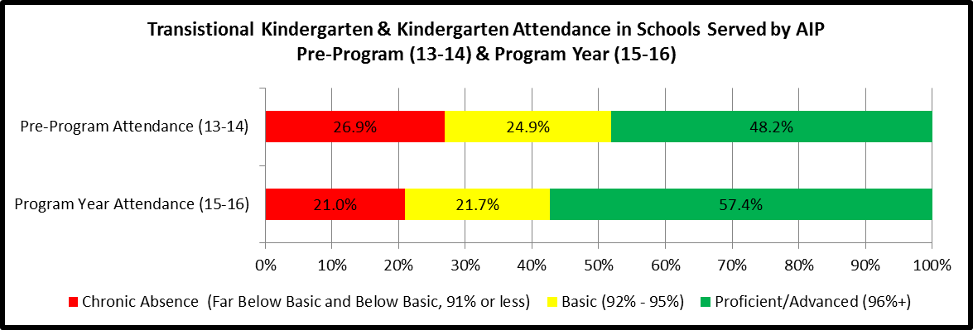


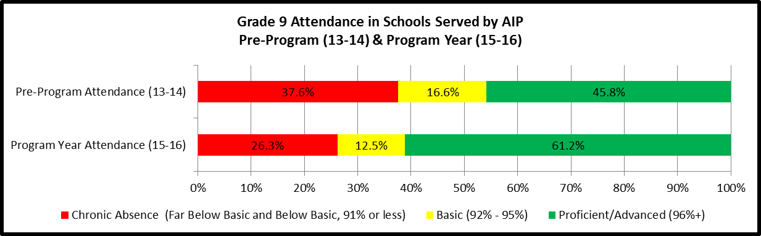


AIP Year-End Outcome Data

Slide 28
School-based PSA Counselors
School-based PSA Counselors provide comprehensive tiered absence prevention and intervention, as well as, dropout prevention and recovery services.
School-based PSA Counselors play an integral role in the development of the school-site attendance improvement and dropout prevention plans.
These services may include:
  Individual, group and family counseling
  Home visits to gather and exchange information
  Providing in-home counseling as needed
  Collaborate with school officials and community agencies
  Participate in SSPT (COST, SST) and IEP meetings
  Collect, analyze and disseminate data to all stakeholders
  Link and refer to community resources
  Educate stakeholders regarding compulsory education laws, District attendance goals and LCAP accountabilities
Copyright-2016 © Los Angeles Unified School District - All rights reserved
Notes:
Local District PSA Teams serve as the main support for school-purchased PSA Counselors.
The Administrators of the Local Districts are the direct supervisors of school-purchased PSA counselors and perform their evaluation.

Slide 29

A-G Diploma Program
A-G Diploma Counselors focus on dropout prevention, A-G intervention and credit recovery, support for transitions and articulation, and college and career readiness.
At both the middle and high school level, the tiered framework is used to implement, monitor and evaluate the effectiveness of prevention and intervention services provided school-wide and to targeted groups of at-risk students.
Provide intensive case management services and school wide incentive programs. Student achievement and outcome data is collected, analyzed and shared with central staff and school site administrators.
Copyright-2016 © Los Angeles Unified School District - All rights reserved
Notes:
The A-G Diploma Project is a dropout prevention program that works with schools that are Title 1 and/or have high numbers of students who are not track to graduate. PSA counselors provide comprehensive prevention and intervention services to secondary schools within zones of support.
After over a decade of success through our Diploma Project in which provided dropout prevention services to our highest need middle and high schools
LAUSD has invested by ensuring that a PSA Counselor serve every high school in school district in order to provide dropout prevention support to our highest need students
These counselors work directly with students that are behind at least 3 classes and coordinate credit recovery, resources and advocacy.
We also continue to serve 20 of the highest need middle school by implementing a prevention component focusing on sixth grade and providing intensive intervention for our struggling eighth grade students
Increase the percentage of targeted students attending at 96% or higher rate
Decrease the percentage of targeted students who are chronically absent (attending at/below 91% rate)
Reduce credit deficiency/the percentage of students demoted or failing to promote between grade levels for the class of 2017, 2018, 2019, and 2020
Increase the percentage of targeted students who are on-track to on-time A-G diploma attainment/graduation
Identify students who qualify for exemptions from District graduation requirements as appropriate
Recover students who have dropped out by providing multiple pathways and assistance to support each student toward diploma/Hi-SET attainment

Slide 30
FamilySource Partnership Program
The FamilySource Partnership Program (FSPP) is a collaborative effort between the Los Angeles Unified School District (LAUSD) and the City of Los Angeles which began in 2014
PSA Counselors are co-located at 13 FamilySource Centers (FSC) to address barriers to academic success and provide academic consultation
Link students and families to FSC services (e.g., tutoring, case management, counseling, recreational activities, legal services, etc.)
Support parent engagement and education services through parenting classes and parent workshops
Assess and connect students referred through the Los Angeles School Police Department Diversion Referral program to FamilySource services and other community agencies
Copyright-2016 © Los Angeles Unified School District - All rights reserved

Slide 31
Foster Youth Achievement Program
Provide comprehensive services to maximize educational outcomes, the emotional well-being, and social development for children in out-of-home care and/or on probation
The program has a multi-disciplinary staff responsible for providing academic support, vocational/career counseling, transition support and case management services
Currently, there are 8,278 foster youth attending LAUSD schools

Slide 32
Group Home Scholars Program
Supports students in out-of-home care and/or who are under the jurisdiction of the Department of Probation
Collaborates with:
  LAUSD’s Foster Youth Achievement Program
  Department of Children & Family Services
  Los Angeles County Office of Education
  Probation Department
Provides targeted case management, counseling services, tiered support services and interventions for students residing in group homes
Program staff are housed in select schools, group homes, probation offices and the central LAUSD office
Copyright-2015 © Los Angeles Unified School District - All rights reserved
Notes:
The Group Home Scholars Program works with students foster care that are placed in group homes and/or are transitioning from juvenile detention centers. They provide instructional and counseling support services to students so that we can help ensure they have equal access to a quality education.
9 PSA Counselor provide targeted supported to our students that are placed in out of home care
These counselors advocate to ensure that they
I’d like to ask Marquis and all of the Counselors on her team to stand.

Slide 33
Homeless Education Program
Provide assistance to homeless students and families in compliance with the McKinney Vento Homeless Assistance Act
Ensure that schools are following district policy and federal mandates for the education of homeless students
Remove barriers to academic success for Homeless students, providing equal access to education as their housed peers
Effectively serve students and families in transition, providing advocacy and referral services that foster a sense of empowerment and stability
Leverage program resources by collaborating with community partners and coordinating fundraising efforts
Copyright-2015 © Los Angeles Unified School District - All rights reserved
Notes:
The Homeless Education Program assists homeless students and families to ensure that they have the services they need to succeed and excel academically.
The Program PSA Coordinator is Nancy Gutierrez.
I’d like to ask Nancy and all of the Counselors on her team to stand.

Slide 34
Juvenile Hall/Camp Returnee
In L.A. County, approximately 180 juvenile offenders are sent home from a detention facility each month (LA County Dept. of Probation)
Two-thirds of all youth released from LA County correctional facilities reside within LA Unified School District, making it the highest population of probation students in the nation
Provide early intervention, dropout prevention & recovery services to students returning from juvenile detention facilities
Enhanced case management is utilized to ensure timely enrollment, increased school attendance and academic achievement, school stability, and access to resources.
11 Juvenile Hall/Camp Returnee counselors serve LAUSD

Slide 35
YouthSource City-Partnership
PSA Counselor is co-located at 16 YouthSource Centers
Provide support services such as needs assessments, case management and follow-up, linkages, resources and referrals through the YouthSource system.
Targets youth between the ages of 16-21
Focus on re-engaging students in the educational process and providing opportunities to develop employment skills
Serve as a deterrent, intervention and alternative for all students dealing with citations for daytime curfew violations as part of their Truancy Diversion Program
Since 2012, the City Partnership Program has supported our highest need communities with the highest dropout rate in an effort to re-engage our youth back into an educational setting
Support youth in obtaining their high school diploma or high school equivalency certificate
Link and coordinate services with Workforce Programs to ensure positive outcome
Copyright-2016 © Los Angeles Unified School District - All rights reserved
Notes:
Our partnership with the city has been instrumental in laying the foundation for P3, most significantly it made us more aware of the need to identify other key partners to build on this work.
Since 2012, the City Partnership Program has supported our highest need communities with the highest dropout rate in an effort to re-engage our youth back into an educational setting.
15 PSA counselors provide direct services
This partnership represents a proactive commitment to doing whatever it takes to achieve positive youth outcomes
The collaboration has prevented youth who need services from slipping through the cracks. In the past – Youth had to return to previous school for credit/transcript info- many would not return.
Having a PSA at the center allows youth who walk into one of the Centers and be serviced by staff who have access to their educational records and can therefore begin connecting them to appropriate services
Since 2012,-- 25, 742 Youth have received an educational assessment by PSA Counselor
Pupil Services and Attendance Counselors have been co-located within City of Los Angeles YouthSource Centers and community based organizations in order to serve our students collaboratively.
YouthSource Centers are also part of a City-Partnership and serve as Youth Source Work Centers throughout the City of Los Angeles. These centers provide services to students between the ages of 14-24 with a focus on re-engaging students to school and provide them with opportunities to develop work skills.

Slide 36

Student Recovery Day

Slide 37
PURPOSE
Re-engage students and families and provide resources and support to transition youth back into school
Educate the community about compulsory education laws and the impact of chronic absenteeism
Assist schools with recovering out of school youth with the ultimate goal of decreasing the dropout rate
Create a sense of ownership in bringing students back to school
Heighten district/community awareness of the number of students missing from our schools

Slide 38
SRD Outcomes
2008-2016
Number of Schools | Volunteers | Phone Calls | Home Visits | Students Recovered | TDAP Verifications Received | Businesses Visited
85 | 4,421 | 16,977 | 10,812 | 5,219 | 582 | 3,702

Slide 39

Questions & Answers
Alicia Garoupa, Interim Director
alicia.garoupa@lausd.net
(213) 241-3844
http://pupilservices.lausd.net/

