Slide 1


Language Development
Parent Community Services

Slide 2
Objectives:
To understand the importance of promoting language development
To learn the domains and skills that comprise language development
To learn ways to support language development at home

Slide 3
Language is:
the essential means of social communication
the medium by which higher intellectual processes are revealed
how we express inner thoughts, emotions and establish rules
how we make sense of complex and abstract thought
how we maintain our culture

Slide 4

Language Development
Think-Pair-Share
When does language development begin?
How can language development be supported at home?

Slide 5
Language Development
at home

Slide 6
Listening
Comprehension
The ability to process auditory information in order to understand it, remember it, discuss it and retell it.

Slide 7
Listen carefully..
Andy’s mom says: “Please finish your homework, put your notebooks away and get ready for dinner. I will know you are ready for dinner once your notebooks are put away.”
What is Andy supposed to do?

Slide 8
Listen carefully…
A teacher tells the class: “Tomorrow we are going to start our project about family histories. I want you to bring to class some pictures of your family. If you can, bring two pictures that show all the people in your family. We will use these pictures in the project”.
What do the students need to bring for their project?

Slide 9

Following Directions

Slide 10
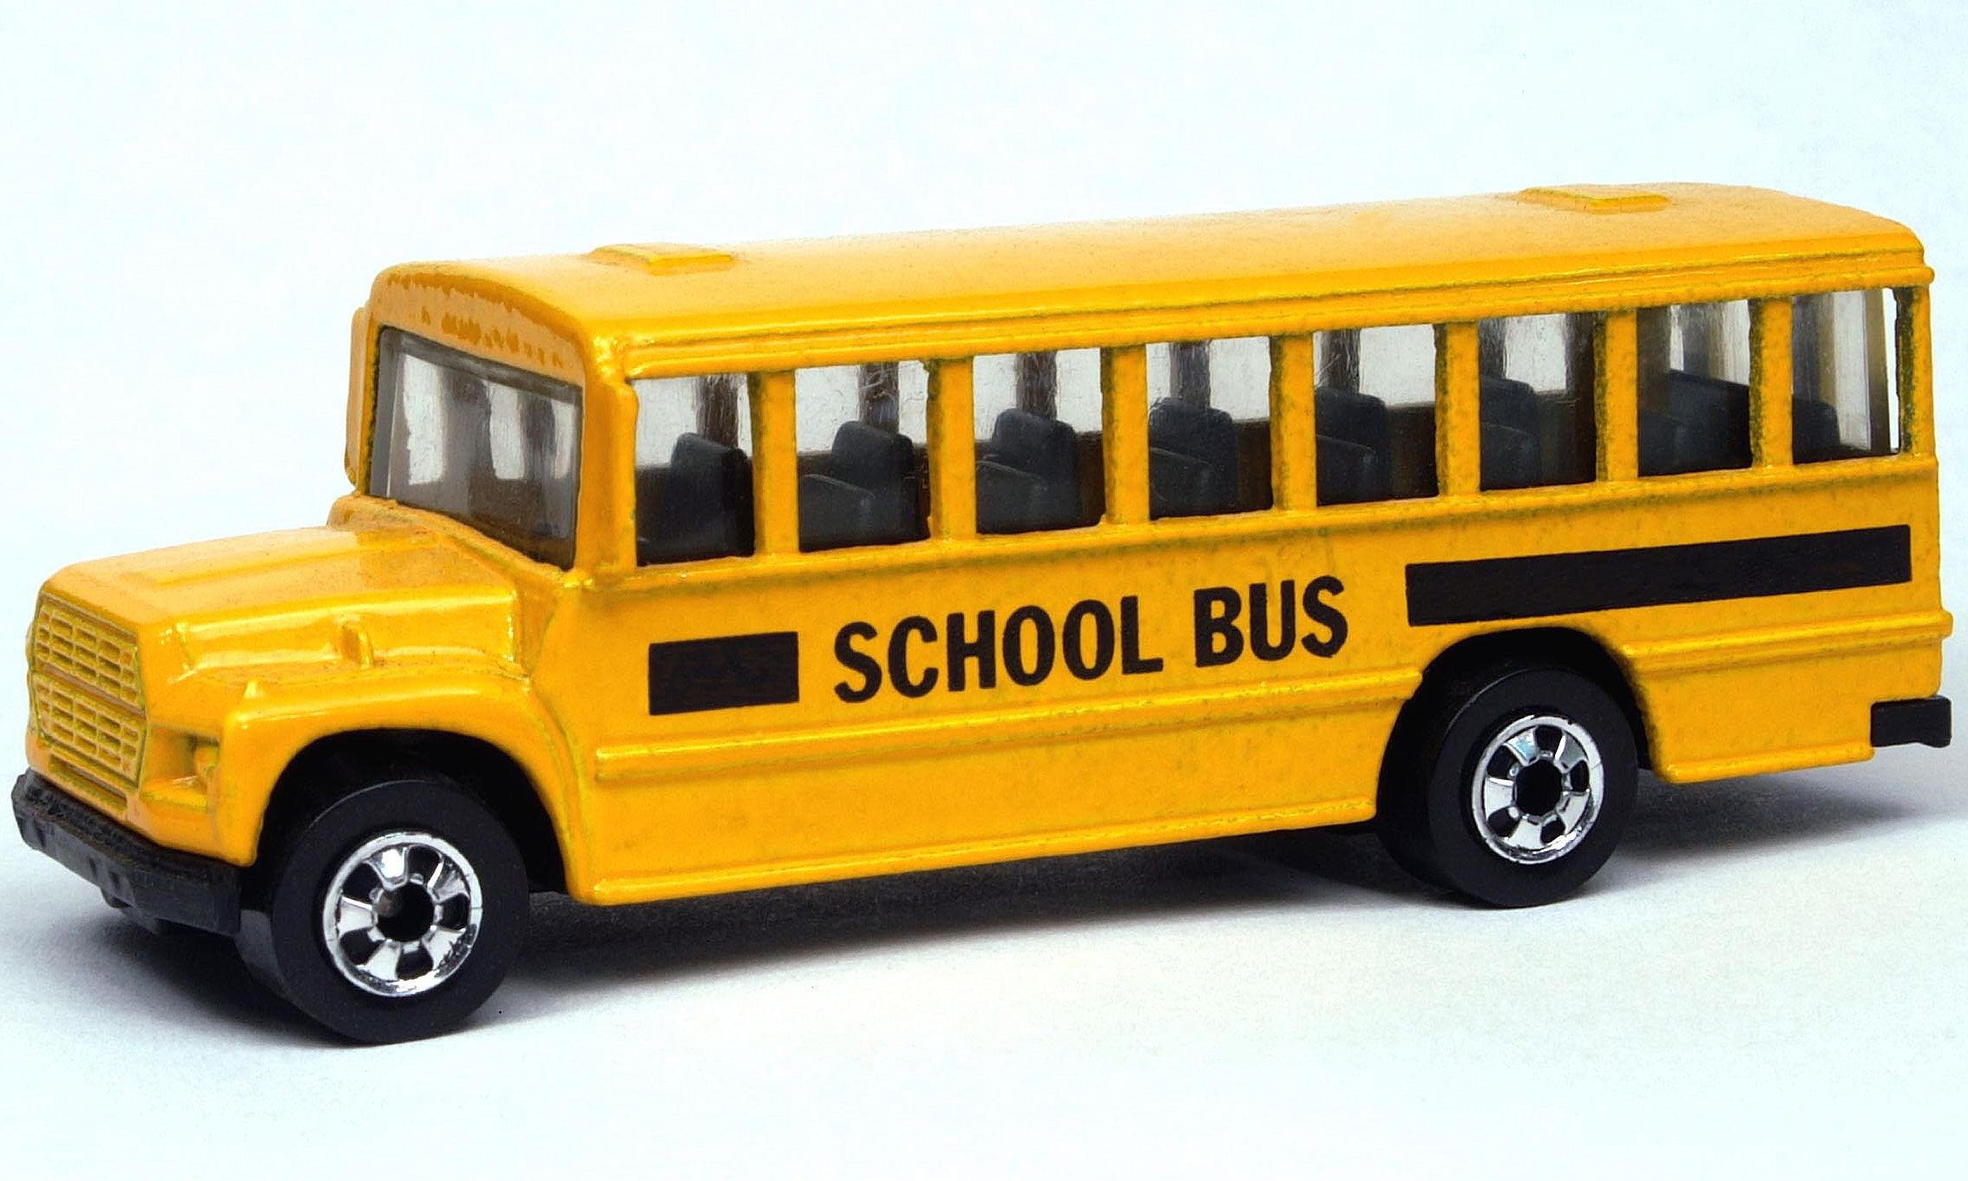
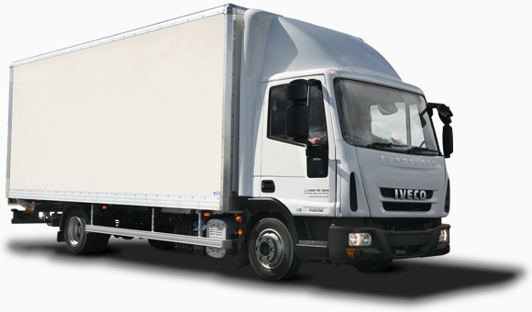
Choose the picture that shows a line connecting the bus to the truck. Mark your answer.

Slide 11



Draw a circle around the fruit. Mark your answer.

Slide 12
Oral Vocabulary
Words we use in speaking or recognize in listening.

Slide 13

What is this?
What is it used for?

Slide 14
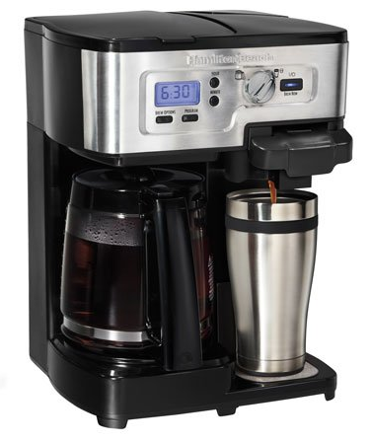
What is this?
What is it used for?

Slide 15

What is the lady doing?

Slide 16

What are they doing?

Slide 17
Speech Functions
How language is used to convey information and express social relationships.

Slide 18
You are drawing a picture. You want to borrow a blue marker from your friend.
.
What question would you ask your friend?
Listen carefully…

Slide 19
You are working on a science project in your classroom. You need more materials.
.
What would you say to your teacher?
Listen carefully…

Slide 20

Choose & Give Reasons

Slide 21
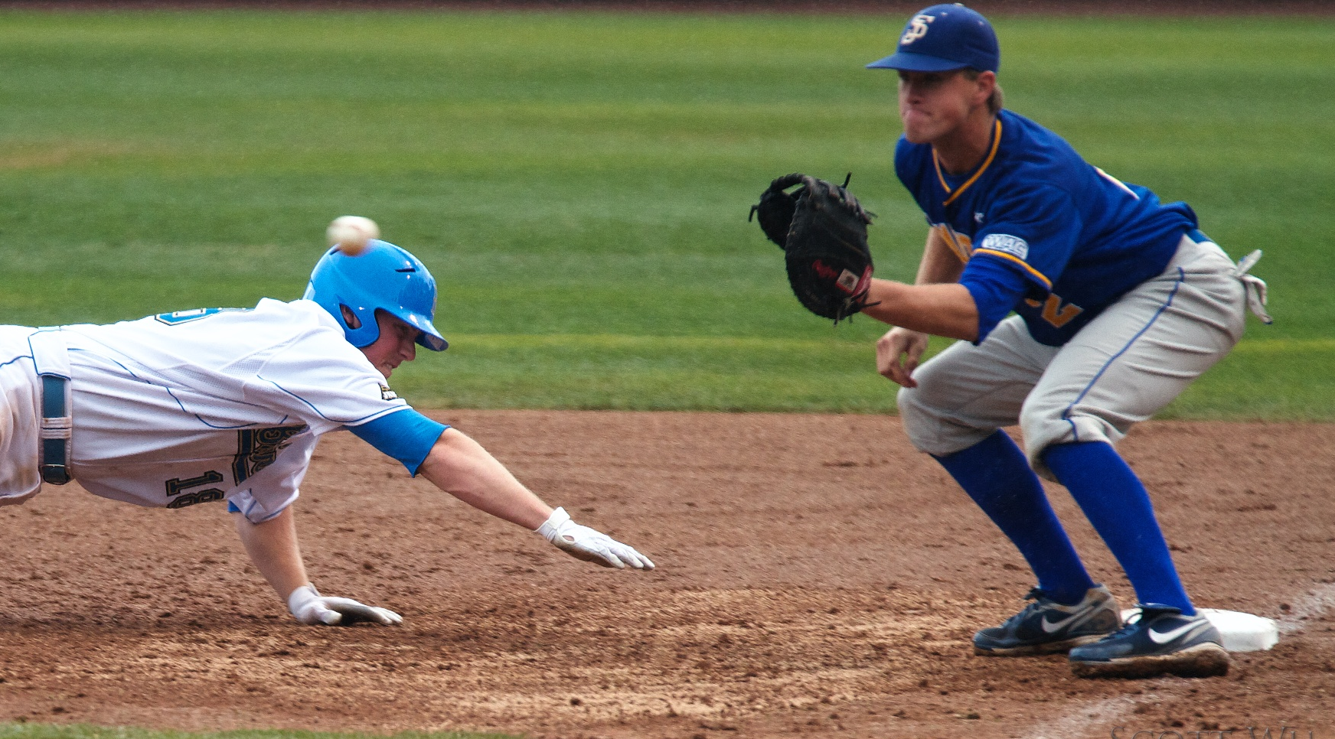

Which would you rather do…
go to a baseball game or
go to the movies
Please tell me two reasons why.

Slide 22
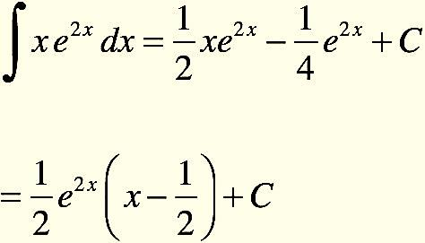

Which would you rather do…
work on a math problem or
write an essay
Please tell me two reasons why.

Slide 23

4 Picture Narrative

Slide 24
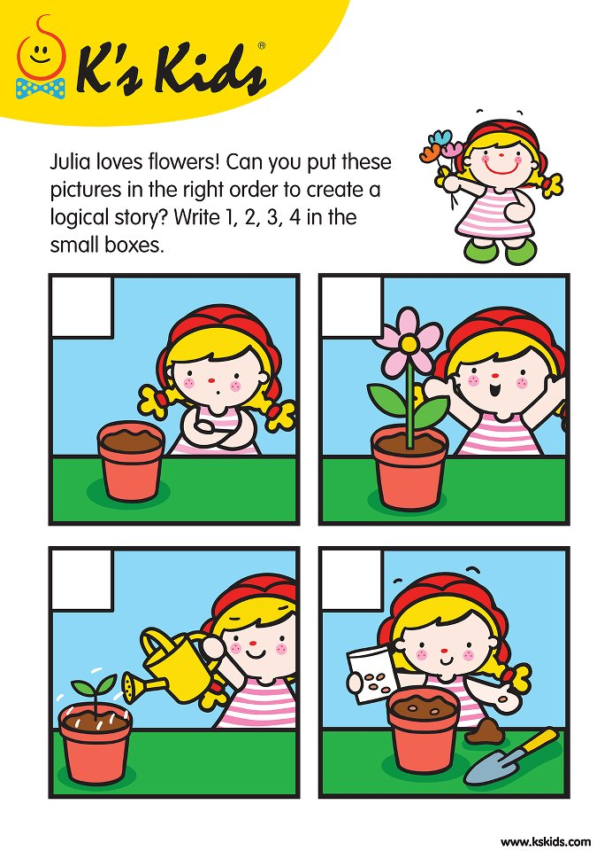
I am going to show you some pictures that tell a story. I will start the story and you will then tell me what happens next. Natalia had an idea!. What happened next? Tell me a complete story using lots of details.

Slide 25
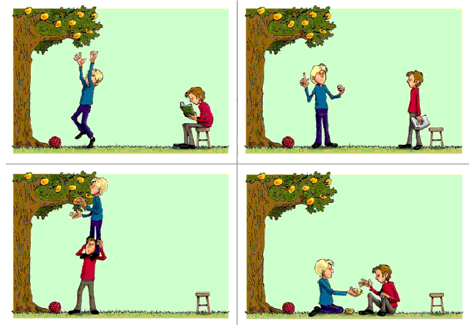
I am going to show you some pictures that tell a story. I will start the story and you will then tell me what happens next. Mark wants an apple. What happened next? Tell me a complete story using lots of details.

Slide 26
Antonyms
A word opposite in meaning to another.

Slide 27
The antonym (opposite) of…
straight is
crooked

Slide 28


The antonym (opposite) of…
courteous is
rude

Slide 29
Synonym
An synonym is a word that is similar in meaning to another.

Slide 30

The synonym (same) of…
rich is
affluent

Slide 31

The synonym (same) of…
cost is
price

Slide 32
Homographs
are words which are spelled the same, and have more than one meaning.

Slide 33


light

Slide 34


spring

Slide 35


palm

Slide 36
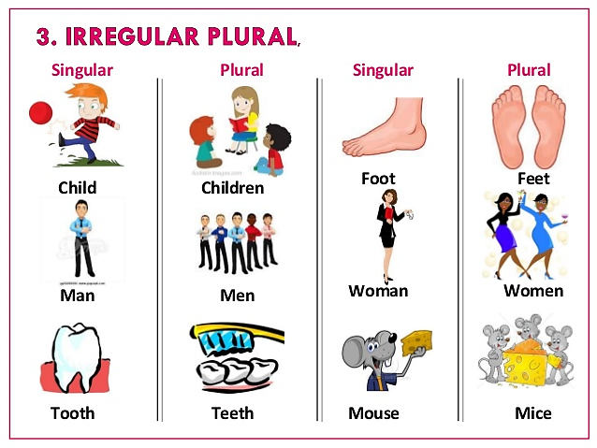
Singular to Plural

Slide 37
Find the word that means more than one party.
partis
partys
parties
partyes

Slide 38

Writing Sentences

Slide 39
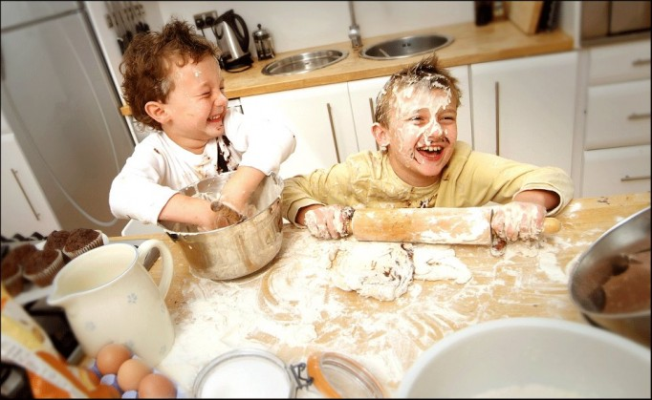
Using a lot of details, write one sentence that describes what is happening in the picture.

Slide 40
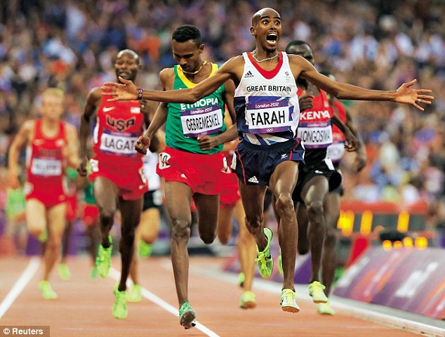
Using a lot of details, write one sentence that describes what is happening in the picture.

Slide 41

Reading

Slide 42
Questions to ask your child…
    What is the best title for this story?
    What is the setting for this story?
    What is most likely to happen next?
    What is the main idea of the story?
    What inferences can you make about……?

Slide 43


Practical Suggestions

Slide 44

Language Development
Give your full attention when your child starts a conversation
Acknowledge, encourage, and praise all attempts to speak. Show that you understand the word or phrase by fulfilling the request, if appropriate.
Pause after speaking. This gives your child a chance to continue the conversation.

Slide 45

Language Development
Introduce new words and offer their definition, or use them in a context that is easily understood. This may be done in an exaggerated manner. "I think I will drive the vehicle to the store. I am too tired to walk."

Slide 46

Language Development
Work on forming and explaining categories. Identify the thing that does not belong in a group of similar objects:
"A shoe does not belong with an apple and an orange because you can't eat it; it is not round; it is not a fruit."

Slide 47

Language Development
Offer a description or clues, and have your child identify what you are describing:
"We use it to sweep the floor" (a broom).
"It is cold, sweet, and good for dessert. " (ice cream).

Slide 48

Language Development
Help your child follow two- and three-step directions: "Go to your room, and bring me your book."
Encourage your child to give directions. Follow his or her directions as he or she explains how to build a tower of blocks.

Slide 49
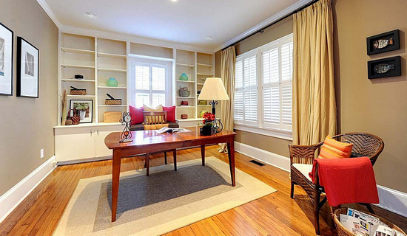
Language Development
Talk about the different rooms and furnishings in the house, explaining their purpose and use.

Slide 50

Language Development
The television also can serve as a valuable tool. Talk about what the child is watching. Have him or her guess what might happen next. Talk about the characters. Are they happy or sad?” Ask your child to tell you what has happened in the story. Act out a scene together, and make up a different ending.

Slide 51

Language Development
While shopping for groceries, discuss what you will buy, how many you need, and what you will make. Discuss the size (large or small), shape (long, round, square), and weight (heavy or light) of the packages.

Slide 52
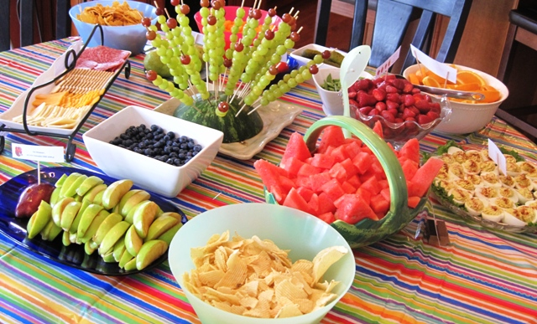
Language Development
Take advantage of daily activities. For example, while in the kitchen, encourage your child to name the utensils needed. Discuss the foods on the menu, their color, texture, and taste. Where does the food come from? Which foods do you like? Which do you dislike? Who will clean up?

Slide 53
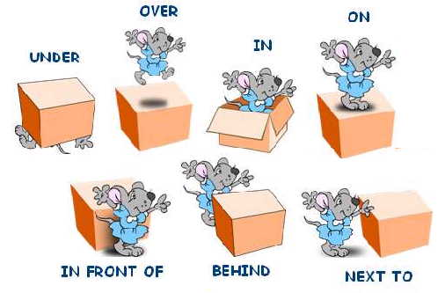
Language Development
Emphasize the use of prepositions by asking him or her to put the napkin on the table, in your lap, or under the spoon. Identify who the napkin belongs to: "It is my napkin." "It is Daddy's." "It is John's."

Slide 54
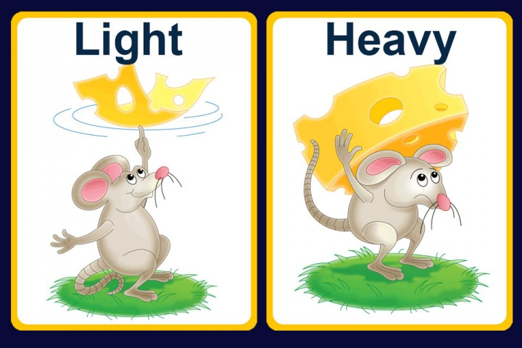
Language Development
Talk about spatial relationships (first, middle, and last; right and left) and opposites (up and down; on and off).

Slide 55
Resources
CA Department of Education CELDT Released Test Questions
American Speech-Language-Hearing Association

Slide 56
Thank You!

Slide 57


https://achieve.lausd.net/pcss
Notes:
Families can obtain more resources by going to our PCS web site.

