Slide 1
Planning for Student Success
Planeando para éxito estudiantil
Becoming Familiar with the School Plan for Student Achievement
Federal and State Education Programs
2025-2026
Familiarizarse con el Plan Escolar para el Rendimiento Académico Estudiantil
Programas Educativos Federales y Estatales
2025-2026

Slide 2

Outcomes
Resultados
Understand why School Site Council develops a School Plan for Student Achievement (SPSA)
Understand the main components of the SPSA
Know how to find your school’s SPSA online
Entender por qué el Consejo del Plantel Escolar desarrolla un Plan Escolar para el Rendimiento Académico Estudiantil (SPSA)
Entender los componentes principales del SPSA
Saber cómo encontrar el SPSA de su escuela por el internet

Slide 3
What is a School Plan for Student Achievement (SPSA)?
¿Qué es un Plan Escolar para el Rendimiento Académico Estudiantil (SPSA)?
SPSA: a written plan that creates a program to improve student achievement using federal funds
Purpose: improve academic achievement of students at risk of not meeting grade-level standards
School Site Council: develops it yearly
SPSA: un plan escrito que crea un programa para mejorar el rendimiento estudiantil a través de los fondos federales
Propósito: mejorar el rendimiento académico de los estudiantes en riesgo de no cumplir los estándares a nivel de grado
Consejo del Plantel Escolar: lo desarrolla anualmente
Notes:
An important note to start us off is that Ed. Code requires that a plan be developed and written by SSC (required by federal law and Ed. Code 640001)

Slide 4
Why a School Plan for Student Achievement? ¿Por qué un Plan Escolar para el Rendimiento Académico Estudiantil?
Involves school community in planning process to assess students’ needs and ensure that students succeed
Evaluates how well current plan activities and program expenditures are working
Determines focus for future plan activities and program expenditures
Supports the continuous improvement cycle
Involucrar a la comunidad escolar en el proceso de planificación para evaluar las necesidades de los estudiantes y asegurarse de que todos los estudiantes logren el éxito
Evaluar qué tan exitosas fueron las actividades del plan actual y los gastos de los programas
Determinar el enfoque para futuras actividades del plan y los gastos de los programas
Apoyar el ciclo continuo de mejora
Notes:
SSC is made up of various groups including school staff, administrators, parents, and in the case of our secondary schools, it also includes students and that is very intentional because the plan should represent the input, experience, and knowledge of all these groups in order to assess students’ needs and ensure that they succeed.
SSC also evaluates how well the current plan activities and program expenditures are working. This is very important because that evaluation process helps SSC identify strategies that are effective that should be continued as well as strategies that did not improve student achievement or increase parent engagement and therefore should be discontinued or revised.
Based on the analysis of data, SSC determines focus areas for future plan activities and expenditures
Finally, the SPSA revolves around what is called the cycle of continuous improvement, which we will go through in more detail during the presentation

Slide 5
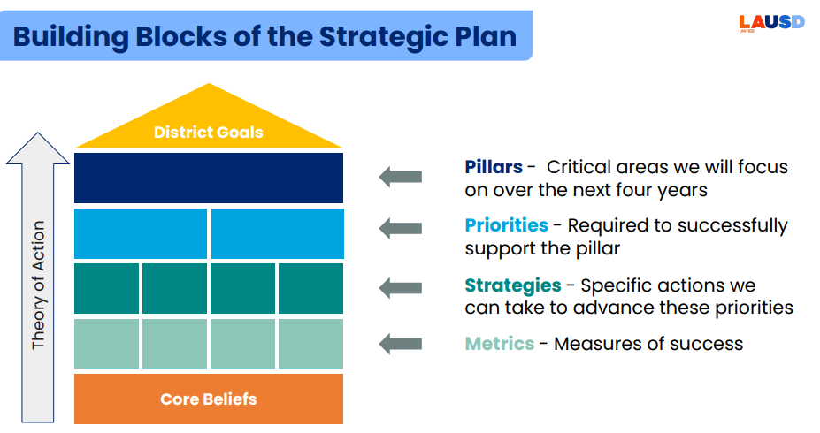
District Strategic Plan Plan Estratégico del Distrito
Elemento Constitutiva del Plan Estratégico
Metas del Distrito
Pilar – Áreas criticas en las que nos enfocaremos durante los próximos cuatro años.
Prioridades – Requerido para apoyar el pilar con éxito
Estrategias – Acciones especificas que podemos tomar para avanzara estas prioridades
Medida – Medidas de éxito
Teoría de Acción
Creencias Fundamentales
Notes:
The SPSA provides all stakeholders the opportunity to learn about the mission and vision of the school, the demographics, and the various programs
The SPSA was revised in the 23-24 school year to align with the District Strategic Plan
The building blocks of this strategic plan include what we call Pillars or critical areas where as a District we will focus our efforts over the next four years
Supporting implementation of the Pillars are priorities or specific focus areas within each pillar
Supporting implementation of the priorities are strategies or specific actions we can take ensure that we are effectively addressing the priorities
Finally, the strategic plan includes metrics or measures of success. In other words, data to help us determine if we are on track to improve student achievement, build parent capacity, and improve student well being.

Slide 6
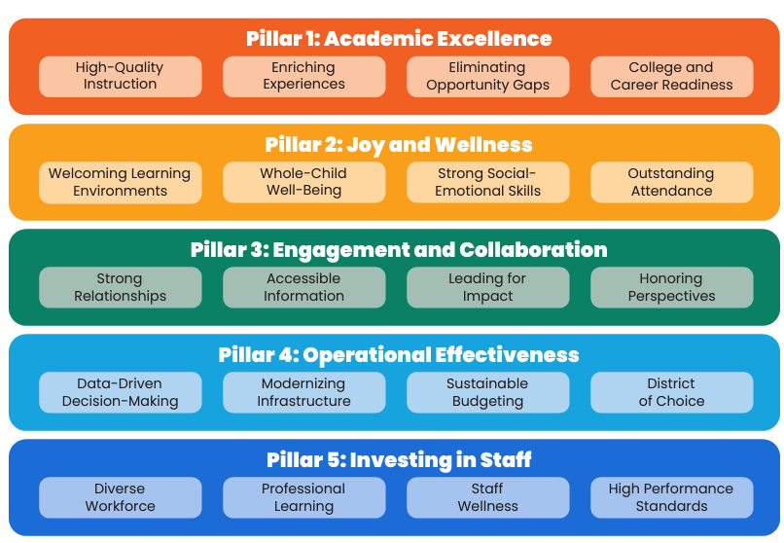
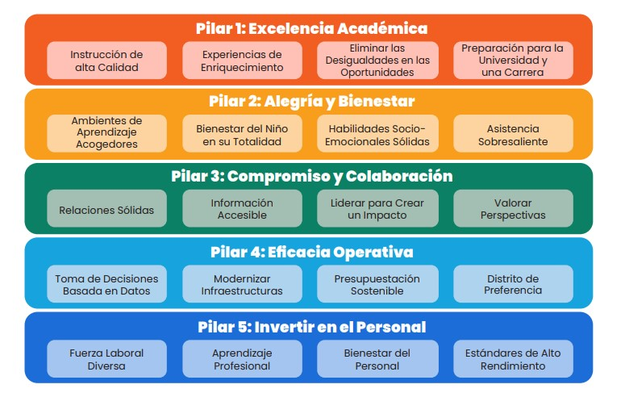
Strategic Plan Pillars & Priorities Plan Estratégico Pilares y Prioridades
Notes:
The District Strategic Plan consists of 5 Pillars which include:
1.Pillar 1: Academic Excellence
2.Pillar 2: Joy & Wellness
3.Pillar 3: Engagement & Collaboration
4.Pillar 4 Operational Effectiveness
5.Pillar 5: Investing in Staff
The SPSA directly addresses Pillars 1, 2, 3 with Pillars 4 and 5 embedded throughout the plan.
Pillar number 1, Academic Excellence encompasses: Graduation/College Career Readiness, ELA, Math, EL Programs, and Other Academic Content which includes content areas such as science and social studies
Pillar number 2, Joy and Wellness, addresses attendance, suspension, and social-emotional supports for students
Pillar number 3, Engagement & Collaboration, focuses on parent, student, and staff engagement and collaboration.

Slide 7
SPSA: Continuous Improvement Cycle
SPSA: Ciclo de mejora continua constante
Conduct comprehensive needs assessment, including data analysis/SPSA Evaluation
Develop measurable objectives and identify evidence-based strategies in the SPSA Pillar pages
Develop budget based upon prioritized expenditures that support and align to the evidence-based strategies described in the SPSA Pillar pages
Monitor the implementation of the SPSA and adjust as necessary
Realizar la evaluación integral de las necesidades incluyendo un análisis de datos y evaluación del SPSA
Desarrollar objetivos medibles e identificar las estrategias basadas en evidencia en las páginas del SPSA
Desarrollar un presupuesto basado en los gastos clasificados por prioridad que apoyen y estén alineados con las estrategias basadas en evidencia en las páginas pilares del SPSA
Monitorear la implementación del SPSA y modificar cuando sea necesario
SPSA: Continuous Improvement Cycle
SPSA: Ciclo de mejora continua constante
Notes:
SSC develops, implements, and monitors the effectiveness of the plan using what is known as the SPSA Cycle of Continuous Improvement .
Throughout today’s presentation, we will go over each component or phase of this continuous improvement cycle

Slide 8
Developing the SPSA Desarrollando un SPSA
SSC – Remember to make use of all the available expertise and experts at your school site:
SSC – Recuerde hacer uso de los expertos existentes en el plantel escolar:
SPSA Pillar | School Staff to Consult | Regional Staff to Consult
Excelencia Académica | Administradore Educadores Coordinadores Entrenadores Consejeros | Coordinadores de Titulo I Coordinadores de Aprendices de Ingles (MMALT) Administradores Involucramiento de Familia y Comunidad (FACE)
Alegría & Bienestar | PSA PSW Psicólogo Enfermero | Coordinadores de Título I
Compromiso & Colaboración | Representante de la Comunidad Enlace de Familia | Administradores Involucramiento de Familia y Comunidad (FACE)
SPSA Pillar | School Staff to Consult | Regional Staff to Consult
Academic Excellence | Administrators Teachers Coordinators Coaches Counselors | Title I Coordinators English Learner (MMALT) Coordinators Family and Community Engagement (FACE) Administrators
Joy & Wellness | PSA PSW Psychologist Nurse | Title I Coordinators
Engagement & Collaboration | Community Representative Parent Resource Liaison | Family and Community Engagement (FACE) Administrators
*In secondary schools, involve student stakeholders in eliciting their voice and participation
*En escuelas secundarias,, involucrar, a estudiantes interesados para obtener su voz y participación
Notes:
As SSC members, we want you to utilize the supports from experts at your school and region to develop a great plan.
Your school site staff is there to support your school. Ask for help or advice whenever you need it!
For the academic excellence pillar pages, talk to experts in that area such as Administrators, teachers, Coordinators, Coaches, and Counselors, and other school staff who can help you identify root causes as to why students may not be achieving and provide guidance on how to best address their needs
When addressing the Joy & Wellness pillar to improve student attendance, suspension, and social-emotional challenges impacting students, speak to experts in that area such as the Pupil Services Attendance or PSA counselor, talk to the Psychiatric Social Worker or PSW, the school psychologist, and nurse who can provide expert feedback that can guide the decisions of SSC when developing measurable objectives and strategies for that pillar page.
When addressing the Engagement & Collaboration Pillar, get input from parents and community representatives about how to improve communication, engagement, and academic achievement and in secondary schools, also involve student representatives.
Your Regional staff is also there to support your school. You can utilize the expertise of Regional Title I Coordinators, Family and Community Engagement Administrators, English Learner Program Coordinators, and the Regional Directors that support your school.

Slide 9
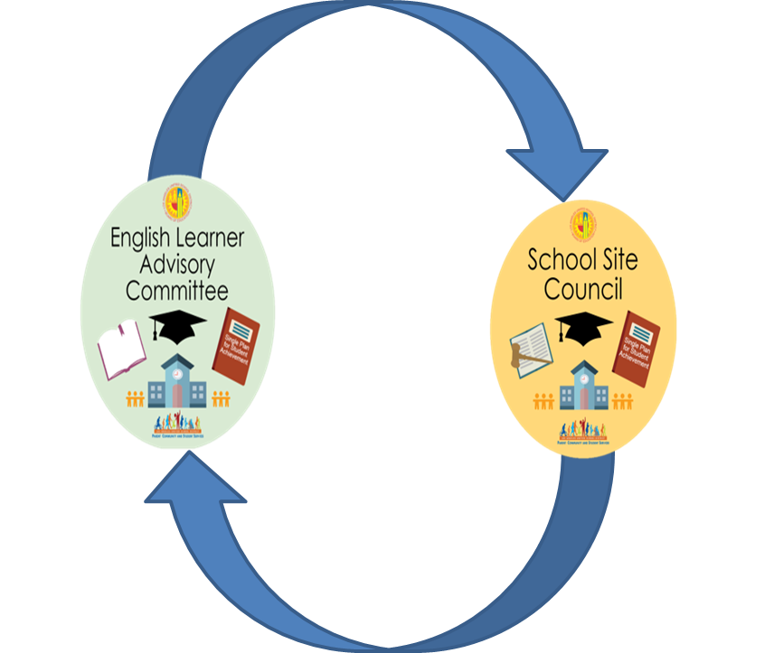

Connection Between ELAC and SSC
Conexión entre
ELAC y SSC
School Site Council is responsible for developing the SPSA with advisement from the ELAC on an annual basis.
El Consejo del Sitio Escolar es responsable de desarrollar la SPSA con el asesoramiento anual de la ELAC.
Notes:
The SPSA and accompanying budgets need to be developed with recommendations from appropriate committees; and the written recommendations must be brought to the School-Site Council (SSC) for review and approval.
The school’s English Learner Advisory Committee (ELAC) is one of those that must have the opportunity to provide recommendations.

Slide 10
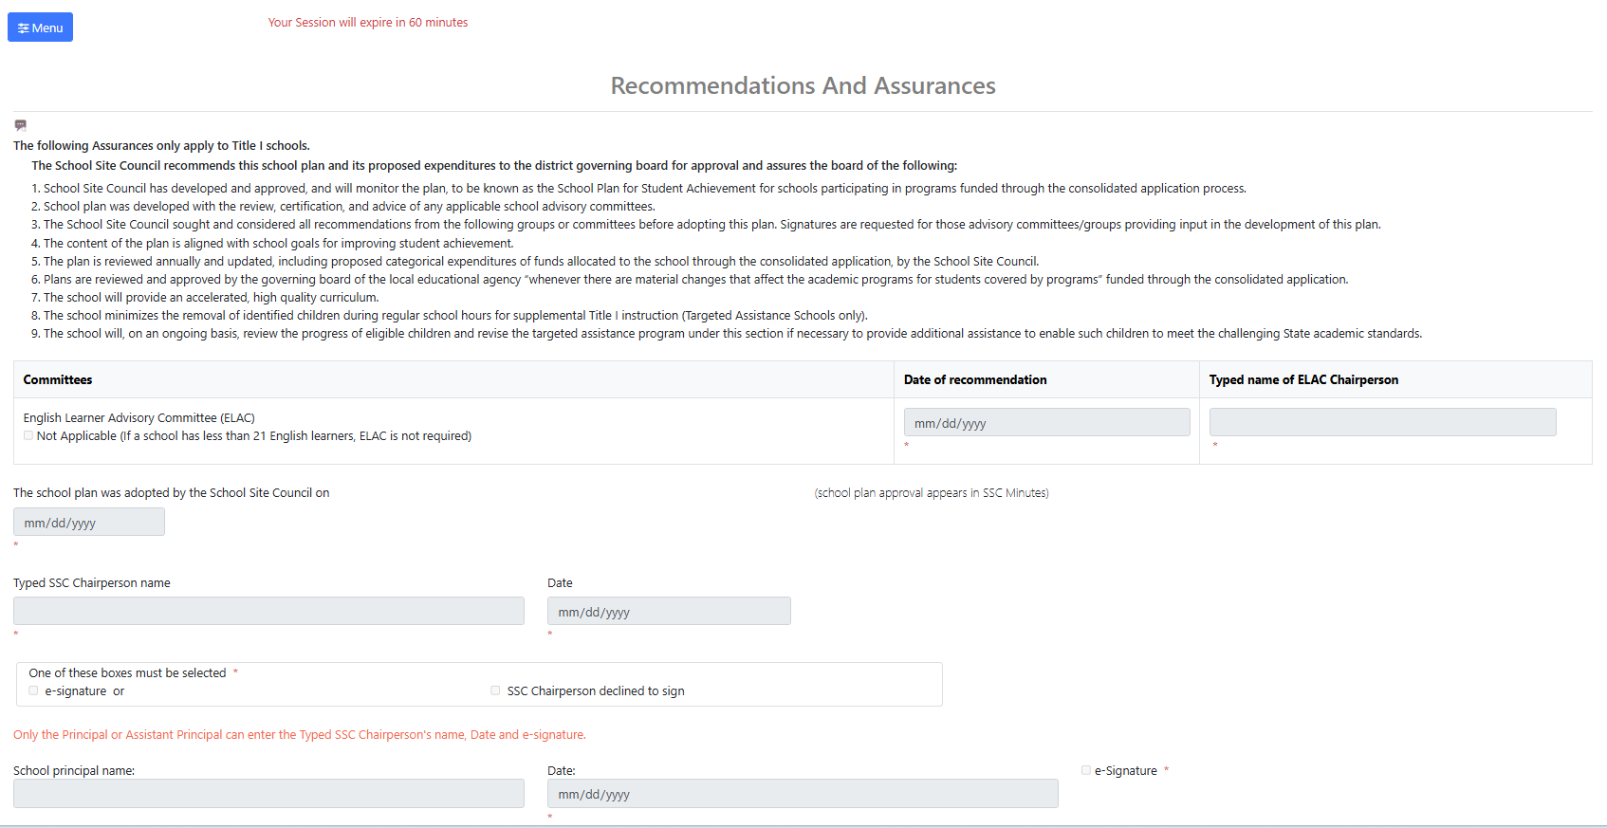
Let’s look at Section 3 of the SPSA, starting on Page XX. Turn and talk: Share one interesting part of this page with a partner. What do you notice?
Veamos la Sección 3 del SPSA, comenzando en la página XX. Comenta con tu compañero: Comparte una parte interesante. ¿Que notas?

Slide 11
ELAC Advisement
Consideración de ELAC
Membership reviews and discusses EL data and programs.
1
Membership will take a vote
2
After the meeting, ELAC provides the written advice to the SSC
3
La membresía revisa y discute los datos y programas de EL.
1
La membresía tomará una votación.
2
Después de la reunión, ELAC proporciona el asesoramiento por escrito al SSC.
3
Notes:
ELAC recommendations involve a 3-step process:
First ELAC members review and discuss English Learner data and programs with the goal of providing SSC with data driven input on how to meet the needs of EL students and help them to become proficient in English as well as academically successful in all areas
Step 2, the ELAC membership votes on formal recommendations to send to SSC for review
Step 3, after the meeting, ELAC provides written recommendations to SSC. The ELAC and SSC policy bulletin includes templates for providing formal recommendations to SSC.

Slide 12
SSC Approval Aprobación de SSC
SSC reviews and discusses advisement from ELAC.
1
Membership will take a vote to consider and accept advisement from ELAC.
2
After the meeting, SSC provides a written response to the ELAC.
3
SSC revisa y discute el asesoramiento de ELAC.
1
La membresía tomará una votación para considerar y aceptar el asesoramiento de ELAC.
2
Después de la reunión, el SSC proporciona una respuesta por escrito al ELAC.
3
Notes:
Likewise, SSC follows a 3-step process for reviewing ELAC recommendations:
First, SSC reviews and discusses the recommendations from ELAC, including any relevant data
Step 2, SSC membership votes on the recommendations from ELAC
Step 3, after the mtng., SSC provides a written response to ELAC regarding their recommendations. In other words, SSC lets ELAC know if the recommendations have been accepted, declined, or revised.

Slide 13
SSC Response
Respuesta de SSC
SSC must respond​ to ELAC's written advice within 30 days, or at the next official ​SSC meeting.​ ELAC Advisement must be an Action Item on the SSC agenda
SSC debe responder al consejo escrito de ELAC dentro de los 30 días, o en la próxima reunión oficial de SSC. El asesoramiento de ELAC debe ser un punto de acción en la agenda de SSC
Notes:
SSC must respond to ELAC’s written recommendations within 30 days or at the next official SSC mtng.
SSC response to ELAC must be an Action Item on the SSC agenda meaning that SSC must vote on whether to accept or decline ELAC recommendations.

Slide 14
The SPSA must include… El SPSA debe incluir…
Comprehensive Needs Assessment
Objectives set to improve pupil outcomes
Evidence-based strategies, actions or services
Proposed Expenditures
Monitoring and Evaluation
Evaluación Integral de las Necesidades
Objetivos establecidos para mejorar los resultados de los estudiantes
Estrategias, acciones o servicios fundamentados por evidencias
Gastos Propuestos
Supervisión y Evaluación
Notes:
•There are certain required components of the SPSA that SSC must ensure are completed including:
•A Comprehensive Needs Assessment
•Measurable objectives or goals to improve student outcomes
•Evidence-based strategies and actions that, based on research and data, have proven to be effective in improving student achievement.
•Proposed expenditures to support implementation of the strategies and actions
•And monitoring and Evaluation of the plan.

Slide 15
SPSA: Continuous Improvement Cycle
SPSA: Ciclo de mejora continua constante
Conduct comprehensive needs assessment, including data analysis/SPSA Evaluation
Develop measurable objectives and identify evidence-based strategies in the SPSA Pillar pages
Develop budget based upon prioritized expenditures that support and align to the evidence-based strategies described in the SPSA Pillar pages
Monitor the implementation of the SPSA and adjust as necessary
Realizar la evaluación integral de las necesidades incluyendo un análisis de datos y evaluación del SPSA
Desarrollar objetivos medibles e identificar las estrategias basadas en evidencia en las páginas del SPSA
Desarrollar un presupuesto basado en los gastos clasificados por prioridad que apoyen y estén alineados con las estrategias basadas en evidencia en las páginas pilares del SPSA
Monitorear la implementación del SPSA y modificar cuando sea necesario
SPSA: Continuous Improvement Cycle
SPSA: Ciclo de mejora continua constante
Notes:
-Now we will take a more in depth look at the cycle of continuous improvement
-We’ll start with the first phase which is conducting the comprehensive needs assessment which includes data analysis and the annual SPSA Evaluation.

Slide 16

Comprehensive Needs Assessment
Evaluación Integral de las Necesidades
Conduct the annual SPSA Evaluation to determine if measurable objectives from the prior school year were met
Analyze current state and local data and identify the underlying issues impacting student achievement
Identify areas of need based on the data and root causes in order to develop SPSA measurable objectives, strategies, and actions
Llevar a cabo la evaluación anual de SPSA para determinar si se cumplieron los objetivos medibles del año escolar anterior
Analizar los datos estatales y locales actuales e identificar los problemas subyacentes que afectan el rendimiento estudiantil
Identificar áreas de necesidad basadas en los datos y las causas fundamentales para desarrollar objetivos, estrategias y acciones medibles de SPSA
This Photo by Unknown author is licensed under CC BY-SA-NC.
Notes:
The comprehensive needs assessment starts with conducting the anual SPSA Evaluation to determine if measurable objectives from the prior School year were met.
Before schools begin to analyze current data, we want them to reflect on the SPSA developed in the prior School year to determine which goal or measurable objectives were met and what contributed to the School meeting the goals
We also want schools to reflect on the goals that were not met in the previous year and to think about what they Will do differently.
The next step in the comprehensive needs assessment process is to analyze more current data to identify identify underlying issues impacting student achievement
Once the underlying issues are identified, the School can determine areas of need in order to develop measurable objectives targeting improving those areas of need and the strategies and actions the School Will implement to meet the measurable objectives.

Slide 17
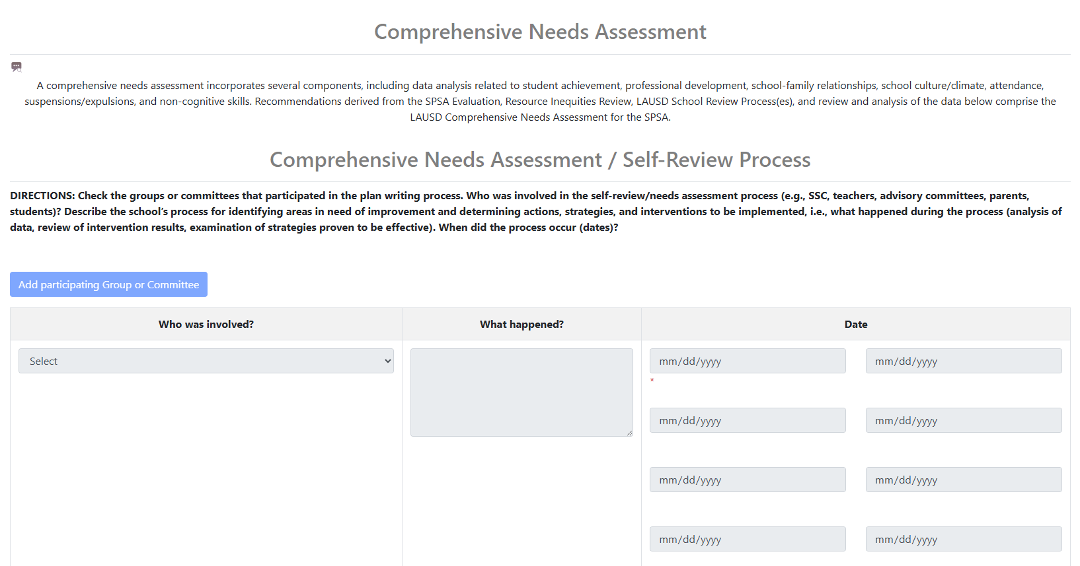
Let’s look at Section 9 of the SPSA, starting on Page XX. Turn and talk: Share one interesting part of this page with a partner. What do you notice?
Veamos la Sección 9 del SPSA, comenzando en la página XX. Comenta con tu compañero: Comparte una parte interesante. ¿Que notas?

Slide 18
SPSA: Continuous Improvement Cycle
SPSA: Ciclo de mejora continua constante
Conduct comprehensive needs assessment, including data analysis/SPSA Evaluation
Develop measurable objectives and identify evidence-based strategies in the SPSA Pillar pages
Develop budget based upon prioritized expenditures that support and align to the evidence-based strategies described in the SPSA Pillar pages
Monitor the implementation of the SPSA and adjust as necessary
Realizar la evaluación integral de las necesidades incluyendo un análisis de datos y evaluación del SPSA
Desarrollar objetivos medibles e identificar las estrategias basadas en evidencia en las páginas del SPSA
Desarrollar un presupuesto basado en los gastos clasificados por prioridad que apoyen y estén alineados con las estrategias basadas en evidencia en las páginas pilares del SPSA
Monitorear la implementación del SPSA y modificar cuando sea necesario
SPSA: Continuous Improvement Cycle
SPSA: Ciclo de mejora continua constante
Notes:
-The next part of the cycle of continuous improvement involves developing measurable objectives or goals to target areas in need of improvement and also developing strategies and actions to meet the target goals.

Slide 19

Measurable Objectives to improve pupil outcomes Objetivos mensurables establecidos para mejorar los resultados de los estudiantes
The measurable objectives must address the needs of pupil groups as identified though the comprehensive needs assessment.
The measurable objectives should be based upon the analysis of verifiable state data, including state indicators from the CA Dashboard and may include any data voluntarily developed to measure pupil achievement.
Schools develop two types of Objectives:
-Implementation
-Improvement
Los objetivos mensurables deben atender las necesidades de los grupos de estudiantes según se identifican a través de la evaluación integral de las necesidades.
Las escuelas desarrollan dos tipos de objetivos:
-Implementación
-Mejoramiento
Los objetivos mensurables deben basarse en el análisis de los datos estatales verificables, incluidos los indicadores estatales del Tablero de datos escolares de California y pueden incluir cualquier dato desarrollado voluntariamente para medir el rendimiento de los estudiantes.
Notes:
-The measurable objectives should address needs identified during data analysis as part of the comprehensive needs assessment. The two go hand in hand in that the data should determine the kind of measurable objective or goals that the school is writing.
-The objectives should be based on multiple data sources
-Schools write two different types of objectives:
1. Implementation Objectives aligned to a strategy in their plan
2. Improvement Objectives aligned to measurable student achievement or parent engagement data
-Provide personal example of Implementation and Improvement Objectives (e.g., Improvement Objective = I will learn 100 words in Spanish by June; Implement Objective= I will practice Spanish 3 x a week for 5 months using a language software program)

Slide 20
Evidence-based Strategies, Actions or Services Estrategias, acciones o servicios fundamentados por evidencias
The strategies and activities being provided to meet the measurable objective can be centered around:
Las estrategias y actividades que se están realizando para cumplir con el objetivo mensurable pueden centrarse en:
Capacitación profesional
Enseñanza eficaz del salón de clases
Ampliar la capacidad de los padres
Building Parent Capacity
Professional Development
Effective Classroom Instruction
Interventions
Building Parent Capacity
Notes:
Once the measurable objectives are determined, SSC should develop evidence-based strategies and actions to meet the measurable objectives. By evidence based, we mean strategies that been proven through research and data to improve student outcomes.
The strategies can be centered around:
PD
Effective Classroom Instruction
Intervention during and outside of the regular school day
Building Parent Capacity

Slide 21
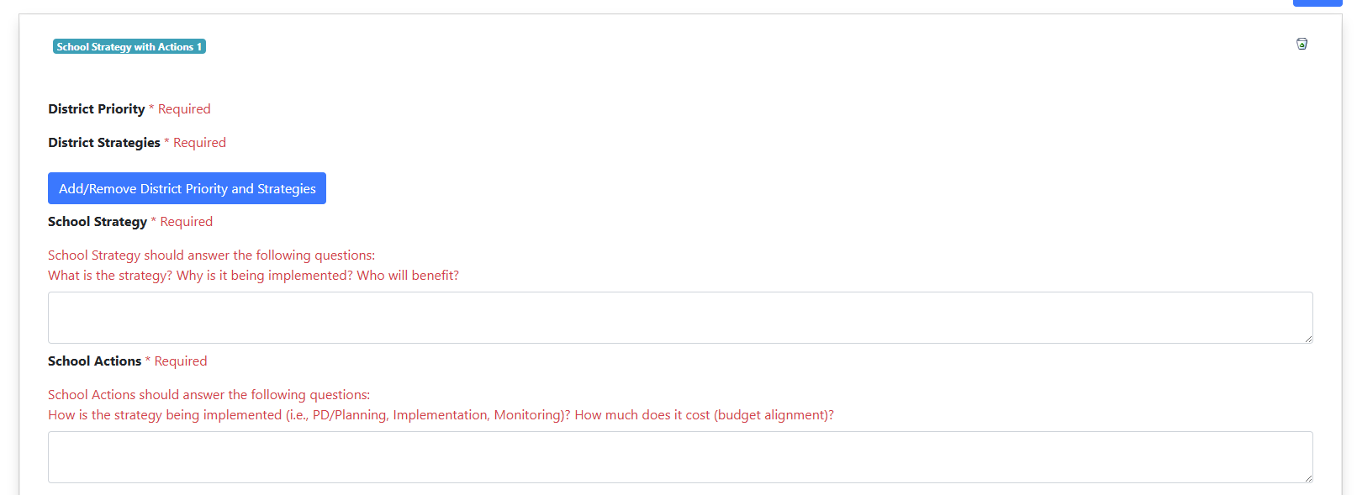
Let’s look at Section 12 of the SPSA, starting on Page XX. Turn and talk: Share one interesting part of this page with a partner. What do you notice?
Veamos la Sección 12 del SPSA, comenzando en la página XX. Comenta con tu compañero: Comparte una parte interesante. ¿Que notas?

Slide 22
SPSA: Continuous Improvement Cycle
SPSA: Ciclo de mejora continua constante
Conduct comprehensive needs assessment, including data analysis/SPSA Evaluation
Develop measurable objectives and identify evidence-based strategies in the SPSA Pillar pages
Develop budget based upon prioritized expenditures that support and align to the evidence-based strategies described in the SPSA Pillar pages
Monitor the implementation of the SPSA and adjust as necessary
Realizar la evaluación integral de las necesidades incluyendo un análisis de datos y evaluación del SPSA
Desarrollar objetivos medibles e identificar las estrategias basadas en evidencia en las páginas del SPSA
Desarrollar un presupuesto basado en los gastos clasificados por prioridad que apoyen y estén alineados con las estrategias basadas en evidencia en las páginas pilares del SPSA
Monitorear la implementación del SPSA y modificar cuando sea necesario
SPSA: Continuous Improvement Cycle
SPSA: Ciclo de mejora continua constante
Notes:
-You have analyzed data, identified critical student needs, developed measurable objectives to target improvement, and developed school strategies and actions to meet the objectives.
-The next step in the cycle of continuous improvement is to develop your school Title I budget to support implementation of the strategies and actions within the plan.

Slide 23
Funding Source vs. Program Fuente de fondos vs. programa
Does your school see Title I as a “funding source” or as a program? [Hint: Title I is a program]
¿Su escuela ve Título I como una "fuente de fondos" o como un programa? [Pista: El Título I es un programa]
Vs.
Notes:
Ask the question not as a way for them to share out but to remind that the plan is living document intended to strengthen the instructional program through the cycle of continuous improvement.
-As SSC members, I want you to consider this question-does your school see Title I as a funding source or as a program.
-The correct answer is that Title I is a program. In other words, the data analysis, development of measurable objectives and evidence-based strategies and actions as part of the SPSA Cycle of Continuous Improvement should drive the decisions on how the school budgets and spends their Title I funds and not the other way around.

Slide 24
Expenditures Gastos
Every proposed expenditure of Title I funds must be “allowable” as defined by law and District policy. It therefore must meet the following criteria:
Cada uno de los gastos propuestos con fondos de Título I deben de ser permisibles según lo define la ley y la política del Distrito. Por lo tanto, debe cumplir con los siguientes criterios:
Necessary - The proposed expenditure appropriately addresses one or more program needs identified and targeted in the school’s SPSA.
Reasonable - The purchase price does not exceed that which would be incurred by a prudent person under the circumstances at the time.
Necesario- El gasto propuesto debe de atender apropiadamente una o más de las necesidades del programa identificadas y especificadas en el SPSA.
Razonable- el precio de compra no excede a lo que se le cobraría una persona prudente bajo las mismas circunstancias dentro de ese momento.
Notes:
-When budgeting funds, SSC should ensure that the funds are supporting strategies that address the needs identified in the comprehensive needs assessment.
-SSC should also ensure that the federal funds are used in a way that is equitable and we want to make a clear distinction between equal and equitable. Equitable doesn’t necessarily mean that everyone at the school site receives the same level of services, it means that the supplemental funds are being utilized to support the needs of those students most at risk of not meeting achievement standards so they can be at the same level as other students who do not need those additional supports or the same level of supports.
-When budgeting Title I funds, SSC must adhere to three important principals:
1. The use of the funds must be necessary. By necessary we mean that it addresses one or more needs identified in the SPSA as part of that comprehensive Needs Assessment Process and the use of the funds must be explicitly described in the SPSA
2. The use of the funds must be reasonable meaning that the expense is reasonable under the circumstances at the time. For ex., when thinking about providing access to technology for every student, it might not be reasonable to purchase macbook laptops that cost over a thousand dollars per device when you can provide students with chromebooks that only cost $300 per device and still provide students with the type of technology access that they need. In other words, you want to ensure that as a School Site Council, you are making thoughtful decisions about how to provide the maximum benefit to students with the Title I funds available.

Slide 25
Expenditures Gastos
Every proposed expenditure of Title I funds must be “allowable” as defined by law and District policy. It therefore must meet the following criteria:
Cada uno de los gastos propuestos con fondos de Título I deben de ser permisibles según lo define la ley y la política del Distrito. Por lo tanto, debe cumplir con los siguientes criterios:
Allocable-Consistent with applicable rules, limits, and other requirements*
The expenditure must be specifically described and budgeted in the School Plan for Student Achievement (SPSA)
Asignable y consistente con las normas, límites y otro requisito que apliquen*
El gasto debe ser descrito específicamente en el Plan Escolar para el Rendimiento Académico Estudiantil (SPSA).
* Includes the requirement that all Title I expenditures must be “allocable”
*Incluye el requisito que todos los gastos de Título I deben ser fondos que se pueden asignar
Notes:
-The third guiding principle is that the funds must be allowable as defined by law and District policy. Our Federal and State Education Programs has a Program and Budget Handbook available on our FSEP website that provides an overview of allowable expenditures using Title I funds and the expenditure must be specifically described and budgeted in the SPSA.

Slide 26
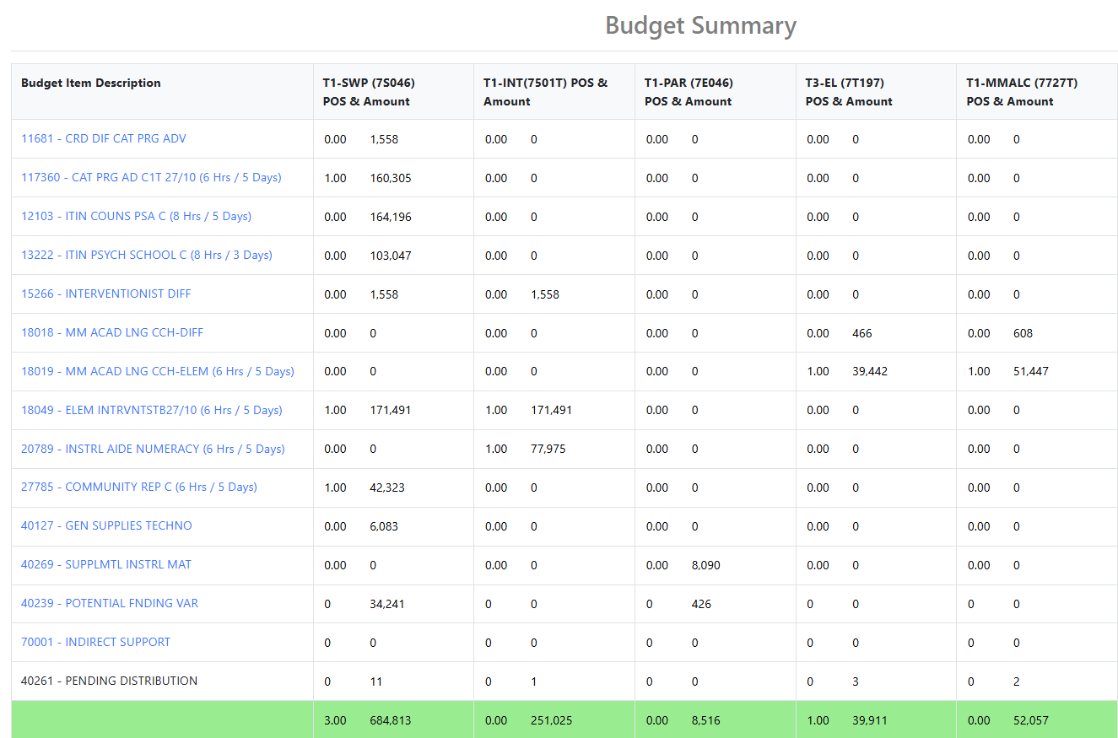
Look throughout the SPSA. On what pages do you find information about the funds for the investments made in the plan?
¿En qué páginas encuentras información sobre los fondos para las inversiones realizadas en el plan?

Slide 27
SPSA: Continuous Improvement Cycle
SPSA: Ciclo de mejora continua constante
Conduct comprehensive needs assessment, including data analysis/SPSA Evaluation
Develop measurable objectives and identify evidence-based strategies in the SPSA Pillar pages
Develop budget based upon prioritized expenditures that support and align to the evidence-based strategies described in the SPSA Pillar pages
Monitor the implementation of the SPSA and adjust as necessary
Realizar la evaluación integral de las necesidades incluyendo un análisis de datos y evaluación del SPSA
Desarrollar objetivos medibles e identificar las estrategias basadas en evidencia en las páginas del SPSA
Desarrollar un presupuesto basado en los gastos clasificados por prioridad que apoyen y estén alineados con las estrategias basadas en evidencia en las páginas pilares del SPSA
Monitorear la implementación del SPSA y modificar cuando sea necesario
SPSA: Ciclo de mejora continua constante
SPSA: Continuous Improvement Cycle
Notes:
-The last phase of the cycle of continuous improvement involves ongoing monitoring of plan implementation. The SPSA should be part of every SSC meeting throughout the year to ensure that the plan is being implemented effectively and make changes to the plan if necessary when a strategy or expenditure is not supporting student achievement or parent engagement.
-However, it's important to note that this is a continuous cycle that is ongoing throughout the school year-you should be constantly analyzing data, adding or modifying strategies as necessary, and constantly reviewing your budgets to ensure that they are truly supporting improved student and parent engagement outcomes.

Slide 28
Ongoing Monitoring and Evaluation Monitoreo continuo y evaluación
Do the measurable objectives and strategies in the SPSA address students’ needs?
Are plan objectives being achieved?
Are strategies and actions being fully implemented (if not, what are the barriers?)
Does the evidence show that the strategies are an effective way to help students?
¿Será que los objetivos mensurables y las estrategias incluidos en el SPSA atienden las necesidades estudiantiles?
¿Se están alcanzando los objetivos del plan?
¿Se están implementado de lleno las estrategias y las acciones (si no es así, cuáles fueron los obstáculos)?
¿Muestran las evidencias que las estrategias son una manera eficaz para ayudar a los estudiantes?
Notes:
As SSC monitors and evaluates the plan, you should be asking yourselves these questions
Do the measurable objectives and strategies address students needs?
Are plan objectives being achieved?
Are strategies and actions being fully implemented? If not, what is preventing us from implementing them effectively?
Does evidence show that the strategies are effective in improving student achievement?

Slide 29
Ongoing Monitoring and Evaluation Monitoreo continuo y evaluación
Did our strategies lead to improvement?
Which strategies are effective for improving student achievement? Are any ineffective?
Based on results, what will you adopt, adapt, or abandon in the plan?
¿Nuestra estrategias nos llevaron a una mejora?
¿Qué estrategias son más eficaces en mejorar el rendimiento estudiantil? ¿Alguna fue ineficaz?
Basado en esto, ¿qué adoptará, ¿qué se adaptará o qué se abandonará del plan?
Notes:
-Additional questions to consider are:
Did our strategies lead to improvement?
Which strategies are effective for improving student achievement? Are there any that are ineffective?
What evidence do we have that the strategies were effective or ineffective?
Based on data, what will keep , change, or eliminate in the plan?

Slide 30
Resources Recursos
Notes:
-In the last section of this presentation we are going to walk you through how to access your school’s information including the SPSA and budgets

Slide 31
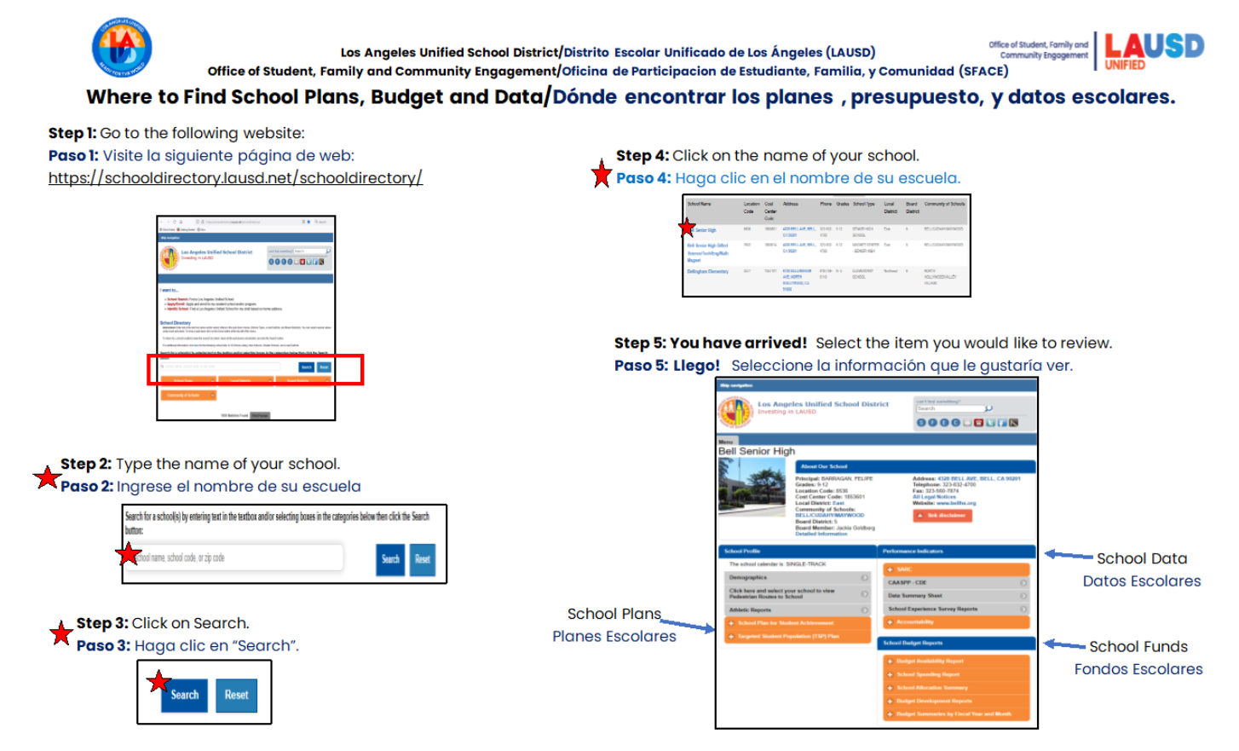
Accessing the Budget Acceso al presupuesto
Notes:
•To look up a copy of your school’s budget you can follow these 5 easy steps:
1. Go to the LAUSD School Directory
2. Type in the name of your school
3. Click on Search
4. Click on the School Name
5. Select the School Budget Data you want to review

Slide 32
How to Find Your School’s SPSA Online Cómo encontrar el SPSA de su escuela en línea
Go to the LAUSD Home Page
Click on “Find-a-School”
Click “School Directory”(new LAUSD Homepage only)
Type School Name
Click “Search”
Click School Name that Appears
Click “School Plan for Student Achievement”
Click “Go”
School Plan for Student Achievement will appear as a PDF file
Visitar la (nueva) página principal de LAUSD
Hacer clic en "Find a School"
Haga clic en "School Directory" (Directorio de escuelas)(solo en la nueva página de inicio de LAUSD)
Ingresar el nombre de la escuela
Hacer clic en “Search”
Hacer clic en el nombre de la escuela una vez aparezca
Hacer clic en “School Plan for Student Achievement”
Hacer clic en “Go”
Aparecerá el Plan Escolar para el Rendimiento Académico Estudiantil como un documento en formato de PDF
Notes:
-Likewise, to access your school SPSA, follow the same exact steps, except this time you will select the School SPSA on the school information page.

Slide 33

NOTE: Your school’s 2025-2026 SPSA can be downloaded/saved or
printed as a PDF file.
NOTA: Se puede bajar/guardar o imprimir en formato PDF el SPSA
2025-2026 de su escuela.
Notes:
-You can access a PDF of prior year SPSA plans or current 25-26 SPSA once it is approved.

Slide 34
Regional Title I Coordinators
Coordinadores Regionales de Título I
Region | Title I Coordinators | Email
East | Reyna Corral Ileana Albert Diana Sánchez | reyna.corral@lausd.net ina3368@lausd.net dab9296@lausd.net
North | Kristi Schlachet Daniella Simon Cecilia Riquelme | kms4424@lausd.net dxs3318@lausd.net criquelm@lausd.net
South | Deborah Davidock Dr. Maria Morales Thomas Oscar Salas | dad7293@lausd.net m.moralesthomas@lausd.net osalas@lausd.net
West | Celina Reynoso Susan Jamerson | celina.reynoso@lausd.net susan.jamerson@lausd.net
Virtual Academies & Option Schools | Vacant | Vacant
Notes:
•It was mentioned earlier that you can rely on support from various experts including the Regional Title I Coordinators.
•Here is their contact information by Region in case you have questions or need additional support related to Title I.

Slide 35
Regional FACE Administrators Administradores Regionales de FACE
Region | FACE Administrative Coordinators | Email
East | Megan Guerrero Amaris Medina | mguerr3@lausd.net amaris.medina@lausd.net
North | Laura Fuentes Dr. Jeremiah Gonzalez | lxf1109@lausd.net jjg2443@lausd.net
South | Ursula Martin | umartin@lausd.net
West | Crystal Dukes | crystal.dukes@lausd.net
Virtual Academies & Option Schools | Connie Brandstetter | clb0104@lausd.net
Notes:
•You also have wonderful support from your Regional Family and Community Engagement Administrators and here is their contact information by Region.

Slide 36
Check for Understanding Verificar el entendimiento
Which committee is required to approve the SPSA?
ELAC
B. Safety Committee
C. SSC
D. School Staff
¿Qué comité está obligado a aprobar el SPSA?
A. ELAC
B. Comité de Seguridad
C. SSC
D. Personal de la escuela
C

Slide 37
Check for Understanding Verificar el entendimiento
Which is not one of the District Strategic Plan blocks?
Strategies
B. Objectives
C. Priorities
D. Pillars
¿Cuál no es uno de los bloques del Plan Estratégico Distrital?
A. Estrategias
B. Objectivos
C. Prioridades
D. Pilars
B

Slide 38
Check for Understanding Verificar el entendimiento
How many Pillars are there in the District Strategic Plan?
4
B. 3
C. 6
D. 5
¿Cuántos pilares hay en el Plan Estratégico Distrital?
A. 4
B. 3
C. 6
D. 5
D

Slide 39
Check for Understanding Verificar el entendimiento
ELAC Develops the SPSA with recommendations from SSC?
True
B. False
ELAC desarrolla el SPSA con recomendaciones del SSC
A. True
B. False
B

Slide 40
Check for Understanding Verificar el entendimiento
SSC must respond to ELAC recommendations within…
15 days
B. 1 week
C. 30 days
D. 20 days
El SSC debe responder a las recomendaciones de ELAC dentro de...
A. 15 dias
B. 1 semana
C. 30 dias
D. 20 dias
C

Slide 41
Check for Understanding Verificar el entendimiento
SSC has the sole responsibility to write the SPSA?
True
B. False
SSC tiene la responsabilidad exclusiva de redactar el SPSA
A. True
B. False
B

Slide 42
Check for Understanding Verificar el entendimiento
A Needs Assessment is based on what teachers want?
True
B. False
Una evaluación de necesidades se basa en lo que quieren los profesores
A. True
B. False
B

Slide 43
Check for Understanding Verificar el entendimiento
The SPSA includes the following types of objectives
Implementation
B. Improvement
C. Implementation and Improvement
D. None of the Above
El SPSA incluye los siguientes tipos de objetivos.
A. Implementación
B. Mejora
C. Implementación y mejora
D. Ninguno de los anteriores
C

Slide 44
Check for Understanding Verificar el entendimiento
The use of Title I funds must be…
Necessary
B. Reasonable
C. Allocable/Allowable
D. All of the Above
El uso de los fondos del Título I debe ser...
Necessaria
B. Razonable
C. Asignable/Permitida
D. Todo la anterior
D

Slide 45
Check for Understanding Verificar el entendimiento
The SPSA Cycle of Improvement is Continuous
True
B. False
El ciclo de mejora de SPSA es continuo
A. True
B. False
A

