Slide 1

School Site Council (SSC)
Orientation
Date:________
School Name: _______________
Bulletin 6745.7 Guidelines for Required School Site Council and English Learner Advisory Committee
Orientación del Consejo del Plantel Escolar (SSC)
Fecha: ____________
Nombre de la escuela: _____________
Boletin 6745.7 Normas para el Requerido Consejo del Plantel Escolar y el Comité Asesor para Aprendices de Inglés
Notes:
Click

Slide 2


Welcome Bienvenidos
Principal
Director(a)
Student Body President
Presidente Estudiantil
Community Representative
Representante de Comunidad
School Title I Designee
Designada(o) del Programa Título I
English Learner Program Designee
Designada(o) del Programa de Aprendices de Inglés
name
name
name
name
name
School Leadership Team / Equipo de Liderazgo Escolar
Notes:
Please ensure that each school leadership member offers a warm greeting.
Click

Slide 3

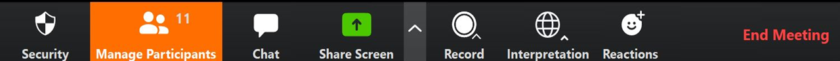
Interpretation Services: Laptop or Computer
Servicios de interpretación: computadora portátil o
de escritorio
Click on the globe icon at the bottom of the screen.
Select the language of preference for you.
You will engage and listen to the presentation in the language you select.
Haga clic en el símbolo del mundo en la parte de abajo de su pantalla.
Seleccione el idioma que le gustaría escuchar.
Participará y escuchará la presentación en el idioma que seleccione.
Notes:
Say: We have interpretation services if you are joining us on a computer.
I am sorry Chromebook don’t offer the translation feature. If you are on a Chromebook, please stay on your computer so you can see us on the screen and use the Chat feature. For audio, join us via phone.
I will provide more guidance shortly.
For those that are on the computer, please click on the globe icon at the bottom of the screen.
Select the language of preference for you.
You will engage and listen to the presentation in the language you select.
Click

Slide 4


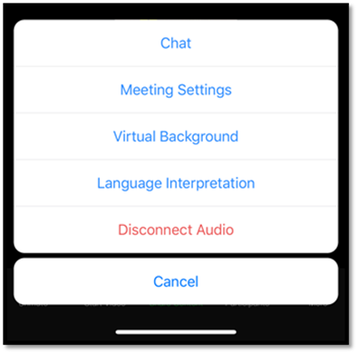
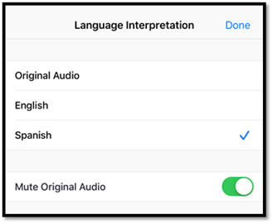
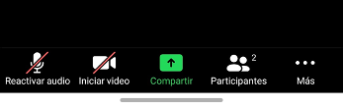
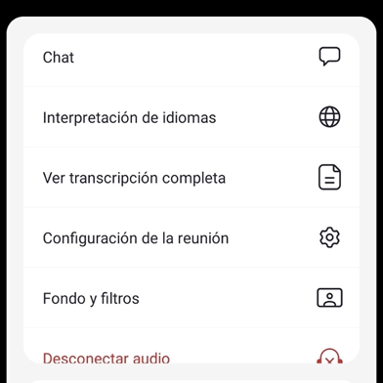
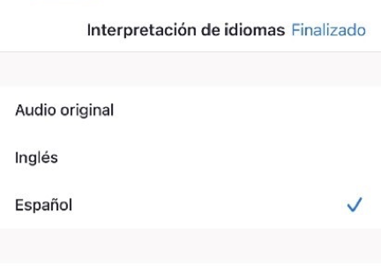
Interpretation Services: Mobile Device
Servicios de interpretación: Dispositivo móvil
Notes:
Say: For those who are joining us via phone, please click on the three dots.
Select Language Interpretation.
Select language of preference
Click on Done.
Click

Slide 5
Steps to Rename Yourself on Zoom
Cómo cambiar su nombre en su pantalla
Step 1: Hover over your picture located by the picture gallery with your cursor and search for the three dots found on the top right-hand corner of your picture.
Step 2: Click the three-dotted icon found over your picture.
Step 3: Click More.
Step 4: Choose Rename.
Step 5: Enter the full name used when you enrolled your students at the school site, then click Save to finish the change.
Paso 1: Ponga su cursor en su foto ubicada en la galería de fotos y busque los tres puntitos en la esquina de la parte derecha de su rectángulo con su foto.
Paso 2: Haga clic en los tres puntitos que están en su foto.
Paso 3: Haga clic en Más.
Paso 4: Escoja Re nombrar.
Paso 5: Ingrese su nombre completo de la manera que lo escribió al matricular a sus estudiantes en el plantel escolar, después haga clic en Guardar para aceptar el cambio.
Notes:
Say: In order to know who is in the room, please do the following 5 steps:
Step 1: Hover over your picture located by the picture gallery with your cursor and search for the three dots found on the top right-hand corner of your picture.
Step 2: Click the three-dotted icon found over your picture.
Step 3: Click More.
Step 4: Choose Rename to change your screen name displayed to other participants.
Step 5: Enter the full name used when you enrolled your students at the school site, then click Save to finish the change.
Click

Slide 6

Participación por medio de Zoom
Engaging on Zoom
If you need assistance accessing Zoom for this meeting, send an email to ___________ and a team member will assist you.
Zoom includes a “Chat” tab where you can type your questions for the presenters.
Si necesita ayuda con acceder a Zoom para esta reunión, envíe un correo electrónico a _______________ y un miembro de nuestro equipo le ayudará.
Zoom tiene una pestaña de Chat en la que usted puede hacer preguntas a los presentadores.
Notes:
To do: Add contact e-mail.
Say: If you need assistance, accessing zoom for this meeting send an email to ___________ and a team member will assist you. Zoom includes a “Chat” tab where you can type your questions for the presenters.
Click

Slide 7
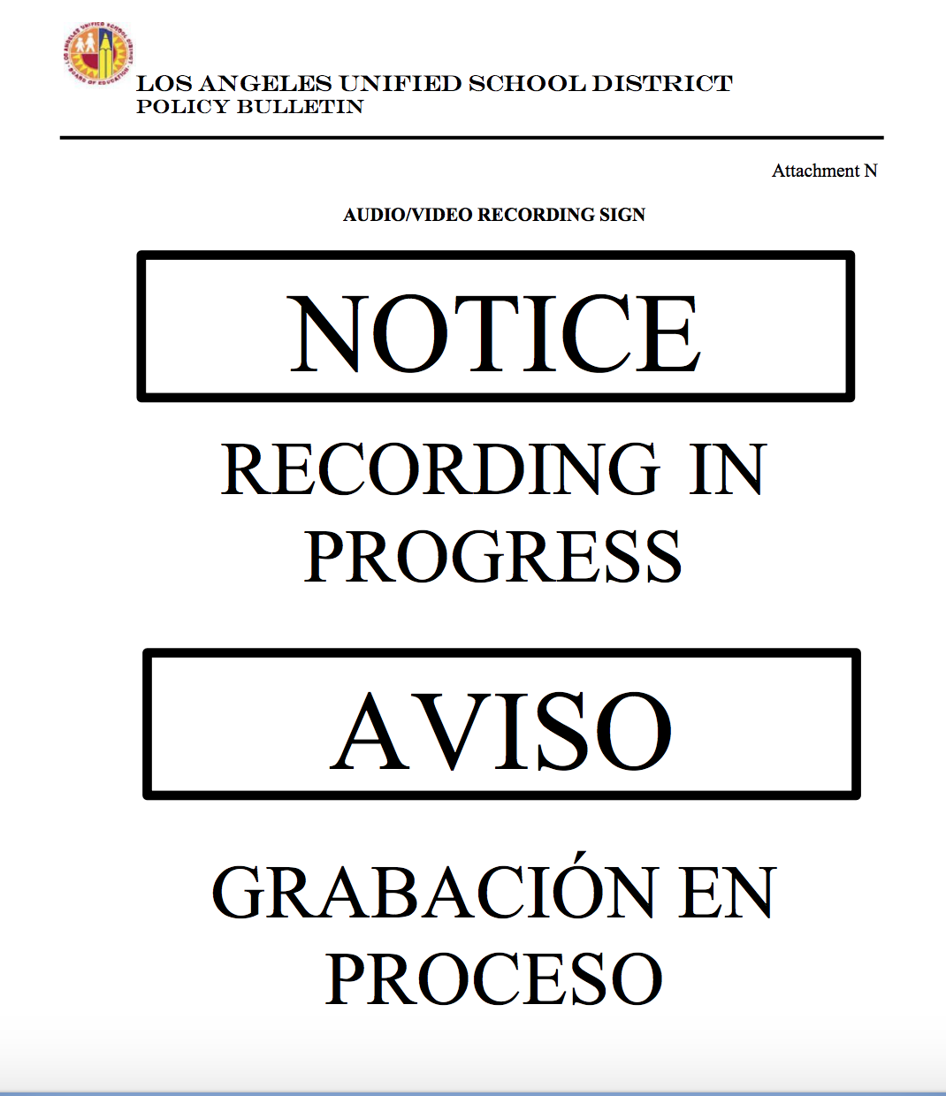
Sign In
Attendance:
Welcome! Please sign in on the Chat.
Please enter your first and last name and indicate if you are a parent/legal guardian of a student at the school site, community member, staff or visitor.
Asistencia:
¡Bienvenidos! Por favor, registrarse en el “Chat”.
Favor de escribir su nombre y apellido e indique si usted es un padre o madre/tutor legal, miembro de la comunidad, empliado/a o visitante.
Notes:
Ensure that the Chat is set with Host only so that parents-student name association is private for school personnel viewing only.
Say: Please note that this meeting is being recorded. In order to know who is in the room, please use the chat to sign in for this meeting.
Please enter your first and last name and indicate if you are a parent/legal guardian of a student at the school site, community member, staff or visitor.
Important note: throughout the meeting remind parents not to right student information in the chat as well as emails and phone numbers .
Click

Slide 8

Pledge of Allegiance
Juramento a la Bandera
I pledge allegiance to the flag of the United States of America and to the Republic for which it stands, one nation under God, indivisible, with liberty and justice for all.
Prometo lealtad a la bandera de los Estados Unidos de América y a la República que representa, una nación ante Dios, indivisible con libertad y justicia para todos.
Notes:
Say: Might I have a volunteer lead us in the Pledge of Allegiance?
Click

Slide 9
Abbreviations
Abreviaciones
English Learner Advisory Committee (ELAC)
School Site Council (SSC)
English Learner (EL)
Reclassified Fluent English Proficient (RFEP)
Initial Fluent English Proficient (IFEP)
English Only (EO)
Uniform Complaint Procedures (UCP)
District English Learner Advisory Committee (DELAC)
Transitional Kindergarten (TK)
Expanded Transitional Kindergarten (ETK)
Comité Asesor para Aprendices de Inglés (ELAC)
Consejo del Plantel Escolar (SSC)
Aprendiz de inglés (EL)
Reclasificación como Competente en el idioma inglés (RFEP)
Inicialmente Competente en el idioma inglés (IFEP)
Sólo inglés (EO)
Uniformes para Presentación de Quejas (UCP)
Comité Asesor del Distrito para Aprendices de Inglés (DELAC)
Kinder Transicional (TK)
Kinder Transicional Ampliado (ETK)
Notes:
Say: Our purpose together today is the following:
To review the functions and operation of the mandated English Learner Advisory Committee (ELAC) and School Site Council (SSC).
Understand the roles and responsibilities of the English Learner Advisory Committee (ELAC) members and School Site Council Committee (SSC)
Understand the orientation and election process for the ELAC and the SSC.
Click

Slide 10
Purpose
Próposito
Repasar las funciones y el funcionamiento del Consejo del Plantel Escolar (SSC)
Entender las funciones y responsabilidades SSC
Entender el proceso de la orientación y elecciones para ELAC y SSC
To review the functions and operation of the mandated School Site Council (SSC)
Understand the roles and responsibilities of the SSC
Understand the orientation and election process for the ELAC and the SSC
Notes:
Say: Our purpose together today is the following:
To review the functions and operation of the mandated School Site Council (SSC).
Understand the roles and responsibilities of the School Site Council Committee (SSC)
Understand the orientation and election process for the SSC.
Click

Slide 11
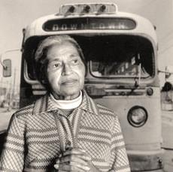
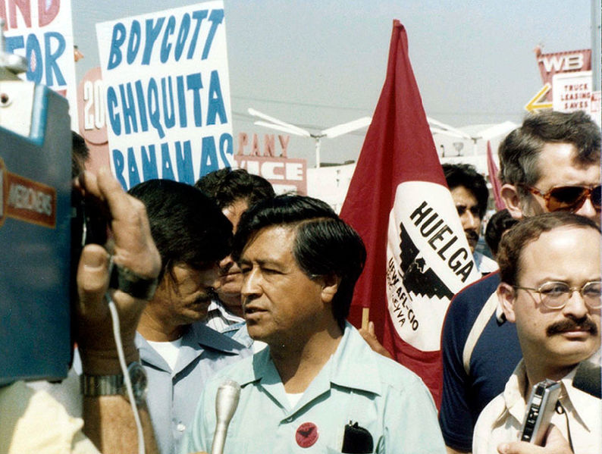

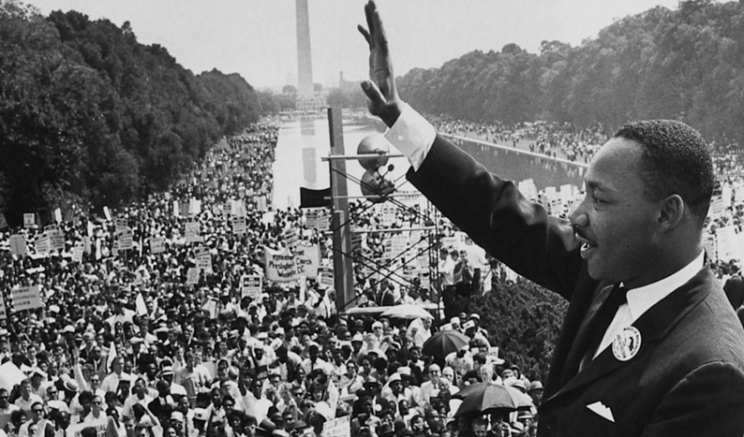
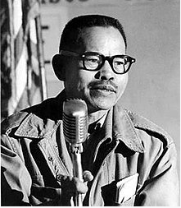
School Site Council (SSC) and the English Learner Advisory Committee (ELAC) Rooted in the Civil Rights Movement
Consejo del Plantel
Escolar (SSC) y el Comité Asesor para Aprendices de Ingles (ELAC) son parte del movimiento de derechos cívicos
Rosa Parks
Cesar Chavez
Martin Luther King Jr.
Modesto "Larry" Dulay Itliong
Notes:
Say: We are going to start our session with a little reflection.
The Civil Rights Movement has been in existence since the early 30’s where historical/great leaders set the pathway for equal voice and opportunity.
We saw it through Rosa Parks who fought against segregation, with Cesar Chavez who was an American labor leader and civil rights activists, with Martin Luther King when he gave his "I Have A Dream" speech, and Modesto "Larry" Dulay Itliong, who organized the West Coast agricultural workers starting in the 1930’s and rose to national prominences in 1965. (For more information, see notes below.)
In that same year (1965) President Lyndon B. Johnson established the Elementary and Secondary Education Act (ESEA), which is part of that establishment of opportunities for underserved students and families in our work with Title I. Most recently, President Obama reauthorized the ESEA in 2015 and renamed it the Every Student Succeeds Act that dictates educational requirements for our students and families.
This brief outline is shared by LAUSD to ground parent and family engagement throughout LAUSD.
Click
Just for your information:
Rosa Parks was an American civil rights activist whose refusal to give up her seat on a public bus precipitated the 1955–56 Montgomery bus boycott in Alabama, which became the spark that ignited the civil rights movement in the United States. She is known as the “mother of the civil rights movement.”
Cesar Chavez (born Cesario Estrada Chavez /ˈtʃɑːvɛz/; Spanish: [ˈt͡ʃaβes]; March 31, 1927 – April 23, 1993) was an American labor leader and civil rights activist. Along with Dolores Huerta, he co-founded the National Farm Workers Association (NFWA), which later merged with the Agricultural Workers Organizing Committee (AWOC) to become the United Farm Workers (UFW) labor union. Ideologically, his world-view combined leftist politics with Catholic social teachings.
Martin Luther King Jr. (born Michael King Jr.; January 15, 1929 – April 4, 1968) was an American Baptist minister and activist who became the most visible spokesman and leader in the civil rights movement from 1955 until his assassination in 1968. An African American church leader and the son of early civil rights activist and minister Martin Luther King Sr., King advanced civil rights for people of color in the United States through nonviolence and civil disobedience. Inspired by his Christian beliefs and the nonviolent activism of Mahatma Gandhi, he led targeted, nonviolent resistance against Jim Crow laws and other forms of discrimination.
Modesto "Larry" Dulay Itliong (October 25, 1913 – February 1977^{[a]}), also known as "Seven Fingers",^{[3]} was a Filipino-American labor organizer.
He organized West Coast agricultural workers starting in the 1930s, and rose to national prominence in 1965, when he, Philip Vera Cruz, Benjamin Gines and Pete Velasco, walked off the farms of area table-grape growers, demanding wages equal to the federal minimum wage, that became known as the Delano grape strike.^{[4][5][6]} He has been described as "one of the fathers of the West Coast labor movement."^{[7]} He is regarded as a key figure of the Asian American movement.

Slide 12
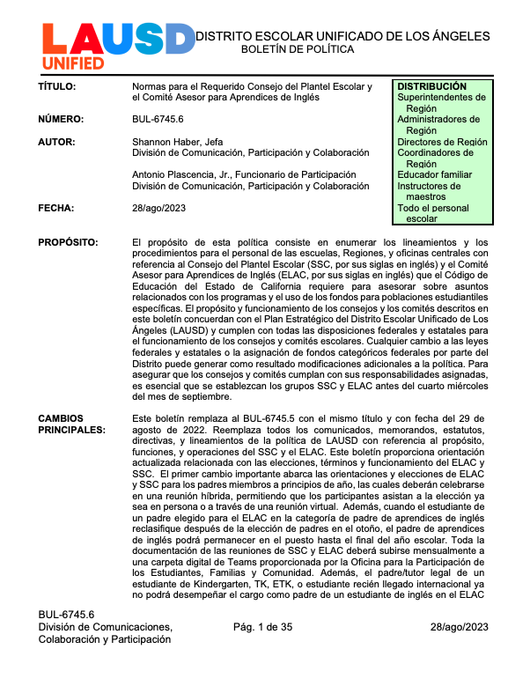
Bulletin 6745.6 Guidelines for the Required
School Site Council and English Learner Advisory Committee
Boletín 6745.6 Normas para el Requerido Consejo del Plantel
Escolar y el Comité Asesor para Aprendices de Inglés
Bulletin 6745.7 is available in
English and Spanish.
The bulletin and handouts can be found at:
https://bit.ly/Policies_Families_SFACE
El Boletín 6745.7 está disponible
en inglés y español:
El boletín y las hojas de información se encuentran en:
https://bit.ly/Policies_Families_SFACE
Notes:
Say: One of the structures that supports the Civil Rights Movement by creating an opportunity for all families, staff and students to work together in closing the achievement gap is the School Site Council and the ELAC, as noted in the previous slide. Our District provides guidance about the proper formation and functioning of the SSC and ELAC through Bulletin 6745.7, which contains the guidelines for SSC and ELAC as well as a variety of templates that you find in the back to support your work as members and officers.
You can download a copy of the Bulletin by going to https://bit.ly/Policies_Families_SFACE
Note: The Word version of all templates is available in Tools for Schools under the SSC tab: https://achieve.lausd.net/Page/11304
Click

Slide 13
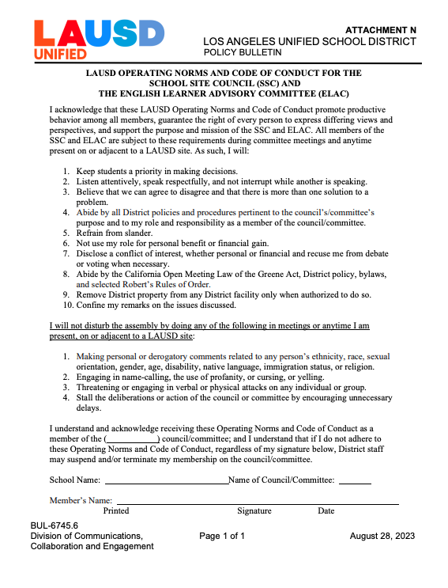
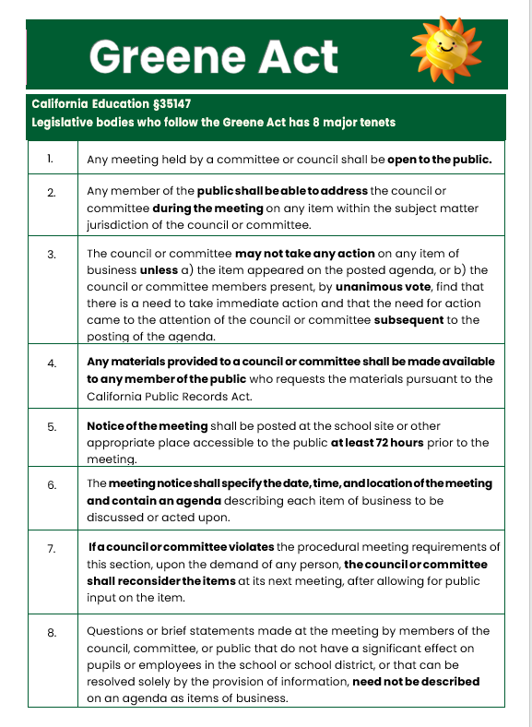
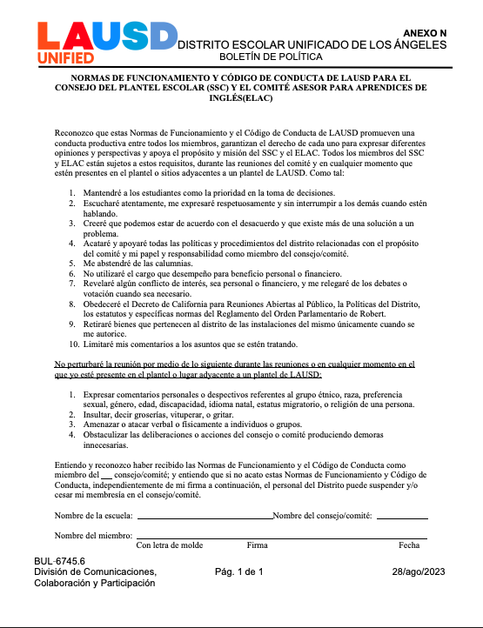
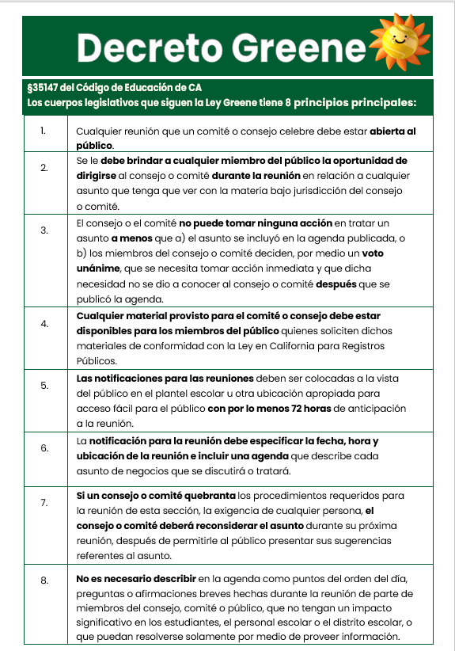
Handouts
Hojas Informativas
LAUSD Operating Norms and Code Of Conduct for the SSC and the ELAC
Normas de Funcionamiento de LAUSD para El SSC y ELAC
Greene Act
Decreto Greene
Notes:
Say: If you become a member, these are some key items you need to know.
These handouts can be found in Tools for Schools under the SSC tab: https://achieve.lausd.net/Page/11304
As members, you will be asked to sign the LAUSD Operating Norms and the Code of Conduct for ELAC and SSC.
It asks that we keep students as priority in making decisions.
Listen attentively, speak respectfully and not interrupt while another is speaking
Believe we can agree to disagree and that there is more than one solution to a problem.
The Greene Act is what guides the operation of our ELAC and SSC meetings.
Some of the key requirements are:
Any member of the public shall be able to address the committee or council during the meeting on any item within the subject matter jurisdiction of the council or committee.
Notice of the meeting shall be posted at the school site or other appropriate place accessible to the public at least 72 hours prior to the meeting.
The meeting notice shall specify the date, time, and location and contain an agenda describing each item of business to be discussed or acted upon.
If you notice, these documents are about keeping order and offering respect to all.
Click

Slide 14
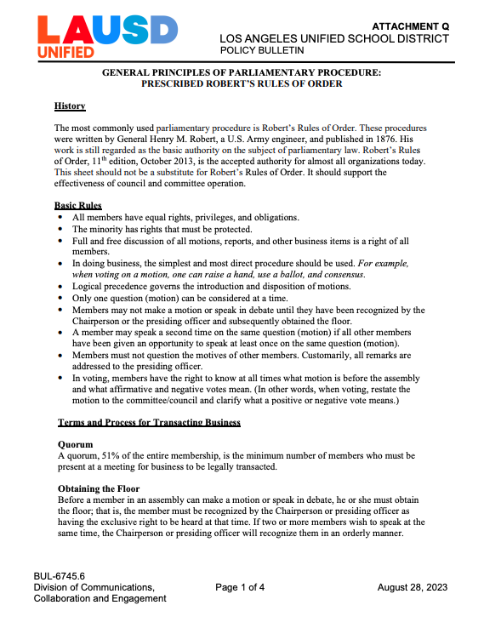
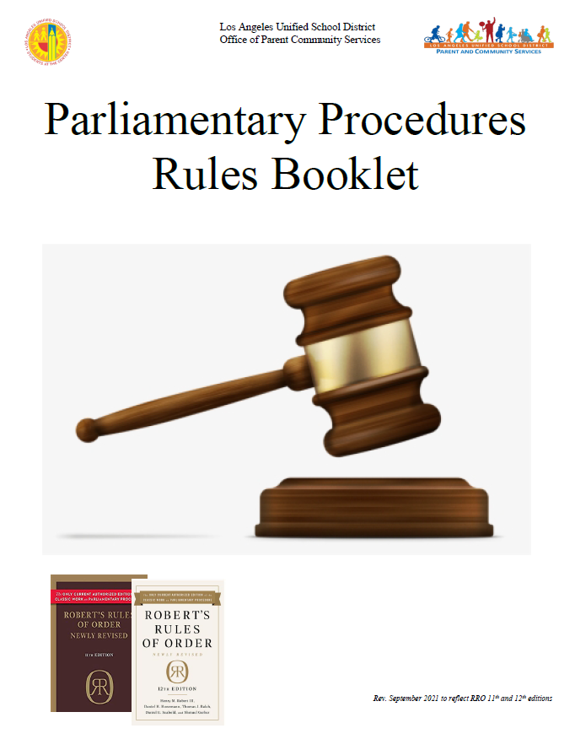
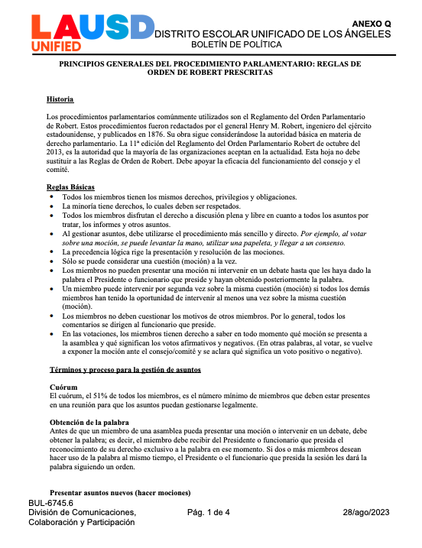
Handouts
Hojas Informativas
Roberts Rules of Order: Attachment Q
Normas de Robert: Adjunto Q
Parliamentary Procedures
Reglas Parlamentarias
Notes:
Say: If you become a member of the SSC or ELAC, these are some key items you need to know. These are tools that will help support our officers as they lead the work in partnership with us.
Attachment Q is the Selected Robber's Rules of Order Parliamentary Procedures
Parliamentary Procedures Rules Booklet provides additional guidance and definitions.
Click

Slide 15

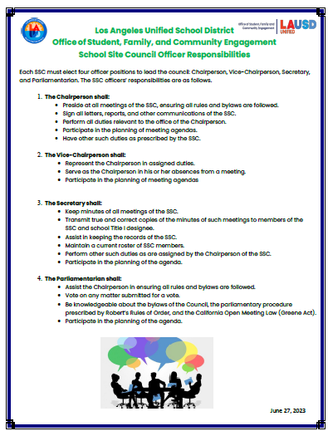
Handouts
Hojas Informativas
School Site Council (SSC): Purpose, Composition and Responsibilities
Consejo del Plantel Escolar: Propósito, Composición, y Responsabilidades
School Site Council (SSC):
Officer Responsibilities
Consejo del Plantel Escolar (SSC):
Responsabilidades de los Funcionario
Notes:
Say: Today we will cover the School Site Council (SSC) and English Learner Advisory Committee: Purpose, Composition and Responsibilities. In addition to the roles and responsibilities of the School Site Council (SSC) Officer.
Click

Slide 16
School Site Council (SSC)
Bulletin 6745.7: Guidelines for the Required School Site Council and English Learner Advisory Committee
Consejo del Plantel Escolar(SSC)
Bóletin 6745.7: Normas para el requerido Consejo del Plantel Escolar y el Comité Asesor para Aprendices de Inglés
Notes:
Click

Slide 17
Why do schools
form an SSC?
¿Por qué las escuelas forman un SSC?
Cada escuela con un código como escuela de Distrito del Condado (CDS) asignado por la Secretaría de Educación del Estado de California (CDE) debe establecer un Consejo del Plantel Escolar (SSC) como un consejo de toma decisiones para todos los programas financiados a través de la Solicitud Consolidada (Con App).
Every school with a County District School (CDS) code assigned by the California Department of Education (CDE) shall establish a School Site Council (SSC) as the decision-making council for all programs funded through the Consolidated Application (Con App).
Notes:
Say: Why do schools form a SSC? Because it is required by law as the decision-making group of stakeholders (at each school with its own CDS code) which develops the plan for additional funds to provide resources for students that are at risk of failing.
Note: The Con App is an application that the District completes each year to receive Title I, II, III and IV funding.

Slide 18
Why do schools form a SSC?
¿Por qué las escuelas forman un SSC?
Requires districts receiving federal, state and other applicable funding, through the Consolidated Application process, ensure that participating schools develop a School Plan for Student Achievement (SPSA).
Requiere que los distritos que reciben fondos estatales, federales u otros fondos aplicables mediante el proceso de la Solicitud Consolidada, se aseguren que las escuelas participantes desarrollen un Plan Escolar para el Rendimiento Académico Estudiantil (SPSA).
Notes:
Say: Schools receiving Title I funds need to develop a plan for those funds, called the SPSA, and that plan needs to show the thinking of why the funds are going to be spent as planned. The SPSA needs to be developed by the SSC, and the plan and its corresponding budget need to be approved by the SSC, which usually happens in February or March of each year.
This is your main responsibility. As SSC members you will develop the SPSA after reviewing student and family data, developing some key findings about the data, identifying some measurable goals to improve the data and strategies to meet those goals.
Click

Slide 19
What are the SSC Responsibilities?
¿Cuáles son las responsabilidades del SSC?
Desarrollar el contenido del SPSA.
Revisar el SPSA anualmente y actualizarlo, incluyendo el gasto propuesto de los fondos asignados a la escuela.
Revisar y aprobar el SPSA en una reunión programada regularmente siempre que haya cambios materiales que afectan los programas académicos.
Responder al asesoramiento por escrito de ELAC sobre los programas y servicio EL relacionados con el SPSA dentro de 30 días calendario o en la próxima reunión del SSC.
Develop the content of the SPSA.
Review the SPSA annually and update, including the proposed expenditure of funds allocated to the school.
Review and approve the SPSA at a regularly scheduled meeting whenever material changes affect the academic programs.
Respond to ELAC’s written advice on EL Programs and services related to the SPSA within 30 calendar days or at the next SSC meeting.
Notes:
Say: In more detail, the development of the SPSA must be done in consultation with others, and there are some additional responsibilities of the council. (Read the slide)
Develop the content of the SPSA.
Shall review the SPSA annually and update, including the proposed expenditure of funds allocated to the school through the Con App and the LCAP.
Review and approve the SPSA at a regularly scheduled meeting whenever there are material changes that affect the academic programs for students covered by programs identified in this part CA ED Code, Section 64001 [i]
Respond to ELAC’s written advice on the SPSA within 30 calendar days or at the next SSC meeting.
Click

Slide 20
What are the SSC Responsibilities?
¿Cuáles son las responsabilidades
del SSC?
To ensure that all federal mandates, including those for parent involvement, are met, specifically:
The development and approval of the school-level Title I Parent and Family Engagement Policy (PFEP).
The development and approval of the Title I School-Parent Compact.
The development and approval of the Title I parent involvement budget.
Asegurar que todos los mandatos federales, que incluye aquellos para la participación de los padres, se cumplan, específicamente:
El desarrollo y la aprobación de la Política del Título I para la Involucración de los Padres y las Familias a nivel escolar (PFEP, por sus siglas en inglés).
El desarrollo y la aprobación del Contrato entre la Escuela y los Padres.
El desarrollo y aprobación del presupuesto para la participación de los padres del Título I.
Notes:
Say: The SSC has a role in giving input into the development and approving the Title I Parent and Family Engagement Policy. (Read the slide.)
Click
Ensure that all federal parental and family engagement mandates are met, specifically:
The development and approval of the school-level Title I Parent and Family Engagement Policy (PFEP).
The development and approval of the Title I School-Parent Compact.
The development and approval of the Title I parent involvement budget.

Slide 21
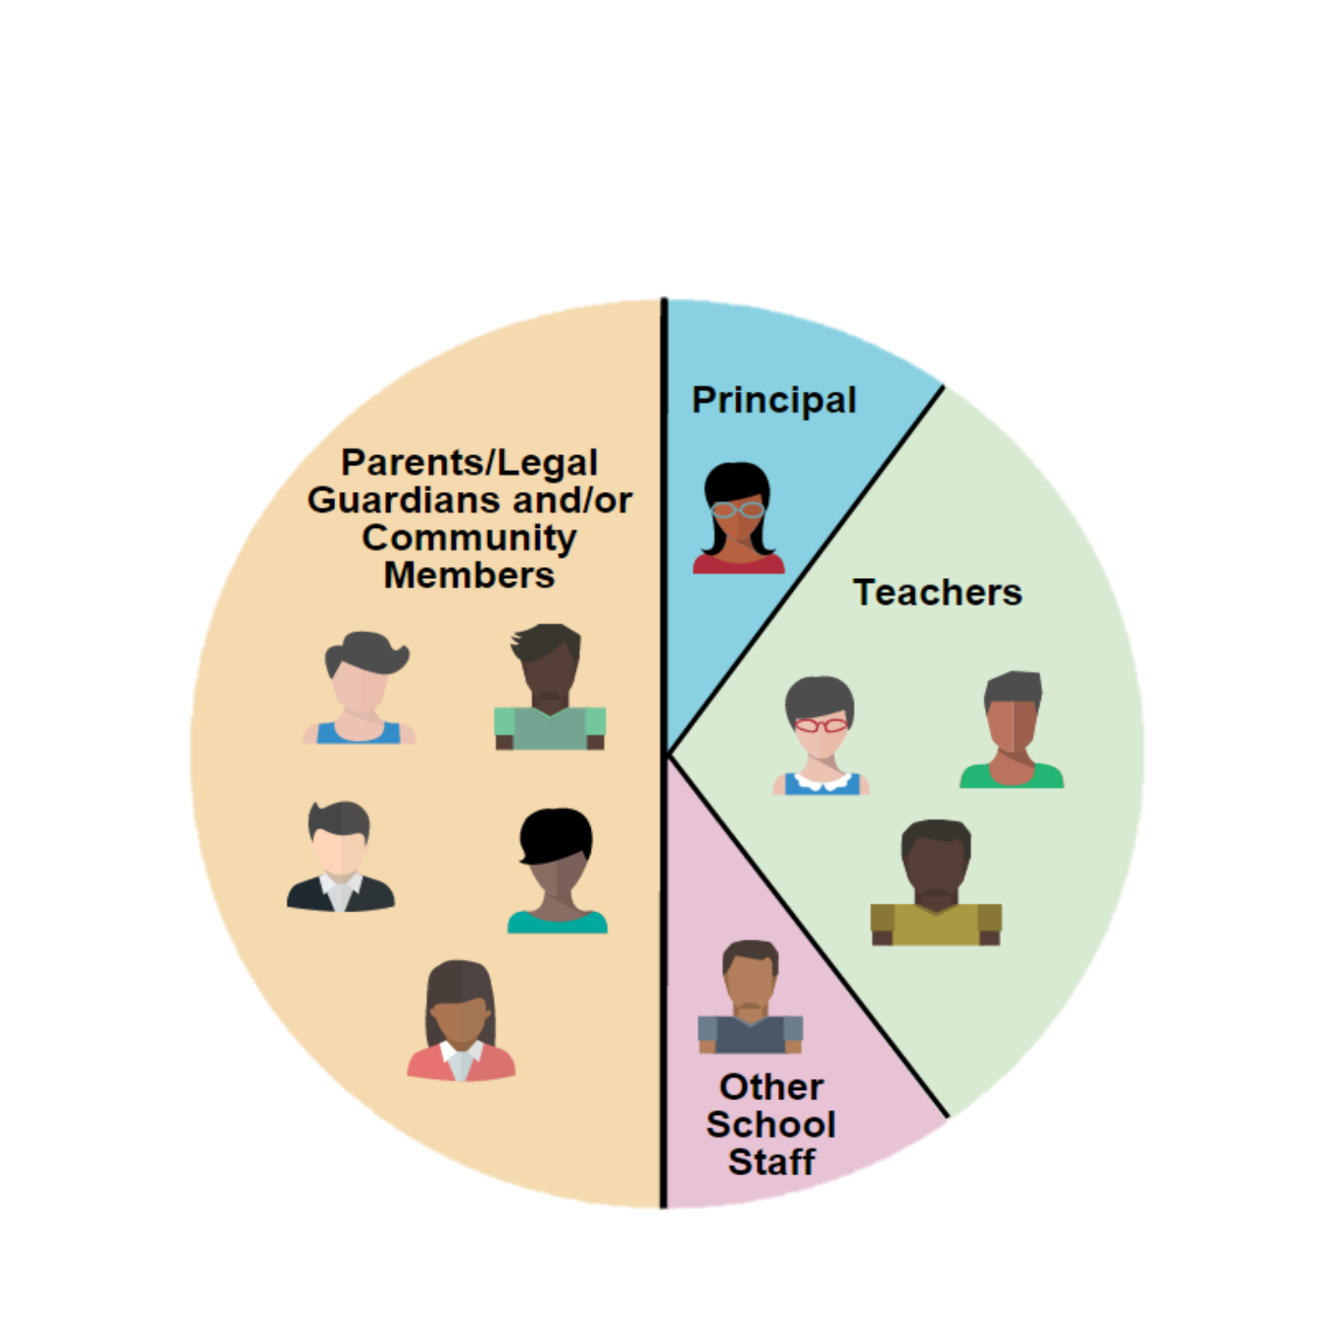
SSC ELEMENTARY COMPOSITION*
SAMPLE
MUESTRA
CONFIGURACIÓN DEL
SSC PARA
ESCUELAS PRIMARIAS*
Not employed at the child’s school
Parent Member:
Is an individual who is a mother, father or legal guardian not employed at the school with which the council is affiliated.
Community Member:
Resides and/or works within a specific school’s attendance boundary. PROOF IS REQUIRED.
On an annual basis, parents designate by vote whether to assign their parent member seat(s) on the council to eligible community members.
Director o designado
Padre miembro:
Esta persona es madre, padre, o tutor legal quien no es empleado de la escuela con la que está afiliada el consejo.
Miembro de la Comunidad:
Vive y/o trabaja dentro de los límites específicos de asistencia escolar. SE REQUIERE COMPROBANTE.
Anualmente, los padres designan por votación si asignarán sus puestos como miembros de padres en el comité a los miembros elegibles de la comunidad.
Padres/Tutores Legales y Miembros de la Comunidad
No es empleado en la escuela del niño
Maestros
Otro Personal Escolar
All members must be elected by their peers, except the principal or his/her designee, who is the only automatic member.
Todos los miembros deben ser electos por el grupo que representa, excepto al director escolar o la persona que él/ella designe, quien es el único miembro automático.
Notes:
Say: This slide describes the composition of the SSC at the elementary school level. (Review the contents of the circle first, explaining the members of the SSC. Then highlight the definition of the parent and community members on the left, being sure to emphasize that only parents can vote for the parent and community seats.)
Please review the Bulletin 6745.6, page 37, Attachment A for composition options.
Standard elementary size is 10 (5 on the staff side – 5 on the Parent/Community Side)
All members must be elected by their peers, except the principal or his/her designee, who is the only automatic member.
Click

Slide 22
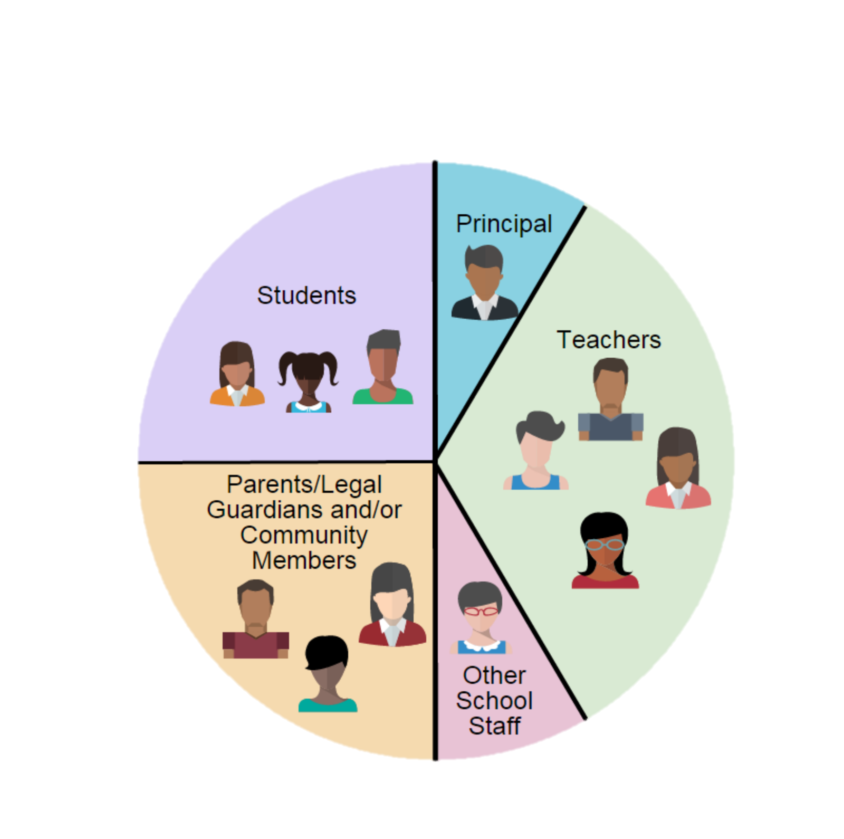
SSC SECONDARY COMPOSITION*
SAMPLE
MUESTRA
CONFIGURACIÓN DEL SSC PARA ESCUELAS SECUNDARIAS*
According to California Education Code, section 65000, for secondary schools:
parity between parents/community and students is no longer required
parity between staff and non-staff is required
the SSC must be composed of at least 10 members
*According to the California Education Code, section 33133(c), at middle schools, an SSC may, but is not required to, include student representation.
De conformidad con la sección 65000 del Código de Educación del Estado de California, para las escuelas de nivel secundario:
No se requiere paridad entre los padres de familia/comunidad y los estudiantes
se requiere paridad entre las personas que son empleados y las que no lo son.
el SSC debe de contar con mínimamente 10 miembros.
*Conforme la sección 33133 (c) del Código de Educación del Estado de California, en las escuelas intermedias, un SSC puede, pero no se le requiere, que incluya representación estudiantil.
Director
Estudiantes
Maestros
Not employed at the child’s school
No es empleado en la escuela del niño
Padres/Tutores Legales y Miembros de la Comunidad
Notes:
Say: There have been changes in the secondary composition with regards to parity between the parents and students; however, there must be parity between the school employees group and the parent/student group. (Read the slide, explaining the contents of the circle first. Then highlight some of the changes on the left.)
Please review the Bulletin 6745.6, Page 38, Attachment A for more composition options.
According to California Education Code, section 65000, for secondary schools:
parity between parents/community and students is no longer required
parity between staff and non-staff is required
the SSC must be composed of at least 10 members
Community member:
Resides and/or works within a specific school’s attendance boundary. PROOF IS REQUIRED.
According to the California Education Code, section 33133(c), at middle schools, a SSC may, but is not required to, include student representation.
Once again please note that all members must be elected by thier peers, except the principal or his/her designee, who is the only automatic member.

Slide 23
SSC
Alternates Optional
Suplentes del
SSC Opcional
Election of alternates for the council is optional.
Alternates should be elected for all stakeholder groups e.g., teachers, parents, students, and other school personnel, except the principal or designee.
The principal’s designee is not an alternate but a member of the SSC.
La elección de los suplentes para el consejo o comité es opcional.
Se debería de elegir a suplentes para todas las partes interesadas como los maestros, padres, estudiantes y otros empleados escolares, excepto para el director escolar o la persona designada.
La persona designada por el director escolar no es un suplente, pero es miembro del SSC.
Notes:
Say: This is for your information only. (Read the slide.)
(Select the option that is applicable to your school.)
Option 1: In our Bylaws, we have no alternates, but this might be something we might what to add in our bylaws for next year.
Or
Option 2: In our Bylaws, we have 1 alternate for parents, 1 alternate for teachers, 1 alternate for other staff and one for students, if applicable.
Say: Please keep in mind that alternates are used to fill a mid-year vacancy only. They are elected during our regular election, so that if we lose a member during the year, we don’t need to hold new elections. This is not a shared position or one which allows for the alternate to take the place of a member if he or she is absent.
Click

Slide 24
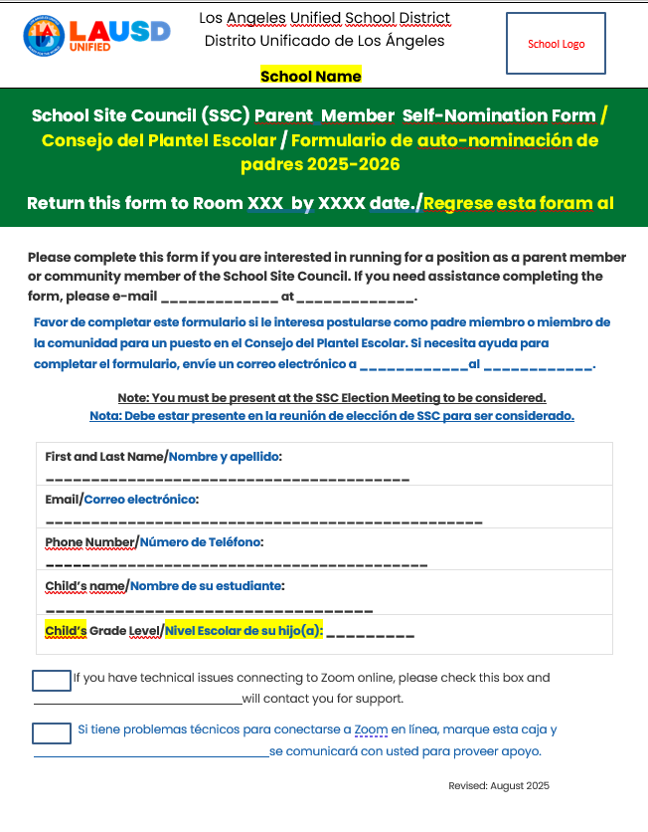
SSC Parent Member Self-Nomination Form
Formulario de SSC para auto nominación de padres miembros
Paper form available in the main office.
Formulario para llenar en papel disponible en la oficina principal.
Electronic fillable form available at the following link: _____________
Formulario electrónico está disponible en el siguiente enlace: ___________
Notes:
Say: At the orientation, you were informed of the self-nomination form. If you didn’t submit it, you can still self nominate during the election meeting. The form lets us provide any support which may be needed for interested candidates.
Click

Slide 25
SSC Officers
Funcionarios del SSC
CHAIRPERSON
PRESIDENTE/A
VICE-CHAIRPERSON
VICE-PRESIDENTE
SECRETARY
SECRETARIO/A
PARLIAMENTARIAN
REPRESENTANTE PARLAMENTARIO
Notes:
Say: SSC has four officers. I will share a little about each of their responsibilities, which we will review again when we have officer elections.
The first one is Chairperson. (Read descriptions below.)
CHAIRPERSON
Preside at all meetings.
Sign all letters, reports and other communications of the council.
Perform all duties relevant to the office of the Chairperson.
Participate in the planning of the meeting agendas.
Have other such duties as are prescribed by the council.
Click VICE-CHAIRPERSON
Represent the Chairperson in assigned duties.
Substitute for the Chairperson in his or her absence.
Participate in the planning of the agenda.
Click SECRETARY
Conduct roll call to establish quorum.
Keep minutes of all regular and additional meetings of the council.
Provide the signed and dated original meeting minutes to the principal or designee.
Assist in keeping the records of the council.
Maintain a current roster of the council members.
Perform other such duties as are assigned by the Chairperson.
Participate in the planning of the agenda
Click PARLIAMENTARIAN
Assist the Chairperson in ensuring all rules and bylaws are followed.
Be knowledgeable about the California Open Meeting Law (Greene Act), District policies, bylaws of the council, and selected parliamentary procedures.
Participate in the planning of the agenda.

Slide 26
Bylaws
Estatutos
Personalize standard bylaws provided in BUL. 6745.7
Bylaws allow SSC maintain orderly flow of engagement
Bylaws follow Greene Act requirements from the CA Education Code
Modifications must be approved by the Region School Family and Community Engagement Unit
Personalizar los estatutos estandarizados proveídos en el boletín 6745.7
Los estatutos permiten que SSC mantenga un flujo ordenado de participación.
Los estatutos siguen los requisitos del Decreto Greene del Código de Educación de CA
Las modificaciones deben ser aprobadas por la Unidad de Participación de los Padres y la Comunidad de la Región
Notes:
Say: The Bylaws allow for SSC to maintain an orderly process of engagement
The Greene Act is the law that outlines the procedures we must follow before and during the meeting.
The Bylaws and Greene Act help us insure that we are respectful of the voice of all members and insure that we offer an opportunity to the public so that they can address the committee.

Slide 27
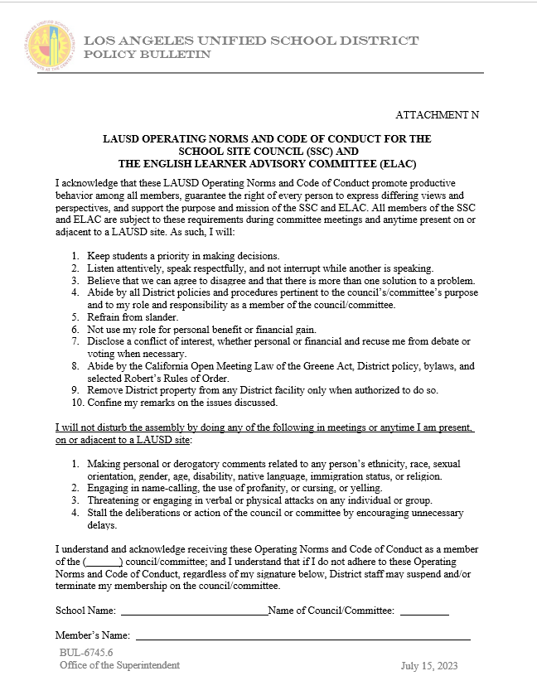
LAUSD Operating Norms and Code of Conduct for the SSC and the ELAC
Normas de Funcionamiento de LAUSD y Código de Conducta para el SSC y ELAC
As members, you will be asked to sign the LAUSD Operating Norms and the Code of Conduct for ELAC and SSC.
It asks that we keep students as a priority in making decisions.
Listen attentively, speak respectfully and not interrupt while another is speaking
Believe we can agree to disagree and that there is more than one solution to a problem.
Como miembros, se les pedirá que firmen las Normas de Funcionamiento y el Código de Conducta de LAUSD para ELAC y SSC.
Pide que mantengamos a los estudiantes como la prioridad en la toma de decisiones.
Escuchar atentamente, hablar con respeto y no interrumpir mientras hablan otras personas
Creer que podemos estar de acuerdo en estar en desacuerdo y que hay más de una solución a un problema.
Notes:
Say: As members you will be asked to sign the LAUSD Operating Norms and the Code of Conduct for ELAC and SSC.
It asks that we keep students as priority in making decisions.
Listen attentively, speak respectfully and not interrupt while another is speaking
Believe we can agree to disagree and that there is more than one solution to a problem.
Activity:
Of the three norms that are listed, which is the one that speak to you?
Please write it in the Chat.
(Read a couple out loud.)
Click

Slide 28
Greene Act
Decreto Greene
El Decreto Greene es lo que guía el funcionamiento de nuestras reuniones de ELAC y SSC. Algunos de los requisitos clave son:
Se le debe brindar a cualquier miembro del público la oportunidad de dirigirse al consejo o comité durante la reunión en relación a cualquier asunto que tenga que ver con la materia bajo jurisdicción del consejo o comité.
El aviso de la reunión se publicará al menos 72 horas antes de la reunión.
La notificación para la reunión debe especificar la fecha, hora y ubicar e incluir una agenda que describa cada asunto que se discutirá o tratará.
The Greene Act is what guides the operation of our ELAC and SSC meetings. Some of the key requirements are:
Any member of the public shall be able to address the council or committee during the meeting on any item within the subject matter jurisdiction of the council or committee.
Notice of the meeting shall be posted 72 hours prior to the meeting.
The meeting notice shall specify the date, time, and location of the meeting and contain an agenda describing each item of business to be discussed or acted upon.
Notes:
Say: The Greene Act is what guides the operation of our ELAC and SSC meetings.
Some of the key requirements are:
Any member of the public shall be able to address the committee or council during the meeting on any item within the subject matter jurisdiction of the council or committee.
Notice of the meeting shall be posted at the school site or other appropriate place accessible to the public at least 72 hours prior to the meeting.
The meeting notice shall specify the date, time, and location and contain an agenda describing each item of business to be discussed or acted upon.
Click

Slide 29

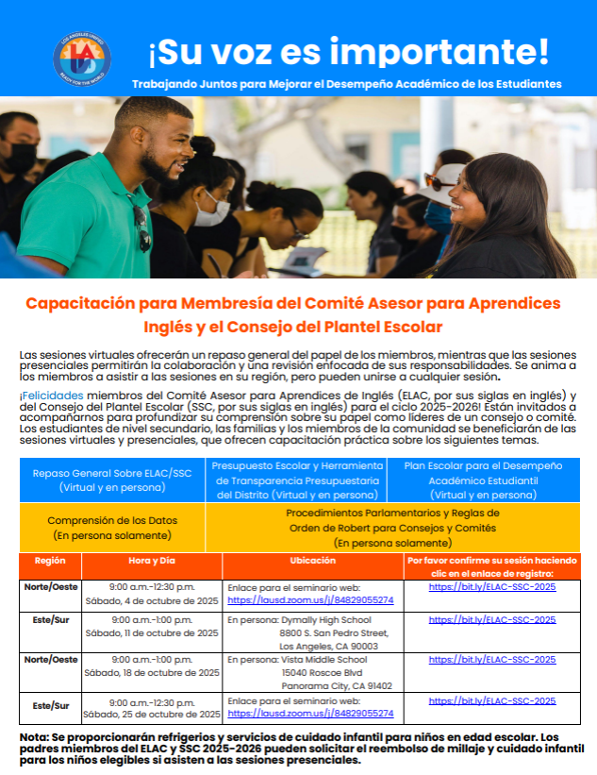
2025-2026 SSC Membership Training
Capacitación para Miembros del SSC 2025-2026

Slide 30

Notes:
Say: Do you have any questions regarding SSC. Remember to join us on (date) for SSC elections at (time).
Click

Slide 31
Contact Information
Información de Contacto
School Logo
Name and Title
E-mail:
Phone Number:
Nombre y Título:
Correo Electrónico:
Número de teléfono:
Notes:
Say: Do you have any questions regarding SSC. Remember to join us on (date) for SSC elections at (time).
Click

Slide 32
Thank you!!!
¡¡¡Gracias!!!
Contact your Region Family and Community Engagement (FACE) Administrative Coordinator.
Comuníquese con su Administrador de la Unidad de Participación de Familias y Comunidad (FACE).
Region/Región | FACE Administrative Coordinator | Email
East/Este | Megan Guerrero Amaris Medina | mguerr3@lausd.net amaris.medina@lausd.net
West/Oeste | Crystal Dukes | crystal.dukes@lausd.net
North/Norte | Laura Fuentes & Jeremiah Gonzalez | Lxf1109@lausd.net Jjg2443@lausd.net
South/Sur | Ursula Martin | umartin@lausd.net
Virtual Academy/ Academia Virtual | Marie Sa Michinard | mls0363@lausd.net
Notes:
Say: Thank you for joining us. If you have additional questions regarding School Site Councils and how they operate in our District or need additional support, you can always contact the Region Family and Community Engagement Unit. The names of the administrators for these teams are listed here.
I look forward to partnering with you this year.

