Slide 1


English Learner Advisory Committee (ELAC) Orientation
Date:________
School Name: _______________
Bulletin 6745.7 Guidelines for Required School Site Council and English Learner Advisory Committee
Orientación del Comité Asesor para Aprendices de Inglés (ELAC)
Fecha: ____________
Nombre de la escuela: _____________
Boletin 6745.7 Normas para el Requerido Consejo del Plantel Escolar y el Comite Asesor para Aprendices de Inglés
Notes:
Say: Thank you for taking the time and interest in joining today’s ELAC Orientation meeting.

Slide 2

Welcome
Bienvenidos
Principal
Director(a)
Student Body President
Presidente Estudiantil
Community Representative
Representante de la Comunidad
School Title I Designee
Designada(o) del Programa Título I
English Learner Program Designee
Designada(o) del Programa de Aprendices de Inglés
School Leadership Team / Equipo de Liderazgo Escolar
Notes:
Do: Please ensure that each school leadership team member offers a warm greeting.

Slide 3

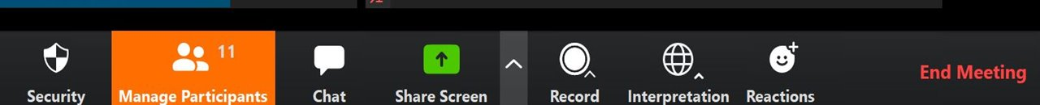
Interpretation Services: Laptop or Computer
Servicios de interpretación: computadora portátil o de escritorio
Click on the globe icon at the bottom of the screen.
Select the language of preference for you.
You will engage and listen to the presentation in the language you select.
Haga clic en el símbolo del mundo en la parte de abajo de su pantalla.
Seleccione el idioma que le gustaría escuchar.
Participará y escuchará la presentación en el idioma que seleccione.
Notes:
Say: We have interpretation services if you are joining us on a computer. Chromebook do not offer the translation feature. If you are on a Chromebook, please stay on your computer so you can see us on the screen and use the chat feature. For audio join us via phone.
I will provide more guidance shortly.
For those that are on the computer please click on the globe icon at the bottom of the screen.
Select the language of preference.
You will engage and listen to the presentation in the language you select.
Click
Diga:
Tenemos servicios de interpretación, si nos acompaña a través de una computadora.
Desafortunadamente los Chromebooks no ofrecen esta característica. Si está usando un Chromebook, quédese en la computadora para que pueda ver la presentación en una pantalla más grande y usar el chat. Pero, puede usar su teléfono para escuchar el audio.
Daré más instrucciones a continuación.
Para los que nos acompañan en una computadora, haga clic en el símbolo del mundo en la parte de abajo de la pantalla.
Seleccione su idioma de preferencia.
Participará y escuchará la presentación en el idioma que seleccione.

Slide 4

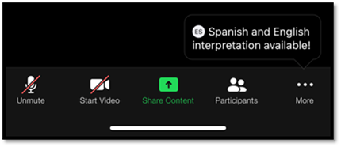
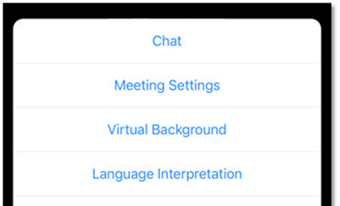
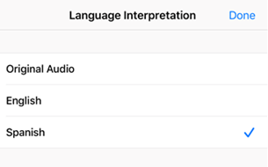
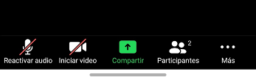
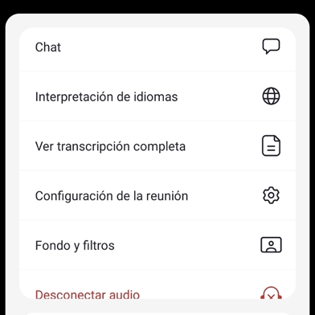
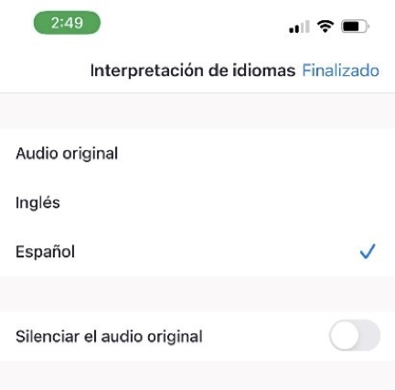
Interpretation Services: Mobile Device
Servicios de interpretación: Dispositivo móvil
Notes:
Say: For those who are joining us via phone, please click on the three dots.
Select language interpretation.
Select language of preference
Click on done.
Click
Diga: Para los que nos acompañan por teléfono, haga clic en los tres puntos.
Seleccione interpretación de idiomas.
Seleccione idioma de preferencia
Haga clic en aceptar.
Clic

Slide 5
Steps to Rename Yourself on Zoom
Como cambiar su nombre en su pantalla
Step 1:
Step 2:
Step 3:
Step 4:
Step 5:
Hover over your picture located
by the picture gallery with your cursor and search for the three dots found on the top right-hand corner of your picture.
Click the three-dotted icon found over your picture.
Click More.
Choose Rename.
Enter the full name used when you enrolled your students at the school site, then click Save to finish the change.
Paso 1:
Paso 2:
Paso 3:
Paso 4:
Paso 5:
Ponga su cursor en su foto ubicada en la galería de fotos y busque los tres puntitos en la esquina de la parte derecha de su rectángulo con su foto.
Haga clic en los tres puntitos que están en su foto.
Haga clic en Más.
Escoja Re nombrar.
Ingrese su nombre completo de la manera que lo escribió al matricular a sus estudiantes en el plantel escolar, después haga clic en Guardar para aceptar el cambio.
Notes:
Say: We’d like to know who is in the room, please rename yourself by following these 5 steps.
Step 1: Hover over your picture located by the picture gallery with your cursor and search for the three dots found on the top right-hand corner of your picture.
Step 2: Click the three-dotted icon found over your picture.
Step 3: Click More.
Step 4: Choose Rename to change your screen name displayed to other participants.
Step 5: Enter the full name used when you enrolled your students at the school site, then click Save to finish the change.
Click
Diga:
Queremos saber quién está presente, favor de cambiar su nombre en su pantalla, siga los cinco pasos a continuación.
Paso 1: Ponga su cursor en el cuadro en la galería de participantes con su nombre y busque los tres puntitos en la esquina derecha superior de su cuadro.
Paso 2: Haga clic en el ícono con los tres puntos en su cuadro.
Step 3: Haga clic en Más
Paso 4: Seleccione Renombrar para cambiar su nombre que se muestra a los participantes.
Paso 5: Ingrese su nombre completo que se usó para inscribir a su estudiante en el plantel escolar, después haga clic en Aceptar para efectuar el cambio.

Slide 6

Engaging on Zoom
Participación por medio de Zoom
If you need assistance accessing Zoom for this meeting, send an email to ___________ and a team member will assist you.
Zoom includes a “Chat” tab where you can type your questions for the presenters.
Si necesita ayuda con acceder a Zoom para esta reunión, envíe un correo electrónico a _______________ y un miembro de nuestro equipo le ayudará.
Zoom tiene una pestaña de Chat en la que usted puede hacer preguntas a los presentadores.
Notes:
Say: If you need assistance, accessing zoom for this meeting send an email to ___________ and a team member will assist you.
Zoom includes a “Chat” tab where you can type your questions for the presenters.
Click
Diga: Si necesita ayuda con acceder a Zoom durante esta sesión, envíe un correo electrónico a ____________ y alguien del equipo le ayudará.
Zoom incluye una pestaña de chat en la que puede enviar preguntas a los presentadores.

Slide 7

Pledge of Allegiance
Juramento a la Bandera
I pledge allegiance to the flag of the United States of America and to the Republic for which it stands, one nation under God, indivisible, with liberty and justice for all.
Prometo lealtad a la bandera de los Estados Unidos de América y a la República que representa, una nación ante Dios, indivisible con libertad y justicia para todos.
Notes:
Do: Have a participant lead the Pledge of Allegiance in both languages.

Slide 8
Purpose
Próposito
Review the functions and operation of the mandated English Learner Advisory Committee (ELAC).
Understand the roles and responsibilities of the ELAC members.
Understand the orientation and election process for the ELAC.
Repasar las funciones y el funcionamiento del requerido Comité Asesor para Aprendices de Inglés (ELAC).
Entender las funciones y responsabilidades de los miembros de ELAC.
Entender el proceso de la orientacion y elecciones para ELAC.
Notes:
Do: Review the purpose of today's ELAC Orientation meeting:
Review the functions and operation of the mandated English Learner Advisory Committee (ELAC).
Understand the roles and responsibilities of the ELAC members.
Understand the orientation and election process for the ELAC.

Slide 9
Sign In
Registrar
Attendance
Welcome! Please sign in on the Chat.
Please enter your first and last name and indicate if you are a parent/legal guardian of a student at the school site, community member, staff or visitor.
Attendance
¡Bienvenidos! Por favor, regístrese en el chat.
Favor de escribir su nombre y apellido, e indique si es padre/ madre o tutor legal de un estudiante, miembro de la comunidad, personal o visitante.
Notes:
Say: If you are joining in person, please sign in on the sign-in sheet. If you are joining via Zoom, sign-in on the chat.
Let us know if you are a parent/legal guardian of an EL, community member, or visitor.
Chat should be open to “Panelist” only and link must remain open at all times.

Slide 10
English Learner Advisory Committee (ELAC)
Bulletin 6745.7 Guidelines for Required School Site Council and English Learner Advisory Committee
Comite Asesor para Aprendices de Ingles
Boletin 6745.7 Normas para el Requerido Consejo del Plantel Escolar y el Comite Asesor para Aprendices de Ingles
Notes:
Say: We will begin with an overview of the English Learner Advisory Committee (ELAC).

Slide 11
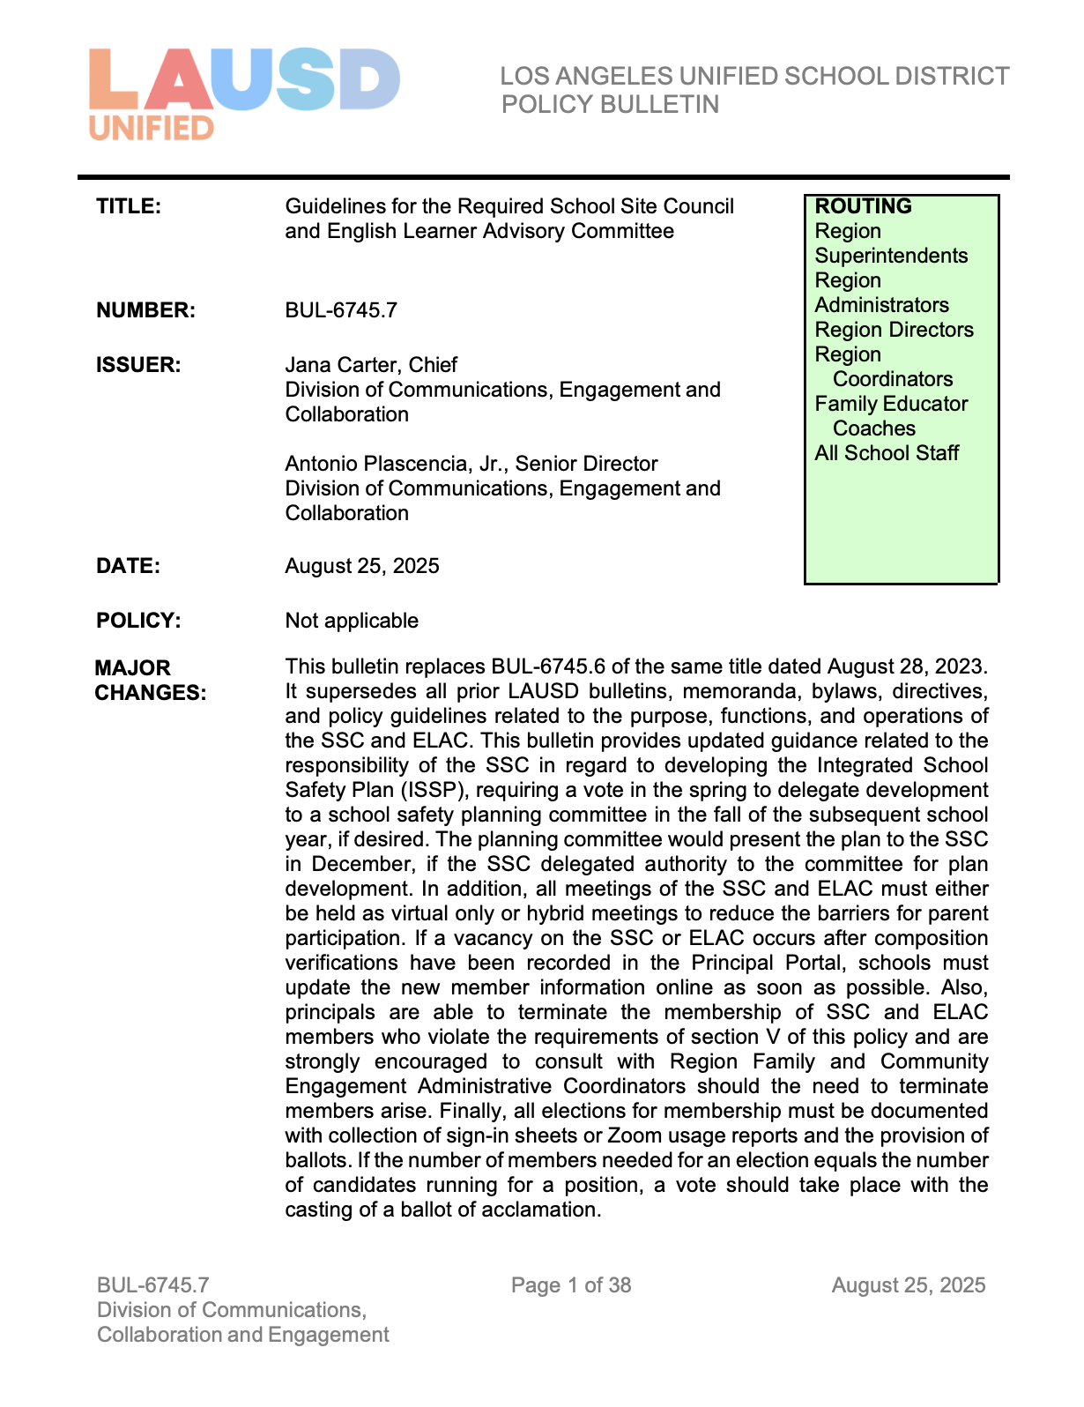
Bulletin 6745.7 Guidelines for the Required
School Site Council and English Learner Advisory Committee
Boletín 6745.7 Normas para el Requerido Consejo del Plantel
Escolar y el Comité Asesor para Aprendices de Inglés
Bulletin 6745.7 is available in
English and Spanish.
The bulletin and handouts can be found at:
https://bit.ly/Policies_Families_SFACE
El Boletín 6745.7 está disponible
en inglés y español:
El boletín y las hojas de información se encuentran en:
https://bit.ly/Policies_Families_SFACE
Notes:
Say: LAUSD provides guidance on the proper formation and function of the ELAC, referenced on Bulletin 6745.7: Guidelines for the Required School Site Council and English Learner Advisory Committee.

Slide 12
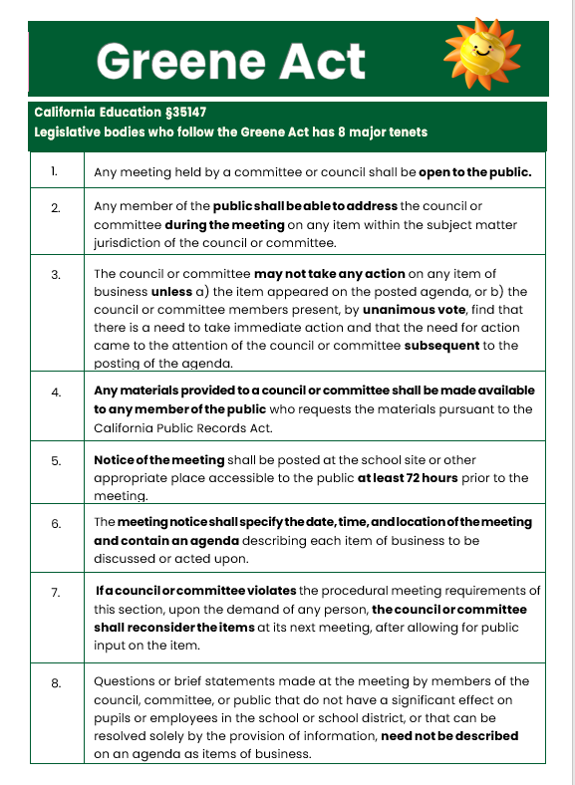
Greene Act
Decreto Greene
The Greene Act is what guides the operation of our ELAC meetings. Some of the key requirements are:
Any member of the public shall be able to address the council or committee during the meeting on any item within the subject matter jurisdiction of the council or committee.
Notice of the meeting shall be posted 72 hours prior to the meeting.
The meeting notice shall specify the date, time, and location of the meeting and contain an agenda describing each item of business to be discussed or acted upon.
El Decreto Greene es lo que guía el funcionamiento de nuestras reuniones de ELAC. Algunos de los requisitos clave son:
Se le debe brindar a cualquier miembro del público la oportunidad de dirigirse al consejo o comité durante la reunión en relación a cualquier asunto que tenga que ver con la materia bajo jurisdicción del consejo o comité.
El aviso de la reunión se publicará al menos 72 horas antes de la reunión.
La notificación para la reunión debe especificar la fecha, hora y ubicar e incluir una agenda que describa cada asunto que se discutirá o tratará.
Notes:
Say: At the school site level, the "Greene Act" refers to a specific part of California’s Education Code (often cited as Greene Act requirements), which ensures that advisory committees like ELAC operate transparently and publicly.
🔑 Purpose: To ensure that ELAC meetings are open, public, and follow rules that protect parent and community involvement — especially for English learner families.

Slide 13
Abbreviations
Abreviaturas
English Learner Advisory Committee (ELAC)
School Site Council (SSC)
English Learner (EL)
Reclassified Fluent English Proficient (RFEP)
Initial Fluent English Proficient (IFEP)
English Only (EO)
Uniform Complaint Procedures (UCP)
District English Learner Advisory Committee (DELAC)
Transitional Kindergarten (TK)
Expanded Transitional Kindergarten (ETK)
Comité Asesor para Aprendices de Inglés (ELAC)
Consejo del Plantel Escolar (SSC)
Aprendiz de inglés (EL)
Reclasificación como Competente en el idioma inglés (RFEP)
Inicialmente Competente en el idioma inglés (IFEP)
Sólo inglés (EO)
Uniformes para Presentación de Quejas (UCP)
Comité Asesor del Distrito para Aprendices de Inglés (DELAC)
Kinder Transicional (TK)
Kinder Transicional Ampliado (ETK)
Notes:
Say: Here's a list of commonly used abbreviations that are often mentioned during ELAC (English Learner Advisory Committee) meetings.
This can be a helpful reference for parents, staff, and community members involved in ELAC discussions.

Slide 14
Why must schools form an ELAC?
¿Por qué deben las escuelas forman un ELAC?
In accordance with the California Education Code, section 52176(b), all schools with twenty-one or more English Learner (EL) students, not including Reclassified Fluent English Proficient (RFEP) students, are required to establish an English Learner Advisory Committee (ELAC).
De acuerdo con la sección 52176 (b) del Código de Educación de California, todas las escuelas con veintiún o más estudiantes aprendices de inglés (EL), sin incluir a los estudiantes Reclasificados como Competentes en el Idioma Inglés (RFEP), deben establecer un Comité Asesor para Aprendices de Inglés (ELAC).
Notes:
Ask: Why must schools form an ELAC?
Say: In accordance with the California Education Code, section 52176(b), all schools with twenty-one or more English Learner (EL) students, not including Reclassified Fluent English Proficient (RFEP) students, are required to establish an English Learner Advisory Committee (ELAC).
EL Designees will share that the school currently has ___ identified English Learner students. Since this number is greater than 21, we are required by California law to form an English Learner Advisory Committee (ELAC).

Slide 15
Why must schools form an ELAC?
¿Por qué deben las escuelas forman un ELAC?
Schools are required to form an ELAC at any time during the school year when the number of identified English Learner students reaches 21 or more. All parents with EL students attending the school where the ELAC is established are eligible and should be encouraged to participate in the ELAC.
Se requiere que las escuelas establezcan un ELAC en cualquier momento durante el año escolar cuando el número de estudiantes identificados como aprendices de inglés llegue a ser 21 o más. Todos los padres con estudiantes de EL que asisten a la escuela donde se establece el ELAC son elegibles y deben ser alentados a participar en el ELAC.
Notes:
Say: Schools are required to form an ELAC at any time during the school year when the number of identified English Learner students reaches 21 or more. All parents with EL students attending the school where the ELAC is established are eligible and should be encouraged to participate in the ELAC.

Slide 16
What are the ELAC Member Responsibilites?
¿Cuales son las responsabilidades de los Miembros de ELAC?
Contribute to the development of the School Plan for Student Achievement (SPSA) for ELs.
Assist in developing the schoolwide needs assessment.
Assist with ways to make parents aware of the importance of regular school attendance.
Provide written advice to the SSC regarding programs and services for EL students.
Contribuir al desarrollo del Plan Escolar para el Rendimiento Estudiantil (SPSA) para ELs.
Ayudar con el desarrollo de la evaluación de necesidades a nivel escolar.
Ayudar con maneras para que los padres estén consientes de la importancia de la asistencia regular a la escuela.
Proporcionar sugerencias por escrito al SSC en relación a los programas y servicios para los estudiantes EL.
Notes:
Say: What are the ELAC Member Responsibilities?
Read the following:
Contribute to the development of the School Plan for Student Achievement (SPSA) for ELs.
Assist in developing the schoolwide needs assessment.
Assist with ways to make parents aware of the importance of regular school attendance.
Provide written advice to the SSC regarding programs and services for EL students.

Slide 17
What are the ELAC Members Responsibilties?
¿Cuales son las responsabilidades de los Miembros de ELAC?
Provide advice on EL supports: Advice may be centered on student performance and parent and family engagement data (refer to Bulletin 6745. 7 – page 23, letter f).
Each ELAC must have the opportunity to elect one English Learner parent member to attend the Region ELAC Delegate Convening.
Proporcionar asesoramiento sobre los apoyos a los estudiantes EL: El asesoramiento puede centrarse en el rendimiento del estudiante y los datos de participación de los padres y la familia (Consulte el Boletín 6745.7 – página 19, letra f).
Cada ELAC del plantel escolar debe seleccionar un padre EL que asista a la reunión convocatoria de ELAC de Región.
Notes:
Read the following:
Provide advice on EL supports: Advice may be centered on student performance and parent and family engagement data (refer to Bulletin 6745. 7 – page 23, letter f).
ELPAC
I-Ready
Reading Inventory (RI)
Reclassification rates
Long Term English Learner (LTEL) data
Smarter Balanced Assessment (SBA)
Each ELAC must have the opportunity to elect one English Learner parent member to attend the Region ELAC Delegate Convening.

Slide 18



ELAC Advisement Process
ELAC provides written advice to the SSC.
SSC responds to ELAC'S written advice within 30 days or at the next SSC meeting.
Notes:
Do: Explain how ELAC provides advice to SSC and how SSC responds within 30 days or at the next meeting
ELAC Reviews EL Programs & Data ↓
ELAC Prepares Written Advice/Recommendations ↓
ELAC Submits Written Advice to SSC ↓
SSC Receives Advice ↓
SSC Reviews Advice ↓
SSC Responds in Writing
Within 30 days OR
At the next SSC meeting (whichever comes first) ↓
Response Communicated Back to ELAC & Community
Explains how advice was accepted, modified, or declined

Slide 19
ELAC Member Responsibilities
Responsabilidades de los miembros de ELAC
Attend all meetings.
Be in person or log into the school site's virtual meeting platform when voting.
Convene at least six times per year at a time that is agreeable to members. These six meetings do not include the mandatory orientation and election.
Asistir a todas las reuniones.
Estar en persona o por medio de una plataforma virtual del sitio escolar al votar.
Reunirse a lo menos seis veces al año en un momento que sea conveniente para los miembros. Estas seis reuniones no incluyen la requerida orientación y elección.
Notes:
Say: Now let’s review additional responsibilities of ELAC members
Attend all meetings. Consistent participation is expected.
Be in person or log into the school site’s virtual meeting platform when voting. Members must be present (physically or virtually) to cast votes.
Convene at least six times per year Meetings should be scheduled at times convenient for the members.
Note: These six meetings do not include the mandatory orientation and election.

Slide 20
English Learner Advisory Committee (ELAC)
Comite Asesor para Aprendices de Ingles
COMPOSITION / COMPOSICION
Notes:
Say: Now let’s look at the Composition for ELAC?
Who Can Join ELAC?

Slide 21
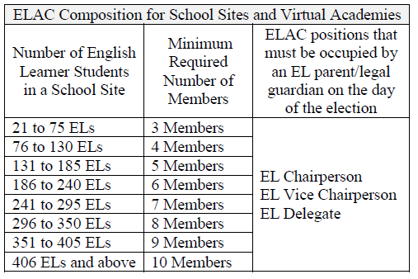
Composition: Parents and legal guardians of EL students not employed by LAUSD shall constitute the same percentage of the ELAC membership as their children represent of the student body.
Example: If a school has 100 students and 30 are EL students and a committee of 10 is established, a minimum of 3 EL parents would be needed and the other members would make up the difference.
Composición: Los padres y tutores legales de los estudiantes EL que no son empleados de LAUSD, deben constituir equitativamente o exceder el porcentaje de estudiantes EL en la escuela.
Ejemplo: Si una escuela tiene 100 estudiantes y 30 son estudiantes EL y se establece un comité de 10, se necesitaría un mínimo de 3 padres EL y los otros miembros formarían parte de la diferencia.
Activity
How many members do we need?
Please write it in the chat.
Actividad
¿Cuántos miembros necesitamos? Favor de escribirlo en el chat.
Notes:
Say: Parents and legal guardians of English Learners (EL) shall constitute at least the same percentage of the ELAC membership as their children
represent of the student body (California Education Code, Section 52176 (b).

Slide 22
Composition
Composición
Parents/legal guardians of students from any of these language classifications: Reclassified Fluent English Proficient (RFEP), Initial Fluent English Proficient (IFEP), and English Only (EO)​
LAUSD employees from the school site​
Secondary students (grades 6-12)​
Community members or representatives from the community-based organizations that are actively involved in the school​
PTA/PTSA/PTO/Booster Club members
Parents/legal guardians of students from any of these language classifications: Reclassified Fluent English Proficient (RFEP), Initial Fluent English Proficient (IFEP), and English Only (EO)​
LAUSD employees from the school site​
Secondary students (grades 6-12)​
Community members or representatives from the community-based organizations that are actively involved in the school​
PTA/PTSA/PTO/Booster Club members
Notes:
Say: Other ELAC members may be elected from the following groups:
Parents/legal guardians of students from any of these language classifications: Reclassified Fluent English Proficient (RFEP), Initial Fluent English Proficient (IFEP), and English Only (EO)
LAUSD employees from the school site
Secondary students (grades 6-12)
Community members or representatives from community-based organizations that are actively involved in the school
PTA/PTSA/Booster Club members

Slide 23
English Learner Advisory Committee (ELAC)
Comite Asesor para Aprendices de Ingles
EL DELEGATE
DELEGADO PARA APRENDICES DE INGLES (EL)
Notes:
Say: Each school site ELAC must elect one of its EL members to be the EL Delegate (5CCR Section 11308 [b]) and attend the Region EL Delegate Convening.
The EL Delegate must be occupied by an EL parent / legal guardian.

Slide 24
EL Delegate Responsibilities
Responsabilidades del Delegado EL
The EL Delegate must attend the Region EL Delegate Convening in the fall, representing the school’s ELAC to elect members to the District English Learner Advisory Committee (DELAC).
The Delegate has the opportunity to nominate or self-nominate to run for a seat on the DELAC.
The Delegate votes to seat representatives on the DELAC.
As a DELAC representative you learn about:
English Learner supports at the District level.
Local Control and Accountability Plan (LCAP).
El Delegado de EL debe asistir a la Reunión Regional de Delegados de EL en el otoño, representando al ELAC de la escuela para elegir a los miembros del Comité Asesor del Distrito para Aprendices de Inglés (DELAC).
El Delegado tiene la oportunidad de nominar o auto-nominarse para postularse a un puesto en el DELAC.
El Delegado vota para postular a representantes en el DELAC.
Como representante de DELAC, usted aprende sobre:
Apoyos para Aprendices de Inglés a nivel del Distrito.
Plan de Control Local y Rendimiento de Cuentas (LCAP).
Notes:
Say: The EL Delegate must attend the Region EL Delegate Convening when scheduled by Region FACE.
The EL Delegate has the opportunity to nominate or self-nominate to run for a seat on the DELAC.
The EL Delegate votes to seat representatives on the DELAC
As a DELAC representative you learn about:
English Learner supports at the District level.
Local Control and Accountability Plan (LCAP).

Slide 25
English Learner Advisory Committee (ELAC)
Comite Asesor para Aprendices de Ingles
DELAC
Notes:
Say: What is the DELAC?

Slide 26
What is the DELAC?
¿Qué es el DELAC?
California Education Code (62002.5, 52176) and the CA Code of Regulations (11308) require the establishment of a District English Learner Advisory Committee (DELAC) for districts with 51 or more English Learners.
LAUSD’s DELAC is a group of parents who represent the parents/guardians of English Learners in LAUSD.
El Código de Educación de California (62002.5, 52176) y el Código de Reglamentos de California (11308) requieren el establecimiento de un Comité Asesor del Distrito para Aprendices de Inglés (DELAC) en los distritos que tienen 51 o más estudiantes del idioma inglés.
El DELAC de LAUSD es un grupo de padres que representan a los padres/tutores de estudiantes del idioma inglés en el LAUSD.
Notes:
Say: California Education Code (62002.5, 52176) and the CA Code of Regulations (11308) require the establishment of a District English Learner Advisory Committee (DELAC) for districts with 51 or more English Learners. LAUSD’s DELAC is a group of parents who represent the parents/guardians of English Learners in LAUSD.

Slide 27
DELAC Responsibilities
Responsabilidades del DELAC
The DELAC shall advise the school district governing board on at least the following tasks:
Development of a district master plan for education programs and services for English learners. The district master plan will take into consideration the school site master plans.
Conducting of a district wide needs assessment on a school-by-school basis.
Establishment of district program, goals, and objectives for programs and services for English learners.
Development of a plan to ensure compliance with any applicable teacher and/or teacher aide requirements.
El DELAC debe asesorar a la mesa directiva del distrito escolar sobre al menos las siguientes tareas:
El desarrollo del plan maestro del distrito para los programas educativos y servicios para los alumnos aprendices del inglés, tomando en consideración los planes maestros escolares para rendimiento académico de cada escuela.
La administración de una evaluación de necesidades en el distrito llevada a cabo en cada escuela.
El establecimiento de programa, metas, y objetivos de los programas y servicios a nivel del distrito para los alumnos aprendices del inglés.
El desarrollo de un plan del distrito para asegurar que los maestros y auxiliares de maestros que trabajan con los alumnos aprendices del inglés cumplan con los requisitos profesionales pertinentes.
Notes:
Say: What are the DELAC’s responsibilities?
Review the following:
Development of a district master plan for education programs and services for English learners. The district master plan will take into consideration the school site master plans.
Conducting of a district wide needs assessment on a school-by-school basis.
Establishment of district program, goals, and objectives for programs and services for English learners.
Development of a plan to ensure compliance with any applicable teacher and/or teacher aide requirements.

Slide 28
DELAC Responsibilities
Responsabilidades del DELAC
Review and comment on the school district reclassification procedures.
Review and comment on the written notifications required to be sent to parents and guardians.
If the DELAC acts as the English learner parent advisory committee under California Education Code Sections 52063(b)(1) and 52062(a)(2), the DELAC shall also review and comment on the development or annual update of the Local Control and Accountability Plan (LCAP).*
Revisar y comentar acerca del procedimiento del distrito para la reclasificación de los alumnos aprendices del inglés.
Revisar y comentar sobre las notificaciones escritas que se requieren enviar a los padres o tutores.
Si el DELAC sirve de comité asesor de padres de aprendices del inglés bajo el Código de Educación de California Secciones 52063(b)(1) y 52062(a)(2), el DELAC debe revisar y comentar sobre el desarrollo o actualización anual del Plan de Control Local y Responsabilidad de Cuentas (LCAP).*
Notes:
Do: Continue reviewing:
Review and comment on the school district reclassification procedures.
Review and comment on the written notifications required to be sent to parents and guardians.
If the DELAC acts as the English learner parent advisory committee under California Education Code Sections 52063(b)(1) and 52062(a)(2), the DELAC shall also review and comment on the development or annual update of the Local Control and Accountability Plan (LCAP).*

Slide 29
EL Delegate Convening Dates
Fecha de la Convocatoria de Delegado EL
Virtual Academies Academias Virtuales | Region West Región Este | Region West Región Oeste | Region South Región Sur | Region North Región Oeste
10:00 am Date/Fecha October 1, 2025 1 de octubre de 2025 | 9:00 am- 1:00 pm Date/Fecha October 6, 2025 6 de octubre de 2025 | 10:00 am 1:00 pm Date/Fecha October 8, 2025 8 de octubre de 2025 | 9:00 am- 1:00 pm Date/Fecha October 9, 2025 9 de octubre de 2025 | 9:00 am- 1:00 pm Dates/Fecha September 10, 2025 10 de octubre de 2025
Notes:
Say: These are the dates scheduled for the EL Delegate Convenings.
Reminder: The EL Delegate must attend the Region EL Delegate Convening, where both representatives and alternates will be elected to serve on the District English Learner Advisory Committee (DELAC).

Slide 30
English Learner Advisory Committee (ELAC)
Comite Asesor para Aprendices de Ingles
OFFICER DUTIES / DEBERES DE FUNCIONARIOS
Notes:
Say: Officers are elected to the English Learner Advisory Committee (ELAC) to help organize, lead, and manage the work of the committee effectively throughout the school year.
Elections give ELAC a democratic, parent-led structure, which is important because parents of English Learners must be the majority of the committee and have a strong voice in school decisions.

Slide 31
Officer Duties
Deberes de los Funcionarios
Chairperson shall:
Preside at all the meetings of the ELAC, ensuring all rules and bylaws are followed.
Sign all letters, reports, and other communications of the ELAC.
Perform all duties relevant to the office of the Chairperson.
Participate in the planning of meeting agendas.
Have other such duties as prescribed by the ELAC.
El Presidente debera:
Encabezar todas las reuniones de ELAC , asegurandose que se cumpla con todas las reglas y estatutos.
Firmar todas las cartas, informes y cualquier otro tipo de comunicacion del ELAC.
Desempenar otros deberes apropiados para el cardo gel Presidente.
Participar en la planificacion de las agendas para la reuniones.
Desempenar otros deberes asignados por ELAC.
Notes:
Say: The Chairperson shall:
Preside at all meetings of the ELAC, ensuring all rules and bylaws are followed.
Sign all letters, reports, and other communications of the ELAC.
Perform all duties relevant to the office of the Chairperson.
Participate in the planning of meeting agendas.
Have other such duties as prescribed by the ELAC.

Slide 32
Officer Duties
Deberes de los Funcionarios
Vice-Chairperson shall:
Represent the Chairperson in assigned duties.
Serve as the Chairperson in his or her absence from a meeting.
Participate in the planning of meeting agendas.
El Presidente debera:
Representar al Presidente en sus deberes asignados.
Fungir como el Presidente en su ausencia en las reuniones.
Participar en la planificacion de las agendas para las reuniones.
Notes:
Say: Vice-Chairperson shall:
Represent the Chairperson in assigned duties.
Serve as the Chairperson in his or her absence from a meeting.
Participate in the planning of meeting agendas.

Slide 33
Officer Duties
Deberes de los Funcionarios
Secretary shall:
Keep minutes of all meetings of the ELAC.
Transmit true and correct copies of the minutes of such meetings to members of the ELAC and to the coordinator/designee.
Assist in the maintenance of ELAC records.
Maintain a current roster of ELAC members.
Participate in the planning of the agenda.
Perform other such duties as are assigned by the Chairperson of the ELAC.
El Secretario debera:
Registrar actas para todas las reuniones de ELAC.
Proporcionar copias exactas de las actas de dichas reuniones a los miembros de ELAC y coordinador / designado.
Ayudar con mantener los registros de ELAC.
Mantener una lista actualizada de los miembros de ELAC.
Desempenar otros deberes asignados por el presidente del ELAC.
Participar en la planificacion de la agenda.
Notes:
Say: Secretary shall:
Keep minutes of all meetings of the ELAC.
Transmit true and correct copies of the minutes of such meetings to members of the ELAC and to the coordinator/designee.
Assist in the maintenance of ELAC records.
Maintain a current roster of ELAC members.
Participate in the planning of the agenda.
Perform other such duties as are assigned by the Chairperson of the ELAC.

Slide 34
Officer Duties
Deberes de los Funcionarios
Parliamentarian shall:
Assist the Chairperson in ensuring all rules and bylaws are followed.
Vote on any matter submitted for a vote.
Be knowledgeable about the bylaws of the committee, parliamentary procedures, prescribed by Robert's Rules of Order, and the California Open Meeting Law (Greene Act).
Participate in the planning of agenda.
Representante Parlamentario debera:
Ayudar al presidente para garantizar que todos los reglamentos y estatutos se cumplan.
Participar en la votacion de cualquier asunto que se someta a voto.
Estar informado sobre los estatutos del comite, los procedimientos parlamentarios, la seleccion del Reglamento del Orden Parlamentario de Roberto y la Ley de Reuniones Publicas de California (Decreto Greene).
Participar en la planificacion de la agenda.
Notes:
Say: Parliamentarian shall:
Assist the Chairperson in ensuring all rules and bylaws are followed.
Vote on any matter submitted for a vote.
Be knowledgeable about the bylaws of the committee, parliamentary procedures, prescribed by Robert's Rules of Order, and the California Open Meeting Law (Greene Act).
Participate in the planning of the agenda.

Slide 35
English Learner Advisory Committee (ELAC)
Comite Asesor para Aprendices de Ingles
SCHOOL’S RESPONSIBILITY
RESPONSABILIDAD DE LA ESCUELA
Notes:
Say: What is the school’s responsibility
Form an ELAC, if a school has 21 or more English Learner students enrolled.
Train and support ELAC members by helping parents participate meaningfully.
Hold elections to ensure fairness and parent leadership.
Organize regular meetings to keep ELAC members active and informed.
Respond to recommendations by respecting the committee’s advisory role.
Support DELAC by linking the school ELAC to the district-level committee.

Slide 36
What is the school's Responsibility?
¿Qué es la responsabilidad de la escuela?
Provide materials and training to assist members in carrying out their responsibilities.
Training must be planned in full consultation with committee members.
Training should include:
Master Plan for English Learners
Importance of School Attendance
School Plan for Student Achievement
Comprehensive Needs Assessment,
Uniform Complaint Procedures (UCP)
Rights and responsibilities, among other topics
Proveer materiales y capacitación para ayudar a los miembros a cumplir con sus responsabilidades.
La capacitación debe planificarse en consulta con los miembros del comité.
La capacitación debe incluir:
Plan maestro para aprendices de inglés
Importancia de asistencia escolar
Plan escolar para el rendimiento estudiantil (SPSA)
Evaluación integral de necesidades
Procedimientos de las Quejas Uniformes (UCP)
Derechos y responsabilidades de los entre otros temas
Notes:
Say: ELAC members shall receive training materials and training which will assist them in carrying out their required advisory responsibilities.
Ongoing support and development opportunities shall be provided to ensure members are informed and confident in fulfilling their roles.

Slide 37
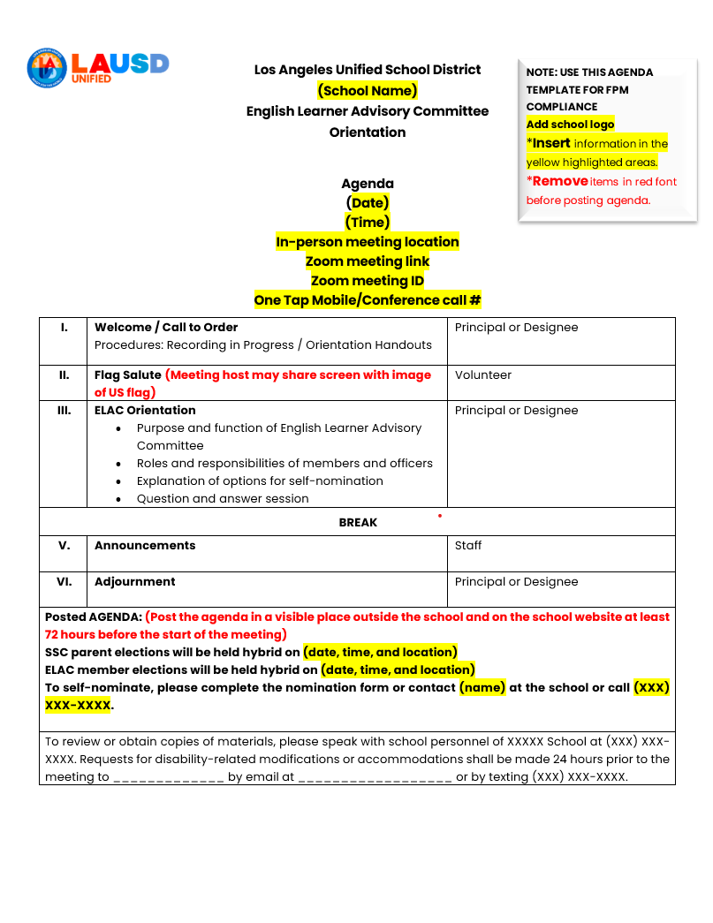
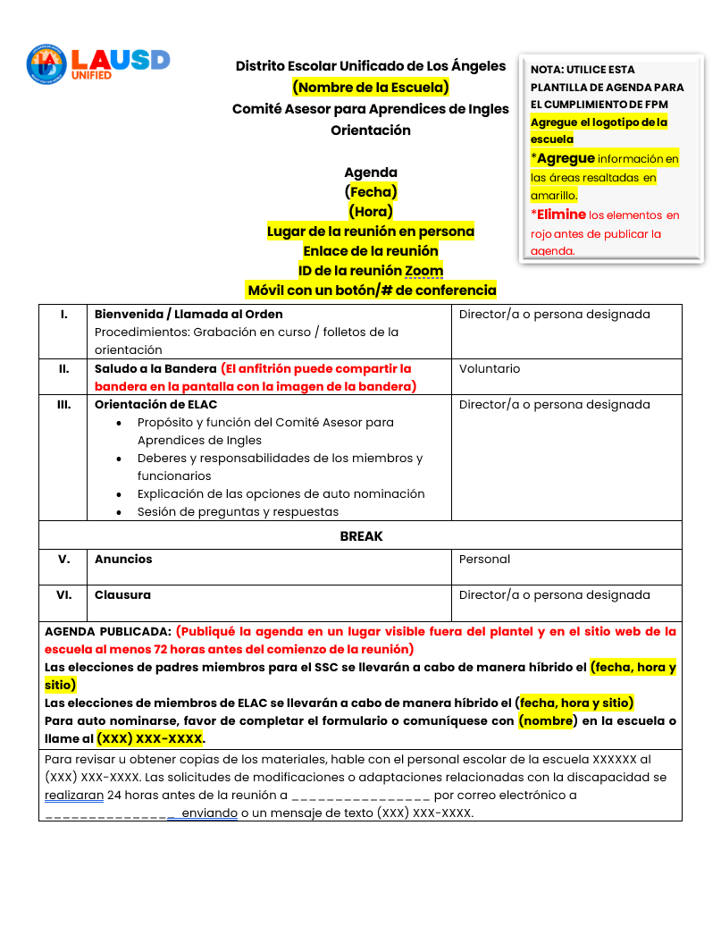
Agenda
English Learner Advisory Committee (ELAC)
Comité Asesor para Aprendices de Inglés (ELAC)
Notes:
Say: An ELAC agenda is a list of required topics that will be discussed at an ELAC meeting.
The agenda must be posted 72 hours before the meeting – this is a legal requirement under the Greene Act.
It keeps the meeting organized and informs the public.
It ensures parents know what will be discussed so they can participate.
It helps the school stay transparent and accountable.

Slide 38
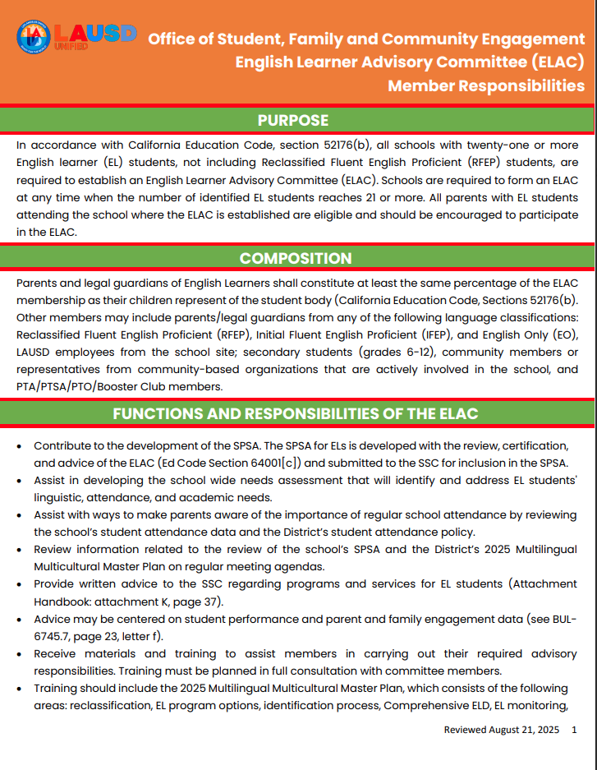
Handouts
Hojas Informativas
English Learner Advisory Committee (ELAC): Purpose, Composition
and Responsibilities
Comité Asesor para Aprendices de Inglés (ELAC) Propósito, Composición,
y Responsabilidades
Notes:
Say: This handout explains the English Learner Advisory Committee (ELAC)—specifically its:
Purpose: Why the committee exists and what it aims to do.
Composition: Who can be members and how the committee is formed.
Responsibilities: What the committee members are expected to do throughout the school year.
It serves as a guide to help parents, staff, and community members understand the role and duties of ELAC, which supports English Learner (EL) students and their families in the school community.

Slide 39
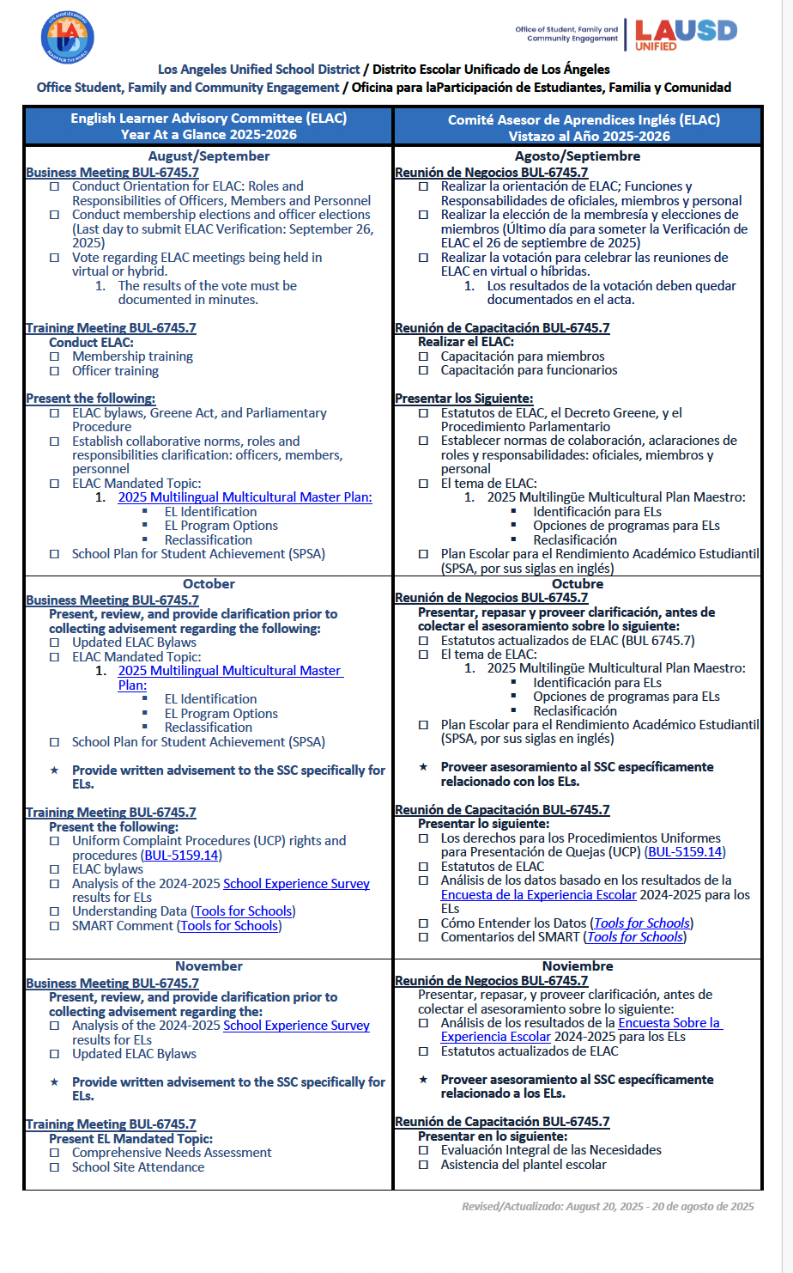
Handouts
Hojas Informativas
ELAC At a Glance
2025-2026
Vistazo al Año 2025-2026
Notes:
Say: ELAC At a Glance is a quick summary of the ELAC’s work throughout the school year, including the state requirements for ELAC as outlined in the California Education Code. It is encouraged that the school shares his document with English Learner parents and ELAC members.

Slide 40
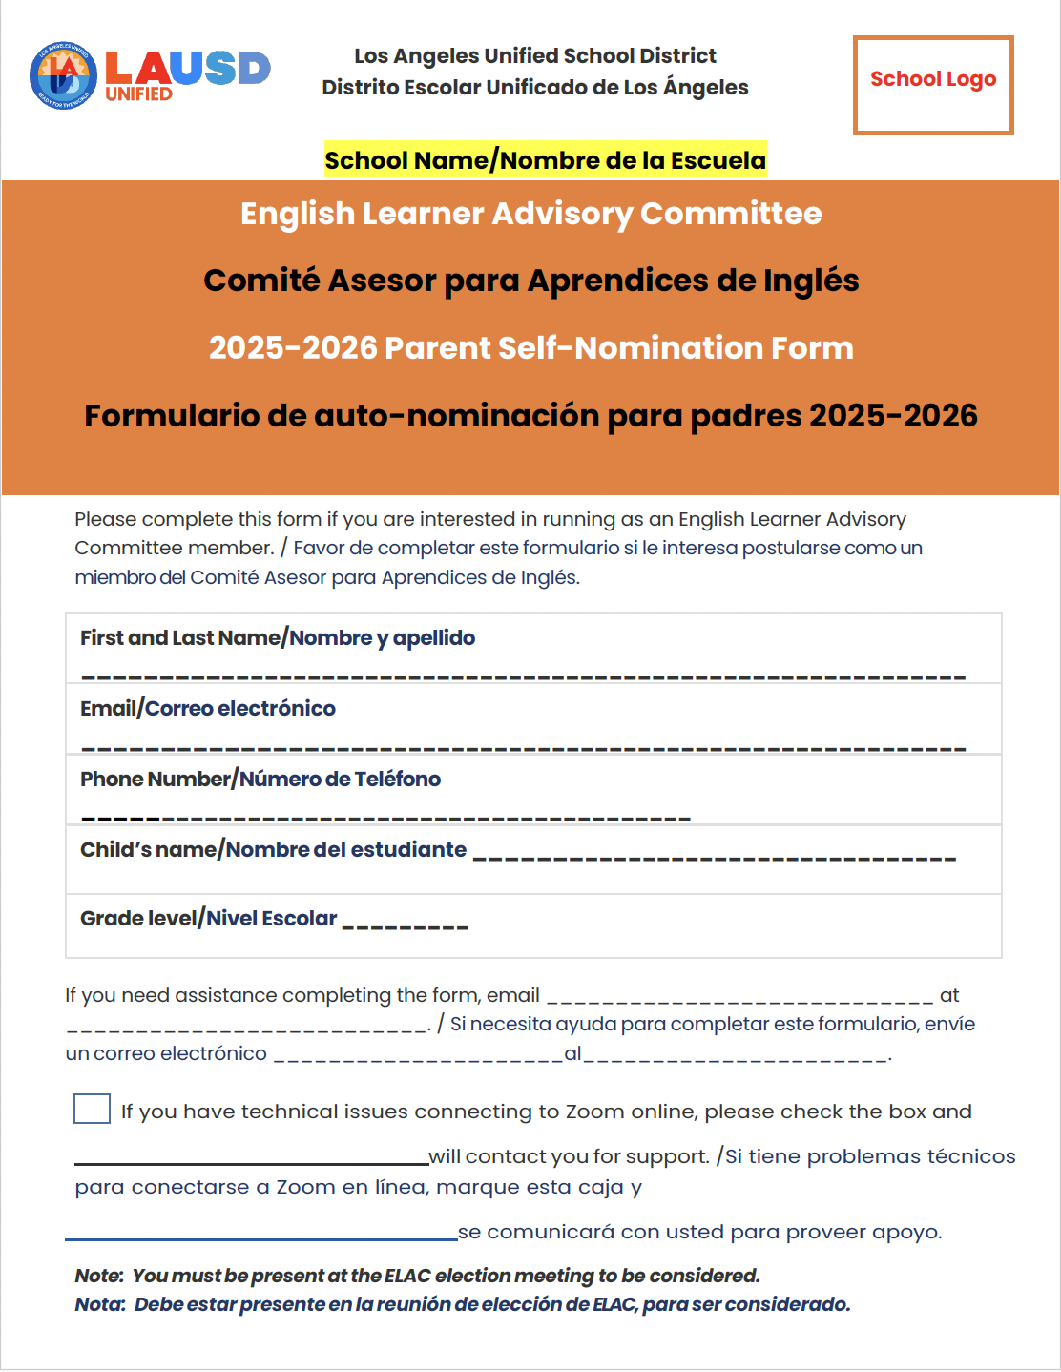
ELAC Parent Member Self-Nomination Form
Formulario de Auto nominación para Padres Miembros del ELAC
Paper form available in the main office.
Formulario para llenar en papel disponible
en la oficina principal.
Electronic fillable form available at the following link: _____________
Formulario electrónico está disponible en el siguiente enlace: ___________
Notes:
Say: A Parent Member Self-Nomination Form is a way for parents or legal guardians to volunteer to join a school committee that helps improve education and programs for students. By submitting this form, you are saying:
You want to advise on the decisions that affect how the school supports English Learners.
You want to give feedback on school programs, budgets, and family engagement.
You want to become more involved in your child’s education.
You want to represent the voices of other families in your school community.
Parent Member Self-Nomination Forms are available at your school.

Slide 41
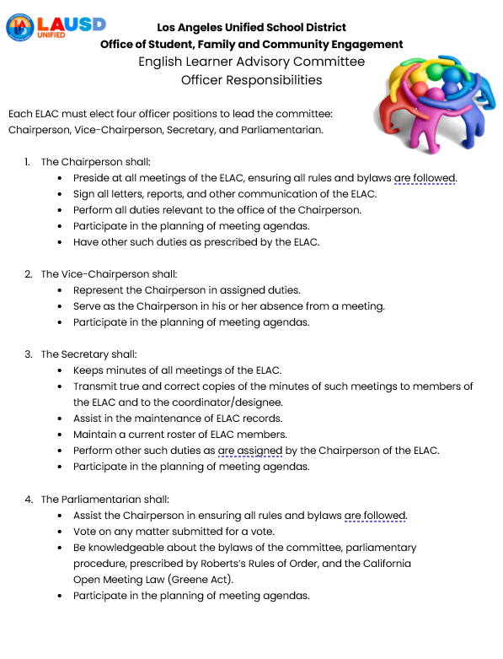
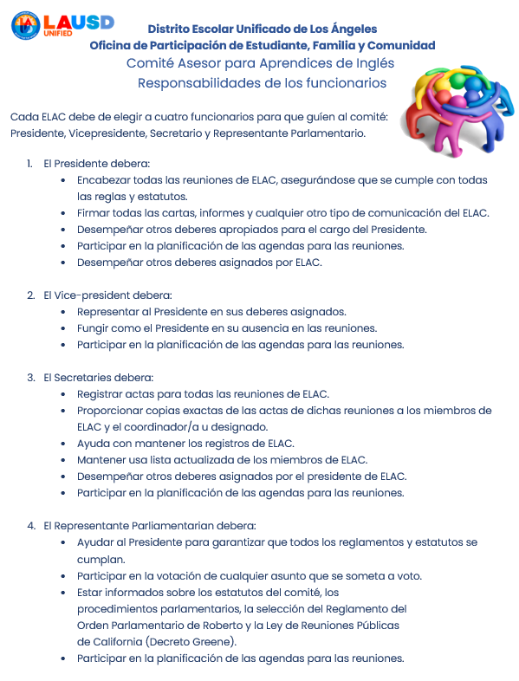
Handouts
Hojas Informativas
English Learner Advisory Committee (ELAC): Officer Responsibilities
Comité Asesor para Aprendices de Inglés (ELAC): Responsabilidades de los Funcionarios
Notes:
Say: Each ELAC must elect 4 officers, read the description for each officer.
The following are:
Chairperson
Vice-Chairperson
Secretary
Parliamentarian

Slide 42
Bylaws
Estatutos
Personalize standard bylaws provided in BUL. 6745.7
Bylaws allow for ELAC to maintain orderly flow of engagement
Bylaws follow Greene Act requirements from the CA Education Code
Modifications must be approved by the Region School Family and Community Engagement Unit.
Personalizar los estatutos estandarizados proveídos en el boletín 6745.7
Los estatutos permiten que ELAC mantenga un flujo ordenado de participación.
Los estatutos siguen los requisitos del Decreto Greene del Código de Educación de CA
Las modificaciones deben ser aprobadas por la Unidad de Participación de los Padres y la Comunidad de la Región
Notes:
Say: Bylaws are the rules that guide how the English Learner Advisory Committee (ELAC) is organized and how it operates.
Bylaws Are Important:
They keep meetings fair, organized, and legal.
They ensure all voices, especially parents of English Learners, are included.
They help prevent confusion or conflict about how the committee works.
They are required in many districts as part of compliance.

Slide 43
LAUSD Operating Norms and Code of Conduct for the ELAC
Normas de Funcionamiento de LAUSD y Código de Conducta para el ELAC
As members, you will be asked to sign the LAUSD Operating Norms and Code of Conduct for ELAC.
Ask that we keep students a priority in making decisions.
Listen attentively, speak respectfully, and do not interrupt each other.
Believe that we can agree to disagree and that there is more
Como miembros, se les pedirá que firmen las Normas de Funcionamiento y el Código de Conducta de LAUSD para ELAC.
Pide que mantengamos a los estudiantes como la prioridad en la toma de decisiones.
Escuchar atentamente, hablar con respeto y no interrumpir mientras hablan otras personas.
Creer que podemos estar de acuerdo en estar en desacuerdo y que hay más de una solución a un problema.
Notes:
Say: The LAUSD Operating Norms and Code of Conduct are guidelines that ensure respectful, inclusive, and effective engagement in school site-level and district-level parent advisory committees.
Why They Matter
Build trust and safety for all participants.
Encourage meaningful engagement, especially from families of English Learners.
Help meetings run smoothly, efficiently, and with shared respect.
Align with broader district values around equity, transparency, and community partnership.

Slide 44
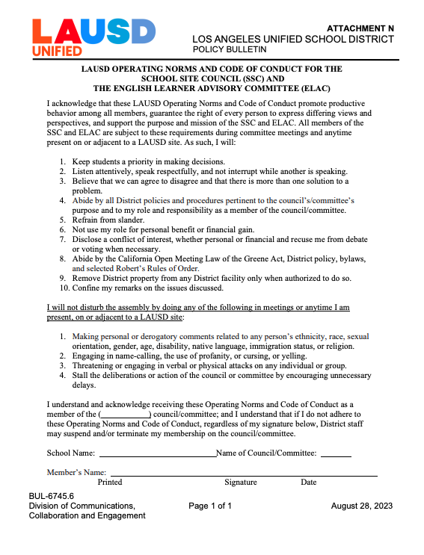
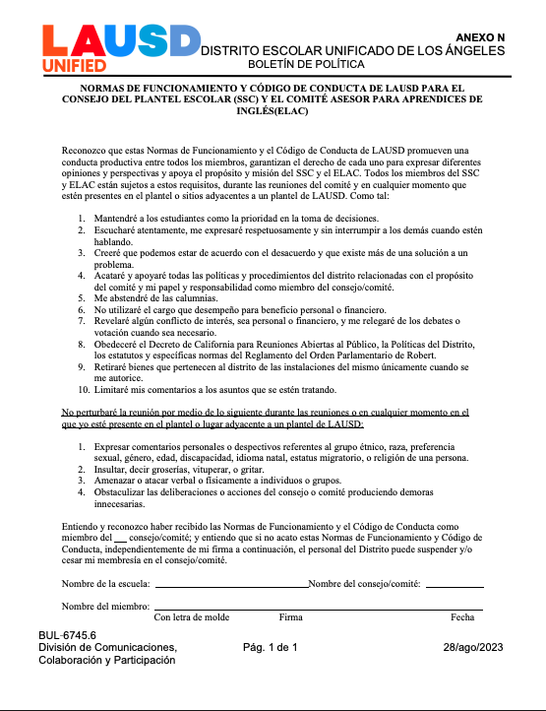
LAUSD Operating Norms and Code Of Conduct for ELAC
Normas de Funcionamiento de LAUSD para el ELAC
Notes:
Say: The LAUSD Operating Norms and Code of Conduct establish expectations for conduct and participation in district committees. They ensure a respectful, equitable, and procedural environment aligned with legal standards. ELAC members must adhere to these norms, regardless of their signature.

Slide 45
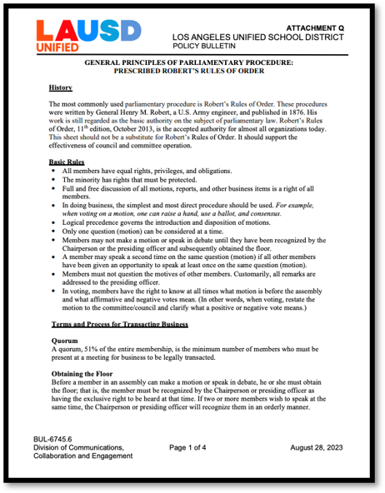
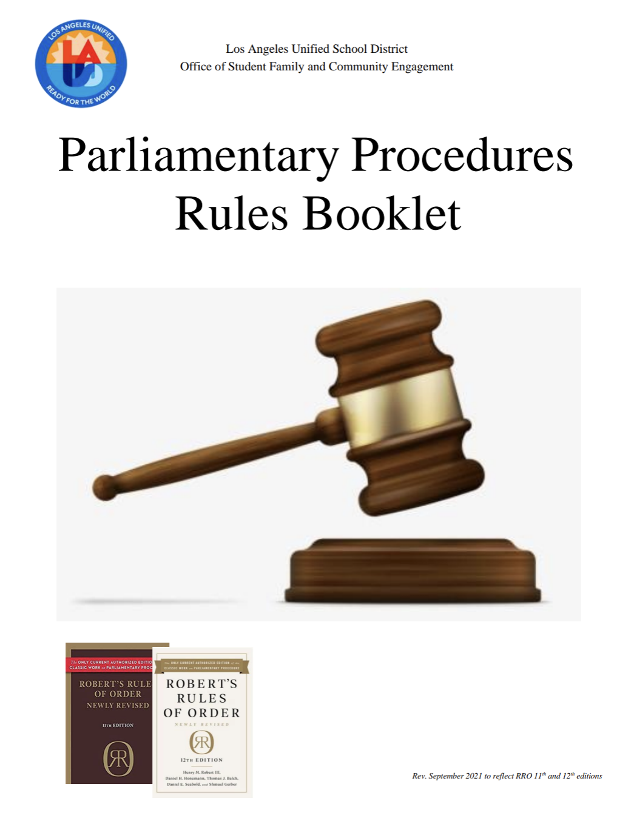
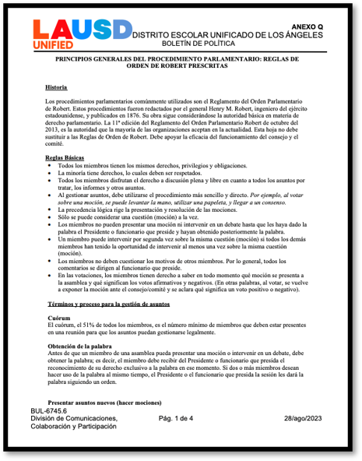

Handouts
Hojas Informativas
Roberts Rules of Order – Attachment Q
Normas de Robert - Adjunto Q
Parliamentary Procedure
Procedimiento Parlamentario
Notes:
Say: Robert’s Rules of Order are a set of formal meeting procedures (also called parliamentary procedures) used to keep meetings fair, organized, and respectful.
Many school committees, including ELAC, follow RRO to make sure everyone has a voice, and decisions are made clearly and democratically.

Slide 46

Notes:
Ask: Do you have any questions regarding the ELAC?

Slide 47

Contact Information
Información de Contacto
School Logo
Name and Title
E-mail:
Phone Number:
Nombre y Título
Correo Electrónico:
Número de teléfono:
Notes:
Do: Insert your school’s logo and contact information.

Slide 48
Thank you!!
Gracias!!
Contact your Region Family and Community Engagement Administrative Coordinator.
Comuníquese con su Administrador de la Unidad de Participación de Familias y Comunidad.
Region/Región | PACE Administrative Coordinator | Email
East/Este | Megan Guerrero Amaris Medina | mguerr3@lausd.net amaris.medina@lausd.net
West/Oeste | Crystal Dukes | crystal.dukes@lausd.net
North/Norte | Laura Fuentes Jeremiah Gonzalez | Lxf1109@lausd.net Jjg2443@lausd.net
South/Sur | Ursula Martin | umartin@lausd.net
Virtual Academy Academia Virtual | Marie Sa Michinard | mls0363@lausd.net
Notes:
Say: You may contact your Region Family and Community Engagement Administrative Coordinator if you have additional questions regarding the EL Delegate Convening.
Thank you for joining today’s ELAC Orientation.
Please join us for the ELAC Election scheduled on (Add date and time).

