Slide 1

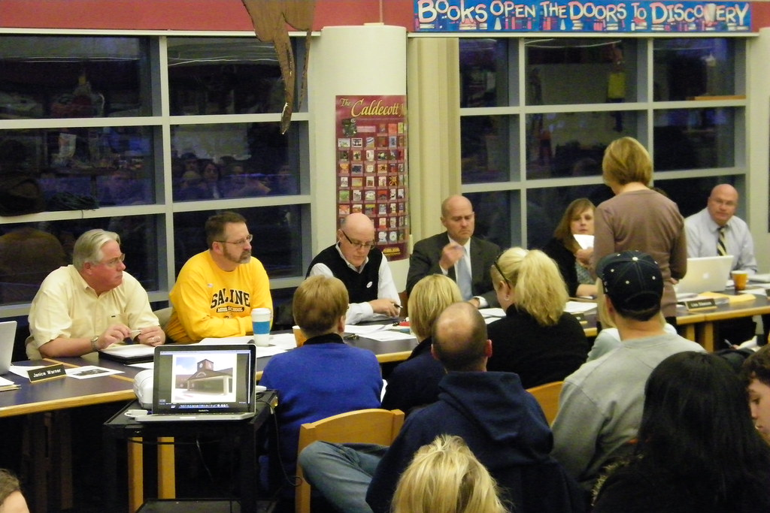

English Learner Advisory Committee
Officer Training
Capacitación de los Funcionarios del Comité Asesor para Aprendices de Inglés
BUL 6745.6 Guidelines for the Required School Site Council and English Learner Advisory Committee
BUL 6745.6 Normas para el Requerido Consejo del Plantel Escolar y el Comité Asesor para Aprendices de Inglés
This Photo by Unknown Author is licensed under CC BY-SA-NC
Notes:
Please play music as participants arrive.
Say: Welcome and thank you for becoming a SSC member.
During today’s training you will learn about our SSC leadership team.
Note: If you are meeting in person and you are not Hybrid, please hide slides 2, 3, 4, and 5
Click

Slide 2

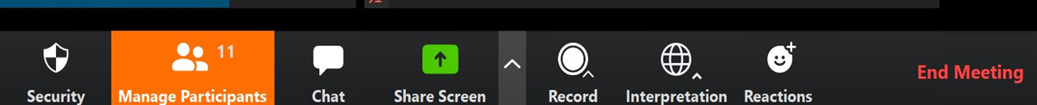
Interpretation Services: Laptop or Computer
Servicios de Interpretación: Computadora o computadora portátil
Click on the globe icon at the bottom of the screen.
Select your language of preference.
You will engage and listen to the presentation in the language you select.
Haga clic en el símbolo del mundo en la parte de abajo de su pantalla.
Seleccione el idioma que le gustaría escuchar.
Participará y escuchará la presentación en el idioma que seleccione.
Notes:
Say:
We have interpretation services if you are joining us on a computer.
I am sorry Chromebooks don’t offer the feature. If you are on a Chromebook, please stay on your computer for so you can see us on the screen and use the chat feature. For audio, join us via phone.
I will provide more guidance shortly.
For those that are on the computer, please click on the globe icon at the bottom of the screen.
Select your language of preference.
You will engage and listen to the presentation in the language you select.
Click
Diga:
Tenemos servicios de interpretación, si nos acompaña a través de una computadora.
Desafortunadamente los Chromebooks no ofrecen esta característica. Si está usando un Chromebook, quédese en la computadora para que pueda ver la presentación en una pantalla más grande y usar el chat. Pero, puede usar su teléfono para escuchar el audio.
Daré más instrucciones a continuación.
Para los que nos acompañan en una computadora, haga clic en el símbolo del mundo en la parte de abajo de la pantalla.
Seleccione su idioma de preferencia.
Participará y escuchará la presentación en el idioma que seleccione.
Clic

Slide 3

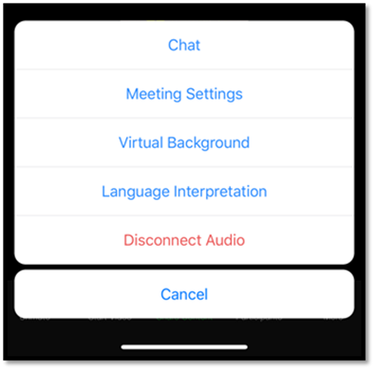

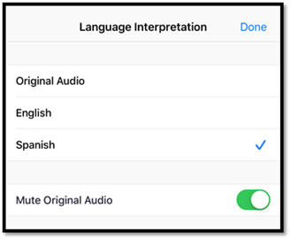

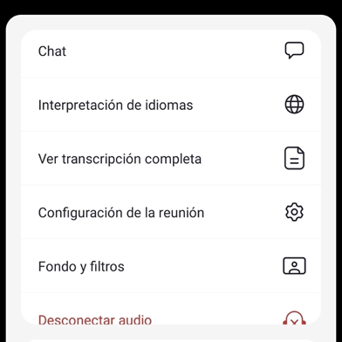
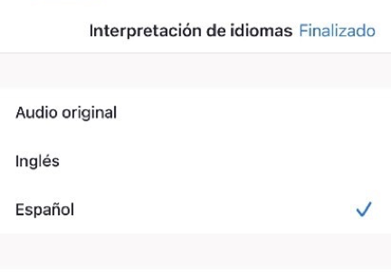
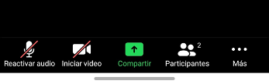
Interpretation Services: Mobile Device
Servicios de interpretación: dispositivo móvil
Notes:
Say: For those who are joining us via phone, please click on the three dots.
A window will open and click on the words, language interpretation.
Select your language of preference.
Click on Done to activate interpretation.
Even though most of the presentation is in English, participants might speak in Spanish, so please select your langrage so that you can understand your Spanish-speaking collogues.
Click
Diga: Para los que nos acompañan por teléfono, haga clic en los tres puntos.
Se abrirá una ventana. Hágale clic a e interpretación de idiomas.
Seleccione idioma de preferencia
Haga clic a finalizado para activar la interpretación.
Clic

Slide 4
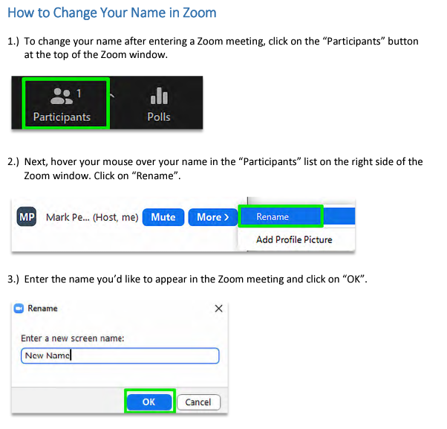
How to Rename Yourself on Zoom
Cómo Cambiar su
Nombre en Zoom
In the Zoom meeting, click on the “Participants” list on the bottom of your Zoom window.
Hover your mouse over your name in the “Participants” list on the right side of the Zoom screen. Click on “Rename”.
Please rename yourself with your first and last name.
En la reunión de Zoom, haga clic en la lista de "Participantes" en la parte inferior de la ventana de Zoom.
Pase el cursor sobre su nombre en la lista de "Participantes" al lado derecho de la pantalla de Zoom. Haga clic
en “Renombrar".
Cambie su nombre incluyendo su nombre
y apellido.
Notes:
Say:
We’d like to know who is in the room, please rename yourself by doing the following 5 steps.
Step 1: Hover over your picture located by the picture gallery with your cursor and search for the three dots found on the top right-hand corner of your picture.
Step 2: Click the three-dotted icon found over your picture.
Step 3: Click More.
Step 4: Choose Rename to change your screen name displayed to other participants.
Step 5: Enter the full name used when you enrolled your students at the school site, then click Save to finish the change.
Click
Diga:
Para saber quién está presente, siga los cinco pasos a continuación.
Paso 1: Ponga su cursor en el cuadro en la galería de participantes con su nombre y busque los tres puntitos en la esquina derecha superior de su cuadro.
Paso 2: Haga clic en el ícono con los tres puntos en su cuadro.
Step 3: Haga clic en Más
Paso 4: Seleccione Renombrar para cambiar su nombre que se muestra a los participantes.
Paso 5: Ingrese su nombre completo que se usó para inscribir a su estudiante en el plantel escolar, después haga clic en Aceptar para efectuar el cambio.
Clic

Slide 5

Participación por medio de Zoom
Engaging on Zoom
If you need assistance, accessing zoom for this meeting send an email to ___________ and a team member will assist you.
Zoom includes a “Chat” tab where you can type your questions for the presenters.
Si necesita ayuda con acceder a Zoom para esta reunión, envíe un email a _______________ y un miembro de nuestro equipo le ayudará.
Zoom tiene una pestaña de Chat en la que usted puede hacer preguntas a los presentadores.
Notes:
To do: Add contact e-mail
Say: If you need assistance accessing zoom for this meeting, send an email to ___________ and a team member will assist you.
Zoom includes a “Chat” tab where you can type your questions for the presenters.
Click
Qué Hacer: Agregue el email de contacto
Diga: Si necesita ayuda con acceder a Zoom durante esta sesión, envíe un email a ____________ y alguien del equipo le ayudará.
Zoom incluye una pestaña de chat en la que puede enviar preguntas a los presentadores.
Clic

Slide 6

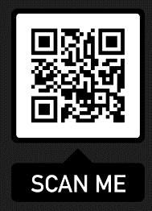
Guidelines/
Guía
LAUSD Bulletin 6745.6: Guidelines for the Required ELAC and SSC (English) and (Spanish) available at:
El Boletín 6745.6: Guía de los requisitos del ELAC y SSC disponible en (inglés) y (español) disponible en:
https://achieve.lausd.org/sface
Notes:
The Bulletin contains the guidelines for ELAC and in the back section, you will find templates to support your work as officers.
You can download a copy of the Bulletin by going to https://achieve.lausd.net/pcss
Note: The Word version of all templates is available in Tools for Schools on this website under the ELAC tab:
https://www.lausd.org/Page/10779
Say: LAUSD has a Bulletin that provides guidance to all districts and school staff regarding the state and federal requirements for School Site Council and the English Learner Advisory Committee and is available in English and Spanish at https://achieve.lausd.net/pcss
The last section contains the templates that we will introduce during this presentation.
Click

Slide 7
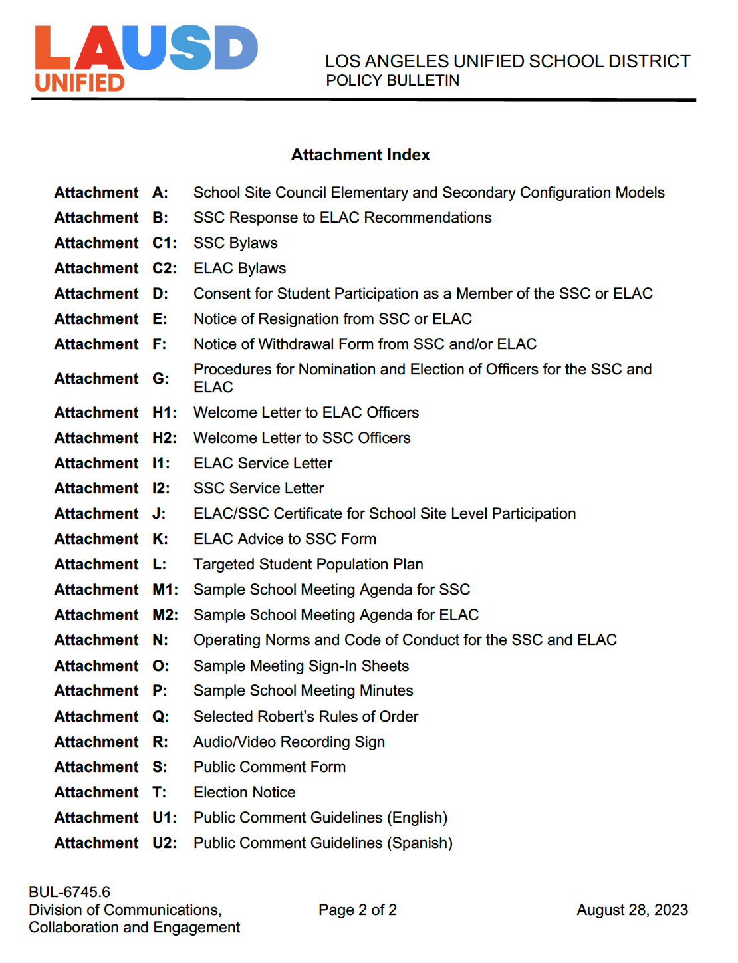
Bulletin 6745.6
Attachment Index
Índice de Adjuntos del Boletín 6745.6
Notes:
Say: This is a list of all the attachments available in Bulletin 6745.6. Some of the attachments are in yellow. These are the most important because they guide our monthly work.
Attachment B: SSC Response to ELAC Recommendations
Attachment C2: ELAC Bylaws
Attachment E: Notice of Resignation from ELAC
Attachment F: Notice of Withdrawal Form from ELAC
Attach
Sample School Meeting Agenda for SSC
Attachment L: Sample Meeting Sign-In Sheets
Attachment M: Sample School Meeting Minutes
Attachment P: Public Comment Form
These attachments will be collected and kept at the school and saved for 5 years.
The titles highlighted in gray are the documents you need to know as officers, especially the Parliamentarian.
Attachment A: School Site Council Elementary and Secondary Configuration Models (incase we want to increase our membership in the future)
Attachment C1: SSC Bylaws
Attachment K: Operating Norms and Code of Conduct for the SSC and ELAC
Attachment N: Selected Robert’s Rules of Order
Attachment R: Public Comment Guidelines
Attachment R1: Public Comment Guidelines (Spanish)
They provide guidance in case there are any operational questions.
The other attachments are to support the ELAC and SSC work in general.
Attachment C1: SSC Bylaws
Attachment C2: ELAC Bylaws
Attachment D: Consent for Student Participation as a Member of the SSC or ELAC
Attachment E: Notice of Resignation from SSC or ELAC
Attachment E1: Notice of Withdrawal Form from SSC and/or ELAC
Attachment F: Procedures for Nomination and Election of Officers for the SSC and ELAC
Attachment G1: Welcome Letter to ELAC Officers
Attachment G2: Welcome Letter to SSC Officers
Attachment G3: ELAC Service Letter
Attachment G4: SSC Service Letter
Attachment G5: ELAC/SSC Certificate for School Site Level Participation
Attachment H: ELAC Advice to SSC Form
Attachment I: Targeted Student Population Plan
Attachment J1: Sample School Meeting Agenda for ELAC
Attachment O: Audio/Video Recording Sign
Attachment Q: Election Notice
Click

Slide 8
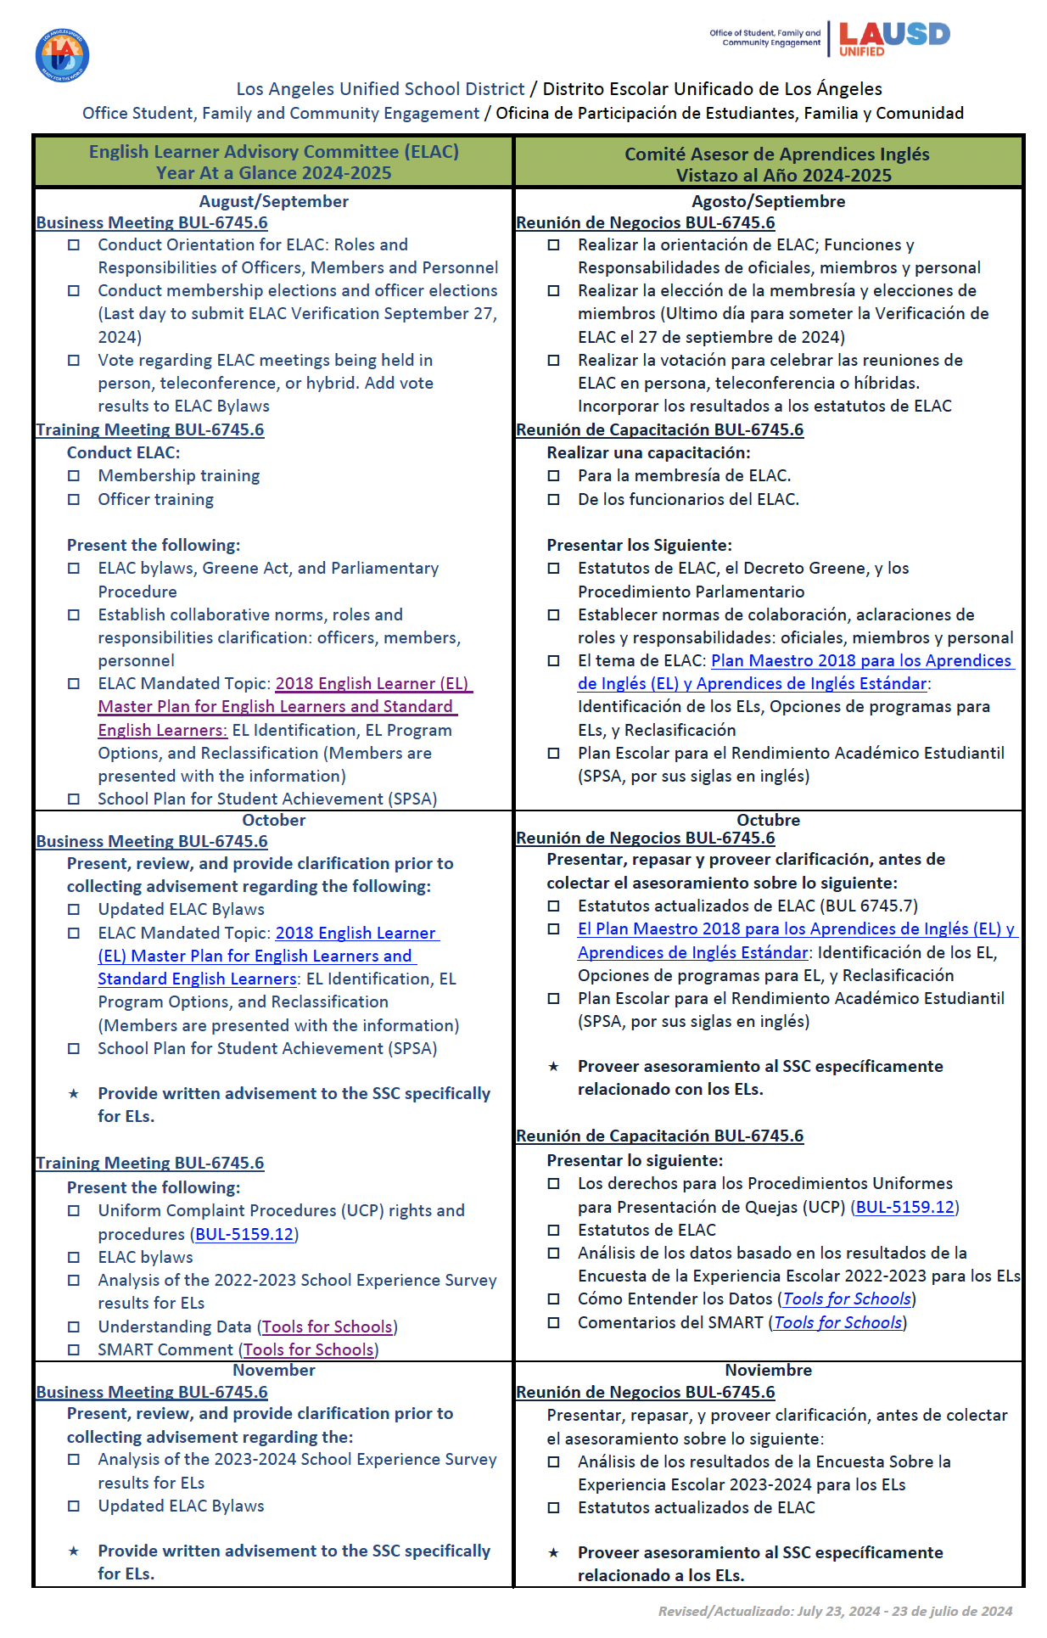
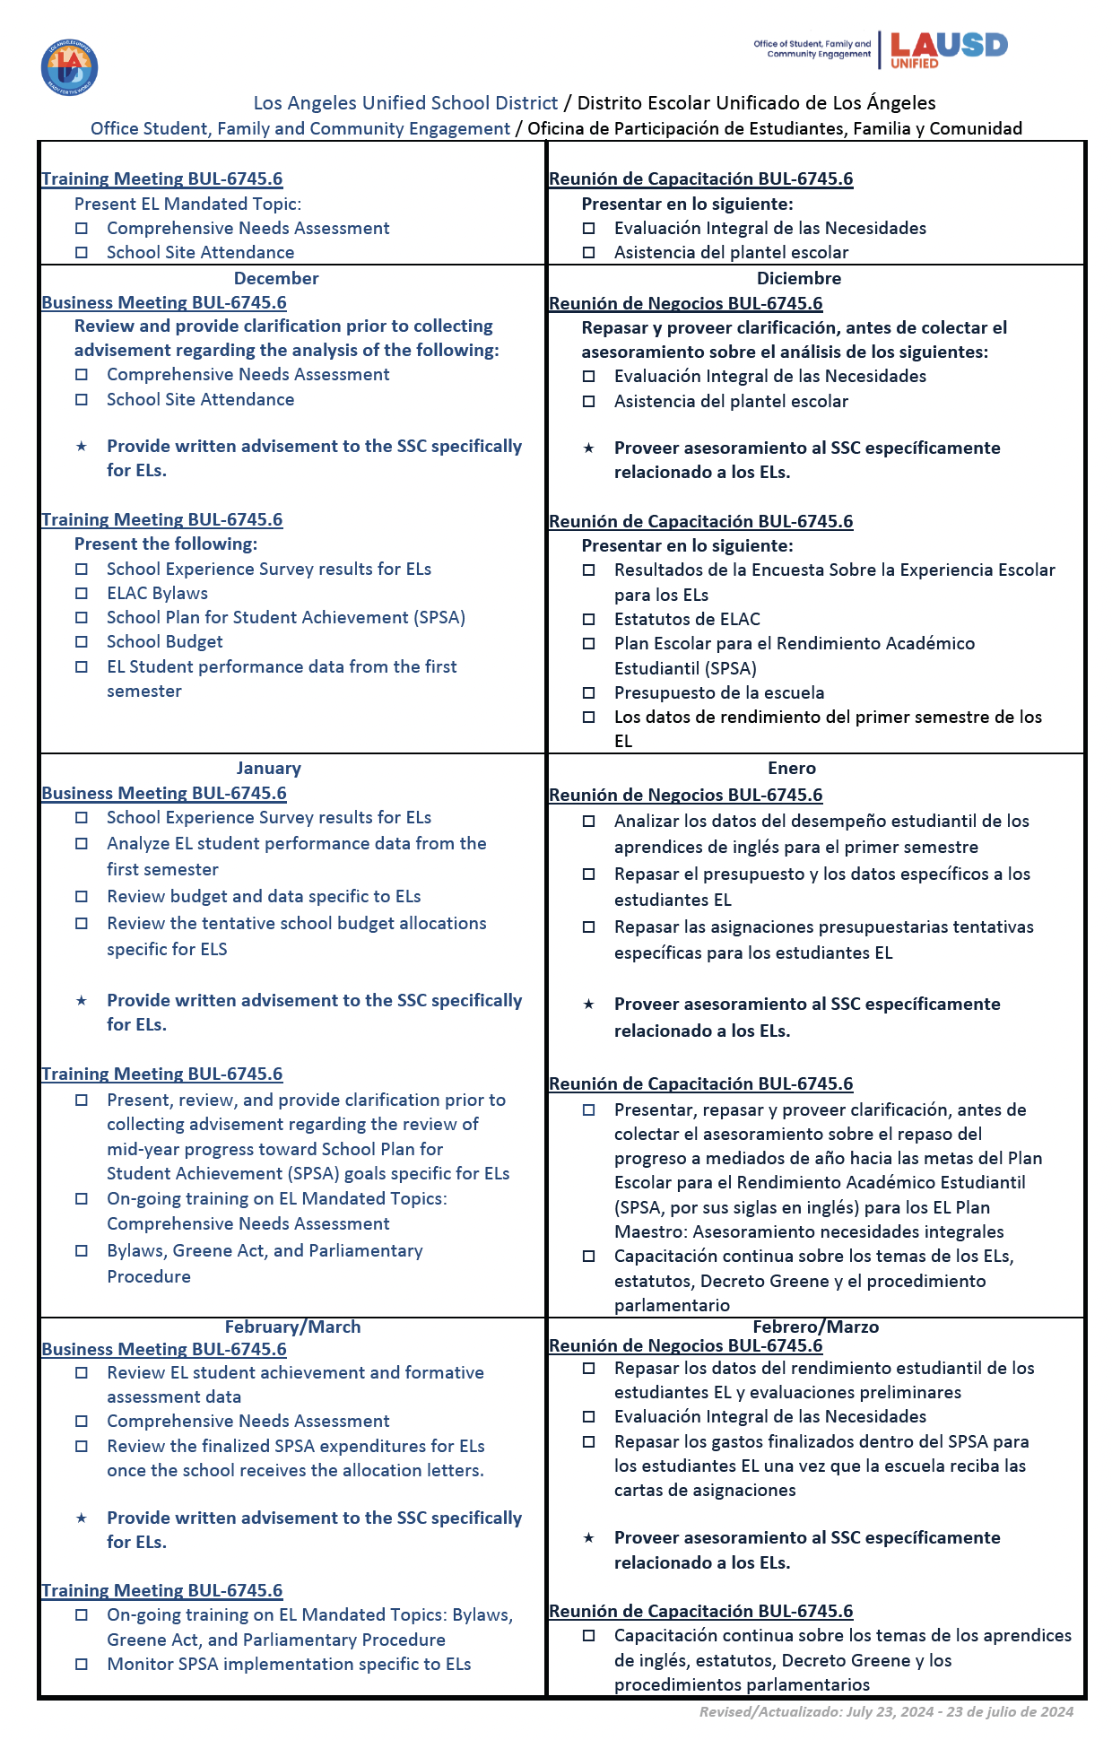
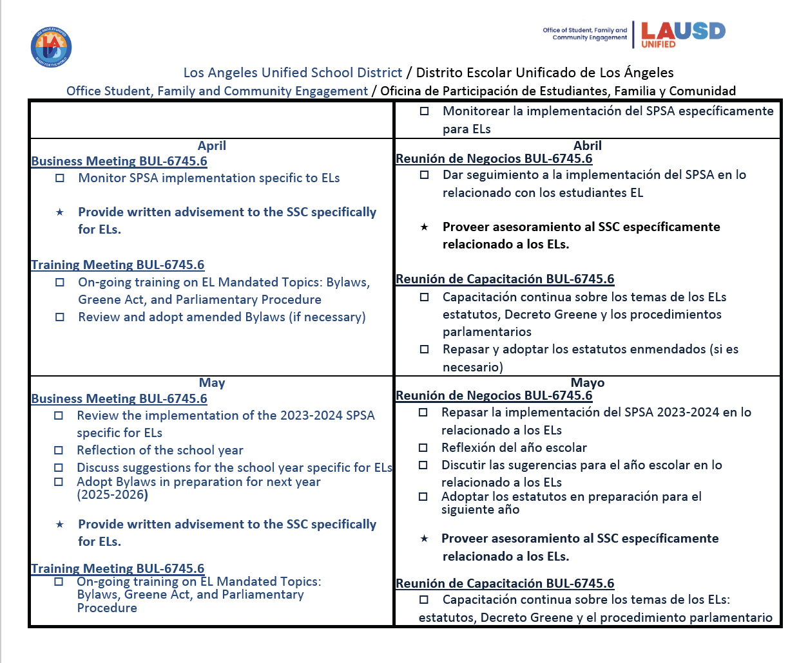
English Learner Advisory Committee
Comité Asesor para Aprendices de Inglés​

Slide 9
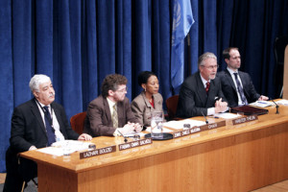
ELAC Officers Roles and Responsibilities
Función y Responsabilidades de los Funcionarios del ELAC

Slide 10
ELAC Officers Roles and Responsibilities
Función y Responsabilidadesde los Funcionarios del ELAC
.
.
.
.
Name,
Chairperson/
Presidenta
Name,
Vice-Chairperson/
Vice-Presidenta
Name,
Secretary/
Secretaria
Name,
Parliamentarian/
Parlamentaria
Notes:
To do: Insert pictures and names.
Click

Slide 11
Definition | Definición
Presides at all meetings.
Presidir en todas las reuniones.
Chairperson: A person that leads the meeting. This person directs what is discussed in the meeting, as per the agenda.
Presidente: La persona que está a cargo de la reunión. Esta persona tiene la capacidad de dirigir lo que qué se discute algo en la reunión, de acuerdo a la agenda.
01
Participates in agenda planning with the other officers and school staff.
Participar en la planificación de la agenda con los otros funcionarios y personal escolar
Other duties as prescribed by the council.
Desempeñar otras responsabilidades establecidas por el consejo.
04
Chairperson
Presidente/a
02
03
Signs all pertinent documents.
Firmar todos los documentos pertinentes.
Notes:
Say: Let's get started by reviewing the definition of a Chairperson.
A Chairperson is a person that is in charge of the meeting. This person has the ability to direct where and what is discussed in the meeting.
Click & words will appear – ask for a volunteer to read.
Presides at all meetings.
Click & words will appear – ask for a volunteer to read.
Participate in agenda planning with the other officers and school staff.
Click & words will appear – ask for a volunteer to read.
Sign all pertinent documents.
Click & words will appear – ask for a volunteer to read.
Other duties as are prescribed by the council.
Click

Slide 12
Definition | Definición
Serves as the Chairperson in
his or her absences.
Funge como el Presidente en su ausencia.
Vice-Chairperson: A person who leads the meeting in the absence of the Chairperson.
Vice-Presidente: La persona que está a cargo de la reunión cuando el presidente/a esté ausente.
01
Participates in agenda planning
with the other officers and school staff.
Vice-
Chairperson
Vice-
Presidente
Represents the Chairperson in assigned duties.
Representa al Presidente en sus deberes
Participa en la panificación de la agenda con los otros funcionarios y personal
escolar
03
02
Notes:
Say: Let's review the definition of a Vice-chairperson.
A Vice-chairperson is a person that oversees the meeting in the absence of the Chairperson
Click & words will appear – ask for a volunteer to read.
Presides the meetings in the absence of the Chairperson.
Click & words will appear – ask for a volunteer to read.
Represent the Chairperson in assigned duties.
Click & words will appear – ask for a volunteer to read.
Participate in agenda planning with the other officers and school staff.
Click

Slide 13
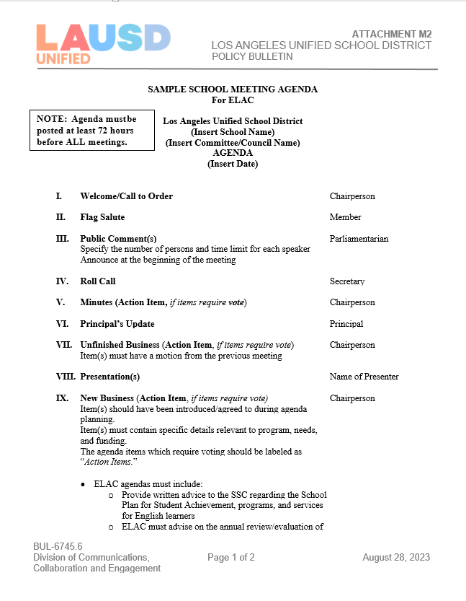
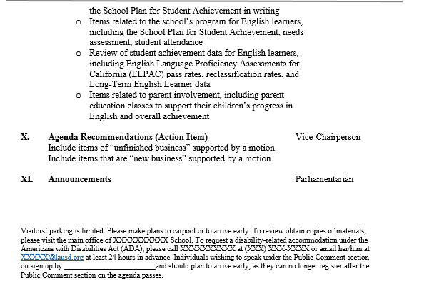
Agenda Template
(Attachment M2)
Planilla de la Agenda (Adjunto M2)
ELAC agendas must include:
Welcome /Call to order
Flag Salute
Public Comments
Roll Call
Minutes (Action Item)
Principal Update
Unfinished Business (Action Item)
Presentation (s)
New Business (Action Item)
Agenda Recommendations (Action Items)
Announcements
La agenda de ELAC debe incluir:
Bienvenida/ Llamada al orden
Saludo a la bandera
Comentarios públicos
Pasar lista
Aprobación de actas (Acción)
Actualización del director
Asuntos pendientes (Acción)
Presentaciones
Nuevos asuntos (Acción)
Recomendaciones para la agenda (Acción)
Anuncios
Public Comment must be on all agendas. Comentatio Publico debe de star en todas la agendas.
Agenda items to include
Puntos en la agenda que deben de incluyer.
Posting and contact information
Fecha de cuando se publico la agenda y informcacion de contactol
Notes:
Note: Agenda templates in Word are available in Tools for Schools under the SSC tab: https://achieve.lausd.net/Page/11304
Say: SSC agendas must include:
Welcome Call to Order
Flag Salute
Public Comments
Roll Call
Approval of Minutes (Action)
Principal Update
Unfinished Business (Action)
Presentations
New Business (Action)
Agenda Recommendations (Action)
Announcements
Adjournment
Click & agenda will fly in.
Click

Slide 14
Definition | Definición
Transmits true and correct copies of the minutes of such meetings to members.
Entregar copia precisa y correcta de las actas a los miembros.
Secretary: A person that is responsible for the documentation of the council’s business.
Secretario/a: Una persona que es responsable de la documentación de los asuntos
del consejo.
01
Other duties as assigned by the SSC Chairperson.
Desempeñar otras responsabilidades establecidas por el Presidente.
Participates in agenda planning with the other officers and school staff.
Participar en la planificación de la agenda con los otros funcionarios y personal escolar
04
Secretary
Secretaria
02
03
Maintains a current roster of SSC members.
Mantener una lista actualizada de la membresía de SSC.
Notes:
Say: Let's get started by reviewing the definition of a Secretary.
A Secretary is a person that is in charge of the meeting. This person has the ability to direct where and what is discussed in the meeting.
Click & words will appear – ask for a volunteer to read.
Transmit true and correct copies of the minutes of such meetings to members
Click & words will appear – ask for a volunteer to read.
Participate in agenda planning with the other officers and school staff.
Click & words will appear – ask for a volunteer to read.
Maintain a current roster of SSC members.
Click & words will appear – ask for a volunteer to read.
Other duties as are prescribed by the Chairperson
Click

Slide 15
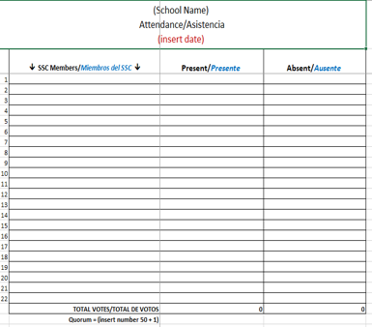
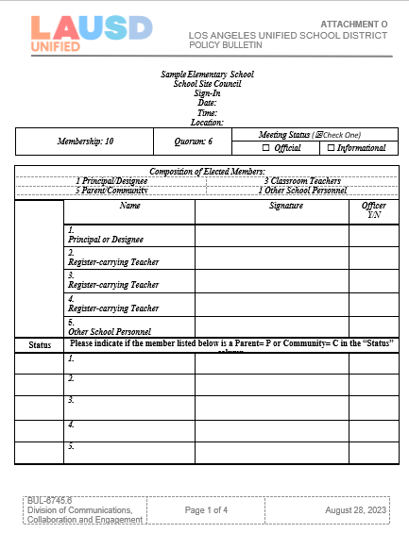
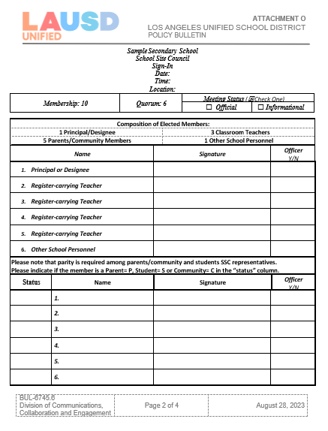
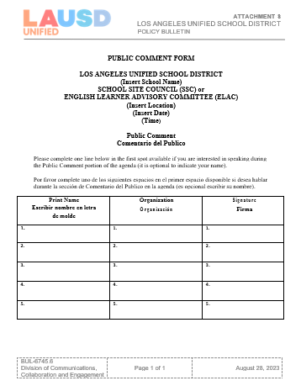
Attendance Roster Lista de Asistencia
If your ELAC voted to meet via Zoom or hybrid for the rest of the year, members must sign-in via Chat by writing their names and roles.
If hybrid you must also have physical paper sign-ins.
You will submit single usage report to your file.
Si su ELAC votó por reunirse por medio de Zoom o en formato híbrido para lo que resta del año, deben registrarse por medio del Chat al escribir su nombre y cargo. Si la reunión es hibrido tiene que tener una lista física de papel para los participantes in vivo. También someterán el reporte del usuario único a su archivo.
Public Comment (Attachment S)
Comentario Publico (Adjunto S)
Sign-in Sheets (Attachment L)
Lista de asistencia (Adjunto L)
Elementary/Primarias
Secondary/
Nivel secundario
Notes:
Note: Attendance roster templates in Word are available in Tools for Schools under the SSC tab: https://achieve.lausd.net/Page/11304
Please put this form is a Google folder that members can access without their LAUSD Single Sign-on.

Slide 16
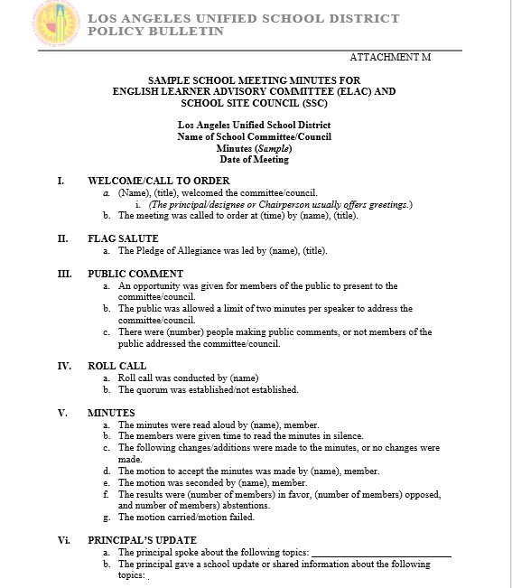
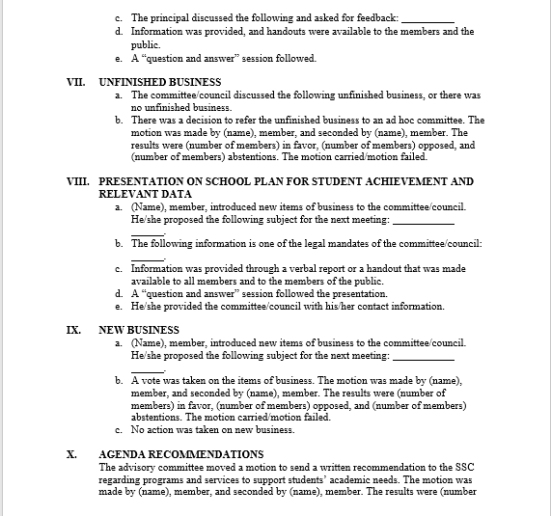
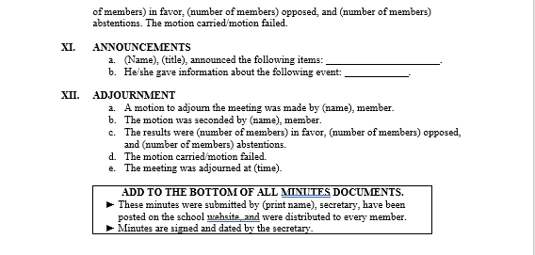
Minute Template
(Attachment M )
Planilla de las Actas (Adjunto M )
The minutes template has suggested language to support your writing of minutes. You must represent every item listed on the agenda in your minutes. The minutes must include the following:
Motions: Action/Advisement from a member that must include their name, what they stated, name of person who seconded the motion and a vote must be taken.
Vote: Part of the motion process. Minutes must reflect how many are in favor, are against, or abstain, and if the motion passed or failed.
La planilla del acta cuenta con lenguaje sugerido para apoyar con la redacción del acta. Debe de representar cada asunto enumerado en la agenda dentro del acta. El acta debe de incluir lo siguiente:
Mociones: Las acciones/asesoramiento de los miembros deben incluir su nombre, lo que expresaron, nombre de la persona que secundó la moción y se debe de someter a votación.
Votación: Parte del proceso de la moción. El acta debe reflejar cuántos están a favor, en contra, o que se abstienen y si la moción se aprobó o fracasó.
Notes:
Say: Attachment M is the minutes template, and it looks like this. I know it might be a little intimidating, but I have great news for you. The minutes template has suggested language to support your writing of minutes. You must represent every item listed on the agenda in your minutes. The minutes must include the following:
Who: name and title of person
What: name of presentation/topic and a brief overview of what was presented.
Time: Starting and ending time.
Roll call and establishment of quorum: 50+1% of the members must be present to establish quorum. If quorum is not established the meeting is informative only no action can be taken.
Motions: Action/Advisement from a member that must include their name, what they stated, name of person who seconded the motion and a vote must be taken.
Vote: Part of the motion process. Minutes must reflect how many are in favor, are against, or abstain, and if the motion passed or failed.
Please know that my team and I will be at your side to support you in any way we can.
Click

Slide 17
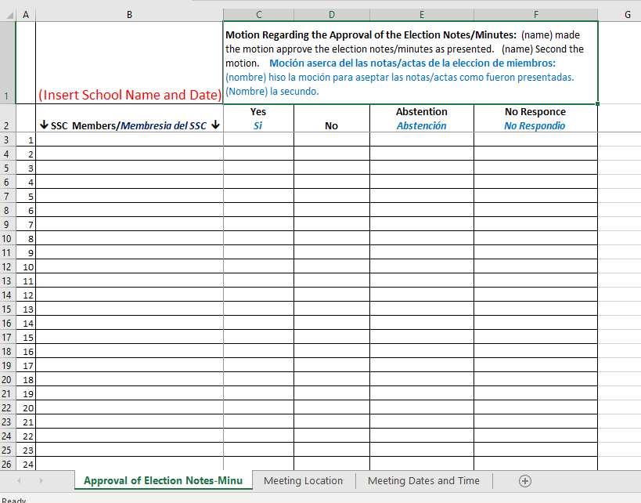
Roll Call Voting Roster Lista de Asistencia para la Votación
Notes:
Note: Roll Call Voting Roster templates in Word are available in Tools for Schools under the SSC tab: https://achieve.lausd.net/Page/11304
Please put this form is a Google folder that members can access without their LAUSD Single Sign-on.

Slide 18
Assists the Chairperson in ensuring all rules and bylaws are followed.
Ayudar al presidente en asegurar que todas las reglas y estatutos se respeten.
Definition | Definición
Parliamentarian: A person who is expert in the formal rules and procedures of deliberation of the committee or council.
Representante Parlamentario: La persona que es experta en las reglas y procedimientos formales para las deliberaciones del comité o consejo.
01
Participates in agenda planning with the other officers and school staff.
Participar en la planificación de la agenda con los otros funcionarios y personal escolar.
Be knowledgeable about the governing documents of SSC.
Tener conocimientos sobre los documentos de guía para el SSC.
Parliamentarian
Representante Parlamentario
04
02
03
Votes on any matter submitted for a vote.
Votar por cualquier asunto que se someta a votación.
Notes:
Say: Let's continue by reviewing the definition of a Parliamentarian.
The Parliamentarian is a person who is expert in the formal rules and procedures of deliberation of the committee or council.
Click & words will appear – ask for a volunteer to read.
Assist the Chairperson in ensuring all rules and bylaws are followed.
Click & words will appear – ask for a volunteer to read.
Participate in agenda planning with the other officers and school staff.
Click & words will appear – ask for a volunteer to read.
Vote on any matter submitted for a vote.
Click & words will appear – ask for a volunteer to read.
Be knowledgeable about the governing documents of SSC.
Click

Slide 19
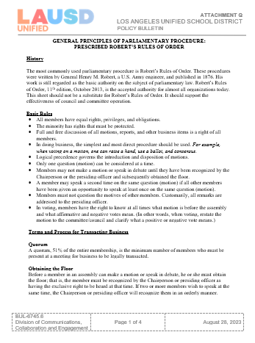
Selected Roberts Rules​
of Order
(Attachment Q)
Normas Selectas de las
Normas de ​Orden
Parlamentario de Robert
(Adjunto Q)
Basic Rules
Normas Básicas
All members have equal rights, privileges, and obligations.
The minority has rights that must be protected.
Full and free discussion of all motions, reports, and other business items is a right of all members.
• Todos los miembros tienen los mismos derechos, privilegios y obligaciones.
• La minoría tiene derechos, lo cuales deben ser protegidos.
• Todos los miembros disfrutan el derecho a discusión plena y libre en cuanto a todas las mociones, los informes y otros asuntos.
Notes:
Say: The General Principles of Parliamentary Procedure: Prescribed Robert’s Rules Of Order document starts with the history, moves on to basic rules and continues with terms and process for "transacting business", which is the formal way of saying voting, or taking action.
Please keep in mind that Robert’s Rules is about using orderly procedures to have discussion and make decisions, encouraging respect for all members and guests.
As there are many rules, we are going to focus on the basic rules.
Might I have a volunteer read the first 3 points?
Click & statements will fly in.
Say: I will read the next statement to clarify what this will look like at our school, since we are meeting____________ (Remember if meeting via Zoom or if you are Hybrid, you must do a roll call vote.)
Click & statement will fly in.
Might I have a volunteer read the last 2 points?
Click & statements will fly in.
Click

Slide 20
Selected Roberts Rules
of Order
(Attachment Q )
Normas Selectas de las
Normas de Orden
Parlamentario de Robert
(Adjunto Q )
Basic Rules
Normas Básicas
Members may not make a motion or speak in debate until they have been recognized by the Chairperson or the presiding officer and subsequently obtained the floor.
A member may speak a second time on the same question (motion) if all other members have been given an opportunity to speak at least once on the same question (motion).
Los miembros no pueden hacer una moción o hablar durante el debate hasta que hayan sido reconocidos por el presidente o funcionario que rige y le conceda la palabra.
Un miembro puede hablar por segunda vez referente al mismo asunto (moción) si todos los miembros han tenido la oportunidad de hablar por lo menos una vez referente al mismo asunto (moción).
Notes:
Say:
Might the Parliamentarian read the next points please.
Members may not make a motion or speak in debate until they have been recognized by the Chairperson or the presiding officer and subsequently obtained the floor.
A member may speak a second time on the same question (motion) if all other members have been given an opportunity to speak at least once on the same question (motion).
Thank you.
This is where being the Parliamentarian can be tricky. My recommendation is that you ask “Has everyone had an opportunity to speak, before I recognize…… again?”
Might I have a volunteer read the last 2 points?
Click & statements will fly in.
Are there any questions?
Click

Slide 21
Selected Roberts Rules
of Order
(Attachment Q )
Normas Selectas de las
Normas de Orden
Parlamentario de Robert
(Adjunto Q )
Basic Rules
Normas Básicas
Members must not question the motives of other members. Customarily, all remarks are addressed to the presiding officer.
In voting, members have the right to know at all times what motion is before the assembly and what affirmative and negative votes mean. (In other words, when voting, restate the motion to the committee/council and clarify what a positive or negative vote means.)
Los miembros no deben cuestionar los motivos de los otros miembros. Regularmente, todos los comentarios son dirigidos al funcionario que preside en la reunión.
Durante la votación, los miembros tienen el derecho de saber en todo momento qué moción está ante la membresía y qué significa un voto a favor o en contra. (En otras palabras, al votar, vuelva a exponer la moción al comité/consejo y aclare lo que significa un voto a favor o en contra)
Notes:
Say:
Might the Parliamentarian read the next points please.
Members may not make a motion or speak in debate until they have been recognized by the Chairperson or the presiding officer and subsequently obtained the floor.
A member may speak a second time on the same question (motion) if all other members have been given an opportunity to speak at least once on the same question (motion).
Thank you.
This is where being the Parliamentarian can be tricky. My recommendation is that you ask “Has everyone had an opportunity to speak, before I recognize…… again?”
Might I have a volunteer read the last 2 points?
Click & statements will fly in.
Are there any questions?
Click

Slide 22
Selected Robert's Rules
of Order
(Attachment Q )
Normas Selectas de las Normas de ​Orden Parlamentario de Robert (Adjunto Q)
Basic Rules
Normas Básicas
• A tratar asuntos, se debe utilizar el procedimiento más sencillo y directo. Por ejemplo, cuando se vota por una moción, se puede levantar la mano, usar una boleta electoral y por consenso.
• La prioridad de la lógica dirige la presentación y disposición de las mociones.
• Solamente un asunto (moción) se puede considerar a la vez.
In doing business, the simplest and most direct procedure should be used. For example, when voting on a motion, one can raise a hand, use a ballot, and consensus.
Logical precedence governs the introduction and disposition of motions.
Only one question (motion) can be considered at a time.
Notes:
Say: The General Principles of Parliamentary Procedure: Prescribed Robert’s Rules Of Order document starts with the history, moves on to basic rules and continues with terms and process for "transacting business", which is the formal way of saying voting, or taking action.
Please keep in mind that Robert’s Rules is about using orderly procedures to have discussion and make decisions, encouraging respect for all members and guests.
As there are many rules, we are going to focus on the basic rules.
Might I have a volunteer read the first 3 points?
Click & statements will fly in.
Say: I will read the next statement to clarify what this will look like at our school, since we are meeting____________ (Remember if meeting via Zoom or if you are Hybrid, you must do a roll call vote.)
Click & statement will fly in.
Might I have a volunteer read the last 2 points?
Click & statements will fly in.
Click

Slide 23
Selected Roberts Rules
of Order
(Attachment N )
Normas Selectas de las Normas de ​Orden Parlamentario de Robert (Adjunto N )
Basic Rules
Normas Básicas
Members must not question the motives of other members. Customarily, all remarks are addressed to the presiding officer.
In voting, members have the right to know at all times what motion is before the assembly and what affirmative and negative votes mean. (In other words, when voting, restate the motion to the committee/council and clarify what a positive or negative vote means.)
Los miembros no deben cuestionar los motivos de los otros miembros. Regularmente, todos los comentarios son dirigidos al funcionario que preside en la reunión.
Durante la votación, los miembros tienen el derecho de saber en todo momento qué moción está ante la membresía y qué significa un voto a favor o en contra. (En otras palabras, al votar, vuelva a exponer la moción al comité/consejo y aclare lo que significa un voto a favor o en contra)
Notes:
Say:
Might the Parliamentarian read the next points please.
Members may not make a motion or speak in debate until they have been recognized by the Chairperson or the presiding officer and subsequently obtained the floor.
A member may speak a second time on the same question (motion) if all other members have been given an opportunity to speak at least once on the same question (motion).
Thank you.
This is where being the Parliamentarian can be tricky. My recommendation is that you ask “Has everyone had an opportunity to speak, before I recognize…… again?”
Might I have a volunteer read the last 2 points?
Click & statements will fly in.
Are there any questions?
Click

Slide 24


Public Comment
(Attachment P)
Comentario Público (Adjunto P)
Please display timer when leading Public Comment.
Favor de mostrar el cronómetro al realizar el Comentario Público.
Notes:
Say: Let's look at the Public Comment Form, Attachment S and Public Comment Guidelines Form, Attachment U1
The Public Comment sheet will be placed near the regular sign-in sheets.
(If meeting on Zoom or Hybrid, Public Comment participants need to sign-in using the Chat.)
Public Comment Guidelines Form, Attachment U1
Members of the public are invited to address the ELAC in accordance with the specific guidelines below:
¨ Speakers for public comment must sign up on a first-come, first-served basis at the meeting.
¨ No slot for public comment will be held or served by proxy.
¨ Each speaker will be allowed a single appearance at the public comment time.
¨ A time allotment of 1 minute will be provided to a maximum of 5 people.
The following are the instructions for how to sign up for public comment:
1. Interested speakers for public comment can register at_______________ (writing your name is optional).
2. Interested speakers may register for public comment about fifteen minutes before the scheduled start time of the meeting.
3. A committee officer will call speakers on the list in the order they are received. *It is recommended that the Parliamentarian assist the Chairperson with the list. A timer will be projected to assist the speaker in monitoring the time.
4. Once public comment slots are filled, no additional speakers may be signed up. Speakers must wait until the public comment item on the agenda for their names to be called to speak.
Click

Slide 25
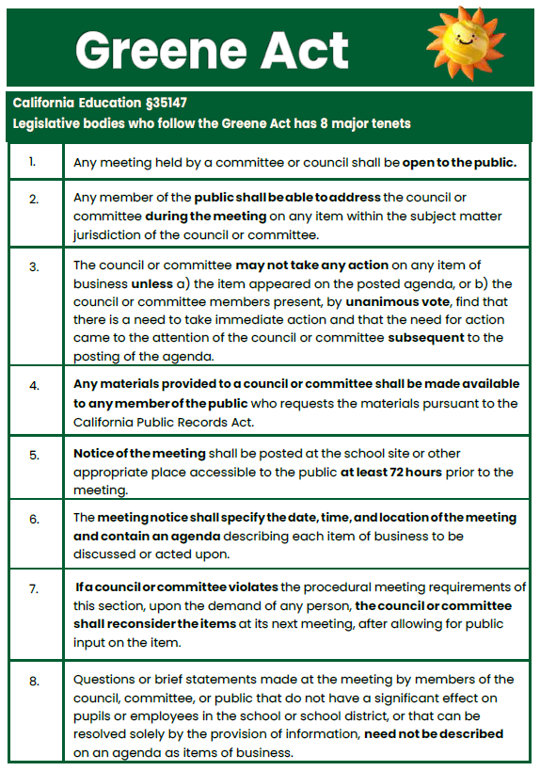
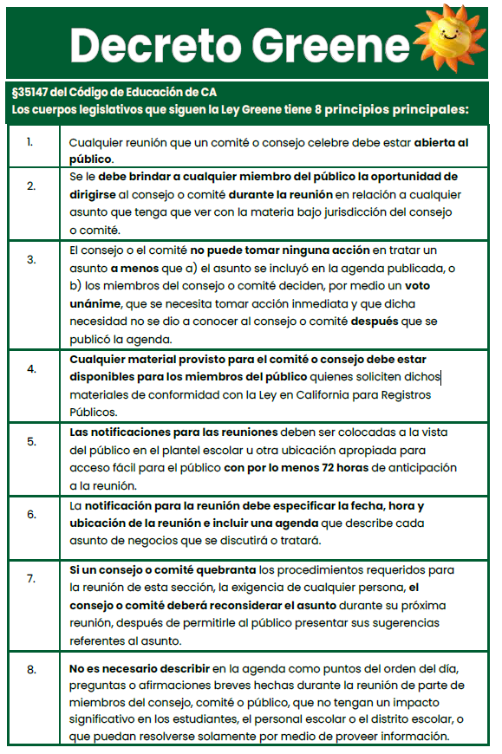
THE GREENE ACT School/District Councils & English Learner Committees El DECRETO “GREENE” Los consejos escolares/del distrito y Comités para Aprendices de Inglés
Notes:
Say: School Site Council is governed by the Greene Act. It is very important for all of us to know and understand the why of certain guides and practices.
Click

Slide 26
The Greene Act
El Decreto “Greene”
Cualquier reunión que un comité o consejo celebre debe estar abierta al público.
Se le debe brindar a cualquier miembro del público la oportunidad de dirigirse al consejo o comité durante la reunión en relación a cualquier asunto que tenga que ver con la materia bajo jurisdicción del consejo o comité.
Any meeting held by a committee or council shall be open to the public.
Any member of the public shall be able to address the council or committee during the meeting on any item within the subject matter jurisdiction of the council or committee.
Notes:
Say: Might I have a volunteer read the first two rules of the Greene Act?
Any meeting held by a committee or council shall be open to the public.
Any member of the public shall be able to address the council or committee during the meeting on any item within the subject matter jurisdiction of the council or committee.
Are there any questions before we move on?
Click

Slide 27
The Greene Act
El Decreto “Greene”
3. The council or committee may not take any action on any item of business unless a) the item appeared on the posted agenda, or b) the council or committee members present, by unanimous vote, find that there is a need to take immediate action and that the need for action came to the attention of the council or committee subsequent to the posting of the agenda.
4. Any materials provided to a council or committee shall be made available to any member of the public who requests the materials pursuant to the California Public Records Act.
3. El consejo o el comité no puede tomar ninguna acción en tratar un asunto a menos que a) el asunto se incluyó en la agenda publicada, o b) los miembros del consejo o comité deciden, por medio un voto unánime, que se necesita tomar acción inmediata y que dicha necesidad no se dio a conocer al consejo o comité después que se publicó la agenda.
4. Cualquier material provistos para el comité o consejo debe estar disponibles para los miembros del público quienes soliciten dichos materiales de conformidad con la Ley en California para Registros Públicos.
Notes:
Say: Might I have a volunteer read the next two items here?
The council or committee may not take any action on any item of business unless a) the item appeared on the posted agenda, or b) the council or committee members present, by unanimous vote, find that there is a need to take immediate action and that the need for action came to the attention of the council or committee subsequent to the posting of the agenda.
Any materials provided to a council or committee shall be made available to any member of the public who requests the materials pursuant to the California Public Records Act.
Are there any questions before we move on?
Click

Slide 28
The Greene Act
El Decreto “Greene”
5. Las notificaciones para las reuniones deben ser colocadas a la vista del público en el plantel escolar u otra ubicación apropiada para acceso fácil para el público con por lo menos 72 horas de anticipación a la reunión.
6. La notificación para la reunión debe especificar la fecha, hora y ubicación de la reunión e incluir una agenda que describe cada asunto de negocios que se discutirá o tratará.
7. Si un consejo o comité quebranta los procedimientos requeridos para la reunión de esta sección, la exigencia de cualquier persona, el consejo o comité deberá reconsiderar el asunto durante su próxima reunión, después de permitirle al público presentar sus sugerencias referente al asunto.
5. Notice of the meeting shall be posted at the school site or other appropriate place accessible to the public at least 72 hours prior to the meeting.
6. The meeting notice shall specify the date, time, and location of the meeting and contain an agenda describing each item of business to be discussed or acted upon.
7. If a council or committee violates the procedural meeting requirements of this section, upon the demand of any person, the council or committee shall reconsider the items at its next meeting, after allowing for public input on the item.
Notes:
Say: Would an officer like to read the next 3 to the team? Are there any questions before we move on?
Click

Slide 29
The Greene Act
El Decreto “Greene”
8. Questions or brief statements made at the meeting by members of the council, committee, or public that do not have a significant effect on pupils or employees in the school or school district or that can be resolved solely by the provision of information, need not be described on the agenda as items of business.
8. No es necesario describir en la agenda como puntos del orden del día, preguntas o afirmaciones breves hechas durante la reunión de parte de miembros del consejo, comité o público, que no tengan un impacto significativo en los estudiantes, el personal escolar o el distrito escolar, o que puedan resolverse solamente por medio de proveer información.
* Notices and agendas should be posted in an area that is visible to all members of the school community, including parents/guardians.
* Los avisos y agendas deben publicarse en un área visible para todos los miembros de la comunidad escolar, incluidos los padres/tutores.
Notes:
Say: I will read this slide.
Now that we have reviewed all 8 rules of the Greene Act, you might understand a little bit better why your roles of officers is so important in a different way. There are laws which cover the operation of this council to promote transparency and orderly engagement.
We are a team.
As officers, you are a key part of the school's leadership, helping to elevate the voice of all members on the SSC.
Click

Slide 30

Next Steps
How might we work together to support one another as leaders?
Próximos Pasos
¿Cómo podemos trabajar juntos para apoyarnos uno al otro como líderes?
Notes:
Say: After all we have learned today, how might we work together to support one another as leaders? I would like to hear from each one of you. What are your thoughts about how we can best share our thoughts and opinions to help our children?
Our school is committed to helping you lead this committee.
(School leader shares commitment to leaders.)
Click

Slide 31
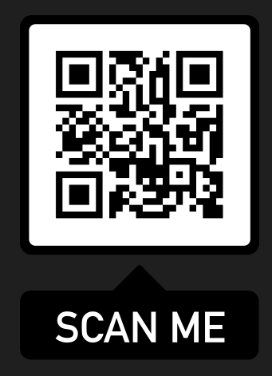
Family Engagement Resources Recursos para la Participación de Familias Resources are available on the home page of Student, Family, and Community Engagement (SFACE):/Hay recursos disponibles en la pagina de principal de la Oficina de Participación de Estudiantes, Familias, y Comunidad https://achieve.lausd.org/sface.

Slide 32
Contact information Información de Contacto:
Name:___________
E-mail:___________
Phone: ___________
Thank you for your leadership
and commitment!
Gracias por su liderazgo
y compromiso!
Notes:
Say: I am so excited and look forward to working with you. Thank you for being an ELAC member and for taking on the responsibility of being an officer.
If you have any questions or need to reach me, please feel free to reach out via email or by phone.
Once again, thank you.
Click

