Slide 1


Orientation and Election of Officers
District English Learner Advisory Committee
2016-2017

Slide 2
District English Learner Advisory Committee (DELAC)
The California Education Code (62002.5, 5CCR 11308, 52176) requires the establishment of a District English Learner Advisory Committee (DELAC) for districts with at least 50 or more English Learners.
The Parent, Community and Student Services will convene 6 DELAC meetings throughout the school year in addition to meetings for the purpose of orientation, officers’ election, two Local Control and Accountability Plan Comment Development sessions (LCAP) and Leadership Training sessions.
Meetings will be held at the Parent, Community and Student Services (PCSS)
Located at: 1360 W. Temple Street
Los Angeles, CA 90026
(213) 481-3350

Slide 3
Purpose and Responsibilities of the DELAC
Advise the LAUSD Board of Education on the following:
English Learner Master Plan
Districtwide comprehensive needs assessment
Establishment of District program goals and objectives for English learners
A plan to ensure District compliance with the provisions of Section 52178 (teacher credentialing and waivers).

Slide 4
Purpose and Responsibilities of the DELAC (cont.)
Advise the LAUSD Board of Education on the following:
Administration of the annual language census
Local Control and Accountability Plan
Single Plan for Student Achievement
Importance of attendance

Slide 5
DELAC Members and Alternates
DELAC
Northeast
8 members
2 alternates
Northwest
8 members
2 alternates
East
8 members
2 alternates
South
8 members
2 alternates
West
8 members
2 alternates
Central
8 members
2 alternates
48 members and 12 alternates representing each of the 6 local districts

Slide 6
Term of Membership
DELAC members were elected to either a 1- or 2-year term.
Each year in the term is defined as a school year.
Terms are not transferrable between members.
DELAC officers will serve for a term of one year until new officers are elected in the Fall of the subsequent year.

Slide 7
DELAC Alternates
Alternates will serve for a 1 year term and will replace a member within the same local district who cannot complete his/her term.
Only elected DELAC alternates are eligible to fill an elected member vacancy.
Alternates are not eligible to serve as officers.
Alternates will be seated 30 minutes after the scheduled start time of the meeting when a member of the same local district is not present.

Slide 8
DELAC Officers
Chairperson
Vice-Chairperson
Secretary
Parliamentarian
Public Relations Officer

Slide 9
Chairperson
Preside over DELAC meetings
Be fair and impartial at all times
Perform additional duties appropriate to the office of the chairperson as prescribed by the PCSS, LAUSD, and the Board of Education
Plan the agenda with PCSS and DELAC officers

Slide 10
Vice-Chairperson
Represent the chairperson in his/her absence or in assigned duties as prescribed by PCSS
Assist the chairperson as requested
Plan the agenda with PCSS and DELAC officers

Slide 11
Secretary
Take and maintain minutes of all meetings of the DELAC
Provide original meeting minutes to PCSS and a copy to the chairperson
Conduct roll call
Plan the agenda with PCSS and DELAC officers

Slide 12
Parliamentarian
Assist the chairperson in ensuring all rules and bylaws are followed
Be knowledgeable about bylaws of the committee, parliamentary procedures as prescribed by PCSS, and Greene Act
Plan the agenda with PCSS and DELAC officers

Slide 13
Public Relations
Announce public comment on the agenda
Promote the purpose and work of the DELAC
Plan the agenda with PCSS and DELAC officers

Slide 14
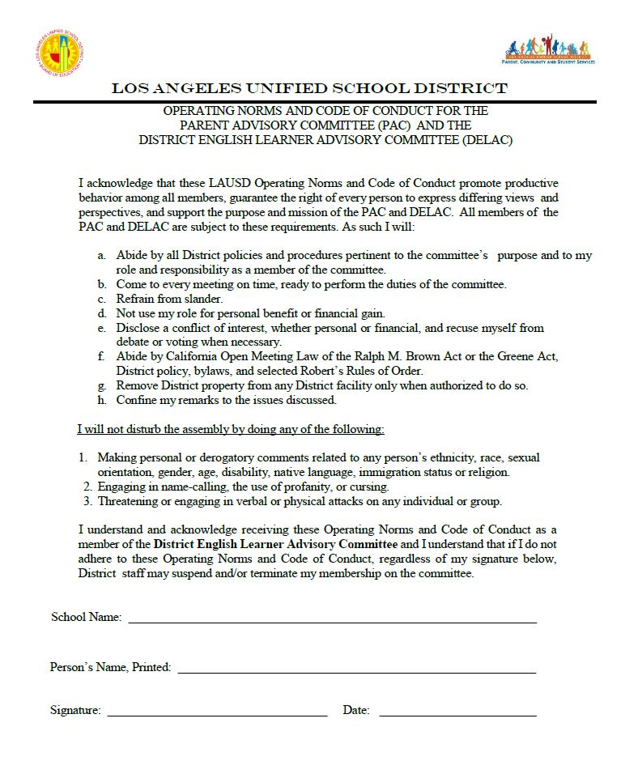
Operating Norms

Slide 15


