Slide 1
Back-to-School
[School Logo]
[Teacher name]
[Subject and/or Grade Level]
Room number]
[School name]
Notes:
[Total Time: 40 minutes]
[Time, this slide: 3 minutes]
[Show this screen during the introduction and framing of the night]
Welcome to Back-to-School Night, families! I’m excited to be your child’s teacher this year. During Back-to-School Night, the teachers get an opportunity to talk with families about the year ahead: what your child will learn and do, and what the behavior expectations are.
This evening I will be telling you about the major topics your child will be learning and practicing this year, but I also want to learn about you and your child. You know your child better than anyone else -- and I recognize that you are experts on your own children!
To begin, you’re probably curious about me… [Suggestions for sharing: besides where you were born and where you went to school, speak about your favorite thing to do, share about your pet, talk about why you become a teacher and the kind of teacher you have always wanted to be.]

Slide 2
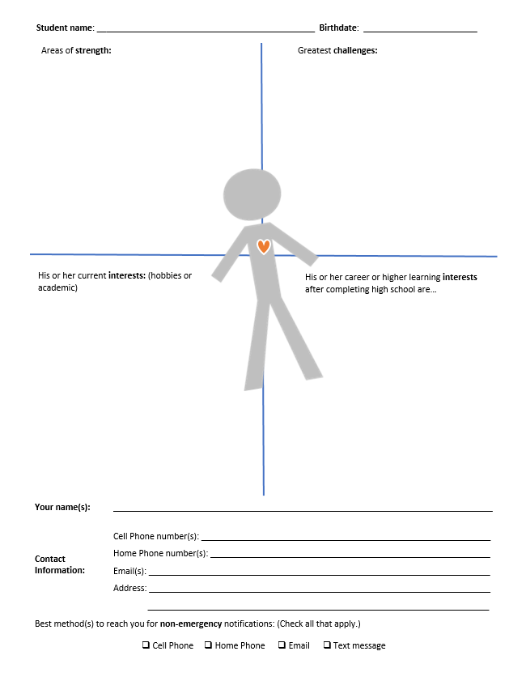
Introduction Activity
Notes:
[Total time, this activity: about 12 minutes]
As you came into the room, you received this sheet. Now that I’ve had a chance to tell you a little about myself, I’d like to know more about your child. There are four quadrants on this sheet. Please tell me about your child’s strengths, challenges and interests. Feel free to include both academic strengths and challenges and social-emotional strengths and challenges. There is also a space to provide me with an additional piece of information about your child—something extra that you’d like me to know. You can tell me about the ways your child learns best, for example. Feel free to use symbols, pictures, and words to complete each section.
[Explanation of activity: 1 minute]
At the bottom of the page is a section for you to give me your contact information. This is only for non-emergencies such as school events and reminders. Please take the next 4 minutes to fill out the sheet and then I will guide you through the next step.
[Time to fill out the sheet: 4 minutes]
Hopefully you had a chance to complete the sheet. If not, you can continue to work on it, but I’d like to collect them from you before you leave. Our classroom is a community focused on one goal—student learning—and we are all partners in that work.
Please turn to someone you don’t know very well yet at your table and share with them for ONE MINUTE something about your child. Then, they will share with you something about their child for ONE MINUTE.
[Partners share: 2 minutes]
Next, I’m going to ask you to get to know one another even more by finding one commonality between your children and one difference. You’ll have TWO MINUTES to talk.
[Commonality and difference: 2 minutes]
Which pair might like to share a commonality or difference between their children?
[Whole group share: 3 minutes]

Slide 3
What are the major topics students will learn about this year?
Subject A
Subject B
Notes:
[Total time for this slide: 5 minutes-10]
I was circulating around the room as the partners were talking and I learned more about a few students as I listened to those who shared. I’m looking forward to reading about all of your children. Please make sure I have your worksheet in my hands before you leave tonight.
We are here with a common goal—student learning. Next I want to share with you some really big ideas or major topics we will be covering this year by subject matter…
[Click through subjects and give brief explanations: 5 minutes]
Take TWO MINUTES to know one another even more by sharing some things you do at home to support your children’s learning. For example… [Suggestion for teacher: Tell about something you do at home, or your parents did, such as reading together, counting, singing, or story-telling.]
[Share what we do at home: 2 minutes]
Which pair would like to share some things you do at home? Were they similar or different?
[Whole group share: 3 minutes]

Slide 4
How will students practice and demonstrate their learning throughout the year?
Students will practice their learning through:
Students will demonstrate their learning through:
[list some examples of student practice here]
[list major projects, tests, etc. here]
Notes:
[Total time for this slide: 5 minutes]
For each of the major topics, students will have many opportunities to practice and demonstrate their learning. Practice can come in the form of classwork and homework. Some examples are: [read examples]
[Be sure to provide any examples of interactive homework, that is, homework that is meant to be completed with parents.]
Students demonstrate their learning through projects, quizzes and tests. Sometimes, students are required to exhibit and explain their work to demonstrate what they have learned. For example: [read examples]
What questions might you ask at home to encourage your children to demonstrate what they are learning in class? [Take 2 or 3 responses, as time permits.]

Slide 5
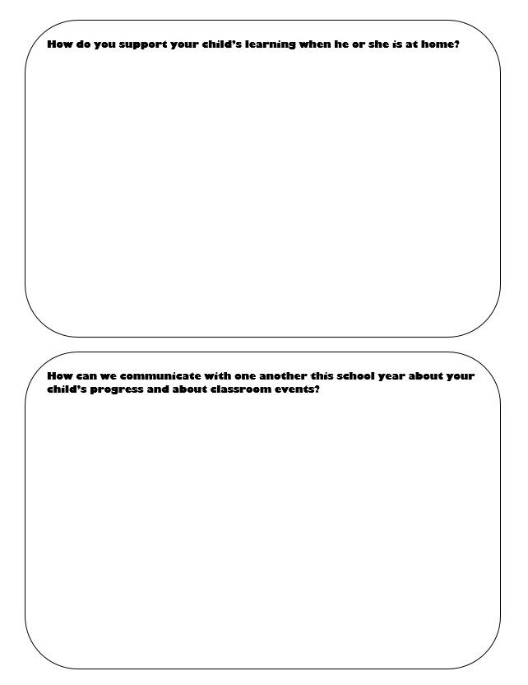
Learning Partnership Activity
John N.
Luz R
Leah B.
Gloria A.
Phillip R.
Lisa P.
Mark T.
Angelina C.
Notes:
[Total time for this activity: 7 minutes or more]
For the remaining time tonight, I’d like you to grab a few sticky notes and write down some of the ways you help your child practice his or her learning at home. I’d also like to know about your preferences for keeping in touch about what your children are learning and doing in class.
Please put your name on each sticky note, so I can connect your idea or preference with your family. So if, for example, you would like to know the strategies I’m using to teach [reading] this year, let me know you’re interested in learning about that and I can send you resources or invite you into the classroom on a day I’m teaching that lesson.
There are several posters around the room with the same information. Feel free to post your thoughts on any one! As you walk around, take note of the student work on the walls and see if you can connect it with the big learning ideas I mentioned earlier.
All this information will be going into our school-parent compact, which will describe how parents and teachers will work together to improve student learning.
[If additional information is needed, e.g. room parent, fundraising committee, etc., provide an additional sign up sheet or poster.]

Slide 6
Let’s keep in touch!
How to reach me:
Call front office and arrange a conference or classroom visit
Email me. My email address is: ______________
Come to Parent-Teacher and Student-Led Conferences
Before/After school hours:
Notes:
-Slide #6 [Project while parents are walking around posting comments with sticky notes]
I’m going to be here [in the front/in the center of the room] in case you would like to ask me any questions. And, if you have any questions in the future, this is my contact information. The best way to reach me is _____________________________.

