Slide 1

HIGH FREQUENCY WORDS
Parent and Community Services

Slide 2

THINK-PAIR-SHARE

Slide 3
DEFINITION
High Frequency Words (HFW) are the most commonly used words in the English Language.

Slide 4
HIGH FREQUENCY WORDS
until
such
there
have
might
must
about
the

Slide 5
INTERESTING FACTS
12 HFW account for 25% of everything we read and write.
100 HFW account for 50% of everything we read and write.
About 300 HFW account for 75% of everything we read and write.

Slide 6

DATA
Research suggest that students who learn all High Frequency Words normally outperform their counterparts in both reading fluency and reading comprehension.

Slide 7
THE TEN WORDS
These are the ten words that the student will study, practice, and learn in a given week.

Slide 8
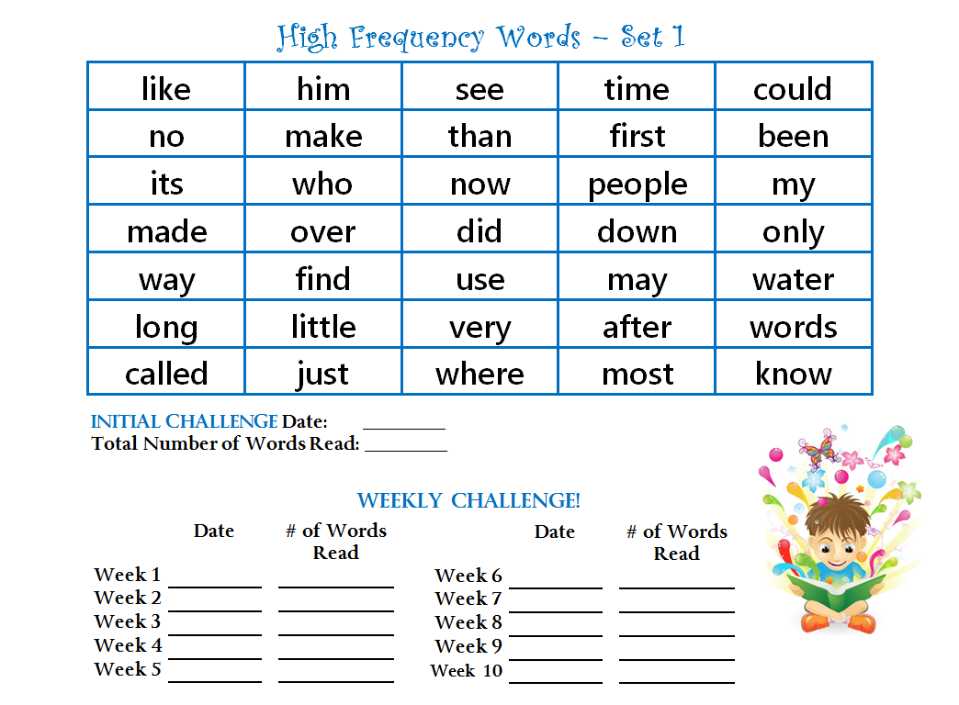
INITIAL CHALLENGE

Slide 9
ACTIVITIES

Slide 10
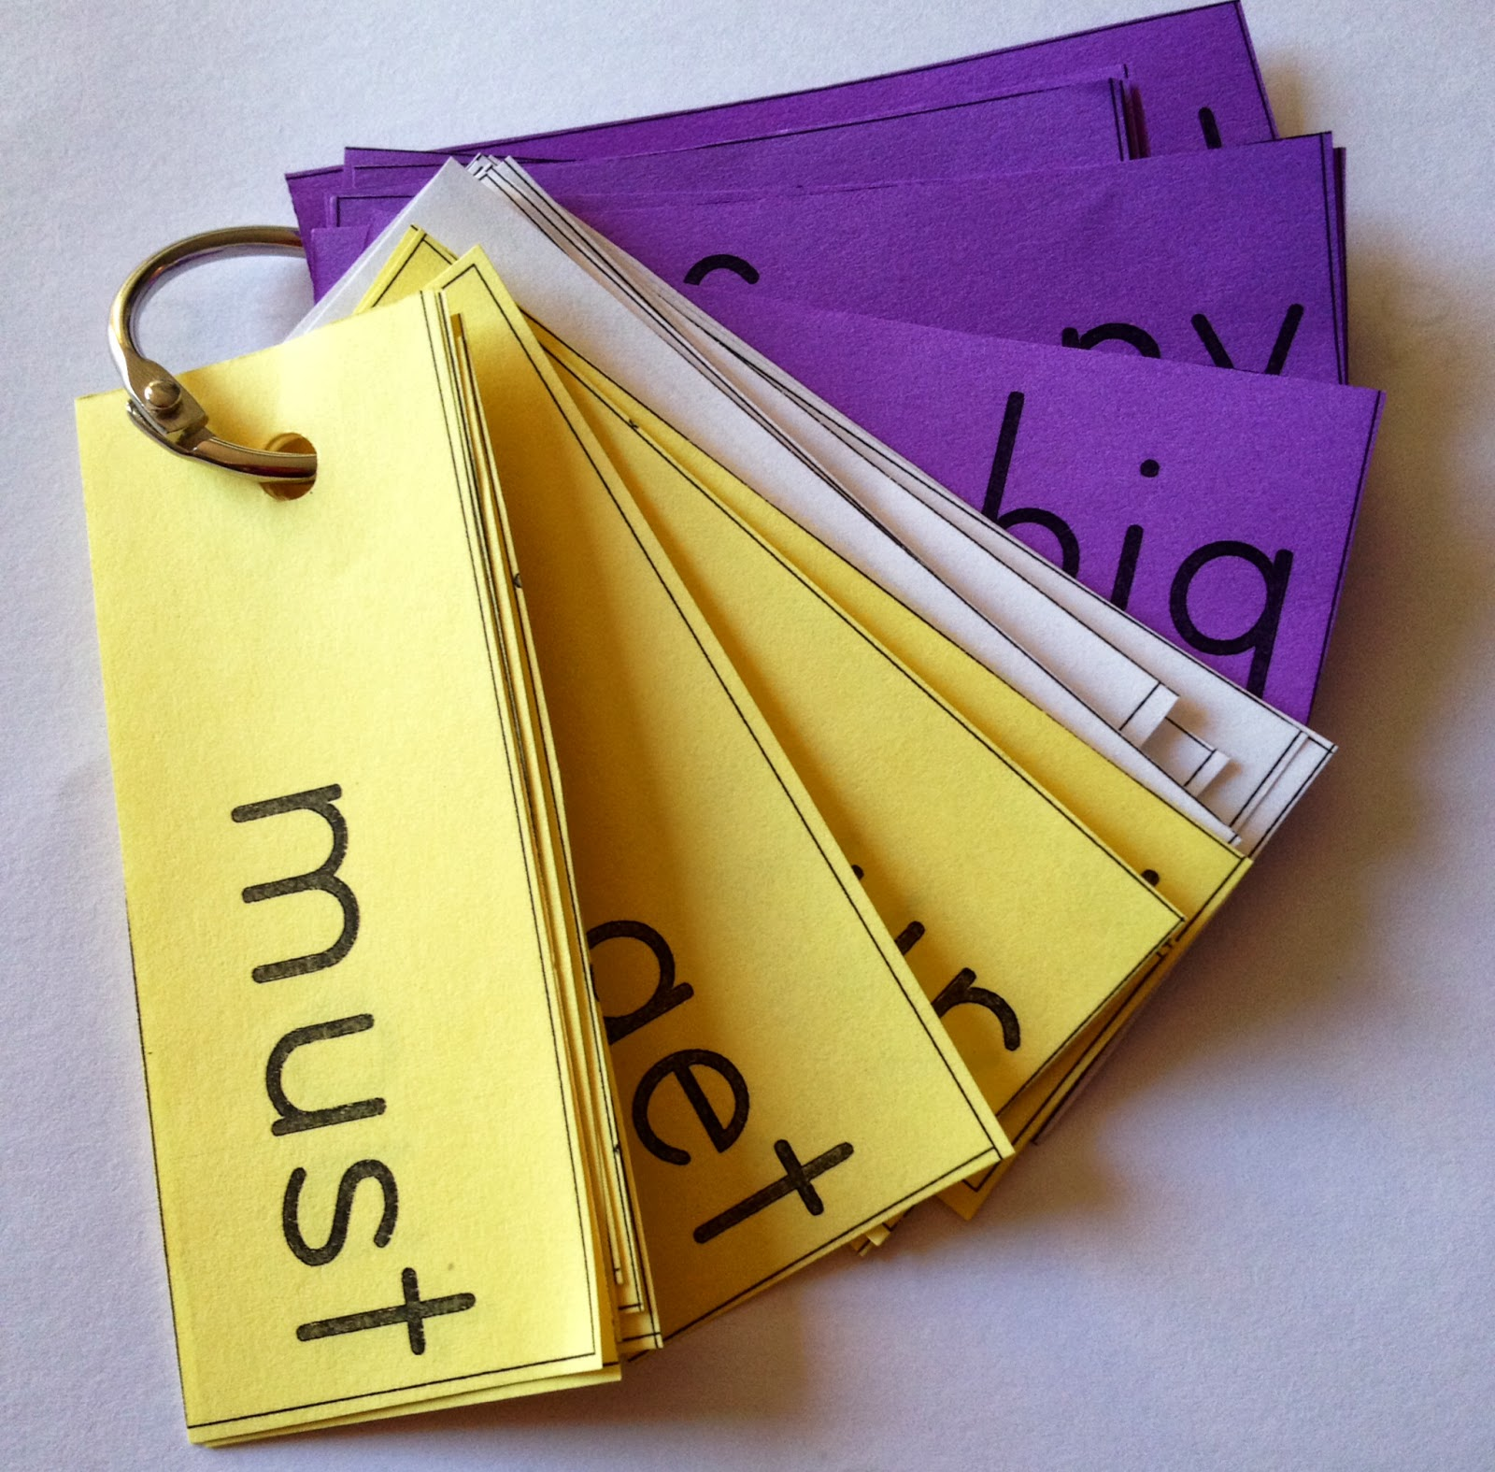
ACTIVITY Words on a Ring
Flashcards are widely used as a learning drill to aid memorization by repetition.
Students read each card aloud. Parent provides support as needed.

Slide 11

ACTIVITY Funny Names
Each member of the family selects one of “the ten” High Frequency Word cards and pins it on. This word becomes his/her name for the week.
into
most

Slide 12
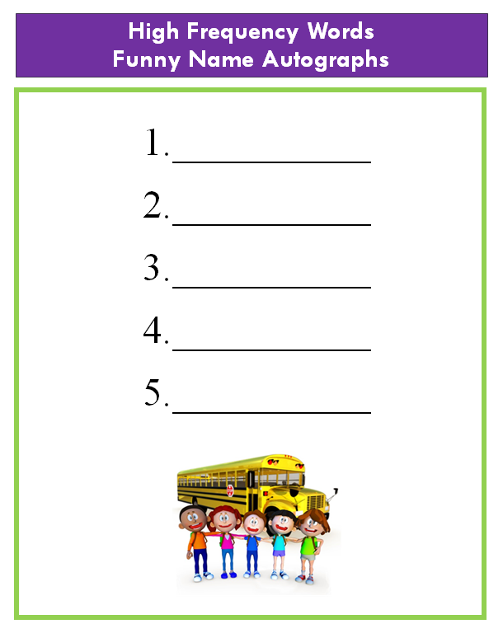
ACTIVITY Funny Name Autographs
This activity is an extension of the Funny Names Game.
Members of the family will use the High Frequency Word Funny Name Autographs sheet and ask each other to sign their “funny name” on the sheet.

Slide 13


ACTIVITY Word Detectives
Parents ask their child to find and circle or highlight “the ten” High Frequency Words that they are currently working on, in newspapers, magazines, cereal boxes or any other printed materials.
The child can also count how many times each word was found.

Slide 14
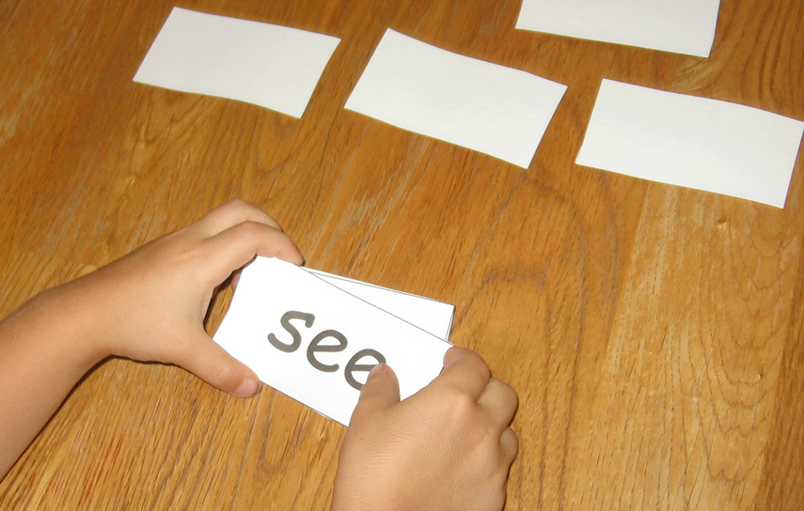
ACTIVITY Concentration
“The ten” High Frequency Word cards are placed face down. The child will pick up one card at a time. If the child knows the word, he/she gets to keep the card. If not, the word is placed face down again.

Slide 15
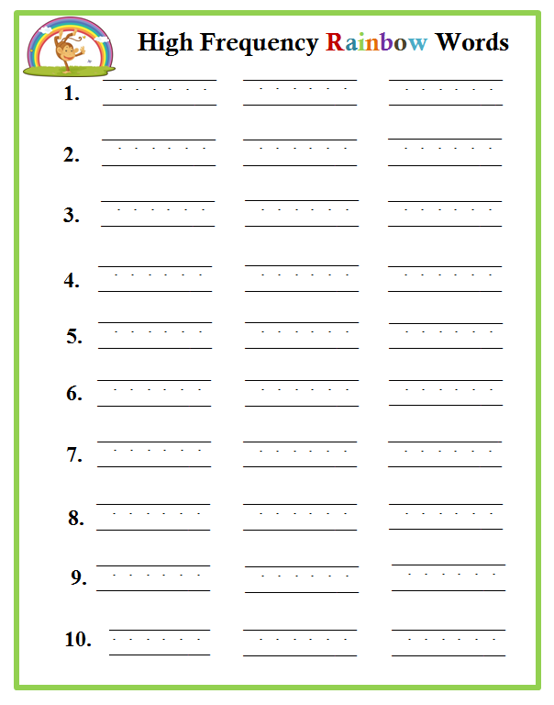
ACTIVITY Rainbow Words
The child will print “the ten” words on the High Frequency Rainbow Words worksheet. Using different color crayons, the child will trace each word three times, reading each word each time.

Slide 16
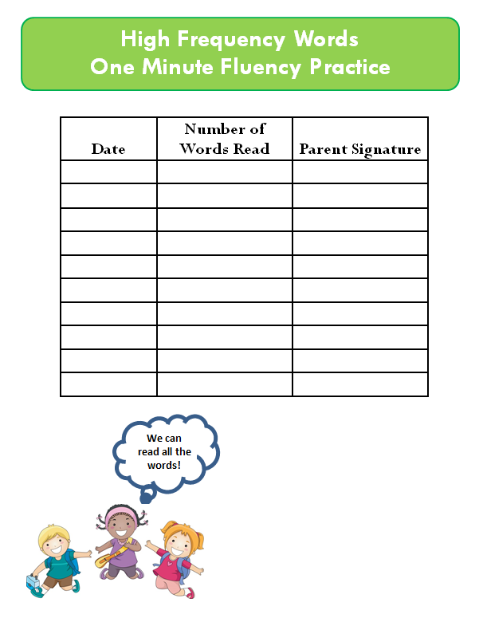
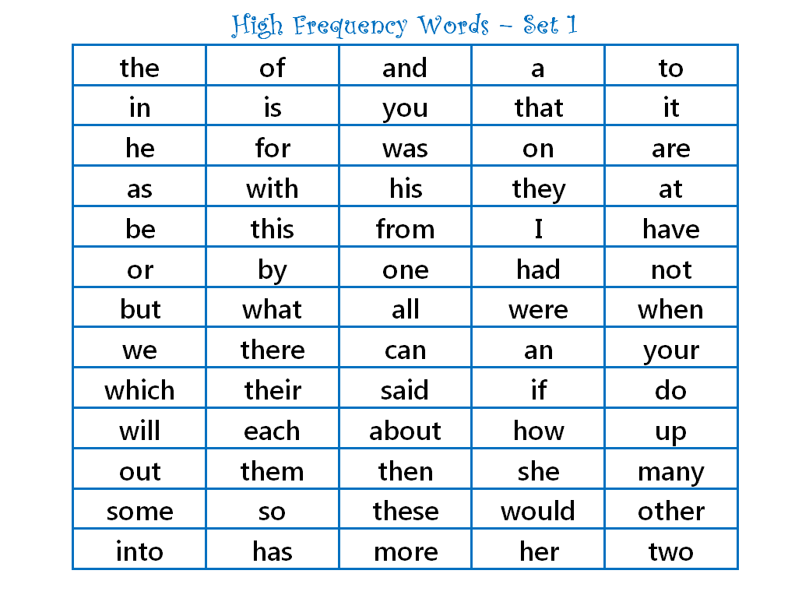
ACTIVITY 1 Minute Fluency Practice
Notes:
Have students perform timed reading twice per week, and you will see their reading rate and fluency improve.

Slide 17
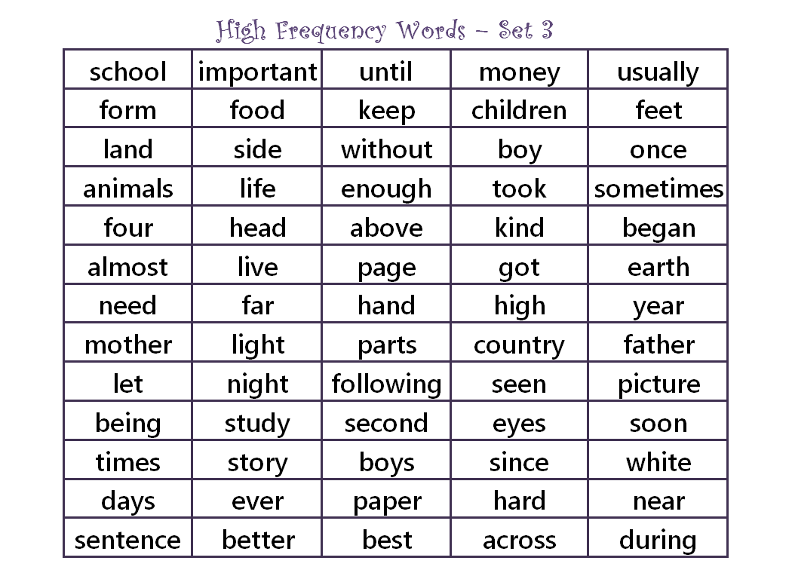
ACTIVITY Daily Practice
The child practices reading the words they already know and “the ten” words they are working on. Parents provide support as needed.

Slide 18
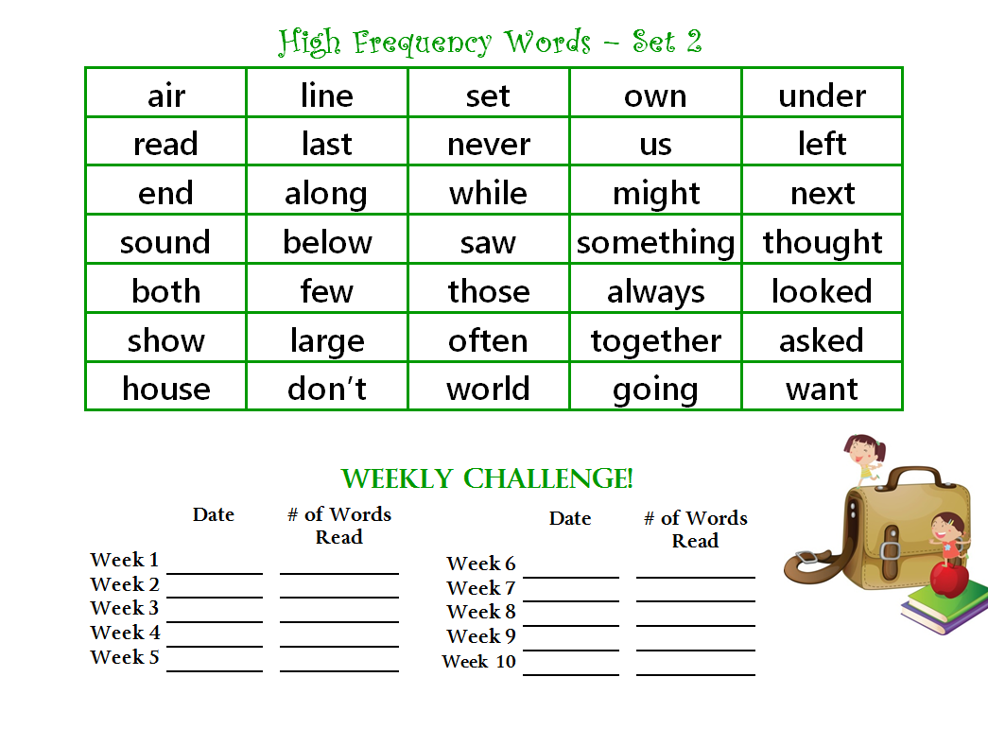
WEEKLY CHALLENGES
Parents will administer weekly HFW challenge to monitor the progress of their children.
Progress monitoring will inform parents when their child has mastered each set of words and will indicate that the child is ready for a new set of words.

Slide 19
What is the difference?
1 minute fluency practice
Daily practice
Weekly challenges

Slide 20
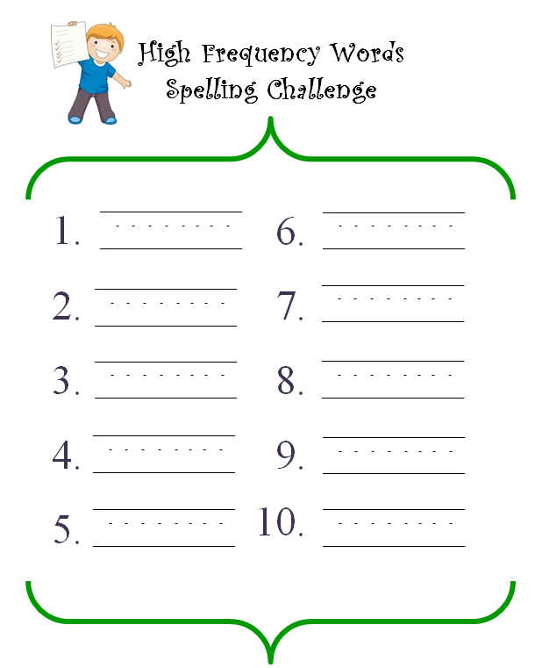
SPELLING CHALLENGE

Slide 21
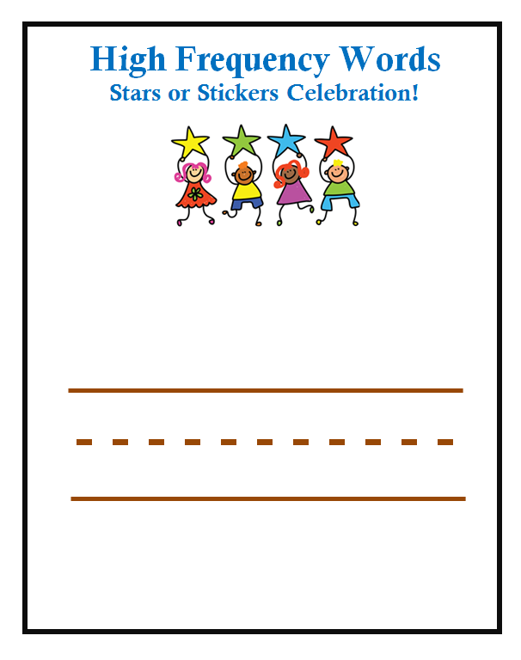
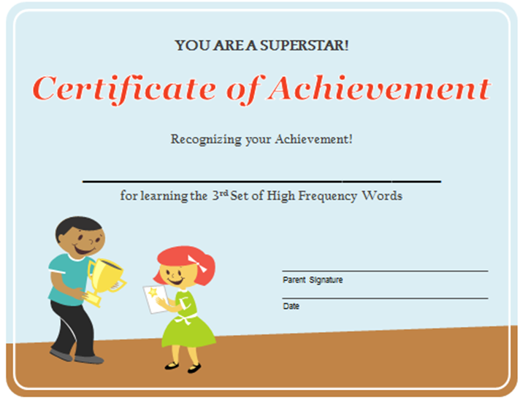
CELEBRATIONS

Slide 22
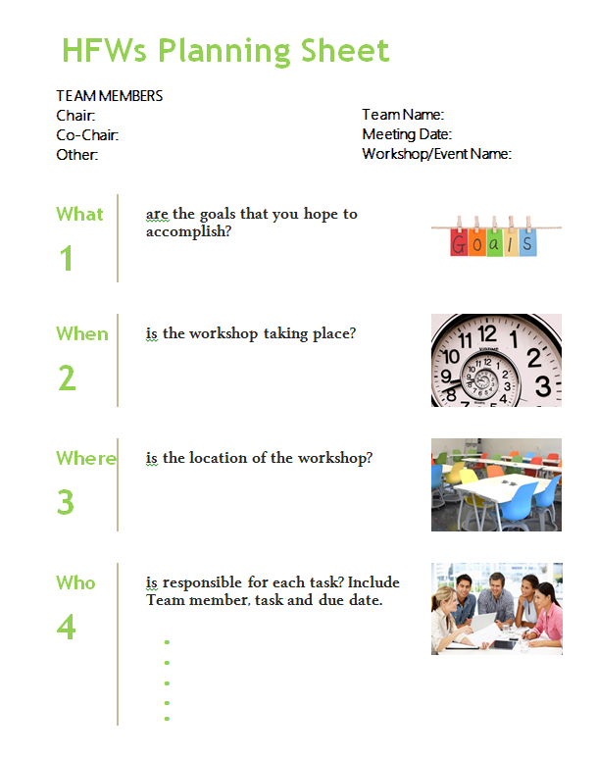
PLANNING

Slide 23

QUESTIONS

Slide 24

THANK YOU

