Slide 1

School Site Council (SSC) Parent
Election
Date:_____
Bulletin 6475.6 Guidelines for Required School Site Council and English Learner Advisory Committee
Elección de Padres del Consejo del Plantel Escolar (SSC)
Fecha: ____________
Boletin 6475.6 Normas para el requerido Consejo del Plantel Escolar y el Comité Asesor para Aprendices de Inglés
Notes:
Click

Slide 2


Welcome Bienvenidos
Principal
Director(a)
Student Body President
Presidente Estudiantil
Community Representative
Representante de Comunidad
School Title I Designee
Designada(o) del Programa Título I
English Learner Program Designee
Designada(o) del Programa de Aprendices de Inglés
name
name
name
name
name
School Leadership Team /Equipo de Liderazgo Escolar
Notes:
To do: Complete slide. Please ensure that each school leadership member offers a warm greeting.
Click

Slide 3

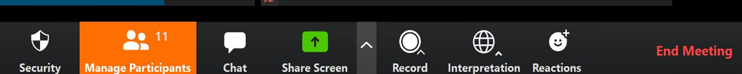
Interpretation Services: Laptop or Computer
Servicios de interpretación: computadora portátil o de escritorio
Click on the globe icon at the bottom of the screen.
Select the language of preference for you.
You will engage and listen to the presentation in the language you select.
Haga clic en el símbolo del mundo en la parte de abajo de su pantalla.
Seleccione el idioma que le gustaría escuchar.
Participará y escuchará la presentación en el idioma que seleccione.
Notes:
Say: We have interpretation services if you are joining us on a computer.
I am sorry Chromebooks don’t offer the translation feature. If you are on a Chromebook, please stay on your computer for so you can see us on the screen and use the chat feature. For audio join us via phone.
I will provide more guidance shortly.
For those that are on the computer ,please click on the globe icon at the bottom of the screen.
Select the language of preference for you.
You will engage and listen to the presentation in the language you select.
Click

Slide 4


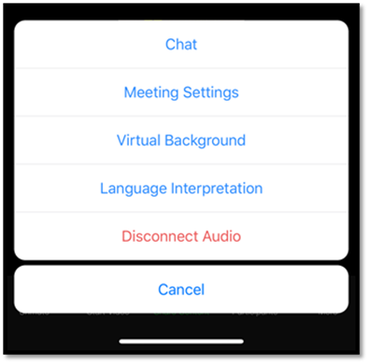
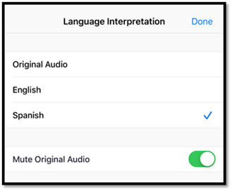
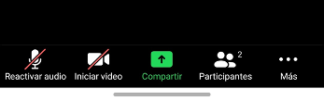
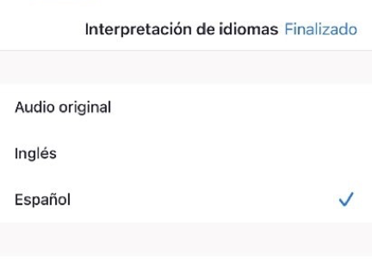
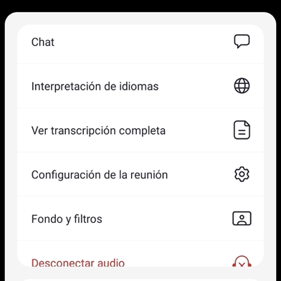
Interpretation Services: Mobile Device
Servicios de interpretación: dispositivo móvil
Notes:
Say: For those who are joining us via phone, please click on the three dots.
Select Language Interpretation.
Select language of preference.
Click on Done.
Click

Slide 5
Steps to Rename Yourself on Zoom
Cómo cambiar el nombre en su pantalla
Step 1: Hover over your picture located by the picture gallery with your cursor and search for the three dots found on the top right-hand corner of your picture.
Step 2: Click the three-dotted icon found over your picture.
Step 3: Click More.
Step 4: Choose Rename
Step 5: Enter the full name used when you enrolled your students at the school site, then click Save to finish the change.
Paso 1: Ponga su cursor en su foto ubicada en la galería de fotos y busque los tres puntitos en la esquina de la parte derecha de su rectángulo con su foto.
Paso 2: Haga clic en los tres puntitos que están en su foto.
Paso 3: Haga clic en Más.
Paso 4: Escoja Re nombrar
Paso 5: Ingrese su nombre completo de la manera que lo escribió al matricular a sus estudiantes en el plantel escolar, después haga clic en Guardar para aceptar el cambio.
Notes:
Say: In order to know who is in the room, please follow the following 5 steps:
Step 1: Hover over your picture located by the picture gallery with your cursor and search for the three dots found on the top right-hand corner of your picture.
Step 2: Click the three-dotted icon found over your picture.
Step 3: Click More.
Step 4: Choose Rename to change your screen name displayed to other participants.
Step 5: Enter the full name used when you enrolled your students at the school site, then click Save to finish the change.
Click

Slide 6

Engaging on Zoom
Participación por medio de Zoom
If you need assistance accessing Zoom for this meeting, send an email to ___________ and a team member will assist you.
Zoom includes a “Chat” tab where you can type your questions for the presenters.
Si necesita ayuda con acceder a Zoom para esta reunion, envie un coreo a _______________ y un miembro de nuestro equipo le ayudara.
Zoom tiene una pistaña de Chat en donde usted puede hacer preguntas a los presentadores.
Notes:
To do: Add contact e-mail.
Say: If you need assistance accessing Zoom for this meeting, send an email to ___________ and a team member will assist you. Zoom includes a “Chat” tab where you can type your questions for the presenters.
Click

Slide 7

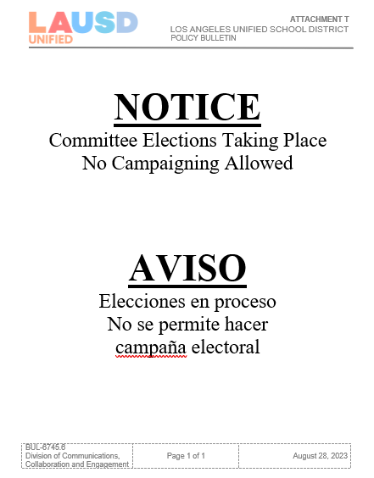
Sign In
Attendance:
Welcome! Please sign in on the Chat.
Please enter your first and last name and indicate if you are a parent/legal guardian of a student at the school site, community member, staff or visitor.
Parents/legal guardians, please type your child’s first and last name.
Lista de Asistencia
Asistencia:
¡Bienvenidos! Por favor, registrarse en el “Chat”.
Favor de escriba su nombre y apellido e indique si usted es un padre o madre/tutor legal, miembro de la comunidad, o visitante.
Padre o madre/tutor legal, por favor también escriban el nombre y apellido de su estudiante.
Notes:
Say: Please note that this meeting is being recorded.
In order to know who is in the room, please use the Chat as the sign-in to this meeting.
Please enter your first and last name and indicate if you are a parent/legal guardian of a student at the school site, community member, or visitor.
Parents/legal guardians, please type your child’s first and last name.
Click

Slide 8

Pledge of Allegiance
Juramento a la Bandera
I pledge allegiance to the flag of the United States of America and to the Republic for which it stands, one nation under God, indivisible, with liberty and justice for all.
Prometo lealtad a la bandera de los estados Unidos de América y a la Republica que representa, una Nación ante Dios, indivisible con Libertad y justicia para todos.
Notes:
Say: Might I have a volunteer lead us in the Pledge of Allegiance?
Click

Slide 9
Purpose
Proposito
Understand the roles and responsibilities of the School Site Council (SSC) members
Understand the election process for the School Site Council (SSC) Parent and Community Members
Entender las funciones y responsabilidades de los miembros del Consejo del Plantel Escolar (SSC)
Entender el proceso de la elecciones para el Consejo del Plantel Escolar (SSC)
Notes:
Say: Our purpose here today is to:
Understand the roles and responsibilities School Site Council ((SSC)) members
Understand the election process for the SSC.
Click

Slide 10
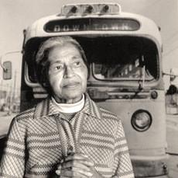
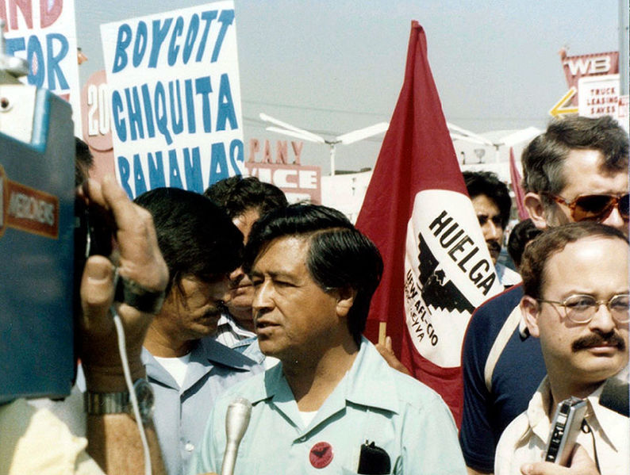

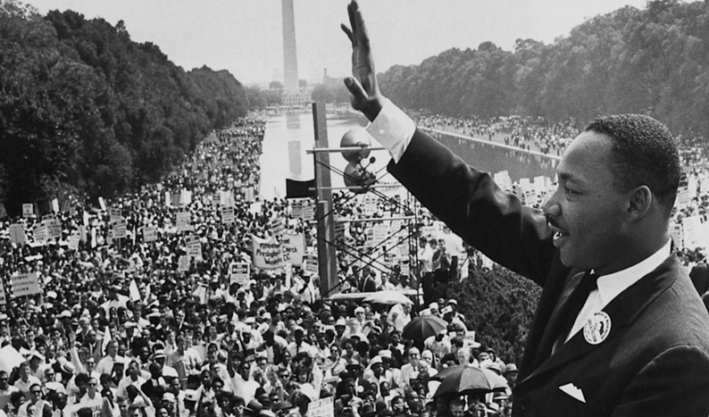
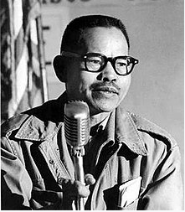
School Site Council (SSC) and the English Learner Advisory Committee (ELAC) Rooted in the Civil Rights Movement
Consejo del Plantel
Escolar (SSC) y el Comité Asesor para Aprendices de Ingles (ELAC) son parte de movimiento de derechos cívicos
Rosa Parks
Cesar Chavez
Martin Luther King Jr.
Modesto "Larry" Dulay Itliong
Notes:
Say: We are going to start our session with a little reflection.
The Civil Rights Movement has been in existence since the early 30’s where historical/great leaders set the pathway for equal voice and opportunity.
We saw it through Rosa Parks who fought against segregation, with Cesar Chavez who was an American labor leader and civil rights activists, with Martin Luther King when he gave his "I Have A Dream" speech, and Modesto "Larry" Dulay Itliong, who organized the West Coast agricultural workers starting in the 1930’s and rose to national prominences in 1965. (For more information, see notes below.)
In that same year (1965) President Lyndon B. Johnson established the Elementary and Secondary Education Act (ESEA), which is part of that establishment of opportunities for underserved students and families in our work with Title I. Most recently, President Obama reauthorized the ESEA in 2015 and renamed it the Every Student Succeeds Act that dictates educational requirements for our students and families.
This brief outline is shared by LAUSD to ground parent and family engagement throughout LAUSD.
Click
Just for your information:
Rosa Parks was an American civil rights activist whose refusal to give up her seat on a public bus precipitated the 1955–56 Montgomery bus boycott in Alabama, which became the spark that ignited the civil rights movement in the United States. She is known as the “mother of the civil rights movement.”
Cesar Chavez (born Cesario Estrada Chavez /ˈtʃɑːvɛz/; Spanish: [ˈt͡ʃaβes]; March 31, 1927 – April 23, 1993) was an American labor leader and civil rights activist. Along with Dolores Huerta, he co-founded the National Farm Workers Association (NFWA), which later merged with the Agricultural Workers Organizing Committee (AWOC) to become the United Farm Workers (UFW) labor union. Ideologically, his world-view combined leftist politics with Catholic social teachings.
Martin Luther King Jr. (born Michael King Jr.; January 15, 1929 – April 4, 1968) was an American Baptist minister and activist who became the most visible spokesman and leader in the civil rights movement from 1955 until his assassination in 1968. An African American church leader and the son of early civil rights activist and minister Martin Luther King Sr., King advanced civil rights for people of color in the United States through nonviolence and civil disobedience. Inspired by his Christian beliefs and the nonviolent activism of Mahatma Gandhi, he led targeted, nonviolent resistance against Jim Crow laws and other forms of discrimination.
Modesto "Larry" Dulay Itliong (October 25, 1913 – February 1977^{[a]}), also known as "Seven Fingers",^{[3]} was a Filipino-American labor organizer.
He organized West Coast agricultural workers starting in the 1930s, and rose to national prominence in 1965, when he, Philip Vera Cruz, Benjamin Gines and Pete Velasco, walked off the farms of area table-grape growers, demanding wages equal to the federal minimum wage, that became known as the Delano grape strike.^{[4][5][6]} He has been described as "one of the fathers of the West Coast labor movement."^{[7]} He is regarded as a key figure of the Asian American movement.

Slide 11
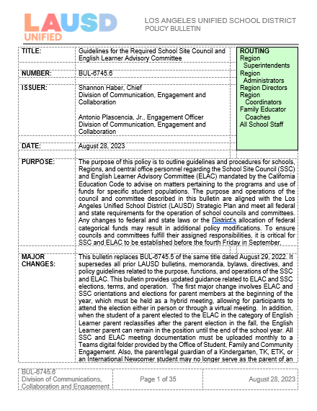
Bulletin 6745.6 Guidelines for the Required
School Site Council and English Learner Advisory Committee
Boletín 6745.6 Normas para el Requerido Consejo del Plantel
Escolar y el Comité Asesor para Aprendices de Ingles
Bulletin 6745.6 is available in English and Spanish:
https://achieve.lausd.net/pcss
El Boletín 6745.6 esta disponible en Ingles y Español:
https://achieve.lausd.net/pcss
Notes:
Say: One of the structures that grew out of the Civil Rights Movement in our work with Title I is the School Site Council. It is meant to be a group with diverse stakeholders coming together to share their voices on how to help our highest need students and families receive the support needed to increase their academic achievement and wellness. Our District provides guidance on the School Site Council in Bulletin 6745.5.
Bulletin 6745.5 that contains the guidelines for SSC and the English Learner Advisory Committee, as well as a variety of templates to support the work of SSC members and officers.
You can download a copy of the Bulletin by going to https://achieve.lausd.net/pcss
Note: The Word version of all templates is available on this website under the Tools for Schools tab under the SSC heading: https://achieve.lausd.net/Page/11304
Click

Slide 12
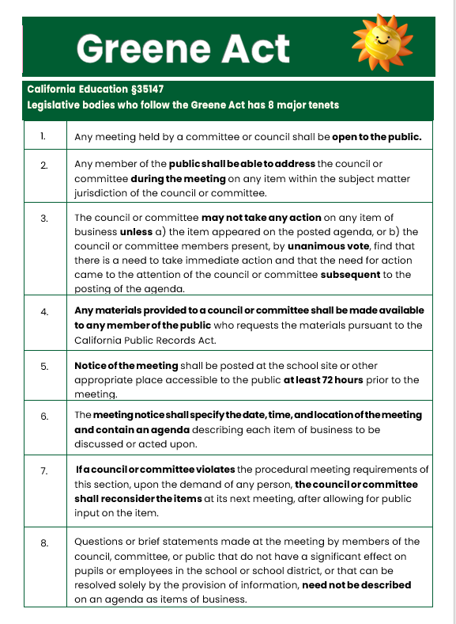
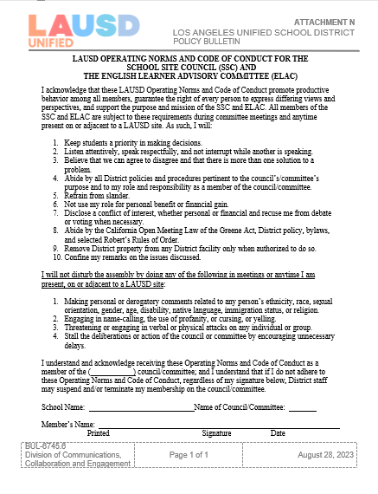
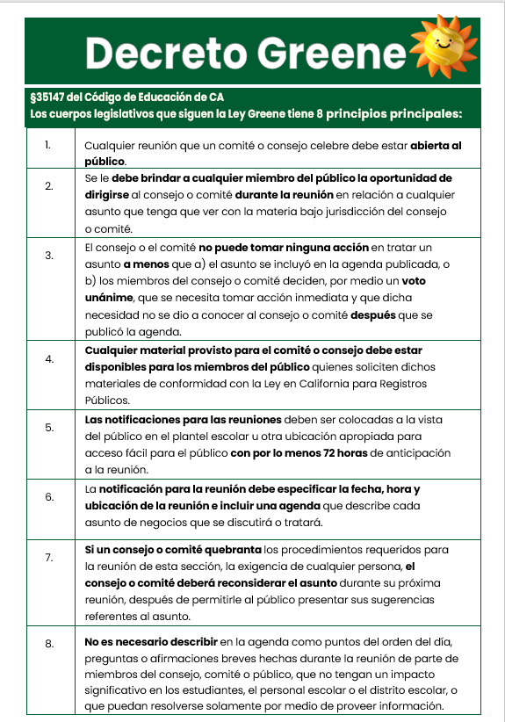
Handouts
Hojas Informativas
LAUSD Operating Norms And Code Of Conduct For The SSC And The ELAC
Normas de Funcionamiento de LAUSD Para El SSC y ELAC
Greene Act
Decreto Greene
Notes:
Say: If you become a member, these are some key items you need to be know.
Note: The Operating Norms can be found in the Bulletin. The Greene Act is referred to in the Bulletin and its summary can be found in CA Education Code, Section 35147.
Say: As members you will be asked to sign the LAUSD Operating Norms and the Code of Conduct for ELAC and SSC. These norms and requirements serve as agreements members make to communicate and engage using democratic principles. Here are a few of the items listed therein:
It asks that we keep students as a priority in making decisions.
Listen attentively, speak respectfully and not interrupt while another is speaking.
Believe we can agree to disagree and that there is more than one solution to a problem.
The Greene Act is what guides the operation of our ELAC and SSC meetings.
Some of the key requirements are:
Any member of the public shall be able to address the committee or council during the meeting on any item within the subject matter jurisdiction of the council or committee.
Notice of the meeting shall be posted at the school site or other appropriate place accessible to the public at least 72 hours prior to the meeting.
The meeting notice shall specify the date, time, and location and contain an agenda describing each item of business to be discussed or acted upon.
As you notice, these documents are about keeping order and offering respect to all.
Click

Slide 13
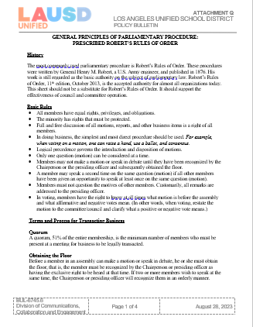
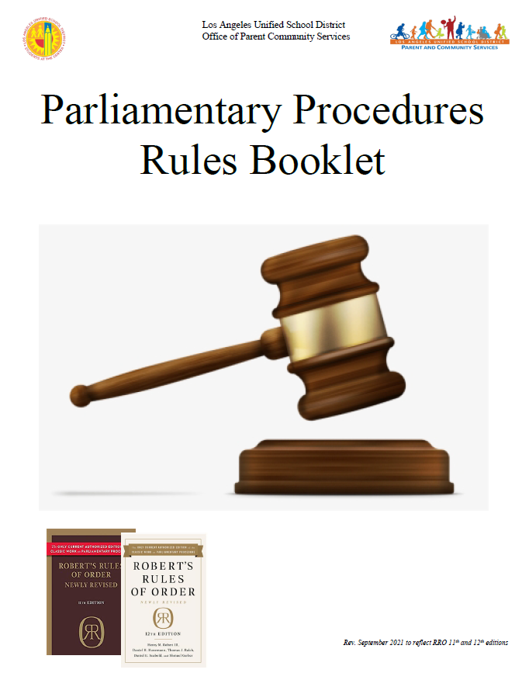
Handouts
Hojas Informativas
Roberts Rules of Order
Reglas de Roberto
Attachment Q
Parliamentary Procedures
Folleto Reglas Parlamentarias
Notes:
Say: If you become a member, these are some key items you need to be know.
These are tools that will help support our officers as they lead the work in partnership with us.
Attachment Q is the Selected Robert's Rules of Order, which is a type of parliamentary procedure.
Parliamentary Procedures Rules Booklet provides additional guidance and definitions, and it can be found on this link on the slide: https://achieve.lausd.net/cms/lib/CA01000043/Centricity/Domain/577/CAC/Spanish%20Booklet%20Brief%20Parliamentary%20Procedures%20Guide_%20rev%20%2010%201%20%2021%20Spanish_.pdf
Click

Slide 14


Handouts
Hojas Informativas
School Site Council (SSC): Purpose, Composition and Responsibilities
Consejo Del Plantel Escolar (SSC): Propósito, Composición, y Responsabilidades
School Site Council (SSC)
Officer Responsibilities
Consejo del Plantel Escolar (SSC)
Responsabilidades de los Oficiales
Notes:
Say: Today we will cover the purpose, composition and responsibilities of the School Site Council (SSC). We will provide more information on the specific responsibilities of officers at a later date, and we wanted you to know that there are officers for this council who lead the orderly operation of this group.
Click

Slide 15
School Site Council (SSC)
Bulletin 6475.5 Guidelines for Required School Site Council and English Learner Advisory Committee
Consejo del Plantel Escolar (SSC)
Boletin 6475.5 Normas para el requerido Consejo del Plantel Escolar y el Comité Asesor para Aprendices de Inglés
Notes:
Click

Slide 16
LAUSD Operating Norms And Code Of Conduct For The SSC And The ELAC
Normas de Funcionamiento y el Codigo de Conducta de LAUSD Para El SSC y ELAC
As members, you will be asked to sign the LAUSD Operating Norms and the Code of Conduct for ELAC and SSC.
It asks that we keep students as priority in making decisions.
Listen attentively, speak respectfully and not interrupt while another is speaking
Believe we can agree to disagree and that there is more than one solution to a problem.
Como miembros, se les pedirá que firmen las Normas Operativas del LAUSD y el Código de Conducta para ELAC y SSC.
Pide que mantengamos a los estudiantes como prioridad en la toma de decisiones.
Escuche atentamente, hable con respeto y no interrumpa mientras otro habla
Creer que podemos estar de acuerdo en estar en desacuerdo y que hay más de una solución para un problema.
Notes:
Say: As shared earlier, all SSC members are asked to sign the LAUSD Operating Norms and the Code of Conduct for ELAC and SSC to serve as working agreements for the year.
It asks they we keep students as priority in making decisions.
Listen attentively, speak respectfully and not interrupt while another is speaking
Believe we can agree to disagree and that there is more than one solution to a problem.
Activity:
Of the three that are listed, which is the one that speaks to you?
Please write it in the Chat.
(Read a couple out loud.)
Click

Slide 17
Bylaws
Estatutos
Personalize standard bylaws provided in BUL. 6745.5
Bylaws allow for ELAC to maintain orderly flow of engagement.
Bylaws follow Greene Act requirements from the CA Education Code.
Modifications must by approved by Local District Parent and Community Engagement Unit.
Personalice los estatutos estandarizados en el BUL. 6745.5
Los estatutos permiten que ELAC mantenga un flujo ordenado de participación.
Los estatutos siguen los requisitos de la Ley Greene del Código de Educación de CA.
Las modificaciones deben se aprobadas por la Unidad de Participación de los Padres y la Comunidad del Distrito Local.
Notes:
Say: Another document that assists with the orderly and transparent operation of the SSC is its Bylaws. The Bylaws allow for SSC to be conducted fairly, as it should be reviewed and completed with the SSC members. The Bylaws are structured following the Greene Act, which is the law that outlines the procedures we must follow before and during the meeting. The Bylaws and Greene Act help us insure that we are respectful of the voice of all members and insure that we offer an opportunity to public so that they can address the council.
Read the slide.

Slide 18
Why do we need to form a SSC?
¿Porque necesitamos formar un SSC?
Every school with a County District School (CDS) code assigned by the California Department of Education (CDE) shall establish a School Site Council (SSC) as the decision-making council for all programs funded through the Consolidated Application (ConApp).
Cada escuela con un código como escuela de Distrito del Condado (CDS) por la Secretaría de Educación del Estado de California (CDE) debe establecer un Consejo del Plantel Escolar (SSC) como un consejo que toma decisiones para todos los programas financiados a través de la Solicitud Consolidada (ConApp).
Notes:
Say: Why do we have an SSC? Because it is required by law as the decision-making group of stakeholders (at each school with its own CDS code) which develops the plan for additional funds to provide resources for students that are at risk of failing.
Note: The ConApp is an application that the District completes each year to receive Title I, II, III and IV funding.
Click

Slide 19
Why do we need to form a SSC?
¿Porque necesitamos formar un SSC?
Requires districts receiving federal, state and other applicable funding, through the ConApp process, ensure that participating schools prepare a School Plan for Student Achievement (SPSA).
Requiere que los distritos que reciben fondos estatales, federales u otros fondos aplicables mediante el proceso de la Solicitud Consolidada, se aseguren que las escuelas participantes desarrollen un Plan Escolar para el Rendimiento Académico Estudiantil (SPSA).
Notes:
Say: Schools receiving Title I funds need to develop a plan for those funds, called the SPSA, and that plan needs to show the thinking of why the funds are going to be spent as planned. The SPSA needs to be developed by the SSC, and the plan and its corresponding budget need to be approved by the SSC, which usually happens in February or March of each year.
This is your main responsibility. As SSC members you will develop the SPSA after reviewing student and family data, developing some key findings about the data, identifying some measurable goals to improve the data and strategies to meet those goals.
Click

Slide 20
What are the SSC Responsibilities?
¿Cuales son las responsabilidades del SSC?
Develop, review and adopt the SPSA in consultation with relevant stakeholders and, where applicable, with the ELAC.
Respond in writing to ELAC’s written recommendations on the SPSA within 30 calendar days or at the next SSC meeting.
Ensure that all federal parental and family engagement mandates are met.
Desarrollar, revisar y adoptar el SPSA en consulta con las partes interesadas relevantes y cuando corresponda, con ELAC.
Responder por escrito a las recomendaciones escritas del ELAC, dentro de un período de 30 días calendario o durante la siguiente reunión del SSC.
Asegurar que se cumplan todos los mandatos federales para la involucración de los padres y las familias.
Notes:
Say: In more detail, the development of the SPSA must be done in consultation with others, and there are some additional responsibilities of the council. (Read the slide)
Develop, review and adopt the SPSA in consultation with relevant stakeholders and, where applicable, with the ELAC.
Respond in writing to ELAC’s written recommendations on the SPSA within 30 calendar days or at the next SSC meeting.
Ensure that all federal parental and family engagement mandates are met.
Click

Slide 21





ELAC Recommendation Process
El Proceso para las Recomendaciones de ELAC
The ELAC
sends written recommendations
to the SSC.
El ELAC envía
recomendaciones
escritas al SSC.
English Learner Advisory Committee
El SSC debe
contestar a las recomendaciones escritas dentro de 30 días o en la próxima reunión oficial
del SSC.
School Site Council
SSC must respond
to written recommendations within 30 days, or at the next official
SSC meeting.
Notes:
Say: This is an important responsibility for ELAC, to write recommendations to the SSC which will support English learners in the school.
The ELAC is advisory only. It needs to submit recommendations to the school’s decision-making council which is the School Site Council.
Then the SSC must consider the ELAC's written recommendation and respond within the 30-day window or at the next official SSC meeting.
Click

Slide 22
What are the SSC Responsibilities?
¿Cuales son las responsabilidades del SSC?
To ensure that all federal mandates, including those for parent involvement, are met, specifically:
The development and approval of the school-level Title I Parent and Family Engagement Policy (PFEP).
The development and approval of the Title I School-Parent Compact.
The development and approval of the Title I parent involvement budget.
Asegurar que todos los mandatos federales, que incluye aquellos para la participación de los padres, se cumplan, específicamente:
El desarrollo y la aprobación de la Política del Título I para la Involucración de los Padres y las Familias a nivel escolar (PFEP, por sus siglas en inglés).
El desarrollo y la aprobación del Contrato entre la Escuela y los Padres.
El desarrollo y aprobación del presupuesto para la participación de los padres del Título I.
Notes:
Say: The SSC has a role in giving input into the development and approving the Title I Parent and Family Engagement Policy. (Read the slide.)
Click

Slide 23
SSC Composition Formation for Parent and Community
Composición y Formación de Padres y Comunidad
Elementary School Level
Nivel Escolar Elemental
Parent Member:
Is an individual who is a mother, father or legal guardian not employed at the school with which the council is affiliated.
Community member:
Resides and/or works within a specific school’s attendance boundary. PROOF IS REQUIRED.
On an annual basis, parents designate by vote whether to assign their parent member seat(s) on the council to eligible community members.
Padre miembro:
Esta persona es madre, padre, o tutor legal quien no es empleado de la escuela con la que está afiliada el consejo.
Miembro de la Comunidad:
Vive y/o trabaja dentro de los límites específicos de asistencia escolar SE REQUIERE COMPROBANTE.
Anualmente, los padres designan por votación si asignarán sus puestos como miembros de padres en el comité a los miembros elegibles de la comunidad.
Parents/
Legal Guardians – Community Members
Padres/Tutores Legales – Miembros de la Comunidad
Principal or Designee
Director o administrador designado
(1)
Classroom Teachers
Maestros de salón de clase
(5)
(3)
(1)
Only Parent elect Parent and Community members./Solamente los Padres pueden elegir a los Padres y a los miembros de la comunidad
Other Staff
Otro personal
Notes:
Say: This slide describes the composition of the SSC at the elementary school level. (Review the contents of the circle first, explaining the members of the SSC. Then highlight the definition of the parent and community members on the left, being sure to emphasize that only parents can vote for the parent and community seats.)
Please review the Bulletin 6745.5, page 37, Attachment A for composition options.
Standard elementary size is 10 (5 on the staff side – 5 on the Parent/Community Side)
All members must be elected by their peers, except the principal or his/her designee, who is the only automatic member.
Click

Slide 24
SSC Composition Formation for Parent and Community
Secondary School Level
Nivel Escolar Secundaria
Composición y Formación de Padres y Comunidad
De conformidad con la sección 65000 del Código de Educación del Estado de California, para las escuelas de nivel secundario:
  No se requiere paridad entre los padres de familia/comunidad y los estudiantes
  se requiere paridad entre las personas que son empleados y las que no lo son.
  el SSC debe de contar con mínimamente 10 miembros.
  Miembro de la Comunidad:
  Vive y/o trabaja dentro de los límites específicos de asistencia escolar SE REQUIERE COMPROBANTE.
Conforme la sección 33133 (c) del Código de Educación del Estado de California, en las escuelas intermedias, un SSC puede, pero no se le requiere, que incluya representación estudiantil.
According to California Education Code, section 65000, for secondary schools:
  parity between parents/community and students is no longer required
  Teachers must be the majority
  the SSC must be composed of at least 10 members
Community member:
Resides and/or works within a specific school’s attendance boundary, PROOF IS REQUIRED.
According to the California Education Code, section 33133(c), at middle schools, a SSC may, but is not required to, include student representation.
Only Parent elect Parent and Community members./Solamente los Padres pueden elegir a los Padres y a los miembros de la comunidad
Parents/
Legal guardians – Community Members
Padres/Tutores Legales – Miembros de la Comunidad
Principal or Designee
Director o administrador designado
Classroom Teachers
Maestros de salón de clase
Students
Estudiantes
Other Staff
Otro personal
Notes:
Say: There have been changes in the secondary composition with regards to parity between the parents and students; however, there must be parity between the school employees group and the parent/student group. (Read the slide, explaining the contents of the circle first. Then highlight some of the changes on the left.)
Please review the Bulletin 6745.5, Page 38, Attachment A for more composition options.
According to California Education Code, section 65000, for secondary schools:
parity between parents/community and students is no longer required
parity between staff and non-staff is required
the SSC must be composed of at least 10 members
Community member:
Resides and/or works within a specific school’s attendance boundary. PROOF IS REQUIRED.
According to the California Education Code, section 33133(c), at middle schools, a SSC may, but is not required to, include student representation.
Once again please note that all members must be elected by thier peers, except the principal or his/her designee, who is the only automatic member.
Click

Slide 25
SSC Alternates Optional
Suplentes del SSC Opcional
La elección de los suplentes para el consejo o comité es opcional.
Se debe de elegir a suplentes para todas las partes interesadas como los maestros, padres, estudiantes y otros empleados escolares, excepto para el director escolar o la persona designada.
La persona designada por el director escolar no es un suplente, pero es miembro del SSC.
Election of alternates for the council is optional.
Alternates should be elected for all stakeholder groups e.g., teachers, parents, students, and other school personnel, except the principal or designee.
The principal’s designee is not an alternate but a member of the SSC.
Notes:
Say: This is for your information only. (Read the slide.)
(Select the option that is applicable to your school.)
Option 1: In our Bylaws, we have no alternates, but this might be something we might what to add in our bylaws for next year.
Or
Option 2: In our Bylaws, we have 1 alternate for parents, 1 alternate for teachers, 1 alternate for other staff and one for students, if applicable.
Say: Please keep in mind that alternates are used to fill a mid-year vacancy only. They are elected during our regular election, so that if we lose a member during the year, we don’t need to hold new elections. This is not a shared position or one which allows for the alternate to take the place of a member if he or she is absent.
Click

Slide 26
SSC Officers
Oficiales de SSC
CHAIRPERSON
PRESIDENTE/A
VICE-CHAIRPERSON
VICE-PRESIDENTE
SECRETARIO/A
SECRETARY
PARLIAMENTARIAN
REPRESENTANTE PARLAMENTARIO
Notes:
Say: SSC has four officers. I will share a little about each of their responsibilities, which we will review again when we have officer elections.
The first one is Chairperson. (Read descriptions below)
CHAIRPERSON
Preside at all meetings.
Sign all letters, reports and other communications of the council.
Perform all duties relevant to the office of the Chairperson.
Participate in the planning of the meeting agendas.
Have other such duties as are prescribed by the council.
Click VICE-CHAIRPERSON
Represent the Chairperson in assigned duties.
Substitute for the Chairperson in his or her absence.
Participate in the planning of the agenda.
Click SECRETARY
Conduct roll call to establish quorum.
Keep minutes of all regular and additional meetings of the council.
Provide the signed and dated original meeting minutes to the principal or designee.
Assist in keeping the records of the council.
Maintain a current roster of the council members.
Perform other such duties as are assigned by the Chairperson.
Participate in the planning of the agenda
Click PARLIAMENTARIAN
Assist the Chairperson in ensuring all rules and bylaws are followed.
Be knowledgeable about the California Open Meeting Law (Greene Act), District policies, bylaws of the council, and selected parliamentary procedures.
Participate in the planning of the agenda.

Slide 27
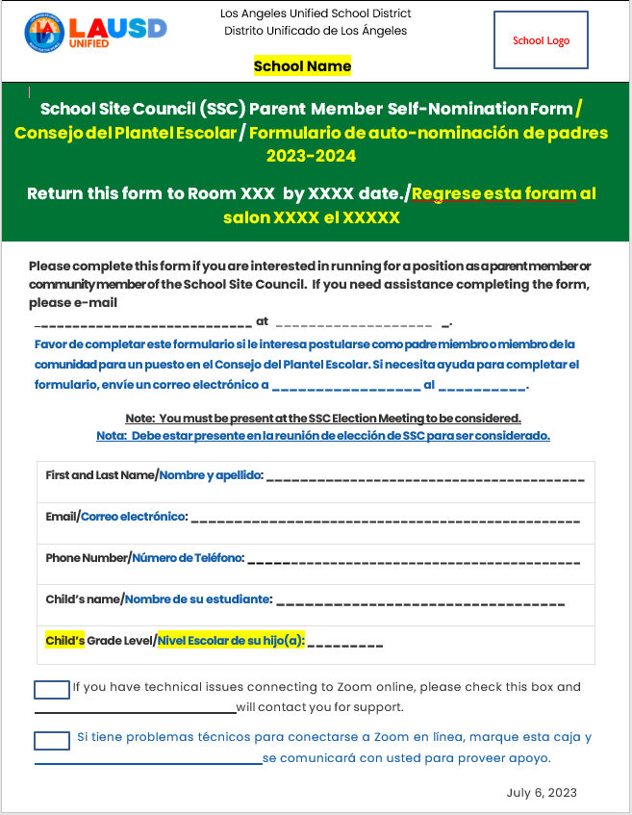
SSC Parent Member Self-Nomination Form
Formulario de SSC de autonominación de padres
Paper form available in the main office.
Forma para llenar manualmente disponible en la oficina principal.
Electronic fillable form available at the following link: _____________
Forma electonica esta disponible en el enlace: ___________________
Notes:
Say: At the orientation, you were informed of the self-nomination form. If you didn’t submit it, you can still self nominate during the election meeting. The form lets us provide any support which may be needed for interested candidates.
Click

Slide 28
SSC Parent Member Self-Nominations
Formulario de SSC de autonominación de padres
Parent/Legal Guardian Name Nombre de Padres/Tutores Legal
1.
2.
3.
4.
5.
6.
7.
1. Add names of Parent/Legal Guardians that have submitted names.
1. Agrega los nombres de los Padres/Tutores Legales que han sometido su nombre.
2. Nominees must be present at the election to be considered for membership.
2. Los nominados deben de estar presente en la eleccion par poder someter su nombre.
Notes:
Say: These are the names of the parents/legal guardians that have submitted the nomination forms and expressed interest in the SSC. Prior to starting the election, I will write them on the official election ballot, if they are present.
Remember, nominees must be present at the election to be considered for membership
Click

Slide 29

Notes:
Say: Do you have any questions regarding the SSC?
Click

Slide 30

Break Descanso
Notes:
Please ask participants to stretch.

Slide 31
Parent/Community SSC Member Election
Elección de Miembros de Padres/Comunidad
del SSC

Slide 32
Parent/Community SSC Member Election
Elección de Miembros de Padres/Comunidad
del SSC
Motion regarding Community Members:
Mocion por miembros de la comunidad:
On an annual basis, parents designate by vote whether to assign their parent member seat(s) on the council to eligible community members.
Anualmente, los padres designan por votación si asignarán sus puestos como miembros de padres en el comité a los miembros elegibles de la comunidad.
Notes:
Say: All parents/legal guardians must take a vote before the election process is open to decide whether or not any seats will be designated to community members. This must happen on an annual basis. If you designate a seat to a community member, it means that you are giving them the ability to speak and vote in your place.
Are there any community members present that are interested in being a member of the School Site Council?
Parents, there are #___community members present here today.
(Inform parents that community members present, who are interested in becoming a School Site Council member, would be seated on the parent side in the place of parent seats.)
Ask parent/legal guardian to make a motion regarding the designation of seats to community members.
I recognize (Name) :
Please say “I, first and last name, make a motion to not give/give # of seats to community members.”
I recognize (Name):
Please say “I, first and last name, second the motion to not give/give # of seats to community members.”
To do:
Add the name of the person making the motion to the Excel spreadsheet.
Number of seats allocated.
Name of the person who seconded the motion.
Make sure that the names of all parents/legal guardians that are present are on the second column, starting on the third row.
Display the Excel sheet so all participants can view it.
Click

Slide 33
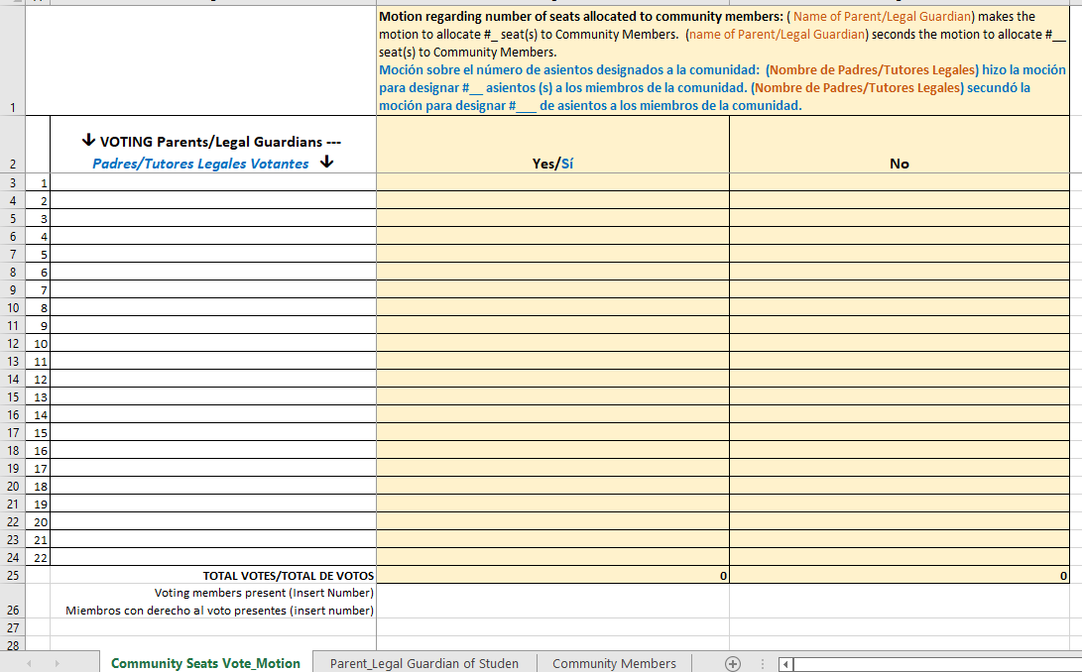
Motion regarding allocation of seats to community members
Moción acerca de los asientos a las miembros de la comunidad
Notes:
To do:
Add the name of the person making the motion on row 1 column 3
# of seats allocated
name of the person who seconded the motion
Make sure that the names of all parents/legal guardians are present are on the second column, starting on the third row.
Once all names are displayed, repeat the motion and take a roll call vote.
Display the Excel sheet.
Click

Slide 34
Parent/Community SSC Member Election
Elección de Miembros de Padres/Comunidad
del SSC
Parent and Legal Guardian
Elections
Elección de Padres/Tutores Legales
Only parents/legal guardians elect parent and community members.
Solamente los padres/tutores legales pueden elegir a los padres y a los miembros de la comunidad.
Notes:
Say: I would like to thank those who served as SSC members last year.
We have #__ seats available to parents/legal guardians and # (0, 1, 2, 3,) seats for the community member(s). Remember only parents can elect parents/legal guardians and can nominate others and self-nominate.
We had _______ parents/legal guardians submit their names. And they are present and will be added to the Ballot in a few moments...Or...They are not present, so their names will not be added to the Ballot.
At this moment, I would like to declare all parent seats vacant.
(Take names from the floor and write them on the 2nd row, starting on column 2C.)
Display Excel sheet.
Click

Slide 35
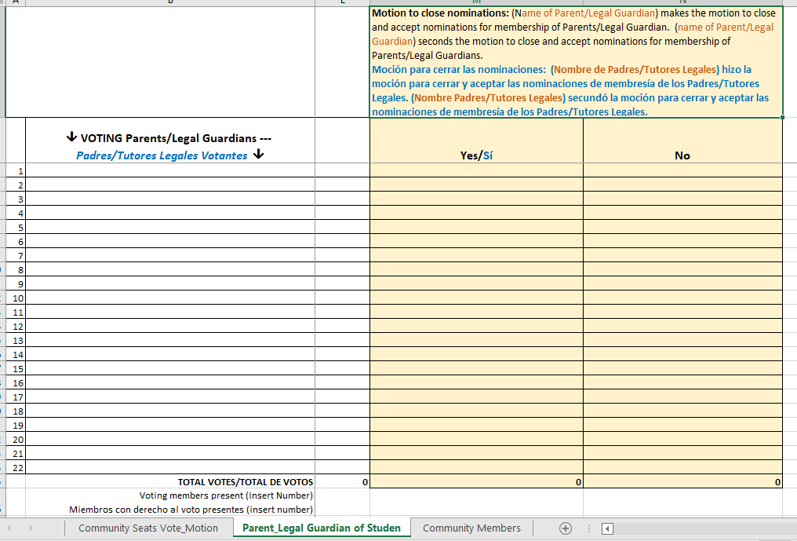
Parent/Legal Guardian
*Ballot
*Motion to close and accept nominees
Padres/Tutores Legales
*Boleta
*Moción para cerrar y aceptar a los nomínanos
Notes:
To do:
Make sure that the names of all parents/legal guardians that are present are on the second column, starting on the third row.
Once all names are displayed, open the floor for nominations and declare all seats vacant.
Add the name of any who self-nominate or who accept the nomination, if they are present.
Ask the question three times, “Is anyone else interested?”
If none are interested, ask for a motion to close nominations.
Add the name of the person making the motion.
Add the name of the person who seconded the motion.
Repeat the motion audibly and take a roll call vote.
Once you have finished taking the roll call vote, continue by saying the following:
Please state your name and who you are voting for.
Once everyone has voted, please announce the results.
Display the Excel sheet.
Click

Slide 36
Parent/Community SSC Member Election
Elección de Miembros de Padres/Comunidad
del SSC
Community Member
Miembros de la Comunidad
Solamente los padres pueden elegir a los padres y a los miembros de la comunidad.
Only parents elect parent and community members.
Notes:
Say: There were # of seat(s) allocated to community member(s).
In a moment I will lead those elections.
I would like to remind you that only parents/legal guardians can vote, but only community members can self-nominate or nominate other community members.
Click

Slide 37
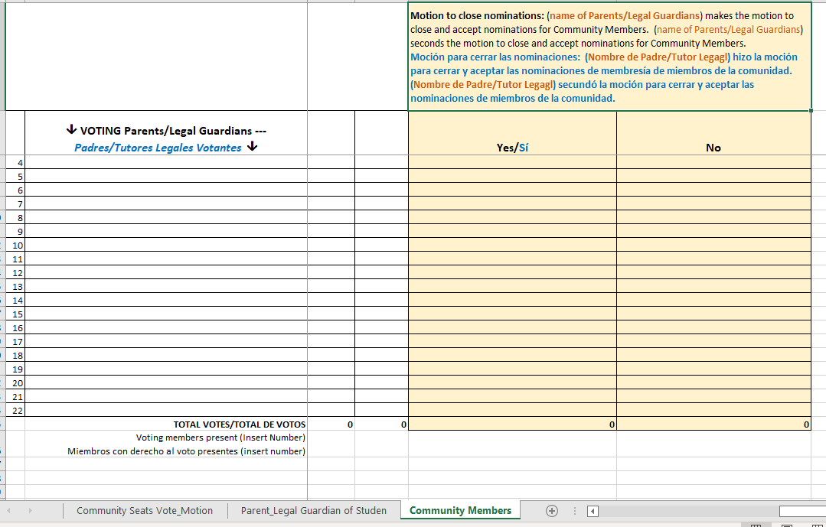
Motion regarding allocation of seats to community members
Moción acerca de los asientos a las Miembros de la Comunidad
Notes:
To do:
Make sure that on the names of all parents/legal guardians that are present are on the second column, starting on the third row.
Once all names are displayed, state how many seats are available.
Open the floor for nominations.
Type the names of the community members who accept their nominations or self-nominate.
Ask the question three times, “Is anyone else interested?”
If none are interested, ask for a motion from the parents to close nominations.
Add the name of the person making the motion.
Add the name of the person who seconded the motion.
Repeat the motion audibly and take a roll call vote.
Once you have finished taking the roll call vote, continue by saying the following:
Please state your name and who you are voting for.
Once everyone has voted, please announce the results.
Display the Excel sheet.
Click

Slide 38

SSC Election of Officers
1st meeting
Elecciones de Oficiales de SSC
1^{ra} reunion
Principal, Teachers,
and other staff
_______
Director, Maestra,
y otro personal
Parents-Community
Secondary Students
_______
Padres-Comunidad
Estudiantes Secundarios
The quick brown fox jumped over the lazy dog.
SSC Officers Elections and First SSC Meeting/ Elecciones de Funcionarios y Primera Reunion del SSC
Date/Fecha:
Time/Horario:
Zoom ID/ID de Zoom:
Notes:
Say: Thank you.
On (date), we will have our first SSC meeting with the teachers, other staff, students (applicable), and principal.
We will elect our officers, approve the notes from each election, and vote on the location, date, and times of our meetings for the year.
Click

Slide 39
Contact Information
Información de Contacto
(Name), Title
E-mail/Correo Electrónico
Phone Number/Numero de Teléfono
School Logo
(Name), Title
E-mail/Correo Electrónico
Phone Number/Numero de Teléfono
(Name), Title
E-mail/Correo Electrónico
Phone Number/Numero de Teléfono
Notes:
Say: I look forward to working with you. This is our contact information.
If you have any questions, please reach out to us.
Click

Slide 40
Thank you!!!
¡¡¡Gracias!!!
Contact your Local District Parent and Community Engagement Administrator for support.
Comuníquese con su Administrador del Distrito Local de Padres y
Involucración de Comunidad por apoyo.
Region/Región | PACE Administrative Coordinator | Email
East/Este | Megan Guerrero | mguerr3@lausd.net
West/Oeste | Estelle Baptiste (Interim) | ebaptist@lausd.net
North/Norte | Laura Fuentes & Jeremiah Gonzalez | Lxf1109@lausd.net Jjg2443@lausd.net
South/Sur | Leticia Estrada de Carreon | ldecarre@lausd.net
Virtual Academy/Academia Virtual | Laura Bañuelos | lxb0446@lausd.net
Notes:
Say: Thank you for joining us. If you have additional questions regarding School Site Councils and how they operate in our District, or if you need additional support, you can always contact the Local District Parent and Community Engagement team as well. The name of the administrators for these teams are listed here.
I look forward to partnering with you this year.

