Slide 1



District English learner
Advisory Committee
(delAC)
Officers’ Orientation and Election Meeting
Thursday, November 9,2017
2017

Slide 2

Welcome and Review of Agenda
Welcome
Office of Parent And Community Services Update
Public Comment
Grounding Activity
Presentation: Orientation for DELAC Representatives and Alternates
Purpose of DELAC
Roles and Responsibilities of Representatives, Alternates and Officers
Roll Call
Review of Election Guidelines and Process
Election of Officers
Announcements
Adjournment

Slide 3

Norms
1. Put kids first.
2. Respect the opinions of others.
3. Follow directions given before speaking.
4. Wait to be recognized before speaking.
5. No campaigning once the Orientation begins.
6. No texting or talking during the election.
7. Follow all election guidelines.

Slide 4

Today’s Outcomes
Review the purpose of the District English Learner Advisory Committee (DELAC) and the important role it plays
Review the expectations for DELAC Representatives and Alternates
Election of DELAC Officers

Slide 5

Report From Office of Parent and Community Services:
Parents Putting Kids First

Slide 6
Grounding Activity
Who inspired you to be involved in your child’s education?
Take 1 minute to think about who inspired you to be involved in your child’s education and why?
On the signal, you will have 2 minutes to pair share with your elbow partner. Remember to share who inspired you and why.

Slide 7

Public Comments
First 5 speakers on the list will speak for 2 minutes each.
1

Slide 8
Orientation for the DELAC Representatives and Alternates

Slide 9
District English Learner Advisory Committee (DELAC)
The California Education Code (62002.5, 5CCR 11308, 52176) requires the establishment of a District English Learner Advisory Committee (DELAC) for districts with at least 50 or more English Learners.
The Office of Parent and Community Services will convene DELAC meetings throughout the school year in addition to meetings for the purpose of Local Control and Accountability Plan (LCAP) Comment and Development sessions and training sessions.
Meetings will be held at the Parent and Community Services (PCS) located at
1360 W. Temple Street, Los Angeles, CA 90026.

Slide 10
DELAC Members and Alternates
The DELAC has a total of 48 English Learner parent representatives and 12 alternates representing each of the 6 Local Districts (LDs).
Alternates are not eligible to serve as Officers.
Alternates will be seated 30 minutes after the scheduled start time of the meeting.
Only elected DELAC alternates are eligible to fill an elected member vacancy.

Slide 11
Purpose and Responsibilities of the DELAC
Advise on programs, goals, rationale, structure and outcomes of the instructional programs for ELs.
Advise on the development of a plan to ensure compliance with any applicable teacher and instructional aide requirements.
Advise on the District-wide/school-by- school needs assessment of EL students.
Advise on administration of the District’s Annual Language Census.

Slide 12
Purpose and Responsibilities of the DELAC
Review and comment on the District’s reclassification procedures.
Review and comment on the written notification required to be sent to parents and guardians.
Participate in relevant training sessions that assist members in carrying out their responsibilities as specified in this section.
Local Control and Accountability Plan (LCAP) comments
Consolidated Application (CON APP) comments

Slide 13
Roles and Responsibilities of DELAC Officers
Public Relations Officer
Parliamentarian
Secretary
Vice-Chairperson
Chairperson

Slide 14
PUBLIC RELATIONS OFFICER
The Public Relations Officer shall:
Serves as a good will ambassador to promote the mission and activities of DELAC
Promote parent engagement as a means of improving student achievement
Publicize District-wide parent learning opportunities, such as conferences, trainings, events and activities to all parents and schools

Slide 15
PARLIAMENTARIAN
The Parliamentarian shall:
Assist the Chairperson in ensuring all rules and bylaws are followed
Be knowledgeable about bylaws of the committee, parliamentary procedure, Robert’s Rules of Order and the open meeting provisions of the Greene Act
Participates in agenda planning

Slide 16
SECRETARY
The Secretary shall:
Keep minutes of all regular and special meetings of the DELAC
Transmit accurate copies of the minutes of all meetings to members
Provide the original meeting minutes to PCS
Assists with general communication to members
Assist PCS in maintaining records at the site for five (5) years
Participates in agenda planning
Perform other duties as assigned by the Chairperson

Slide 17
VICE-CHAIRPERSON
The Vice-Chairperson shall:
Represent the Chairperson in his/her absence or in assigned duties
Participate in the agenda planning
Assist the Chairperson as requested

Slide 18
CHAIRPERSON
The Chairperson shall:
Preside over the DELAC meeting
Plan the agenda in collaboration with DELAC officers and PCS staff
Be fair and impartial at all times
Sign all DELAC letters, reports and other communications
Ensure that minutes are properly recorded
Perform additional duties appropriate to the office of the Chairperson

Slide 19


R
O
L
L
C
A
L
L

Slide 20
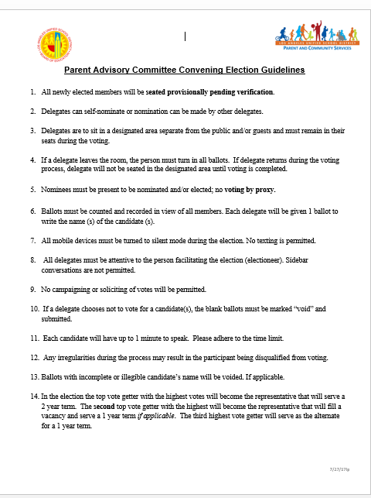

Review of Election Guidelines and Process

Slide 21
ELECTIONS OF OFFICERS
Public Relations Officer
Parliamentarian
Secretary
Vice-Chairperson
Chairperson

Slide 22

DELAC OFFICERS
2017

Slide 23

Thank You

